Slide 1
CogSci 190 “Sensemaking and Organizing” Spring 2019
Robert J. Glushko glushko@berkeley.edu
2 April 2019 19) Category Structure; Institutional Categories

Slide 2
Review of Spring Break
Did you find yourself thinking about organizing systems?
Did people say you talked funny or were noticing / obsessing about things that they didn’t understand?

Slide 3
Rooms at Matachica Resort (Belize) are Identified by “Fruit Color”
Strawberry Melon Pineapple
This was where I went on Spring Break in 2018

Slide 4
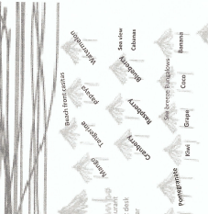
But Without Any Organizing Principles!
Fruits arranged by type (trees, berries…)? NO
Any relationship to room type? NO
Not alphabetic, so no easy way to find room given its name
Inconsistent color naming rule (inside color or outside color?)

Slide 5
Plan for the Course
We can analyze sensemaking and organizing from four interrelated perspectives:
As a member of a social, cultural, or language community (linguistics, sociology, social network analysis)
As an individual (psychology and philosophy)
In institutional contexts (law and business)
In data-intensive or scientific contexts (statistics, computer science, info visualization).

Slide 6
Sensemaking and Organizing in Defined/Institutional Contexts
[19-April 2] Institutional Categories
[20-April 4] Classification; Standardization
[21-April 9] Vocabulary control, authority, interoperability
[22-April 11] Organizing and Interaction Design

Slide 7
Institutional Categorization
Explicit construction of a semantic model of a domain to enable more control, robustness, and interoperability than is possible with just the cultural system
Do you see that this implies that institutional and cultural categories for the same domain can be very different, even incompatible?
Essential in abstract, information-intensive domains where semantic precision is essential for processes and transactions
Why is this especially important for automated transactions?
7

Slide 8
Creating Institutional Categories
Institutional categories are often developed via rigorous and formal processes (e.g., in standards organizations or legislative bodies) (“Parliamentary procedure”) and require ongoing governance and maintenance
Why do institutional categories need to change?
This is NOT how most individual categories are developed, and NO cultural categories are developed this way
8

Slide 9
Institutional != Unbiased
Creating institutional categories by more systematic processes than cultural or individual categories does not prevent them from being biased
Indeed, the goal of institutional categories is often to impose or incentivize biases in interpretation or behavior
9

Slide 10
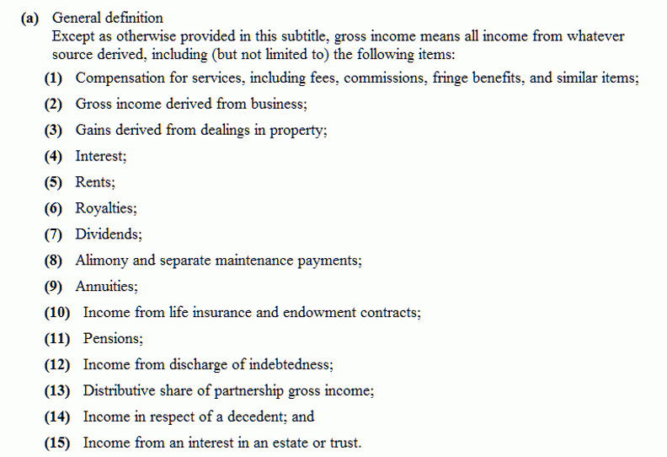
"Gross Income" Tax Code Categories
If dividends are taxable income, isn’t this double taxation?
Why isn’t inherited money taxable?
10

Slide 11
Cultural / Nonstandard {and,or,vs.} Institutional / Standard Categories
Because institutional categories are usually defined in domains with established cultural categories, their co-existence and co-evolution can be problematic
Their definitions can be incompatible
Miscommunication results if one party is using a cultural definition and other is using an institutional one

Slide 12
“Natural” {and,or,vs.} “Organic”
Many packaged foods, beverages, and consumer products are marketed as “natural” and people often pay a lot more for them
Likewise, many products are marketed as “organic”
“Organic” as applied to food is an institutional category regulated by governmental food safety authorities, such as the US Department of Agriculture (USDA) or European Commission (EC)
“Natural” has no legal definition… and as a result there are many lawsuits arguing that products are mislabeled and misrepresenting

Slide 13
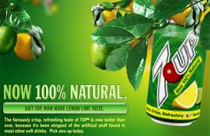
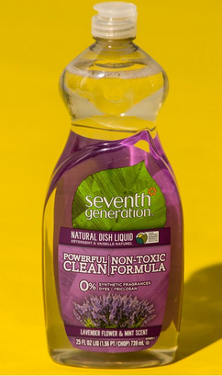
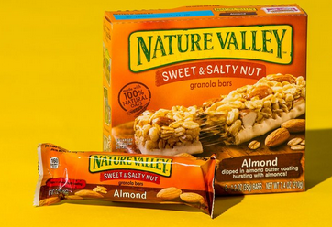
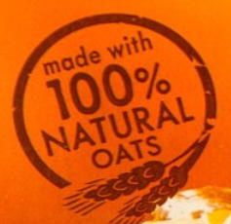
Defining “Natural”

Slide 14
“Chicken” as a Cultural Category
WIKIPEDIA: “The chicken is a domesticated fowl”
Reared for food (as meat and for eggs)
Kept as pets (In Asia, chickens with striking plumage have long been kept for ornamental purposes)
Calling someone “chicken” to suggest they are weak or afraid is a 400-year-old metaphor
The game of “chicken” in which two drivers (or opponents in some game or negotiation) will both suffer bad outcomes unless one or both of them concedes to the other
“Cock fighting” – a “sport” where two birds (often armed with metal claws) fight each other, with associated gambling

Slide 15
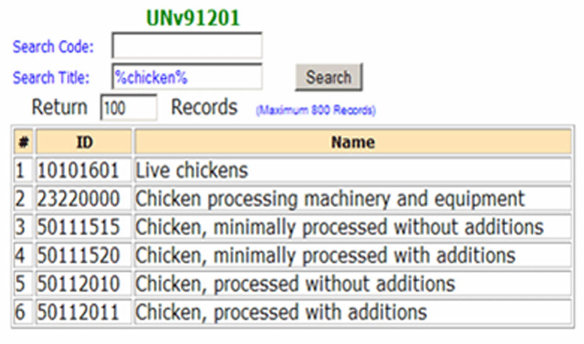
Institutional Categories for Chicken: UN Standard Products and Services Codes
https://www.unspsc.org/
Who would need something like this?
15

Slide 16
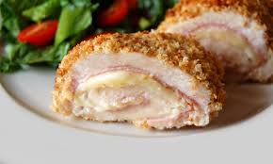
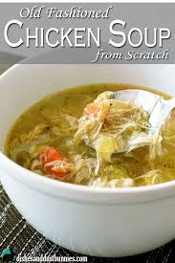
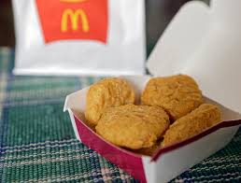
Do
Chicken cordon bleu
Chicken nuggets
Chicken soup
Require the same quality of chicken?

Slide 17
Recycling: Cultural Categories Co-evolving with Institutional Ones
Recycling – for paper, important in Japanese culture starting in 9th century
In US - given huge boost in WWII with government mandates to conserve and reuse material needed in war
Metal
Paper
Rubber

Slide 18
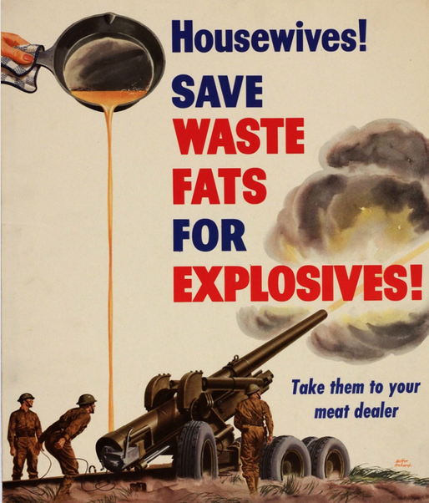
WWII: Recycling “Propaganda Posters”

Slide 19
Recycling: Cultural Categories Co-evolving with Institutional Ones
In 1970, on “Earth Day” twenty million people demonstrated for environmental protection
Later that year Congress created the EPA
But mandatory recycling didn’t begin until late 1980, and was on a state-by-state basis with no national standards
Today, economic benefits of recycling are falling (why?), which is reducing institutional mandates (cities lose money now), but recycling culture is well-established in some places
Today most people would consider glass, metal, and plastic as recyclable resources (i.e., in their cultural categories)
But cities vary immensely in their “recycling organizing systems” and to the extent to which they are institutionally formalized

Slide 20
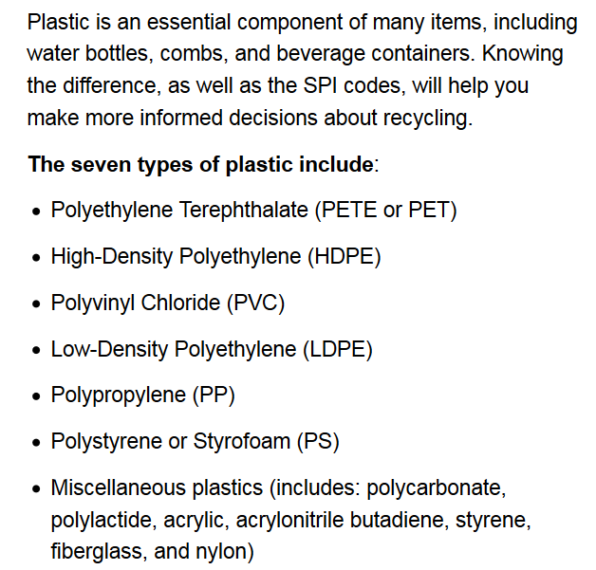
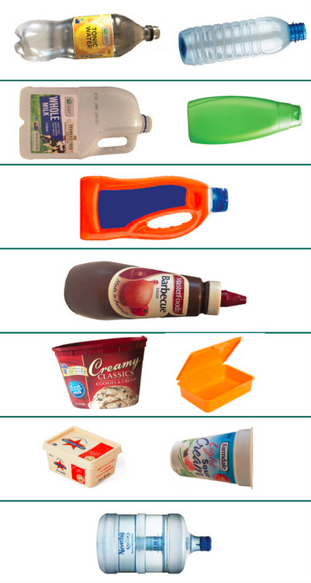
Categories of Plastic and Recycling (as defined by Plastics Industry Association)
Which types of plastic are recyclable?
Did you know that Styrofoam is a plastic material?

Slide 22
Principles for Creating Categories (“Category Structure”)
Enumeration
Single Properties
Multiple Properties
Similarity / Family Resemblance
Theory-Based (or Analogy-based)
Goal-Derived (or Activity-based)
22

Slide 23
Defining Categories by Enumeration
Simplest way to define a category is by enumerating (listing) its members
This principle is also called EXTENSIONAL definition; the members of the set are called the EXTENSION
This principle is easy to understand and implement; the meaning of a category or concept is NOT a property test; it is simply the specific set of resources associated with it
So learning an enumerative category just means “memorizing its members”
23

Slide 24
Pac-12 Conference: An Institutional Enumeration
Do Arizona, Utah, and Colorado have any “Pac” properties?
Why are these 12 schools the members of this conference?

Slide 25
The Limits of Enumerative Definition
Enumerative categories enable membership to be unambiguously determined, but that doesn’t mean that they are uncontroversial – there might be competing enumerations
EXAMPLE : Is Gender Binary?
25

Slide 26
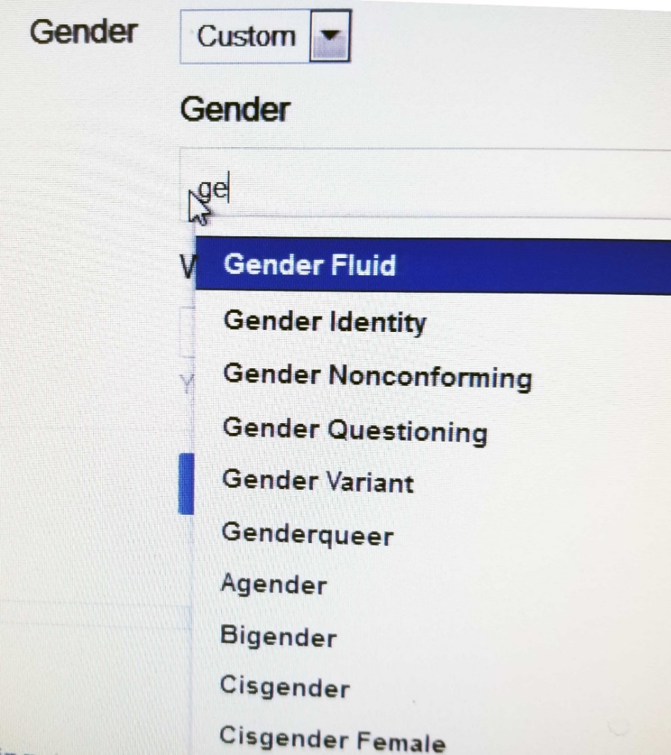
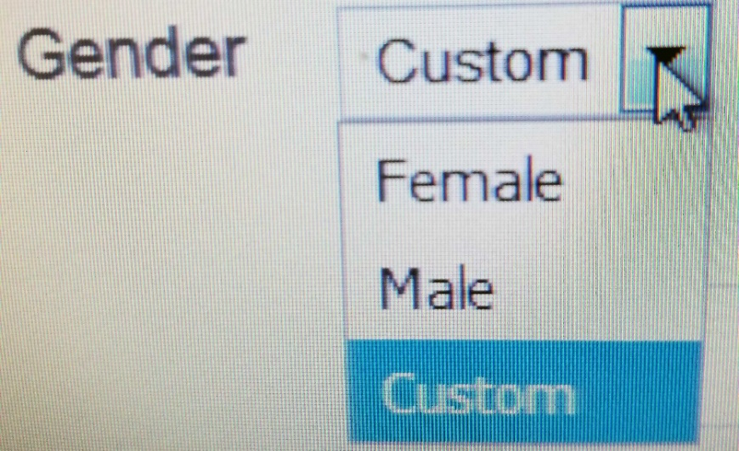
Facebook Offers 56 Gender Categories
Why are binary gender category systems much more common than non-binary gender category systems?
How would Facebook’s category system for gender work if applied in the “offline” world?

Slide 27
The “Planet” Category
For millennia, “planet” was a cultural category that contained the five visible planets in our solar system (Earth was not considered a planet, because it was assumed that the planets orbited the Earth)
Earth joined the planet category after the Copernican revolution, as did what we now know as the large asteroids
Asteroids were later removed from the category when it was discovered that they were much smaller that all other planets
When Pluto was discovered in 1930, it was categorized as the ninth planet in our solar system

Slide 28
The Limits of Enumerative Definition
At some point an enumerative category might contain so many members that it must be sub-divided or be given a definition based on principles other than enumeration
What happened to the “planet” category when large objects were discovered orbiting around stars other than the Sun?
28

Slide 29
International Astronomical Union Re-defines “Planet” (2003)
“A celestial body that is
in orbit around a star
has sufficient mass for its self-gravity to overcome rigid body forces so that it assumes a hydrostatic equilibrium (nearly round) shape
has cleared the neighborhood around its orbit.”

Slide 30
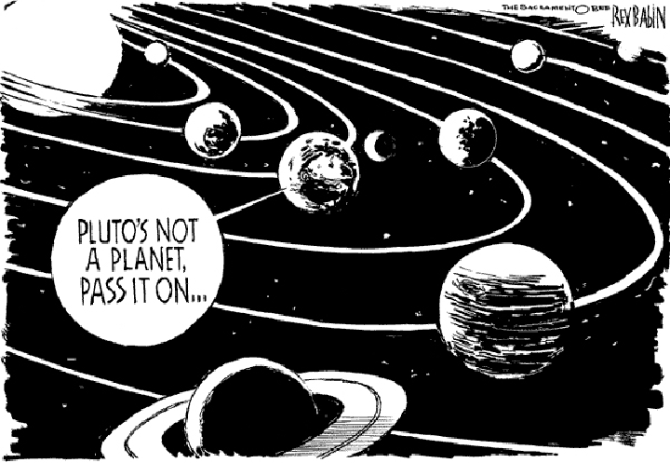
Sorry, Pluto
30

Slide 31
Specifying Enumerations
You should be excruciatingly careful when you define a category by enumeration
The legal principle of “implied exclusion” says that if you “expressly name” or “designate” some list anything not named is excluded
Legal disputes often reflect different interpretations of category membership and whether a list of category members is exhaustive (“the following”) or merely illustrative (“including” or “such as”)
Why is an “Other” category usually a bad idea?
31

Slide 32
Categories Defined by Single Properties
Another way to create a simple category system is to use only the values of any single property, especially when the possible values are discrete and not very numerous
Intrinsic static properties are often the easiest ones to use (color, size, shape…)
Learning the category is simple – what’s the property?
32

Slide 33
Categories Defined by Single Properties - Limitations
Whenever a single property is used to define a system of categories, the choice of property is critical (WHY?)
How does the number of properties used to define a category affect the coherence or homogeneity of the category members?
33

Slide 34
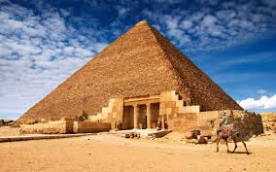
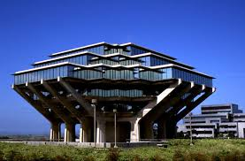
Single Property Category: “Pyramid- Shaped”
34

Slide 35
Pyramid Man-Made? Location? Shape?
Yes Yes Egypt
Yes No Glacier Park
Yes Yes UC San Diego
35

Slide 36
A Category System for Shirts Using just the “Style” Property
SHIRTS
Dress
Work
Party
Athletic
Each value of the Style property becomes a sub-category
(This property and the values it can take are “cultural”)

Slide 37
Multiple Property Categories
When items being categorized can be described using easily observed “separable” or “combining” properties, categories are often based on multiple properties
Each successive property differentiates the items in a category to create a hierarchy of sub-categories
Property order determines the hierarchy
How do we choose the properties?
How do we determine the order in which we apply them?
37

Slide 38
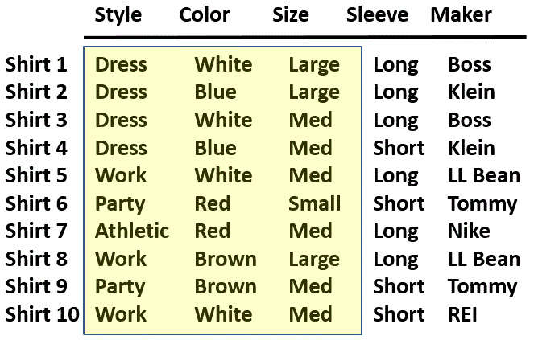
A Collection of Shirts (Using Separable “Cultural” Properties)
38

Slide 39
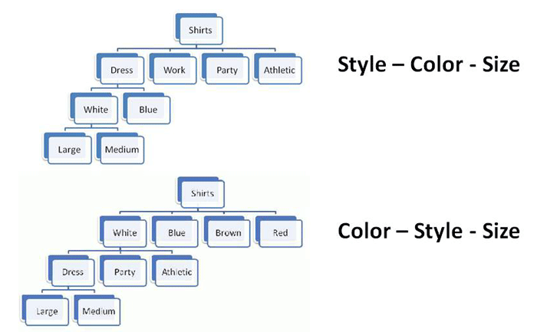
Using 3 Properties: Property Order Determines the Category Hierarchy
39

Slide 40
Classical Categories
“Classical” categories can have large numbers of category members, but they have clear boundaries defined by a small number of ESSENTIAL or necessary and sufficient properties
Necessary means that every instance must have the property to be in the category
Sufficient means that any instance that has the necessary properties is in the category
Example: A Prime Number is an integer divisible only by itself and 1
Every prime number has these properties
If a number has these properties, it is prime
40

Slide 41
Implications of “Necessary and Sufficient” Properties
Because category membership is defined by rules, all members of the category have equal status in the equivalence class
Classical categories are conceptually simple and have straightforward implementations in technologies like database schemas, decision trees, and classes in programming languages
Many laws and regulations define categories using these principles, but this can make them less robust wrt technology or cultural change
41

Slide 42
Wittgenstein
Ludwig Wittgenstein (1889-1951) – "philosophy of ordinary language" - first to discuss problems with classical category theory
Enumerative categories embody the idea that “meaning is reference” – a concept means what it refers to; you understand words by following the association to their “extensions”
Wittgenstein argued that most words don’t have fixed extensions because what they refer to can depend on context: “meaning is use”
42

Slide 43
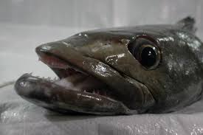
If Meaning was just Reference...
If "meaning" was just based on reference would names matter?
Prune == Dried Plum
Chinese Gooseberry == Kiwi Fruit
Patagonian Toothfish == Antarctic Cod == Chilean Sea Bass
43

Slide 44
Implications of “Meaning is Use”
There may be defining features for typical instances
But there are no features that are necessary and sufficient for all examples of the category
Even when features can be identified, they change in different contexts and over time
Different instances vary substantially in how typical or representative they are of the category even though they share all the required features
This can make the category hard to learn
Wittgenstein's classic counterexample is "Game“ (TDO 7.3.5)
44

Slide 45
Probabilistic Categories & Family Resemblance
In some domains instances of a category can share many features, some instances might have properties that are not widely shared, and some important discriminating properties might be difficult to perceive
Birds:
All have feathers, wings, beaks, 2 legs
But some fly or swim and some don’t
The shape of their beaks, wings, and feet varies a great deal
45

Slide 46
Implications of Probabilistic Properties
Correlations among the properties make it necessary to determine an instance’s category membership in a statistical or probabilistic manner based on the overall similarity between it and other items in the category
Some features are better predictors of category members than others, which results in: Typicality / gradience / centrality effects
The perceived centrality or typicality of category membership depends on the extent to which the most characteristic properties are shared
Instances with more of the characteristic properties are “better” category members
➔ fuzzy and flexible category boundaries
46

Slide 47
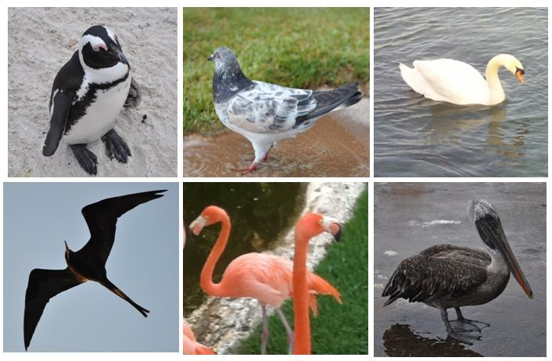
Gradience in Category Membership
Which bird is most typical of the category?
Least typical?
47

Slide 48
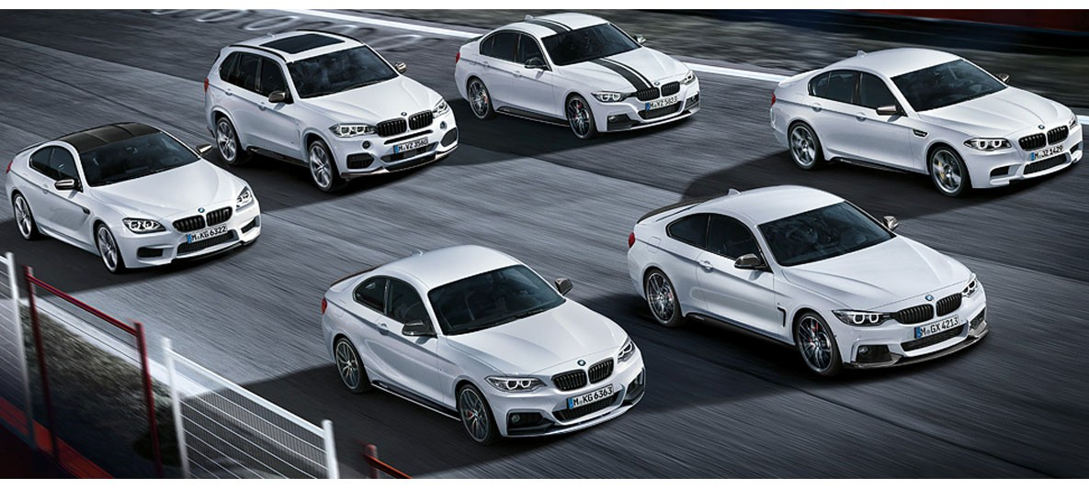
Family Resemblance
Categories defined by “family resemblance” have many features with high predictive value for category membership even if they are not perfectly correlated with each other
The BMW M Class
<put your family photo here>

Slide 49
Probabilistic Categories in Context
The correlations among properties that cause typicality effects also imply that the resemblances among the members of a category might be based on different subsets of their properties when different members are compared
Put another way, a definition of a category that enables accurate classification of instances in one context might not work in other contexts
49

Slide 50
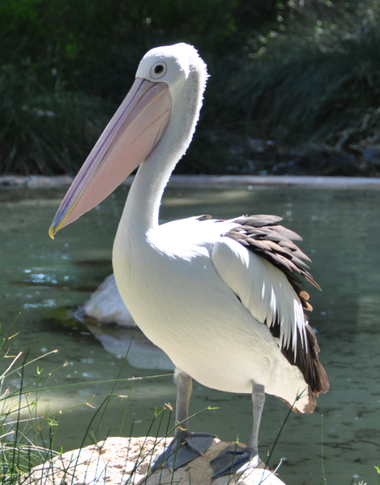
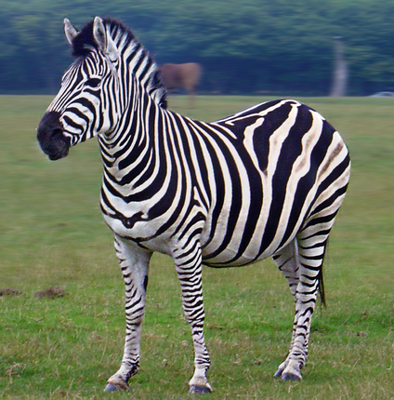
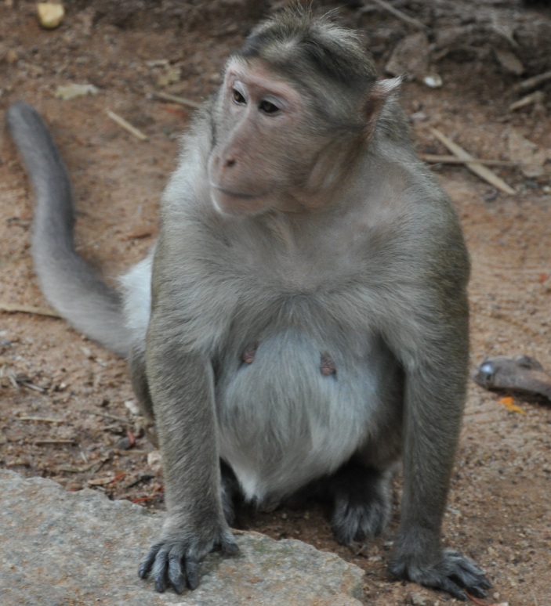
Stripes Are A Characteristic Feature for Zebras and A Good Discriminating Feature with Other Animals

Slide 51
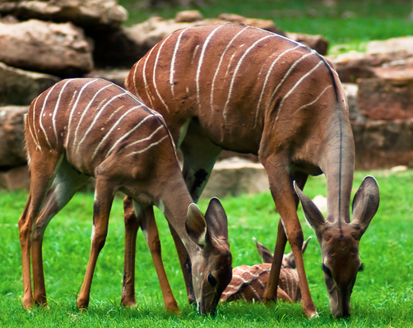
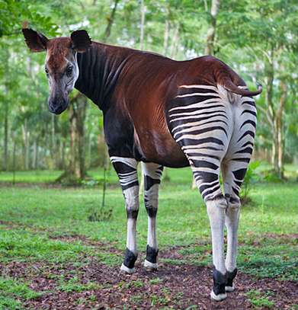
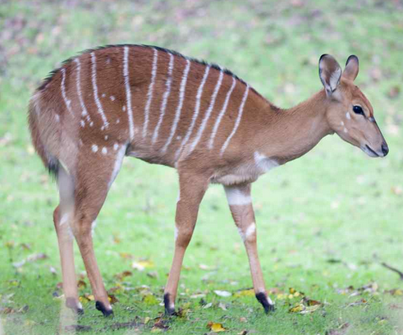
Stripes Are No Longer A Good Discriminating Feature
Kudu
Bongo
Okapi

Slide 52
Similarity as a Categorization Principle
It is often said that we can define categories on the basis of resource similarity:
Something is categorized as an A and not a B if it is more similar to A’s best or most typical member rather than it is to B’s
Similarity is a very intuitive notion and it underlies the idea that some kinds of categories are more natural or basic than others
52

Slide 53
Defining Similarity
STOP and THINK: We haven’t defined similarity!
Some people say that similarity is a meaningless and "mostly vacuous" concept because there must always be some unstated set of properties
So the meaning of similarity is defined by the specific properties and metrics used to compare them
Once we identify the properties and how they are used, there is nothing for a "similarity" mechanism to do
(We will discuss similarity in detail in a few weeks)
53

Slide 54
Theory-Based Categories
Sometimes a category is defined because of a theory of causation or capability that explains why some collection of things go together
A good theory yields an abstract or analogical similarity that can "trump" similarity or family resemblance based on surface properties
TDO’s example: “Computer” – a category of things that are able to compute
54

Slide 55
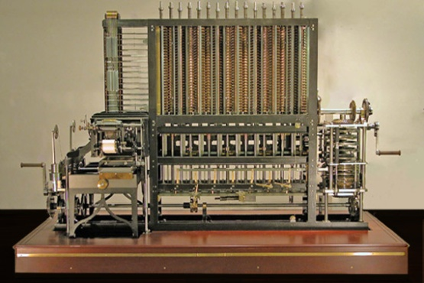
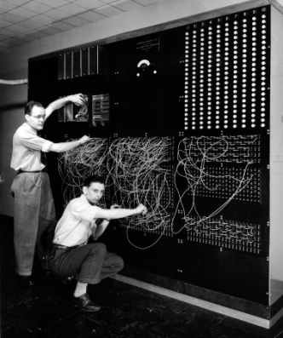
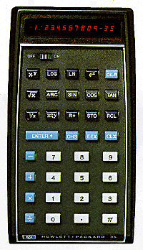
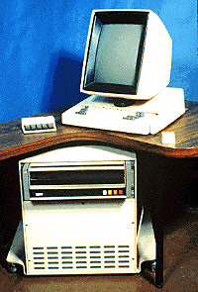
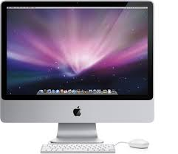
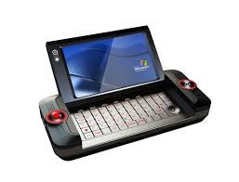
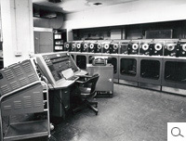
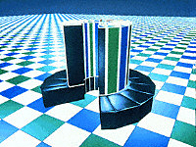
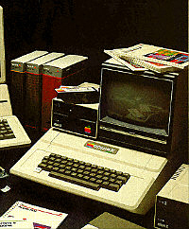
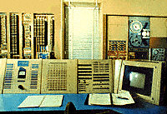
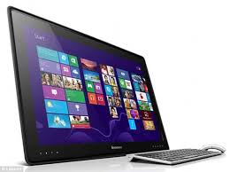
Theory-Based Category: Computer
Category of "computer" is based on being able to compute
55

Slide 56
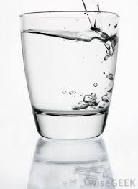
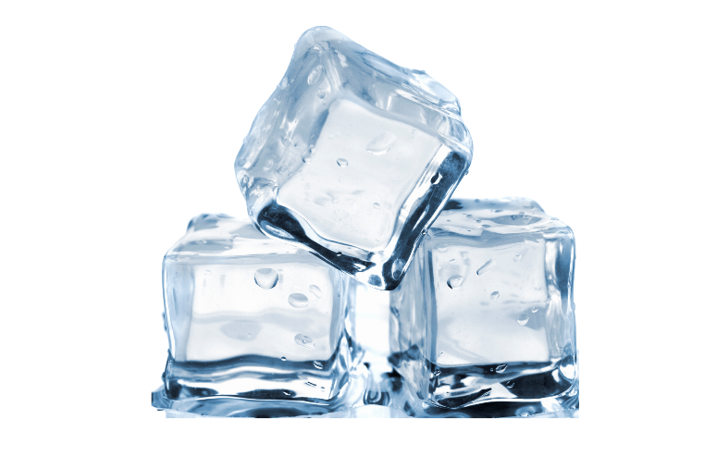
Theory-Based Category: H2O
All the same chemical compound
56

Slide 57
Goal-Derived Categories
You are moving to a far-off city and want to get rid of unwanted possessions. What will you sell at your “garage sale?”
You arrive at the new city. What are the ways you will try to make new friends?
You want to celebrate Thanksgiving with your new friends. What will you need to cook a big dinner?
The members of each of these categories have few or no discernable properties in common
These are unlikely to be lexicalized because of their ad hoc-ness and context-dependence
57

Slide 58
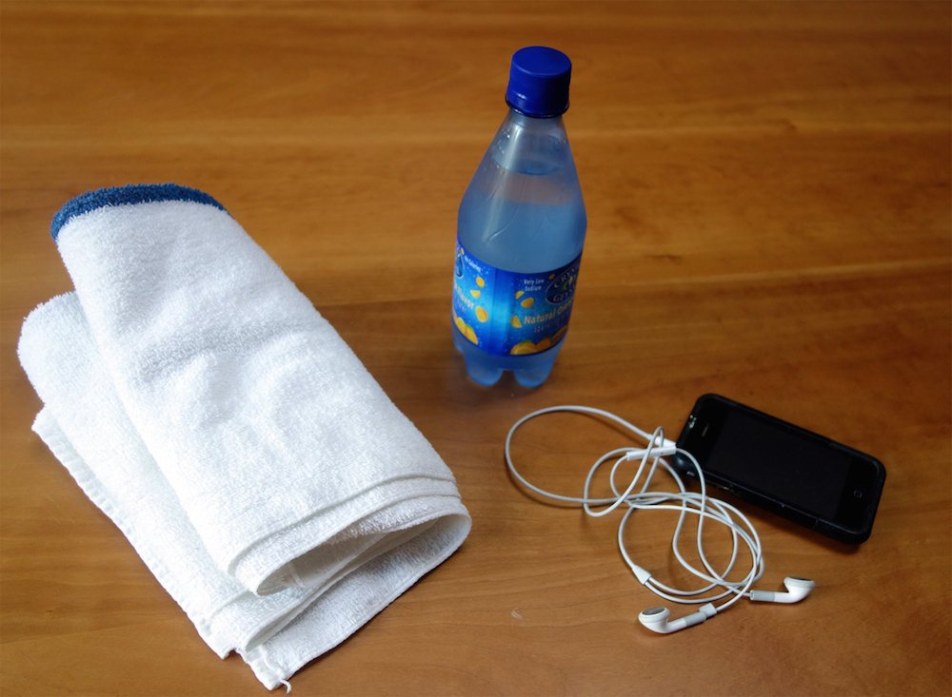
Goal-Derived Personal Category (TDO 7.3.7)
58

