Slide 1
CogSci 190 “Sensemaking and Organizing” Spring 2019
Robert J. Glushko glushko@berkeley.edu
4 April 2019 20) Classification; Standards and Specifications

Slide 2
Today’s Lecture
Understanding classification
Classification is purposeful
Classification is principled
Classification is biased
Standards and Specifications
Standards for Bibliographic Classification
Library of Congress
Dewey

Slide 3
Distinguishing Categorization and Classification
Categories are EQUIVALENCE CLASSES - sets of resources, processes, and events that we treat the same
A Classification (noun) (or Classification Scheme) is a SYSTEM OF CATEGORIES, ordered according to a PRE-DETERMINED SET OF PRINCIPLES and used to organize a collection of resources
Classification (verb) is the process of systematically assigning resources to intentional (often institutional) categories in a classification system
3

Slide 4
Classification Is Purposeful
Classifications arrange resources to provide structure for and increase the precision of INTERACTIONS in organizing systems by human or computational agents
Classifications are essential in useful work
They serve as a reference model to individual domains and the relationships among them to help people understand and communicate the concepts and relationships
4

Slide 5
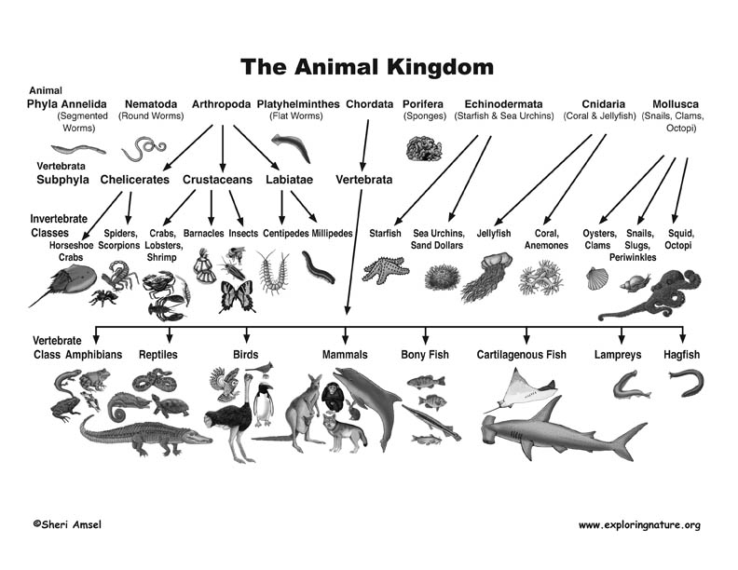

Slide 6
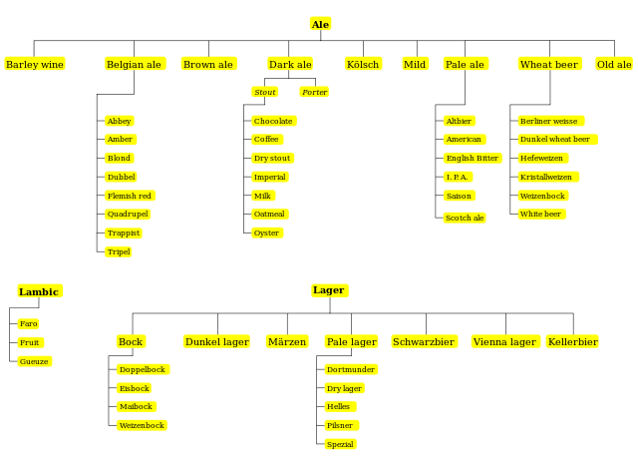
The Beer Kingdom

Slide 7
Classification Schemes (1)
A CLASSIFICATION SCHEME follows one or more organizing principles
An ENUMERATIVE scheme itemizes all possible categories and resources can be assigned into one and only one of them
A HIERARCHICAL or TAXONOMIC scheme is created when multiple resource properties are used by organizing principles; each property creates another level
7

Slide 8
Classification Schemes (2) Faceted Classification
A FACETED classification scheme uses multiple resource properties, but does not require every resource to have a value for every property and allows the properties to be considered in any order
Enumerative and faceted logically opposites of each other. Enumerative creates every possible category in advance; a faceted classification scheme creates its categories “on demand” only when they are needed when some resource takes on descriptive values on some set of facets
8

Slide 9
Faceted classification is commonly used in web sites where the resources have many properties

Slide 10
Classification is “Principled” (apology for the polysemy)
The principles for defining categories (enumeration, properties, similarity, family resemblance, etc.) are embodied in the classifications that use these principles
But the resulting classification system follows other systematic design principles that reflect its purposes, scope, scale, intended lifetime, extensibility, and other considerations
Being "principled" means that once these design choices are made they should be consistently followed
10

Slide 11
Hierarchy and Uniqueness Principles
Hierarchy: Each category is successively divided into smaller subdivisions according to a feature or property
Uniqueness: Every type of resource is classified in only one subdivision
These two principles are very common, might feel like “natural” principles
What assumptions about the domain are implied by this kind of classification?
11

Slide 12
Factors that Influence A Design Methodology
FLASHBACK
Your understanding of the problem and problem domain
How stable or predictable the domain is
Whether your design decisions are easily changed
Whether others must be involved in the design process

Slide 13
“Principled Justification” for the Classification Scheme
Warrant: What is the justification for the choice of categories and their names?
“Literary” Warrant: Classify only the resources we have?
“Scientific” Warrant: Use expert categories and names
“Use” Warrant: Use categories and names from “ordinary” people
13

Slide 14
The "One and Only One Place" Rule in Library Classification
If each resource instance goes in one and only one category it won't always be easy to decide what description or property determines the categorization
A book's title is often a clue to the subject
What is the topic of Who Moved My Cheese?
Should Leaves of Grass be assigned to the "Gardening" category?
But the title should never be the only thing analyzed
14

Slide 15
“Principled” Does Not Imply “Good” or “the Only Way”
Many of the category design choices can be arbitrary and others may involve tradeoffs that depend on:
the nature of the resources and the complexity of the resource domain
the purposes of the classification
the amount of effort available
the capabilities of the people doing the classification and of the people using it
15

Slide 16
Principles for Maintaining the Classification
How long does the classification system need to last? Is there a commitment or methods in place to maintain the classification system? (forever?)
Do we classify resources or items just once, or can we change categories and assignments over time?
What if the meaning of the category (and its descriptors) changes?
What if the resources or items that have been categorized have changed?
16

Slide 17
Meanings Change!
L of C established around 1800
Q Science
R Medicine
S Agriculture
T Technology
What did these terms mean in 1800? In 2018?
What did “Computing” mean 50 years ago? 10 years ago? 1 year ago? What will it mean in 2030?

Slide 18
When “Computers” Were People

Slide 19
Every Classification is "Biased"
Every classification is arbitrary because the criteria used to establish the categories reflect a point of view or perspective on the domain that intentionally excludes all other perspectives
Every classification system implicitly or explicitly contrasts {"good", "standard“} and {"bad", "nonstandard“} ways of understanding things
Natural vs. man-made disaster?
Dietary supplement vs. beverage?
Employee vs. contractor, full vs. part time?
19

Slide 20
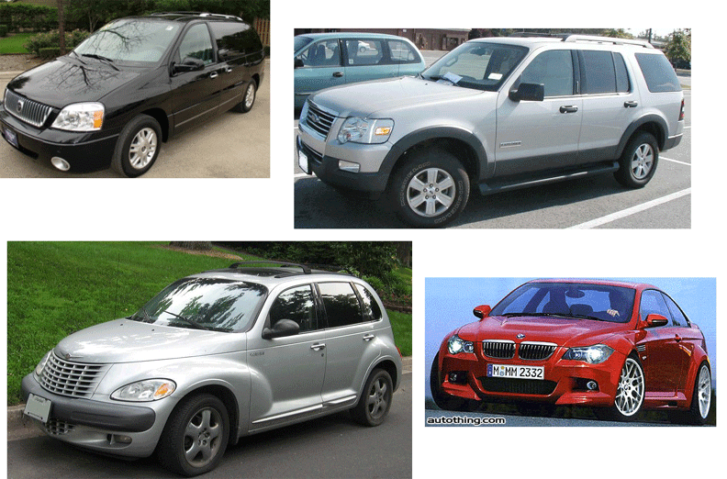
CAFE Categories: Find the Truck(s)
(See sidebar near TDO 7.2.4)
20

Slide 21
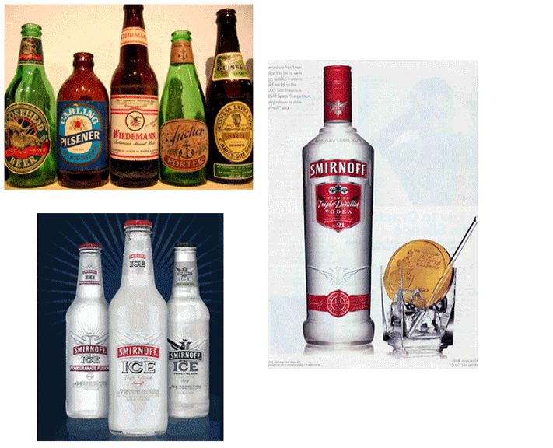
Beverage Categories: Find the Beer
21

Slide 22
Bibliographic Classification
Much of our thinking about classification systems comes from the bibliographic domain, which is distinctive because of:
Scale, complexity, and degree of standardization
Standards and rules for classification
Legacy of physical arrangement, user access, circulation
22

Slide 23
Classification Scale
How many distinct categories (SKUs) does a supermarket or “superstore” the size of Wal-Mart or Home Depot have?
How many distinct categories are in the Library of Congress subject headings?
How many unique items are in the libraries of a large research university?

Slide 24
Library of Congress Classification
The US Library of Congress was established in 1800 with a very practical focus, with no intent to devise an organizing scheme that could be used elsewhere
It got off to a bad start when the British burned it down (along with the White House) during the “War of 1812” in 1814
The library was restarted with Thomas Jefferson’s personal library, which broadened its scope, influenced the subsequent LCC scheme
24

Slide 25
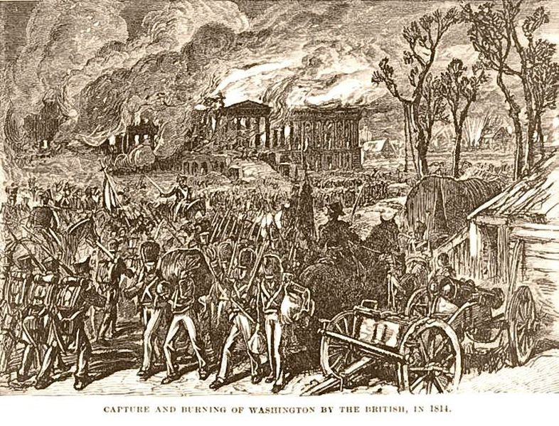
British Burn the White House (1814)
25

Slide 26
Library of Congress Classification
The LCC has 21 top level categories, identified by (arbitrary?) letters instead of numbers like the Dewey system
Each top level category is further divided, and then once again… a very deep system that makes it practical but not theoretically grounded
The LCC is biased toward the US and toward the needs of a national government, and definitely shows its age
26

Slide 27
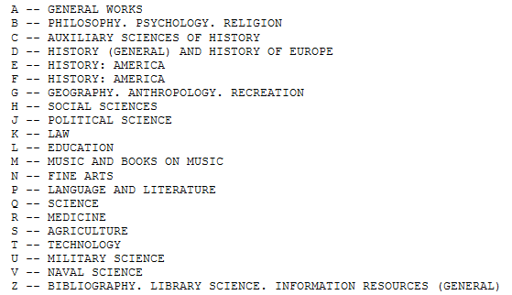
Library of Congress Classification
27

Slide 28
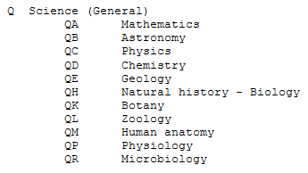
Where’s Computer Science?
28

Slide 29
Where’s Computer Science?

Slide 30
Cognitive Science Books
The Design of Everyday Things (Norman)
TS171.4 .N67
Parallel Distributed Processing (Rumelhart & McClelland)
BF455 .R853
Women, Fire, and Dangerous Things (Lakoff)
P37 .L344
Cognition in the Wild (Hutchins)
BF311 .H88
The Discipline of Organizing (Glushko)
Z666.5 .D57

Slide 31
Dewey Decimal Classification http://www.oclc.org/dewey.en.html
Started in 1876, the DDC is the most widely used classification system in the world, especially in public libraries
Easy to use to locate resources in libraries because of its numerical notation
The DDC is proprietary and must be licensed from OCLC in Dublin OH
31

Slide 32
Dewey Decimal Classification
The DDC is divided into ten main classes, which together cover the entire world of knowledge. Each main class is further divided into ten divisions, and each division into ten sections
Melvil Dewey wanted to develop a universal classification, but it was done in the context of the library of Amherst College, which introduced significant bias because of the contents of its collection and school’s religious orientation at the time
32

Slide 33
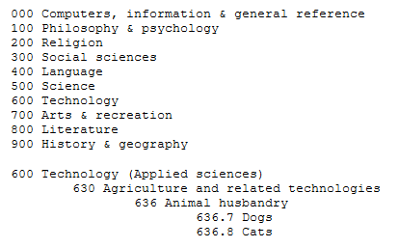
Dewey Decimal Classification
33

Slide 34
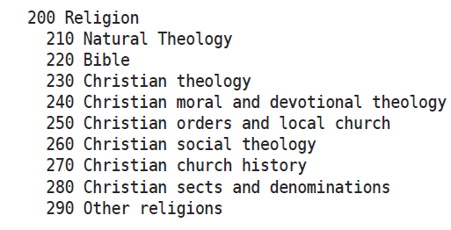
Dewey Decimal Classification for “Religion”

Slide 35
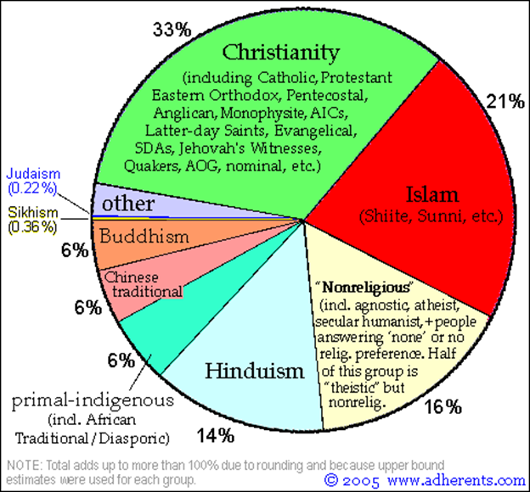
How does the Dewey Decimal classification for “Religion” reflect the practice of religion or “non-religion” in the world?

Slide 36
http://www.oclc.org/en-US/dewey/features/religion/browser.html

Slide 37
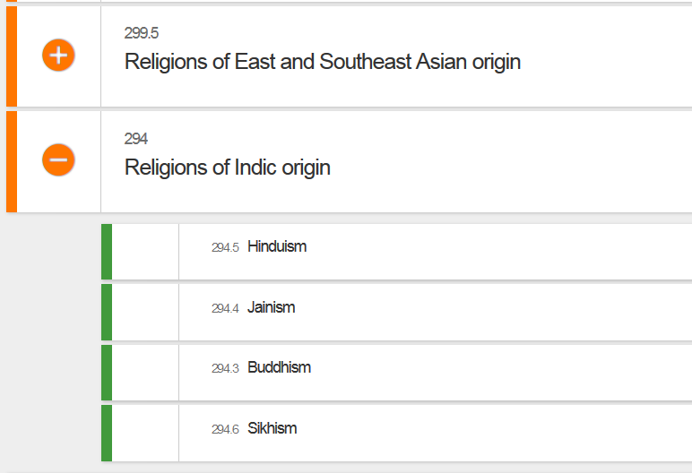

Slide 38
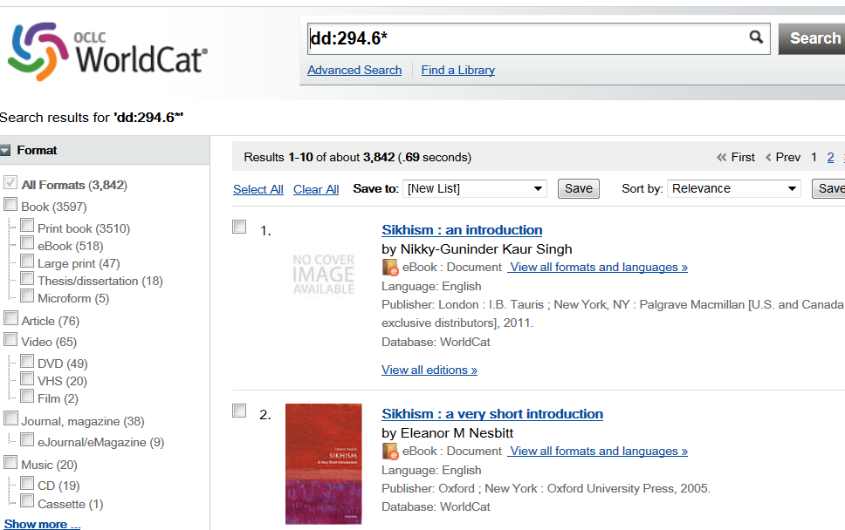

Slide 39
Classification and Standardization (1)
Classifications and standards both impose order on resources
They both distinguish, explicitly or implicitly, between standard / appropriate / effective and nonstandard / inappropriate / ineffective ways of creating organizing, and using resources
But this does not imply that a standard is a good one or that the best one will win a “standards war”
STOP AND THINK: Examples of standards wars?
39

Slide 40
Classification and Standardization (2)
Some classifications become standards
Every successful standard imposes a classification system
Standards and classification systems can have significant inertia, becoming part of the "installed base" or "infrastructure" and difficult to change
40

Slide 41
"Specifications"
A specification is an explicit and detailed description about how something (a product, system, service, or practice) works that might include:
the definitions of the key concepts or terms used in the description
the materials from which it is made
the components (tangible or intangible) that are arranged or assembled to make it work
the methods or processes by which it operates
the inputs and outputs for each method or process
41

Slide 42
"Standards"
A standard is a published specification that is developed and maintained by consensus of all the relevant stakeholders in some domain
following a defined and transparent process
usually under the auspices of a dedicated organization with the authority to create standards
The rigor and transparency of the process by which a standard is created is essential to its legitimacy
Some governments or other large procurers or products of systems require that they be based on these "de jure" standards
42

Slide 43
Why Standards Exist (1)
Standards serve as a coordinating mechanism whenever there are alternative ways of doing or making something that might be incompatible or that otherwise wouldn't be possible
Cost savings from economies of scale and interoperability
Standards can also serve as a regulating mechanism to restrict behavior or operation that might be unsafe, unfair, or otherwise "harmful“
43

Slide 44
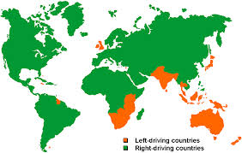
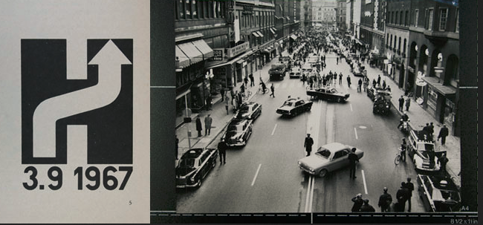
Which Side to Drive On?
‘Högertrafikomläggningen’ in Sweden

Slide 45
Why Standards Exist (2)
Many standards define technical specifications and procedures to ensure a "common design" or "interoperability"-- TDO calls these "institutional semantics"
Standards define institutional categories about models, behaviors, or processes - TDO calls these "institutional taxonomies" (like the UNSPSC)
Interoperability is essential for infrastructure – “what other things run on” – plumbing, electricity, wires, roads, electromagnetic spectrum
45

Slide 46
Why Standards Exist (3)
A third kind of standard is implicit in the content and organization of any “form” that collects the information needed to perform some task
These standards make processes more efficient and enable the aggregation and analysis of information to understand events and trends
Because the requirements that are designed into the form are rarely explicit, these types of standards often last much longer than they should
46

Slide 47
Who Sets Standards? (1)
Some technical standards are set by governments in order to protect the public interest
Other standards are set by organizations created precisely for the purpose of setting standards
Other standards are set by groups of companies who may or may not establish an ongoing organization and governance procedures to maintain and extend a standards "family" around the initial standard
47

Slide 48
Who Sets Standards? (2)
Other "standards" begin as proprietary vendor specifications that will become "de facto" standards if they are widely adopted and achieve market dominance
Often "de facto" standards are submitted to a standards organization with the goal of "rubber stamping" them as "de jure" ones
48

Slide 49
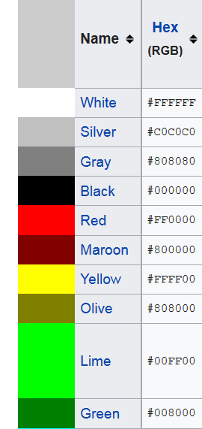
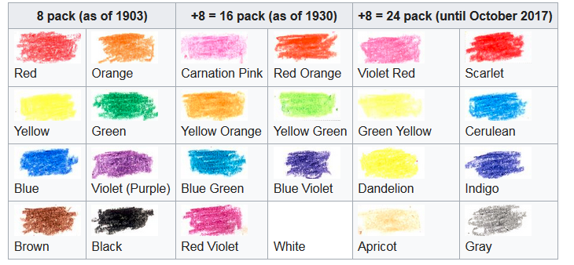
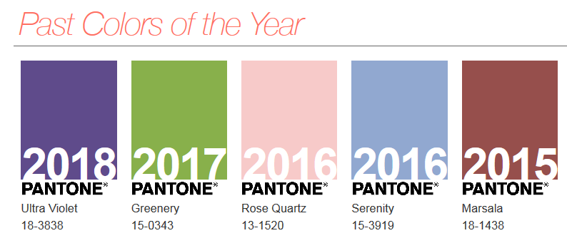
Different Color {Standards, Specifications}?
Web sRGB
Crayola Crayons
Pantone

Slide 50
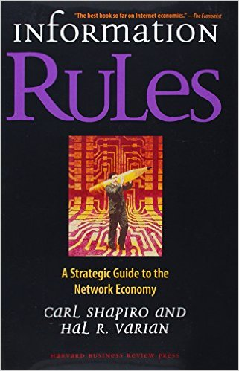
Standards and Network Effects
Standards are especially important in industries or domains that have significant "network effects" where the value of a product or service depends on the number of interoperable or compatible ones
These contexts are sometimes called "winner take all" markets, which is why standards wars take place - because of the economic implications
How do you encourage and enable others to conform to a standard?
50

Slide 51
Specifications {and,or,vs.} Standards
"All standards are specifications, but not all specifications are standards"
Any person, firm, or ad hoc group can create a specification and then use it themselves, try to get others to use it, or prevent others from using it
In contrast, standards are sometimes created by people or groups who aren't themselves planning to use them, but standards are generally made available for anyone's use at no cost or under "reasonable and non-discriminatory" terms
But the widespread adoption (or "traction") of a specification is often more important than whether or not is was created by a "standards" organization
51

