Slide 1
CogSci 190 “Sensemaking and Organizing” Spring 2019
Robert J. Glushko glushko@berkeley.edu
21) 9 April 2018 Vocabulary Control; Interoperability (and achieving it);
Structured Web content; The Modeling Debate

Slide 2
Today’s Topics
Vocabulary Control
Interoperability (and achieving it)
Structured Web content
The Modeling Debate

Slide 3
Why We Need Controlled Vocabularies
The words people use to describe things or concepts are "embodied" in their context and experiences... so they are often different or even "bad" with respect to the words used by others
These naturally-occurring words are an "uncontrolled vocabulary” that people use when they describe and search for resources
Searches made using an uncontrolled vocabulary will fail to match resources described using controlled terms

Slide 4
CV as an Artificial Language
A CV is an artificial language to be used in place of the "natural" ones that people would otherwise use
A CV standardizes the terms (such as subject headings, names, classifications, etc.) assigned by organizers / cataloguers / indexers
A CV can be thought of as a fixed or closed dictionary in which everything must be defined using the same set of terms

Slide 5
Types of Controlled Vocabularies
Dictionaries, thesauri, ontologies
Authority controls for names, places, time periods
Identifiers
Code lists
Subject heading lists
Classification schemes
Schemas/domain-specific languages/”tag sets”
Some of these we’ve covered before, because names and controlled vocabularies are essential in many contexts of sensemaking and organizing

Slide 6
Definitions of Ontology
FLASHBACK
“Ontology” can describe artifacts with different degrees of structure that differ:
... In how precisely the terms are defined
... In how precisely the relationships among them are expressed
The simplest ontology is a dictionary; a thesaurus is a somewhat more complex one
More complete ontologies are expressed using formal logic-based language
6

Slide 7
A Formula for Definitions
hyponym = {adjective+} hypernym {distinguishing clause+}
Robin = Migratory BIRD with clear melodious song, a reddish breast, gray or black upper plumage
Doesn't mention every characteristic of hyponym, only those needed to distinguish from other hyponyms
7

Slide 8
Getty Categories for the Description of Works of Art (CDWA)
FLASHBACK
The CDWA is a massive metadata schema with 532 elements and sub-elements
Each element typically has a controlled vocabulary or recommends one (e.g., Art and Architecture Thesaurus)
There is a core set of 36 elements
CDWA-Lite is the XML specification for another simple subset of CDWA
8

Slide 9
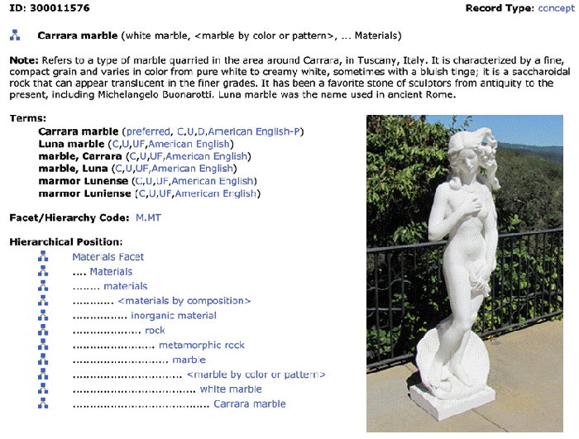
FLASHBACK
Art and Architecture Thesaurus
9

Slide 10
Code Lists
Codes are constrained sets of values
Codes establish their meaning by reference to those values, often by abbreviations
Using codes in vocabularies and resource descriptions promotes consistency and makes meaning unambiguous

Slide 11
External and Internal Codes
External codes are those maintained by some entity or organization outside of your control (ISO, ANSI, etc.)
ISO 639 - language codes (DE, EN, FR, …)
ISO 3166 - country codes (CAN, FRA, MEX, USA, …)
ISO 4217 - currency codes (CAD, EUR, GDP, USD, …)
IATA airport codes (SFO, JFK, IAD, LHR, YYZ, YUL, ...)
Internet Top Level Domains (.com, .edu, .gov, …)
Postal codes (94109, 94574, N6G 1W8, …)
Internal codes are code sets that you can define and control (e.g., company mail codes)

Slide 12
Schemas/Domain-Specific Languages
In addition to standardizing the content of resource descriptions a CV might also standardize the features/properties/categories to which the standardized vocabulary is applied
This work represents a significant investment in defining a domain, identifying its key semantic components, and specifying the constraints and rules governing the combination and reuse of those components

Slide 13
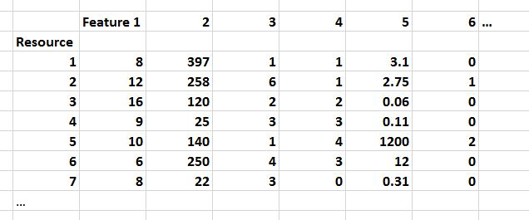
FLASHBACK
In data science, resource descriptions are typically called “properties” or “features” in a dataset like this…
A schema specifies the elements or features of a resource description
A CV specifies the possible values for a resource description

Slide 14
Why Schemas?
Schemas for structured content are desirable because a set of tags that is designed for a specific problem or industry creates structured information that is more “computable” and interoperable

Slide 15
Inter-Enterprise Data Interoperability
Data interoperability between different companies or different units of a large firm so they can do business with each other is a huge IT challenge
Suppose you say "my ordering service requires a purchase order that conforms to this schema"
This says "send me MY purchase order" not "send me YOUR purchase order"
Will the purchase orders being used by other firms meet your interface requirement, either directly or after being transformed?
15

Slide 16
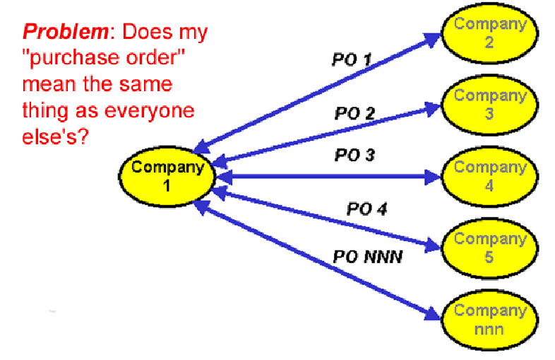
To Interoperate, or not to Interoperate?
16

Slide 17
Mapping in and out of Hub Language
If all parties/applications/services use the same information model, or rely on a hub language for their external interfaces, an exponential interoperability challenge becomes a linear one
Mapping tools for transforming instances from an internal information model to another one are ubiquitous as standalone tools and as parts of application servers
17

Slide 18
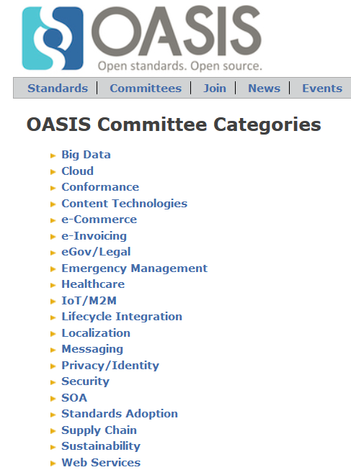

Slide 19
The “Universal Business Language”
UBL, the Universal Business Language, defines a royalty-free library of standard XML business documents supporting digitization of the commercial and logistical processes for domestic and international supply chains such as procurement, purchasing, transport, logistics, intermodal freight management, and other supply chain management functions
65 document types all built from a library of semantic building blocks that include what all business documents “talk about” – parties, locations, currencies, units, etc.

Slide 20
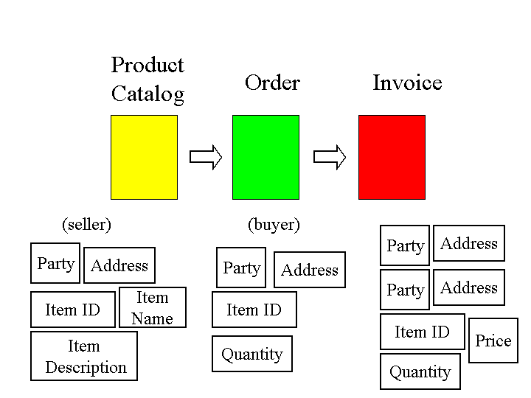
“Component Architecture” for Document Types

Slide 21
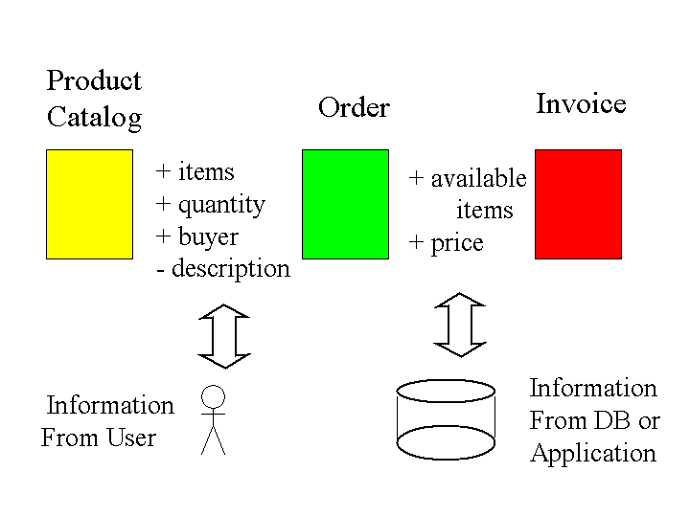
Document Architecture ⬄ Software Architecture

Slide 22
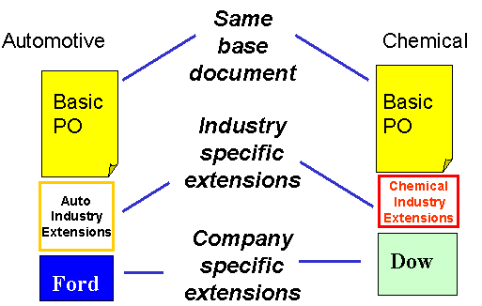
Interoperability Enabled by Reusable Components in a Common Document Architecture

Slide 23
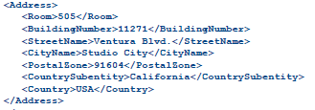
Example: Model of a Purchase Order
EXPECTED ADDRESS

Slide 24
Some Ways NOT to Interoperate
Elements with the same meaning can have different names ("IssueDate" vs "OrderIssueDate")
Elements with the same meaning can have different names or different formats even when they have the same name (September 11, 2001, 9/11/2001 and 9-11-01; 11/09/01 in Europe)
Same meaning, but encoded differently: in XML using attributes instead of elements
24

Slide 25
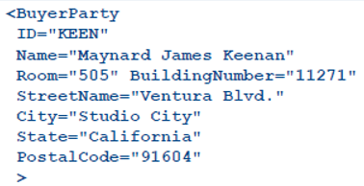
What Interoperability Problem Is Posed Here? Can It Be Resolved Reliably?

Slide 26
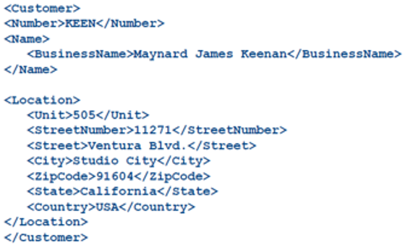
What Interoperability Problem Is Posed Here? Can It Be Resolved Reliably?

Slide 27
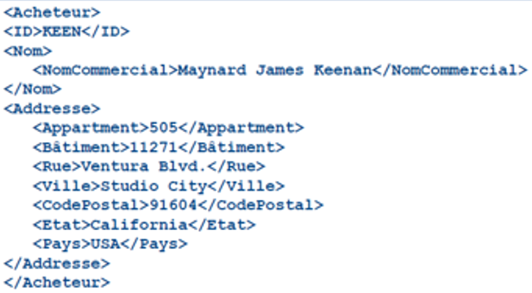
What Interoperability Problem Is Posed Here? Can It Be Resolved Reliably?

Slide 28
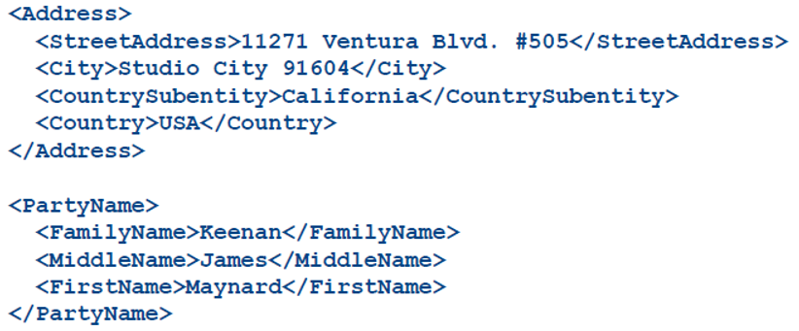
What Interoperability Problem Is Posed Here? Can It Be Resolved Reliably?

Slide 29
Syntactic, Structural, & Semantic Interoperability
SYNTACTIC interoperability is just the ability to exchange information
STRUCTURAL interoperability means that all of the expected information components are present with the same arrangement and granularity
SEMANTIC interoperability requires that the content of the message be understood by the recipient application or process
Semantic integration is the process by which this common semantic model is created
29

Slide 30
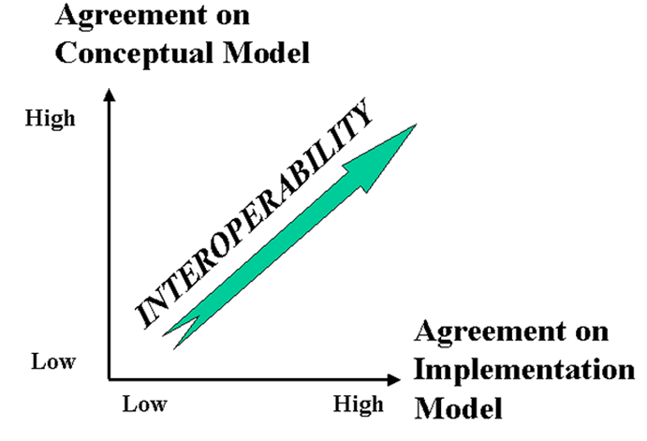
The Dimensions of Interoperability
30

Slide 31
Conceptual Disagreement
<Address>
<Latitude direction=“N”>37.871</Latitude>
<Longitude direction=“W”>-122.271</Longitude>
</Address>
If you give this address to the postal service… will your package get there?

Slide 32
Operation Clean Data
In 2003 one British military inventory system used stock number 99 000 1111 to identify a ration pack, while an­other inventory system used the same number to identify an electronic ra­dio valve
Not all of the identifiers were “NATO standard” ones
Two inventory systems might use different identifiers for the same item

Slide 33
Causes of Dirty Data
Technology Causes – different or obsolete legacy systems with different data models/formats
Process Causes – different intended uses, quality standards, legal/regulatory requirements
Mergers, acquisitions, other organizational changes that bring data together that wasn’t designed to be combined

Slide 34
Achieving Data Quality
Determine whether the problems are more technology ones or process/management ones
Prioritize the data items… but how?
Involve the data owners… if you can find them (look for the “headwaters”)
Data cleaning is like medical diagnosis; symptoms can tell you what the diseases are; cure the disease rather than continuously treat the symptoms
Set realistic goals for data quality and lifetime

Slide 35
The Modeling Debate
Information models that are precisely structured with semantics clearly separated from presentation take a lot of effort to create and use
How much modeling is necessary and justified?
Who does the work and who gets the benefit?
What is the tradeoff between expressive power /computability and ease of use?

Slide 36
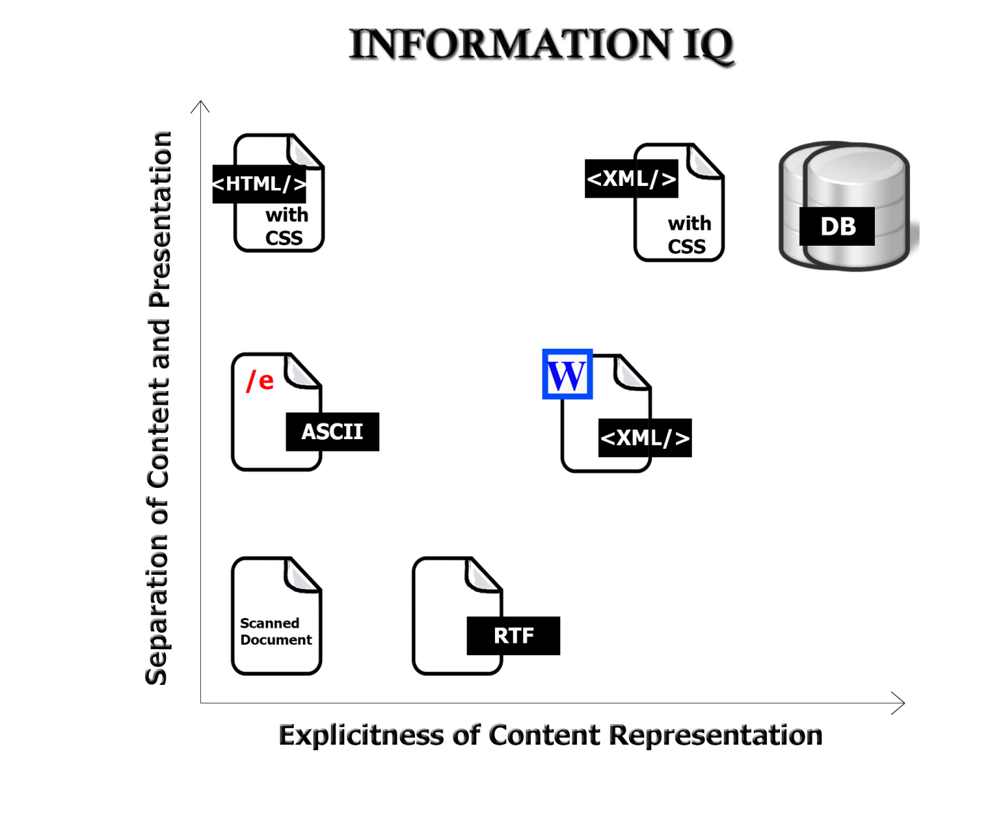
The Digital Format Matters!
FLASHBACK
36

Slide 37
The Web and HTML
30 years ago Tim Berners-Lee created HTML (“hypertext markup language”) as a simple and limited “presentation layer” vocabulary to make it easy to use
HTML’s idea of using tags to mark up pieces of text according to how they should appear on the page for people to read them is very easy to understand and led to the Web’s rapid adoption
The first version of HTML had only about 11 tags – paragraphs, headings, lists

Slide 38
The Limits of HTML
Many people criticized HTML and argued that a fixed set of presentation-oriented tags was a substantial step backwards for authors, readers, and their organizations
The limitations of HTML were most obvious in websites and applications that had to “down-transform” structured content from databases

Slide 39
XML (“extensible markup language”)
XML was invented 20 years ago for structured publishing and transactions on the web
XML enables the design of “schemas” or “vocabularies” or “tag sets” and the specification of the rules by which they are arranged (“validation”)
So instead of a fixed tag set like HTML, XML's purpose is radically different – it is a “metalanguage” – a general syntax for encoding models and instances of things and processes

Slide 40
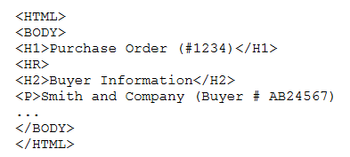
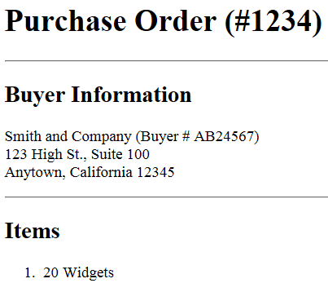
If you give this HTML source file to a web browser it renders it in a human-readable way because “presentation rules” are built into the browser

Slide 41
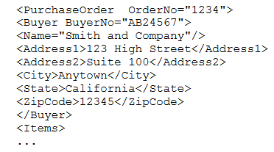
If you give this XML source file to a web browser it needs an XML transform (“style sheet”) to assign formatting
Different transforms might be needed for different devices, users, or consuming applications

Slide 44
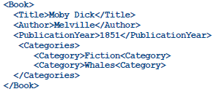
Elements vs. Attributes
The attribute representation is legal and semantically equivalent but not as useful

Slide 45
XML vs. Microformats, Schema.org
“Heavyweight” models needed for robust computation and interoperability “by machines” are most often defined as XML schemas – see https://www.oasis-open.org/
But a large number of more “lightweight” models for creating structured content “for eyes” use HTML attribute syntax to make them easier to embed in web pages

Slide 46
Microformats
Microformats represent a very different approach to modeling and encoding "document types"
Instead of following rigorous (and slow) design methods to create standard reusable information models they are more of a grass-roots effort to create XHTML "chunks" embeddable in web pages
Commonly used microformats are those for personal contact information, calendar events, and a few other small chunks of structured data

Slide 47
Schema.org
Schema.org expanded and optimized the microformat concept for the benefit of search engines and other applications that rely heavily on structured data
The use of these structured “semantic fragments” in web pages enables search engines to return more precise and relevant results

Slide 48
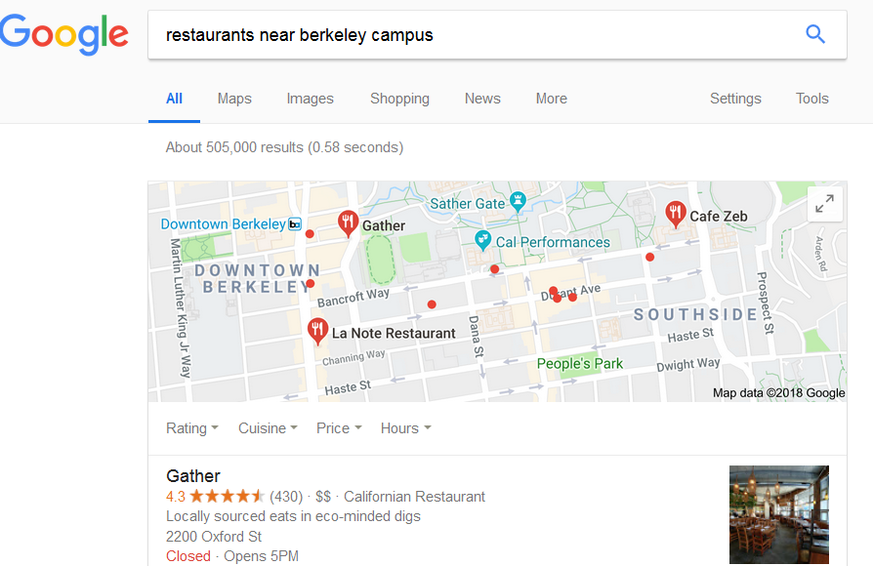

Slide 49
<div>
<h1>Avatar</h1>
<span>Director: James Cameron (born August 16, 1954)</span>
<span>Science fiction</span>
<a href="../movies/avatar-theatrical-trailer.html">Trailer</a>
</div>
SIMPLE HTML
SCHEMA.ORG “Movie”
<div itemscope itemtype="http://schema.org/Movie">
<h1>Avatar</h1>
<span>Director: James Cameron (born August 16, 1954)</span>
<span>Science fiction</span>
<a href="../movies/avatar-theatrical-trailer.html">Trailer</a>
</div>

Slide 50
Assignment 7: Modeling a “Sporting Event”
Your assignment is to create a vocabulary for describing a sporting event. This assignment will expose you to the processes and decisions involved in modeling and resource description: scoping the vocabulary, making decisions about trade-offs, choosing meaningful names and definitions, and being aware of the biases embedded in your vocabulary.
Part 1: Scoping the Vocabulary
Part 2: Defining the Descriptors
Part 3: Encoding an Instance
Part 4: Swapping Vocabularies
Part 5: Reflections
Due Tuesday April 16
In Class on April 16
Due Thursday April 18

