Slide 1
CogSci 190 “Sensemaking and Organizing” Spring 2019
Robert J. Glushko glushko@berkeley.edu
11 April 2019 22) Organizing and Interaction Design;
Choice Architecture;
Faceted Classification

Slide 2
Today’s Topics
Organizing and Interaction Design
How the organizing principles, abstraction, and granularity of categories affects interactions
Choice architecture
Behavioral economics from the perspective of the organizer rather than from the perspective of the user (topic of March 18 lecture)
Faceted classification
Activities
Designing a faceted classification
Designing a hierarchical classification

Slide 3
Interactions –The Why of Organizing Systems
INTERACTIONS include any activity, function, or service supported by or enabled with respect to the resources in a collection or with respect the collection as a whole
Whenever we select a resource for inclusion in an organizing system, describe it, or arrange it according to an organizing principle, we (should) have an interaction in mind
TDO calls this “organizing on the way in”
3

Slide 4
Requirements for Interactions
All organizing systems have some common interactions, but we want to pay attention to the more resource-specific interactions that create the most value
The priorities of the interactions are often determined by decisions about intended users
The interactions must be discoverable and invokable by their intended users
“UID” = “user {interface, interaction} design
4

Slide 5
Value Creation: Affordances vs. Designed Interactions
For physical resources, many potential interactions are inherent in their affordances – perceptible and actionable properties that determine what can be done with them
Digital resources require “designed interactions” made possible by intentional acts of description, arrangement, or technological mediation

Slide 6
Classifications and Interactions
Classifications arrange resources into categories
So every classification increases the capability and efficiency of interactions with resources that are “co-located” or “within-category” and makes “between-category” interactions less efficient
The granularity of the classification determines the specificity of the interactions
The structure and description of a classification influences how people use it
6

Slide 7
Classification on Sports Websites
What questions does this organization make easy / hard to answer?

Slide 8
HOW ARE MY HOME TEAMS DOING?
HOME NFL NBA MLB NHL
SF 49ers Warriors Giants Sharks
A’s
LA Rams Lakers Dodgers Kings
Clippers Angels
Seattle Seahawks Sonics Mariners

Slide 9
National and State “Obamacare” Sites

Slide 10
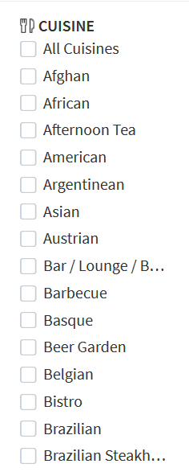
Different Classification Granularity on “Find Restaurant” Websites
Open Table: > 100 categories
Zagat: 11 categories

Slide 11
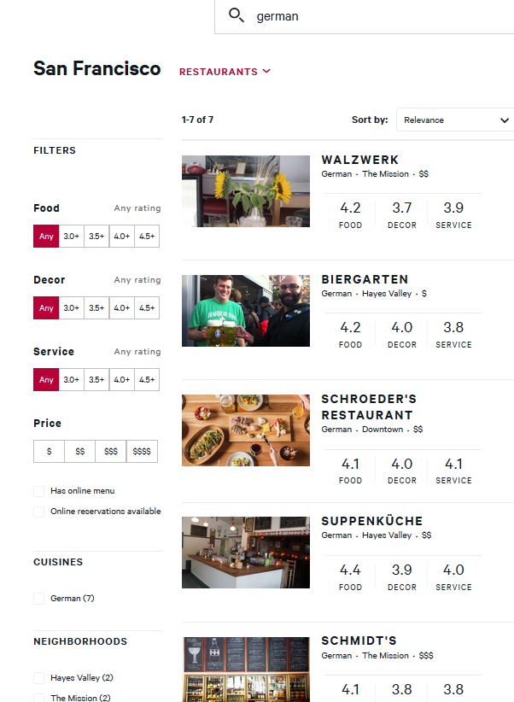
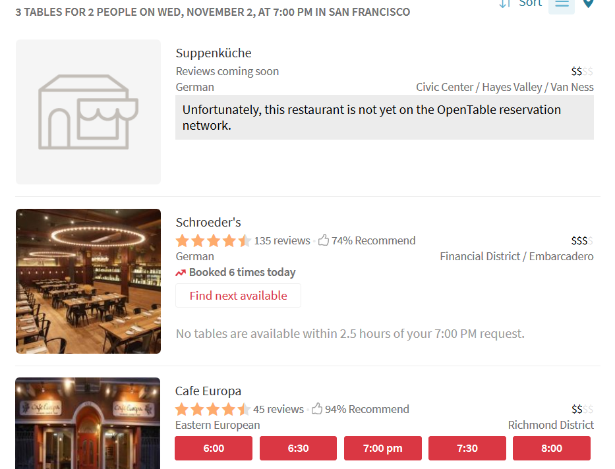
Zagat : 7 German Restaurants
Open Table : 3 German Restaurants

Slide 12
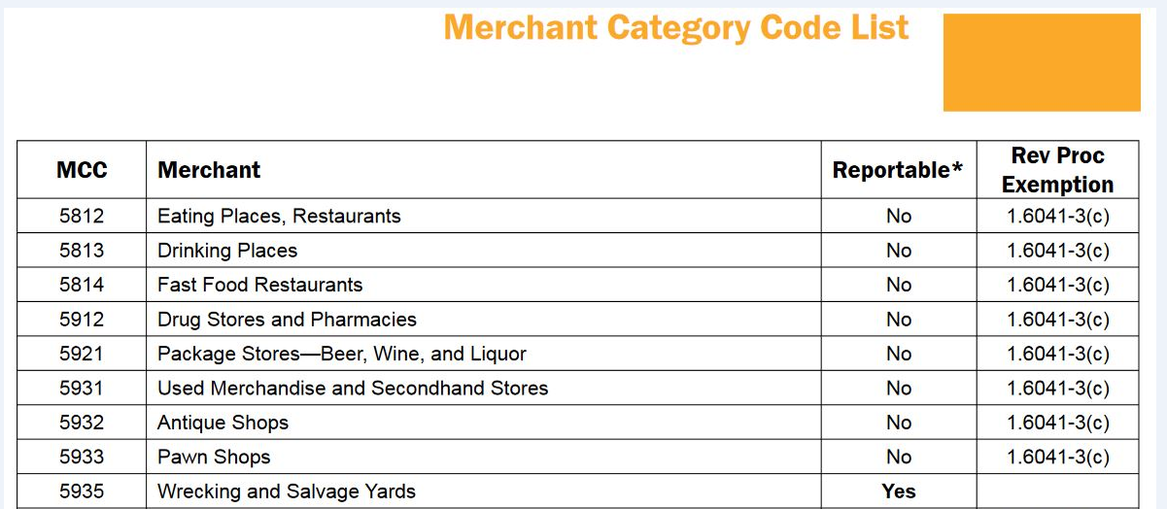
Classifications and Interactions
Standard classifications for products and business services make it easier to discover suitable resources, integrate them into your own processes, or to comply with rules and regulations
12

Slide 13
UI Design to Support Interaction
Many interactions with physical and digital resources are invoked and performed using controls or other “user interface elements”
These controls and UI elements have affordances too, and good design makes it easy to see how to use them
Does the arrangement of the controls map well to the arrangement of the resources they control?
13

Slide 14
Classification and Interactions
Effective user interfaces to physical or digital organizing systems present and reinforce the logical classifications they embody
If the resources belong to logical groups or categories, does the arrangement of the controls reflect them?
14

Slide 15
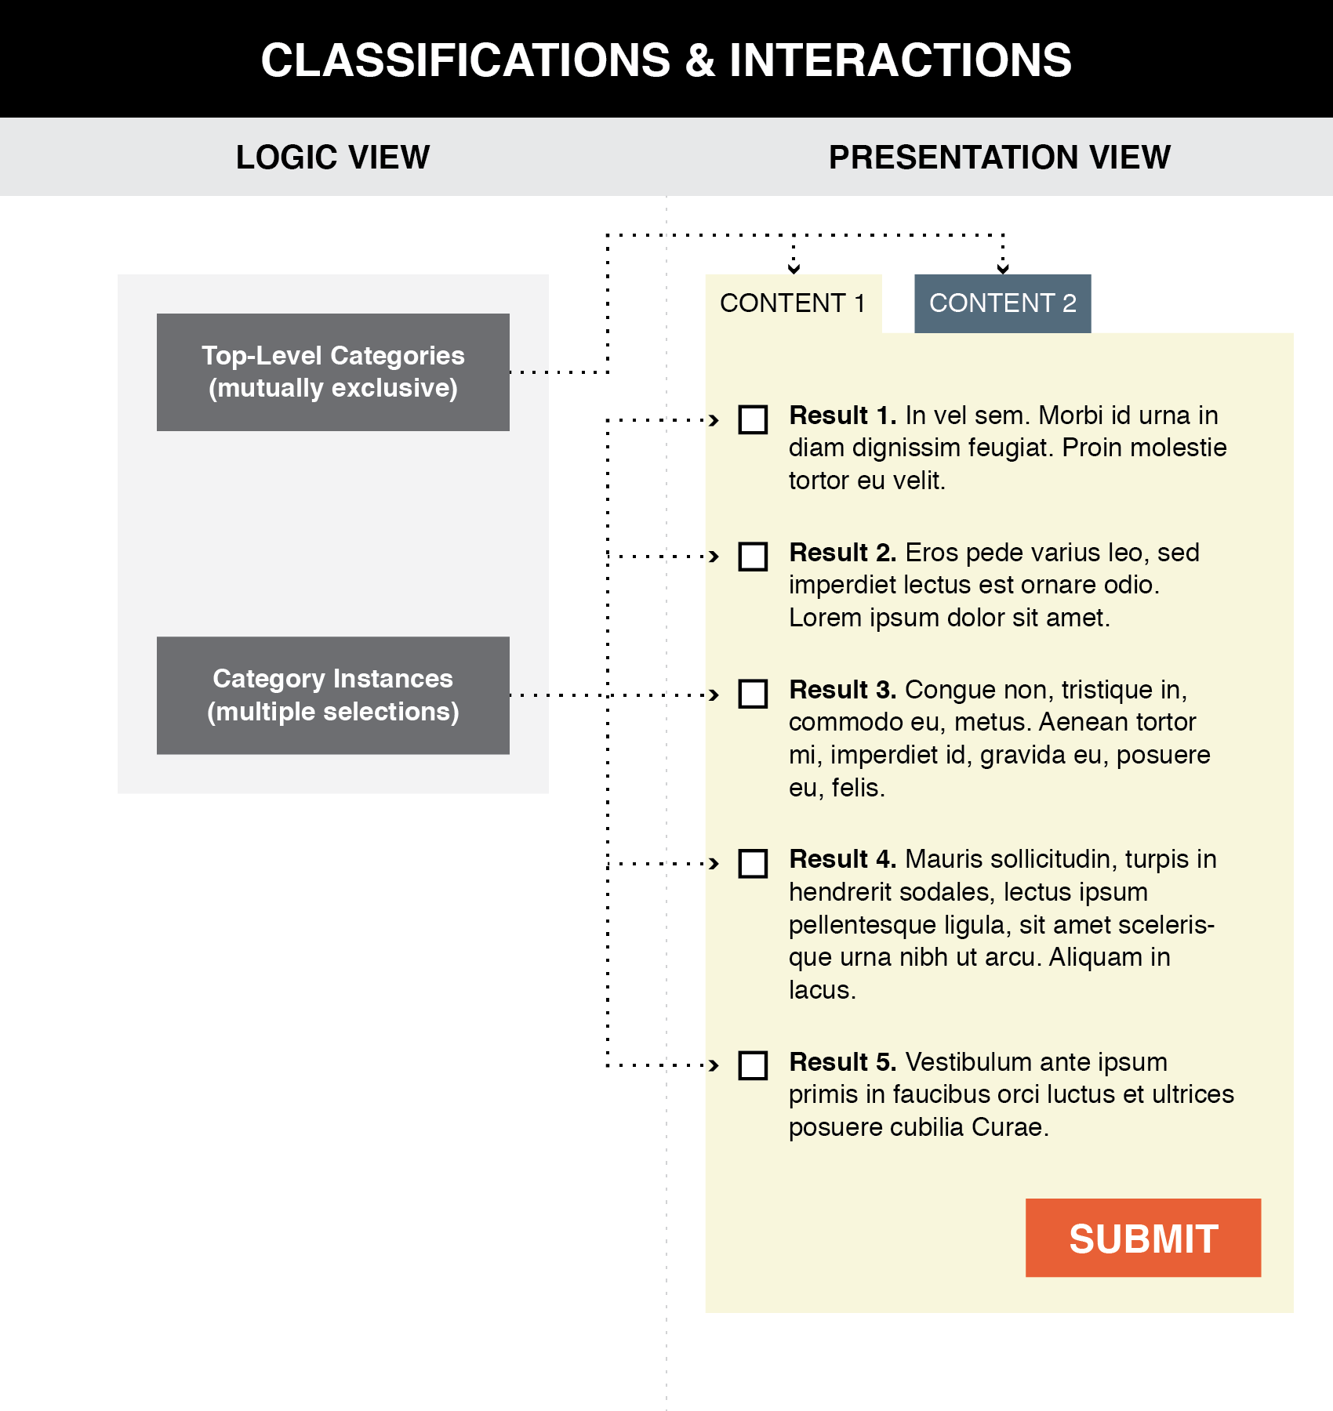
Good user interface design creates a clear mapping between a classification scheme and the arrangements and interactions that users see (TDO Figure 8.1)
15

Slide 16
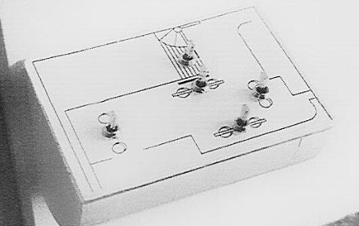
AFTER: Switches arranged to match room layout
BEFORE: Array of 6 light switches
Donald Norman, The Design of Everyday Things

Slide 17
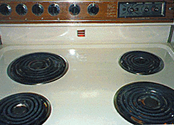
Good and Bad Mappings
17

Slide 18
Beer tap handles used to distinguish identical knobs in control room of a nuclear power plant
Donald Norman, The Design of Everyday Things

Slide 19
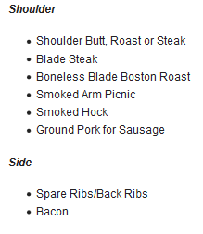
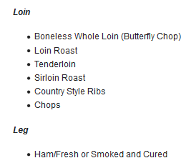
A Conventional Presentation of a Classification: Tabular categories and subcategories

Slide 20
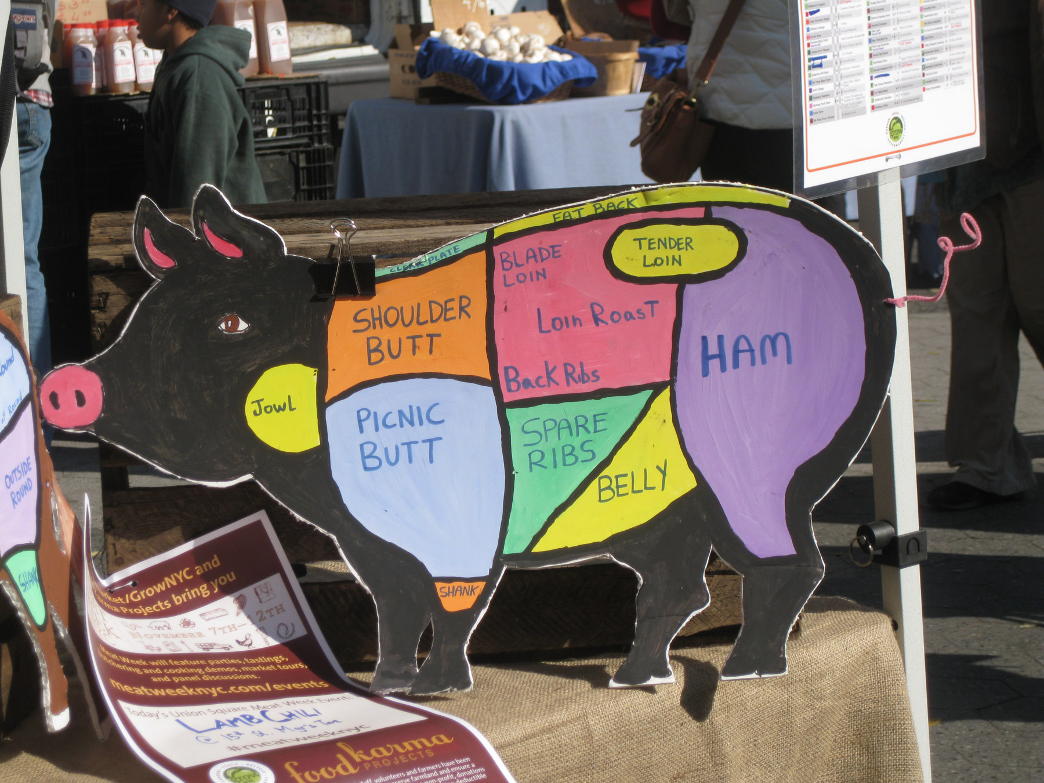
More Intuitive Presentation of the Classification
Photo taken by Bob Glushko at Union Square Greenmarket, NYC

Slide 21
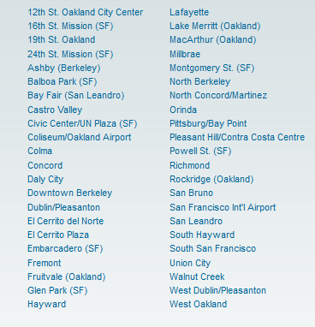
FLASHBACK: Poor Communication of a Classification
BART Station List
Better Might Be Something Like…
San Francisco
Embarcadero
Montgomery
Powell
Civic Center
…
Oakland
West Oakland
12 Street
19 Street
MacArthur
Rockridge
…
Berkeley
Ashby
Berkeley Downtown
Berkeley North

Slide 22
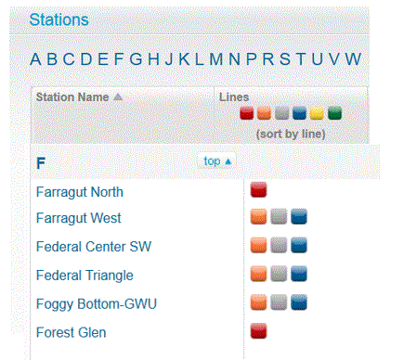
Some Advice for BART from the Washington Metro
Color coded by Train Line
Station names that follow rules

Slide 23
Business Organization, Classification, and Interactions
A fundamental tension in business organization is whether to classify functions to optimize “inside” interactions or “outside” ones
A company is organized “on the inside” so its business units can work together to accomplish its objectives (“businesses as organizing systems”)
But this “org chart” classification of business functions isn’t useful for customers (Why not?)
And neither is useful for employees, who would prefer yet another classification? (What and why?)
23

Slide 24
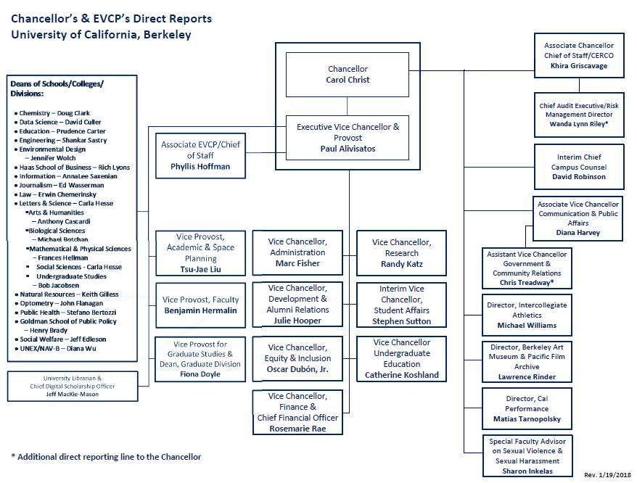
UC Berkeley’s Internal Classification of Functions and Responsibilities

Slide 25
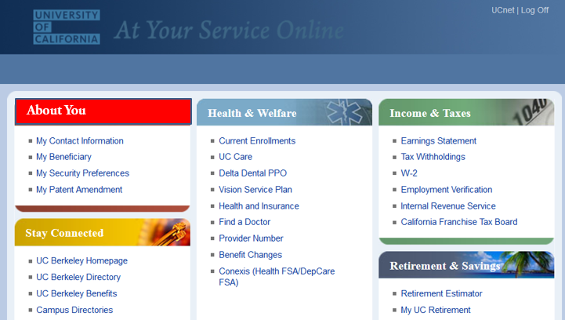
Public View
Of UCB
Employee View
Of UCB

Slide 26
The “Interaction Intensity” Pattern for Business Organization
In service design, interaction intensity is often measured by the number of “touch points” they require to create value
This view lets us treat intensity as a design parameter to differentiate service offerings of the same type or industry domain
The “generic” service offering is a design pattern that can be increased or reduced in intensity by changing the number of touch points
Notes:
26

Slide 27
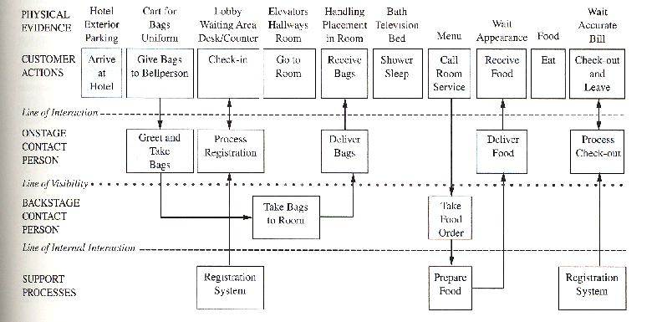

Slide 28
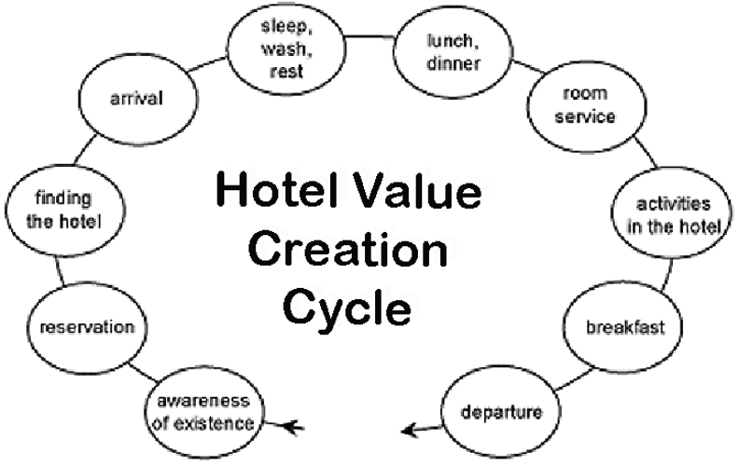
Interaction Design Pattern: “Generic” Hotel
28

Slide 29
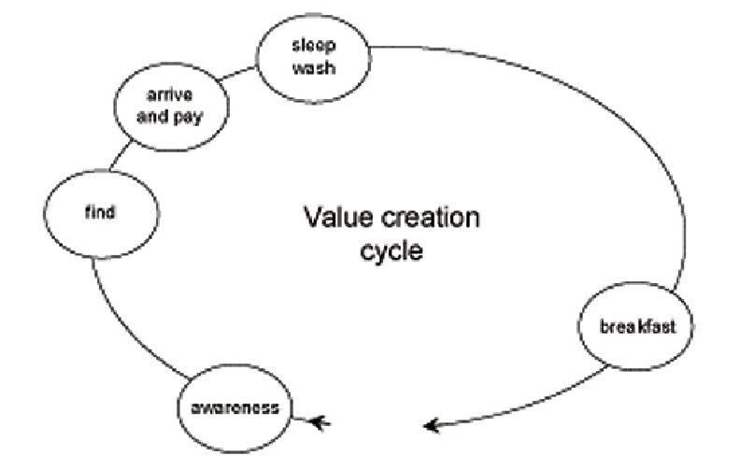
A “Budget” Hotel with Fewer Interactions
29

Slide 30
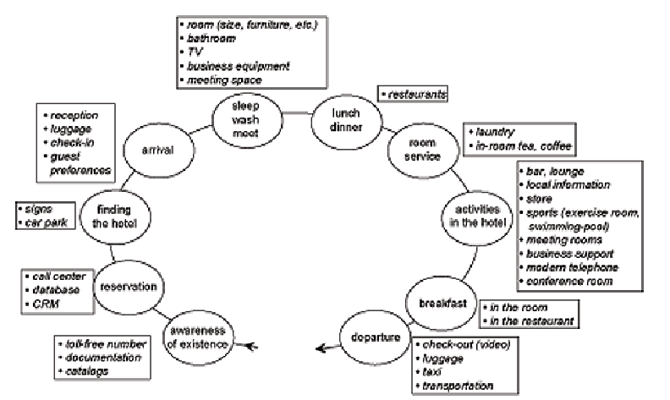
A “Luxury” Hotel with More Interactions
30

Slide 31
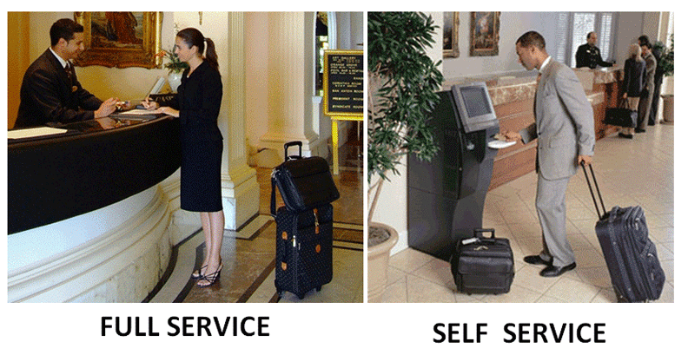
Interaction Alternatives Accommodate User Preferences
..and keyless entry systems let you skip the lobby and go directly to your room, using your smart phone app as the key
31

Slide 32
Choice Architecture

Slide 33
FLASHBACK IDEAS
Many interactions – especially with physical resources - seem unmediated when they take place
This means we don't always realize the role of additional descriptions or organization in supporting or improving interactions
Choices about descriptions and organizing principles involve tradeoffs that determine which interactions are efficient, possible, difficult, or impossible
33

Slide 34
“The Tools of Choice Architecture”
Johnson, Eric J., et al. "Beyond nudges: Tools of a choice architecture." Marketing Letters 23.2 (2012): 487-504.
The way a choice is presented influences what a decision-maker chooses. We divide these tools into two categories:
those used in structuring the choice task
those used in describing the choice options
34

Slide 35
Choice Architecture in TDOspeak
Choice Architecture says:
TDO says:
There is no neutral architecture
We can vary the order of choice alternatives
We can change the number of categories
We can change the labels of alternatives or categories
People prefer choices that are easier to describe
TRADEOFFS
All systems of categories are biased
We can use different organizing principles
We can vary the abstraction and granularity of categories
Naming and resource description is difficult, contentious, and makes a difference
TRADEOFFS

Slide 36
How Many Alternatives?
Need to enable “a reasoned consideration of tradeoffs among conflicting values” but “not seem overwhelming”
Too few options may generate context-specific preference where the presence or absence of one option influences what is chosen
Too many options create “choice overload” or the “paradox of choice” because the initial attractiveness of many alternatives decreases the motivation to choose any particular one
36

Slide 37
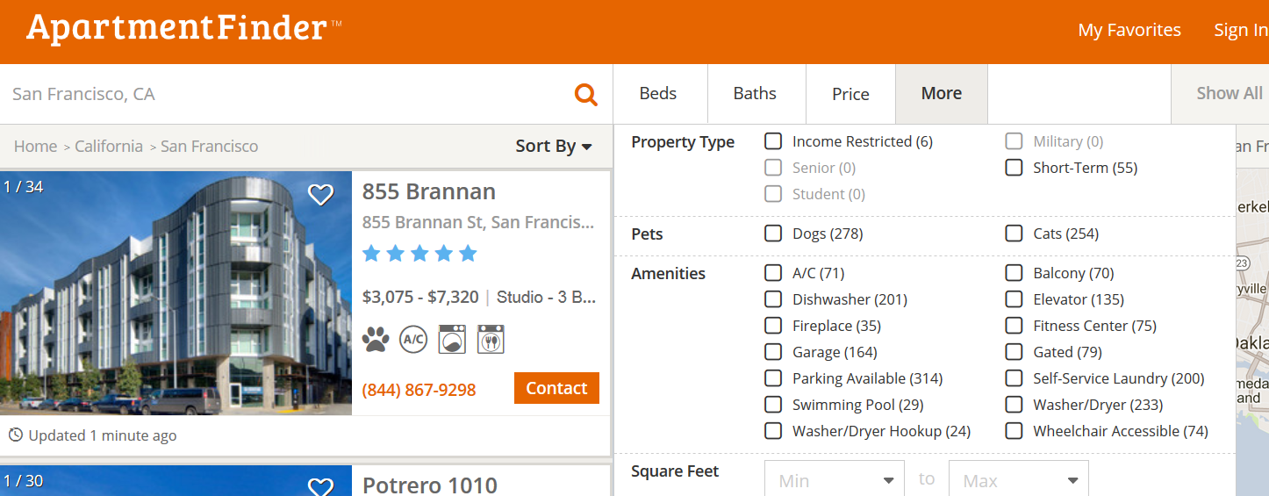
Choice Overload?
Looking for an apartment? Over 20 potentially relevant attributes here
Notes:
Choice Overload?

Slide 38
Defaults
For any choice that needs to be made, there should be an associated default rule that determines what happens to the decision maker if she does nothing
Usually the answer is that if you do nothing, nothing changes; whatever is happening continues to happen
For “opt-out” defaults a majority of choosers will do nothing, and things can happen that the chooser might not want or not know about
38

Slide 39
Types of Defaults
Configuration defaults apply at the first encounter with a choice
Could be the same for everyone, a normative or recommended alternative
Mandated choice
Reuse defaults apply to subsequent encounters
Persistence of original choice
Reverting to original default
Predictive defaults based on user modeling
39

Slide 40
Decision Staging
When facing a small number of well understood alternatives, “rational” people will examine all the attributes of all the alternatives and then make tradeoffs when necessary
If consumers are rational, “utility-maximizing agents”, their preferences for any finished product should be independent of the order in which they considered its attributes: any order should yield an equivalent “final” bundle
But as the choices become more numerous or vary on more dimensions, people are more likely to adopt simplifying strategies that aren’t entirely rational
40

Slide 41
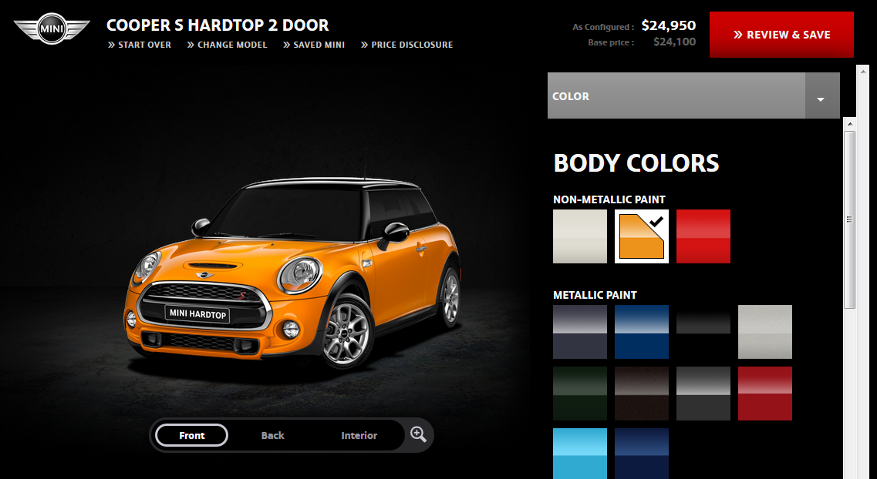
Product Configuration (miniusa.com)
Constructing the preferred product via a sequence of attribute decisions

Slide 42
How Attribute Order Affects Choice
Changes in the order by which the attributes are considered can substantially influence the choices made
If you start with attributes with lots of options, the chooser is more likely to accept default alternatives on later attributes, even if these decisions involve relatively few options that would ordinarily require less capacity to evaluate
STOP and THINK
What would cause this? How would a choice architect use this to his advantage?
42

Slide 43
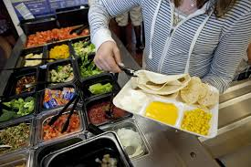
If school kids are more likely to eat foods at eye level at the beginning and end of the cafeteria buffet, how do you arrange the food?
Notes:
Arrange the food to make the students best off
Arrange the food at random
Arrange the food to get the kids to pick the same foods they would choose on their own
Maximize the sales of the items from the suppliers that are willing to offer the largest bribes
Maximize profits

Slide 44
Naïve Diversification / Partition Dependence
The is a general psychological tendency or preference towards equal amounts or proportions when given a set of allocation choices
If there are 3 categories you put 1/3 in each
Such “naive diversification" is thought to arise from a desire for variety-seeking, to hedge against risky or uncertain prospects, and minimize potential regret
Effects are stronger for people with weaker intrinsic preferences or knowledge

Slide 45
Stop and Think: Supermarket Shopping
What categories do you use when you make a list (explicit or implicit) for supermarket shopping?
Do these categories align with those used by the store to organize the goods, or are they different (e.g., healthy, party foods, cheap?) than the store ones?
Are you influenced by the placement of items in the store to buy things not on your list?
If you wanted people to eat healthier, how would you redesign the store or shopping carts to do that?

Slide 46
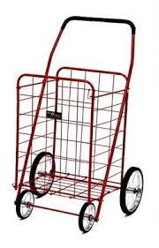
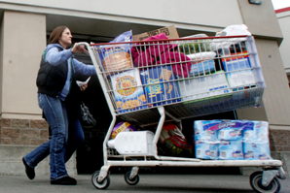
Shopping Cart Size and Partition Effects
When you go to the store, do you choose a shopping basket or shopping cart? Even if you didn’t intend to, do you often buy more if you pick the shopping cart?
Two grocery store studies found that most shoppers purchased fruits and vegetables in quantities relative to the size of their allocated partition within a shopping cart
Partitions are effective because they suggest purchase norms

Slide 47
Attribute Descriptions
People make comparisons on the basis of resource attributes, and ideal decisions would consider all attributes and weight them according to their importance to the decider
But choice architects can manipulate the salience of attributes
Choice sets that can be described simply are preferred over other sets that seem more complicated, even when the complicated ones offer more objective value
People like things that are orderly in arrangement

Slide 48
Choosing Beer Bundles
Two bundles differ only on the third beer
Some bundles have beers from 4 different breweries
People have a preference for all the same or all different bundles
Evers, Ellen R.K. and Inbar, Yoel and Loewenstein, George and Zeelenberg, Marcel, Order Preference (July 16, 2014). http://ssrn.com/abstract=2466991

Slide 49
Faceted Classification

Slide 50
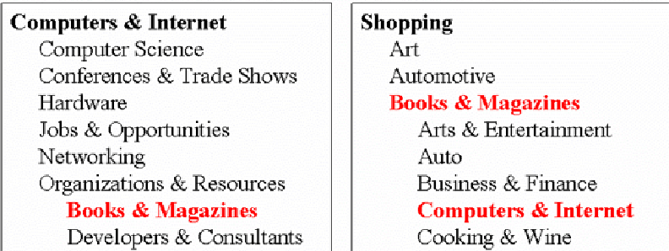
The Need For Multiple Classifications
50

Slide 51
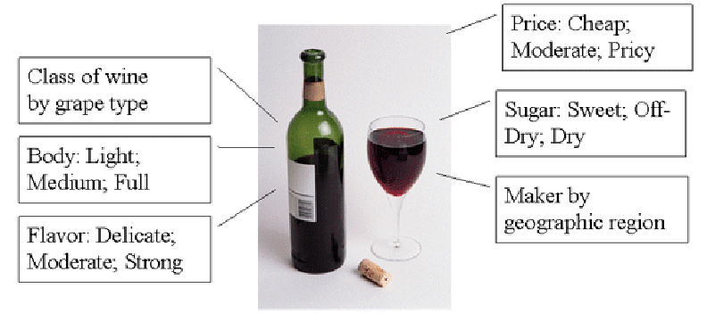
Wine Classifications
51

Slide 52
Faceted Classification
FACETS are an alternative to hierarchical classification that overcome many of its limitations
Instead of creating a deep category hierarchy, facets create multi-dimensional categories that are defined (or generated) through grammatical composition (or combination) from the (characteristics or dimensions or relations) in the domain
Facets divide a domain or subject into "homogeneous" or "semantically cohesive" categories of manageable size
52

Slide 53
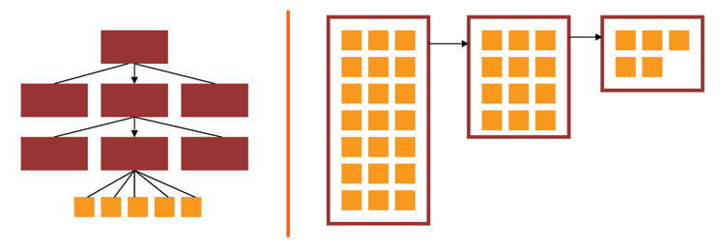
Facets and User Interfaces
Sequential category selection, results only at leaf nodes
Each selection yields results, subsequent selections refine the results set
53

Slide 54
Facets as a Controlled Vocabulary
The relationships between the facets enable a small CONTROLLED VOCABULARY to generate:
Many structured descriptions
That are complex, but formally structured
That enable us to describe things we don't have words for
54

Slide 55
Some Live Examples
CDW
Yelp
Epicurious
Build your own BMW
55

Slide 56
Designing a Faceted Classification (TDO 8.4.4)
Collect examples that need to be classified
Identify candidates for facets and subfacets by analyzing the examples
Order foci within facets
Determine grammar for ordering and combining facets and subfacets
Create new facets and subfacets where needed
Test classification scheme on new examples
Iterate and refine throughout
56

Slide 57
Types of Facets
Enumerative -- a set of mutually exclusive possible values
Boolean -- yes or no on some dimension
Hierarchical or taxonomic -- organize the instances by logical containment
Spectrum -- numerical attributes on some range, with min and max
57

Slide 58
Choosing Facets
ORTHOGONALITY - facets are independent dimensions
SEMANTIC BALANCE - top level facets are the most important semantic dimensions of the domain; values within facets are at equal semantic level
COVERAGE - all current instances can be classified
SCALABILITY - future instances can be classified
OBJECTIVITY - instances can be objectively classified; might also be called CONCRETENESS
NOT IDIOSYNCRATIC - facet semantics should be "mainstream" or "normative" and not rely on clever, fanciful or metaphoric interpretation
58

Slide 59
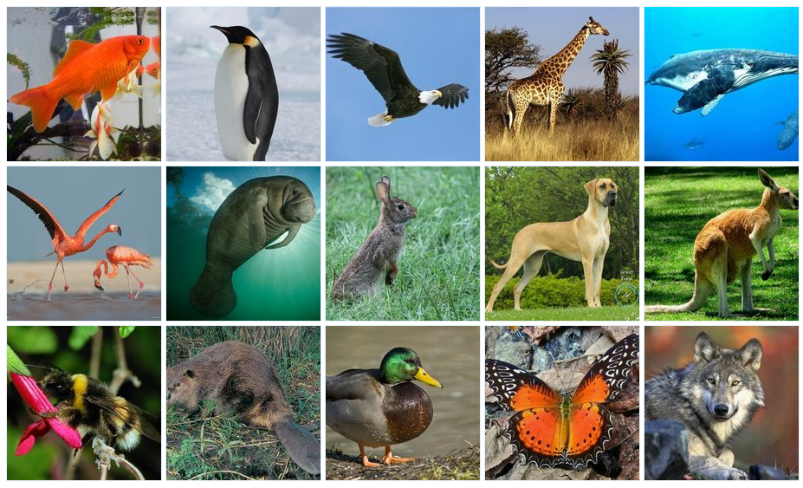
Faceted Classification for the Animals
Activity 1 for 11 April 2019
59

Slide 60
Activity 2 for 11 April 2019
Complete the concept hierarchy (taxonomy) between “Vehicle” and these 16 hyponyms
Use as many intermediate levels and sub-categories as you like
(After the blank slide) Test your taxonomy to see if the five additional vehicles fit in one of the categories you’ve created

Slide 61
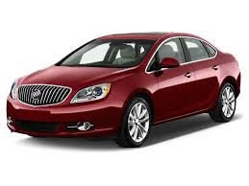
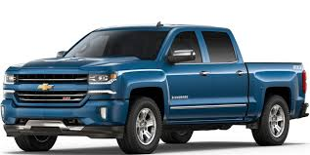
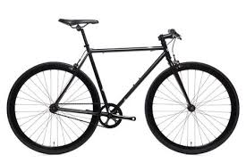
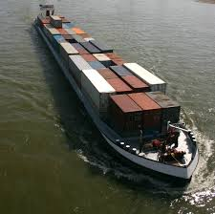
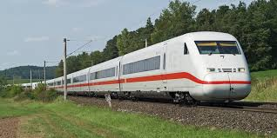
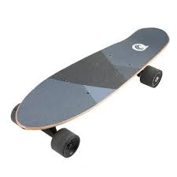
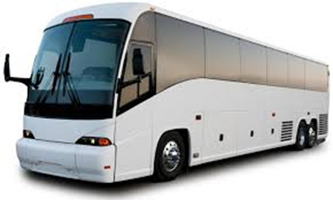
Passenger automobile
Pick-up Truck
Bicycle
Passenger Train
Cargo Barge
Bus
Cargo Aircraft
Skateboard

Slide 62
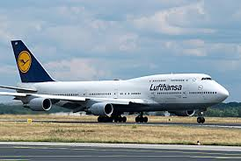
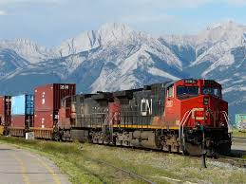
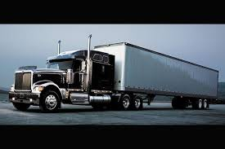
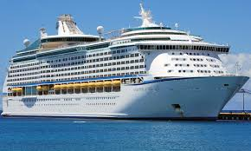
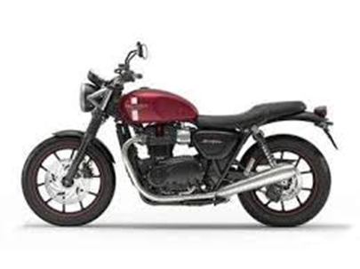
Rowboat
Passenger Aircraft
Freight Train
Cargo Truck
Cruise Ship
Motorcycle

Slide 64
Remotely Piloted Drone Aircraft

Slide 65
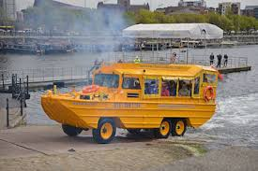
Amphibious “Duck Boat”

Slide 66
Space Shuttle

Slide 67
Submarine

Slide 68
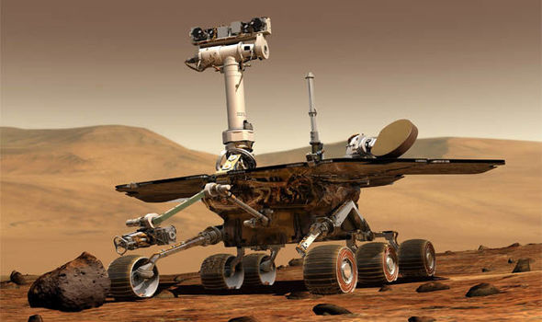
Mars Rover

