Slide 1
CogSci 190 “Sensemaking and Organizing” Spring 2019
Robert J. Glushko glushko@berkeley.edu
16 April 2019 23) REVIEW: Modeling & Resource Description

Slide 2
An Introduction to Modeling - 1
Models are simplified descriptions of a domain or resource type that abstract from its complexity to emphasize some features or characteristics while intentionally de-emphasizing others
The primary purpose of modeling is to better understand some existing system or environment and its resources and to describe this understanding so it can be communicated and applied
2

Slide 3
The Modeling Gap
There is an essential difference or gap between the real world being modeled and any models of it, or else the models would serve no purpose
3

Slide 4
La trahison des images – Magritte (1929)

Slide 5
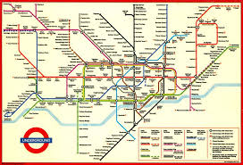
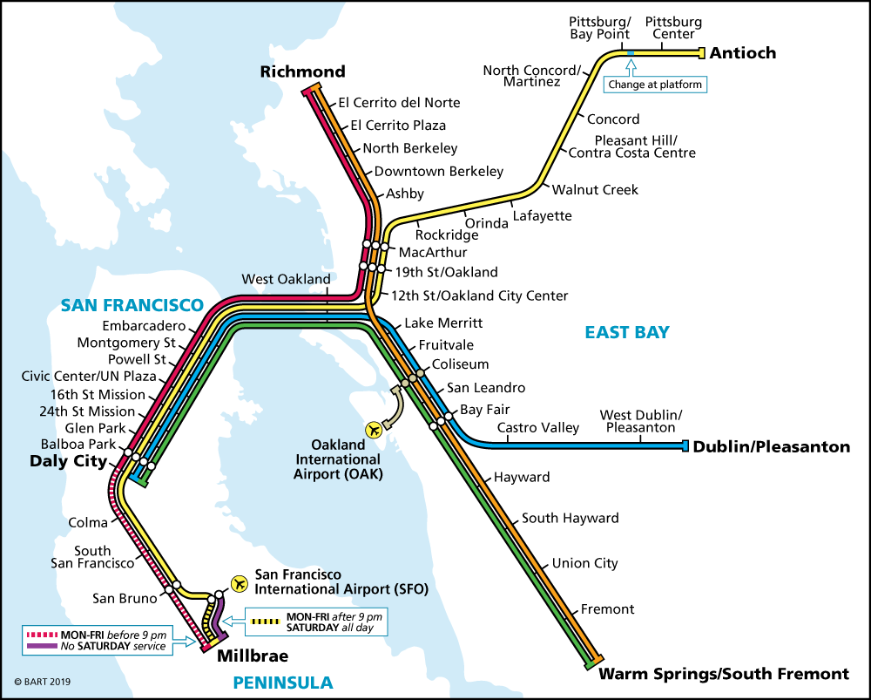
“The map is not the territory”
LONDON
BART

Slide 6
Process of Describing Resources (TDO 5.3)
Identify / scope the resources to be described
Determine the uses of the descriptions
Study the resource(s) to identify descriptive properties
Design the description vocabulary
Design the description form and implementation
Create the descriptions (either "by hand" or by some automated / computational process
Evaluate the descriptions
6

Slide 7
Scoping and Description
How explicit and thorough these 7 steps need to be depends on what we are calling "scope“
Do we know who the users are?
Are the describers the users?
Do we have all the resources, a representative set, or just the first set ... do we know what else is coming?
7

Slide 8
Description is Challenging!
People use different words for the same things, and the same words for different things (TDO 4.4)
Describing and organizing always (explicitly or implicitly) takes place in some context
The context shapes which resource properties are important and the organizing principles that use those properties
8

Slide 9
Designing the Description Vocabulary
Good descriptions use terms that their intended users might use
Good descriptions don't contain details that aren't necessary
Good descriptions are created systematically and follow standards
What if these three design principles suggest incompatible vocabularies?
9

Slide 10
Tradeoffs involving Description
Is it easier to create structured or unstructured descriptions?
If we want to combine information from many different authors or sources, what are the implications for description and organizing decisions?
Is it easier to combine information from different authors or sources if it is structured or unstructured?
10

Slide 11
Creating Resource Descriptions
By professionals: "Institutional" descriptions that follow standards
By authors: Best knowledge of purpose and intended audience
By users: Most variable, influenced by social purposes
By automated processes: Most reliable, primarily technical / objective properties but semantic description capability is emerging
11

Slide 12
Descriptive Precision
Writers, poets, painters, composers, sculptors, technical writers, programmers, producers, architects, designers, and devices or machines can all create resources
The Dublin Core vocabulary for describing web pages has a single property for indicating a “creator” (TDO 5.3.1.3)
“Shakespeare” and “Hubble Telescope” are both “creators”
Easy to use, but this tradeoff loses a great deal of precision compared to larger and more controlled vocabularies

Slide 13
Assignment 7
Your assignment is to create a vocabulary for describing a sporting event. This assignment will expose you to the processes and decisions involved in modeling and resource description
scoping the vocabulary
making decisions about trade-offs
choosing meaningful names and definitions
being aware of the biases embedded in your vocabulary
What biases did YOU bring to this assignment? Did you recognize them?

Slide 14
Assignment 7 – Modeling Decisions
What range of events do you want your description to apply to (a single sport, or many different sports)?
Did you recognize this as an implied classification problem?
How did you decide where to “slice through the tree”
Did you consider the “swap the models” activity when you made these decisions?

Slide 15
The Classification Problem(s)
TRICK QUESTIONS! There are many different classifications you might have considered

Slide 16
Classification Using “Sports Equipment”
BALL SPORT TYPES:
the ball only
ball and a stick or bat
ball over the net

Slide 17
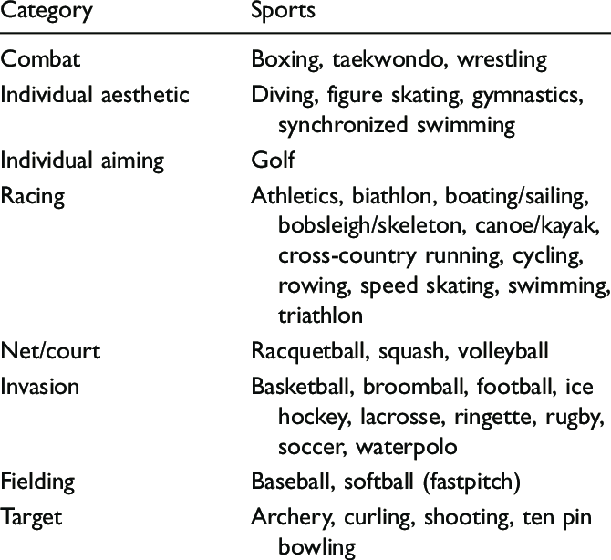
Classification by “Core Activity” or Goal

Slide 18
Other Ways to Classify Sports
Professional, Collegiate, Amateur, Recreational
Team or Individual
Venue: Indoor, Outdoor, Arena, Sports-specific
…

Slide 19
Assignment 7 – Modeling Decisions
How many “levels” of descriptors do you want or need? You can have a “flat” vocabulary where all the descriptors are at the same level, or a hierarchy where some descriptors are “containers” for others
What kinds of descriptors most naturally suggest container elements?

Slide 20
What Is Being Organized?
Identifying the unit of analysis is a central problem in every intellectual or scientific discipline – “what exactly are we talking about?” – and in every organizing system
Resources that are aggregates or composites of other resources, or that have internal structure, or that can have many attributes, pose questions about the granularity of their "thingness”
20

Slide 21
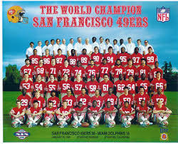
Granularity Analysis: Sports Team
A sports team is treated as a single resource for some purposes (which ones?)
Or as a collection of individuals, or as a number of sets of individuals for other purposes (which ones?)
Notes:
Although we have many choices about how we can organize football players, all of them will include the concept of a single player as the smallest identifiable resource. We are never going to think of a football player as an intentional collection of separately identified leg, arm, head, and body resources because there are no other ways to “assemble” a human from body parts. Put more generally, there are some natural constraints on the organization of matter into parts or collections based on sizes, shapes, materials, and other properties that make us identify some things as indivisible resources in some domain.

Slide 22
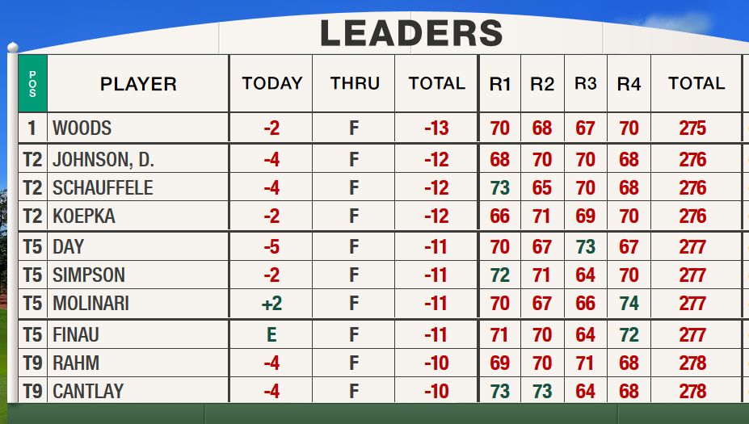
How Many Things is a Golf Tournament? (2019 Master’s)

Slide 23
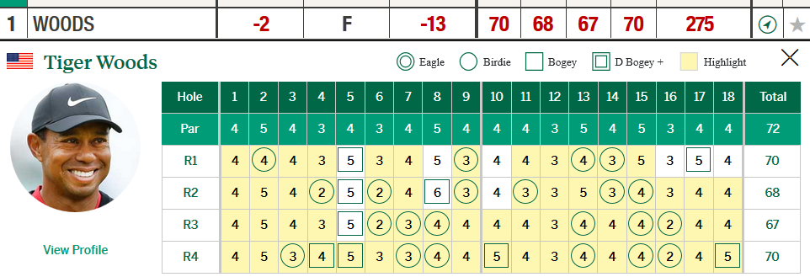
<TournamentResults>
<Players>
<Woods>
<Round1>
<Hole1>4</Hole1>
<Hole2>4</Hole2>
…
</Round1>
<Round2>…
</Woods>
<Johnson>…
</Players>

Slide 24
Assignment 7 – Modeling Decisions
How many descriptors do you need for a full, useful description of an event?
Do you see how this depends on the scope of the vocabulary?
Do you see how it depends on what “useful” means – what will the model be used for?
A descriptor can summarize or aggregate information to make the “raw” descriptors unnecessary

Slide 25
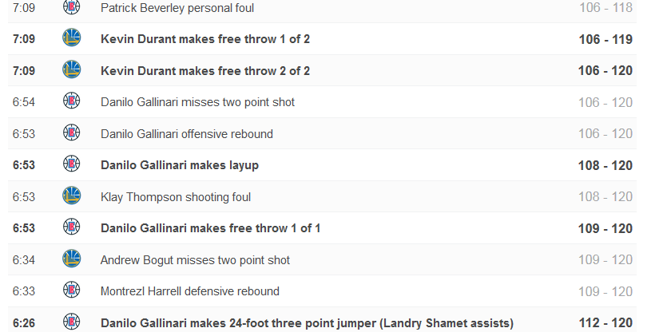

Slide 26
The Modeling Gap
The “modeling gap” is the set of potential descriptors of the event that you chose not to include in your model
What are some of these descriptors that you didn’t use?
26

Slide 27
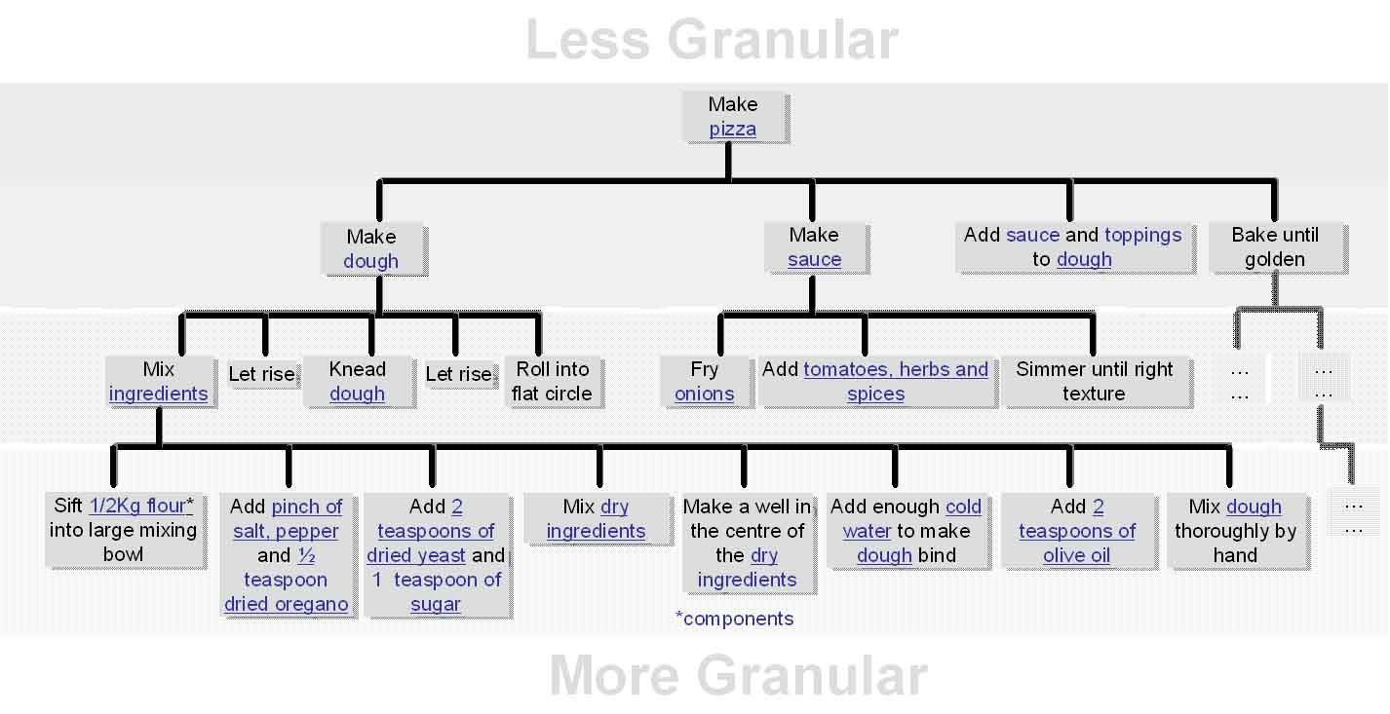

Slide 28
A Less Granular Model
Do the differences between the two models make them suitable for different purposes?

Slide 29
The Least Granular Model

Slide 30
Uses for a Sporting Event Model
Auto-generate news stories
Share news stories between news agencies, newspapers, sports statistic databases
Fantasy sports leagues
Sports historians
Other users of sports data (e.g., for data-driven selection, wagering)

Slide 31
Assignment 7 – Definitions
For each descriptor, write a 1-2 sentence definition. Be concise and specific! You might find it helpful to use the “definition template” you’ve seen several times this semester:
hyponym = {adjective+} hypernym {distinguishing clause+}
How does writing definitions using this template affect the modeling process?
Did you find yourself iterating on some definitions as a concept hierarchy emerged?

Slide 32
Schemas/Domain-Specific Languages
In addition to standardizing the content of resource descriptions a CV might also standardize the features/properties/categories to which the standardized vocabulary is applied
This work represents a significant investment in defining a domain, identifying its key semantic components, and specifying the constraints and rules governing the combination and reuse of those components

Slide 33
A Domain-Specific Language for Sports?
Did it occur to you that the domain of “sports events” might be one where a standard schema language might have been created?
Who would create such a standard?
What might it look like?

Slide 34
The “Universal Business Language”
UBL, the Universal Business Language, defines a royalty-free library of standard XML business documents …
65 document types all built from a library of semantic building blocks that include what all business documents “talk about” – parties, locations, currencies, units, etc.
Could a “Universal Sports Language” use a similar component architecture so that the specific languages for different sports reused the most general semantic components?

Slide 35
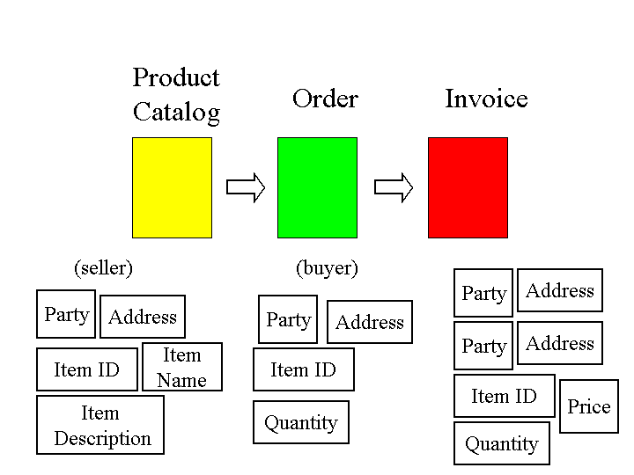
“Component Architecture” for Document Types

Slide 36
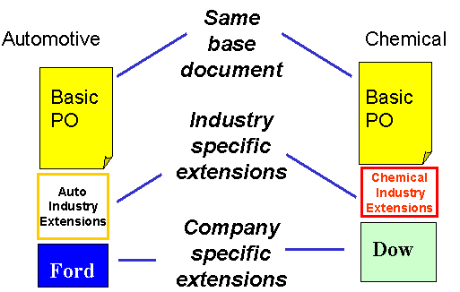
Interoperability Enabled by Reusable Components in a Common Document Architecture

Slide 37
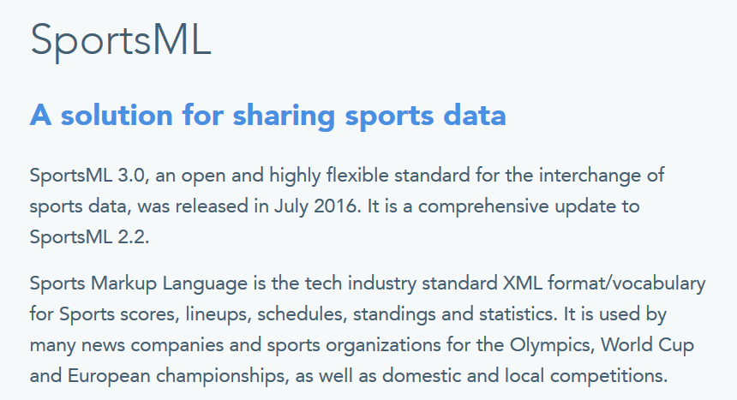
https://iptc.org/standards/sportsml-g2/

Slide 38
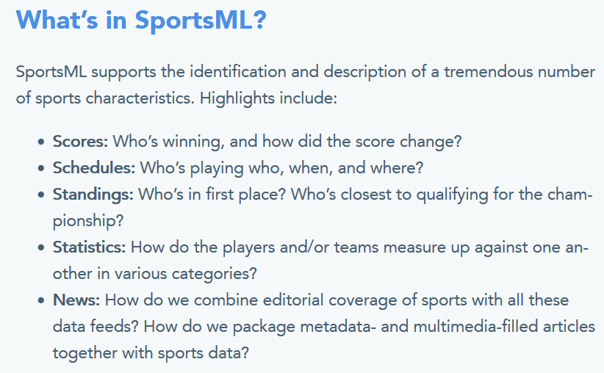

Slide 40
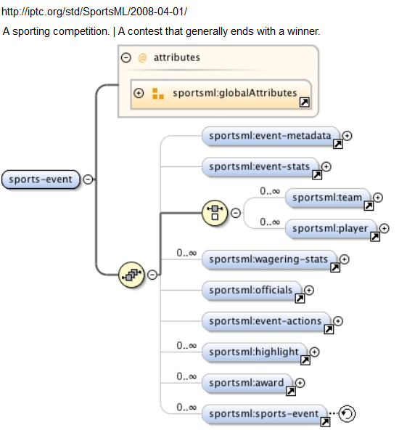

Slide 41
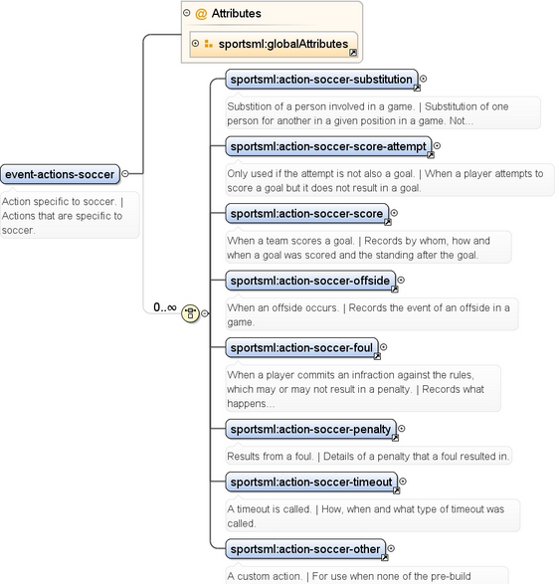

Slide 42
Code Lists
Codes are constrained sets of values
Using codes in vocabularies and resource descriptions promotes consistency and makes meaning unambiguous
Are any of the descriptors in your event model definable by code lists or enumerations?

