Slide 1
CogSci 190 “Sensemaking and Organizing” Spring 2019
Robert J. Glushko glushko@berkeley.edu
18 April 2019 24) REVIEW: Organizing, Categorization, and Classification

Slide 2
S & O Endgame…
4/18: 2nd Course Review
4/23: “Interaction Traces” ; “Diary for a Day” Assignment; CASE STUDIES
4/25: “Computational Description”
4/30: “Computational Classification” ; Discuss “Diary for a Day” Assignment
5/2: PRACTICE EXAM
5/3: Last Day for “Free Read” of Case Study Report
5/7: FINAL EXAM anytime until 5/14
5/9? : Case Study Presentations; Class Party
5/12: Case Study Reports Due

Slide 3
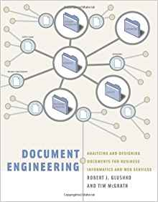
Buy This Book!
(only $5.75 on Amazon)
If you don’t think it was worth it, I will buy it back from you

Slide 4
The Document Type Spectrum
Different domains or types of documents can be distinguished according to the extent to which their content is semantically prescribed, by the amount of internal structure, and by the correlations of their presentation and for­matting to their content and structure
Notes:
This text here comes straight from the book…. And while it is extremely important, it is extremely dense and I need to explain it
Documents and data are not totally different things… they fall on a continuum, a spectrum. Colors at the endpoints of the rainbow are easy to tell apart, but adjacent colors are not that different
Good example is medical records; doctors like to write narrative notes, other people convert them into more granular structure to drive transactional processes, doctor then has to deal with the information created as a result of those transactions, get it back into narrative form
.

Slide 5
The Document Engineering Approach

Slide 7
Course Review / Practice Exam
The remainder of the slides serve as a course review on organizing principles, categorization, and classification
SLIDES IN RED are questions for you to answer (either in your group or by yourself if you’re not in class today)
Questions like these will be on your practice exam (May 2) and on your take-home final exam
The slides that follow each RED slide review the relevant concepts and guidance for answering the question, so don’t look at them before you’ve tried to answer it

Slide 8
The “Milk” Category
Define “milk”
Do “soy milk” or “almond milk” or other plant-based drinks (that vegans or lactose-intolerant people drink) fit into the milk category?
What is the best argument for including these drinks in the milk category?
What is the best argument for not including these drinks in the milk category?

Slide 9
Cultural Categories
We use tens of thousands of categories that are embodied in our culture and language
They develop slowly and typically change slowly
Many have a perceptual or sensorimotor origin based on natural boundaries or discontinuities in perception and experience
Learned implicitly through development via parent-child interactions, language, and experience
Informal and contextual acquisition makes cultural categories flexible, creative, generative
9

Slide 10
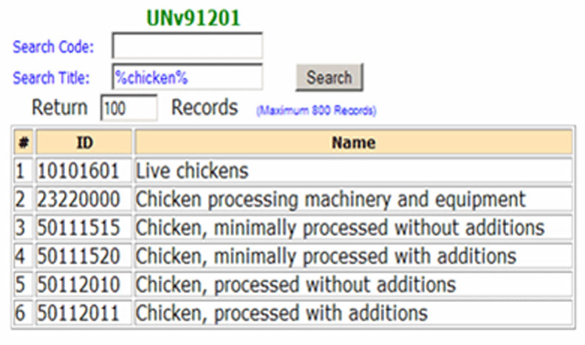
Institutional Categories for Chicken: UN Standard Products and Services Codes
https://www.unspsc.org/
Who would need something like this?
10

Slide 11
Faceted Classification
You are organizing these household “tools” :
Blender, Screwdriver, Tape measure, Frying pan, Electric Drill, Rake, Sponge mop, Vacuum cleaner, Shovel, Bucket
Create a faceted classification system for household tools that uses between 3 and 5 facets, along with the values that each facet can have
What facets did you consider but choose not to use? Why are they not as good as the ones you chose?

Slide 12
Choosing Facets
ORTHOGONALITY - facets are independent dimensions
SEMANTIC BALANCE - top level facets are the most important semantic dimensions of the domain; values within facets are at equal semantic level
COVERAGE - all current instances can be classified
SCALABILITY - future instances can be classified
OBJECTIVITY - instances can be objectively classified; might also be called CONCRETENESS
NOT IDIOSYNCRATIC - facet semantics should be "mainstream" or "normative" and not rely on clever, fanciful or metaphoric interpretation
12

Slide 13
Hierarchical Classification
You are organizing these household “tools” :
Blender, Screwdriver, Tape measure, Frying pan, Electric Drill, Rake, Sponge mop, Vacuum cleaner, Shovel, Bucket
Create a hierarchical classification system for household tools (TOOLS is the root) with at least one level of hyponyms between the root and the leaf nodes where the specific tools are organized
What hyponyms did you consider but choose not to use? Why are they not as good as the ones you chose?
Which classification is better, the faceted one or the hierarchical one?
Would your classifications be different if you had done the hierarchical one first?

Slide 14
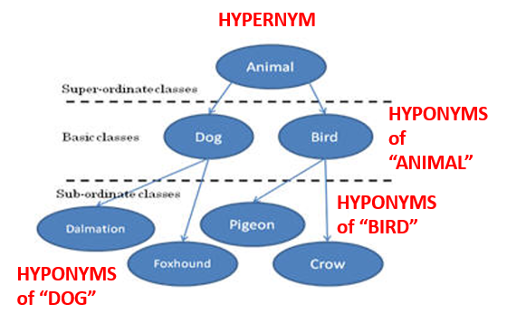

Slide 15
Hierarchy and Uniqueness Principles
Hierarchy: Each category is successively divided into smaller subdivisions according to a feature or property
Uniqueness: Every type of resource is classified in only one subdivision
These two principles are very common, might feel like “natural” principles
What assumptions about the domain are implied by this kind of classification?
15

Slide 16
Categorization and Bias
It has been said many times this semester that “Every system of categories is biased.”
What are the sources of this bias?
Is this typical bias a good thing or bad thing?
How is bias different in (a) categories created by an individual for personal purposes (b) cultural categories (c) institutional categories?
How can you reduce or eliminate the bias in a system of institutional categories?
How can you reduce or eliminate the bias in a system of cultural categories?

Slide 17
Every Classification is "Biased"
Every classification is arbitrary because the criteria used to establish the categories reflect a point of view or perspective on the domain that intentionally excludes all other perspectives
Every classification system implicitly or explicitly contrasts {"good", "standard“} and {"bad", "nonstandard“} ways of understanding things
Natural vs. man-made disaster?
Dietary supplement vs. beverage?
Employee vs. contractor, full vs. part time?
17

Slide 18
Individual Categories
FLASHBACK
Created to satisfy ad hoc requirements that emerge from an individual’s unique experiences, preferences, and resource collections
Created intentionally in response to specific organizing requirements, often short-term ones
Can have an imaginative or metaphorical basis that distorts or misinterpret cultural categories
Collection hobbies often embody peculiar individual categories
18

Slide 19
Why => Bias in Organizing Systems
Personal and cultural categories and organizing systems are highly biased
Creating institutional categories using more systematic processes does not prevent them from being biased
Indeed, the goal of institutional categories is often to impose or incentivize biases in interpretation or behavior
19

Slide 20
Organizing Principles
Intentional arrangements of resources arrangements follow one or more ORGANIZING PRINCIPLES. These principles use properties or descriptions that are associated with the resources.
Why is it desirable to think of these principles in an implementation-neutral way?
What comes first, the descriptions or the organizing principles?
What is the relationship between resource descriptions, organizing principles, and interactions in an organizing system?
20

Slide 21
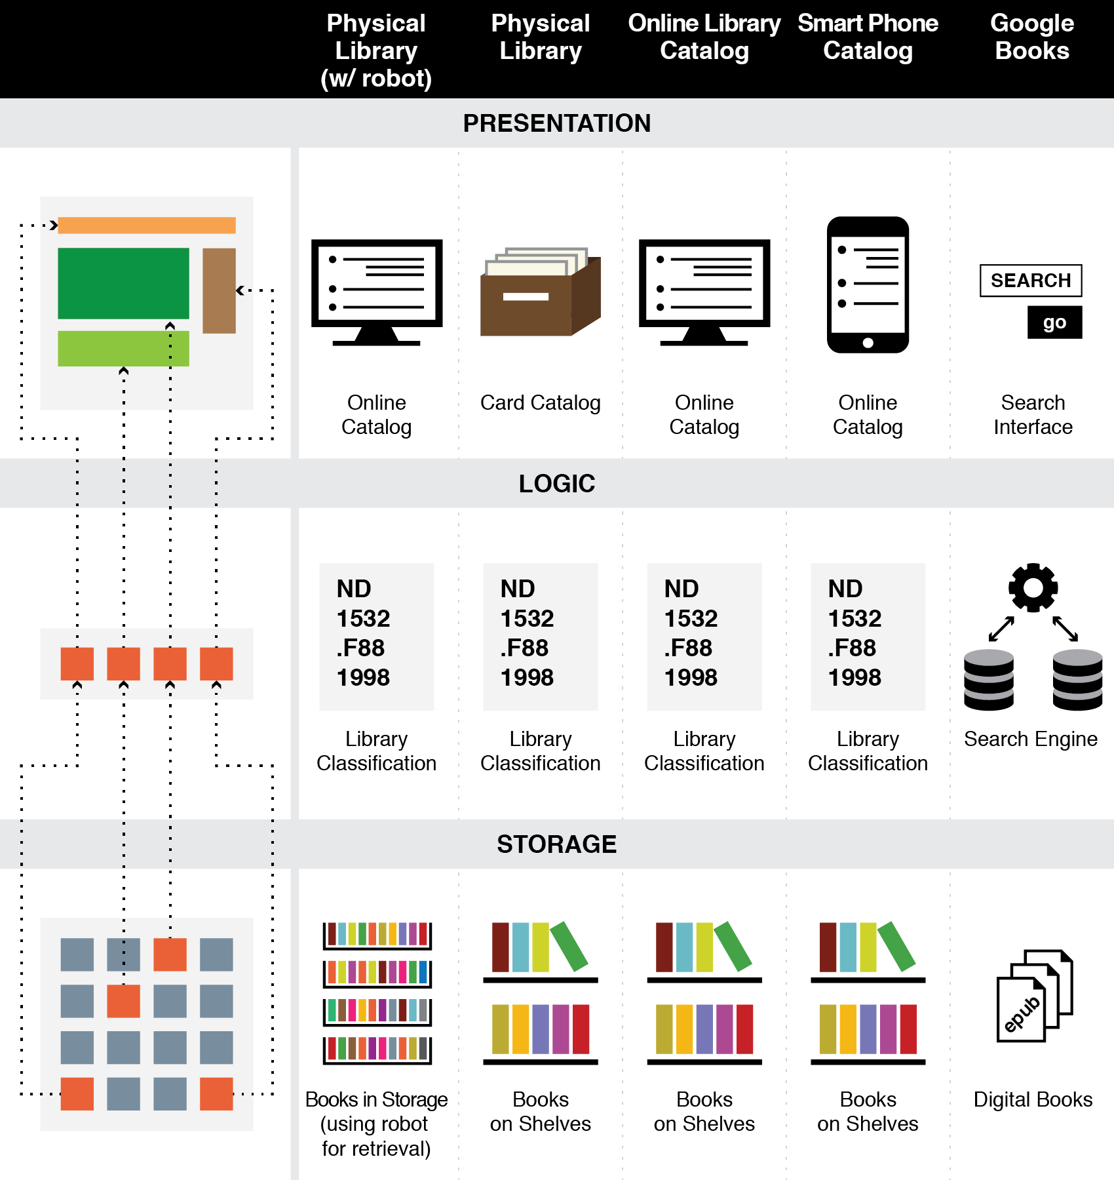
FLASHBACK
The Three-Tier Architecture
Organizing Principles are logically separated from Implementation and Presentation Tiers

Slide 22
Expected Lifetime
Usually correlated with number of users and resources; small collections with single users are often ad hoc and don’t outlive the specific tasks for which they were created
Think architecturally to enable more robustness and flexibility with respect to changes in technology or business contexts
22

Slide 23
Classification and Interactions
Effective user interfaces to physical or digital organizing systems present and reinforce the logical classifications they embody
If the resources belong to logical groups or categories, does the arrangement of the controls reflect them?
23

Slide 24
Choice Architecture in TDOspeak
Choice Architecture says:
TDO says:
There is no neutral architecture
We can vary the order of choice alternatives
We can change the number of categories
We can change the labels of alternatives or categories
People prefer choices that are easier to describe
TRADEOFFS
All systems of categories are biased
We can use different organizing principles
We can vary the abstraction and granularity of categories
Naming and resource description is difficult, contentious, and makes a difference
TRADEOFFS

Slide 25
Let Me Say it Another Way
Resource description and organizing are intrinsically connected
You can’t organize what you haven’t described implicitly or explicitly.. because the principles embodied in any organizing system reflect decisions about what resource descriptions to use

Slide 26
Organizing Principles [2]
What organizing principles are “generic” in the sense that they can be used for almost any type of resource?
Why is it sometimes necessary to use organizing principles that only work in very limited resource domains?
Does it matter in which order the organizing principles are applied to arrange a collection of resources?
26

Slide 27
Organizing Principles [2]
For physical resources the properties are often:
Perceptual – what does it look like?
Material – what is it made of?
Task-oriented – how is it used?
For information resources the properties are often semantic ones – what is it about?
27

Slide 28
Organizing Principles [3]
Other typical arrangements are based on ownership, origin, taxonomic, or “taskonomic” or behavioral properties (usage frequency, correlated usage)
Any resource with a orderable name or identifier can have alphabetic or numeric ordering
Any resource with an associated date (creation, acquisition) can have chronological ordering
28

Slide 29
Description is Challenging!
People use different words for the same things, and the same words for different things (TDO 4.4)
Describing and organizing always (explicitly or implicitly) takes place in some context
The context shapes which resource properties are important and the organizing principles that use those properties
29

Slide 30
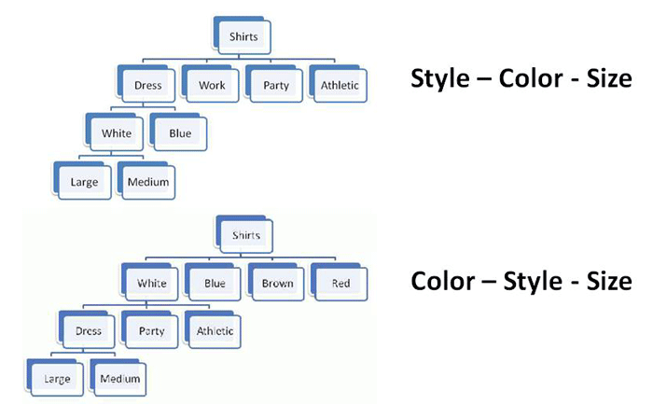
Multiple Properties in Different Order
Organizing the Shirts in a Department Store
30

Slide 31
Taxonomy and Taskonomy
Define each of these organizing approaches
Think of some examples where they can co-exist in an organizing system
How do these approaches relate to the concepts of distributed cognition?

Slide 32
The Semantics of "Inclusion"
One class or type of resources logically contains another; predicate is usually “is-a” or "is-a-type-of"
A set of interconnected class inclusion relationships defines a HIERARCHY or TAXONOMY
An inclusion relationship between an instance and a class -- assigning an instance to a class - is CLASSIFICATION
32

Slide 33
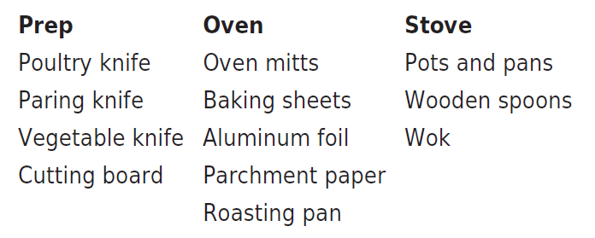
Taskonomy
In contrast to "taxonomy" - an approach to organization based on similarity of content or characteristics - a "taskonomy" organizes on the basis of purpose or "activity structure“
A COOK’S TASKONOMY (Figure 8.1 in TDO)
33

Slide 34
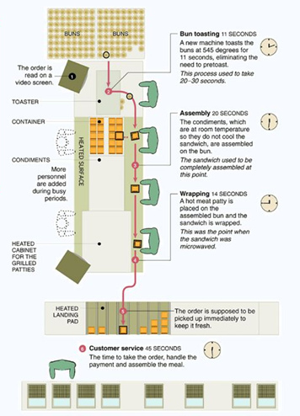
Using Space to Simplify Choice
A production line serially decomposes a complex task by dividing the space in which it is performed into functional stations where sub-tasks are performed
Each spatial region creates a task context in which only certain skills, tools, and rules are appropriate
Once a context has been selected, the local affordance make clear what can and must be done
The New McDonalds Layout

Slide 35
Natural and Basic Categories
Why do we consider some types of categories to be more natural than others?
Why do we consider some levels of abstraction in categories to be more basic than others?
Are natural and basic categories the same in all cultures? Why or why not?

Slide 36
“Carving Nature at its Joints”
FLASHBACK
Over 2000 years ago Plato argues that species are distinguished by "carving nature at its joints" - where the natural differences between things are the largest or most salient or where there are few connections
I.e., there are “natural kinds” – categories are discovered, not invented
"Joints" and the boundaries they create between things exist to some extent with physical resources and are manifested in their surface or perceptible properties
36

Slide 37
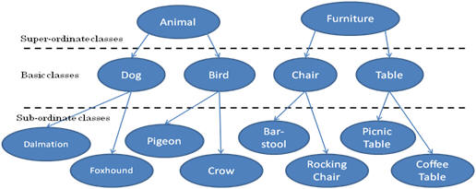
Three-Level Category Hierarchy

Slide 38
Basic-Level Categories: Why
“The world is structured because real-world attributes do not occur independently of each other”
“Combinations of attributes of real objects do not occur uniformly. Some pairs, triples, or n-tuples are quite probable, appearing in combination sometimes with one, sometimes another attribute; others are rare; others logically cannot or empirically do not occur.”
Basic objects (e.g., bird, chair) are at the level at which there are attributes common to all or most members of the category

Slide 39
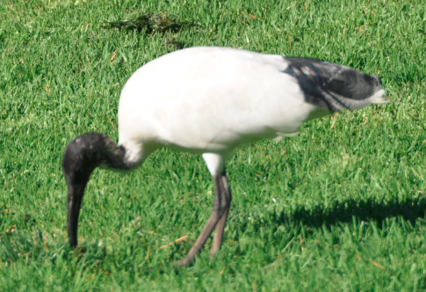
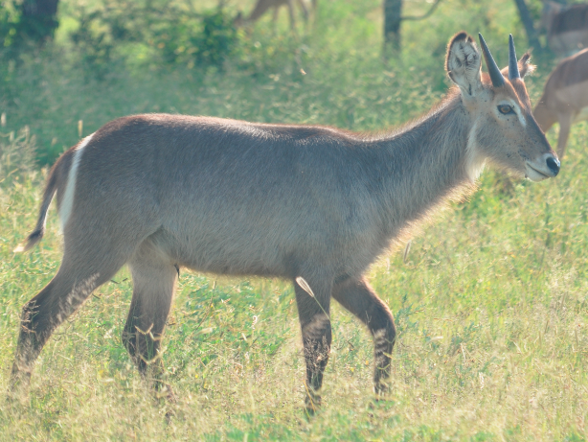
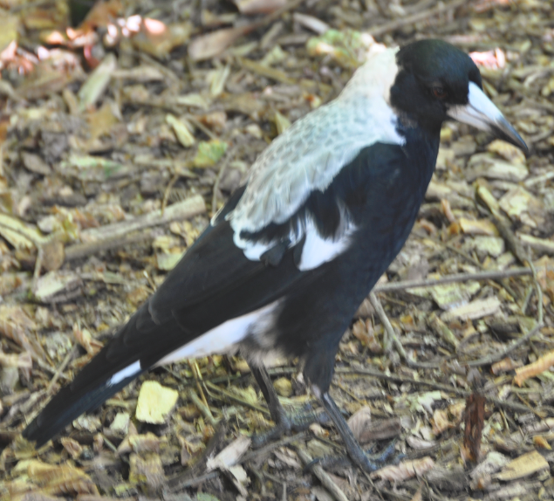
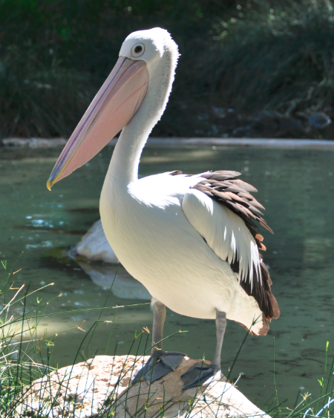
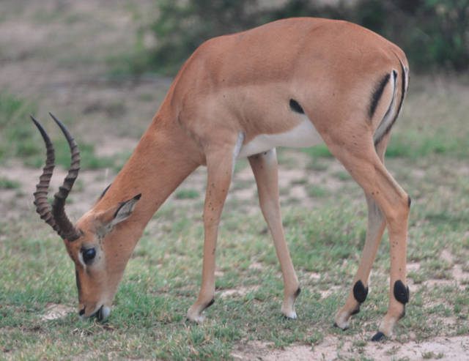
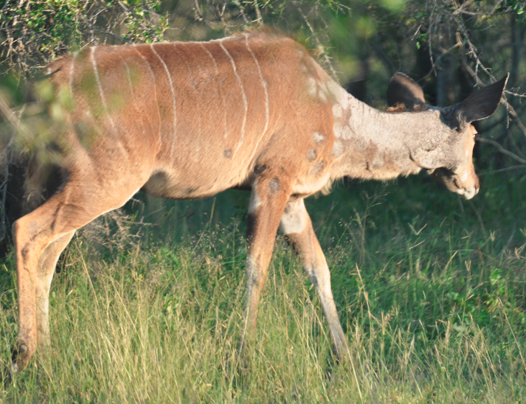
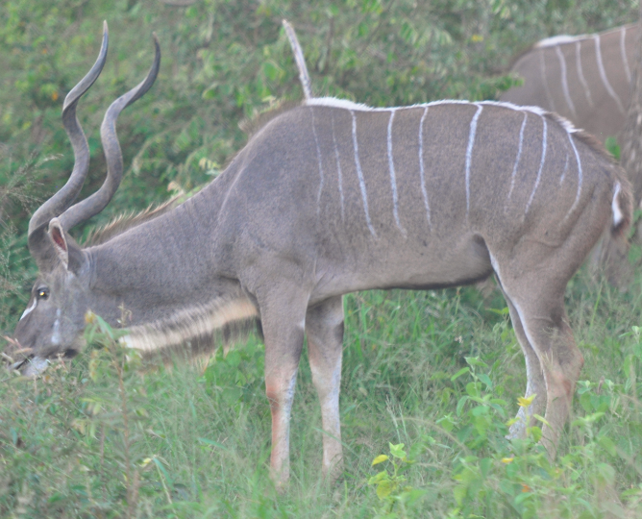
FLASHBACK
Shared Visible Features Carve These Animals into Two Categories

Slide 40
Category Structure
What principles determine membership in a category defined by enumeration?
What kinds of problems can arise in the implementation and use of enumerated categories?
What kinds of categories are defined using “necessary and sufficient” properties? Why are these categories preferred by designers of information systems?

Slide 41
Defining Categories by Enumeration
Simplest way to define a category is by enumerating (listing) its members
This principle is also called EXTENSIONAL definition; the members of the set are called the EXTENSION
This principle is easy to understand and implement; the meaning of a category or concept is NOT a property test; it is simply the specific set of resources associated with it
So learning an enumerative category just means “memorizing its members”
41

Slide 42
The Limits of Enumerative Definition
At some point an enumerative category might contain so many members that it must be sub-divided or be given a definition based on principles other than enumeration
What happened to the “planet” category when large objects were discovered orbiting around stars other than the Sun?
42

Slide 43
Specifying Enumerations
You should be excruciatingly careful when you define a category by enumeration
The legal principle of “implied exclusion” says that if you “expressly name” or “designate” some list anything not named is excluded
Legal disputes often reflect different interpretations of category membership and whether a list of category members is exhaustive (“the following”) or merely illustrative (“including” or “such as”)
Why is an “Other” category usually a bad idea?
43

Slide 44
Classical Categories
“Classical” categories can have large numbers of category members, but they have clear boundaries defined by a small number of ESSENTIAL or necessary and sufficient properties
Necessary means that every instance must have the property to be in the category
Sufficient means that any instance that has the necessary properties is in the category
Example: A Prime Number is an integer divisible only by itself and 1
Every prime number has these properties
If a number has these properties, it is prime
44

Slide 45
Classical Categories
“Classical” categories can have large numbers of category members, but they have clear boundaries defined by a small number of ESSENTIAL or necessary and sufficient properties
Necessary means that every instance must have the property to be in the category
Sufficient means that any instance that has the necessary properties is in the category
Example: A Prime Number is an integer divisible only by itself and 1
Every prime number has these properties
If a number has these properties, it is prime
45

Slide 46
Naming is Hard!
What kinds of problems can arise with “naturally-occurring” names?
How can these problems be prevented, eliminated, or made less serious?
If you are creating an organizing system in some domain and discover a controlled vocabulary in that domain, what should you do?

Slide 47
Issues with Names and Naming – 1
A specific resource or type or resource can often have multiple names; these are SYNONYMS or ALIASES
Different things can sometimes have the same names -- these are HOMOGRAPHS or POLYSEMES
Which is the more important problem?
47

Slide 48
Issues with Names and Naming – 2
False cognates (GIFT, PAIN)
A name can have undesirable associations
A name can have assume impermanent attributes or associations or be “faddish” (baby names over time)
Alphabetic ordering bias
Autogenerated names don’t convey any meaning (SCAN0098.JPG)
Problems caused by careless programmers
48

Slide 49
Schemas/Domain-Specific Languages
In addition to standardizing the content of resource descriptions a CV might also standardize the features/properties/categories to which the standardized vocabulary is applied
This work represents a significant investment in defining a domain, identifying its key semantic components, and specifying the constraints and rules governing the combination and reuse of those components

