Slide 1
CogSci 190 “Sensemaking and Organizing” Spring 2019
Robert J. Glushko glushko@berkeley.edu
23 April 2019 25) Organizing with “Interaction Resources”

Slide 2
S & O Endgame…
4/23: “Interaction Traces” ; “Diary for a Day” Assignment; CASE STUDIES
4/25: “Computational Description”
4/30: “Computational Classification” ; Discuss “Diary for a Day” Assignment
5/2: PRACTICE EXAM
5/3: Last Day for “Free Read” of Case Study Report
5/7: FINAL EXAM anytime until 5/14
5/9: Case Study Presentations & Class Party at Hearst Annex (data science)
5/12: Case Study Reports Due

Slide 3
1984… written in 1949
The telescreen received and transmitted simultaneously. Any sound that Winston made, above the level of a very low whisper, would be picked up by it, moreover, so long as he remained within the field of vision which the metal plaque commanded, he could be seen as well as heard
There was of course no way of knowing whether you were being watched at any given moment. How often, or on what system, the Thought Police plugged in on any individual wire was guesswork. It was even conceivable that they watched everybody all the time. But at any rate they could plug in your wire whenever they wanted to.
You had to live -- did live, from habit that became instinct -- in the assumption that every sound you made was overheard, and, except in darkness, every movement scrutinized.
- George Orwell, 1984 (page 1)

Slide 4
Taking Attendance with Face Recognition
1) I have uploaded your CAL ID photos (from bCourses) to a face recognition system (https://aws.amazon.com/rekognition/)
2) I pointed my live video USB or IP camera at the classroom door, and then connected to the face recognition system
3) The face recognition system identifies you as you come to class
4) Less work for Lauren. Any objections?

Slide 5
Today’s Topics
Interaction traces
Transaction traces
Sensor traces
Egocentric
Group
Location-based
How are these traces used?
They aren’t because it is too difficult or because there is no value proposition
They are used to help us
Personalization when we want it
Profiling: fraud detection with credit cards
They are used against us
Personalization when we don’t want it
Surveillance
Data mine, or data factory?

Slide 6
Interaction Traces with Physical Resources
Interactions involving physical agents and resources often leave traces or other evidence
These traces can be unintentional or intentional
These traces tend to fade over time, and different traces with the same resource lack consistency

Slide 7
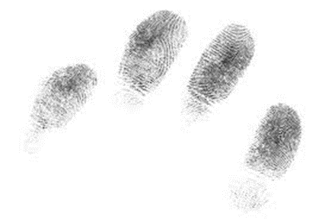
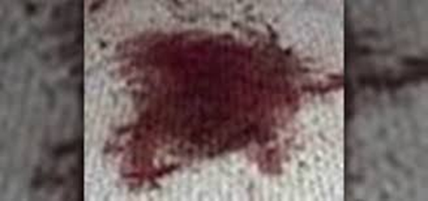
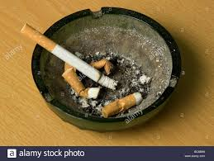
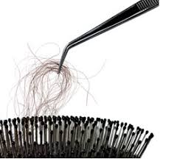
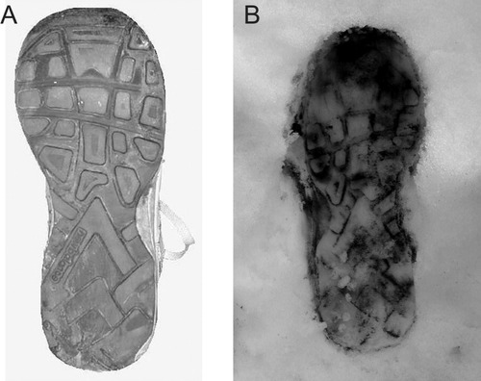
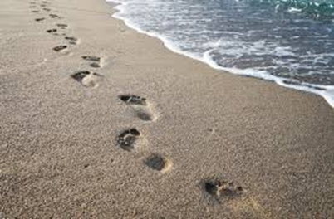
TRACES LEFT BY PEOPLE

Slide 8
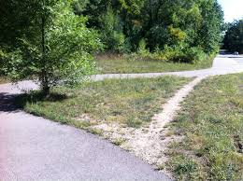
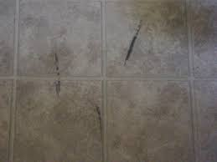
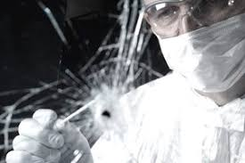
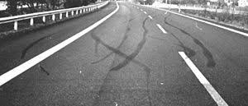
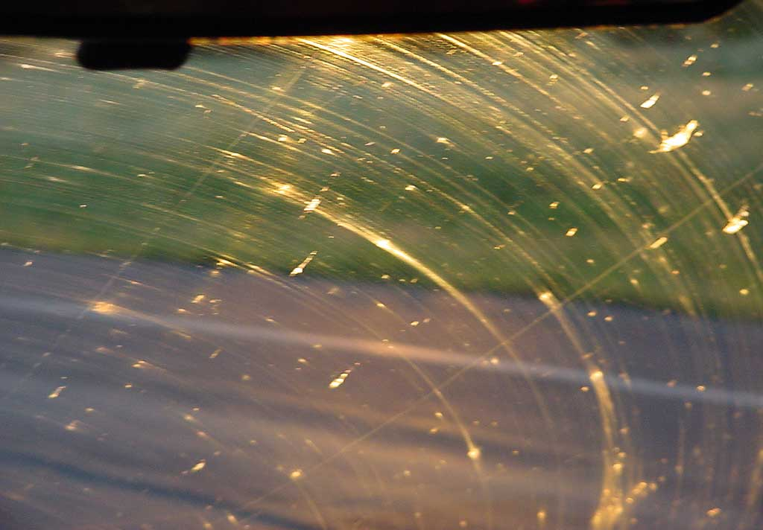
MORE TRACES
Can you identify specific resources, or only the types of resources that left these traces?

Slide 9
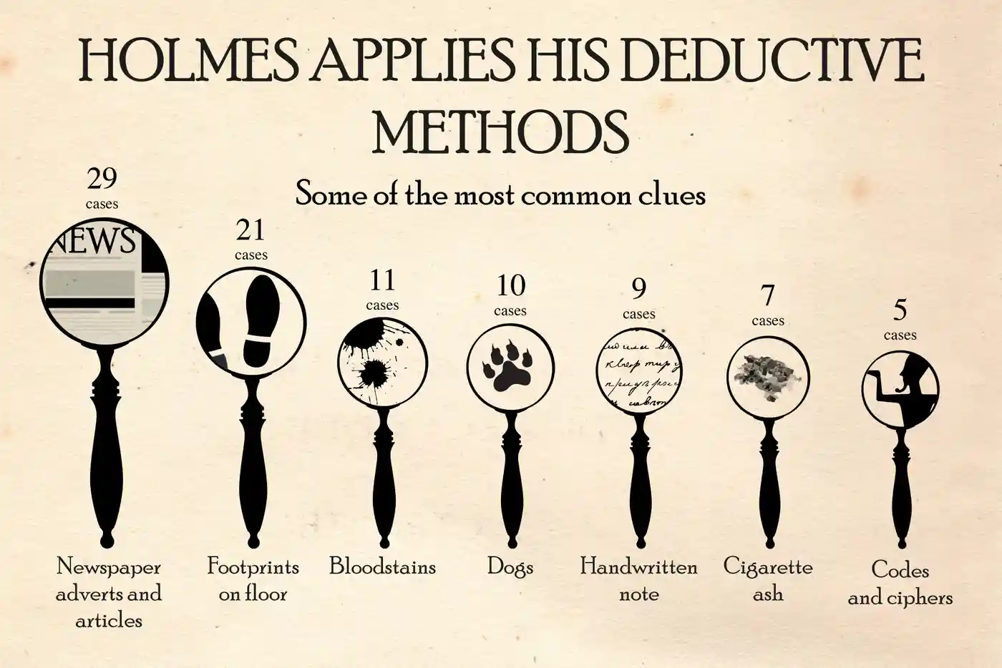
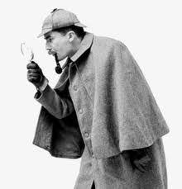
Traces can sometimes be used “forensically” to identify their sources

Slide 10
Interaction Traces with Digital or Sensor-Augmented Resources
Traces become predictable, persistent, and consistent
Traces can be analyzed, aggregated, and become the basis of new, enhanced, or personalized interactions
However, when these traces are made by people, their uses raise numerous issues of privacy and exploitation

Slide 11
Interaction Traces from Digital Transactions
Credit card, debit card, mobile phone, APIs (e.g., Stripe) … one-time or recurrent payments
Arguably voluntary… because sometimes you could have paid with cash… although many merchants are now refusing cash
Both sides get accurate and complete transaction records
Pre-paid cards and “crypto” cards enable anonymous transactions
You can also hide behind a “limited liability company” and have payments made by it

Slide 12
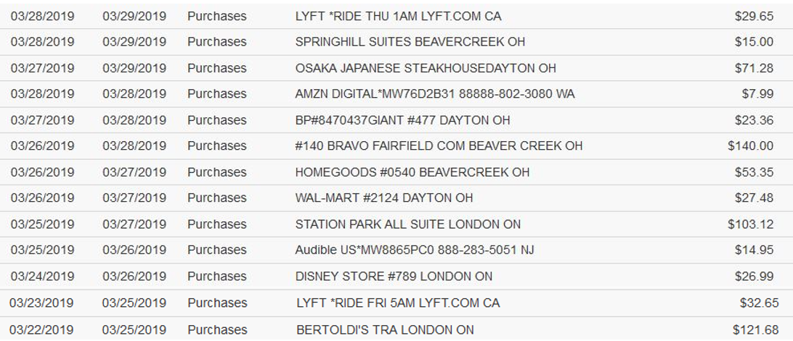
Credit Card Transactions - Spring Break Trip to Canada and Ohio
From SFO to home
Hotel, Dayton OH
Hotel, London ON
Toys for child
From home to SFO

Slide 13
Some Fastrak Data – Bridge Toll Transactions

Slide 14
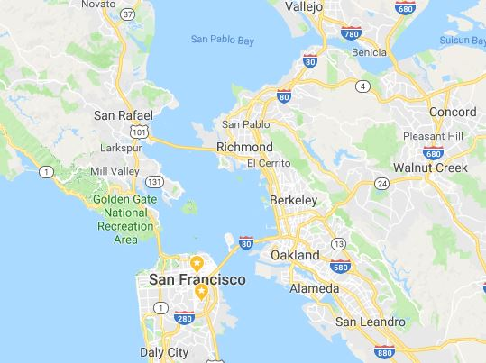
Where’s Bob and Where Has He Been?
3
4
2
1

Slide 15
Tourists and Locals Photos
Do tourists take photos in different locations than locals?
Use geotagged photos on Flickr website and assume:
A person who has posted photos whose dates span more than one month is a local
A person whose posted photos are all dated within one week of each other
https://www.flickr.com/photos/24431382@N03/sets/72157624209158632/ HAS MAPS OF 136 CITIES

Slide 16
Tourist and Local Photos (red = tourist, blue = local, yellow = can’t classify)

Slide 17
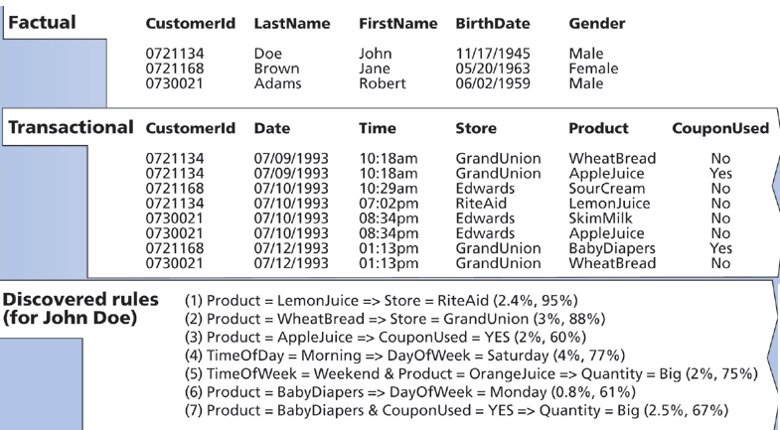
Building a Customer Profile with Data Mining
How would this profile be used to benefit the customer?
Could it be used in ways that don’t benefit the customer?

Slide 18
Inferring Customer Profile from Transaction Data

Slide 19
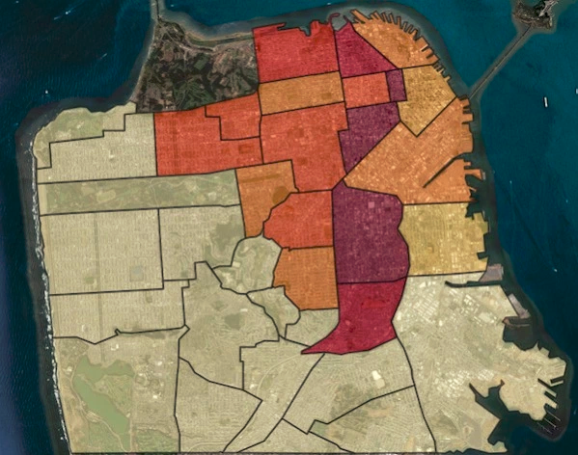
What Uber Knows About Your “Love Life”
Uber bragged in a (since deleted) blog post that it discovered a ride pattern – a person who took a ride between 10pm and 4am on a Friday or Saturday night, and then took a second ride from within 1/10th of a mile of the previous nights’ drop-off point 4-6 hours later
In San Francisco, the most one-night stands originated in Chinatown, the Mission, Downtown, Bernal Heights, Russian Hill, the Marina, and the Castro-Upper Market area.

Slide 20
Interaction Traces from Web Search and Navigation Behavior
Platforms and popular apps use these traces to personalize your experiences and shape your behavior
Possible to hide or anonymize some of your web transactions, but not all of them and not easily
Use “private browsing” modes and do not allow sites to leave cookies
Use disposable phone numbers whenever you are asked to provide one
Set up a VPN (virtual private network) to hide your real IP address
Use a mailbox address for any deliveries from online purchases
Don’t use your phone’s location service
Stop using Facebook

Slide 21
Firefox Browser Cookies

Slide 22
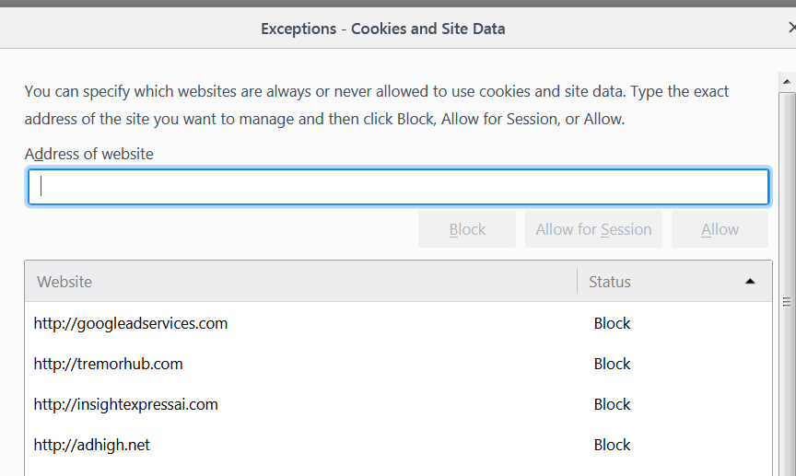
Block the Bad Cookies

Slide 23
Interaction Traces with “Digital Assistants”
Any interaction with a digital assistant like Siri or Alexa or Google Home
Starts with speech recognition, but a transaction nonetheless
And you can buy stuff or search the web with them
But don’t they have to be “always on” to be useful?

Slide 24
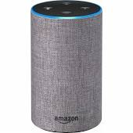
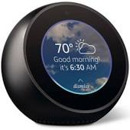
2019, or 1984?
Amazon's voice-controlled Alexa products are considered "always-on" devices — but that doesn't mean they record customers' conversations. The devices constantly listen for a user to say a "wake word," which triggers Alexa to begin recording voice data and respond to commands
On many occasions, however, Alexa has mistakenly detected its “wake word”, recorded a private conversation, and forwarded it to someone in the speaker’s insurance list of phone contacts

Slide 25
Resource Agency
Traditional organizing systems contain tangible and static resources that must be acted upon or interacted with to produce an effect
Active resource create effects or value on their own, sometimes when then initiate interactions with static or passive resources.
Sensors, web-based services, information feeds are active resources that often are combined to implement business processes or business models
People are almost always active resources that initiate interactions, especially with each other
25

Slide 26
Active / Operant / Smart Resources
“Smart” is a commonly used description of resources that can exploit sensing, computing, and communication capabilities
Virtually any product that uses electricity - toys, coffeemakers, cars, medical diagnostic machines - possesses inherent data processing capabilities. Each has a wealth of information about its current status, usage history, and performance
A “smart” resource with an IP address is said to be part of the “Internet of Things”
26

Slide 27
The “Smartness” Continuum
Sensing or Awareness – measuring some aspect of the environment
Actuation – initiate some action or message
Connectivity – connected to other resources
Computation or Programmability – so they can analyze and adapt
Composability and Cooperation – can function as modules or services in more complex systems
27

Slide 28
Interaction Traces from Sensors
Sensors enable the continuous collection of streams of low-level data about people and their environments.
Locations, physiological states, contact with other people, situated uses of devices, and other digital traces can potentially be recorded and analyzed
Each of these kinds of data can be collected at virtually any frequency, with or without participant knowledge or intervention, and for extended periods of time

Slide 29
Egocentric Sensor Data: A Single Person’s Data
Data from an single individual’s use of a computer, a smartphone, or a different piece of technology
measure a person’s physiological state
monitor their movements, location, or interactions using the sensors on a mobile phone
or collect information about activity within a private or semiprivate space

Slide 30
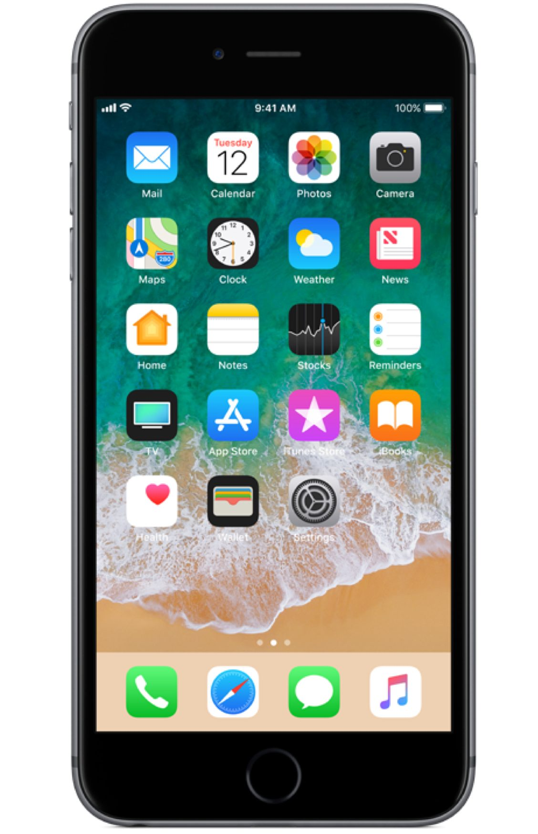
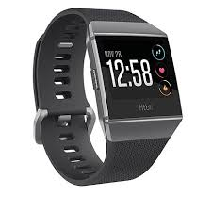
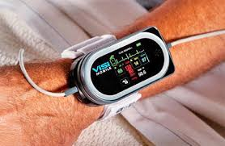
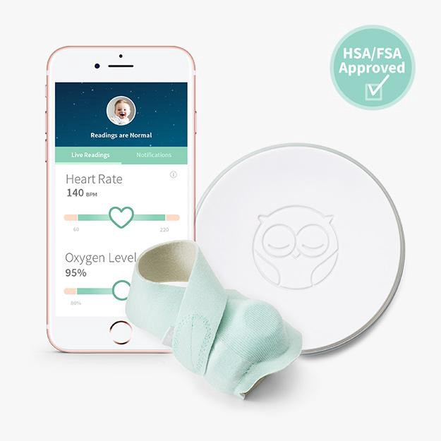
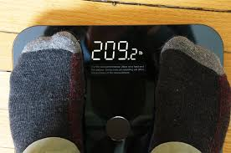
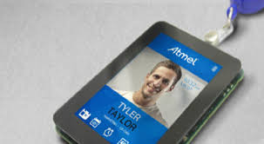

Slide 31
Biometric Identity
Biometric data can create a very precise profile of an individual… and it is hard to change your biometric identity once it is created
"You can delete cookies. You can change browsers. And you can leave your smartphone at home. But you can't delete your face, and you can’t leave it at home.“
facial recognition expert Alvaro Bedoya, executive director of Georgetown Law's Center on Privacy & Technology.
Is this a good thing, or a bad thing?

Slide 32
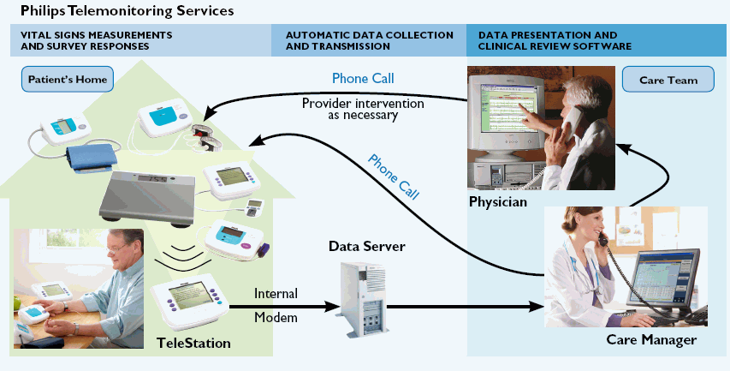
Remote Patient Monitoring
Wearable devices or home appliances can capture vital signs and activity data and inform medical personnel as needed
Enabling "aging in place" with "assistive technology" can vastly improve the quality of life for old folks
32

Slide 33
Good and Bad Uses of Health Sensors and Tracking
Ingestible “Smart pills” that detect when patient takes them
Ovia, a pregnancy-tracking app, sends data to a woman’s employer, which wanted to ensure that her pregnancy had no complications (to save medical insurance money)

Slide 34
“AI Is Changing Insurance” (NY Times, 4/10/2019)
John Hancock insurance will reduce your life insurance premiums if your Fitbit or Apple Watch proves you are living a healthy life: getting exercise, enough sleep, not eating too much
State Farm has filed patents for “aggregating and correlating information for life management purposes” (“smart home” data, vehicle data, personal health data)

Slide 35
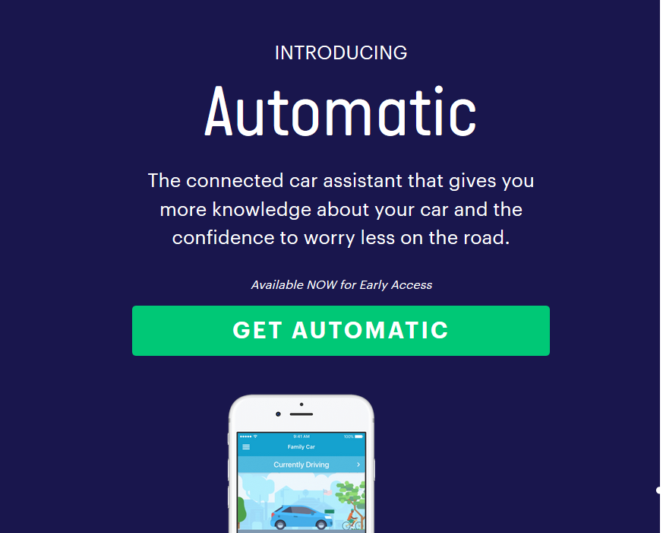

Slide 36
The “Connected Car”

Slide 37
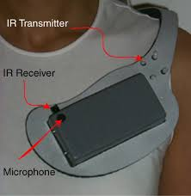
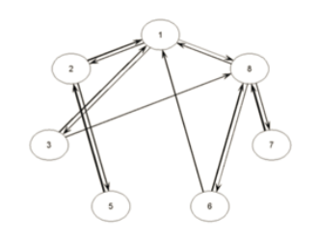
Instrument a Group – “Social” Sensing
Sensors can also be used to instrument—and answer research questions about—groups of people at the same time. This group - centric approach can involve simply capturing the same signals as for a single person, but across a group over the same window of time, or it might involve deploying a broader set of environmental or infrastructural sensors in a shared/community space or collecting data about more interpersonal types of interactions
Would you want to work in a place that made you wear sensors like these?

Slide 38
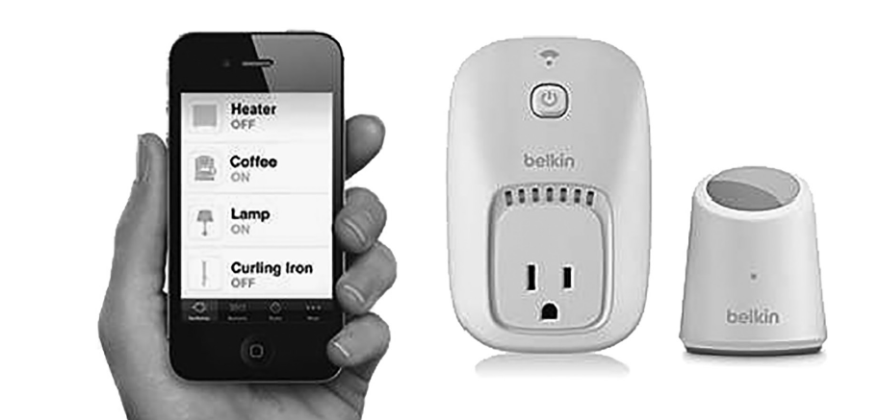
Instrument a Particular Location: Smart Homes

Slide 39
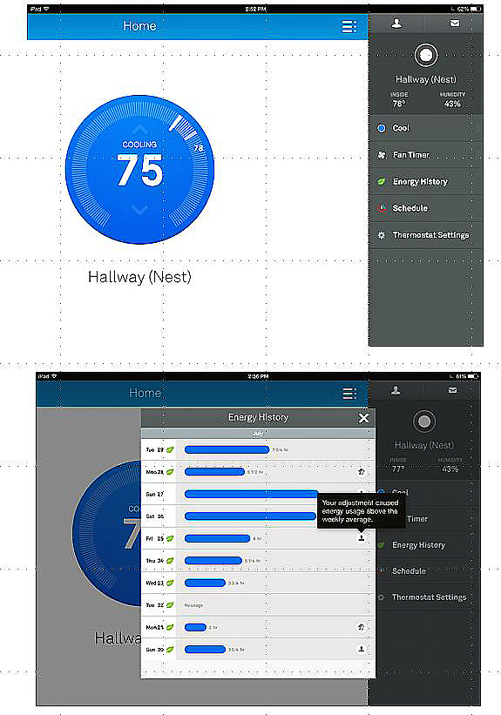
The Nest Learning Thermostat
The thermostat control panel and an energy history report
Can serve as a hub device, communicating with lights, appliances, alarms, your car, your fitness sensor, and other active resources

Slide 40
Retail: “Customer Experience Management” Using Sensors
The retail environment is the medium through which customers and products come together
Real-time customer tracking (RFID, GPS, video, clickstream) allows retailers:
to manage the in-store communication and staffing processes
to connect consumers’ needs and goals with the available products and services (perhaps by organizing them on the basis of analyzed shopping behavior)

Slide 41
Important Customer “Touch Points”
Store Entrance and Window Displays
Lead Fixtures and Merchandising
End-of-Aisle Displays
High Volume / Margin Departments
Customer Service Desk
Checkout

Slide 42
Shopping Carts with Sensors (10 years ago)

Slide 43
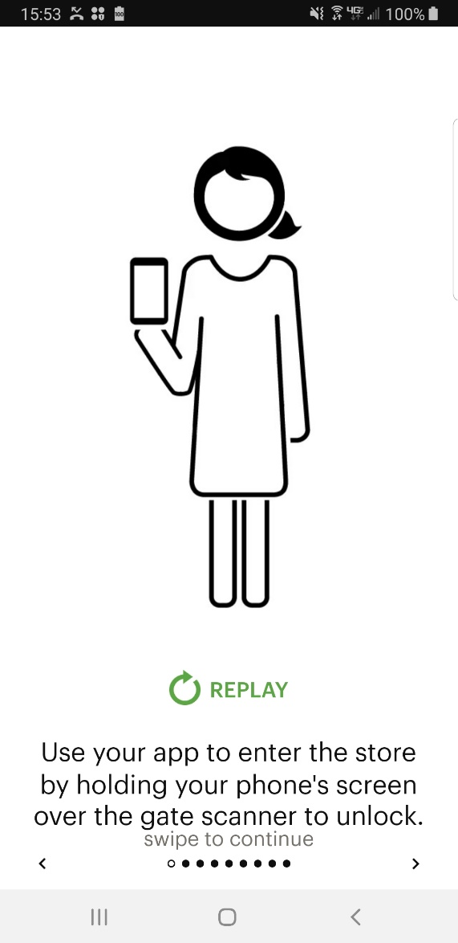
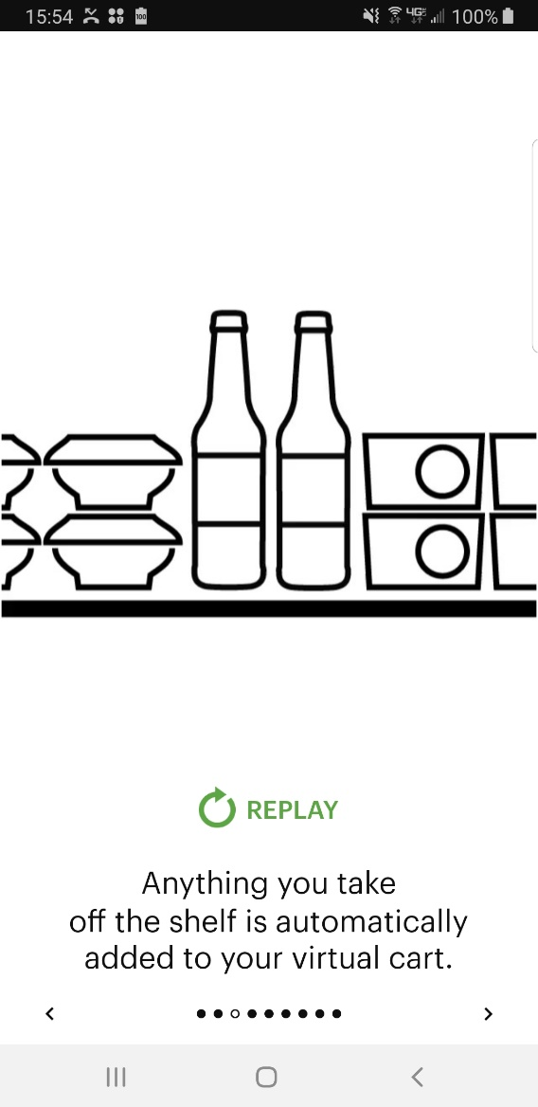
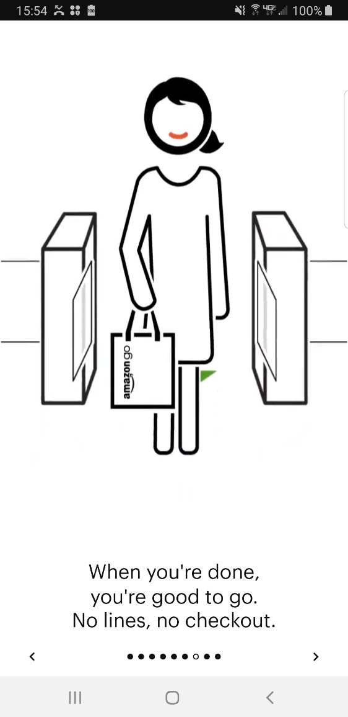
Amazon Go Store (2019)
AMAZON KNOWS WHO IS IN THE STORE, BUT HOW DOES IT CONNECT PURCHASES TO THAT PERSON IF YOU DON’T HAVE TO USE A “PHYSICAL” CART…

Slide 44
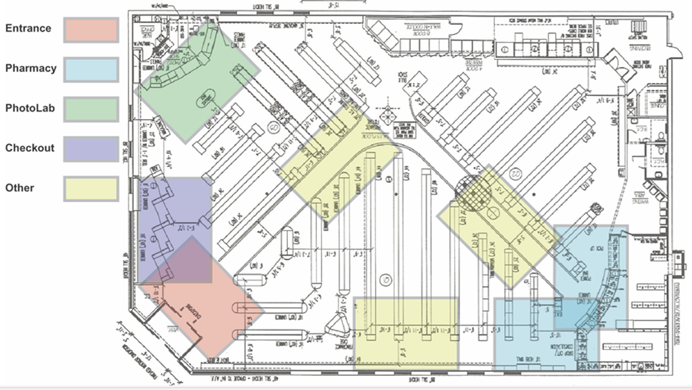
Video Tracking of Shoppers

Slide 45
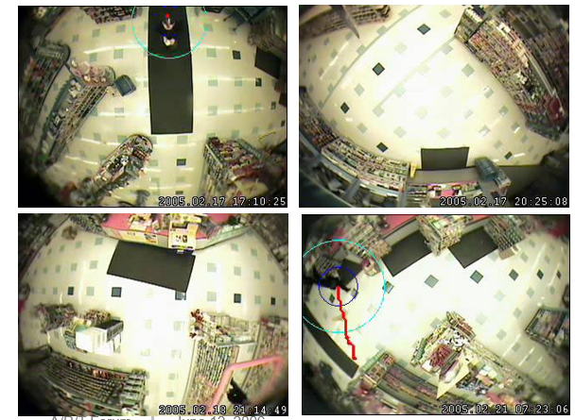
Real-time Behavior Analysis with Live Video
Detect Customer
Track Customer Movement
Recognize the Activity Pattern

Slide 46
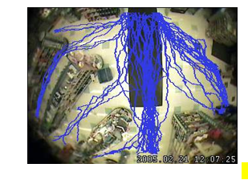
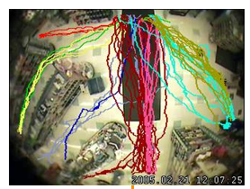
Aggregated Movement Tracking
Movement Patterns

Slide 47
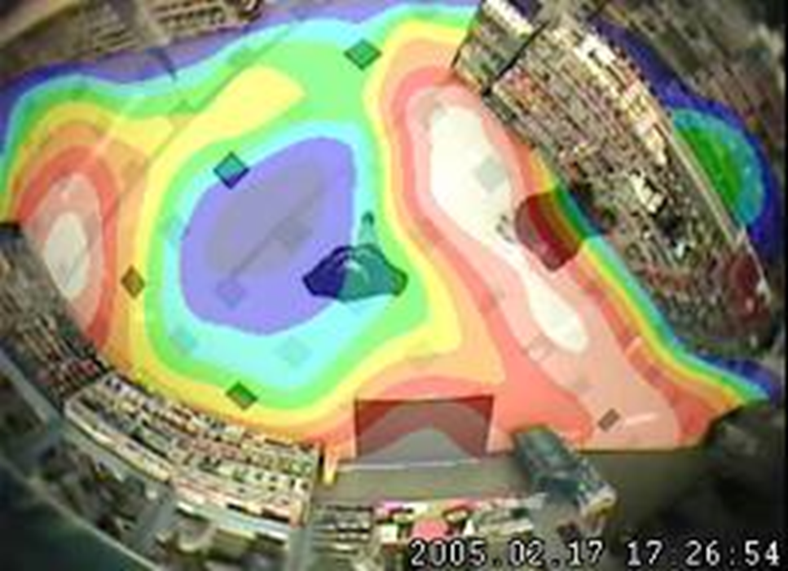
Patterns of “Dwell Time”

Slide 48
Stop and Think
Why do store employees wear uniforms?
To make it easy for customers to identify employees so they can ask for help…
To make it easy for …
Do the activity patterns for customers and employees differ?

Slide 49
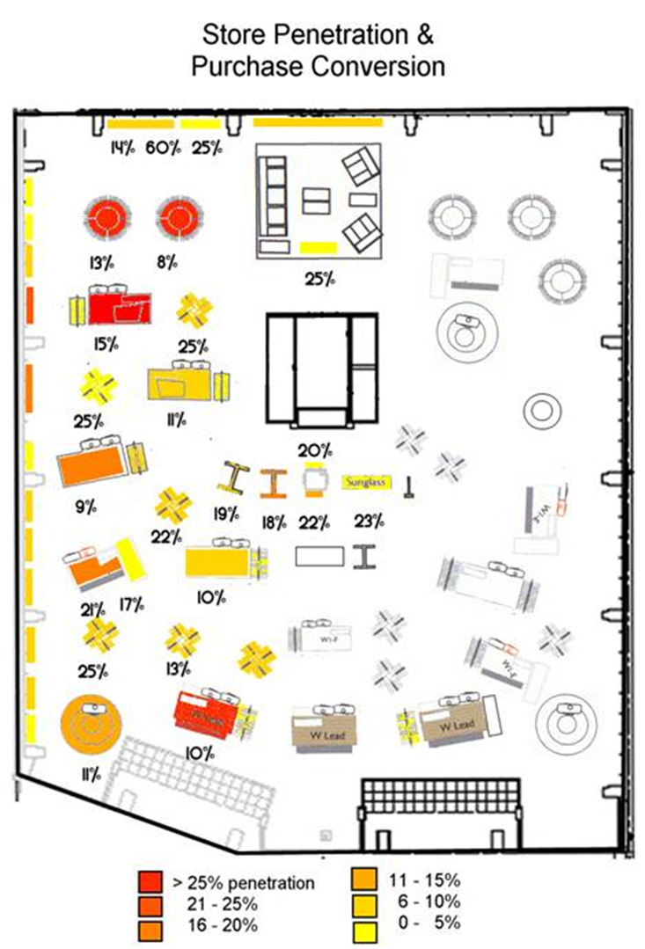
Where do customers go in the store?
How much time do they spend there?
Does this correlate with how much money they spend?

Slide 50
Penetration and Purchasing Analysis
Low penetration categories may require additional navigational aids, new product displays, merchandising, and/or changes in store layout to improve traffic flow
Categories with low purchase conversion rates may indicate weaknesses in product assortment, pricing, or presentation

Slide 51
Amazon Go Store (2019)
HOW MIGHT REAL TIME VIDEO ANALYSIS ENABLE AMAZON TO CONNECT PURCHASES TO A PERSON WITHOUT NEEDING A“PHYSICAL” CART?
How do less technically-advanced stores associate purchases with a person or account?

Slide 52
Stop and Think
You have an elderly grandparent who wants to remain in her home (alone) rather than in a group assisted living facility
How could you use:
Individual sensors
Group sensors
Space sensors

Slide 53
Stop and Think
Recent past: traffic congestion, speeding tickets issued by police
Present: Sensors inform us about congestion so we can try to avoid it, tickets issued automatically by surveillance system
Future 1: Sensor data used to increase insurance rates for speedy and aggressive drivers, impose penalties and fines automatically, track vehicles on “probation”
Future 2: Interconnection of smart vehicles and smart roads enables congestion prediction, dynamic pricing of toll roads, adjustment of traffic lights and speed limits => much lower congestion and greater safety

Slide 54
Stop and Think
Data Factory vs Data Mine (Nicholas Carr)
Is data produced by me, or extracted from me?
What does it matter what metaphor we use?

Slide 55
Assignment 8 – Diary for a Day
On one single day between April 24 and April 29, keep a "diary" of the interaction traces created by and about you, and the document types that you create or encounter (stop when you get 15 of each)
Organize your diary information in two concept hierarchies, one with “Document” at the top of the hierarchy, and the other with “Interaction Trace” at the top
Define 5 of the intermediate categories in each hierarchy using the hyponym = {adjective+} hypernym {distinguishing clause+} template

