Slide 1
CogSci 190 “Sensemaking and Organizing” Spring 2019
Robert J. Glushko glushko@berkeley.edu
23 April 2018 25) Computational Resource Description; Similarity

Slide 2
S & O Endgame…
4/25: “Computational Description”
4/30: “Computational Classification” ; Discuss “Diary for a Day” Assignment
5/2: PRACTICE EXAM on 5/2 or 5/3
5/3: Last Day for “Free Read” of Case Study Report
5/7: FINAL EXAM anytime until 5/14
5/9: Case Study Presentations & Class Party at Hearst Annex (data science)
5/12: Case Study Reports Due

Slide 3
Describing Documents - Motivation
Extracting a set of terms for describing the documents in a collection is the foundation for information retrieval
Small collections might be adequately described by traditional bibliographic descriptors based on intrinsic properties (author, title) or with assigned keywords
But these aren’t precise enough to distinguish documents in large collections
The words in the documents can be used as additional descriptions
3

Slide 4
Creating Resource Descriptions
FLASHBACK
By authors/creators: Best knowledge of purpose and intended audience
By professionals: "Institutional" descriptions that follow standards are likely to be more accurate, precise, consistent
By users: Most variable, influenced by social purposes
By automated processes (TDO 5.4, 7.5.3…)
4

Slide 5
Comparing Resource Descriptions
All information retrieval systems compare a description of a user’s needs with descriptions of the resources that might satisfy them
Identifying relevant documents is equivalent to defining a category to which the query and retrieved information (document) both belong
Likewise, any “classifier” whose purpose is to determine the category to which a resource belongs must compare a resource description with some description or representation of the category

Slide 6
Glossary: Information Retrieval
The “IR model” specifies the representations of queries and documents in the collection being searched
“Text processing” extracts and merges multiple word forms into a single form or “index term”
The set of terms in a search query or document to be matched is compared against the term representation for each document in the collection
6

Slide 7
Glossary: Data Science & Machine Learning
The process of choosing a set of properties or attributes of resources is called “Feature Selection”
When multiple candidate properties or attributes are combined into a new feature this is “Feature Engineering” or “Feature Extraction”
Determining how these features are used to classify or predict something is called “Model Construction”
7

Slide 8
Computational Resource Description

Slide 9
Why we need more than “just the words”
If we want to know what a document is about, we could look at all the words to see if any of them are the topics we are interested in
But linear search through a document takes O(n) time, where n is the length of the document or document collection
That takes too long, so we need descriptions of documents that are much smaller than the documents!
What words best describe a document?

Slide 10
What Words Best Describe a Document?
Not all words are equally useful indicators of what a document is about; many are irrelevant or redundant
Nouns and noun groups carry more "aboutness" than adjectives, adverbs, and verbs
Very frequent words that occur in all or most documents add NOISE because they cannot discriminate between documents
So it is worthwhile to pre-process the text of documents to select / create a smaller set of terms that better represent them; in IR these are called the INDEX terms
Can we think of this selection and processing as creating a controlled vocabulary for describing the contents of a document collection?
10

Slide 11
Stop and Think
What is a “word” in a document?
A digital resource is a sequence of bits
How does this sequence of bits become words?
How does this set of all the words in a document become the much smaller set that usefully describes the document?
THE ANSWER: “Text Processing”
(But what do we mean by that?)

Slide 12
Text Processing: Operational Overview
DECODING -- extracting the text to be processed from its stored representation, turning the bits and bytes into characters in some language
FILTERING -- creating a stream of characters by removing formatting or non-semantic markup
TOKENIZATION -- segmenting the character stream into linguistic units
NORMALIZATION -- creating “terms” - equivalence classes from tokens with superficially different character sequences
12

Slide 13
Text Processing: Operational Overview
STEMMING -- removing affixes and suffixes to allow the retrieval of syntactic and morphological variations of query terms
STOPWORD ELIMINATION -- remove words that poorly discriminate between documents
SELECTING INDEX TERMS -- choosing terms (or groups of them) as indexing elements
13

Slide 14
Decoding
The sequence of characters in a stored document might be represented in any number of single- or multi-byte encoding schemes
Determining this encoding can be easy (file extensions, internal or external metadata, MIME types) -- but not always
Text encoding specs are well-documented but "commercial products can easily live or die by the range of encodings they support“
Some formats are hard to decode; XML in UTF-8 is easy
14
Notes:
that's because most people don't realize that every application might have its own optimized file format and so they're not aware of this problem (this is why XML as a human-readable text format is so important)

Slide 15
Sentence Segmentation
Many IR and text processing applications (translation, summarization) require that the documents be broken into their constituent sentences
STOP AND THINK: Define “sentence” so that a computer program can identify them
Punctuation marks like -- . , ! ? " -- can make this easy; but not always
But abbreviations like “Dr.” break the obvious rule, and even more complex rules like "period-space-capital letter" signals a sentence break still makes a lot of mistakes
15

Slide 16
Tokenization
Another problem that seems trivial -- just use white space, right?
But what about:
abbreviations (Dr. is a word)
hyphens (sometimes part of a word, but sometimes a result of formatting)
case (do we distinguish Bank from bank?)
16

Slide 17
Tokenization Challenges [1]
Character sequences where the tokens include complex alphanumeric structure or punctuation syntax:
glushko@ischool.berkeley.edu
10/26/53
October 26, 1953
55 B.C
B-52
501(c)(3)
128.32.226.140
My PGP key is 324a3df234ch23e
http://people.ischool.berkeley.edu/~glushko/
17

Slide 18
Tokenization Challenges [2]
We've seen that treating numbers and number-like-things as indexable tokens is important
Is 1998 the same as 1,998?
Is 103 the same as .103?
How many different numbers might appear in texts? More than the number of word tokens?
Maybe we should only index numbers when they are combined with letters or punctuation
18

Slide 19
Tokenization Challenges [3]
The language that the characters represent needs to be identified during decoding because it influences the order and nature of tokenization
In languages that are written right-to-left like Arabic and Hebrew, left-to-right text can be interspersed, like numbers and dollar amounts
In German compound nouns don't have spaces between the tokens
19

Slide 20
Tokenization in "Non-Segmented" Languages
And these problems in "segmented languages" that use white space and punctuation to delimit words seem trivial compared to problems tokenizing Oriental languages that are "non-segmented"
These languages have ideographic characters that can appear as one-character words but they also can combine to create new words.
20

Slide 21
Stemming and Lemmatization
Many languages have some inﬂectional and derivational morphology, where similar words have similar forms:
organizes, organized, organizing
Stemming and lemmatization reduce this variety to a single common base form by “chopping” off the inflections
organizes, organized, organizing → organize

Slide 22
Normalization [1]
Often two character sequences are not exactly the same but you want to treat them as equivalent
Capital and lower-case characters are typically "case-folded" or “downcased” to lower-case
Lets you find matches at beginning of sentences, but watch out for proper names like General Electric, Bush which should not be case-folded
22

Slide 23
Normalization [2]
Apostrophes, hyphens, accents, and diacritics are often removed
anti-discriminatory and antidiscrimatory, cliché and cliche
But in some languages diacritics distinguish words
pena and peña mean different things in Spanish
23

Slide 24
Selecting Index Terms
At this stage in text processing the text collection is represented as a set of stems or phrases
But not all of them should be kept; some will retrieve too many, and some too few documents
We can select better index terms if we analyze the frequency distribution of the words in the collection
24

Slide 25
Stop or Noise Words [1]
Any word that doesn't convey meaning by itself can't help us "find out about" anything and would never help in a query so it can be discarded
In English these STOP or NOISE words include:
determiners, such as "the" and "a(n)"
auxiliaries, such as "might," "have," and "be"
conjunctions, such as "and," "that," and "whether"
degree adverbs, such as "very" and "too“
How frequent are these words in a typical document?
25

Slide 26
Stop or Noise Words [2]
The 10 most frequent words in English can account for 20% of the words in a document; you've never noticed that because they are everywhere
These words are always among the most frequent in a collection
So stop or noise words are usually not determined by frequency analysis – they are used as a kind of negative dictionary; it a word in in this dictionary it gets discarded
But we can’t completely ignore these words. Why not?
26

Slide 27
But Stop Words are Needed for Phrases… “To Be Or Not To Be”
A phrase is a group of words that needs to be treated as a unit because the meaning of its constituent words can't be combined into the meaning of the phrase
"birth control" is not "birth" + "control"
"venetian blinds" are not disabled Italians
"united states" ...
Phrases can be identified "by hand," using grammatical analysis, and by a "try everything" or “collocation extraction” automated approach that finds phrases that occur with non-negligible frequency
27

Slide 28
The Boolean Model of Document Description

Slide 29
The Boolean Model
The Boolean model represents documents and queries as sets of index terms that are either present or absent
This is a “bag of words” – no sentence structure or languageness remains
Term frequency is not represented in any way; terms are either present or absent
This enables comparisons between queries and document collections using set theory operations with Boolean algebra, making relevance a binary decision
THIS IS THE CLASSICAL MODEL OF CATEGORIES DEFINED BY NECESSARY AND SUFFIEICENT PROPERTIES
29

Slide 30
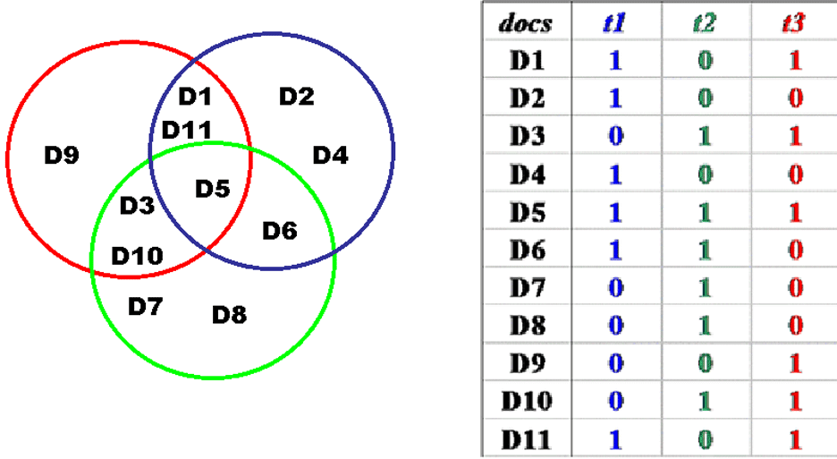
Boolean Document Representation: Terms Present or Absent
30

Slide 31
Relevance in the Boolean Model
Because terms are either present or absent, a document is either relevant or not relevant
But this is clearly flawed -- if a query is "a and b" the Boolean model retrieves only those documents that contain both of them, and treats documents that contain only a or only b as equally irrelevant
THIS IS EQUIVALENT TO SAYING THAT THE BOOLEAN MODEL HAS NO WAY TO REPRESENT TYPICALITY OR GRADED MEMBERSHIP IN A CATEGORY
31

Slide 32
Gradience in Category Membership
Which bird is most typical of the category?
Least typical?
32

Slide 33
Motivating Term Weighting
The Boolean model represents documents as a set of index terms that are either present or absent
This binary notion doesn't fit our intuition that terms differ in how much they suggest what the document is about
We will capture this notion by assigning weights to each term in the index
33

Slide 34
The Vector Model of Document Description

Slide 35
Vectors
Vectors are an abstract way to think about a list of numbers
Any point in a vector space can be represented as a list of numbers called "coordinates" which represent values on the "axes" or "basis vectors" of the space
35

Slide 36
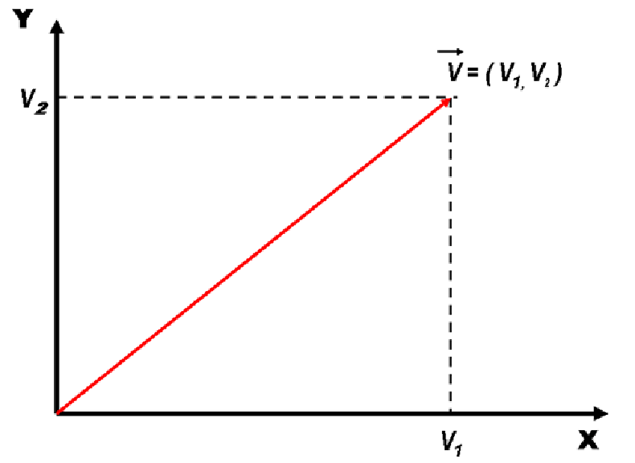
Vectors
36

Slide 37
Document Representation in the Vector Model
Documents and queries are represented in the same way as word or term vectors
Each dimension is the count of occurrences for a term
There is no representation of word order (sentence structure) in the vector - it is still just a BAG OF WORDS
37

Slide 38
Document Similarity in the Vector Model
Vector algebra provides a model for computing similarity between queries and documents and between documents because of assumption that "closeness in space" means "closeness in meaning”
How does this change the relevance measure?
38

Slide 39
Calculating Similarity in Vector Models
The similarity between a query and a document, or between two documents, is defined as the "inner product" of their vectors
The inner product of two vectors is the sum of the products of their overlapping terms (so similarity increases when they have more terms in common)
v1 = (3, 8, 4) v2 = (2, 3, 1)
(3, 8, 4) x (2, 3, 1) = (3 x 2) + (8 x 3) + (4 x 1) = 34
39

Slide 40
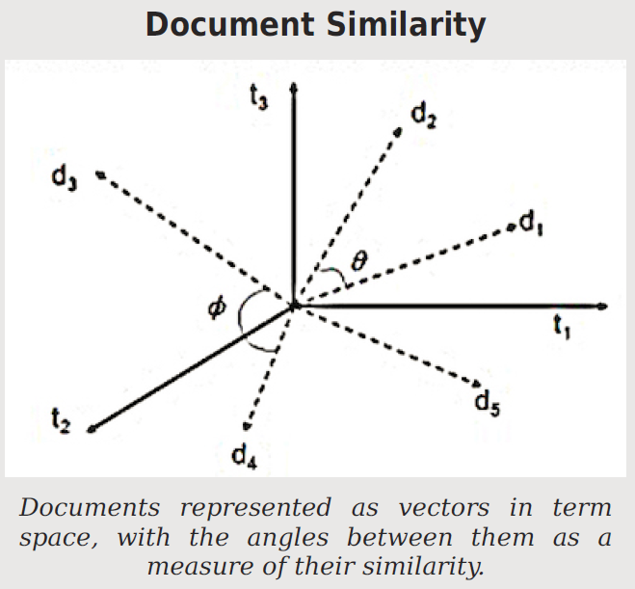
When document vectors are normalized to length 1, the cosine between them is a similarity measure that ranges from 0 to 1

Slide 41
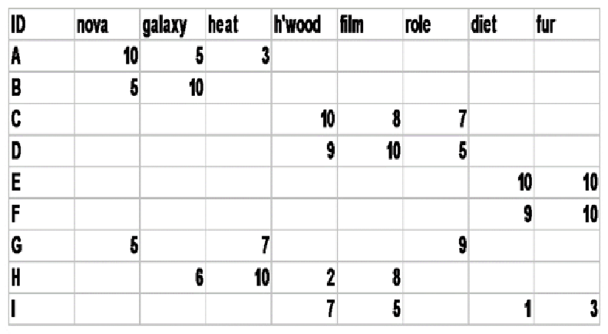
Document x Term Matrix
We can represent for each document the frequency of the words (or terms created by stemming morphologically related words) that it contains
41

Slide 42
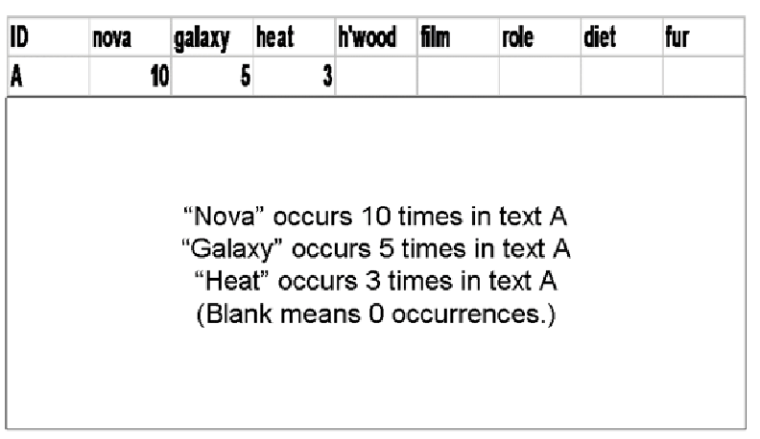
Document Vector
42

Slide 43
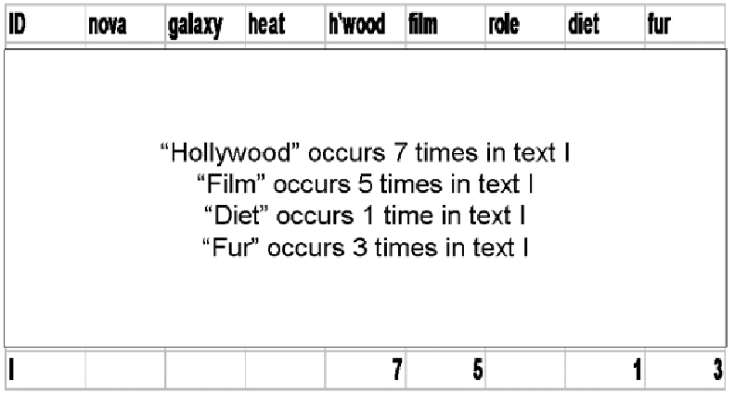
Document Vector
43

Slide 44
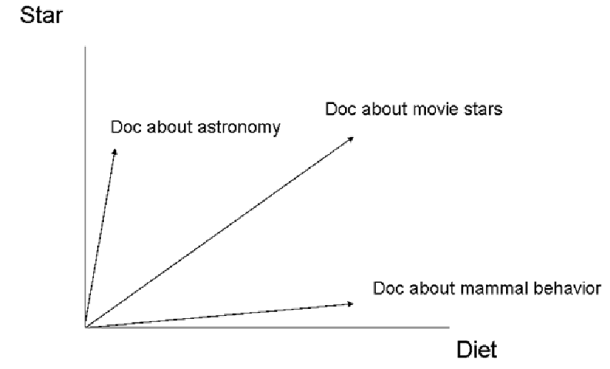
Documents in Term Space – 2D
44

Slide 45
Term Distributions as Document Descriptions

Slide 46
The Zipf Distribution
In any natural language, we can observe that:
A few items occur very frequently
A medium number of items have medium frequency
Very many items occur very infrequently (the “long tail”)
46

Slide 47
The Zipf Distribution
An approximate model of this distribution is the Zipf Distribution, which says that the frequency of the i-th most frequent word is 1/(i^a) times that of the most frequent word
Because of the huge range in frequency and the long tail, the distribution is often drawn on a log-log scale
47

Slide 48
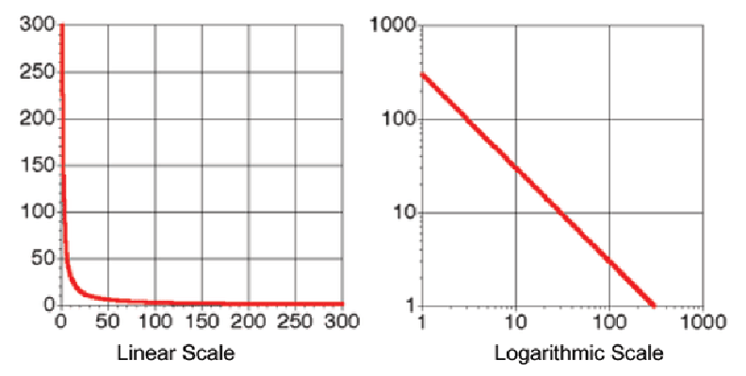
Zipf Distribution – Linear vs. Log Plotting
48

Slide 49
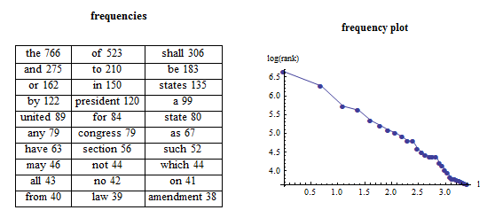
Zipf Distribution – US Constitution
49

Slide 50
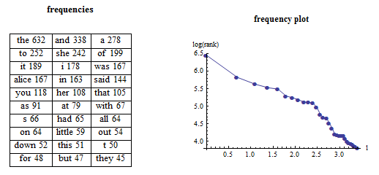
Zipf Distribution – Alice in Wonderland
50

Slide 51
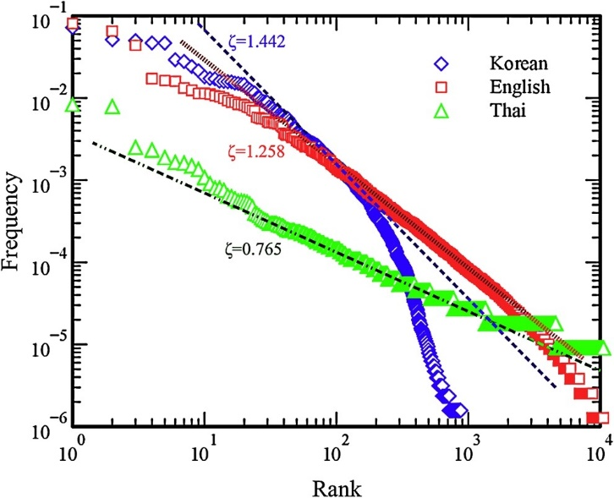
Zipf – Bible in 3 Languages
Mehri, A., & Jamaati, M. (2017). Variation of Zipf's exponent in one hundred live languages: A study of the Holy Bible translations. Physics Letters A, 381(31), 2470-2477.

Slide 52
Similarity

Slide 53
Defining Similarity
Some people say that similarity is a meaningless and "mostly vacuous" concept because there must always be some unstated description properties when two things are compared
Once similarity is defined in terms of specific properties and some metric for comparing them, there is nothing for a "similarity" mechanism to do
53

Slide 55
STOP AND THINK: Is Similarity a Symmetric Relationship?
The Jaccard measure assumes a very simple concept of similarity that is a symmetric relationship
Does “A is similar to B” (or “A is like B”) mean the same thing as “B is similar to A” (or “B is like A”)?
55

Slide 56
Properties of Semantic Relationships: Symmetry
FLASHBACK
SYMMETRY: the order in which the arguments of a binary relationship doesn't matter
Homer Simpson => is-married-to => Marge Simpson
Marge Simpson => is-married-to => Homer Simpson
56

Slide 57
STOP AND THINK: HOW SIMILAR ARE A AND B?
CASE 1
Object A
CASE 2
Object A
P1
P2
P9
P4
P2
P3
P5
P1
P3
P4
P7
P6
P11
P5
P6
P8
P10
P7
P12
P13
Object B
Object B

Slide 58
Similarity Can be Asymmetric
When we compare an A with a B with a statement about similarity, we often order A and B to make the more salient or “feature complex” one as the referent
“the portrait resembles the father” NOT “The father resembles the portrait”
The more salient resource is judged less similar to the less salient one than vice versa
North Korea is judged more similar to China than China is judged similar to North Korea
58

Slide 59
Tversky’s Contrast Model
Tversky proposed to measure similarity using a more general formula that considers both shared and distinctive features
Each of these three sets can be weighted differently
This model can explain why similarity judgments are not always symmetric
59

Slide 60
Geometric or Distance Models
If the property values are metric, each resource is represented as a point in N-dimensional space, with property values as the coordinates
We can measure the differences between the values on each shared property separately
Similarity is inversely related to distance computed as
60

Slide 62
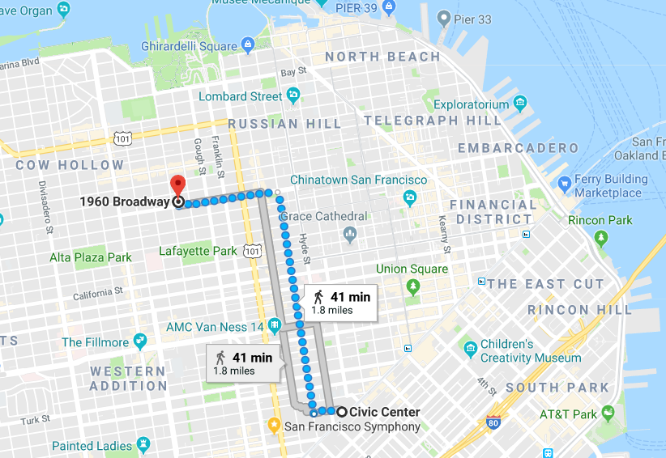
“City Block” Distance Measurement

Slide 63
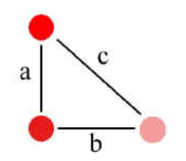
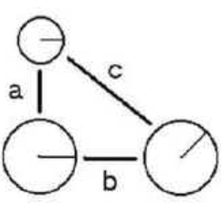
Fused vs. Separable Properties
Properties of color and saturation are fused, and Euclidean metrics better fit similarity judgments
Circle size and radius angle are separable properties, and City Block metric better fits similarity judgments

Slide 64
Infinite Exponents
The Chebyshev function defines the distance between two items as the difference of their values on the single property with the greatest difference (this treats the exponent as infinite)
Two items could have similar or even identical values on most properties, but if they differ much on just one property, they will be treated as very dissimilar
People often use this function… or something like it… in their social behavior

Slide 65
Zero Exponents
At the other extreme, if the exponent is reduced to zero, this treats each proper­ty as binary, either present or absent, and the distance function becomes a count of the number of times that the value of the property for one item is dif­ferent from the value for the other one
This is called the “Hamming distance”

Slide 66
Transformational Models of Similarity
Transformational models assume that the similarity between two things is inver­sely proportional to the complexity of the transformation required to turn one into the other
The simplest transformational model of similarity counts the number of properties that would need to change their values
The “edit distance” between two strings is the number of insertion, deletion, and sub­stitution operations needed
Book -> Bob : delete “o”, substitute “b” for “k” (distance = 2)
66

Slide 67
Structure Models
Geometric and Feature models don’t work well when comparing things that have lots of internal hierarchical or relational structure
In these cases, comparing matching features is insufficient; you need to compare features with similar roles in structures or relationships
Similarity is like analogy
In analogies, relationships are shared
In similarity, both relationships and features are shared
67

Slide 68
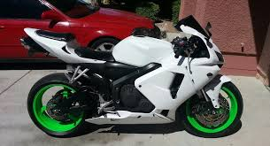
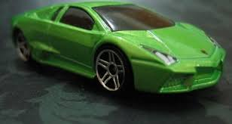
Common Feature But Low Similarity
These two things share the feature “green” but this matching feature does not increase their similarity much because the motorcycle’s wheels do not correspond to the car body

Slide 69
Today’s Most Important Slides

Slide 70
Comparing Resource Descriptions
All information retrieval systems compare a description of a user’s needs with descriptions of the resources that might satisfy them
Identifying relevant documents is equivalent to defining a category to which the query and retrieved information (document) both belong
Likewise, any “classifier” whose purpose is to determine the category to which a resource belongs must compare a resource description with some description or representation of the category

Slide 71
What Words Best Describe a Document?
Not all words are equally useful indicators of what a document is about; many are irrelevant or redundant
Nouns and noun groups carry more "aboutness" than adjectives, adverbs, and verbs
Very frequent words that occur in all or most documents add NOISE because they cannot discriminate between documents
So it is worthwhile to pre-process the text of documents to select / create a smaller set of terms that better represent them; in IR these are called the INDEX terms
Can we think of this selection and processing as creating a controlled vocabulary for describing the contents of a document collection?
71

Slide 72
Selecting Index Terms
At this stage in text processing the text collection is represented as a set of stems or phrases
But not all of them should be kept; some will retrieve too many, and some too few documents
We can select better index terms if we analyze the frequency distribution of the words in the collection
72

Slide 73
The Boolean Model
The Boolean model represents documents and queries as sets of index terms that are either present or absent
This is a “bag of words” – no sentence structure or languageness remains
Term frequency is not represented in any way; terms are either present or absent
This enables comparisons between queries and document collections using set theory operations with Boolean algebra, making relevance a binary decision
THIS IS THE CLASSICAL MODEL OF CATEGORIES DEFINED BY NECESSARY AND SUFFIEICENT PROPERTIES
73

Slide 74
Document Representation in the Vector Model
Documents and queries are represented in the same way as word or term vectors
Each dimension is the count of occurrences for a term
There is no representation of word order (sentence structure) in the vector - it is still just a BAG OF WORDS
74

Slide 75
Document Similarity in the Vector Model
Vector algebra provides a model for computing similarity between queries and documents and between documents because of assumption that "closeness in space" means "closeness in meaning”
How does this change the relevance measure?
75

Slide 76
The Zipf Distribution
In any natural language, we can observe that:
A few items occur very frequently
A medium number of items have medium frequency
Very many items occur very infrequently (the “long tail”)
76

Slide 77
Defining Similarity
Some people say that similarity is a meaningless and "mostly vacuous" concept because there must always be some unstated description properties when two things are compared
Once similarity is defined in terms of specific properties and some metric for comparing them, there is nothing for a "similarity" mechanism to do
77

