Slide 1
CogSci 150 “Sensemaking and Organizing” Spring 2021
Robert J. Glushko glushko@berkeley.edu
19 January 2021
1) Course Introduction;
the Concept of the “Organizing System”

Slide 2
Lecture 0
Yesterday (day 0 of the semester) I recorded a short zoom lecture that:
Introduced the teaching team, Bob and Nicole
Reviewed the student survey
Gave an overview of the course plan and how we will use Zoom and other methods
Covered course administrivia
If you haven’t watched this lecture, do it ASAP – you can find it in the Media Gallery
(but I will repeat some very important slides)

Slide 3
How We’ll Zoom (thanks for the suggestions)
STOP AND THINK: I’m going to ask a lot of questions and give you time to answer them for yourselves and each other
STOP AND TALK: I will stop talking and ask if you have any questions
BREAKOUT ROOMS: We will have breakout rooms for small group discussions
CHAT CHANNEL: Nicole will monitor the chat channel so you can ask questions there… either she’ll answer them or ask me to answer them during our STOP AND TALK breaks
And the lectures will be recorded

Slide 4
Today’s Outline
Sensemaking {and, or, vs.} Organizing
Motivating the Discipline of Organizing
Concepts for Organizing Systems
Breakout Session

Slide 5
The Course in One Slide
When something “makes sense” or “is organized” we are imposing or discovering order in the arrangement of concepts, events, or resources of some kind
Sensemaking and organizing are fundamental human activities that raise many multi- or trans-disciplinary questions about perception, knowledge, decision making, interaction with things and with other people, values and value creation

Slide 6
Plan for the Course
We can analyze sensemaking and organizing from four interrelated perspectives:
As a member of a social, cultural, or language community (linguistics, sociology, social network analysis)
As an individual (psychology and philosophy)
In institutional contexts (law and business)
In data-intensive or scientific contexts (statistics, data science, computer science, info visualization)

Slide 7
Sensemaking {and, or, vs.} Organizing

Slide 8
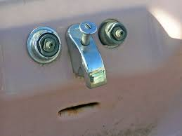
Sensemaking
Making sense of, or giving meaning to something, especially observations or experiences
Some sensemaking is automatic, done by hard-wired brain mechanisms that simplify and organize sensory and perceptual input
Gestalt Principles
Pareidolia

Slide 9
Sensemaking in infants is driven by “statistical learning” to identify which acoustic differences matter in their native language, using frequency and transitional probability to learn words from speech

Slide 10
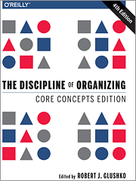
Organizing
Creating capabilities by intentionally imposing order and structure
“TDO” from now on

Slide 11
Sensemaking {and, or, vs.} Organizing
Sensemaking can be considered a superset of, or a more generic perspective, on organizing
“People organize to make sense of equivocal inputs and enact this sense back into the world to make it more orderly” - (Weick 2005)
But I think it is better to see it as one end of an automatic <-> intentional continuum defined by the extent to which organizing is intentional

Slide 12
Sensemaking at the Supermarket
Physical resources are often organized according to intrinsic physical properties like their size, color, or shape
This organization is most effective when these properties are selection criteria because the human visual system quickly attends to them

Slide 13
Sensemaking {and, or, vs.} Organizing
For most domains/resource types, selection criteria and other requirements for interaction mandate intentional organization that exploits semantic or functional properties instead of perceptual/physical ones
Put more simply… color or shape are not useful organizing principles for many types of resource collections even though they are perceived quickly

Slide 14
Organizing Books by Color
Might be aesthetic for your personal book collection (or as a Zoom background decoration), but not an effective organizing principle for a library (WHY NOT?

Slide 15
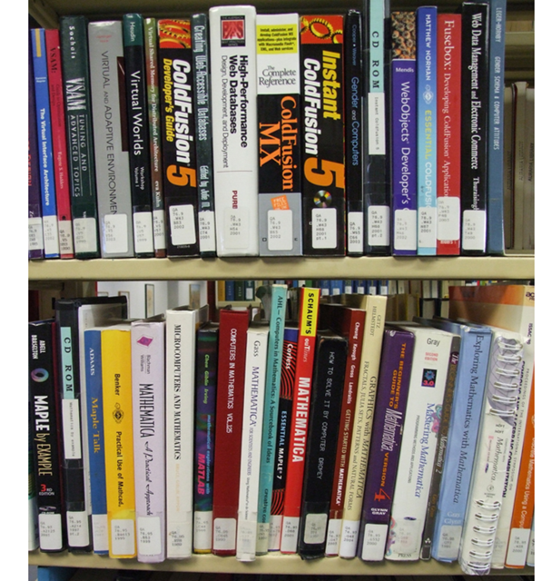
Organizing Books by Content
Organizing books according to their content is the only scalable approach when the collection gets larger

Slide 16
Stop and Think
If you were living 10,000 years ago, what astronomical and terrestrial events would be most salient to you?
How would making sense of these events enable you to organize your life?
What evidence do we have today of these ancient efforts at sensemaking and organizing?

Slide 17
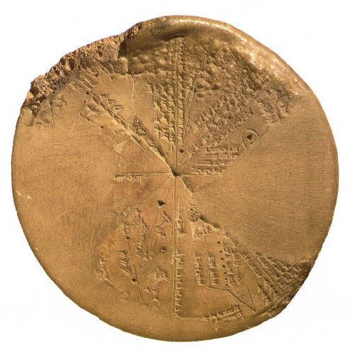
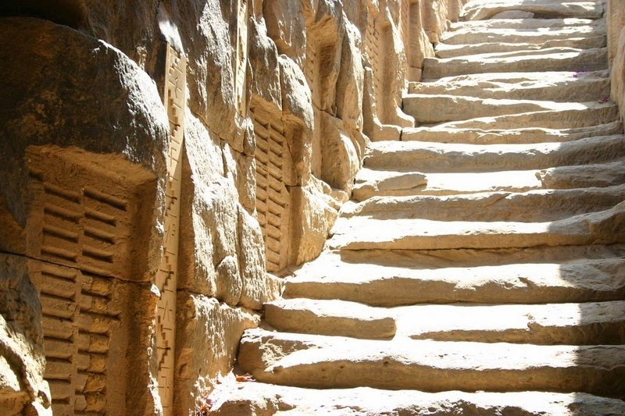
We Have Always Organized/
Tried to Make Sense
For thousands of years, even before the invention of written language, people have systematically collected things, information about those things, and observations of all kinds to understand how their world works
Babylonian Astronomy
Ancient Egyptian Hydrology – Nile Flood Records
17

Slide 18
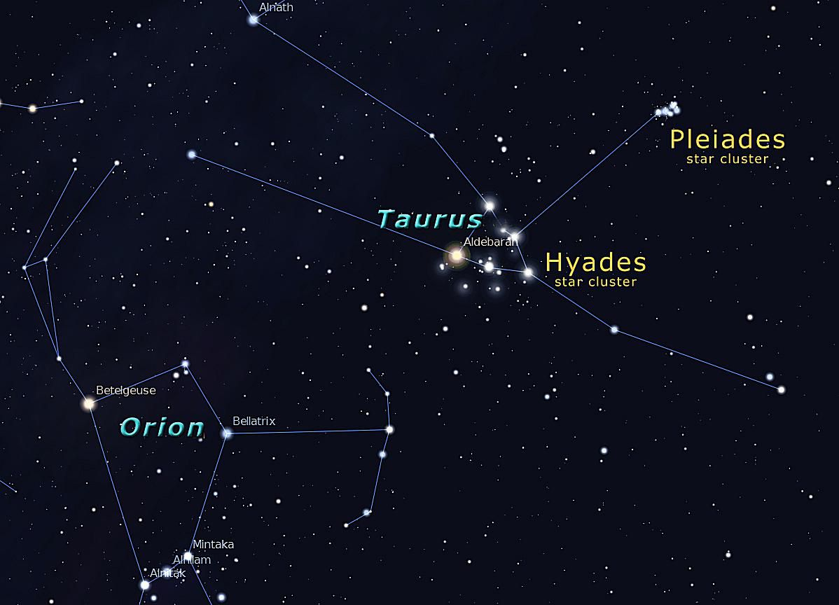
Ancient humans imposed “constellations” on observations of stars so they could represent and communicate about them
LASCAUX CAVE PAINTINGS
WINTER SKY, NORTHERN HEMISPHERE
2500 years ago, Babylonian astronomers recorded observations for the sun and moon so precisely that their estimates for “year” and “lunar month” were almost exactly the values we use today

Slide 19
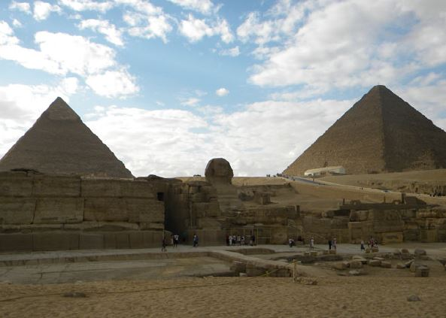
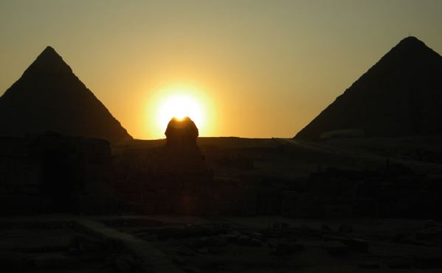
Sensemaking in Ancient Egypt: Archeo-astronomy
The pyramids of Giza in Egypt, the Great Sphinx that stands between them, and an observation terrace are aligned according to two events of critical religious and economic importance:
Sunset on the summer solstice
The onset of the Nile floods
The hieroglyph symbol AKHET means both “horizon” and “flood season”

Slide 20
Sensemaking and Science
A fundamental challenge in sensemaking is balancing the competing goals of understanding a particular collection of things or data and applying that understanding to new instances
The highest level of sensemaking is the creation of scientific theories, with a preference for “more organized” or simpler explanations for the observations
20

Slide 21
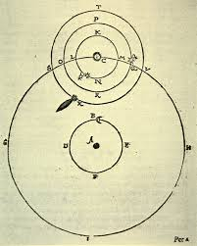
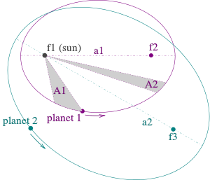
Tycho Brahe vs. Johannes Kepler same data, different theories
Heliocentric elliptical orbits follow “Kepler’s Laws” – simple and elegant theory
Reconciling data with a geocentric organizing principle (dictated by Plato) makes Tycho’s system overly complex and mechanically impossible

Slide 22
Stop and Talk
This is a very ambitious course – it will be broad in topical coverage, and deep in the most important topics
You will learn more questions than answers
YOU WON’T LIKE OR UNDERSTAND EVERTHING TO THE SAME DEGREE. THAT’S EXPECTED AND IS OK!

Slide 23
Motivating the Discipline of Organizing

Slide 24
Everything is Organized
In our daily lives organizing is a fundamental cognitive activity that we often do without thinking much about it
It is also an important part of most business and professional activities
Organizing in any context can be more effective and satisfying if we are more self-aware and systematic about how we organize
24

Slide 25
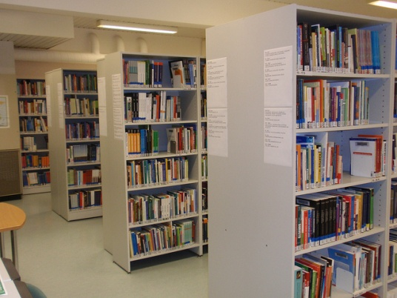
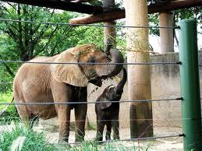
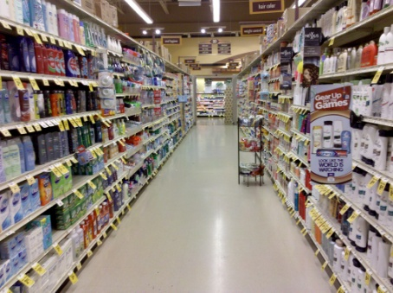
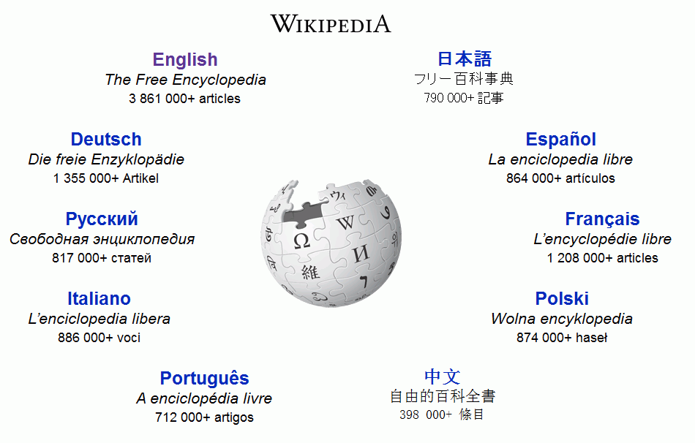
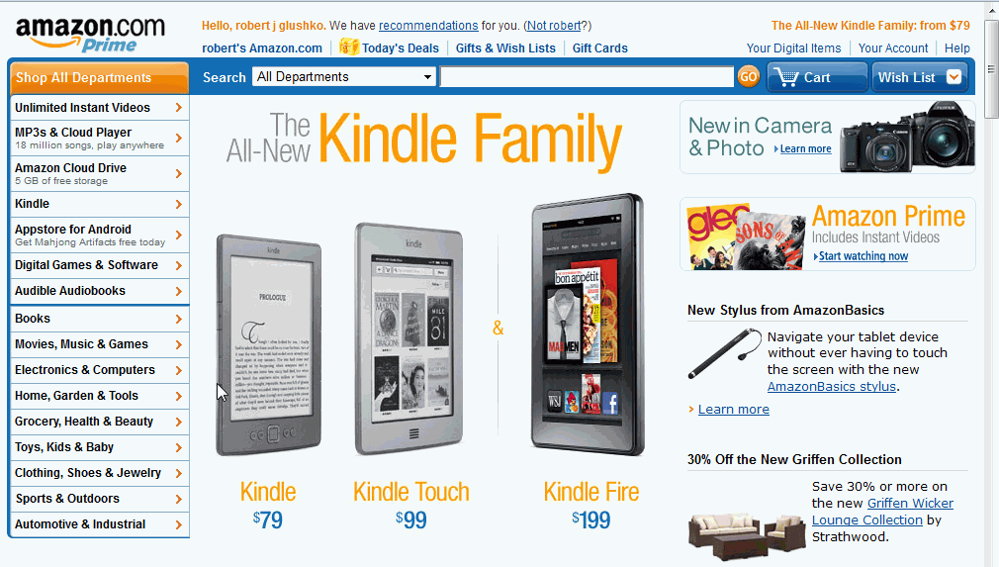
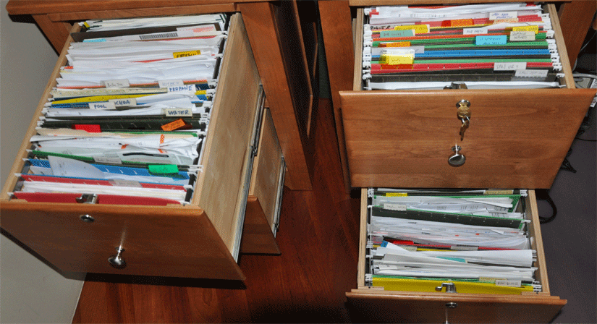
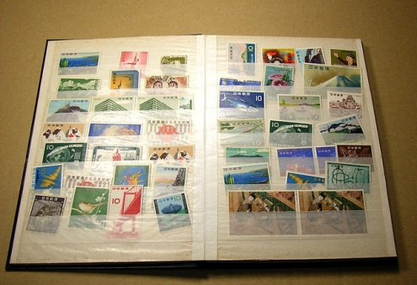
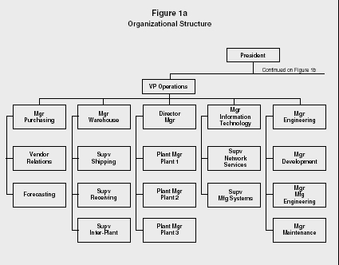
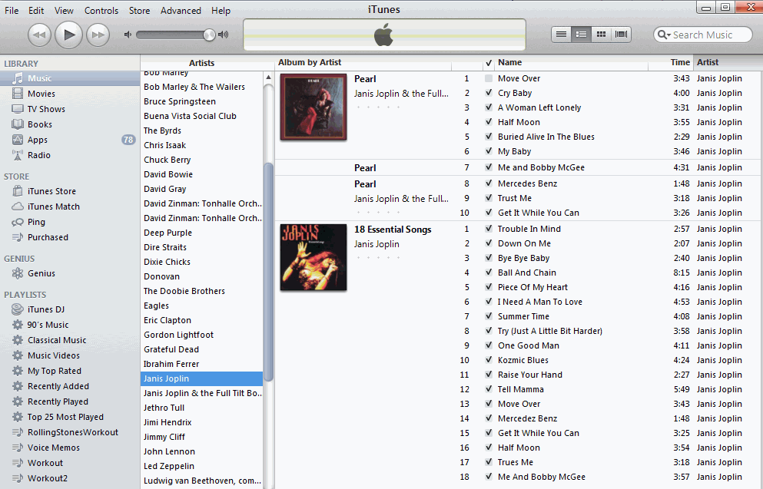
25

Slide 26
What We Organize…
Libraries, museums, business information systems, scientific data… and other institutional resource collections
Different types of documents
Personal information and artifacts of all kinds in our kitchens, closets, personal computers, smartphones…
People
Focus on commonalities, not differences !
26

Slide 27
They are all “Organizing Systems”
A collection of resources intentionally arranged to enable some set of interactions
27

Slide 28
The 6 Dimensions of an Organizing System – Organizing as a Design Problem
What Is Being Organized?
Why Is It Being Organized?
How Is It Being Organized?
When Is It Being Organized?
Who (or What) is Organizing It?
Where is it Organized?
28

Slide 29
Foundational Concepts
Resources
Intentional Arrangement
Organizing Principles used to “Intentionally Arrange” Resources
Interactions that are enabled by the organizing principles

Slide 30
Resources:
Anything of value that can support goal-oriented activity

Slide 31
ANYTHING! TDO Chapter 12 Case Studies
§12.4, “Single-Source Textbook Publishing”
§12.5, “Organizing a Kitchen”
§12.18, “Neuroscience Lab”
§12.16, “The Dabbawalas of Mumbai”
Cases in green are assigned for today; blue next time; red ones for 3rd lecture; black ones later in semester

Slide 32
ANYTHING! Other Case Studies
Ebola Contact Tracing
Spotify’s Recommendations
What3Words
Soccer
The Diagnostic and Statistical Manual of Mental Disorders
Pantone Color System
Cognitive Neuroscience
Time Zones
Orchestra Seating
Medical Emergencies
Organized Crime
NBA Player Tracking
Intentional Communities
Guide Dogs for the Blind
About 100 case studies can be found at https://ischools.org/Discipline-of-Organizing-Case-Studies-Overview/

Slide 33
Your Case Study
You will write a case study like those you read
Aspire to have your case study in next year’s CogSci 150 syllabus; tell an interesting story well
Propose a topic by March 13
Present your case study during RRR week (on May 4 or May 6)
Final case study report due May 10
33

Slide 34
Intentional Arrangement:
Explicit or implicit acts of organization by human or computational agents

Slide 35
Organizing Principles [1]
The resource arrangements follow one or more intentionally selected ORGANIZING PRINCIPLES, ideally expressed in an implementation-neutral way if they are not directly perceivable
ORGANIZING PRINCIPLES use properties or DESCRIPTIONS that are associated with the resources
Similarly, interactions with resources are determined by their organizing principles and descriptions
➔ Organizing, resource description, and interaction design are inherently interconnected activities
35

Slide 36
Say it Again: TDO’s Mantra
Organizing, resource description, and interaction design are inherently interconnected activities

Slide 37
Organizing Principles [2]
For physical resources the properties are often:
Perceptual – what does it look like?
Material – what is it made of?
Task-oriented – how is it used?
For information resources the properties are often semantic ones – what is it about?
37

Slide 38
Organizing System: Home Kitchen
Photo by Emilie Hardman (http://www.flickr.com/photos/quintanaroo/2741672230//) Used by permission
38

Slide 39
Kitchen Organizing Principles
Exploit the constraints of the physical environment
Exploit the physical properties (especially shape and size) of the resources being organized
Organize by task
Organize by frequency of use
Organize by the “social dimensions” of interaction
Organize alphabetically
Some of these are phrased more abstractly to show that none of them are kitchen-specific and could be used elsewhere

Slide 40
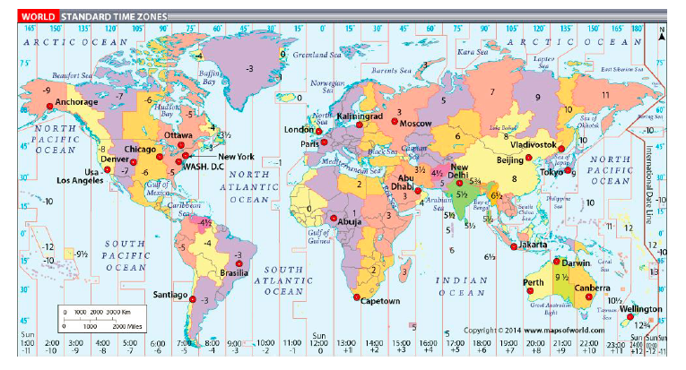
Organizing System: Time Zones

Slide 41
Stop and Think
What are the organizing principles embodied in time zones?
Were any of these principles used to organize the kitchen? (think abstractly…)

Slide 42
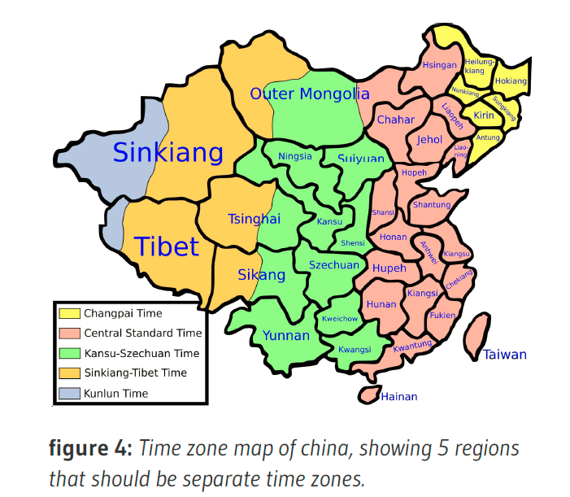

Slide 43
Organizing Principles [3]
Other typical arrangements are based on ownership, origin, taxonomic, or “taskonomic” or behavioral properties (usage frequency, correlated usage)
Resources with a sortable name or identifier can have alphabetic or numeric ordering
Resources with an associated date (creation, acquisition) can have chronological ordering
43

Slide 44
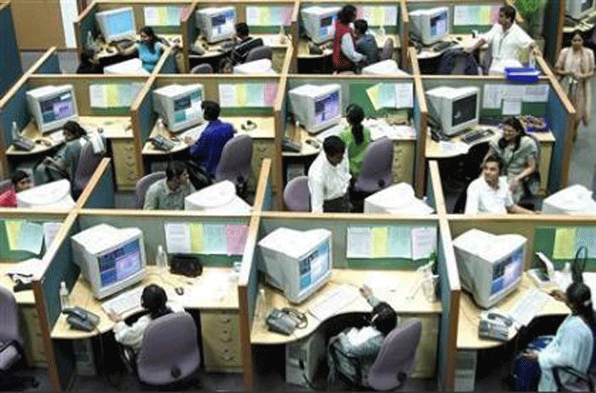
Organizing People by Work Role
Logical View
(org chart)
Implementation View
(floor plan)
44

Slide 45
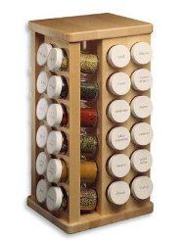
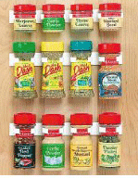
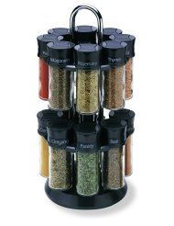
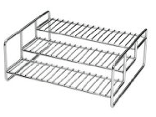
Many Principles don’t Specify Implementation: “Organize Spices Alphabetically”
THINK ARCHITECTURALLY!
45

Slide 46
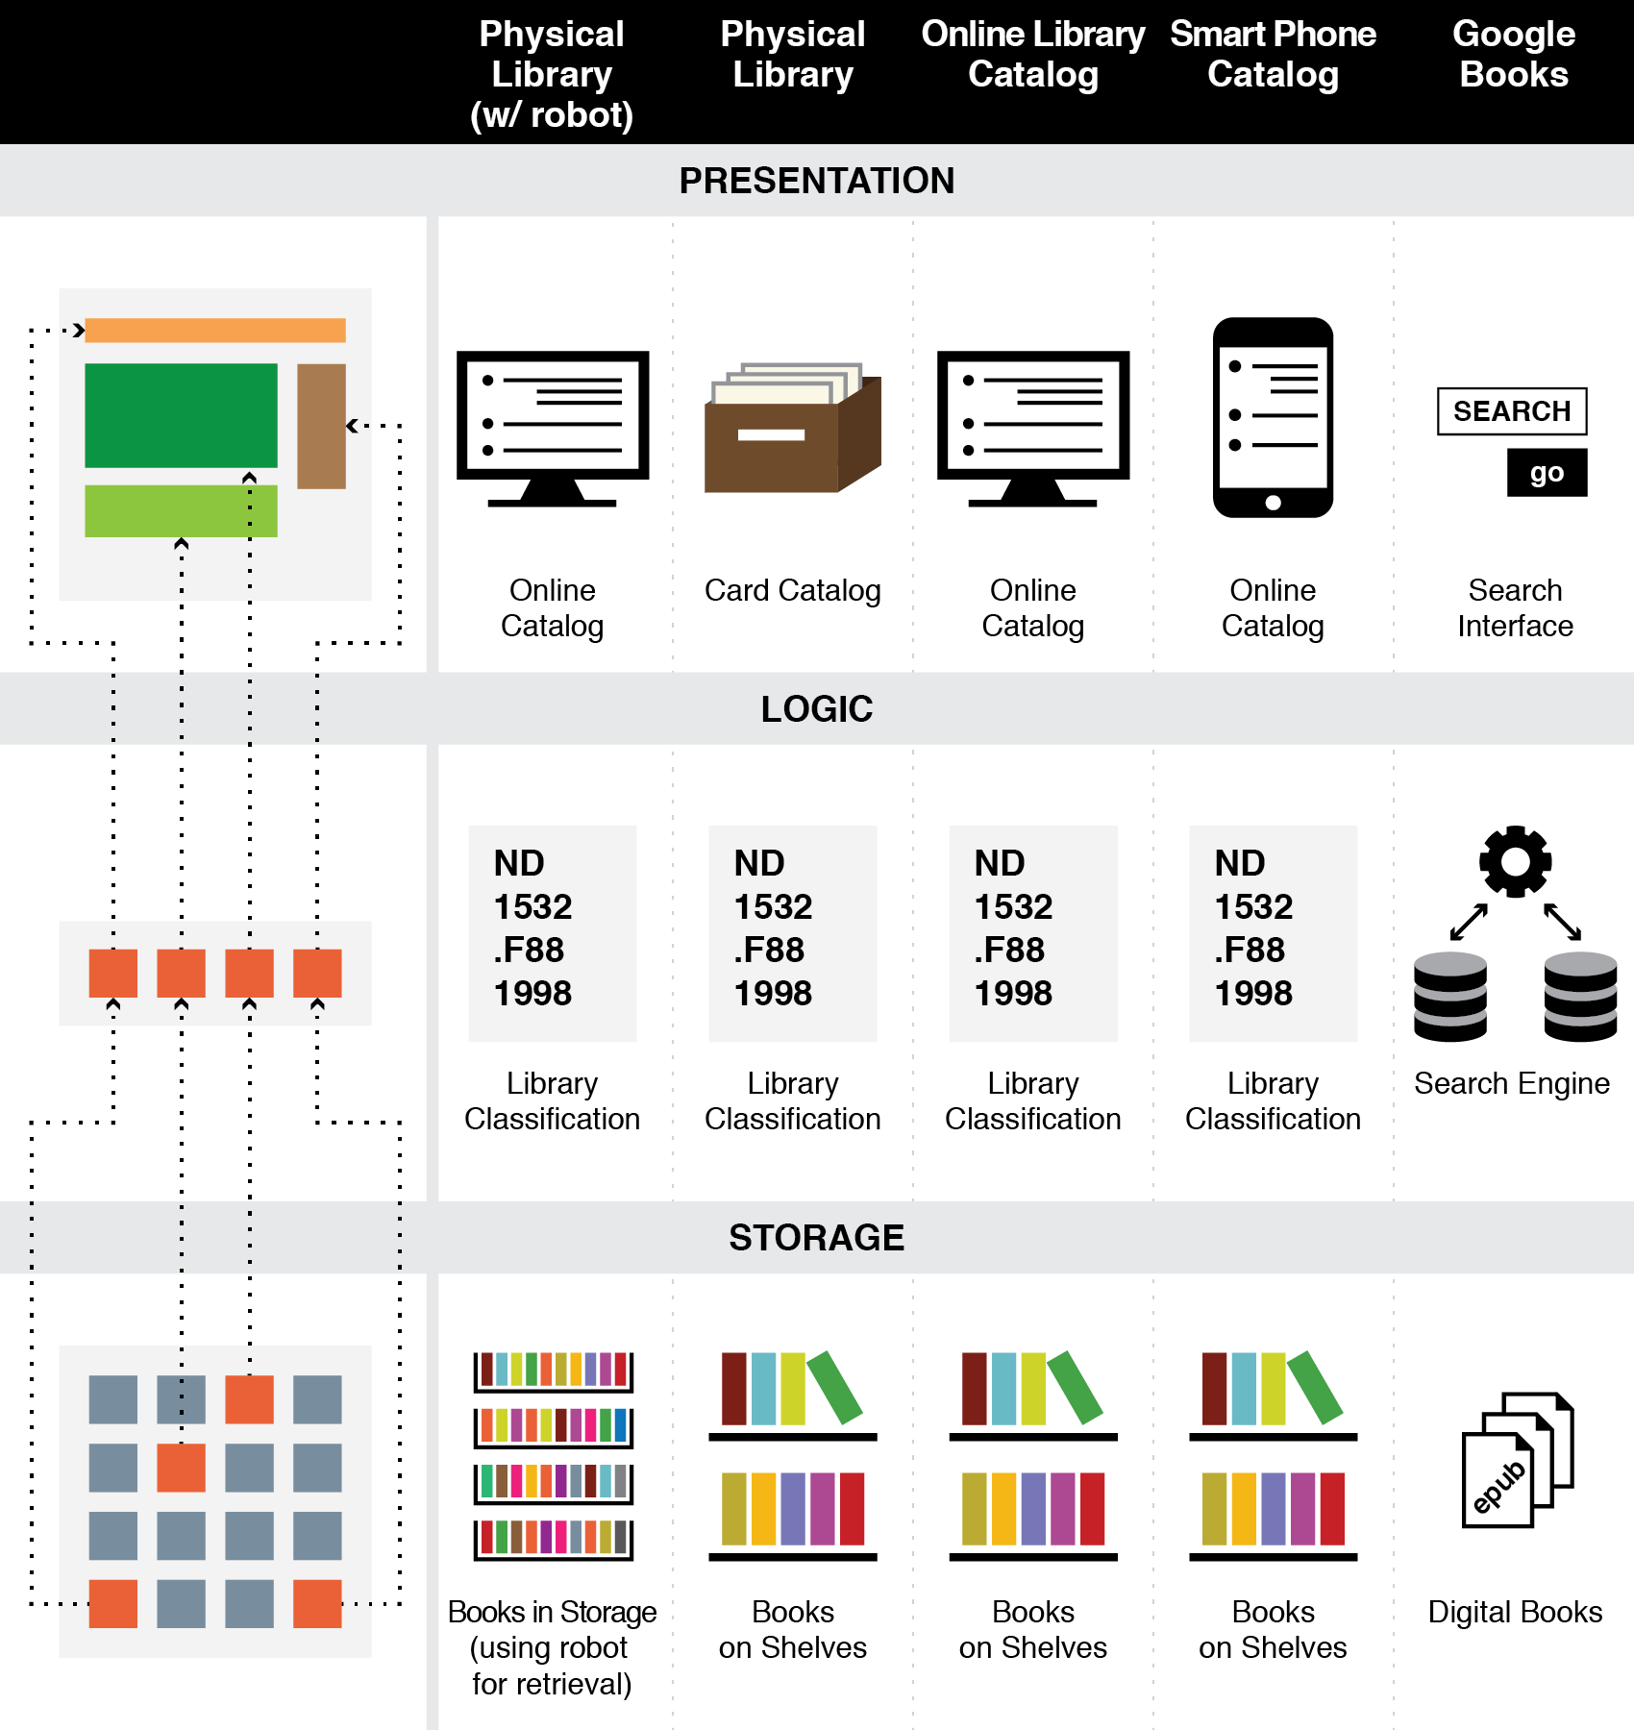
The Three-Tier Architecture
Organizing Principles are logically separated from Implementation and Presentation Tiers

Slide 47
A “Library Robot” Changes Only the Storage Tier
47

Slide 48
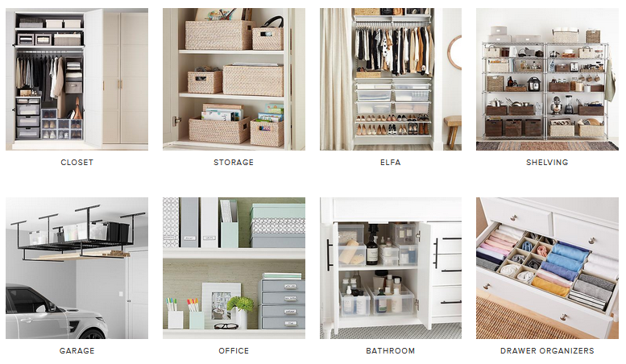
“Getting Organized” by Applying Organizing Principles is ARCHITECTURAL THINKING; “Getting Organized” by Arranging Stuff with “Organizing Furniture” IS NOT!

Slide 49
Interactions –The Why of Organizing Systems
INTERACTIONS include any activity, function, or service supported by or enabled with respect to the resources in a collection or with respect the collection as a whole
Interactions can include access, reuse, copying, transforming, translating, comparing, combining, visualizing, recommending… anything that a person or process can do with the resources…
49

Slide 50
Interactions
Some interactions can be enabled with any type of resource, while others are tied to resource types
The interactions that are supported depend on the nature and extent of the resource descriptions and arrangement
50

Slide 51
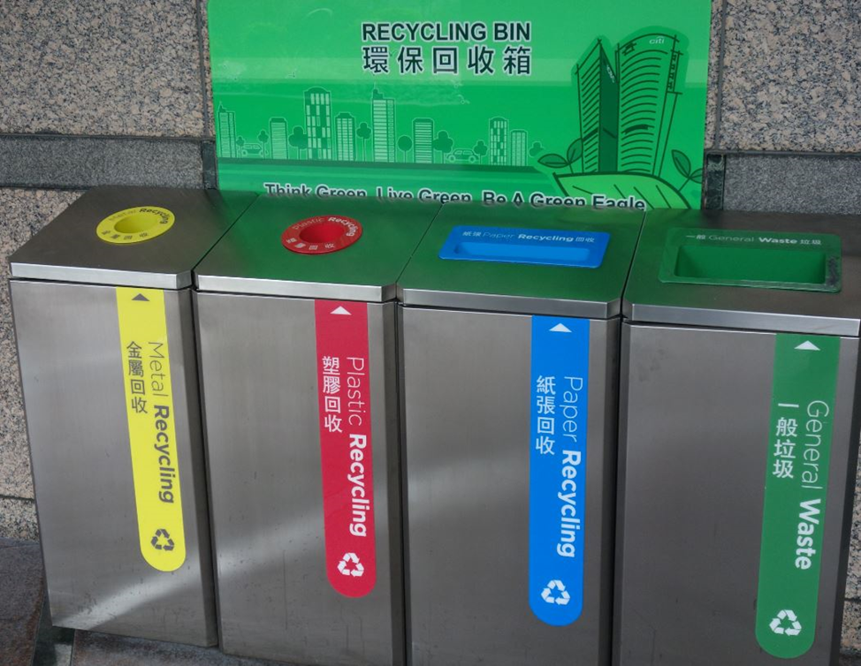
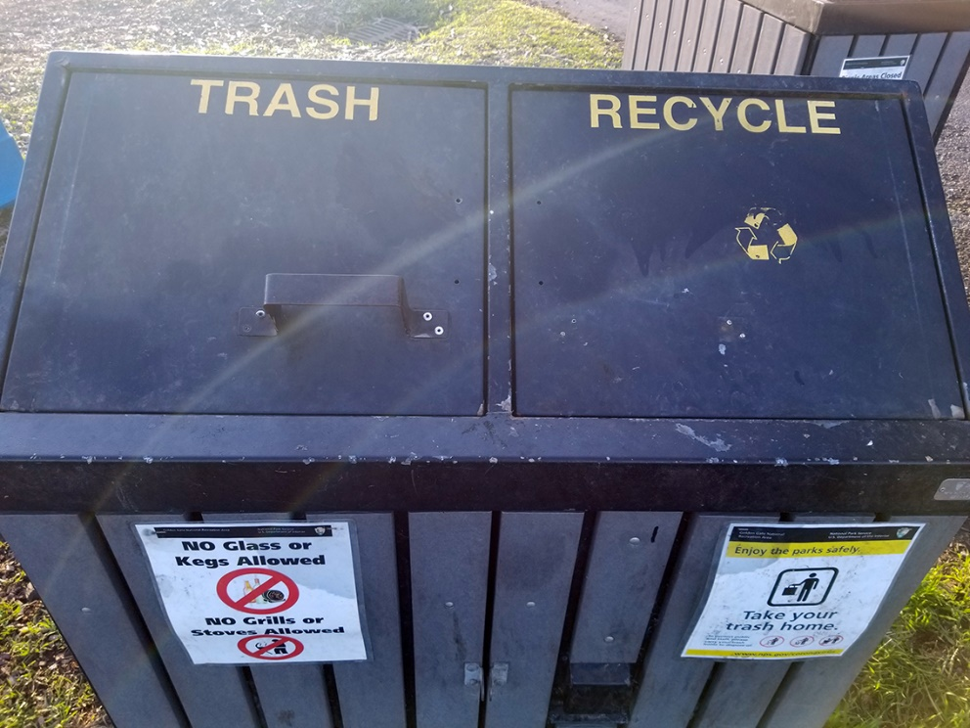
Organizing and Interaction Tradeoffs
How does recycling in Hong Kong (top photo) compare with recycling at SF Fort Mason park (bottom photo)?
What does this imply about the interactions with resources throughout the entire recycling system?
Who does the work? Who gets the benefits?

Slide 52
ORGANIZING SYSTEMS BIG IDEAS
Every organizing system must enable users to interact with its collection of resources
The possible interactions depend primarily on the nature and extent of the descriptions associated with the resources
Intentional arrangement emerges when one or more resource descriptions are used by organizing principles
52

Slide 53
Say it Again: TDO’s Mantra
Organizing, resource description, and interaction design are inherently interconnected activities

Slide 54
Upcoming Syllabus
For 24 January (Design Decisions)
TDO Chapter 2
12.4 Single-source textbook publishing
12.18 Neuroscience lab (Gerber 2013)
Medical Emergencies (Delzompo 2018)
For 29 January (Case Studies)
Organized Crime (Sondhi 2015)
Player Tracking in the NBA (Mon 2016)
Intentional Communities (Sauter 2016)
Guide Dogs for the Blind (Cho 2016)
54

Slide 55
Micro-Assignment 1
4 short answer questions to guide your reading for next time
Should take 10-20 minutes at most
Will “turn on” in bcourses after today’s class
Turn in before class on 1/21
55

Slide 56
Breakout Session – Grandpa’s Records
Your grandfather left you his collection of a few hundred record albums but when they were packed in boxes his organizing system was scrambled so you need to organize them.
The collection contains rock music, folk music, country music, classical music, movie soundtracks, and all sorts of other genres you don’t immediately recognize.
There seems to be a complete collection of all the albums by “The Beatles” and also many albums separately recorded by band members John Lennon, Paul McCartney, and George Harrison after “The Beatles” broke up. There are also some curious albums in which country music artists have recorded “cover versions” of songs by The Beatles.
What resources are being organized?
Why? What specific interactions are you enabling?
How is the collection being organized? (what resource properties are used in organizing principles for the resources?)

