Slide 1
CogSci 150 “Sensemaking and Organizing” Spring 2021
Robert J. Glushko glushko@berkeley.edu
21 January 2021
2) Design Decisions for Organizing Systems

Slide 2
Outline
Organizing Organizing Systems
Category Perspective {and, or, vs.} Dimensional/Design Space Perspective
The Six Design Questions:
What
Why
How
When
By whom or what
Where

Slide 3
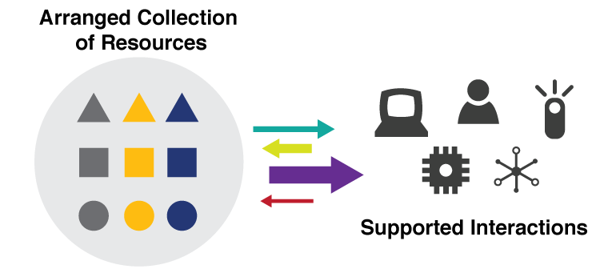
They are all “Organizing Systems”
FLASHBACK
A collection of resources intentionally arranged to enable some set of interactions
3

Slide 4
Organizing Organizing Systems
We can classify organizing systems by:
resource type (the usual way…)
dominant purpose
creator
intended user community
or many other ways
4

Slide 5
Categorizing by Resource Type
Organizing Systems
Collections of Books
(Libraries)
Collections of Art
(Museum)
Collections of Documents
(Archive)
Collections of Data
(Repository)
Collections of Spices (Pantry) …
All languages have these “collective nouns” – - words for “organized collections” and many others that refer to a group whether or not it is organized
STOP AND THINK Self-test: fish, ants, birds, bees, ships, thieves
5

Slide 6
Categorizing by Purpose: Resource Preservation as Means vs. End
Organizing Systems
Memory Institutions
Libraries
Museums
Business Info Systems
Content Management
Archives
CRM
ERP
Preserve the institution that creates or uses the resources
Preserve resources
6

Slide 7
Stop and Think
Define “library” as a category of organizing systems
Don’t think about any specific library … consider all libraries

Slide 8
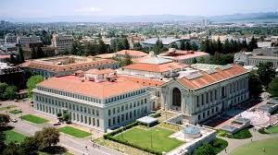
A Library
I told you not to think of any specific library, but you probably couldn’t help yourself and thought of the main Berkeley library
8

Slide 9
A Library
Or you might have thought of the reading room in the main library
9

Slide 10
What Is a Library?
A library might be housed in a building, but the building doesn’t make it a library. Think conceptually, not in terms of implementation
A LIBRARY is a collection of (information?) resources
Organized by “aboutness” to enable “access” and “reuse”
Curated for “public good” and “community creation”
Conventional interaction is “circulation” – borrowing and return of resources…
10

Slide 11
Is a Bookmobile a Library?
11

Slide 12
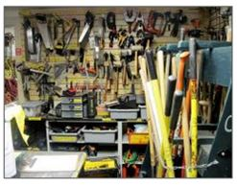
A Library for Tools?
12

Slide 13
Is a “Seed Library” Really a Library?
13

Slide 14
A “Seed Library” for Information?
14

Slide 15
Stop and Think
How do the interactions with “seed libraries” and Wikipedia differ from those in more conventional libraries?
How do museums differ from libraries?

Slide 16
What Is a Museum? (Wikipedia definition)
A collection of artifacts and other objects
… of artistic, cultural, historical, or scientific importance
… available for public viewing
No mention of the fancy building that houses most museum collections
“Viewing” not “circulation” – the defining interaction for most libraries.
16

Slide 17
Stop and Think
Why don’t most museums lend their resources?

Slide 18
Some College Museums Lend Art to Students
If a museum allows its resources to circulate is it acting as a library?
18

Slide 19
Category Thinking about Organizing Resources
Libraries, museums, and many other types of resource collections have conventional characteristics that are deeply embedded in cultural and linguistic categories
(and these characteristics include the “physicality” of library and museum buildings)
19

Slide 20
Consequences of Category Thinking
Using an established category to describe an organizing system reinforces its conventional characteristics, even if we add qualifiers
… and marginalizes any atypical characteristics of the organizing system being categorized or designed
…impedes innovation in design
20

Slide 21
A “Design Space” or “Dimensional” Perspective
In addition to using categories like Library or Museum or Business Information System, consider a specific organizing system as a point in a multidimensional design space and these categories as regions in that space
This treats the familiar categories as “design patterns” that embody typical configurations of design choices
21

Slide 22
Analogical and “White Space” Thinking
We can reason by analogy to identify and apply the principles used in one organizing system to understand or design others
If we think metaphorically of this design space as a map of all organizing systems, we can see less populated or empty regions (“white space”) between the densely-populated centers of the familiar categories – these are places for inventing new kinds of organizing systems
22

Slide 23
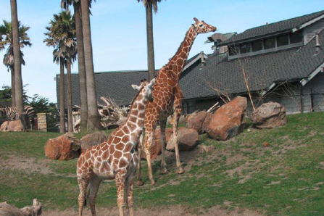
A Zoo
What broader category of organizing system is it in?

Slide 24
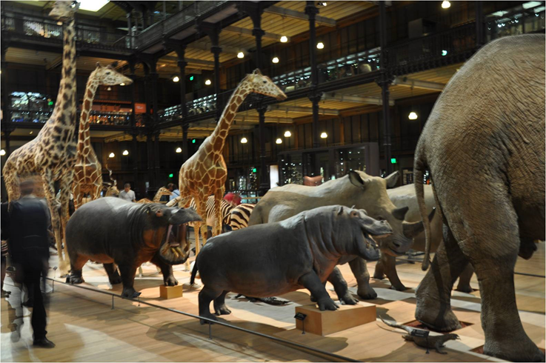
Natural History Museum
How does a natural history museum differ from a zoo?

Slide 25
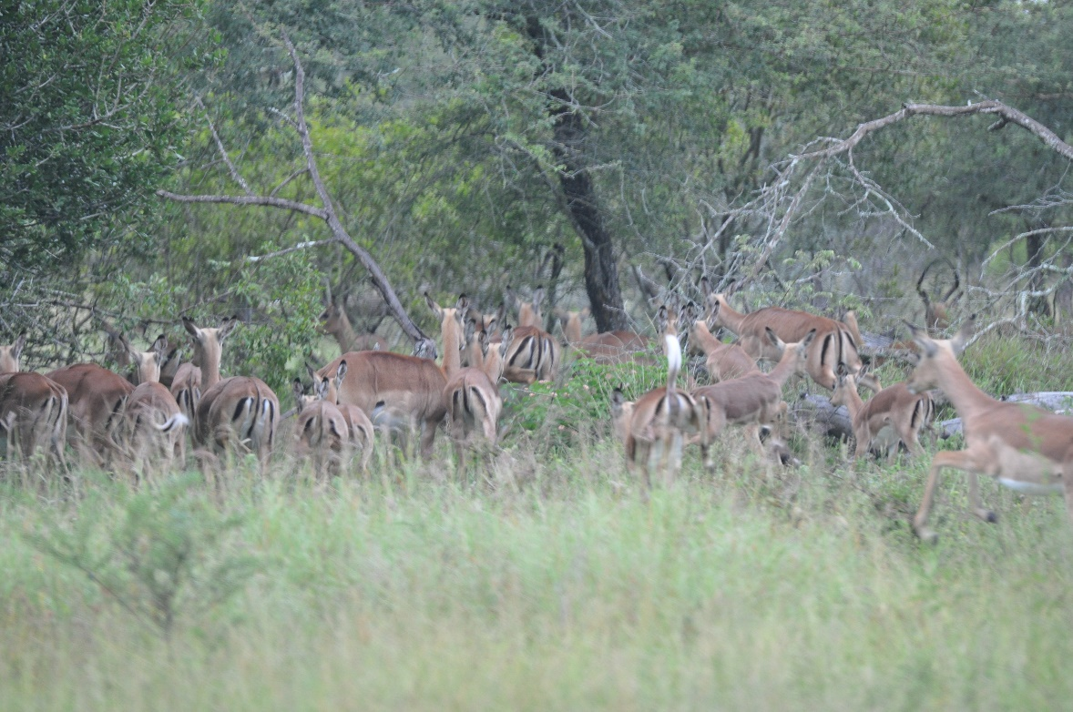
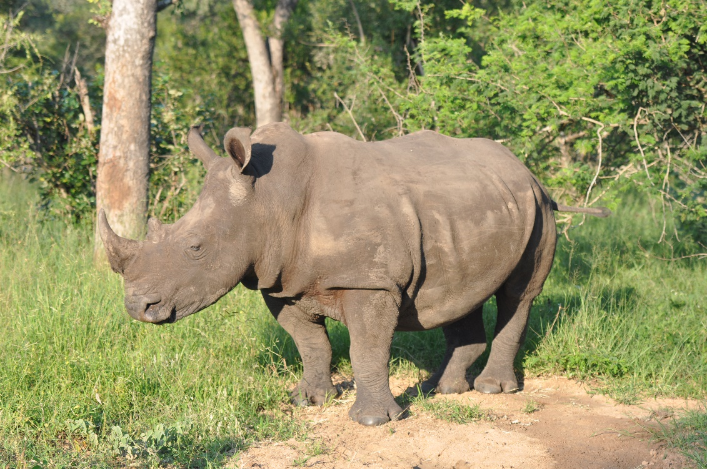
Wild Animal Park
How does a wild animal park like
differ from a zoo?

Slide 26
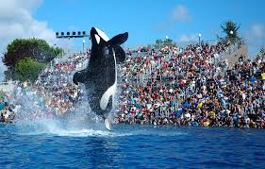
Animal Theme Park:
How does a theme park differ from a wild animal park? From a zoo? From a natural history museum?

Slide 27
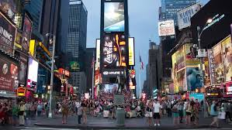
WILD ANIMAL PARK : ANIMAL THEME PARK
CITY : ( ? )
:
?
:
27

Slide 28
Cirque du Soleil == Human Theme Park?
In a circus the performers are trained to carry out unnatural behaviors, but this organizing system doesn’t have a preservation goal
28

Slide 29
Williamsburg == Human Theme Park? == Living History Museum?
This organizing system embodies both the unnatural behaviors of theme parks and the preservation aspects of natural history museums
29

Slide 30
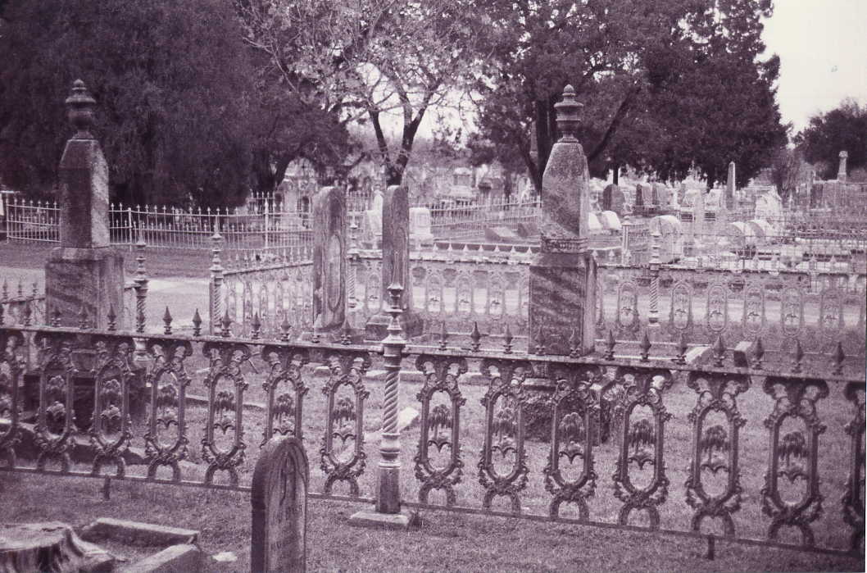
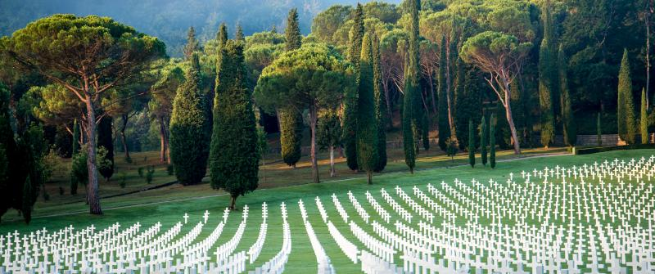
How are cemeteries like museums? How do they differ? What are the organizing principles in cemeteries?

Slide 31
Consequences of Design Space / Dimensional Thinking
Overcomes the bias and conservatism inherent in familiar categories
Design patterns support multi-disciplinary work that cuts across familiar categories and applies knowledge about them to new domains
Creates a design vocabulary for translating concepts and concerns from category and discipline-specific vocabularies (the secret of being a successful consultant)
31

Slide 32
The 6 Dimensions of an Organizing System
What Is Being Organized?
Why Is It Being Organized?
How Is It Being Organized?
When Is It Being Organized?
Who (or What) is Organizing It?
Where is it Organized?
32

Slide 33
Resources:
FLASHBACK
Anything of value that can support goal-oriented activity

Slide 36
Resource
“anything of value that can support goal-oriented activity”
In different domains a resource might be called: object, item, instance, document, artifact, asset, entity.. or given more domain-specific names (“animal” in zoo)
STOP AND THINK: Can someone have a purpose for something that makes them consider it to be a resource when someone else wouldn’t?

Slide 37
What Is Being Organized?
Identifying the unit of analysis is a central problem in every intellectual or scientific discipline – “what exactly are we talking about?” – and in every organizing system
Resources that are aggregates or composites of other resources, or that have internal structure, or that can have many attributes, pose questions about the granularity of their "thingness”
37

Slide 38
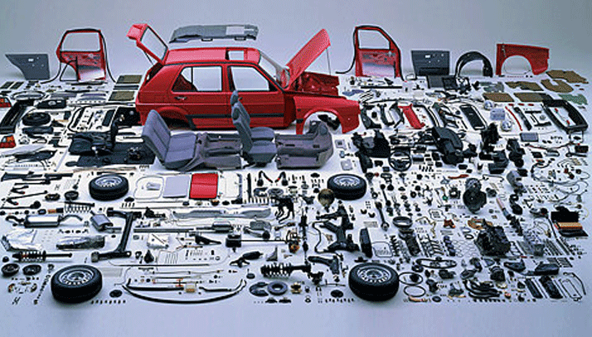
Resource Granularity: How Many Things is a Car?
When is it built? When it is sold? When it is repaired?

Slide 39
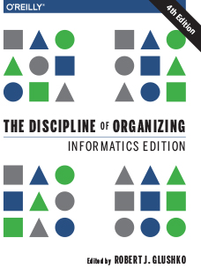
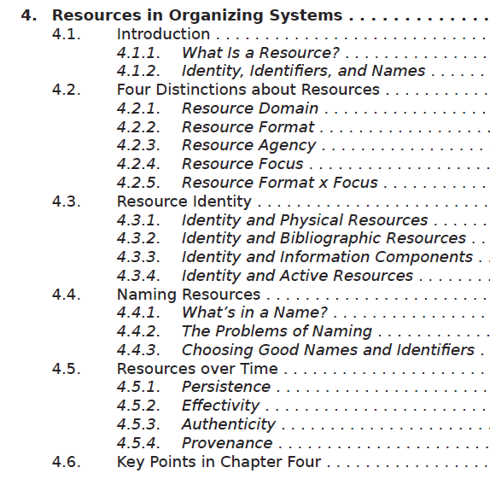
How Many Things is a Book?

Slide 40
Describing and Organizing Classes of Things (1)
Categories are sets or groups of resources, “classes of things” or abstract entities, that are treated the same
We all create individual categories to satisfy ad hoc requirements that emerge from our unique experiences, preferences, and resource collections
Cultural categories are embodied in culture and language and have imprecise / flexible boundaries
40

Slide 41
Describing and Organizing Classes of Things (2)
Institutional categories are explicitly constructed to create a precise semantic model (of what might otherwise be treated as cultural categories)
“color” in ordinary use => Pantone or RGB
In addition to these three “category categories” created by people, computers can create computational categories
41

Slide 42
“Category Categories” for People (1)
Individual categories – how you distinguish different types of friends
Best friend, family friend, work friend, school friends
Cultural categories
jock, nerd, slacker, hipster…
42

Slide 43
“Category Categories” for People (2)
Institutional categories used by governments, business management, industrial organizations
Occupational classifications, visa categories
Computational organizing of individuals
User models, indexes used for predictive analytics, recommendations (e.g., credit scores, Facebook, Amazon, Netflix…)
43

Slide 44
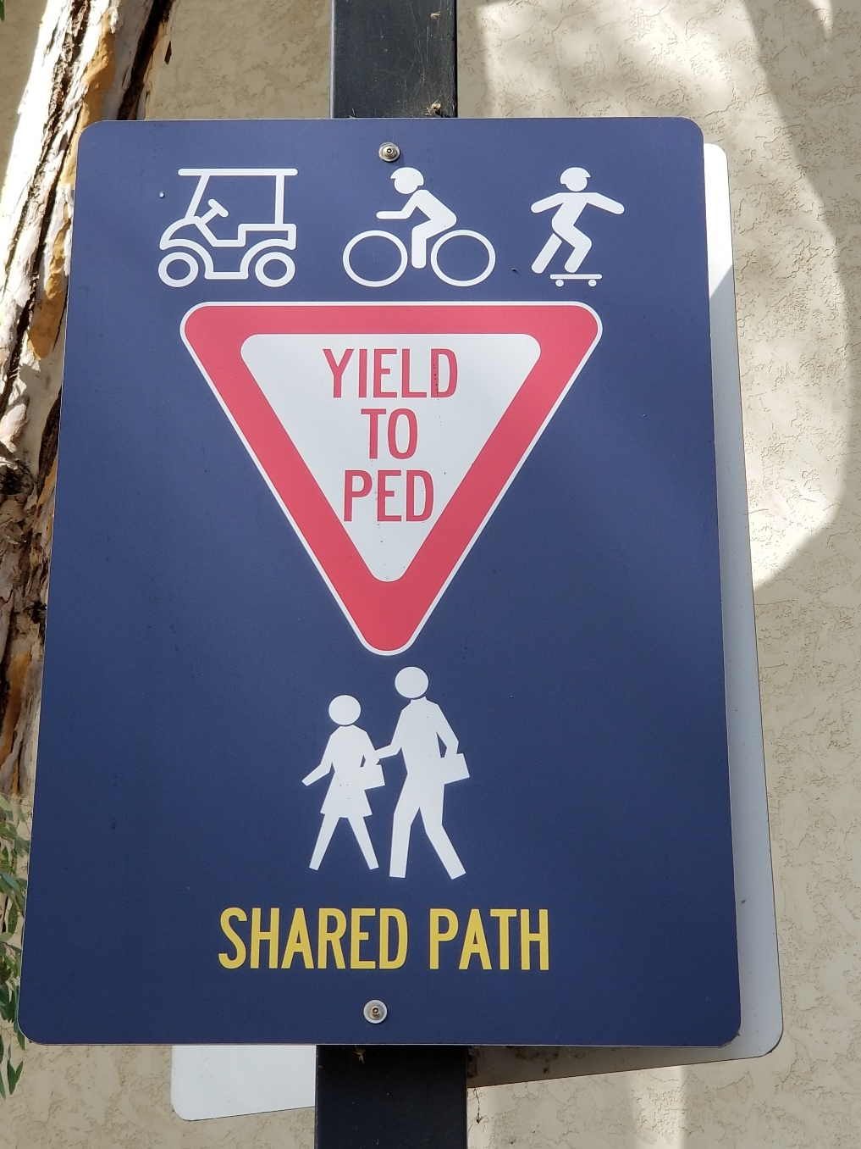
Understanding Categories
This sign defines the “Yield to Ped” category
STOP AND THINK: Define the category so you can make “yield or not” decisions

Slide 45
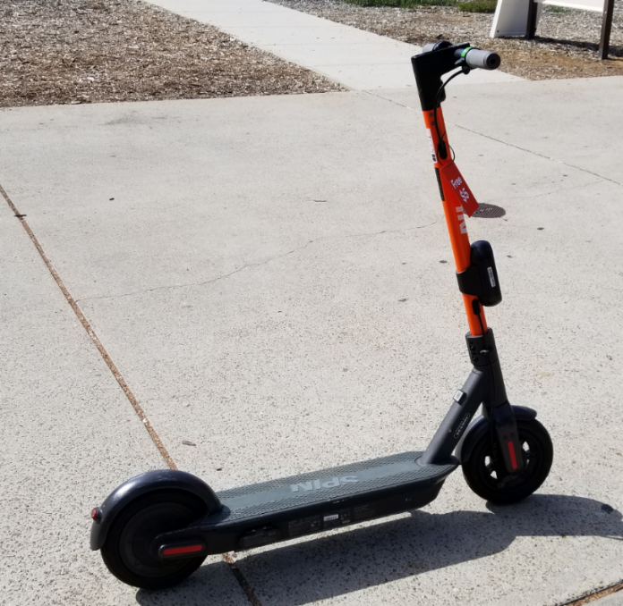
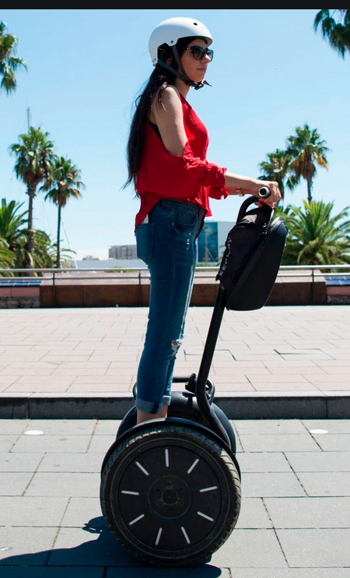
Yield or Not?
Do only carts, bikes, and skateboards need to yield? How about scooters or Segways?
Do you need to revise your category definition to include these?

Slide 46
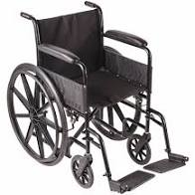
Yield or Not?
If your category is defined by “having wheels” do wheelchairs need to yield to peds?
What is the “category structure” – the way the category is defined?

Slide 47
Interactions –The Why of Organizing Systems
INTERACTIONS include any activity, function, or service supported by or enabled with respect to the resources in a collection or with respect the collection as a whole
The interaction of ACCESS is fundamental in any collection of resources –why would you collect and organize resources you didn’t expect to access in the future?
47

Slide 48
The Most Generic Interactions
Finding a resource that you know exists
Identifying a resource to make sure you have the one you were looking for
Selecting a resource from a set of candidates in a collection
Obtaining the resource if what you have at this point is just a resource description
48

Slide 49
“Why” is much about “Who”
What interactions or services will be supported, and for whom?
Are the uses and users known or unknown?
Are the users primarily people or computational processes?
49

Slide 50
Is “Who” Just You?
Organizing systems that we create for our personal use will naturally embody our individual goals and preferences
But those used by more than one person or for more than one interaction must prioritize the users and the interactions
This means that the organizing system will be more efficient or create more value for some users than for others
STOP AND TALK: Which users and interactions get priority?
50

Slide 51
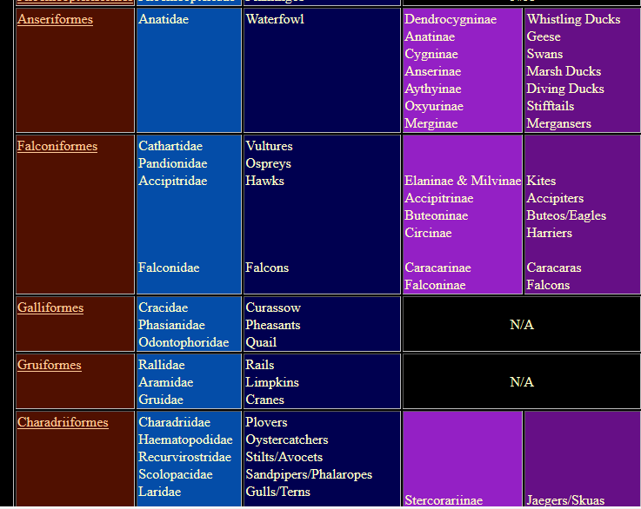
Organizing Birds for Scientists
51

Slide 52
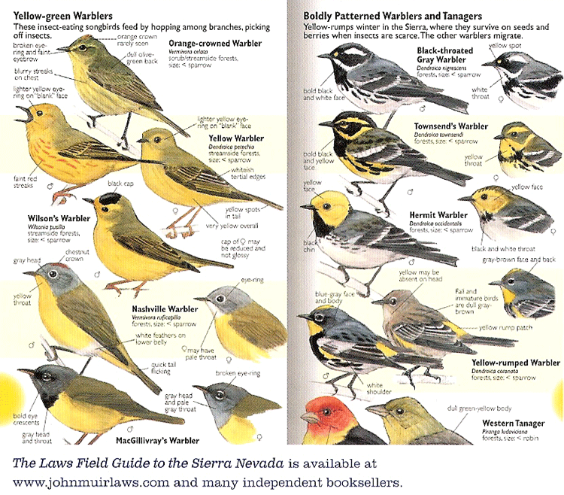
Organizing Birds for Birdwatchers
52

Slide 53
Why => Bias in Organizing Systems
Personal and cultural categories and organizing systems are highly biased
Creating institutional categories using more systematic processes does not prevent them from being biased
Indeed, the goal of institutional categories is often to impose or incentivize biases in interpretation or behavior (deductibility of some types of expenses in the tax code) Other examples?
53

Slide 54
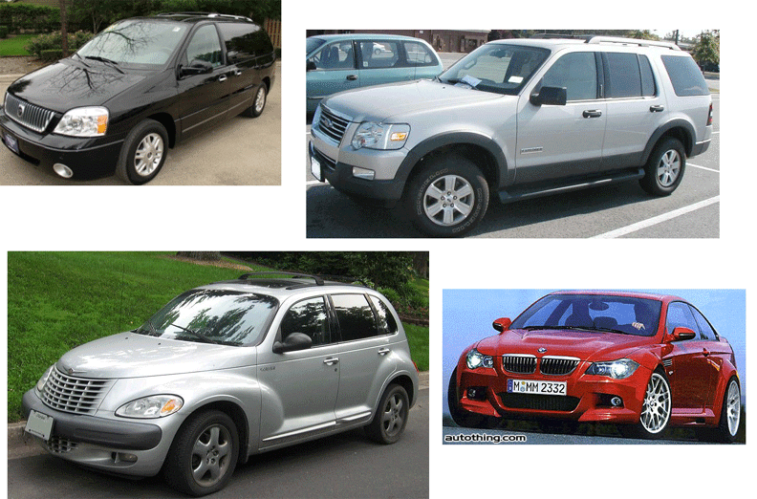
CAFE Categories: Find the Truck(s)
(See sidebar near TDO 7.2.4)
54

Slide 55
Organizing Creates Winners and Losers
Organizing systems embody the priorities and values of those designing them, yielding arrangements and interactions designed to control or change the behaviors of the users
Priority queues
Choice architecture, default values, other aspects of “behavioral economics”
Segregation and discrimination
55

Slide 56
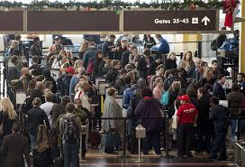
Winners and Losers in Airport Organizing Systems

Slide 57
When Is It Being Organized?
When the resource is created
When it is added to some collection
Just in time when it is about to be used
All the time - continuous or incremental
Never (when would we never organize?)
57

Slide 58
Organizing “On the Way In”
Whenever we select a resource for inclusion in an organizing system, describe it, or arrange it according to an organizing principle, we (should) have an interaction in mind
We include a resource in our system because our users will need it; we assign a resource to one or more categories to help our users find it, understand it, and connect it with other resources in a meaningful way
TDO calls this “organizing on the way in”
58

Slide 59
“Just in Case” Organization
59

Slide 60
Postponing Organization
60

Slide 61
Organizing “On the Way Out”
If a collection of resources isn’t organized to support our desired interactions, computational techniques can re-organize them (if they are digital) or their digital resource descriptions
… by indexing, searching, sorting, transforming, translating, labeling, categorizing, combining, summarizing… (IR, ML, NLP)
This doesn’t always mean that the collection was organized poorly; it might just be organized for different interactions than the ones we want
TDO calls this “organizing on the way out”
61

Slide 62
Who or What Is Organizing?
Authors or creators
Professional organizers
Users “in the wild”
Users "in institutional contexts“
Automated or computerized processes
62

Slide 63
Where is it Organized?
Resources can be organized in physical arrangements that:
enforce efficiency
or reward exploration
Resource arrangements can encourage or discourage interactions between people, to create a sense of freedom, security, or confinement (compare offices, cubicles, open floor plan)
63

Slide 64
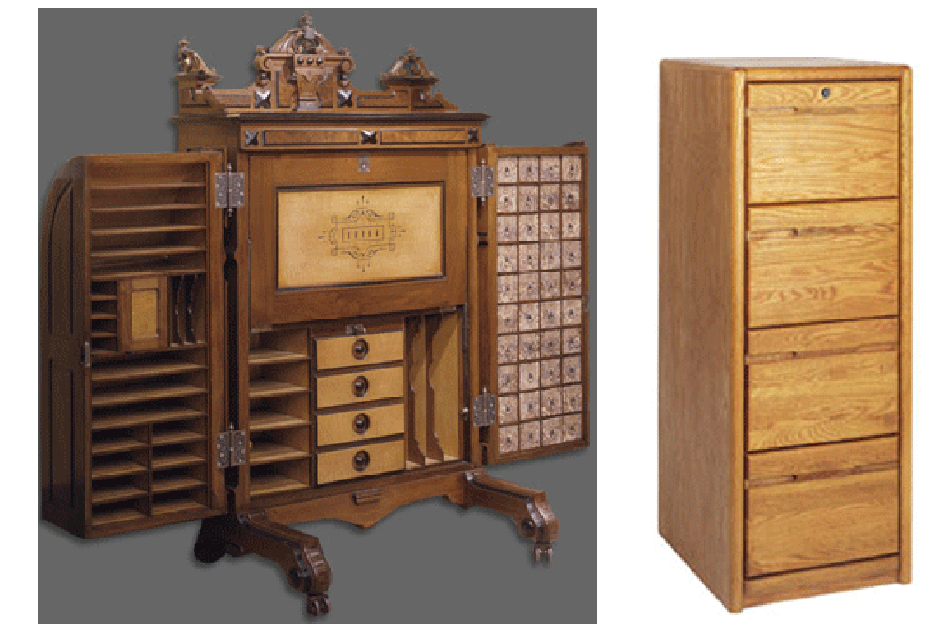
Where is it Organized?
Physical locations can enable or constrain
64

Slide 65
Where Digital Resources Are Organized
For digital resources, where they are organized is often invisible or irrelevant except…
When that would be bad for business
When the law constrains how or what information is organized
65

Slide 66
SUMMARY: The 6 Dimensions of an Organizing System
What Is Being Organized?
Why Is It Being Organized?
How Much Is It Being Organized?
When Is It Being Organized?
Who (or What) is Organizing It?
Where is it Organized?
66

Slide 67
For Next Time
Read some more case studies
Do the homework assignment to practice comparing and contrasting organizing systems in diverse domains
Sign up for “10 minutes Bob Zoom”
67

