Slide 1
CogSci 150 “Sensemaking and Organizing” Spring 2021
Robert J. Glushko glushko@berkeley.edu
26 January 2021
3) Case Studies

Slide 2
Case Studies
1/19
TDO 12.5 Organizing a kitchen
Time Zones
Orchestra Seating Arrangements
1/21
TDO 12.4 Single-source textbook publishing
TDO 12.18 Neuroscience lab
Medical Emergencies
1/26
Organized Crime
NBA Player Tracking
Intentional Communities
Guide Dogs for the Blind
2

Slide 3
Outline
“Single Source Publishing” and TDO
Models for organizing systems
What models, artifacts, or representations best facilitate understanding and interaction?
Small group breakouts to discuss the cases and Assignment 1

Slide 4
Single-Source Textbook Publishing
“Single-source” is a popular slogan in content management. What does it mean?
How is single-source publishing like an automobile assembly line?
When is single-source publishing most necessary and useful?
How does the format and granularity of the source files influence the value of single-sourcing?
4

Slide 5
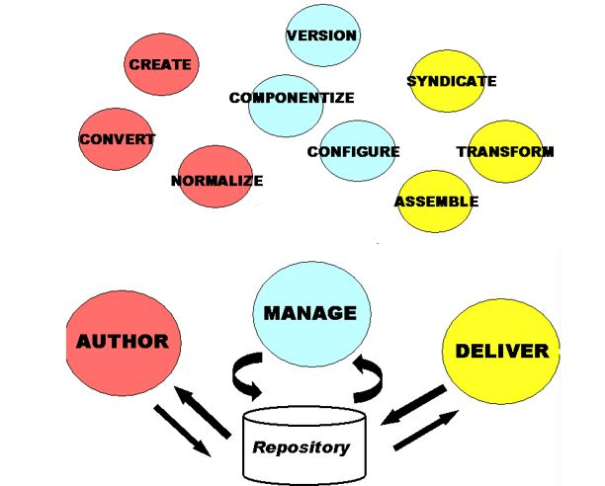
Single-Source Textbook Publishing

Slide 6
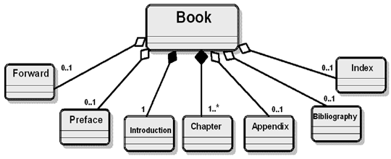
Book Model that Enables Multiple Assemblies

Slide 7
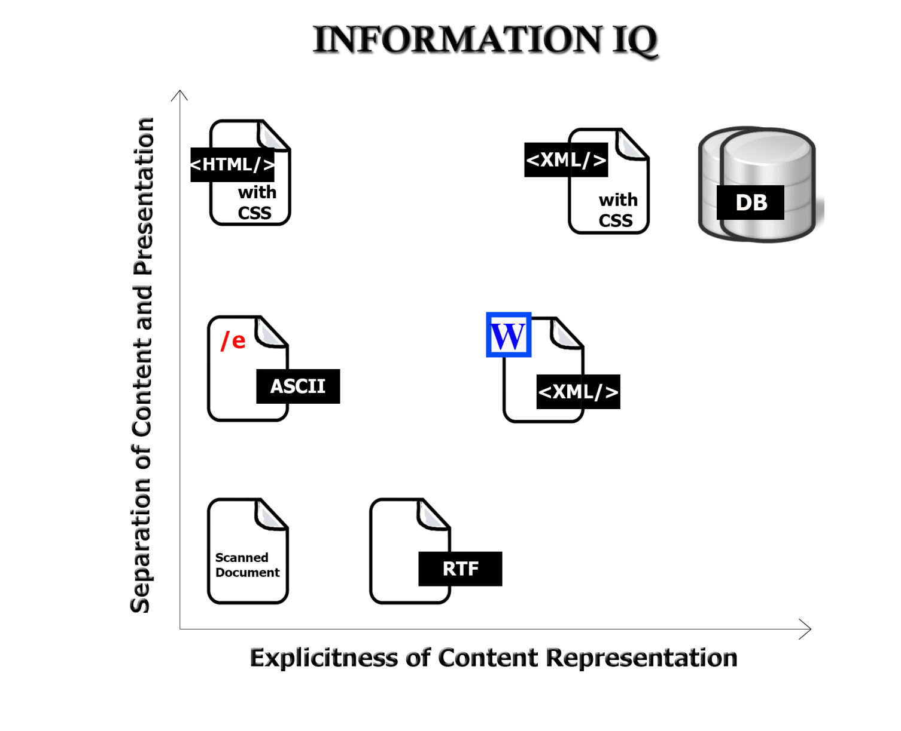
Value Creation with Information Resources
The variety and functions of interactions with digital resources are determined by the amount of structure and semantics represented in their digital encoding, in the descriptions associated with the resources, or by the intelligence of the
computational processes applied to them
7

Slide 8
Say it Again: TDO’s Mantra
Organizing, resource description, and interaction design are inherently interconnected activities

Slide 9
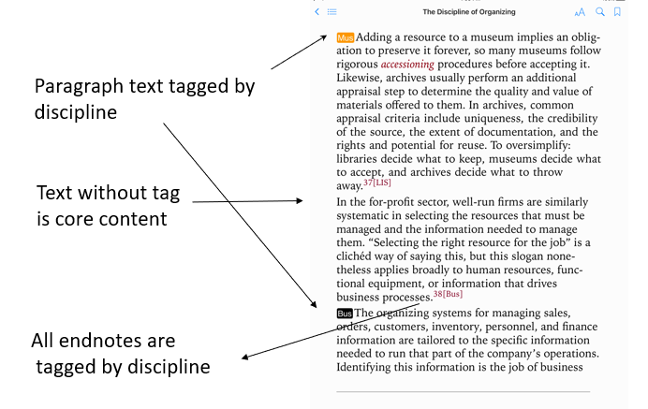
Core and Supplemental Content in TDO eBooks

Slide 10
<phrase audience=“MUS”>Adding a resource</phrase> to a museum implies an obligation to preserve it forever, so many museums follow rigorous <glossterm linkend="gloss_accessioning">accessioning</glossterm> procedures before accepting it. Likewise, archives usually perform an additional <phrase appraisal step</phrase> to determine the quality and value of materials offered to them. </para><para xml:id="para-mnx_4yw_w5" audience="CORE Archives"><phrase role="statement">In archives, common appraisal criteria include uniqueness, the credibility of the source, the extent of documentation, and the rights and potential for reuse.</phrase><phrase role="statement">To oversimplify: libraries decide what to keep, museums decide what to accept, and archives decide what to throw away.</phrase><footnote label="37" xml:id="endnote-037" audience="LIS">

Slide 11
TDO – May 2014
Museums
Library Science
Archives
Cognitive Science
Law
The “Discipline of Organizing” Core
Business
Linguistics
Computer Science
Philosophy
Web Architecture

Slide 12
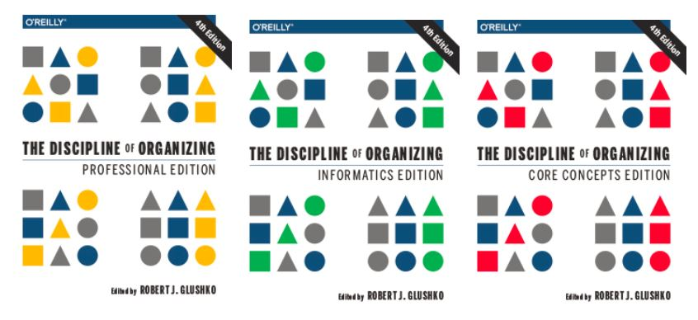
TDO 4nd Edition O’Reilly ebooks (2016)
Contains All Content
Excludes “Memory Institution” Content
Excludes All Discipline-Tagged Content

Slide 13
Models for Organizing Systems

Slide 14
Models for Organizing Systems
Many academic fields – management, operations research, informatics, etc. – provide models for describing organizing systems
These models distinguish and highlight different aspects of the organizing system
They can be thought of as different perspectives or points of view whose effectiveness depends on the nature of the resources and organizing principles in the organizing system
These normative models can be combined, adapted, or otherwise changed to create innovative hybrids that might be better suited for some novel organizing system

Slide 15
Models
Pictorial /Physical / Literal
Schematic / Topological
Functional
Structural
Process
Semantic / Conceptual

Slide 16
Pictorial /Physical / Literal Models
The essence of some organizing systems is the physical arrangement of resources, especially when the physical context controls or constrains interactions with them
A photo conveys a literal description of these types of organizing systems, enabling easy understanding of its layout and scale

Slide 17
Organizing System: Home Kitchen
Photo by Emilie Hardman (http://www.flickr.com/photos/quintanaroo/2741672230//) Used by permission
17

Slide 18
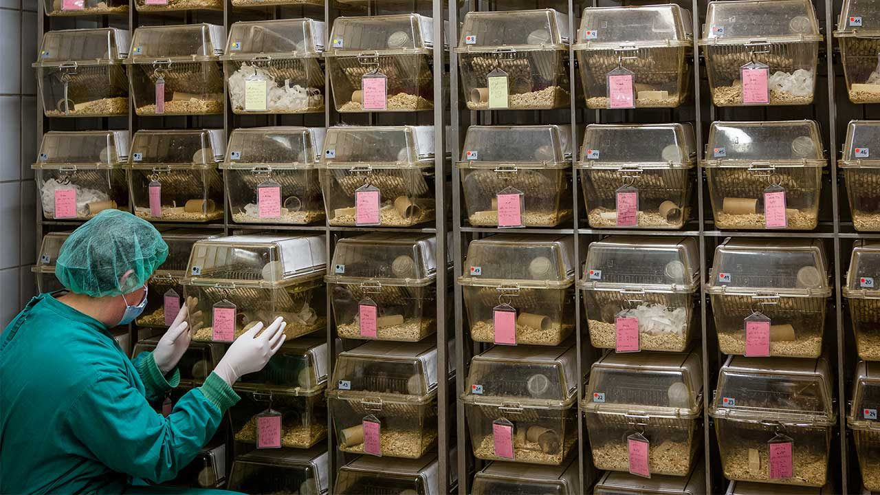
In a Neuroscience Lab, Rats Are Organized
A photo conveys a literal description of the organizing system, emphasizing its layout and scale

Slide 19
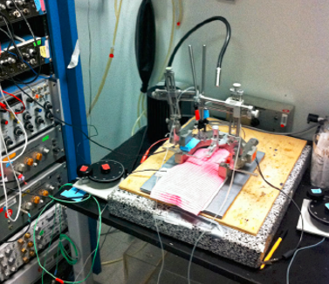
Taskonomic Organization
An array of amplifiers and filters for pro­cessing and recording rats' brain­wave signals (left) is installed in a vertical rack that can be located close to the equipment used to perform surgeries

Slide 20
Stop and Think
Rat resources are initially interchangeable in most respects, but later must be treated as unique resources. Why?

Slide 21
Schematic / Topological
Models
Distinguish the important locations or regions where the resources are arranged
Preserve the important physical characteristics and relationships, but not in a literal/exact way
Often improve comprehensibility by emphasizing interaction or decision points while eliminating irrelevant or distracting detail

Slide 22
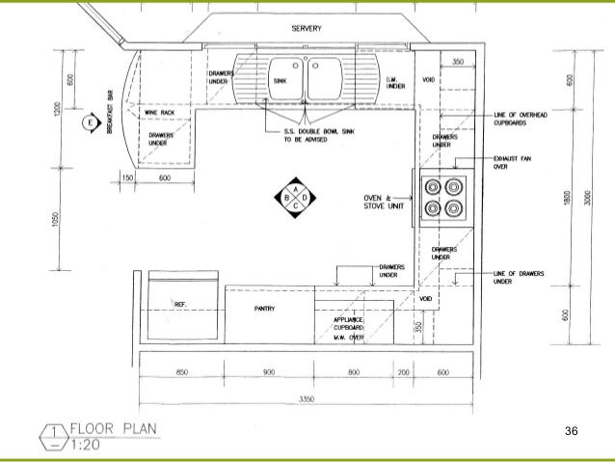
Schematic Representation of a Kitchen

Slide 23
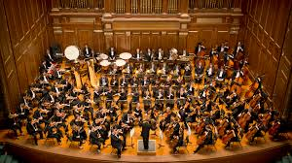
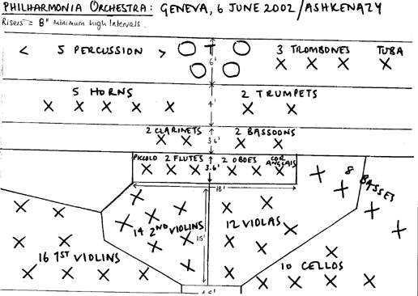
Pictorial
THE ORCHESTRA
Schematic

Slide 24
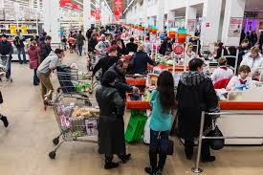
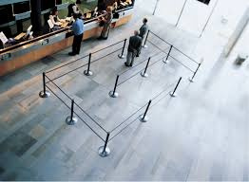
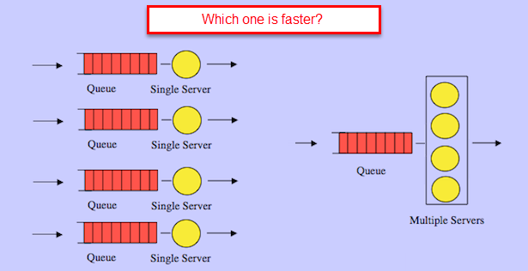
QUEUE LAYOUT Pictorial
Schematic

Slide 25
The BART System Map
In what ways is this map schematic rather than physical or literal?
What are the pros and cons of this design?

Slide 26
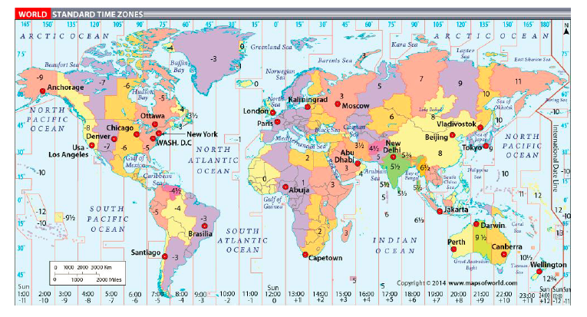
Organizing System: Time Zones
This familiar Mercator cylindrical projection enables “straight line” navigation because N and S are preserved but distorts shapes and sizes toward the N and S poles

Slide 27
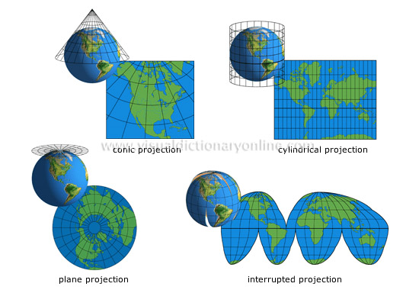
Alternative Map “Projections”
Why is the cylindrical projection the most appropriate for showing time zones?

Slide 28
NBA Player Tracking
Why did sports change from “simple stats” to complex analytics in the last decade? Who uses them?

Slide 29
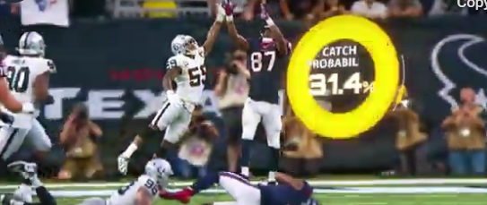
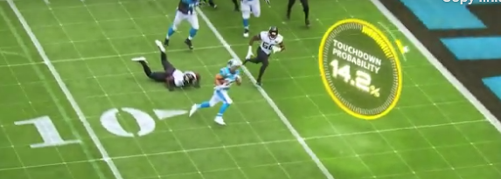
aws.amazon.com/nfl
NFL player tracking, also known as Next Gen Stats, is the capture of real time location data, speed, and acceleration for every player, every play, on every inch of the field. Sensors throughout the stadium track tags placed on players' shoulder pads, charting individual movements within inches.

Slide 30
Stop and Think
What kind of real-time stats about what teachers and student do during a lecture could “Next Gen Zoom” use to improve online instruction?

Slide 31
Functional Models
System described in terms of its functions or component services
Can map directly to the structure of the institution or business that operates the system, or can be more abstract
In information-intensive systems, the functions are expressed as APIs or as information exchanges

Slide 32
Functional Model of a Bank

Slide 33
Spotify API

Slide 34
Structural Models
Emphasize connection relationships within and between resources
Can vary a lot in how abstractly the resources and relationships are represented

Slide 37
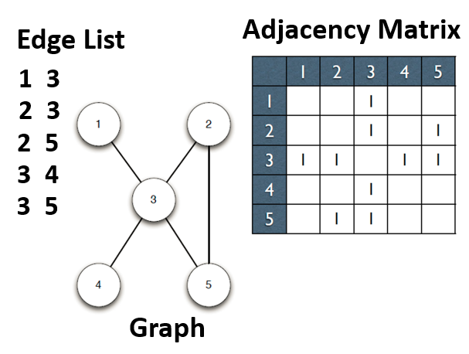
Structural Representations in Graph Theory

Slide 38
Process
Highlight the steps or decision points of value creation, often in temporal sequence
“Service blueprints” are a common framework that combine temporal and architectural perspectives; emphasize the “touch points” where users or customers engage with operators or service providers
Information process models highlight where information flow or computation dictates the change of state

Slide 39
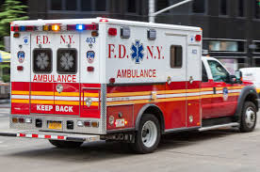
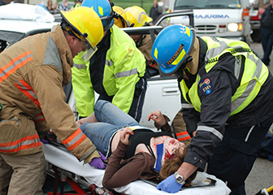
Medical Emergencies

Slide 40
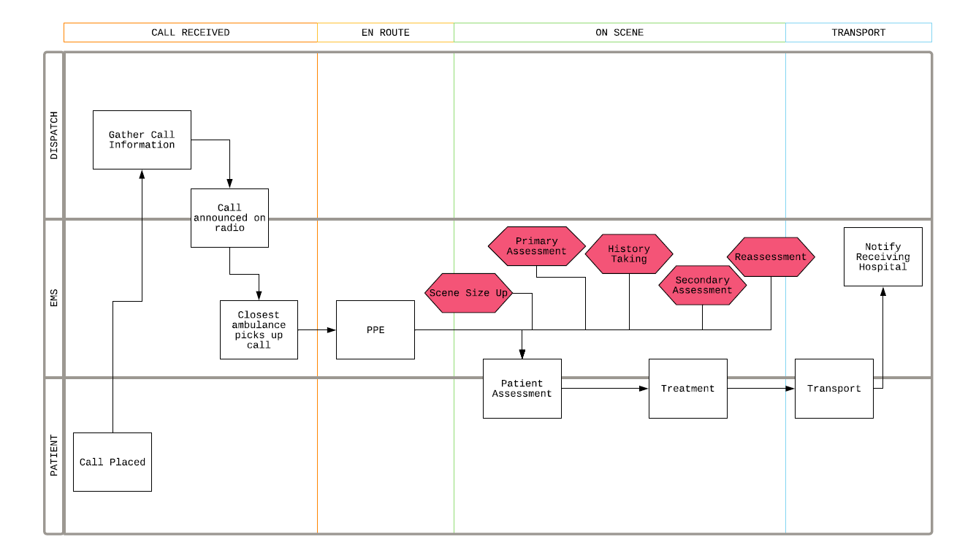
“Service Blueprint” for 911 Medical Emergencies

Slide 41
Stop and Think
How are emergencies classified and how does this determine the use of the EMS resources?
How do standards for resources and processes improve the effectiveness of EMS responses?

Slide 42
Generic Service Blueprint

Slide 43
Service Blueprint for Hotel Stay

Slide 44
Semantic / conceptual
Concept map – emphasizes semantic relationships, often hierarchical
org charts for “human resources”
Compare/contrast 2 or more organizing systems or a system as it changes over time
Decision trees for categorization
Implementation of organizing systems with principles expressed as rules

Slide 45
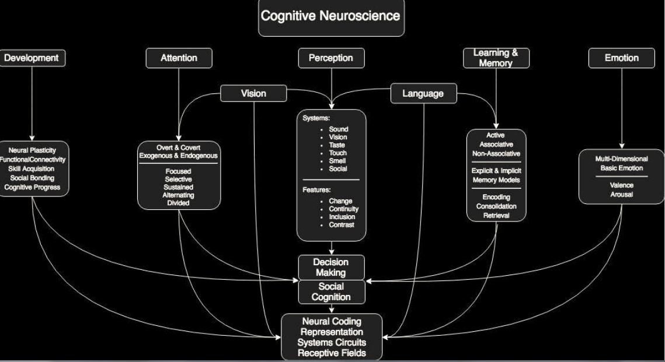

Slide 46
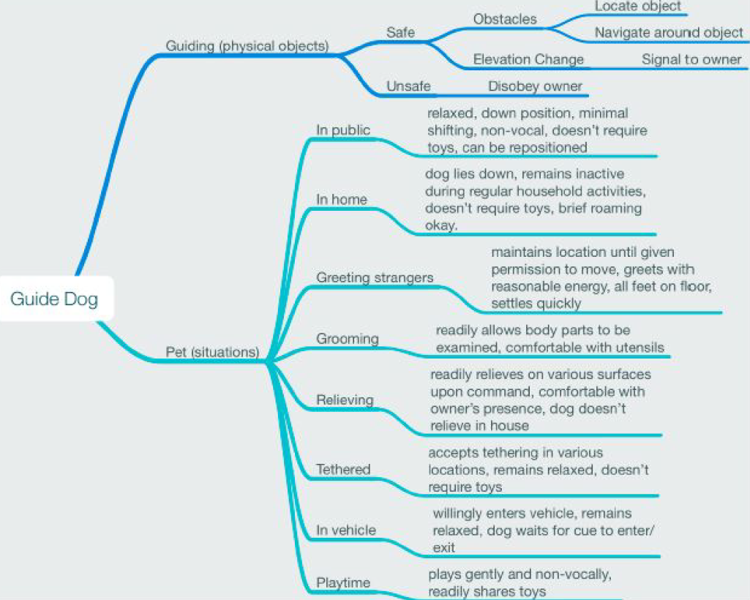

Slide 48
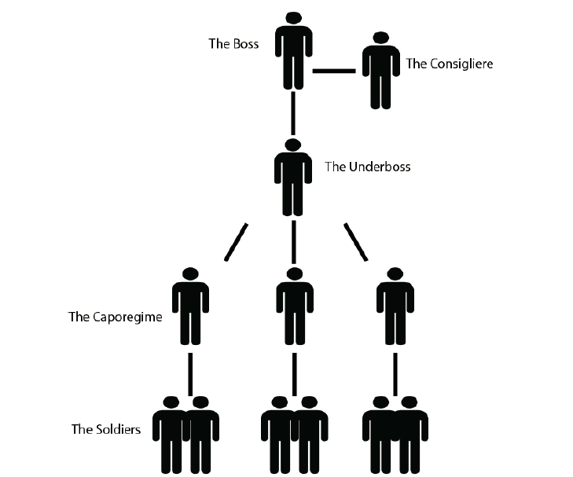
CRIME FAMILY (strong fixed hierarchy)
http://godfather.wikia.com/wiki/Corleone_crime_family

Slide 49
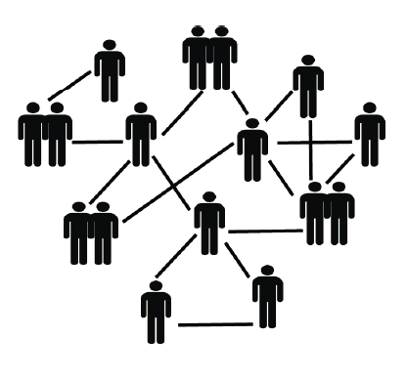
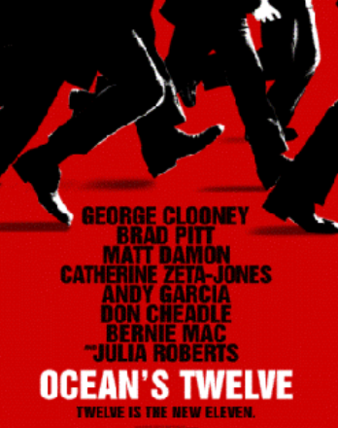
CRIMINAL NETWORK
(ad hoc team selection for each crime)

Slide 50
Document Type Spectrum
Crime Type Spectrum

Slide 51
Which Intentional Community Should You Live In?
Use this decision tree:
https://www.buzzfeed.com/carinasauter/which-intentional-community-should-you-live-in-2q1m9
What is important to you in life?
Where do you want to live?
Which people do you want to live with?
What describes you?

Slide 52
The Evolution of the Diagnostic and Statistical Manual of Mental Disorders
http://www.tiki-toki.com/timeline/entry/749012/An-Overview-of-the-DSM/

Slide 53
Assignment 1 Discussion
Sort the 10 types of resources into resource categories
Find at least three sets of case studies where the same or very similar principles are being applied
In some of the case studies, the type of resource and the context in which they are being organized meant that there were many choices about the organizing principles. In other case studies, the type of resource and the context provided many constraints about the organizing principles. Find at least two case studies of these “choice” and “constraint” situations

Slide 54
Analyzing Organizing Systems
Organizing systems for physical resources often have a lot in common because of the constraints like size, shape, etc that all physical things embody
The scope of an organizing system is always an issue, but sometimes the choice of the “boundaries” of the system are obvious and sometimes there are a great many choices
Sometimes setting the scope can be difficult because there are many other organizing systems in the same or related environment/domain
Some organizing systems can be started small and then incrementally grow in scope and scale. Others must be completely designed before they can be deployed. What is the expected lifetime of the organizing system?
Some organizing systems have very clearly defined users or user types. Others might have much greater variety or much less well-defined user types.
Sometimes users share most of their goals and priorities for interactions, but sometimes they can be in conflict
54

