Slide 1
CogSci 150 “Sensemaking and Organizing” Spring 2021
Robert J. Glushko glushko@berkeley.edu
28 January 2021
4) The Activities of Sensemaking and Organizing

Slide 2
The Activities in Organizing Systems
We can identify four activities in the lifecycle of every organizing system:
Selecting resources
Organizing resources
Designing resource-based interactions and services
Maintaining resources
These are interdependent (remember the mantra?) but we’ll discuss them separately
We often use domain-specific words for these activities
2

Slide 3
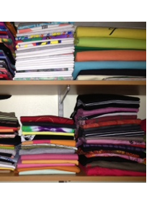
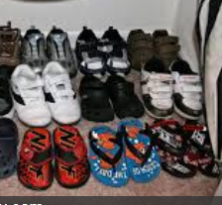
An Organized Closet
3

Slide 4
Activities in a Closet Organizing System…
Selecting: Should I hang up my sweaters in the closet or put them in a drawer?
Organizing: Should I sort my shirts by color, sleeve type, or season?
Supporting Interactions: Do I need separate places for laundry or dry cleaning?
Maintaining: When do I get rid of something?
4

Slide 5
An Organized Data Warehouse
By Hhultgren - Own work, Public Domain, https://commons.wikimedia.org/w/index.php?curid=3552549
5

Slide 6
Activities in a Data Warehouse Organizing System…
Selecting: which data sources should be included? How is their quality assessed?
Organizing: which data formats and schemas will enable effective processing? Are needed transformations made at load time or query time?
Supporting Interactions: what are the most important and frequent queries that need to be pre-configured?
Maintaining: data governance… retention, compliance, privacy issues
6

Slide 7
Selecting Resources

Slide 8
Selecting Resources
SELECTION is the process by which resources are identified, evaluated, and added to a collection
Selection is by definition an intentional process … but this does not mean it is always objective or unbiased
Selection methods and criteria vary across domains (as do the words that describe them)
Some selection methods apply to instances (one-at-a-time), others to resource types
It is essential to have interactions with resources in mind before you choose selectron criteria
8

Slide 9
Typical Selection Criteria
Utility for some specific purpose
Intrinsic value
Scarcity or uniqueness
Newest
To establish a brand or reputation
Conformance to technical specifications
Selection criteria can conflict; you need to prioritize them
9

Slide 10
Selection in Different Domains
Libraries select, collect, organize, conserve, preserve and provide access to information on behalf of a community of users
Museum collections, especially of special or rare items, bring status or prestige whether or not the items have any contemporary use
Hiring decisions are rapidly moving from informal or intuitive criteria to more formal approaches using “predictive analytics” techniques that use information about successful hires to define selection criteria
10

Slide 11
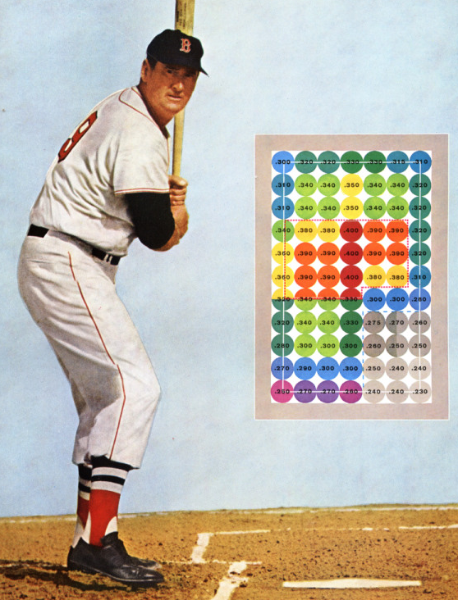
The MoneyBall Effect
Personnel selection is very task dependent and becoming highly data-intensive
STOP AND THINK:
What is the
Moneyball Effect on
{insert some profession or activity here}?
http://www.hardballtimes.com/wp-content/images/tht/williamsgraphic.png

Slide 12
Selection Bias
Organizing systems that we create for our personal use will manifest our individual goals and preferences in how we select resources
Organizing systems used by more than one person will use the selection criteria of the preferred or priority users
Selection can be biased to include or reject (Stanford, Harvard, … vs. SF Academy of Art)
Nepotism, affirmative action, Varsity Blues…
Selection can be “path dependent” and depend on previous selection activities
12

Slide 13
“Path Dependence”
Does the selection principle apply to each candidate resource in isolation?
... or does the selection decision consider the items already in the collection?
... or does the selection decision consider possible future selections?
… or does the selection decision consider selections being made by others?
in what situations does a particular selection preclude another one?
The draft of college athletes by pro teams is a familiar example
13

Slide 14
Upstream and Downstream Selection
Selection based on predictions of future capability or suitability can be thought of as “downstream” selection
But it is also useful to select resources by looking “upstream” and evaluating the people, processes, or systems that create them (the “headwaters”)
Because the quality of these upstream factors determines the quality of the resource
You can’t “test in” quality
It is more effective and efficient to improve quality at the source … this is the basis of the “quality movement”
14

Slide 15
Stop and Think
When universities make admission decisions…
What “downstream” measures do they use?
What “upstream” measures do they use?

Slide 16
Organizing Resources

Slide 17
Organizing Resources
Almost any property of resources can be used to organize them, but the most appropriate or effective properties differ across resource types and tasks
The scope and scale of an organizing system influence/constrain organizing principles and interactions
Decisions about which resource properties will be used in organizing must often precede the creation or selection of the resources
17

Slide 18
Scope and Scale
SCOPE: the breadth and variety of resource types
SCALE: the number of resource instances
Which of these is more important, and why?
18

Slide 19
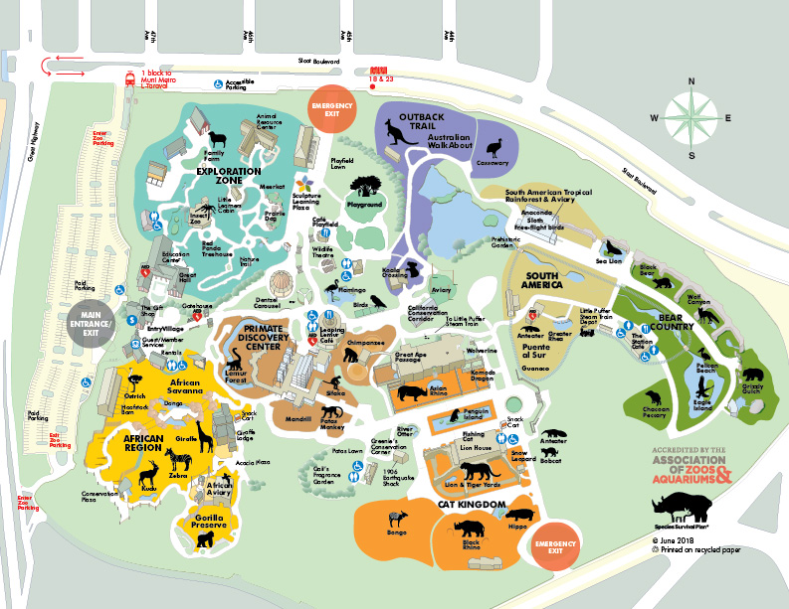
Scope and Scale: Cattle Ranch vs. Zoo
Harris Cattle Ranch Coalinga CA
250,000 cows
400 employees
San Francisco Zoo
2000 animals, 200 species
200 employees

Slide 20
Stop and Think
Why do these organizing systems differ so much in the ratio of employees to animals?

Slide 21
Say it Again: TDO’s Mantra
Organizing, resource description, and interaction design are inherently interconnected activities

Slide 22
Scope and Scale: Tall Data vs. Wide Data
A “tall” dataset might contain many millions or even billions of records, but each has a relatively small number of variables.
A “wide” dataset might have many records, but each record has a large number – hundreds or even thousands - of variables.

Slide 23
Organizing Physical Resources
A physical resource can only be in one place at a time
If its use is predictable, its location can be optimized for that use (“intelligent use of space”)
But what if it is used in more than one place?
Are you are organizing the resources you have, or resources you might have in the future?
23

Slide 24
Mise-en-place
The kitchen organizing system: "put in place”
Advance organization is essential to enable the rapid pace of a restaurant
Ingredients and tools for particular recipes are pre-arranged for efficient cooking and plating
24

Slide 25
Mise-en-place
25

Slide 26
Stop and Talk
What would it mean to “mise en place” your life? How do you decide whether / how much to do it?
Do you judge yourself by the amount of organization in your life? Do you judge others?

Slide 27
Organizing in Physical or Technological Environments
Physical environments create possibilities for organizing and interaction
But there might be constraints that limit them
“Installed base” or “legacy” concerns
27

Slide 28
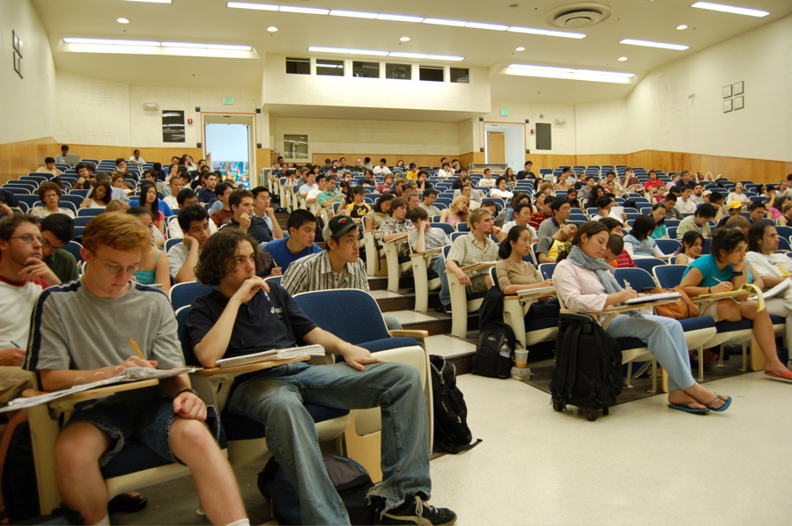
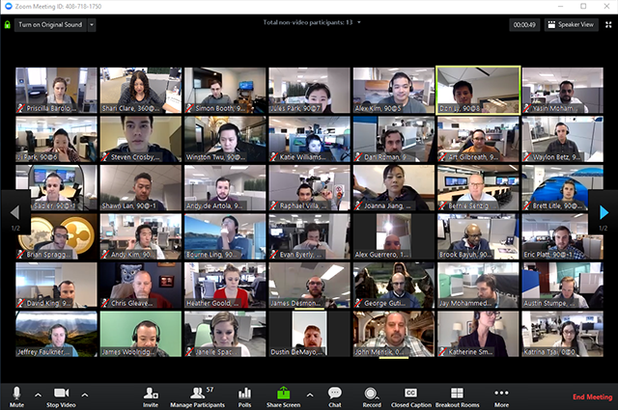
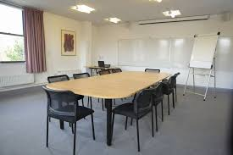
The environment influences the expectations, behavior, and experience of the people who interact with it
28

Slide 29
Be Careful When Selecting Technology
Be careful if you are designing or selecting technology for an organizing system
Avoid resource-specific investments unless absolutely justified
29

Slide 30
How To Be Careful
Estimating the ultimate size of a collection at the beginning of an organizing system’s lifecycle can reduce scaling issues related to storage or interaction space
Invest in flexibility and extensibility
30

Slide 31
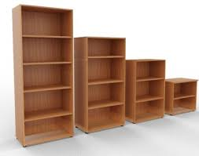
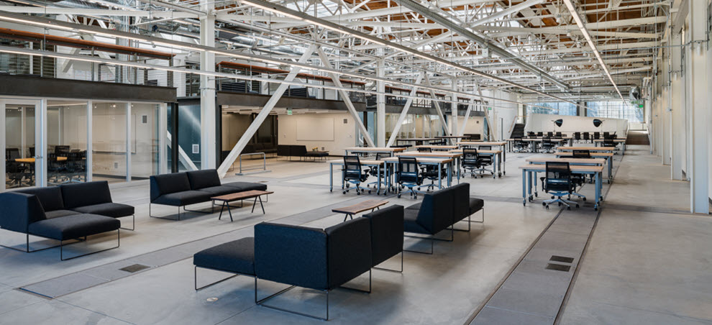
How Big A Bookcase Should You Buy?
How Much Office Space?
Why buy if you can rent or borrow?

Slide 32
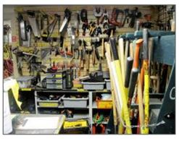
Borrow, Don’t Buy
32

Slide 33
Organizing Digital Resources
Digital resources can be easily duplicated (with perfect copies at almost zero marginal cost) so the “same resource” can be in many places at once
Digital resources that are descriptions of physical resources can be organized more flexibly and efficiently than the resources they describe
33

Slide 34
Designing Interactions with Resources

Slide 35
Requirements for Interactions
All organizing systems have some common interactions, but most of the time we want to pay attention to the more resource-specific interactions that create the most value
The priorities of different interactions are often determined by decisions about intended users
An essential requirement is ensuring that the supported interactions can be discovered and invoked by their intended users (i.e, we need good user interfaces)
35

Slide 36
Interaction and Value Creation
Interactions differ in the absolute and relative amounts of physical manipulation, interpersonal or empathetic contact, and symbolic manipulation or information exchange involved in the interaction
Physical Object Manipulation
Symbolic Manipulation
Interpersonal Interaction
Apte, U. and Mason, R. Global Disaggregation of Information-Intensive Services. Management Science (1995).
36

Slide 37
Value Creation with Physical Resources
Physical manipulation is often the intrinsic type of interaction with physical resources
The resource might have to be handled or directly perceived in order to interact with it
Physical manipulation and interpersonal contact might be required to interact with information resources in physical form like printed books in libraries or music in CDs or albums
What kinds of jobs create value almost entirely through physical interactions with resources?
37

Slide 38
Value Creation with Digital Resources
With digital resources, neither physical manipulation nor interpersonal contact is required for interactions
The essence of the interaction is information exchange or symbolic manipulation of the information contained in the resource
By replacing interactions that involve people and physical resources with symbolic ones, organizing systems can lower their costs without reducing user satisfaction (automation, self-service, outsourcing…)
Digital resource descriptions for information resources can facilitate finding, identifying, selecting, and other “value-creating” interactions even if the resources themselves are not digitized
38

Slide 39
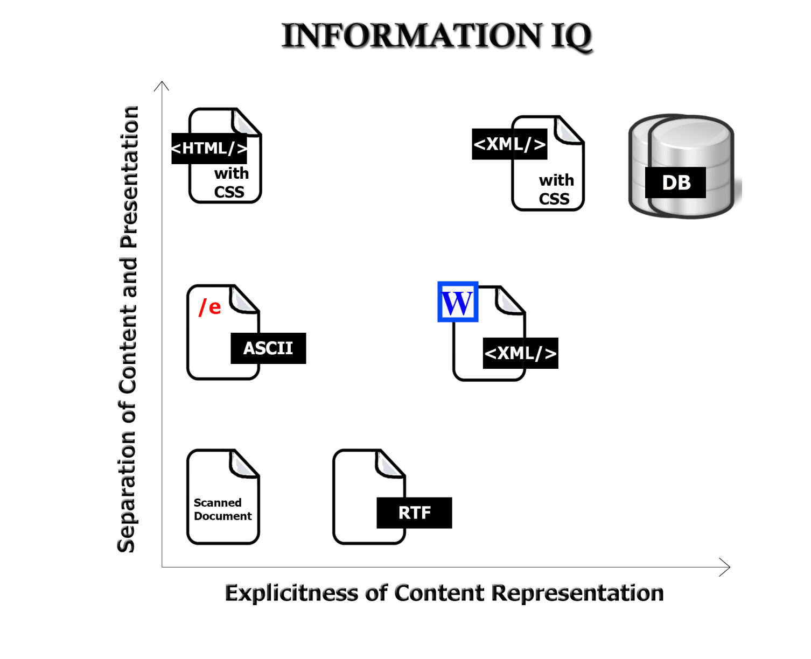
Value Creation with “Smart” Resources
FLASHBACK
The variety and functions of interactions with digital resources are determined by the amount of structure and semantics represented in their digital encoding, in the descriptions associated with the resources, or by the intelligence of the
computational processes applied to them
My first start-up’s value proposition
39

Slide 40
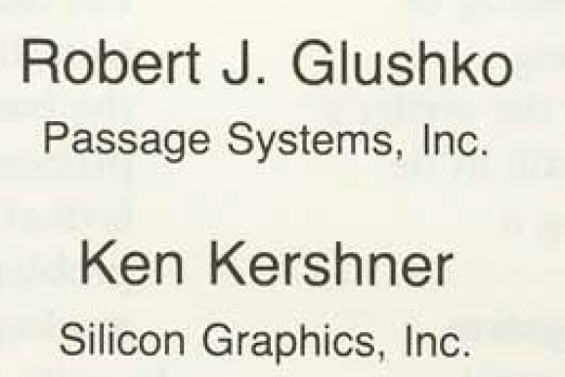

Slide 41
Disaggregation of Symbolic Interaction and Other Impacts of Technology
Information can augment interpersonal and physical interactions
And can also replace them
Robotics,
Remote
manipulation?
Symbolic
Manipulation
(Part 2)
Symbolic Manipulation
(Part 1)
Telepresence?
41

Slide 42
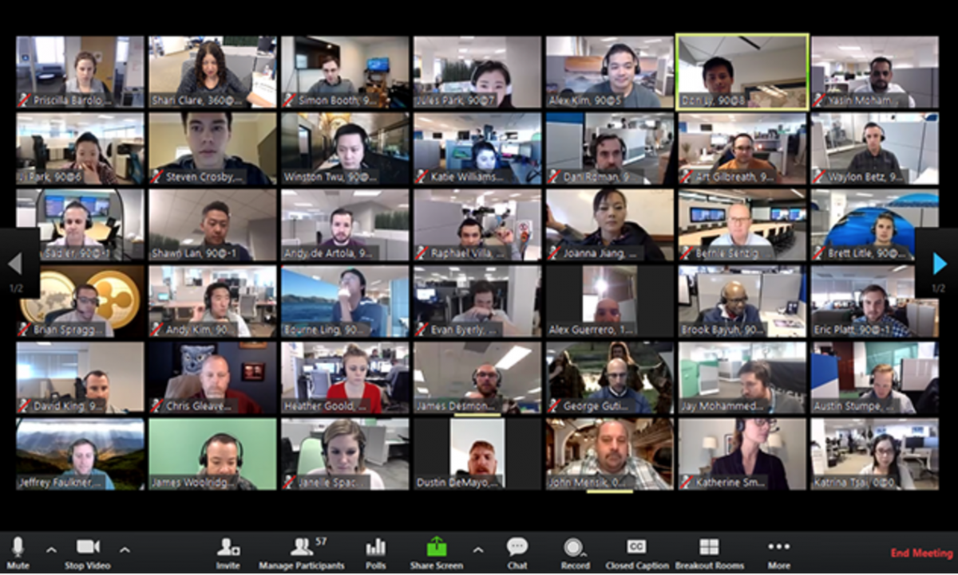
Before “Disaggregation”
After “Disaggregation”
Using Zoom

Slide 43
Maintaining Resources

Slide 44
Resource Preservation as Means vs. End
Organizing Systems
Memory Institutions
Libraries
Museums
Business Info Systems
Content Management
Archives
CRM
ERP
44

Slide 45
Maintaining Resources
Maintaining includes any activity whose purpose is to ensure that a resource will be available at some future time for use or reuse
For many kinds of resources, you need to preserve more than the "primary resource" for it to have future use
Especially true for scientific data, resources collected “by technological means” ; also true of many "cultural heritage" or "natural history" resources
45

Slide 46
Selecting {and,or,vs.} Maintaining
SELECTION is based on some set of implicit or explicit criteria applied to resources
MAINTENANCE activities should be consistent with the selection criteria
More carefully selected resources should be maintained more carefully
46

Slide 47
Organizing {and,or,vs.} Maintaining
How we organize a collection of resources can determine what kinds of maintenance we can do and how hard it is to do it
How well can we anticipate future changes to the collection or the desired interactions?
Designing / organizing for maintainability and extensibility
Resource properties or the intended interactions might change over time
47

Slide 48
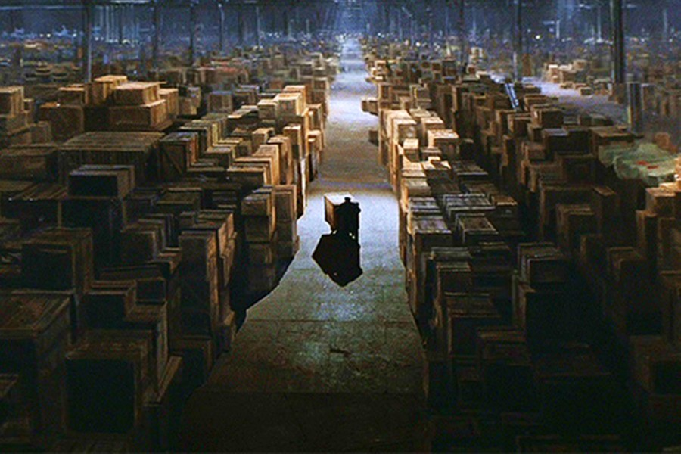
Preservation
Preservation of physical resources requires that they be kept in conditions that prevent their deterioration
It might also include actions to improve access or to restore the resource
B-52 “Boneyard” in Arizona desert
Final scene in ”Raiders of the Lost Ark”
48

Slide 49
Digital Preservation
Preservation of digital copies might seem easier, but other issues arise:
How many copies do we need to ensure preservation?
Do we care about which copy is the original?
How do we prevent or at least detect tampering?
Technological obsolescence of storage media and software requires that preserved digital resources might become inaccessible (compare books on library shelves with files on some storage medium)
49

Slide 50
Stop and Think
Do you have any computers, phones, or storage media on which you can no longer access your information?
Can we always predict the future value or uses of resources?
Why not just preserve anything that MIGHT be valuable or useful in the future if it can’t be replaced?

Slide 51
Preservation (or not) and the Law
Laws requiring it
Sarbanes-Oxley Act – must keep transactional and accounting records to enable traceability
Civil procedure rules for document discovery
Government accountability FOIAs
Laws prohibiting keeping personally identifiable information
HIPPA, FERPA, European “right to be forgotten”
Laws dealing with “failed” preservation
SB 1386 and similar state statues mandating disclosure of data breaches
51

Slide 52
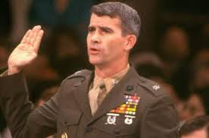
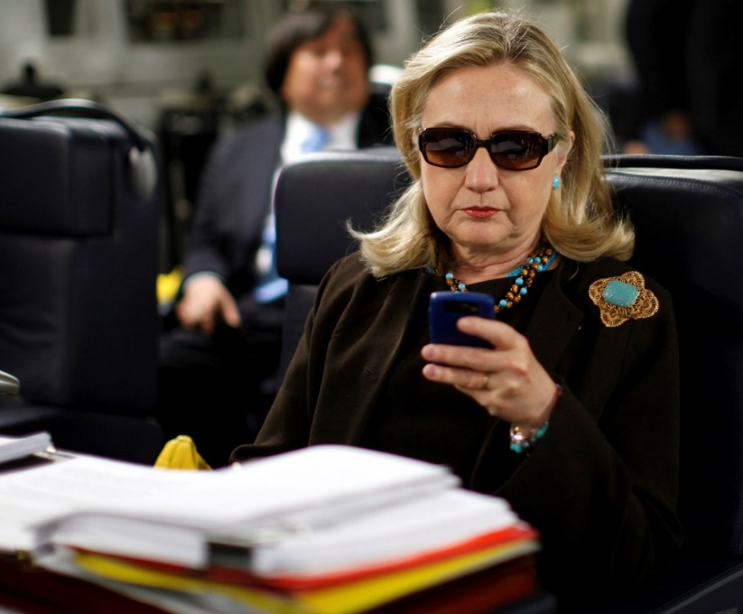
Two (In-)famous Incidents of Not Following the Rules for Information Management and Record-keeping
Oliver North – shredded documents but didn’t realize that his email was backed up
Hillary Clinton – sent messages about classified information on a personal email account

Slide 53
Is A Fish a Document? (1)
John Yates, a commercial fisherman in Florida, was found with red groupers in his catch below the legal size limit. An inspector ordered him to return to port and hand the fish over to the authorities
When he allegedly dumped them overboard instead, he was charged with violating the Sarbanes-Oxley Act, which imposes harsh penalties for destroying “any record, document, or tangible object” to impede a federal investigation
53

Slide 54
Is A Fish a Document? (2)
District court and Court of Appeals said Yates violated Sarbanes-Oxley
The US Supreme Court reversed, ruling in favor of the fisherman (Yates v. United States 2015), finding that “tangible object” must be interpreted in the context of “record” and “document” and, as such, only applies to an object “used to record or preserve information”
54

Slide 55
Curation & Governance (1)
CURATION a common term for maintenance activities in "memory institutions“
It includes work to improve access (through better organization or description) or to restore / transform the resource
Curation decisions are often on an item-by-item basis, or for a set of closely related ones
55

Slide 56
Curation & Governance (2)
GOVERNANCE and Curation overlap, but the former term is more associated with corporate or enterprise data management and focuses more on policy than on process
Governance often has an economic basis or metaphor at its foundation
56

Slide 57
Breakout Discussion about Activities wrt University Courses
How do university students select and organize the courses they take?
What does maintenance mean for the collection of courses?

Slide 58
Course-Related Activities – Student Perspective
What are your most important criteria, in priority order, for choosing which courses to take (in a normal not-zoom semester)?
Are some of these criteria incompatible with each other?
Do all students use the same selection criteria with the same priority?
Is there “path dependence” in your course selection and maintenance?

Slide 59
How does your university select, organize, and maintain the collection of courses it offers?

Slide 60
Course-Related Activities – University Perspective
What criteria do the university or academic departments/programs use to decide which courses to offer in each semester?
What criteria do the university or academic departments/programs use to decide WHEN and WHERE to schedule these courses?
Do any of these criteria conflict with the student criteria?
What kinds of maintenance activities does the university perform wrt offered courses, and why are they necessary?

