Slide 1
CogSci 150 “Sensemaking and Organizing” Spring 2021
Robert J. Glushko glushko@berkeley.edu
4 February 2021
6) Names and Identifiers

Slide 2
Plan for Today’s Lecture
Names – bad ones, good ones, authoritative ones
Special treat for some of you – your first or last names will be examples!
Identifiers
Resources and Identity over time
Breakout Session – Analyzing and Fixing Bad Names and Identifiers
2

Slide 3
STOP AND THINK: Give Me A Name

Slide 4
What is a Name?
A NAME is a label for some thing or some category that is used to distinguish one from another
Many English (sur)names are literally resource descriptions (other languages?)
Occupations: Smith, Miller, Taylor, Wright
Kinship: Johnson, Wilson, Anderson
Appearance: White, Brown, Black
Locations: Bush, Ford, Woods, Hill, Blackburn, Bonnifield, Thames
4

Slide 5
What is a Name?
But most resource names do not convey properties of the resource
If a name is used to refer to some thing and is unique in some context it is an IDENTIFIER
5

Slide 6
Issues with Names and Naming – 1
A specific resource or type or resource can often have multiple SYNONYMS or ALIASES
box, carton
Bob Glushko, Robert J. Glushko, Dr. Bob
Different things can sometimes have the same names -- these are HOMOGRAPHS or POLYSEMES
Bank (money sense), bank (river sense)
John Smith, 张伟(Zhang Wei)
6

Slide 7
Synonyms: What Name Did You Give Me?
Coffee
Cup
Mug
Tasse (if you’re French)
(if you’re Chinese)
杯子

Slide 8
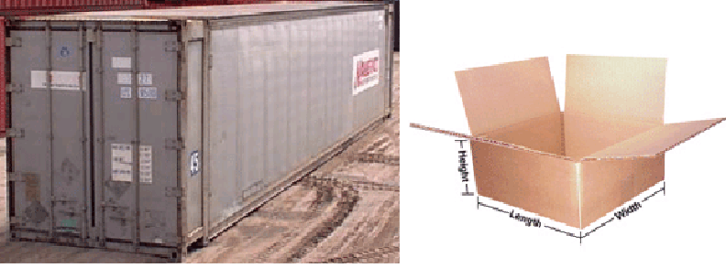
POLYSEMES: Both are “Shipping Containers”
STOP AND THINK: How can you (or some computational process) determine which meaning is intended with polysemous words or phrases?
8

Slide 9
Stop and Think
Why is homonymy a more important concern in naming than synonymy?

Slide 10
The “Vocabulary Problem”
People use a large variety of words for the same thing or concept
Most people - especially system designers - are surprised by this because they think their own word choices are “intuitive” or "natural“
The extreme variability of word selection is an inescapable fact that has its roots in the nature of language and categorization
10

Slide 11
Stop and Think
What are the implications of the vocabulary problem for UI design?
How do you choose names for resources and interactions?
How should you do it?

Slide 12
Issues with Names and Naming – 2
False cognates (GIFT, PAIN)
A name can have undesirable associations
A name can have impermanent attributes or associations or be “faddish” (baby names over time)
Alphabetic ordering bias
Autogenerated names don’t convey any meaning (SCAN0098.JPG)
12

Slide 13
OSHA – In Thai, means “delicious” food “fit for a king”
OSHA, the Occupational Safety and Health Act of 1970, gives employees and their representatives the right to file a complaint and request an OSHA inspection of their workplace if they believe there is a serious hazard

Slide 14
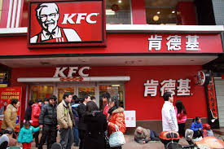
The Most Popular Fast Food Chain in China
A long way from Kentucky, so a name change made sense

Slide 15
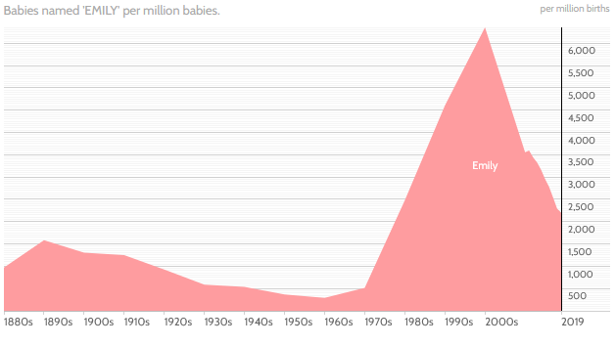
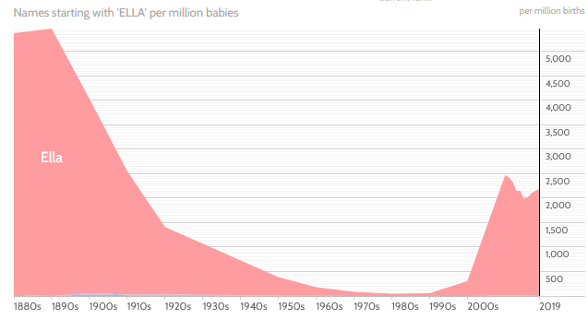
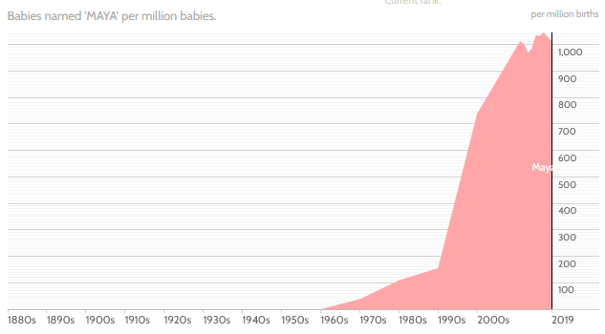
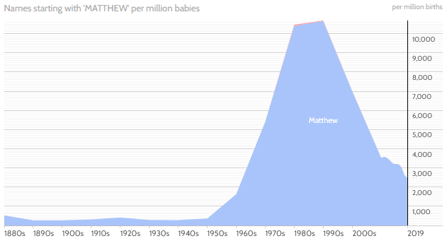
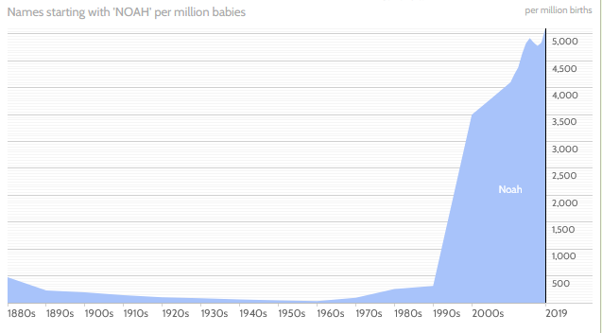
Name Popularity Waxes and Wanes
EMILY
ELLY
MAYA
NOAH
MATTHEW

Slide 16
Jordan (Taylor, Ryan…)

Slide 17
Naming Laws
Many countries (and US states) have laws that restrict the names that can be given to children
José is not recognized as legal in California
Many countries require that names “indicate gender”
Many countries prohibit names that “might offend a reasonable person” or cause trouble for the child (See Sonoran list)
See: Larson, C. F. (2011). Naming Baby: The Constitutional Dimensions of Parental Naming Rights. Geo. Wash. L. Rev., 80, 159.

Slide 18
“China Lucky Numbers” for Air Travel (Wikipedia)
Air Canada route, Shanghai to Toronto: Flight AC88
KLM route, Hong Kong to Amsterdam: Flight KL888
Etihad Airways route, Abu Dhabi to Beijing then onwards to Nagoya: Flight EY888
United Airlines, Beijing to San Francisco: Flight UA888, and the route from Beijing to Newark is Flight UA88
Air Astana, Beijing to Almaty: Flight KC888
British Airways, Chengdu to London: Flight BA88
Cathay Pacific's from Hong Kong to Vancouver and New York is CX888
18

Slide 19
Variant Forms of Names
A generic problem in resource description is dealing with variant name forms
Same person (or resource) uses or is given different names
Many of you use nicknames, or used to
Different people (or resources) use the same name
19

Slide 20
Naming the Same Song via “Crowdsourcing”
Hemerly 2011
20

Slide 21
Different Forms of “Same” Author Name
From an old version of Bowker’s Books in Print
21

Slide 22
Same Name for Different Authors
22

Slide 23
Questions about Names
How many names should be associated with an information object or resource?
Should one be designated as the preferred or authoritative form? Who decides?
What references should be made from other possible forms of names that haven't been used? Should you autocorrect/coerce?
if you have a common last name, should you give your kids a rare first name?
23

Slide 24
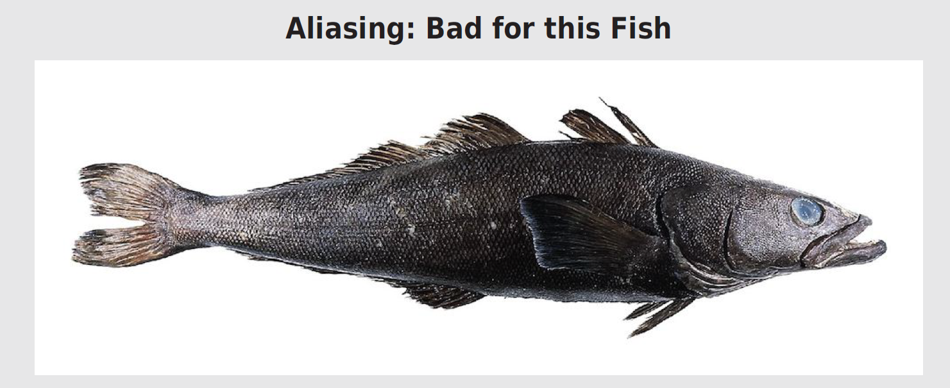
This is a Patagonian Toothfish; they happily swam in Antarctic waters because they are ugly even though they are tasty
An enterprising seafood wholesaler started marketing it as “Chilean Sea Bass” even thought it not found near Chile and is not a bass
This alias led to overfishing; fortunately, most “Chilean Sea Bass” is now farmed; it wasn’t easy

Slide 25
Normative Forms of Names
When names appear in multiple forms, one form needs to be chosen; criteria include:
Fullness (e.g., full names vs. initials only)
Language of the name
Spelling (choose predominant form)
Entry element
"Smith, John" not "John Smith"
"Mao Zedong" or "Zedong, Mao" or "Mao Tse Tung" or ?
25

Slide 26
Authority Control
Authority control is concerned with creation and maintenance of a set of terms that have been chosen as the standard representatives for some resource based on some set of rules
The Library of Congress maintains an "authority file" for the names of persons, corporate entities, geographic names of political entities, and titles of works
See http://www.loc.gov/marc/uma/ and http://authorities.loc.gov/
26

Slide 27
Naming Problems for Places
Variant forms: St. Petersburg, Санкт Пербургскйй, Saint-Pétersbourg
Multiple names: Cluj, in Romania / Roumania / Rumania, is also called Klausenburg and Kolozsvar
Name changes: Bombay -> Mumbai.
Homographs: Alexandria, Vienna, Washington are common
Anachronisms: No Germany before 1870
Vague, e.g. Midwest, Silicon Valley
Unstable boundaries: 19th century Poland; Balkans; USSR, Ukraine
27

Slide 28
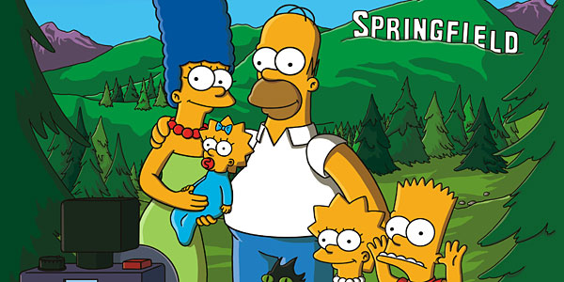
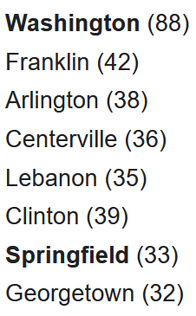
There are over 100 places called “Springfield” in the US, Canada, Australia, the UK, and elsewhere, but this one is more famous
CITY NAMES IN US

Slide 29
Authoritative Place Names
Places have latitude and longitude coordinates, so we can link places and spaces with a GAZETTEER
A gazetteer is a place name authority file that:
Indicates what kind of place it is
Objectively specifies latitude and longitude
Disambiguates similar place names
Brings variant names together
Allows places to be displayed on maps
29

Slide 30
The Name Matching Problem
Name matching" is the task of determining when two different strings denote the same person, object, or other named entity
This problem has many other names:
Co-reference resolution
Duplicate detection
De-duplication
Record linkage
Object consolidation
Merge-purge
Householding
Fuzzy/approximate matching
30

Slide 31
Stop and Think
List all the identifiers that have been assigned to you
If you can’t think of at least 5, try harder

Slide 32
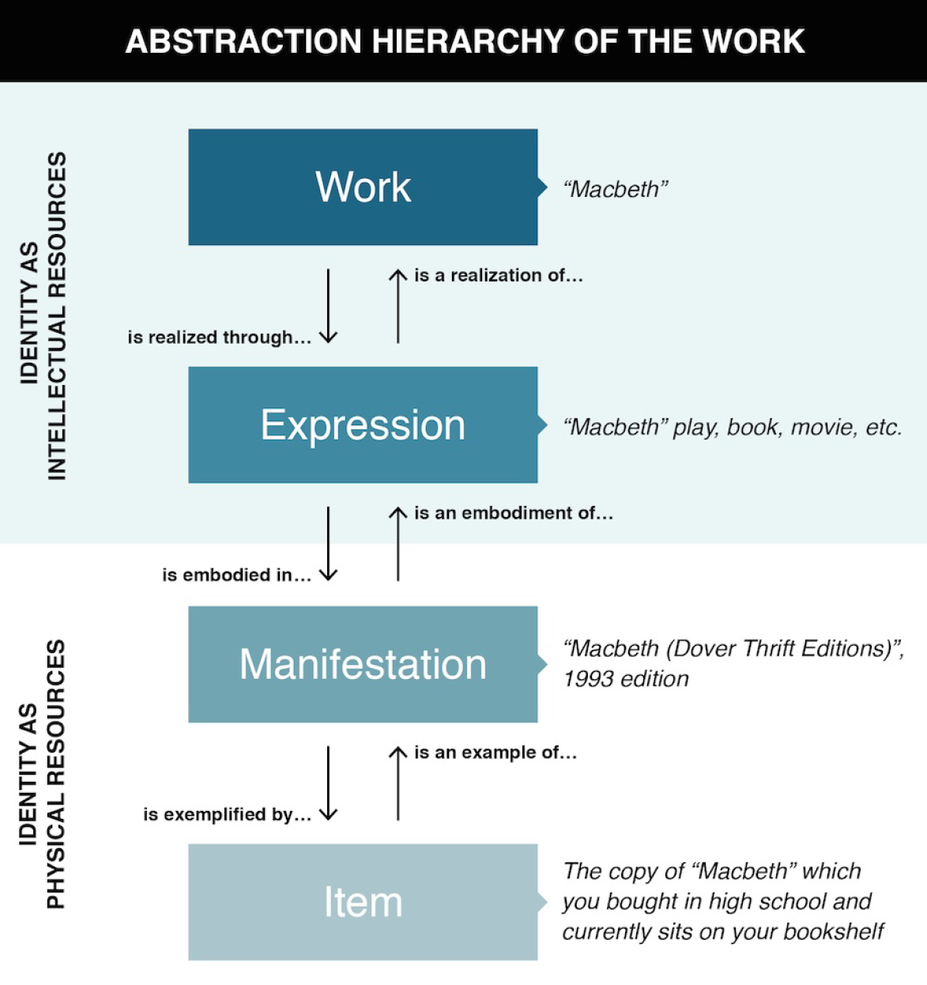
The Identity of Information Resources is an important issue in Library and Information Science
There are three kinds of “Joints” that distinguish the members of an “intellectual category”

Slide 33
Identifiers - 2
Identifiers are UNIQUE if they refer to one and only one resource within some defined context or scope
Identifiers are PERSISTENT if they resolve to the same referent indefinitely, or as long as needed; but persistence is a function of organizations, not technology
33

Slide 34
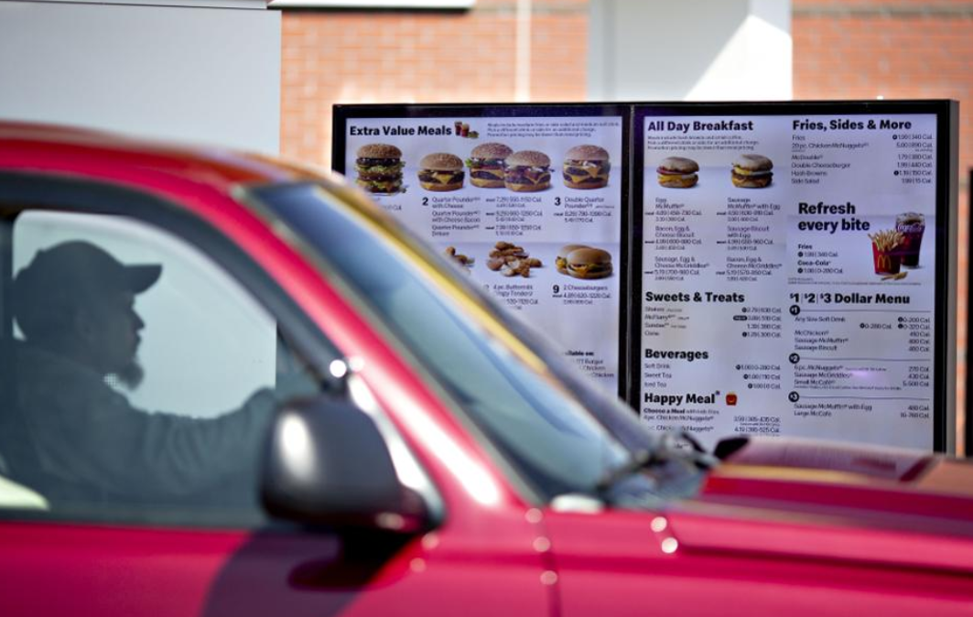
License Plate as Customer Identifier
McDonald’s has been trialing the use of license plates of customers in the drive-thru to identify repeat customers. The driver’s buying history is used to create a personalized menu

Slide 35
Identifiers - 3
Identifiers are UNSTRUCTURED or DUMB (as opposed to STRUCTURED or INTELLIGENT ) if they have no inherent meaning based on their values
Identifier schemes are designed to be STRUCTURED or INTELLIGENT but over time they often become less so
35

Slide 36
ISBN on Bar Code
Publisher
Title
Check Digit
36

Slide 37
Location Identifiers
“Geocoding” identifiers that highly-structured can be used to specify a location
37.871432,-122.258499
What3words case study
My office: (flash.overworked.processes)
Metric distance from town center in France
Addresses in Japan identify buildings by subdividing land into smaller units as needed based on population density
37

Slide 38
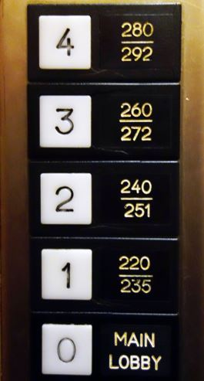
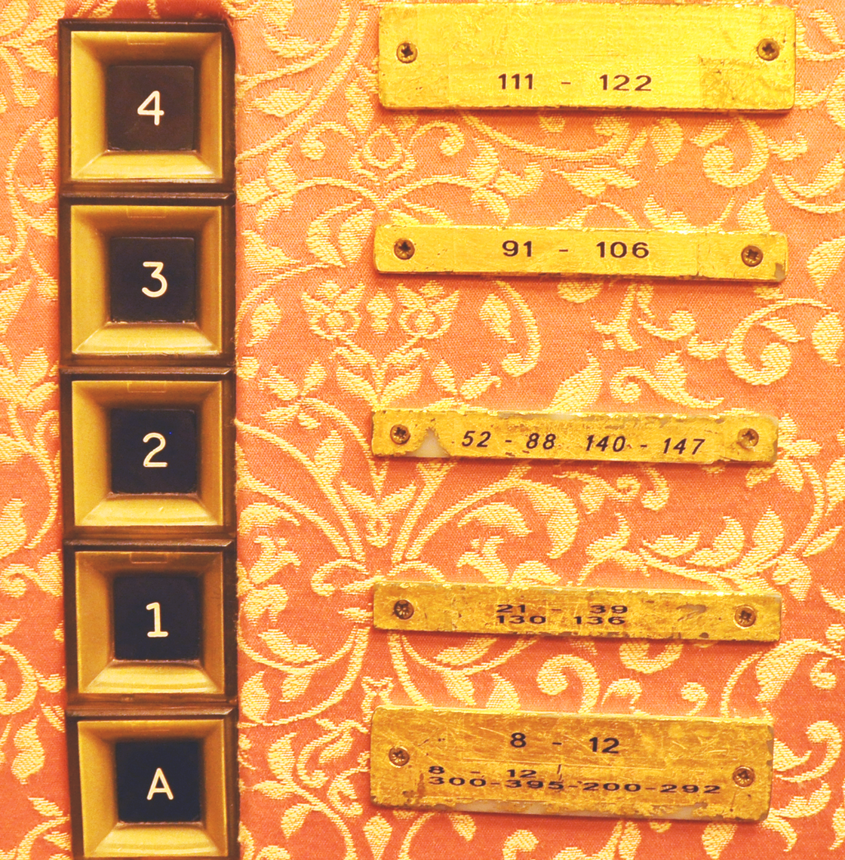
Bad Identifiers for Hotel Rooms: WHY?

Slide 39
Resources and Identity Over Time
Organizing systems continually need to adapt and evolve in response to changes in content and context
New resources are created or added, and other ones are destroyed or culled
Resources might change in controlled ways or in uncontrolled ways
The organizing system might need automated or formal mechanisms for ensuring persistence and authenticity
39

Slide 40
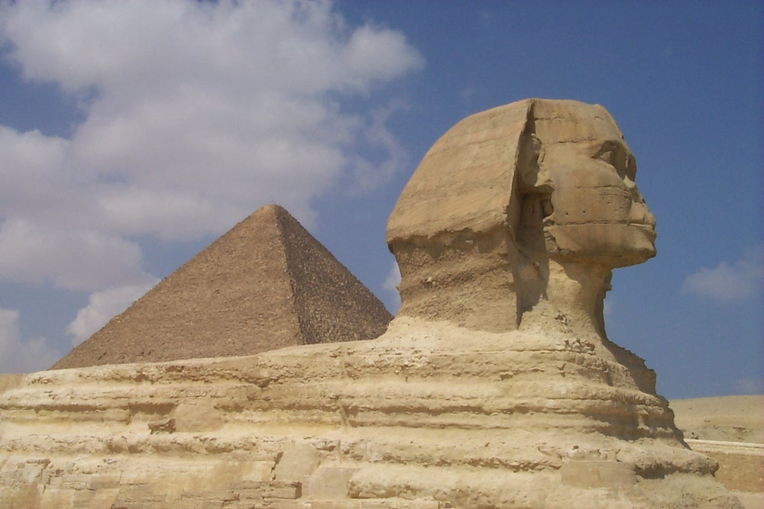
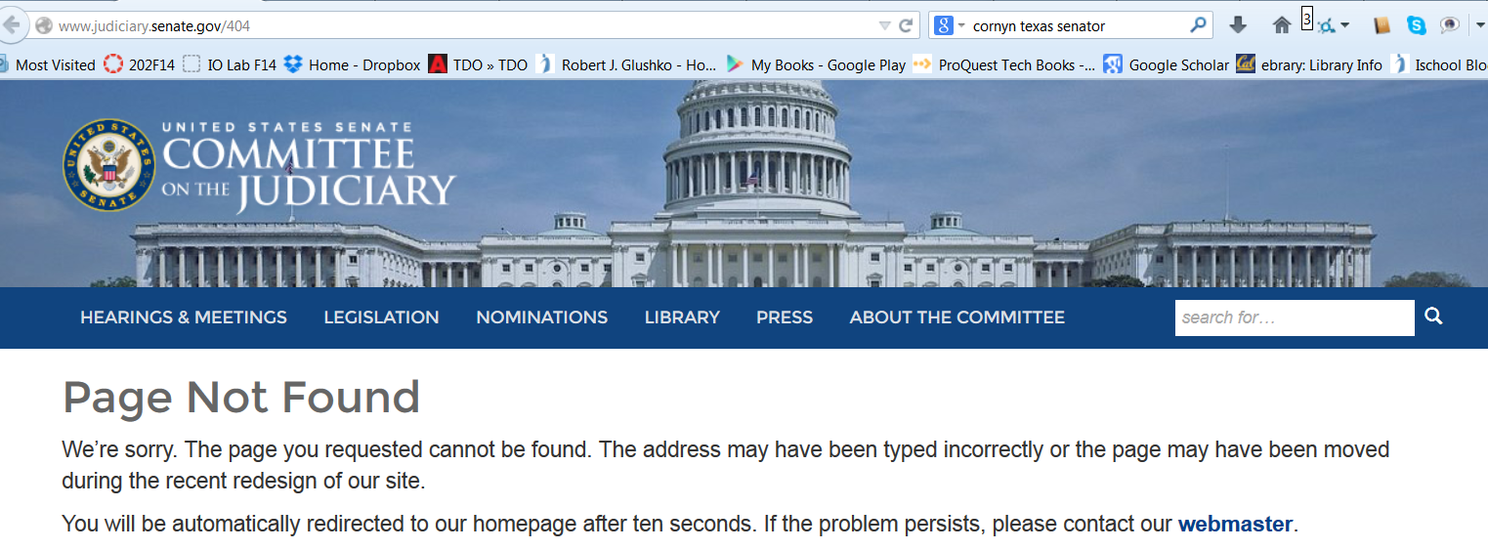
Persistence
40

Slide 41
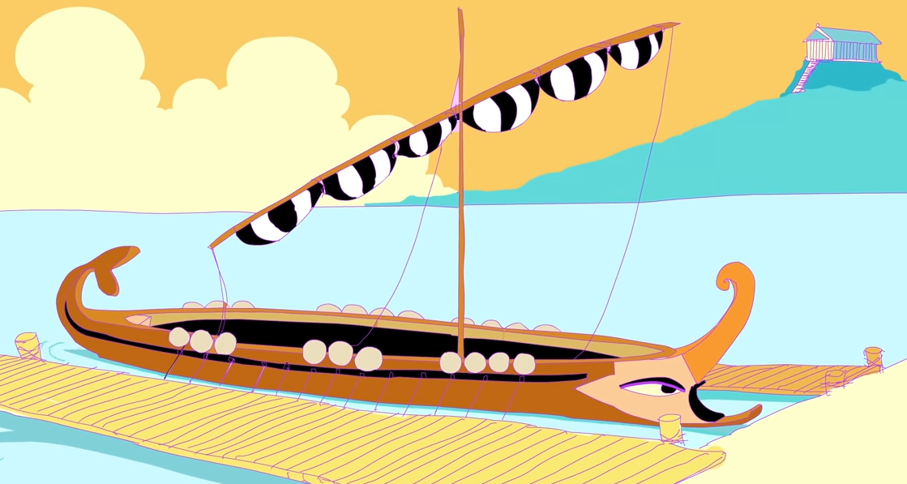
The Paradox of Theseus (1900 years old)
How or whether identity persists over time is a very deep and old question
“The ship wherein Theseus and the youth of Athens returned had thirty oars, and was preserved by the Athenians… they took away the old planks as they decayed, putting in new and stronger timber in their place.
This ship became a standing example among the philosophers, for the logical question of things that grow; one side holding that the ship remained the same, and the other contending that it was not the same”

Slide 42
STOP AND THINK: Who Am I?
Which you is “who”? The person you are today? Five years ago? Who you’ll be in fifty years?
And when is “am”? This week? Today? This hour? This second?
And which aspect of you is “I”? Are you your physical body? Your thoughts and feelings? Your actions?

Slide 43
Authenticity
Buy an autographed photo from Ustar.net and get a Certificate of Authenticity
Or make your own cert?
Famous Forged Documents
Famous Forged {paintings, sculptures, signatures,…}
43

Slide 44
Authenticity in a Digital Environment – 1
We often use judgments about the physical integrity of recorded information to stand in for a judgment about the integrity of the text
Digital resources have no independent physical manifestations or indications of usage that can provide evidence "about their fate in the world”
44

Slide 45
Authenticity in a Digital Environment – 2
The "permeability" of digital environments makes it harder to ensure that resources have not been altered
Scholars trust technological solutions like time stamps. encryption, watermarks, and digital signatures; technologists are skeptical of them
In the digital world selecting for preservation has become a process of constant re-selection
45

Slide 46
Provenance
46

Slide 47
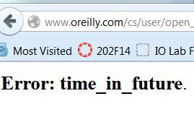
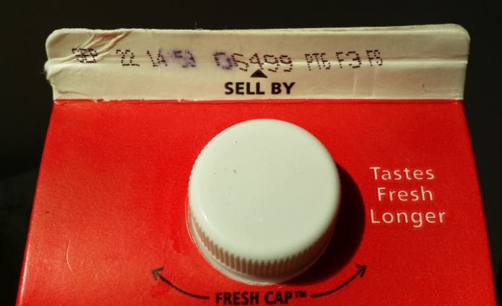
Effectivity
SEC. 108. This title shall take effect on the first day of the sixth month which begins after the date of the enactment of this title, except that the amendments regarding sections 19(b)(7) and 19(b)(8)(D) of the Federal Reserve Act shall take effect on the date of enactment of this title.
(From US Code of Federal Regulations)
47

Slide 48
Putting them all Together
TDO Figure 3.6
48

Slide 49
Breakout Discussions about Names and Identifiers
BART station names
Dwinelle Hall

Slide 50
BART System Map

Slide 51
Bad BART
The station list is organized according to the single principle of alphabetical order of the station names. This principle is not very effective in helping people who are not very familiar with the Bay Area (tourists or newcomers) to find the appropriate origin and destination station. What specific problems with the station naming scheme that undermine the usability of the station list?
How could you change the rules for naming stations to make alphabetical ordering a more effective organizing principle in the station list? Devise some examples of “before” and “after” names that follow your revised naming rules

Slide 52
BART Station List

Slide 53
Bad Identifiers: Dwinelle Hall, UC Berkeley
There are some stories about why the floors and rooms in Dwinelle Hall have their identifiers, but that’s not the question here.
What are the principles for assigning identifiers to rooms and floors?
What problems do these principles create?
What arguments would you make for fixing the problems with a new organizing system?
What arguments would you make for leaving things as they are?
e) If you were designing a new organizing system for Dwinelle, what principles would you use to identify floors and rooms?

Slide 54
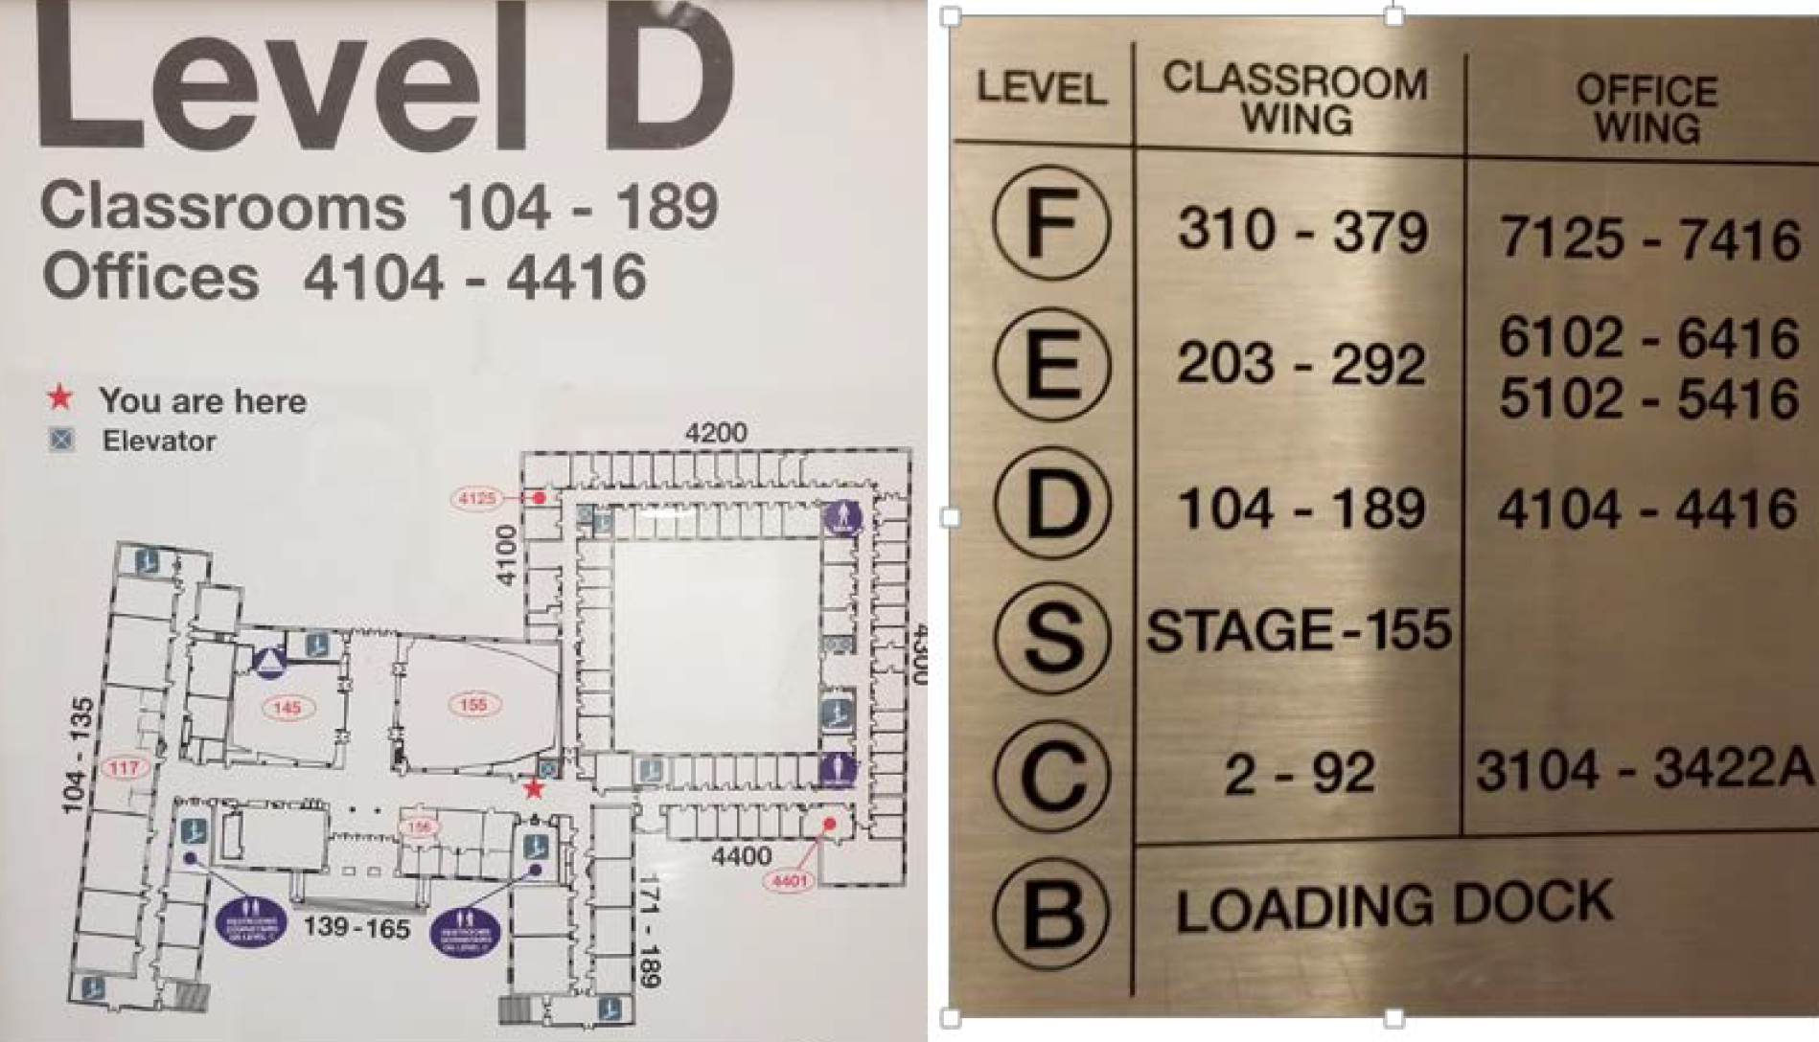
Bad Identifiers: Dwinelle Hall, UC Berkeley

