Slide 1
CogSci 150
“Sensemaking and Organizing”
Spring 2021
Robert J. Glushko
glushko@berkeley.edu
9 February 2021
7) Resource Description

Slide 2

Agenda
What is a resource description?
Why do we describe resources?
Why I despise and banish the term “Metadata”
Exercise To “Identify Descriptive Properties”
TDO 5.3 “The Process of Describing Resources”
A framework for generating resource properties
2

Slide 3
What is a Resource Description?
Information that is created intentionally and associated with a resource to enable it to be organized and interacted with (TDO)
  Flashback: An ORGANIZING SYSTEM is an intentionally arranged collection of resources and the interactions they support
3

Slide 4
Why We Describe Resources
We describe resources so we can refer to them, select them, organize them, interact with them (sometimes to compare them), and maintain them
  (TDO Ch 3 “Activities in Organizing Systems” – 1/28)
Different activities with resources imply different descriptions and different methods of using them
Resource domains can have characteristic or standard resource descriptions that are applied to every resource instance (often called “schemas” or “domain-specific languages”) and in doing so define resource categories
  (TDO Ch 7 “Categorization” – 2/23)
4

Slide 5
Describing Resources <=> Organizing
Resource description and organizing are intrinsically connected
You can’t organize what you haven’t described implicitly or explicitly... because the principles embodied in any organizing system reflect decisions about:
  resource granularity (WHAT to organize)
  resource descriptions (HOW to organize)

Slide 6
Organizing Principles <=>
Resource Descriptions
Frequency of Use <=> Usage information
Color, shape, size… <=> Physical properties
Alphabetical order <=> Sortable resource name or identifier
Chronological order <=> Sortable date/time of important event
Semantic <=> Content description

Slide 7
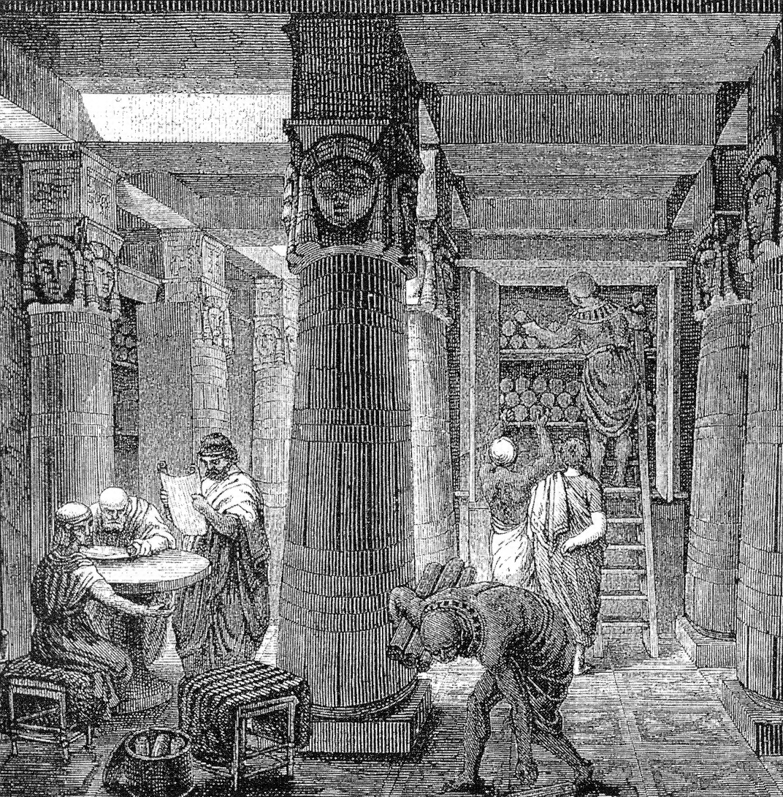
The First Resource Descriptions
The Library of Alexandria had 500,000 papyrus scrolls stored on shelves according to their topic
Starting in 3rd century BCE, each shelf had an associated painted tablet with a list of the titles and authors of the scrolls it contained (these were called pinakes - (pee-na-kays)

Slide 8
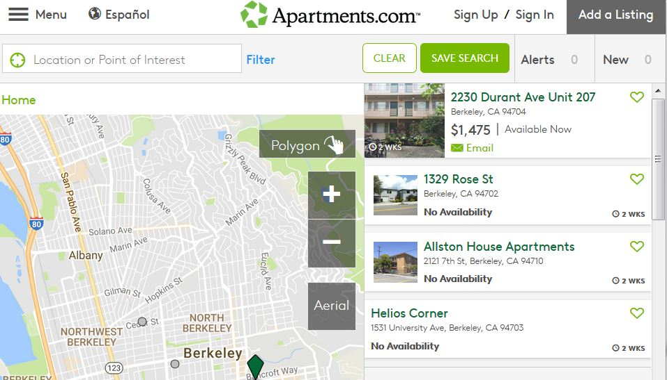
Resource Descriptions as Substitutes
A resource description (e.g., in a library catalog or search engine) is a functional substitute for the resource it describes
Digital descriptions of physical resources enable interactions that are otherwise inefficient or impossible
8

Slide 9
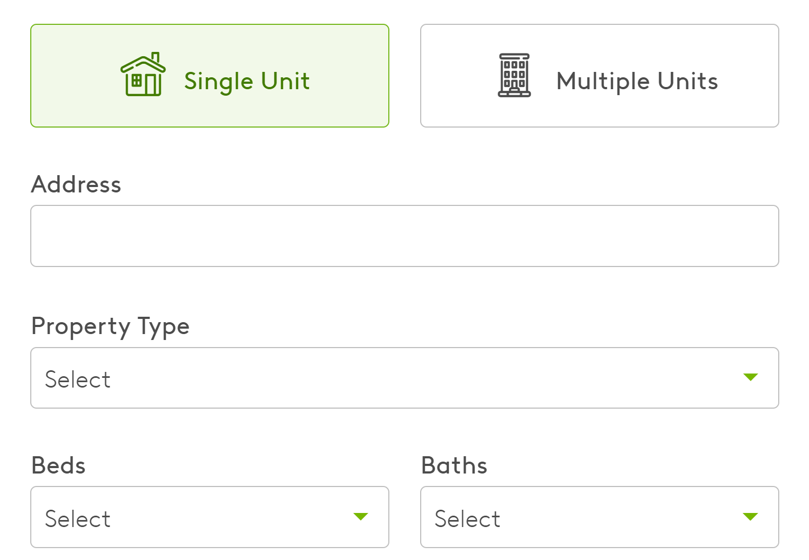
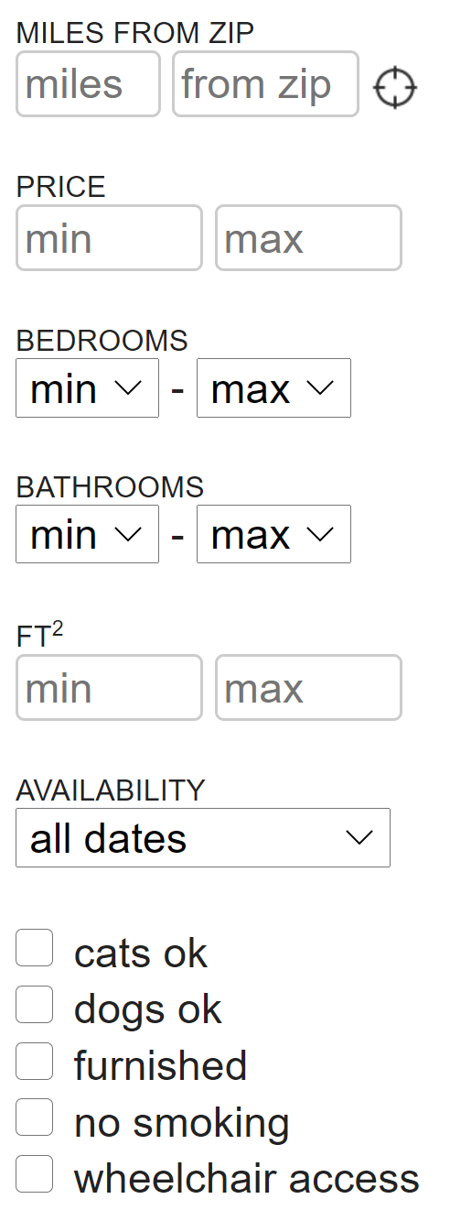
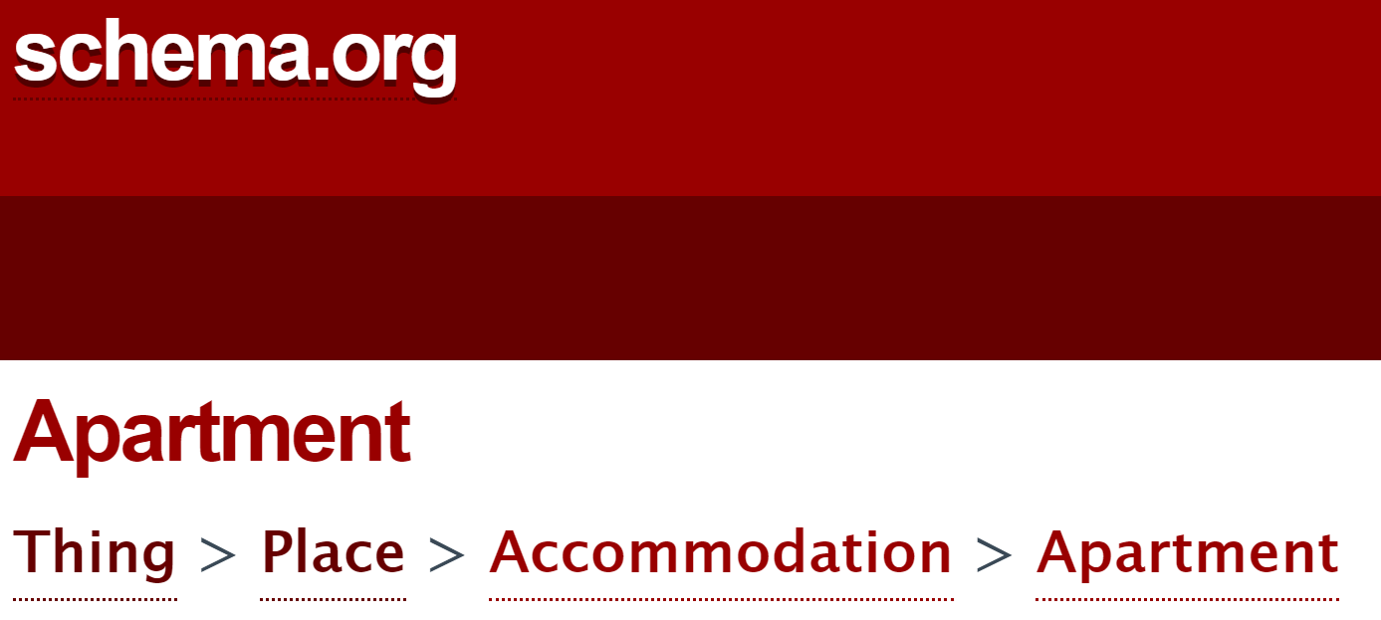
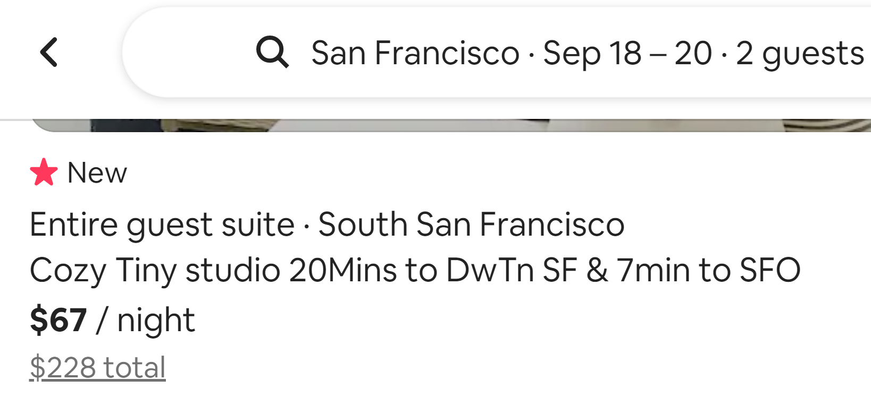
Substitution Requires a “Reasonably Standard”
Description of Instances (a “Schema”)
CRAIGSLIST
APARTMENTS.COM
AIRBNB
9

Slide 10
Preview: Document Analysis
& Document Engineering
A document schema is a specification of the category of resources/events/processes that some set of documents describes
DOCUMENT ANALYSIS is the process of extracting the content components from the structural and presentational components in a document
DOCUMENT ENGINEERING is the process of analyzing the sets of content components taken from a collection of documents, consolidating and organizing them, and then creating a document schema that can be used to enable interactions as required
On 2/11 you’ll learn how to do this (for Assignment 3)
10

Slide 11
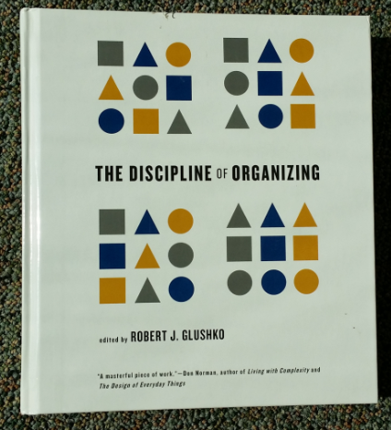
Describing the Same Resource for Different Purposes => Different Schemas
<Book>
<Title>The Discipline of Organizing</Title>
<Editor>Robert J. Glushko</Editor>
<Publisher>MIT Press</Publisher>
<PublicationDate>2013</PublicationDate>
<ISBN>978-0-262-51850</ISBN>
<Keyword>Classification</Keyword>
<Keyword>Resource Description</Keyword>
</Book>
<Book>
<Title>The Discipline of Organizing</Title>
<Weight unit=“pound”>2.58</Weight>
<Height unit=“inch”>9.25</Height>
<Width unit=“inch”>8.25</Width>
<Pages>540</Pages>
<SpineColor>White</SpineColor>
</Book>
11
(TDO 1st edition was available in print)

Slide 12
Resource Focus
In the bibliographic domain the resource vs. description distinction is deeply embedded:
  The books on the library shelves vs. the catalog
In other domains it can be quite arbitrary, and "focus" is an important decision; the same resource can be the primary focus, or a description resource associated with another one that is the primary focus
12

Slide 13
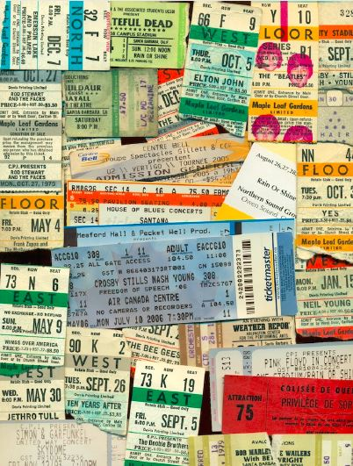
Concert Ticket:
A Resource Composed of Resource Descriptions
The distinction between resource and resource description is sometimes subtle and arbitrary
13

Slide 14
STOP AND THINK: Resource Focus
Other domains where what might look like resource descriptions are treated as primary resources:
  Fantasy sports
  Hashtags, likes, followers, retweets, etc. on social media
In long documents resource descriptions are often aggregated as “finding aids”
  Headings -> table of contents
  Sorted descriptive keywords -> index

Slide 15


Slide 16
Structured descriptions of (information) resources are often called “metadata” (“data about data”)
But unless the resource being described is a collection of data, it is factually wrong
Any resource can have associated descriptions, not just information resources, and the descriptions don’t need to be “data”
The most valuable descriptions are about human resources (i.e., people)
And what’s “metadata” for you might be “data” for me, or vice versa (“Resource Focus”)
16

Slide 17
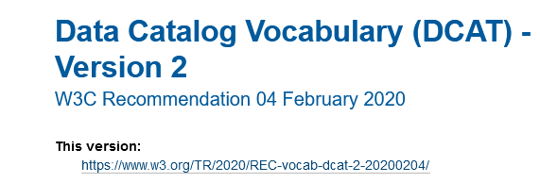
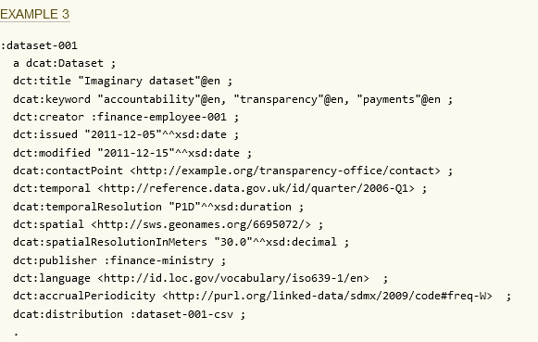
It is OK to say “Metadata” when describing data

Slide 18

But Not When Describing this Resource
Something of value that can be identified and that supports goal-directed activity (TDO 1.3)

Slide 19
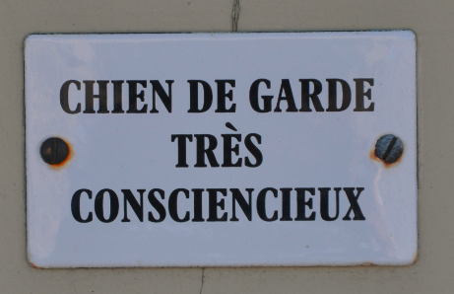
Two Resource Descriptions:
Metadog, not Metadata
dans Les Baux-de-Provence, 8 Août 2013

Slide 20



Icons and Signs as Descriptions of Businesses
These are resource descriptions, but they aren’t
“data about data” in any sense of “data”

Slide 21
Descriptions of “Human Resources” (People)
A great deal of data is collected about people anytime they use the Internet, a cell phone, a credit card, or otherwise interact with systems, sensors, or devices that can collect information about them
These resource descriptions are used computationally to make predictions about beliefs and behavior, and to actively try to change them
  They determine whether to give you credit, to hire / fire / promote you, to arrest / sentence you, to change your diet or exercise routine, or which resources to show you on Google, Facebook, Twitter, Amazon, dating sites, etc.
21

Slide 22


NSA & Govt Tell You “It’s Only the Metadata …. Don’t Worry”
After Edward Snowden in 2013 leaked NSA documents about the NSA’s collection of everyone’s phone call “metadata” we were told it wasn’t surveillance:
Senator Dianne Feinstein, the chair of the Senate intelligence committee: "The call-records program is not surveillance. It does not collect the CONTENT of any communication names or locations. The NSA only collects the type of information found on a telephone bill: phone numbers of calls placed and received, the time of the calls and duration."

Slide 23

Thanks, Dianne for Reassuring Us
Leaked NSA document says metadata collection is one of agency's 'most useful tools'
A leaked NSA newsletter published Wednesday highlights the collection of phone metadata as one of the agency's "most useful tools. The document says that the NSA has used metadata such as numbers called, IP addresses, and call duration to yield "concrete results," such as the capture of terror suspects Khalid Sheikh Mohammed and Abu Zubaida.
https://www.businessinsider.com/nsa-document-metadata-2016-12
FLASHBACK TO “RESOURCE FOCUS” – phone company metadata is NSA data

Slide 24
STOP AND THINK: Describing Yourself
What are the 2 or 3 most important resource descriptions in each context?
  Applying to college
  Applying for a job
  Looking for someone to date
  Looking for a roommate
  Applying for a loan or financial aid
Who / what determines the importance?
What other “contexts of description” have you been in?
How many different descriptions have been assigned to you?
https://www.theguardian.com/commentisfree/2018/mar/28/all-the-data-facebook-google-has-on-you-privacy

Slide 25
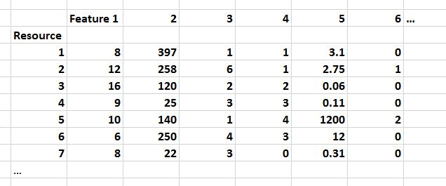
In data science, resource descriptions are typically called “properties” or “features” in a dataset like this…
If you’re given this data set and told to analyze it,
what questions should you ask?

Slide 26
The Wrong Questions To Ask
Will my model be used to predict feature values for new instances, or will it be used to classify them?
What Python library seems like the best fit for the structure of the dataset and the type of model?
Unfortunately, this slide is not a joke; I’ve heard both answers many times
Prediction and classification are important cognitive activities, but when WE do them, we make use of detailed knowledge about resource instances and categories; software doesn’t!
We understand our cognitive “dataset” – we aren’t just feeding some unknown data to some data-hungry software to see what patterns it discovers.
Don’t just “Feed Python”

Slide 27
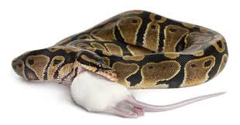
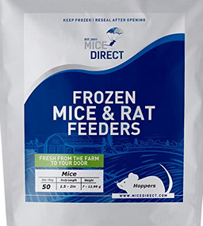
Don’t Just Feed Python!
Sorry I couldn’t resist. You can buy frozen mice to feed your pet python (thaw them first)
But I want you to remember this idea that there is more to data science than feeding data to Python

Slide 28
Big Ideas (1)
Resource description and organizing are intrinsically connected
Any resource can have associated descriptions, and the descriptions don’t need to be “data”
Different activities with resources imply different descriptions and different methods of using them
  The same resource can be a primary one, or a description resource associated with another one that is the primary focus
  The scale and diversity of datasets makes resource description the fundamental challenge in data science
28

Slide 29
Class Exercise To
“Identify Descriptive Properties”
“Data modeling”
“Content modeling”
“Document engineering”
“Feature selection”
“Feature engineering”
(Terms used in systems design,
information architecture)
(Terms used in data science)

Slide 30

Describe Me
What’s the one best word that describes this resource, or the category of resources to which it belongs?
What properties or characteristics of this resource will enable you to determine whether other resources are in the same category as this one?
1
With this picture we will replicate the “Vocabulary Problem”
you learned about last week, but this is just the beginning! ☺

Slide 31
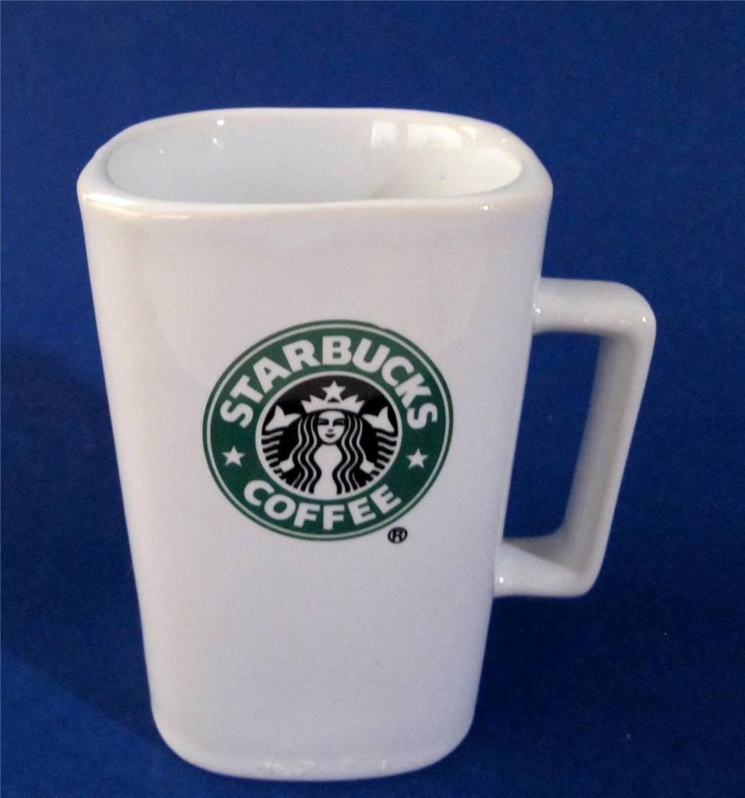
Is there another description term or property that you would assign to this resource so that it can be distinguished from the previous one?
2

Slide 32

Is there another description term or property that you would assign to this resource so that it can be distinguished from the previous one(s)?
3

Slide 33
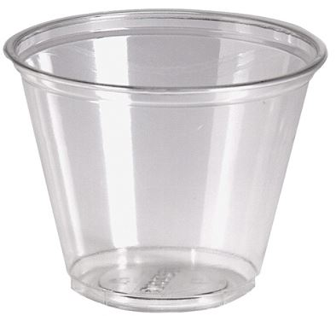
4

Slide 34
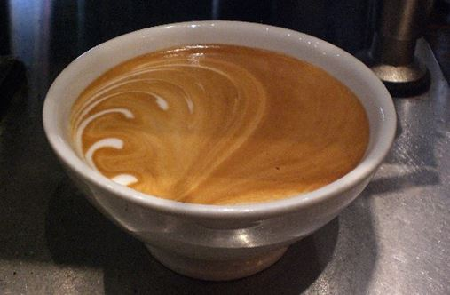
5

Slide 35

6

Slide 36

7

Slide 37
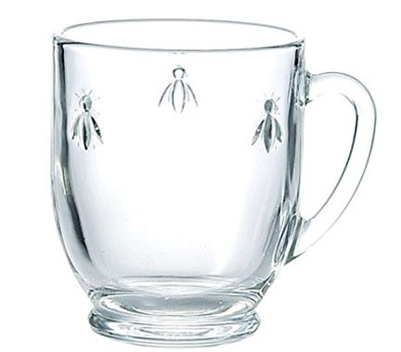
8

Slide 38
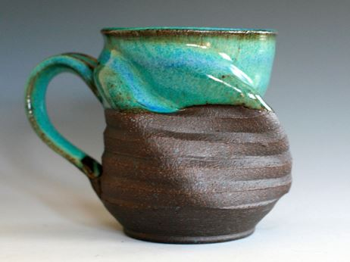
9

Slide 39
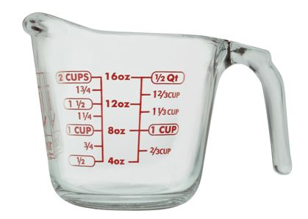
10

Slide 40

11
10

Slide 41
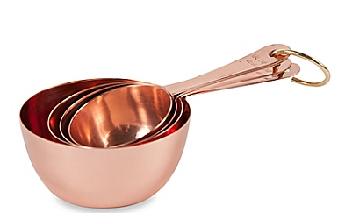
12

Slide 42
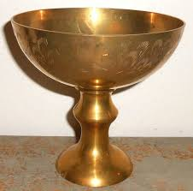
13

Slide 43

14

Slide 44
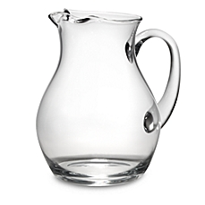
15

Slide 45

16

Slide 46
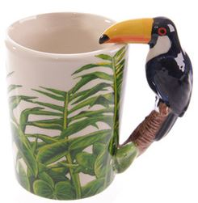
17

Slide 47
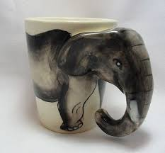
18

Slide 48
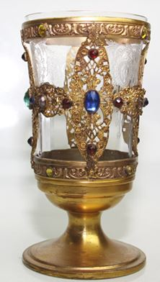
19

Slide 49
Possible Features that are
Directly Observable
Exterior color
Interior color
Exterior finish
Interior finish
Capacity
Weight
Material of manufacture
Size
Shape
Contents

Slide 50
More Directly Observable Features
Current contents
Reusable?
Stackable?
Nestable?
Handmade?
Transparent?
Insulated?
Decorated?
Branded?
Starbucks?
Coffee shop name?
Stem?
Lid?
Measurement marks?

Slide 51
Still More Directly Observable Features
Spout?
Handle?
#of Handles
Handle material
Integrated handle?
Separate handle?
Decorative handle?
Animal handle?
Bird handle?
Toucan handle?
Fish handle?
Lizard handle?

Slide 52
Not Directly Observable Features
Useful in Descriptions
Manufacturer name
Process of manufacture
Place of manufacture
Date of manufacture
Vendor name
Vendor location
Unit price
Bulk price
Previous unit price(s)
Previous bulk price(s)

Slide 53
Still More Possible Features
Current location
Previous location(s)
Primary use
Other use(s)
Current contents
Previous contents
Current user/owner
Previous user(s)/owner(s)
Date of first use
Date of most recent use

Slide 54
Identifying Descriptive Properties
What process did you follow to identify candidate descriptive properties?
It probably seemed easy to come up with description terms, but the vocabulary problem is unavoidable, because there are many words for essentially the same property
  Did you consider descriptive properties that were not directly observable in the instances?
  Did you organize / re-organize the properties as you saw more instances?
  Did you recognize at any point that some features were logically overlapping, correlated, or redundant?
54

Slide 55
Which Descriptions To Use?
It is essential to know the planned uses and interactions with the resources; this is easier to do if a team rather than an individual is describing them
It helps a great deal to know what a collection contains when starting to describe its members… but why?
How many features do we need?
  Specific features are easy to apply to instances, but many instances won’t have those features (=> sparse dataset)
  More abstract features are helpful at bounding the domain / set of possible instances

Slide 56
A Systematic Process for Describing Resources

Slide 57
TDO 5.3 Proposes this Process for Describing Resources
1. Identify / scope the resources to be described
2. Determine the uses of the descriptions
3. Study the resource(s) to identify descriptive properties
4. Design the description vocabulary
5. Design the description form and implementation
6. Create the descriptions (either "by hand" or by some automated / computational process
7. Evaluate the descriptions
57

Slide 58
1. Scoping and Description
How explicit and thorough the 7 steps need to be depends on the collection “scope”
  SCOPE: the breadth and variety of resource types in a collection
  SCALE: the number of resource instances
A broad scope makes it harder to define and bound the resource domain
58

Slide 59
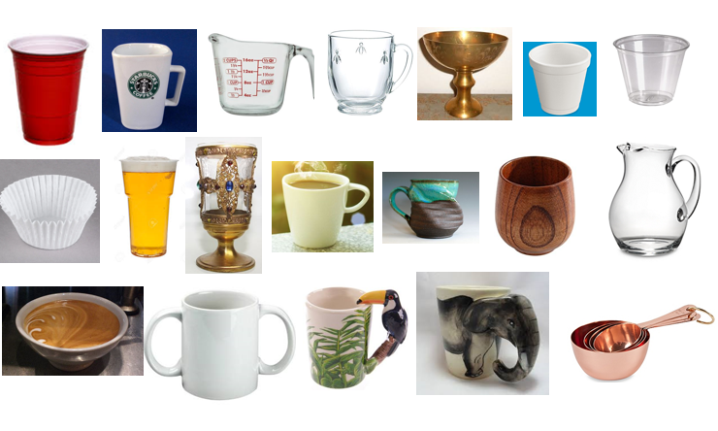
The Complete Set of Instances
This collection has broad SCOPE – it contains a very heterogeneous set of instances, and it is difficult to define and bound the collection domain
How would the process of selecting descriptions have differed if you’d been given all of these at the same time?

Slide 60
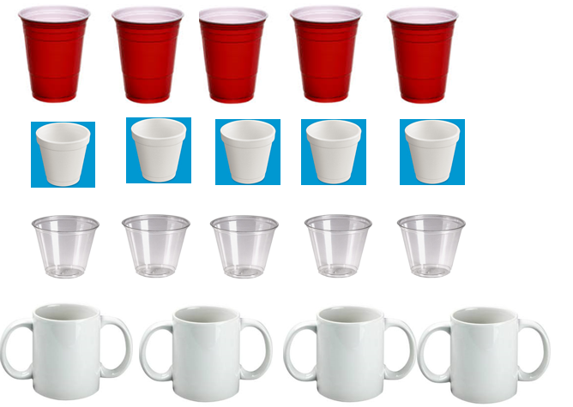
This Collection Has the Same Scale, but Vastly Smaller Scope
Instances in collections with small scope are much easier to describe and organize

Slide 61
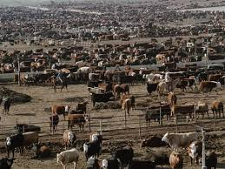
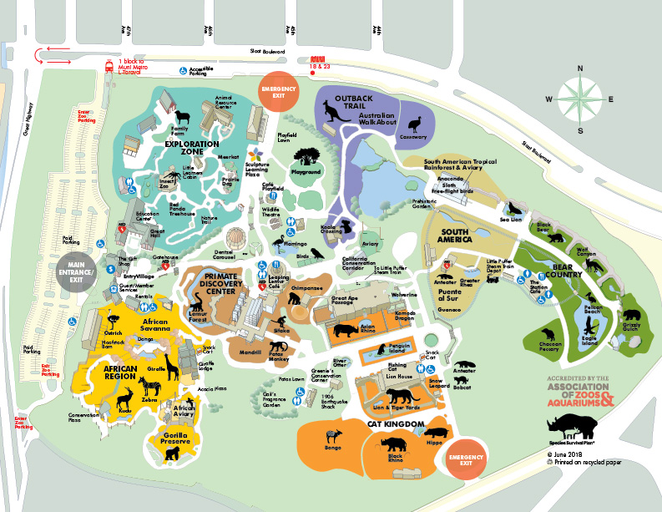
Scope and Scale: Cattle Ranch vs. Zoo
Harris Cattle Ranch
Coalinga CA
250,000 cows
400 employees
San Francisco Zoo
2000 animals, 200 species
200 employees

Slide 62


A “tall” dataset might contain many millions or even billions of records, but each has a relatively small number of variables
(e.g., a bank’s credit card accounts)
Scope and Scale:
Tall Data vs. Wide Data
A “wide” dataset might also have many records, but each record has a large number – hundreds or even thousands - of variables (e.g., predictive analytics, Facebook).
“Tall Data” is traditional computer science and software engineering. “Wide Data” is the cutting edge in data science/ML

Slide 63
Big Ideas (2)
It probably seemed easy to come up with description terms, but the vocabulary problem is real. Friends don’t let friends model alone
  The process and result of identifying descriptions from a series of instances is likely to be very different than from a collection of instances
  The scope of a resource collection – the breadth and heterogeneity of instances – is far more important than scale
  Scope makes resource description and computation with descriptions more challenging
63

Slide 64
2. Users and Uses
Scope also increases the diversity of users and uses for the collection
  Do we know who the users are?
  Are the describers the users?
FLASHBACK:
Organizing Principles <=>
Resource Descriptions
64

Slide 65


3. Study the resource(s) to identify descriptive properties
65

Slide 66
4. Designing the
Description Vocabulary is Hard
People use different words for the same things, and the same words for different things (TDO 4.4 & the Vocabulary Problem)
Describing and organizing always (explicitly or implicitly) takes place in some context
The context shapes which resource properties are important and the organizing principles that use those properties
66

Slide 67

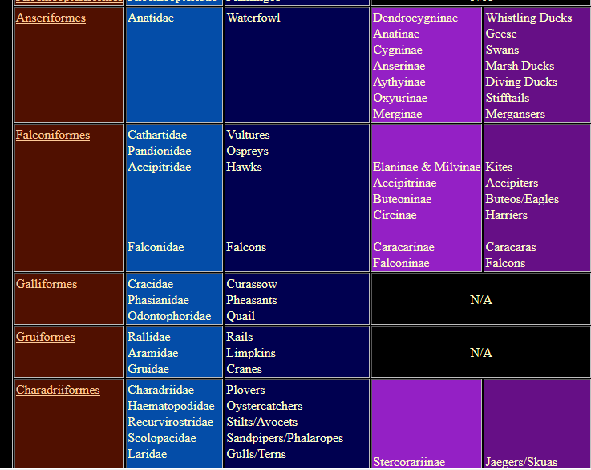
Describing Birds for Scientists
67

Slide 68
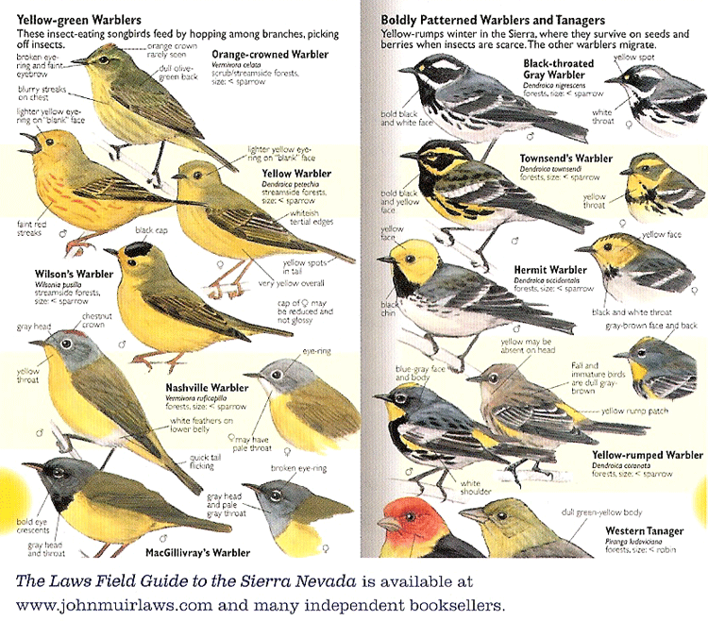
Describing Birds for Birdwatchers
68

Slide 69
Controlled Vocabularies
A Controlled Vocabulary is an artificial language designed to be used in place of the "natural" ones that people would otherwise use, but only “trained describers” can use them
A collection of resource descriptions is vastly more useful when every resource is described using the same features/properties/categories to which the controlled vocabulary is applied, making it a “schema” or “domain-specific language”
Put more simply: Uses, users, and the process by which the description vocabulary is created always create bias in the vocabulary
69

Slide 70
A schema specifies the elements or features
of a resource description
A CV specifies the possible values
for a resource description

Slide 71
5. Description Form and Implementation
  There are many choices for the notation, syntax, and structure of resource descriptions that differ widely in:
    Human interpretability
    Computability
    Compatibility / degree of standardization
  Descriptions created by people are almost always human-readable
  Descriptions created by sensors, software, or other mechanisms are often optimized for computation
  The choices are often contentious and result in “format wars” - XML vs. RDF vs. JSON vs….
71

Slide 72
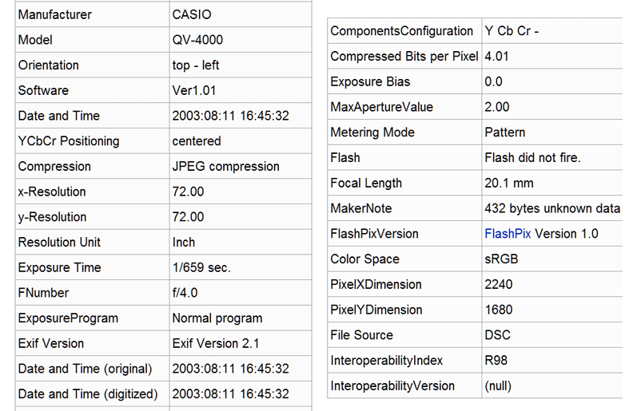
Human-Interpretable Automated Description by Digital Camera (EXIF)
72

Slide 73
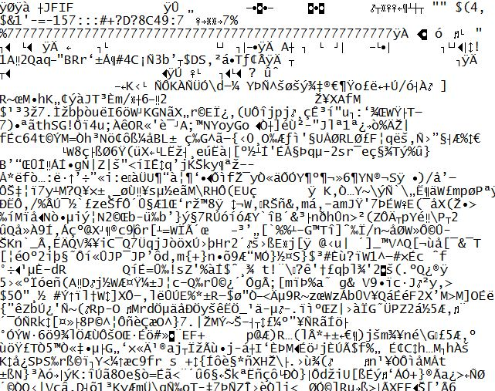
The Semantic Gap in Descriptions Optimized for Computation

Slide 74
6. Different Ways to
Create Resource Descriptions
  By professionals: "Institutional" descriptions that follow standards
  By authors: Best knowledge of purpose and intended audience
  By users: Most variable, influenced by social purposes
  By automated processes: Can reliably assign technical / physical properties but semantic description capability is enabled via supervised learning
74

Slide 75

A Painting Described by the Painter

Slide 76
Descriptive Precision
Writers, poets, painters, composers, sculptors, technical writers, programmers, producers, architects, designers, and devices or machines can all “create” resources
The Dublin Core vocabulary for describing web pages has a single property for indicating a “creator” (TDO 5.3.1.3)
  “Shakespeare” and “Hubble Telescope” are both “creators”
A small description vocabulary is easy to use, but this tradeoff loses a great deal of precision compared to larger and more controlled vocabularies

Slide 77
7. Evaluating
Resource Descriptions
  Quality should be evaluated with respect to intended purposes... but what if different stakeholders have different purposes?
  Creating resource descriptions can be costly; is it worth it? How and when measure the costs?
  Computational description can be less expensive, but is it good enough? What is the cost of less or little transparency in the features?
77

Slide 78
if this is all you’re given, say NO and give up!
If you don’t know about the process by which these descriptions were selected and made “computable” you can’t be confident about the results you’ll get by feeding this dataset to Python

Slide 79
A Typical Data Science Process
Identify a business problem that you can transform into a data science problem
Gather as much relevant data as you can
Clean up the data, using exploratory visualization as an aid
Build an initial model
Evaluate the model – does it label or classify well enough to address the business problem?
Iterate steps 2-5
Deploy model, congratulate yourself

Slide 80


TDO 5.3 Process
DS Process
1. Identify / scope the resources to be described
2. Determine the uses of the descriptions
3. Study the resource(s) to identify descriptive properties
4. Design the description vocabulary
5. Design the description form and implementation
6. Create the descriptions (either "by hand" or by some automated / computational process
7. Evaluate the descriptions
Too often, it takes the data as given; should be “cleaned up” but not fundamentally questioned
80

Slide 81
Let’s Say it Together:
TDO’s Mantra
Organizing,
resource description,
and interaction design are inherently interconnected activities

Slide 82
Resource Description Checklist for Data Scientists
The size and diversity of datasets makes resource description the fundamental challenge in data science
  Where did the data come from (provenance)? Is the source credible? Is the dataset relevant to the questions you’re asking?
    Why were these descriptions selected? What are the possible values? Units and levels of measurement? Precision? Vocabulary control?
    Are the values accurate? Stable? Current? Correlated? Human-interpretable?
    Did the people who designed and collected this dataset think about it in the same way that you do?
82

Slide 83
Big Ideas (3)
Describing and organizing always (explicitly or implicitly) takes place in some context, which shapes which resource properties are important and the organizing principles that use them
  A collection of resource descriptions is vastly more useful when every resource is described using the same features/properties/categories to which the controlled vocabulary is applied, making it a “schema” or “domain-specific language
  Different ways of creating resource descriptions have costs and benefits; who pays the costs and who benefits?
83

Slide 84
A Framework for Generating Resource Properties

Slide 85
A Framework for Generating Description Properties
LIS folks like to create categories of resource descriptions
  Gilliland: content, value, context, structure, format
  Taylor: administrative, descriptive, preservation, technical, use
  Many others…
But my Ischool students couldn’t sort properties reliably into the categories… so I devised a new framework that has turned out to be useful for generating candidate properties in a systematic way
85

Slide 86
Classifying Resource Properties

Slide 87
Intrinsic Properties
Intrinsic properties are inherent in a resource
Some are static, never changing their values
Others are dynamic, but they change “from the inside of the resource” not “from the outside” by actions or efforts of outside agents (like “developmental” properties – age, skill, experience)
Intrinsic properties can sometimes be used as an identifier - like a computed "signature" for a document or media object
87

Slide 88

Distinctive Physical Properties
88

Slide 89
Extrinsic Properties
Extrinsic properties are assigned to a resource rather than being inherent in it
Some extrinsic properties are static: assigned names or identifiers don’t usually change
Other extrinsic properties change often
Extrinsic properties differ in their "decay" functions, rate of change… a lot of data science is figuring out the function that relates the value of some resource property over time
89

Slide 90
Cultural Properties
Cultural properties are extrinsic and assigned to resources; they come from conventional language use or culture and often involve analogy
Because they derive from knowledge of culture or language, they might be unintelligible to people who don't have the same perspective and experience
.. and they might lose their cultural salience
Flapper, Greaser, Groovy, Bollywood, Grunge
Tech bro, One percenter
90

Slide 91

“Holbein” Carpets
Why are these carpets from Central Turkey (dating from 16th century) described with a German painter’s name?
Anatolian Carpet,
16th Century
A
The Ambassadors, 1553

Slide 92
Applying the Framework for
Organizing System of a Kitchen
  Intrinsic static properties: If you store your pots, frying pans, and baking pans and nest each set by size
  Extrinsic static properties: A spice rack with the spices arranged in alphabetical order
  Intrinsic dynamic properties if you arrange your milk and other perishable goods by expiration date, a “useful life remaining” property that decreases to zero as the expiration date approaches
  Extrinsic dynamic properties if you put the most frequently used condiments or spices in the front of a refrigerator or pantry shelf
92

Slide 93
Applying the Framework for a
Document Organizing System
  Intrinsic static properties: Author, date published, words in the text
  Extrinsic static properties: ISBN, LOC Classifications
  Intrinsic dynamic properties: Effectivity (e.g., laws and regulations)
  Extrinsic dynamic properties: Links/citations to and from other documents
93

