Slide 1
CogSci 150 “Sensemaking and Organizing” Spring 2021
Robert J. Glushko glushko@berkeley.edu
11 February 2021
8) Document Engineering; The Modeling Debate

Slide 2
Plan for Today’s Lecture
Document Engineering Methodology
Document Engineering Examples
History Lesson: SGML -> HTML -> XML
The Modeling Debate
Your Modeling Assignment
2

Slide 3
Documents vs. Data
Many people contrast "documents" and "data" and conclude that documents and data cannot be understood and handled with the same terminology, techniques, and tools
The document vs. data distinction is embedded and reinforced in textbooks, technology, and marketing (e.g., “document analysis” vs. “data modeling”, “information science” vs. “data science”)
But documents and data are often found together or interconnected in information processes
The Document Type Spectrum shows that there is no clear boundary
3

Slide 4
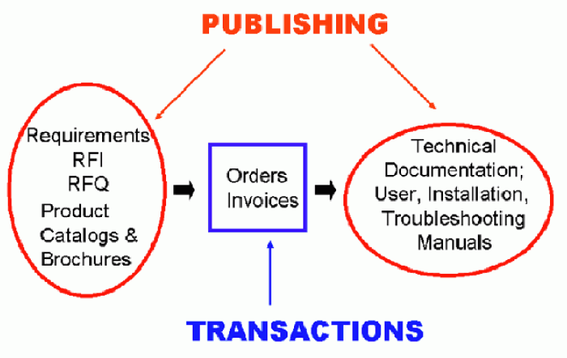
Data and Documents Together

Slide 5
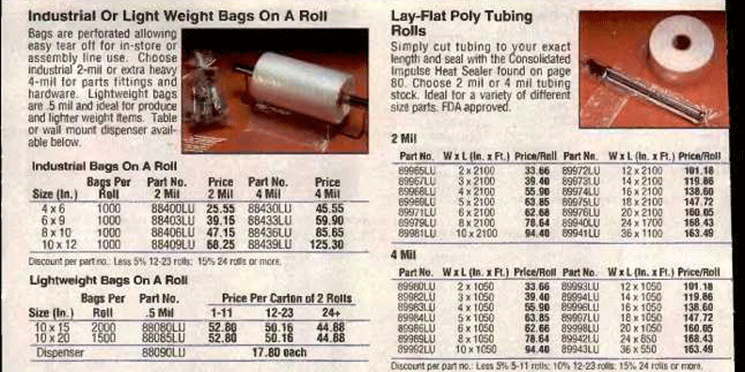
Catalog: Database That Contains Documents

Slide 6
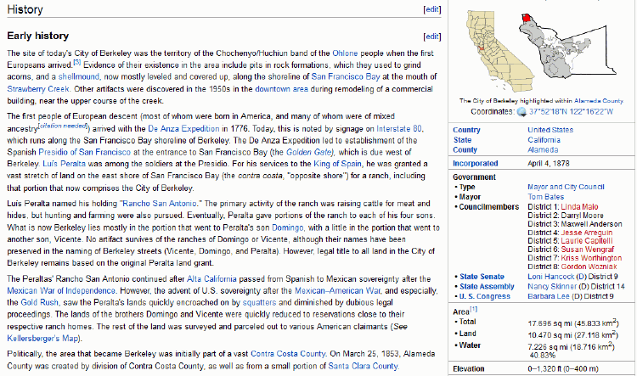
Encyclopedia: Document that Contains Databases

Slide 7
Documents and data are on a continuum The Document Type Spectrum
There is systematic and continuous variation in document instances and types; there is no clear boundary between “documents” and “data”
Document types can be distinguished according to the extent to which their content is semantically prescribed, by the amount of internal structure, and by the correlations of their presentation and for­matting to their content and structure

Slide 8
Document Analysis & Document Engineering
A document schema is a specification of the category of resources/events/processes that some set of documents describes
DOCUMENT ANALYSIS is the process of extracting the content components from the structural and presentational components in a document
DOCUMENT ENGINEERING is the process of analyzing the sets of content components taken from a collection of documents, consolidating and organizing them, and then creating a document schema that can be used to enable interactions as required
8

Slide 9
Document Engineering’s Key Ideas
Document Engineering harmonizes the terminology of document analysis and data modeling and emphasizes what they have in common:
Identifying the presentational, content, and structural components
Eliminating synonymy and homonymy
Identifying and organizing the "good" content components and their relationships to each other
Assembling hierarchical document models to organize components to meet requirements for a specific context
9

Slide 10
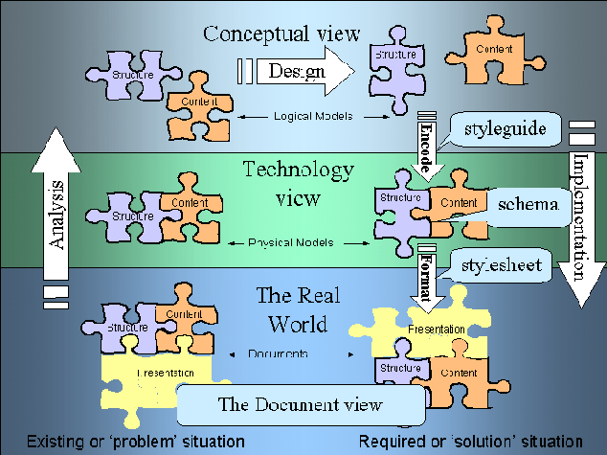
The Document Engineering Approach

Slide 11
From Physical Implementations to Conceptual Models (1)
When we analyze information sources -- interviews, documents, data entry form, sets of data whatever - our goal is to identify and describe the "significant things" or the "information components" and their attributes
If you conduct an interview about the information or documents needed to do something your source will naturally talk about information components as abstract pieces of information
But when you analyze documents the information components aren't as immediately apparent because they are contained in structures and rendered in some presentation
11

Slide 12
From Physical Implementations to Conceptual Models (2)
We must remove the presentational information and dis-assemble the structural information to find the content information that is our highest priority
As we take away presentation and structure, we are abstracting away or generalizing from a physical implementation and creating our first conceptual or logical model of the information components
12

Slide 13
Finding the Right Documents to Analyze
Identifying all the potentially relevant documents or information sources is inherently an iterative task
We locate documents, which may refer or link to other documents, and we locate people who work with the documents, who may refer or link to other documents or people
If there are lots of documents of a particular type, we have to be concerned about representiveness and selection biases
13

Slide 14
Extracting Presentation Rules
Presentation affects structure and content by applying transformation rules to them
To understand the structure and content we must identify and record what the rules of the transformation were
Explicit transform rules can be encoded in templates, stylesheets or source code; if you can find these, use them!
14

Slide 15
Using Correlations or Conventions
Color, pitch, other perceptual dimensions can be correlated with semantic distinctions
Type size is correlated with structural hierarchy
Content types can have characteristic layouts or text attributes
Adjacency can suggest a semantic relationship, like that between figure and caption
Presentation order is sometimes semantically significant
15

Slide 16
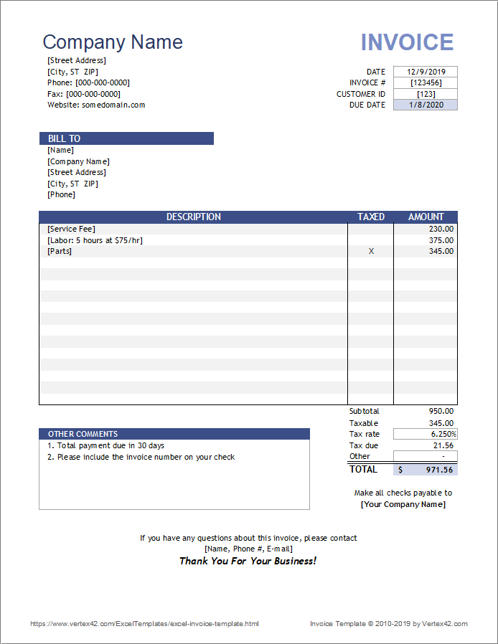
Presentation Information Can Explicitly Label the Content

Slide 17
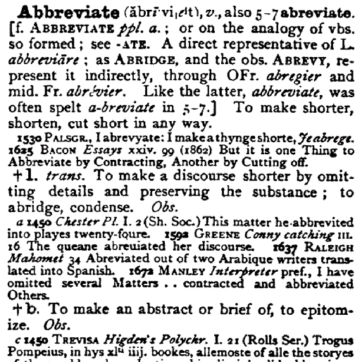
Presentation Conveys Content Distinctions

Slide 18
Presentation that Hides Content Distinctions
Address: Line 1: ________________ Line 2: _________________ City: ____________ State: ________ ZipCode: _________
“Line 1" and “Line 2" are presentation labels that are not useful for any purpose other than printing out an address label
They are not content components; they are hiding content components like "number" and "street”
18

Slide 19
Structural Information
Removing the presentation components allows us to focus on the two remaining types, Structure and Content
Structure is the physical or logical arrangement of components. Paragraphs, titles, sections, footnotes, tables, "parts" in a form, are all structural components
The structural components provide the hierarchical "skeleton" or "scaffold" into which the content components are arranged
19

Slide 20
Content Components
The search for “meaning” in our document analysis ends up with the content.
Content components are the "nouns" in our documents or sets of data – things like "topic," "summary," "name," "address," "price"
20

Slide 21
Generated or Derived Components
"Table of Contents," "Permuted Index," and list of figures, tables, or other types of “aggregation” components can usually be generated or derived from other components and are not components in their own right
Similarly, if “TotalPrice" is "Quantity" x "UnitPrice" we might only want the latter two components in our model since collecting that first one separately could lead to data integrity problems
21

Slide 22
The Simplest Information Component Model
The simplest or minimal information component model is a glossary – a list of the words used to describe or name the "things of significance" and what they mean
This simple data model is augmented by attributes or characteristics of the significant things
The model is further developed as relationships or associations or links between the "significant things" are identified and recorded
22

Slide 23
Information About Candidate Components
What attributes about each type of content might we record in our analysis?
Names/synonyms/homonyms (what it is called) and Identifiers
Definition (what it "means")
Optionality, Cardinality (occurrence rules)
Data Type (text, numbers, date, video) and possible values, code sets, defaults
Relationships/Associations
ANYTHING THAT WOULD ENSURE CORRECT USE
23

Slide 24
Analyzing "Possible Values"
It is critical to capture any rules governing the possible values for a component
Sometimes possible values are conventional, fixed, and span the entire semantic range for some domain (days of week, AM/PM)
Determine who can control the value sets (internal [Manufacturer part #s] vs external [Bar codes, ISO])
Patterns like regular expressions are often useful but not sufficient for validation
And if the set of possible values isn't well motivated, fix it in your component design
24

Slide 25
Harvesting and Consolidation
Harvesting – Create a set of candidate content components by extracting them from the information sources while removing presentation and structure
Consolidation– Identify synonyms and homonyms among the candidate content components, assigning a unique name to each unique meaning as part of a controlled vocabulary
25

Slide 26
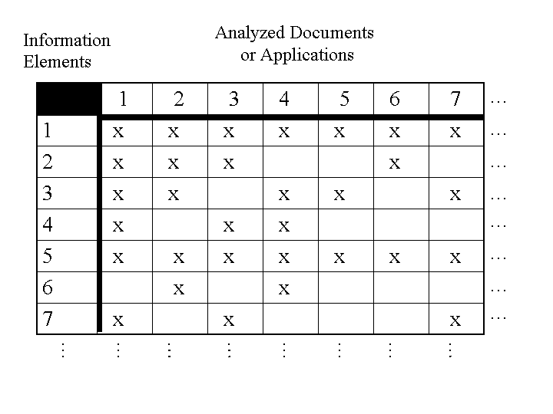
Harvesting Components from Multiple Sources

Slide 27
Consolidating the Harvest
Start with the candidate components from the information source that you believe is the most authoritative or that yielded the most components
Use information about possible values to combine components that are synonyms (different names for the same meaning) and distinguish any homonyms (same names for different meanings)
It is desirable for a set of components to enable one and only one way to describe something
27

Slide 28
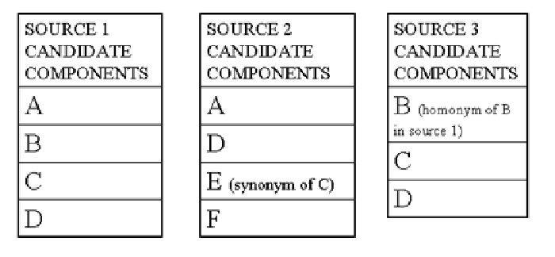
Merging Candidate Components
EXAMPLES ARE FROM DIFFERENT “EVENT CALENDARS”
C is “LOCATION”, E Is “VENUE” - SYNONYMS
B in SOURCE 1 is “TITLE” (of the event).
B in SOURCE 3 is “TITLE” (of the speaker) -- HOMONYMS

Slide 29
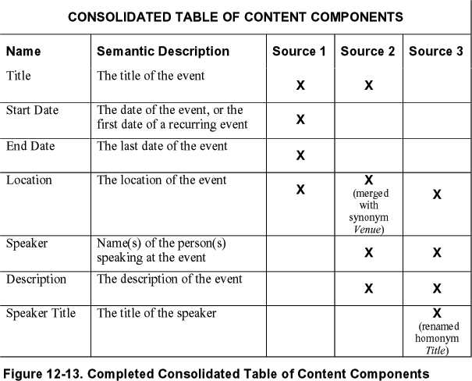
Consolidating Candidate Components

Slide 30
An Extremely Simple Example
5 document instances that contain Name and Address
1) Extract the content components from each
2) Create a Harvest Table to enable Consolidation
3) Create a Model for “Name and Address” that can be used for each of the analyzed instances
4) Create a Component-Value Table to demonstrate the use of the model for one of the instances

Slide 31
Name & Address 1
NAME Bob Glushko
ADDRESS LINE 1 1960 Broadway St. #8
ADDRESS LINE 2 San Francisco CA 94109

Slide 32
Name & Address 2
NAME Bob Glushko
NUMBER & STREET 1960 #8 Broadway St.
CITY San Francisco
STATE CA
ZIP CODE 94109

Slide 33
Name & Address 3
FIRSTNAME Bob
LASTNAME Glushko
NUMBER & STREET 1960 Broadway
UNIT ID 8
CITY San Francisco
STATE CA
ZIP CODE 94109

Slide 34
Name & Address 4
LASTNAME Glushko
FIRSTNAME Bob
BUILDING NUMBER 1960
BUILDING UNIT ID 8
STREET Broadway
CITY San Francisco
STATE OR PROVINCE CA
COUNTRY USA
POSTAL CODE 94109

Slide 35
Name & Address 5
NOM Bob
NOM DE FAMILLE Glushko
NUMÉRO DU BÂTIMENT 270
RUE Saint-Antoine Ouest
VILLE Montreal
PROVINCE QC
CODE POSTAL H2Y OA3

Slide 36
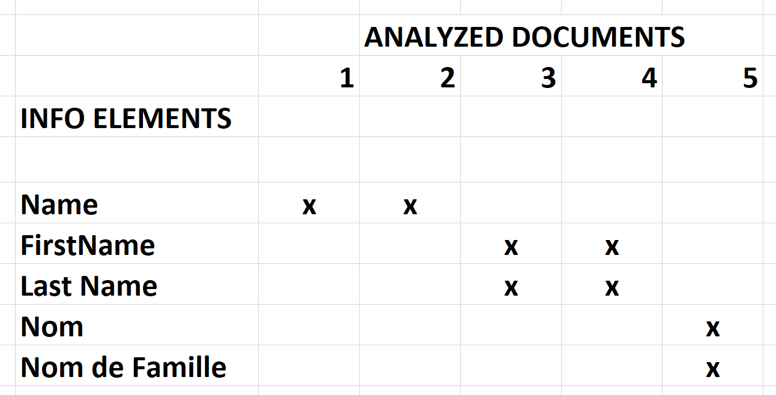
Harvest Table for Name Components

Slide 37
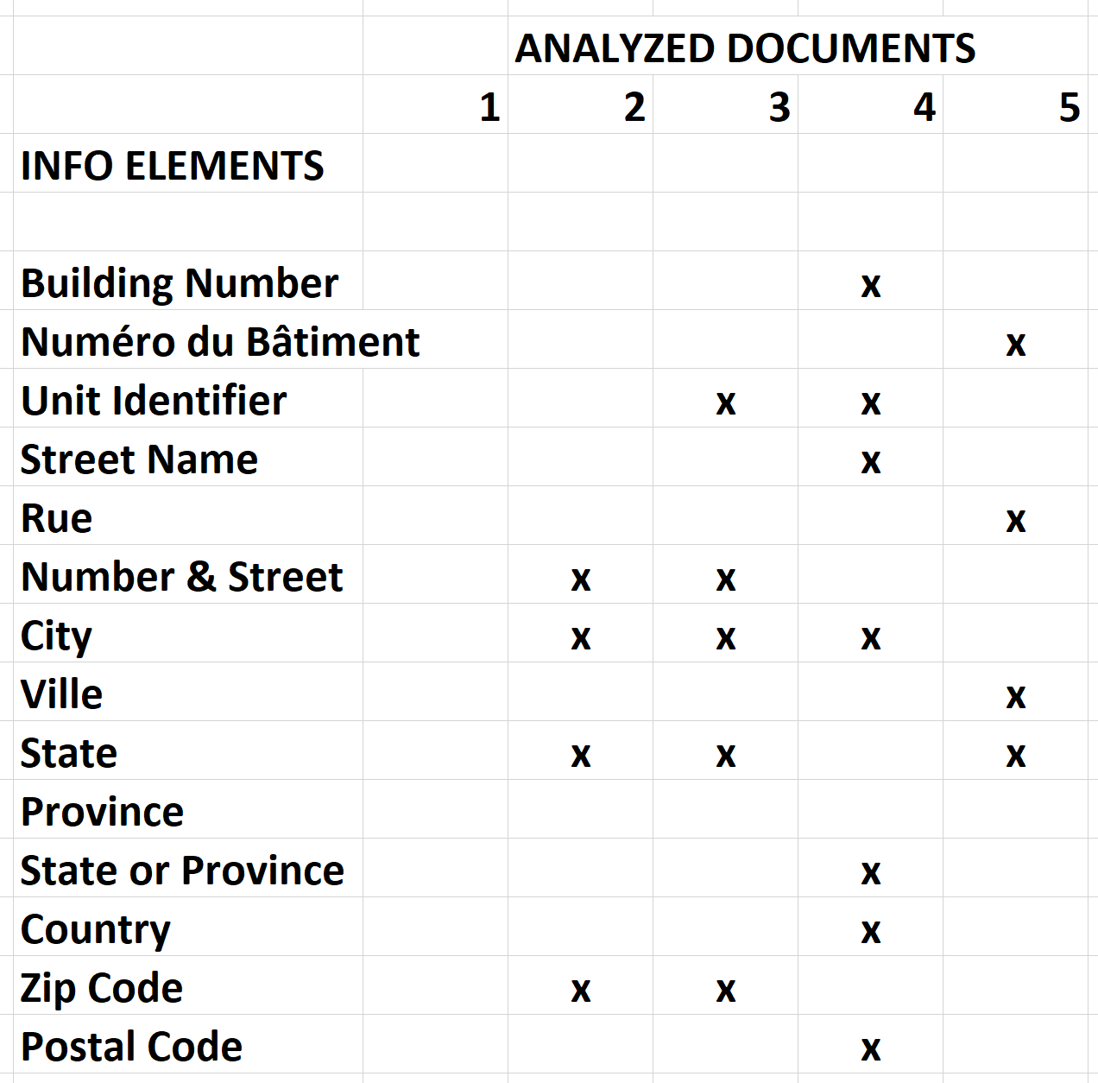
Harvest Table for Address Components

Slide 38
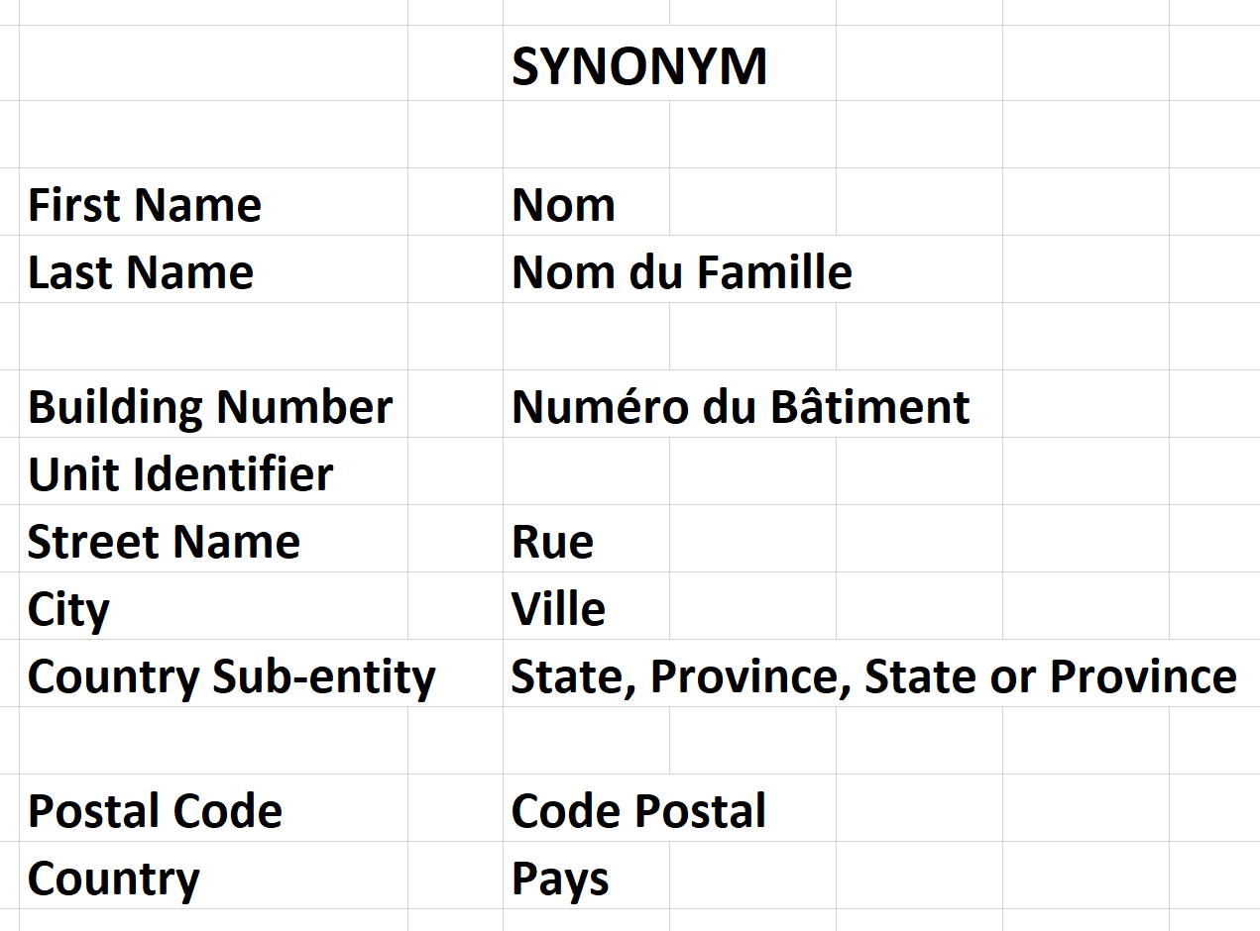
Consolidated Components
Choose one of the harvested names, or devise a more general new one

Slide 39
Name And Address Model
Name
First Name
Last Name
Address
Building Number
Unit ID (optional)
Street Name
City
Country Sub-entity
Postal Code (code list for validation)
Country (optional) (code list for validation, ISO 3166)

Slide 40
Component-Value Table for Document 4
NAME
LASTNAME Glushko
FIRSTNAME Bob
ADDRESS
BUILDING NUMBER 1960
BUILDING UNIT ID 8
STREET NAME Broadway
CITY San Francisco
COUNTRY SUB-ENTITY CA
COUNTRY USA
POSTAL CODE 94109

Slide 41
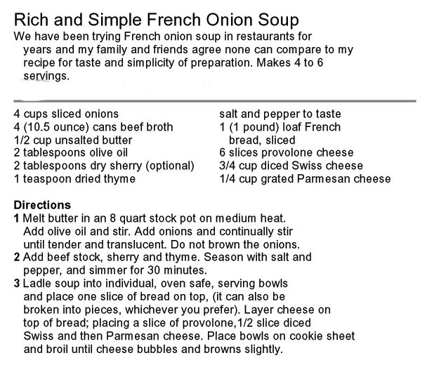
A More Complex Document Type

Slide 42
Deconstruct into Presentation, Structure, and Content
HEADER
Recipe Title
Description
Servings
BODY
Ingredient List
Ingredient
Quantity
Measurement Unit
Ingredient
Directions
Step
Ingredient
Process
Equipment
Cooking Time
Completion Criteria
Serving Instructions

Slide 43
Components Harvested from Other Recipes
Food category / cuisine
Course (breakfast, lunch, dinner, dessert)
Preparation time
Level of difficulty
Nutrition information
Part of a traditional menu? (Thanksgiving, Christmas, birthday, …)

Slide 44
History Lesson SGML -> HTML -> XML

Slide 45
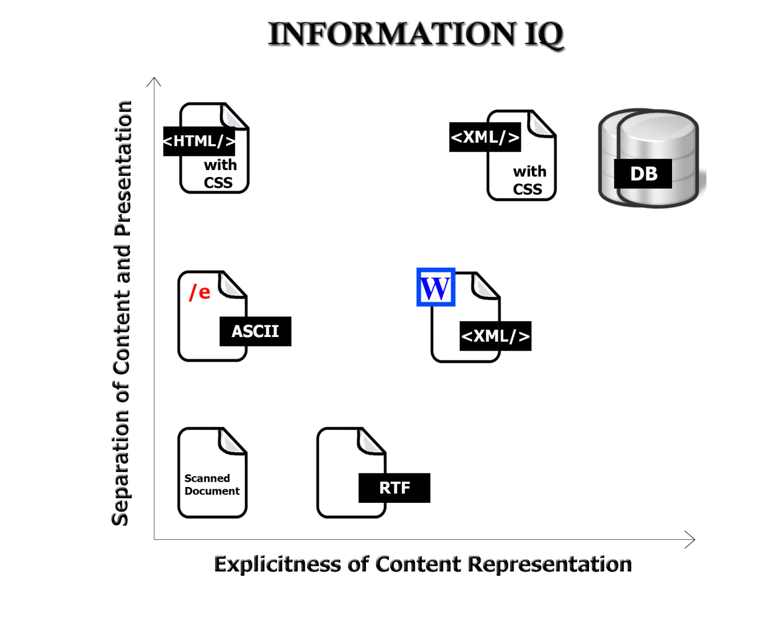
The Digital Format Matters!
FLASHBACK
45

Slide 46
SGML (1)
The “Standard Generalized Markup Language” was invented in the 1960s as digital publishing was taking hold
It is a “metalanguage” - a general syntax for encoding models and instances of things and processes
Its goal was to replace proprietary and opaque text formats with standard and human-readable “marked-up” text that conformed to a data model / or “schema” / or “Document Type Definition” (DTD)

Slide 47
SGML (2)
This schema defined the vocabulary and grammar of the “markup language” – I.e., the tags that labeled the content elements of the document and the rules for combining them
required vs optional elements
Legal values for elements
Identifiers for referring to and linking to elements
SGML’s syntax was complex, making it hard to use, but it was a powerful idea and was adopted by big firms that could justify the investment (e.g., IBM, AT&T, other computer manufacturers)

Slide 48
An Event Calendar (Doc Eng Ch 2)

Slide 49
XML Instance (partial)

Slide 50
Schema for “Event” Document Type (1)

Slide 52
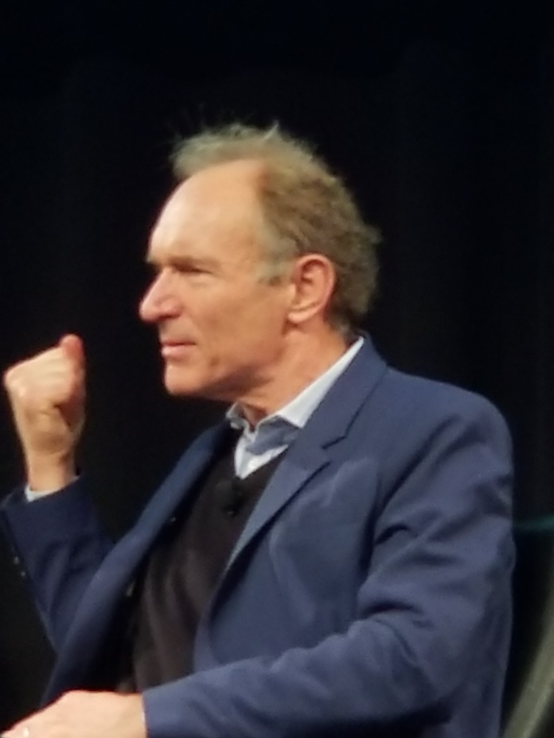
The Web and HTML
30 years ago, (Sir) Tim Berners-Lee invented the Web and created HTML (“hypertext markup language”) as a simple and limited “presentation layer” vocabulary
He explicitly rejected SGML’s “metalanguage” and content tagging
HTML’s idea of using tags to mark up pieces of text according to how they look is very easy to understand and led to the Web’s rapid adoption
The first version of HTML had only about 11 tags – paragraphs, headings, lists

Slide 53
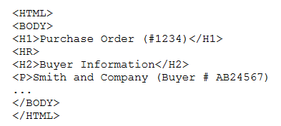
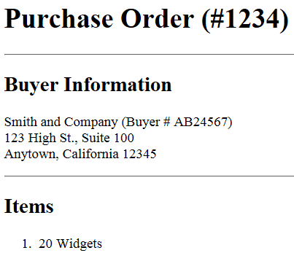
If you give this HTML source file to a web browser it renders it in a human-readable way because “presentation rules” are built into the browser

Slide 54
The Limits of HTML
Many people criticized HTML and argued that a fixed set of presentation-oriented tags was a substantial step backwards for authors, readers, and their organizations who had been using SGML-based document type models
The limitations of HTML were most obvious in websites and applications that had to “down-transform” structured content from databases

Slide 55
XML (“extensible markup language”)
XML was invented 25 years ago as a streamlined SGML for structured publishing and transactions on the web
Like SGML, XML enables the design of “schemas” or “vocabularies” or “tag sets” and the specification of the rules by which they are arranged (“validation”)
Giving HTML a schema (XHTML) made it qualitatively better

Slide 56
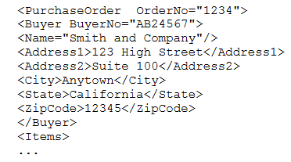
If you give this XML source file to a web browser it needs an XML transform (“style sheet”) to assign formatting
Different transforms might be needed for different devices, users, or consuming applications

Slide 57
The Modeling Debate – “Schemas” vs. “Tag Sets”

Slide 58
The Modeling Debate
Information models that are precisely structured with semantics clearly separated from presentation take a lot of effort to create and use
How much modeling is necessary and justified?
Who does the work and who gets the benefit?
What is the tradeoff between expressive power /computability and ease of use?

Slide 59
Heavyweight vs. Lightweight Modeling (1)
At one end of the modeling continuum, “heavyweight” methods are based on consensus requirements that are identified and then satisfied in the most robust way possible
These "heavyweight" approaches are expensive to follow but the models are credible and prescriptive and enable “traceability” of analysis and design decisions
Examples of standards organizations that follow heavyweight methods: OASIS, W3C
59

Slide 60
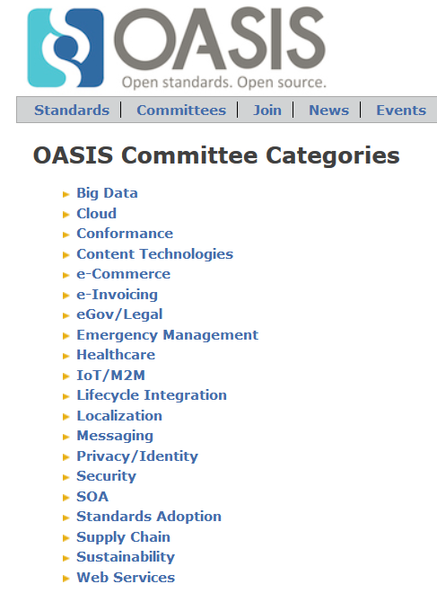
“Heavyweight” models needed for robust computation and interoperability “by machines” are most often defined as XML schemas that are developed very systematically – see https://www.oasis-open.org/

Slide 61
Microformats
Microformats represent a very different approach to modeling and encoding "document types"
Instead of following rigorous (and slow) design methods to create standard reusable information models they are more of a grass-roots effort to create XHTML "chunks" embeddable in web pages using attribute syntax
Commonly used microformats are those for personal contact information, calendar events, and a few other small chunks of structured data

Slide 62
Schema.org
Schema.org expanded and optimized the microformat concept for the benefit of search engines and other applications that rely heavily on structured data
The use of these structured “semantic fragments” in web pages enables search engines to return more precise and relevant results

Slide 63
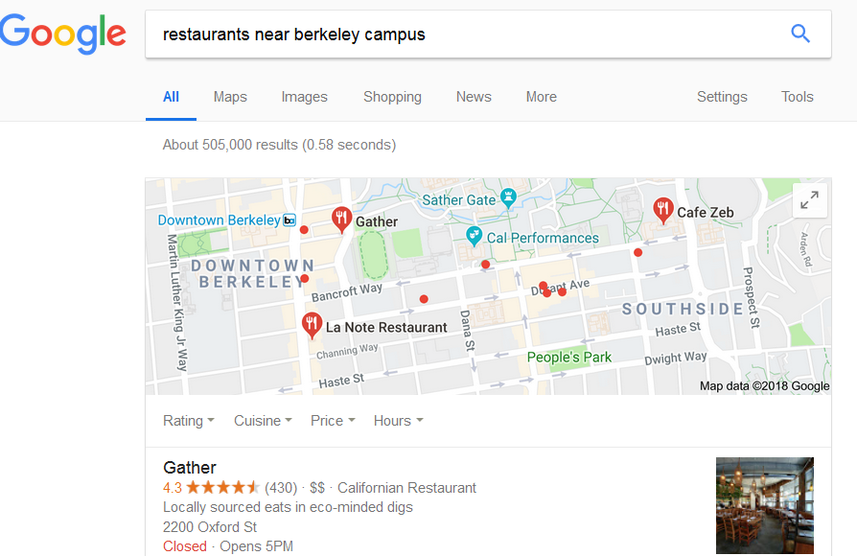

Slide 64
<div>
<h1>Avatar</h1>
<span>Director: James Cameron (born August 16, 1954)</span>
<span>Science fiction</span>
<a href="../movies/avatar-theatrical-trailer.html">Trailer</a>
</div>
SIMPLE HTML
SCHEMA.ORG “Movie”
<div itemscope itemtype="http://schema.org/Movie">
<h1>Avatar</h1>
<span>Director: James Cameron (born August 16, 1954)</span>
<span>Science fiction</span>
<a href="../movies/avatar-theatrical-trailer.html">Trailer</a>
</div>

Slide 65
There Are No Modeling Shortcuts
You might think that "modeling" means "writing a schema given a set of instances" or "inferring a schema from a single instance" (like you can with the "autogenerate" function in many XML editors)
But schemas developed without a stage of conceptual design (other than very simple ones) are rarely very useful because they are too closely tied to the particular instances used, which may not be representative
There is an inescapable tradeoff in description vocabularies between expressive power /computability (exemplified by XML) and ease of use (HTML)?
You get what you pay for
65

Slide 66
Your Modeling Assignment

Slide 67
Assignment 3
Given 4 documents that describe sporting events, or 4 documents that describe apartments for rent
1) You and an assigned partner each select one set of documents
2) Separately
Extract the content components from each
Create a Harvest Table to enable consolidation
Create a Model that can be used for all the analyzed instances (use any syntax you like)
Document the Model so your partner can use it to encode another instance
3) Jointly reflect on the process and models

Slide 68
Championship Sporting Event Story
On February 2, 2020, SuperBowl 54 took place at Miami’s Hard Rock Stadium. In this annual football game to determine the NFL champion, the American conference champs Kansas City Chiefs and the National conference champs San Francisco 49ers were tied 10-10 after two periods. The 49ers led 21-10 lead after the third period, but the Chiefs staged an epic comeback with 21 fourth period points to win. Chiefs quarterback Patrick Mahomes was named the game’s MVP, passing for two touchdowns and finishing the game with 286 passing yards. 62417 fans were in attendance, the second lowest number in SuperBowl history, beating only that of the first SuperBowl played in 1967.

Slide 69
Apartment for Rent Story
The recently opened six-story Macarthur Commons apartment complex in Oakland with 385 units towers over the BART station, making it ideal for anyone who commutes by BART around the Bay Area. Be the first to live in this top-floor 2BR,2 bath unit (1300 sq feet) with floor-to-ceiling windows that take full advantage of the stunning San Francisco view. It comes with a balcony, a gourmet kitchen, full-size stacked washer and dryer, reserved parking, and super high-speed fiber internet service. The building has a sky deck with pool, a fitness center, a coffee lounge, an outdoor dog run, and an entertainment room with massive HDTVs. It’s a bargain at $5100 a month.

