Slide 1
CogSci 150 “Sensemaking and Organizing” Spring 2021
Robert J. Glushko glushko@berkeley.edu
16 February 2021
9) Describing Non-Text Resources: Art, Artifacts, Music, …

Slide 2
Plan for Today’s Lecture
Granularity and Abstraction in Describing Art, Artifacts, Music, …
The Sensory and Semantic Gaps
Describing Music
“Professional” Descriptions
2

Slide 3
Non-text Resources (some overlapping categories)
Tangible Medium
Art, sculpture, physical designs
Audio (speech, music, sound)
Graphics and Images
“Moving” Images (video)
Multimedia -- Composed of more than one form of media
Time-based media -- Audio and video
3

Slide 4
The “Things” for Non-text Resources? (Granularity and Abstraction)
Songs and sound recordings
album, playlist, queue
cover, remake
mix, remix
sample, soundbite
Video
clip, snippet, still
broad-/narrow-/simul-/tele-/web-/pod- cast
4

Slide 5
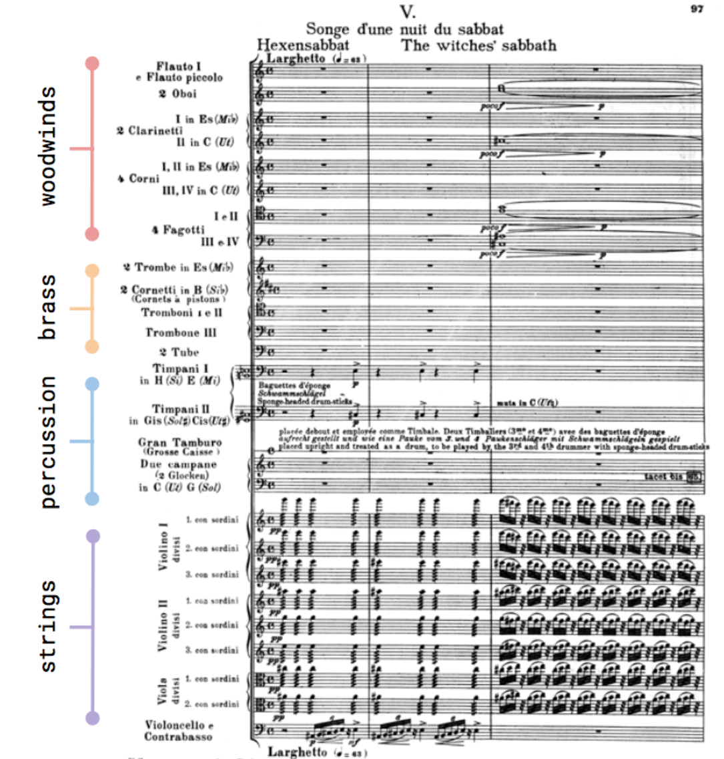
How Many Things is a Symphony?
Symphonie Fantastique, Op. 14: V
Songe d'une Nuit du Sabbat
Hector Berlioz
(1830)

Slide 6
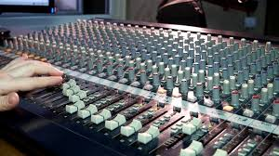
Audio Mixing – Making One Thing From Many

Slide 7
Shazam and Soundhound (and Shamu?)
Shazam – recognizes a specific piece of music using its unique “audio fingerprint”
Soundhound – identifies songs, but can do it from humming or whistling
STOP AND THINK: Why is Shamu on this slide?
7

Slide 8
Shamu for Songs
If there are many different performances of “the same song” at what point does a variation become a different song?
Is one of these performances the exemplar or prototype of the song? (Sometimes the “cover” is vastly more popular than the original)
Or should we reject the idea that some specific performance is the exemplar and treat any “song” as a large category with many members

Slide 9
What's Different About Describing Non-text Resources?
Sensory Gap
Semantic Gap
9

Slide 10
The Sensory Gap (1)

Slide 11
The Sensory Gap (2)
An infinite number of different sensory "signals“ can be produced by the same object
…And different objects can produce similar signals
Our human perceptual machinery can usually determine when different "signal patterns" are the same object or when similar patterns are different ones
But this object recognition or “computer vision” capability eluded computers for decades, and only recently have deep learning and convolutional neural networks closed this “sensory gap”
11

Slide 12
The Semantic Gap
Instruments, devices, and sensors encode data in formats that are optimized for efficient capture, storage, decoding, or other processing
The representation of the object can't be (easily) processed to understand what the object "means"
There is a semantic gap between the descriptions that people assign and those that can be assigned by automated mechanisms or that are otherwise built into the storage format
STOP AND THINK: What are some examples of resource descriptions assigned by technologies?
12

Slide 13
Luminosity Histogram

Slide 14
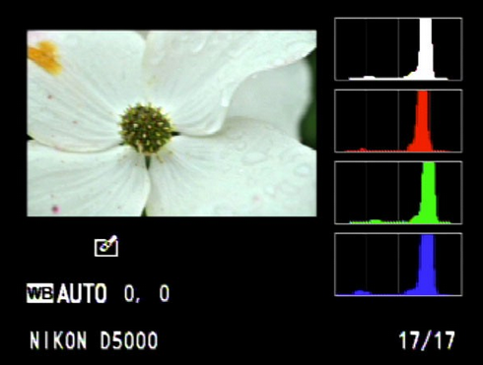
Color Histogram

Slide 15
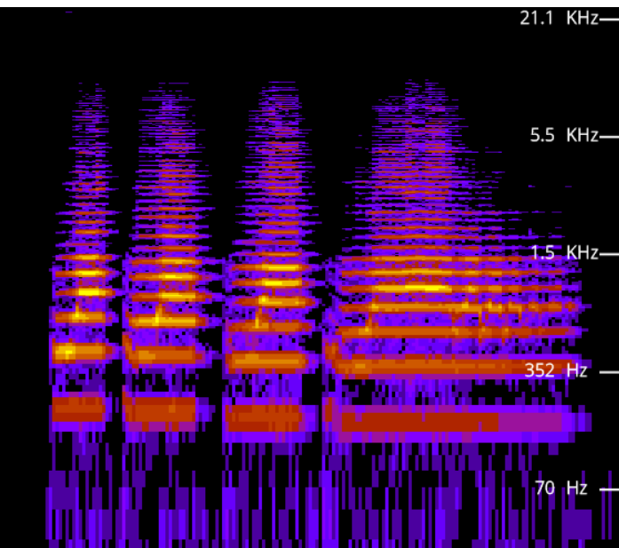
Spectogram
A visual representation of the frequency spectrum of an auditory signal as it varies with time
https://academo.org/demos/spectrum-analyzer/

Slide 16
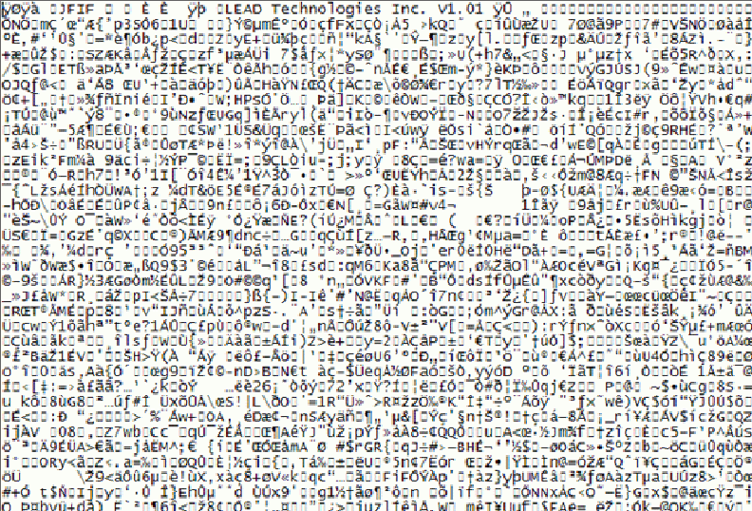
What’s this Picture About?

Slide 17
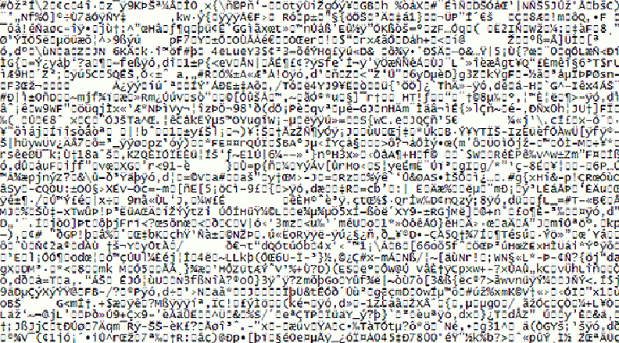
Name That Tune

Slide 18
Bridging the Semantic Gap, or Not?
Bridging the semantic gap means extracting features from non-text content to infer semantic-level descriptions from them, even if those features are not interpretable
An image signature can be extracted from low-level features like color, shape, texture, and luminosity, and images are classified by computing the similarity between signatures
Deep learning approaches combine many layers of feature extractors to significantly improve object recognition
Is this visual scene indoors or outdoors? Nature, cityscape, or crowd scene? What are the objects? Who are those people? Are they happy or about to attack the Capitol?
18

Slide 19
Are these New Problems?
Museums face some of the same or similar problems in describing art works and artifacts:
There may be many artifacts that represent the same "work" - this is like the "sensory" gap
The materials or medium in which the artifact is embodied don't convey semantics "on their surface" - this is the semantic gap
Museums have been around a LONG time… some have been continuously operating for hundreds of years
19

Slide 20
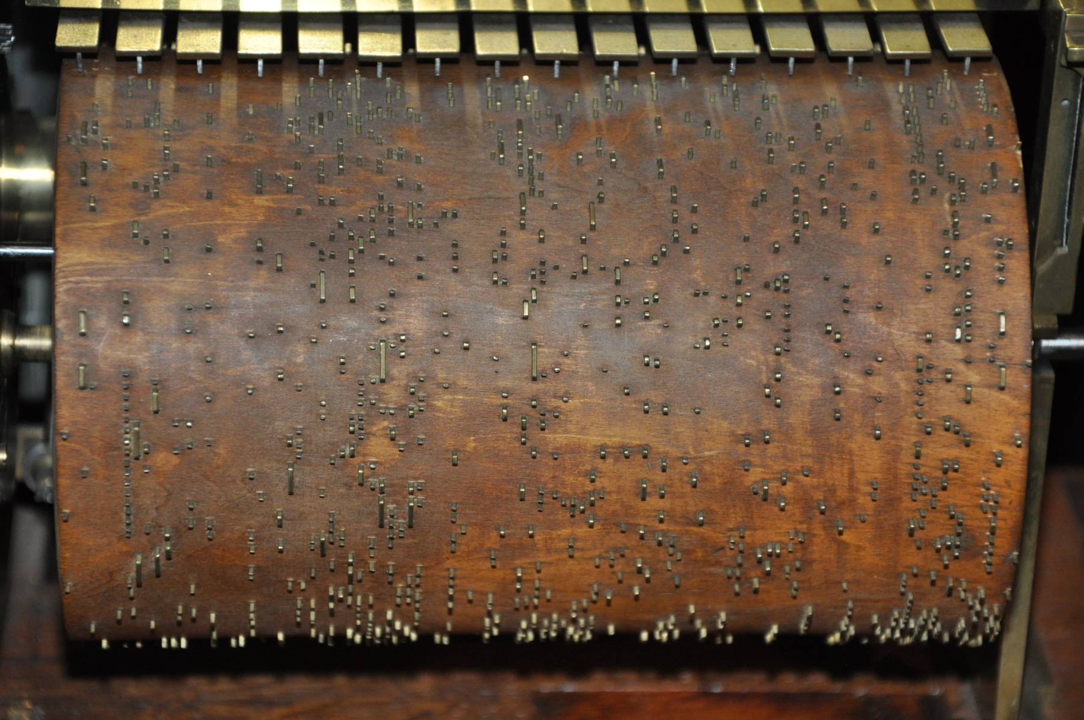
Name That Tune

Slide 21
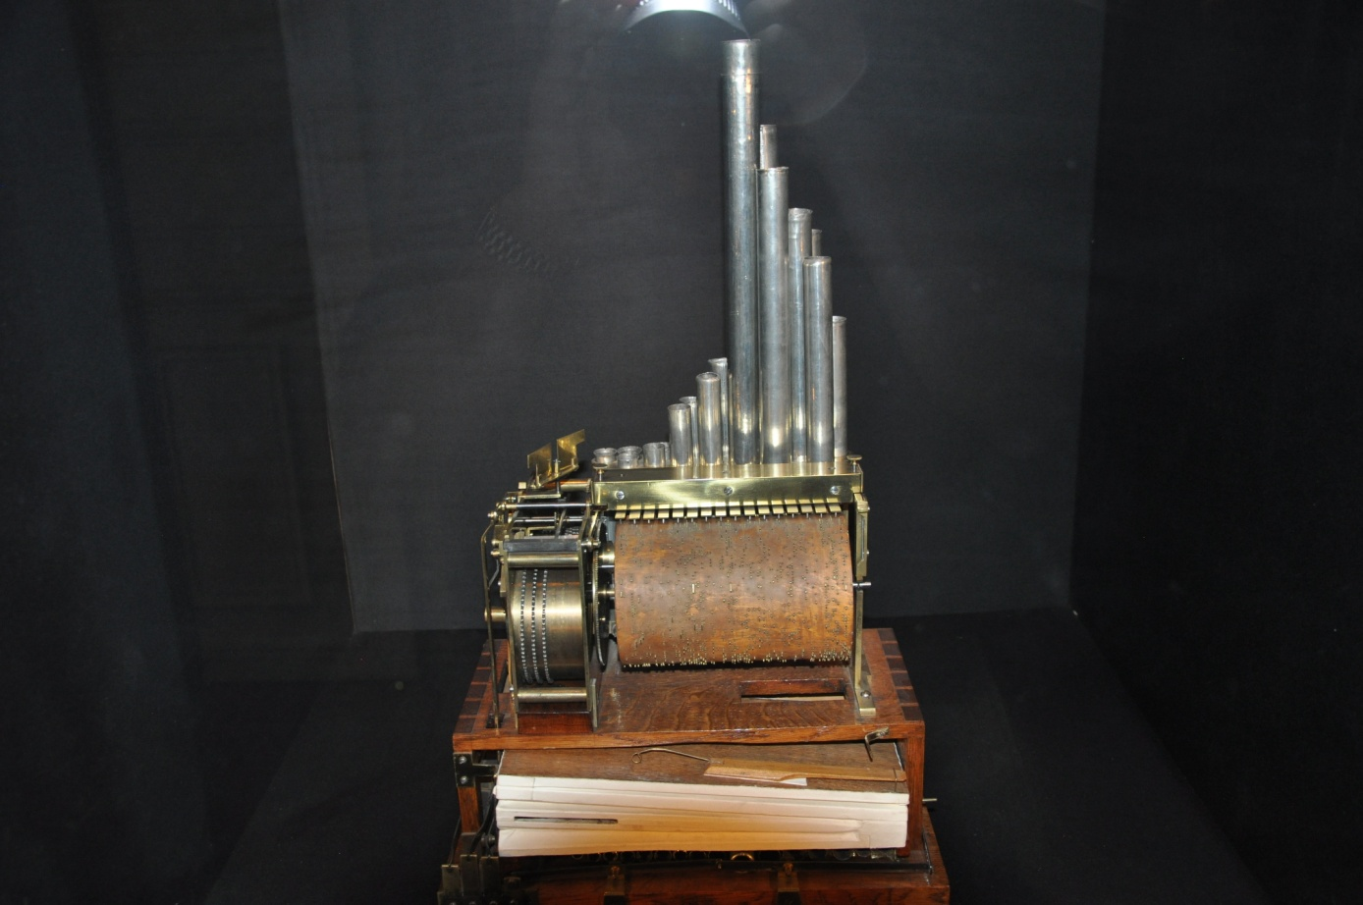
Music Box Controlled by Spoked Cylinder
In Paris the Musée des arts et métiers is never crowded… great place to visit

Slide 22
Some Problems May Be New
The temporal structure of music and video mandates new descriptive vocabulary and new ways to identify meaningful components
Music and video meet emotional/psychological needs that are more complex than those for “text documents" - so the descriptions of the latter have to be able to address these needs
People don't usually access or retrieve music "to satisfy information requirements”... Video sometimes is, but not the most frequent reason
22

Slide 23
Describing Music

Slide 24
Describing Music: Why
Generic reasons for description: Finding, Identifying, Selecting, Obtaining, Exploring
Recommending tracks or artists we might like (e.g., Pandora, Spotify)
Finding copyrighted music where it isn’t supposed to be…so music publishers and distributors can collect data that gets money to the people who deserve it
24

Slide 25
Types of Music Descriptions
The track – size, duration, bitrate, key, energy level, BPM
The medium– CD, cassette, vinyl, streaming
The format – lossless: WAV, AIFF, ...; lossy: MP3, WMA, ...
Who made it, and how it was made - who composed it, who performed on it, what instruments were used, who recorded it
How it relates to other music
What it sounds like, how it makes you feel
What is the musical structure (repetition, contrast, transformation, other compositional patterns)?
25

Slide 26
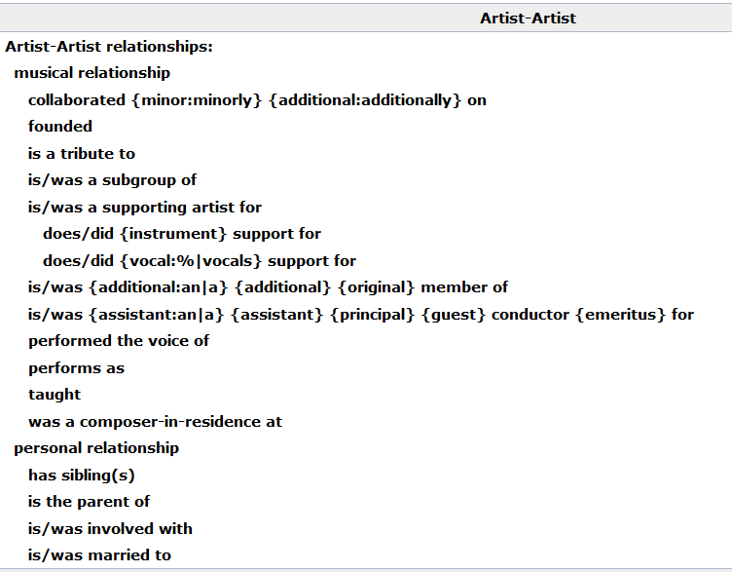
Relationships in Musicbrainz Database
26

Slide 27
Describing a Music Recording: Where & How Much
Oldest method: encode descriptions in filenames
Example: https://archive.org/details/gd73-02-09.sbd.bertha-fink.14939.sbeok.shnf
“Improvement” – encode description into the music files
ID3 format (1996) initially added as a hack to MP3 music files, which had no place for descriptions
Today – rich music descriptions that are managed by applications apart from the recordings
27

Slide 28
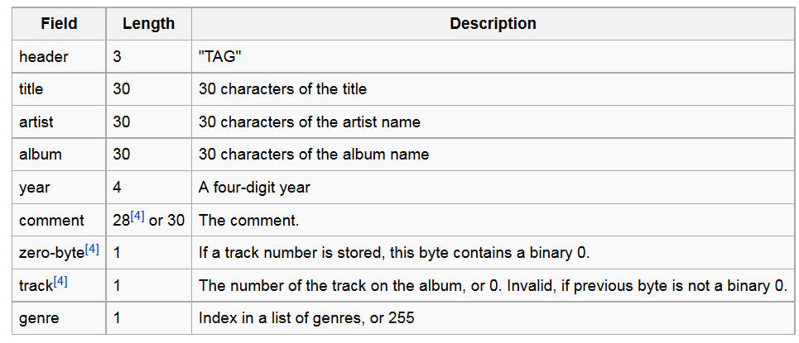
ID3
Barely adequate for ordinary “rock” or “pop” songs: Smoke on the Water / Deep Purple / Machine Head / 1972
It fails miserably for classical music; no way to encode part-whole relationships, composer, conductor, other stuff that matters to serious music people
28

Slide 29
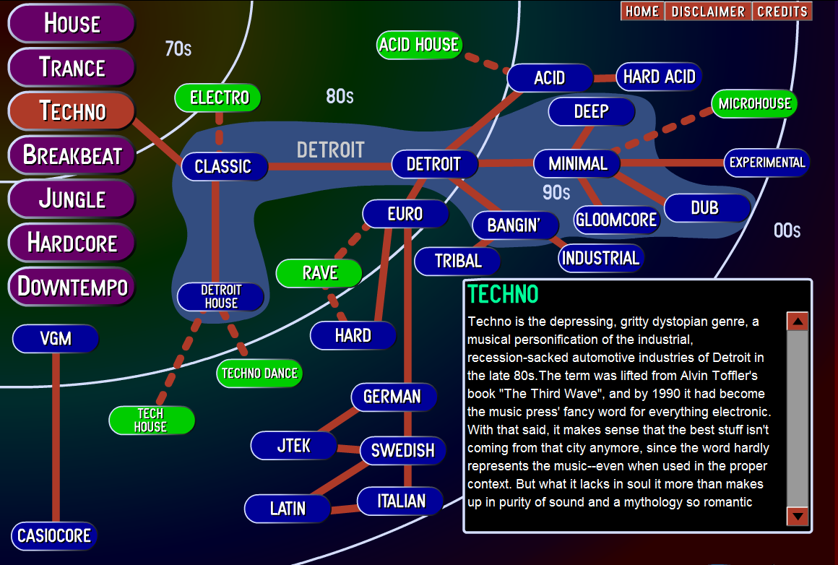
Music Genres (defined by human experts)

Slide 30
The Music Genome (1)
About 20 years ago Pandora's founder Tim Westergren hired Stanford musicology grad students (led by Nolan Gasser) to implement his vision that there were “music species” that could be defined by sets of “music genes”
An old idea – Hungarian composer Bartok classified thousands of folk songs into melodic families over a hundred years ago (Note 305 in TDO 4th Professional edition)
“Groups of genes” for musical analysis include melody, harmony, rhythm, form, instrumentation, lyrics
30

Slide 31
The Music Genome (2)
A song can have as many as 450 genes; rock and pop songs have 150 genes, rap songs have 350, jazz songs have approximately 400, classical music often more
A specific gene might be “wah-wah and fuzz guitar distortion”, “gender of lead vocalist”, very granular features
If you don’t know what “wah-wah and fuzz” are: https://www.youtube.com/watch?v=yzUJS4kjzcs
2 million songs analyzed manually (20-30 minutes each, 25 people doing it); this collection used to train computational classifier
31

Slide 32
Data-driven Organization of Music and Music Artists
Every interaction with music that CAN be captured is probably being captured; this includes music playing in any connected app, music streaming, and what else?
These rich data sets can be analyzed to organize music and to organize music artists
Example: “Music Map” organizes artists by their musical similarity and into five popularity categories: Undiscovered, promising, established, mainstream, epic
32

Slide 33
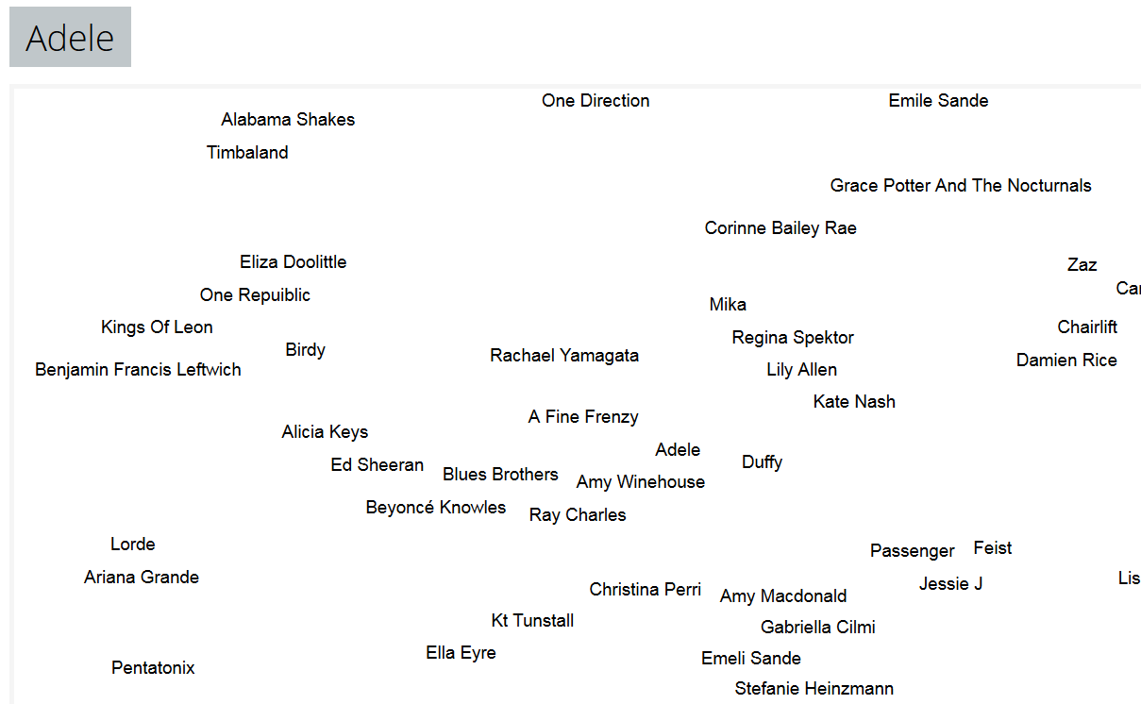
Musical Similarity to Adele http://www.music-map.com/adele.html

Slide 34
Professional Descriptions for Non-text Resources

Slide 35
"Professional" Descriptions for Multimedia and Non-textual Works
Museum works and other non-text artifacts have long been described by professionals using structured resource descriptions according to classification rules
The descriptions are often "layered" beginning with accessible properties with more analytic descriptions added for those objects that warrant them
35

Slide 36
Layered Descriptions
Why do we need different levels of description?
Does every resource need them? For what kinds of works is it worth making this investment?
What kinds of people/skills are required to be work at each of these levels" -- and at what cost?

Slide 37
Panofsky's Three Levels of Meaning
Description ("Preiconographic“ or “Primary”)
Identification ("Iconographic“ or “Secondary”)
Interpretation ("Iconologic“)
37

Slide 38
Description / “Preiconographic” / Primary Level
The "primary" or "natural" subject matter of a work
“The kind of thing” - the generic elements or things depicted in, on, or by an object / image / artwork
These would be recognizable by anyone, regardless of their expertise or training
38

Slide 39
Identification / “Iconographic” / Secondary Level
The (authoritative) name of the subject or thing depicted in the work
Can require research or fact assembly from sources of social and cultural knowledge
39

Slide 40
Interpretation / “Iconologic” Level
The meaning or theme represented by the subject matter or iconography of the work
This meaning is often symbolic, and deeply grounded in the culture in which the work was created
Done by domain and methodology experts
40

Slide 41
PRIMARY: Marble statue of nude woman standing on a seashell
SECONDARY: Statue made in 2005 by Lucio Carusi of Carrara, Italy, titled “Venus”, made of local marble
INTERPRETIVE: 3D transformation of 1486 painting by Italian painter Sandro Botticelli, titled “Birth of Venus.” Carusi’s Venus is substantially slimmer in proportions because of changing notions of female beauty
(TDO Figure 5.6)
Panovsky’s 3-Level Scheme
41

Slide 42
“Birth of Venus” Uffizi Gallery, Florence Italy

Slide 43
Getty Categories for the Description of Works of Art (CDWA)
The CDWA is a large vocabulary with 532 elements and sub-elements
Each element typically has a controlled vocabulary or recommends one (e.g, Art and Architecture Thesaurus)
There is a core set of 36 elements
CDWA-Lite is the XML specification for another simple subset of CDWA
43

Slide 44
CDWA’s First Question
You should have been able to guess the first question raised in the CDWA documentation
Section 1.1 of the CDWA (the top-level element) is “Object/Work”
Works of art or architecture may be considered a single item, or they may be made up of many physical parts or arranged in separate physical groupings. It is necessary to define the particular work of art, architecture, or group of objects in question, whether it be a single painted canvas, or an altarpiece made up of many panels…
44

Slide 45
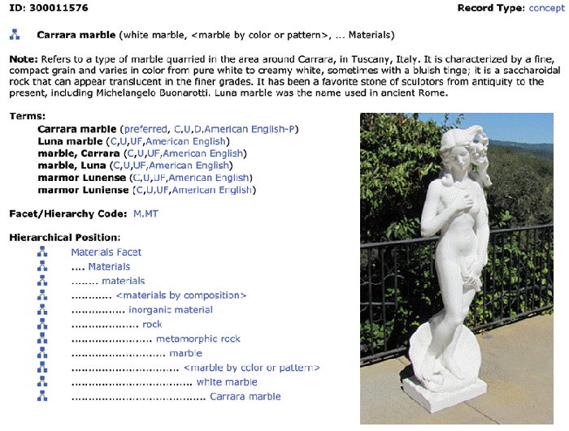
Art and Architecture Thesaurus
45

Slide 46
Can You Describe this Painting? At What Level(s)?
The painter
Not the only time this subject has been painted

Slide 47
The Shamu Question for Paintings
“Adoration of the Magi” is the most popular theme in Christian painting; it is the name of a category of paintings as well as the name of each of them

