Slide 1
CogSci 150 “Sensemaking and Organizing” Spring 2021
Robert J. Glushko glushko@berkeley.edu
16 February 2021
9) Describing Non-Text Resources: Art, Artifacts, Music, …

Slide 2
Course Review

Slide 3
The Course in One Slide
When something "makes sense” or " is organized” we are imposing or discovering order in the arrangement of concepts, events, or resources of some kind.
Sensemaking and organizing are fundamental human activities that raise many multi- or trans-disciplinary questions about perception, knowledge, decision making, interaction with things and with other people, values and value creation.

Slide 4
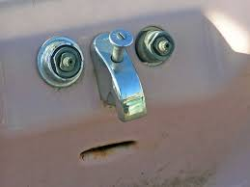
Sensemaking
Making sense of, or giving meaning to something, especially observations or experiences
Some sensemaking is automatic, done by hard-wired brain mechanisms that simplify and organize sensory and perceptual input
Gestalt Principles
Pareidolia

Slide 5
Sensemaking {and, or, vs.} Organizing
Sensemaking can be considered a superset of, or a more generic perspective, on organizing
But I think it is better to see it as one end of an automatic <-> intentional continuum defined by the extent to which organizing is intentional

Slide 6
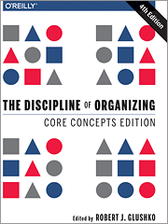
Organizing
Creating capabilities by intentionally imposing order and structure

Slide 7
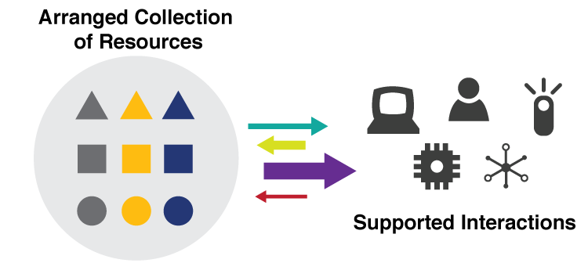
They are all “Organizing Systems”
A collection of resources intentionally arranged to enable some set of interactions
7

Slide 8
ORGANIZING SYSTEMS BIG IDEAS
Every organizing system must enable users to interact with its collection of resources
The possible interactions depend primarily on the nature and extent of the descriptions associated with the resources
Intentional arrangement emerges when one or more resource descriptions are used by organizing principles
8

Slide 9
Say it Again: TDO’s Mantra
Organizing, resource description, and interaction design are inherently interconnected activities

Slide 10
Consequences of Category Thinking
Using an established category to describe an organizing system reinforces its conventional characteristics, even if we add qualifiers
… and marginalizes any atypical characteristics of the organizing system being categorized
10

Slide 11
A “Design Space” or “Dimensional” Perspective
In addition to using categories like Library or Museum or Business Information System, consider a specific organizing system as a point in a multidimensional design space and these categories as regions in that space
This treats the familiar categories as “design patterns” that embody typical configurations of design choices
11

Slide 12
The 6 Dimensions of an Organizing System
What Is Being Organized?
Why Is It Being Organized?
How Much Is It Being Organized?
When Is It Being Organized?
Who (or What) is Organizing It?
Where is it Organized?
12

Slide 13
Consequences of Dimensional Thinking
Overcomes the bias and conservatism inherent in familiar categories
Design patterns support multi-disciplinary work that cuts across familiar categories and applies knowledge about them to new domains
Creates a design vocabulary for translating concepts and concerns from category and discipline-specific vocabularies (the secret of being a successful consultant)
13

Slide 14
The Activities in Organizing Systems
We can identify four activities in the lifecycle of every organizing system:
Selecting resources
Organizing resources
Designing resource-based interactions and services
Maintaining resources
14

Slide 15
Domain-Specific Terms
Selecting – acquisition, accessioning, ingesting, ?
Organizing – grouping, exhibiting, positioning, integrating, alphabetizing, ?
Interactions – searching, finding, identifying, ?
Maintenance – removing, discarding, deleting, ?

Slide 16
Resources:
Anything of value that can support goal-oriented activity

Slide 17
What is a Resource?
When you look at, refer to, or pick up a natural physical object, it usually seems that it is "one thing"
But many things have highly visible parts or internal structures, and we must decide whether to treat them as assemblies or aggregations of these separate things
For digital and computational resources, it is much harder to know how many parts we can or should identify
17

Slide 18
Two Aspects of “Thingness”
Two separate aspects cut across the "thingness" distinctions:
Granularity – do we think of the resource as unitary, or as consisting of parts?
Abstraction – “thing” or “type of thing” – are we thinking of the resource as a single instance or as a member of a bigger category?
18

Slide 19
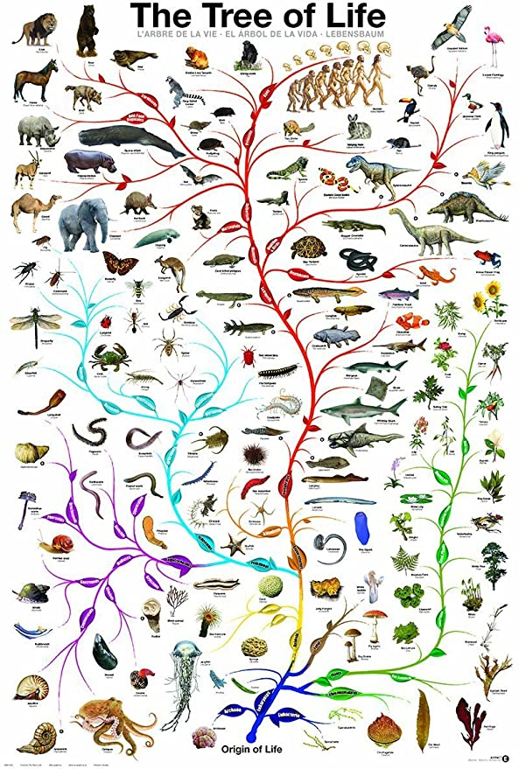
“Carving Nature at its Joints”
Over 2000 years ago Plato argued that species are distinguished by "carving nature at its joints" - where the natural differences between things are the largest or most salient
I.e., there are “natural kinds” – categories are discovered, not invented
19

Slide 20
Finding the Joints
Today we call Plato’s method “unsupervised learning” - you don’t know what the category labels are, but you can determine the category boundaries if you:
Make the similarity of things in the same category as high as possible while making the similarity between categories as low as possible
Do this by finding “clusters” or correlations of feature values
This is easy to say but can be computationally complex
20

Slide 21
Carving Information at its Joints? (“Information Architecture”)
The granularity of physical resources is more easily determined than for information resources, because information "joints" are much more arbitrary
There might be indications "on the surface" that suggest the "joints" between information resources, but these represent design decisions, might be more structure or presentation oriented than content- oriented distinctions, and are subject to cognitive interpretation
21

Slide 22
The Document Type Spectrum
Different domains or types of documents can be distinguished according to the extent to which their content is semantically prescribed, by the amount of internal structure, and by the correlations of their presentation and for­matting to their content and structure
Documents and data fall on a continuum

Slide 23
Resource Abstraction: “Thing” vs. “Type of Thing”
We often blur the distinction between individual things (or instances of things) and classes of things
You can buy that at Home Depot
You can see that in the Louvre
Identifying a resource as an instance is not the same as identifying the category or "equivalence class" to which it belongs
23

Slide 24
“Shamu” -- Instance or Type?
24

Slide 25
Intentional Arrangement:
Explicit or implicit acts of organization by human or computational agents

Slide 26
Organizing Resources
Almost any property of resources can be used to organize them, but the most appropriate or effective properties differ across resource types and tasks
The scope and scale of an organizing system influence/constrain organizing principles and interactions
Decisions about which resource properties will be used in organizing must often precede the creation or selection of the resources
26

Slide 27
A “tall” dataset might contain many millions or even billions of records, but each has a relatively small number of variables
(e.g., a bank’s credit card accounts)
Scope and Scale: Tall Data vs. Wide Data
A “wide” dataset might also have many records, but each record has a large number – hundreds or even thousands - of variables (e.g., predictive analytics, Facebook).
“Tall Data” is traditional computer science and software engineering. “Wide Data” is the cutting edge in data science/ML

Slide 28
Organizing Principles <=> Resource Descriptions
Frequency of Use <=> Usage information
Color, shape, size… <=> Physical properties
Alphabetical order <=> Sortable resource name or identifier
Chronological order <=> Sortable date/time of important event
Semantic <=> Content description

Slide 29
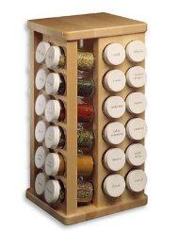
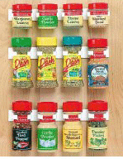
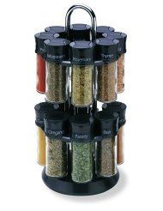
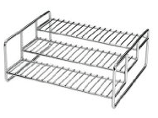
Principles don’t Specify Implementation: “Organize Spices Alphabetically”
THINK ARCHITECTURALLY!
29

Slide 30
What is a Name?
But most resource names do not convey properties of the resource
If a name is used to refer to some thing and is unique in some context it is an IDENTIFIER
30

Slide 31
Issues with Names and Naming – 1
A specific resource or type or resource can often have multiple SYNONYMS or ALIASES
box, carton
Bob Glushko, Robert J. Glushko, Dr. Bob
Different things can sometimes have the same names -- these are HOMOGRAPHS or POLYSEMES
Bank (money sense), bank (river sense)
John Smith, 张伟(Zhang Wei)
31

Slide 32
The “Vocabulary Problem”
People use a large variety of words for the same thing or concept
Most people - especially system designers - are surprised by this because they think their own word choices are “intuitive” or "natural“
The extreme variability of word selection is an inescapable fact that has its roots in the nature of language and categorization
32

Slide 33
Issues with Names and Naming – 2
False cognates (GIFT, PAIN)
A name can have undesirable associations
A name can have impermanent attributes or associations or be “faddish” (baby names over time)
Alphabetic ordering bias
Autogenerated names don’t convey any meaning (SCAN0098.JPG)
33

Slide 34
Questions about Names
How many names should be associated with an information object or resource?
Should one be designated as the preferred or authoritative form? Who decides?
What references should be made from other possible forms of names that haven't been used? Should you autocorrect/coerce?
if you have a common last name, should you give your kids a rare first name?
34

Slide 35
Resources and Identity Over Time
Organizing systems continually need to adapt and evolve in response to changes in content and context
New resources are created or added, and other ones are destroyed or culled
Resources might change in controlled ways or in uncontrolled ways
The organizing system might need automated or formal mechanisms for ensuring persistence and authenticity
35

Slide 36
Putting them all Together
TDO Figure 3.6
36

Slide 37
Why We Describe Resources
We describe resources so we can refer to them, select them, organize them, interact with them (sometimes to compare them), and maintain them
(TDO Ch 3 “Activities in Organizing Systems” – 1/28)
Different activities with resources imply different descriptions and different methods of using them
Resource domains can have characteristic or standard resource descriptions that are applied to every resource instance (often called “schemas” or “domain-specific languages”) and in doing so define resource categories
(TDO Ch 7 “Categorization” – 2/23)
37

Slide 38
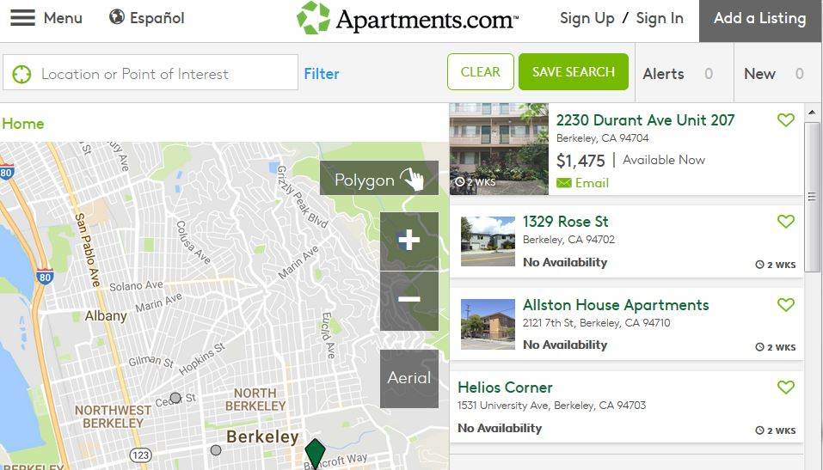
Resource Descriptions as Substitutes
A resource description (e.g., in a library catalog or search engine) is a functional substitute for the resource it describes
Digital descriptions of physical resources enable interactions that are otherwise inefficient or impossible
38

Slide 39
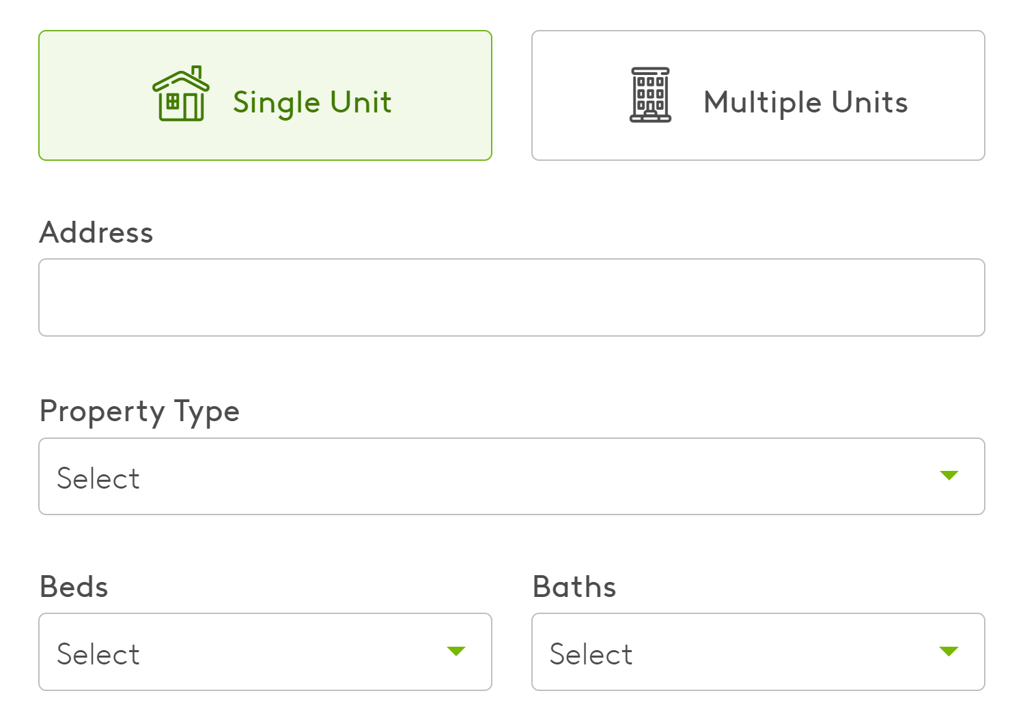
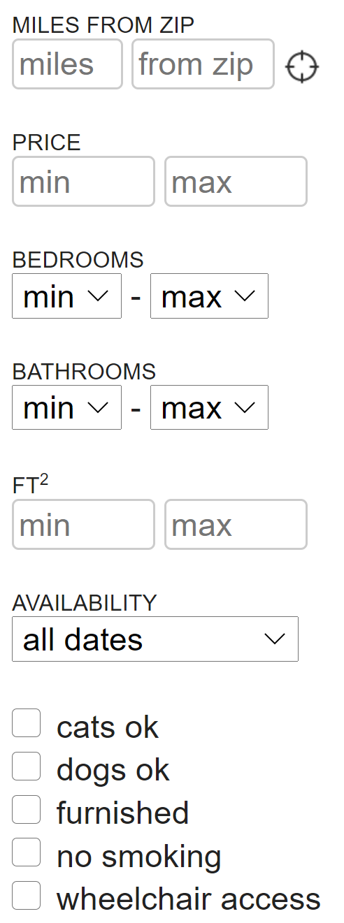
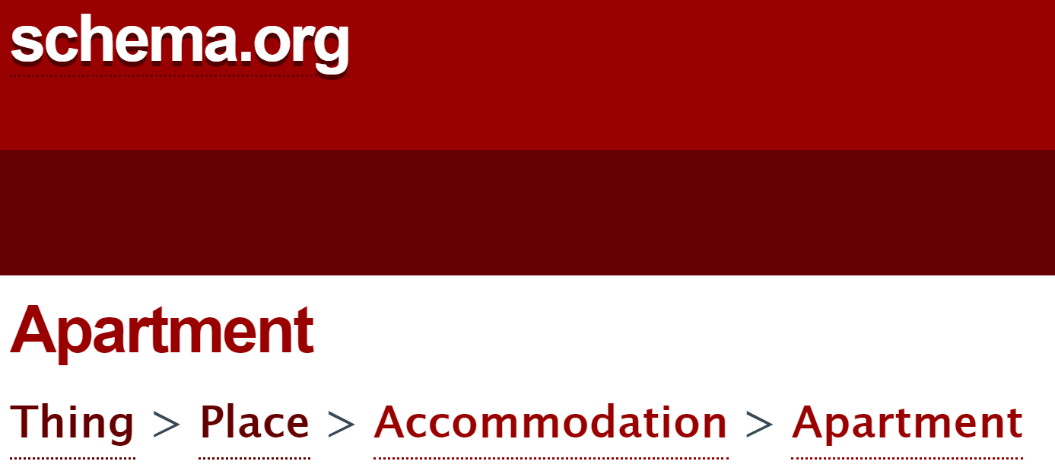
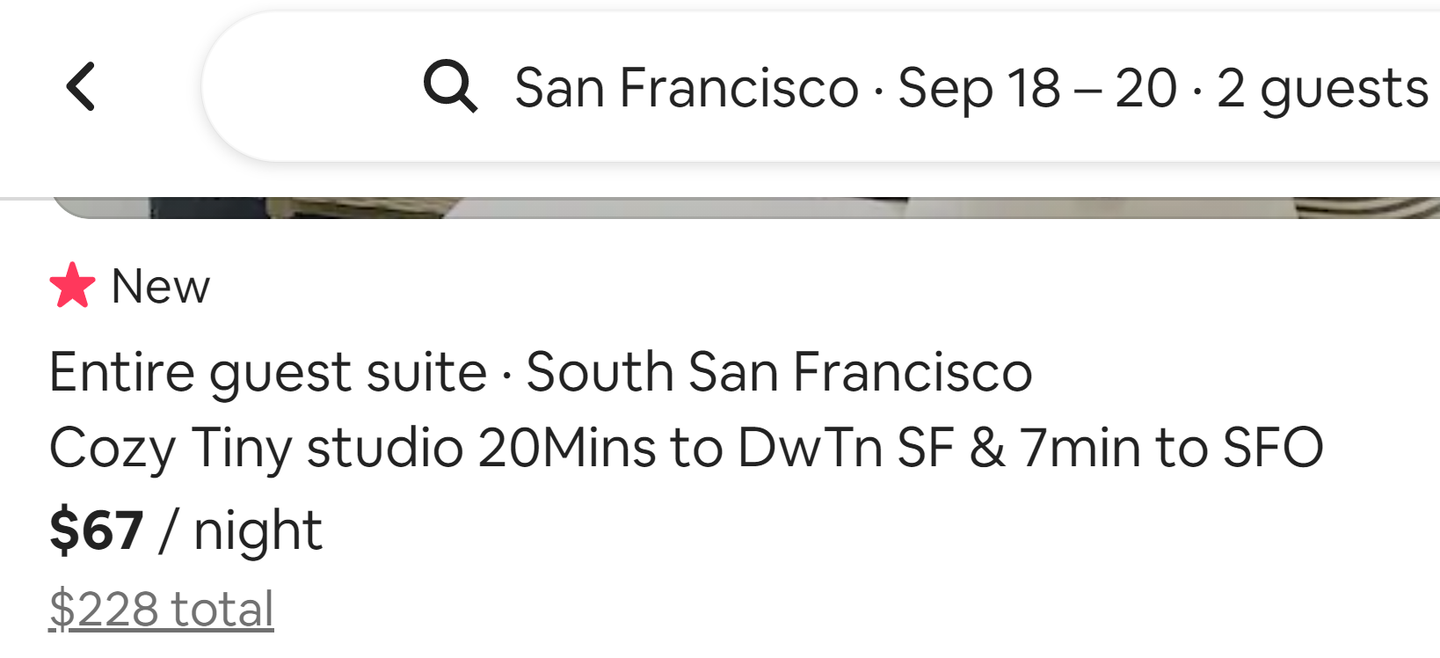
Substitution Requires a “Reasonably Standard” Description of Instances (a “Schema”)
CRAIGSLIST
APARTMENTS.COM
AIRBNB
39

Slide 41
Structured descriptions of (information) resources are often called “metadata” (“data about data”)
But unless the resource being described is a collection of data, it is factually wrong
Any resource can have associated descriptions, not just information resources, and the descriptions don’t need to be “data”
The most valuable descriptions are about human resources (i.e., people)
And what’s “metadata” for you might be “data” for me, or vice versa (“Resource Focus”)
41

Slide 42
Big Ideas (1)
Resource description and organizing are intrinsically connected
Any resource can have associated descriptions, and the descriptions don’t need to be “data”
Different activities with resources imply different descriptions and different methods of using them
The same resource can be a primary one, or a description resource associated with another one that is the primary focus
The scale and diversity of datasets makes resource description the fundamental challenge in data science
42

Slide 43
TDO 5.3 Proposes this Process for Describing Resources
1. Identify / scope the resources to be described
2. Determine the uses of the descriptions
3. Study the resource(s) to identify descriptive properties
4. Design the description vocabulary
5. Design the description form and implementation
6. Create the descriptions (either "by hand" or by some automated / computational process
7. Evaluate the descriptions
43

Slide 44
Which Descriptions To Use?
It is essential to know the planned uses and interactions with the resources; this is easier to do if a team rather than an individual is describing them
It helps a great deal to know what a collection contains when starting to describe its members… but why?
How many features do we need?
Specific features are easy to apply to instances, but many instances won’t have those features (=> sparse dataset)
More abstract features are helpful at bounding the domain / set of possible instances

Slide 45
Big Ideas (2)
It probably seemed easy to come up with description terms, but the vocabulary problem is real. Friends don’t let friends model alone
The process and result of identifying descriptions from a series of instances is likely to be very different than from a collection of instances
The scope of a resource collection – the breadth and heterogeneity of instances – is far more important than scale
Scope makes resource description and computation with descriptions more challenging
45

Slide 46
Big Ideas (3)
Describing and organizing always (explicitly or implicitly) takes place in some context, which shapes which resource properties are important and the organizing principles that use them
A collection of resource descriptions is vastly more useful when every resource is described using the same features/properties/categories to which the controlled vocabulary is applied, making it a “schema” or “domain-specific language
Different ways of creating resource descriptions have costs and benefits; who pays the costs and who benefits?
46

Slide 47
Controlled Vocabularies
A Controlled Vocabulary is an artificial language designed to be used in place of the "natural" ones that people would otherwise use, but only “trained describers” can use them
A collection of resource descriptions is vastly more useful when every resource is described using the same features/properties/categories to which the controlled vocabulary is applied, making it a “schema” or “domain-specific language”
Put more simply: Uses, users, and the process by which the description vocabulary is created always create bias in the vocabulary
47

Slide 48
Resource Description Checklist for Data Scientists
The size and diversity of datasets makes resource description the fundamental challenge in data science
Where did the data come from (provenance)? Is the source credible? Is the dataset relevant to the questions you’re asking?
Why were these descriptions selected? What are the possible values? Units and levels of measurement? Precision? Vocabulary control?
Are the values accurate? Stable? Current? Correlated? Human-interpretable?
Did the people who designed and collected this dataset think about it in the same way that you do?
48

Slide 49
Say it Again: TDO’s Mantra
Organizing, resource description, and interaction design are inherently interconnected activities

