Slide 1
CogSci 150 “Sensemaking and Organizing” Spring 2021
Robert J. Glushko glushko@berkeley.edu
18 February 2021 10) Introduction to Categorization; Cultural Categories; Linguistic Relativity; Bi-lingualism and Bi-culturalism

Slide 2
Outline
Categories of Categories
Cultural categories
Natural categories
Linguistic relativity
Bilingualism and Biculturalism

Slide 3
Categories of Categories
Categories are sets or groups of resources, “classes of things” or abstract entities, that are treated the same
In TDO there are two ways to contrast categories
CATEGORY CONTEXT: How they are created (individual, cultural, institutional, computational)
CATEGORY STRUCTURE: How they are defined or structured (enumerated, property-based, similarity based…)

Slide 4
Plan for the Course
We can analyze sensemaking and organizing from four interrelated perspectives:
As a member of a social, cultural, or language community (linguistics, sociology, social network analysis)
As an individual (psychology and philosophy)
In institutional contexts (law and business)
In data-intensive or scientific contexts (statistics, computer science, info visualization).

Slide 5
Describing and Organizing Classes of Things (1)
We all create individual categories to organize our possessions, activities, and interactions
Our organizing systems are often ad hoc and idiosyncratic to satisfy the requirements that emerge from our unique experiences, preferences, and resource collections
5

Slide 6
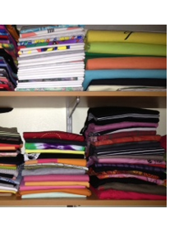
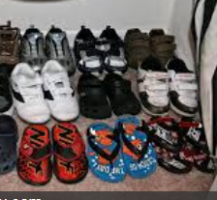
An Organized Closet
6

Slide 7
Describing and Organizing Classes of Things (2)
Cultural categories are embodied in culture and language and have imprecise / flexible boundaries
Individual categories often make use of or are derived from cultural categories
7

Slide 8
Color in Culture
How Color Changes the Mood in Art

Slide 9
A Calming Color Scheme
“Water Lilies”
Claude Monet, 1916

Slide 10
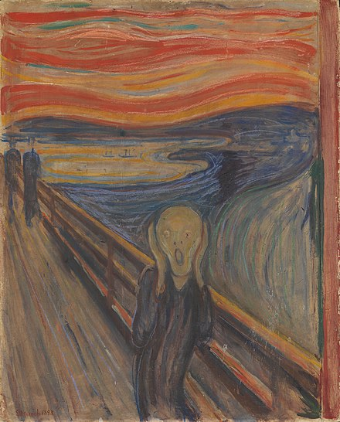
Not Calm, Distressing
“The Scream”
Edvard Munch, 1893

Slide 11
Not Calm. Not Distressing
“Color Study”
Wassily Kandinsky, 1913

Slide 12
Describing and Organizing Classes of Things (3)
Institutional categories are explicitly constructed to create a precise semantic model (of what might otherwise be treated as cultural categories)
And often co-exist with them (e.g., “Color”)
Institutional categories are essential in abstract, information-intensive domains where semantic precision is essential for processes, transactions, and analyses (especially automated ones)
12

Slide 13
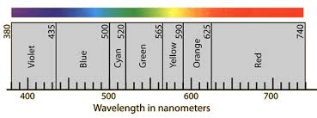
Color Defined by Wavelength
Pantone Color System

Slide 14
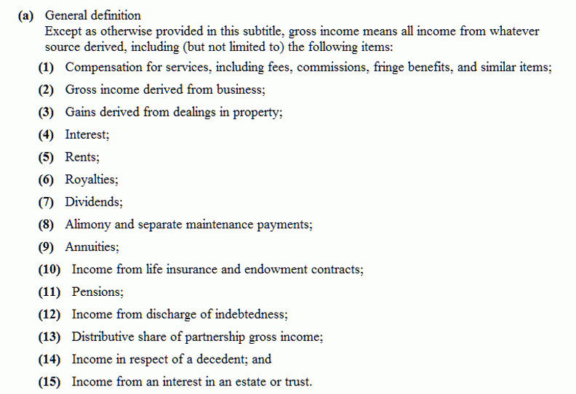
"Gross Income" Tax Code Categories
14

Slide 15
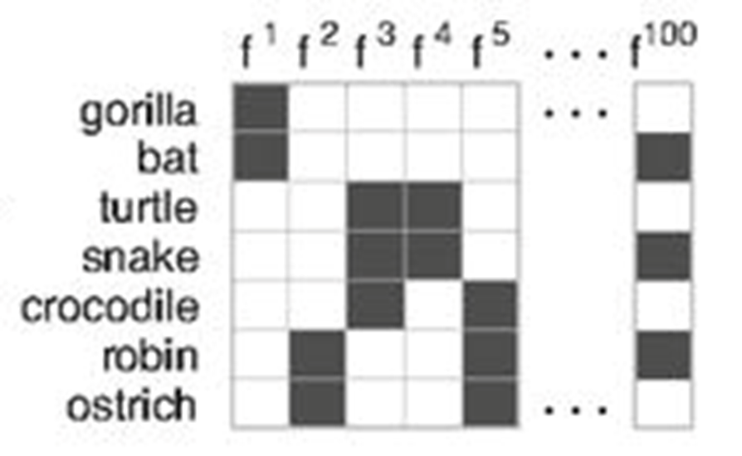
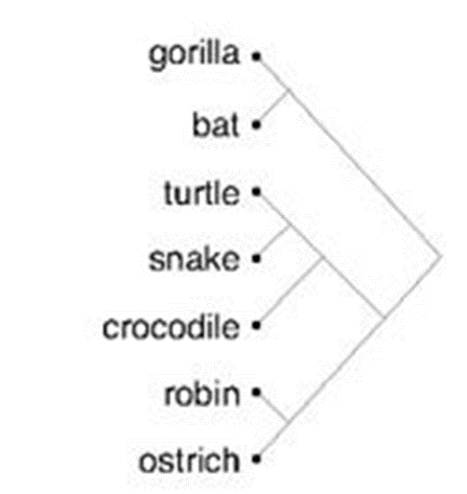
Describing and Organizing Classes of Things (4)
Computational categories are created by computers
Hierarchical clustering: Start with each item in its own cluster, merge the two most similar clusters, recalculate similarity between clusters, do it again. Builds a tree from the bottom up
15

Slide 16
Cultural Categories
We use tens of thousands of categories that are embodied in our culture and language
… oops, we haven’t defined “culture”
And defining it is a bit tricky (STOP AND THINK)
16

Slide 17
Some Definitions of “Culture”
the customary beliefs, social forms, and material traits shared by a group of people in a place or time (culture in the world?)
whatever someone has to know or believe in order to operate in a manner acceptable to other members of a group they belong to (culture in the mind?)
whatever knowledge or beliefs other groups have that prevents them from seeing the world objectively and “correctly” – the way we do (is culture defined relatively?)
17

Slide 18
Comparing Cultures
How can we compare cultures?
Are there primitive, native, intuitive or scientific cultures that can be arranged on some continuum of maturity or capability?

Slide 19
Culture as a “System of Meaning”
Culture is not chaotic or random … it is a SYSTEM (an organizing system) (of systems…)
This system determines what sorts of things or events need to be attended to and explained (these are the “resources” in a culture)
It establishes complex interrelated beliefs and behaviors to create a “system of meaning” about those things and events
19

Slide 20
Cultural Categories (1)
We use tens of thousands of categories that are embodied in our culture and language
They develop slowly and typically change slowly
Many have a perceptual or sensorimotor origin based on natural boundaries or discontinuities in perception and experience
….such as
20

Slide 21
Cultural Categories (2)
Learned implicitly through development via parent-child interactions, language, and experience (food, family, fate…)
Informal and contextual acquisition makes cultural categories flexible, creative, generative
… which is why there are often contrasts between cultures in how they view very familiar categories
21

Slide 22
Cultural Categories (3)
Formal education can teach cultural categories, but the non-formal mechanisms often dominate or interfere
Cultures in which formal education is absent or uncommon are laboratories for the study of “intuitive” or “folk” cognition
22

Slide 23
Cultural Categories (4)
When properties or behaviors co-occur in predictable ways, it is useful to have category words that name them => emergence of language, lexicalization
Frequency justifies the effort to learn the word; you can always describe something, but easier to use its name as a shorthand
Linguists argue that the categories of “noun” and “verb” are universal – things that are “time –stable” and things that are actions or events
23

Slide 24
STOP AND THINK “Systems of Meaning”
What are some examples of the systems of meaning that create human culture?
How can we discover, identify, and understand the organizing principles and categories for these systems of meaning?
What additional things/events are organized to create structure for “university student” culture?

Slide 25
Natural / Basic-Level Categories

Slide 26
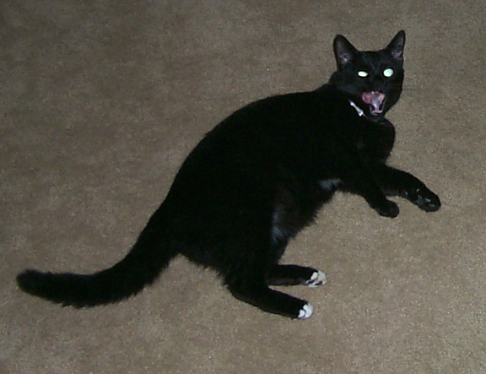
Category Hierarchies
Categories can be organized into a hierarchy from the most general to the most specific
My cat can be described as
An animal
A mammal
A cat
An American Shorthair
Boris
Which of these descriptions are used most often or seem the most natural?
26

Slide 27
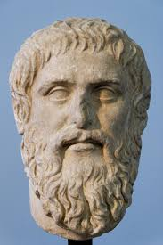
“One of the most basic functions of all organisms is the cutting up of the environment into classifications by which nonidentical stimuli can be treated as equivalent.”
Rosch, E., et al. (1976). Basic Objects in Natural Categories
I think you should have said
“carved up” and given me
some credit - Plato

Slide 28
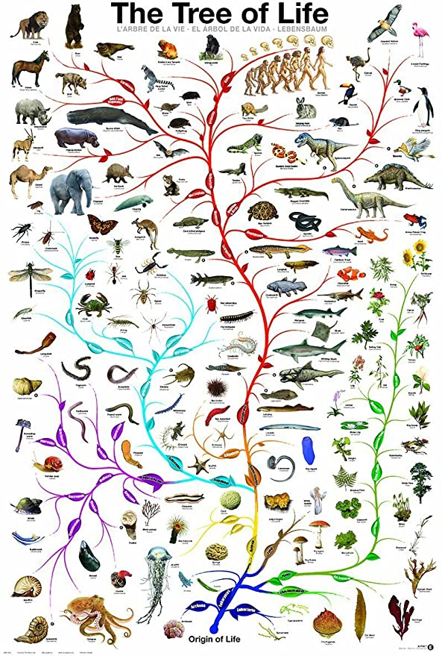
“Carving Nature at its Joints”
FLASHBACK
Over 2000 years ago Plato argued that species are distinguished by "carving nature at its joints" - where the natural differences between things are the largest or most salient
I.e., there are “natural kinds” – categories are discovered, not invented
28

Slide 29
Basic-Level Categories: Why
“The world is structured because real-world attributes do not occur independently of each other”
“Combinations of attributes of real objects do not occur uniformly. Some pairs, triples, or n-tuples are quite probable, appearing in combination sometimes with one, sometimes another attribute; others are rare; others logically cannot or empirically do not occur.”
Basic objects (e.g., bird, chair) are at the level at which there are attributes common to all or most members of the category

Slide 30
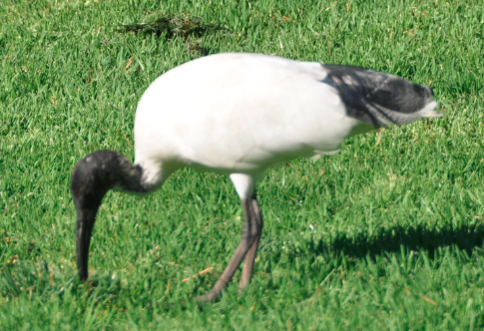
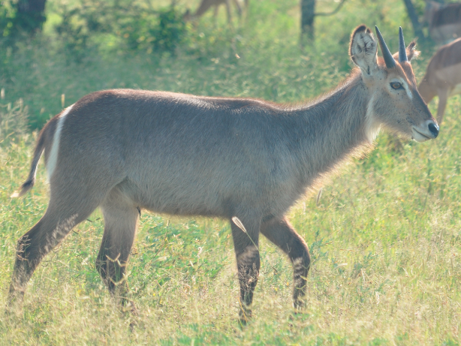
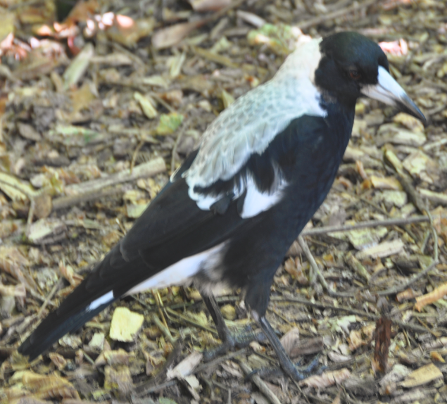
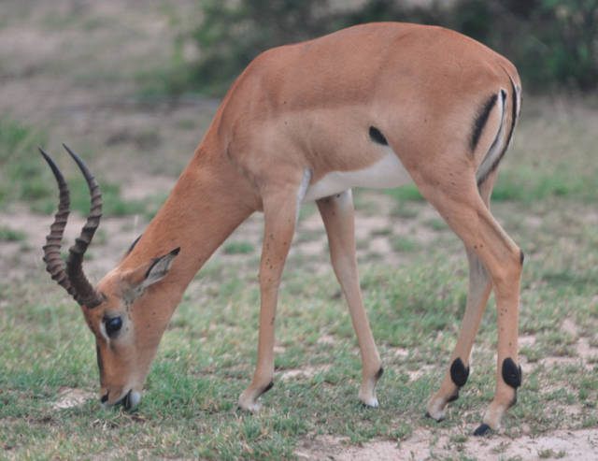
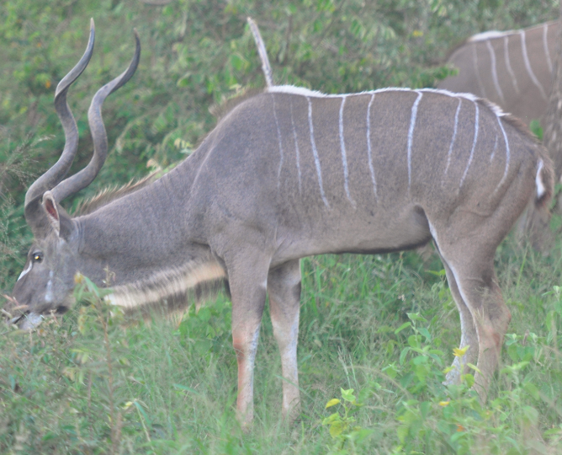
FLASHBACK
Shared Visible Features Carve These Animals into Two Categories

Slide 31
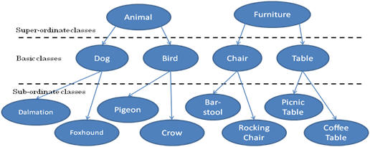
Three-Level Category Hierarchy
STOP AND THINK: What are the lower two levels for VEHICLE, RESIDENCE?

Slide 32
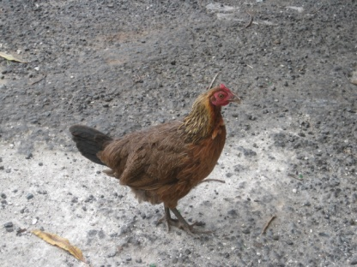
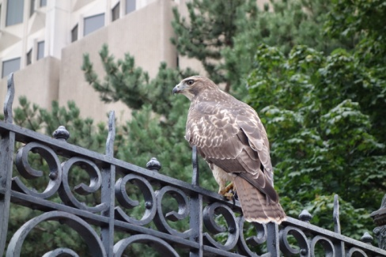
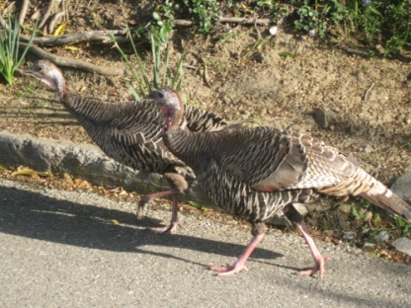
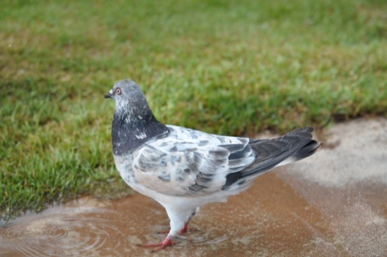
Basic-Level Categories: What
Members tend to have the same shape
They tend to "share parts"
The same motor movements are involved in interacting with them
32

Slide 33
Basic-Level Categories for Activities and Events
Basic level categories are usually thought of as referring to things, but this idea also applies to activities and events
Purchasing something
Shopping at the supermarket
Picking out tomatoes in the vegetable aisle
The essential idea: At the basic level: within-category similarity is maximized, between category similarity is minimized

Slide 34
Basic Categories and Language Use
Let the animal out
Let the mammal out
Let the cat out
Let the American Shorthair out
Let Boris out
34

Slide 35
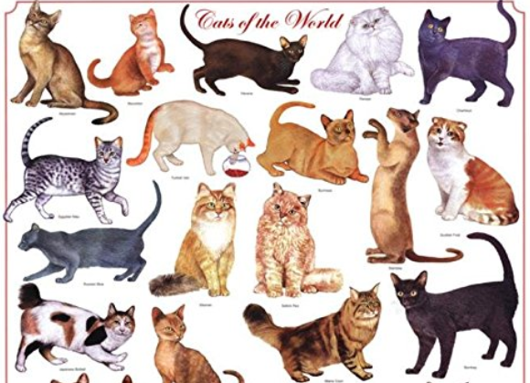
But Not in this Context

Slide 36
Tradeoffs in Abstraction and Granularity
The abstraction level we choose determines how precisely we identify resources. When we want to make a general claim, or communicate that the scope of our interest is broad, we use superordinate categories
As we go down in the category hierarchy, the categories have fewer members, so we can refer more precisely
I’m thinking of a building on campus…
I’m thinking of a tall building with a pyramid-shaped top…
36

Slide 37
STOP AND THINK
Compare “washing your clothes” with “getting dressed” and “putting clean clothes away”
How do “clothing categories” differ in these contexts?

Slide 38
The Precision-Simplicity Tradeoff
Precise (very granular) categories enable efficient communication – if every distinguishable color had its own name, “color talk” would be very concise
But this large set of color categories would not be as simple and easy to learn, remember, and use as one with a small set of color terms
The semantic systems in natural languages tend to achieve a near-optimal tradeoff between these two constraints to balance category abstraction and granularity
Regier, T., Kemp, C., & Kay, P. (2015). 11 Word Meanings across Languages Support Efficient Communication. The handbook of language emergence, 87, 237.
38

Slide 39
Descriptive Precision
Writers, poets, painters, composers, sculptors, technical writers, programmers, producers, architects, designers, and devices or machines can all “create” resources
The Dublin Core vocabulary for describing web pages has a single property for indicating a “creator” (TDO 5.3.1.3)
“Shakespeare” and “Hubble Telescope” are both “creators”
A small description vocabulary is easy to use, but this tradeoff loses a great deal of precision compared to larger and more controlled vocabularies

Slide 40
Linguistic Relativity

Slide 41
Language {and,or,vs.} Thought
What is the relationship between language and thought?
Universalist view: Languages are built on a universal cognitive and conceptual foundation that they use differently
Relativist view: Languages create categories that shape perception, causing speakers of different languages to conceptualize the world in fundamentally different ways
Reconciliation? Universal conceptual basis for the categorical distinctions that languages make, but that this conceptual foundation may be altered by language and culture
41

Slide 42
Linguistic Relativity
Languages differ a great deal in the words they contain (which concepts are lexicalized)
They also differ in more fundamental ways by requiring speakers or writers to attend to details about the world or aspects of experience that another language allows them to ignore
Does this mean that people can't understand concepts that are not lexicalized?

Slide 43
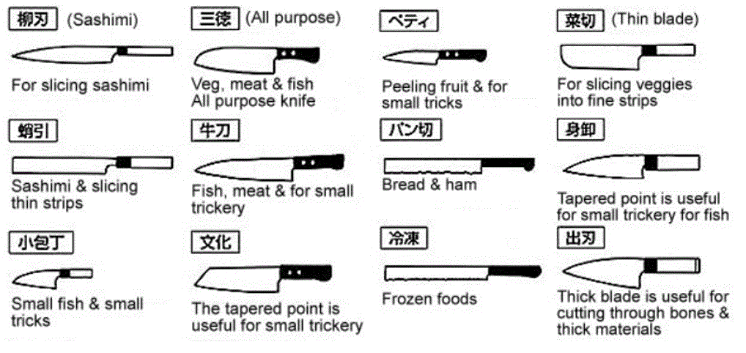
Japanese Kitchen Knives
Does your language have different words for each of these kinds of knives? If it doesn’t, can you still distinguish them? TUTORIAL

Slide 44
Alternative: Linguistic Relativity & the Whorfian Hypothesis
Benjamin Whorf (mid 20th century) is widely credited and miscredited with the strong form of the hypothesis that "language shapes thought" - that the categories embodied in languages shape or even constrain how people perceive and understand the world
Popular argument: Eskimos have lots of words for different kinds of snow, so they think about snow differently than native speakers of other languages
What’s the flaw in this argument?
44

Slide 45
Hinting at Linguistic Relativity in Iceland Advertisement

Slide 46
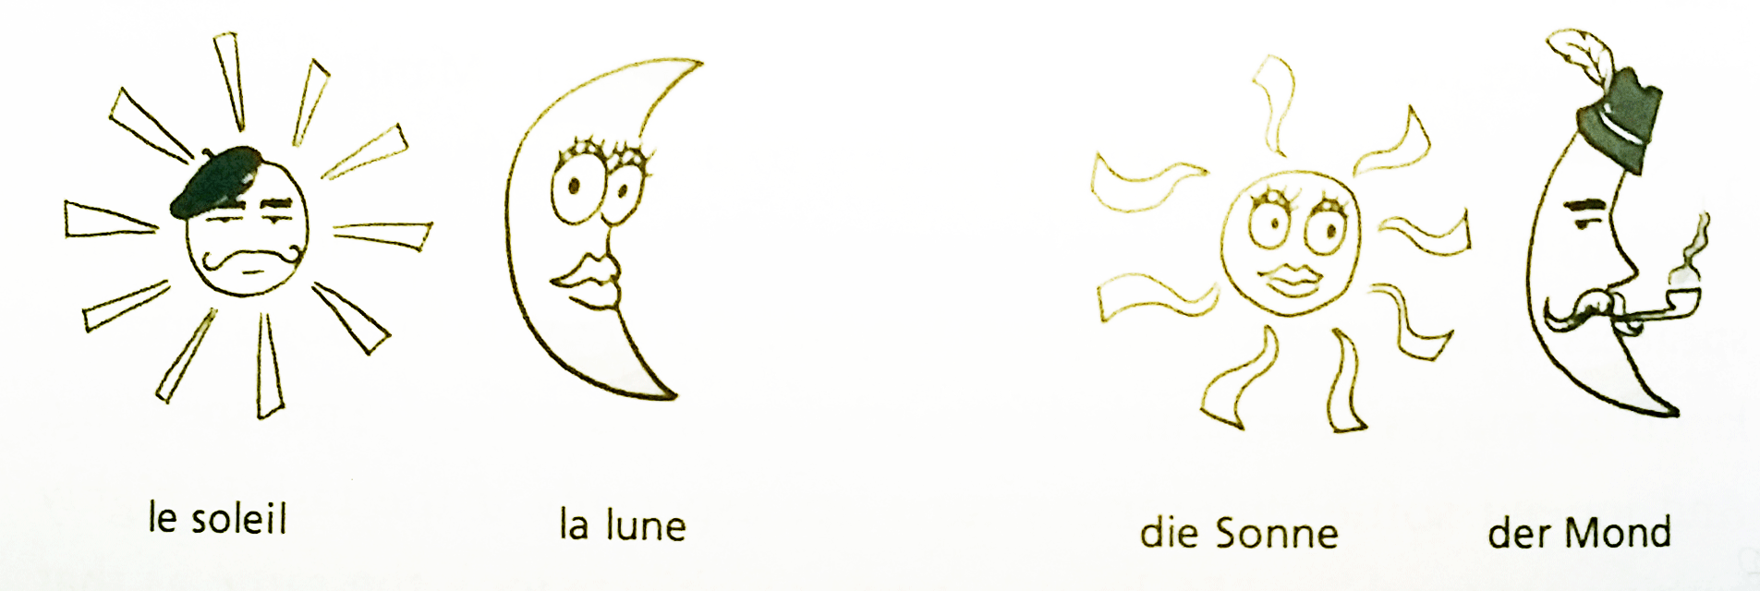
“Weak” Linguistic Relativity is Real
In languages in which nouns have gender, people associate gender-specific characteristics
English marks verb tense, Russian marks both tense and gender; Turkish marks verbs according to whether the speaker has first-hand knowledge of the act
French: Sun is M, Moon is F
German: Sun is F, Moon is M

Slide 47
Color in Language
English Speakers – “Blue” is one category
Russian Speakers – “Blue” is two categories
Winawer, J., Witthoft, N., Frank, M. C., Wu, L., Wade, A. R., & Boroditsky, L. (2007). Russian blues reveal effects of language on color discrimination. Proceedings of the national academy of sciences, 104(19), 7780-7785.

Slide 48
“Languages differ essentially in what they must convey and not in what they may convey.”
Jakobson, Roman (1959) 'On linguistic aspects of translation'

Slide 49
No Shamu Problem in German: “the same thing” must be disambiguated
Zwei Jungs können nicht zur gleichen Zeit dasselbe Hemd anziehen, wohl aber das gleiche.
Two guys can’t wear the same shirt at the same time, but they can wear the same shirt

Slide 50
“Culture” Shapes Meaning and Language
English-speaking Americans “on the left” and “on the right” use the same words but with very different meanings
Marriage, freedom, liberty, responsibility
They use different words to frame the same issues
“Pro-life” vs. “Pro-choice”, “Spending” vs. Stimulus”, “Estate tax” vs. “Death tax”
STOP AND THINK – What other words do the left and right define differently?
50

Slide 51
Bilinguals & Biculturals

Slide 52
Bilinguals & Biculturals: Definitions
Simultaneous bilinguals - Both languages learned concurrently from birth
Second language learners – 2nd language learned after first language is established
Bicultural bilinguals – Speak two languages and identify as belonging to both cultures
Monocultural bilinguals – Speak two languages but identify with one culture

Slide 53
2nd Language Competence
Many bilinguals are fluent speakers of both languages but have only minimal writing competence in one of them
Degree of competence in 2nd language reflects perception of the degree to which one’s identity in 2nd language is “compatible and integrated”
Relative social status of the two languages influences the extent of “compatibility and integration”

Slide 54
Vocabulary Learning
Learning any language requires “tuning” of the mechanisms of speech perception, which in turn reduces the ability to discriminate speech features used in other languages
But vocabulary learning in a first language is faster as a result of this “tuning”
Infants raised in bilingual environments have slower “neural commitment” because they are learning vocabulary in two languages
(more on this statistical learning topic on 3/11)
54

Slide 55
Cognitive Performance
Many cognitive performances of bicultural bilinguals may vary with the language used in testing
Many multilinguals report different personalities, or even different worldviews, when they speak their different languages
These personality/culture shifts can be primed by speaking the language or by more subtle signals and symbols that “prime” one culture
55

Slide 56
Code Switching
Bilingual children are constantly alternating between different words that describe the same things
This “code switching” might underlie findings that bilingual adults demonstrate more cognitive flexibility and better “executive control”

Slide 57
Expanding scope – culture {and, or, vs.} thought
Some places with many bilinguals (Montreal, Los Angeles) bring together people who differ in language but share much common culture
Are there cultural and language differences that are so large that they result in qualitative cognitive contrasts?

Slide 58
Breakout Discussions about “Code Switching”
Do any of you identify yourselves as bilingual or bicultural? Which category? What aspects of your life history were deterministic here?
In what situations do you “switch codes” for your language and culture?
Does the character or extent of your code switching differ according to context or location?

