Slide 1
CogSci 150 “Sensemaking and Organizing” Spring 2021
Robert J. Glushko glushko@berkeley.edu
23 February 2021 11) Cognitive Universals? Folk biology; Myths

Slide 2
To Get Along… (from Atran & Medin)
To get along in the world, people need to be able to understand and predict
the general properties and behaviors of physical objects and substances (physics)
the more specific properties of plants and animals (biology)
the particular properties of their fellow human beings (psychology)

Slide 3
Outline
Knowledge about trees
Universal cognition?
Primitive/savage/native minds?
Folk biology vs “expert” biology
WEIRD science
The evolution and dispersion of myths
Document Engineering assignment

Slide 4
20 Trees
Acacia
Bamboo
Birch
Buckeye
Cedar
Dogwood
Elm
Eucalyptus
Holly
London Plane
Loquat
Magnolia
Maple
Melaleuca
Oak
Pine
Pittosporum
Poplar
Redwood
Yew
How many of these 20 tree names do you know?
How many of the trees do you think you could identify?

Slide 5
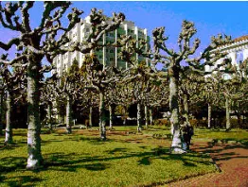
Name That Tree!

Slide 6
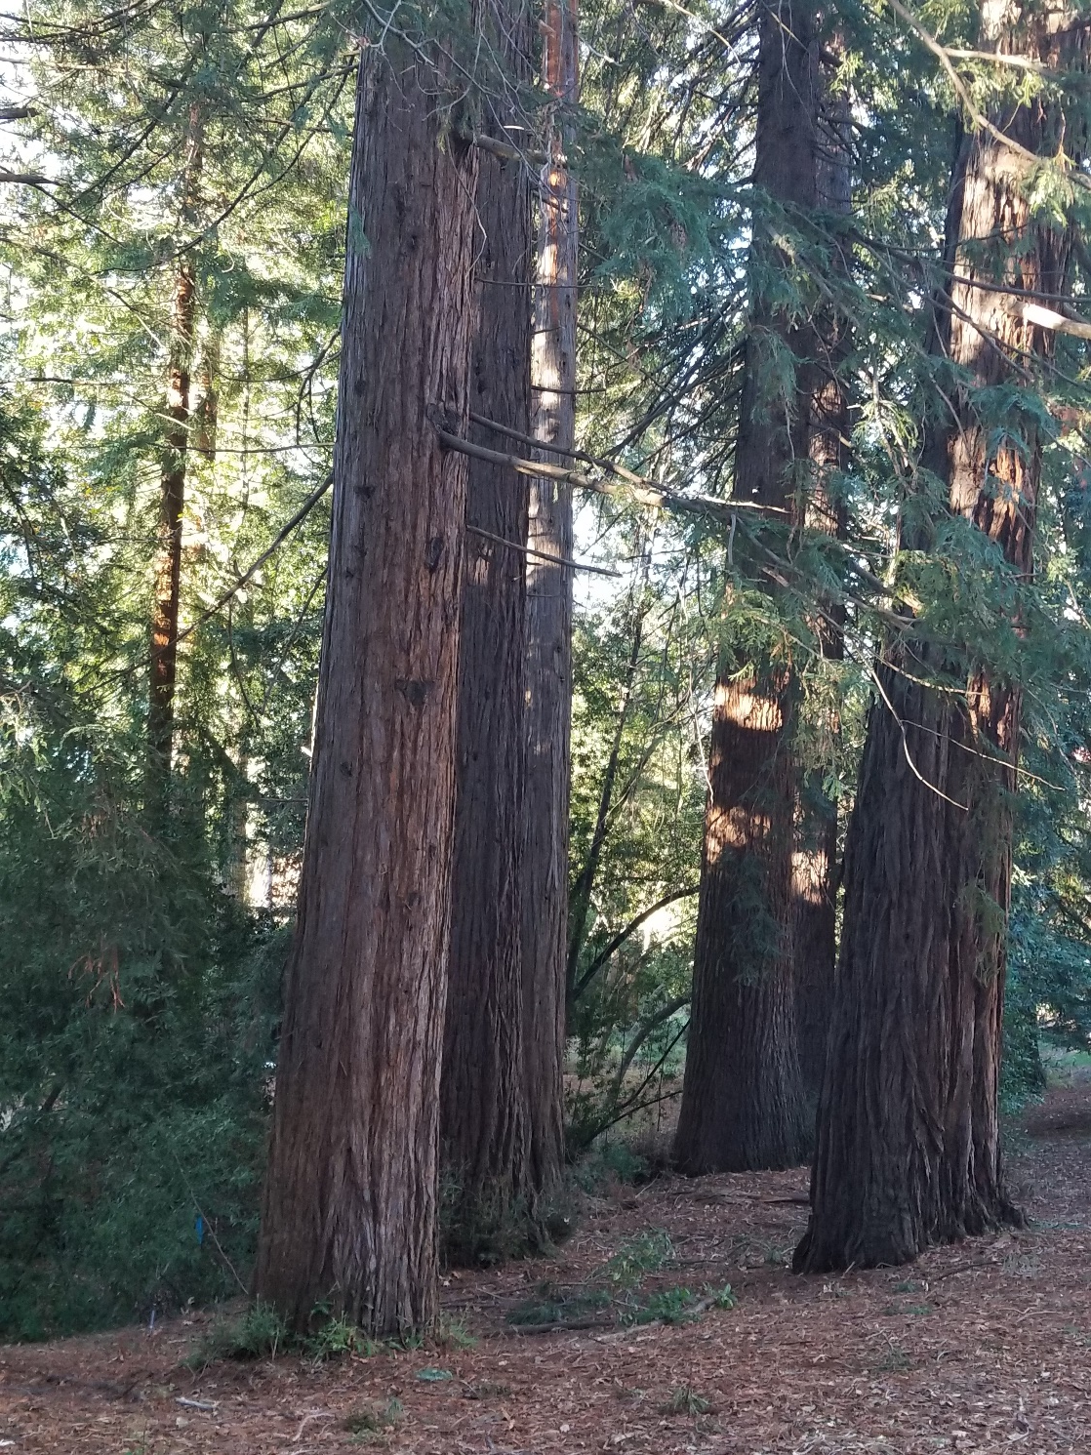

Slide 7
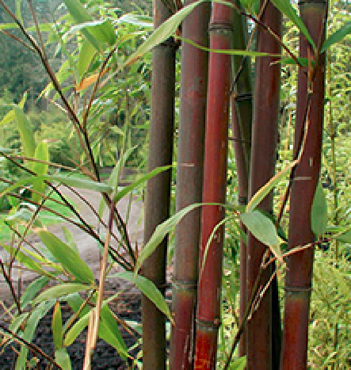

Slide 8
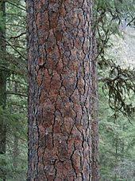
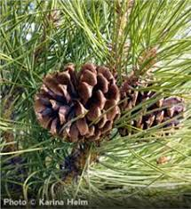

Slide 9
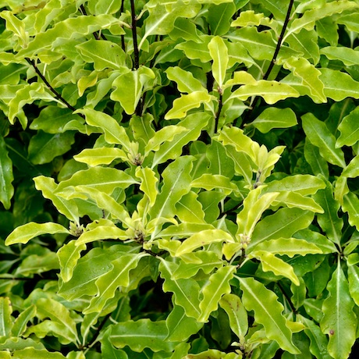
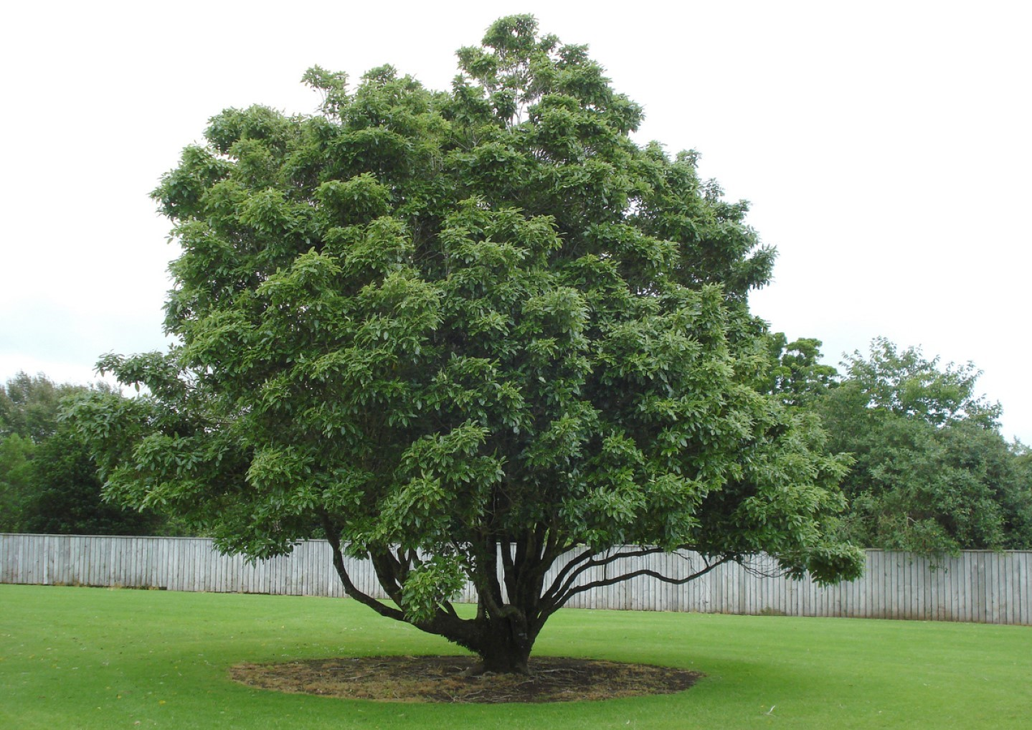

Slide 10
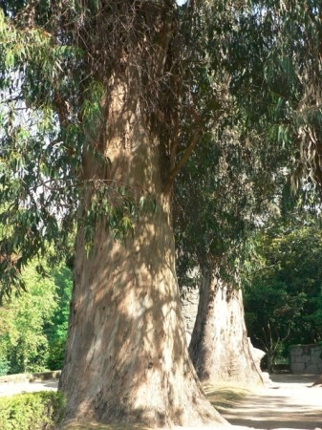

Slide 11
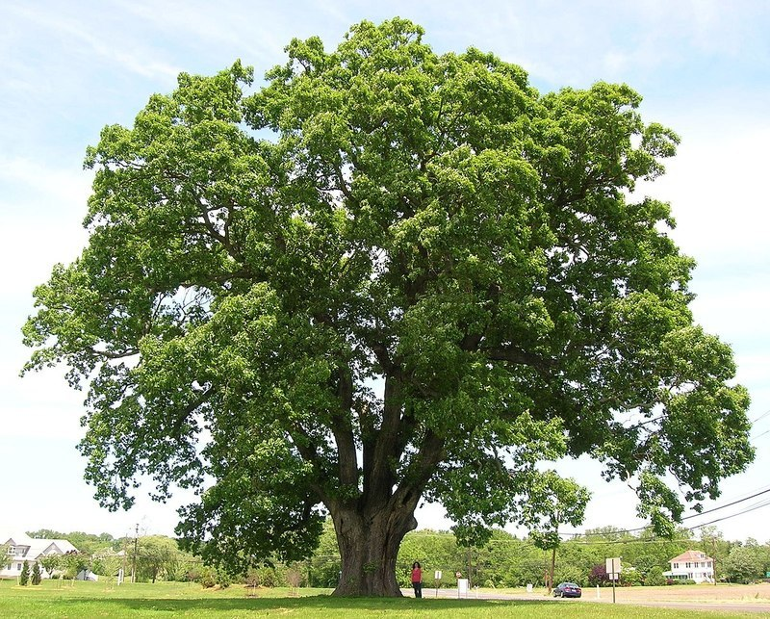

Slide 12
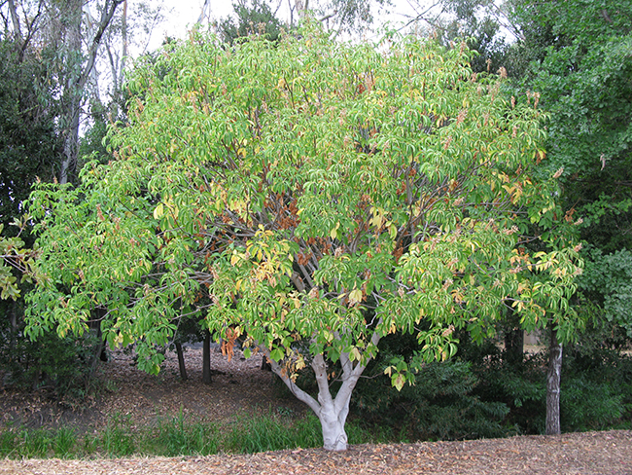

Slide 13
Your Knowledge of Trees
Of the 20 tree names… every tree is on the Berkeley campus, and 7 of the listed trees are within a few hundred yards from the Campanile
…Including 6 of the 8 trees you just saw pictures of
How many different tree species do you think there are on the Berkeley campus?

Slide 14
Shamu for Berkeley Campus Trees (Many of the tree names identify categories with many species)
Acacia (5)
Birch (5)
Cherry (6)
Dogwood (5)
Elm (5)
Eucalyptus (8)
Magnolia (5)
Maple (9)
Oak (22)
Pine (22)
As of 2016, there were 276 different species of trees on the campus

Slide 15
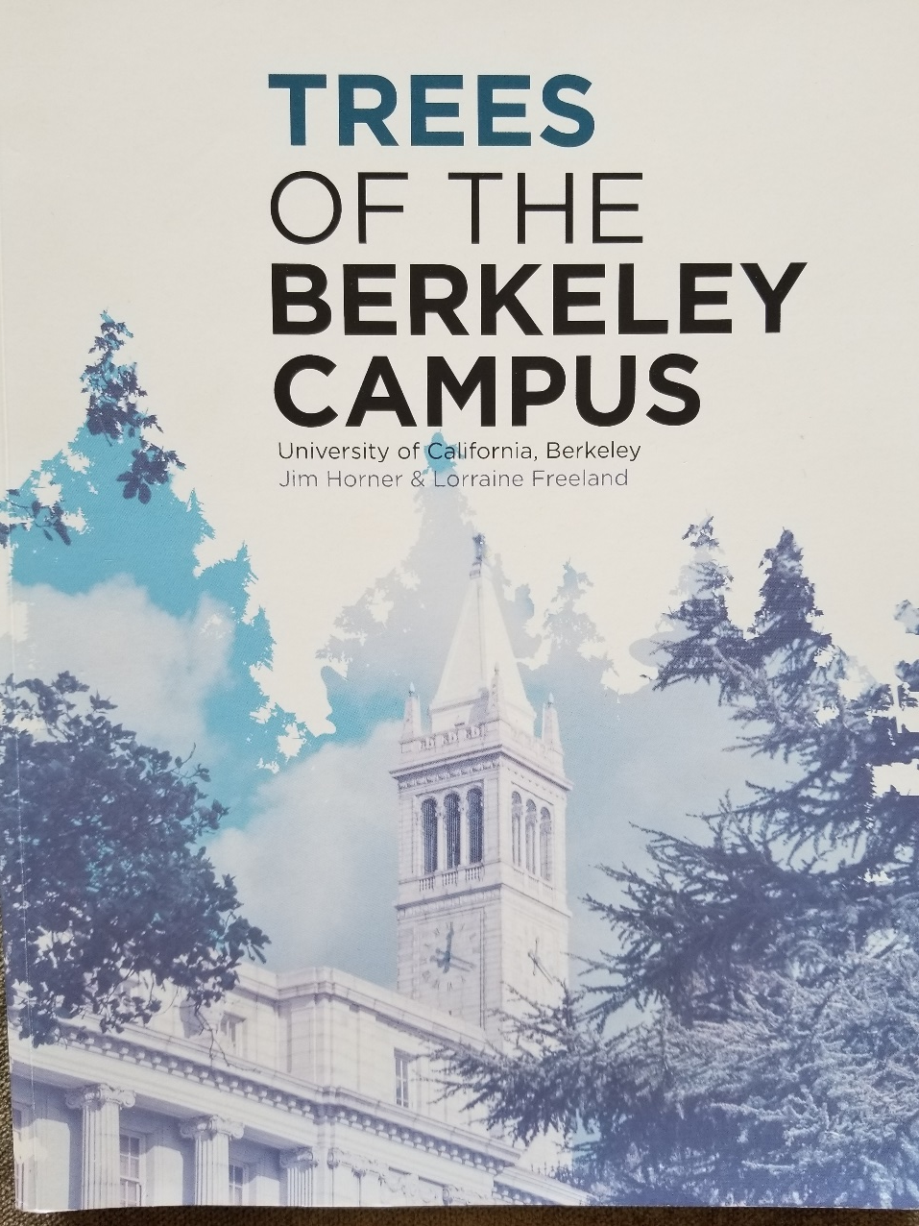
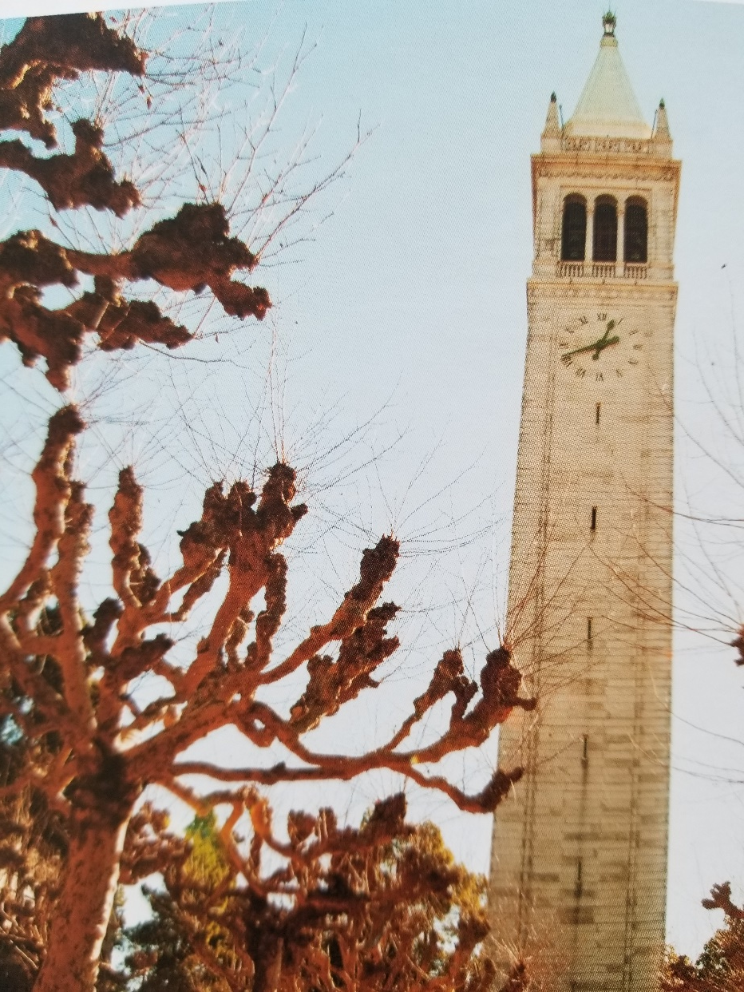
London Plane trees

Slide 16
Your Knowledge of Trees
How would you rate your knowledge of trees?
Compared to a “typical” Berkeley student
Compared to someone who works with trees (landscape designer, arborist)
Compared to a botanist or “plant scientist”
Compared to someone who lives in a Northern California forest area
Compared to someone who lives in the Amazon rain forest
What determines someone’s level of knowledge about trees?

Slide 17
Comparative Knowledge About Trees
Maintenance workers, landscaper designers, and botanists know a lot about trees, but
How do botanists, maintenance workers, and landscape designers differ in how they think about trees?
4-year-old children living in rain forests can identify more trees than US college students
Some adults can identify and reason about hundreds of different trees and plants

Slide 18
What An Adult Inhabitant of the Ecuador Rain Forest Knows
Berlin, Brent. Ethnobiological classification: Principles of categorization of plants and animals in traditional societies. 1992

Slide 19
Universal Cognition?

Slide 20
Is There Universal Cognition? (1)
Two fundamental cognitive processes are categorization (how do we decide what objects are the same kind of thing) and inductive reasoning (given that one object or class exhibits a property, how do we decide whether other related objects or classes do).
Are these and other cognitive processes universal? Do all people have the same “cognitive toolkit” to use?
How should we try to answer these questions?

Slide 21
Is There Universal Cognition? (2)
We can compare different groups doing the same or equivalent cognitive tasks to look for differences
But which groups should we compare?
If people in one culture differ from those in another on cognitive tasks, why?
(Medin and Atran’s framing: How can cognitive psychology and anthropology fit together?)

Slide 22
Possible Sources of Cognitive Differences
If people in one culture differ from those in another on cognitive tasks, why?
because use different cognitive mechanisms?
because they have had different life experiences and have been exposed to different aspects of the world?
because they have been explicitly taught different things or taught in different ways?

Slide 23
Some Definitions of “Culture”
FLASHBACK
the customary beliefs, social forms, and material traits shared by a group of people in a place or time (culture in the world?)
whatever someone has to know or believe in order to operate in a manner acceptable to other members of a group they belong to (culture in the mind?)
whatever knowledge or beliefs other groups have that prevents them from seeing the world objectively and “correctly” – the way we do (is culture defined relatively?)
23

Slide 24
Culture as a “System of Meaning”
FLASHBACK
Culture is not chaotic or random … it is a SYSTEM (of systems…)
This system determines what sorts of things or events need to be attended to and explained
It established complex interrelated beliefs and behaviors to create a “system of meaning” about those things and events
24

Slide 25
Systems of Meaning – What vs How (1)
Roy D’Andrade (1981) suggested a division of labor between psychology and anthropology:
Cognitive anthropology would study what people think about (ethnography)
Cognitive psychology would study how people think (experiments)
What assumptions does this research strategy make about how cognitive processing works?
25

Slide 26
Systems of Meaning – What vs How (2)
Andrade’s proposal came at a time when cognitive science was dominated by a “human information processing” view of cognition; “’the mind is a computer” metaphor
This implies that processing is largely independent of context
Content varies across cultures, but the processor itself, and hence the processing, are universal, that is, independent of people's cultural background.
26

Slide 27
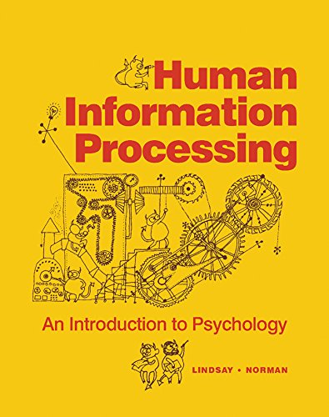
The “Human Information Processor” (1970s)

Slide 29
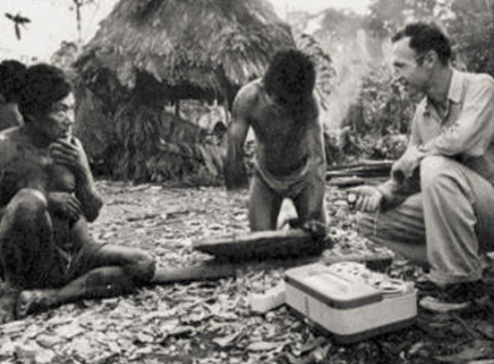
The Stereotype of an Ethnographic Study – 1930s?
Ethnography:
“writing about people”
Understanding
a community or culture through observation, interviews, and collection and analysis of artifacts

Slide 30
The Savage/Primitive Mind
Anthropology emerged in the 19th century as an extension of “natural history”
Just as Europeans studied the flora and fauna on remote locations (often European colonies) they also studied the language, culture, and artifacts of the people who lived there
Many of these peoples had no written language and limited technology, which led some anthropologists to describe them as savage or primitive compared with “modern Europeans”

Slide 31
Cognition of the “Savage Mind”
Language analysis suggested that cognition of pre-literate rural cultures was different – and less abstract – than European thinking
Such languages have many very specific words for a detailed inventory of plant and animal species and varieties
They lack words for abstract categories like “tree” or “animal”
Other languages that otherwise identify specific animals or plants often no not name those that are neither useful nor harmful
Do you agree that these language properties suggest a more primitive mind?

Slide 32
An Alternative Explanation
“Folk biology” (studying ordinary people’s relationships with plants and animals) suggests that there are universal principles for perceiving, classifying, and naming biological kinds
The use of more or less abstract terms is a function not of greater or lesser intellectual capacity, but of differences in the interests – in their intensity and attention to detail – of particular social groups
Ordinary person: “look at that interesting tree”
Botanist: “That’s a dawn redwood, also known as Metasequoia glyptostroboides. It’s the shortest redwood that never grows taller than 50 meters.”

Slide 33
Ethnobiological (“Folk”) Classification
“Folk biology” (studying ordinary people’s relationships with plants and animals) reveals that people in all cultures classify plants and animals into species-like groups
These species-like groups are further organized in a non-arbitrary hierarchy that can be scientifically interpreted in terms of “speciation” from a common ancestor

Slide 34
Five Levels of Taxonomic Classification
Berlin, Brent, Dennis E. Breedlove, and Peter H. Raven. "General principles of classification and nomenclature in folk biology." American anthropologist 75, no. 1 (1973): 214-242.

Slide 35
The Five Levels
“Unique Beginner” (at the top of, or root of, the tree) - categories like “plant” or “animal”
“Life-form” – typically a single word like “tree”, “vine”, “grass”, or “mammal”
“Generic” - first learned, most commonly used, and most psychologically salient description descriptor – “oak”, “pine”, “perch”
“Specific” and “varietal” – more particular, qualified names like “black spruce”, “white pine”

Slide 36
Folk Biology
This hierarchical system is complemented by other classifications for particular uses (beneficial vs. harmful, edible vs. inedible, wild vs. domestic, etc.)
These classification systems enable systematic inferences about the distribution of physical and ecological properties
These regularities are best explained in terms of the similarities in how people perceive and appreciate (largely unconsciously) that natural groupings of plants and animals in their environment
36

Slide 37
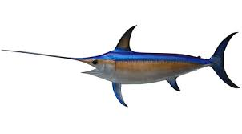
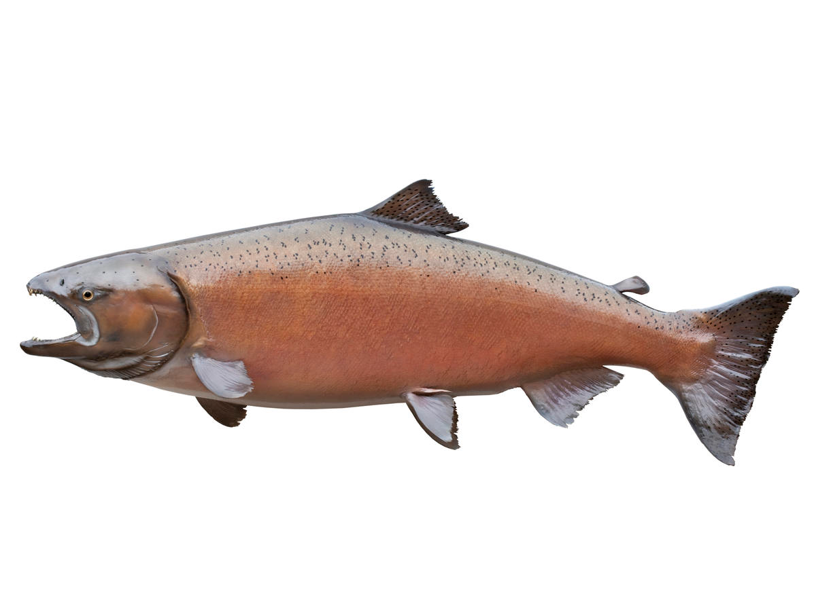
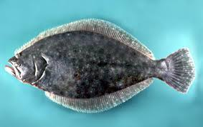
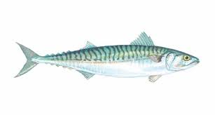
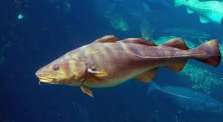
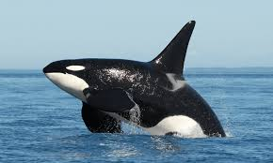
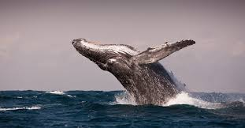
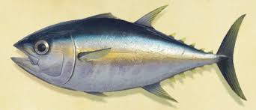
Sort Into Groups that “Go Together by Nature”
SWORDFISH
SALMON
FLOUNDER
MACKEREL
ORCA
COD
HUMPBACK WHALE
BLUE SHARK
TUNA
What Features or Properties Would YOU Use to Categorize Fish?

Slide 38
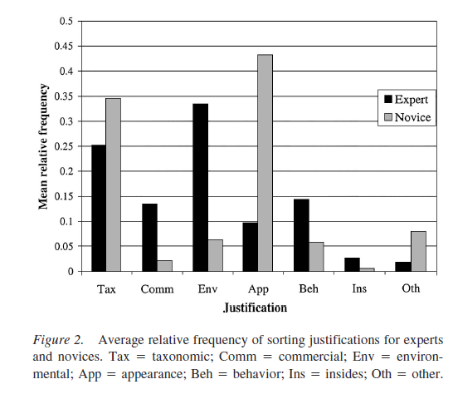
Rationales for “Fish Sorting” (Shafto & Coley, 2003)
Appearance
Environment

Slide 39
Classifying and Reasoning About Birds and Fish
When people are asked to sort birds or fish into groups that “go together by nature” experts in diverse cultures rely on both visible features (“morphology”) and on less-visibly distinctive features that enable the same function
Experts put greater emphasis on ecological relationships (which animals share habitats) and commercial/utilitarian factors
In contrast, people without expert knowledge sort primarily on visible features
39

Slide 40
An Expert’s Taxonomy

Slide 41
“Approaches to Nature” Identified in Folk Biology Studies (Bang, Medin, Atran 2007)
HOLISTIC -A belief that everything in nature is interconnected; harmony and balance in nature.
SPIRIITUAL - A tendency to access or ﬁnd spiritual meanings, lessons, importance (“Mother Earth”)
TRADITIONAL - Referring to an activity in nature as something that has occurred throughout history and should continue for that reason.
SURVIVAL SKILLS - A belief that nature is something that can harm us if underestimated.
MORALISTIC - Strong feelings of moral and ethical responsibility.

Slide 42
“Approaches to Nature” (2)
ECOLOGISTIC - Nature can be understood from empirical study from a systems perspective. Relating species to other aspects of nature.
PERSONAL UTILITY – Providing human sustenance, protection, and security for the self or those in the immediate family or social network
ABSTRACT RESPECT - A positive but abstract attitude towards nature
ABSTRACT KNOWLEDGE - Expressing learning goals abstractly
DISTANT UTILITY – Utility for others

Slide 43
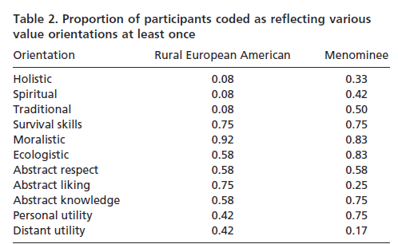
Comparing the Value Orientations of European Americans and Native Americans in Rural Wisconsin

Slide 44
STOP AND THINK:
Have YOU Ever Been A Subject In A Psychology Experiment?
How Representative Are YOU Of All Humankind?

Slide 45
The Search For Universals from Atran & Medin)
If cognitive psychology thinks that universals are desirable, it has a peculiar way of going about its quest for them
It would not be much of a caricature to suggest that cognitive psychology does not search for universality but rather assumes it

Slide 46
Do WEIRD Subjects Make Bad Science?
Many psychological studies of categorization and reasoning use undergraduates to make claims about human cognition
These subjects come from: Western, educated, industrialized, rich, and democratic societies (WEIRD populations)
Similarly, many studies of children aimed to understand the development of cognition use children in schools affiliated with or near universities
46

Slide 47
Do WEIRD Subjects Make Bad Science? (2)
This means that researchers have neglected roughly 95% of the world population, about which – from a psychological and cognitive science perspective – we know practically nothing
There is increasing evidence and concern that WEIRD subjects are among the least representative populations one could find for generalizing about humans
They exhibit a much narrower range of rationales or attitudes toward nature
47

Slide 48
The “Devolved” Mind
Researchers have found it convenient to treat undergraduates as the reference population and to categorize groups that know more as “experts”
An alternative perspective would be to take the knowledge of the typical member of a non-industrialized society as the standard
With this reference point, undergraduate knowledge would be considered much below average or “devolved” – cognitively impoverished, with only generic reasoning strategies to rely on

Slide 49
“We are all born with native minds, though some develop in a manner better attuned to their natural surroundings than others. The full expression of the folk-biology module requires environmental triggering conditions and cultural support that may be lacking for certain groups in industrialized societies, including the usual participants in most cognitive and developmental psychology experiments.
- Medin & Atran, “The Native Mind: Biological Classification and Reasoning in Development and Across Cultures” (2004, p. 980)

Slide 50
From a theoretical perspective, the chief interest in studying these groups may not be to establish a baseline for generalizations about folk-biological knowledge but to explore the cognitive consequences of limited input”
- Medin & Atran, “The Native Mind: Biological Classification and Reasoning in Development and Across Cultures” (2004, p. 980)

Slide 51
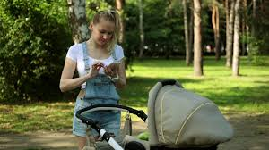
These phone-addicted parents are clearly not pointing out the natural world to their neglected kids
https://nypost.com/2018/05/19/our-digital-addictions-are-killing-our-kids/

Slide 52
Cultural Support for Knowledge (or the lack of it)
When you were a child, did your parents call your attention to plants and animals? If they did, did they refer to robins, trout, and maples or to birds, fish, and trees?
Do you consider yourself devolved with respect to the natural world?
Should we blame your parents for your lack of knowledge about nature?
How might we measure the amount of cultural support?

Slide 53
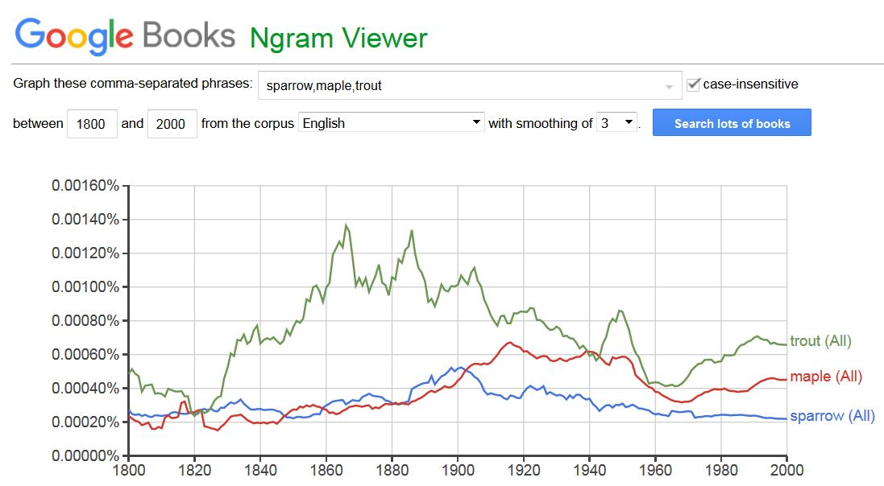

Slide 54
Get a Pet; Go Outside and Play
In technologically-oriented cultures contact with biological kinds may be so minimal that researchers can demonstrate significant differences in children's biological reasoning as a function of whether they do or do not have goldfish as pets
Optional Homework Assignment…. Go for a walk (without your phone in your hand) and look for interesting trees or plants (then, take out your phone and take a photo of what makes it interesting).

Slide 55
To Make You Feel Better… Recognize These Restaurant Names?
Arby’s
Burger King
Chick fil-A
Chipotle
Dairy Queen
Dominos
Dunkin’ Donuts
Jack in the Box
KFC
Little Caesars
McDonalds
Panda Express
Panera
Papa John
Pizza Hut
Sonic Drive In
Starbucks
Subway
Taco Bell
Wendy’s
How many of these names would an Anchuar living in the Ecuadorian rain forest recognize?

Slide 56
Stop and Think
FLASHBACK
If you were living 10,000 years ago, what astronomical and terrestrial events would be most salient to you?
How would making sense of these events enable you to organize your life?
What evidence do we have today of these ancient efforts at sensemaking and organizing?

Slide 57
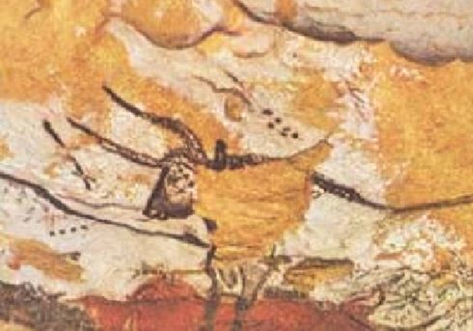
STOP AND THINK: Lascaux Cave Paintings
Are they just animals with star backgrounds?
Are the animals IN the sky?
Are they star maps with animal constellations ?

Slide 58
Constellations ⬄ Myths
Myths that relate terrestrial activities and celestial organization appear in many diverse cultures around the world, suggesting that stars were very important
The “Cosmic Hunt” myth, in which an animal is chased into the sky and becomes a constellation, is found in different versions in diverse cultures all over the world
As the myth moved around, different people adapted the story to include the animals and stars most important to them

Slide 59
The Evolution of Myths

Slide 60
D’Huy’s Analysis of Myths
Analyzed 47 versions of the Cosmic Hunt in terms of 93 “mythemes,” specific semantic components
The animal is a herbivore
A woman breaks a taboo
A divine person stops a hunter
A god transforms an animal into a constellation…
Used software developed by evolutionary biologists to compare the DNA sequences of different species to construct “family trees”
He found that the Cosmic Hunt originated in Northern Eurasia and then spread west to Europe and east to the Americas
So there are Greek versions and Iroquois versions with a common ancestor, but none in Australian aboriginal culture
STOP AND THINK: What does this tell us about how old this myth is?

Slide 61
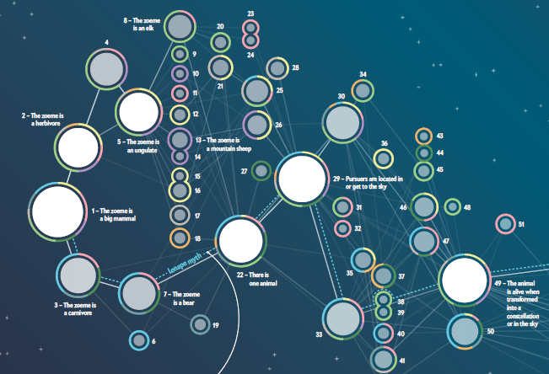

Slide 62
The Land Bridge
It is believed that a small human population of at most a few thousand traversed the land bridge from eastern Siberia sometime after 16,500 years ago but before the bridge was covered by the sea about 11,000 years ago (“Beringia” article in Wikipedia)
So the Cosmic Hunt myth could be 15,000 years old!

Slide 63
Sorry Carl, You’re Wrong
Carl Jung (1875-1961) was a Swiss psychiatrist and psychoanalyst whose work has been influential
One of his core ideas is that a person’s life is a process of “individuation” to create a unique self from a “collective unconscious” shared by all humans
Jung argues that myths are “archetypes” of the collective unconscious
So if myths are universal, any myth should be anywhere people are
AND D’HUY WOULDN’T FIND ANY PATTERNS IN HOW MYTHS EVOLVE AND DISPERSE

Slide 64
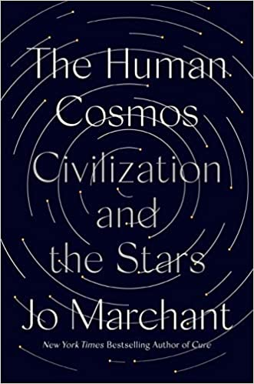
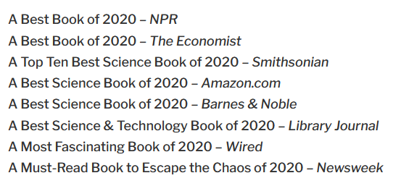
Read This Book!

Slide 65
The Document Engineering Assignment

Slide 66
General Comments
Everyone demonstrated that they understood the various activities and associated work products, and some of you did exceptional work with very precise documentation of the domain model.
But when I ask you to produce specific work products, don’t invent new ones. Trust me, when I say “do it this way” with some examples it is probably a way that is easier to do and understand than some other way (and easier to evaluate).

Slide 67
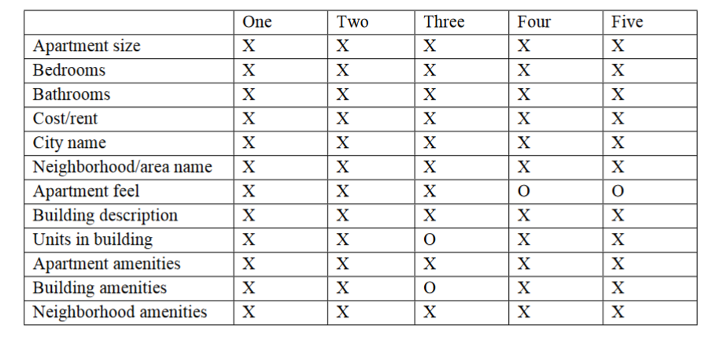
Harvest Table

Slide 68
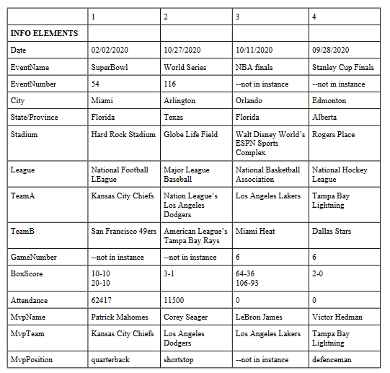
Composite Harvest Table

Slide 69
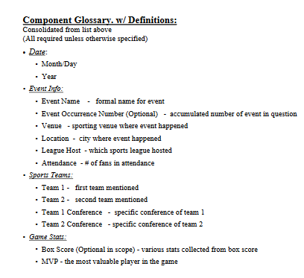
Excellent Use of Containers with
Good Documentation

Slide 70
Misinterpreting “Required or Optional?”
“Does the instance need to include this component to be valid?” Given the “robo-journalism” back story, this means “does the program always need the component, or can it generate an acceptable story without it?” If every story contains the component, it is required.
Some of you instead focused on the content of the component, not whether it was present or absent. Every apartment story mentioned parking in one way or another, but some of the apartments didn’t have garages or reserved parking. A component about Parking is required so the story will be able to say whether or not there is any.

Slide 71
Granularity {and, or, vs.} Optionality (1)
All of my apartment stories mentioned a city and a neighborhood, and I hinted that because my descriptions about locations and neighborhoods were highly varied (and in every story) you might use phrases like “LocationDescription” as a broad component that could contain any of the descriptions
Some of you treated city+neighborhood as a single component like “Location,” which would be too semantically blunt with a realistic sized apartment collection (people would want to sort by city).

Slide 72
Granularity {and, or, vs.} Optionality (2)
Some of you got a little lost in the specific content of the stories and proposed a long list of optional components like “NearAForest” and “PackedWithBoutiquesAndRestaurants.” A robo-journalism program would need some kind of location description, but if you itemize with too much granularity, you’ll label all the components as Optional
A good compromise that some of you proposed was to divide “Amenities” into those for “Neighborhood,” “BuildingOrComplex,” and “Apartment”

Slide 73
Containers {and, or, vs.} Qualified Names
I should have used containers in step 6 of the assignment and used specific component names because I would have given you some implicit instruction about how to structure and name components. Containers convey meaning explicitly, which is considered a better modeling practice than conveying meaning implicitly with “qualified names”
Use qualified names to resolve homonyms (“EventTitle” vs “SpeakerTitle”), not to replace containers

Slide 74
Explicit Containers
SportingEvent
Title
Date
Day
Month
Year
Venue
Location
Name

Slide 75
Implicit Containers with Qualified Names
SportingEventTitle
SportingEventDateDay
SportingEventDateMonth
SportingEventVenueLocation

Slide 76
There Are No Modeling Shortcuts
FLASHBACK
Schemas developed without a stage of conceptual design (other than very simple ones) are rarely very useful because they are too closely tied to the particular instances used, which may not be representative
There is an inescapable tradeoff in description vocabularies between expressive power /computability (exemplified by XML) and ease of use (HTML)?
You get what you pay for… UNLESS SOMEONE ELSE HAS ALREADY DONE THE WORK
In general, if your work would benefit from a standard document schema, before you start trying to design one, look for one!
76

Slide 77
Yes, There is a SportsML
To provide a consistent format for sports scores, schedules, and statistics, an open, non-proprietary XML standard was created in 2003 by the International Press Telecommunications Council (IPTC), an association of the largest news agencies in the world including the Associated Press, Reuters, and the New York Times.
SportsML has a core schema used for all sports (competitors, locations, dates, etc.) and sport-specific “plug-ins” with the content components needed to describe events in that sport
https://www.iptc.org/std/SportsML/1.0/documentation/documentation-navigation.html

Slide 78
Yes, There is A “Real Estate” ML
https://www.retall.org/

