Slide 1
CogSci 150 “Sensemaking and Organizing” Spring 2021
Robert J. Glushko glushko@berkeley.edu
25 February 2021 12) Describing Relationships & Structures, Part 1: Semantic & Lexical Relationships

Slide 2
Why This Stuff Matters!
An organizing system can use existing relationships among resources, or it can create relationships by applying organizing principles to arrange the resources
We need a vocabulary for talking about these relationships precisely and consistently so that we can analyze, design, reason about them, and implement them in organizing systems
In fact, we need 5 different vocabularies because there are 5 different perspectives on relationships
2

Slide 3
Five Perspectives on Relationships (1)
SEMANTIC: the meaning of the association
LEXICAL: how the conceptual description of a relationship is expressed using words in a specific language
“specific language” is highlighted because for any given concept, some languages might have specific words for it and others might not
i.e., the mapping between concepts and words differs across languages.
3

Slide 4
Five Perspectives on Relationships (2)
STRUCTURAL: analyzes the patterns of association, arrangement, proximity, or connection between resources (and often ignores the reasons for them)
ARCHITECTURAL: emphasizes the number (binary, ternary, etc.) and abstraction level of the components of a relationship, which together characterize its complexity
4

Slide 5
Five Perspectives on Relationships (3)
IMPLEMENTATION: how the relationship is implemented in a particular notation and syntax and the manner in which relationships are arranged and stored in some technology environment
Do we implement in a natural language or an artificial one like XML or formal logic?
5

Slide 6
THE SEMANTIC PERSPECTIVE ON RELATIONSHIPS
6

Slide 7
Defining "Relationship“ (Kent, “Data and Reality”)
“An association among several things, with that association having a particular significance”
"A relationship is sequence of categories, that includes one thing from each category”
“things” in the first definition can be instances, but in the second case they are definitely types…
Homer is married to Marge
A husband is married to a wife
7

Slide 8
Defining "Relationship” (2)
The reason is an important part of the relationship
Multiple relationships can exist among the same objects, so the order of the objects usually matters
Bob is older than Tom Tom is older than Bob THE ORDER MATTERS HERE BECAUSE “is older than” is an ASYMMETRIC relationship
Bob is the brother of Tom Tom is the brother of Bob THE ORDER DOESN’T MATTER BECAUSE “is the brother of” is a SYMMETRIC or BI-DIRECTIONAL relationship
8

Slide 9
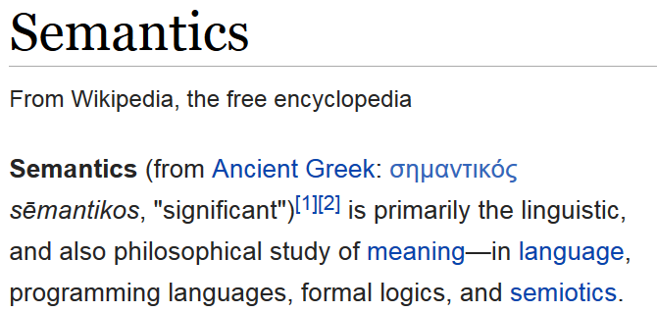
9

Slide 10
If “semantic” is defined as “relating to meaning or language or words” that does not seem helpful here because we were supposed to distinguish the meaning perspective from the language or lexical perspective
And if “semantics” means “meaning,” what does “meaning” mean?
10

Slide 11
Defining and Dictionaries
DICTIONARY: a resource that lists the words of a language (typically in alphabetical order) and gives their meaning
But how can we a word in a non-circular way that doesn't rely on lots of undefined meanings...
To understand a word, you have to understand all the words in its definition, so you look up those words… and suppose that the first word appears in one of the definitions…
Is there a solution to this problem?
11

Slide 12
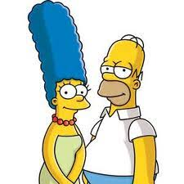
A Non-Circular Definition: The Semantic Perspective on Relationships
The essence of relationships; why the resources are related
Relies on or expresses information that is not directly available from perception
“Homer is married to Marge" is a semantic relationship
"Homer is standing next to Marge" is a structural relationship that is perceivable
12

Slide 13
Making Meaning (1)

Slide 14
Making Meaning (2)
Draw two diagrams that represent these assertions:
"Mary and Sue are sisters“
"Sally and Martha are mothers”
14

Slide 15
Mother
Mary
Sue
Mary and Sue are sisters…
…of each other

Slide 16
Mary’s Mother
Mary
Mary’s Sister(not Sue)
Mary and Sue are sisters…
…of other people
Sue’s Mother
Sue
Sue’s Sister (not Mary)

Slide 17
Sally
Sally’s Child
Sally and Martha are mothers
…of different children
Martha
Martha’s Child

Slide 18
Sally and Martha are mothers
…Sally is Martha’s mother
Sally
Martha (Sally’s Child)
Martha’s Child

Slide 19
Language and Meaning
Words and sentence structure only hint at meaning
Meaning is constructed not just from the literal language used, but from all the clues or cues in the CONTEXT OF USE
The relationships between things can differ in different contexts
19

Slide 20
If “meaning is constructed from context”… then what does “context” mean?
20

Slide 21
Defining “Context”
The context in which language is understood includes:
the common knowledge of the “sender” and “receiver”
any assumptions they make
any previous discourse they have had
the current discourse
the current situation (location, time, environment)
inferences from all of these
21

Slide 22
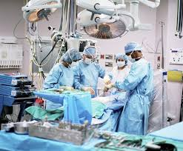
Context and Meaning
In the operating room,
the surgeon used a knife
to cut the …?
22

Slide 23
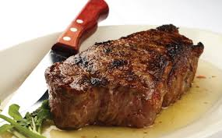
Context and Meaning
In the restaurant, the surgeon used a knife to cut the …?
SAME RESOURCES
DIFFERENT CONTEXTS => DIFFERENT MEANING
23

Slide 24
Where Does “Context” Come From?
A “lexicon” is proposed by many theories of language knowledge as the “mental dictionary” where word meanings are stored
If “context” is part of the meanings of words, each dictionary entry (“lexical representation”) is essentially unbounded
So we can’t understand words by “retrieving their definitions”
How else might contextual knowledge of meaning be used?
24

Slide 25
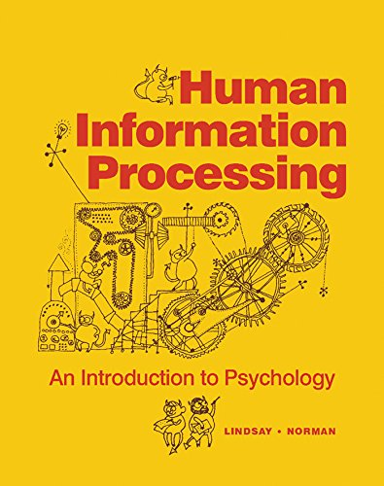
The “Human Information Processor” (1970s)
FLASHBACK

Slide 26
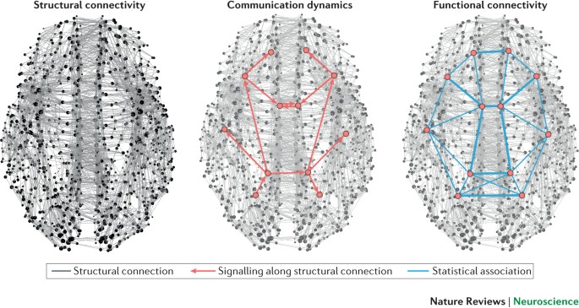
Cooperative Computation
The “lexicon” is distributed in many brain regions and multiple word meanings are activated in parallel. “Context” determines which meaning is selected

Slide 27
Specifying Semantic Relationships
"A relationship is sequence of categories, that includes one thing from each category“
Predicate/Argument Syntax:
is-married-to (Homer Simpson, Marge Simpson)
Subject / Predicate / Argument Syntax:
Homer Simpson => is-married-to => Marge Simpson
27

Slide 28
Relationship “Degree”
The DEGREE or ARITY of a relationship is the number of entity types or categories in the relationship. This is usually, though not always, the number of arguments in the relationship expression
A husband is-married-to a wife
HAS DEGREE TWO or IS BINARY (husband, wife)
A person is married-to-a person
HAS DEGREE ONE or IS UNARY (person)
28

Slide 29
Types of Semantic Relationships
To fully understand a domain you need to know different types of relationships about and between the resources it contains
Class inclusion
Part-whole inclusion
Attribution
29

Slide 30
The Semantics of "Inclusion"
One class or type of resources logically contains another; predicate is usually “is-a” or "is-a-type-of"
A set of interconnected class inclusion relationships defines a HIERARCHY or TAXONOMY
An inclusion relationship between an instance and a class -- assigning an instance to a class - is CLASSIFICATION
30

Slide 31
CATEGORIZATION IS NOT CLASSIFICATION
CATEGORIZATION most often means the creation or specification of a set of classes or category in which all the members are treated as equivalent for some purpose
Assigning an instance to a class or category is CLASSIFICATION
31

Slide 32
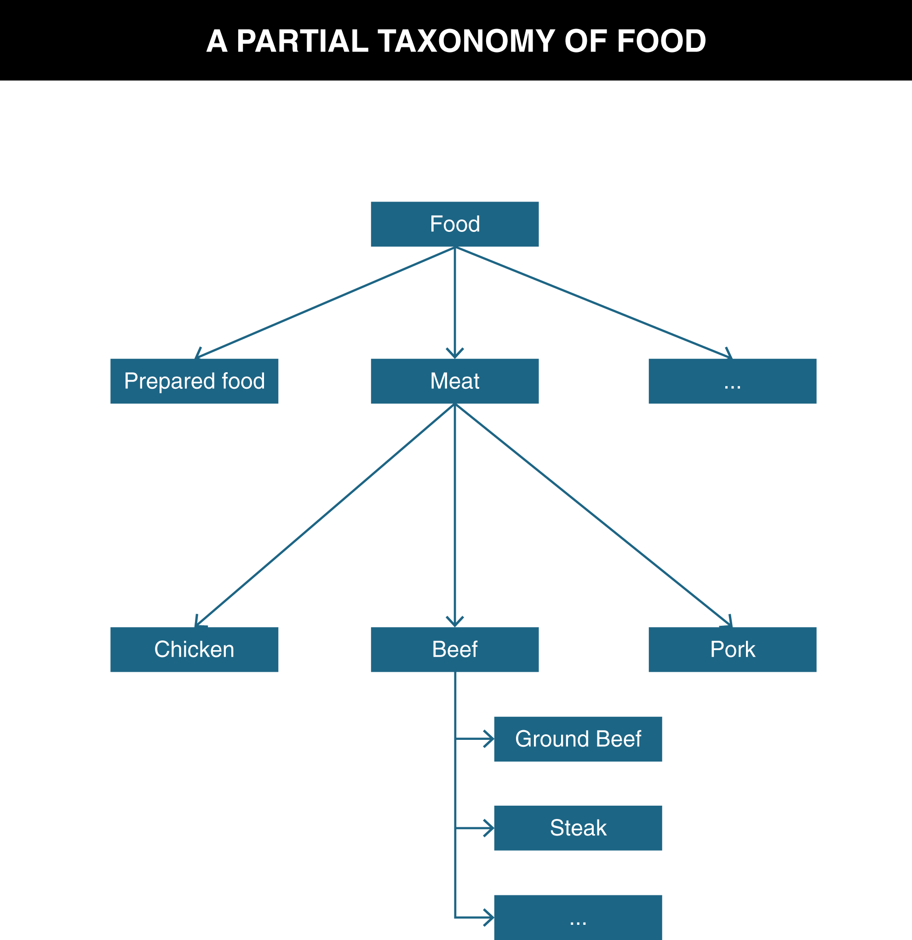
TDO Figure 6.1

Slide 33
Ontology
An ontology defines the concepts and terms used to describe and represent some domain or area of knowledge
To fully understand a domain you need to know different types of relationships about and between the resources it contains
Class inclusion relationships form a kind of backbone or framework to which other kinds of relationships attach, creating a network of relationships
33

Slide 34
Definitions of Ontology
“Ontology” can describe artifacts with different degrees of structure that differ:
... In how precisely the terms are defined
... In how precisely the relationships among them are expressed
The simplest ontology is a dictionary; a thesaurus is a somewhat more complex one
More complete ontologies are expressed using formal logic-based language
34

Slide 35
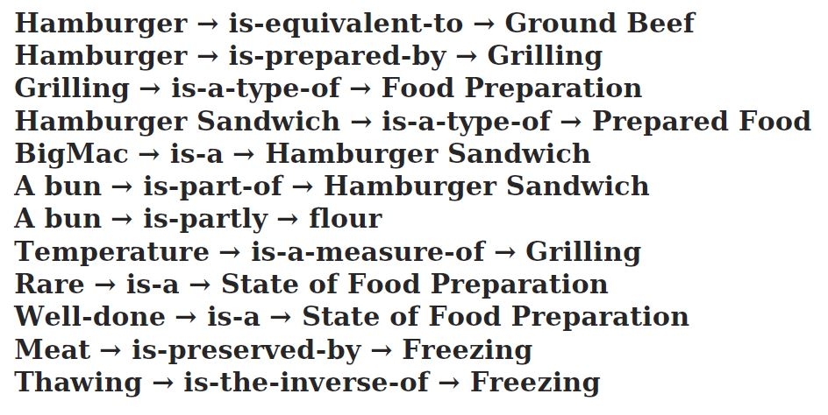
Ontological Assertions That Annotate the Food Taxonomy
???
The first assertion is also not quite right… It’s hard to be semantically precise

Slide 36
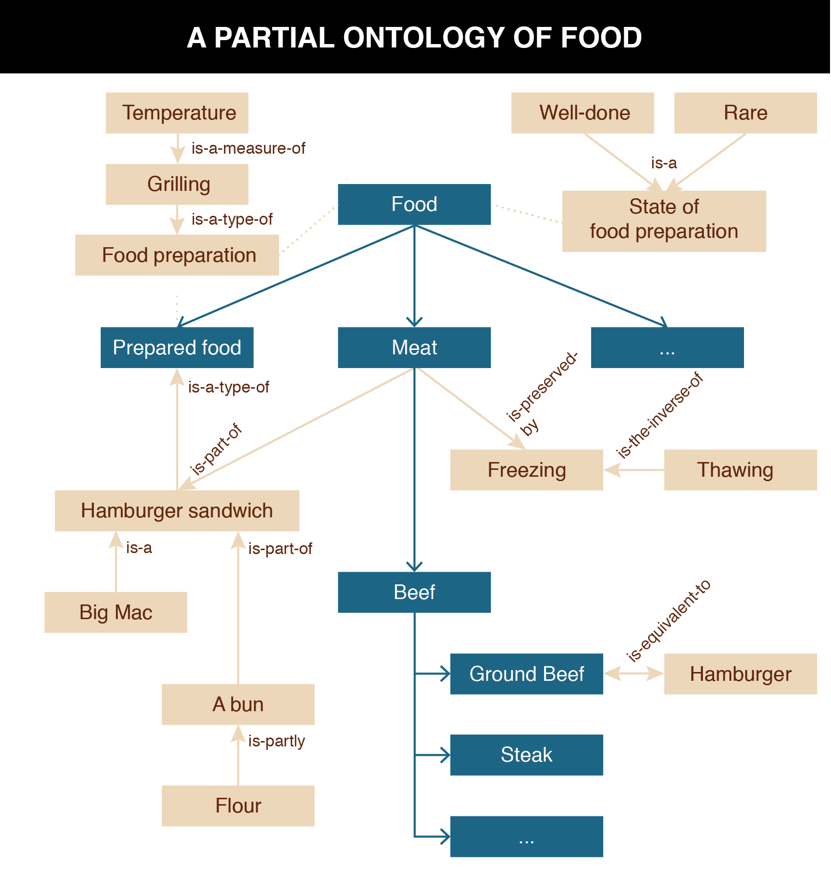
TDO Figure 6.2
Oops! This should say “has part”

Slide 37
Part-Whole (Meronymic) Inclusion
A resource class or instance can contain another as physical or logical parts
Expressed using “is-part-of,” “is-partly,” or with other similar predicate expressions
The engine is part of the car
The book is part of the library
Wine is partly alcohol
The Napa Valley is part of Northern California
Extra time is part of a football match
37

Slide 38
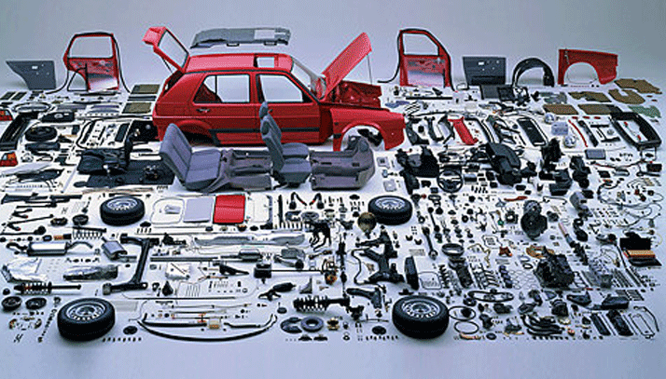
Part-Whole Relationship (Component-Object)

Slide 39
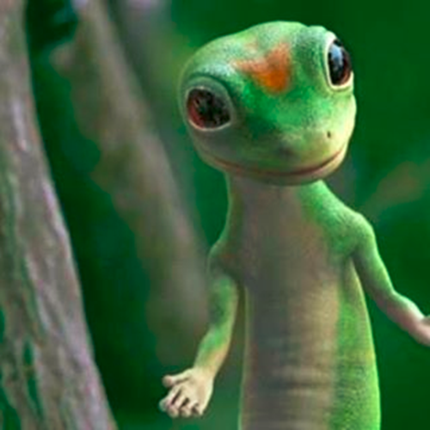
“Attribution” Relationships
In contrast to inclusion expressions that state relationships between resources, attribution relationships assert or assign values to properties for a particular resource
Attribution can be a binary relationship whose predicate has a single argument:
Martin the Gecko => is-small
"Title" : "Moby Dick“
Or with two arguments:
Martin => has-size => small
39

Slide 40
The Semantics of “Attribution”
There are often many different ways of expressing equivalent attribute values.
Martin → has-size → 6 inches
Martin → has size → 152 mm
Do these mean the same thing?
40

Slide 41
THE LEXICAL PERSPECTIVE ON RELATIONSHIPS
41

Slide 42
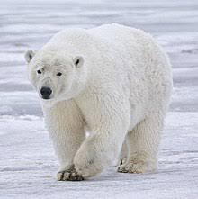
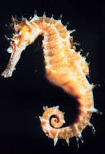
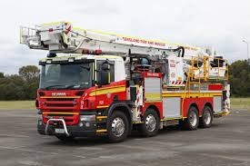
The Lexical Perspective on Relationships
A prototypical word is the minimal "meaning bearing" element of language
But this definition is oversimplified…some things are named using two words
…but are best treated as a single unit of meaning because what they mean isn't decomposable into the meaning of the two parts
42

Slide 43
The Lexical Perspective on Relationships
Words express concepts and relationships, but not all concepts and relationships have words for them (are "lexicalized")
We don't have a word for "all the stuff you'd take from your home if the fire was coming in 10 minutes" but we just created a concept for it
These "lexical gaps" differ from language to language
Whereas "conceptual gaps" -- the things we can't think of -- may be innate and universal
43

Slide 44
Lexicalization of Inverse Relationships
In some domains there are words for both relationships and their inverses – both relationships are “lexicalized”
Kinship is the best example, where many languages lexicalize both directions
Is parent of – is child of
uncles, aunts – nephews, nieces
But many more relationships are lexicalized in only one direction

Slide 45
Relationships Among Words / Relationships Among Concepts
Representing the relationships among words is a task for linguistics and cognitive science
In contrast, representing the relationships among concepts is a task for computer science
Understanding both kinds of relationships is essential for designers of organizing systems
45

Slide 46
Relationships Among Words
Hyponymy/Hyperonymy
Synonymy
Polysemy
Antonymy
Metonymy
46

Slide 47
Hyponymy/Hyperonymy
When words encode IS-A or inclusion relationships, the word for the more specific class is the HYPONYM and the other is the HYPERNYM
So there can be a "lexical hierarchy" that represents the "semantic hierarchy"
Often used to situate "basic categories" with respect to superordinate and subordinate categories
47

Slide 48
Hyponymy/ Hyperonymy
A is a hyponym of B if A is a type of B
A robin is a hyponym of bird
A is a hypernym of B if B is a type of A
An animal is a hypernym of bird
48

Slide 49
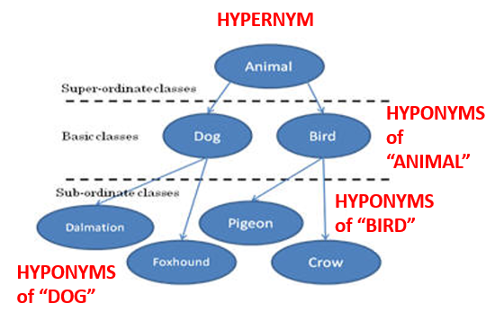

Slide 50
A Formula for Definitions
hyponym = {adjective+} hypernym {distinguishing clause+}
Robin = Migratory BIRD with clear melodious song, a reddish breast, gray or black upper plumage
Doesn't mention every characteristic of hyponym, only those needed to distinguish from other hyponyms
50

Slide 51
Synonymy
Synonyms are different word forms that can express the same concept
cat, feline, Siamese cat
Absolute synonyms that can always substitute for each other probably don't exist
Propositional synonyms are those where substituting one for another isn’t likely to change the truth value of the statement
Lisa Simpson plays the {violin, fiddle}
51

Slide 52
Polysemy
Many "word forms" (particular spelling patterns) are polysemous with multiple senses established in the language -- they are semantically ambiguous
- That dog has floppy ears - She has a good ear for jazz.
"bank" (financial) has related senses:
- a building (the bank on Shattuck) - specific financial firm (Wells Fargo) - where money is kept (abstract notion) - where anything of value is kept (more abstract)
52

Slide 53
Antonymy
Antonyms are lexical opposites
Some are inherently binary “true antonyms”
dead / alive, true / false, on / off
Others are "graded"
long / short, hot / cold
Markedness: one member of a pair is more restricted in its contexts
long is unmarked, short is marked
tall/short, old/young
53

Slide 54
Metonymy
The lexical representation of or analogy to part-whole or meronymic relationships
Using one aspect of something to stand for the whole
"Bank" as building stands for the institution of the "bank"
"The White House released new budget figures today"
54

Slide 55
Implications for Vocabulary Design
Choosing vocabulary terms for resource descriptions and precisely defining their semantics is essential but impossible to do perfectly
Your vocabulary must express what YOU intend, so you "look inward" -- analyze how you think about a domain
You want others to understand what you mean, so you also "look outward" -- analyze the terms used by users, competitors, or subject matter experts
You should reuse other vocabularies or thesauri if they exist to improve transformability and interoperability
55

Slide 56
Practice Makes Perfect hyponym = {adjective+} hypernym {distinguishing clause+}
A textbook = { } book { }
A convertible = { } car { }
A cottage = { } residence { }
A catamaran = {} watercraft {}

Slide 57
THE ARCHITECTURE OF COMPLEXITY
57

Slide 58
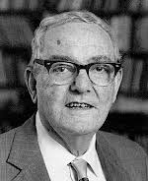
Herbert Simon (1916-2001)
Often called the “founding father of AI” (“Sciences of the Artificial” - 1968 book)
Strongly shaped cognitive science and behavioral economics (“bounded rationality”)
Nobel Prize winner in economics
Turing Prize winner in computer science
58

Slide 59
Simon’s Article Was Influential

Slide 60
Hierarchy
Complex systems are often hierarchical, composed on interrelated sub-systems, each in turn hierarchic until we reach some lowest level where the elements are elementary
But the stopping point is often arbitrary (TDO’s “abstraction and granularity” issues)
60

Slide 61
Hierarchy and Interaction
The groupings in a hierarchic structure can be defined operationally by some measure of interaction; clusters of dense interaction are within a level
In most biological and physical systems intense interaction implies spatial proximity (but technology can change this by disaggregation information interactions)
61

Slide 62
Complexity and Description
Most of the complex structures found in the world are enormously redundant, and we can use this redundancy to simplify their description
But to use it, to achieve the simplification, we must find the right representation, which is the “task of science”
62

Slide 63
State and Process Descriptions
Pictures, blueprints, most diagrams, chemical structural formulae are state descriptions
These describe the world as sensed; they provide the criteria for identifying objects, often by modeling the objects themselves
Recipes, differential equations, equations for chemical reactions are process descriptions
These describe the world as acted upon; they provide the means for producing or generating objects having the desired characteristics
Substituting process descriptions for state descriptions has been an important development in science
63

Slide 64
ASSIGNMENT 4:
TAXONOMY & DEFINITION
Create a taxonomy for 14 hyponyms of “vehicle”
Test and refine it using Miller’s formula for definitions
Test it with 5 new instances
Due on Tuesday March 2
64

Slide 65
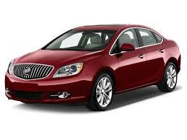
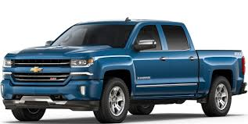
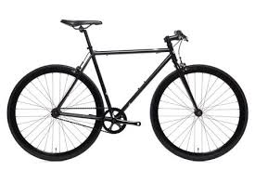
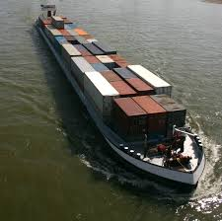
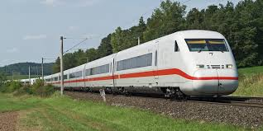
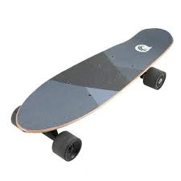
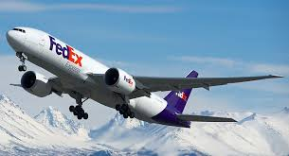
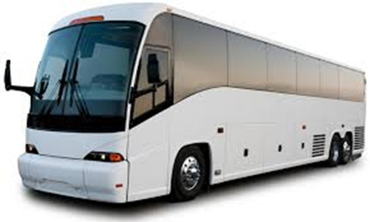
Passenger automobile
Pick-up Truck
Bicycle
Passenger Train
Cargo Barge
Bus
Cargo Aircraft
Skateboard

Slide 66
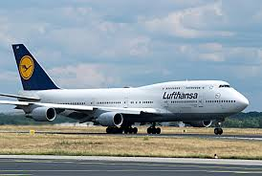
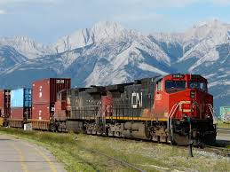
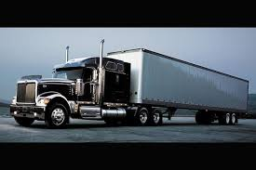
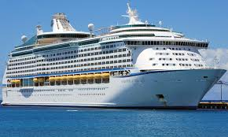
Rowboat
Passenger Aircraft
Freight Train
Cargo Truck
Cruise Ship
Motorcycle

