Slide 1
CogSci 150 “Sensemaking and Organizing” Spring 2021
Robert J. Glushko glushko@berkeley.edu
2 March 2021 13) Describing Relationships & Structures; Social Network Analysis

Slide 2
The Structural Perspective on Relationships
Analyzing the association, arrangement, proximity, or connection between resources without primary concern for their meaning or the origin of these relationships
Sometimes structure is all we know...and sometimes we ignore what we know about relationship semantics to focus on the generic aspect of structural connectivity (such as “degrees of separation”)
2

Slide 3
FLASHBACK
Thanks, Dianne for Reassuring Us
Leaked NSA document says metadata collection is one of agency's 'most useful tools'
A leaked NSA newsletter published Wednesday highlights the collection of phone metadata as one of the agency's "most useful tools. The document says that the NSA has used metadata such as numbers called, IP addresses, and call duration to yield "concrete results," such as the capture of terror suspects Khalid Sheikh Mohammed and Abu Zubaida.
https://www.businessinsider.com/nsa-document-metadata-2016-12
FLASHBACK TO “RESOURCE FOCUS” – phone company metadata is NSA data

Slide 4
Internal and External Structure
Resources can have INTERNAL structure as well as EXTERNAL structure that connects them to other resources
We often make arbitrary decisions about the granularity with which we describe the internal structure of a resource
Stop and think: We often describe the relationships between companies in terms of the company-to-company transactions they carry out, but could we focus on interactions between their employees?
4

Slide 5
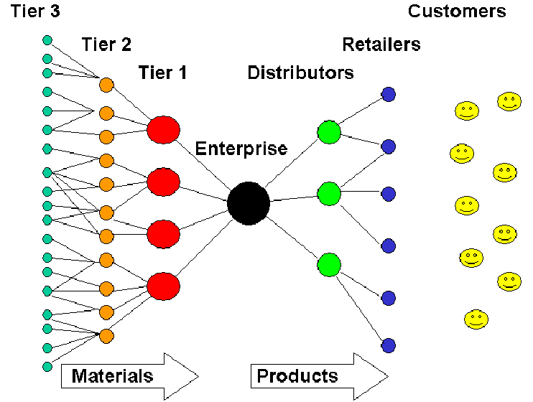
Example: Generic Supply Chain
5

Slide 6
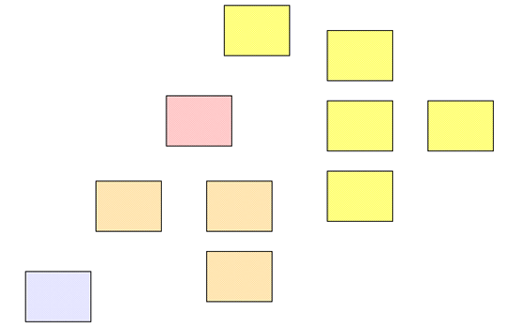
Separate Resources or Resource Components?
The boundaries we impose to identify resources determines whether some structure is internal or external with respect to them
6

Slide 7
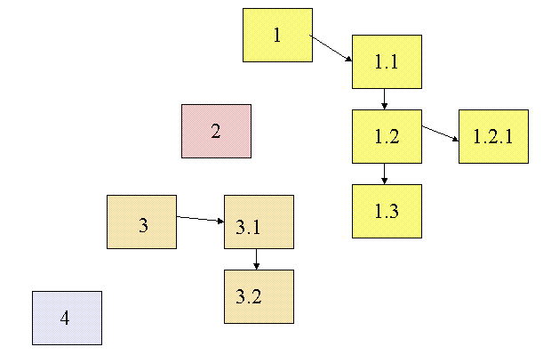
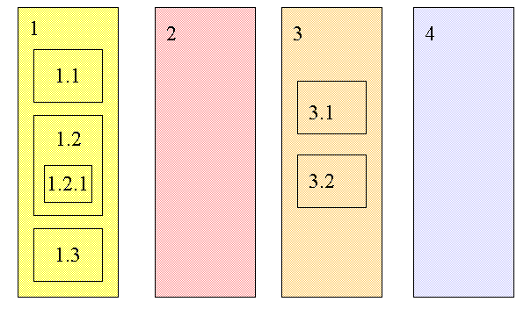
Changing Resource Boundaries Changes External to Internal Structure
Do these represent the same structural relationships among information resources?

Slide 8
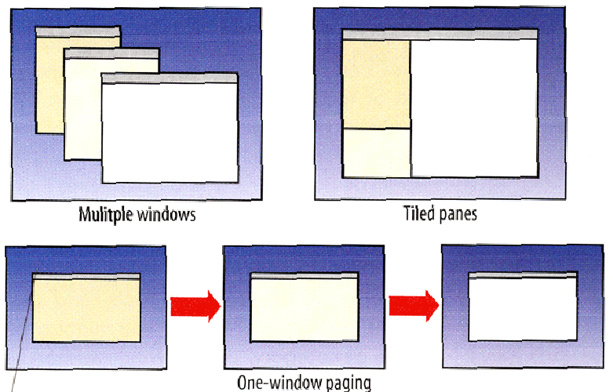
External or Internal Structures in a User Interface?

Slide 9
Familiar Terms for Internal Document Structures
Footnotes and Endnotes (often contain citations to external resources)
Cross references within the document
Pull quotes (structures for emphasizing some document content)
Sidebars (supplemental content)
Annotations (could be considered footnotes created by readers rather than by the author)
9

Slide 10
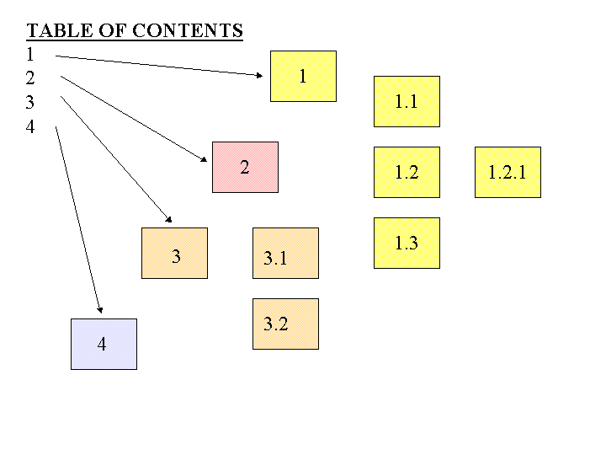
A Table of Contents is a Numeric Hierarchical Set of Structural Links to Document Components

Slide 11
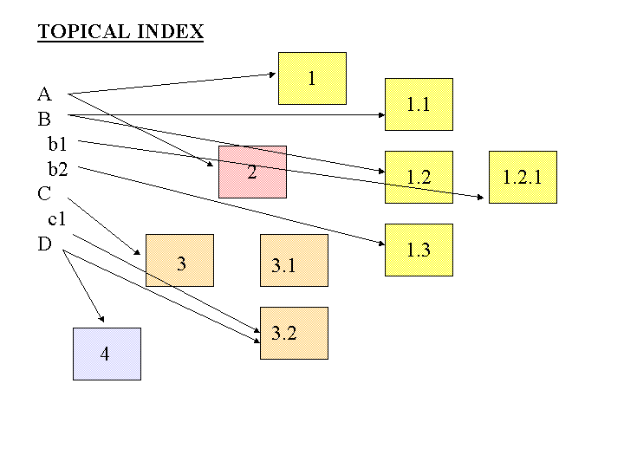
An Index is An Alphabetically Arranged Set of Semantic Links to Document Components

Slide 12
External or Between-Document Links
From document to document
From document to document component
From document component to document
From document component to document component

Slide 13
“Hypertext” Vocabulary: Link Properties
Starting point of the link (the ANCHOR)
The end point of the link (the DESTINATION)
The reason for the link (the LINK TYPE)
The DIRECTIONALITY
The number of resource types (ARITY or DEGREE) or resource instances (CARDINALITY) linked to (1-1 or 1-many)
Example: Link from a word to its definition, a picture, and pronunciation
13

Slide 14
Separation of Link Concerns
These structural and semantic issues are distinct from presentation ones that UX designers deal with
Is the presence of the link indicated (the LINK MARKER)?
Does the link marker change to indicate that the link has been followed?
Is the LINK TYPE indicated by some presentation convention?
Is the DESTINATION TYPE indicated by some presentation convention?

Slide 15
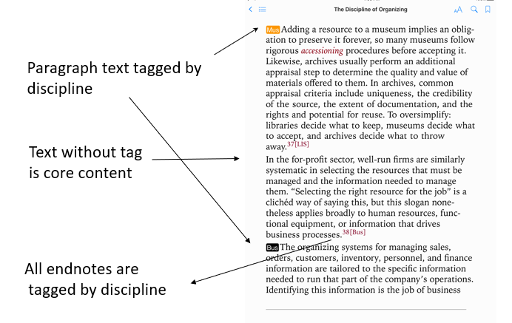
Hypertext UX in TDO eBooks
FLASHBACK

Slide 16
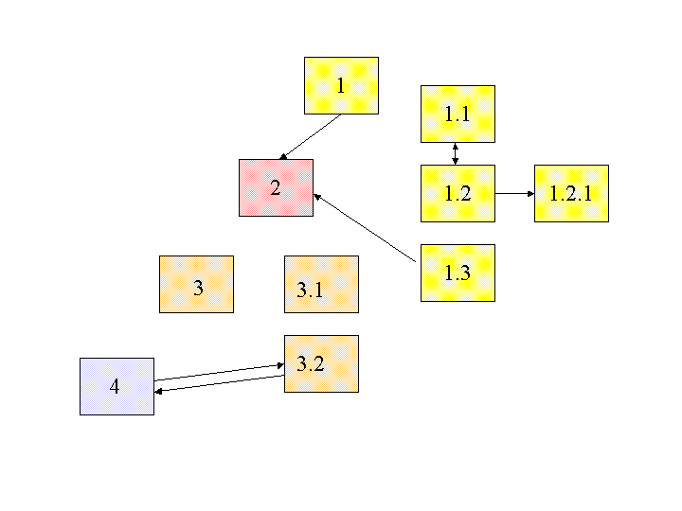
Embedded Links
Are the links embedded in the resources, or are they architecturally distinct in a “link base”?

Slide 17
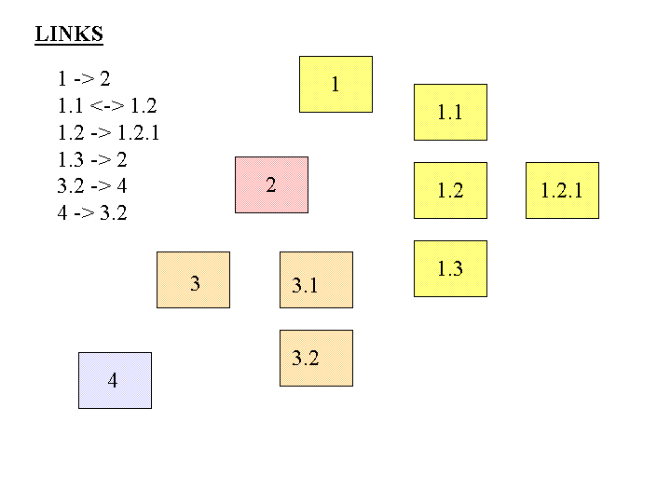
Separate Links
What would it mean to store links apart from the resources? What are the implications?

Slide 18
Abstract Thinking About Linking
We can analyze all of these with some common concepts and abstractions
Links between printed or digital documents
Links between web pages
Links between databases
Links – communication and information flows - between people, organizations, any other kind of interacting “actors” or resources – social networks
18

Slide 19
Linking in Relational Databases
A relational database system consists of a set of data tables (often managed by a single firm)
The rows in a table describe resources; the columns are the values of the properties or attributes in the resource description
One of the properties is the “primary key” whose value uniquely identifies the resource in a given row of a particular table
Tables can be linked by using their “foreign key” – a resource description in one table that is the primary key in another

Slide 20
Linking Between Datasets
There are usually many collections of data about the same type of resources
But often the resources are not identified and described in the same way (because they are from different firms)
Different granularity
Different properties in the resource descriptions
Different perspectives or principles governing the values of the resource descriptions
If the same resources can be identified in different datasets, they can be linked

Slide 21
Alternative Vocabulary: Graph Theory
We can apply graph theory to understanding relationships from a structural perspective
A GRAPH treats resources as VERTICES or NODES
The pairwise relationships between resources are represented by the EDGES that connect them
If the edges have an associated direction, this is a DIRECTED graph
A WEIGHT can be assigned to each edge if the relationship is numerical (distance, cost, time, frequency of interaction, perceived strength, etc.)
21

Slide 22
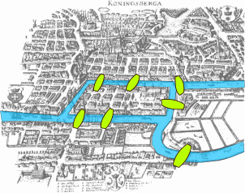
The Origins of Graph Theory (Euler 1735)
2 islands, 7 bridges – can you visit all 4 land masses without crossing any bridge more than once? Euler (1735) proved you couldn’t and invented much of graph theory to explain it
Euler’s Seven Bridges of Königsberg Problem
22

Slide 23
Three Network Representations
Edge List
Essentially the raw data, the list of relationships
Matrix
Necessary for computation
Graph
Easiest to grasp patterns

Slide 24
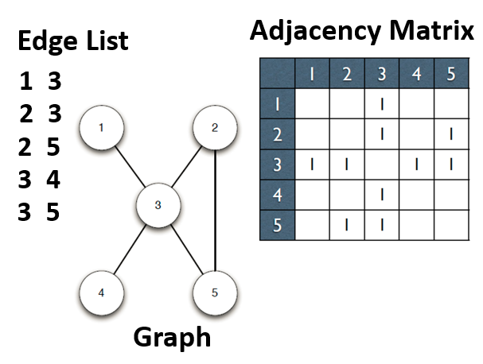

Slide 25
Relationship “Abstraction and Granularity”
A relationship between two people could be abstractly characterized as a “connection”
But it could also be analyzed with more granularity as a set of different relationships
Are they members of the same work organization?
Do they have face-to-face meetings
Do they regularly send email or text messages to each other?
Do they talk on the telephone?
Each of these more granular definitions of a relationship could define separate (but overlapping) networks

Slide 26
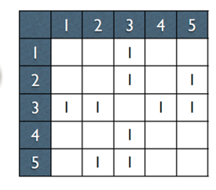
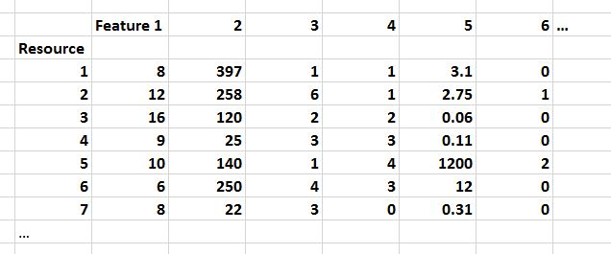
If this is all you’re given, give up!
FLASHBACK

Slide 27
Properties of Graphs
Reachability – is there a path between any two nodes in the graph?
Shortest path – if there are multiple paths between two nodes, which is the shortest?
Subgraph discovery – are there sub-graphs that are completely contained in a larger graph? (e.g., “invisible college”)
Centrality – which nodes are the most connected or have the average shortest paths to the other nodes?
27

Slide 28
Reachability and Transitive Closure
The REACHABILITY property of a graph is "can you get there from here”
We can determine whether a path exists between any two nodes in a graph by calculating the transitive closure of the graph
This is done by taking its adjacency matrix and raising it to the nth power, where n is the number of vertices in the graph
When we raise the graph to the kth power, we add exactly the edges which represent paths of length k in the original graph.
28

Slide 29
Degrees of Separation (“edge counting”)
If you have 44 Facebook friends, and each of those people has 44 friends who are not also your friends
And each of them has 44 friends, and each of those has 44 new friends…
In a chain of just 6 steps, you would be connected to 44 ^ 6 people…. Which is 7,256,313,856 (more than everyone in the world, and they’re not all on Facebook)
A 2011 Facebook analysis computed the average “degree of separation” of any two individuals in the “Facebook world” to be 4.74
29

Slide 30
How Important Are “Degrees of Separation?”
How often do you interact with / communicate with someone more than 2 steps away?
2nd degree connections are thought to be the most important ones in many respects because they are more likely to have new information, innovations, contacts, jobs… because you already know that stuff about your 1st-degree network
Granovetter, M. S. (1973). The strength of weak ties. American journal of sociology, 78(6), 1360-1380.
30

Slide 31
Shortest Path (weighted edges)
If edges are weighted (different costs in distance, time, etc.) the shortest path between two nodes in the graph might not be the one with the fewest edges
The shortest path problem is ubiquitous, and its solution has obvious value – travel, transportation, grocery shopping,…
financial arbitrage?
31

Slide 32
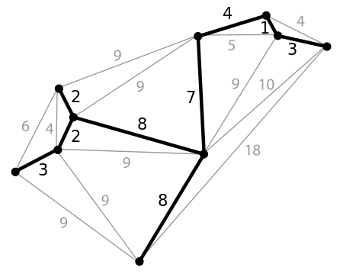
Minimum Spanning Tree
A spanning tree of a graph is a subgraph that is a tree that connects all the vertices
Why would we want to find the spanning tree with the shortest path?
32

Slide 33
Centrality Measures
Degree Centrality – number of direct connections
Closeness – low average path length
Betweenness – a location in the network that interconnects different clusters
33

Slide 34
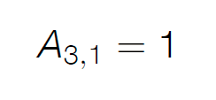
Are 3 and 1 connected?
In-degree is the number of incoming connections
Out-degree is the number of outgoing connections
In an undirected graph like this these numbers are the same!

Slide 35
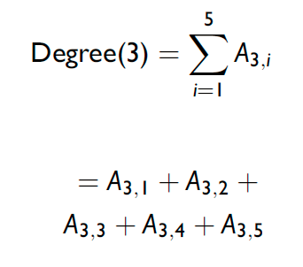
Computing “Degree Centrality”

Slide 36
“Degree Centrality” for Each Node

Slide 38
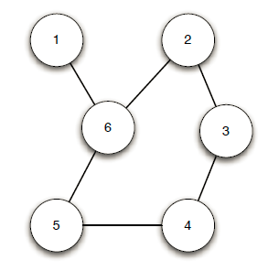
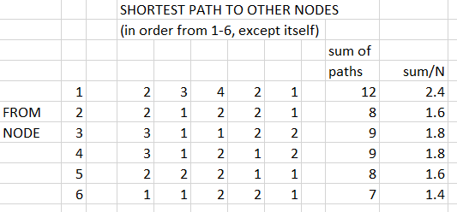
A More Complex Example
Does Node 6 Seem The Most Central?
Does Node 1 Seem The Least Central?

Slide 39
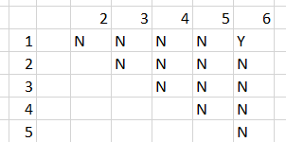
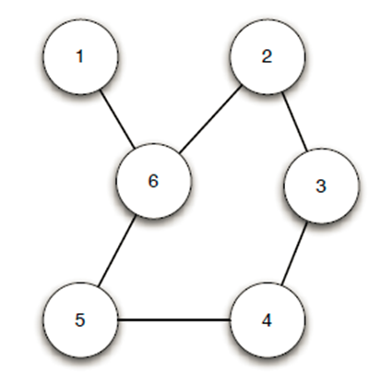
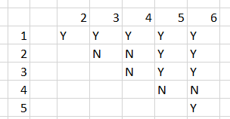
Betweenness Centrality
Node 1 - On 1 Shortest Path
How often does a node fall “between” any two nodes on their shortest path?
Node 6 – On Many Shortest Paths

Slide 40
Moving Beyond Graph Analysis to “Relational” & “Social Network” Analysis
We've been treating relationships in purely structural terms - is one thing connected to another - but we can refine that into two perspectives:
RELATIONAL analysis treats links as indicators of the amount of connectedness or the direction of flow between documents, people, groups, journals, disciplines, domains, organizations, or nations
EVALUATIVE analysis treats links as indicators of the level of quality, importance, influence or performance of documents, people, groups
40

Slide 41
Social Networks
When nodes represent people, groups, organizations, etc., thee structure of the graph and the weights assigned to edges can be interpreted in social terms like popularity power, and influence
Many social networks are directed graphs because of asymmetries in status, power, or values
Tightly connected communities can hinder rather than help the spread of information (or innovations)
Analogy to epidemics… if there is some probability of infecting someone you come into contact with, the more different people you encounter will determine how fast a disease spreads
41

Slide 42
Questions about Individuals
Who is the most popular person in the network?
Who has the most influence?
Who connects or serves as the bridge/gatekeeper between different groups
If you want to disrupt a network, which individual should you remove (or convince to defect, subvert, etc.)
Can we predict social behavior by analyzing patterns in the structure of the network?
42

Slide 43
NSA’s Social Network Analysis (as revealed by Edward Snowden)
The agency was authorized to conduct “large-scale graph analysis on very large sets of communications metadata without having to check foreignness” of every e-mail address, phone number or other identifier, the document said.
The agency can augment the communications data with material from public, commercial and other sources, including bank codes, insurance information, Facebook profiles, passenger manifests, voter registration rolls and GPS location information, as well as property records and unspecified tax data, according to the documents.
NSA Gathers Data on Social Connections of US Citizens.
NY Times 28 Sept 2013
43

Slide 44
Breakout Session 1
(4 person groups)
Discuss Assignment 4: Vehicle Taxonomy

Slide 45
Compare Your Vehicle Taxonomies
Number of levels; breadth vs. depth
Robustness
Could your taxonomy handle the 5 test cases?
Which case(s) did not have a clear fit?
How much did “Miller definitions” help? Did you use them iteratively?
Select the overall best taxonomy in your group
Post “Our group is done” in Chat when finished
45

Slide 46
Your Assignment
Complete the concept hierarchy (taxonomy) between “Vehicle” and the 14 hyponyms shown on the next two slides
Use as many intermediate levels and sub-categories as you need to organize everything
Create a diagram by hand or with a drawing tool to show your taxonomy (like TDO Figure 6.1)
Test and refine your concept hierarchy using Miller’s formula for definitions to define each hyponym (the formula is on the slide following the 14 hyponyms)
This list of 14 definitions should also be turned in
Test your taxonomy using the 5 instances shown on the last 5 slides
For each new instance, name the category in which it fits
If it doesn’t fit in your taxonomy, explain why and how the taxonomy should change to enable it to fit
If your taxonomy changed as a result of the 5 test cases, revise your diagram and submit it

Slide 47
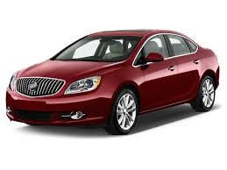
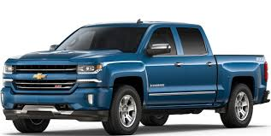
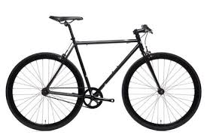
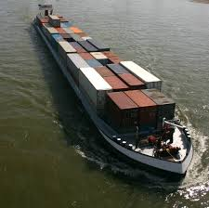
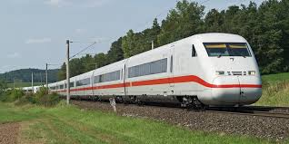
Passenger automobile
Pick-up Truck
Bicycle
Passenger Train
Cargo Barge
Bus
Cargo Aircraft
Skateboard

Slide 48
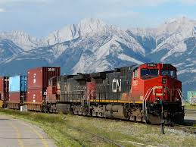
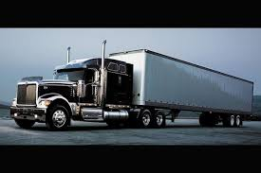
Rowboat
Passenger Aircraft
Freight Train
Cargo Truck
Cruise Ship
Motorcycle

Slide 49
Miller’s Formula for Definitions (TDO 6.4.1.1)
hyponym = {adjective+} hypernym {distinguishing clause+}
Robin = Migratory BIRD with clear melodious song, a reddish breast, gray or black upper plumage
Doesn't mention every characteristic of hyponym, only those needed to distinguish from other hyponyms
49

Slide 50
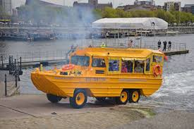
Amphibious “Duck Boat”

Slide 51
Submarine

Slide 52
Space Shuttle

Slide 53
Remotely Piloted Drone Aircraft

Slide 54
Mars Rover

Slide 55
BACK FROM BREAKOUT Compare Your Vehicle Taxonomies
Number of levels; breadth vs. depth
Robustness
Could your taxonomy handle the 5 test cases?
Which case(s) did not have a clear fit?
How much did “Miller definitions” help? Did you use them iteratively?
OK to share the best taxonomies?
55

Slide 56
Breakout Session 2
(in pairs)
Calculate and interpret centrality measures for a social network
Might not be time for this… if not, do it as an “exercise for the student” to ensure you know how the calculations work

Slide 57
A Small Social Network
10 Nodes (people) and 18 Edges (representing their professional interactions).

Slide 58
Answer these Questions
DEGREE CENTRALITY (# of direct connections)
Who is the most connected person?
Who is the least connected person?
CLOSENESS (average path length)
Which person has the most influence?

Slide 59
Computing “Degree Centrality”

Slide 61
DO THE CALCULATIONS BEFORE LOOKING AT THE NEXT SLIDES
(the answers!)

Slide 62
Questions About Individuals
Who is the most/least connected person?
Diane is the most connected, but she’s connected to people who are all connected to each other
The least connected person IN THIS NETWORK is Jane
Which person has the most influence?
Fernando and Garth have the highest “closeness” scores and so are well positioned to know what’s going on in the entire network (and can influence everyone more easily than anyone else)
Who connects or bridges different sub-groups?
Heather has the highest “betweenness” score; she keeps Ike and Jane connected to the “Diane” clique and so she is also very influential

Slide 63
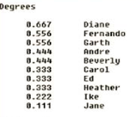
Calculations taken from http://www.orgnet.com/sna.html

Slide 64
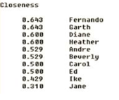
Calculations taken from http://www.orgnet.com/sna.html

Slide 65
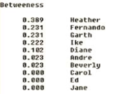
Calculations taken from http://www.orgnet.com/sna.html

Slide 66
Don’t Feel Sorry for Ike & Jane
Ike and Jane have low centrality scores for THIS NETWORK… but Ike and Jane are not in the “small company” that everyone else works for, and they have their own networks that are not depicted when the network is scoped to emphasize the relationships in that company
66

Slide 67
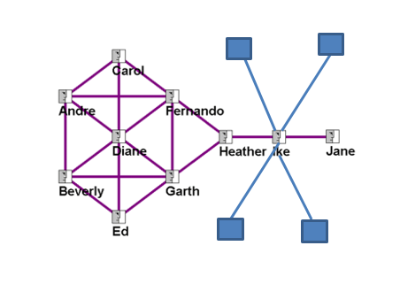

Slide 68
The PageRank of a page is defined recursively and depends on the number and PageRank metric of all pages that link to it ("incoming links"). A page that is linked to by many pages with high PageRank receives a high rank itself.
It weights the contribution of the incoming links by dividing it by the number of their outgoing links

Slide 69
Upcoming Events
Midterm a week from today… 6 of 9 short answers, 90 minutes anytime on 3/9
Practice exam questions available today
Evening of 3/11 class party – being planned by Aurum+
Case study assignment instructions on 3/9; 1 paragraph proposal due on 3/13 (good thing to discuss with others at class party)
3/16 breakout discussions of case study proposals in groups created by teaching team
3/20-3/29 SPRING BREAK!!!!!!!!

