Slide 1
CogSci 150 “Sensemaking and Organizing” Spring 2021
Robert J. Glushko glushko@berkeley.edu
4 March 2021 14) Social Thinking;
{Mis, Dis} Information

Slide 2
Course Checkpoint
This is the halfway point in the semester (lecture 14) and the last lecture in the section of the course on sensemaking in language and culture – which is why it is a good place to have a midterm exam on 3/9 (next Tuesday)
Today’s lecture builds a lot on the previous lecture on structural relationships and social network analysis
On 3/11 (next Thursday) we begin the “Individual Context” of Sensemaking and Organizing with “Automatic Organizing”

Slide 3
Social Thinking
How do the groups we explicitly or implicitly belong to influence how and what we think? (our “Sensemaking”)
When and why does social thinking create worse decisions and outcomes?
Can social thinking create better decisions and outcomes?

Slide 4
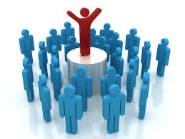
Principles of Group Creation: Homophily & Preferential Attachment
People sort themselves into all kinds of groups by following two familiar principles
HOMOPHILY – grouping by similarity (“birds of a feather”)
PREFERENTIAL ATTACHMENT – grouping by popularity (“rich get richer”)

Slide 5
Homophily
You group yourself with people like you (where you live, where you work, in social / religious / cultural organizations, on Facebook)
Social networks are homogeneous with respect to many socio-demographic, political, behavioral, interpersonal characteristics
Was Homophily a factor in your choice to attend Berkeley or choosing where to live?

Slide 6
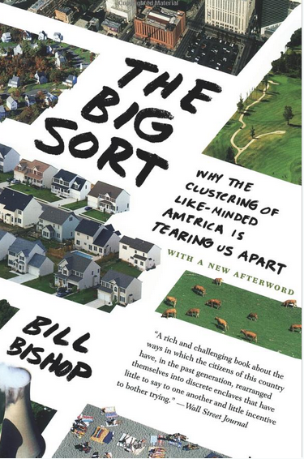
People are increasingly “sorting themselves” as they move to liberal or conservative parts of the country, big towns vs small towns

Slide 7
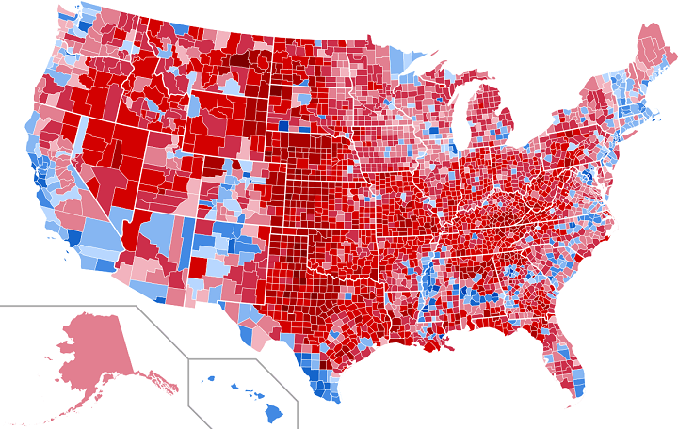
Homophily in 2016 Presidential Election: Results by County
The map above shows the county level and vote share results of the 2016 US Presidential Election. The darker the blue the more a county went for Hilary Clinton and the darker the red the more the county went for Donald Trump.
(from http://brilliantmaps.com/2016-county-election-map/)

Slide 8
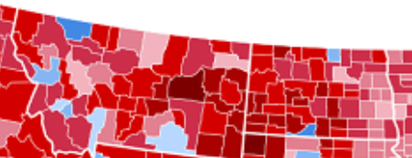
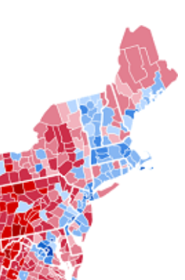
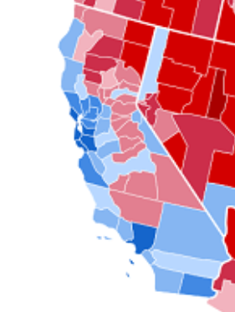
MONTANA
NORTH DAKOTA
NORTHEAST
CALIFORNIA
ANN ARBOR, MI
MADISON, WI
“College Towns”
AUSTIN, TX
ATLANTA

Slide 9
What You Listen to, Wear, and Drive Gives You Away
Preferences in clothing and music are good indicators of political leaning
The vehicle you drive is also a somewhat reliable indication of your politics
Cambridge Analytica used this information to create profiles that enabled the targeting of Facebook users
Can you contrast clothes / cars for conservatives with those for lefties?

Slide 12
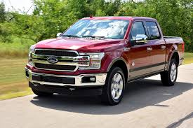
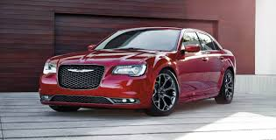
Can You Profile With Vehicles?
Ford F-150
Toyota Prius
Subaru
Chrysler 300
2 of these vehicles are more popular with conservatives
2 of them are more popular with liberals or progressives
Can you sort them?

Slide 13
Preferential Attachment
You group yourself with people who are popular
But this makes them MORE popular because of their popularity… which makes them still more popular…
Do you use Twitter? People “follow” twitter accounts (mostly people, but not always)
Guess some of the 20 most followed Twitter accounts

Slide 14
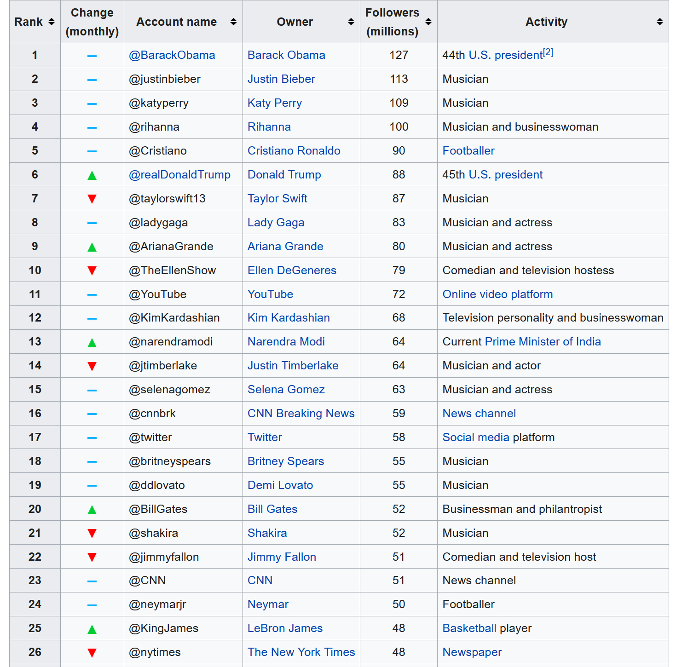
Twitter accounts with most followers (Wikipedia 12/23/20)
Do you see any interesting categories or patterns here?
Data a bit out of date
Trump now has 0
As of 2/15, Biden has 29M, not in the top 50

Slide 15
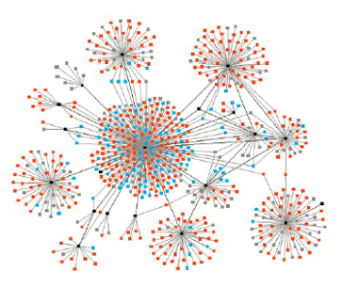
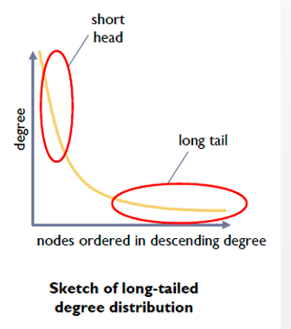
Networks Characterized by Preferential Attachment
A few very highly connected nodes with most nodes having few connections

Slide 16
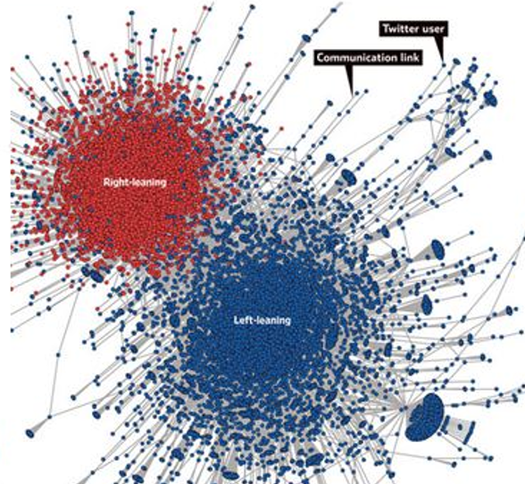
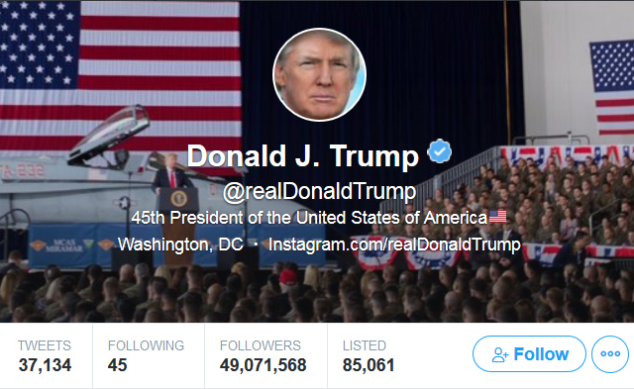
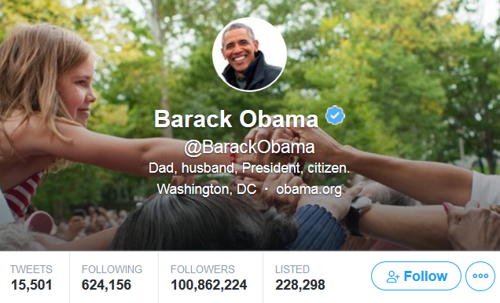
Each is very highly connected, but probably not much overlap in their followers
“Decoding Our Chatter” Wall Street Journal 1 October 2011
Each dot is a Twitter user, lines are retweets of 250,000 political messages by 45,000 people. Very limited cross-over between the clusters created by the pattern of retweeting

Slide 17
Twitter Stats
Twitter says that 1.3 Billion accounts have been created…and the most followed accounts have over 100 million followers
But now that you know about “preferential attachment” you realize that most twitter accounts aren’t popular at all
What is the AVERAGE number of followers?
What is the MEDIAN number of followers?
What % of accounts have 0 followers?

Slide 18
A Very Long Tail
The average number of followers is 707, but because of the extremely skewed distribution, this is much higher than the median (the halfway point in the distribution)
The median number of followers is 1, and 391 million twitter accounts have 0 followers
But that’s not surprising, since only about half of the twitter accounts have ever sent a tweet

Slide 19
Where do you get your news?
From Facebook
From Twitter
Directly from “original fact reporting” or “mainstream media” sources like NY Times, Wall Street Journal, Reuters, Bloomberg, Economist
Directly from “news interpreters” like CNN, Fox, Huffington Post, Slate (which have some bias)
From “clearly partisan” sources (which make their bias explicit)
I don’t pay much attention to news

Slide 20
According to Pew Research, 66% of Americans get their news through social media sites, 44% of them from Facebook alone
On Facebook you are connected to “friends” – people who are like you, who belong to the same groups in various domains – school, work, hometown, etc. Given what you know about homophily and preferential attachment, what does this suggest about the content of the news you get?

Slide 21
Some Implications
If you get most of your news from groups you belong to you are biased to believe it
Because of conversational conventions / maxims
Because of confirmation bias
Because of the narrative fallacy
Because of the “filter bubble”
Because of framing effects

Slide 22
Biases in “Information Gathering”
In normal conversation people follow cooperative principles so they assume that what they hear is true
Grice’s Maxims:
Be informative
Be truthful
Be relevant
Be clear
This is a bias against being skeptical
See “Cooperative Principle” in Wikipedia

Slide 23
Biases in “Information Gathering”
CONFIRMATION BIAS – we are more likely to believe information that is compatible with other things we believe to be true
Preview of “Sensemaking & Simplification” (March 11)
Interpreting data by imposing some sense or structure helps the brain encode data efficiently; we can invert this logic and use the brevity of the encoding as a measure of the amount of sense that it makes of the data.
Nick Chater

Slide 24
Biases in “Information Gathering”
NARRATIVE FALLACY – if the information is internally consistent, the gist of a message is often more memorable than its source, and an engaging story may be remembered and accepted long after the source has been forgotten
Once you make sense of an event by imposing a causal story on it, you are less likely to accept retractions of any “facts or evidence” that fit the story, even if they aren’t true

Slide 25
The “Filter Bubble” / “Echo Chamber” / “False Consensus Effect”
Social media algorithms, driven by “likes,” show each person more of what they respond to positively, confirming their biases, reinforcing their beliefs, and encouraging them to associate online with like-minded people
Isn’t the business model behind social media (especially Facebook) to enable the creation of groups that will appeal to advertisers?
Do you realize that your social media “feed” contains a very different set of things than other people see?

Slide 26
Flashback to 2016 Presidential Election
“I don’t know how Trump won the election. No one I know voted for him”
-San Francisco voter
What would a voter in a small town in rural West Virginia say?

Slide 27
Flashback to 2016 Presidential Election
“I don’t understand how the election was that close. No one I know voted for Clinton”
-small town West Virginia voter

Slide 28
These group properties and the biases we have about information we get from the groups we belong to would matter less if all the information we received was “true”… but it isn’t
You won’t believe how important this is in your daily life! You need to know now! Read this before it is too late!

Slide 29
“Misinformation”
MISINFORMATION is false or inaccurate information, especially that which is deliberately intended to deceive
Sources of misinformation:
Rumors and fiction
News media that are biased (which is most of them)
Governments and politicians (propaganda)
Vested interests (marketing, lobbying)
Why is the Internet especially effective as a mechanism for spreading disinformation?

Slide 30
The Internet and Misinformation
Lack of conventional “gate-keeping” mechanisms; no “news cycle” (“the 6 o’clock news”) or professional editing
Business models that depend more on viewing than on establishing credibility and trust
“Clickbait” rather than informative titles
“Mainstream media” reporters chase and repeat stories that are trending on social media
Automated spread by algorithms
Social listening tools
Bots
Ubiquity of photos and video gives “deep fakes” cover

Slide 31
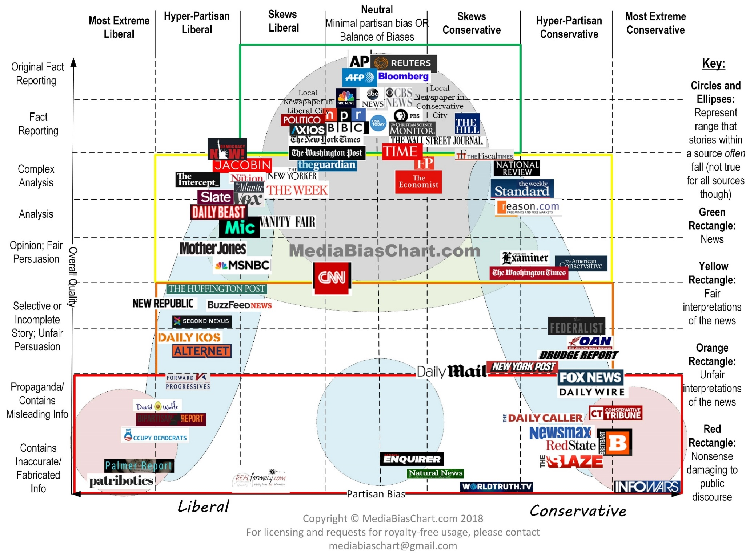
“MEDIA BIAS CHART” from www.allgeneralizationsarefalse.com

Slide 32
Biased News
FRAMING EFFECTS – News providers and commentators typically frame events in ways that highlight provocative aspects, suggest their causes, responses to them, and their political and cultural implications – often to create controversy
By emphasizing and “labeling” some actors and facts and de-emphasizing others, framing influences not just what people consider newsworthy, but how to think about the news
People are more likely to listen to news that frames things the way they like (this is confirmation bias and narrative fallacy) RECENT EXAMPLES?

Slide 33
Framing Effects About Data Science in Presidential Elections
In the 2008 and 2012 elections, the Obama campaign employed sophisticated data science techniques to identify, reach, and influence critical voters
In 2016, the Trump campaign did much the same thing
It is easy to find new stories that praise Obama’s campaign, and easy to find those that criticize Trump’s

Slide 34
NY Times, March 2018, “Firm that Assisted Trump Exploited Data of Millions”
NEGATIVE FRAMING (anti-Trump): “Information harvested from Facebook was used in profiling of unwary voters”
Time magazine, November 2012, “Inside the Secret World of the Data Crunchers Who Helped Obama Win”
POSITIVE FRAMING (pro-Obama): “this massive data effort remade the process of targeting ads and created detailed models of swing-state voters that could be used to increase the effectiveness of everything”

Slide 35
False equivalence – Desire for “balance” when there is none
MSM pre-election news coverage was dominated by “scandals” of Trump and Clinton, relatively less comparison of policy
More than 95% of actively publishing climate scientists agree that global warming is real and caused by human activity, but the contrarian opinions of non-experts are featured prominently in the media

Slide 36
Fake News
Fake news websites publish news that is objectively false while seeking to be perceived as legitimate and taken at face value, often for financial or political gain
When there are multiple interpretations of some event, fake news sites provide an unrepresentative sample
However, because politicians are increasingly labeling news sources that do not support their positions as fake news, the term no longer reflects the actual veracity of the information

Slide 37
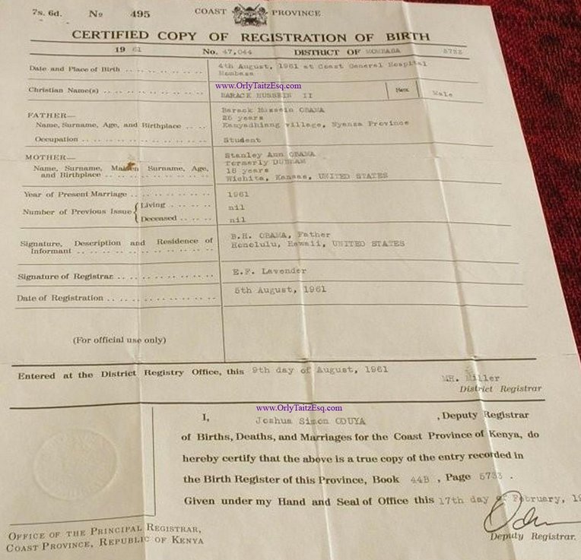
Obama’s Kenyan Birth Certificate

Slide 38
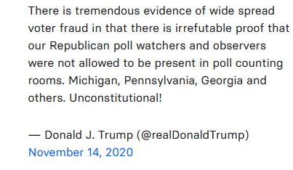
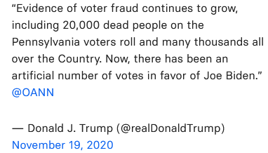

Slide 39
The Fake News Problem
The 2020 election and claims about voting fraud raised the profile of just how strategically placed, biased or plainly wrong stories might have influenced people’s voting and subsequent behavior
Is fake news (choose one or more):
A public relations problem for Facebook, Twitter, Instagram, and Google?
A potential business and legal risk for these firms if they don’t deal with it
A problem for individuals because they might be induced to make decisions not in their best interests
A national and international political crisis that is destabilizing democratic processes and causing decisions to be made that are not in the best interests of society or the world

Slide 40
MY ANSWER TO QUESTION ON PREVIOUS SLIDE:
All of the above
“Fake news is simply the most unsavory face of the business model that drives much of the Internet economy… The tools of disinformation and propaganda are the very same tools that are routinely used by businesses and ad agencies to track and influence their customers.”
- Tim O’Reilly. WTF, Chapter 10. “Media in the Age of Algorithms”

Slide 41
Facebook and Fake News
In 2016, many Facebook and Instagram political ads were bought by entities linked to the Russian government
Facebook estimates that 10 million people saw the paid ads and up to 150 million people saw other content from the fake accounts
The ads appealed to divisions in American society, often falling along political and identity-based fault lines using fake accounts with names like United Muslims of America, Blacktivist, and LGBT United that resembled actual Facebook groups

Slide 42
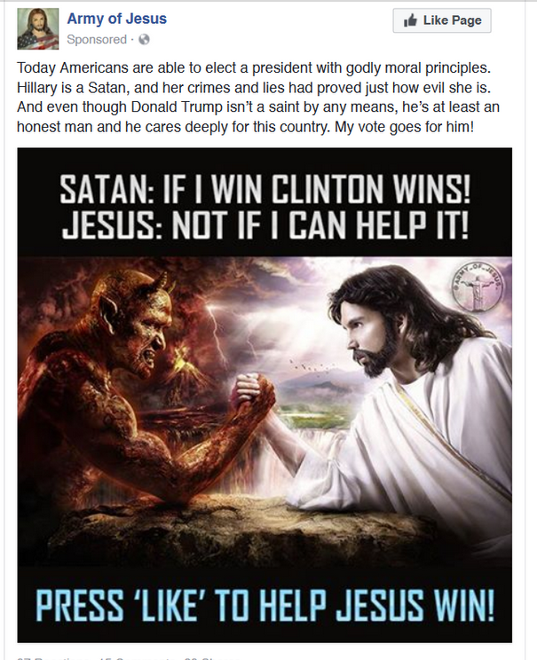
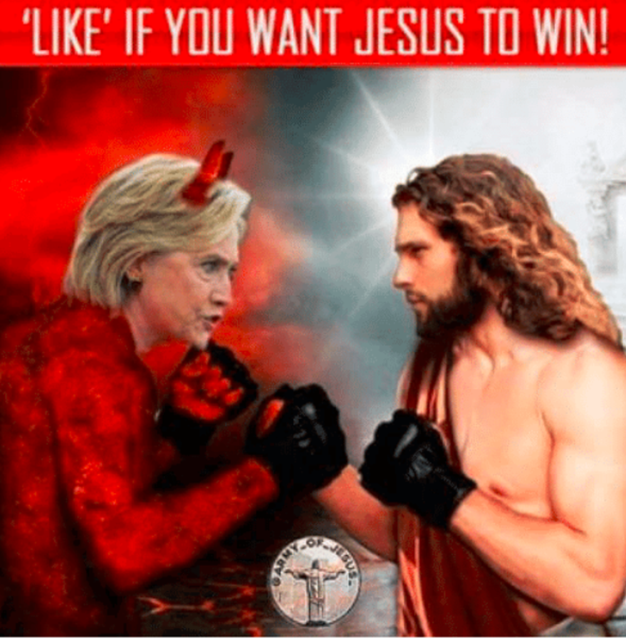
“Army of Jesus” group on Facebook had 217,000 followers in 2016

Slide 43
“Born Liberal” group supported Bernie Sanders and attacked Clinton

Slide 45
Elizabeth Warren Dares Facebook
In 2019 Democratic presidential candidate Elizabeth Warren demanded that Facebook (“a disinformation-for-profit-machine”) do more to block fake news
She bought a political ad – “Breaking News” – that claimed that Facebook and Mark Zuckerberg had endorsed Trump
Facebook removed the ad after a few days…

Slide 46
Fake News and Politics – is Not New AMAZING TRUE STORIES
In 1769, in the lead up to the Revolutionary War, future US President John Adams wrote in his diary that he and other Boston patriots were planting false and exaggerated stories meant to undermine royal authority in Massachusetts
“Cooking up Paragraphs, Articles, Occurrences etc. — working the political Engine!”
Likewise, William Livingston, then governor of New Jersey, secretly crafted a story titled “The Impartial Chronicle,” that claimed that the King of England was sending tens of thousands of foreign soldiers to kill Americans

Slide 47
Dealing with Fake News
Stop it from being produced (make it criminal)
Produce news using computer programs (e.g., “Narrative Science”) that is neutral by design and then get people to read this, or swamp fake news with it?
Stop it from reaching you (improved classification algorithms, or censorship?)
Hire or incentivize people to identify it, and then the platform can retract it / remove it
Which of these approaches do you most prefer?
Which one you would be most opposed to?

Slide 48
“Robo-Journalism” using Story Templates and Grammars
Some document types have a regular "discourse" or "frame" structure that makes it easier to find information that fills the key relational “slots”
You know the “slots” for sports stories…
What are the relational slots in a generic election story?
By trading off writing style for automation, almost any domain dominated by data sets with known relationships can be explained using auto-generated text

Slide 49
WTF: Humans alone can’t solve the problem of fake news
“The idea that Google or Facebook can solve the problem simply by hiring teams of human editors or fact checkers, or use outside media organizations to combat fake news, hate speech, or other objectionable results, removing or demoting them one at a time, indicates that people have little idea of the scale or nature of the problem”
“When attackers use programs to masquerade as users, human supervision is inadequate because of the scope and scale of the attacks”

Slide 50
WTF: How algorithms can defeat fake news
Just as the google search algorithm uses lots of signals to determine relevance, platforms should use lots of signals to determine truth
# and credibility of sources are very important
Are there multiple sources for the same facts
Platforms can discourage people from sharing stories they haven’t read
Platforms can reduce confirmation bias by showing alternate sources with the “opposing bias”

Slide 51
Blue Feed / Red Feed (created by the Wall Street Journal)
Screen shot taken 2 March 2018
http://graphics.wsj.com/blue-feed-red-feed/#/immigration

Slide 52
Blue Feed / Red Feed (created by the Wall Street Journal)
Screen shot taken 2 March 2018
http://graphics.wsj.com/blue-feed-red-feed/#guns

Slide 53
Deep Fakes
Queen Elizabeth’s TikTok Dance (2:00)
Obama and Jordan Peele

Slide 54
Plus ça change, plus c'est la même chose
Facebook will allow political ads again starting March 4
Facebook said Tuesday it’s resuming political, electoral and social issue ads on Thursday after a temporary ban put in place after the November 2020 U.S. presidential election.
The company said in October it would be halting political advertising for an indefinite period after the election to prevent confusion or abuse.
“Unlike other platforms, we require authorization and transparency not just for political and electoral ads, but also for social issue ads, and our systems do not distinguish between these categories,” Facebook said in a post Tuesday.

Slide 55
How Social Thinking can be Positive
Predictive markets, wisdom of crowds demonstrate that:
A diverse group has a lot more information than an individual or homogenous group has…
As long as individuals act independently and ignore the “signals” provided by others…
And the individually provided information can be aggregated
But this assumes that people have some relevant knowledge; aggregating random ideas won’t produce wisdom
An effective group listens more to objectively more authoritative people (e.g., scientific experts)
Can social media applications be adapted to enable the creation and management of groups with these member properties?

Slide 56
Midterm Exam – Tuesday March 9
Choose 6 of 9 short answer questions
Open book, open readings, open notes, open any study materials you create separately or collectively between now and March 8
You can take the exam during any 90-minute period during the 24 hours of March 9 (California time)
REVIEW THE “COURSE REVIEW” SLIDES LINKED TO SYLLABUS FOR FEB 16
WRITE ANSWERS TO THE SAMPLE QUESTIONS

