Slide 1
CogSci 150 “Sensemaking and Organizing” Spring 2021
Robert J. Glushko
glushko@berkeley.edu
18 March 2021
18) Categories made by individuals, Cognitive overload and offloading; distributed cognition and taskonomy

Slide 2
Outline
Information Overload
Distributed Cognition & External Representation
External Representation and Interaction
The Intelligent Use of Space
Activity-based or “Taskonomic” Organizing
Personal Information Management
The Memex

Slide 3
The Context: Individual Organizing Systems and Categories
Created to satisfy ad hoc requirements that emerge from an individual’s unique experiences, preferences, utility functions, and resource collections
Created intentionally in response to specific organizing requirements, often short-term ones
Can have an imaginative or metaphorical basis that distorts or misinterpret cultural categories
How people organize their personal information has been much studied
3

Slide 4
Information Overload

Slide 5
Definitions of Information Overload
Too much information supply
Too much interruption and multi-tasking
Too little processing capacity
Too little time to process the information
Too little time to interact with relevant people
Feelings of stress, confusion, anxiety, and low motivation for information-intensive tasks
Why does it matter how we define information overload? Could you measure these quantitatively?

Slide 6
Factors Influencing Information Overload
Information quantity, frequency, intensity, and quality
The capabilities of the person receiving, processing, or communicating the information
The processes and tasks for the information
The information technology used
Formal and informal organizational / communication structures (“Social Thinking”)

Slide 7
How Much Information Is Enough? It’s Hard to Know (from Kirsh (2000), “A Few Thoughts on Cognitive Overload”)

Slide 8
Countermeasures to Overcome Information Overload
Better personal information management
Better selection of information sources
Exploit technology for automatic and assisted information organization and use
…. How well does this work in our Facebook or Twitter feeds?

Slide 9
Some Implications
FLASHBACK
If you get most of your news from groups you belong to you are biased to believe it
Because of conversational conventions / maxims
Because of confirmation bias
Because of the narrative fallacy
Because of the “filter bubble”
Because of framing effects

Slide 10
Distributed Cognition & “External Representation”

Slide 11
“Distributed Cognition” (Hollan, Hutchins, & Kirsh, 2000)
"Distributed cognition" is a "dialect" of cognitive science that views cognitive activity as not just something that takes place within the mind of a single person at some moment in time; it is:
Distributed and organized across the members of a social or goal-oriented group
Distributed and organized between people and the technology and artifacts they create and use
Distributed through time; results of earlier events and interactions that transform future ones
11

Slide 12
Systems of Meaning – What vs How (2)
Andrade’s proposal to divide “studies of meaning” between anthropology and psychology came at a time when cognitive science was dominated by a “human information processing” view of cognition; “’the mind is a computer” metaphor
This implies that processing is largely independent of context; assumes that content varies across cultures, but the processor itself, and hence the processing, are universal, that is, independent of people's cultural background
12

Slide 13
Application Areas for DCog
DCog concepts are mostly used in systems design and implementation in specific work environments to make people efficient and effective
Its main method is field research, going into the workplace and making rigorous observations (often video), studying and coding the recorded activities using qualitative research methods (“ethnography”)
Goal is to understand and codify the various ways in which cognitive structures and processes are distributed between internal and external representations, across a group of individuals, and across space and time

Slide 14
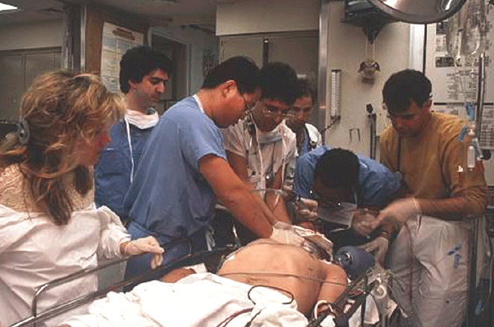
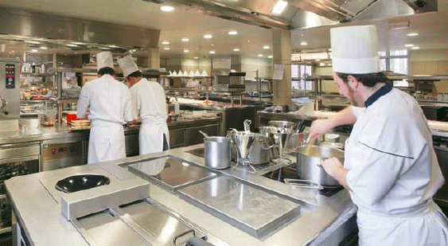
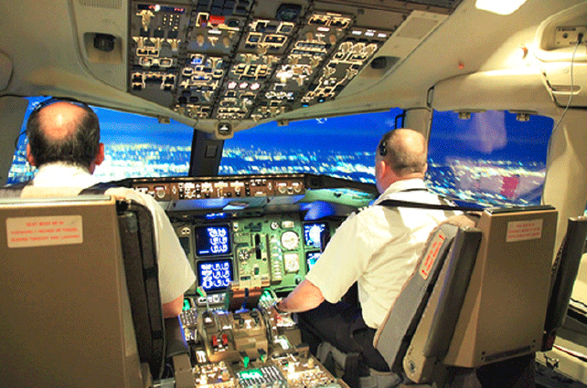
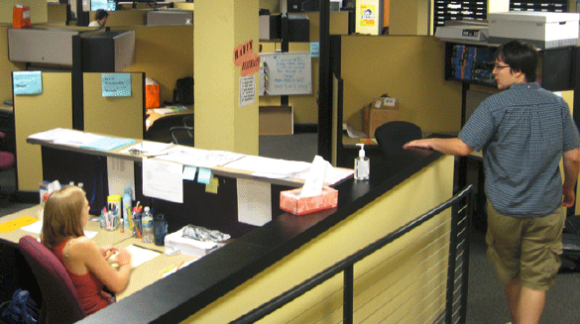
Intensive Care Units, Offices, Kitchens, & Cockpits

Slide 15
“The Intelligent Use of Space”
Kirsh, David. "The intelligent use of space." Artificial intelligence 73, no. 1 (1995): 31-68.
“Work materials” and “artifacts” are more than just the inputs and outputs of cognitive activity; they can become part of the cognitive system”
"Whether we are aware of it or not, we are constantly organizing and reorganizing our workplace to enhance performance"
“At times the histories of use are perceptually available to us in ways that support the tasks we are doing"
"When space is used well, it reduces the time and memory demands of our tasks... to simplify choice, to simplify perception, and simplify internal computation”
15

Slide 16
Mise-en-place
16

Slide 17
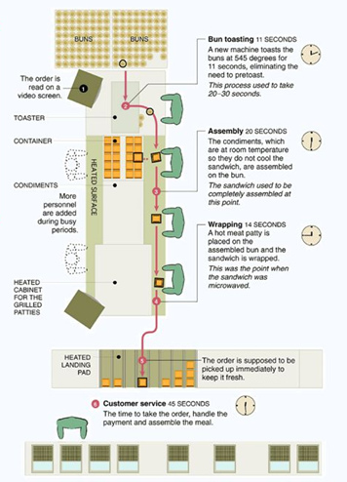
Using Space to Simplify Choice
A production line serially decomposes a complex task by dividing the space in which it is performed into functional stations where sub-tasks are performed
Each spatial region creates a task context in which only certain skills, tools, and rules are appropriate
Once a context has been selected, the local affordance make clear what can and must be done
The New McDonalds Layout

Slide 18
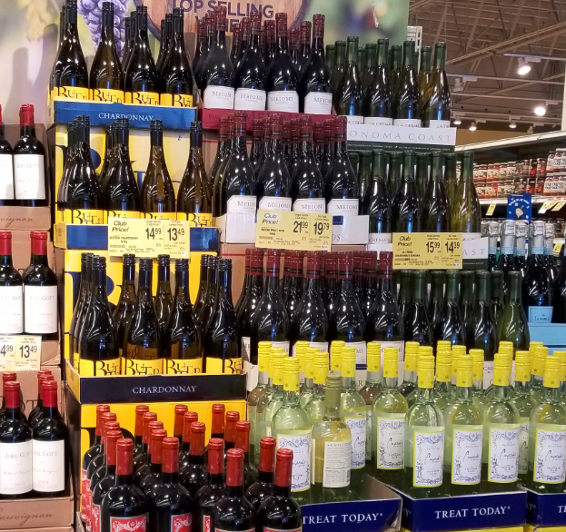
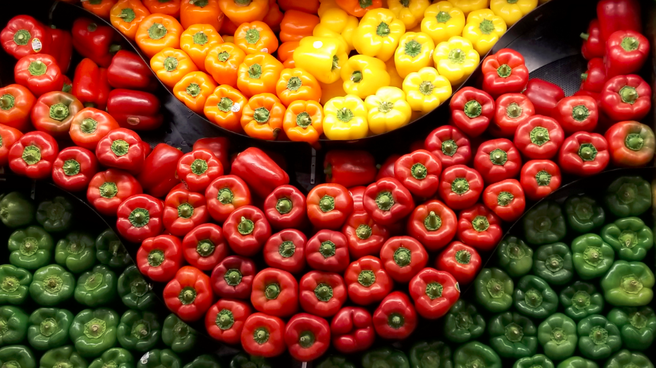
Using Space to Simplify Perception
Arrange objects in space so they form categories that reflect relevant preconditions, or properties that are useful to notice or exploit

Slide 19
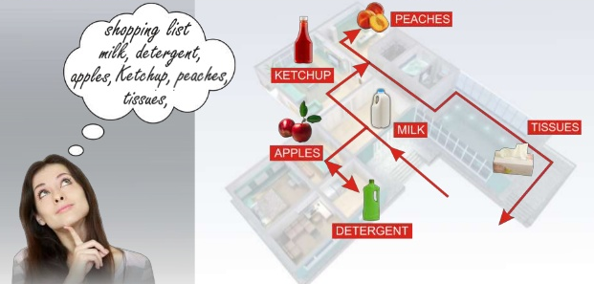
The Intelligent Use of “Mental Space” – The Method of Loci
The hippocampus, the brain component dedicated to memory, is highly developed for storing and recalling memories of physical locations
The ancient Greeks relied on this capability and devised a mnemonic system—the method of loci—which involved attaching things to remember, the key ideas in a speech perhaps, to well-known physical locations
While giving the speech one imagines walking through that physical location from idea to idea
Today, champion memorizers use this technique to associate items with places in vividly imagined “memory palaces.”

Slide 20
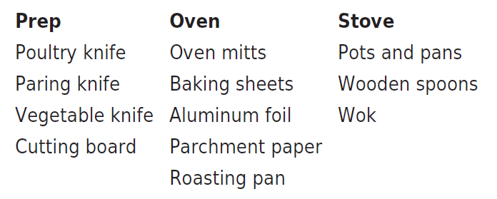
Taskonomy
In contrast to "taxonomy" - an approach to organization based on similarity of content or characteristics - a "taskonomy" organizes on the basis of purpose or "activity structure“
A COOK’S TASKONOMY (Figure 8.1 in TDO)
Grocery stores and supermarkets are mostly organized taxonomically, but have some taskonomic classification
20

Slide 21
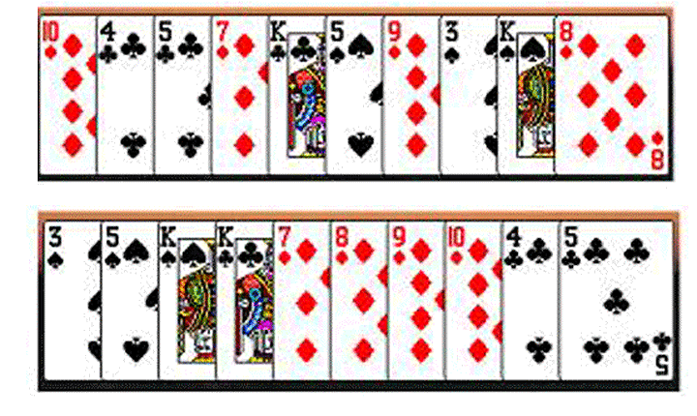
Task-Based Card Sorting
Which arrangement of cards better supports the gin rummy’s players sub-goals and plans?
21

Slide 22
Offloading Memory
Offloading cognition into-the-world is a ubiquitous part of our everyday cognitive lives
We can also offload future memory demands into the world using external tools to supply perceptual cues that can trigger intended actions

Slide 23
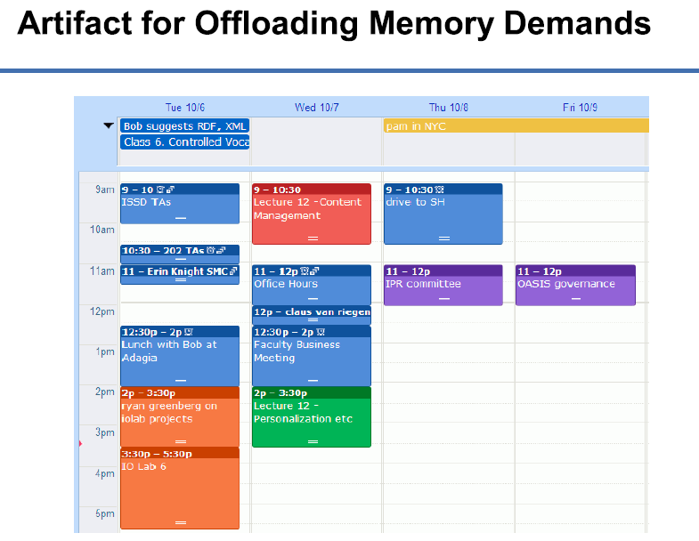

Slide 24
It’s Not Just a Cup; It’s a Document
What role does the “cup as document” perform at Starbucks?

Slide 25
It’s Not Just A Cup; It’s Offloaded Memory
The cup improves quality at “specification time” by recording drink orders in a consistent and robust way
The order of the cups is an external representation of the “production queue”
It improves quality at “production time” because the barista's memory load is minimized
Kirsh, D. (2005). Multi-Tasking and cost structure: Implications for design. In Proceedings of the Annual Meeting of the Cognitive Science Society

Slide 26
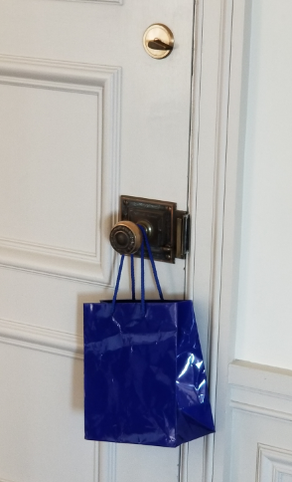
Offloading “Prospective Memory”
We rely on memory not only to recall information from the past but also to execute intended behaviors in the future. Our ability to remember delayed intentions is called “prospective memory”
Delayed intentions can be triggered by perceptual cues in our environment

Slide 27
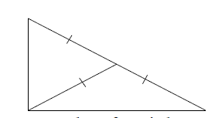
Benefits of “External Representation” (Kirsh – Interaction, External Representation, and Sensemaking (2009))
External representations enables us to solve problems and understand concepts that are too difficult “just by thinking”
A basic property of right-angled triangles is that the length of a median extending from the right angle to the hypotenuse is itself one half the length of the hypotenuse

Slide 28
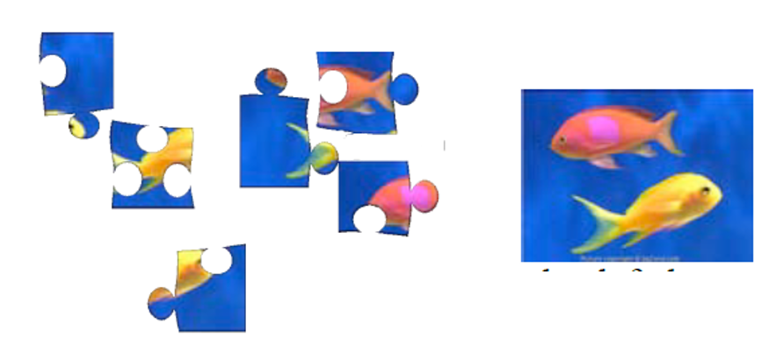
Benefits of Interaction with External Representations
Through interaction it is easier to process more efficiently (i.e. with better speed-accuracy), more deeply, more precisely, and often more broadly than by working inside the head alone
Can the jigsaw images on the left be perfectly assembled into the picture on the right?

Slide 29
Benefits of “Reformulation”
Representations differ in how explicitly they encode information
Externalized representations can often be reformulated to make them more explicit, easier to understand and think with
The cost structure of computation is very different outside the head than inside

Slide 30
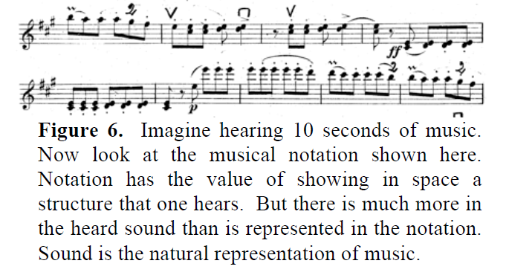
Benefits of “Natural Encoding”
Every representational system or modality has its strengths and weaknesses
An inference or attribute that is obvious in one system may be non-obvious in another

Slide 31
The BART System Map
In what ways is this map schematic rather than physical or literal?
What are the pros and cons of this design?

Slide 32
Benefits of “Multiple Representation”
Sometimes a non-natural or non-literal representation can be more revealing than the original representation because it can be parameterized or simulated
Multiple representations that emphasize different properties can suggest new benefits or insights
Visual designers who move between pen and paper, 3D mockups and rapid prototypes are familiar with this idea

Slide 33
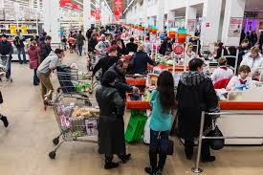
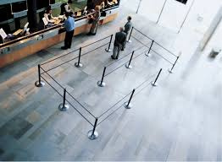
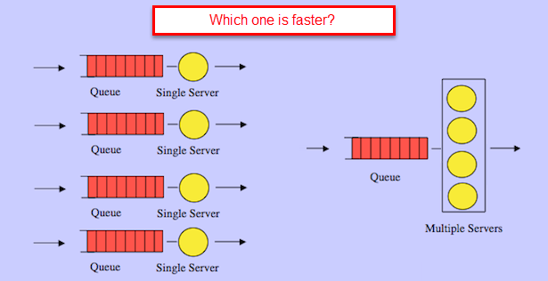
QUEUE LAYOUT Pictorial
Schematic

Slide 34
Some Questions
Automated/autonomous systems and products are “smarter” the more we offload cognitive demands onto them. But what are the downsides?
Do you remember addresses and phone numbers, or do you just use them on your smartphone?
We can search the web for almost anything
How does this change how we read, study, learn?
Is Google making us lazy and stupid?

Slide 35
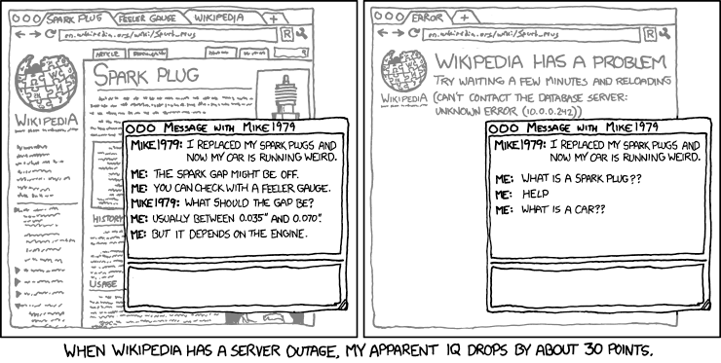

Slide 36
Drop in – Professor David Kirsh
Professor and former head of UCSD’s Cognitive Science Department
Wikipedia says his research interests include interactive design, collaborative environments, cognitive aspects of multimedia design, information architecture, attention management and human-computer interaction
I have known David for a long time; he’s a witty and fun guy who likes to cook and do woodworking design projects

Slide 37
Personal Information Management

Slide 38
Personal Information Management
"The practice and the study of the activities that people perform to acquire, organize, maintain, and retrieve information for everyday use"
PIM covers personal actions (or inactions) that are the result of individual choices
Having this discretion about information organization and "making sense of it" to make decisions is a defining characteristic of professional, as opposed to clerical, information work

Slide 39
Contrasting PIM Strategies
People differ a lot in their PIM strategies
“Pilers” vs. “Filers” (“Slobs” vs. “Neat Freaks”) is a classic contrast and a recurring theme in popular culture
Do you make a lot of effort to remember and organize information, or do you assume you can always find it on your phone or via web search?
Is part of your PIM strategy to rely on other people for information you might need?

Slide 40
PIM and Technology
Because PIM is embedded in user tasks and work context it reflects the prevailing technology support for information work
There have been numerous disruptive technologies for PIM
The personal computer had an enormous impact
Then came “luggables” and “portable” notebook computers
The smart phone and “cloud storage” enables much of a user’s PIM to be always accessible, making PCs and notebooks less important

Slide 41
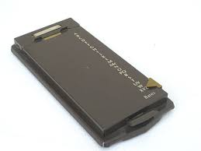
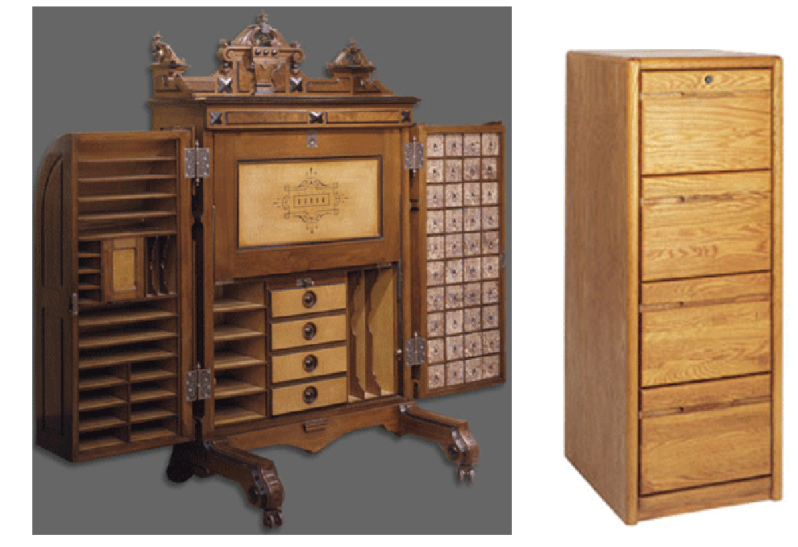
Historically Disruptive Technologies for PIM
3
1
2
4

Slide 42
The Contemporary PIM Challenge
Vastly more personal information of all kinds
Much of this information is in incompatible digital formats produced and consumed by a variety of devices and applications
These devices and applications separately provide support for PIM that is collectively incompatible
But our work often requires that information be created, managed, and retrieved in ways that cut across these format and device boundaries
What can be done to ensure that PIM can span devices and applications?

Slide 43
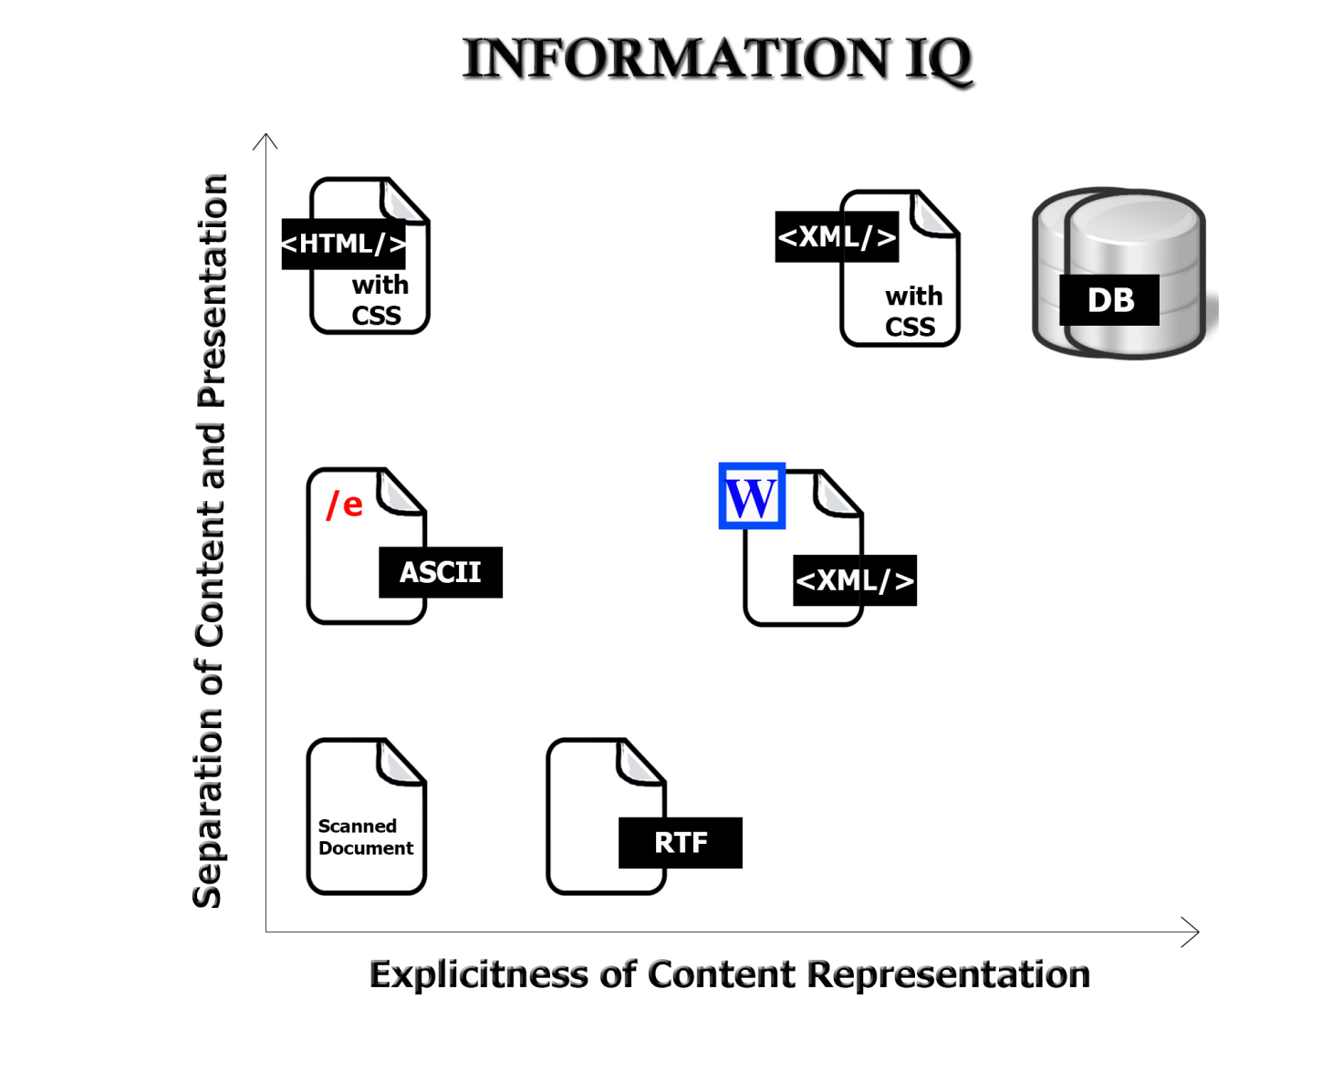
The Digital Format Matters!
FLASHBACK
43

Slide 44
Your “Personal Information Space”
Your PSI is an abstract organizing system that contains all the various physical and digital information resources that are nominally under your control
Some of these are located "in the cloud" and are thus only indirectly controllable, but people tend to think of all the distributed digital storage as being "in one place"
A fundamental challenge is maintaining an integrated view of the PSI
A corollary challenge is reconciling the tension between one's PSI and the need to contribute and use information from common information spaces

Slide 45
What’s In YOUR PSI?
Dropbox Google Docs
Collaboration apps like Slack
Smartphone Apps

Slide 46
PIM Activities
Selection (Keeping) activities are carried out when you encounter information - they determine the input of information into the PSI
Organizing by intentionally applying principles that arrange resources in ways that enable desired interactions
Interactions: Finding or re-finding activities within the PSI determine the output of info from the PSI or its use in work
Maintenance activities are those taken to organize, re-organize, or integrate the PSI

Slide 47
Selection Decisions
Pushed information comes to our PSI (not as the result of any immediate action on our part); could be previously-selected subscriptions, social media notifications
Pulled or Retrievable information is what we intentionally seek
What is YOUR mixture of pushed and pulled information? How (or do) you manage or maintain the proportions over time?

Slide 48
Decisions to Make on Information Exposure / Receipt
Consume immediately
Ignore (is this “keeping by default” ?)
Keep
What types of information fall into each category?
What are reasons for keeping information?

Slide 49
Decisions About Keeping and Organizing
Does the "to be kept" information item fit into our existing classification scheme within our PSI?
If we use an existing category or location or naming scheme, is the degree of "fit" acceptable or does it distort the existing organizational or naming scheme?
Is it necessary to create new categories, locations, or names?
Do we abstract / summarize / data mine / secure or otherwise process the "to be kept" information?
How much of this "keeping and organization" work could be done automatically?

Slide 50
The Memex

Slide 51
Vannevar Bush ‘As We May Think”
MIT Scientist
Ran the Office of Scientific Research and Development during WW2, which coordinated all the work of scientists (including the Manhattan project)
His efforts after the war to continue federal funding for scientific research led to creation of NSF
“As We May Think” has been cited nearly 10,000 times and is one of the most influential writings of the “computing era”
51

Slide 52
“There is a growing mountain of research. But there is increased evidence that we are being bogged down today as specialization extends. The investigator is staggered by the findings and conclusions of thousands of other workers—conclusions which he cannot find time to grasp, much less to remember, as they appear.”
“The difficulty seems to be…that publication has been extended far beyond our present ability to make real use of the record.”

Slide 53
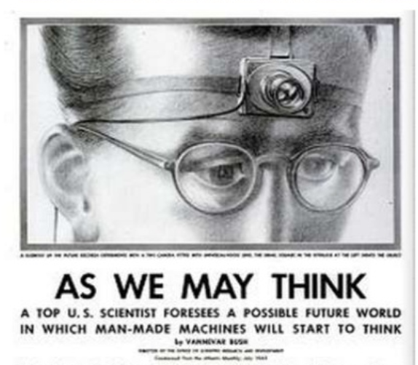
A memex is a device in which an individual stores all his books, records, and communications, and which is mechanized so that it may be consulted with exceeding speed and flexibility. It is an enlarged intimate supplement to his memory.
Consider a future device for individual use, which is a sort of mechanized private file and library

Slide 54
The Memex
54

Slide 55
Memex New Ideas
“The human mind works by association” -> hypertext linking in “trails”
Because trails are separate packages of links, they can be shared and combined
Text or voice annotation of documents
Speech synthesis

Slide 56
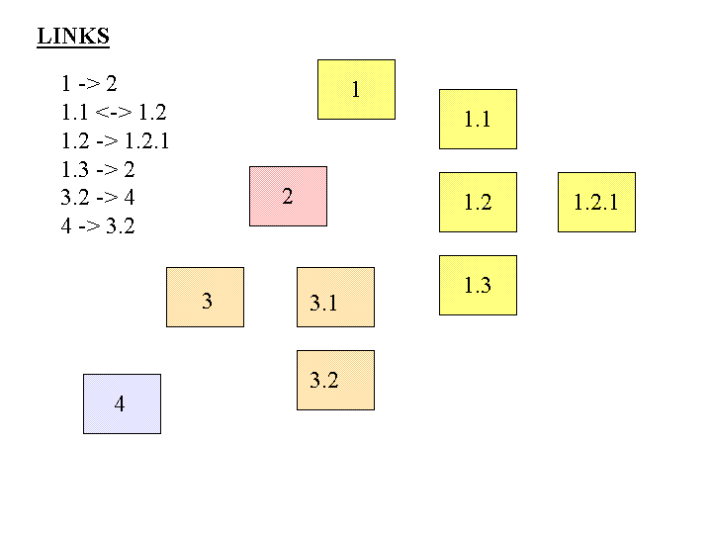
FLASHBACK
Separate Links
What would it mean to store links apart from the resources? What are the implications?

Slide 57
Memex Limitations
Linear extrapolation of prevailing technology, “technical difficulties of all sorts have been ignored”
No mechanism for searching documents or trails
Memexes are stand-alone, not networked

Slide 58
Memex as an Organizing System
What?
Why?
How much?
When?
Who (and by what means)?)
Test your understanding of Memex
58

Slide 59
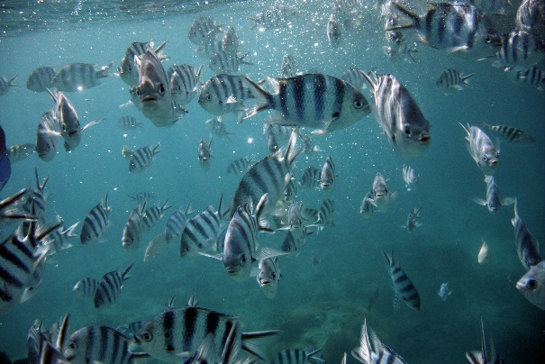
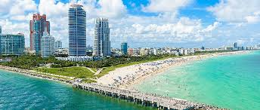
Enjoy Your Spring Break
I plan to enjoy mine!

Slide 60
Breakout Session – Midcourse Evaluation
Discuss as a group
What one or two things about this class do you like, should we do more of?
What one or two things about this class do you not like, should we do less of?
Anything else you think the professor needs to hear from students
Summarize your discussion (anonymously if you prefer) in Google Doc

