Slide 1
CogSci 150 “Sensemaking and Organizing” Spring 2021
Robert J. Glushko glushko@berkeley.edu
30 March 2021
19) Category Structure; Institutional Categories

Slide 2
Categories of Categories
FLASHBACK
Categories are sets or groups of resources, “classes of things” or abstract entities, that are treated the same
In TDO there are two ways to contrast categories
CATEGORY CONTEXT: How they are created (individual, cultural, institutional, computational)
CATEGORY STRUCTURE: How they are defined or structured (enumerated, property-based, similarity based…)

Slide 3
Plan for the Course
We can analyze sensemaking and organizing from four interrelated perspectives:
As a member of a social, cultural, or language community (linguistics, sociology, social network analysis)
As an individual (psychology and philosophy)
In institutional contexts (law and business)
In data-intensive or scientific contexts (statistics, computer science, info visualization).

Slide 4
Sensemaking and Organizing in Defined/Institutional Contexts
[19 – March 30] Category Structure; Institutional Categories
[20 – April 1] Classification; Standardization;
[21 – April 6] Vocabulary Control; Interoperability
[22 – April 8] Organizing and Interaction Design; Applied Behavioral Economics

Slide 5
Principles for Creating Categories (TDO 7.3) (“Category Structure”)
Enumeration
Single Properties
Multiple Properties
Similarity / Family Resemblance
Theory-Based (or Analogy-based)
Goal-Derived (or Activity-based)

Slide 6
Enumerated Categories

Slide 7
Defining Categories by Enumeration
Simplest way to define a category is by enumerating (listing) its members
This principle is also called EXTENSIONAL definition; the members of the set are called the EXTENSION
This principle is easy to understand and implement; the meaning of a category or concept is NOT a property test; it is simply the specific set of resources in it
Learning an enumerative category just means “memorizing its members,” which is why it is impractical for categories with many members
Membership might seem arbitrary because it might or might not be based on shared properties

Slide 8
Pac-12 Conference: An Institutional Enumeration
Do Arizona, Utah, and Colorado have any “Pac” properties?
Why are these 12 schools the members of this conference?
Why are Utah and Colorado in the South Division ?
LATITUDE (N)
Berkeley 37.87
Boulder 40.02
Salt Lake 40.76

Slide 9
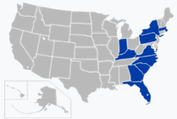
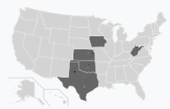
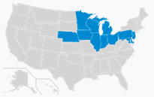
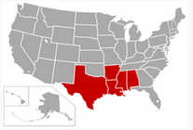
Other Sports Conferences with Some Arbitrary Enumerations
“Atlantic Coast Conference” has 3 schools not on coast
“Big 12” Conference has 10 member schools
“Big 10” Conference has 14 member schools
“Southwestern Conference” has 2 member schools in the SouthEAST

Slide 10
Competing Enumerations
Enumerative categories enable membership to be unambiguously determined, but that doesn’t mean that they are uncontroversial – there might be competing enumerations
EXAMPLE : Is Gender Binary?

Slide 11
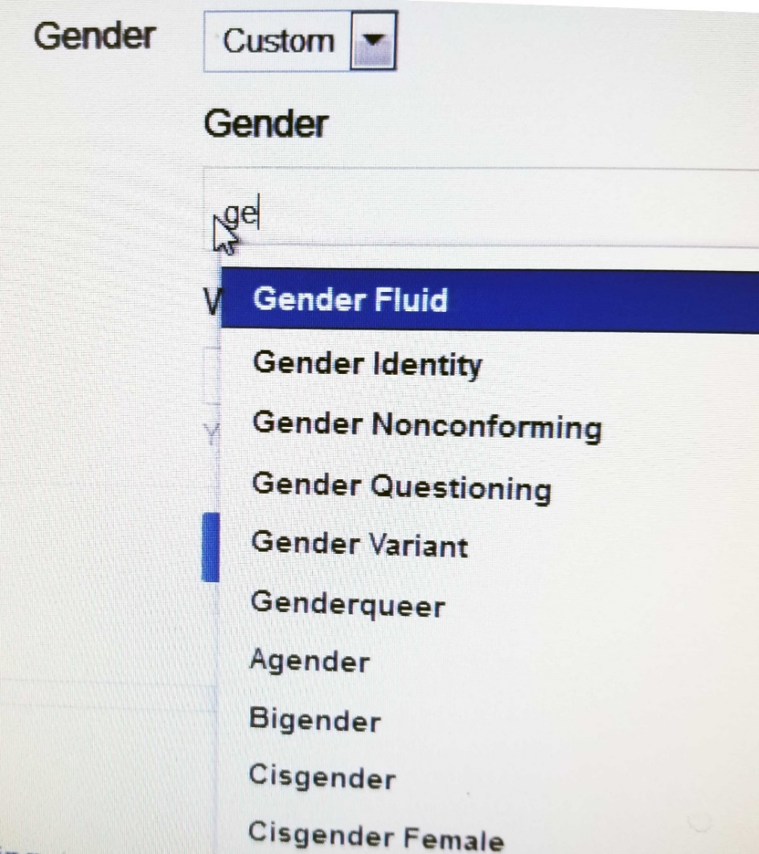
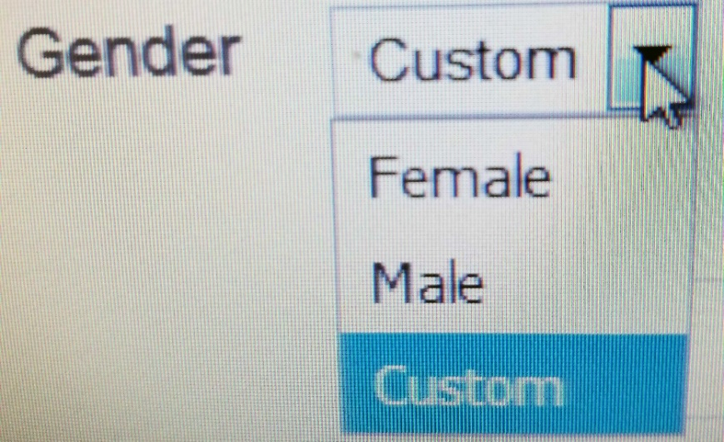
Facebook Offers 56 Gender Categories
Why are binary gender category systems much more common than non-binary gender category systems?

Slide 12
Specifying Enumerations
You should be excruciatingly careful when you define a category by enumeration
The legal principle of “implied exclusion” says that if you “expressly name” or “designate” some list anything not named is excluded
Legal disputes often reflect different interpretations of category membership and whether a list of category members is exhaustive (“the following”) or merely illustrative (“including” or “such as”)
This is why an “Other” category is a bad idea!

Slide 13
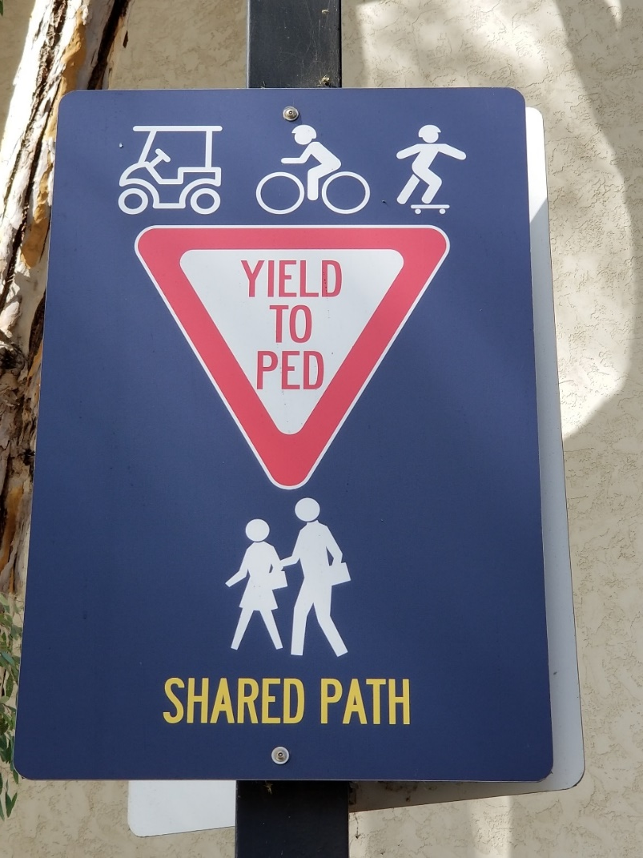
Which Category Definition is Easier to Understand?
Defined by a Single Property
Defined by Enumeration?

Slide 14
The Enumerated “Planet” Category
For millennia, “planet” was an enumerated cultural category that contained the five visible planets in our solar system (Earth was not considered a planet, because it was assumed that the planets orbited the Earth)
Earth joined the planet category after the Copernican revolution, as did what we now know as the large asteroids
Asteroids were later removed from the category when it was discovered that they were much smaller that all other planets
When Pluto was discovered in 1930, it was categorized as the ninth planet in our solar system

Slide 15
Enumerative Definition Doesn’t Scale
What happened to the “planet” category when “exoplanets” were discovered orbiting around stars other than the Sun? (over 4000 have been identified)
At some point an enumerative category might contain so many members that it must be sub-divided or be given a definition based on principles other than enumeration

Slide 16
International Astronomical Union Re-defines “Planet” using shared properties (2003)
“A celestial body that is
in orbit around a star
has sufficient mass for its self-gravity to overcome rigid body forces so that it assumes a hydrostatic equilibrium (nearly round) shape
has cleared the neighborhood around its orbit”

Slide 17
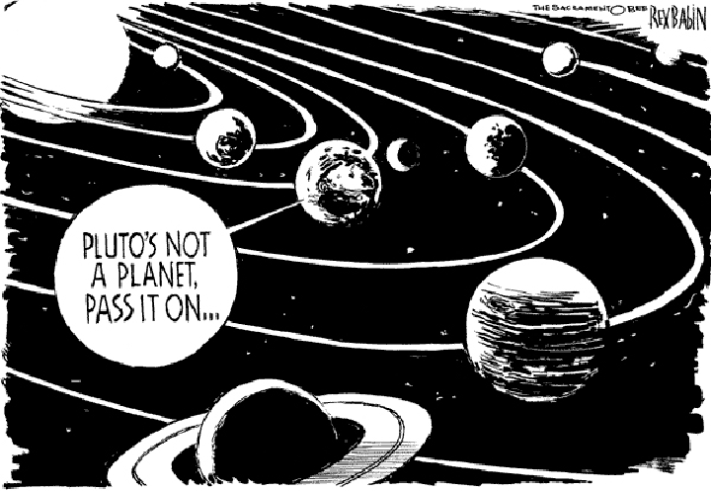
Sorry, Pluto, You’re Now a “Dwarf” Planet

Slide 18
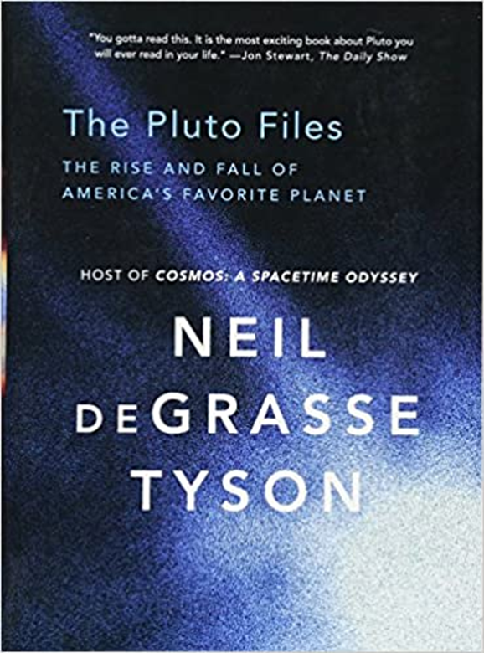
Rubbing it in on Pluto

Slide 19
Categories Defined by Single Properties

Slide 20
Categories Defined by Single Properties
A very simple way to define a category is to use only the values of any single property, especially when the possible values are discrete and not very numerous
Intrinsic static properties are often the easiest ones to use (color, size, shape…)
It is also desirable to use properties that objectively measurable and orderable, or tied to well-established cultural categories
Learning the category is simple – what’s the property?

Slide 21
Categories Defined by Single Properties - Limitations
Whenever a single property is used to define a system of categories, the choice of property is critical (WHY?)
When a single property defines a category, how does this affect the coherence or homogeneity of the category members?

Slide 22
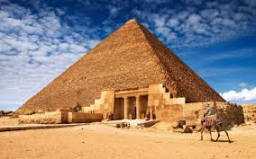
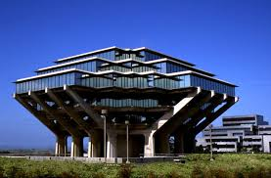
Single Property Category: “Pyramid- Shaped”

Slide 23
Pyramid Man-Made? Location? Shape?
Yes Yes Egypt
Yes No Glacier Park
Yes Yes UC San Diego

Slide 24
A Category System for Shirts Using just the “Style” Property
SHIRTS
Dress
Work
Party
Athletic
Each value of the Style property becomes a sub-category
(This property and the values it can take are “cultural”)

Slide 25
Multiple Property Categories

Slide 26
Multiple Property Categories
When items being categorized can be described using easily observed “separable” or “combining” properties, categories are often based on multiple properties
Each successive property differentiates the items in a category to create a hierarchy of sub-categories
Property order determines the hierarchy
How do we choose the properties?
How do we determine the order in which we apply them?

Slide 27
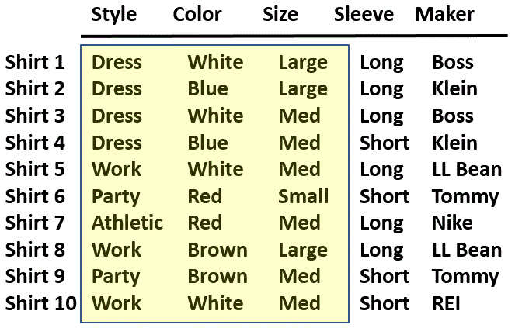
A Collection of Shirts (Using Separable “Cultural” Properties)
27

Slide 28
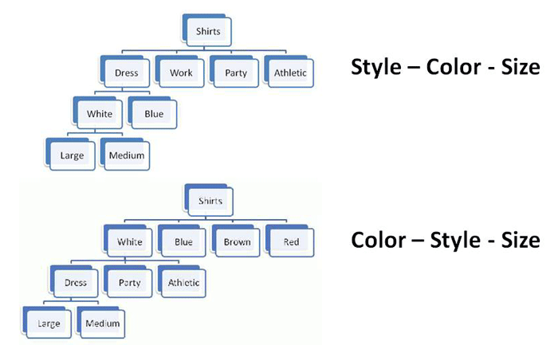
Property Order Determines the Category Hierarchy
Imagine shopping in two physical stores organized in these contrasting ways

Slide 29
Classical Categories
“Classical” categories can have large numbers of category members, but they have clear boundaries defined by a small number of ESSENTIAL or necessary and sufficient properties
Necessary means that every instance must have the property to be in the category
Sufficient means that any instance that has the necessary properties is in the category

Slide 30
Classical Category: Prime Number
A Prime Number is an integer divisible only by itself and 1
Every prime number has these properties (Necessity)
If a number has these properties, it is prime (Sufficiency)

Slide 31
Implications of “Necessary and Sufficient” Properties
Because category membership is defined by rules, all members of the category have equal status in the equivalence class
Classical categories are conceptually simple and have straightforward implementations in technologies like database schemas, decision trees, and classes in programming languages

Slide 32
Categories Defined by Probabilities and “Family Resemblance”

Slide 33
Wittgenstein
Ludwig Wittgenstein (1889-1951) – "philosophy of ordinary language" - first to discuss problems with classical category theory
Enumerative categories embody the idea that “meaning is reference” – a concept means what it refers to; you understand words by following the association to their “extensions”
Wittgenstein argued that most words don’t have fixed extensions because what they refer to can depend on context: “meaning is use”

Slide 34
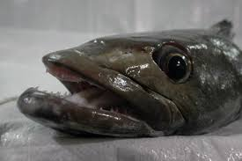
If Meaning was just Reference...
If "meaning" was just based on reference would names matter?
Prune == Dried Plum
Chinese Gooseberry == Kiwi Fruit
Patagonian Toothfish == Antarctic Cod == Chilean Sea Bass
Anyone have some examples from languages other than English?

Slide 35
Implications of “Meaning is Use”
There may be defining features for typical instances
But there are no features that are necessary and sufficient for all examples of the category
Even when features can be identified, they change in different contexts and over time
Different instances vary substantially in how typical or representative they are of the category even though they share all the required features
This can make the category hard to learn
Wittgenstein's classic counterexample is "Game“ (TDO 7.3.5)

Slide 36
Probabilistic Categories & Family Resemblance
In some domains instances of a category can share many features, some instances might have properties that are not widely shared, and some important discriminating properties might be difficult to perceive
Birds:
All have feathers, wings, beaks, 2 legs
But some fly or swim and some don’t
The shape of their beaks, wings, and feet varies a great deal
36

Slide 37
Implications of Probabilistic Properties
Correlations among the properties make it necessary to determine an instance’s category membership in a statistical or probabilistic manner based on the overall similarity between it and other items in the category
Some features are better predictors of category members than others, which results in: Typicality / gradience / centrality effects
37

Slide 38
Implications of Probabilistic Properties
The perceived centrality or typicality of category membership depends on the extent to which the most characteristic properties are shared
Instances with more of the characteristic properties are “better” category members
➔ fuzzy and flexible category boundaries
38

Slide 39
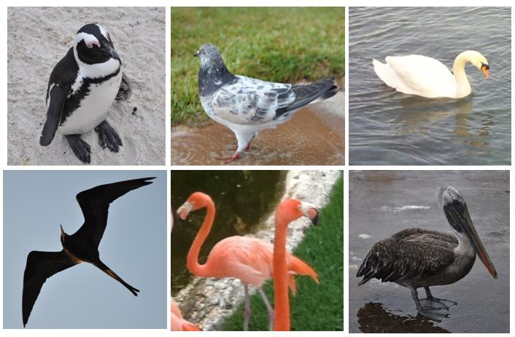
Gradience in Category Membership
Which bird is most typical of the category?
Least typical?
39

Slide 40
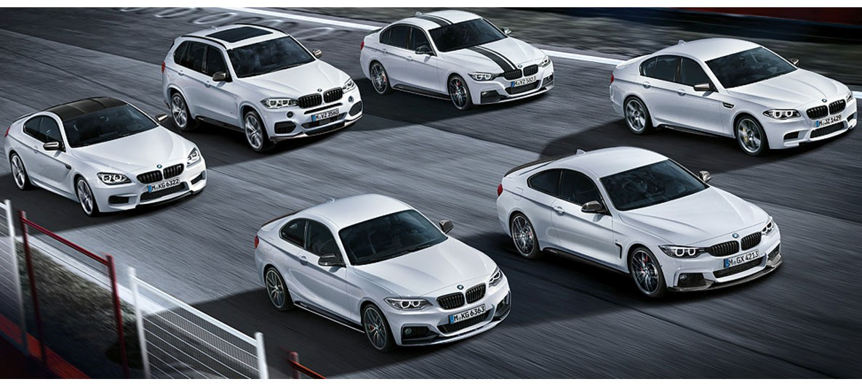
Family Resemblance
Categories defined by “family resemblance” have many features with high predictive value for category membership even if they are not perfectly correlated with each other
The BMW M Class
<put your family photo here>

Slide 41
Probabilistic Categories in Context
The correlations among properties that cause typicality effects also imply that the resemblances among the members of a category might be based on different subsets of their properties when different members are compared
Put another way, a definition of a category that enables accurate classification of instances in one context might not work in other contexts
NOTE TO DATA SCIENTISTS: Choose your training data carefully!
41

Slide 42
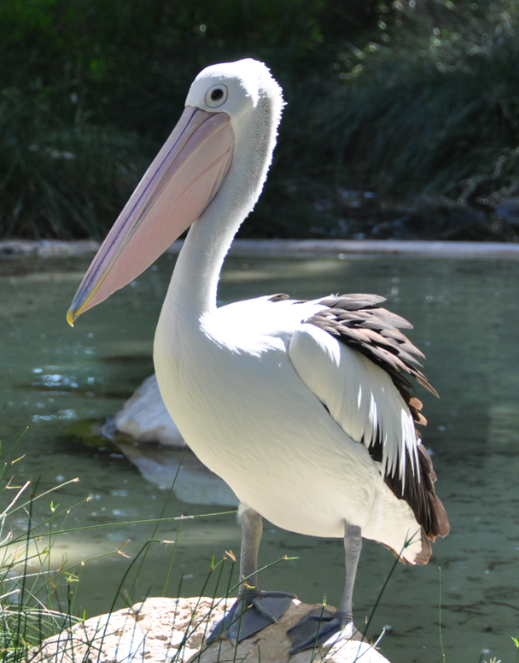
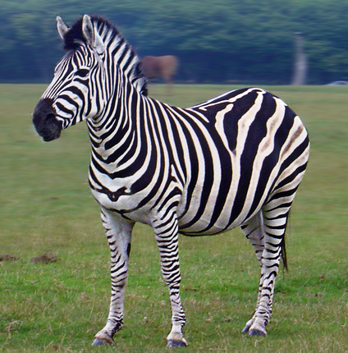
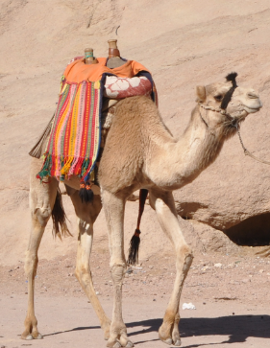
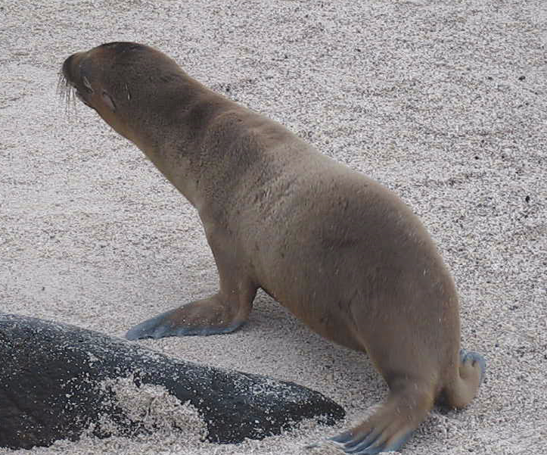
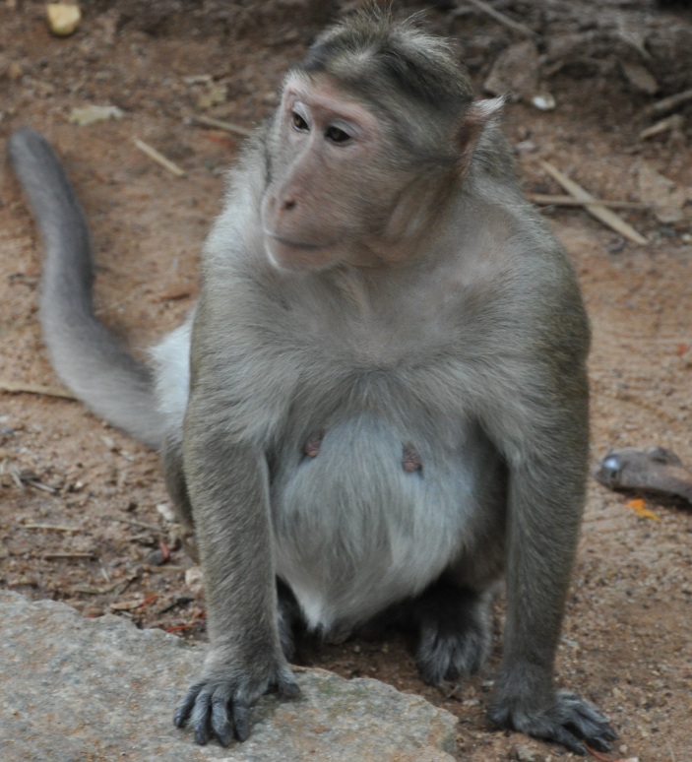
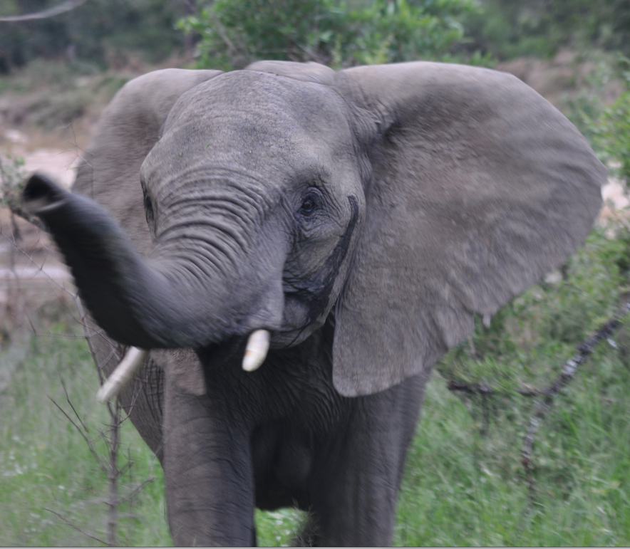
Stripes Are A Characteristic Feature for Zebras and A Good Discriminating Feature with Other Animals

Slide 43
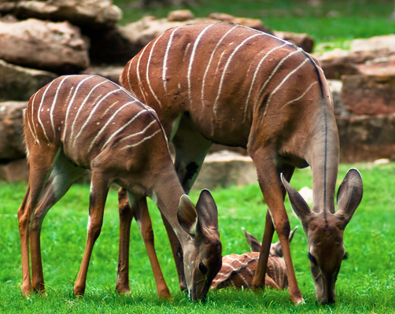
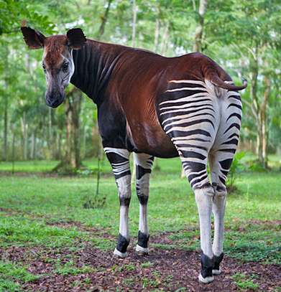
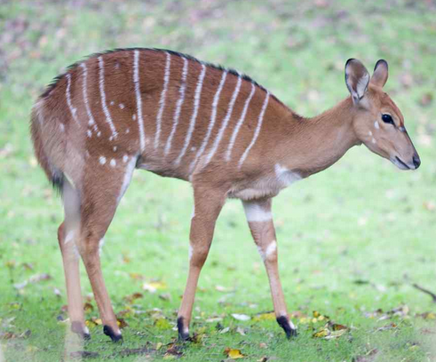
Stripes Are No Longer A Good Discriminating Feature
Kudu
Bongo
Okapi

Slide 44
Similarity as a Categorization Principle
It is often said that we can define categories on the basis of resource similarity:
Something is categorized as an A and not a B if it is more similar to A’s best or most typical member rather than it is to B’s
Similarity is a very intuitive notion and it underlies the idea that some kinds of categories are more natural or basic than others
44

Slide 45
Defining Similarity
STOP and THINK: We haven’t defined similarity!
Some people say that similarity is a meaningless and "mostly vacuous" concept because there must always be some unstated set of properties
So the meaning of similarity is defined by the specific properties and metrics used to compare them
Once we identify the properties and how they are used, there is nothing for a "similarity" mechanism to do
(We will discuss similarity in detail in a few weeks)
45

Slide 46
Theory-Based Categories
Sometimes a category is defined because of a theory of causation or capability that explains why some collection of things go together
A good theory yields an abstract or analogical similarity that can "trump" similarity or family resemblance based on surface properties
TDO’s example: “Computer” – a category of things that are able to compute
46

Slide 47
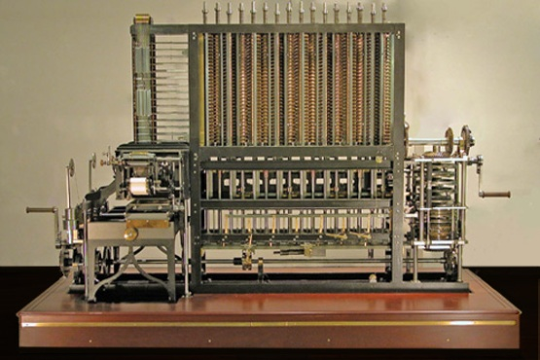
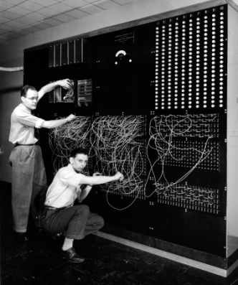
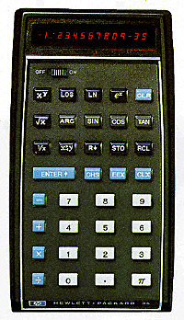
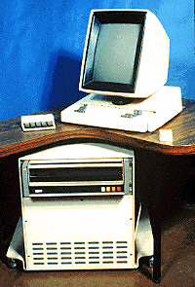
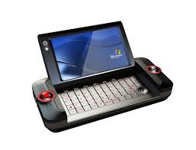
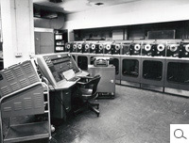
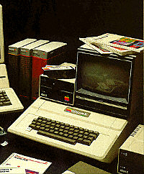
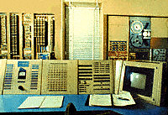
Theory-Based Category: Computer
Category of "computer" is based on being able to compute
47

Slide 48
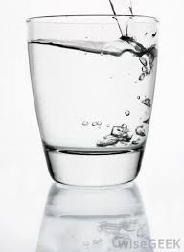
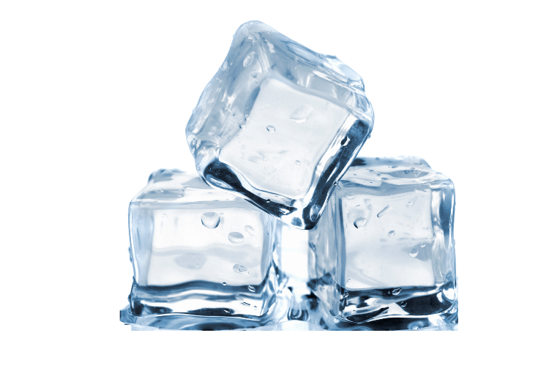
Theory-Based Category: H2O
All the same chemical compound
48

Slide 49
Goal-Derived Categories
You are moving to a far-off city and want to get rid of unwanted possessions. What will you sell at your “garage sale?”
You arrive at the new city. What are the ways you will try to make new friends?
You want to celebrate Thanksgiving with your new friends. What will you need to cook a big dinner?
The members of each of these categories have few or no discernable properties in common
These are unlikely to be lexicalized because of their ad hoc-ness and context-dependence
49

Slide 50
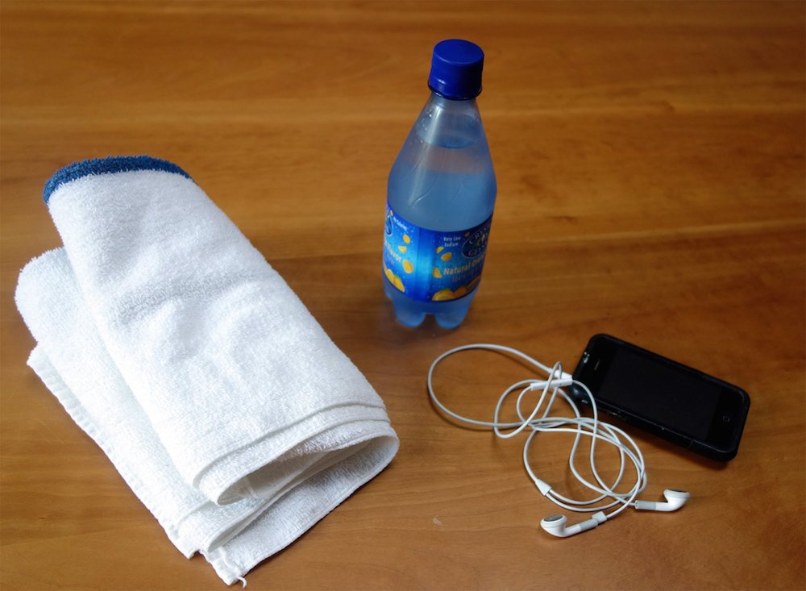
Goal-Derived Personal Category (TDO 7.3.7)
50

Slide 51
Institutional Categorization

Slide 52
Institutional Categorization
Explicit construction of a semantic model of a domain to enable more control, robustness, and interoperability than is possible with just the cultural system
Do you see that this implies that institutional and cultural categories for the same domain can be very different, even incompatible?
Essential in abstract, information-intensive domains where semantic precision is essential for processes and transactions
Why is this especially important for automated transactions?
52

Slide 53
Creating Institutional Categories
Institutional categories are often developed via rigorous and formal processes (e.g., following “document engineering” and “parliamentary procedure” methods in standards organizations or legislative bodies) and require ongoing governance and maintenance
Why do institutional categories need to change?
This is NOT how most individual categories are developed, and NO cultural categories are developed this way
53

Slide 54
Institutional != Unbiased
Creating institutional categories by more systematic processes than cultural or individual categories does not prevent them from being biased
Indeed, the goal of institutional categories is often to impose or incentivize biases in interpretation or behavior
54

Slide 55
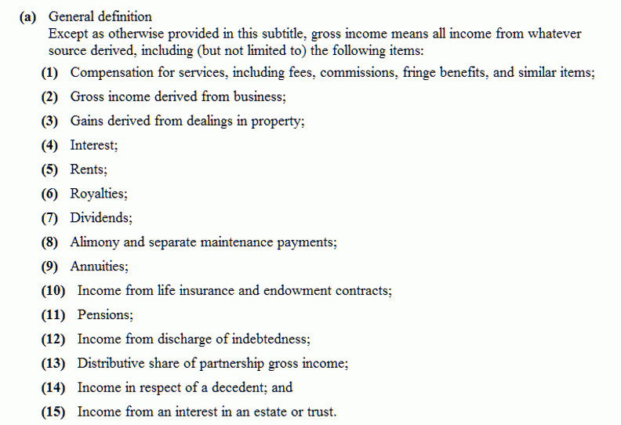
"Gross Income" Tax Code Categories
If dividends are taxable income, isn’t this double taxation?
Why isn’t inherited money taxable?
55

Slide 56
Cultural / Nonstandard {and,or,vs.} Institutional / Standard Categories
Because institutional categories are usually defined in domains with established cultural categories, their co-existence and co-evolution can be problematic
Their definitions can be incompatible
Miscommunication results if one party is using a cultural definition and other is using an institutional one

Slide 57
“Chicken” as a Cultural Category
WIKIPEDIA: “The chicken is a domesticated fowl”
Reared for food (as meat and for eggs)
Kept as pets (In Asia, chickens with striking plumage have long been kept for ornamental purposes)
Calling someone “chicken” to suggest they are weak or afraid is a 400-year-old metaphor
The game of “chicken” in which two drivers (or opponents in some game or negotiation) will both suffer bad outcomes unless one or both of them concedes to the other
“Cock fighting” – a “sport” where two birds (often armed with metal claws) fight each other, with associated gambling

Slide 58
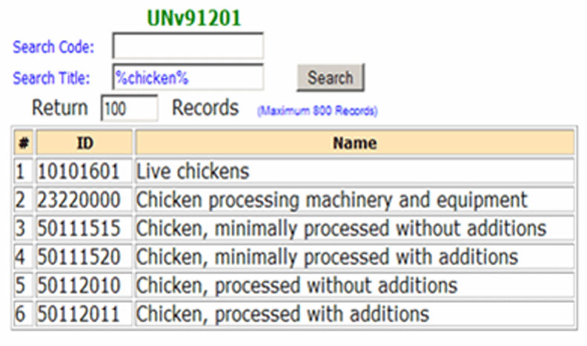
Institutional Categories for Chicken: UN Standard Products and Services Codes
https://www.unspsc.org/
Who would need something like this?
58

Slide 59
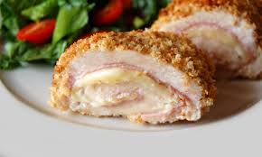
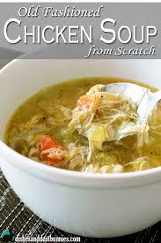
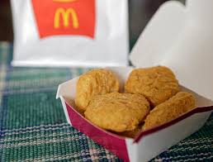
Do
Chicken cordon bleu
Chicken nuggets
Chicken soup
Require the same quality of chicken?

Slide 60
Breakout Session
What kinds of category structures are most often used to create categories in each of the three category contexts (individual, cultural, institutional)?
Defining “game”
“Natural” {and,or,vs.} “Organic”
“Friend” IRL vs. “Friend” in Facebook
And if there’s time, talk about your case studies!

Slide 61
Category Structure
BREAKOUT DISCUSSION 1: What kinds of category structures are most often used to create categories in each of the three category contexts?
Enumeration
Single Properties
Multiple Properties
Similarity / Family Resemblance
Theory-Based (or Analogy-based)
Goal-Derived (or Activity-based)
Category
Contexts
Individual
Cultural
Institutional
61

Slide 62
Breakout Discussion 2
Wittgenstein use the category of “game” as his counter-example against the idea that categories could be defined by a set of shared properties
Spend a minute or two trying to define “game”
What are some “typical” games given your definition?
What are some “atypical” games?
What are some new types of games that have “pushed out” the category boundary?

Slide 63
Breakout Discussion 3 “Natural” {and,or,vs.} “Organic”
Many packaged foods, beverages, and consumer products are marketed as “natural” and people often pay a lot more for them
Likewise, many products are marketed as “organic”
“Organic” as applied to food is an institutional category regulated by governmental food safety authorities, such as the US Department of Agriculture (USDA) or European Commission (EC)
“Natural” has no legal definition
What are the implications of these differences?

Slide 64
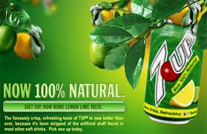
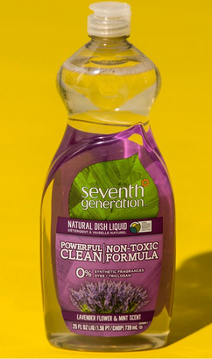
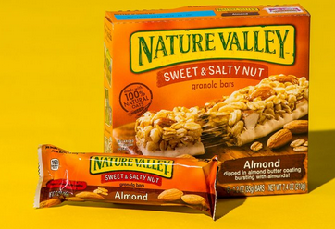
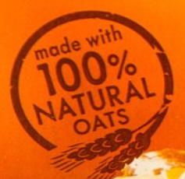
“Natural”

Slide 65
Organic?

Slide 66
Breakout Discussion 4
Define the cultural category of “friend”
Are there different sub-categories of friends that fit into this definition?
Define the institutional category of “friend” as used by Facebook

