Slide 1
CogSci 150 “Sensemaking and Organizing” Spring 2021
Robert J. Glushko
glushko@berkeley.edu
1 April 2021
20) Classification; Standards and Specifications

Slide 2
Today’s Lecture
Understanding classification
Classification is purposeful
Classification is principled
Classification is biased
Bibliographic Classification
Classification Schemes/Structures
Specifications {and, or, vs.} Standards
Breakout on Classification

Slide 3
Distinguishing Categorization and Classification
Categories are EQUIVALENCE CLASSES - sets of resources, processes, and events that we treat the same
A Classification (noun) (or Classification Scheme) is a SYSTEM OF CATEGORIES, ordered according to a PRE-DETERMINED SET OF PRINCIPLES and used to organize a collection of resources
Classification (verb) is the process of systematically assigning resources to intentional (often institutional) categories in a classification system
3

Slide 4
Classification Is Purposeful
Classifications arrange resources to provide structure for and increase the precision of INTERACTIONS in organizing systems by human or computational agents
Classifications are essential in useful work
They serve as a reference model to individual domains and the relationships among them to help people understand and communicate the concepts and relationships
4

Slide 5
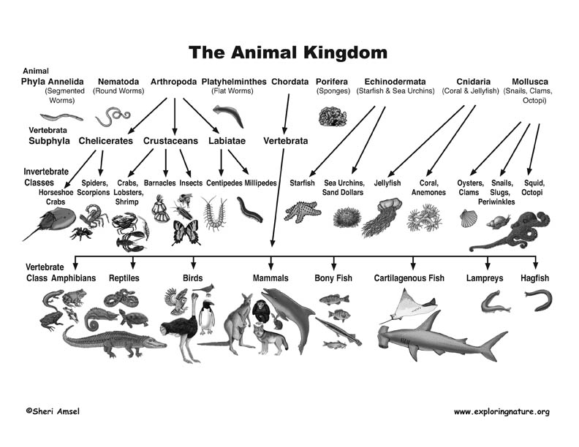

Slide 6
Classification is “Principled” (apology for the polysemy wrt “Organizing Principles”)
Any substantial classification system follows systematic design principles that reflect its purposes, scope, scale, intended lifetime, extensibility, and other considerations
Being "principled" means that once these design choices are made, they should be consistently followed
A very common principle is uniqueness; the categories are mutually exclusive
6

Slide 7
“Principled” Does Not Imply “Good” or “the Only Way”
Many of the category design choices can be arbitrary and others may involve tradeoffs that depend on:
the nature of the resources and the complexity of the resource domain
the purposes of the classification
the amount of effort available
the capabilities of the people doing the classification and of the people using it
7

Slide 8
Descriptive Precision
FLASHBACK
Writers, poets, painters, composers, sculptors, technical writers, programmers, producers, architects, designers, and devices or machines can all “create” resources
The Dublin Core vocabulary for describing web pages has a single property for indicating a “creator” (TDO 5.3.1.3)
“Shakespeare” and “Hubble Telescope” are both “creators”
A small description vocabulary is easy to use, but this tradeoff loses a great deal of precision compared to larger and more controlled vocabularies

Slide 9
“Justification” for the Classification Scheme
Warrant: What is the justification for the choice of categories and their names?
“Literary” Warrant: Classify only the resources we have?
“Scientific” Warrant: Use expert categories and names
“Use” Warrant: Use categories and names from “ordinary” people
9

Slide 10
Maintaining the Classification
How long does the classification system need to last? Is there a commitment or methods in place to maintain the classification system? (forever?)
Do we classify resources or items just once, or can we change categories and assignments over time? (versioning?)
What if the meaning of the category (and its descriptors) changes?
What if the resources or items that have been categorized have changed?
10

Slide 11
Every Classification is "Biased"
Every classification is arbitrary because the criteria used to establish the categories reflect a point of view or perspective on the domain that intentionally excludes all other perspectives
Every classification system implicitly or explicitly contrasts {"good", "standard“} and {"bad", "nonstandard“} ways of understanding things
Natural vs. man-made disaster?
Dietary supplement vs. beverage?
Employee vs. contractor, full vs. part time?
11

Slide 12
Understanding “Unemployed”
People with jobs are employed
People who are jobless, looking for a job, and available for work are unemployed.
The labor force is made up of the employed and the unemployed.
People who are neither employed nor unemployed are not in the labor force.
There is NO category that directly measures the percentage of people who “are not working”
(Why does this matter?)

Slide 13
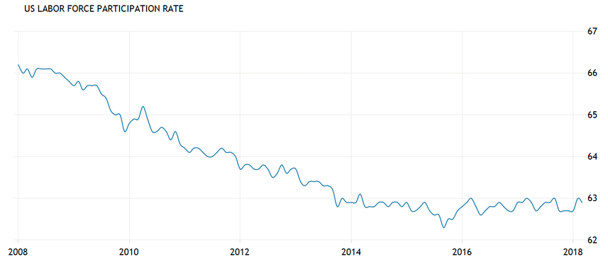
US Unemployment Rate (%)
US Labor Force Participation Rate (%)

Slide 14
True News
The beginning of 2012 was one of the worst months for labor in US history, with a total of 2.3 million people losing jobs or leaving the workforce in a single month. Yet, the official unemployment rate showed a decline from 8.5% to 8.3% in January - and was such cheering news that it set off a stock rally
The 2020 Covid outbreak caused the US unemployment rate to jump from 3.8% in February to 14.4% in April, but 4 million people stopped looking for work during this period
How are the definitions of “unemployed” and other categories tied to politics?

Slide 15
Bibliographic
Classification

Slide 16
Bibliographic Classification
Much of our thinking about classification systems comes from the bibliographic domain, which is distinctive because of:
Scale, complexity, and degree of standardization
Standards and rules for classification
Legacy of physical arrangement, user access, circulation
16

Slide 17
Classification Scale
How many distinct categories (SKUs) does a supermarket or “superstore” the size of Wal-Mart or Home Depot have?
How many distinct categories are in the Library of Congress subject headings?
How many unique items are in the libraries of a large research university?

Slide 18
Dewey Decimal Classification http://www.oclc.org/dewey.en.html
Started in 1876, the DDC is the most widely used classification system in the world, especially in public libraries
Easy to use to locate resources in libraries because of its numerical notation
The DDC is proprietary and must be licensed from OCLC in Dublin OH
18

Slide 19
Dewey Decimal Classification
The DDC is divided into ten main classes, which together cover the entire world of knowledge. Each main class is further divided into ten divisions, and each division into ten sections
Melvil Dewey wanted to develop a universal classification, but it was done in the context of the library of Amherst College, which introduced significant bias because of the contents of its collection and school’s religious orientation at the time
19

Slide 20
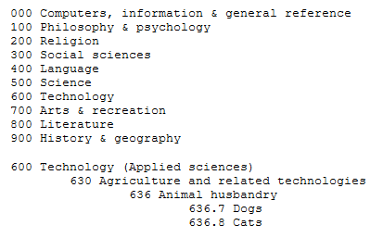
Dewey Decimal Classification
The concept of “pet” wasn’t commonly used in the 19th century
20

Slide 21
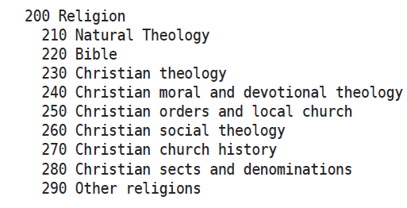
Dewey Decimal Classification for “Religion”

Slide 22
Library of Congress Classification
The US Library of Congress was established in 1800 with a very practical focus, with no intent to devise an organizing scheme that could be used elsewhere
It got off to a bad start when the British burned it down (along with the White House) during the “War of 1812” in 1814
The library was restarted with Thomas Jefferson’s personal library, which broadened its scope, influenced the subsequent LCC scheme
22

Slide 23
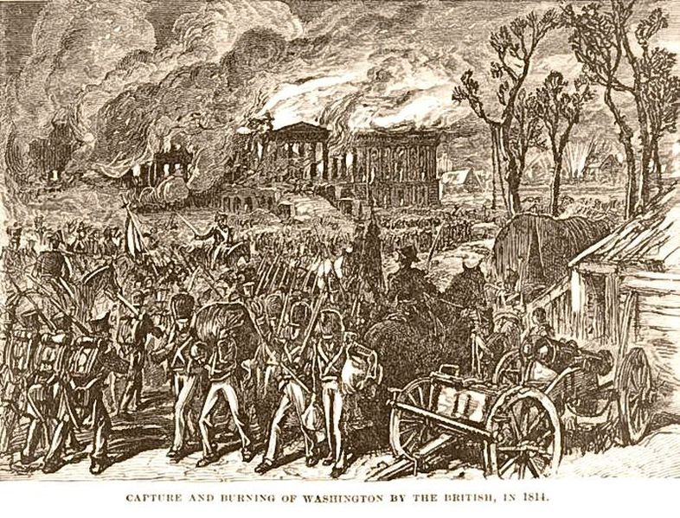
British Burn the White House (1814)
23

Slide 24
Library of Congress Classification
The LCC has 21 top level categories, identified by (arbitrary?) letters instead of numbers like the DCC
Each top-level category is further divided, and then once again… a very deep system that makes it practical but not theoretically grounded
The LCC is biased toward the US and toward the needs of a national government, and definitely shows its age
24

Slide 25
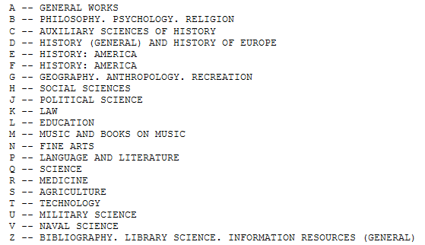
Library of Congress Classification
25

Slide 26
Meanings Change!
L of C established around 1800
Q Science
R Medicine
S Agriculture
T Technology
What did these terms mean in 1800? In 2020?
What did “Computing” mean 50 years ago? 10 years ago? 1 year ago? What will it mean in 2030?

Slide 27
When “Computers” Were People

Slide 28
Classification Schemes / Structures

Slide 29
Classification Schemes (TDO 8.1.4)
A CLASSIFICATION SCHEME follows one or more organizing principles
BUT I WISH I HADN’T USED THIS TERM IN TDO. IT WOULD HAVE BEEN BETTER TO USE
“CLASSIFICATION STRUCTURE”
Just as “category structure” (enumeration, properties, similarity, etc.) describes the ways in which the members of a category are defined, we can discuss “classification structure” as the principles by which sets of categories can be defined and related to each other
29

Slide 30
Classification Schemes/ Structures (1)
A CLASSIFICATION SCHEME/STRUCTURE follows one or more principles
An ENUMERATIVE scheme itemizes all possible categories, and any resource can be assigned into one and only one of them
A HIERARCHICAL or TAXONOMIC scheme is created when multiple resource properties are used by organizing principles; each property creates another level whose categories are logically contained in the categories above them in the hierarchy
30

Slide 31
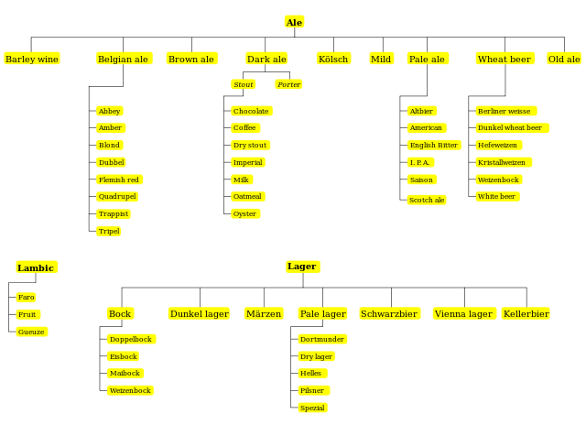
The Beer Kingdom

Slide 32
Faceted Classification

Slide 33
Classification Structures: Faceted Classification
Some domains have a primary hierarchical structure (like biological taxonomies), while others have multiple dimensions or characteristics that determine their equivalence classes
A FACETED classification structure uses multiple resource properties like a hierarchical one, but does not require every resource to have a value for every property and allows the properties to be considered in any order
FACETED structures are especially useful when people differ in their property knowledge or preferences
33

Slide 34
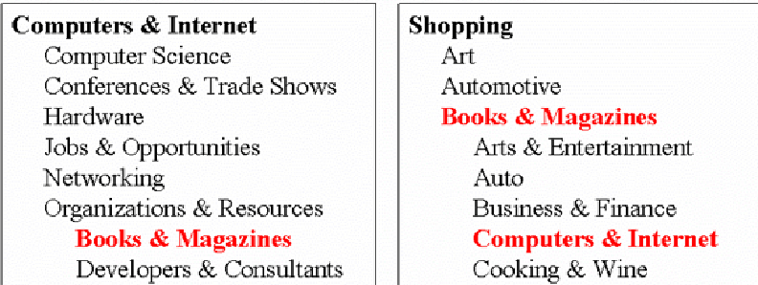
The Need For Multiple Classifications
34

Slide 35
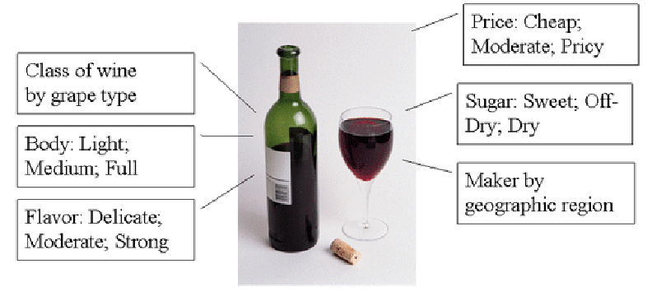
Wine Classifications
35

Slide 36
Faceted Classification
FACETS are an alternative to hierarchical classification that overcome many of its limitations
Instead of creating a deep category hierarchy, facets create multi-dimensional categories that are defined (or generated) through grammatical composition (or combination) from the (characteristics or dimensions or relations) in the domain
Facets divide a domain or subject into "homogeneous" or "semantically cohesive" categories of manageable size
36

Slide 37
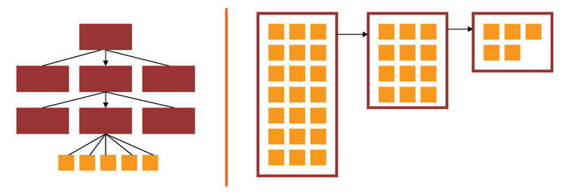
Facets and User Interfaces
Sequential category selection, results only at leaf nodes
Each selection yields a set of results, and subsequent selections refine the results set
37

Slide 38
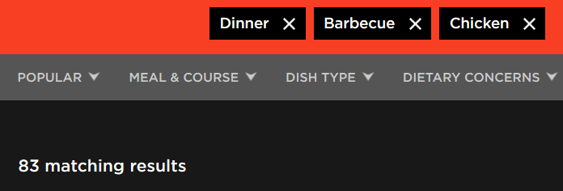
Faceted classification is commonly used in web sites where the resources have many properties

Slide 39
Types of Facets
Enumerative -- a set of mutually exclusive possible values
Boolean -- yes or no on some dimension
Hierarchical or taxonomic -- organize the instances by logical containment
Spectrum -- numerical attributes on some range, with min and max
39

Slide 40
Choosing Facets
ORTHOGONALITY - facets are independent dimensions
SEMANTIC BALANCE - top level facets are the most important semantic dimensions of the domain; values within facets are at equal semantic level
COVERAGE - all current instances can be classified
SCALABILITY - future instances can be classified
OBJECTIVITY - instances can be objectively classified; might also be called CONCRETENESS
NOT IDIOSYNCRATIC - facet semantics should be "mainstream" or "normative" and not rely on clever, fanciful or metaphoric interpretation
40

Slide 41
Contrasting Enumerative and Faceted Classification Structures
Enumerative and faceted structures are logically opposites of each other
Enumerative structures create every possible category in advance
A faceted classification structure creates its categories “on demand” only when they are needed when some resource takes on values on some set of facets
41

Slide 42
Would Faceted Classification Work Better Here? (properties in any order)

Slide 43
Specifications
{and, or, vs.}
Standards

Slide 44
"Specifications"
A specification is an explicit and detailed description about how something (a product, system, service, or practice) works that might include:
the definitions of the key concepts or terms used in the description
the materials from which it is made
the components (tangible or intangible) that are arranged or assembled to make it work
the methods or processes by which it operates
the inputs and outputs for each method or process
44

Slide 45
"Standards"
A standard is a published specification that is developed and maintained by consensus of all the relevant stakeholders in some domain
following a defined and transparent process
usually under the auspices of a dedicated organization with the authority to create standards
The rigor and transparency of the process by which a standard is created is essential to its legitimacy
Some governments or other large procurers or products of systems require that they be based on these "de jure" standards
45

Slide 46
Classification and Standardization (1)
Classifications and standards both impose order on resources
They both distinguish, explicitly or implicitly, between standard / appropriate / effective and nonstandard / inappropriate / ineffective ways of creating organizing, and using resources
But this does not imply that a standard is a good one or that the best one will win a “standards war”
STOP AND THINK: Examples of standards wars?
46

Slide 47
Classification and Standardization (2)
Some classifications become standards
Every successful standard imposes a classification system
Standards and classification systems can have significant inertia, becoming part of the "installed base" or "infrastructure" and difficult to change
47

Slide 48
Why Standards Exist (1)
Standards serve as a coordinating mechanism whenever there are alternative ways of doing or making something that might be incompatible or that otherwise wouldn't be possible
Cost savings from economies of scale and interoperability
Standards can also serve as a regulating mechanism to restrict behavior or operation that might be unsafe, unfair, or otherwise "harmful“
48

Slide 49
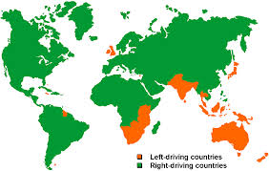
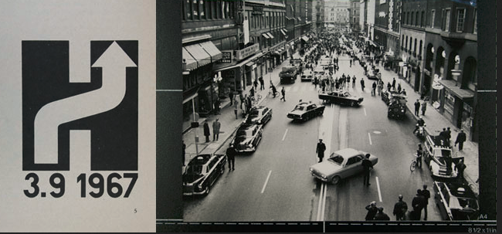
Which Side to Drive On?
‘Högertrafikomläggningen’ in Sweden

Slide 50
Why Standards Exist (2)
Many standards define technical specifications and procedures to ensure a "common design" or "interoperability"-- TDO calls these "institutional semantics"
Standards define institutional categories about models, behaviors, or processes - TDO calls these "institutional taxonomies" (like the UNSPSC)
Interoperability is essential for infrastructure – “what other things run on” – plumbing, electricity, wires, roads, electromagnetic spectrum
50

Slide 51
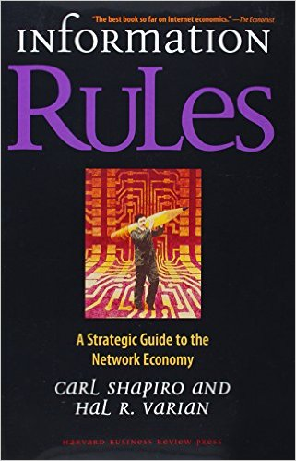
Standards and Network Effects
Standards are especially important in industries or domains that have significant "network effects" where the value of a product or service depends on the number of interoperable or compatible ones
These contexts are sometimes called "winner take all" markets, which is why standards wars take place - because of the economic implications
How do you encourage and enable others to conform to a standard?
51

Slide 52
Who Sets Standards? (1)
Some technical standards are set by governments in order to protect the public interest
Other standards are set by organizations created precisely for the purpose of setting standards
Other standards are set by groups of companies who may or may not establish an ongoing organization and governance procedures to maintain and extend a standards "family" around the initial standard
52

Slide 53
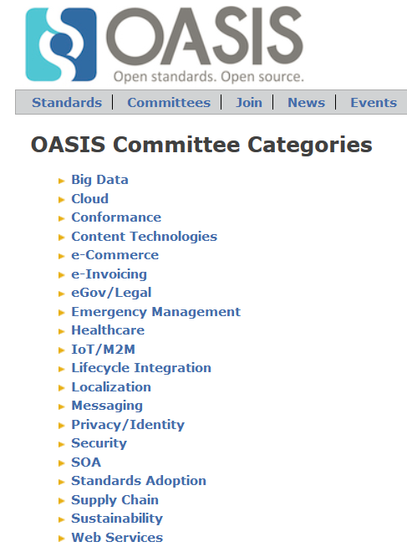

Slide 54
Who Sets Standards? (2)
Other "standards" begin as proprietary vendor specifications that will become "de facto" standards if they are widely adopted and achieve market dominance
Often "de facto" standards are submitted to a standards organization with the goal of "rubber stamping" them as "de jure" ones
54

Slide 55
Specifications {and,or,vs.} Standards
"All standards are specifications, but not all specifications are standards"
Any person, firm, or ad hoc group can create a specification and then use it themselves, try to get others to use it, or prevent others from using it
In contrast, standards are sometimes created by people or groups who aren't themselves planning to use them, but standards are generally made available for anyone's use at no cost or under "reasonable and non-discriminatory" terms
But the widespread adoption (or "traction") of a specification is often more important than whether it was created by a "standards" organization
55

Slide 56
Lessons From Standards Making: The "Person-Concept" Tradeoff
Semantic agreement comes at a cost driven by the number of people who require a shared understanding, and by the number of concepts they must all understand
A small group of people can agree on a complex standard, or a large group of people can agree on a simple one
…especially when participants are just trying to agree on how to describe pre-existing shared concepts rather than having to define them first
Rosenthal, A., Seligman, L., and Renner, S. 2004. From semantic integration to semantics management: case studies and a way forward. SIGMOD Rec. 33, 4 (Dec. 2004), 44-50
56

Slide 57
Lessons from Standards Making: Incentives and Disincentives
Approaches that require perfect coordination and altruism are of no practical interest
Disincentives to agree on semantics arise if agreement means that someone has to change an implementation and pay the cost of doing so
Model-driven development tools that generate needed software artifacts (e.g., system and user interfaces) from specifications can encourage standards adoption by reducing the transition costs
57

Slide 58
Lessons from Standards Making: Community Characteristics
Is there a primary stakeholder with decision making authority, or is authority distributed?
What are participants' obligations to support the standard?
Do the participants already share an understand of the domain to be standardized?
58

Slide 59
Lessons from Standards Making: Enterprise Data Standards
Standards-making can be successful when a "single authority exercises effective control over the system requirements, funding, the developers, and the users"
But a very large enterprise cannot hope to construct a single data model (or even a single-set of universally understood concept definitions) for all the data it requires
59

Slide 60
Lessons from Standards Making: "Communities of Interest"
Standards making is best organized around naturally formed communities of interest rather than "org chart" organizations
Different types of communities might be needed to develop, deploy, and maintain a standard
Who should be involved in creating a standard vocabulary for describing a sporting event?
60

Slide 61
Using Standards in Organizing Systems
You may be required by the government, by your customers, or by "business partners" to conform to some organizing standards
But to the extent that standards embody best practices, it is a good idea to follow them anyway
Key Questions: When should you use an externally-required standard as your internal standard, and when should you “conform” by conversion or transformation “on the way out”
61

Slide 62
Standards for Document Description in Organizing Systems (1)
For specific vocabularies or "domain-specific languages" (e.g., HTML, UBL, SPL, DocBook, DITA, EPUB, SVG)
For schema languages that formally define the domain-specific languages (e.g., XSD)
For "profiles" that suggest modeling practices like degree of abstraction and granularity, or constrain the possible values for some descriptor (e.g., AAT)
For the metalanguages used to encode the DSLs and schema languages (e.g., XML, SGML)
62

Slide 63
Standards for Document Description in Organizing Systems (2)
For the construction of file and document names
For identifying resources and namespaces
For specifying versions, stages or revisions of documents or other resources
63

Slide 64
Other Standards for Organizing Systems
Metadata standards (MARC, Dublin Core, EAD, METS, RDF, OWL)
Standards for classification (LoC, DD, BISAC)
Standards for thesaurus construction
Standards for processes (WS-*)
Standards for communication protocols
64

Slide 65
BREAKOUT SESSION: Classification Bias?
For each of these classifications, identify aspects of their definitions that introduce bias. Why was this particular bias chosen? What alternative definitions might have been used?
An airline classifies a plane’s departure as “on time” if it leaves the gate no later than 10 minutes after its scheduled time
Utilities like PG&E and Comcast report service outages in terms of the number of “customers” affected
Sports teams include season ticketholders who didn’t show up when they report the “paid attendance” to a game

Slide 66
The Dewey “Religion Browser”
www.oclc.org/en-US/dewey/features/religion/browser.html
What problem is it trying to solve?
Why does it try to solve it this way?
How successful is it in solving it?
Or study the following screen shots…
66

Slide 67
Dewey Decimal Classification for “Religion”

Slide 68
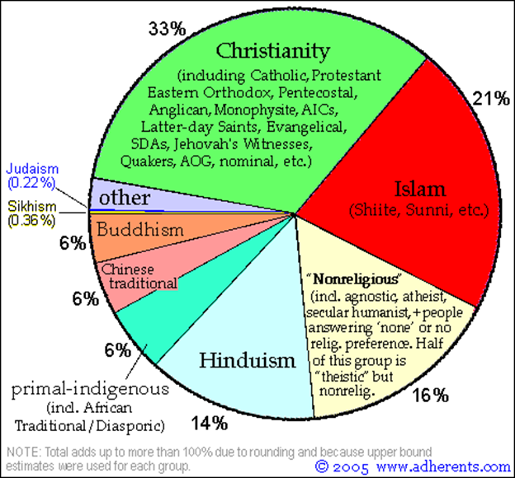
How does the Dewey Decimal classification for “Religion” reflect the practice of religion or “non-religion” in the world?

Slide 69
http://www.oclc.org/en-US/dewey/features/religion/browser.html

Slide 70
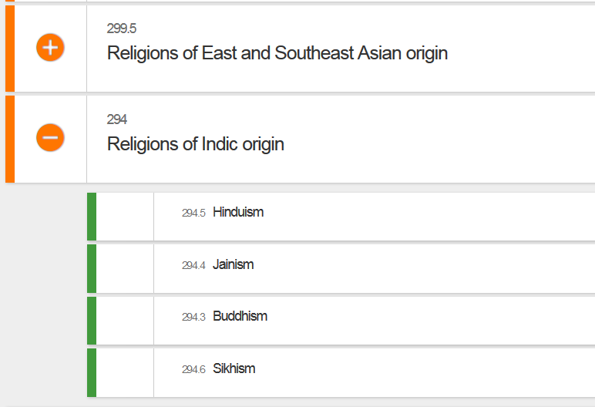

Slide 71
