Slide 1
CogSci 150 “Sensemaking and Organizing” Spring 2021
Robert J. Glushko
glushko@berkeley.edu
6 April 2021
21) Business as Organizing Systems:
Measurement;
Controlled Vocabularies; Interoperability

Slide 2
Measurement

Slide 3
Measurement
Every business and much of modern life depends on the ability to accurately quantify properties and to communicate these measurements
Measurement units are highly abstract, enabling them to apply broadly across domains
But their origins are highly concrete, often based on body parts or work artifacts, and they were tied to narrow contexts of use

Slide 4
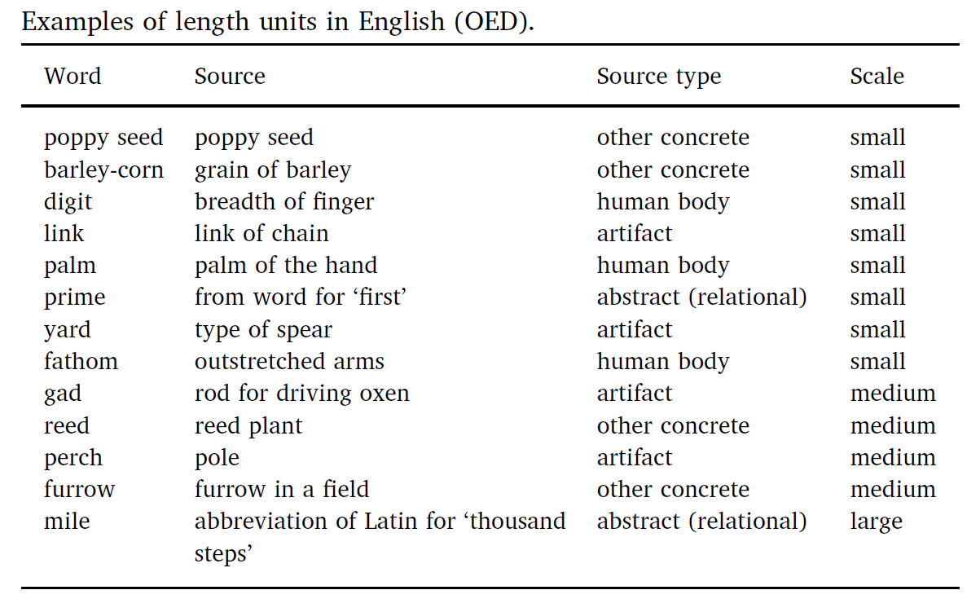

Slide 5
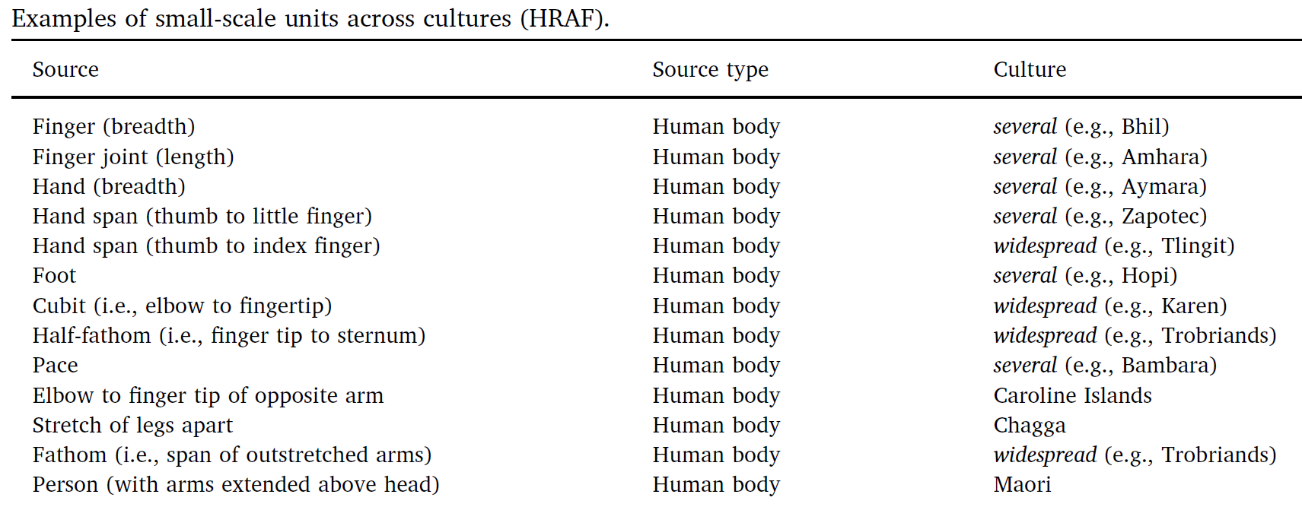
Body-Part Measures In Other Cultures

Slide 6
Maori Measures (12 different units based on body parts)

Slide 7
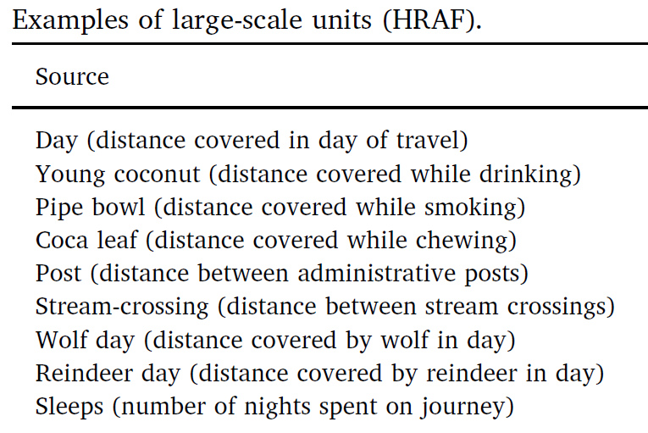
Large-Scale Measures

Slide 8
The Evolution of Measurement
Ad hoc comparisons between two concrete things (measure a log with your foot)
Conventions emerge for comparators (always use your foot to measure length)
Standardization of the comparator (“foot” defined as an average or ideal)
Standardized comparators organized in hierarchical systems of units in which they are defined in terms of each other

Slide 9
An illustration from Geomtrei (1608 edition), by Jacob Köbel, of a procedure for determining a “lawful foot” and, at the same time, a “lawful rood” (a measure equivalent to 16 feet). He describes having sixteen men “of different sizes,” upon leaving church, arrange their left feet in a row. The resulting full length will be a standard rood, and one 16th of it will be a standard foot.
Standards-Making from Body Parts

Slide 10
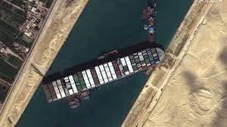
We’re Not Finished
Even though we now have abstract and standards systems of measurement, we continue to use concrete objects as comparators
“The Ever Given is one of the largest container ships in the world, about the length of four football fields”

Slide 11
Controlled Vocabularies

Slide 12
Why We Need Controlled Vocabularies
The words people use to describe things or concepts are "embodied" in their context and experiences... so they are often different or even "bad" with respect to the words used by others
These naturally-occurring words are an "uncontrolled vocabulary” that people use when they describe and search for resources
Searches made using an uncontrolled vocabulary will fail to match resources described using controlled terms

Slide 13
CV as an Artificial Language
A CV is an artificial language to be used in place of the "natural" ones that people would otherwise use
A CV standardizes the terms (such as subject headings, names, classifications, etc.) assigned by organizers / cataloguers / indexers
A CV can be thought of as a fixed or closed dictionary in which everything must be defined using the same set of terms

Slide 14
Types of Controlled Vocabularies
Dictionaries, thesauri, ontologies
Authority controls for names, places, time periods
Identifiers
Code lists
Subject heading lists
Classification schemes
Schemas/domain-specific languages/”tag sets”
Some of these we’ve covered before, because names and controlled vocabularies are essential in many contexts of sensemaking and organizing

Slide 15
A Formula for Definitions
hyponym = {adjective+} hypernym {distinguishing clause+}
Robin = Migratory BIRD with clear melodious song, a reddish breast, gray or black upper plumage
Doesn't mention every characteristic of hyponym, only those needed to distinguish from other hyponyms
15

Slide 16
Code Lists
Codes are constrained sets of values
Codes establish their meaning by reference to those values, often by abbreviations
Using codes in vocabularies and resource descriptions promotes consistency and makes meaning unambiguous

Slide 17
External and Internal Codes
External codes are those maintained by some entity or organization outside of your control (ISO, ANSI, etc.)
ISO 639 - language codes (DE, EN, FR, …)
ISO 3166 - country codes (CAN, FRA, MEX, USA, …)
ISO 4217 - currency codes (CAD, EUR, GDP, USD, …)
IATA airport codes (SFO, JFK, IAD, LHR, YYZ, YUL, ...)
Internet Top Level Domains (.com, .edu, .gov, …)
Postal codes (94109, 94574, N6G 1W8, …)
Internal codes are code sets that you can define and control (e.g., company mail codes)

Slide 18
Don’t Mess With Standards Bodies?

Slide 19
Schemas/Domain-Specific Languages
In addition to standardizing the content of resource descriptions a CV might also standardize the features/properties/categories to which the standardized vocabulary is applied
This work represents a significant investment in defining a domain, identifying its key semantic components, and specifying the constraints and rules governing the combination and reuse of those components

Slide 20
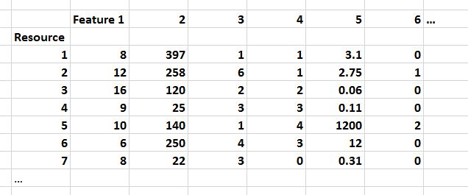
FLASHBACK
In data science, resource descriptions are typically called “properties” or “features” in a dataset like this…
A schema specifies the elements or features of a resource description
A CV specifies the possible values for a resource description

Slide 21
An Organizing System Perspective on Business

Slide 22
Businesses as Organizing Systems
The definition of Organizing System as an intentionally arranged collection of resources can be applied to business design and operation
It is also easy to see that at an abstract level almost all businesses are organized according to similar principles and patterns
Businesses share common external influences, especially those in the same industry
They also share common internal influences and goals
22

Slide 23
What Businesses Do
Design and Engineering – figuring out how to make stuff, increasingly by collaborating with people who make the materials and components; if the stuff is intangible, this activity means “how to deliver it successfully to customers”
Manufacturing – making stuff, often with much of the assembly done “upstream” in a supply chain or by collaborating with people who are "downstream" toward the customer to customize it; intangible stuff often is delivered in more tangible packages
Human Resources, Finance, MIS – organizing and taking care of the people who do everything
Information Systems – designing, deploying, supporting computing and communications infrastructure
23

Slide 24
Describing What Businesses Do
Organization-level or business model patterns: marketplace, auction, supply chain, build to order, drop shipment, vendor managed inventory, etc.
Business process patterns: procurement, payment, shipment, reconciliation, etc.
Business information patterns: document models for catalog, purchase order, invoice, etc., and models for the components they contain for party, time, location, measurement, price, etc.
➔ Universal Business Language
24

Slide 26
Generalizing Business Patterns
You can identify business model patterns inductively, by looking at specific examples of businesses and factoring out repeating elements
Bank in supermarket
Fast food franchise in supermarket
Post office in supermarket
==> PATTERN: Complementary product or service for supermarket customers "plugged into" supermarket
How is “complementary” defined?
26

Slide 27
The Co-evolution of Technology and Business Organization
Info & Com technology has changed the structure and operation of firms to be less hierarchical and more networked
Information about goods becomes a good (or a service)
From forecast/schedule-driven to demand/event-driven business models
From tightly to loosely coupled relationships/architectures
From proprietary to standard models with reusable components
“How Models and Patterns Evolve” – Chapter 5 of Document Engineering book
27

Slide 28
The Data-Driven Business
No forecast can ever be as accurate as actual sales and demand information
The key to business optimization isn't doing things faster according to plans, it is doing things smarter according to actual demand
"Information-driven decisions" can be made more reliably and with less latency when applications and sensor networks collect information
28

Slide 29
Supply Chains and Inter-Enterprise Information Exchange

Slide 30
The Supply Chain Pattern
A supply chain is an organizing system that defines the end-to-end view of the buy-side and sell-side relationships of an enterprise
A supply chain is the network of facilities and distribution capabilities an enterprise uses to:
"Source" (or "procure") raw materials (chemicals, ores, grains, ...) or components
Transform the materials or assemble the components into products
Deliver the products to customers (indirectly through distributors or stores or directly to the purchaser)
30

Slide 31
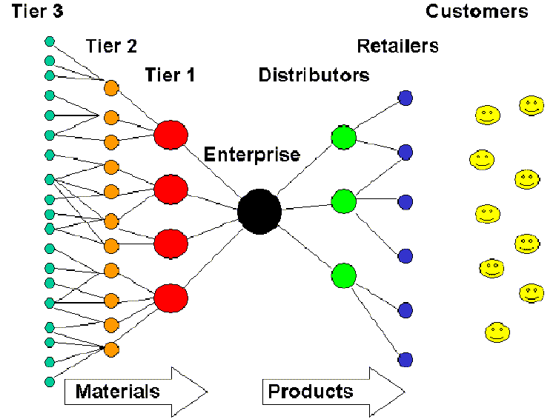
Conceptual Model of a Supply Chain
31

Slide 32
The Information Supply Chain
The flow of materials and goods in a supply chain is accompanied by information about it
But information about supply chain activities and processes is increasingly separated from the physical flow of materials and goods, and for information-based services there are no physical resources to move
32

Slide 33
The Information Supply Chain
Information also flows in the opposite direction from the customer, retailers, and distributors back into the supply chain – this is also called the DEMAND CHAIN
The information supply chain has become especially important because increased global competition and better-informed customers are forcing forms to shift from forecast to demand (i.e., customer) driven business models
33

Slide 34
Design Issues for the Information Supply Chain
What information is exchanged?
Which entities in the supply chain exchange information?
What is the frequency of this information exchange?
Which entity or event initiates the exchange?
34

Slide 35
Data Quality

Slide 36
Operation Clean Data
In 2003 one British military inventory system used stock number 99 000 1111 to identify a ration pack, while an­other inventory system used the same number to identify an electronic ra­dio valve
Not all the identifiers were “NATO standard” ones
Two inventory systems might use different identifiers for the same item

Slide 37
Causes of Dirty Data
Technology Causes – different or obsolete legacy systems with different data models/formats
Process Causes – different intended uses, quality standards, legal/regulatory requirements
Mergers, acquisitions, other organizational changes that bring data together that wasn’t designed to be combined

Slide 38
Achieving Data Quality
Determine whether the problems are more technology ones or process/management ones
Prioritize the data items… but how?
Involve the data owners… if you can find them (look for the “headwaters”)
Data cleaning is like medical diagnosis; symptoms can tell you what the diseases are; cure the disease rather than continuously treat the symptoms
Set realistic goals for data quality and lifetime

Slide 39
Interoperability

Slide 40
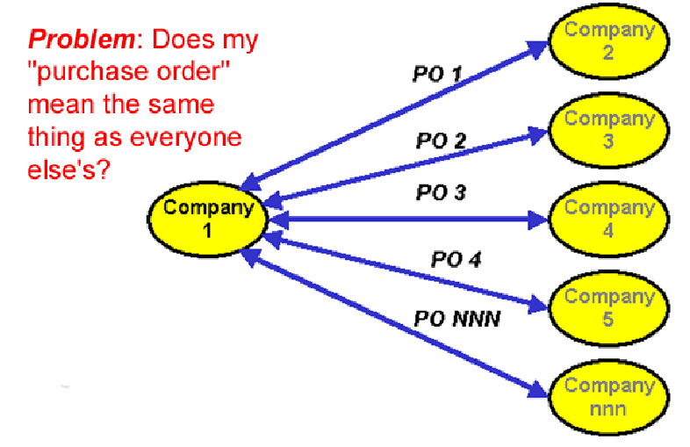
To Interoperate, or not to Interoperate?
40

Slide 41
Syntactic, Structural, & Semantic Interoperability
SYNTACTIC interoperability is just the ability to exchange information
STRUCTURAL interoperability means that all the expected information components are present with the same arrangement and granularity
SEMANTIC interoperability requires that the content of the message be understood by the recipient application or process
Semantic integration is the process by which this common semantic model is created
41

Slide 42
Some Ways NOT to Interoperate
Elements with the same meaning can have different names ("IssueDate" vs "OrderIssueDate")
Elements with the same meaning can have different names or different formats even when they have the same name (September 11, 2001, 9/11/2001 and 9-11-01; 11/09/01 in Europe)
Same meaning, but encoded differently: in XML using attributes instead of elements; in EDIFACT syntax instead of XML, in French rather than in English
42

Slide 43
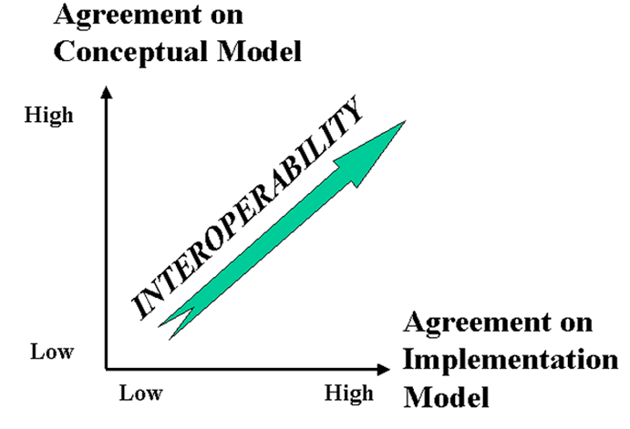
The Dimensions of Interoperability
43

Slide 44
Conceptual Disagreement
<Address>
<Latitude direction=“N”>37.871</Latitude>
<Longitude direction=“W”>-122.271</Longitude>
</Address>
If you give this address to the postal service… will your package be delivered?

Slide 45
The “Universal Business Language”
UBL, the Universal Business Language, defines a royalty-free library of standard XML business documents supporting digitization of the commercial and logistical processes for domestic and international supply chains such as procurement, purchasing, transport, logistics, intermodal freight management, and other supply chain management functions
65 document types all built from a library of semantic building blocks that include what all business documents “talk about” – parties, locations, currencies, units, etc.

Slide 46
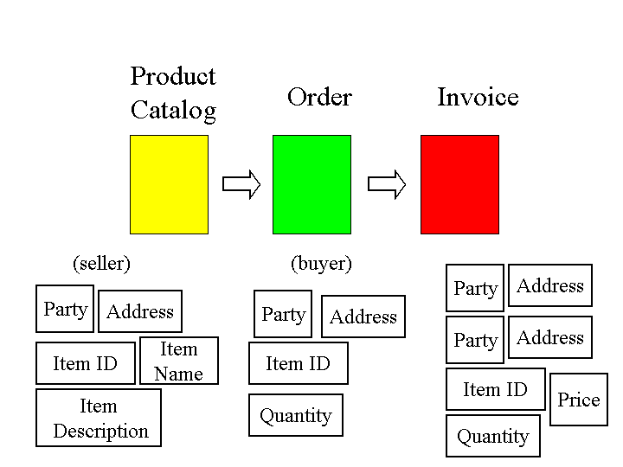
“Component Architecture” for Document Types

Slide 47
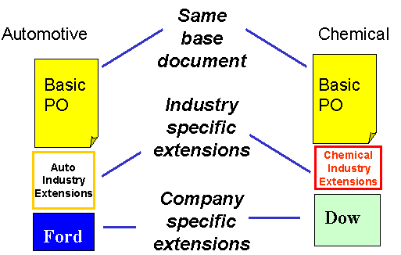

Slide 48
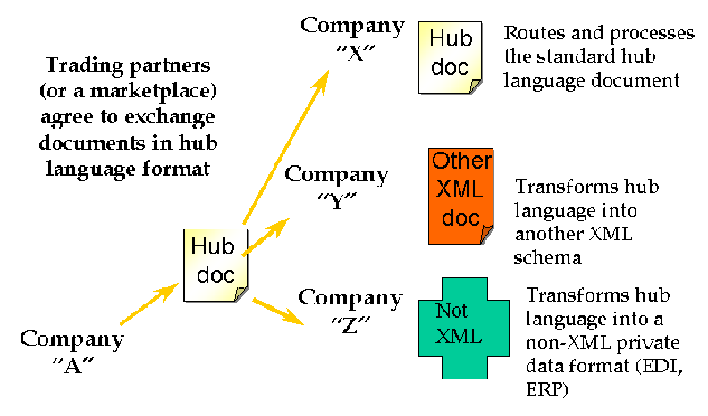
Interchange / Hub Languages
48

Slide 49
Mapping in and out of a Hub Language
If all parties/applications/services rely on a hub language for their external interfaces, an exponential interoperability challenge becomes a linear one
Mapping tools for transforming instances from an internal information model to another one are ubiquitous as standalone tools and as parts of application servers
49

Slide 50
Breakout Session – Interoperability
Do some “document engineering” and then some “software engineering” to determine if these 8 examples can be made to interoperate
Check your work with the analyses on the last slide

Slide 51
CONCEPTUAL MODEL FOR “ORDER”

Slide 52
XML Schema Notes
All the elements of “Party,” “Address,” and “Book Item” are defined as “strings” (plain text)
“Base Price” is defined as a “decimal”
“Quantity” is defined as an “integer”

Slide 53
Example: Conforming Order

Slide 54
1) What Interoperability Problem Is Posed Here? Can It Be Resolved Reliably?
(XML attributes rather than elements;
Aka “programmer ML”)

Slide 55
2) What Interoperability Problem Is Posed Here? Can It Be Resolved Reliably?
(comma-separated syntax, “Excel-style”)

Slide 56
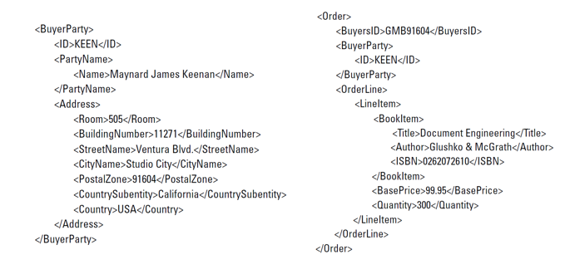
3) What Interoperability Problem Is Posed Here? Can It Be Resolved Reliably?
(two separate documents sent to the seller)

Slide 57
4) What Interoperability Problem Is Posed Here? Can It Be Resolved Reliably?

Slide 58
5) What Interoperability Problem Is Posed Here? Can It Be Resolved Reliably?

Slide 59
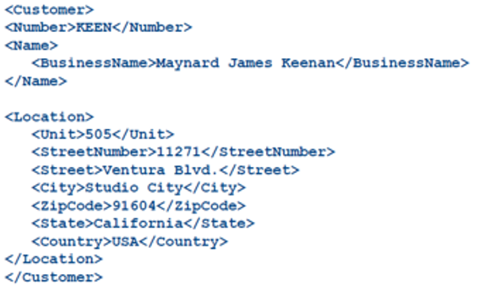
6) What Interoperability Problem Is Posed Here? Can It Be Resolved Reliably?

Slide 60
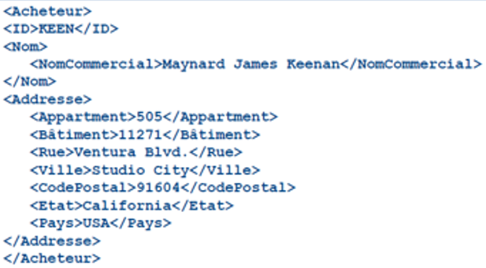
7) What Interoperability Problem Is Posed Here? Can It Be Resolved Reliably?

Slide 61
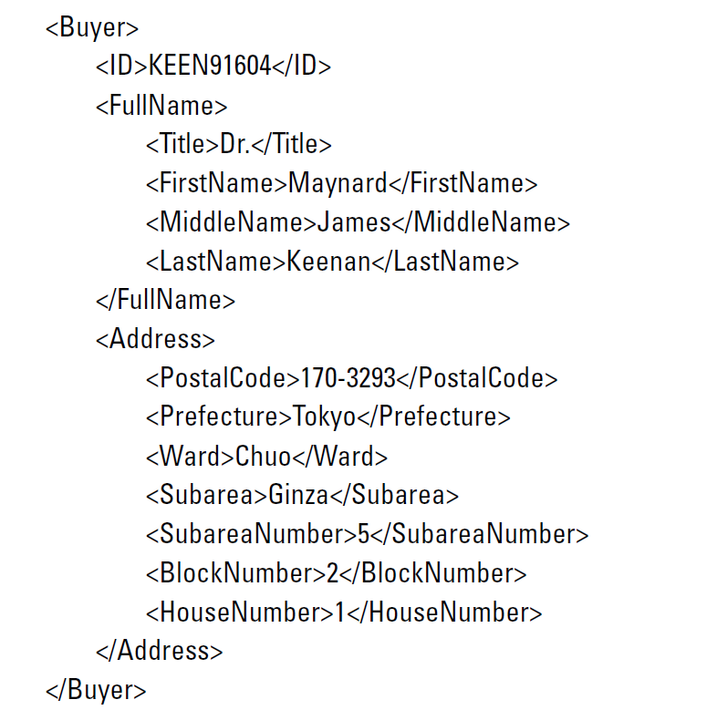
8) What Interoperability Problem Is Posed Here? Can It Be Resolved Reliably?

Slide 62
Analysis
Fields are labeled as required by the model, so this is probably just a syntax problem, easy to fix
If the spreadsheet columns were defined with the correct semantics, this is also easy to transform to the desired order model
Because the document instances can be linked by the Buyer’s ID number, these two documents can easily be merged to create the desired order, and because each document conforms to the expected structure for its part, no additional transformation is required.
Easy fix; a more granular model can be transformed into the less granular target model
But a less granular model can’t reliably be parsed into the target model
Content semantics looks OK – synonyms can be transformed with a dictionary
Content semantics looks OK – but we need a French dictionary
The address is perfectly sensible for Japan but is conceptually incompatible with the North American address model in the target order. Looks like the sample from which the model was derived didn’t include Japanese orders

