Slide 1
CogSci 150 “Sensemaking and Organizing” Spring 2021
Robert J. Glushko
glushko@berkeley.edu
8 April 2021
22) Organizing and Interaction Design;
Applied Behavioral Economics
Choice Architecture;

Slide 2
Today’s Topics
Organizing and Interaction Design
How the organizing principles, abstraction, and granularity of categories affects interactions
Applied behavioral economics
People don’t always make “rational” decisions because they aren’t cognitively capable of doing so
They use heuristics to reduce the cognitive load of decision making, which often work… but sometimes they don’t
Choice architecture
Behavioral economics from the perspective of the organizer rather than from the perspective of the user

Slide 3
Interactions –The Why of Organizing Systems
INTERACTIONS include any activity, function, or service supported by or enabled with respect to the resources in a collection or with respect the collection as a whole
Whenever we select a resource for inclusion in an organizing system, describe it, or arrange it according to an organizing principle, we (should) have an interaction in mind
TDO calls this “organizing on the way in”
3

Slide 4
Requirements for Interactions
All organizing systems have some common interactions, but we want to pay attention to the more resource-specific interactions that create the most value
The priorities of the interactions are often determined by the priority of intended users
The interactions must be discoverable and invokable by their intended users
“UID” = “user {interface, interaction} design
4

Slide 5
Affordances

Slide 6
Affordances
For physical resources, many potential interactions are inherent in their affordances – perceptible and actionable properties that determine what can be done with them
Many organizing systems use these inherent affordances as the basis for resource selection, arrangement, and interaction design
6

Slide 7
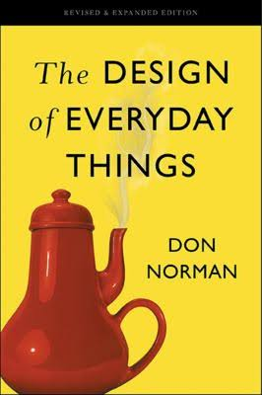
Design and Organizing
“intentional arrangement of resources and the interactions they support? – that’s what design does” (Don Norman)
7

Slide 8
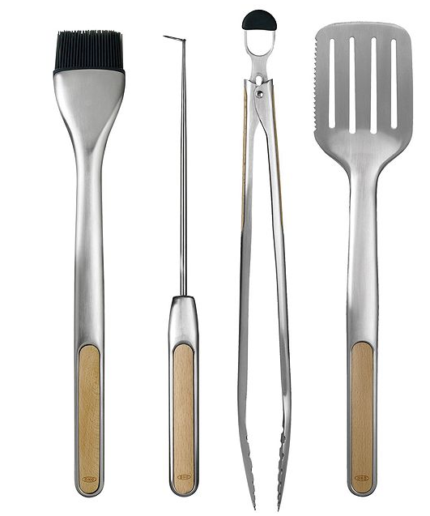
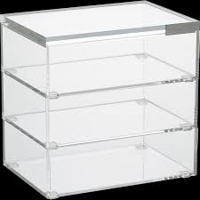
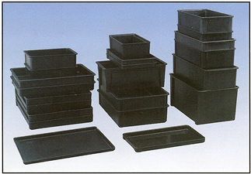
Easily Perceivable Affordances
8

Slide 9
Specialized Affordances
The design and shape of hammers lets you quickly perceive how you would hold and use one, but hammer designs are also very specialized
If you needed to perform a “hammering” task but didn’t have a hammer, what other things could you use instead?

Slide 10
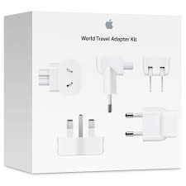
Easily Perceivable “Negative-Affordances”
“You can’t put a square peg in a round hole”
10

Slide 11
UI Design to Support Interaction
Many interactions with physical and digital resources are initiated using designed controls or other “user interface elements”
These controls and UI elements have affordances too, and good design makes it easy to see how to use them (and bad design doesn’t)
Does the arrangement of the controls map well to the arrangement of the resources they control?
11

Slide 12
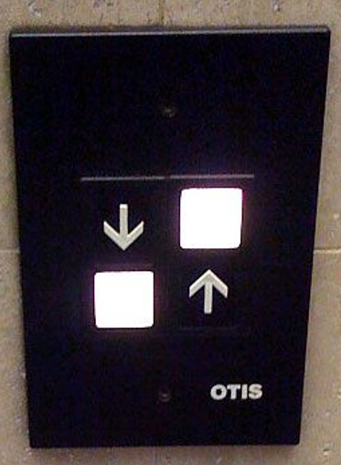
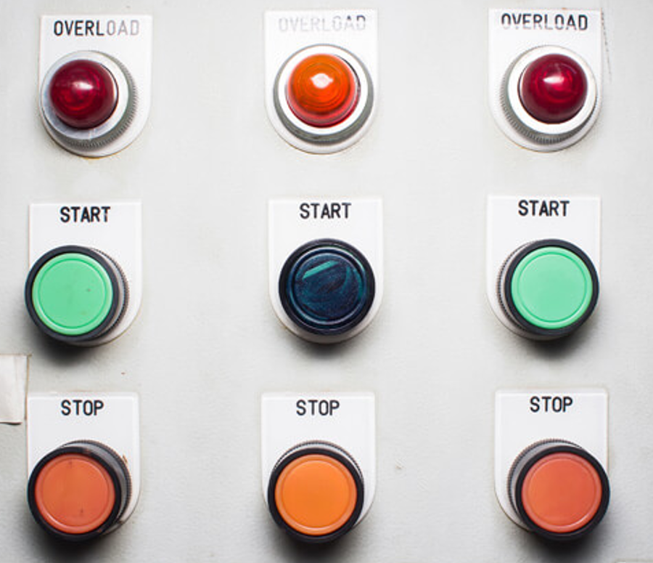
Which Button Do I Push?

Slide 13
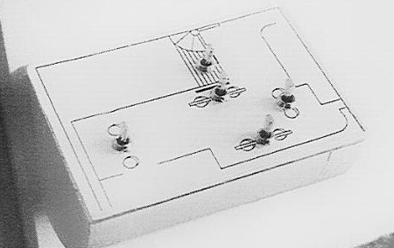
BEFORE: Array of 6 light switches
AFTER: Switches arranged to match room layout
Donald Norman, The Design of Everyday Things

Slide 14
Beer tap handles used to distinguish identical knobs in control room of a nuclear power plant
in Norman,
TDoET

Slide 15
Creating New Capabilities
The interactions that are “afforded” by inherent properties are distinct from the “designed interactions” that are made possible by intentional acts of description, arrangement, or technological mediation
Creating new capabilities/affordances is often the purpose of design
15

Slide 16
Design and “Capability Discovery”
With physical resources, good design makes it easy to distinguish between parts and properties that are functional and those that are decorative or otherwise non-functional
But with digital and computational resources, it is often impossible to discern capability because it is internally implemented rather than inherent in perceptible surface properties
What can I do? How do you interact with me?
16

Slide 17
Interactions with Digital and Computerized Resources
Even when we see some indications of potential interactions we can't directly understand or compare their capability
17

Slide 18
Classifications and Interactions

Slide 19
Classifications and Interactions
Classifications arrange resources into categories
Every classification increases the capability and efficiency of interactions with resources that are “co-located” or “within-category” and makes “between-category” interactions less efficient
The granularity of the classification determines the specificity of the interactions
The structure and description of a classification influences how people use it
19

Slide 20
Classification on Sports Websites
What questions does this organization make easy / hard to answer?

Slide 21
HOW ARE MY HOME TEAMS DOING?
HOME NFL NBA MLB NHL
SF 49ers Warriors Giants Sharks
A’s
LA Rams Lakers Dodgers Kings
Clippers Angels
Seattle Seahawks Sonics Mariners

Slide 22
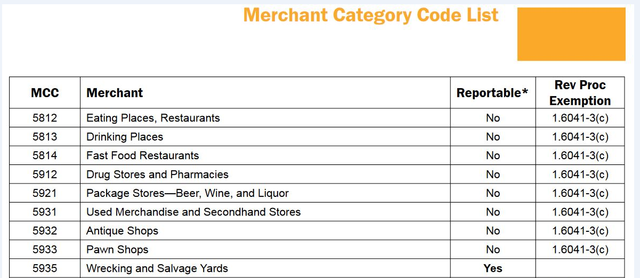
Classifications and Interactions
Standard classifications for products and business services make it easier to discover suitable resources, integrate them into your own processes, or to comply with rules and regulations
22

Slide 23
Classification and Interactions
Effective user interfaces to physical or digital organizing systems present and reinforce the logical classifications they embody
If the resources belong to logical groups or categories, does the arrangement of the controls reflect them?
23

Slide 24
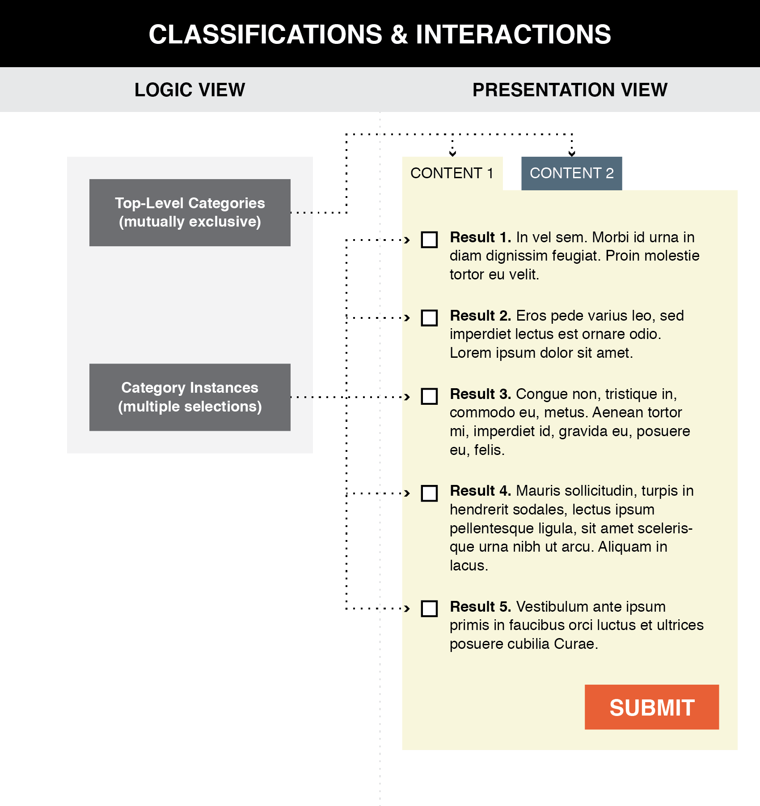
Good user interface design creates a clear mapping between a classification scheme and the arrangements and interactions that users see (TDO Figure 8.1)
24

Slide 25
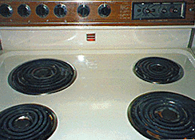
How Good is the Mapping from Logical Groups to Controls?
25

Slide 26
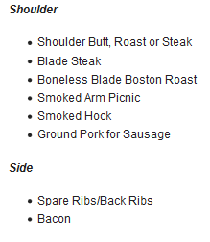
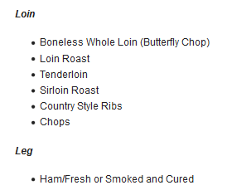
A Conventional Presentation of a Classification: Tabular categories and subcategories

Slide 27
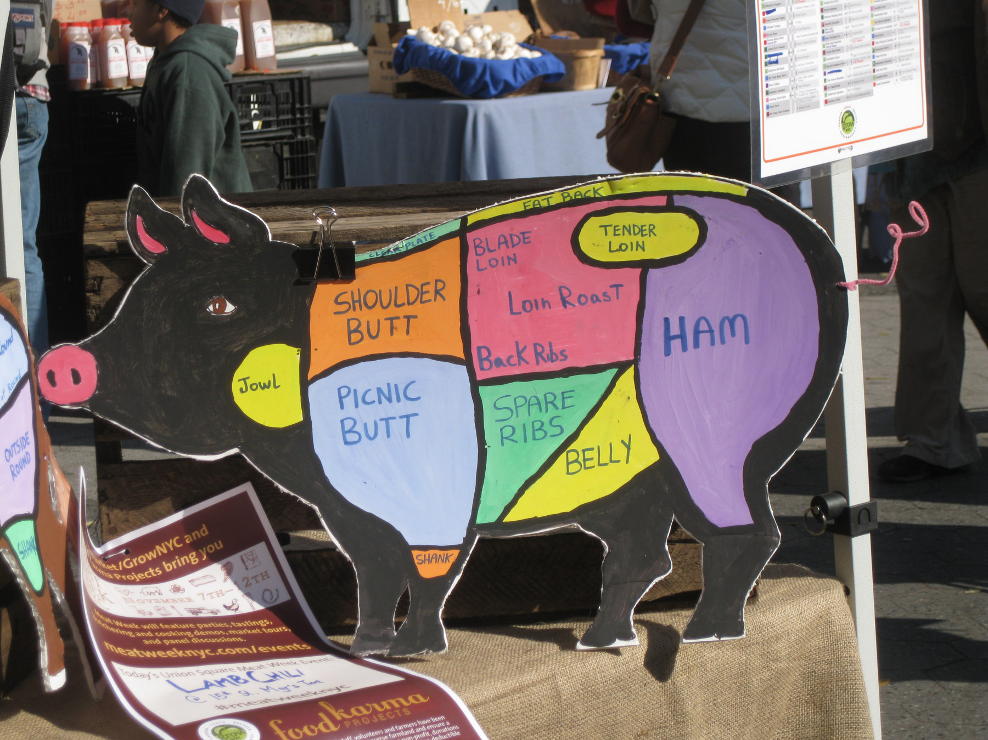
More Intuitive Presentation of the Classification
Photo taken by Bob Glushko at Union Square Greenmarket, NYC

Slide 28
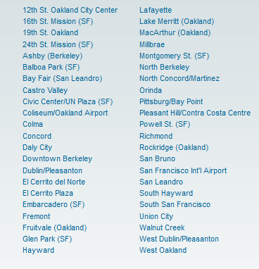
FLASHBACK: Poor Communication of a Classification
BART Station List
Better Might Be Something Like…
San Francisco
Embarcadero
Montgomery
Powell
Civic Center
…
Oakland
West Oakland
12 Street
19 Street
MacArthur
Rockridge
…
Berkeley
Ashby
Berkeley Downtown
Berkeley North

Slide 29
Applied Behavioral Economics

Slide 30
Exercise 1
“Steve is very shy and withdrawn, invariably helpful, but with little interest in people, or in the world of reality. A meek and tidy soul, he has a need for order and structure, and a passion for detail.”
Is Steve more likely to be:
a farm worker
a college librarian
a pilot
a schoolteacher
a salesperson
a physician

Slide 31
Exercise 2
“Linda is thirty-one years old, single, outspoken, and very bright. She majored in philosophy. As a student, she was deeply concerned with issues of discrimination and social justice, and also participated in antinuclear demonstrations.”
Is Linda more likely to:
Be active in the feminist movement?
Be a bank teller?
Be a bank teller and active in the feminist movement?

Slide 32
Exercise 3
Which of these “Heads” and “Tails” sequences of 6 flips of a “fair” coin is most likely? Least likely?
1) H H H T T T
2) H H H H T H
3) H T H T T H

Slide 33
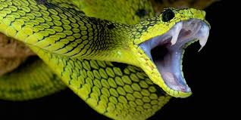
Exercise 4
Which of these is the most frequent cause of human deaths?
1. Shark attacks while swimming, surfing, or scuba diving
2. Bites from a poisonous snake
3. Bites from a mosquito
What information are you using to answer this question?

Slide 34
Decision Making and Assessing Probabilities
Many of the decisions we make in our personal and professional lives are in situations where outcomes are uncertain
Is there a “rational” way to assess probabilities and make decisions?
HINT:
Probability of an event = ? divided by ?

Slide 35
Decision Making and Assessing Probabilities
Is there a “rational” way to assess probabilities and make decisions?
How does this “rational” way compare to what people actually do?
Do people want to act rationally?
If they don’t or can’t, why not?

Slide 36
Economic Theories of Human Decision Making (1)
Economic theories of human decision making assume that people can be reasonably approximated or described as “rational” agents
Individuals have precise information about the consequences of their actions
Individuals have sufficient time and capability to weigh alternatives

Slide 37
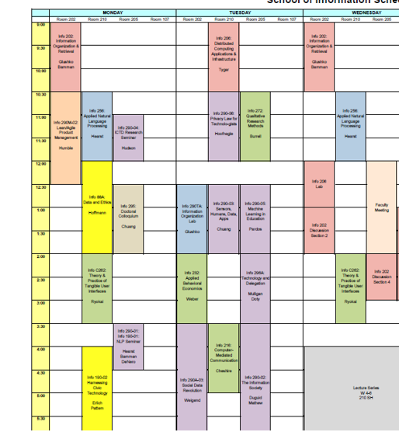
Deciding What Courses to Take
Did you have precise information about the content of a course, or how taking it would advance your career goals?
(…but first, do you know all of your career goals?)
Did you have sufficient time and capability to study the syllabus and course evaluations for every course you might take?

Slide 38
Economic Theories of Human Decision Making (2)
Different outcomes can be compared in terms of their “utility” (which is revealed by the choices people make)
The “value” or “utility” of a choice is the expected value of its probabilistic outcomes
Rational agents seek to maximize their utility

Slide 39
Deciding What Courses to Take
Can you rate each individual course in terms of how likely it is to advance your career goals?
Course A would be easy and interesting, and somewhat relevant to career goals
Course B would be pretty hard, but would probably help me get an internship
Course C would be very hard, but I’m sure that if I did well, the company that I worked for as an internship would offer me a full-time job
…
Can you compare different sets of courses in terms of how likely they are to advance your career goals?
Courses A, B, and G would be a pretty good schedule, not overwhelmingly hard, and would probably enhance my chances of getting a good job
Courses A, B, and C would be really hard, but I’d be sure of getting the job I want … but I’d have no free time
…

Slide 40
Deciding What Courses to Take
What future events comprise the “total number of outcomes” when it comes to choosing sets of courses to take?
Which combinations of courses will result in successful outcomes?
How far into the future do you look when you predict whether some set of courses will lead to a successful outcomes?

Slide 41
Economic Theories of Human Decision Making (3)
The “rational choice theory” enables calculations and predictions in situations with uncertainty (for example, in “game theory”)
Decisions that deviate from this theory can occur if people have incomplete information or insufficient time
But these deviations should be unsystematic because the factors that cause them are random and “average out”

Slide 42
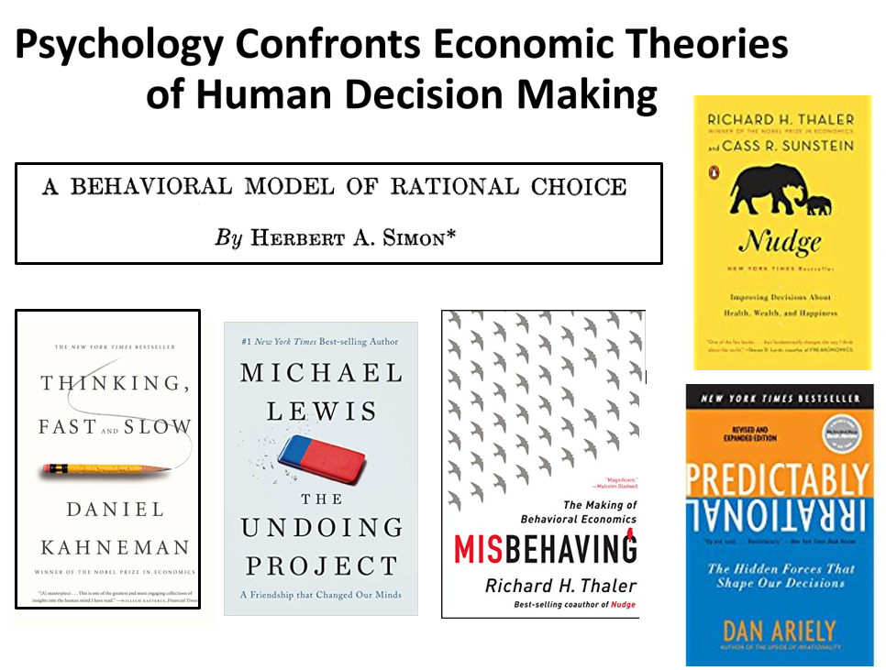

Slide 43
Bounded Rationality (Simon)
“Because of the psychological limits of the organism (particularly with respect to computational and predictive ability), actual human rationality-striving can at best be an extremely crude and simplified approximation to the kind of global rationality that is implied, for example, by game-theoretical models”
- Herbert Simon (1955). A behavioral model of rational choice. The quarterly journal of economics, 69(1), 99-118.
Simon was more famous for other research (how big firms work, which won econ Nobel prize in 1978), and for a book called “Sciences of the Artificial” (AI), so his critique of rational decision making didn’t have that great of an impact as it otherwise might have

Slide 44
Bounded Rationality
People often lack perfect information of outcomes and probabilities, and don’t have the time and cognitive capabilities to make the calculations implied by rational choice theory
Decision-makers act as satisficers, seeking a satisfactory solution rather than an optimal one
Can you think of situations where you settled for a satisficing solution rather than the optimal one?
When would you want to hold out for the optimal solution?

Slide 45
Beyond Bounded Rationality
Bounded rationality can explain why people sometimes make suboptimal decisions
But rational choice theory expects that suboptimal decisions should be unsystematic
WHY?
Tversky & Kahneman identified numerous systematic errors in judgment and proposed psychological mechanisms for them, mostly in terms of decision-making heuristics

Slide 46
“People rely on a limited number of heuristic principles which reduce the complex tasks of assessing probabilities and making predictions to simple judgmental operations. In general, these heuristics are quite useful, but sometimes they lead to severe and systematic errors”
Amos Tversky & Daniel Kahneman

Slide 47
Heuristics
A heuristic is any approach to problem solving, learning, or discovery that employs a practical method not guaranteed to be optimal or perfect, but sufficient for the immediate goals
When finding an optimal solution is impossible or impractical, heuristics can be used to speed up the process of finding a satisfactory solution
Heuristics can be mental shortcuts that ease the cognitive load of making a decision

Slide 48
Tversky & Kahneman’s Human Probability-Assessment Heuristics
Representativeness
The more object X is similar to class Y, the more likely we think X belongs to Y
Availability
The easier it is to consider instances of class Y, the more frequent we think it is

Slide 49
Representativeness Bias (1): Ignoring Prior Probabilities
It is easier to assess similarity than to compute probabilities
If people judge the probability that X belongs in class Y by how representative it is (its similarity to a stereotype) they will ignore the prior probabilities

Slide 50
Steve
Steve is very unlikely to be a college librarian because they are only ½ of 1 percent of the total people in these occupations
a farm worker (over 3,000,000)
a college librarian (about 100,000)
a pilot (about 600,000)
a school teacher (over 3,000,000)
a sales person (over 15,000,000)
a physician (over 1,000,000)

Slide 51
Representativeness Bias (2): Misconception of Chance
People expect random sequences to be “representatively random” even when the sequence is short
E.g., they consider a coin-toss run of HTHTTH to be more likely than HHHTTT or HHHHTH (they expect too many alternations and too few runs)
The Gambler’s Fallacy
After a run of reds in a roulette, black will make the overall run more representative

Slide 52
“Rational” Calculation of Probability
Example: 6 flips of a fair coin produces 64 different sequences, each of which is equally likely (½ * ½ * ½ * ½* ½ * ½ = 1/64)
H H H T T T, H H H H T H, H T H T T H, …
But in these 64 sequences there are
1 that have 0 or 6 heads (6 or 0 tails)
6 that have 1 or 5 heads (5 or 1 tails)
15 that have 2 or 4 heads (4 or 2 tails)
20 ways to get 3 heads and 3 tails

Slide 53
“Chance is commonly viewed as a self-correcting process in which a deviation in one direction induces a deviation in the opposite direction to restore the equilibrium. ”
Amos Tversky & Daniel Kahneman
Does this remind you of some concept from the lecture on causality and explanation?

Slide 54
Karma
FLASHBACK
Karma in several Eastern religions is the spiritual principle of cause and effect where intent and actions of an individual (cause) influence the future of that individual (effect)
Good intent and good actions contribute to good karma and future happiness, while bad intent and bad actions contribute to bad karma and future suffering
Hindu theories of salvation posit that future births and life situations will be conditioned by actions performed during one’s present life—which itself has been conditioned by the accumulated effects of actions performed in previous lives.

Slide 55
Representativeness Bias (3): Conjunctive Fallacy
The joint probability of two independent events cannot be more probable than either of them occurring separately
But if the conjunction seems like a representative outcome it can be judged more likely

Slide 56
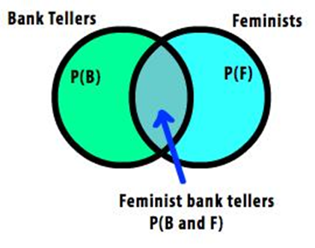
Conjunctive Fallacy with Linda
Be active in the feminist movement?
Be a bank teller?
Be a bank teller and active in the feminist movement?

Slide 57
The Availability Heuristic
“Availability is a useful clue for assessing frequency or probability, because instances of large classes are usually recalled better and faster than instances of less frequent classes. ”
Amos Tversky & Daniel Kahneman

Slide 58
Availability Biases : Ease of Retrievability
Classes whose instances are more easily retrievable will seem larger
For example, judging if a list of names had more men or women depends on the relative frequency of famous names
Salience affects retrievability
E.g., watching a car accident increases subjective assessment of traffic accidents
Recency affects retrievability

Slide 60
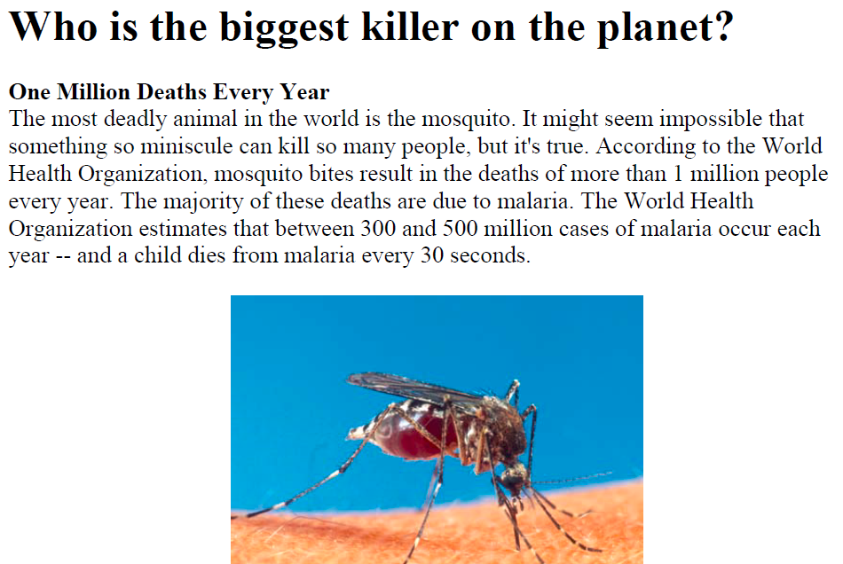

Slide 61
Choice Architecture

Slide 62
FLASHBACK TO RESOURCE DESCRIPTION
Many interactions – especially with physical resources - seem unmediated when they take place
This means we don't always realize the role of additional descriptions or organization in supporting or improving interactions
Choices about descriptions and organizing principles involve tradeoffs that determine which interactions are efficient, possible, difficult, or impossible
62

Slide 63
“The Tools of Choice Architecture”
Johnson, Eric J., et al. "Beyond nudges: Tools of a choice architecture." Marketing Letters 23.2 (2012): 487-504.
The way a choice is presented influences what a decision-maker chooses. We divide these tools into two categories:
those used in structuring the choice task
those used in describing the choice options
63

Slide 64
Choice Architecture in TDOspeak
Choice Architecture says:
TDO says:
There is no neutral architecture
We can vary the order of choice alternatives
We can change the number of categories
We can change the labels of alternatives or categories
People prefer choices that are easier to describe
TRADEOFFS
All systems of categories are biased
We can use different organizing principles
We can vary the abstraction and granularity of categories
Naming and resource description is difficult, contentious, and makes a difference
TRADEOFFS

Slide 65
How Many Alternatives?
Need to enable “a reasoned consideration of tradeoffs among conflicting values” but “not seem overwhelming”
Too few options may generate context-specific preference where the presence or absence of one option influences what is chosen
Too many options create “choice overload” or the “paradox of choice” because the initial attractiveness of many alternatives decreases the motivation to choose any particular one
65
Notes:
more options increase the chances of offering a preference match to the consumer, and second that more options places a greater cognitive burden on consumers because of the additional need to evaluate options.

Slide 66
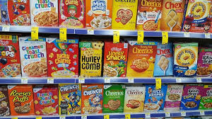
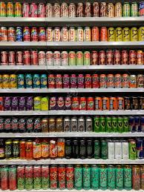
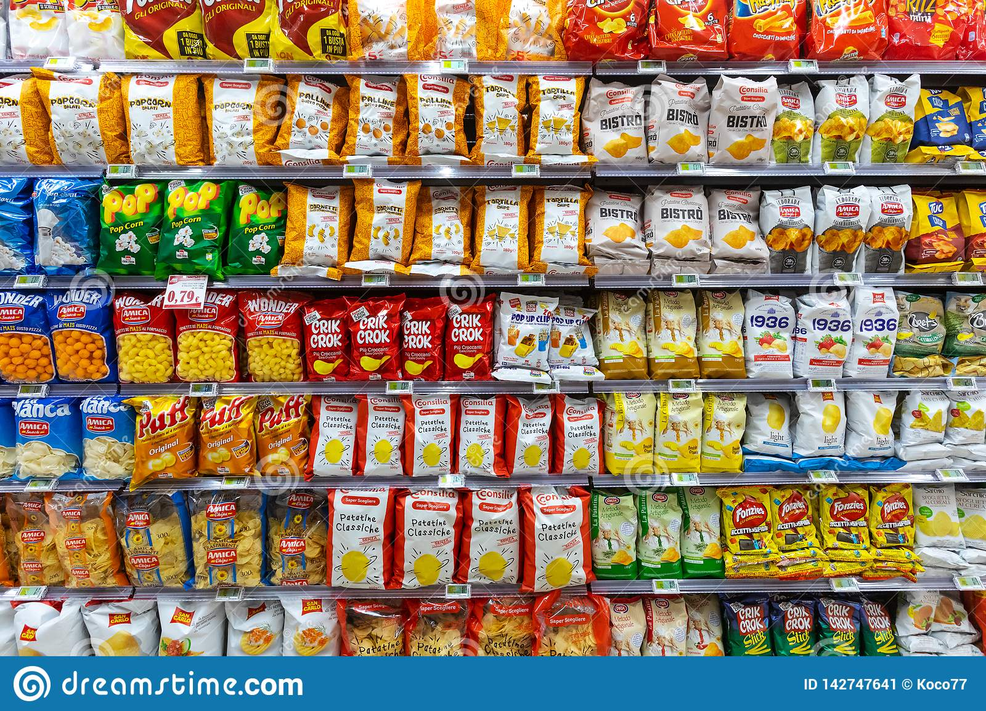
Choice Overload?

Slide 67
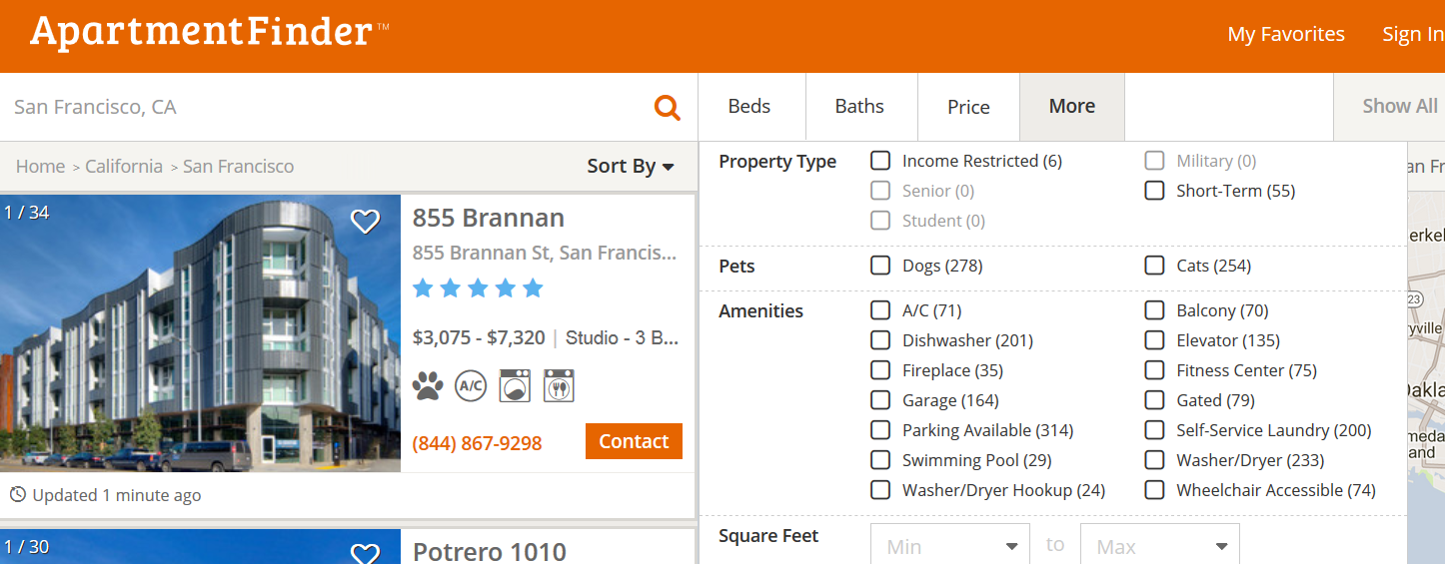
Choice Overload?
Looking for an apartment? Over 20 potentially relevant attributes here
Notes:
Choice Overload?

Slide 68
Defaults
For any choice that needs to be made, there should be an associated default rule that determines what happens to the decision maker who does nothing
Usually, the answer is that if you do nothing, nothing changes; whatever is happening continues to happen
For “opt-out” defaults most choosers will do nothing, and things can happen that the chooser might not want or not know about
This bias to do nothing is essential to Facebook’s business model… “you can choose not to share any personal data” (if you can figure out how to use our complicated UI)
68

Slide 69
Types of Defaults
Configuration defaults apply at the first encounter with a choice
Could be the same for everyone, a normative or recommended alternative
Mandated choice (benefit or nuisance?)
Reuse defaults apply to subsequent encounters
Persistence of original choice
Reverting to original default
Predictive defaults based on user modeling
69

Slide 70
Decision Staging
When facing a small number of well understood alternatives, “rational” people will examine all the attributes of all the alternatives and then make tradeoffs when necessary
If consumers are rational, “utility-maximizing agents”, their preferences for any finished product should be independent of the order in which they considered its attributes: any order should yield an equivalent “final” bundle
But as the choices become more numerous or vary on more dimensions, people are more likely to adopt simplifying strategies that aren’t entirely rational
70

Slide 71
Product Configuration (miniusa.com)
Constructing the preferred product via a sequence of attribute decisions

Slide 72
How Attribute Order Affects Choice
Changes in the order by which the attributes are considered can substantially influence the choices made
If you start with attributes with lots of options, the chooser is more likely to accept default alternatives on later attributes, even if these decisions involve relatively few options that would ordinarily require less capacity to evaluate
STOP and THINK
What would cause this? How would a choice architect use this to his advantage?
72

Slide 73
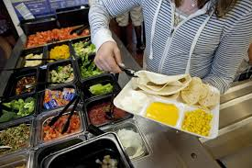
If school kids are more likely to eat foods at eye level at the beginning and end of the cafeteria buffet, how do you arrange the food?

Slide 74
Attribute Descriptions
People make comparisons on the basis of resource attributes, and ideal decisions would consider all attributes and weight them according to their importance to the decider
But choice architects can manipulate the salience of attributes
Choice sets that can be described simply are preferred over other sets that seem more complicated, even when the complicated ones offer more objective value
People like things that are orderly in arrangement

Slide 75
Choosing Beer Bundles
Two bundles differ only on the third beer
Some bundles have beers from 4 different breweries
People have a preference for all the same or all different bundles
Evers, Ellen R.K. and Inbar, Yoel and Loewenstein, George and Zeelenberg, Marcel, Order Preference (July 16, 2014). http://ssrn.com/abstract=2466991

Slide 76
The Course “End Game”
Tuesday 4/13
Case study breakout session
“drop-in” by Alex Boxer
Assignment: revise your case study overview, WHAT, WHY report by Friday 4/16; add comments or questions to all case studies in Google doc by Tuesday 4/20
Thursday 4/15
Guest lecture by Amy Fox
Tuesday 4/20
Course review; Study questions for exam distributed
Case study breakout session

Slide 77
The Course “End Game”
Thursday 4/22
No class meeting; Timed exam anytime all day
Tuesday 4/27 and Thursday 4/29
Lectures on “Computational description” and “Computational classification”
Tuesday 5/4 and Thursday 5/6
Case study presentations (5 minutes)
Monday May 10 - your written case study
If you turn in a draft by 5/6, you’ll get comments by 5/6

