Slide 1
CogSci 150 “Sensemaking and Organizing” Spring 2021
Robert J. Glushko glushko@berkeley.edu
20 April 2021
25) Course Review

Slide 2
Course Review

Slide 3
The Course in One Slide
When something "makes sense” or " is organized” we are imposing or discovering order in the arrangement of concepts, events, or resources of some kind.
Sensemaking and organizing are fundamental human activities that raise many multi- or trans-disciplinary questions about perception, knowledge, decision making, interaction with things and with other people, values and value creation.

Slide 4
Plan for the Course
We can analyze sensemaking and organizing from four interrelated perspectives:
As a member of a social, cultural, or language community (linguistics, sociology, social network analysis)
As an individual (psychology and philosophy)
In institutional contexts (law and business)
In data-intensive or scientific contexts (statistics, computer science, info visualization).

Slide 5
Categories of Categories
Categories are sets or groups of resources, “classes of things” or abstract entities, that are treated the same
In TDO there are two ways to contrast categories
CATEGORY CONTEXT: How they are created (individual, cultural, institutional, computational)
CATEGORY STRUCTURE: How they are defined or structured (enumerated, property-based, similarity based…)

Slide 6
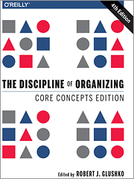
Organizing
Creating capabilities by intentionally imposing order and structure

Slide 7
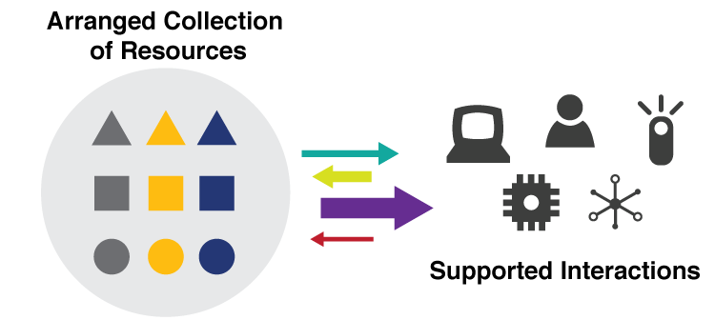
They are all “Organizing Systems”
A collection of resources intentionally arranged to enable some set of interactions
7

Slide 8
ORGANIZING SYSTEMS BIG IDEAS
Every organizing system must enable users to interact with its collection of resources
The possible interactions depend primarily on the nature and extent of the descriptions associated with the resources
Intentional arrangement emerges when one or more resource descriptions are used by organizing principles
8

Slide 9
Interactions –The Why of Organizing Systems
INTERACTIONS include any activity, function, or service supported by or enabled with respect to the resources in a collection or with respect the collection as a whole
Whenever we select a resource for inclusion in an organizing system, describe it, or arrange it according to an organizing principle, we (should) have an interaction in mind
TDO calls this “organizing on the way in”
9

Slide 10
A “Design Space” or “Dimensional” Perspective
In addition to using categories like Library or Museum or Business Information System, consider a specific organizing system as a point in a multidimensional design space and these categories as regions in that space
This treats the familiar categories as “design patterns” that embody typical configurations of design choices
10

Slide 11
The 6 Dimensions of an Organizing System
What Is Being Organized?
Why Is It Being Organized?
How Much Is It Being Organized?
When Is It Being Organized?
Who (or What) is Organizing It?
Where is it Organized?
11

Slide 12
Consequences of Dimensional Thinking
Overcomes the bias and conservatism inherent in familiar categories
Design patterns support multi-disciplinary work that cuts across familiar categories and applies knowledge about them to new domains
Creates a design vocabulary for translating concepts and concerns from category and discipline-specific vocabularies (the secret of being a successful consultant)
12

Slide 13
External Representations are Organizing Systems

Slide 14
The Activities in Organizing Systems
We can identify four activities in the lifecycle of every organizing system:
Selecting resources
Organizing resources
Designing resource-based interactions and services
Maintaining resources
14

Slide 15
Resources:
Anything of value that can support goal-oriented activity

Slide 16
What is a Resource?
When you look at, refer to, or pick up a natural physical object, it usually seems that it is "one thing"
But many things have highly visible parts or internal structures, and we must decide whether to treat them as assemblies or aggregations of these separate things
For digital and computational resources, it is much harder to know how many parts we can or should identify
16

Slide 17
Two Aspects of “Thingness”
Two separate aspects cut across the "thingness" distinctions:
Granularity – do we think of the resource as unitary, or as consisting of parts?
Abstraction – “thing” or “type of thing” – are we thinking of the resource as a single instance or as a member of a bigger category?
17

Slide 18
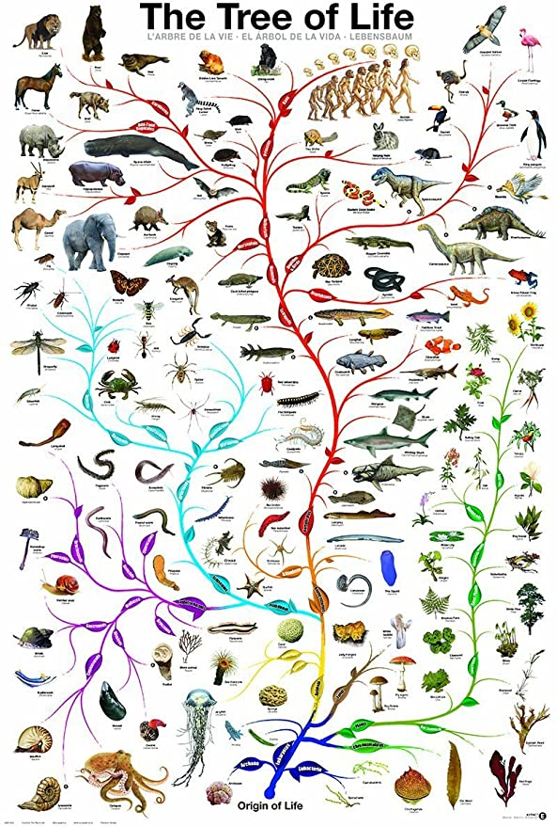
“Carving Nature at its Joints”
Over 2000 years ago Plato argued that species are distinguished by "carving nature at its joints" - where the natural differences between things are the largest or most salient
I.e., there are “natural kinds” – categories are discovered, not invented
18

Slide 19
Finding the Joints
Today we call Plato’s method “unsupervised learning” - you don’t know what the category labels are, but you can determine the category boundaries if you:
Make the similarity of things in the same category as high as possible while making the similarity between categories as low as possible
Do this by finding “clusters” or correlations of feature values
This is easy to say but can be computationally complex
19

Slide 20
Carving Information at its Joints? (“Information Architecture”)
The granularity of physical resources is more easily determined than for information resources, because information "joints" are much more arbitrary
There might be indications "on the surface" that suggest the "joints" between information resources, but these represent design decisions, might be more structure or presentation oriented than content- oriented distinctions, and are subject to cognitive interpretation
20

Slide 21
The Document Type Spectrum
Different domains or types of documents can be distinguished according to the extent to which their content is semantically prescribed, by the amount of internal structure, and by the correlations of their presentation and for­matting to their content and structure
Documents and data fall on a continuum

Slide 22
Resource Abstraction: “Thing” vs. “Type of Thing”
We often blur the distinction between individual things (or instances of things) and classes of things
You can buy that at Home Depot
You can see that in the Louvre
Identifying a resource as an instance is not the same as identifying the category or "equivalence class" to which it belongs
22

Slide 23
“Shamu” -- Instance or Type?
23

Slide 24
Intentional Arrangement:
Explicit or implicit acts of organization by human or computational agents

Slide 25
Organizing Resources
Almost any property of resources can be used to organize them, but the most appropriate or effective properties differ across resource types and tasks
The scope and scale of an organizing system influence/constrain organizing principles and interactions
Decisions about which resource properties will be used in organizing must often precede the creation or selection of the resources
25

Slide 26
Organizing Principles <=> Resource Descriptions
Frequency of Use <=> Usage information
Color, shape, size… <=> Physical properties
Alphabetical order <=> Sortable resource name or identifier
Chronological order <=> Sortable date/time of important event
Semantic <=> Content description

Slide 27
Resources and Identity Over Time
Organizing systems continually need to adapt and evolve in response to changes in content and context
New resources are created or added, and other ones are destroyed or culled
Resources might change in controlled ways or in uncontrolled ways
The organizing system might need automated or formal mechanisms for ensuring persistence and authenticity
27

Slide 28
Putting them all Together
TDO Figure 3.6
28

Slide 29
Why We Describe Resources
We describe resources so we can refer to them, select them, organize them, interact with them (sometimes to compare them), and maintain them
(TDO Ch 3 “Activities in Organizing Systems” – 1/28)
Different activities with resources imply different descriptions and different methods of using them
Resource domains can have characteristic or standard resource descriptions that are applied to every resource instance (often called “schemas” or “domain-specific languages”) and in doing so define resource categories
(TDO Ch 7 “Categorization” – 2/23)
29

Slide 30
Big Ideas (1)
Resource description and organizing are intrinsically connected
Any resource can have associated descriptions, and the descriptions don’t need to be “data”
Different activities with resources imply different descriptions and different methods of using them
The same resource can be a primary one, or a description resource associated with another one that is the primary focus
The scale and diversity of datasets makes resource description the fundamental challenge in data science
30

Slide 31
TDO 5.3 Proposes this Process for Describing Resources
1. Identify / scope the resources to be described
2. Determine the uses of the descriptions
3. Study the resource(s) to identify descriptive properties
4. Design the description vocabulary
5. Design the description form and implementation
6. Create the descriptions (either "by hand" or by some automated / computational process
7. Evaluate the descriptions
31

Slide 32
The “Vocabulary Problem”
People use a large variety of words for the same thing or concept
Most people - especially system designers - are surprised by this because they think their own word choices are “intuitive” or "natural“
The extreme variability of word selection is an inescapable fact that has its roots in the nature of language and categorization
32

Slide 33
Big Ideas (2)
It probably seemed easy to come up with description terms, but the vocabulary problem is real. Friends don’t let friends model alone
The process and result of identifying descriptions from a series of instances is likely to be very different than from a collection of instances
The scope of a resource collection – the breadth and heterogeneity of instances – is far more important than scale
Scope makes resource description and computation with descriptions more challenging
33

Slide 34
Big Ideas (3)
Describing and organizing always (explicitly or implicitly) takes place in some context, which shapes which resource properties are important and the organizing principles that use them
A collection of resource descriptions is vastly more useful when every resource is described using the same features/properties/categories to which the controlled vocabulary is applied, making it a “schema” or “domain-specific language
Different ways of creating resource descriptions have costs and benefits; who pays the costs and who benefits?
34

Slide 35
Resource Description Checklist for Data Scientists
The size and diversity of datasets makes resource description the fundamental challenge in data science
Where did the data come from (provenance)? Is the source credible? Is the dataset relevant to the questions you’re asking?
Why were these descriptions selected? What are the possible values? Units and levels of measurement? Precision? Vocabulary control?
Are the values accurate? Stable? Current? Correlated? Human-interpretable?
Did the people who designed and collected this dataset think about it in the same way that you do?
35

Slide 36
Syntactic, Structural, & Semantic Interoperability
SYNTACTIC interoperability is just the ability to exchange information
STRUCTURAL interoperability means that all the expected information components are present with the same arrangement and granularity
SEMANTIC interoperability requires that the content of the message be understood by the recipient application or process
Semantic integration is the process by which this common semantic model is created
36

Slide 37
Some Ways NOT to Interoperate
Elements with the same meaning can have different names ("IssueDate" vs "OrderIssueDate")
Elements with the same meaning can have different names or different formats even when they have the same name (September 11, 2001, 9/11/2001 and 9-11-01; 11/09/01 in Europe)
Same meaning, but encoded differently: in XML using attributes instead of elements; in EDIFACT syntax instead of XML, in French rather than in English
37

Slide 38
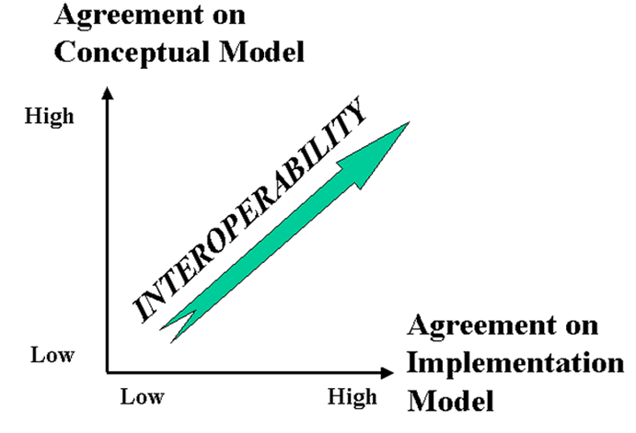
The Dimensions of Interoperability
38

Slide 39
Say it Again: TDO’s Mantra
Organizing, resource description, and interaction design are inherently interconnected activities

Slide 40
Describing and Organizing Classes of Things (1)
We all create individual categories to organize our possessions, activities, and interactions
Our organizing systems are often ad hoc and idiosyncratic to satisfy the requirements that emerge from our unique experiences, preferences, and resource collections
40

Slide 41
Describing and Organizing Classes of Things (2)
Cultural categories are embodied in culture and language and have imprecise / flexible boundaries
Individual categories often make use of or are derived from cultural categories
41

Slide 42
Describing and Organizing Classes of Things (3)
Institutional categories are explicitly constructed to create a precise semantic model (of what might otherwise be treated as cultural categories)
And often co-exist with them (e.g., “Color”)
Institutional categories are essential in abstract, information-intensive domains where semantic precision is essential for processes, transactions, and analyses (especially automated ones)
42

Slide 43
Color in Culture
How Color Changes the Mood in Art

Slide 44
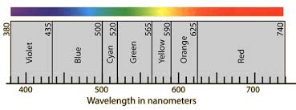
Color Defined by Wavelength
Pantone Color System

Slide 45
Every Classification is "Biased"
Every classification is arbitrary because the criteria used to establish the categories reflect a point of view or perspective on the domain that intentionally excludes all other perspectives
Every classification system implicitly or explicitly contrasts {"good", "standard“} and {"bad", "nonstandard“} ways of understanding things
Natural vs. man-made disaster?
Dietary supplement vs. beverage?
Employee vs. contractor, full vs. part time?
45

Slide 46
STOP AND THINK: Classifications and Bias
Every classification is biased, but how does bias differ in individual categories, cultural categories, and institutional categories?

Slide 47
STOP AND THINK: Is a Burrito a Sandwich?
A Worcester, Pennsylvania Panera Bread franchise sued to block a Qdoba Mexican Grill from opening in its shopping complex, citing its contract to be the sole sandwich shop on the block. Qdoba makes the bulk of its income selling burritos. In Panera's view, that put Qdoba in the sandwich business.
“Sandwich” and “burrito” are cultural categories, but are they also institutional ones in this case?

Slide 48
Classifications and Interactions
Classifications arrange resources into categories
Every classification increases the capability and efficiency of interactions with resources that are “co-located” or “within-category” and makes “between-category” interactions less efficient
The granularity of the classification determines the specificity of the interactions
The structure and description of a classification influences how people use it
48

Slide 49
“The Tools of Choice Architecture”
Johnson, Eric J., et al. "Beyond nudges: Tools of a choice architecture." Marketing Letters 23.2 (2012): 487-504.
The way a choice is presented influences what a decision-maker chooses. We divide these tools into two categories:
those used in structuring the choice task
those used in describing the choice options
49

Slide 50
Choice Architecture in TDOspeak
Choice Architecture says:
TDO says:
There is no neutral architecture
We can vary the order of choice alternatives
We can change the number of categories
We can change the labels of alternatives or categories
People prefer choices that are easier to describe
TRADEOFFS
All systems of categories are biased
We can use different organizing principles
We can vary the abstraction and granularity of categories
Naming and resource description is difficult, contentious, and makes a difference
TRADEOFFS

Slide 51
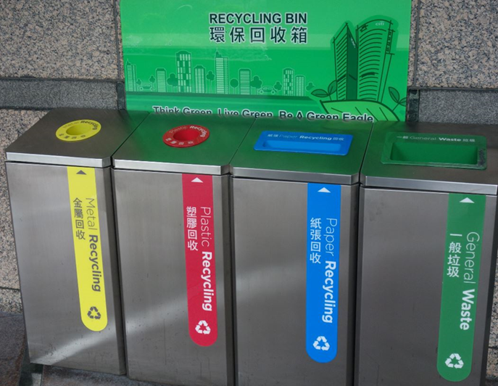
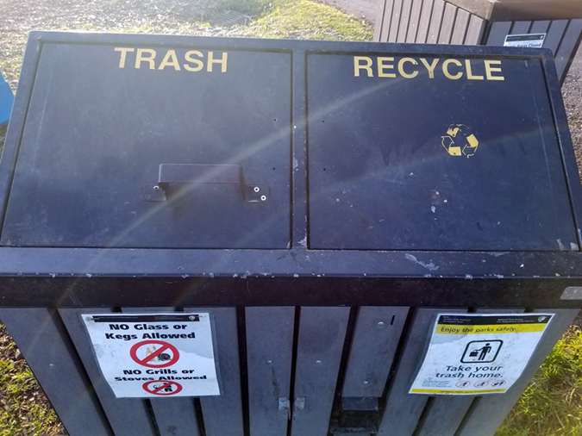
STOP AND THINK: Choice Architecture
How and why do these “recycling architectures” differ?
Which system is likely to result in more recycling?
Does that make it better, or is this just a design decision about whether recycling is done “on the way in” or “on the way out?”
If more granular categories cause more recycling, why not have even more categories?

Slide 52
Principles for Creating Categories (TDO 7.3) (“Category Structure”)
Enumeration
Single Properties
Multiple Properties
Similarity / Family Resemblance
Theory-Based (or Analogy-based)
Goal-Derived (or Activity-based)

Slide 53
Categories Defined by Single Properties
A very simple way to define a category is to use only the values of any single property, especially when the possible values are discrete and not very numerous
Intrinsic static properties are often the easiest ones to use (color, size, shape…)
It is also desirable to use properties that objectively measurable and orderable, or tied to well-established cultural categories
Learning the category is simple – what’s the property?

Slide 54
Multiple Property Categories
When items being categorized can be described using easily observed “separable” or “combining” properties, categories are often based on multiple properties
Each successive property differentiates the items in a category to create a hierarchy of sub-categories
Property order determines the hierarchy
How do we choose the properties?
How do we determine the order in which we apply them?

Slide 55
Implications of “Necessary and Sufficient” Properties
Because category membership is defined by rules, all members of the category have equal status in the equivalence class
Classical categories are conceptually simple and have straightforward implementations in technologies like database schemas, decision trees, and classes in programming languages

Slide 56
Probabilistic Categories & Family Resemblance
In some domains instances of a category can share many features, some instances might have properties that are not widely shared, and some important discriminating properties might be difficult to perceive
Birds:
All have feathers, wings, beaks, 2 legs
But some fly or swim and some don’t
The shape of their beaks, wings, and feet varies a great deal
56

Slide 57
Implications of Probabilistic Properties
Correlations among the properties make it necessary to determine an instance’s category membership in a statistical or probabilistic manner based on the overall similarity between it and other items in the category
Some features are better predictors of category members than others, which results in: Typicality / gradience / centrality effects
57

Slide 58
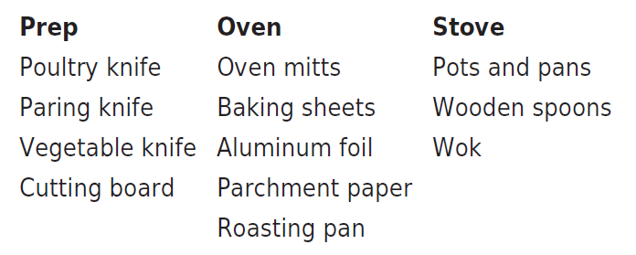
Taskonomy
In contrast to "taxonomy" - an approach to organization based on similarity of content or characteristics - a "taskonomy" organizes on the basis of purpose or "activity structure“
A COOK’S TASKONOMY (Figure 8.1 in TDO)
Grocery stores and supermarkets are mostly organized taxonomically, but have some taskonomic classification
58

Slide 59
Distinguishing Categorization and Classification
Categories are EQUIVALENCE CLASSES - sets of resources, processes, and events that we treat the same
A Classification (noun) (or Classification Scheme) is a SYSTEM OF CATEGORIES, ordered according to a PRE-DETERMINED SET OF PRINCIPLES and used to organize a collection of resources
Classification (verb) is the process of systematically assigning resources to intentional (often institutional) categories in a classification system
59

Slide 60
Bibliographic Classification
Much of our thinking about classification systems comes from the bibliographic domain, which is distinctive because of:
Scale, complexity, and degree of standardization
Standards and rules for classification
Legacy of physical arrangement, user access, circulation
60

Slide 61
STOP AND THINK: Classifying Cognitive Science
The Design of Everyday Things (Norman)
TS171.4 .N67
Parallel Distributed Processing (Rumelhart & McClelland)
BF455 .R853
Explorations in Parallel Distributed Processing (McClelland and Rumelhart)
QA76.5 .M2951
Women, Fire, and Dangerous Things (Lakoff)
P37 .L344
Cognition in the Wild (Hutchins)
BF311 .H88
The Discipline of Organizing (Glushko)
Z666.5 .D57
Why are these books scattered throughout the library of congress classification?
What does this mean for a cogsci student in a library?

Slide 62
Faceted Classification
FACETS are an alternative to hierarchical classification that overcome many of its limitations
Instead of creating a deep category hierarchy, facets create multi-dimensional categories that are defined (or generated) through grammatical composition (or combination) from the (characteristics or dimensions or relations) in the domain
Facets divide a domain or subject into "homogeneous" or "semantically cohesive" categories of manageable size
62

Slide 63
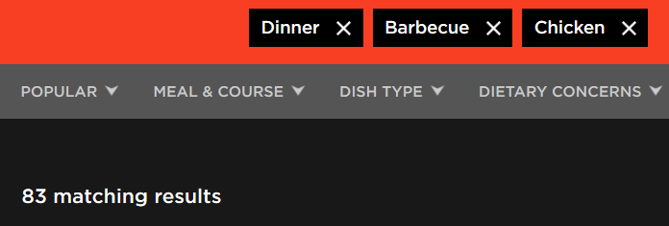
Faceted classification is commonly used in web sites where the resources have many properties

