Slide 1
CogSci 150 “Sensemaking and Organizing” Spring 2021
Robert J. Glushko
glushko@berkeley.edu
27 April 2021
27) Computational Description

Slide 2
Course Endgame
TODAY (4/27): “Computational Description”
THURSDAY (4/29): “Computational Classification”
TUESDAY 5/4: Case Study Presentations
THURSDAY 5/6: Case Study Presentations
FRIDAY 5/7: Last Day for “Free Read” of Case Study Report (comments back by 5/8)
MONDAY 5/10: Case Study Reports Due

Slide 3
Case Study Presentations
TELL A STORY ABOUT YOUR ORGANIZING SYSTEM in 5 minutes
No more than 3 slides; one should be the “artifact” that conveys the biggest ideas and that you’ll spend the most time explaining
For inspiration, flashback to “Models for Organizing Systems” in 1/26 lecture
Don’t mindlessly follow the design questions outline – emphasize the ones that are most important for your organizing system
Sign up for your time slot on 5/4 or 5/6 in the Google Doc linked to in yesterday’s announcement

Slide 4
Today’s Lecture
“Describing Documents” – the connection between “Information Retrieval” and “Data Science”
“Text processing” to find the best words to describe documents
The Boolean model
The Vector model
Term distributions as document descriptions

Slide 5
This week’s lectures on Computational Description and Computational Classification are an insane attempt to compress a semester of information science and machine learning topics into two lectures
My goal is to help you see how these topics fit into the discipline of organizing, not to fully explain them in much detail (which is why we had the exam last week that didn’t include these topics)
I will be speed talking through my slides (even more than usual) because I expect that if you care, you will study them when you have time after the semester is over
If you’re not into these topics, feel free to turn off your video, drop off, or work on your case study, or something else

Slide 6
Creating Resource Descriptions
FLASHBACK
By authors/creators: Best knowledge of purpose and intended audience
By professionals: "Institutional" descriptions that follow standards are likely to be more accurate, precise, consistent
By users: Most variable, influenced by social purposes
By automated processes (TDO 5.4, 7.5.3…)
6

Slide 7
Comparing Resource Descriptions
All information retrieval systems compare a description of a user’s needs with descriptions of the document resources that might satisfy them
“Relevant documents” are the category to which the search query and retrieved information (document) both belong
Likewise, any “classifier” whose purpose is to determine the category to which a resource belongs must compare the resource description with some description or representation of the category

Slide 8
Describing Documents - Motivation
Small collections might be adequately described by traditional bibliographic descriptors based on intrinsic properties (author, title) or with assigned keywords
But these aren’t precise enough to distinguish documents in large collections
Extracting a set of terms for describing the documents in a collection is the foundation for information retrieval
8

Slide 9
Glossary: Information Retrieval
The “IR model” specifies the representations of queries and documents in the collection being searched
this should remind you of “Category Structure” – the specification of the tests for category membership
“Text processing” extracts and merges multiple word forms into a single form or “index term”
The set of terms in a search query or document to be matched is compared against the term representation that describes each document in the collection
9

Slide 10
“Category Structure” (Principles for Creating Categories)
FLASHBACK
Enumeration
Single Properties
Multiple Properties
Similarity / Family Resemblance
Theory-Based (or Analogy-based)
Goal-Derived (or Activity-based)
10

Slide 11
Glossary: Data Science & Machine Learning
The process of choosing a set of properties or attributes of resources is called “Feature Selection”
When multiple candidate properties or attributes are combined into a new feature this is “Feature Engineering” or “Feature Extraction”
Determining how these features are used to classify or predict something is called “Model Construction”
11

Slide 12
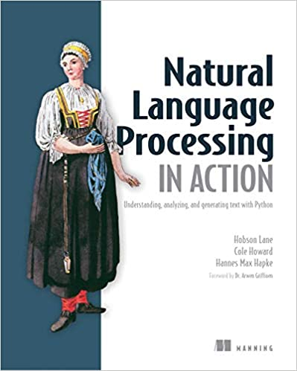
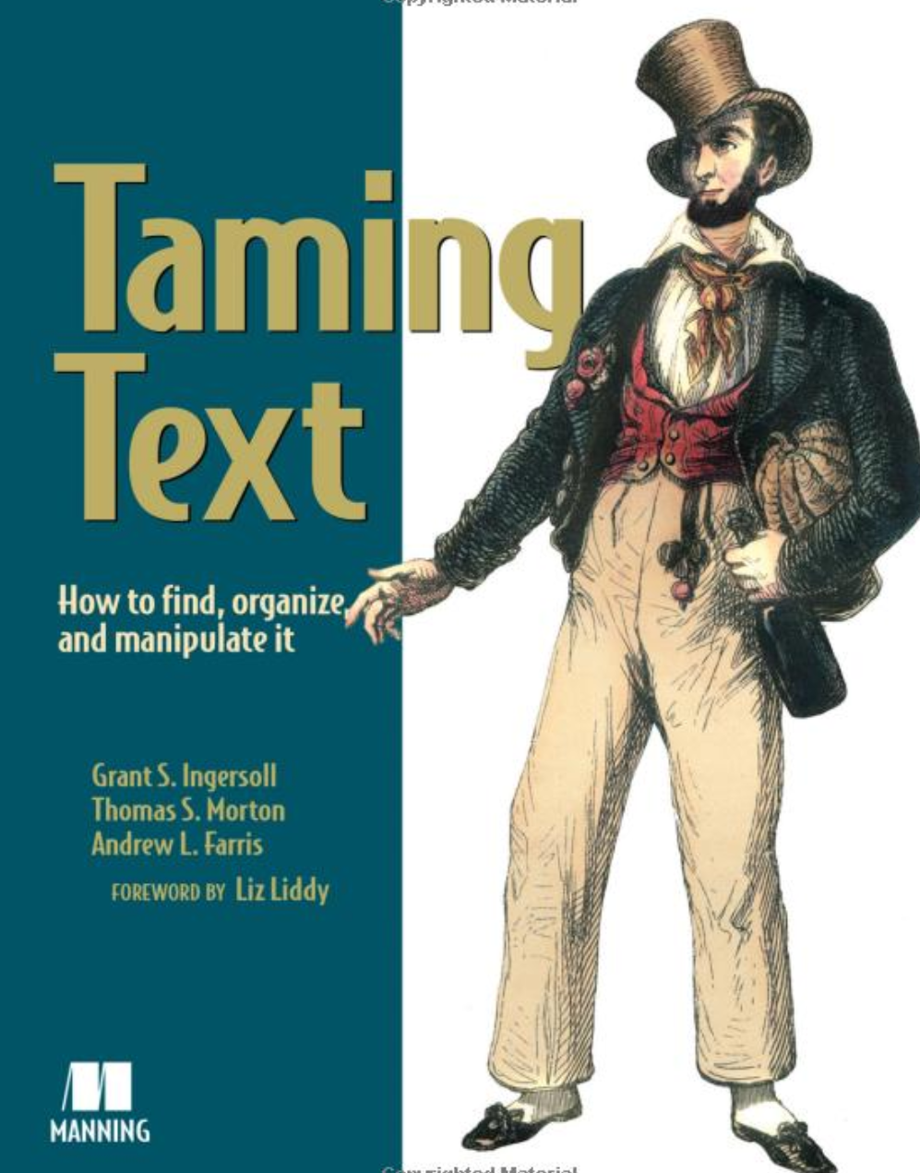
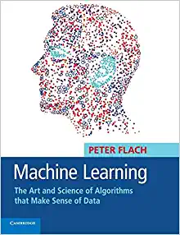
Recommended Texts

Slide 13
Computational Resource Description
Some of this material is discussed in TDO 10.3 and 10.4, which I didn’t assign because its tone is a little dated (*a lot has changed in the last 7 or 8 years)

Slide 14
Why we need more than “just the words”
If we want to know what a document is about, we could look at all the words to see if any of them are the topics we are interested in
But linear search through a document takes O(n) time, where n is the length of the document or document collection
This is infeasible for all but trivially small collections, so we need descriptions of documents that are much smaller than the documents!
What words best describe a document?

Slide 15
What Words Best Describe a Document? (1)
Not all words are equally useful indicators of what a document is about; many are irrelevant or redundant
Nouns and noun groups carry more "aboutness" than adjectives, adverbs, and verbs
Very frequent words that occur in all or most documents add NOISE because they cannot discriminate between documents
15

Slide 16
What Words Best Describe a Document? (2)
For any large document collection, it is necessary to pre-process the text of documents to select / create a smaller set of terms that better represent them; in IR these are called the INDEX terms
This selection and processing creates a controlled vocabulary for describing the contents of a document collection
16

Slide 17
Extracting the “Words”
(btw, we haven’t defined “word” yet…)
A digital resource is a sequence of bits
How does this sequence of bits become words?
How does this set of all the words in a document become the much smaller set that usefully describes its?
THE ANSWER: “Text Processing”

Slide 18
Text Processing: Operational Overview (1)
DECODING -- extracting the text to be processed from its stored representation, turning the bits and bytes into characters in some language by following the text encoding specification (e.g., UTF-8)
FILTERING -- creating a stream of characters by removing formatting or non-semantic markup
It is more important to focus on the processes where “languageness” matters:
TOKENIZATION -- segmenting the character stream into linguistic units
NORMALIZATION -- creating “terms” – categories of all the tokens with superficially different character sequences
18

Slide 19
Text Processing: Operational Overview (2)
STEMMING -- removing affixes and suffixes to allow the retrieval of syntactic and morphological variations of query terms
STOPWORD ELIMINATION -- remove words that poorly discriminate between documents
SELECTING INDEX TERMS -- choosing terms (or groups of them) as indexing elements
19

Slide 20
Sentence Segmentation
Many IR and text processing applications (translation, summarization) require that the “character stream” in documents be broken into their constituent sentences
STOP AND THINK: Define “sentence” so that a computer program can identify them
Not quite right: A sentence is the longest string between two sentence delimiters
Dr. Glushko, this is harder than it looks.
20

Slide 21
Tokenization
Identifying the “linguistic units” is another problem that seems trivial -- just use white space, right?
But what about:
abbreviations (Dr. is a word)
hyphens (sometimes part of a word, but sometimes a result of formatting)
21

Slide 22
Tokenization Challenges [1]
Many character strings include complex alphanumeric structure or punctuation syntax:
glushko@berkeley.edu
10/26/53
October 26, 1953
55 B.C
B-52
501(c)(3)
128.32.226.140
My PGP key is 324a3df234ch23e
https://bcourses.berkeley.edu/courses/1500399/
22

Slide 23
Tokenization Challenges [2]
The language that the characters represent needs to be identified during decoding because it influences the order and nature of tokenization
In languages that are written right-to-left like Arabic and Hebrew, left-to-right text can be interspersed, like numbers and dollar amounts
But how do you identify the language? That’s a classification problem that we’ll talk about in the next lecture
23

Slide 24
Tokenization Challenges [3]
In German compound nouns don't have spaces between the tokens
Many Asian languages combine ideographic symbols that can stand alone or be combined
Analogy in English:
TOGETHER could be interpreted as a single word or as its constituent words: TO GET HER
24

Slide 25
Stemming (and “Lemmatization”)
Many languages have some inﬂectional and derivational morphology, where similar words have similar forms:
organizes, organized, organizing
Stemming and lemmatization reduce this variety to a single common base form by “chopping” off the inflections
organizes, organized, organizing → organize

Slide 26
Normalization [1]
Often two character sequences are not the same, but you want to treat them as equivalent
Capital and lower-case characters are typically "case-folded" or “downcased” to lower-case
This enables you to find matches at beginning of sentences, but watch out for proper names like General Electric, Bush which should not be case-folded
26

Slide 27
Normalization [2]
Apostrophes, hyphens, accents, and diacritics are often removed
anti-discriminatory and antidiscrimatory, cliché and cliche
But in some languages, diacritics distinguish words
pena and peña mean different things in Spanish
27

Slide 28
Selecting Index Terms
At this stage in text processing the text collection is represented as a set of stems or phrases
But not all of them should be kept; some will retrieve too many, and some too few documents
We can select better index terms if we analyze the frequency distribution of the words in the collection
28

Slide 29
Stop or Noise Words [1]
Any word that doesn't convey meaning can't help us "find out about" anything so it can be discarded
In English these STOP or NOISE words include:
determiners, such as "the" and "a(n)"
auxiliaries, such as "might," "have," and "be"
conjunctions, such as "and," "that," and "whether"
degree adverbs, such as “very” and “too”
How frequent are these words? What percentage of the words in a typical English-language document do the 10 most frequent words account for?
29

Slide 30
Stop or Noise Words [2]
The 10 most frequent words in English can account for 20% of the words in a document; you've never noticed that because they are everywhere
These words are always among the most frequent in a collection
Stop or noise words are usually not determined by frequency analysis – they are used as a kind of negative dictionary; it a word in in this dictionary it gets discarded
But we can’t completely ignore these words. Why not?
30

Slide 31
“To Be Or Not To Be”
A phrase is a group of words that needs to be treated as a unit because the meaning of its constituent words can't be combined into the meaning of the phrase
"birth control" is not "birth" + "control"
"venetian blinds" are not visually disabled Italians
"united states" ...
Phrases can be identified "by hand," using grammatical analysis, and by a "try everything" or “collocation extraction” automated approach that finds phrases that occur with non-negligible frequency
31

Slide 32
The Boolean Model of Document Description

Slide 33
The Boolean Model
The Boolean model represents documents and queries as sets of index terms that are either present or absent
This is a “bag of words” – no sentence structure or languageness remains
Term frequency is not represented in any way; terms are either present or absent
This enables comparisons between queries and document collections using set theory operations with Boolean algebra, making relevance a binary decision
THIS “IR MODEL” IMPLEMENTS ONE OF THE MODELS OF “CATEGORY STRUCTURE” (3/30 lecture) … WHICH ONE?
33

Slide 34
Classical Categories
FLASHBACK
“Classical” categories can have large numbers of category members, but they have clear boundaries defined by a small number of ESSENTIAL or necessary and sufficient properties
Necessary means that every instance must have the property to be in the category
Sufficient means that any instance that has the necessary properties is in the category
34

Slide 35
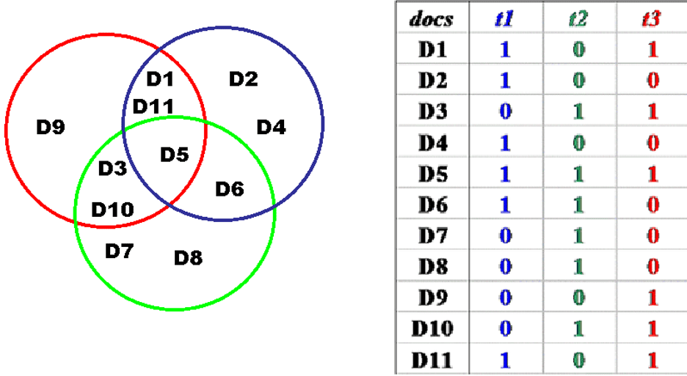
Boolean Document Representation: Terms Present or Absent
35

Slide 36
Relevance in the Boolean Model
Because terms are either present or absent, a document is either relevant or not relevant
But this is clearly flawed -- if a query is "a and b" the Boolean model retrieves only those documents that contain both of them, and treats documents that contain only a or only b as equally irrelevant
THIS IS EQUIVALENT TO SAYING THAT THE BOOLEAN MODEL HAS NO WAY TO REPRESENT TYPICALITY OR GRADED MEMBERSHIP IN A CATEGORY
36

Slide 37
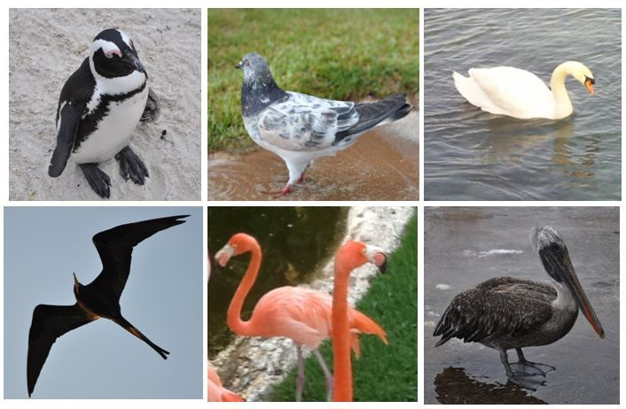
Gradience in Category Membership
Which bird is most typical of the category?
Least typical?
37

Slide 38
Motivating Term Weighting
The Boolean model represents documents as a set of index terms that are either present or absent
This binary notion doesn't fit our intuition that terms differ in how much they suggest what the document is about
We will capture this notion by assigning weights to each term in the index
38

Slide 39
The Vector Model of Document Description

Slide 40
Vectors
Vectors are an abstract way to think about a list of numbers
Any point in a vector space can be represented as a list of numbers called "coordinates" which represent values on the "axes" or "basis vectors" of the space
40

Slide 41
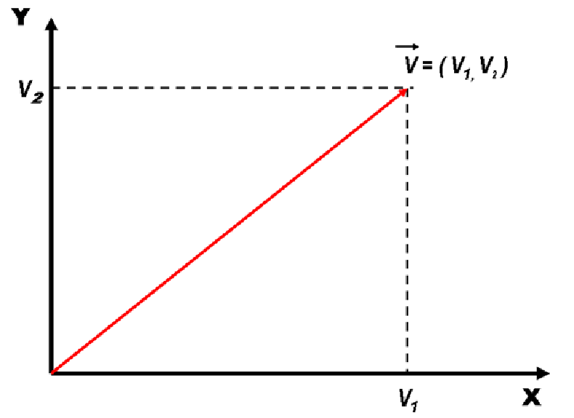
Vectors
41

Slide 42
Document Representation in the Vector Model
Documents and queries are represented in the same way as word or term vectors
Each dimension is the count of occurrences for a term
There is no representation of word order (sentence structure) in the vector - it is still just a BAG OF WORDS
42

Slide 43
Document Similarity in the Vector Model
Vector algebra provides a model for computing similarity between queries and documents and between documents because of assumption that "closeness in space" means "closeness in meaning”
How does this change the relevance measure?
Have we defined “similarity” or are we just hand-waving?
43

Slide 44
Defining Similarity
Some people say that similarity is a meaningless and "mostly vacuous" concept because there must always be some unstated description properties when two things are compared
Once similarity is defined in terms of specific properties and some metric for comparing them, there is nothing for a "similarity" mechanism to do
Defining similarity in some way based on properties is an implementation of which model of category membership?
44

Slide 45
Calculating Similarity in Vector Models
The similarity between a query and a document, or between two documents, is defined as the "inner product" of their vectors
The inner product of two vectors is the sum of the products of their overlapping terms (so similarity increases when they have more terms in common)
v1 = (3, 8, 4) v2 = (2, 3, 1)
(3, 8, 4) x (2, 3, 1) = (3 x 2) + (8 x 3) + (4 x 1) = 34
Other models define similarity differently. Next lecture!
45

Slide 46
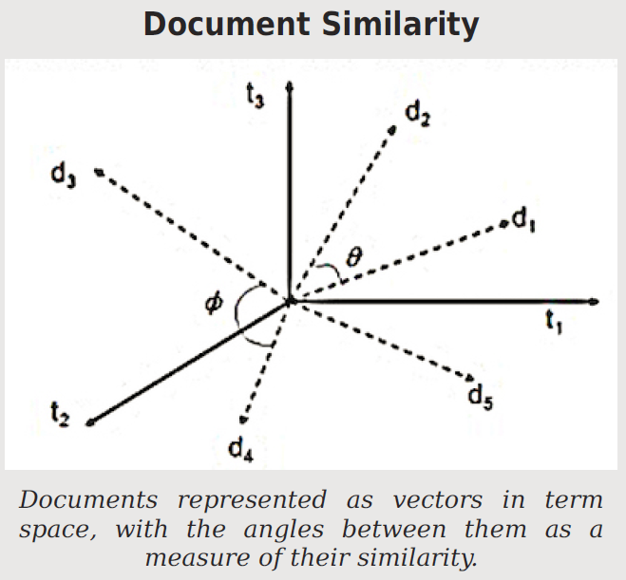
When document vectors are normalized to length 1, the cosine between them is a similarity measure that ranges from 0 to 1

Slide 47
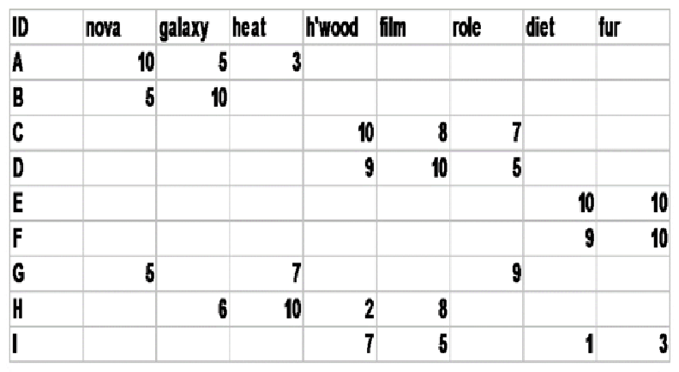
Document x Term Matrix
We can represent for each document the frequency of the words (or terms created by stemming morphologically related words) that it contains
47

Slide 48
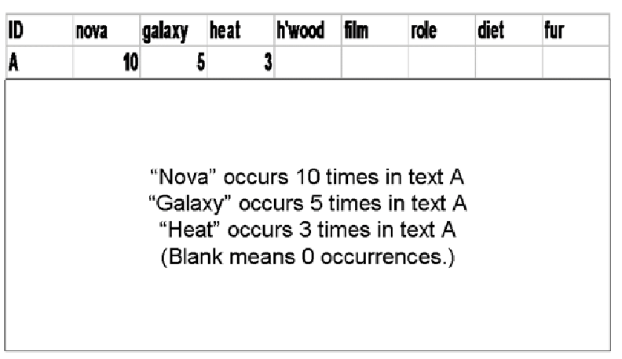
Document Vector
48

Slide 49
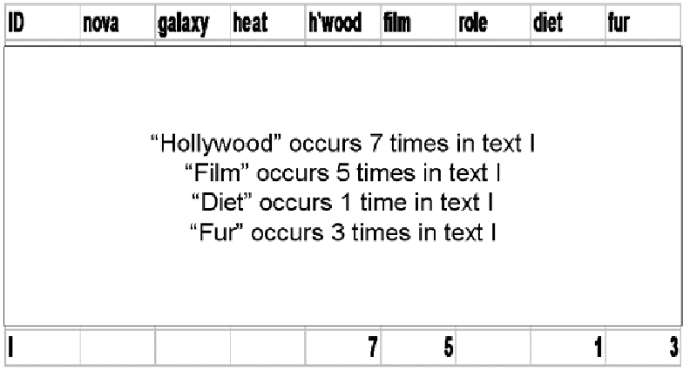
Document Vector
49

Slide 50
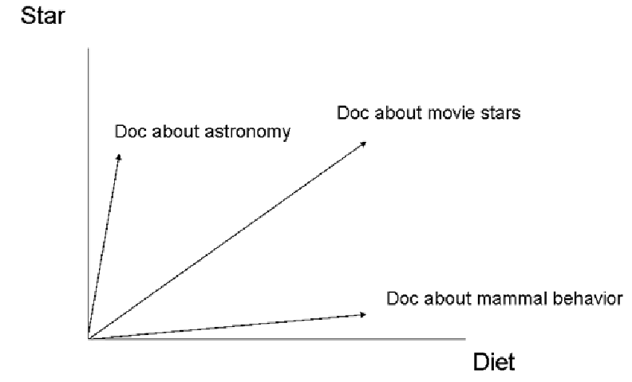
Documents in Term Space – 2D
50

Slide 51
Term Distributions as Document Descriptions

Slide 52
The Zipf Distribution
In any natural language, we can observe that:
A few items occur very frequently
A medium number of items have medium frequency
Very many items occur very infrequently (the “long tail”)
52

Slide 53
The Zipf Distribution
An approximate model of this distribution is the Zipf Distribution, which says that the frequency of the i-th most frequent word is 1/(i^a) times that of the most frequent word
Because of the huge range in frequency and the long tail, the distribution is often drawn on a log-log scale
53

Slide 54
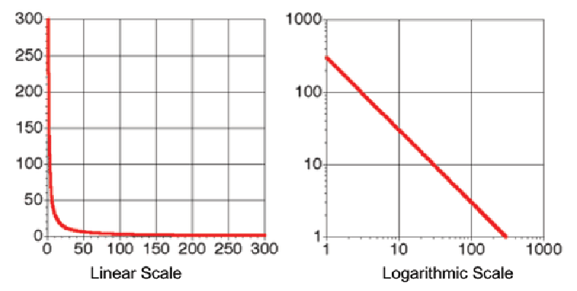
Zipf Distribution – Linear vs. Log Plotting
54

Slide 55
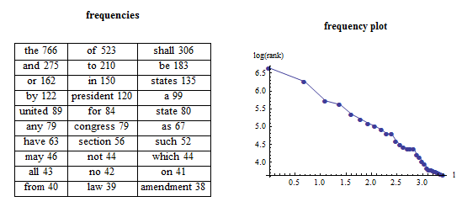
Zipf Distribution – US Constitution
55

Slide 56
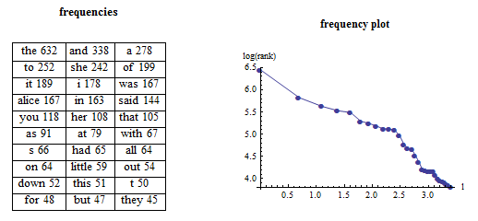
Zipf Distribution – Alice in Wonderland
56

Slide 57
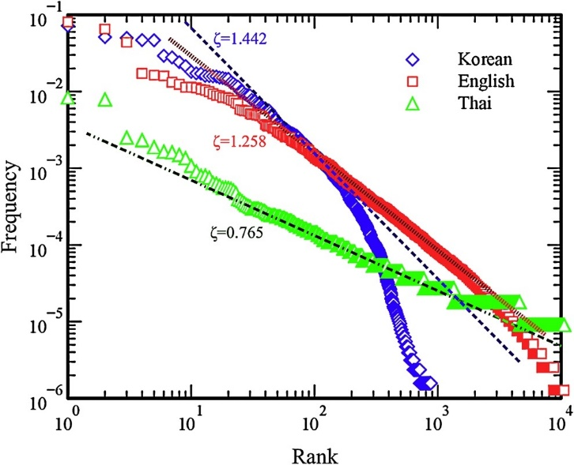
Zipf – Bible in 3 Languages
Mehri, A., & Jamaati, M. (2017). Variation of Zipf's exponent in one hundred live languages: A study of the Holy Bible translations. Physics Letters A, 381(31), 2470-2477.

Slide 58
TODAY’S MOST IMPORTANT SLIDES

Slide 59
Comparing Resource Descriptions
All information retrieval systems compare a description of a user’s needs with descriptions of the document resources that might satisfy them
“Relevant documents” are the category to which the search query and retrieved information (document) both belong
Likewise, any “classifier” whose purpose is to determine the category to which a resource belongs must compare the resource description with some description or representation of the category

Slide 60
What Words Best Describe a Document? (2)
For any large document collection, it is necessary to pre-process the text of documents to select / create a smaller set of terms that better represent them; in IR these are called the INDEX terms
This selection and processing creates a controlled vocabulary for describing the contents of a document collection
60

Slide 61
Selecting Index Terms
At this stage in text processing the text collection is represented as a set of stems or phrases
But not all of them should be kept; some will retrieve too many, and some too few documents
We can select better index terms if we analyze the frequency distribution of the words in the collection
61

Slide 62
The Boolean Model
The Boolean model represents documents and queries as sets of index terms that are either present or absent
This is a “bag of words” – no sentence structure or languageness remains
Term frequency is not represented in any way; terms are either present or absent
This enables comparisons between queries and document collections using set theory operations with Boolean algebra, making relevance a binary decision
62

Slide 63
Document Representation in the Vector Model
Documents and queries are represented in the same way as word or term vectors
Each dimension is the count of occurrences for a term
There is no representation of word order (sentence structure) in the vector - it is still just a BAG OF WORDS
63

Slide 64
Document Similarity in the Vector Model
Vector algebra provides a model for computing similarity between queries and documents and between documents because of assumption that "closeness in space" means "closeness in meaning”
How does this change the relevance measure?
Have we defined “similarity” or are we just hand-waving?
64

Slide 65
The Zipf Distribution
In any natural language, we can observe that:
A few items occur very frequently
A medium number of items have medium frequency
Very many items occur very infrequently (the “long tail”)
65

