Slide 1
CogSci 150 “Sensemaking and Organizing” Spring 2021
Robert J. Glushko
glushko@berkeley.edu
29 April 2021
28) Computational Categorization and Classification

Slide 2
Course Endgame
TODAY (4/29): “Computational Classification”
TUESDAY 5/4: Case Study Presentations
THURSDAY 5/6: Case Study Presentations
FRIDAY 5/7: Last Day for “Free Read” of Case Study Report (comments back by 5/8)
MONDAY 5/10: Case Study Reports Due

Slide 3
Distinguishing Categorization and Classification
FLASHBACK
Categories are EQUIVALENCE CLASSES - sets of resources, processes, and events that we treat the same
A Classification (noun) (or Classification Scheme) is a SYSTEM OF CATEGORIES, ordered according to a PRE-DETERMINED SET OF PRINCIPLES and used to organize a collection of resources
Classification (verb) is the process of systematically assigning resources to categories in a classification system
3

Slide 4
Classifiers
A COMPUTER SCIENCE DEFINITION:
A classifier is a system whose input is a vector of discrete or continuous feature (or attribute) values and whose output is the name of the class
This vector might be the description of a document, an image, a person, a molecule, just about anything
If the “Classifier” is a person determining what type of thing something is, does this definition still fit?
4

Slide 5
Classifiers - Examples
Classifiers for text identify its language, topic, author, sentiment, or other characteristics
Recommendation systems identify “matching” resources in different categories
If two people tend to agree on their movie ratings, then if one of them likes a new movie, you can recommend it to the other
Classifiers can identify categories of people who are likely or not likely to do something (“behavior prediction”)
5

Slide 6
Classifying Classification Tasks
Binary classification – example: spam or not?
Multi-class
1 of M – where does this resource fit into some set of categories
Example: in which existing Amazon or Spotify category does this belong?
N of M – what topic or keyword from some controlled vocabulary do we apply to this resource? We can consider this as multiple binary classifications (does this topic fit or not?)

Slide 7
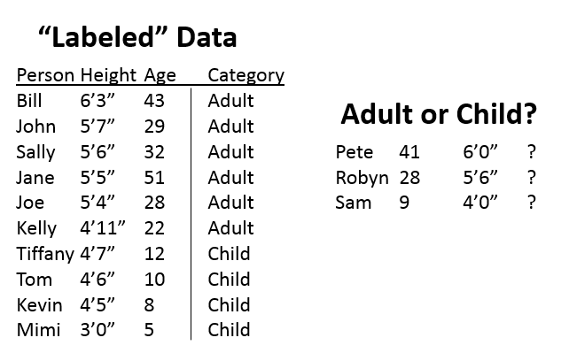
A Simple 2-Category Classification Problem
Here we have some “labeled data”-- a dataset with 2 features for each person being classified and the category each belongs to.
We then are given 3 new people with their feature values and our task it the classify them as adult or child.
Why is this a “simple”
classification problem?

Slide 8
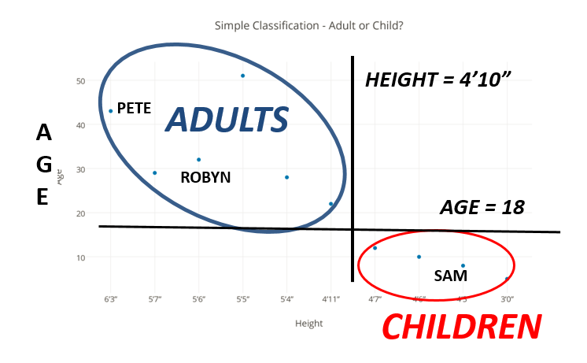
Why This Is a “Simple” Classification: You Don’t Need Labeled Data or Computation to Distinguish the Categories
Some classification tasks are simple because the categories are “far apart” (or “carved at the joints”) and the resource properties are easy to understand

Slide 9
Computational Categorization

Slide 10
Categories from Descriptive Statistics (1)
The simplest way to create categories is to compute descriptive statistics and histograms for property values
These reveal if there is any useful or meaningful variation that could be the basis of an organizing principle
Example:
If I measured the heights of everyone in this class, there is enough variation to make it possible and perhaps useful to arrange you by height (if I’m trying to create a basketball team)
If I measured the diameter of your head, there probably isn’t enough variation to be useful for anything

Slide 11
Categories from Descriptive Statistics (2)
The interpretability of the categories is limited by the levels of measurement embodied in the property value, which determines how much quantitative processing makes sense
Even for nominal level data that has no intrinsic order (values are labels or identifiers), it can be useful to organize resources according to the frequency of specific property values; the MODE is the most frequently occurring one

Slide 12
Categories from Descriptive Statistics (3)
If property values are ordinal level data, resources can be organized from the lowest to highest property value; the middle value of a list sorted this way is the MEDIAN
The median divides the values into two categories with the same number of members; we can generalize this idea to create any number of equal-size categories:
Percentiles(100 categories), deciles (10), quartiles (4)
You can also create named categories from ordinal properties (low, moderate, high cost; new, almost new, old, very old…)

Slide 13
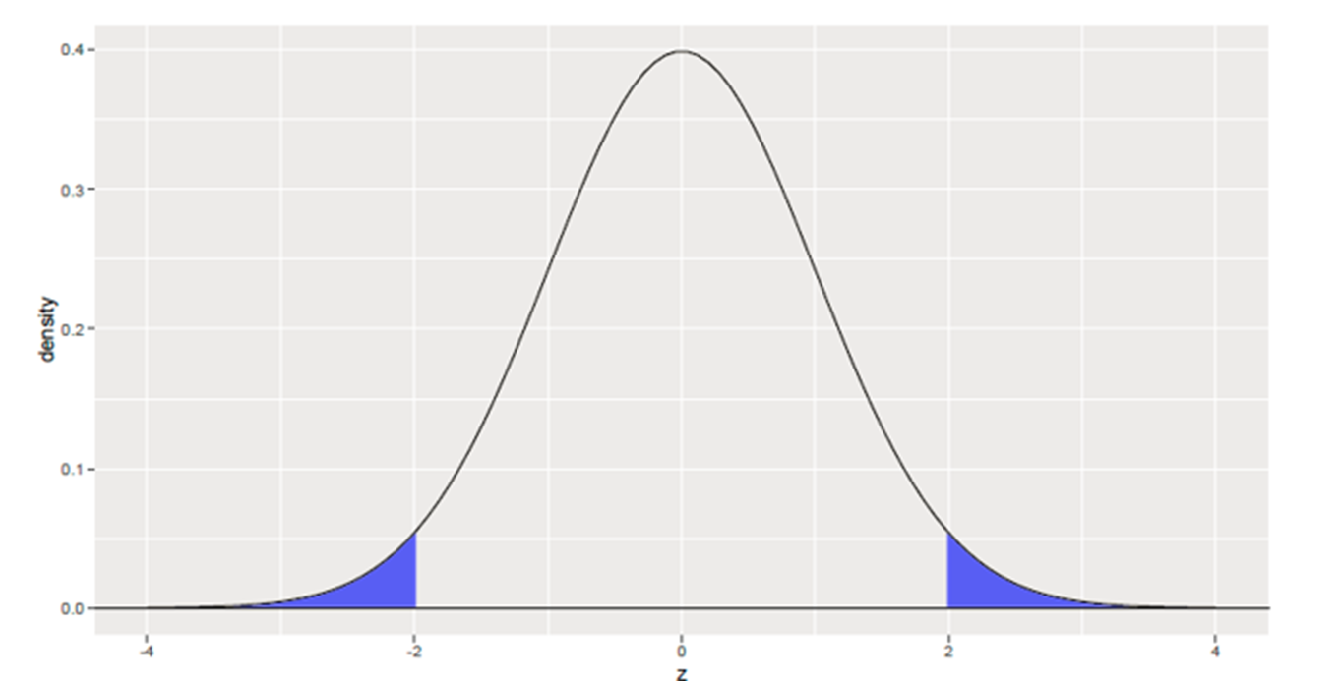
Categories from Descriptive Statistics (4)
If property values are interval level data, it is meaningful to calculate the distance between values, and the MEAN or AVERAGE is the value for which the sum of the absolute distances to each other value is 0
We can create resource categories using the probability of their property values (e.g., as measured in STANDARD DEVIATION)
“Generic” Labels:
Values with prob < .05
are “Outliers”
“Six Sigma” defects occur
with a prob < .00066

Slide 14
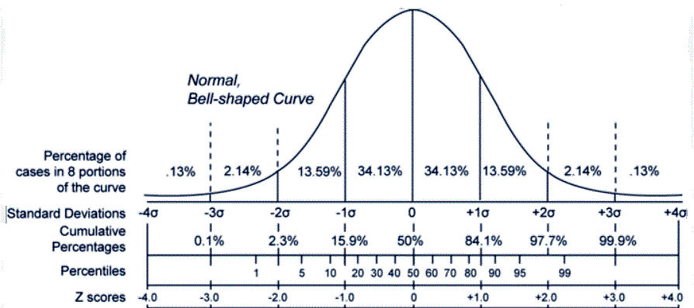
“Unlabeled” Categories from Descriptive Statistics
14

Slide 15
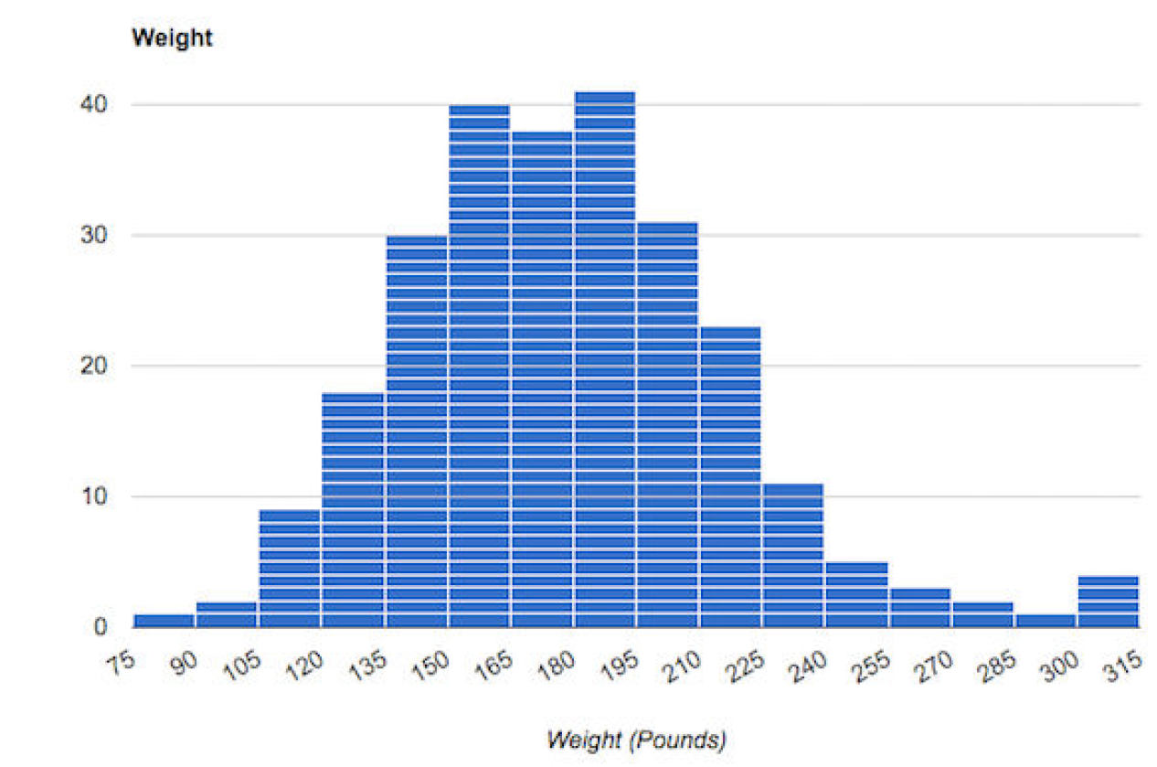
ALWAYS LOOK at the Data!
Descriptive statistics are useful, but you should always look at the data because that shows things not revealed in the statistics
Bimodality -> two categories of observations?
End of range anomaly -> measurement limitation?

Slide 16
Anscombe’s Quartet
All 4 datasets have identical x and y means and variances

Slide 17
Categories from Simple Descriptive Statistics Can be (Intentionally) Biased
You (or someone else) chose a unit of analysis (“What resources are being organized?”) for which the property values are measured
Changes in category granularity can introduce large changes in the values of descriptive statistics
Put another way… you can often devise a category system for which your descriptive statistics can tell a biased story

Slide 18
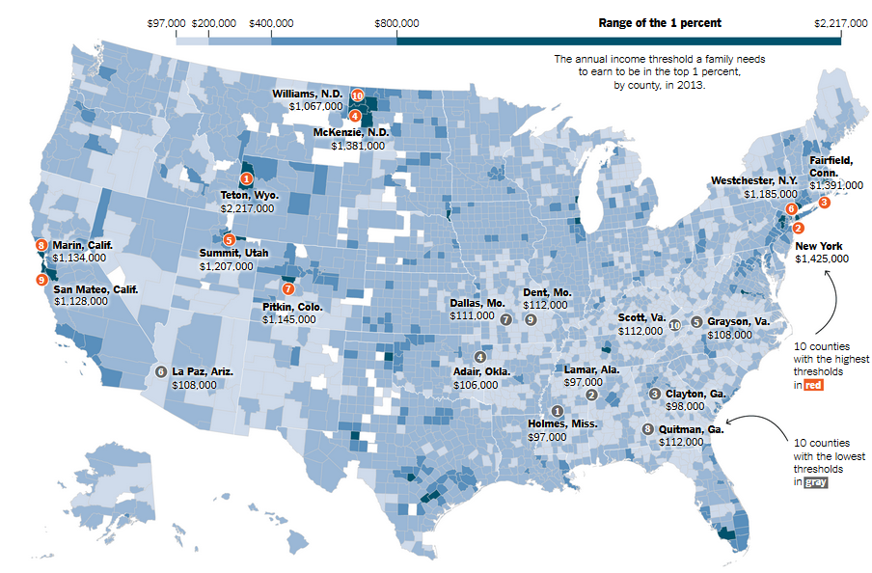
Income Categories: Find the “1-percenters” in the US

Slide 19
“Income Inequality” Categories
In some parts of the US, you need to make >$2M to be in the 1% (Jackson Hole, Wyoming)
In Mississippi the 1% category is less than $100K – less than the MEDIAN salary in the Bay Area
In the world as a whole, a $47K annual income would make you a 1-percenter
Which makes the people in the US complaining about income inequality seem a little spoiled and whiny!

Slide 20
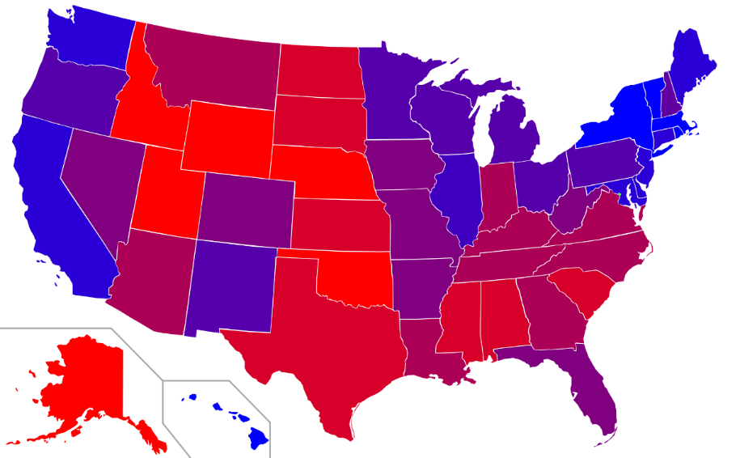
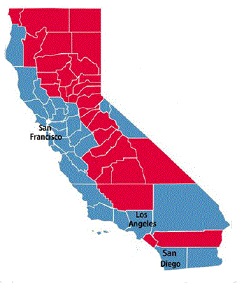
“Choropleth Maps” -- Red and Blue States vs. Red and Blue Counties
Changing the category granularity tells a very different story
California - a “Blue State” (last 4 presidential elections)
But only the urban counties and Lake Tahoe are actually Blue

Slide 21
Similarity

Slide 22
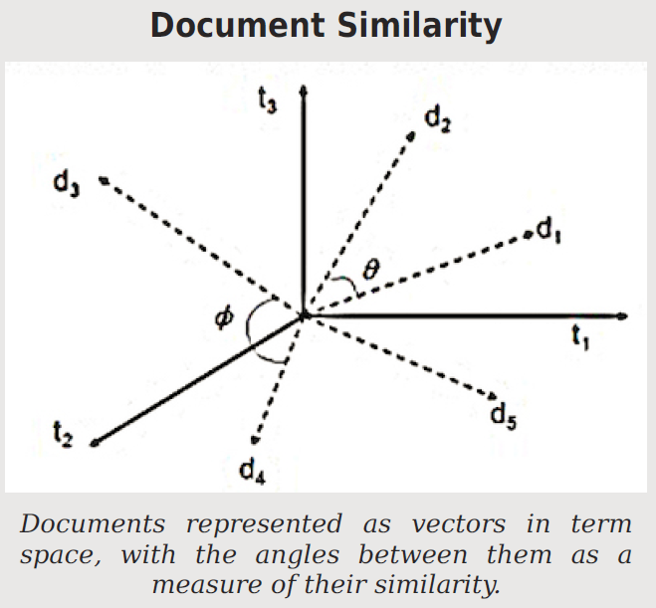
FLASHBACK: The Document Vector Model
When document vectors are normalized to length 1, the cosine between them is a similarity measure that ranges from 0 to 1

Slide 23
Why Google Invented “Page Rank”
The first web search engines in the early 1990s used document vectors and computed similarity/relevance using cosine similarity because this works well in “controlled” library and commercial document management systems
But for short queries, this method highly ranks short documents that contain little more than the query terms… which enabled “search engine bombing”
Google added “page ranking” to its relevance calculations to bias results toward web pages that were highly linked to (not likely to be the trivially short ones used in “bombing”)
23

Slide 24
Defining Similarity
Some people say that similarity is a meaningless and "mostly vacuous" concept because there must always be some unstated description properties when two things are compared
Once similarity is defined in terms of specific properties and some metric for comparing them, there is nothing for a "similarity" mechanism to do
Defining similarity in some way based on properties is an implementation of the qualitative notion of family resemblance
24

Slide 25
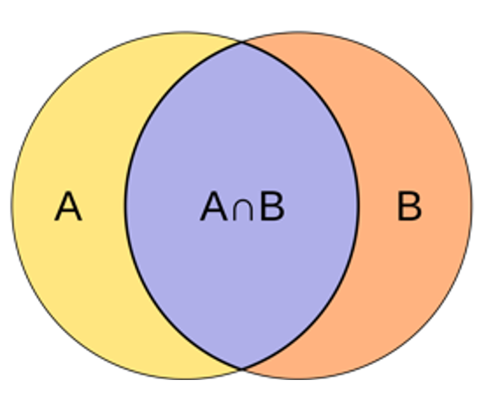
Jaccard Similarity: Proportion of Shared Features
If resources are represented as sets of properties, some might be shared, and others are distinctive and not shared
Since this is a proportion, the values range from 0 (no shared features) to 1 (all features are shared)

Slide 26
Jaccard Similarity
Jaccard is the simplest property-based similarity measure
It makes the most sense when features are binary, either present or absent
Jaccard can be used with document vector models if terms aren’t weighted by frequency

Slide 27
STOP AND THINK: HOW SIMILAR ARE A AND B?
CASE 1
Object A
CASE 2
Object A
P1
P2
P9
P4
P2
P3
P5
P1
P3
P4
P7
P6
P11
P5
P6
P8
P10
P7
P12
P13
Object B
Object B

Slide 28
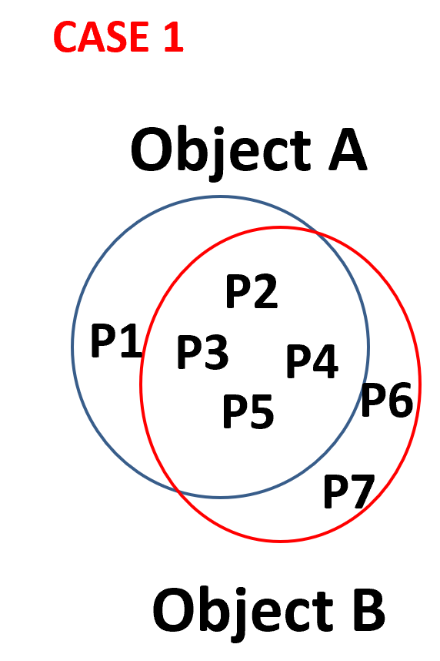
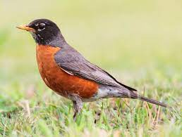
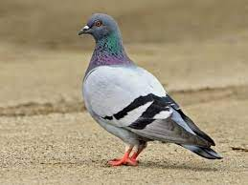
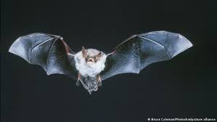
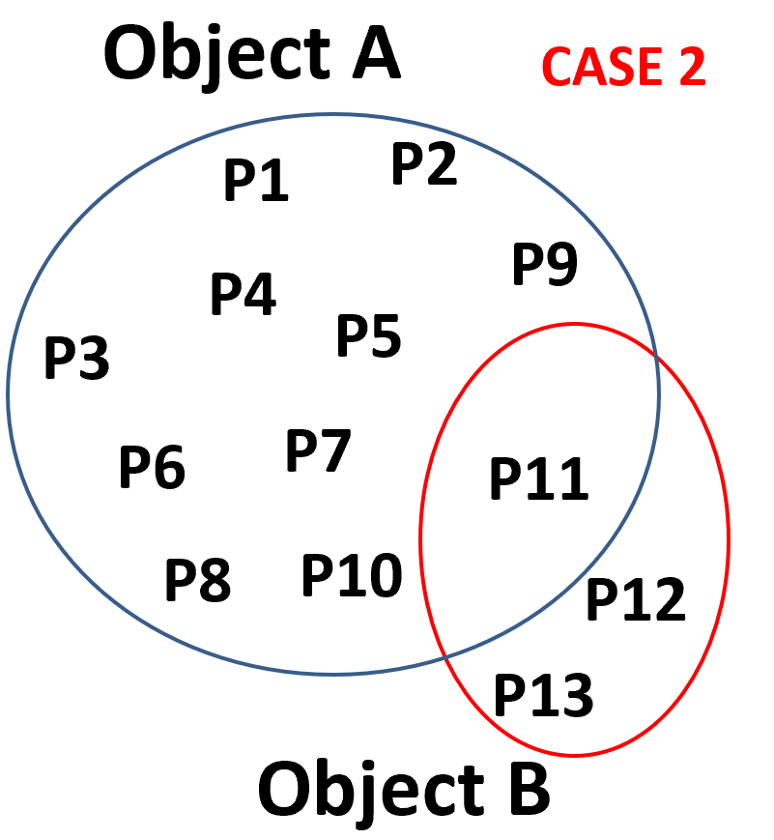
Jaccard Similarity Example
Case 1: A is a robin, B is a pigeon, very similar birds, share the characteristic bird features with just a few small differences; similarity is high: 4/7
Case 2: A is a robin; B is a bat – share the flying feature but nothing else; similarity is low (1/13)
They have few shared features, so the similarity calculation is dominated by their distinctive features

Slide 29
A “Jaccard-like” Heuristic for Designing “Semantically Balanced” Categories
In a good system of categories, the categories at the same hierarchical level (co-hyponyms) have the same degree of abstraction or breadth
A heuristic for doing this is to ensure that the pairwise similarity is about the same for all category pairs
Musical Instruments
Woodwinds
Violins
Cellos
Musical Instruments
Woodwinds
Strings
Violins and cellos are much more similar to each other than they are to woodwinds
29

Slide 30
STOP AND THINK: Is Similarity a Symmetric Relationship?
The Jaccard measure uses a very simple concept of similarity and assumes that it is a symmetric relationship
Does “A is similar to B” (or “A is like B”) mean the same thing as “B is similar to A” (or “B is like A”)?
30

Slide 31
Similarity Can be Asymmetric
When we compare an A with a B with a statement about similarity, we often order A and B to make the more salient or “feature complex” one as the referent
“the portrait resembles the father” NOT “The father resembles the portrait”
The more salient resource is judged less similar to the less salient one than vice versa
North Korea is judged more similar to China than China is judged similar to North Korea
Jaccard similarity can’t handle asymmetry because it treats all features as equally important
31

Slide 32
Tversky’s Contrast Model
Tversky proposed a more general measure of similarity that considers both shared and distinctive features
Each of these three sets can be weighted differently, unlike Jaccard where they are equally weighted
This model explains why similarity judgments are not always symmetric (cf. ANCHORING BIAS in T & K, 4/8)
32

Slide 33
Tversky Asymmetric Similarity
A description of China requires more properties than a description of North Korea
The two countries have a small number of properties in common
Because the distinctive features of China are more important than those of North Korea, their greater weighting reduces the similarity when China is compared to NK rather than vice versa

Slide 34
Geometric or Distance Models of Similarity
If the property values are metric, a resource can be represented as a point in N-dimensional space, with property values as the coordinates
We can measure the differences between the values on each shared property separately
Similarity is inversely related to distance computed as
The most common distance model is the Euclidean one. What exponent does it use? What happens if we use other exponents?
34

Slide 35
What is the exponent in the city block distance function?
Do you see how this simply adds the distances on each dimension?

Slide 36
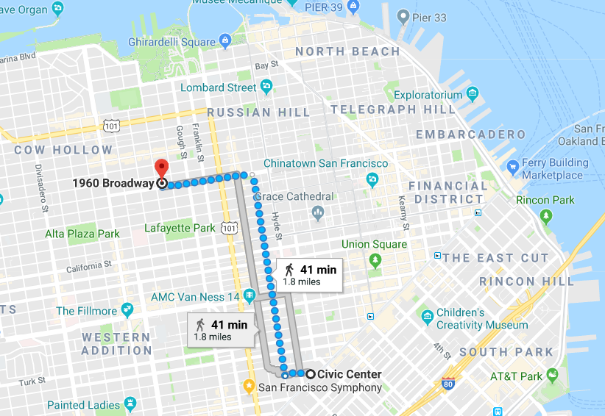
“City Block” Distance Measurement

Slide 37
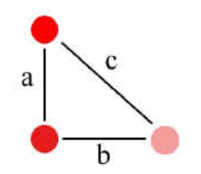
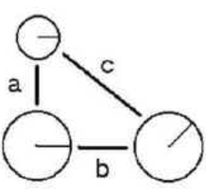
Fused vs. Separable Properties
Properties of color and saturation are fused, and Euclidean metrics better fit similarity judgments
Circle size and radius angle are separable properties, and City Block metric better fits similarity judgments

Slide 38
Infinite Exponents
The Chebyshev function defines the distance between two items as the difference of their values on the single property with the greatest difference (this treats the exponent as infinite)
Two items could have similar or even identical values on most properties, but if they differ much on just one property, they will be treated as very dissimilar
People often use this function… or something like it… in their social behavior. We can make an analogy to stereotyping or prejudice when a person is just like you in all ways except for the one property you view as nega­tive, which then becomes the only one that matters to you

Slide 39
Zero Exponents
At the other extreme, if the exponent is reduced to zero, this treats each proper­ty as binary, either present or absent, and the distance function becomes a count of the number of times that the value of the property for one item is dif­ferent from the value for the other one
This is called the “Hamming distance”

Slide 40
Transformational Models of Similarity
Transformational models assume that the similarity between two things is inver­sely proportional to the complexity of the transformation required to turn one into the other
The simplest transformational model of similarity counts the number of properties that would need to change their values
The “edit distance” between two strings is the number of insertion, deletion, and sub­stitution operations needed
Book -> Bob : delete “o”, substitute “b” for “k” (distance = 2)
40

Slide 41
Structure Models
Geometric and Feature models don’t work well when comparing things that have lots of internal hierarchical or relational structure
In these cases, comparing matching features is insufficient; you need to compare features with similar roles in structures or relationships
Similarity is like analogy
In analogies, relationships are shared
In similarity, both relationships and features are shared
41

Slide 42
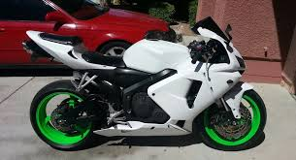
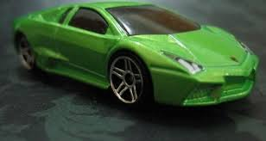
Common Feature But Low Similarity
These two things share the feature “green” but this matching feature does not increase their similarity much because the motorcycle’s wheels do not correspond to the car body

Slide 43
Structure Models are Asymmetric
Structural comparisons can often be made in both directions
Each direction implies a different meaning
“A man is like a tree” -> a man has roots
“A tree is like a man” -> a tree has a life history
43

Slide 44
Computational Classification

Slide 45
Why Computational Classification?
Some classification tasks are hard because the categories are “close together” and the resource properties or features involved are not easy to understand and use
Some classification tasks are inherently difficult:
they require feature selection or extraction from a very large candidate set
the algorithms by which the classier learns and uses the features are complex
Sometimes simple classification tasks can't be done by people at the needed scale or speed

Slide 46
Creating a Classifier
A (machine) learner takes a set of pairs of inputs and outputs and devises a mapping between them
If the outputs are “labeled” or categorized already, this is SUPERVISED learning
If the learner has to discover the mapping by detecting the “interesting patterns” in the data, this is UNSUPERVISED learning (also called “statistical pattern recognition”)
Most human learning is unsupervised; even when labels are provided, they rarely cover more than a fraction of the possible examples of the category
The goal of every classifier is to be able to generalize beyond the examples used to train the classifier

Slide 47
The Classification Process
Train and test
after you've chosen features and an algorithm, you let it "learn" - adjusting the weights it gives to each feature....
Classify new examples
Analyze the results
Modify the training data, adjust the learning algorithm, and train again

Slide 48
Three Parts in Every Classifier
Representation
the formal language used by the classifier: what kind of model can the learner learn?
Evaluation
the “objective” or scoring” function: how good is the classifier?
Optimization
how does the learning algorithm search for a better solution?

Slide 49
ML approaches / models
These differ “in how they learn” and in “what they learn” – different assumptions about the domain, how clear the boundaries are between categories
LOGICAL – category membership can be determined using understandable rules about feature values
Decision trees
GEOMETRIC – resources are represented in a multidimensional feature space and concepts like distances, lines, and planes are used to create the boundaries between categories
Nearest-neighbors, Support vector machines
PROBABILISTIC – features have probabilities; goal is to estimate the probability of category membership from the probability distributions for the features
Naïve Bayes (called “naïve” because it makes the assumption that features are independent, even though they aren’t)
This taxonomy comes from Flach (2012), Machine Learning

Slide 50
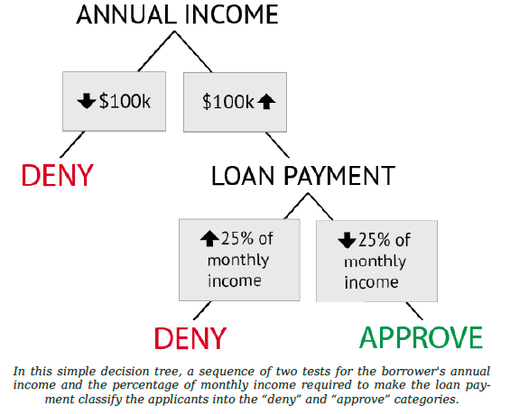
Simplest Computational Classifier:
Rule-Based Decision Tree
TDO Figure 7.1
How is this decision tree using the concepts of classical categories?

Slide 51
Simplest Computational Classifier:
Rule-Based Decision Tree
TDO Figure 7.1
Should you give this person a loan?
We describe each person with two features, annual income and the amount of the loan payment they would have as a percentage of their income.
We test these feature values in succession, so there’s a hierarchy of binary classifiers.
Only people who pass both tests are members of the “approve” category and can get a loan

Slide 52
Unsupervised Learning: Clustering
Clustering is an unsupervised learning method to automatically group related content or resources by discovering the correlations between features or properties of the things to be classified (usually via computations that maximize similarity within categories and minimize it between them)
Items are represented as a vector of property values or probabilities of property values, which enables similarity to be calculated using some kind of distance function
Similarity is iteratively recalculated each time an item is added to a cluster

Slide 53
Clustering Search Results
Search result clustering can be quite effective when users enter generic or ambiguous terms (such as apple) or when the dataset contains a disparate set of categories
Labels take on more significance, since users will likely treat them like facets to make decisions about how to further navigate the result set

Slide 54
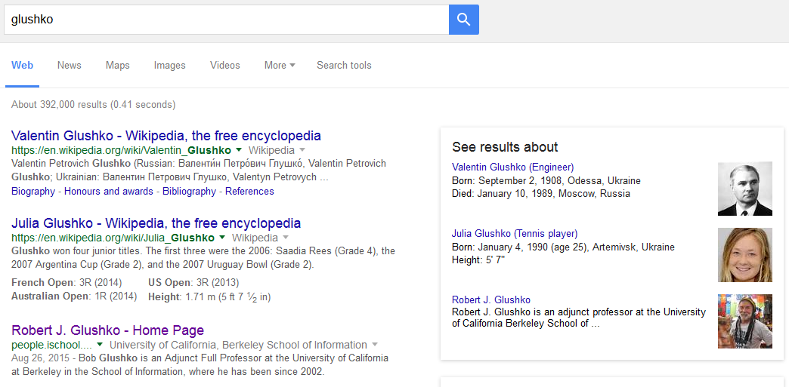
Categorized Search Results

Slide 55
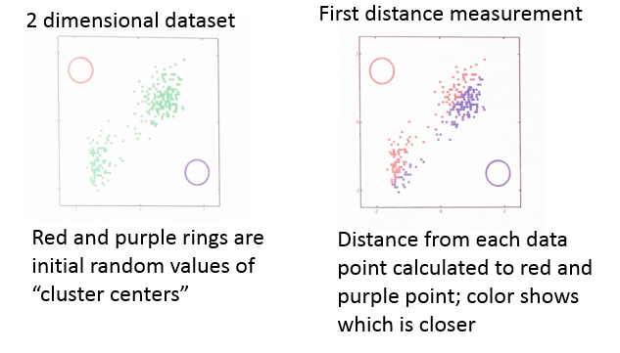
K-Means Clustering Example
From Murphy, “Machine Learning”, p 353
(The most popular unsupervised learning algorithm, uses iterative similarity recalculation)

Slide 56
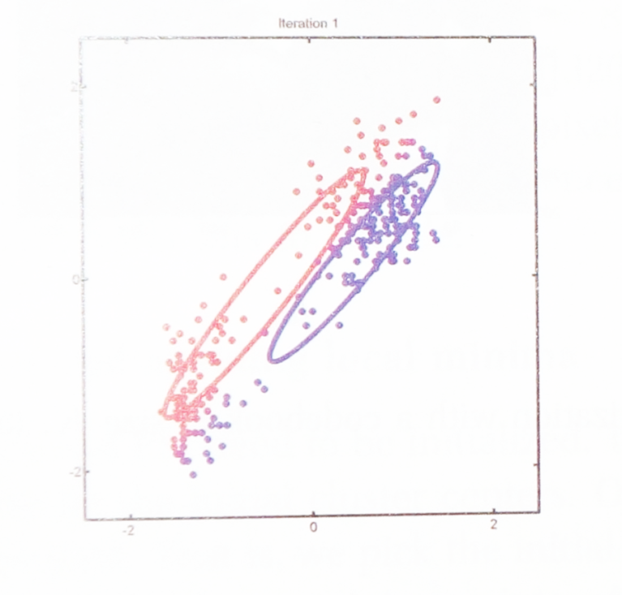
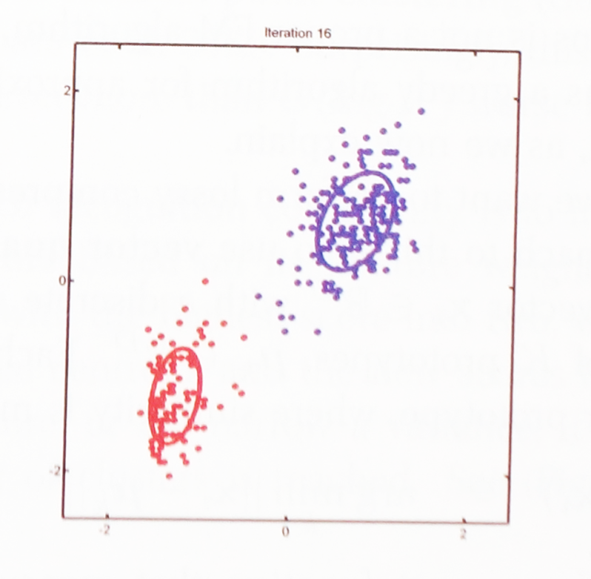
Clustering Example
From Murphy, “Machine Learning”, p 353
First recalculation
After 16 recalculations
Average of points assigned to each color becomes new value of parameter
The parameters have converged to clearly identify the centers of the red and purple clusters

Slide 57
If you like to study algorithms… otherwise just skip this slide

Slide 58
In the previous example I slipped something by you, which is that I just assumed there were two clusters, because that’s what the data plot seemed to be showing. Many clustering algorithms find as many clusters as you tell it to look for (that’s the k).
So how would you find the value of k that fits the data best?

Slide 59
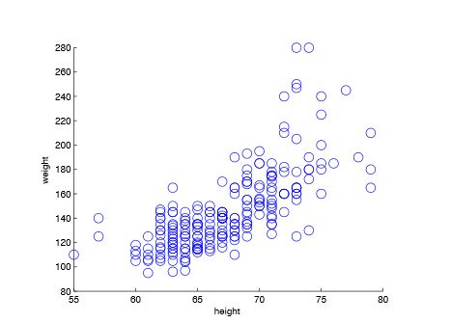
How Many Categories Here?
Height and weight dataset

Slide 60
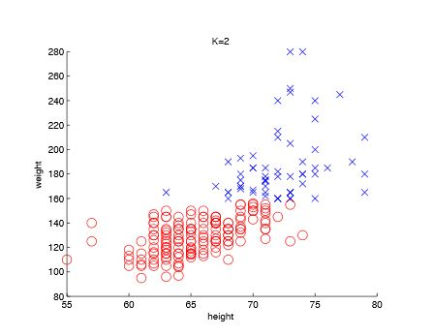
K=2
We know our sample contains Men and Women
Try K=2 and see if that creates useful categories

Slide 61
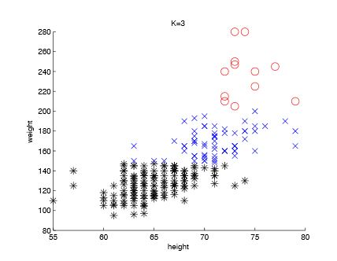
K=3
But if we know that we have women, men who are not basketball players, and men who are basketball players in the sample, try k=3

Slide 62
Another commonly used clustering algorithm is called hierarchical clustering – it creates a tree structure of categories that are progressively more abstract – doesn’t label them

Slide 63
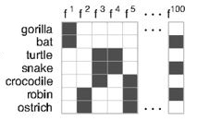
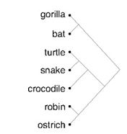
Hierarchical Clustering Example
Charles Kemp, and Joshua B. Tenenbaum PNAS, “The Discovery of Structural Form” 2008;105:10687-10692
Start with each item in its own cluster, merge the two most similar clusters, recalculate similarity between clusters, do it again… Builds a tree from the bottom up.

Slide 64
After We’ve Clustered, We Classify
Algorithms that create clusters or categories of similar items can be later used as classifiers by using the same similarity measures to compare the unclassified items against items that are labeled by category
Different approaches:
Compare against prototypes of each category, an average of all the properties of all the category members
Compare against examples that are close to the center of each category (“nearest neighbors”)
Compare against the examples that are near category boundaries (“support vectors”)

Slide 65
Text Classification using Zipf Distribution & Similarity

Slide 66
Classification using N-Grams
A text can be sliced into a set of overlapping N-grams, an N-character contiguous “slice”
The word “TEXT” can be composed of these N-grams:
Uni-grams: _, T, E, X, T, _
Bi-grams: _T, TE, EX, XT, T_
Tri-grams: _TE, TEX, EXT, XT_, T__
Quad-grams: _TEX, TEXT, EXT_, XT__, T___
(The Google Books “N-gram viewer” enables the “quantitative analysis of culture” via analysis of usage trends for words and grammatical constructions)

Slide 67
N-Gram Frequency in European Languages
The highest frequency N-grams are generally single characters, function words, and the most common prefixes and suffixes
(Grefenstette, “Comparing two language identification schemes,” 1995)

Slide 68
Identifying a Language
The N-grams in collections of documents from known languages are arranged in decreasing frequency (or probability) order (cf. Zipf’s Law)
The same representation is created for a document in the unknown language
The document N-gram vector is compared to the N-gram vectors for each language, and the nearest vector identifies the document’s language

Slide 69
Sensemaking & Organizing on Machine Learning & Computational Classification

Slide 70
The S & O Perspective on the Supervised Learning process
Specify classes (categories)
How many classes should there be? What biases does the system embody? What is the “warrant” for the classes?
Label examples
Are the examples representative? How are they selected? A larger training set might discover more classes.
Who does the labeling? Can you find enough experts to label a large enough training set? Is the labeling process reliable?
Extract features / Choose a classifier algorithm
How are the features that are identified influenced by the system of classes? More classes means that more features will be needed, but they might be less interpretable

Slide 71
The S & O Perspective on the Machine Learning product
One important way in which ML approaches differ is the extent to how the classifier works can be interpreted in by people
For some classification problems it might not matter (e.g., predicting the weather), but for others interpretability could be required by law, by common sense, or by ethical guidelines
Many supervised learning techniques are not interesting from a S&O perspective because they just trying to do what people do at greater speed and scale and don’t provide new insight
On the other hand, unsupervised learning programs that try to discover categories can provide new insights
Likewise, approaches that reduce the dimensionality of resource description can provide insight

Slide 72
EPILOG

Slide 73
The Course in One Slide
When something "makes sense” or " is organized” we are imposing or discovering order in the arrangement of concepts, events, or resources of some kind.
Sensemaking and organizing are fundamental human activities that raise many multi- or trans-disciplinary questions about perception, knowledge, decision making, interaction with things and with other people, values and value creation.

Slide 74
Plan for the Course
We can analyze sensemaking and organizing from four interrelated perspectives:
As an individual (psychology and philosophy)
As a member of a social, cultural, or language community (linguistics and sociology)
In institutional contexts (law and business)
In data-intensive or scientific contexts (statistics, computer science, info visualization).

Slide 75
This is NOT the end of S&O
It IS the end of my lectures: 1000+ pages of assigned reading, many assignments, 26 class meetings
But how you think and talk about cognitive science, information, sensemaking, and organizing has changed immensely
(I hope) this transformation will shape the remainder of your Berkeley experience and the rest of your personal and professional lives
Thank you for giving me the privilege of helping with this transformation
75

