Slide 1
CogSci 150 “Sensemaking and Organizing” Spring 2022
Robert J. Glushko glushko@berkeley.edu
18 January 2022
1) Course Introduction;
the Concept of the “Organizing System”

Slide 2
Outline
Introducing the Teaching Team
Introducing Sensemaking and Organizing
Introducing the Course
The Discipline of Organizing
Motivation
Core Concepts
Course Policies and Administrivia

Slide 3
My Lecture Notes
I have always used lots of slides with extensive notes with photos and graphics
In Zoomland, students told me it was harder to take notes, so I made my lecture notes even more detailed than before
And since we’re in Zoomland for at least a few weeks I will continue to do it
You don’t have to frantically type… trust yourself to listen and use my slides for review
They will ALWAYS be linked in the syllabus before each class in the lecture number and date [ ]

Slide 4
Introducing The Teaching Team

Slide 5
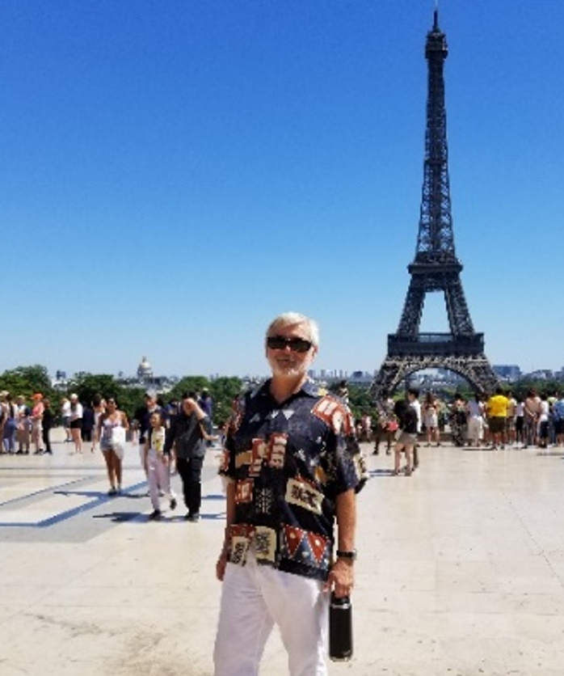
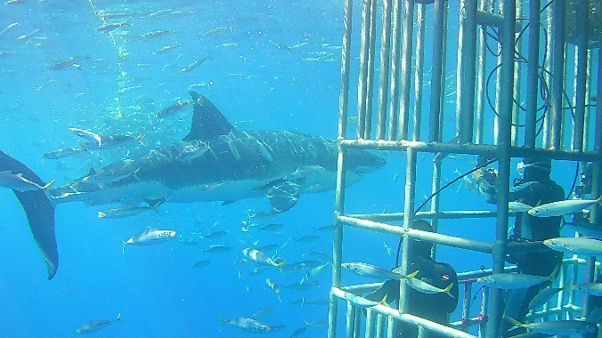
The Teaching Team: Bob Glushko
Intellectual roots in Psychology, Software Engineering, and CogSci (UCSD PhD)
Spent 20+ years in industry R&D and as entrepreneur (doing a lot of applied CogSci as co-founder of two start-ups)
“Retired” from Silicon Valley to Berkeley in 2002
Until 2017 on the School of Information faculty
Joined the CogSci program faculty in 2017
Hobbies are scuba diving (350 dives) and travel (75 countries)

Slide 6
The Teaching Team: Aurum Kathuria

Slide 7
Introducing the Students
You are a very diverse group in interests and experience
…details to follow

Slide 8
Introducing Sensemaking and Organizing

Slide 9
The Course in One Slide
(course catalog description)
When something “makes sense” or “is organized” we are discovering or imposing order in the arrangement of concepts, events, or resources of some kind
Sensemaking and organizing are fundamental human activities that raise many multi- or trans-disciplinary questions about perception, language, knowledge, decision making, and interaction with things and with other people

Slide 10
Stop and Think… What is the relationship between the concepts of Sensemaking and Organizing? Are they synonyms? Or is organizing a subset of sensemaking?
Sensemaking {and, or, vs.} Organizing
SENSEMAKING: Making sense of, or giving meaning to something, especially observations or experiences
ORGANIZING: Intentionally imposing order and structure to create capabilities or enable interactions

Slide 11
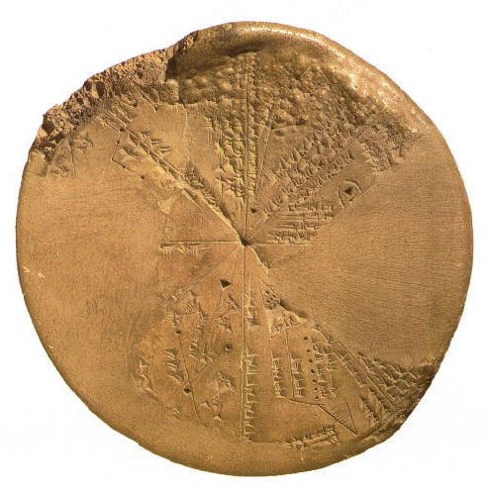
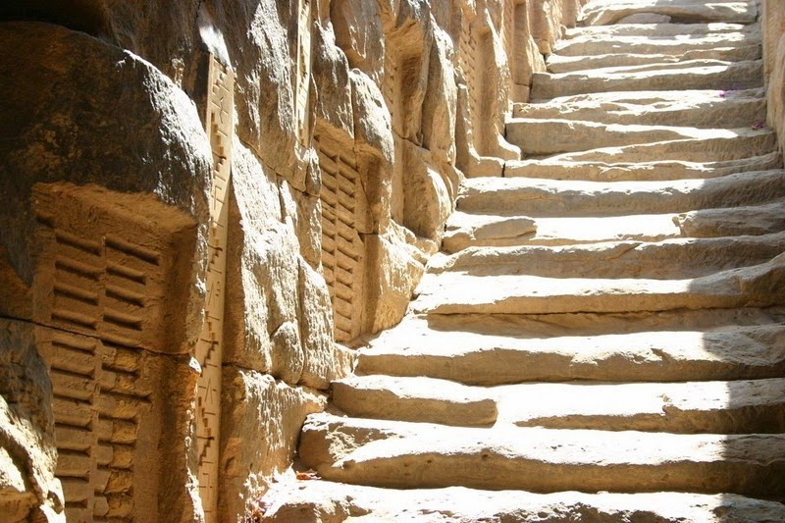
People Have Long Tried to “Make Sense”
For thousands of years, even before the invention of written language, people have systematically collected things, information about those things, and observations of all kinds to understand how their world works
Babylonian Astronomy
Ancient Egyptian Hydrology – Nile Flood Records

Slide 12
Stop and Think… If “to understand how their world works” is the reason for sensemaking, we need to explain what that means What sorts of astronomical and terrestrial events would ancient humans have noticed? (DO YOU NOTICE THEM TODAY?) How did ancient humans know when they understood these events? Specific example – how did ancient Egyptians know that they understood the flooding of the Nile?

Slide 13
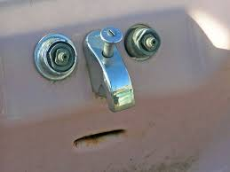
Automatic Sensemaking
Some sensemaking is automatic, done by hard-wired brain mechanisms that simplify and interpret sensory and perceptual input; humans are pattern-finders
Gestalt
Principles
Pareidolia
Michotte Causality

Slide 14
Sensemaking in infants is driven by “statistical learning” to identify which acoustic differences matter in their native language, using frequency and transitional probability to learn words from speech

Slide 15
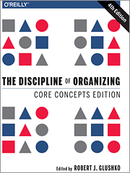
Organizing
Intentionally imposing order and structure to create capabilities or enable interactions
WHAT is being organized?
WHY is it being organized?
HOW – what “organizing principles" are used?
“TDO” from now on

Slide 16
What We Organize…
Libraries, museums, business information systems, scientific data… and other institutional resource collections
Different types of documents
Personal information and artifacts of all kinds in our kitchens, closets, personal computers, smartphones…
People
These are clearly different types of things being organized, but what do they have in common?
16

Slide 17
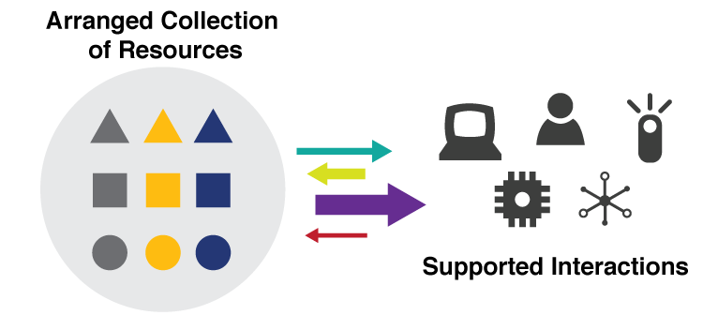
An “Organizing System”
A collection of resources intentionally arranged to enable some set of interactions
17

Slide 18
Are Sensemaking and Organizing Fundamentally Different?

Slide 19
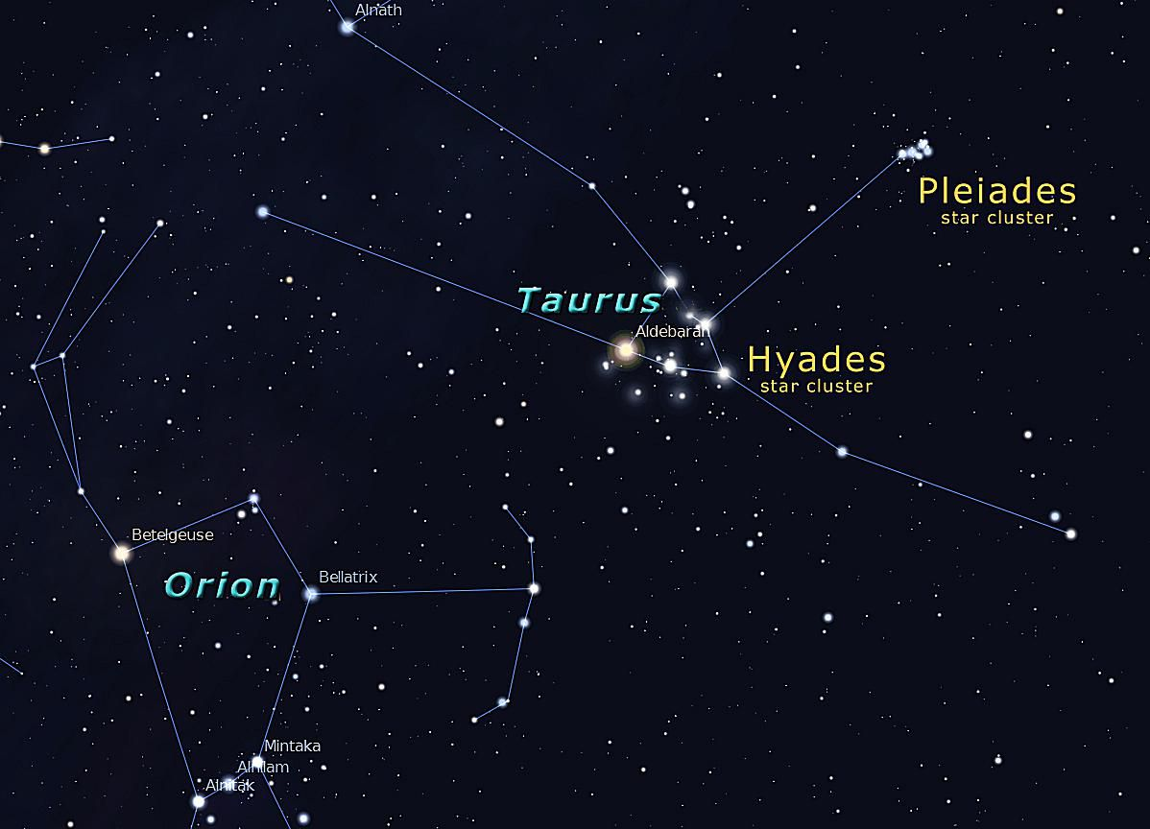
Ancient humans organized their star observations by creating “constellations” so they could tell stories
Are constellations “intentional arrangements?”
WINTER SKY, NORTHERN HEMISPHERE
LASCAUX CAVE PAINTINGS
2500 years ago, Babylonian astronomers recorded observations for the sun and moon and organized them into calendars. They were precise - their estimates for “year” and “lunar month” were almost exactly the values we use today

Slide 20
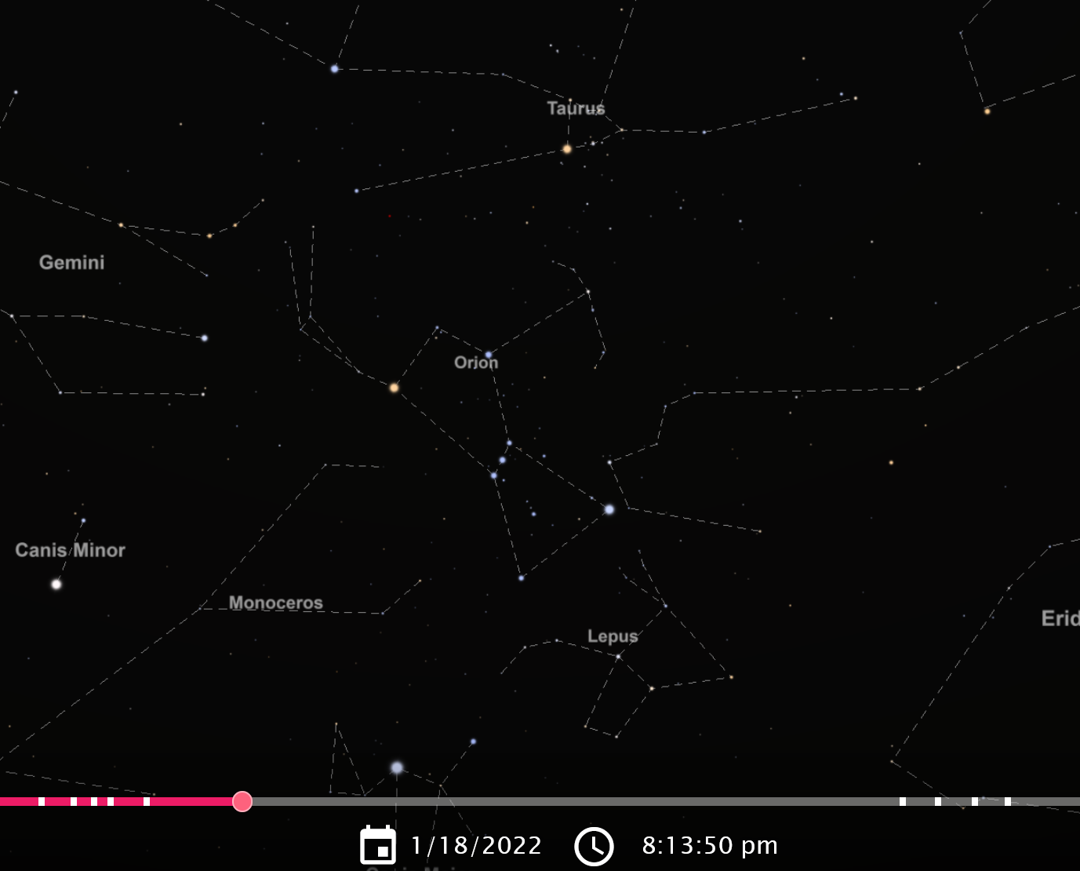
Tonight’s Sky (compare to previous slide)

Slide 21
Organizing Is Intentional… But Can Exploit Automatic Sensemaking
Physical resources are often organized according to intrinsic physical properties like their size, color, or shape
This organization is most effective when these properties are selection criteria because the human visual system quickly attends to them

Slide 22
But Should You Organize Books by Color?
Might be aesthetic for your personal book collection (or as a Zoom background decoration), but not an effective organizing principle for a library (WHY NOT?)

Slide 23
Sensemaking {and, or, vs.} Organizing
For most domains/resource types, selection criteria and other requirements for interaction mandate intentional organization that exploits semantic or functional properties instead of perceptual/physical ones
Put more simply… color or shape are not useful organizing principles for many types of resource collections even though they are perceived quickly

Slide 24
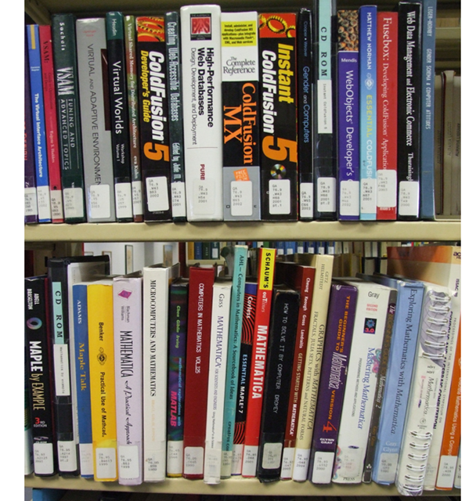
Organizing Books by Content
Organizing books according to their content is the only scalable approach when the collection gets larger

Slide 25
Sensemaking and Science
A fundamental challenge in sensemaking is balancing the competing goals of understanding a particular collection of things or data and applying that understanding to new instances
The highest level of sensemaking is the creation of scientific theories, with a preference for “more organized” or simpler explanations for the observations
25

Slide 26
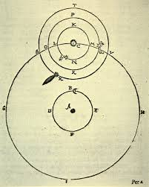
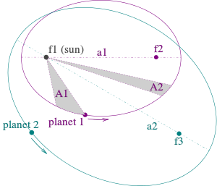
Tycho Brahe vs. Johannes Kepler same planet data, different theories
Heliocentric elliptical orbits follow “Kepler’s Laws” – simple and elegant theory
Reconciling data with a geocentric organizing principle (dictated by Plato) makes Tycho’s system overly complex and mechanically impossible

Slide 27
Sensemaking {and, or, vs.} Organizing ???
They aren’t synonyms but they have overlapping meaning
Sensemaking can be considered a superset of, or a more generic perspective, on organizing
“People organize to make sense of equivocal inputs and enact this sense back into the world to make it more orderly” - (Weick 2005)
But we can also think of sensemaking and organizing as endpoints on an automatic to intentional “organizing continuum”

Slide 28
Introducing the Course

Slide 29
Plan for the Course (1)
After discussing the foundational concepts of the discipline of organizing for a few weeks, we will analyze sensemaking and organizing from four interrelated perspectives:
As a member of a social, cultural, or language community
As an individual
In institutional contexts
In data-intensive or scientific contexts

Slide 30
Plan for the Course (2)
These perspectives take a very broad look across many disciplines that organize and make sense in different but complementary ways
The DISCIPLINE OF ORGANIZING is their intersection
And much of COGNITIVE SCIENCE is involved
As a member of a social, cultural, or language community (anthropology, linguistics, sociology, social network analysis)
As an individual (perception, developmental psychology, philosophy, behavioral economics)
In institutional contexts (law, business, information science)
In data-intensive or scientific contexts (data science, computer science, info visualization)
What part of Cognitive Science is NOT here?
30

Slide 31
A Different Kind of Course
We will discuss a very broad range of content types, emphasizing the concepts that interconnect them rather than cramming the facts from disconnected areas
This course poses a lot of questions and proposes some ways of answering them… and most people don’t even realize that these are important questions
You won’t be interested in everything to the same degree, so once you understand the big ideas in an area, it is OK to save your time and motivation for topics you care about more

Slide 32
Stop and Talk
This is a very ambitious course
You will learn more questions than answers
If this course doesn’t radically change the way you look at the world, then I’ve failed as the teacher (…and you’ve failed as the student)

Slide 33
Motivating the Discipline of Organizing

Slide 34
Everything is Organized
In our daily lives organizing is a fundamental cognitive activity that we often do without thinking much about it
It is also an important part of most business and professional activities
Organizing in any context can be more effective and satisfying if we are more self-aware and systematic about how we organize
34

Slide 35
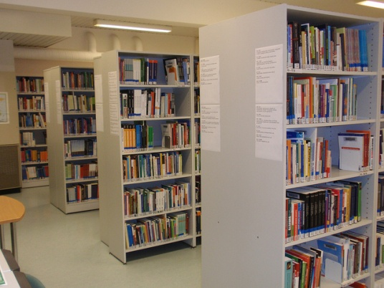
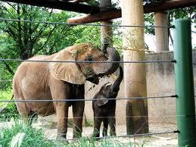
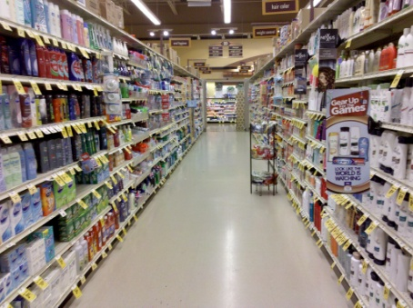
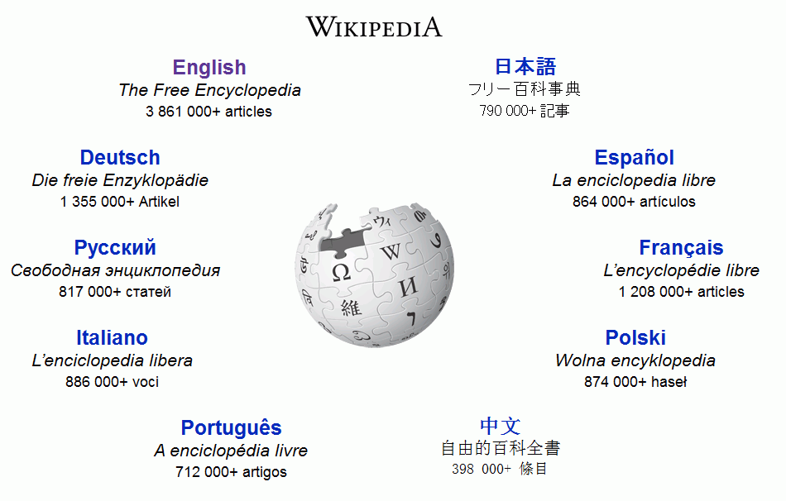
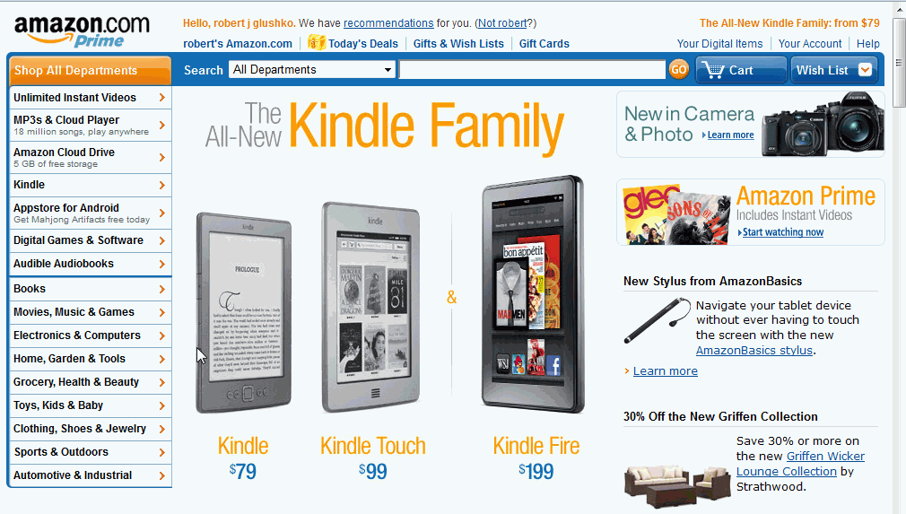
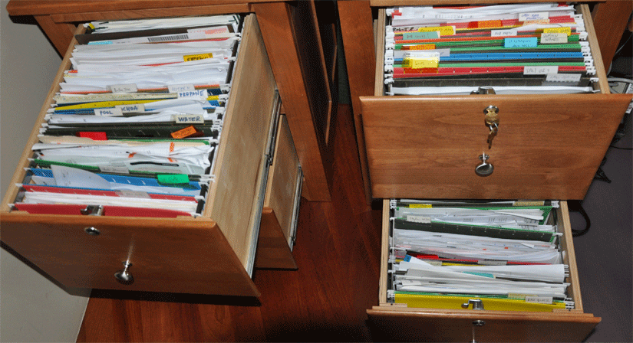
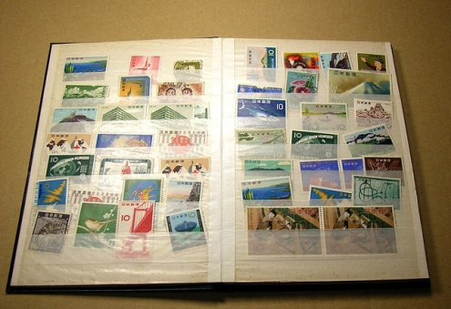
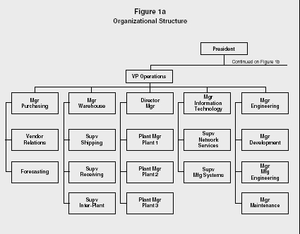
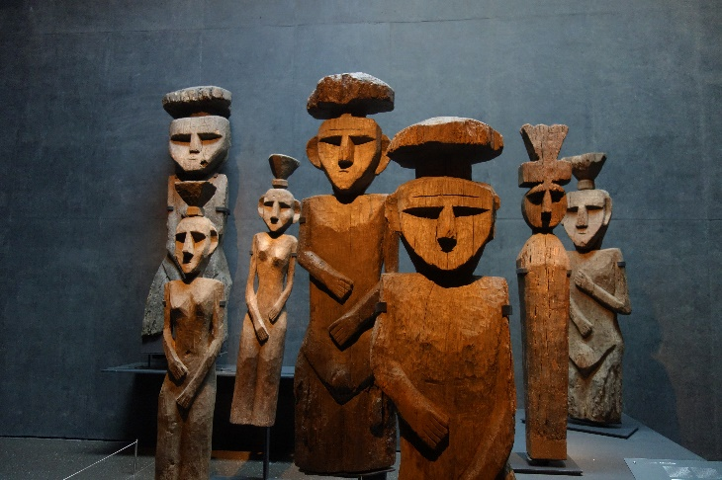
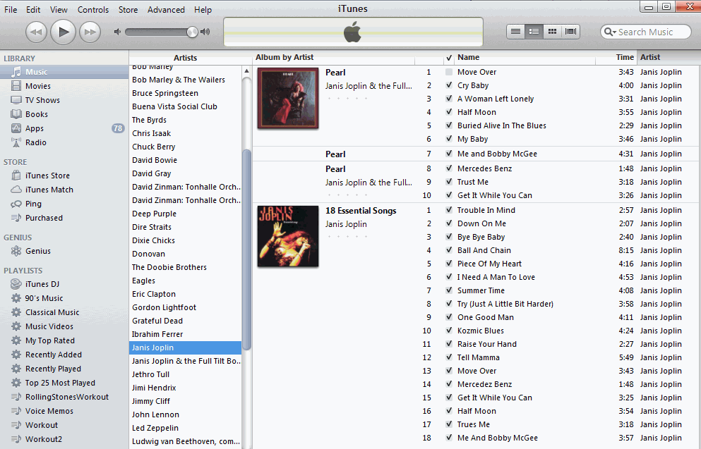
35

Slide 36
They are all “Organizing Systems”
A collection of resources intentionally arranged to enable some set of interactions
36

Slide 37
The 6 Dimensions of an Organizing System – Organizing as a Design Problem
What Is Being Organized?
Why Is It Being Organized?
How Is It Being Organized?
When Is It Being Organized?
Who (or What) is Organizing It?
Where is it Organized?
37

Slide 38
Foundational Concepts
Resources
Intentional Arrangement
Organizing Principles used to “Intentionally Arrange” Resources
Interactions that are enabled by the organizing principles

Slide 39
Resources:
Anything of value that can support goal-oriented activity

Slide 40
ANYTHING! TDO Chapter 12 Case Studies
§12.4, “Single-Source Textbook Publishing”
§12.5, “Organizing a Kitchen”
§12.18, “Neuroscience Lab”
§12.16, “The Dabbawalas of Mumbai”
Cases in green are assigned for today; blue next time; red ones for 3rd lecture; black ones later in semester

Slide 41
ANYTHING! Other Case Studies
Stage Play
Spotify
Intentional Communities
What3Words
Soccer
Occupational Classification
Pantone Color System
Fitbits
Time Zones
Orchestra Seating
Medical Emergencies
Organized Crime
NBA Player Tracking
Intentional Communities
Guide Dogs for the Blind
About 100 case studies can be found at https://ischools.org/Discipline-of-Organizing-Case-Studies-Overview/

Slide 42
Intentional Arrangement:
Explicit or implicit acts of organization by human or computational agents

Slide 43
Organizing Principles [1]
The resource arrangements follow one or more intentionally selected ORGANIZING PRINCIPLES, ideally expressed in an implementation-neutral way if they are not directly perceivable
ORGANIZING PRINCIPLES use properties or DESCRIPTIONS that are associated with the resources
Similarly, interactions with resources are determined by their organizing principles and descriptions
➔ Organizing, resource description, and interaction design are inherently interconnected activities
43

Slide 44
What resource property is used by an alphabetical ordering principle?
What interactions are enabled by this organizing principle?

Slide 45
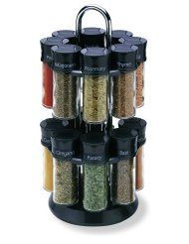
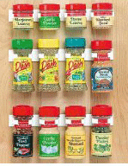
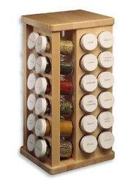
“Organize Spices Alphabetically”
An Alphabetical Organizing Principle Does Not Specify Any Particular Implementation
“ARCHITECTURAL THINKING”
45

Slide 46
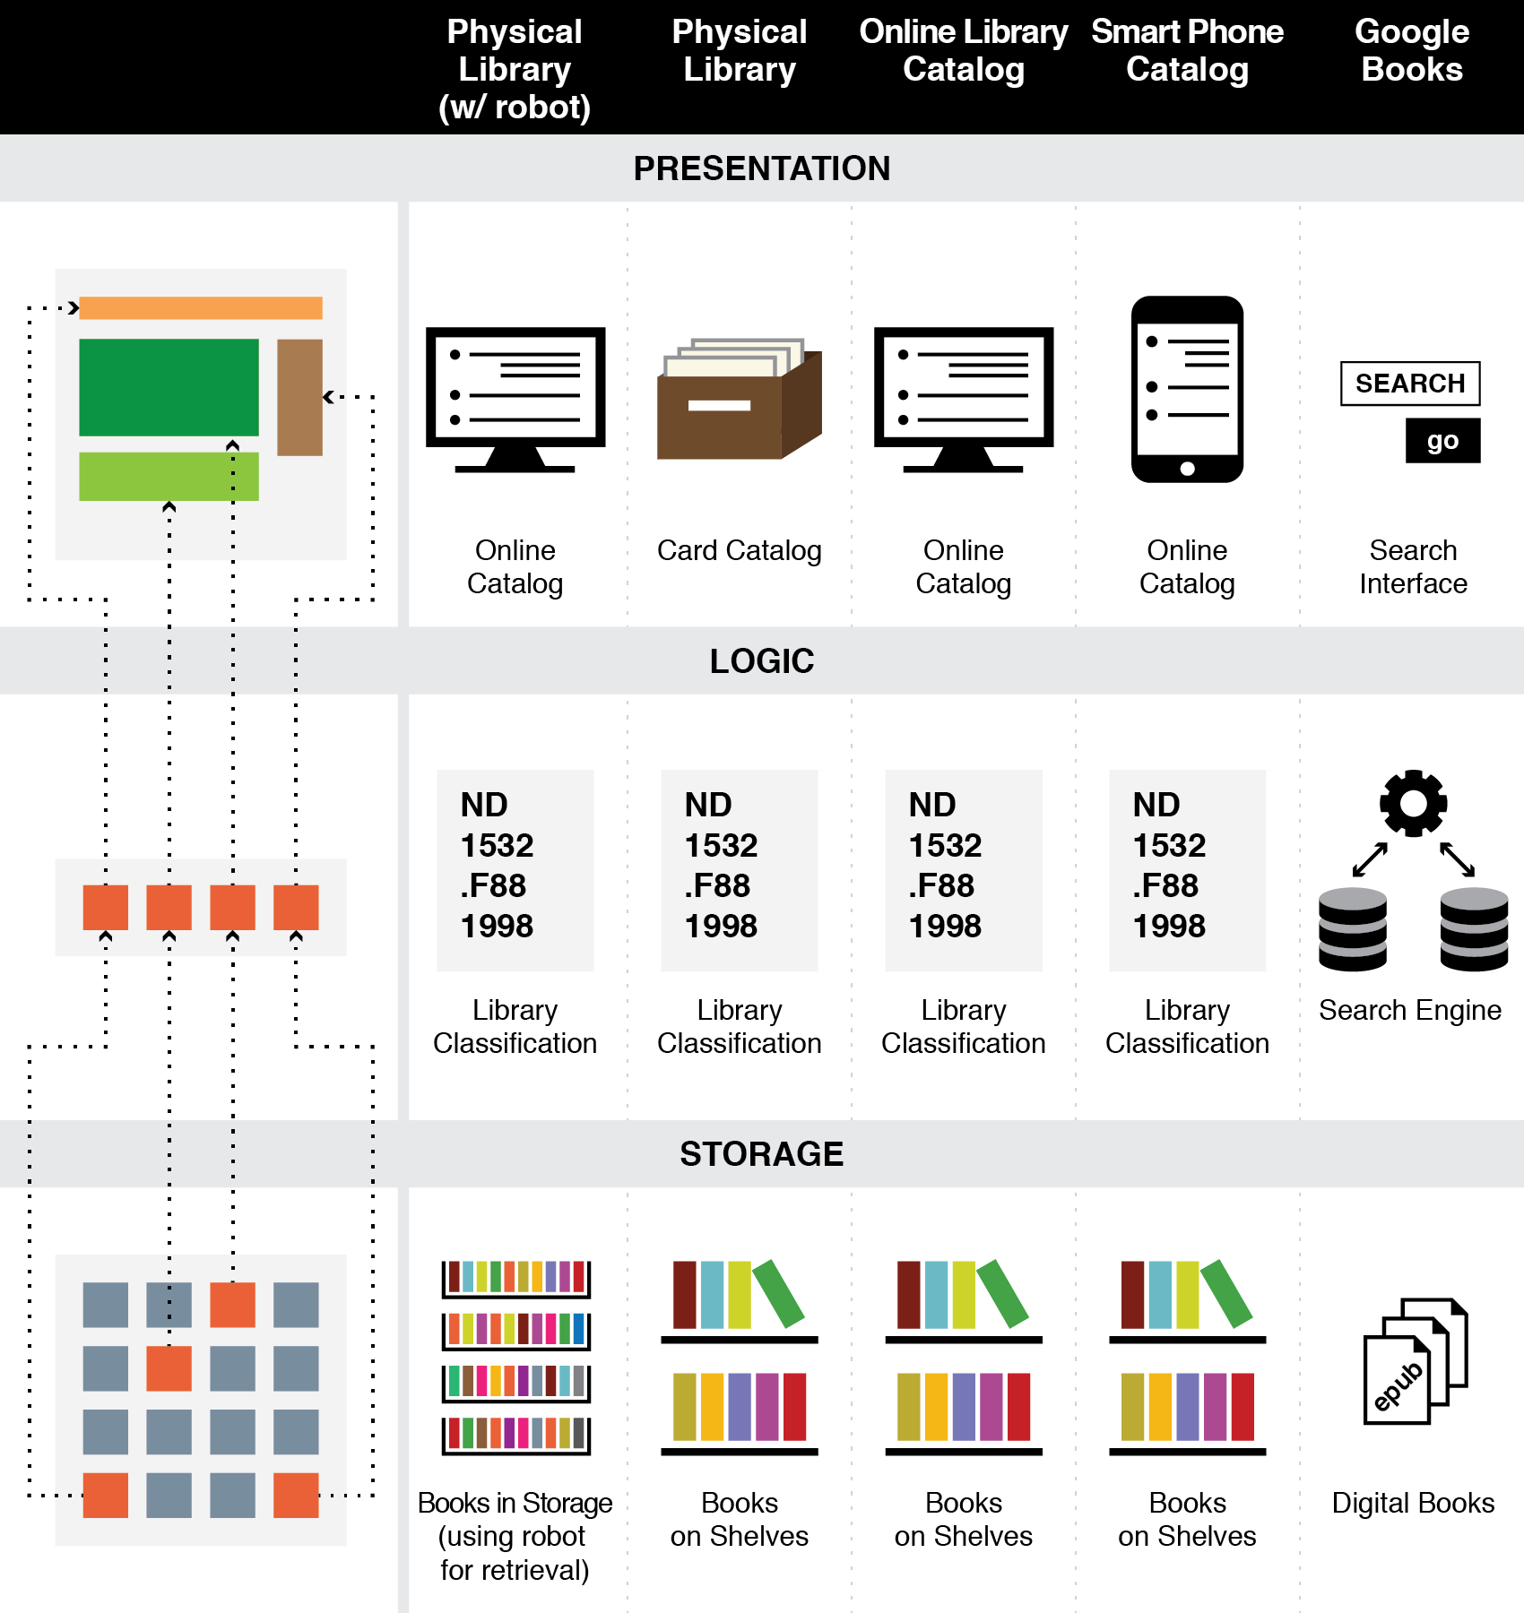
The Three-Tier Architecture
Organizing Principles are logically separated from Implementation and Presentation Tiers

Slide 47
A “Library Robot” Changes Only the Storage Tier
47

Slide 48
Say it Again: TDO’s Mantra
Organizing, resource description, and interaction design are inherently interconnected activities

Slide 49
Organizing Principles [2]
For physical resources the properties are often:
Perceptual – what does it look like?
Material – what is it made of?
Task-oriented – how is it used?
For information resources the properties are often semantic ones – what is it about?
Note to data scientists: “resource properties” are “features” in data-science-speak
49

Slide 50
Organizing System: Home Kitchen
Photo by Emilie Hardman (http://www.flickr.com/photos/quintanaroo/2741672230//) Used by permission
50

Slide 51
Kitchen Organizing Principles
Exploit the constraints of the physical environment
Exploit the physical properties (especially shape and size) of the resources being organized
Organize by task
Organize by frequency of use
Organize by the “social dimensions” of interaction
Organize alphabetically
Some of these are phrased more abstractly to show that none of them are kitchen-specific and could be used elsewhere

Slide 52
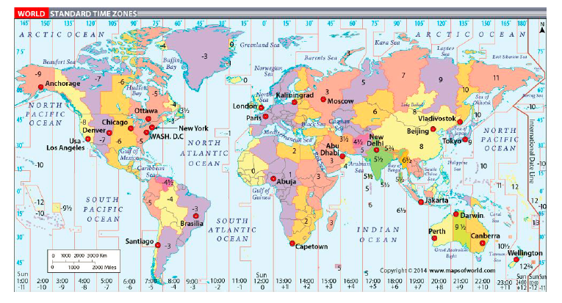
Organizing System: Time Zones
“Carving the World at its Political Joints”

Slide 53
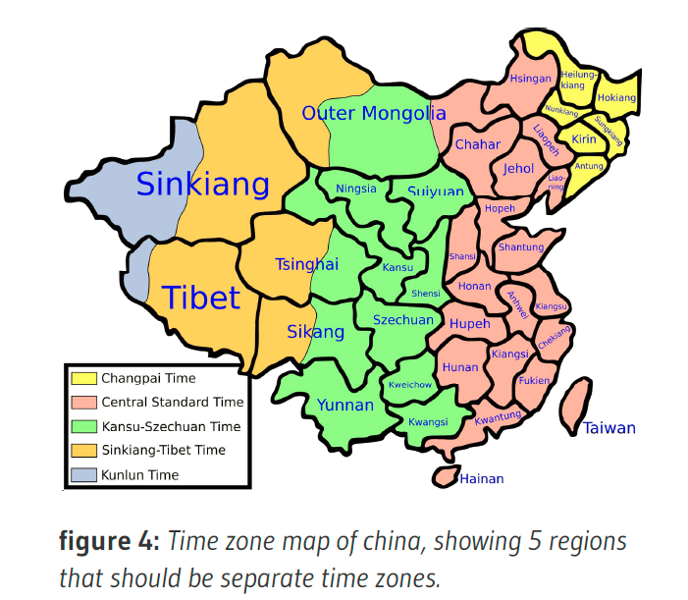

Slide 54
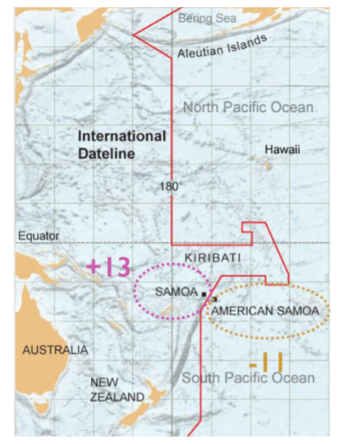
Samoa is an independent county aligned politically and economically with New Zealand and Australia
American Samoa is a United States territory
They are a little more than 100 miles apart
They are 24 hours apart in time

Slide 55
What organizing principles are embodied in time zones?
Were any of these principles used to organize the kitchen? (think abstractly…)

Slide 56
Organizing Principles [3]
Other typical arrangements are based on ownership, origin, taxonomic, or “taskonomic” or behavioral properties (usage frequency, correlated usage)
Resources with an associated date (creation, acquisition) can have chronological ordering
56

Slide 57
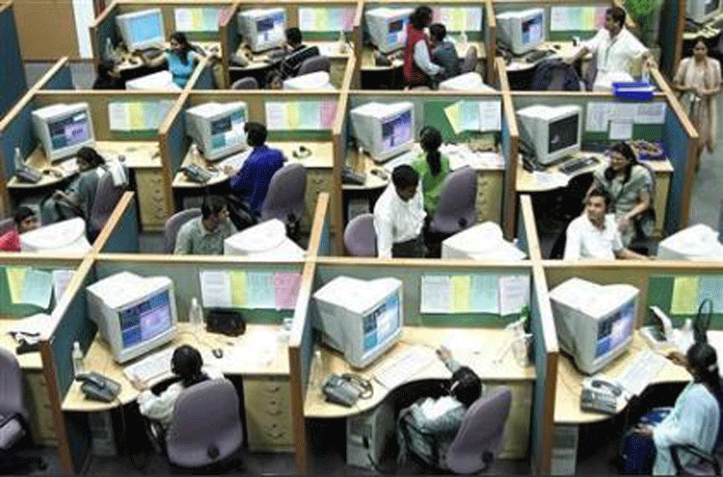
Organizing People by Work Role
Logical View
(org chart)
Implementation View
(floor plan)
57

Slide 58
Interactions –The Why of Organizing Systems
INTERACTIONS include any activity, function, or service supported by or enabled with respect to the resources in a collection or with respect the collection as a whole
Interactions can include access, reuse, copying, transforming, translating, comparing, combining, visualizing, recommending… anything that a person or process can do with the resources…
58

Slide 59
Interactions
Some interactions can be enabled with any type of resource, while others are tied to resource types
(that’s because some resource properties are generic / widely-shared and others are more specific)
The interactions that are supported depend on the nature and extent of the resource descriptions and arrangement
59

Slide 60
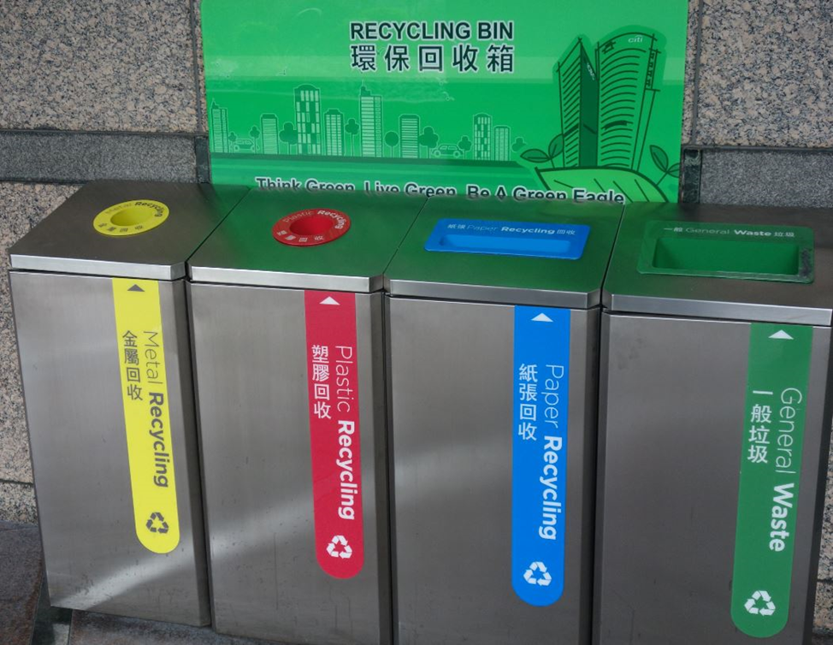
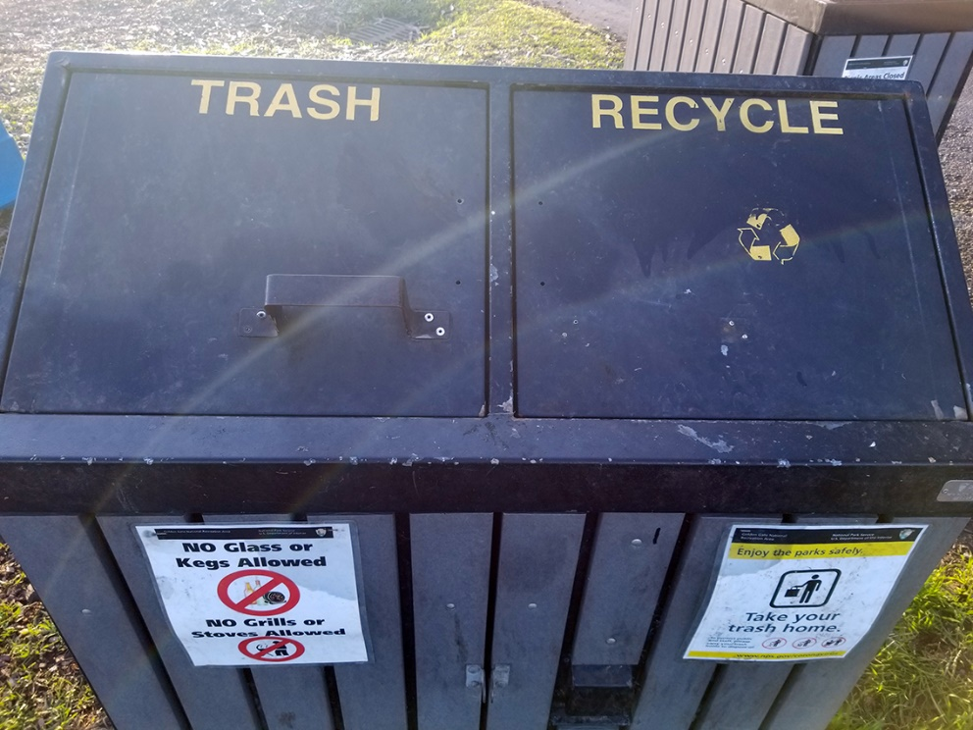
Organizing and Interaction Tradeoffs
How does recycling in Hong Kong (top photo) compare with recycling at SF Fort Mason park (bottom photo)?
What does this imply about the interactions with resources throughout the entire recycling system?
Who does the work? Who gets the benefits?

Slide 61
ORGANIZING SYSTEMS BIG IDEAS
Every organizing system must enable users to interact with its collection of resources
The possible interactions depend primarily on the nature and extent of the descriptions associated with the resources
Intentional arrangement emerges when one or more resource descriptions are used by organizing principles
61

Slide 62
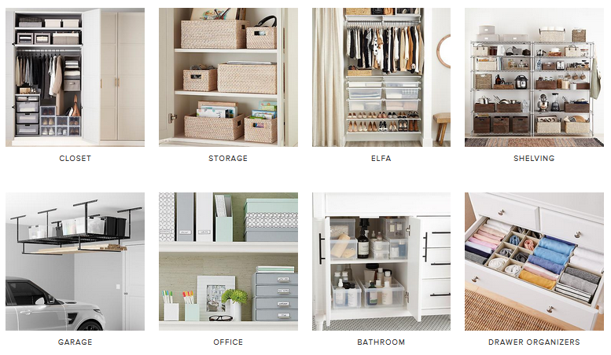
“Getting Organized” by Applying Organizing Principles is ARCHITECTURAL THINKING; “Getting Organized” by Arranging Stuff with “Organizing Furniture” IS NOT!

Slide 63
Course Polices and Administrivia I’ll send out a Zoom recording later today… please watch it before Thursday’s class

