Slide 1
CogSci 150 “Sensemaking and Organizing” Spring 2022
Robert J. Glushko glushko@berkeley.edu
19 January 2022
1.1) “Who Are You” Survey;
Course Policies & Administrivia

Slide 2
The “Who Are You” Survey
Making Sense of the Students

Slide 3
Who Are You (survey, N=23)
You are all juniors or seniors; mostly CogSci majors (18); many are Data Science (8) ; 5 are “Other”
About half of you have cogsci-relevant work or internship experience; most common:
UX/experience design
Product management/marketing
Lab research assistant

Slide 4
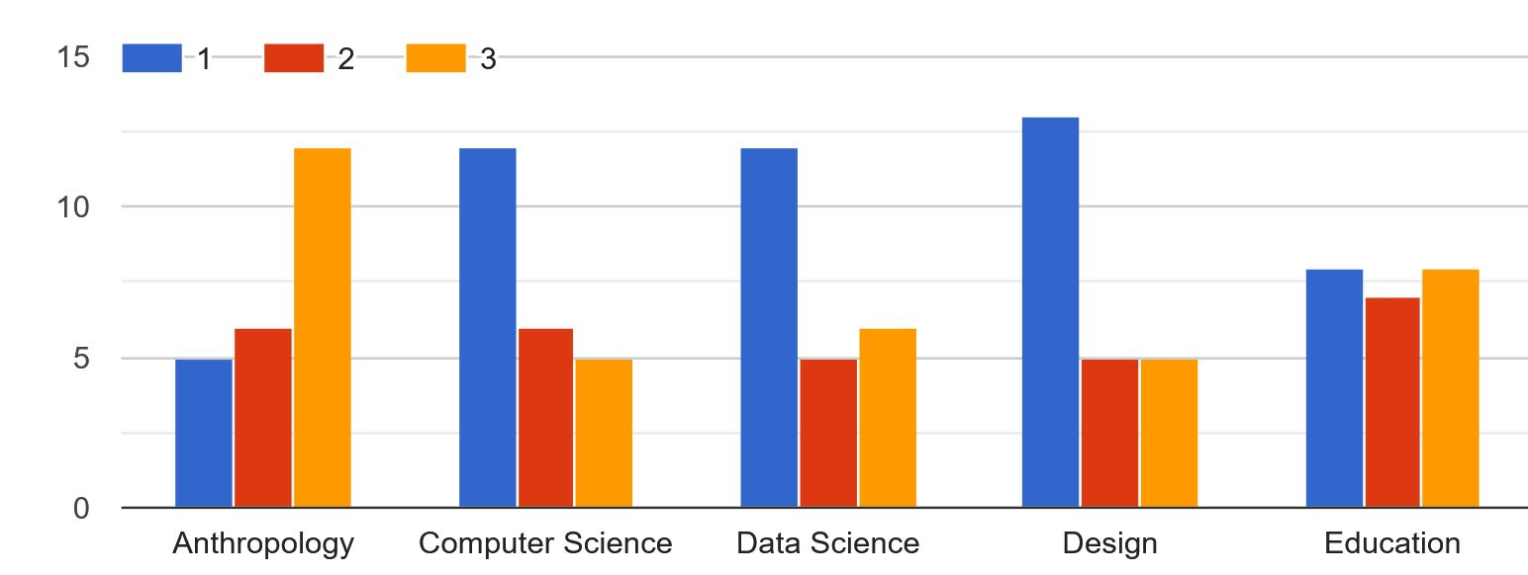
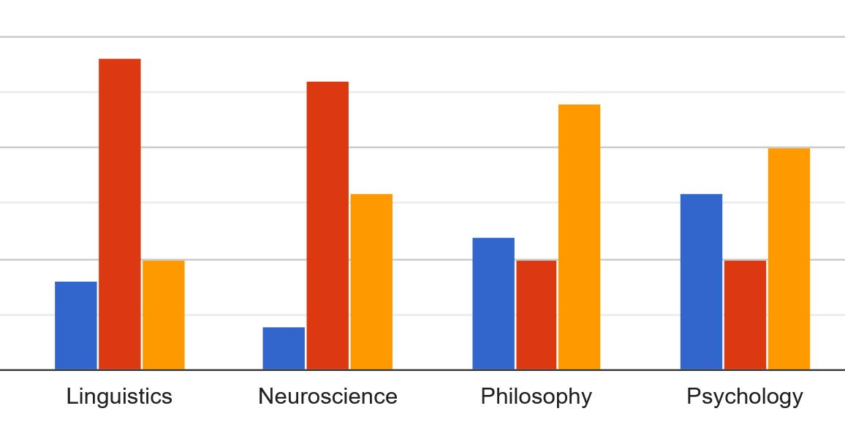
Discipline Interests / Expertise

Slide 5
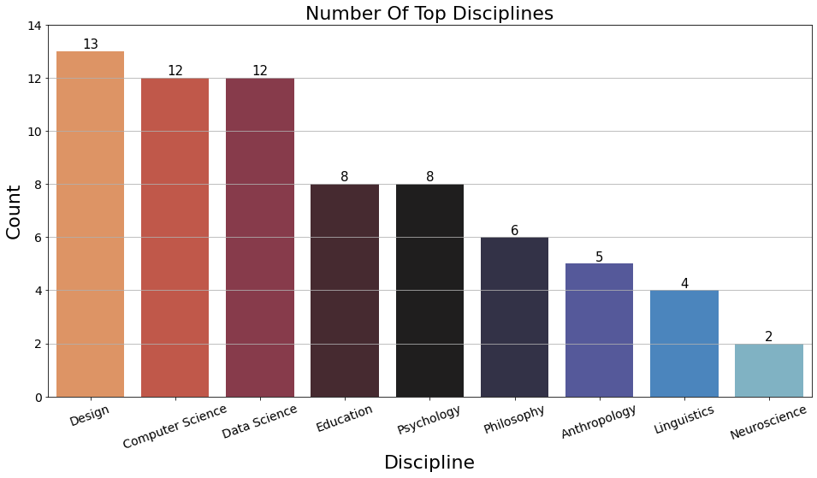
Disciplines Sorted by # of #1s

Slide 6
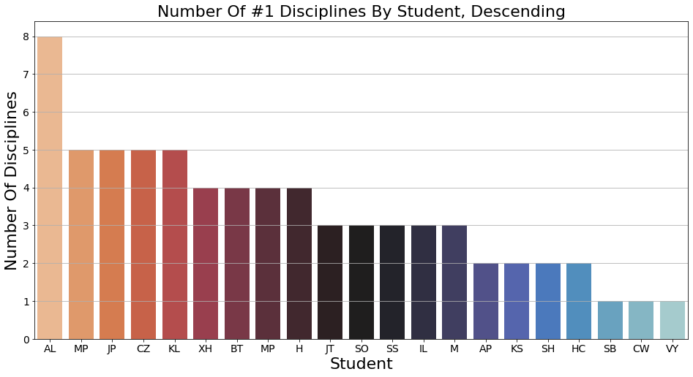
Students Sorted by # of #1s

Slide 7
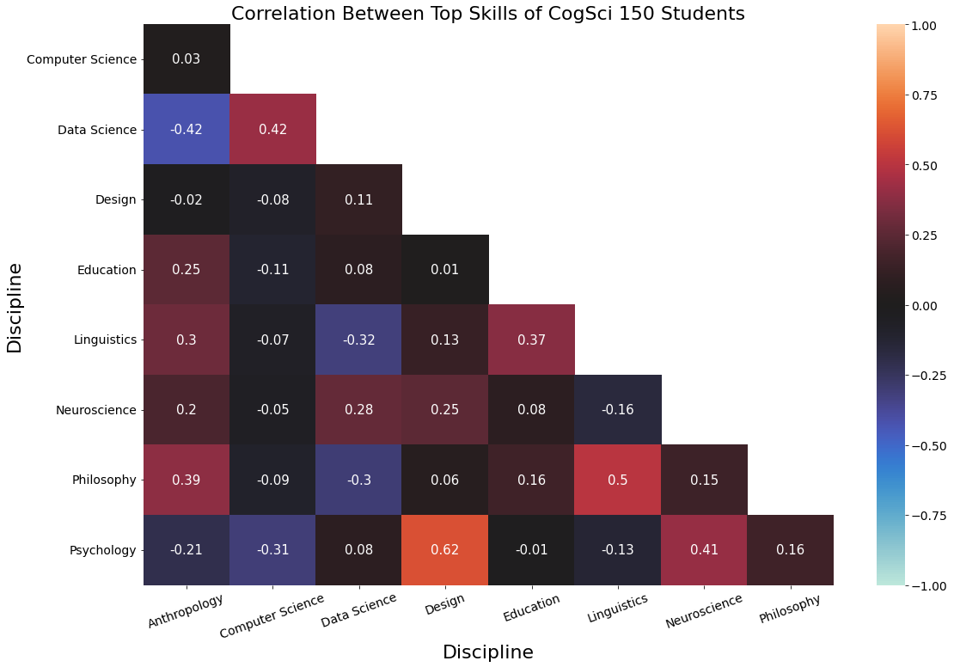
Correlations Between Discipline Pairs

Slide 8
Our Analysis
23 students rated themselves on 9 disciplines
For each of the 36 pairs of disciplines, we calculated the correlation coefficient between the two sets of 23 ratings (using the 1 ratings only) as an estimate of how well the disciplines “go together”
Caveats: very small sample; it would have been better to use every rating (1, 2, or 3) instead of just the 1s
But the results have some “face validity”

Slide 9
What the Correlation Matrix Shows…
Some pairs of disciplines “go together” more than others in the respect that if you have interests/expertise in one you are likely to have them in the other
And the inverse is also true; some disciplines don’t seem to go together very much
Go Together: CS and DS, Design and Psych
No Go: DS and Anthro, CS and Psych

Slide 10
But Wait, There’s More
Many of you said in the survey that it is essential that the teaching team be sensitive to the challenges posed by Covid and Zoom
I want to know what I can do specifically for you, and want to make up for the lesser degree of informal interaction we will have than normal times offer
I will send out an invitation to sign up for a 10 minute “getting to know you” Zoom starting next Monday

Slide 11
Course Policies & Administrivia

Slide 12
Class Preparation and Participation
You are expected to have read the assigned readings before the class meets
Your class participation and assignments will be essential to demonstrate your reading, reflections, and understanding
You can distribute your participation somewhat according to your personal preferences
Should we use Bcourses “Discussions” or some other structured discussion forum?
12

Slide 13
To Zoom, or Not to Zoom
We were {advised, warned, threatened} that Zooming might be required, and here we are in Zoomland
Some things about Zoom are good – chat, breakout sessions, polling
A couple of our lectures might be on Zoom, as will our weekly discussion sessions on Fridays
I will also have Zoom office hours
I will be available for informal chat 15 minutes before and after anytime we’re meeting in Zoomland

Slide 14
Assignments, Exam, Grading
8 Assignments (25%)
Assigned on Tuesday, discussed on Friday
2 Exams
Administered by bCourses to give you schedule choice
Short answer questions
Open book, open notes
Exam 1 (15%), Exam 2 (20%)
Case Study (25%)
Class participation and preparation (15%)
14

Slide 15
Your Case Study
You will write a case study like those you read
Aspire to have your case study in next year’s CogSci 150 syllabus; tell an interesting story well
Propose a topic by March 13
Present your case study during RRR week (on May 4 or May 6)
Final case study report due May 10
15

Slide 16
Other Class Policies and Expectations
Class begins promptly at 11:10 pm Tuesday & Thursday (Pacific Time)
Professor will have drop-in Zoom office hour TBD and will schedule Zoom meetings as needed
GSI will also drop-in Zoom office hour TBD
Lecture notes will be posted before class
16

Slide 17
Friday Discussion Sections
We are working hard to find times on Friday when everyone can make a discussion section
Current proposals are for (10, 11, 12) or (10, 12, 2)
Since they will be on Zoom, we can record them – and if we always discuss what we did in Breakout sessions it might work OK for people who can’t attend
We will decide on this Thursday’s course meeting and our first sessions will be the next day on Friday, Jan 21
17

Slide 18
Academic and Personal Integrity
Unless otherwise instructed, homework assignments are to be completed independently
Exams and assignments are "open book," meaning that you can refer to the instructor's lecture notes, your notes, and anything in the course syllabus. But this is because you will be never be tested on simple facts, definitions, or anything else you can locate in a text somewhere. To copy text or ideas from another source without appropriate reference is PLAGIARISM. You will fail the assignment or exam and there might be further disciplinary action.
18

Slide 19
ZOOM LINK FOR COURSE (11am Pacific Tu and Th)
https://berkeley.zoom.us/j/93862065618

