Slide 1
CogSci 150 “Sensemaking and Organizing” Spring 2022
Robert J. Glushko glushko@berkeley.edu
25 January 2022
3) Case Studies & Models for Organizing Systems

Slide 2
Case Studies So Far
1/18
TDO 12.5 Organizing a kitchen
Time Zones
Orchestra Seating Arrangements
1/20
TDO 12.4 Single-source textbook publishing
TDO 12.18 Neuroscience lab
Medical Emergencies
1/25
Organized Crime
NBA Player Tracking
Intentional Communities
Guide Dogs for the Blind
2

Slide 3
Outline
Models for organizing systems
What models, artifacts, or representations best facilitate understanding and interaction?
Case studies used as examples

Slide 4
Models for Organizing Systems
Many academic fields – management, operations research, informatics, etc. – provide models for describing organizing systems
These models distinguish and highlight different aspects of the organizing system
They can be thought of as different perspectives or points of view whose effectiveness depends on the nature of the resources and organizing principles in the organizing system
These models can be combined, adapted, or otherwise changed to create innovative hybrids that might be better suited for some novel organizing system

Slide 5
Types of Models
Pictorial /Physical / Literal
Schematic / Topological
Functional
Structural
Process
Semantic / Conceptual

Slide 6
Pictorial /Physical / Literal Models
The essence of some organizing systems is the physical arrangement of resources, especially when the physical context controls or constrains interactions with them
A photo conveys a literal description of these types of organizing systems, enabling easy understanding of its layout and scale
Maps are often highly literal depictions of physical or geographical resources

Slide 7
Organizing System: Home Kitchen
Photo by Emilie Hardman (http://www.flickr.com/photos/quintanaroo/2741672230//) Used by permission
7

Slide 8
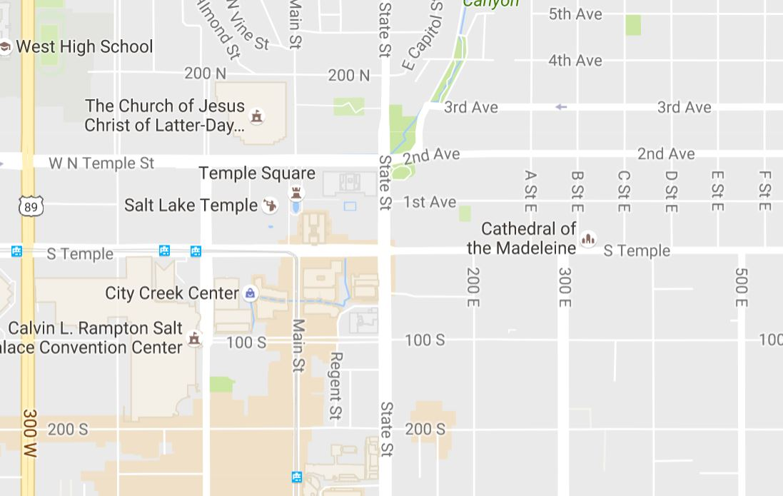
Salt Lake City - Downtown

Slide 9
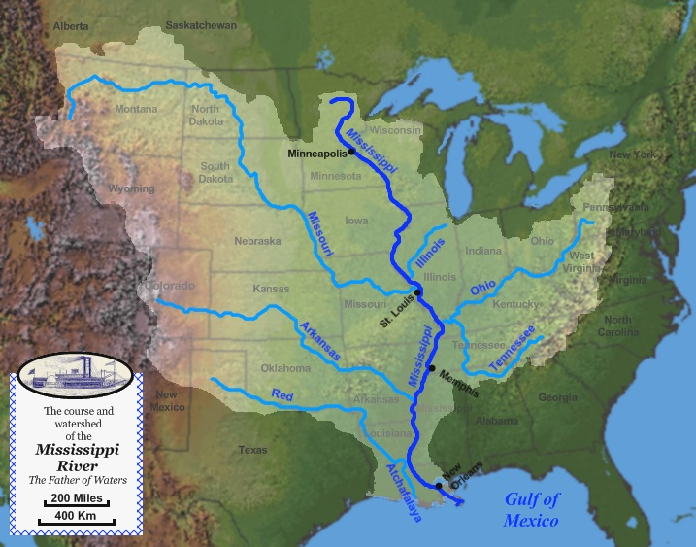

Slide 10
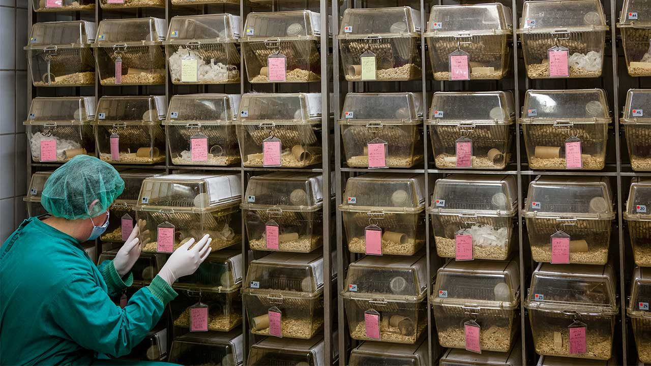
Rats In A Neuroscience Lab Are Organized in “Housing Systems”
A photo conveys a literal description of the organizing system, emphasizing its layout and scale

Slide 11
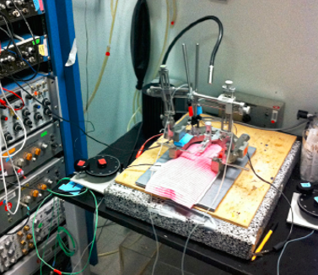
Taskonomic Organization
An array of amplifiers and filters for pro­cessing and recording rats' brain­wave signals (left) is installed in a vertical rack that can be located close to the equipment used to perform surgeries

Slide 12
Stop and Think
Rat resources are initially interchangeable members of a category, but later must be treated as unique resources. Why?

Slide 13
Schematic / Topological
Models
Distinguish the important locations or regions where the resources are arranged
Preserve the important physical characteristics and relationships, but not in a literal/exact way
Often improve comprehensibility by emphasizing interaction or decision points while eliminating irrelevant detail

Slide 14
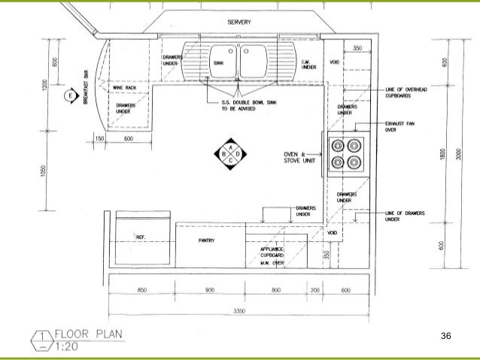
Schematic Representation of a Kitchen

Slide 15
Stop and Think
How are hospitals organized?
What parts / functions would benefit from spatial proximity?
What parts don’t have as many constraints on where they might be located?

Slide 16
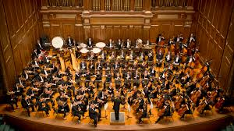
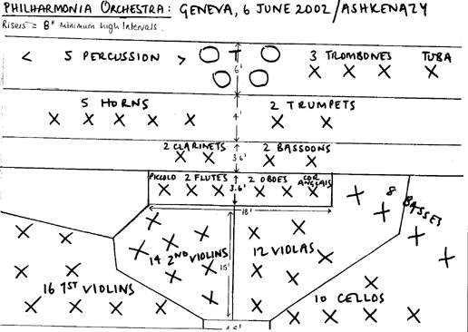
Pictorial
THE ORCHESTRA
Schematic

Slide 17
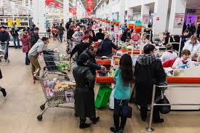
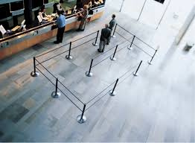
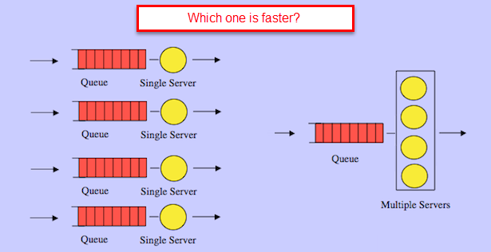
QUEUE LAYOUT Pictorial
Schematic

Slide 18
The BART System Map
In what ways is this map schematic rather than physical or literal?
What are the pros and cons of this design?

Slide 19
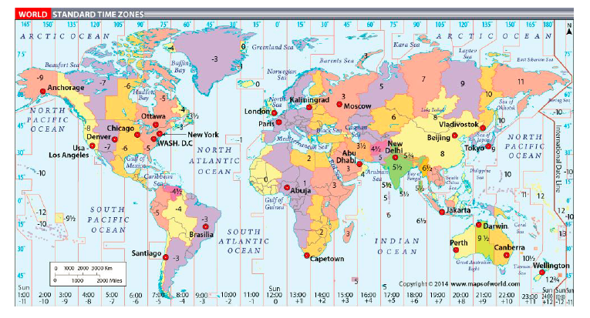
Organizing System: Time Zones
This familiar Mercator cylindrical projection enables “straight line” navigation because N and S are preserved but distorts shapes and sizes toward the N and S poles

Slide 20
Stop and Think
Why is this kind of map projection the most sensible to show time zones?

Slide 21
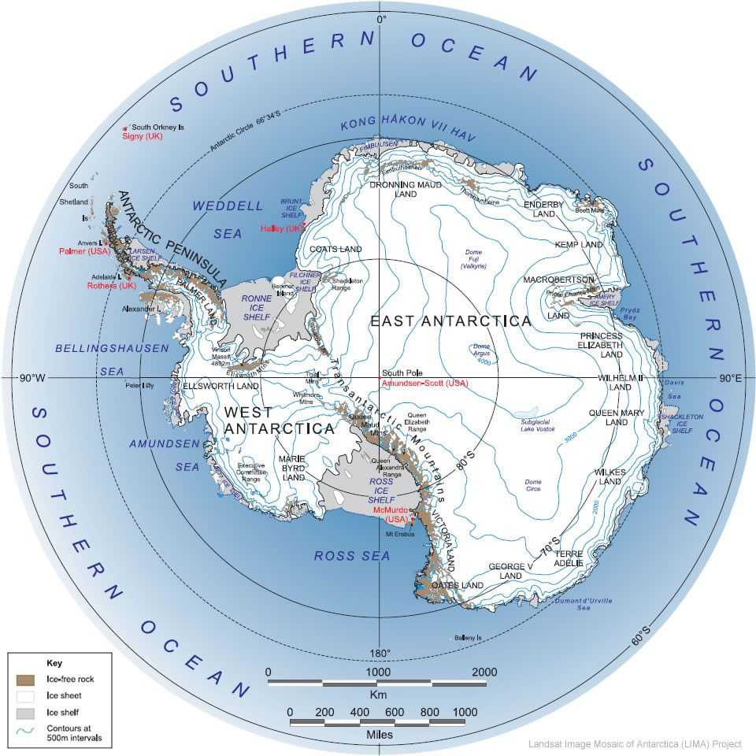
When Mercator Projector Won’t Do
look down at a sphere from any point and the latitude lines remain circles – better for maps of polar regions

Slide 22
NBA Player Tracking
Tracking is based on locations, angles, and distances, but involves complex calculations and statistical comparisons to rate players and game situations

Slide 23
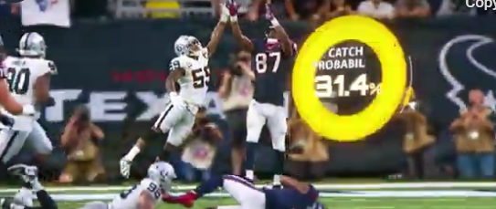
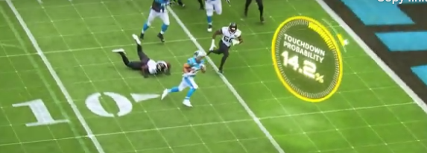
aws.amazon.com/nfl
NFL player tracking, also known as Next Gen Stats, is the capture of real time location data, speed, and acceleration for every player, every play, on every inch of the field. Sensors throughout the stadium track tags placed on players' shoulder pads, charting individual movements within inches.

Slide 24
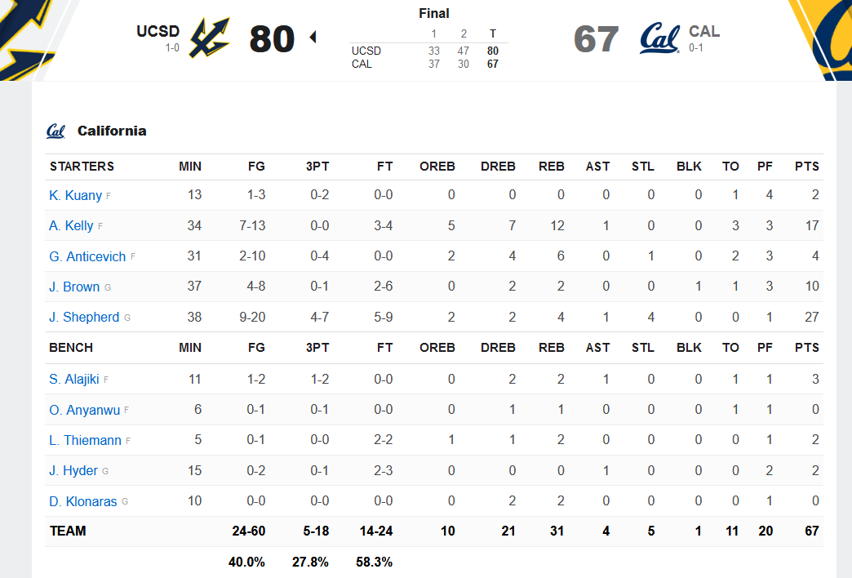
TRADITIONAL BASKETBALL STATS FROM UCSD’S UPSET WIN OVER CAL (11/9/2021)

Slide 25
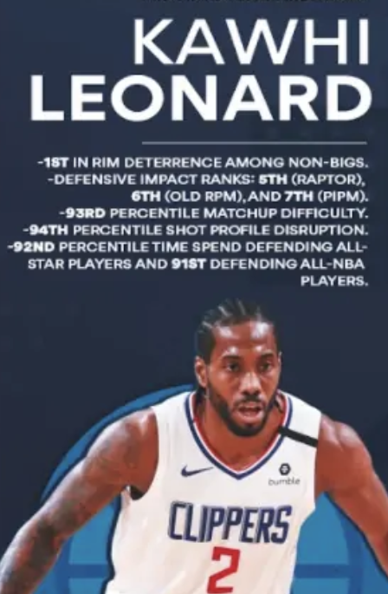
NEXT GEN BASKETRBALL STATS FROM https://www.bball-index.com/

Slide 26
Stop and Think
What kind of real-time stats about what teachers and students do during a lecture could “Next Gen Zoom” use to improve online instruction?

Slide 27
Functional Models
System described in terms of its functions or component services
Can map directly to the structure of the institution or business that operates the system, or can be more abstract
In information-intensive systems, the functions are expressed as APIs or as information exchanges

Slide 28
Functional Model of a Bank

Slide 29
Spotify API

Slide 30
Structural Models
Emphasize connection relationships within and between resources
Can vary a lot in how abstractly the resources and relationships are represented

Slide 31
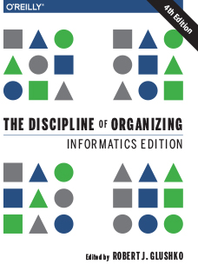
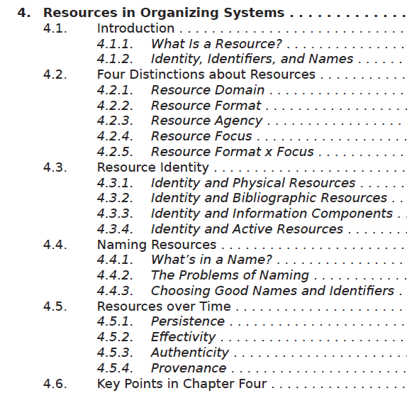
Book With “Literal” Table of Contents

Slide 32
Stop and Think
This example of a table of contents doesn’t explain HOW a table of contents is part of a book’s organizing system
Define “Table of Contents” – how does it represent a book’s structure?

Slide 33
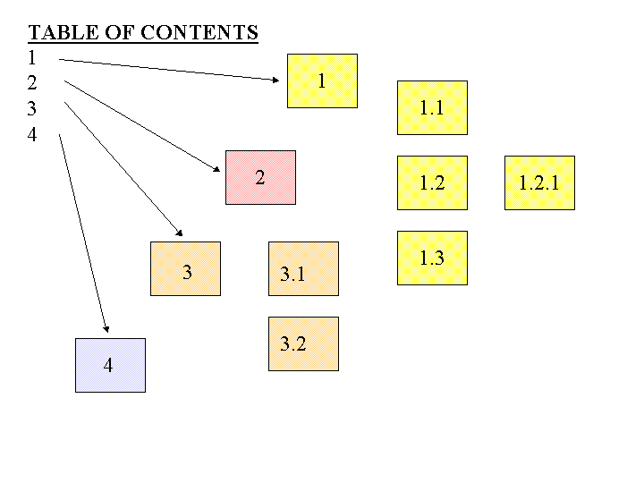
A Table of Contents is a Numeric Hierarchical Set of Structural Links to Document Components

Slide 35
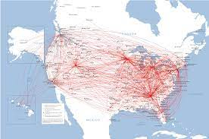
Literal Map, Routes No So Much

Slide 36
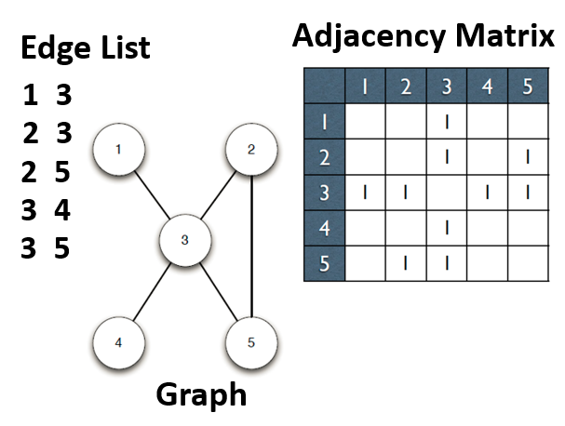
Structural Representations in Graph Theory

Slide 37
Process Models (1)
Highlight the steps or decision points of value creation, often in temporal sequence
“Service blueprints” are a common framework that combine temporal and architectural perspectives; they emphasize the “touch points” where users or customers engage with operators or service providers

Slide 38
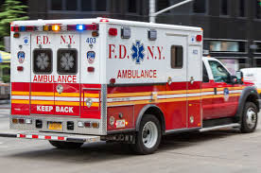
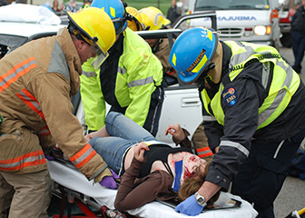
Medical Emergencies

Slide 39
Stop and Think
How are emergencies classified and how does this determine the use of the EMS resources?
How do standards for resources and processes improve the effectiveness of EMS responses?

Slide 40
Stop and Think
An event is a medical emergency because responses must be effectively organized to minimize the response time
What representations best depict processes that take place over time while distinguishing different contexts and actors that might be involved?

Slide 41
Service Blueprints
“Service blueprints” are a common framework that combine temporal and architectural perspectives in a process model
They emphasize the “touch points” the “front stage” where users / customers / service recipients engage with operators or service providers
They also depict the “backstage” interactions between service providers that are invisible to service recipients but create value for them

Slide 42
Front Stage and Back Stage
FRONT STAGE: Where interactions with the service customer/ consumer happen
BACK STAGE: Produces information and “stuff” needed by the front stage
Placement of LINE OF VISIBILITY is a design parameter

Slide 43
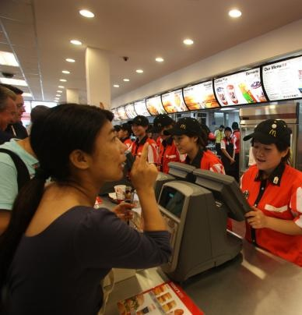
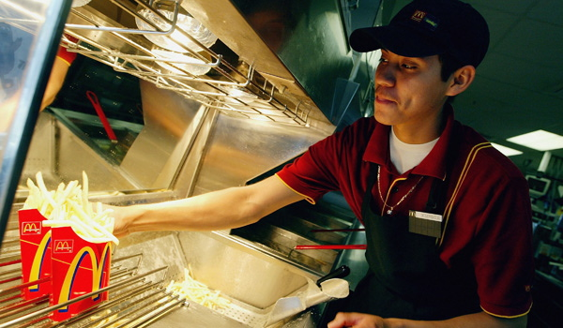
The McDonald’s Experience
Front Stage
Back Stage
Line of Visibility

Slide 44
The Gourmet Restaurant Experience
Front Stage
Back Stage

Slide 45
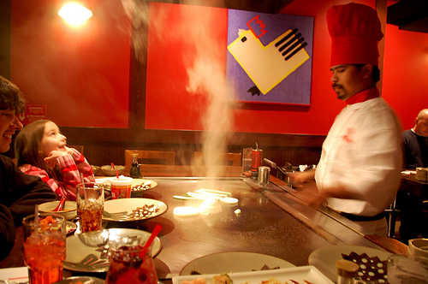
The Benihana Experience
Front Stage
Back Stage

Slide 46
Generic Service Blueprint

Slide 47
Service Blueprint for Hotel Stay

Slide 48
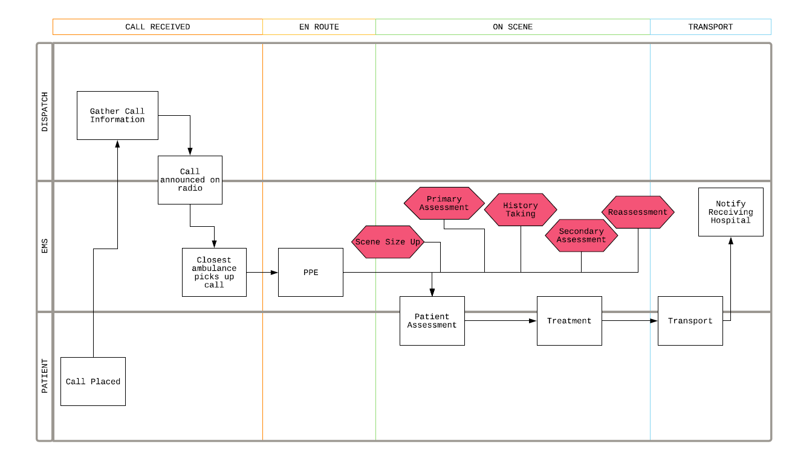
“Service Blueprint” for 911 Medical Emergencies

Slide 49
Service Intensity and Touch Points
Services differ intrinsically in the number of touch points they require to create value; this is often called the service intensity
Traditional P2P service system design ASSUMES that intensity is positively correlated with service quality
This view lets us treat intensity as a design parameter to differentiate service offerings of the same type or industry domain
The “generic” service offering is a design pattern that can be increased or reduced in intensity by changing the number of touch points
Notes:
49

Slide 50
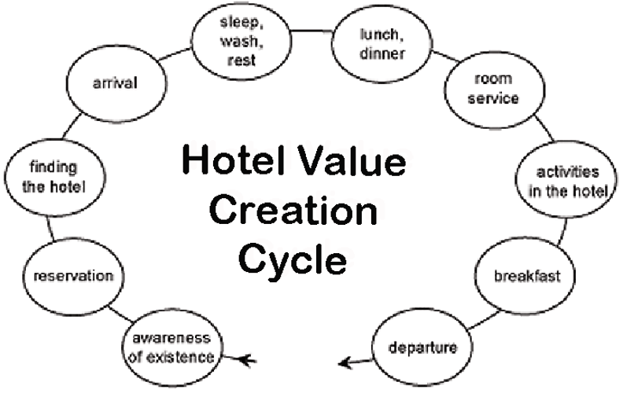
Generic Hotel “Value Creation Cycle”
Notes:
50

Slide 51
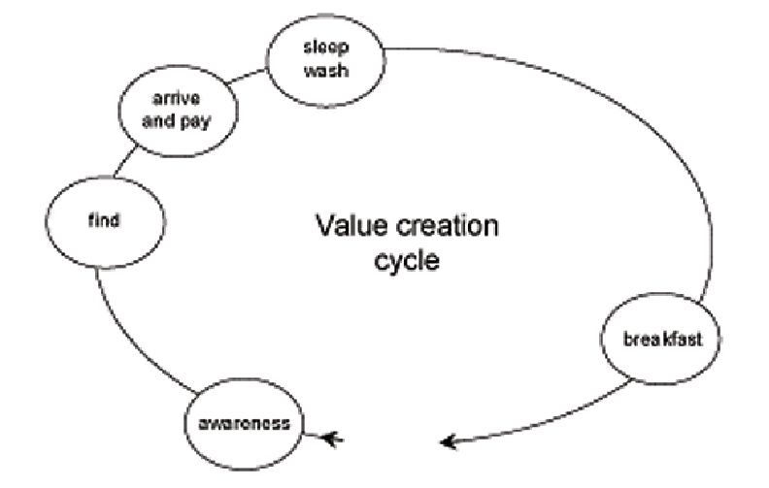
Budget Hotel “Value Creation Cycle”
Notes:
51

Slide 52
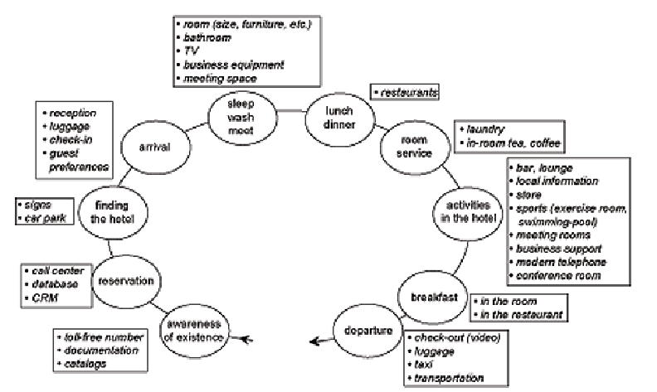
Luxury Hotel “Value Creation Cycle”
Notes:
52

Slide 53
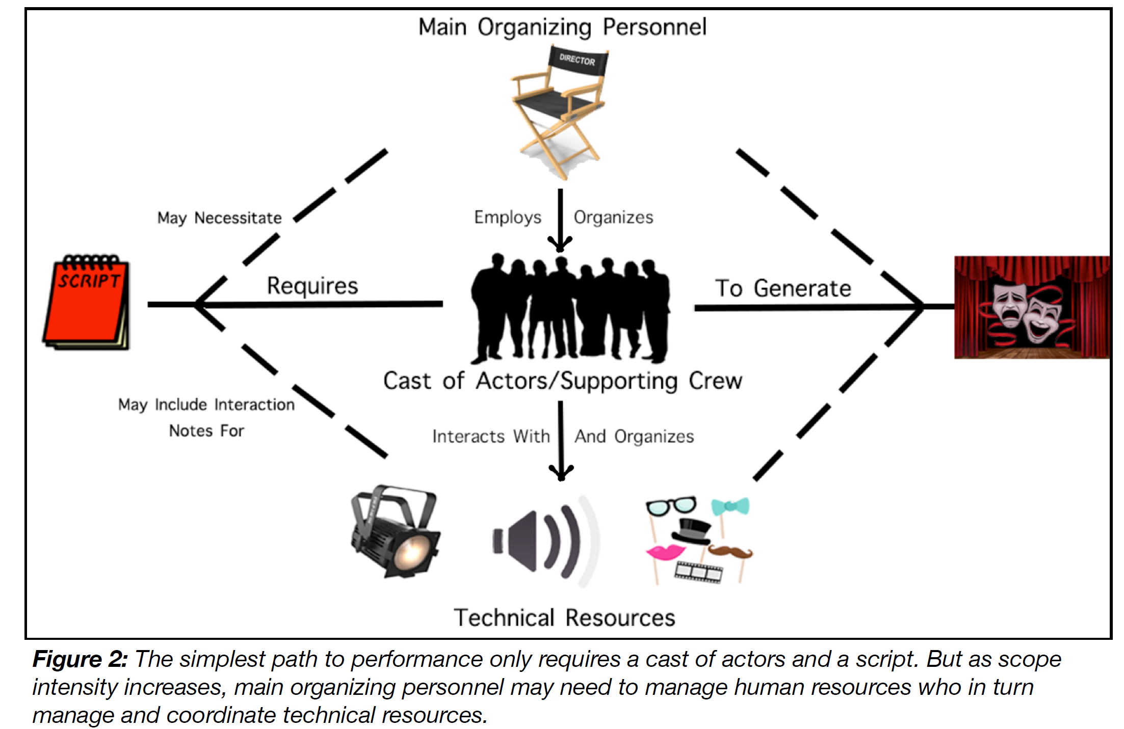
Stage Play Variations

Slide 54
Process Models (2)
Information process models highlight where information flow or computation dictates the change of state
A timeline can show significant events in the evolution of an organizing system (different versions, new requirements, new stakeholders)

Slide 55
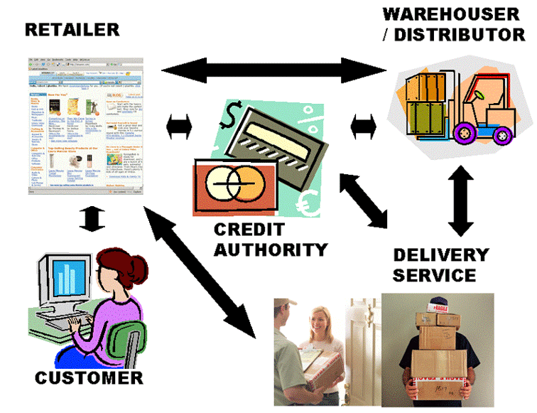
Drop Shipment

Slide 56
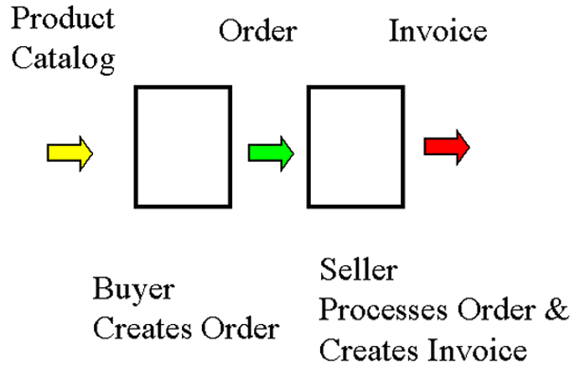
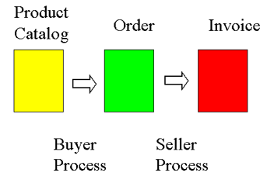
Process-Centric View
Document-Centric View

Slide 57
The Evolution of the Diagnostic and Statistical Manual of Mental Disorders
http://www.tiki-toki.com/timeline/entry/749012/An-Overview-of-the-DSM/

Slide 58
Semantic / conceptual Models
Concept map – emphasizes semantic relationships, often hierarchical
Org charts for “human resources”
Compare/contrast 2 or more organizing systems or a system as it changes over time
Decision trees for categorization
Implementation of organizing systems with principles expressed as rules

Slide 59
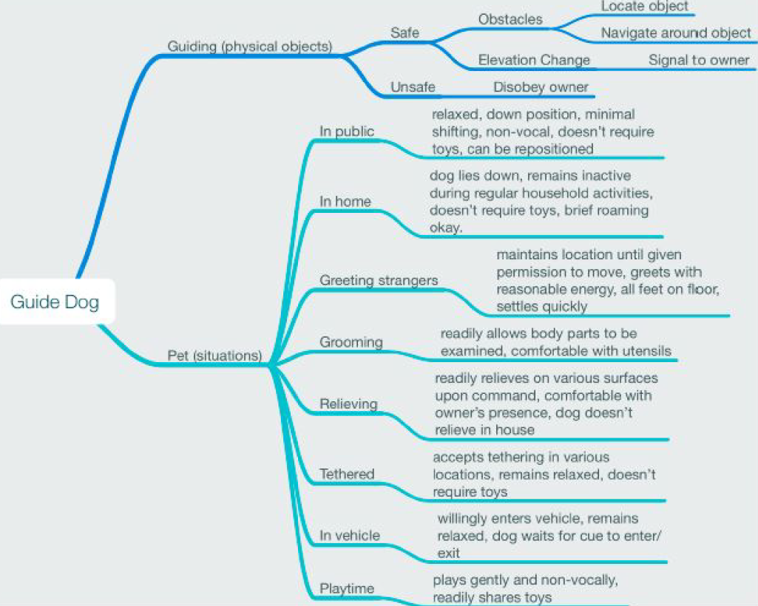

Slide 60
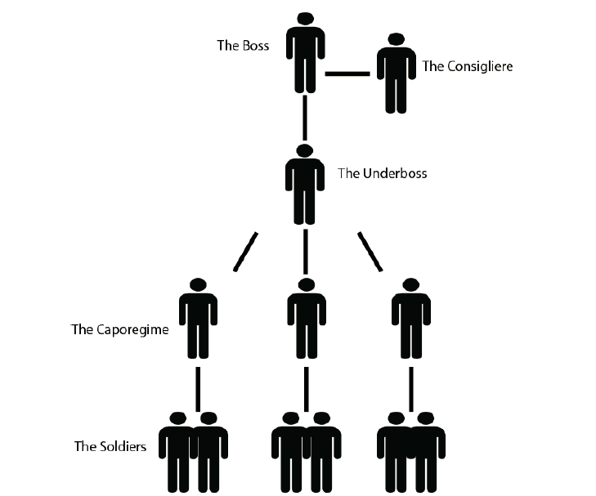
CRIME FAMILY (strong fixed hierarchy)
http://godfather.wikia.com/wiki/Corleone_crime_family

Slide 61
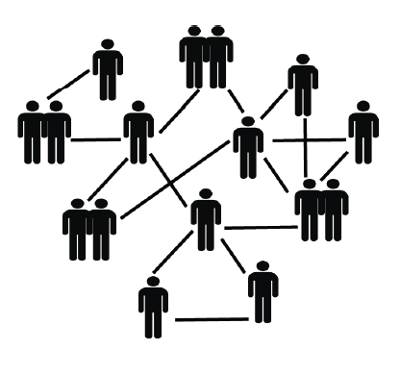
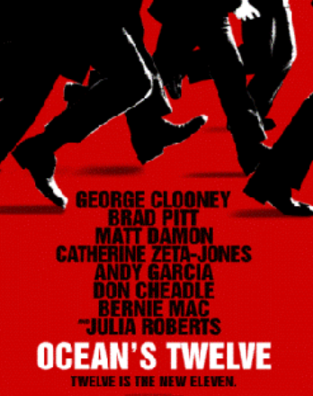
CRIMINAL NETWORK
(ad hoc team selection for each crime)

Slide 62
Document Type Spectrum
Crime Type Spectrum

Slide 63
Which Intentional Community Should You Live In?
Use this decision tree:
https://www.buzzfeed.com/carinasauter/which-intentional-community-should-you-live-in-2q1m9
What is important to you in life?
Where do you want to live?
Which people do you want to live with?
What describes you?

Slide 64
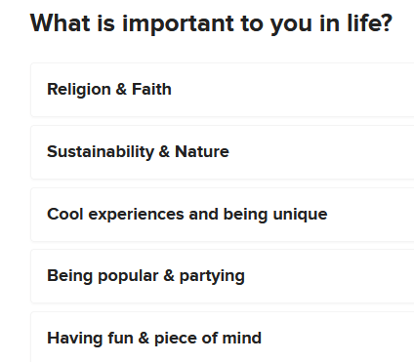

Slide 65
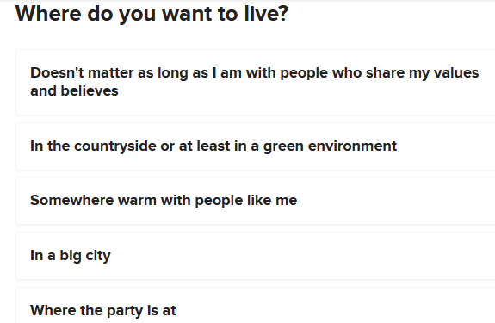

Slide 66
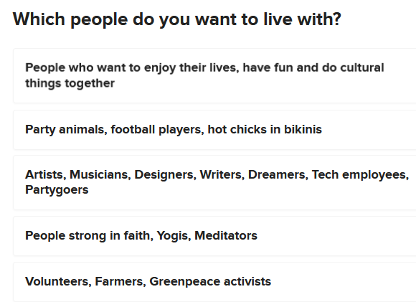

Slide 67
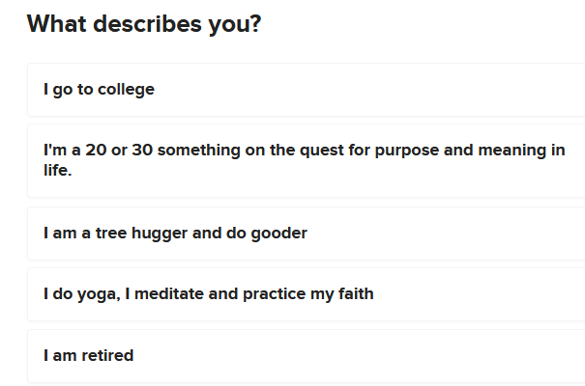

Slide 68
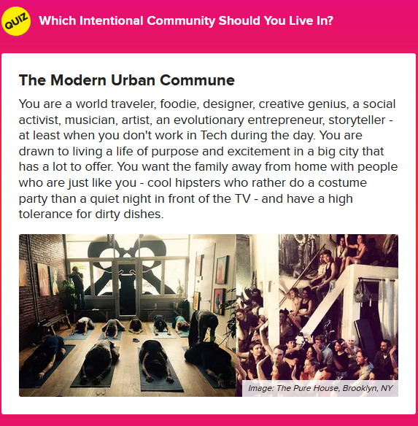

Slide 69
Assignment 1 (due Friday 10am so we can discuss in sections)
10 case studies: sort the 10 types of resources into resource categories
Find at least three sets of case studies where the same or very similar principles are being applied
In some of the case studies, the type of resource and the context in which they are being organized meant that there were many choices about the organizing principles. In other case studies, the type of resource and the context provided many constraints about the organizing principles. Find at least two case studies of these “choice” and “constraint” situations

