Slide 1
CogSci 150 “Sensemaking and Organizing” Spring 2022
Robert J. Glushko glushko@berkeley.edu
3 February 2022
6) Names and Identifiers

Slide 2
Plan for Today’s Lecture
Names – bad ones, good ones, authoritative ones
Identifiers
Resources and Identity over time
Renaming –Why, When, How, …
2

Slide 3
STOP AND THINK: Give Me A Name

Slide 4
What is a Name?
A NAME is a label for some thing or some category that distinguishes one from another
Many English (sur)names are literally resource descriptions that suggest category membership
Occupations: Smith, Miller, Taylor, Wright
Kinship: Johnson, Wilson, Anderson
Appearance: White, Brown, Black
Locations/Origin: Blackburn, Bush, Ford, Hill, Woods, Turk
4

Slide 5
Stop and Think
Many of you speak languages other than English so you might know if surnames in your other language can be resource descriptions…

Slide 6
What is a Name?
Most resource names do not convey properties of the resource
If a name is used to refer to some thing and is unique in some context it is an IDENTIFIER
6

Slide 7
Issues with Names and Naming – 1
A specific resource or type or resource can often have multiple SYNONYMS or ALIASES
box, carton
Bob Glushko, Robert J. Glushko, Dr. Bob
Different things can sometimes have the same names -- these are HOMOGRAPHS or POLYSEMES
Bank (money sense), bank (river sense)
John Smith, 张伟(Zhang Wei)
7

Slide 8
Synonyms: What Name Did You Give Me?
Coffee Cup
Mug
Tasse (if you’re French)
Taza (if you’re Spanish)
(if you’re Chinese)
杯子

Slide 9
Stop and Think
Why is homonymy/polysemy a more important concern in naming than synonymy when referring to resources?

Slide 10
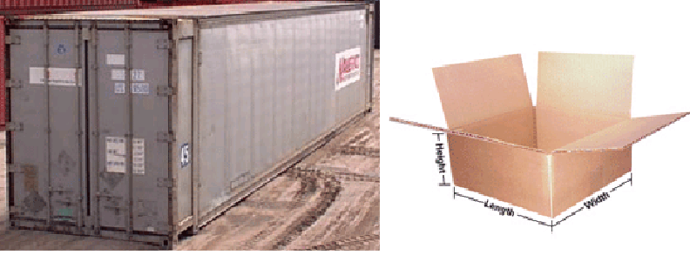
POLYSEMES: Both are “Shipping Containers”
STOP AND THINK: How can you (or some computational process) determine which meaning is intended with polysemous words or phrases?
10

Slide 11
The “Vocabulary Problem”
People use a large variety of words for the same thing or concept
Most people - especially system designers - are surprised by this because they think their own word choices are “intuitive” or "natural“
The extreme variability of word selection is an inescapable fact that has its roots in the nature of language and categorization
11

Slide 12
Stop and Think
What are the implications of the vocabulary problem for UI design?
How do you choose names for resources and interactions?
How should you do it?

Slide 13
Issues with Names and Naming – 2
False cognates (GIFT, PAIN)
A name can have undesirable associations (but renaming can be contentious…)
A name can have impermanent attributes or associations or be “faddish”
Alphabetic ordering bias
Autogenerated names don’t convey any meaning (SCAN0098.JPG)
13

Slide 14
Stop and Think
Are there false cognates in other languages? (let’s take advantage of the language diversity it our class this semester)

Slide 15
“China Lucky Numbers” for Air Travel (Wikipedia)
Air Canada route, Shanghai to Toronto: Flight AC88
KLM route, Hong Kong to Amsterdam: Flight KL888
Etihad Airways route, Abu Dhabi to Beijing then onwards to Nagoya: Flight EY888
United Airlines, Beijing to San Francisco: Flight UA888, and the route from Beijing to Newark is Flight UA88
Air Astana, Beijing to Almaty: Flight KC888
British Airways, Chengdu to London: Flight BA88
Cathay Pacific's from Hong Kong to Vancouver and New York is CX888
What is an unlucky number in China that would never be in a flight number?
15

Slide 16
OSHA – In Thai, means “delicious” food “fit for a king”
OSHA, the Occupational Safety and Health Act of 1970, gives employees and their representatives the right to file a complaint and request an OSHA inspection of their workplace if they believe there is a serious hazard

Slide 17
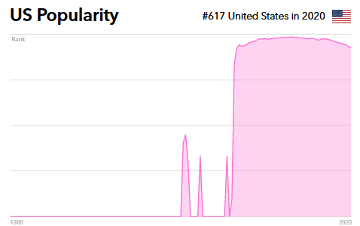
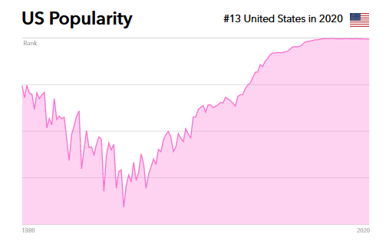
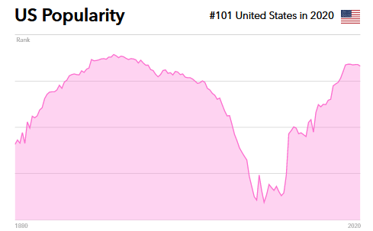
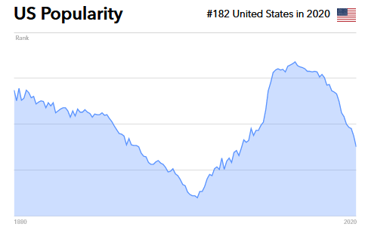
Name Popularity Waxes and Wanes
https://mom.com/baby-names
CARLY
ABIGAIL
VIVIAN
ALEX
What factors or events affect the popularity of names?

Slide 18
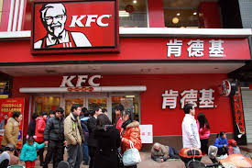
The Most Popular Fast Food Chain in China
A long way from Kentucky, so a name change made sense

Slide 19
Variant Forms of Names
A generic problem in resource description is dealing with variant name forms
Same person (or resource) uses or is given different names
Many of you use nicknames, or used to
Different people (or resources) use the same name
100+ Carly Wright on LinkedIn
40+ Kathryn Larsen on LinkedIn
19

Slide 20
Different Forms of “Same” Author Name
From an old version of Bowker’s Books in Print
20

Slide 21
Same Name for Different Authors
21

Slide 22
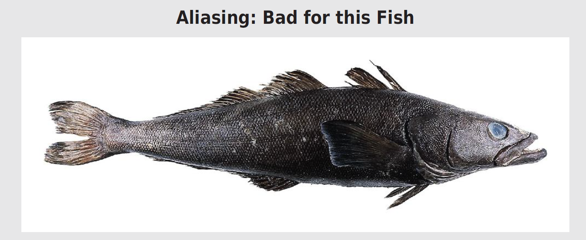
This is a Patagonian Toothfish; they happily swam in Antarctic waters because they are ugly even though they are tasty
An enterprising seafood wholesaler started marketing it as “Chilean Sea Bass” even thought it not found near Chile and is not a bass
This alias led to overfishing; fortunately, most “Chilean Sea Bass” is now farmed; it wasn’t easy

Slide 23
Stop and Think
What other food resources have been renamed or rebranded to make them more appealing or to avoid undesirable associations?

Slide 24
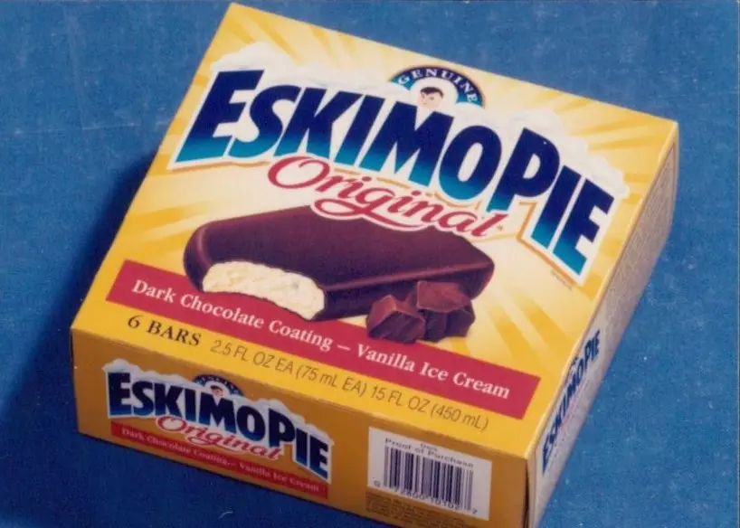
Chinese Gooseberry -> Kiwi Fruit
Eskimo Pie ->
Edy’s Pie

Slide 25
Normative Forms of Names
When names appear in multiple forms, one form needs to be chosen; criteria include:
Fullness (e.g., full names vs. initials only)
Language of the name
Spelling (choose predominant form)
Entry element
"Smith, John" not "John Smith"
"Mao Zedong" or "Zedong, Mao" or "Mao Tse Tung" or ?
25

Slide 26
Authority Control
Authority control is concerned with creation and maintenance of a set of terms that have been chosen as the standard representatives for some resource based on some set of rules
The Library of Congress maintains an "authority file" for the names of persons, corporate entities, geographic names of political entities, and titles of works
See http://www.loc.gov/marc/uma/ and http://authorities.loc.gov/
26

Slide 27
Naming Laws
Many countries (and US states) have laws that restrict the names that can be given to children
José is not recognized as legal in California
Many countries require that names “indicate gender”
Many countries prohibit names that “might offend a reasonable person,” cause trouble for the child, or emphasize religion
See: Larson, C. F. (2011). Naming Baby: The Constitutional Dimensions of Parental Naming Rights. Geo. Wash. L. Rev., 80, 159.
In the US, does the 1st amendment – freedom of speech – protect your right to give your baby any name?

Slide 28
Questions about Names
How many names should be associated with an information object or resource?
Should one be designated as the preferred or authoritative form? Who decides?
What references should be made from other possible forms of names that haven't been used? Should you autocorrect/coerce?
if you have a common last name, should you give your kids a rare first name?
28

Slide 29
Place Names – “Toponyms”
Naming “a piece of space” creates a “place”
Consistency and accuracy in referring to a place prevents confusion in communication
Place names encode the history of settlement, ethnography, immigration, government, or prevailing ideology
Some are thousands of years old, a vital part of individual and collective sensemaking, memory, and identity
Undifferentiated space becomes a place as we get to know it better and give it meaning
29

Slide 30
Street Naming Principles – “Odonomy”
Letters and Numbers to create a grid:
Avenue A, B, C…. , 1st, 2nd, 3rd streets or avenues
Industry or commercial categories: Cannery Row
Landmarks: Wall & Canal Streets, NY City; Mission in SF
Famous people: US Presidents; every US city has a “MLK”
Thematic (often combined with alphabetic ordering)
On SF west side: explorers and early settlers (…, Kirkham, Lawton, Moraga, Noriega, Ortega, Pacheco, Quintara,…)
Washington DC – streets named after states
30

Slide 31
Naming Problems for Places
Variant forms: St. Petersburg, Санкт Пербургскйй, Saint-Pétersbourg
Multiple names: Cluj, in Romania / Roumania / Rumania, is also called Klausenburg and Kolozsvar
Homographs: Alexandria, Vienna, Washington are common
Anachronisms: No Germany before 1870
Vague, e.g., Midwest, Silicon Valley
Unstable boundaries: 19th century Poland; Balkans; USSR, Ukraine
Name changes: Bombay -> Mumbai; St Petersburg -> Petrograd -> Leningrad -> St Petersburg
31

Slide 32
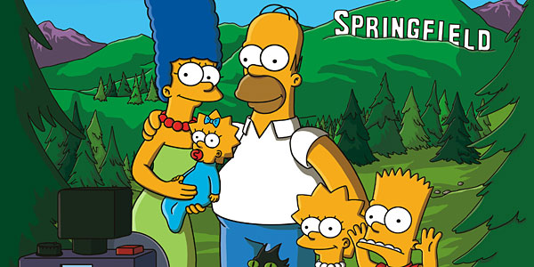
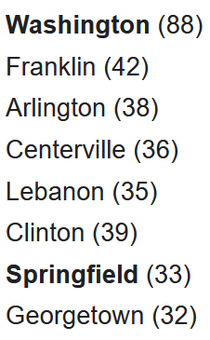
There are over 100 places called “Springfield” in the US, Canada, Australia, the UK, and elsewhere, but this one is more famous
CITY NAMES IN US

Slide 33
Authoritative Place Names
Places have latitude and longitude coordinates, so we can link places and spaces with a GAZETTEER
A gazetteer is a place name authority file that:
Indicates what kind of place it is
Objectively specifies latitude and longitude
Disambiguates similar place names
Brings variant names together
Allows places to be displayed on maps
33

Slide 34
The Name Matching Problem
Name matching" is the task of determining when two different strings denote the same person, object, or other named entity
This problem has many other names (Ironic…)
Co-reference resolution
Duplicate detection
De-duplication
Record linkage
Object consolidation
Merge-purge
Householding
Fuzzy/approximate matching
34

Slide 35
Stop and Think
Data scientists, wake up!
Most of these techniques use the same or very similar algorithms…. How do they work?

Slide 36
Identifiers - 1
An identifier is a special type of name assigned in a controlled way and governed by rules that define possible values and naming conventions; "some person or organization asserts the relationship between the string and the thing” (Coyle, 2006, p. 428)
The same resource can have more than one identifier
How many different identifiers can a person have?
What if the answer is “none”?
36

Slide 37
Stop and Think
List all the identifiers that have been assigned to you
If you can’t think of at least 5, try harder
37

Slide 38
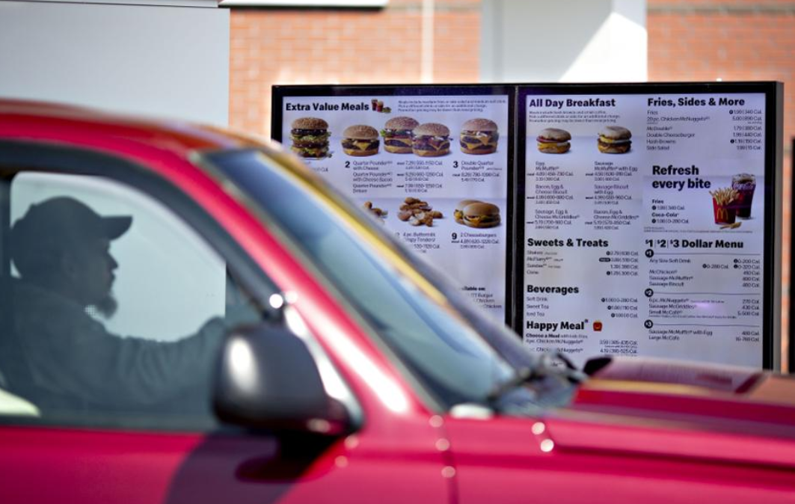
License Plate as Customer Identifier
McDonald’s has been trialing the use of license plates of customers in the drive-thru to identify repeat customers. The driver’s buying history is used to create a personalized menu

Slide 39
Identifiers - 2
Identifiers are UNIQUE if they refer to one and only one resource within some defined context or scope
Identifiers are PERSISTENT if they resolve to the same referent indefinitely, or as long as needed; but persistence is a function of organizations, not technology
39

Slide 40
Identifiers - 3
Identifiers are UNSTRUCTURED or DUMB (as opposed to STRUCTURED or INTELLIGENT ) if they have no inherent meaning based on their values
Identifier schemes are designed to be STRUCTURED or INTELLIGENT but over time they often become less so
40

Slide 41
ISBN on Bar Code
Publisher
Title
Check Digit
41

Slide 42
Location Identifiers
“Geocoding” identifiers that highly-structured can be used to specify a location
37.871432,-122.258499
What3words (WHY?)
My SF home office: goal.piano.bath
Metric distance from town center in France
Addresses in Japan identify buildings by subdividing land into smaller units as needed based on population density
42

Slide 43
Resources and Identity Over Time
Organizing systems continually need to adapt and evolve in response to changes in content and context
New resources are created or added, and other ones are destroyed or culled
Resources might change in controlled ways or in uncontrolled ways
The organizing system might need automated or formal mechanisms for ensuring persistence and authenticity
43

Slide 44
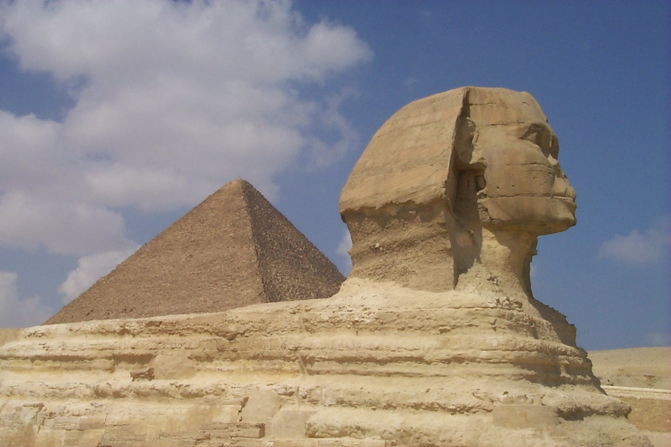
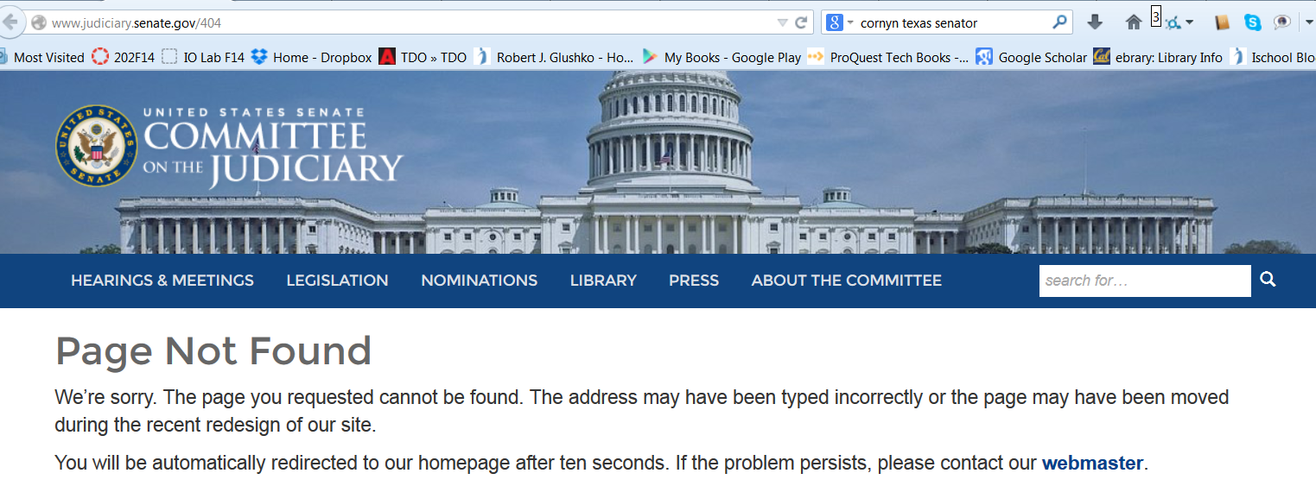
Persistence
44

Slide 45
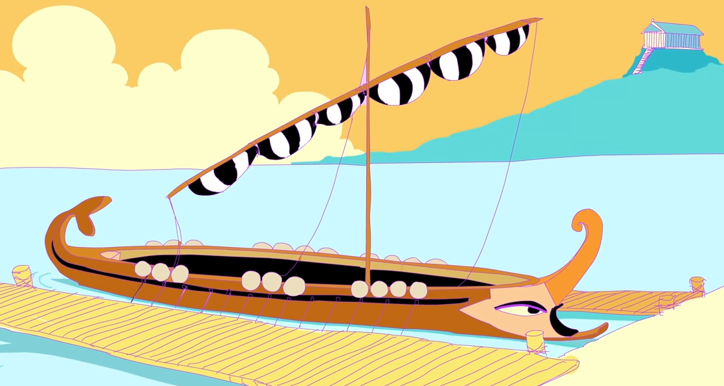
The Paradox of Theseus (1900 years old)
How or whether identity persists over time is a very deep and old question
“The ship wherein Theseus and the youth of Athens returned had thirty oars and was preserved by the Athenians… they took away the old planks as they decayed, putting in new and stronger timber in their place.
This ship became a standing example among the philosophers, for the logical question of things that grow; one side holding that the ship remained the same, and the other contending that it was not the same”

Slide 46
STOP AND THINK: Who Am I?
Which you is “who”? The person you are today? Five years ago? Who you’ll be in fifty years?
And when is “am”? This week? Today? This hour? This second?
And which aspect of you is “I”? Are you your physical body? Your thoughts and feelings? Your actions?

Slide 47
Authenticity
Buy an autographed photo from Ustar.net and get a Certificate of Authenticity
Or make your own cert?
Famous Forged Documents
Famous Forged {paintings, sculptures, signatures,…}
47

Slide 48
Authenticity in a Digital Environment – 1
We often use judgments about the physical integrity of recorded information to stand in for a judgment about the integrity of the text
Digital resources have no independent physical manifestations or indications of usage that can provide evidence "about their fate in the world”
48

Slide 49
Authenticity in a Digital Environment – 2
The "permeability" of digital environments makes it harder to ensure that resources have not been altered
Scholars trust technological solutions like time stamps, encryption, watermarks, and digital signatures; technologists are skeptical of them
In the digital world selecting for preservation has become a process of constant re-selection
49

Slide 50
Provenance
50

Slide 51
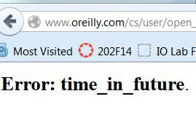
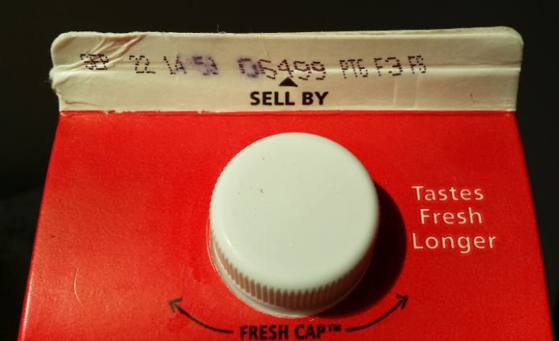
Effectivity
SEC. 108. This title shall take effect on the first day of the sixth month which begins after the date of the enactment of this title, except that the amendments regarding sections 19(b)(7) and 19(b)(8)(D) of the Federal Reserve Act shall take effect on the date of enactment of this title.
(From US Code of Federal Regulations)
51

Slide 52
Putting them all Together
TDO Figure 3.6
52

Slide 53
Place Names – “Toponyms”
FLASHBACK
Naming “a piece of space” creates a “place”
Consistency and accuracy in referring to a place prevents confusion in communication
Place names encode the history of settlement, ethnography, immigration, government, or prevailing ideology
Some are thousands of years old, a vital part of individual and collective sensemaking, memory, and identity
Undifferentiated space becomes a place as we get to know it better and give it meaning
53

Slide 54
Renaming
Place names are sometimes changed but…
It is often a political act that is almost always “socially embedded”
It is often an economic act
It raises questions about who can change a name and who has the standing to object to it
People often react with discontent and sometimes with anger
A new sub-discipline called “political” or “critical” toponomy has emerged
54

Slide 55
Renaming - When
After a governmental or political transition
After “state formation” – to purge colonial legacies and reinforce new identity
To upgrade a location’s value or status (often done by real estate organizations or gentrifiers)
Commercialization of public places
To assert power and sovereignty
Post-conflict / reconciliation / social justice – removing names that honored injustices
55

Slide 56
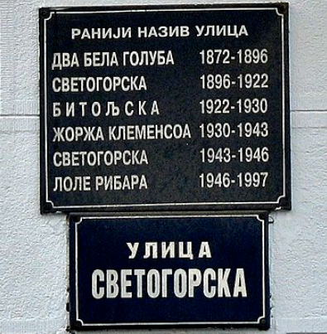
Renaming…over and over
A Belgrade street that began as "Two White Doves" in 1872 was renamed Svetogorska in 1896, Bitoljska in 1922, for Georges Clemenceau in 1930, Svetogorska again in 1943, for Lola Ribar in 1946, and Svetogorska again in 1997
See the sidebar “In Which Country Do You Live?” in TDO Section 4.5.2; the same Belgrade district has been part of 7 countries since 1921
56

Slide 57
India changes colonial city and state names to erase British names

Slide 58
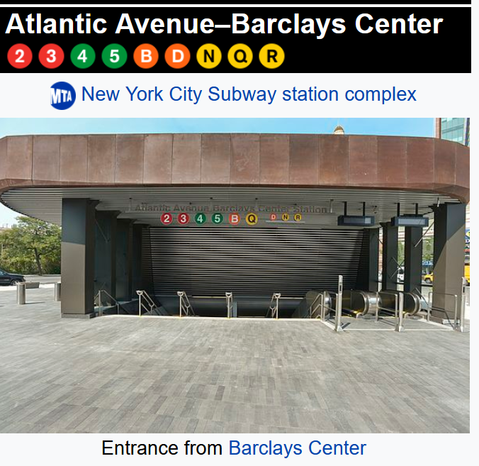
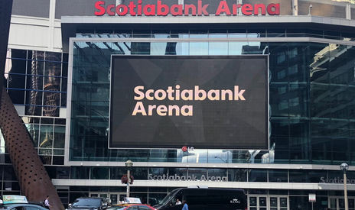
Corporate Branding of Public Spaces
20-year deal in 2017 to name the Toronto arena where the Maple Leafs and Raptors play cost Scotiabank $800M CAD

Slide 59
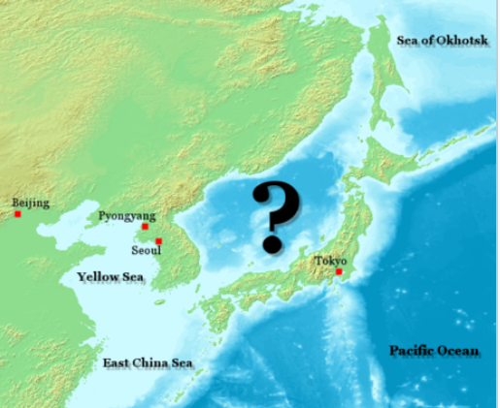
Renaming to Assert Influence
Wikipedia: “Sea of Japan Naming Dispute”
What is the authoritative name of the body of water marked with a "?".
Japan's preference: Sea of Japan
North Korea's preference: Korean East Sea
South Korea's preference: East Sea
59

Slide 60
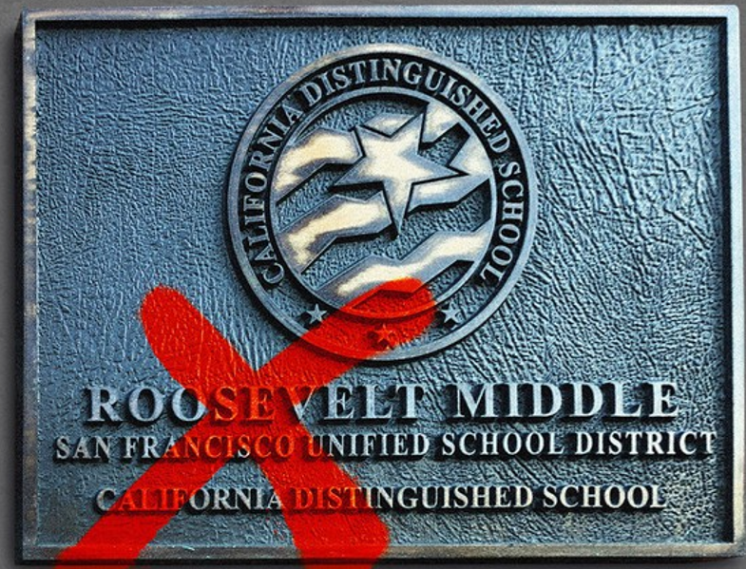
SF School Board Renaming Fiasco
In January 2021, the San Francisco school board announced that 44 public schools that “honored racists and sexists” must be renamed. The people that do not meet the board’s standards include Abraham Lincoln, George Washington, Thomas Jefferson, Theodore Roosevelt, John Muir, Robert Louis Stevenson, Paul Revere, and Dianne Feinstein
In April 2021, after intense local / national / international criticism, the Board suspended the renaming plan

Slide 61
STOP AND THINK
What mistakes did the San Francisco School Board make with this renaming plan?
What process or principles should be followed to ensure that renaming can be accomplished or prevented, depending on what makes sense…
But who should devise the process or principles… and what makes sense?

Slide 62
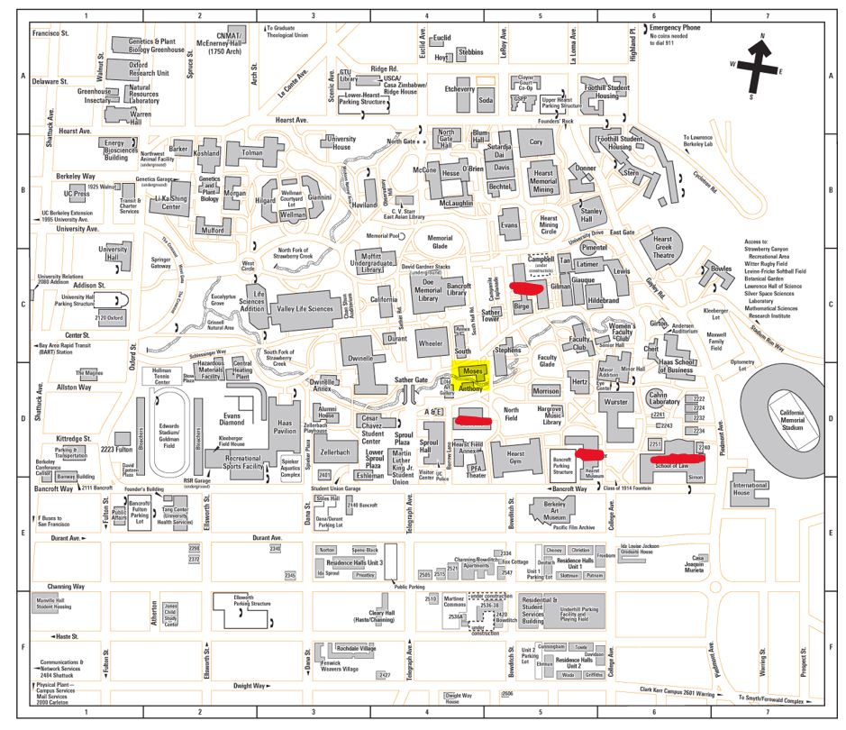
UC Berkeley Building Renaming
https://chancellor.berkeley.edu/task-forces/building-name-review-committee
RED: Renamed
YELLOW: Proposed Renaming

Slide 63
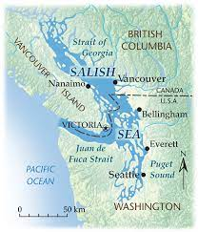
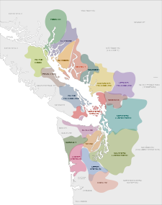
The “Salish Sea” – a Complementary Name, Not a Replacement
The Salish Sea was proposed in 1988 as a name for the combined waters of Georgia Strait, Puget Sound, and Strait of Juan de Fuca., The goal was to raise consciousness about taking care of the region's waters and ecosystems and to honor the indigenous people of the region.

