Slide 1
CogSci 150 “Sensemaking and Organizing” Spring 2022
Robert J. Glushko glushko@berkeley.edu
8 February 2022
7) Resource Description

Slide 2
TDO’s Mantra
Organizing, resource description, and interaction design are inherently interconnected activities

Slide 3
Agenda
What is a resource description?
Why do we describe resources?
Why I despise and banish the term “Metadata”
Exercise To “Identify Descriptive Properties”
TDO 5.3 “The Process of Describing Resources”
3

Slide 4
What is a Resource Description?
Flashback: An ORGANIZING SYSTEM is an intentionally arranged collection of resources and the interactions they support
This definition implies that a resource description is:
Information that is created intentionally and associated with a resource to enable it to be organized and interacted with
4

Slide 5
Describing Resources <=> Organizing
Resource description and organizing are intrinsically connected
You can’t organize what you haven’t described implicitly or explicitly... because the principles embodied in any organizing system reflect decisions about:
resource granularity (WHAT to organize)
resource descriptions (HOW to organize)

Slide 6
Stop and Think
Organizing Principles <=> Resource Descriptions
Example:
Frequency of Use <=> Usage information
The double arrow symbol ⬄means the implications run in both directions:
if you want to organize by frequency of use, you need usage information
If you have usage information, you can organize by frequency of use
You can start with desired organizing principles and then find or create the required descriptions, or start with the descriptions you have and then implement the organizing principles they enable

Slide 7
Organizing Principles <=> Resource Descriptions
Frequency of Use <=> Usage information
Color, shape, size… <=> Physical properties
Alphabetical order <=> Sortable resource name or identifier
Chronological order <=> Sortable date/time of important event
Semantic <=> Content description

Slide 8
The First Resource Descriptions
The Library of Alexandria had 500,000 papyrus scrolls stored on shelves according to their topic
Starting in 3rd century BCE, each shelf had an associated painted tablet with a list of the titles and authors of the scrolls it contained (these were called pinakes - (pee-na-kays)
Scrolls have significant usability problems… so the book was invented

Slide 9
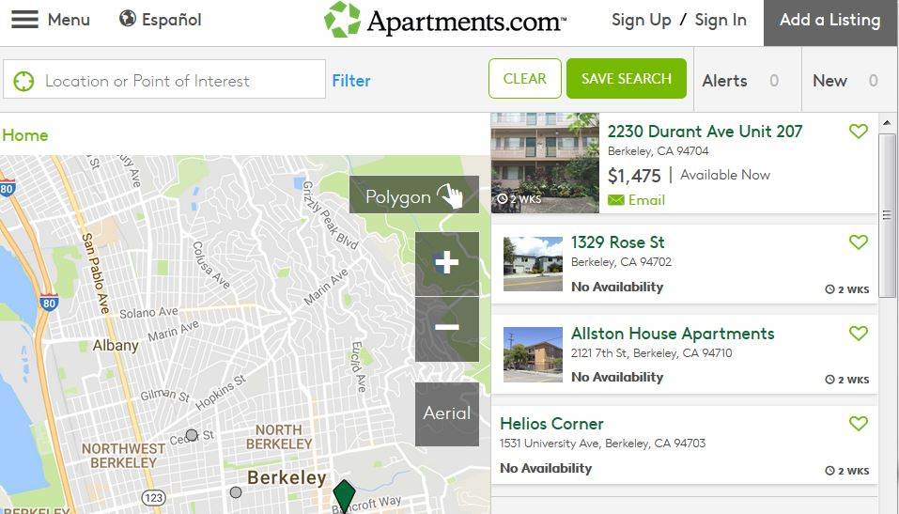
Resource Descriptions as Substitutes
FLASHBACK
A resource description (e.g., in a library catalog or search engine) is a functional substitute for the resource it describes
Digital descriptions of physical resources enable interactions that are otherwise inefficient or impossible
9

Slide 10
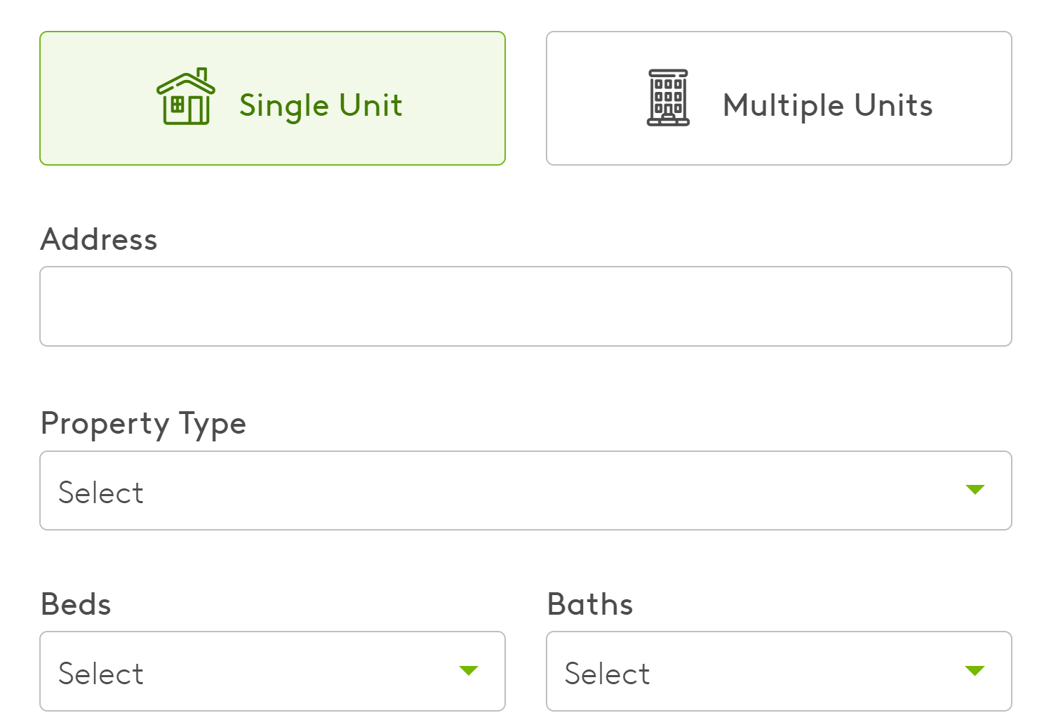
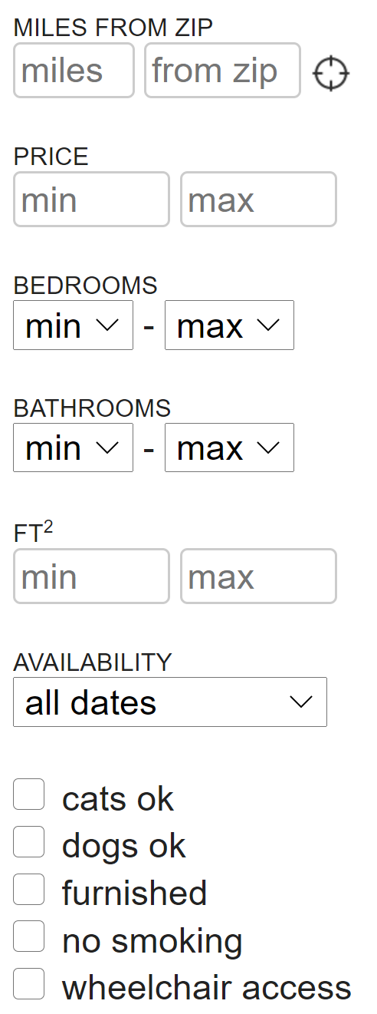
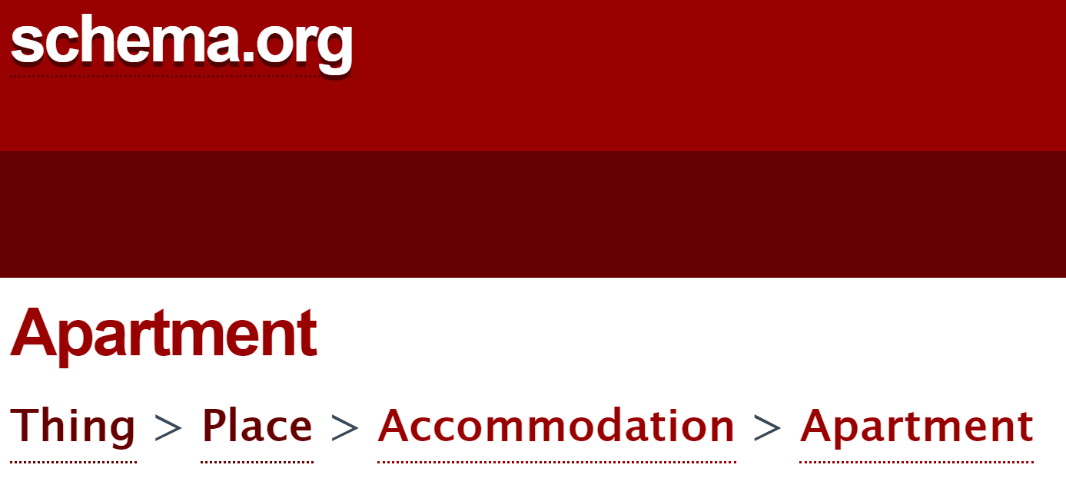
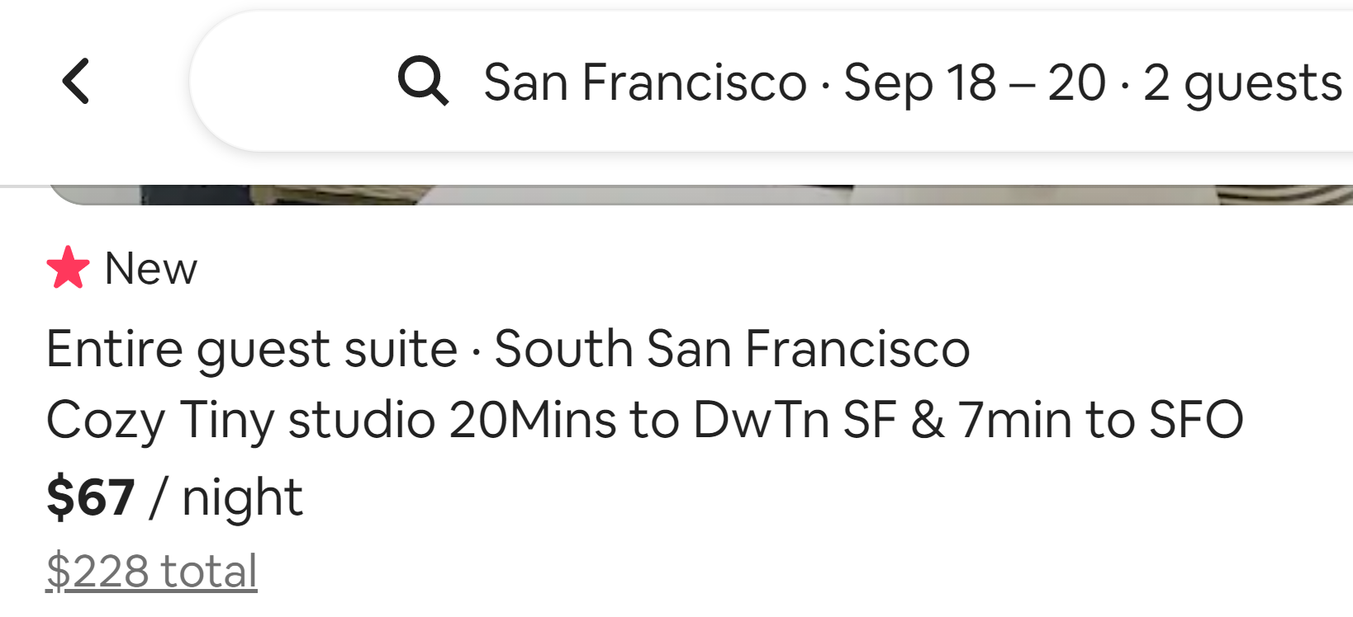
Substitution Requires a “Reasonably Standard” Description of Instances (a “Schema”)
CRAIGSLIST
APARTMENTS.COM
AIRBNB
10

Slide 11
Schemas for Describing Resources
Resource domains can have characteristic or standard resource descriptions that are applied to every resource instance (often called “schemas” or “domain-specific languages”) and in doing so define resource categories
“Categorization” – 2/15
“Document Engineering & Modeling” – 2/22
11

Slide 12
Document Analysis & Document Engineering
A document schema is a specification of the category of resources/events/processes that some set of documents describes
DOCUMENT ANALYSIS is the process of extracting the content components from the structural and presentational components in a document
DOCUMENT ENGINEERING is the process of analyzing the sets of content components taken from a collection of documents, consolidating and organizing them, and then creating a document schema that can be used to enable interactions as required
On 2/22 you’ll learn how to do this (for Assignment 5)
12

Slide 13
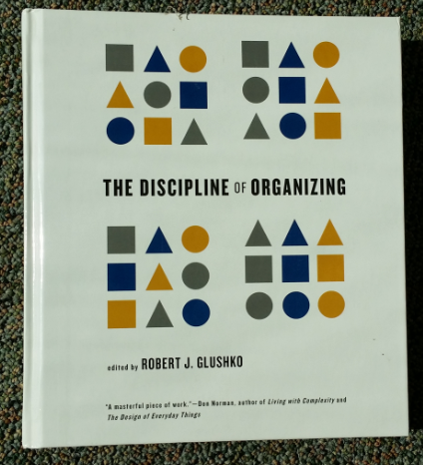
Describing the Same Resource for Different Purposes => Different Schemas
<Book>
<Title>The Discipline of Organizing</Title>
<Editor>Robert J. Glushko</Editor>
<Publisher>MIT Press</Publisher>
<PublicationDate>2013</PublicationDate>
<ISBN>978-0-262-51850</ISBN>
<Keyword>Classification</Keyword>
<Keyword>Resource Description</Keyword>
</Book>
<Book>
<Title>The Discipline of Organizing</Title>
<Weight unit=“pound”>2.58</Weight>
<Height unit=“inch”>9.25</Height>
<Width unit=“inch”>8.25</Width>
<Pages>540</Pages>
<SpineColor>White</SpineColor>
</Book>
13
(TDO 1st edition was available in print)

Slide 14
Stop and Think
These two descriptions for “the same thing” are very different
…because they are used for very different purposes (which are???)
They only share one description: <Title>
What is this “shared description” called in relational database terminology?

Slide 15
Structured descriptions of (information) resources are often called “metadata” (“data about data”)
But unless the resource being described is a collection of data, this is factually wrong

Slide 16
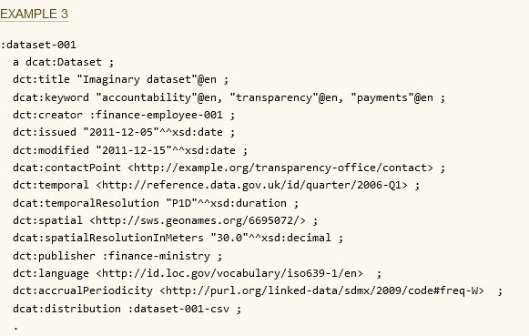
It is OK to say “Metadata” when describing data

Slide 17
But I Think Most Uses of “Metadata” Are Wrong Or Misleading
Any resource can have associated descriptions, not just information resources, and the descriptions don’t need to be “data”
The most valuable descriptions are about human resources (and people aren’t data)
And what’s “metadata” for you might be “data” for me, or vice versa (“Resource Focus”)
17

Slide 18
A Guard Dog is a Resource
Something of value that can be identified and that supports goal-directed activity (TDO 1.3)

Slide 19
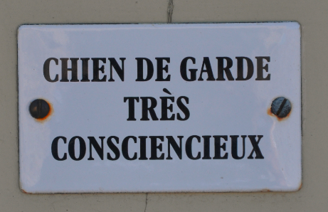
Two Resource Descriptions: Metadog, not Metadata
dans Les Baux-de-Provence, 8 Août 2013

Slide 20
Icons and Signs as Descriptions of Businesses
These are resource descriptions, but they aren’t “data about data” in any sense of “data”

Slide 21
Stop and Think
Why are pictures or physical objects effective as resource descriptions?

Slide 22
Descriptions of “Human Resources” (People)
A great deal of data is collected about people anytime they use the Internet, a cell phone, a credit card, or otherwise interact with systems, sensors, or devices that can collect information about them
These resource descriptions are used computationally to make predictions about beliefs and behavior, and to actively try to change them
They determine whether to give you credit, to hire / fire / promote you, to arrest / sentence you, to change your diet or exercise routine, or which resources to show you on Google, Facebook, Twitter, Amazon, dating sites, etc.
22

Slide 23
NSA & Govt Tell You “It’s Only the Metadata …. Don’t Worry”
After Edward Snowden in 2013 leaked NSA documents about the NSA’s collection of everyone’s phone call “metadata” we were told it wasn’t surveillance:
Senator Dianne Feinstein, the chair of the Senate intelligence committee: "The call-records program is not surveillance. It does not collect the CONTENT of any communication names or locations. The NSA only collects the type of information found on a telephone bill: phone numbers of calls placed and received, the time of the calls and duration."

Slide 24
Stop and Think
Why is there a red herring on the slide?

Slide 25
Thanks, Dianne for Reassuring Us
Leaked NSA document says metadata collection is one of agency's 'most useful tools'
A leaked NSA newsletter published Wednesday highlights the collection of phone metadata as one of the agency's "most useful tools. The document says that the NSA has used metadata such as numbers called, IP addresses, and call duration to yield "concrete results," such as the capture of terror suspects Khalid Sheikh Mohammed and Abu Zubaida.
https://www.businessinsider.com/nsa-document-metadata-2016-12
FLASHBACK TO “RESOURCE FOCUS” – phone company metadata is NSA data

Slide 26
Stop and Think – Describing Yourself
What are the 2 or 3 most important resource descriptions when you:
Apply to college

Slide 27
Stop and Think – Describing Yourself
What are the 2 or 3 most important resource descriptions when you:
Apply for a job after graduation

Slide 28
Stop and Think – Describing Yourself
What are the 2 or 3 most important resource descriptions when you:
Are looking for someone to date

Slide 29
Stop and Think – Describing Yourself
What are the 2 or 3 most important resource descriptions when you:
Apply for a loan or financial aid

Slide 30
Stop and Think – Describing Yourself
Who / what determines the importance of the descriptions in each context?
What other “contexts of description” have you been in?
How many different descriptions have been assigned to you?

Slide 31
If You Aren’t Careful With Your Personal Data, You’re Zucked

Slide 32
Where Do Research Descriptions Come From?
How Do We Design and Select Them?

Slide 33
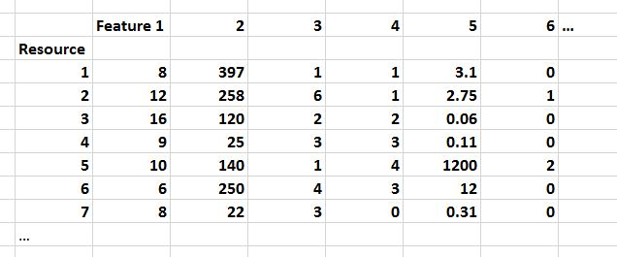
In data science, resource descriptions are typically called “properties” or “features” in a dataset like this…
Resource descriptions often are represented as a “feature vector” – a row in a dataset. Each row is a resource, and the value in each column is a resource description.

Slide 34
Stop and Think
If you’re given this data set and told to analyze it, what questions should you ask first?

Slide 35
Some Good Questions To Ask
Where did this dataset come from and what does it mean?
How were the resources (the rows) defined, designed, or selected?
How were the resource descriptions defined, designed, or selected?
Were the purposes for which these resources and resource descriptions were collected the same as or compatible with those of the intended data analysis?

Slide 36
The Wrong Questions To Ask First
Will my model be used to predict feature values for new instances, or will it be used to classify them?
What Python library seems like the best fit for the structure of the dataset and the type of model?
Unfortunately, this slide is not a joke; I’ve heard both answers many times
Prediction and classification are important cognitive activities, but when WE do them, we make use of detailed knowledge about resource instances and categories; software doesn’t!
We understand our cognitive “dataset” – we aren’t just feeding some unknown data to some data-hungry software to see what patterns it discovers.

Slide 37
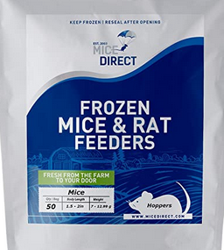
Don’t Just Feed Python!
Sorry I couldn’t resist. You can buy frozen mice to feed your pet python (thaw them first)
But I want you to remember this idea that there is more to data science than feeding data to Python

Slide 38
Class Exercise To “Identify Descriptive Properties”
“Data modeling”
“Content modeling”
“Document engineering”
“Feature selection”
“Feature engineering”
(Terms used in systems design, information architecture)
(Terms used in data science)

Slide 39
Describe Me
What’s the one best word that describes this resource, or the category of resources to which it belongs?
What properties or characteristics of this resource will enable you to determine whether other resources are in the same category as this one?
With this picture we will replicate the “Vocabulary Problem” you learned about last week, but this is just the beginning! ☺

Slide 40
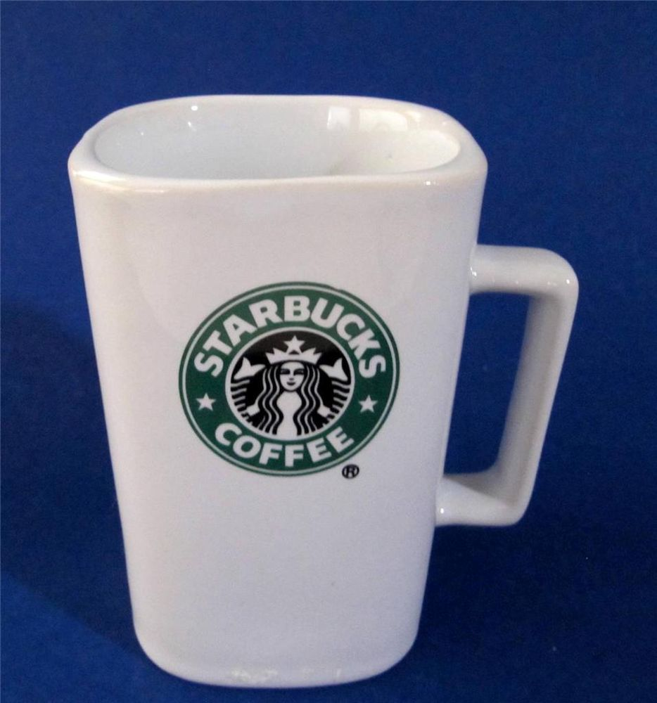
Is there another description term or property that you would assign to this resource so that it can be distinguished from the previous one?

Slide 41
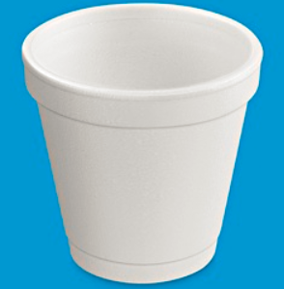
Is there another description term or property that you would assign to this resource so that it can be distinguished from the previous one(s)?

Slide 42
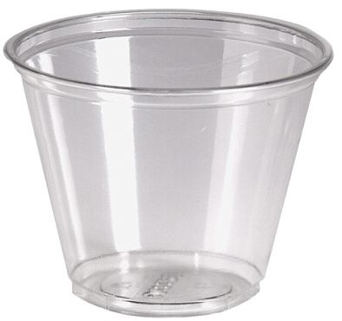

Slide 43
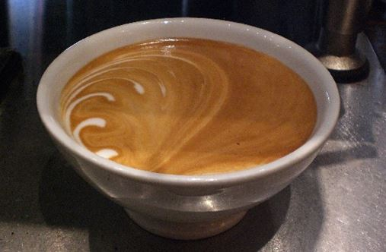

Slide 46
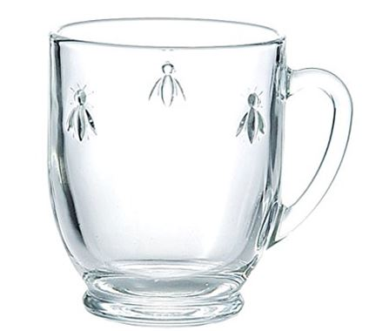

Slide 47
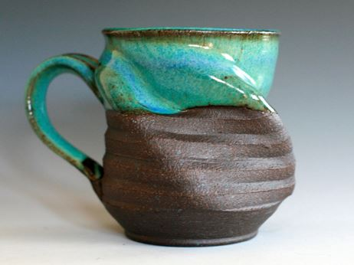

Slide 48
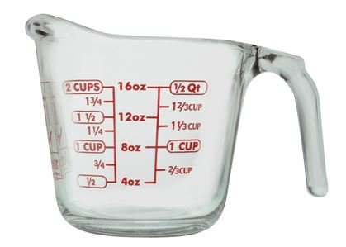

Slide 49
10

Slide 50
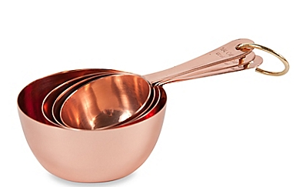

Slide 51
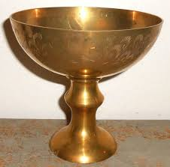

Slide 52
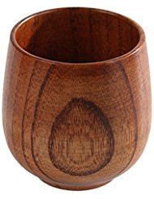

Slide 53
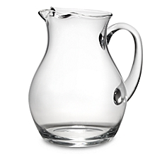

Slide 54
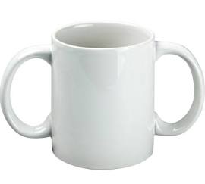

Slide 55
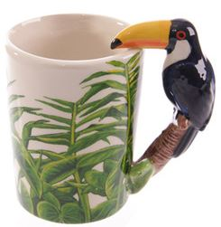

Slide 56
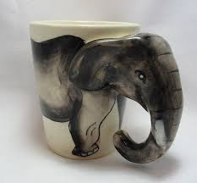

Slide 57
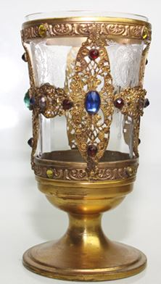

Slide 58
Possible Features that are Directly Observable
Exterior color
Interior color
Exterior finish
Interior finish
Capacity
Weight
Material of manufacture
Size
Shape
Contents

Slide 59
More Directly Observable Features
Current contents
Reusable?
Stackable?
Nestable?
Handmade?
Transparent?
Insulated?
Decorated?
Branded?
Starbucks?
Coffee shop name?
Stem?
Lid?
Measurement marks?

Slide 60
Still More Directly Observable Features
Spout?
Handle?
#of Handles
Handle material
Integrated handle?
Separate handle?
Decorative handle?
Animal handle?
Bird handle?
Toucan handle?
Fish handle?
Lizard handle?

Slide 61
Not Directly Observable Features Useful in Descriptions
Manufacturer name
Process of manufacture
Place of manufacture
Date of manufacture
Vendor name
Vendor location
Unit price
Bulk price
Previous unit price(s)
Previous bulk price(s)

Slide 62
Still More Possible Features
Current location
Previous location(s)
Primary use
Other use(s)
Current contents
Previous contents
Current user/owner
Previous user(s)/owner(s)
Date of first use
Date of most recent use

Slide 63
Identifying Descriptive Properties
What process did you follow to identify candidate descriptive properties?
It probably seemed easy to come up with description terms, but the vocabulary problem is unavoidable, because there are many words for essentially the same property
Did you consider descriptive properties that were not directly observable in the instances?
Did you organize / re-organize the properties as you saw more instances?
Did you recognize at any point that some features were logically overlapping, correlated, or redundant?
63

Slide 64
Which Descriptions To Use?
It is essential to know the planned uses and interactions with the resources; this is easier to do if a team rather than an individual is describing them
It helps a great deal to know what a collection contains when starting to describe its members… but why?
How many features do we need?
Specific features are easy to apply to instances, but many instances won’t have those features (=> sparse dataset)
More abstract features are helpful at bounding the domain / set of possible instances

Slide 65
A Systematic Process for Describing Resources

Slide 66
TDO 5.3 Proposes this Process for Describing Resources
1. Identify / scope the resources to be described
2. Determine the uses of the descriptions
3. Study the resource(s) to identify descriptive properties
4. Design the description vocabulary
5. Design the description form and implementation
6. Create the descriptions (either "by hand" or by some automated / computational process
7. Evaluate the descriptions
66

Slide 67
1. Scoping and Description
How explicit and thorough the 7 steps need to be depends on the collection “scope”
SCOPE: the breadth and variety of resource types in a collection
SCALE: the number of resource instances
A broad scope makes it harder to define and bound the resource domain
67

Slide 68
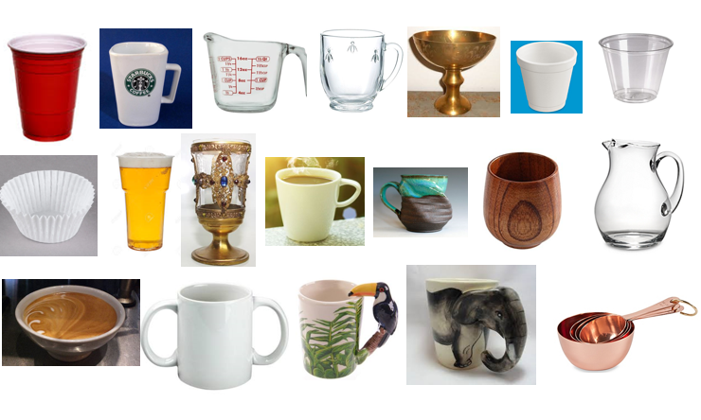
The Complete Set of Instances
This collection has broad SCOPE – it contains a very heterogeneous set of instances, and it is difficult to define and bound the collection domain

Slide 69
Stop and Think
How would the process of selecting descriptions have differed if you’d been given all of these at the same time?

Slide 70
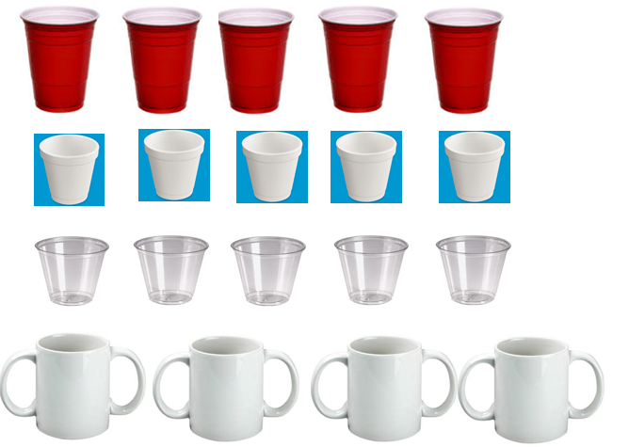
This Collection Has the Same Scale, but Vastly Smaller Scope
Instances in collections with small scope are much easier to describe and organize

Slide 71
A “tall” dataset might contain many millions or even billions of records, but each has a relatively small number of variables
(e.g., a bank’s credit card accounts)
FLASHBACK
Scope and Scale: Tall Data vs. Wide Data
A “wide” dataset might also have many records, but each record has a large number – hundreds or even thousands - of variables (e.g., predictive analytics, Facebook).
“Tall Data” is traditional computer science and software engineering. “Wide Data” is the cutting edge in data science/ML

Slide 72
Big Ideas (1)
It probably seemed easy to come up with description terms, but the vocabulary problem is real. Friends don’t let friends model alone
The process and result of identifying descriptions from a series of instances is likely to be very different than from a collection of instances
The scope of a resource collection – the breadth and heterogeneity of instances – is far more important than scale
Scope makes resource description and computation with descriptions more challenging
72

Slide 73
2. Users and Uses
Scope also increases the diversity of users and uses for the collection
Do we know who the users are?
Are the describers the users?
73

Slide 74
Stop and Think
How does describer == user change things?

Slide 75
3. Study the resource(s) to identify descriptive properties
75

Slide 76
4. Designing the Description Vocabulary is Hard
People use different words for the same things, and the same words for different things (TDO 4.4 & the Vocabulary Problem)
Describing and organizing always (explicitly or implicitly) takes place in some context
The context shapes which resource properties are important and the organizing principles that use those properties
description is always biased in some way
76

Slide 77
Describing the Same Resource for Different Purposes => Different Schemas
FLASHBACK
<Book>
<Title>The Discipline of Organizing</Title>
<Editor>Robert J. Glushko</Editor>
<Publisher>MIT Press</Publisher>
<PublicationDate>2013</PublicationDate>
<ISBN>978-0-262-51850</ISBN>
<Keyword>Classification</Keyword>
<Keyword>Resource Description</Keyword>
</Book>
<Book>
<Title>The Discipline of Organizing</Title>
<Weight unit=“pound”>2.58</Weight>
<Height unit=“inch”>9.25</Height>
<Width unit=“inch”>8.25</Width>
<Pages>540</Pages>
<SpineColor>White</SpineColor>
</Book>
77
(TDO 1st edition was available in print)

Slide 78
Controlled Vocabularies
A Controlled Vocabulary is an artificial language designed to be used in place of the "natural" ones that people would otherwise use, but only “trained describers” can use them
A collection of resource descriptions is vastly more useful when every resource is described using the same features/properties/categories to which the controlled vocabulary is applied, making it a “schema” or “domain-specific language”
78

Slide 79
A schema specifies the elements or features of a resource description
A CV specifies the possible values for a resource description

Slide 80
5. Description Form and Implementation
There are many choices for the notation, syntax, and structure of resource descriptions that differ widely in:
Human interpretability
Computability
Compatibility / degree of standardization
Descriptions created by people are almost always human-readable
Descriptions created by sensors, software, or other mechanisms are often optimized for computation
The choices are often contentious and result in “format wars” - XML vs. RDF vs. JSON vs….
80

Slide 81
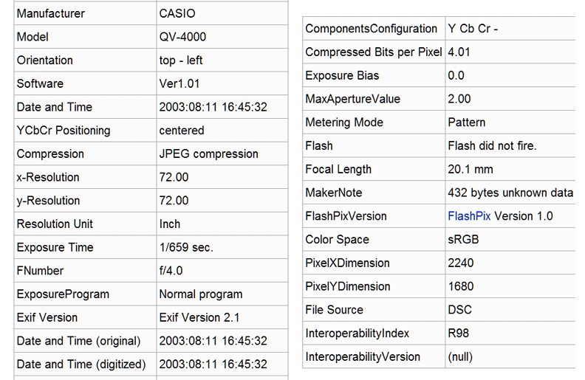
Human-Interpretable Automated Description by Digital Camera (EXIF)
81

Slide 82
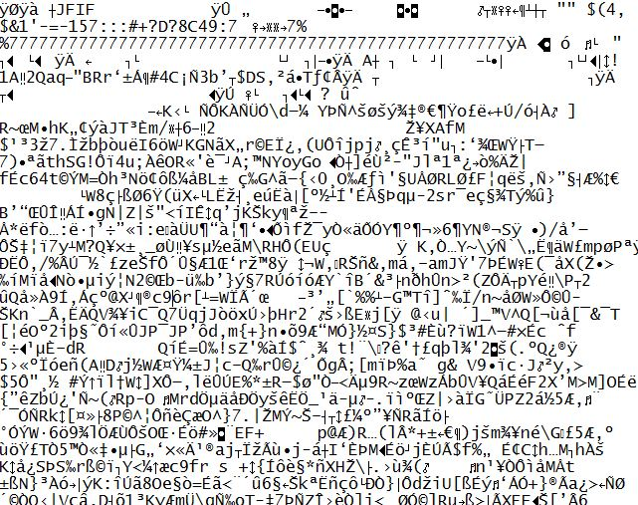
Descriptions Optimized for Computation

Slide 83
6. Different Ways to Create Resource Descriptions
By professionals: "Institutional" descriptions that follow standards
By authors: Best knowledge of purpose and intended audience
By users: Most variable, influenced by social purposes
By automated processes: Can reliably assign technical / physical properties but semantic description capability is enabled via supervised learning
83

Slide 84
A Painting Described by the Painter

Slide 85
Descriptive Precision
Writers, poets, painters, composers, sculptors, technical writers, programmers, producers, architects, designers, and devices or machines can all “create” resources
The Dublin Core vocabulary for describing web pages has a single property for indicating a “creator” (TDO 5.3.1.3)
“Shakespeare” and “Hubble Telescope” are both “creators”
A small description vocabulary is easy to use, but this tradeoff loses a great deal of precision compared to larger and more controlled vocabularies

Slide 86
7. Evaluating Resource Descriptions
Quality should be evaluated with respect to intended purposes... but what if different stakeholders have different purposes?
Creating resource descriptions can be costly; is it worth it? How and when measure the costs?
Computational description can be less expensive, but is it good enough? What is the cost of less or little transparency in the features?
86

Slide 87
A Typical Data Science Process
Identify a business problem that you can transform into a data science problem
Gather as much relevant data as you can
Clean up the data, using exploratory visualization as an aid
Build an initial model
Evaluate the model – does it label or classify well enough to address the business problem?
Iterate steps 2-5
Deploy model, congratulate yourself

Slide 88
TDO 5.3 Process
DS Process
1. Identify / scope the resources to be described
2. Determine the uses of the descriptions
3. Study the resource(s) to identify descriptive properties
4. Design the description vocabulary
5. Design the description form and implementation
6. Create the descriptions (either "by hand" or by some automated / computational process
7. Evaluate the descriptions
Too often, it takes the data as given; should be “cleaned up” but not fundamentally questioned
88

Slide 89
if this is all you’re given, say NO and give up!
If you don’t know about the process by which these descriptions were selected and made “computable” you can’t be confident about the results you’ll get by feeding this dataset to Python

Slide 90
Resource Description Checklist for Data Scientists
The size and diversity of datasets makes resource description the fundamental challenge in data science
Where did the data come from (provenance)? Is the source credible? Is the dataset relevant to the questions you’re asking?
Why were these descriptions selected? What are the possible values? Units and levels of measurement? Precision? Vocabulary control?
Are the values accurate? Stable? Current? Correlated? Human-interpretable?
Did the people who designed and collected this dataset think about it in the same way that you do?
90

Slide 91
Big Ideas
Describing and organizing always (explicitly or implicitly) takes place in some context, which shapes which resource properties are important and the organizing principles that use them
A collection of resource descriptions is vastly more useful when every resource is described using the same features/properties/categories to which the controlled vocabulary is applied, making it a “schema” or “domain-specific language
Different ways of creating resource descriptions have costs and benefits; who pays the costs and who benefits?
91

