Slide 1
CogSci 150
“Sensemaking and Organizing”
Spring 2022
Robert J. Glushko
glushko@berkeley.edu
10 February 2022
8) Describing Non-Text Resources:
Art, Artifacts, Music, …

Slide 2

Dr. Bob – Did You Remember to Start Recording?

Slide 3
Plan for Today’s Lecture
Granularity and Abstraction in Describing Art, Artifacts, Music, …
The Sensory and Semantic Gaps
Describing Music
“Professional” Descriptions
(Friday Section: Review of “Block 1”
of the Course; Overview of Case Study requirements and schedule)
3

Slide 4
Non-text Resources
(some overlapping categories)
  Tangible Medium
    Art, sculpture, physical designs
  Audio (speech, music, sound)
  Graphics and Images
  “Moving” Images (video)
Multimedia -- Composed of more than one form of media
Time-based media -- Audio and video
4

Slide 5
The “Things” for Non-text Resources?
(Granularity and Abstraction)
Songs and sound recordings
  album, playlist, queue
  cover, remake
  mix, remix
  sample, soundbite
Video
  clip, snippet, still
broad-/narrow-/simul-/tele-/web-/pod- cast
5

Slide 6
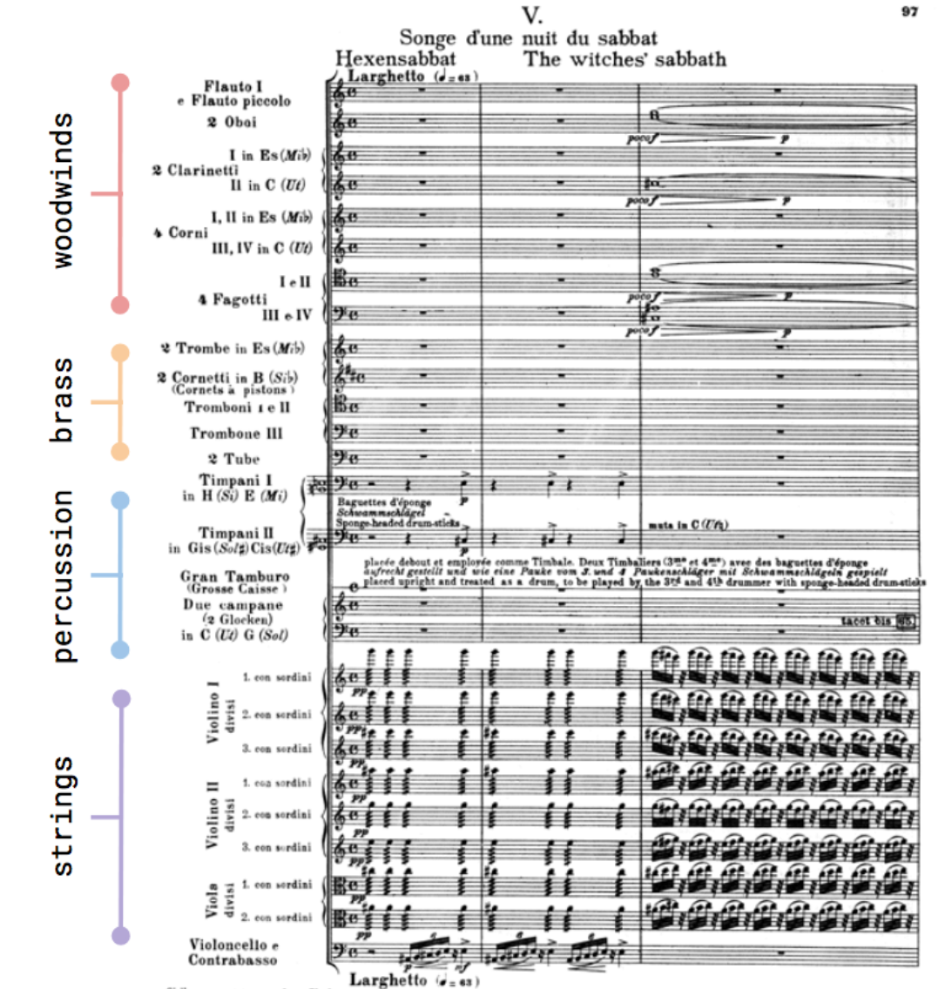
How Many Things is a Symphony?
Symphonie Fantastique, Op. 14: V
Songe d'une Nuit du Sabbat
Hector Berlioz
(1830)

Slide 7
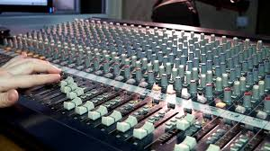
Audio Mixing –
Making One Thing From Many

Slide 8

Shazam and Soundhound (and Shamu?)
Shazam – recognizes a specific piece of music using its unique “audio fingerprint”
Soundhound – identifies songs, but can do it from humming or whistling
STOP AND THINK:
Why is Shamu on this slide?
8

Slide 9
STOP AND THINK: Shamu for Songs
If there are many different performances of “the same song” at what point does a variation become a different song?
Is one of these performances the exemplar or prototype of the song? (Sometimes the “cover” is vastly more popular than the original)
Or should we reject the idea that some specific performance is the exemplar and treat any “song” as a large category with many members

Slide 10
What's Different About Describing
Non-text Resources?
Sensory Gap
Semantic Gap
10

Slide 11

The Sensory Gap (1)

Slide 12
The Sensory Gap (2)
An infinite number of different sensory "signals“ can be produced by the same object
…And different objects can produce similar signals
Our human perceptual machinery can usually determine when different "signal patterns" are the same object or when similar patterns are different ones
But this object recognition or “computer vision” capability eluded computers for decades, and only recently have deep learning and convolutional neural networks closed this “sensory gap”
12

Slide 13
STOP AND THINK: Object Recognition
Two ways to think about the sensory gap
COGNITIVE: The sensory gap is evidence of the incredible power of the human visual and cognitive systems to apply neural computation and knowledge to enable visual perception
COMPUTATIONAL: It is asking a lot for a computer to reconstruct and recognize a 3D or 4D world from 2D (photos) or 3D (video) projections of it

Slide 14
The Semantic Gap
Instruments, devices, and sensors encode data in formats that are optimized for efficient capture, storage, decoding, or other processing
The representation of the object is opaque and can't be (easily) processed to understand what the object "means"
There is a semantic gap between the descriptions that people assign and those that can be assigned by automated mechanisms or that are otherwise built into the storage format
STOP AND THINK: What kinds of data can be captured? What are some examples of resource descriptions assigned by technologies?
14

Slide 15
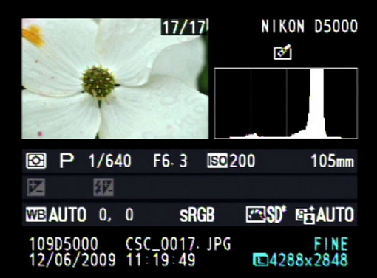
Luminosity Histogram (for people)

Slide 16
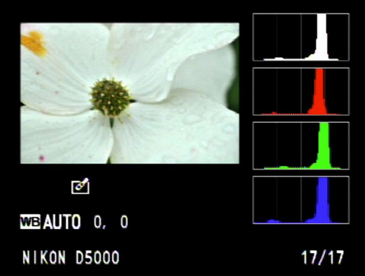
Color Histogram (for people)

Slide 17
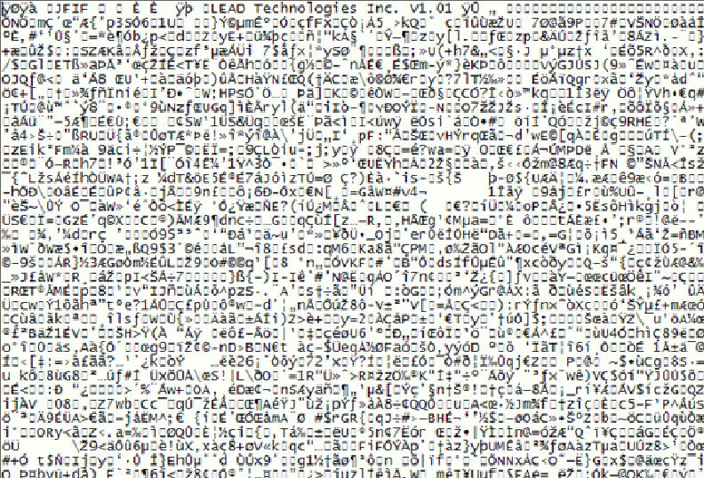
What’s this Picture About?

Slide 18
STOP AND THINK:
Smart Photo Processing?
Modern digital cameras (dedicated devices or on cell phones) and photo-processing apps like Photoshop use these histograms to enhance photos
But if the camera does this automatically, you need to disable these capabilities sometimes to take photos that capture a scene as you perceive it

Slide 19
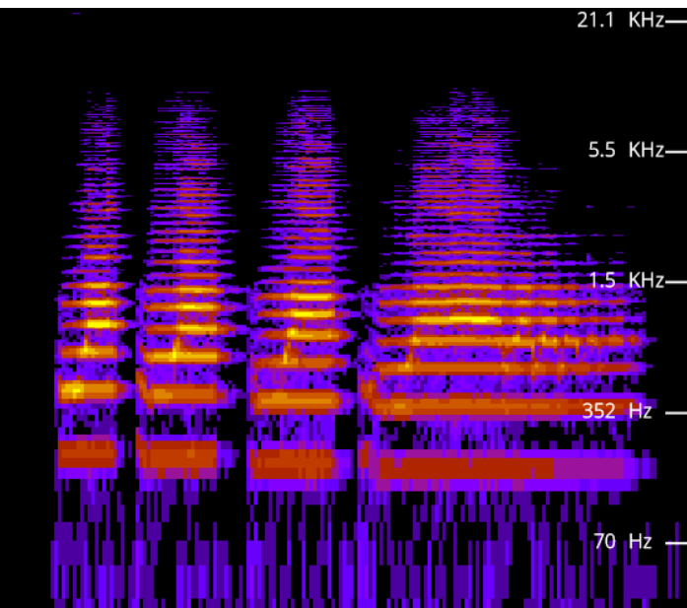
Spectogram
A visual representation
of the frequency spectrum of an auditory signal as it varies with time
https://academo.org/demos/spectrum-analyzer/

Slide 20
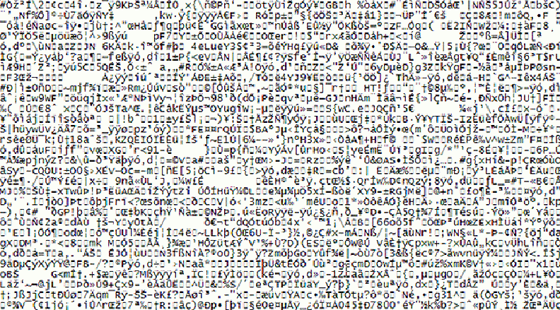
Name That Tune

Slide 21
Stop and Think
Is the Semantic Gap between a technological representation and its meaning a new problem?

Slide 22
Are these New Problems?
Museums face some of the same or similar problems in describing art works and artifacts:
    There may be many artifacts that represent the same "work" - this is like the "sensory" gap
    Which skeleton best represents a dinosaur species?
    Which pose of the skeleton is best?
22

Slide 23
Are these New Problems?
    (and btw … museums have been around a long time; oldest one was established around 2500 years ago)
    The materials or medium in which the artifact is embodied don't convey semantics "on their surface" - this is the semantic gap
23

Slide 24



What Do I Mean?

Slide 25
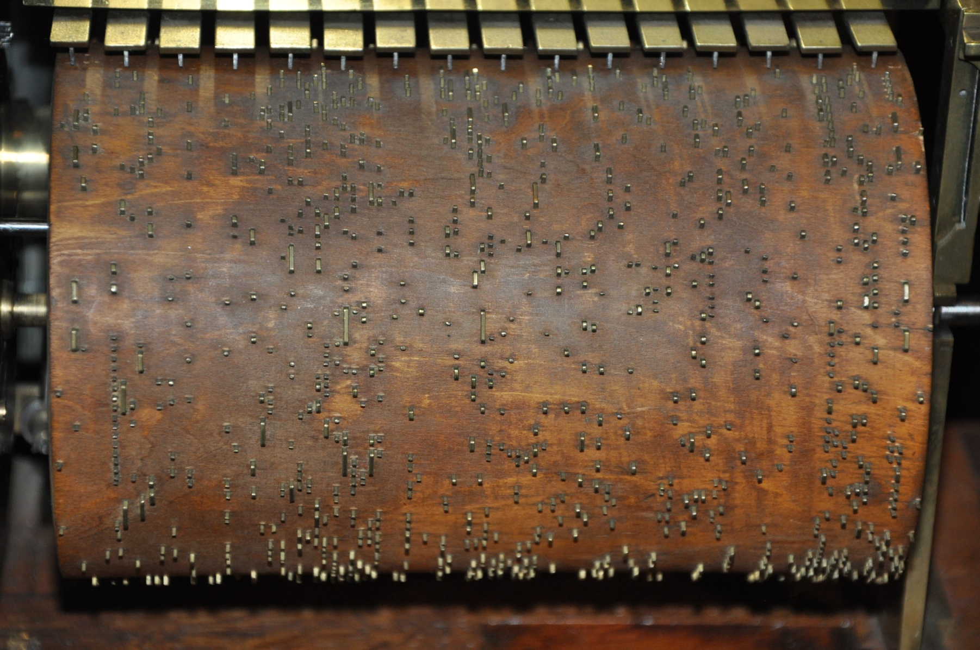
Name That Tune

Slide 26
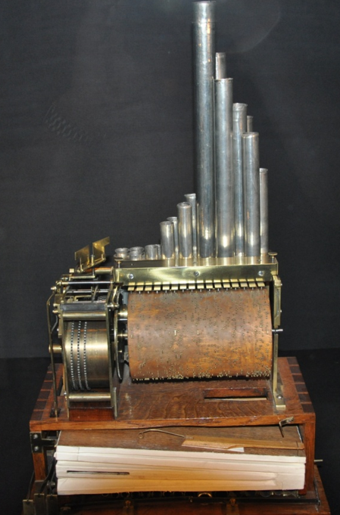
Music Box Controlled by
Spoked Cylinder
(early 19th century)
Musée des arts et métiers, Paris
Oldest science / industrial design museum in Europe, established 1794

Slide 27
Some Problems May Be New
The temporal structure of music and video mandates new descriptive vocabulary and new ways to identify meaningful components
  What does “temporal structure” mean?
Music and video meet emotional/psychological needs that are more complex than those for “text documents" - so the descriptions of the latter must be able to address these needs
  Why do people access or retrieve music and video?
27

Slide 28
Bridging the Semantic Gap, or Not?
Bridging the semantic gap means extracting features from non-text content to infer semantic-level descriptions from them, even if those features are not interpretable
An image signature can be extracted from low-level features like color, shape, texture, and luminosity, and images are classified by computing the similarity between signatures
Deep learning approaches combine many layers of feature extractors to significantly improve object recognition
  Is this visual scene indoors or outdoors? Nature, cityscape, or crowd scene? What are the objects? Who are those people? Are they happy or about to attack the Capitol?
28

Slide 29
Stop and Think
  During the summer 2020 protests and civil disobedience people were angry that face recognition systems were being used to identify people.
  After the January 2021 Capitol events no one objected to the use of face recognition technology
  Should there be limits on the use of face recognition?
  We could use face recognition to enforce mask wearing and automatically deduct fines from bank accounts…

Slide 30
Describing Music

Slide 31
Describing Music: Why
Generic reasons for description: Finding, Identifying, Selecting, Obtaining, Exploring
Recommending tracks or artists we might like (e.g., Pandora, Spotify, Amazon Music)
Finding copyrighted music where it isn’t supposed to be…so music publishers and distributors can collect data that gets money to the people who deserve it
31

Slide 32
Types of Music Descriptions
The track – size, duration, bitrate, key, energy level, BPM
The medium– CD, cassette, vinyl, streaming
The format – lossless: WAV, AIFF, ...; lossy: MP3, WMA, ...
Who made it, and how it was made - who composed it, who performed on it, what instruments were used, who recorded it
How it relates to other music
What it sounds like, how it makes you feel
What is the musical structure (repetition, contrast, transformation, other compositional patterns)?
32

Slide 33
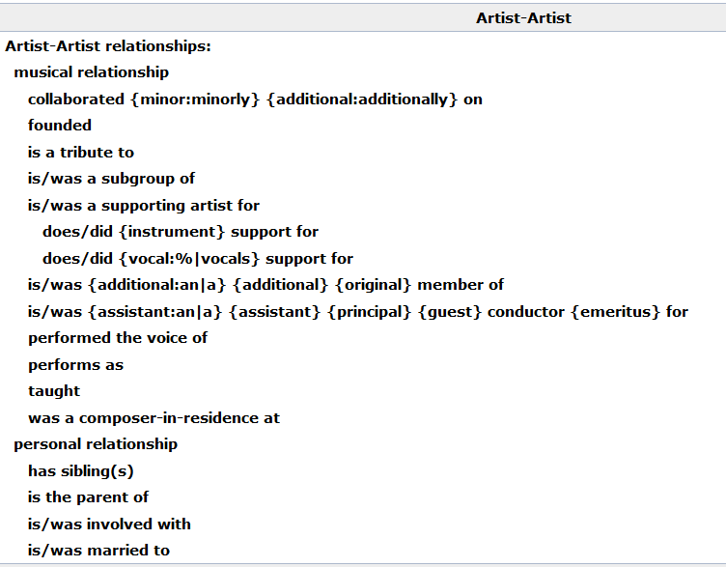
Relationships in Musicbrainz Database
33

Slide 34

Describing a Music Recording:
Where & How Much
Oldest method: encode descriptions in filenames
  Example: https://archive.org/details/gd73-02-09.sbd.bertha-fink.14939.sbeok.shnf
“Improvement” – encode description
into the music files
    ID3 format (1996) initially added as a hack to MP3 music files, which had no place for descriptions
  Today – rich music descriptions that are managed by applications apart from the recordings
34

Slide 35
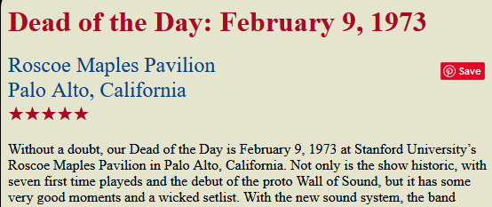
FLASHBACK
Places are a vital part of individual and collective sensemaking, memory, and identity

Slide 36

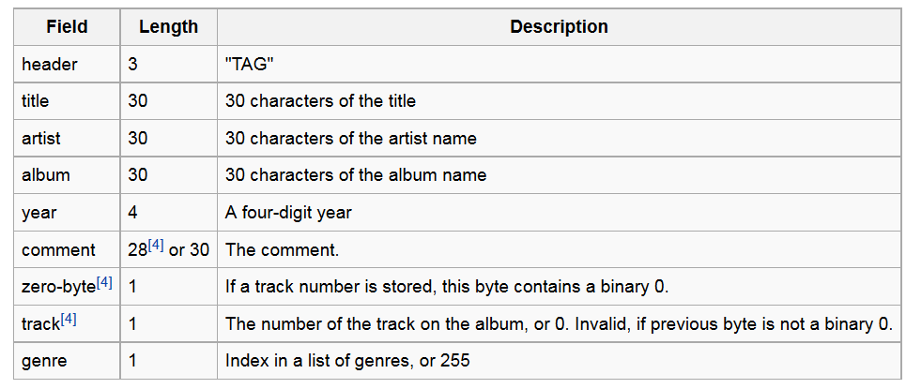


ID3
Barely adequate for ordinary “rock” or “pop” songs: Smoke on the Water / Deep Purple / Machine Head / 1972
It fails miserably for classical music; no way to encode part-whole relationships, composer, conductor, other stuff that matters to serious music people
36

Slide 37
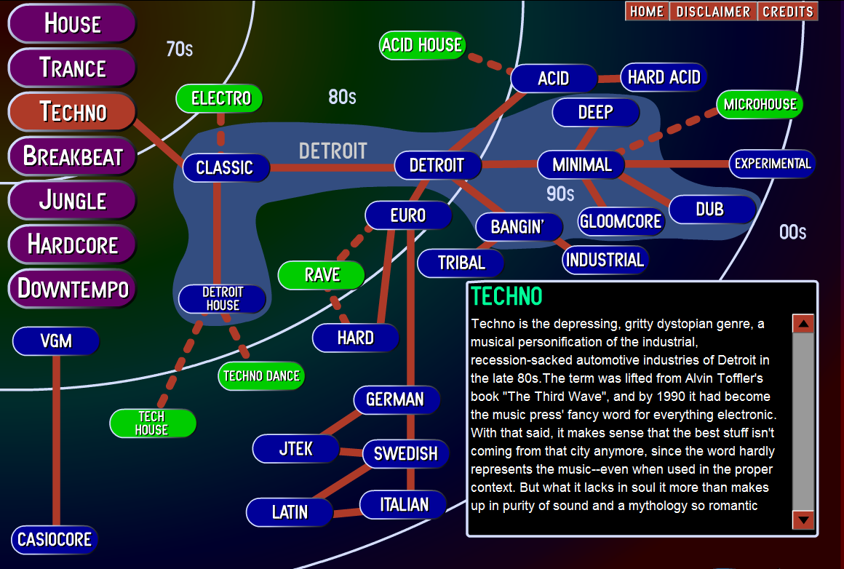
Music Genres (defined by human experts)

Slide 38
The Music Genome (1)
About 20 years ago Pandora's founder Tim Westergren hired Stanford musicology grad students (led by Nolan Gasser) to implement his vision that there were “music species” that could be defined by sets of “music genes”
  An old idea – Hungarian composer Bartok classified thousands of folk songs into melodic families over a hundred years ago (Note 305 in TDO 4th Professional edition)
“Groups of genes” for musical analysis include melody, harmony, rhythm, form, instrumentation, lyrics
38

Slide 39
The Music Genome (2)
A song can have as many as 450 genes; rock and pop songs have 150 genes, rap songs have 350, jazz songs have approximately 400, classical music often more
A specific gene might be “wah-wah and fuzz guitar distortion”, “gender of lead vocalist”, very granular features
  If you don’t know what “wah-wah and fuzz” are: https://www.youtube.com/watch?v=yzUJS4kjzcs
2 million songs analyzed manually (20-30 minutes each, 25 people doing it); this collection used to train computational classifier
39

Slide 40
Data-driven Organization of Music and Music Artists
Every interaction with music that CAN be captured is probably being captured; this includes music playing in any connected app, music streaming, and what else?
These rich data sets can be analyzed to organize music and to organize music artists
Example: “Music Map” organizes artists by their musical similarity and into five popularity categories: Undiscovered, promising, established, mainstream, epic
40

Slide 41
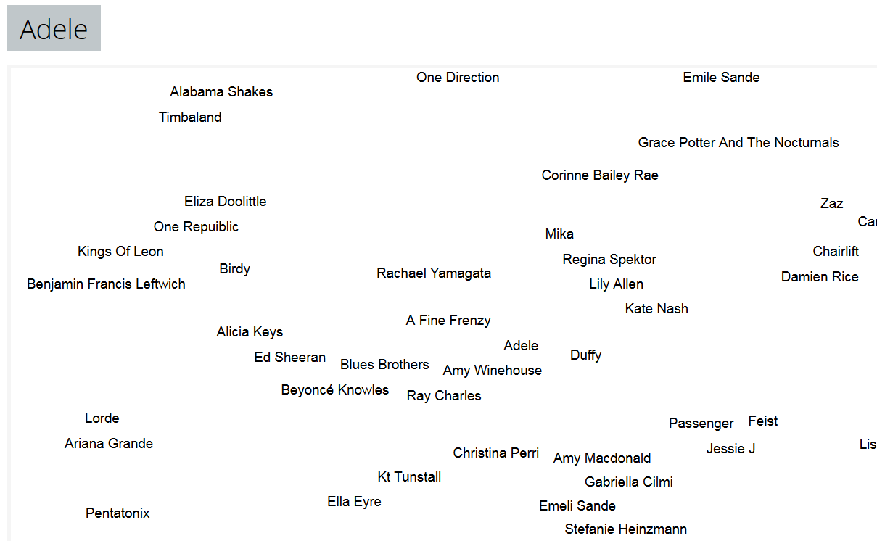


Musical Similarity to Adele http://www.music-map.com/adele.html

Slide 42
Professional Descriptions for Non-text Resources

Slide 43
"Professional" Descriptions for Multimedia and Non-textual Works
Museum works and other non-text artifacts have long been described by professionals using structured resource descriptions according to classification rules
The descriptions are often "layered" beginning with accessible properties with more analytic descriptions added for those objects that warrant them
43

Slide 44
Panofsky's Three Levels of Meaning
Description ("Preiconographic“ or “Primary”)
Identification ("Iconographic“ or “Secondary”)
Interpretation ("Iconologic“)
44

Slide 45
Description / “Preiconographic” /
Primary Level
The "primary" or "natural" subject matter of a work
“The kind of thing” - the generic elements or things depicted in, on, or by an object / image / artwork
These would be recognizable by anyone, regardless of their expertise or training
45

Slide 46
Identification / “Iconographic” /
Secondary Level
The (authoritative) name of the subject or thing depicted in the work
Can require research or fact assembly from sources of social and cultural knowledge
46

Slide 47
Interpretation / “Iconologic” Level
The meaning or theme represented by the subject matter or iconography of the work
This meaning is often symbolic, and deeply grounded in the culture in which the work was created
Done by domain and methodology experts
47

Slide 48

PRIMARY: Marble statue of nude woman standing on a seashell
SECONDARY: Statue made in 2005 by Lucio Carusi of Carrara, Italy, titled “Venus”, made of local marble
INTERPRETIVE: 3D transformation of 1486 painting by Italian painter Sandro Botticelli, titled “Birth of Venus.” Carusi’s Venus is substantially slimmer in proportions because of changing notions of female beauty
(TDO Figure 5.6)
Panovsky’s 3-Level Scheme
48

Slide 49

“Birth of Venus”
Uffizi Gallery, Florence Italy

Slide 50
Stop and Think
Why do we need different levels of description?
Does every resource need them? For what kinds of works is it worth making this investment?
What kinds of people/skills are required to be work at each of these levels" -- and at what cost?

Slide 51

Can You Describe this Painting?
At What Level Is Your Description?
The painter
Not the only time this subject has been painted

Slide 52
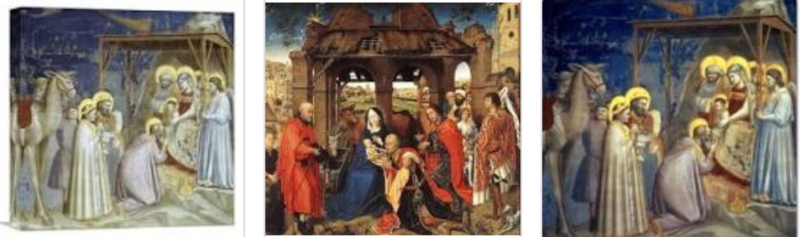
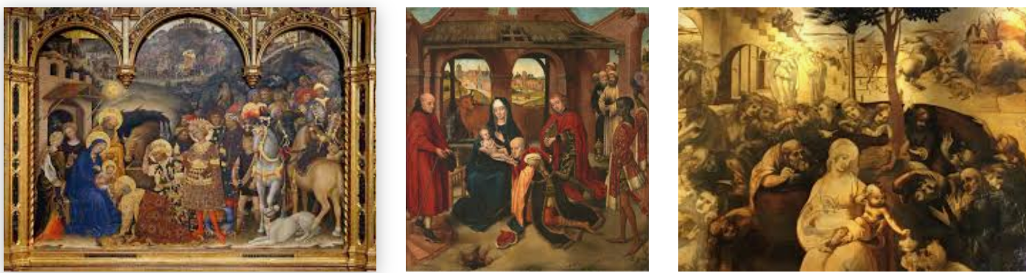
The Shamu Question for Paintings
“Adoration of the Magi” is the most popular theme in Christian painting; it is the name of a category of paintings as well as the name of each of them

Slide 53
Getty Categories for the Description of Works of Art (CDWA)
The CDWA is a large vocabulary with 532 elements and sub-elements
Each element typically has a controlled vocabulary or recommends one (e.g, Art and Architecture Thesaurus)
There is a core set of 36 elements
CDWA-Lite is the XML specification for another simple subset of CDWA
53

Slide 54
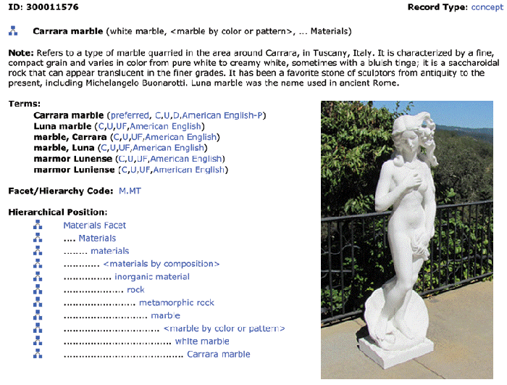
Art and Architecture Thesaurus
54

Slide 55
CDWA’s First Question
You should have been able to guess the first question raised in the CDWA documentation
Section 1.1 of the CDWA (the top-level element) is “Object/Work”
  Works of art or architecture may be considered a single item, or they may be made up of many physical parts or arranged in separate physical groupings. It is necessary to define the particular work of art, architecture, or group of objects in question, whether it be a single painted canvas, or an altarpiece made up of many panels…
55

Slide 56
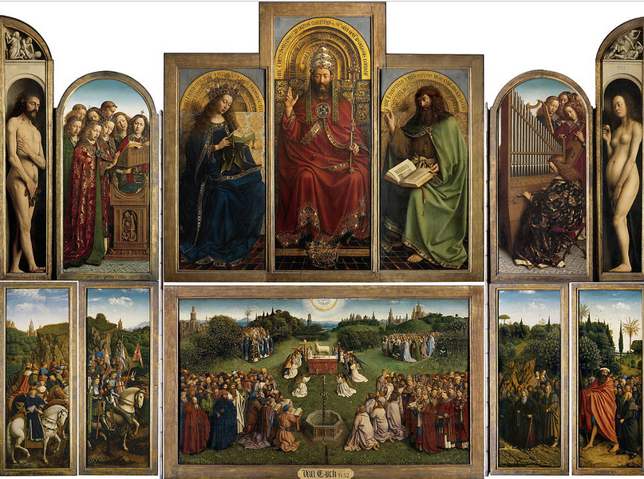
The Ghent Altarpiece
(15th Century)
“A masterpiece of Medieval European art”
Consists of twelve panels
Arranged in two “registers”
Each register has double sets of foldable wings containing inner and outer panel paintings

Slide 57
A Framework for Generating Resource Properties

Slide 58
A Framework for Generating Description Properties
LIS folks like to create categories of resource descriptions
  Gilliland: content, value, context, structure, format
  Taylor: administrative, descriptive, preservation, technical, use
  Many others…
But my Ischool students couldn’t sort properties reliably into the categories… so I devised a new framework that has turned out to be useful for generating candidate properties in a systematic way
58

Slide 59
Classifying Resource Properties

Slide 60
Intrinsic Properties
Intrinsic properties are inherent in a resource
Some are static, never changing their values
Others are dynamic, but they change “from the inside of the resource” not “from the outside” by actions or efforts of outside agents (like “developmental” properties – age, skill, experience)
Intrinsic properties can sometimes be used as an identifier - like a computed "signature" for a document or media object
60

Slide 61

Distinctive Physical Properties
61

Slide 62
Extrinsic Properties
Extrinsic properties are assigned to a resource rather than being inherent in it
Some extrinsic properties are static: assigned names or identifiers don’t usually change
Other extrinsic properties change often
Extrinsic properties differ in their "decay" functions, rate of change… a lot of data science is figuring out the function that relates the value of some resource property over time
62

Slide 63
Cultural Properties
Cultural properties are extrinsic and assigned to resources; they come from conventional language use or culture and often involve analogy
Because they derive from knowledge of culture or language, they might be unintelligible to people who don't have the same perspective and experience
.. and they might lose their cultural salience
Flapper, Greaser, Groovy, Bollywood, Grunge
Tech bro, One percenter
63

Slide 64

“Holbein” Carpets
Why are these carpets from Central Turkey (dating from 16th century) described with a German painter’s name?
Anatolian Carpet,
16th Century
A
The Ambassadors, 1553

Slide 65
Applying the Framework for
Organizing System of a Kitchen
  Intrinsic static properties: If you store your pots, frying pans, and baking pans and nest each set by size
  Extrinsic static properties: A spice rack with the spices arranged in alphabetical order
  Intrinsic dynamic properties if you arrange your milk and other perishable goods by expiration date, a “useful life remaining” property that decreases to zero as the expiration date approaches
  Extrinsic dynamic properties if you put the most frequently used condiments or spices in the front of a refrigerator or pantry shelf
65

Slide 66
Applying the Framework for a
Document Organizing System
  Intrinsic static properties: Author, date published, words in the text
  Extrinsic static properties: ISBN, LOC Classifications
  Intrinsic dynamic properties: Effectivity (e.g., laws and regulations)
  Extrinsic dynamic properties: Links/citations to and from other documents
66

