Slide 1
CogSci 150 “Sensemaking and Organizing” Spring 2022
Robert J. Glushko glushko@berkeley.edu
15 February 2022
9) Introduction to Categorization; Cultural Categories; Astronomical Sensemaking and Other "Natural" Categories

Slide 2
Outline
Categories of Categories
Cultural categories
Natural categories
Constellations and mythology
Astronomical sensemaking

Slide 3
Categories of Categories
Categories are sets or groups of resources, “classes of things” or abstract entities, that are treated the same
In TDO there are two ways to contrast categories
CATEGORY CONTEXT: How they are created (individual, cultural, institutional, computational)
CATEGORY STRUCTURE: How they are defined or structured (enumerated, property-based, similarity based…)

Slide 4
Plan for the Course
We can analyze sensemaking and organizing from four interrelated perspectives:
As a member of a social, cultural, or language community (linguistics, sociology, social network analysis)
As an individual (psychology and philosophy)
In institutional contexts (law and business)
In data-intensive or scientific contexts (statistics, computer science, info visualization).

Slide 5
Describing and Organizing Classes of Things (1)
We all create individual categories to organize our possessions, activities, and interactions
Our organizing systems are often ad hoc and idiosyncratic to satisfy the requirements that emerge from our unique experiences, preferences, and resource collections
How many of you have some article of clothing in your closet that you never wear but which you thought was amazing when you bought it?
5

Slide 6
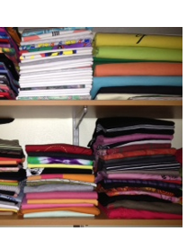
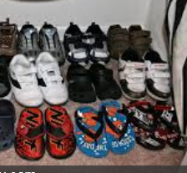
An Organized Closet
6

Slide 7
Describing and Organizing Classes of Things (2)
Cultural categories are embodied in culture and language and have imprecise / flexible boundaries
Individual categories often make use of or are derived from cultural categories
7

Slide 8
Color in Culture
Do you agree with these associations of concepts and colors?
How Color Changes the Mood in Art

Slide 9
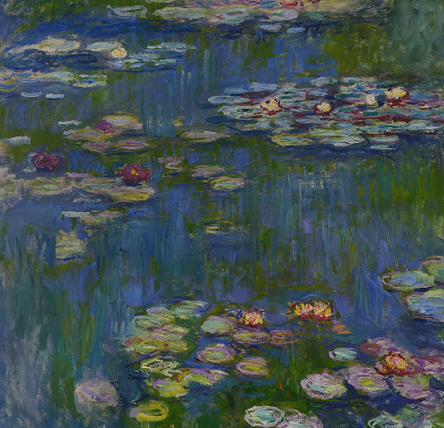
A Calming Color Scheme
“Water Lilies”
Claude Monet, 1916

Slide 10
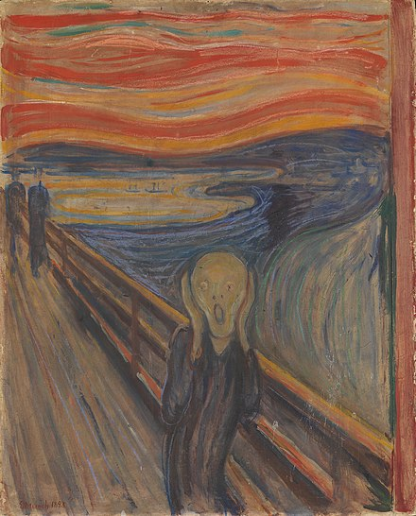
Not Calm, Distressing
“The Scream”
Edvard Munch, 1893

Slide 11
Describing and Organizing Classes of Things (3)
Institutional categories are explicitly constructed to create a precise semantic model (of what might otherwise be treated as cultural categories)
And often co-exist with them (e.g., “Color”)
Institutional categories are essential in abstract, information-intensive domains where semantic precision is essential for processes, transactions, and analyses (especially automated ones)
11

Slide 12
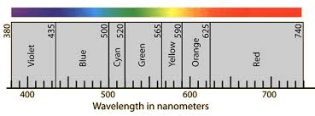
Color Defined by Wavelength
Pantone Color System

Slide 13
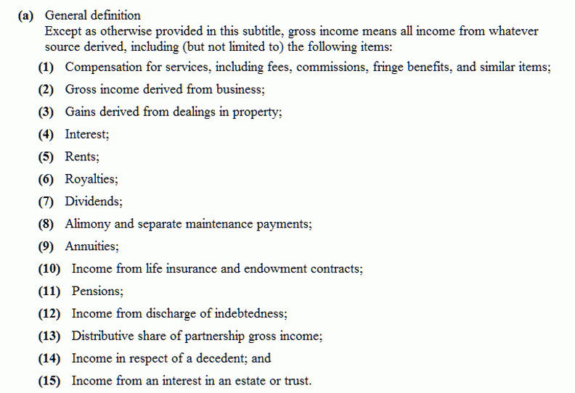
"Gross Income" Tax Code Categories
13

Slide 14
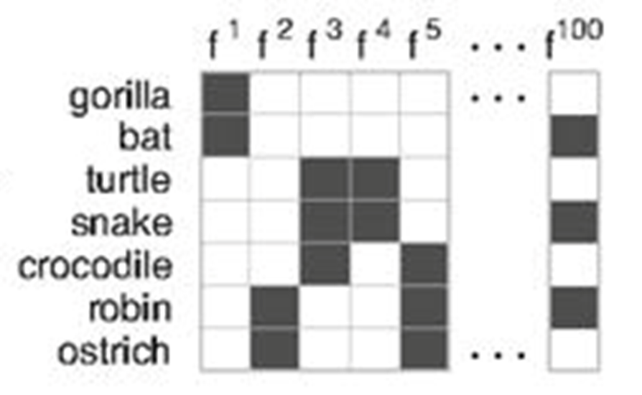
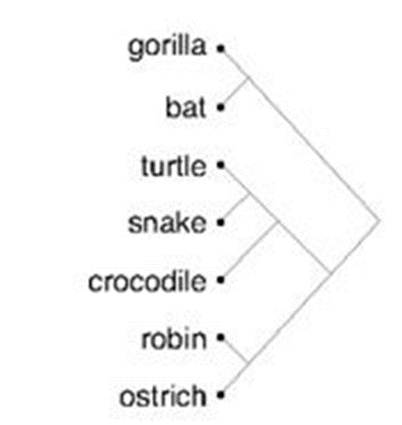
Describing and Organizing Classes of Things (4)
Computational categories are created by computers
Hierarchical clustering: Start with each item in its own cluster, merge the two most similar clusters, recalculate similarity between clusters, do it again. Builds a tree from the bottom up
14

Slide 15
Cultural Categories
We use tens of thousands of categories that are embodied in our culture and language
Many of them are “natural” – based on properties of observable things or experiences
… oops, we haven’t defined “culture”
And defining it is a bit tricky (STOP AND THINK)
15

Slide 16
Some Definitions of “Culture”
the customary beliefs, social forms, and material traits shared by a group of people in a place or time (culture in the world?)
whatever someone has to know or believe in order to operate in a manner acceptable to other members of a group they belong to (culture in the mind?)
whatever knowledge or beliefs other groups have that prevents them from seeing the world objectively and “correctly” – the way we do (is culture defined relatively?)
16

Slide 17
Culture as a “System of Meaning”
Culture is not chaotic or random … it is a SYSTEM (of systems…)
This system determines what sorts of things or events need to be attended to and explained
It established complex interrelated beliefs and behaviors to create a “system of meaning” about those things and events
17

Slide 18
STOP AND THINK “Systems of Meaning”
What are some examples of the systems of meaning that create human culture?
Family structure, kinship,…
What are the systems of meaning in “student culture” that create structure for you?

Slide 19
Natural Categories

Slide 20
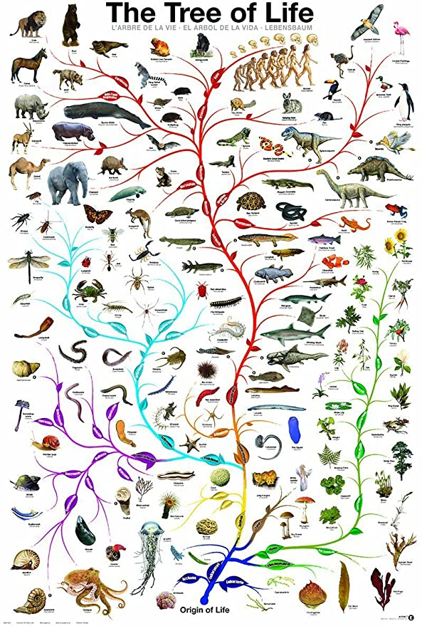
“Carving Nature at its Joints”
FLASHBACK
Over 2000 years ago Plato argued that species are distinguished by "carving nature at its joints" - where the natural differences between things are the largest or most salient
I.e., there are “natural kinds” – categories are discovered, not invented
20

Slide 21
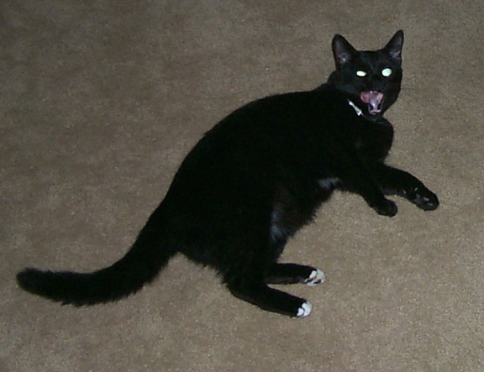
Category Hierarchies and Basic-Level Categories
Categories can be organized into a hierarchy from the most general to the most specific
My cat can be described as
An animal
A mammal
A cat
An American Shorthair
Boris
Which of these descriptions are used most often or seem the most natural?
21

Slide 22
We Most Often Use “Basic-level” Categories or Instance Names
Let the animal out
Let the mammal out
Let the cat out
Let the American Shorthair out
Let Boris out
22

Slide 23
Basic-Level Categories: Why
“The world is structured because real-world attributes do not occur independently of each other”
“Combinations of attributes of real objects do not occur uniformly. Some pairs, triples, or n-tuples are quite probable, appearing in combination sometimes with one, sometimes another attribute; others are rare; others logically cannot or empirically do not occur.”
Basic objects (e.g., bird, chair) are at the level at which there are attributes common to all or most members of the category
(Rosch et al, Basic Objects in Natural Categories, Cognitive Psychology 1976)

Slide 24
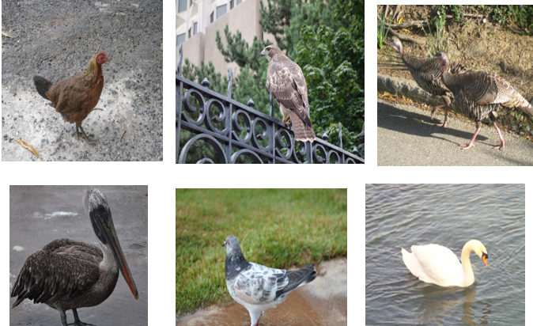
Basic-Level Categories: What
Members tend to have the same shape
They tend to "share parts“ or properties
Interactions with all of them share motor movements
24

Slide 25
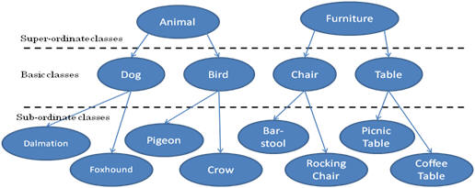
Three-Level Category Hierarchy

Slide 26
STOP AND THINK Basic-Level Categories
Starting with a top-level category of VEHICLE, can you fill out the next two levels of resource types, with an “instance-level” as the fourth level where specific vehicles are organized?
Now do the same for a top-level category of RESIDENCE, which the specific instance where you live in the bottom level

Slide 27
Basic-Level Categories for Activities and Events
Basic level categories are usually thought of as referring to things, but this idea also applies to activities and events
Purchasing something
Shopping at the supermarket
Picking out tomatoes in the vegetable aisle
The essential idea: At the basic level: within-category similarity is maximized, between category similarity is minimized

Slide 28
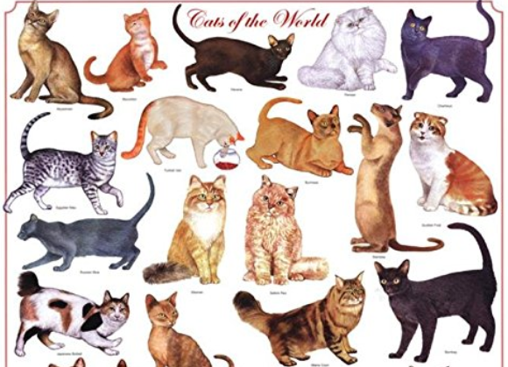
But “Cat” Won’t Work in this Context

Slide 29
Tradeoffs in Abstraction and Granularity
The abstraction level we choose determines how precisely we identify resources. When we want to make a general claim, or communicate that the scope of our interest is broad, we use superordinate categories
As we go down in the category hierarchy, the categories have fewer members, so we can refer more precisely
I’m thinking of a building on campus…
I’m thinking of a tall building with a pyramid-shaped top…
29

Slide 30
STOP AND THINK
Compare “washing your clothes” with “getting dressed” and “putting clean clothes away”
How do “clothing categories” differ in these contexts?

Slide 31
The Precision-Simplicity Tradeoff
Precise (very granular) categories enable efficient communication – if every distinguishable color had its own name, “color talk” would be very concise
But this large set of color categories would not be as simple and easy to learn, remember, and use as one with a small set of color terms
The semantic systems in natural languages tend to achieve a near-optimal tradeoff between these two constraints to balance category abstraction and granularity
Regier, T., Kemp, C., & Kay, P. (2015). 11 Word Meanings across Languages Support Efficient Communication. The handbook of language emergence, 87, 237.
31

Slide 32
Descriptive Precision
Writers, poets, painters, composers, sculptors, technical writers, programmers, producers, architects, designers, and devices or machines can all “create” resources
The Dublin Core vocabulary for describing web pages has a single property for indicating a “creator” (TDO 5.3.1.3)
“Shakespeare” and “Hubble Telescope” are both “creators”
A small description vocabulary is easy to use, but this tradeoff loses a great deal of precision compared to larger and more controlled vocabularies

Slide 33
Constellations and Mythology

Slide 34
Constellations
Humans are “pattern-matching animals” from the moment they are born
There are many other perceptual and cognitive biases toward seeing / describing the world in simple ways (e.g., all the Gestalt perception phenomena, decision making biases exploited in behavioral economics)
This underlies the fact that all cultures share the goal of making sense of astronomical observations
Most constellation shapes are lines, rectangles, or triangles or have some very literal shape relationship to a living object

Slide 35
PREVIEW – “Automatic Organizing”
Continuity – Creating Patterns
Aligned objects are perceived as belonging together, and are perceived as a continuous whole when that perception is a simpler interpretation

Slide 36
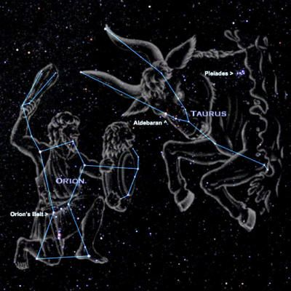
Ancient humans imposed “constellation” patterns on observations of stars so they could represent and communicate about them
WINTER SKY, NORTHERN HEMISPHERE

Slide 37
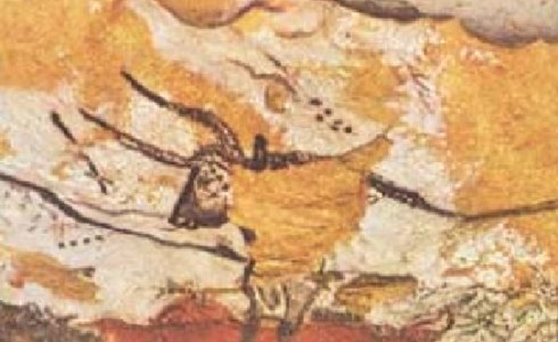
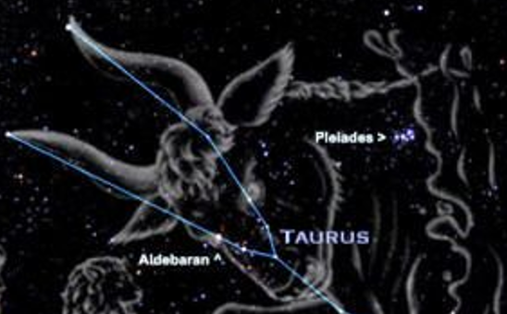
STOP AND THINK: Lascaux Cave Paintings
Are they just animals with star backgrounds?
Are the animals IN the sky?
Are they star maps with animal constellations ?

Slide 38
Constellations ⬄ Myths
Myths that relate terrestrial activities and celestial organization appear in many diverse cultures around the world, suggesting that stars were very important
The “Cosmic Hunt” myth, in which an animal is chased into the sky and becomes a constellation, is found in different versions in diverse cultures all over the world
As the myth moved around, different people adapted the story to include the animals and stars most important to them

Slide 39
We Can Study the Evolution of Myths
A French scientist named Julian D’’Huy analyzed 47 versions of the Cosmic Hunt myths using the techniques of evolutionary biology
He analyzed each version using 93 “mythemes,” specific ideas in the story (by analogy to “genes” in biology)
Some of the mythemes:
The animal is a herbivore
A woman breaks a taboo
A divine person stops a hunter
A god transforms an animal into a constellation…

Slide 40
We Can Study the Evolution of Myths
D’Huy then used the software developed by evolutionary biologists to create “the tree of life” to create “the tree of myths”
He found that the Cosmic Hunt originated in Northern Eurasia and then spread west to Europe and east to the Americas
So there are Greek versions and Iroquois versions with a common ancestor, but none in Australian aboriginal culture
STOP AND THINK: What does this tell us about how old this myth is?

Slide 41
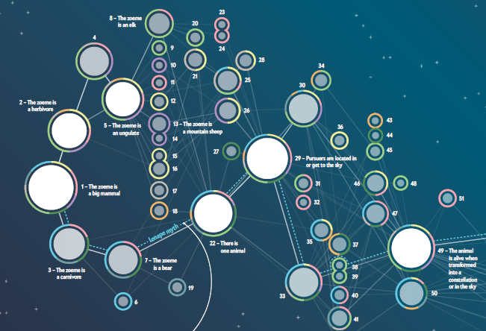

Slide 42
Crossing The Land Bridge
How Could the Cosmic Hunt Myth Get to America?
Until about 11,000 years ago the sea levels were much lower than they are today, and there was a “land bridge” from Siberia to Alaska
It is believed that a small human population crossed the land bridge from eastern Siberia, and they brought the Cosmic Hunt myth with them
So the Cosmic Hunt myth could be 15,000 years old!

Slide 43
Astronomical Sensemaking and Its Natural Categories

Slide 44
Assessing Your “Astronomical Awareness”
What astronomical evidence was used to argue that the earth orbits the sun and reject the compelling perception that the sun moves around the earth once a day?
Does the earth orbit clockwise or counterclockwise around the sun?
Polaris is the “North Star” (or “Pole Star”). Could you find it in the night sky?
What month does the sun reach its highest elevation above the horizon? The full moon?
What causes the seasons? (When is the earth closest to the sun in its orbit?)
Why do we always see the same “face” of the moon throughout the month? (the “man in the moon”)

Slide 45
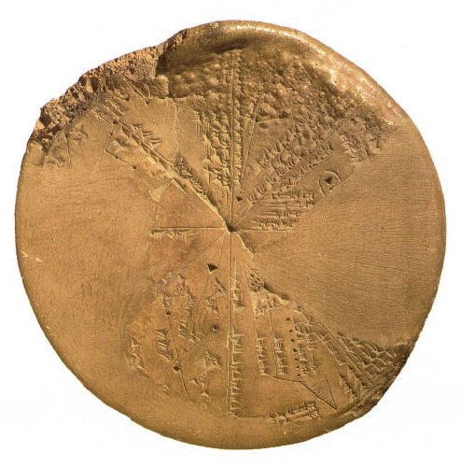
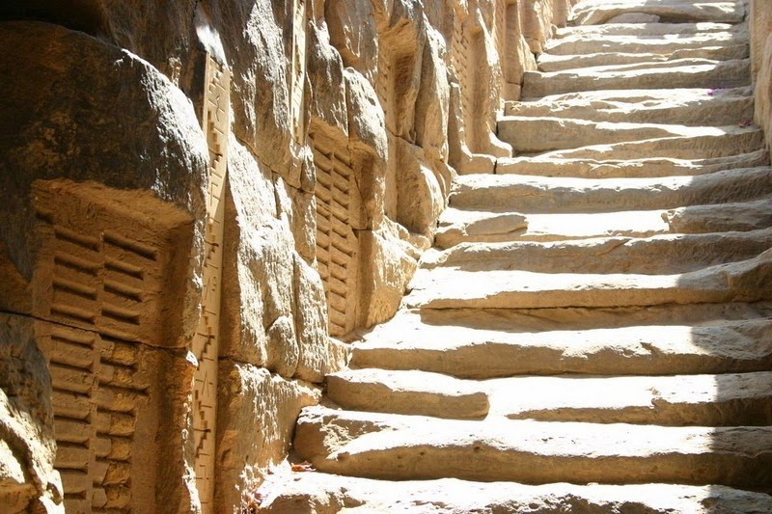
FLASHBACK
People Have Long Tried to “Make Sense”
For thousands of years, even before the invention of written language, people have systematically collected things, information about those things, and observations of all kinds to understand how their world works
Babylonian Astronomy
Ancient Egyptian Hydrology – Nile Flood Records

Slide 46
Stop and Think… If “to understand how their world works” is the reason for sensemaking, we need to explain what that means What sorts of astronomical and terrestrial events would ancient humans have noticed? (DO YOU NOTICE THEM TODAY?) How did ancient humans know when they understood these events? Specific example – how did ancient Egyptians know that they understood the flooding of the Nile?

Slide 47
The Oldest Recorded Eclipse:
March 4, 1223 BCE
Described on a 3300-year-old tablet found in 1948 amid the ruins of the palace in Ugarit, an ancient port city on the northern Mediterranean coast of modern-day Syria
Photos of the eclipse near La Serena, Chile on July 2, 2010

Slide 48
How could you not notice if it turned dark in the middle of the day?

Slide 49
The Cycles of the Sun and Moon

Slide 50
Sunrise, Sunset, Sunrise = ONE DAY
We observe that the sun rises in the east, moves across the sky, and then sets in the west
After about the same amount of time passes, it rises again
It seems there is a regular cycle for the sun to be moving around the earth
We call this cycle a DAY

Slide 51
STOP AND THINK – Days and Hours
When does a day start for you? When does it start “on the clock”?
Sunrise
Noon
Midnight
The duration of daylight varies significantly throughout the year, and the earliest clocks used the sun’s shadow to divide daytime into hours. But this means that the duration of an hour isn’t fixed
What invention shifted the beginning of the day to midnight and created hours of equal duration?

Slide 52
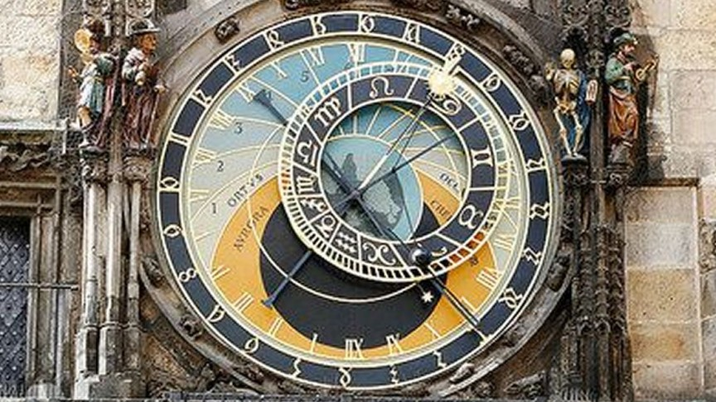
“Astronomical Clock” in Prague

Slide 53
The Moon’s Cycle = ONE MONTH
Like the sun, the moon rises and sets on a regular cycle, but each day it moves “backwards” a little (about 12 degrees of arc) and rises earlier and sets later each day
These observations make people believe that the moon moves around the earth
As the moon moves backwards it also changes its shape from a narrow crescent to a full circle and then back again to a narrow crescent
This cycle of the phases takes about 29 days
We call this cycle a MONTH (“moon-th”)

Slide 54
The Sun’s Cycle Through the Stars = ONE YEAR
The sun also seems to be moving through the stars, and in 365 days the sun returns to the same place in the star background; we call this time period a YEAR
We can organize the stars into different patterns that we call CONSTELLATIONS
The stars that are “behind the sun” as it seems to move are organized into twelve constellations that we call the ZODIAC

Slide 55
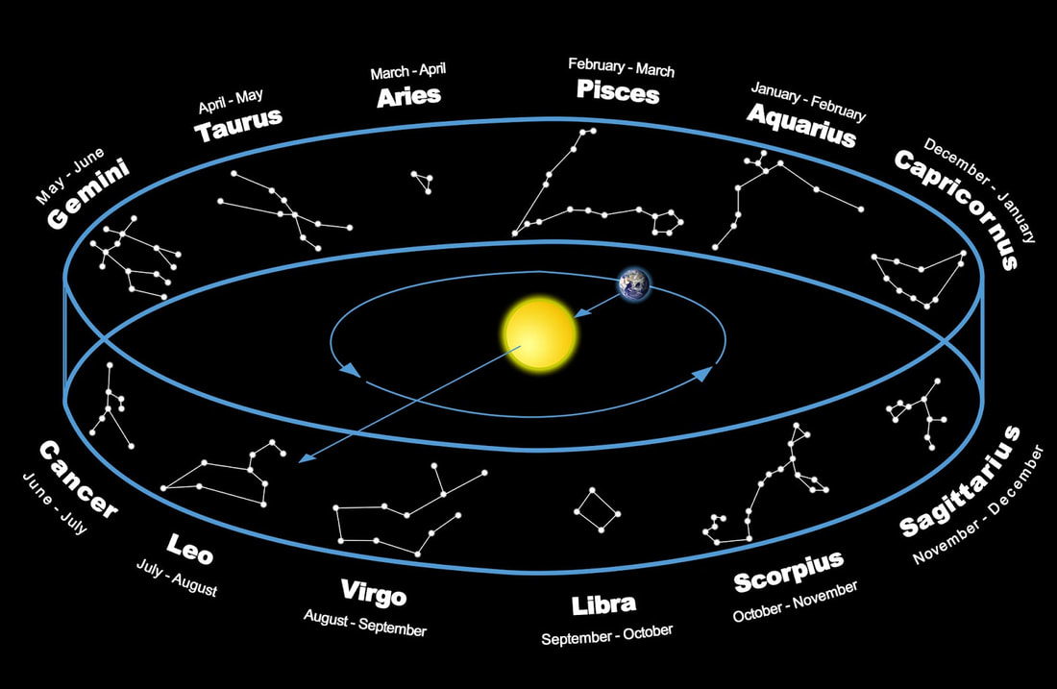
THE ZODIAC
Do You Know Your Zodiac Sign?

Slide 56
Babylonian “Astronomical Diaries”
Around 700 BCE Babylonian King Nabonassar began a research project to record nightly observations of the positions of the moon and planets
Also recorded eclipses, equinoxes, solstices, weather, river levels, noteworthy news events
These records were continuously collected for almost 700 years, and enabled Babylonian astronomers (and later Egyptian ones) to compute astronomical parameters and positions
No other research program of any kind lasted this long (how was this one been managed and sustained?)

Slide 57
Babylonian Astronomy Data
Because the Babylonians used wet clay tablets to write on, many thousands of them have been preserved for nearly 3000 years
Documents written on papyrus (paper made from plants) or parchment (made from leather) deteriorate much faster so we have a lot fewer of them to study

Slide 58
It was not the sun which first furnished early man with the length of the year. Other natural phenomena much more intimately within his circle of observation must first have revealed to him the beginning of another annual cycle
The "heliacal" rising of Sirius is a noticeable and sharply defined event. In Egypt this heliacal rising occurs very near the time of the beginning of the Nile floods around July 19

Slide 59
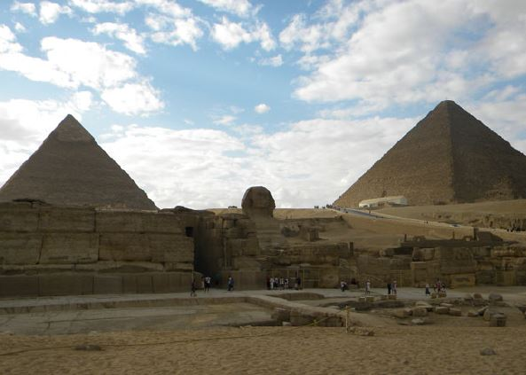
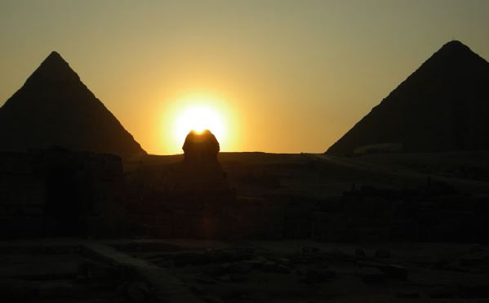
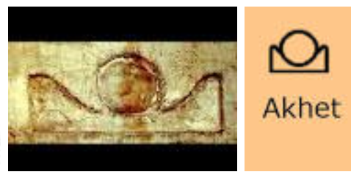
Archeo-astronomy in Ancient Egypt
(about 4500 years ago)
The pyramids of Giza in Egypt, the Great Sphinx that stands between them, and an observation terrace are aligned according to two events of critical religious and economic importance:
Sunset on the summer solstice
The onset of the Nile floods
The hieroglyph symbol AKHET means both “horizon” and “flood season”

Slide 60
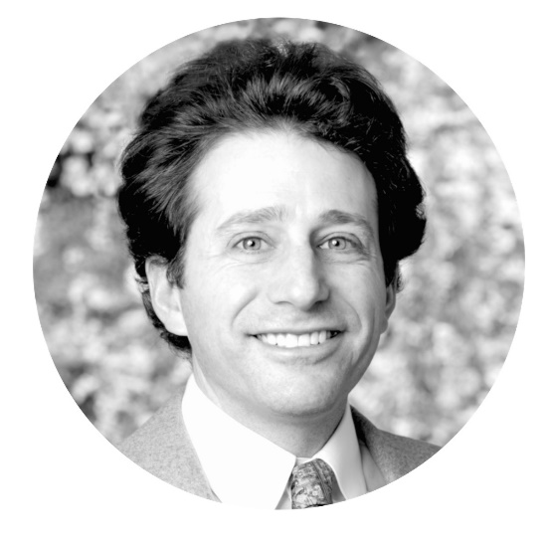
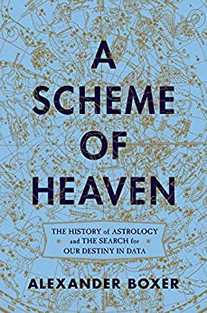
Astronomical Data Science with Alex Boxer
Studied classics, history of science, and physics
Has worked as a data scientist in numerous domains
Author of an amazing book on the co-evolution of astrology, astronomy, and mathematics

Slide 61
Astronomy {and, or, vs.} Astrology
Today astronomy is seen as a serious science and astrology as non-serious entertainment
But for thousands of years there was little practical difference between them
Astrologers were the first data scientists, who carefully analyzed astronomical observations to find the patterns in them and then tried to use these patterns to predict events
Every notable astronomer was also an astrologer, partly because it helped them gain support for their work
Along the way they invented algebra, trigonometry, and geometry

Slide 62
The Egyptian 10-Day Week
From Boxer, A Scheme of Heaven
Four thousand years ago, this map on a coffin identifies thirty- six patches of stars, one for each of the thirty- six ten- day weeks of the Egyptian year. (Boxer p 39)

Slide 63
STOP AND THINK
Why would the ability to predict astronomical events cause rulers / kings or other people in power to support astronomy research?
Are astronomical predictions always distinguishable from astrological ones about people?

Slide 64
The Founding of Baghdad
Baghdad was founded on July 30, 762 as the capital of the Arab and Islamic world
Its design and founding date were based on astrological recommendations by the astronomer/mathematician al- Khwarizmi
Whose Latin name was Algorithmi
His book Kitab al-Jabr wa-l- Muqabala (“Book of Rectifying and Balancing”) gives us the word “Algebra”

Slide 65
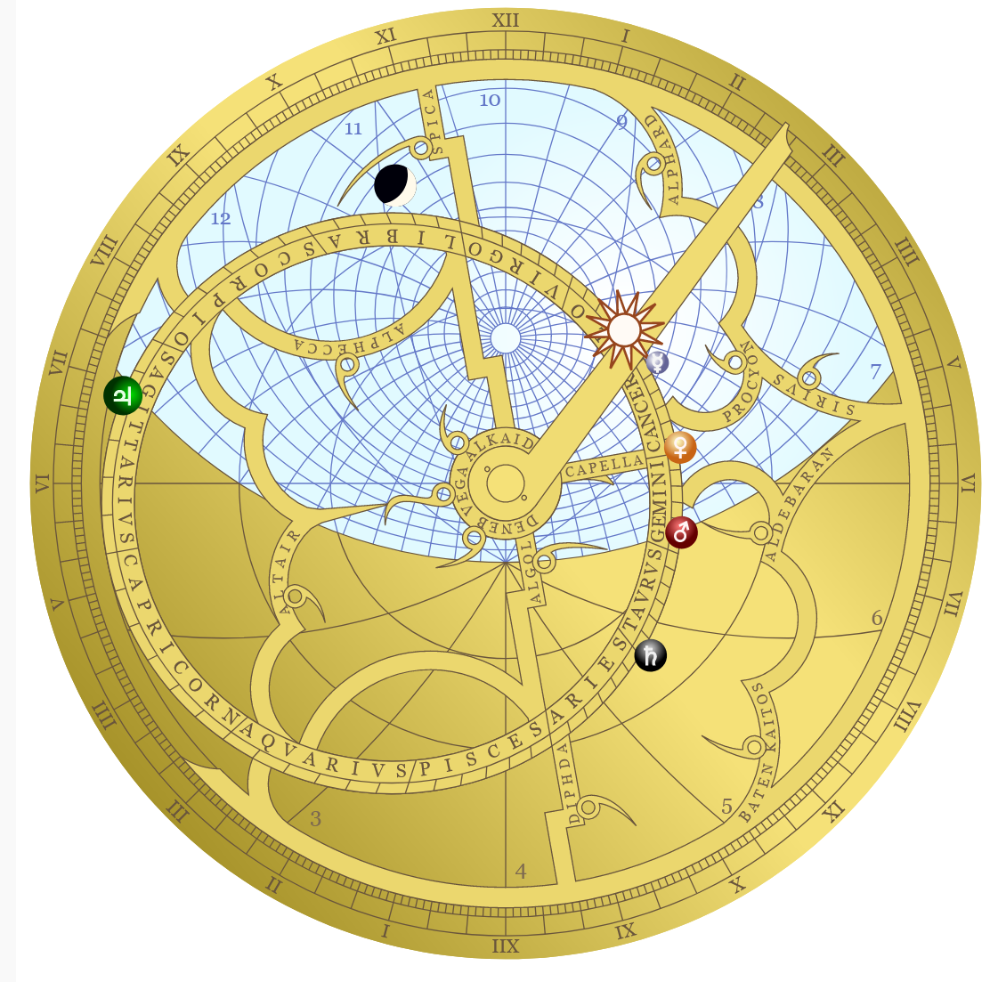
Interactive Astrolabe (a mathematical map of the cosmos) – for Baghdad at 2pm on July 30, 762
From ALEXBOXER.COM
At this precise “founding ceremony” Jupiter, the planet of kingdoms and dynasties, was rising in the east, while Mars, the planet of war, was setting in the west

Slide 66
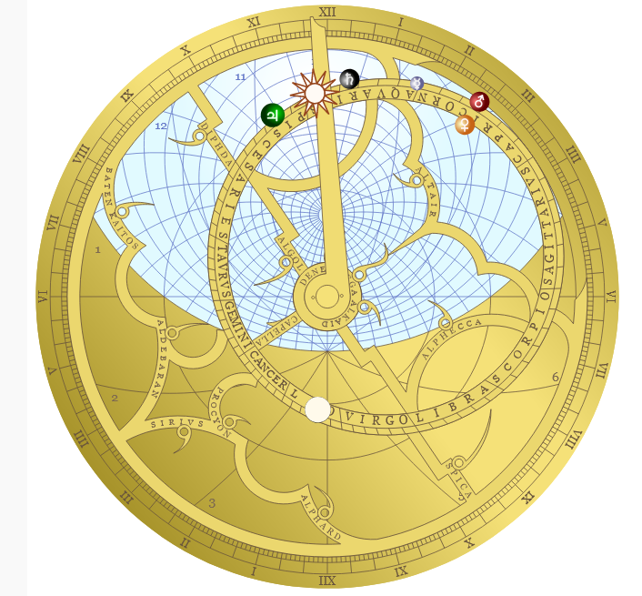
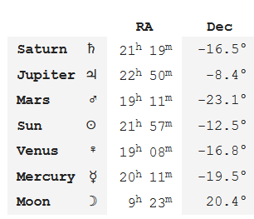
Interactive Astrolabe (a mathematical map of the cosmos) – for Berkeley CA at 12 noon on February 15, 2022
From ALEXBOXER.COM

Slide 67
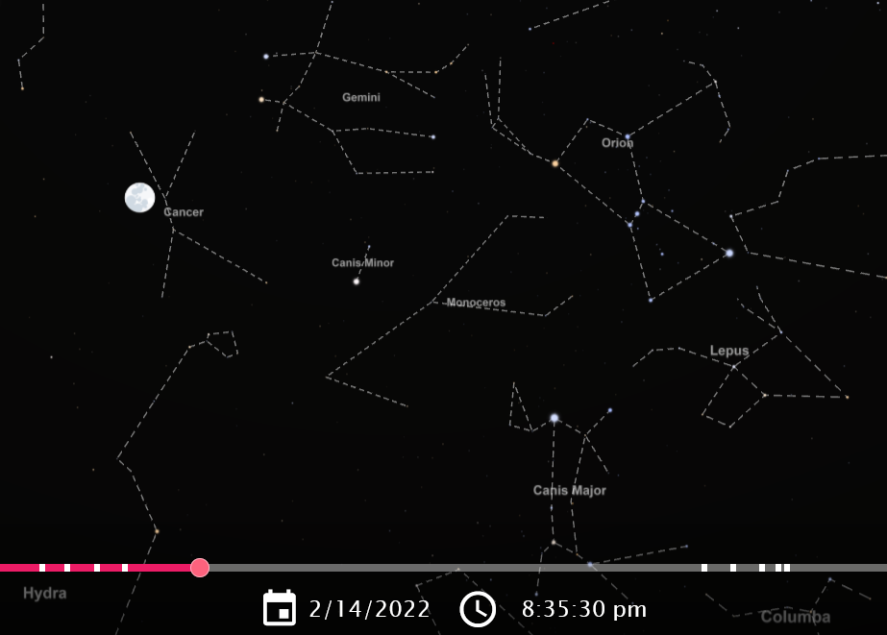
The Moon Tonight
https://www.timeanddate.com/astronomy/night/

Slide 68
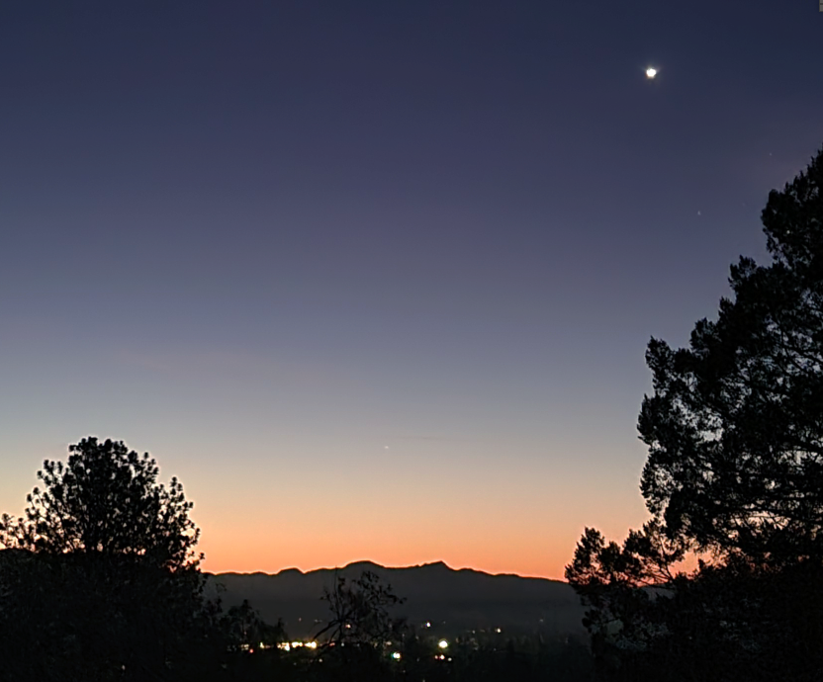
Venus Just Before Sunrise

Slide 69
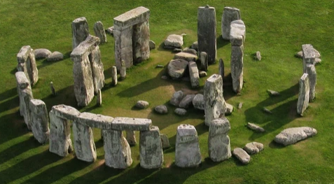
Is Stonehenge a “False Positive?”
Figure 2.3: Sunrise and sunset directions for the latitude of Stonehenge. Even with very minimal assumptions, over 10 percent of the compass is quickly filled up by lines that may seem to be celestially significant.

Slide 70
The Sky and Earth are more Interesting and Important than Instagram and TikTok

Slide 71
Some Answers For Your Astronomical Self-Assessment

Slide 72
Evidence Against The “Revolve Around Earth” Theory
The planets Mercury and Venus are always very close to the sun when we see them
This is easy to explain if they revolve around the Sun and are closer to it than Earth is
It takes complex and mechanically impossible theories to explain planetary observations in a geocentric solar system

Slide 73
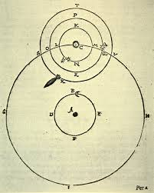
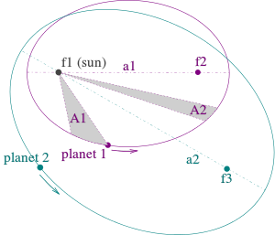
FLASHBACK
Tycho Brahe vs. Johannes Kepler same planet data, different theories
Heliocentric elliptical orbits follow “Kepler’s Laws” – simple and elegant theory
Reconciling data with a geocentric organizing principle (dictated by Plato) makes Tycho’s system overly complex and mechanically impossible

Slide 74
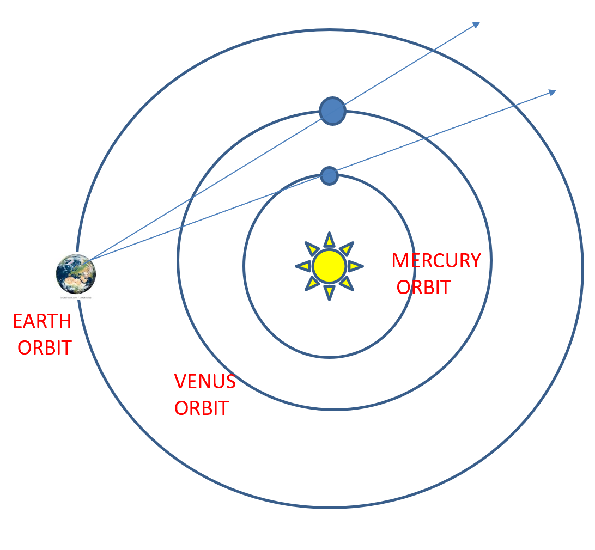
Mercury and Venus Orbits
Are Between the Earth and the Sun
When we see them they can’t be very far from the Sun

Slide 75
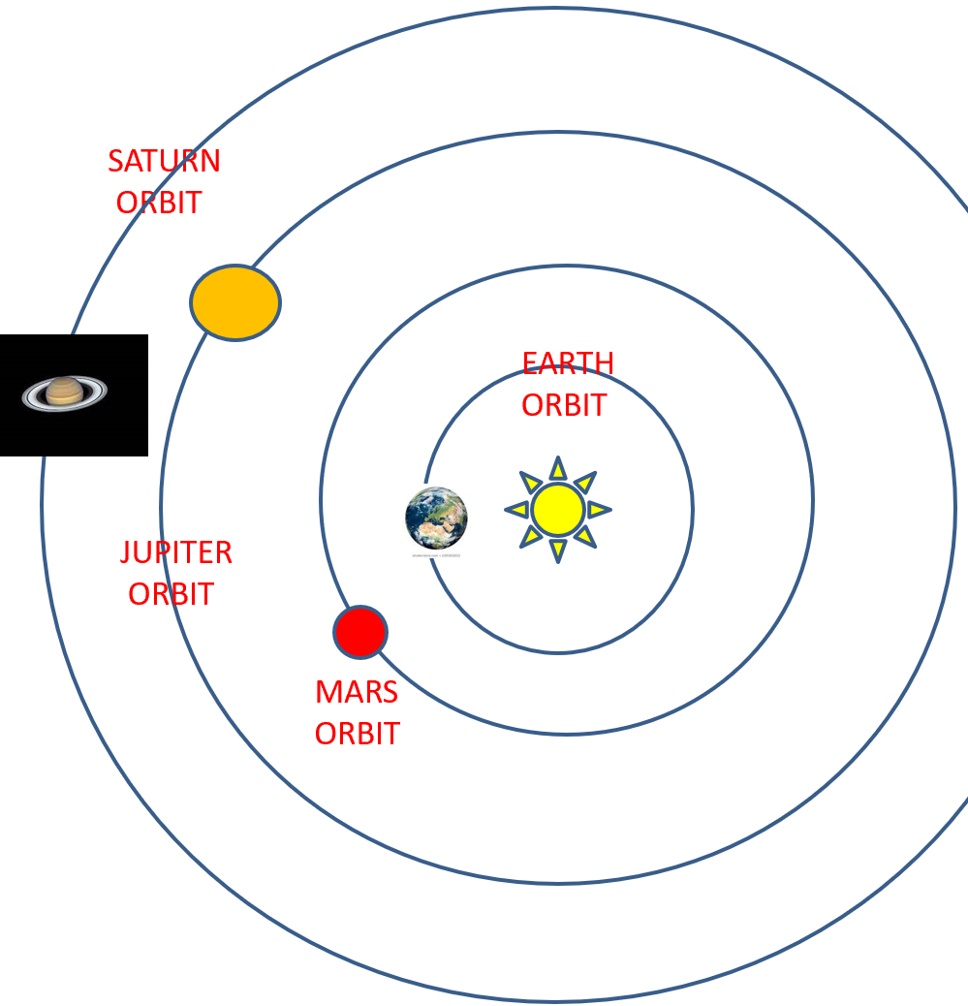
The Other Planets Are Farther From The Sun Than The Earth So we can see them close to the sun or far away from it in the middle of the night

Slide 76
Earth Orbits Counter-Clockwise
…which makes the sun move eastward through the Zodiac

Slide 77
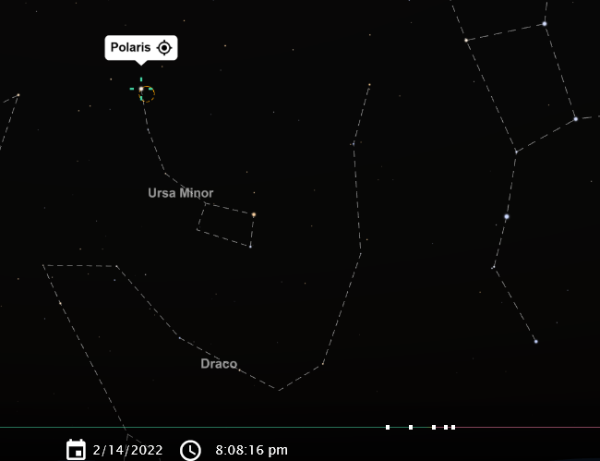
Finding Polaris with the “Pointer Stars” of the Big Dipper

Slide 78
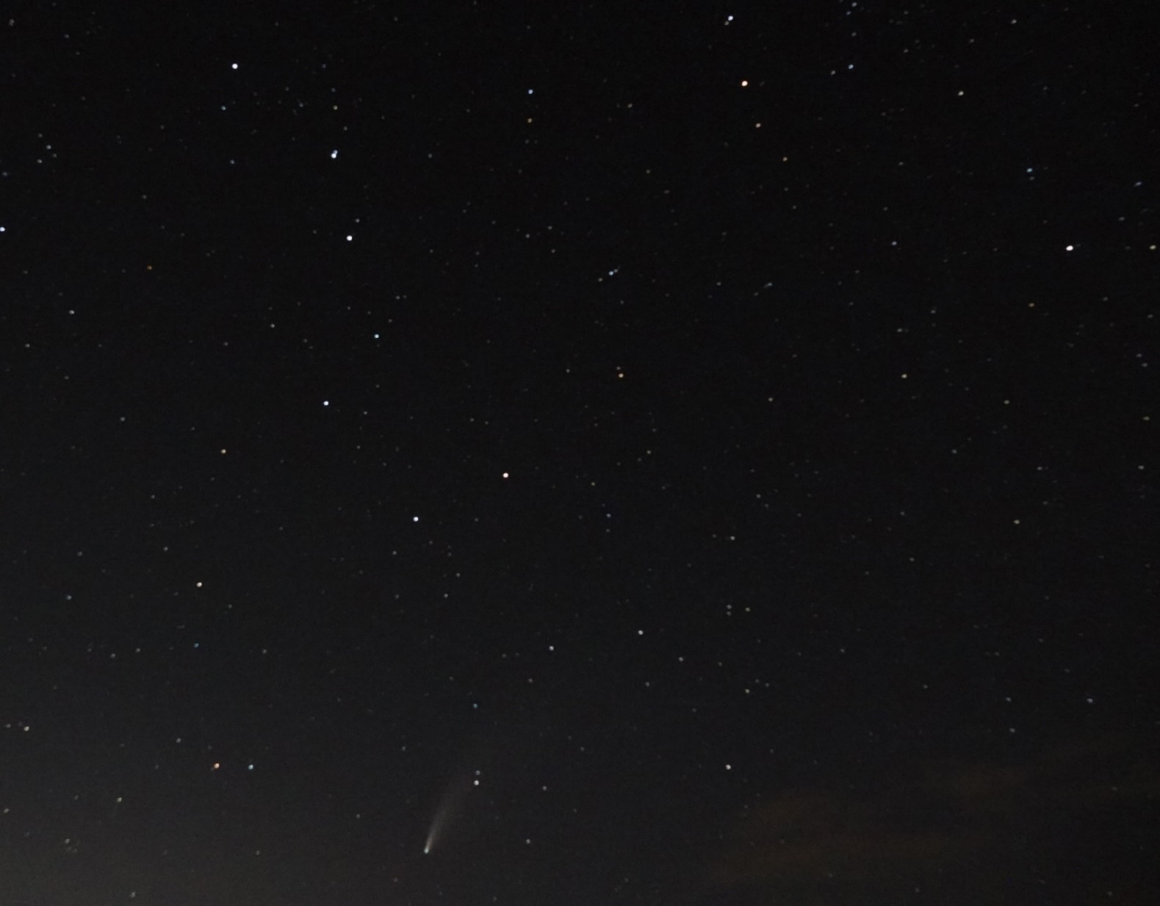
Did You Look Up and See the Comet In July 2020?

Slide 79
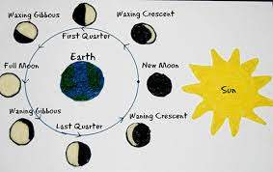
The Moon ORBITS the Earth Every 27 days
We can only see the part of the moon that the SUN is shining on
So the MOON has different SHAPES or PHASES depending on where it is in its ORBIT around the EARTH
Because it takes the same time for the MOON to revolve on its axis, we always see the same side of the moon

