Slide 1
CogSci 150 “Sensemaking and Organizing” Spring 2022
Robert J. Glushko glushko@berkeley.edu
17 February 2022 10) Cognitive Universals? Folk Biology; Linguistic Relativity; Bi-lingualism and Bi-culturalism

Slide 2
To Get Along… (from Atran & Medin)
To get along in the world, people need to be able to understand and predict
the general properties and behaviors of physical objects and substances (physics)
the more specific properties of plants and animals (biology)
the particular properties of their fellow human beings (psychology)

Slide 3
Outline
Knowledge about trees
Universal cognition?
Primitive/savage/native minds?
Folk biology vs “expert” biology
WEIRD science
Linguistic Relativity
Bi-lingualism and Bi-culturalism

Slide 4
20 Trees
Acacia
Bamboo
Birch
Buckeye
Cedar
Dogwood
Elm
Eucalyptus
Holly
London Plane
Loquat
Magnolia
Maple
Melaleuca
Oak
Pine
Pittosporum
Poplar
Redwood
Yew
How many of these 20 words do you recognize as “tree names” (whether or not you can identify them)?
How many of the trees can you identify?

Slide 5
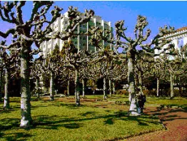
Name That Tree!

Slide 6
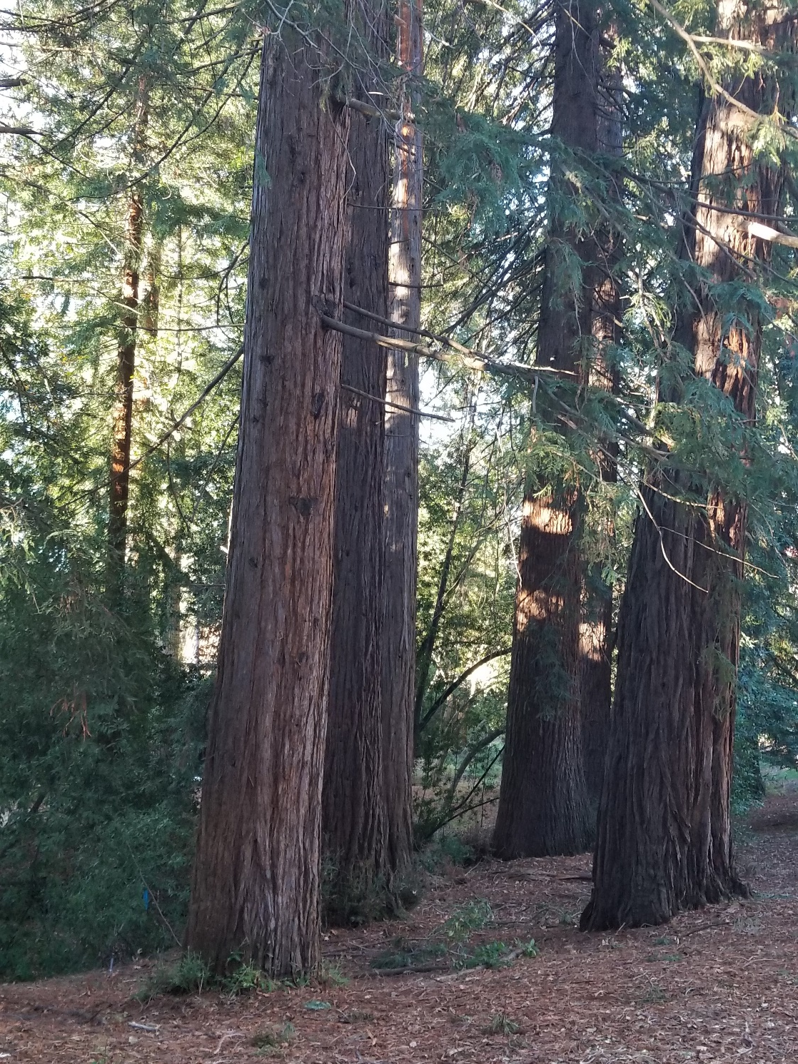

Slide 8
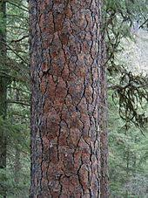
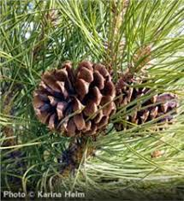

Slide 9
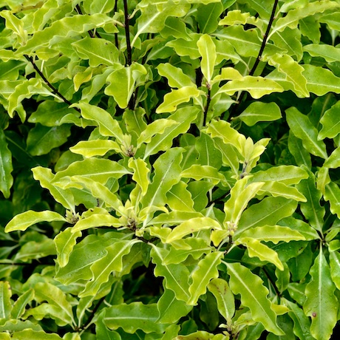
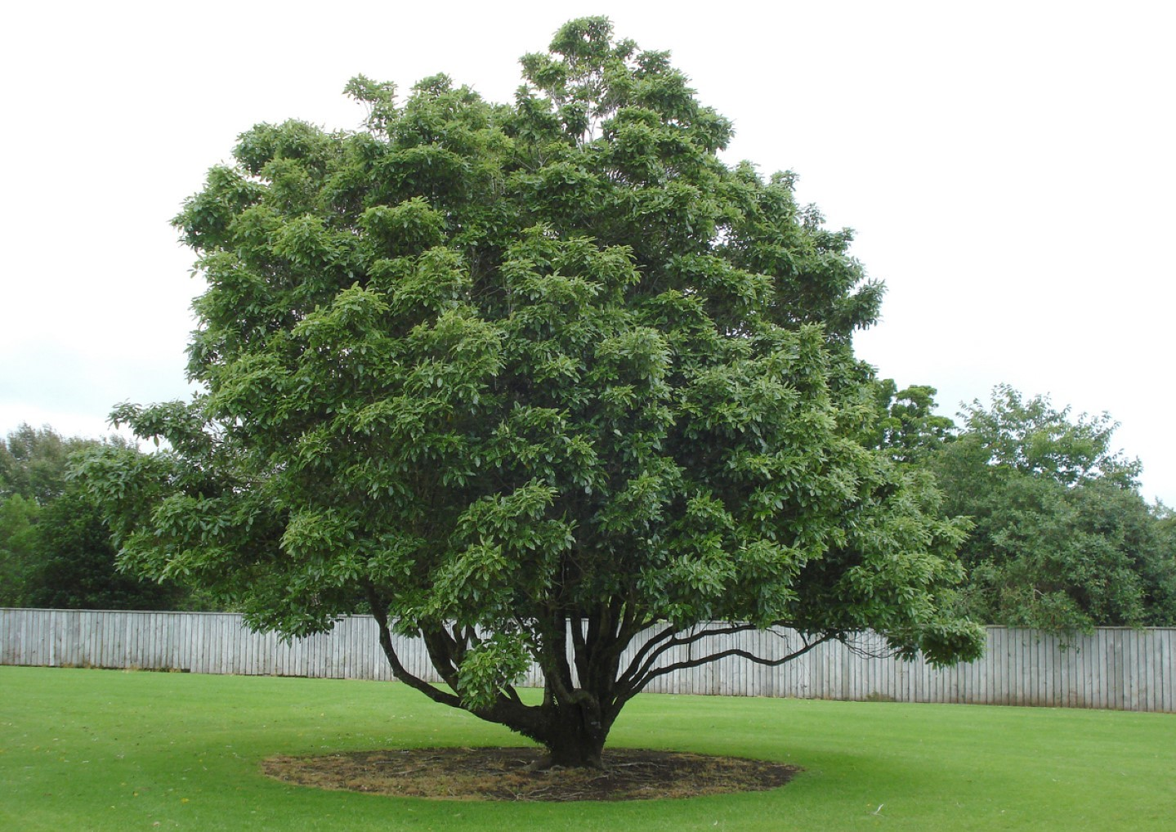

Slide 10
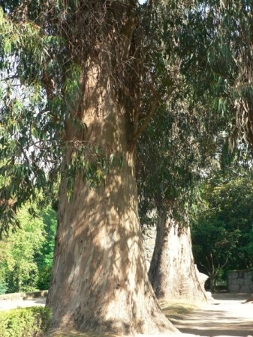

Slide 11
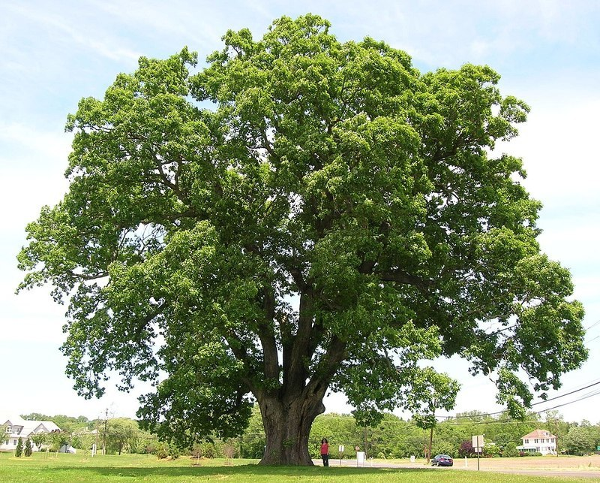

Slide 12
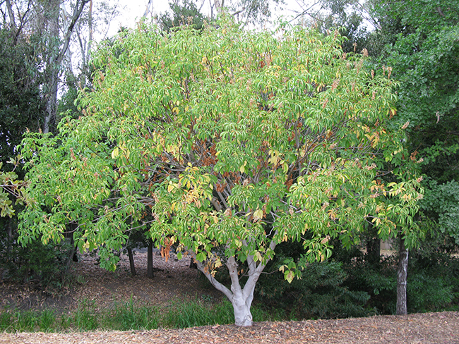

Slide 13
Your Knowledge of Trees
Of the 20 tree names… every tree is on the Berkeley campus, and 7 of the listed trees are within a few hundred yards from the Campanile
…Including 6 of the 8 trees you just saw pictures of
How many different tree species do you think there are on the Berkeley campus?

Slide 14
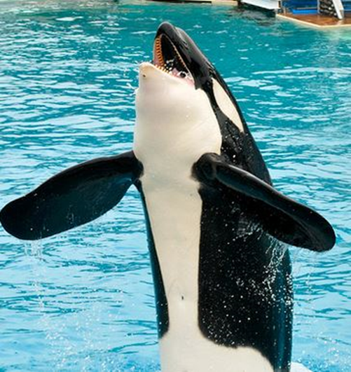
Shamu & Berkeley Campus Trees (Many tree names label the “genus” category that have many species)
Acacia (5)
Birch (5)
Cherry (6)
Dogwood (5)
Elm (5)
Eucalyptus (8)
Magnolia (5)
Maple (9)
Oak (22)
Pine (22)
What am I doing on this slide?
As of 2016, there were 276 different species of trees on the campus

Slide 15
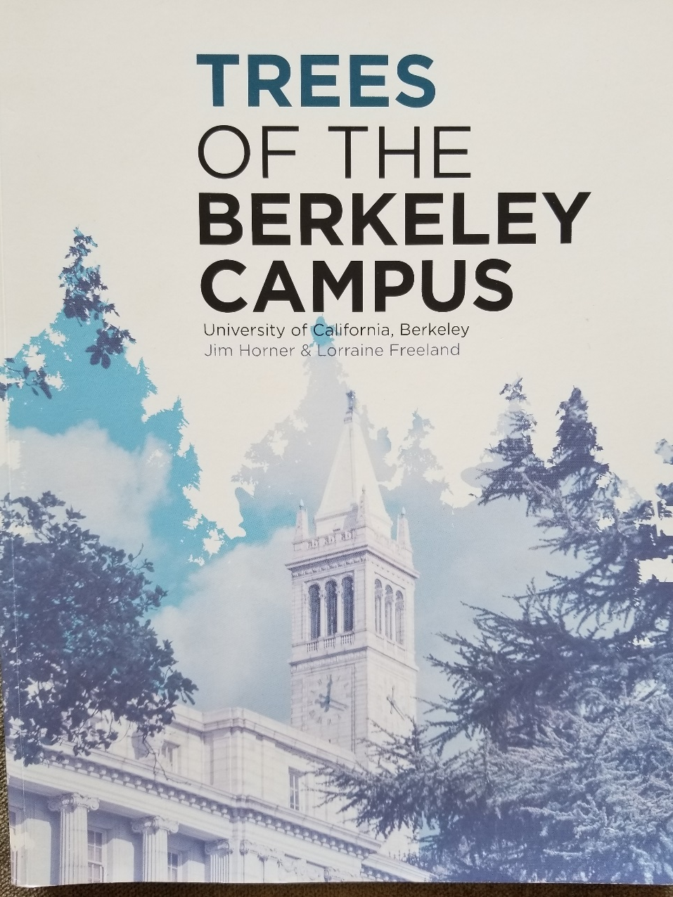
London Plane trees

Slide 16
STOP AND THINK Your Knowledge of Trees
How would you rate YOUR knowledge of trees?
Compared to someone who works with trees (landscape designer, arborist)
Compared to a botanist or “plant scientist”
Compared to someone who lives in a Northern California forest area
Compared to someone who lives in the Amazon rain forest
Compared to a “typical” Berkeley student
What factors determine someone’s level of knowledge about trees?

Slide 17
Comparative Knowledge About Trees
Maintenance workers, landscaper designers, and botanists know a lot about trees, but
How do botanists, maintenance workers, and landscape designers differ in how they think about trees?
Who has the most granular / precise categories?
4-year-old children living in rain forests can identify more trees than US college students
Some adults can identify and reason about hundreds of different trees and plants

Slide 18
What An Adult Inhabitant of the Ecuador Rain Forest Knows
Berlin, Brent. Ethnobiological classification: Principles of categorization of plants and animals in traditional societies. 1992

Slide 19
Universal Cognition?

Slide 20
Is There Universal Cognition?
Two fundamental cognitive processes are categorization (how do we decide what objects are the same kind of thing) and inductive reasoning (given that one object or class exhibits a property, how do we decide whether other related objects or classes do).
We can compare different groups doing the same or equivalent cognitive tasks to see if people use the same “cognitive toolkit”

Slide 21
STOP AND THINK
We can compare different groups doing the same or equivalent cognitive tasks
Which groups should we compare to look for differences?
If people in one culture differ from those in another on cognitive tasks, why?
Are there primitive, native, intuitive, scientific cultures that fall on some continuum of maturity or capability?
(Medin and Atran’s framing: How can cognitive psychology and anthropology fit together?)

Slide 22
Possible Sources of Cognitive Differences
If people in one culture differ from those in another on cognitive tasks, why?
because use different cognitive mechanisms?
because they have had different life experiences and have been exposed to different aspects of the world?
because they have been explicitly taught different things or taught in different ways?

Slide 23
Some Definitions of “Culture”
FLASHBACK
the customary beliefs, social forms, and material traits shared by a group of people in a place or time (culture in the world?)
whatever someone has to know or believe in order to operate in a manner acceptable to other members of a group they belong to (culture in the mind?)
whatever knowledge or beliefs other groups have that prevents them from seeing the world objectively and “correctly” – the way we do (is culture defined relatively?)
23

Slide 24
Culture as a “System of Meaning”
FLASHBACK
Culture is not chaotic or random … it is a SYSTEM (of systems…)
This system determines what sorts of things or events need to be attended to and explained
It established complex interrelated beliefs and behaviors to create a “system of meaning” about those things and events
24

Slide 25
Systems of Meaning – What vs How (1)
Roy D’Andrade (1981) suggested a division of labor between psychology and anthropology:
Cognitive anthropology would study what people think about (ethnography)
Cognitive psychology would study how people think (experiments)
What assumptions does this research strategy make about how cognitive processing works?
25

Slide 26
Systems of Meaning – What vs How (2)
Andrade’s proposal to divide “studies of meaning” between anthropology and psychology came at a time when cognitive science was dominated by a “human information processing” view of cognition; “’the mind is a computer” metaphor
This implies that processing is largely independent of context
Content varies across cultures, but the processor itself, and hence the processing, are universal, that is, independent of people's cultural background
26

Slide 27
The “Human Information Processor” (1970s)

Slide 28
Today we have more complex views of cognition… distributed cognition in the world, distributed representations in the brain … not just memory storage and retrieval

Slide 29
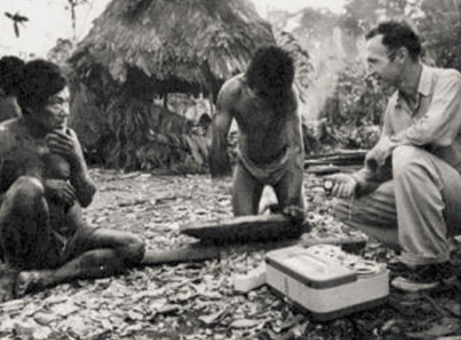
The Stereotype of an Ethnographic Study – 1930s?
Ethnography:
“writing about people”
Understanding
a community or culture through observation, interviews, and collection and analysis of artifacts

Slide 30
The Savage/Primitive Mind
Anthropology emerged in the 19th century as an extension of “natural history”
Just as Europeans studied the flora and fauna on remote locations (often European colonies) they also studied the language, culture, and artifacts of the people who lived there
Many of these peoples had no written language and limited technology, which led some anthropologists to describe them as savage or primitive compared with “modern Europeans”

Slide 31
Cognition of the “Savage Mind”
Language analysis suggested that cognition of pre-literate rural cultures was different – and less abstract – than European thinking
Such languages have many very specific words for a detailed inventory of plant and animal species and varieties
They lack words for abstract categories like “tree” or “animal”
Other languages that otherwise identify specific animals or plants often no not name those that are neither useful nor harmful
Do you agree that these language properties suggest a more primitive mind?

Slide 32
An Alternative Explanation
“Folk biology” (studying ordinary people’s relationships with plants and animals) suggests that there are universal principles for perceiving, classifying, and naming biological kinds
The use of more or less abstract terms is a function not of greater or lesser intellectual capacity, but of differences in the interests – in their intensity and attention to detail – of particular social groups
Ordinary person: “look at that interesting tree”
Botanist: “That’s a dawn redwood, also known as Metasequoia glyptostroboides. It’s also the shortest redwood and never grows taller than 50 meters.”

Slide 33
Ethnobiological (“Folk”) Classification
“Folk biology” (studying ordinary people’s relationships with plants and animals) reveals that people in all cultures classify plants and animals into species-like groups
These species-like groups are further organized in a non-arbitrary hierarchy that can be scientifically interpreted in terms of “speciation” from a common ancestor

Slide 34
Five Levels of Taxonomic Classification
Berlin, Brent, Dennis E. Breedlove, and Peter H. Raven. "General principles of classification and nomenclature in folk biology." American anthropologist 75, no. 1 (1973): 214-242.

Slide 35
The Five Levels
“Unique Beginner” (at the top of, or root of, the tree) - categories like “plant” or “animal”
“Life-form” – typically a single word like “tree”, “vine”, “grass”, or “mammal”
“Generic” - first learned, most commonly used, and most psychologically salient description descriptor – “oak”, “pine”, “perch”
“Specific” and “varietal” – more particular, qualified names like “black spruce”, “white pine”

Slide 36
Folk Biology
This hierarchical system is complemented by other classifications for particular uses (beneficial vs. harmful, edible vs. inedible, wild vs. domestic, etc.)
These classification systems enable systematic inferences about the distribution of physical and ecological properties
These regularities are best explained in terms of the similarities in how people perceive and appreciate (largely unconsciously) that natural groupings of plants and animals in their environment
36

Slide 37
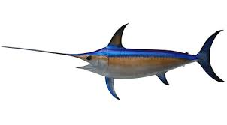
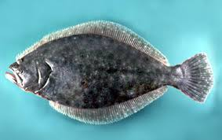
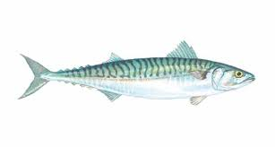
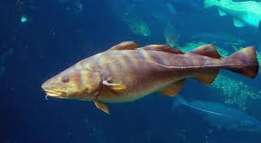
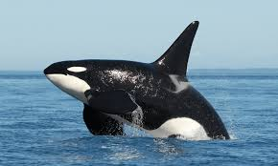
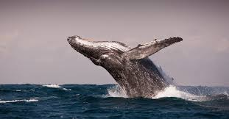
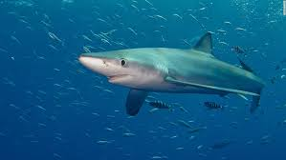
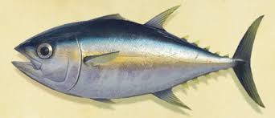
Sort Into Groups that “Go Together by Nature”
SWORDFISH
SALMON
FLOUNDER
MACKEREL
ORCA
COD
HUMPBACK WHALE
BLUE SHARK
TUNA
What Features or Properties Would YOU Use to Categorize Fish?

Slide 38
Classifying and Reasoning About Birds and Fish
When people are asked to sort birds or fish into groups that “go together by nature” experts in diverse cultures rely on both visible features (“morphology”) and on less-visibly distinctive features that enable the same function
Experts put greater emphasis on ecological relationships (which animals share habitats) and commercial/utilitarian factors
In contrast, people without expert knowledge sort primarily on visible features
38

Slide 39
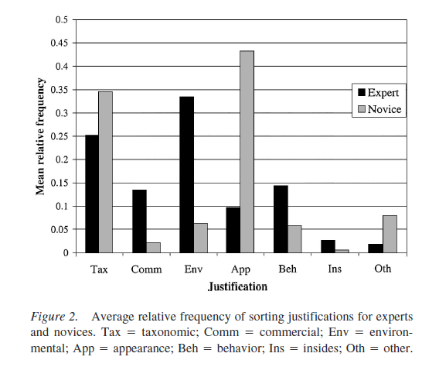
Rationales for “Fish Sorting” (Shafto & Coley, 2003)
Appearance
Environment

Slide 40
An Expert’s Taxonomy

Slide 41
STOP AND THINK:
Have YOU Ever Been A Subject In A Psychology Experiment?
How Representative Are YOU Of All Humankind?

Slide 42
The Search For Universals (from Atran & Medin)
If cognitive psychology thinks that universals are desirable, it has a peculiar way of going about its quest for them
It would not be much of a caricature to suggest that cognitive psychology does not search for universality but rather assumes it

Slide 43
Do WEIRD Subjects Make Bad Science?
Many psychological studies of categorization and reasoning use undergraduates to make claims about human cognition
These subjects come from: Western, educated, industrialized, rich, and democratic societies (WEIRD populations)
Similarly, many studies of children aimed to understand the development of cognition use children in schools affiliated with or near universities
43

Slide 44
Do WEIRD Subjects Make Bad Science? (2)
This means that researchers have neglected roughly 95% of the world population, about which – from a psychological and cognitive science perspective – we know practically nothing
There is increasing evidence and concern that WEIRD subjects are among the least representative populations one could find for generalizing about humans
They exhibit a much narrower range of rationales or attitudes toward nature
44

Slide 45
The “Devolved” Mind
Researchers have found it convenient to treat undergraduates as the reference population and to categorize groups that know more as “experts”
An alternative perspective would be to take the knowledge of the typical member of a non-industrialized society as the standard
With this reference point, undergraduate knowledge would be considered much below average or “devolved” – cognitively impoverished, with only generic reasoning strategies to rely on

Slide 46
“We are all born with native minds, though some develop in a manner better attuned to their natural surroundings than others. The full expression of the folk-biology module requires environmental triggering conditions and cultural support that may be lacking for certain groups in industrialized societies, including the usual participants in most cognitive and developmental psychology experiments.
- Medin & Atran, “The Native Mind: Biological Classification and Reasoning in Development and Across Cultures” (2004, p. 980)

Slide 47
From a theoretical perspective, the chief interest in studying these groups may not be to establish a baseline for generalizations about folk-biological knowledge but to explore the cognitive consequences of limited input”
- Medin & Atran, “The Native Mind: Biological Classification and Reasoning in Development and Across Cultures” (2004, p. 980)

Slide 48
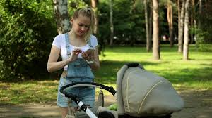
These phone-addicted parents are clearly not pointing out the natural world to their neglected kids
https://nypost.com/2018/05/19/our-digital-addictions-are-killing-our-kids/

Slide 49
Cultural Support for Knowledge (or the lack of it)
When you were a child, did your parents call your attention to plants and animals? If they did, did they refer to robins, trout, and maples or to birds, fish, and trees?
Do you consider yourself devolved with respect to the natural world?
Should we blame your parents for your lack of knowledge about nature?
How might we measure the amount of cultural support?

Slide 50
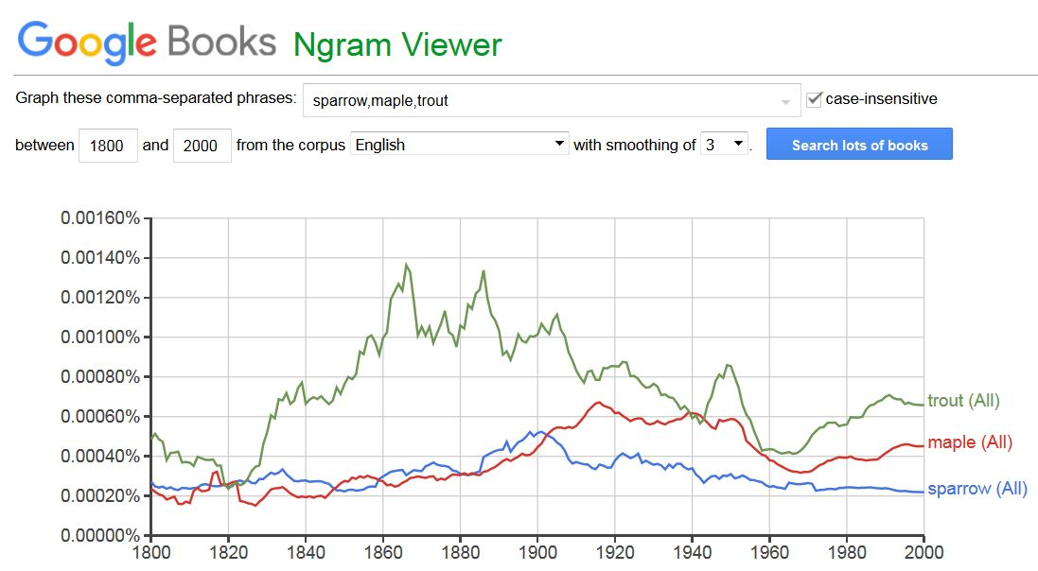

Slide 51
Get a Pet; Go Outside and Play
In technologically-oriented cultures contact with biological kinds may be so minimal that researchers can demonstrate significant differences in children's biological reasoning as a function of whether they do or do not have goldfish as pets
Optional Homework Assignment…. Go for a walk (without your phone in your hand) and look for interesting trees or plants (then, take out your phone and take a photo of what makes it interesting).

Slide 52
To Make You Feel Better… Recognize These Restaurant Names? Can You Categorize/Contrast The Restaurants?
Arby’s
Burger King
Chick fil-A
Chipotle
Dairy Queen
Dominos
Dunkin’ Donuts
Jack in the Box
KFC
Little Caesars
McDonalds
Panda Express
Panera
Papa John
Pizza Hut
Sonic Drive In
Starbucks
Subway
Taco Bell
Wendy’s
How many of these names would an Anchuar living in the Ecuadorian rain forest recognize?

Slide 53
Linguistic Relativity

Slide 54
Language {and,or,vs.} Thought
What is the relationship between language and thought?
Universalist view: Languages are built on a universal cognitive and conceptual foundation that they use differently
Relativist view: Languages create categories that shape perception, causing speakers of different languages to conceptualize the world in fundamentally different ways
Reconciliation? Universal conceptual basis for the categorical distinctions that languages make, but that this conceptual foundation may be altered by language and culture
54

Slide 55
Linguistic Relativity
Languages differ a great deal in the words they contain (which concepts are lexicalized)
They also differ in more fundamental ways by requiring speakers or writers to attend to details about the world or aspects of experience that another language allows them to ignore
Does this mean that people can't understand concepts that are not lexicalized?

Slide 56
STOP AND THINK:
Why do languages differ in which concepts they lexicalize?

Slide 57
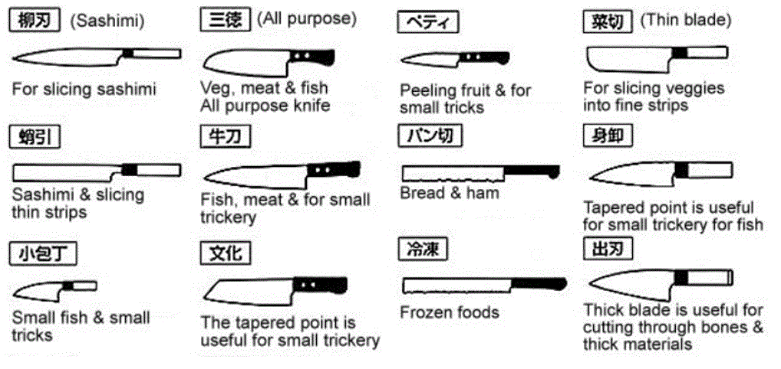
Japanese Kitchen Knives
Does your language have different words for each of these kinds of knives? If it doesn’t, can you still distinguish them? TUTORIAL

Slide 58
Alternative: Linguistic Relativity & the Whorfian Hypothesis
Benjamin Whorf (mid 20th century) is widely credited and miscredited with the strong form of the hypothesis that "language shapes thought" - that the categories embodied in languages shape or even constrain how people perceive and understand the world
Popular argument: Eskimos have lots of words for different kinds of snow, so they think about snow differently than native speakers of other languages
What’s the flaw in this argument?
58

Slide 59
Hinting at Linguistic Relativity in Iceland Advertisement

Slide 60
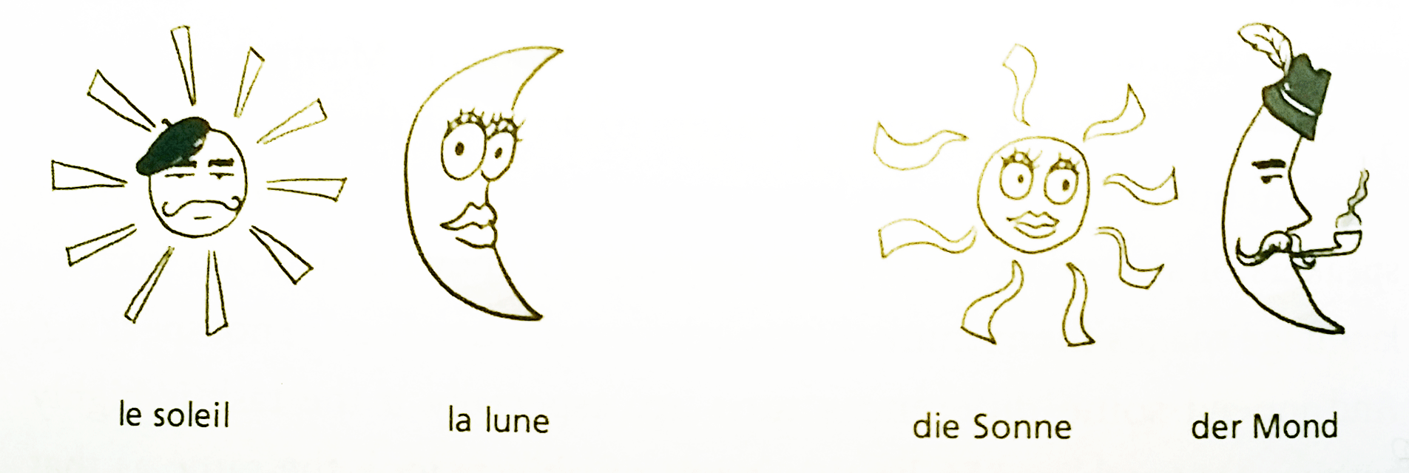
“Weak” Linguistic Relativity is Real
In languages in which nouns have gender, people associate gender-specific characteristics
English marks verb tense, Russian marks both tense and gender; Turkish marks verbs according to whether the speaker has first-hand knowledge of the act
French: Sun is M, Moon is F
German: Sun is F, Moon is M

Slide 61
Color in Language
English Speakers – “Blue” is one category
Russian Speakers – “Blue” is two categories
Winawer, J., Witthoft, N., Frank, M. C., Wu, L., Wade, A. R., & Boroditsky, L. (2007). Russian blues reveal effects of language on color discrimination. Proceedings of the national academy of sciences, 104(19), 7780-7785.

Slide 62
“Languages differ essentially in what they must convey and not in what they may convey.”
Jakobson, Roman (1959) 'On linguistic aspects of translation'

Slide 63
No Shamu Problem in German: “the same thing” must be disambiguated
Zwei Jungs können nicht zur gleichen Zeit dasselbe Hemd anziehen, wohl aber das gleiche.
Two guys can’t wear the same shirt at the same time, but they can wear the same shirt

Slide 64
“Culture” Shapes Meaning and Language
English-speaking Americans “on the left” and “on the right” use the same words but with very different meanings
Marriage, freedom, liberty, responsibility
They use different words to frame the same issues
“Pro-life” vs. “Pro-choice”, “Spending” vs. Stimulus”, “Estate tax” vs. “Death tax”
STOP AND THINK – What other words do the left and right define differently?
64

Slide 65
Bilinguals & Biculturals

Slide 66
Bilinguals & Biculturals: Definitions
Simultaneous bilinguals - Both languages learned concurrently from birth
Second language learners – 2nd language learned after first language is established
Bicultural bilinguals – Speak two languages and identify as belonging to both cultures
Monocultural bilinguals – Speak two languages but identify with one culture

Slide 67
2nd Language Competence
Many bilinguals are fluent speakers of both languages but have only minimal writing competence in one of them
Degree of competence in 2nd language reflects perception of the degree to which one’s identity in 2nd language is “compatible and integrated”
Relative social status of the two languages influences the extent of “compatibility and integration”

Slide 68
Vocabulary Learning
Learning any language requires “tuning” of the mechanisms of speech perception, which in turn reduces the ability to discriminate speech features used in other languages
But vocabulary learning in a first language is faster as a result of this “tuning”
Infants raised in bilingual environments have slower “neural commitment” because they are learning vocabulary in two languages
(more on this statistical learning topic on 3/8)
68

Slide 69
Cognitive Performance
Many cognitive performances of bicultural bilinguals may vary with the language used in testing
Many multilinguals report different personalities, or even different worldviews, when they speak their different languages
These personality/culture shifts can be primed by speaking the language or by more subtle signals and symbols that “prime” one culture
69

Slide 70
Code Switching
Bilingual children are constantly alternating between different words that describe the same things
This “code switching” might underlie findings that bilingual adults demonstrate more cognitive flexibility and better “executive control”

Slide 71
STOP AND THINK “Code Switching”
Do any of you identify yourselves as bilingual or bicultural? Which category? What aspects of your life history were deterministic here?
In what situations do you “switch codes” for your language and culture?
Does the character or extent of your code switching differ according to context or location?

