Slide 1
CogSci 150 “Sensemaking and Organizing” Spring 2022
Robert J. Glushko glushko@berkeley.edu
1 March 2022 13) Describing Relationships & Structures; Social Network Analysis

Slide 2
The Structural Perspective on Relationships
Analyzing the association, arrangement, proximity, or connection between resources without primary concern for their meaning or the origin of these relationships
Sometimes structure is all we know...and sometimes we ignore what we know about relationship semantics to focus on the generic aspect of structural connectivity (such as “degrees of separation”)
2

Slide 3
FLASHBACK
Thanks, Dianne for Reassuring Us
Leaked NSA document says metadata collection is one of agency's 'most useful tools'
A leaked NSA newsletter published Wednesday highlights the collection of phone metadata as one of the agency's "most useful tools. The document says that the NSA has used metadata such as numbers called, IP addresses, and call duration to yield "concrete results," such as the capture of terror suspects Khalid Sheikh Mohammed and Abu Zubaida.
We can learn a lot from just the structure of relationships, independent of any reason for them

Slide 4
STOP AND THINK
An ORG CHART is a structural model of a business that highlights the “control structure” or “management structure” that is reflected in reporting relationships (the “chain of command”)
The size of the business, its industry sector, and its history/culture influence the hierarchy depth, the number of sub-units or people at each level (the “span of control”), and the direction and amount of communication that is allowed or encouraged -- “the organizing principles and the interactions they support”
What are the most common structural models for businesses?

Slide 5
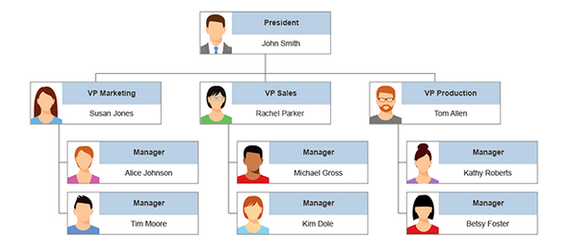
Business Structures (1): Functional Hierarchy
The structure is divided into traditional departments like IT, marketing, finance, human resources, and operations based on everyone's functional role in the organization
https://www.smartdraw.com/organizational-chart/organizational-chart-types.htm

Slide 6
A large SPAN OF CONTROL where a manager has many subordinates suggests that they are all doing the same job and don’t need a lot of individual attention (analogous to cattle ranch vs zoo)

Slide 7
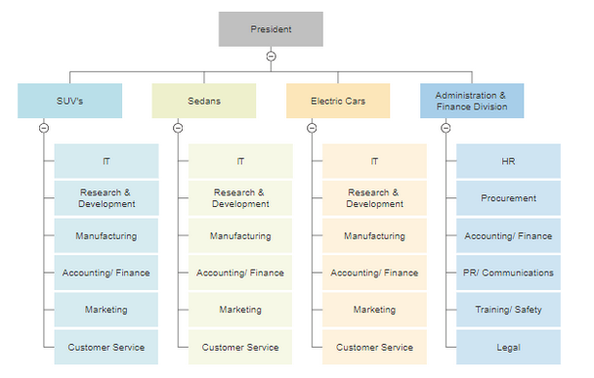
Business Structures (2): Divisions
A divisional organizational chart reflects a company organized along a product line or specific geography; each division has the same functional structure

Slide 8
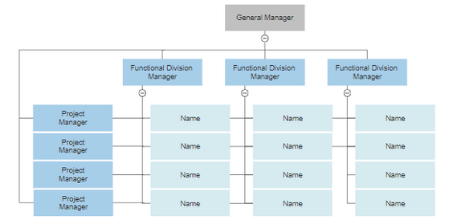
Business Structures (3): Matrix
In a matrix structure employees are divided into teams by projects or product lead by a project or product manager, but also report to a functional manager
If you are a UX or design professional you are likely to have a manager (the head of UX, head of design) but also will report to a project manager

Slide 9
Business Structures (4): Flat
A flat organization structure has few or no levels of management between executives and all other employees. This type of structure empowers self-management and greater decision-making ability for every employee
This is how most “start-ups” are organized when they start…. Do they stay this way? Why causes them to change structure?

Slide 10
Internal and External Structure
Resources can have INTERNAL structure as well as EXTERNAL structure that connects them to other resources
We often make arbitrary decisions about the granularity with which we describe the internal structure of a resource
Stop and think: We often describe the relationships between companies in terms of the company-to-company transactions they carry out, but when would be focus on interactions between their employees?
10

Slide 11
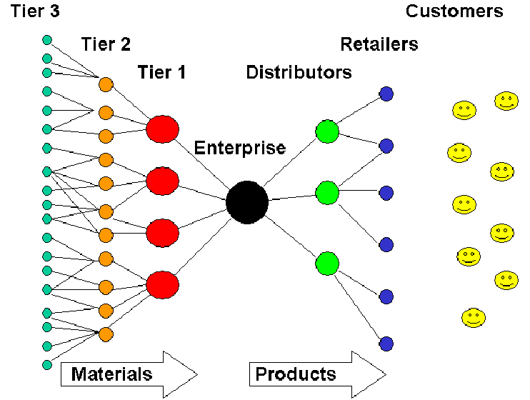
Example: Generic Supply Chain
11

Slide 12
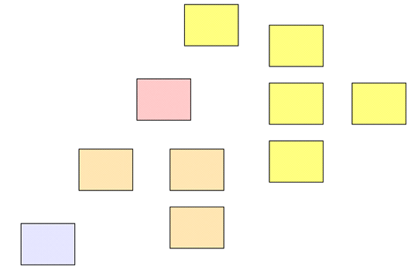
Separate Resources or Resource Components?
The boundaries we impose to identify resources determines whether some structure is internal or external with respect to them
12

Slide 13
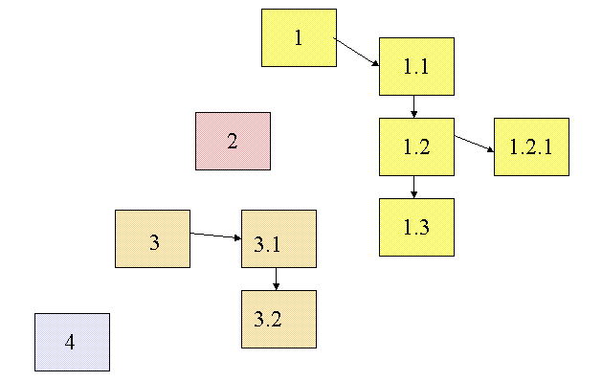
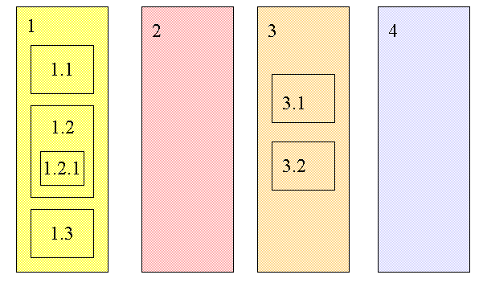
Changing Resource Boundaries Changes External to Internal Structure
Do these represent the same structural relationships among information resources?

Slide 14
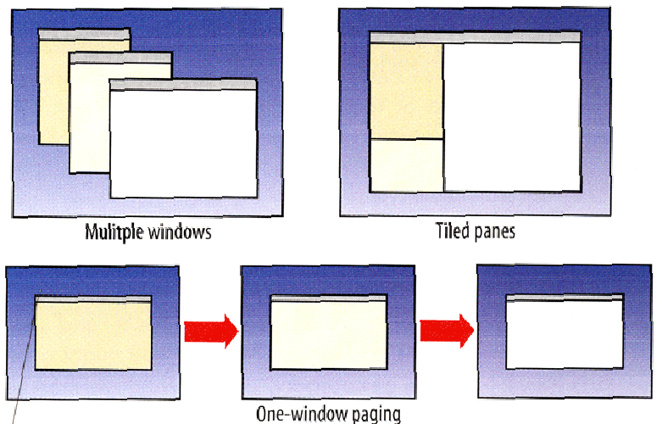
External or Internal Structures in a User Interface?

Slide 15
Familiar Terms for Internal Document Structures
Footnotes and Endnotes (often contain citations to external resources)
Cross references within the document
Sidebars (supplemental content)
Pull quotes (structures for emphasizing some document content)
Annotations (could be considered footnotes created by readers rather than by the author)
15

Slide 16
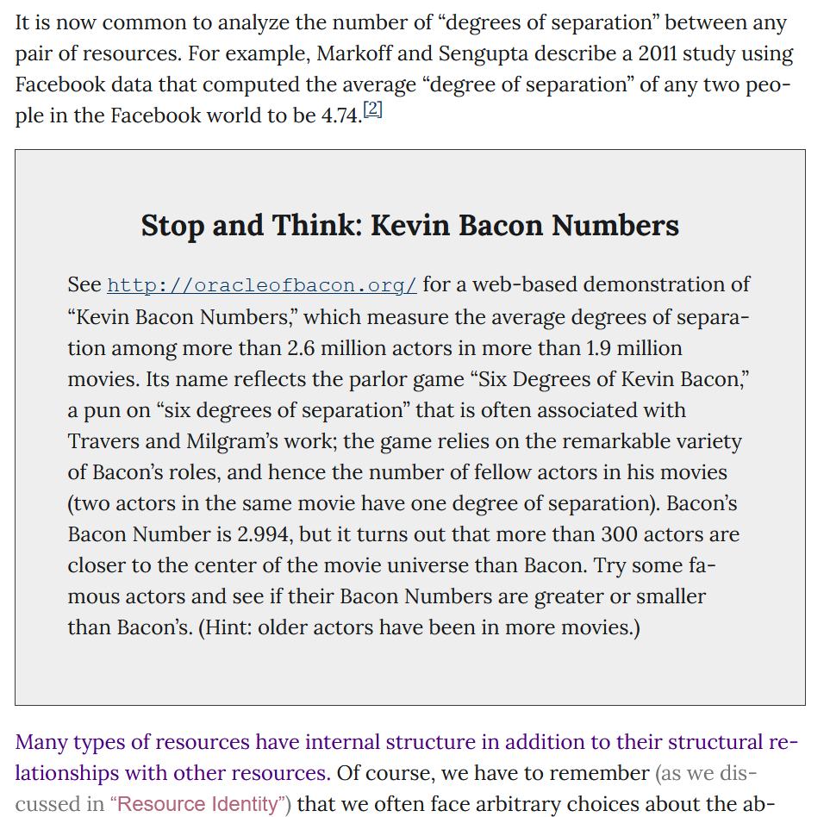
Examples of Internal Document Structure in TDO 6.5, “The Structural Perspective”

Slide 17
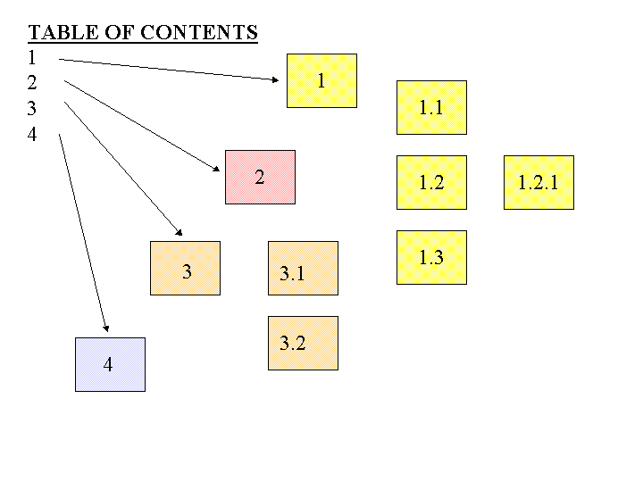
A Table of Contents is a Numeric Hierarchical Set of Structural Links to Document Components

Slide 18
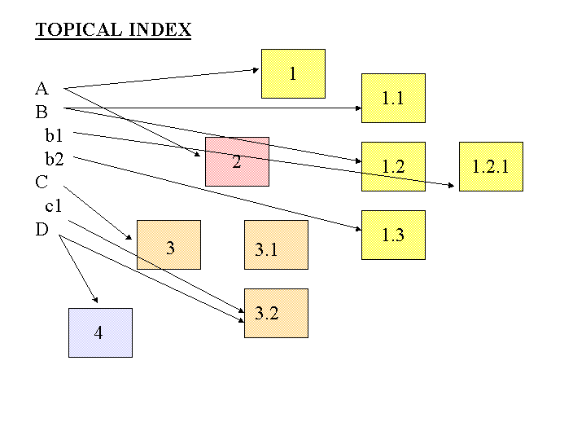
An Index is An Alphabetically Arranged Set of Semantic Links to Document Components

Slide 19
External or Between-Document Links
From document to document
From document to document component
From document component to document
From document component to document component

Slide 20
STOP AND THINK
When you first started writing essays or reports in school your teacher said something like “have at least 5 references listed at the end of your report”
In contrast, scientific and legal writing require much more precision and granularity in references and footnotes
What determines the precision and granularity of within and between-document links?

Slide 21
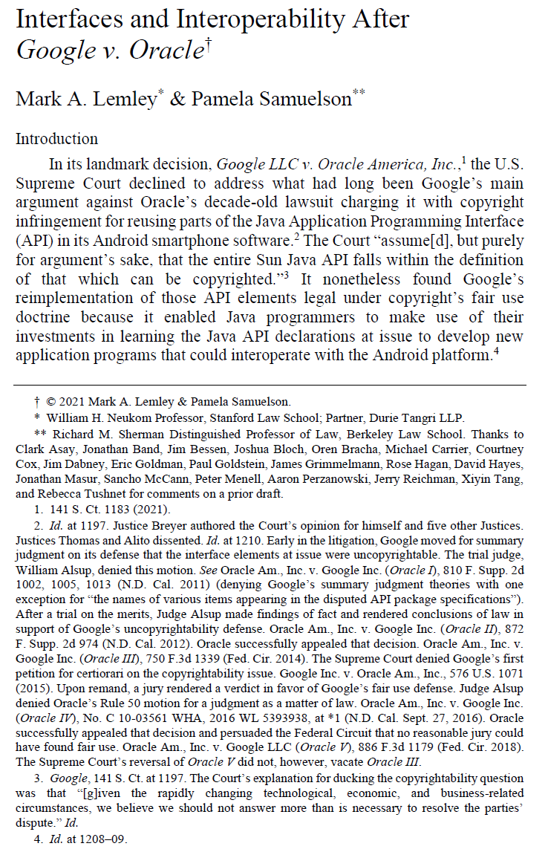
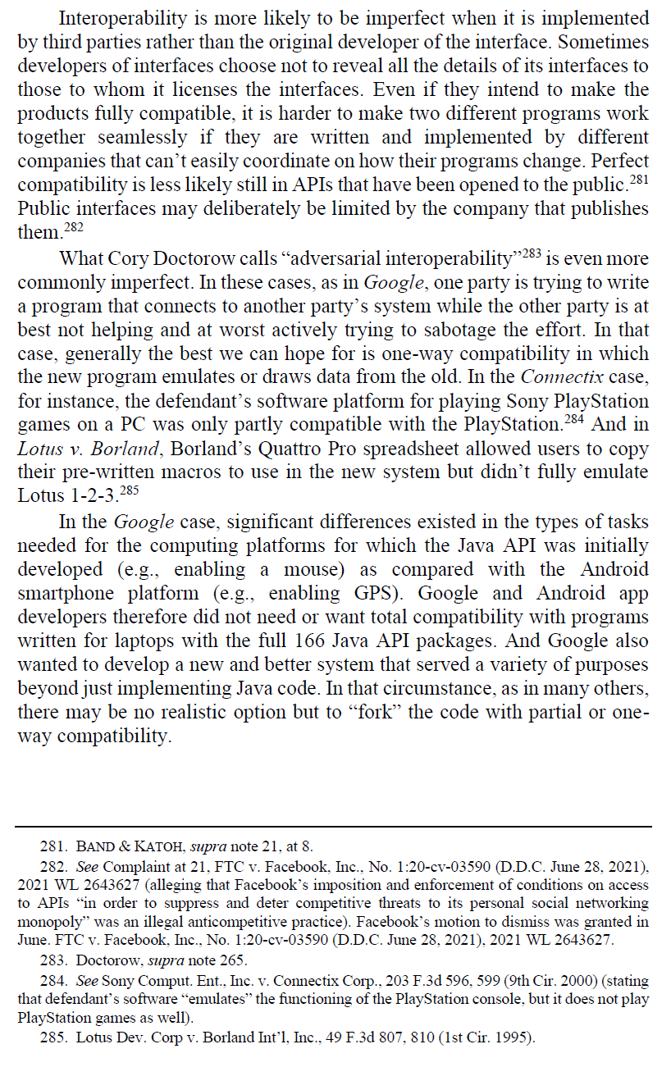

Slide 22
“Hypertext” Vocabulary: Link Properties
Starting point of the link (the ANCHOR)
The end point of the link (the DESTINATION)
The reason for the link (the LINK TYPE)
The DIRECTIONALITY
The number of resource types (ARITY or DEGREE) or resource instances (CARDINALITY) linked to (1-1 or 1-many)
Example: Link from a word to its definition, a picture, and pronunciation
22

Slide 23
Separation of Link Concerns
These structural and semantic issues are distinct from presentation ones that UX designers deal with
Is the presence of the link indicated (the LINK MARKER)?
Does the link marker change to indicate that the link has been followed?
Is the LINK TYPE indicated by some presentation convention?
Is the DESTINATION TYPE indicated by some presentation convention?

Slide 24
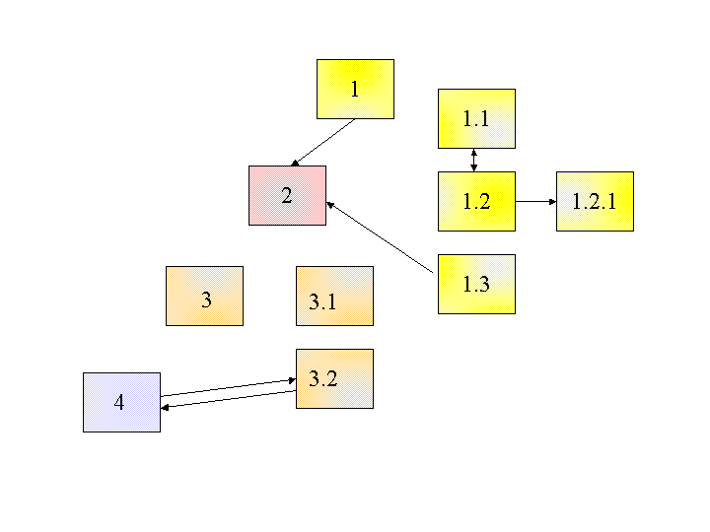
Embedded Links
These links are embedded in the resources (as they are in web pages)

Slide 25
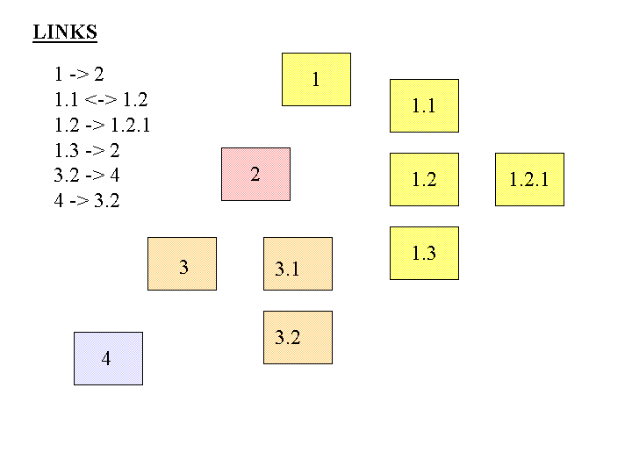
Separate Links
These links are stored separately from the resources in a “link database”

Slide 26
STOP AND THINK
What are the advantages of having links stored apart from the resources they connect?
If this is a good idea, why are links embedded in web pages rather than stored separately?

Slide 27
Hypertext “State of the Art” Before the Web
Hypertext links existed many years before the web in “standalone” resources like CD-ROM encyclopedias
Glushko, Robert J., Mark D. Weaver, Thomas A. Coonan, and Janet E. Lincoln. "Hypertext engineering: practical methods for creating a compact disk encyclopedia." In Proceedings of the ACM conference on Document processing systems, pp. 11-19. 1988.
Link functionality and user interface design was an important differentiator in these systems – many had 1-many links, link typing, bi-directional links, link databases

Slide 28
The Web is Rejected as “Too Simple” by the Hypertext Research Community
In 1989, the ACM Hypertext conference rejected Tim Berners-Lee’s paper on the web because it was too simple by the standards of the research community (he was allowed to give a demo)
My paper at that conference: Glushko, Robert J. "Design issues for multi- document hypertexts." Proceedings of the 2nd ACM conference on Hypertext, pp. 51-60. 1989.
The research community was wrong. The Web took off because it made the right TRADEOFF between ease of use and expressive power. When and how did YOU create your first web page?

Slide 29
Abstract Thinking About Linking
We can analyze many different types of links with some common concepts and abstractions
Links between printed or digital documents
Links between web pages
Links between databases
Links – communication and information flows - between people, organizations, any other kind of interacting “actors” or resources – social networks
But there are different vocabularies for talking about the same concepts…
29

Slide 30
Linking in Relational Databases
A relational database system consists of a set of data tables (often managed by a single firm)
The rows in a table describe resources; the columns are the values of the properties or attributes in the resource description
One of the properties is the “primary key” whose value uniquely identifies the resource in a given row of a particular table
Tables can be linked by using their “foreign key” – a resource description in one table that is the primary key in another

Slide 31
Linking Between Datasets
There are usually many collections of data about the same type of resources
But often the resources have:
Different granularity
Different properties in the resource descriptions
Different perspectives or principles governing the values of the resource descriptions
If the same resources can be identified in different datasets, they can be linked
Why link death records with records about voting and social security payments?

Slide 32
Alternative Vocabulary: Graph Theory
We can apply graph theory to understanding relationships from a structural perspective
A GRAPH treats resources as VERTICES or NODES
The pairwise relationships between resources are represented by the EDGES that connect them
If the edges have an associated direction, this is a DIRECTED graph
A WEIGHT can be assigned to each edge if the relationship is numerical (distance, cost, time, frequency of interaction, perceived strength, etc.)
32

Slide 33
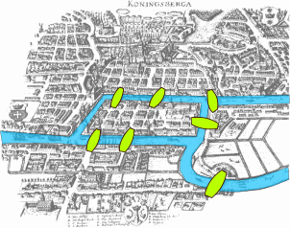
The Origins of Graph Theory (Euler 1735)
2 islands, 7 bridges – can you visit all 4 land masses without crossing any bridge more than once? Euler (1735) proved you couldn’t and invented much of graph theory to explain it
Euler’s Seven Bridges of Königsberg Problem
33

Slide 34
An Unhappy Geopolitical Footnote

Slide 35
Three Network Representations
Edge List
Essentially the raw data, the list of relationships
Matrix
Necessary for computation
Graph
Easiest to grasp patterns

Slide 36
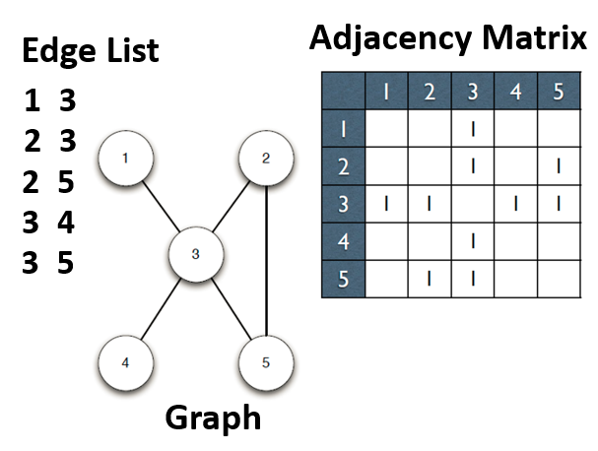

Slide 37
Relationship “Abstraction and Granularity”
A relationship between two people could be abstractly characterized as a “connection”
But it could also be analyzed with more granularity as a set of different relationships
Are they members of the same work organization?
Do they have face-to-face meetings
Do they regularly send email or text messages to each other?
Do they talk on the telephone?
Each of these more granular definitions of a relationship could define separate (but overlapping) networks

Slide 38
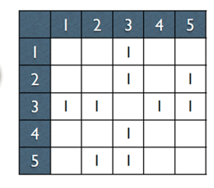
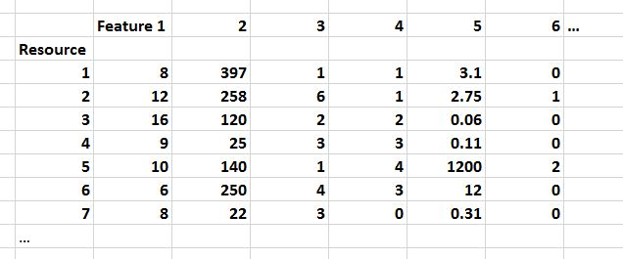
If this is all you’re given, give up!
FLASHBACK

Slide 39
Properties of Graphs
Reachability – is there a path between any two nodes in the graph?
Shortest path – if there are multiple paths between two nodes, which is the shortest?
Subgraph discovery – are there sub-graphs that are completely contained in a larger graph? (e.g., “invisible college”)
Centrality – which nodes are the most connected or have the average shortest paths to the other nodes?
39

Slide 40
Reachability and Transitive Closure
The REACHABILITY property of a graph is "can you get there from here”
We can determine whether a path exists between any two nodes in a graph by calculating the transitive closure of the graph
This is done by taking its adjacency matrix and raising it to the nth power, where n is the number of vertices in the graph
When we raise the graph to the kth power, we add exactly the edges which represent paths of length k in the original graph.
40

Slide 41
Degrees of Separation (“edge counting”)
If you have 44 Facebook friends, and each of those people has 44 friends who are not also your friends…
And each of them has 44 friends, and each of those has 44 new friends…
In a chain of just 6 steps, you would be connected to 44 ^ 6 people…. Which is 7,256,313,856 (more than everyone in the world, and they’re not all on Facebook)
A 2011 Facebook analysis computed the average “degree of separation” of any two individuals in the “Facebook world” to be 4.74
41

Slide 42
How Important Are “Degrees of Separation?”
How often do you interact with / communicate with someone more than 2 steps away?
2nd degree connections are thought to be the most important ones in many respects because they are more likely to have new information, innovations, contacts, jobs… because you already know that stuff about your 1st-degree network
Granovetter, M. S. (1973). The strength of weak ties. American journal of sociology, 78(6), 1360-1380.
42

Slide 43
Shortest Path (weighted edges)
If edges are weighted (different costs in distance, time, etc.) the shortest path between two nodes in the graph might not be the one with the fewest edges
The shortest path problem is ubiquitous, and its solution has obvious value – travel, transportation, grocery shopping…
but also in financial arbitrage…
43

Slide 44
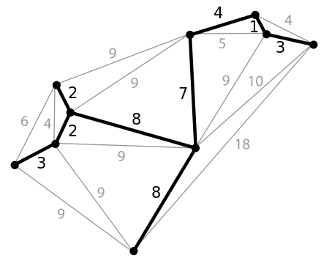
Minimum Spanning Tree
A spanning tree of a graph is a subgraph that is a tree that connects all the vertices
Why would we want to find the spanning tree with the shortest path?
44

Slide 45
Centrality Measures
Degree Centrality – number of direct connections
Closeness – low average path length
Betweenness – a location in the network that interconnects different clusters
45

Slide 46
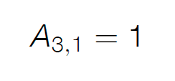
Are 3 and 1 connected?
In-degree is the number of incoming connections
Out-degree is the number of outgoing connections
In an undirected graph like this these numbers are the same!

Slide 47
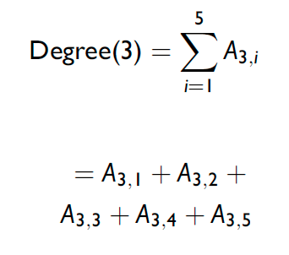
Computing “Degree Centrality”

Slide 48
“Degree Centrality” for Each Node

Slide 50
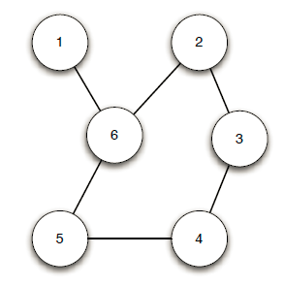
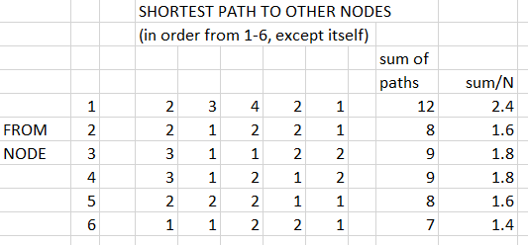
A More Complex Example
Does Node 6 Seem The Most Central?
Does Node 1 Seem The Least Central?

Slide 51
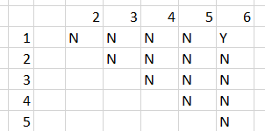
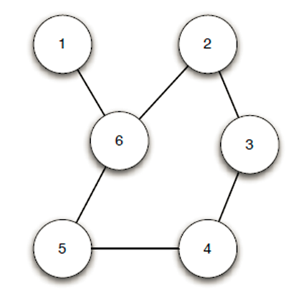
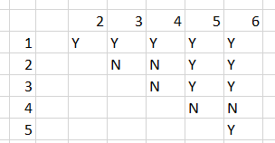
Betweenness Centrality
Node 1 - On 1 Shortest Path
How often does a node fall “between” any two nodes on their shortest path?
Node 6 – On Many Shortest Paths

Slide 52
Moving Beyond Graph Analysis to “Relational” & “Social Network” Analysis
We've been treating relationships in purely structural terms - is one thing connected to another - but we can refine that into two perspectives:
RELATIONAL analysis treats links as indicators of the amount of connectedness or the direction of flow between documents, people, groups, journals, disciplines, domains, organizations, or nations
EVALUATIVE analysis treats links as indicators of the level of quality, importance, influence or performance of documents, people, groups
52

Slide 53
Social Networks
When nodes represent people, groups, organizations, etc., the structure of the graph and the weights assigned to edges can be interpreted in social terms like popularity power, and influence
Many social networks are directed graphs because of asymmetries in status, power, or values
Tightly connected communities can hinder rather than help the spread of information (or innovations)
Analogy to epidemics… if there is some probability of infecting someone you come into contact with, the more different people you encounter will determine how fast a disease spreads
53

Slide 54
Questions about Individuals
Who is the most popular person in the network?
Who has the most influence?
Who connects or serves as the bridge/gatekeeper between different groups
If you want to disrupt a network, which individual should you remove (or convince to defect, subvert, etc.)
Can we predict social behavior by analyzing patterns in the structure of the network?
54

Slide 55
The Document Engineering Assignment

Slide 56
General Comments
Some of you did exceptional work with good harvest and consolidation tables and a clearly documented domain model
Not everyone followed the directions, which were very explicit about producing specific work products
THE MOST IMPORTANT TEST OF YOUR MODEL WAS WHETHER YOUR PARTNER COULD USE IT
Bcourses doesn’t like embedded links in assignment submissions… please submit pdf files instead

Slide 57
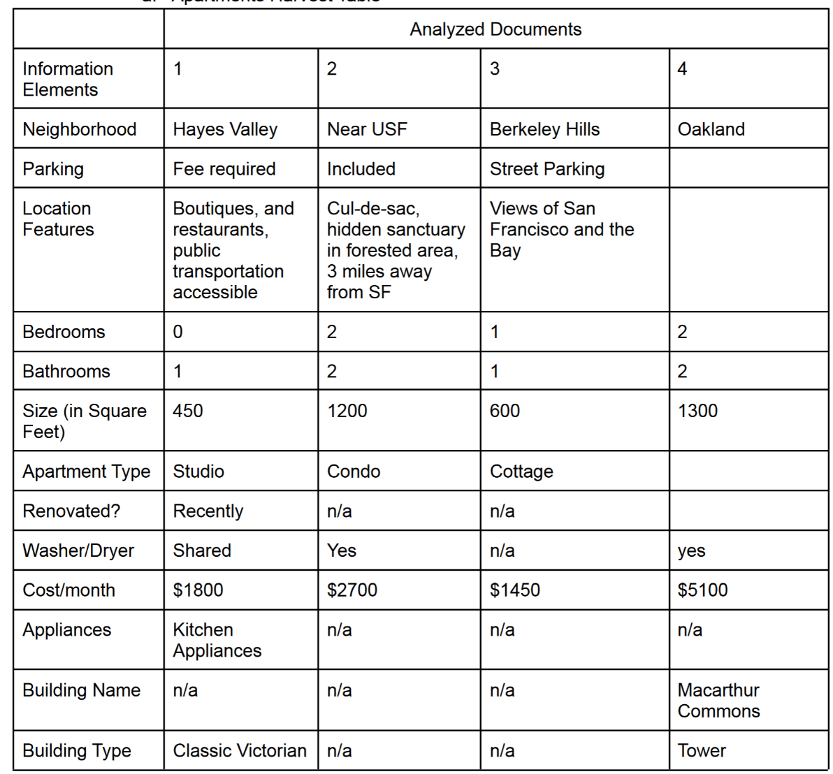
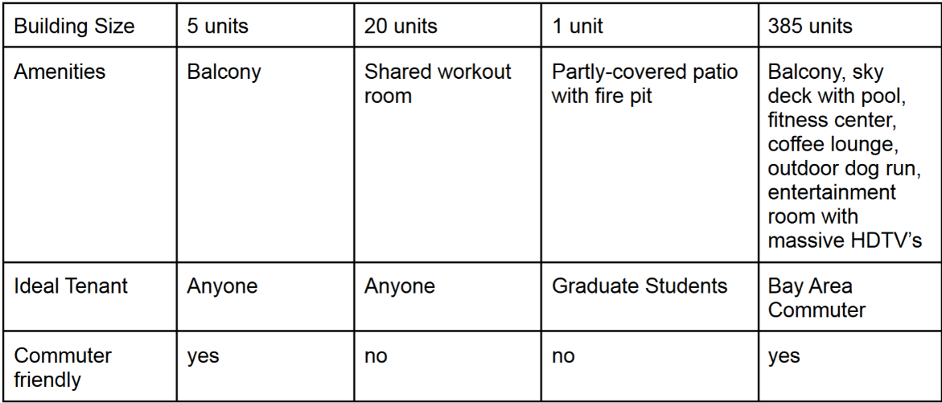
This excellent Harvest table contains the specific details about the content elements harvested from each source document
This makes it easier to see where abstraction would be useful

Slide 58
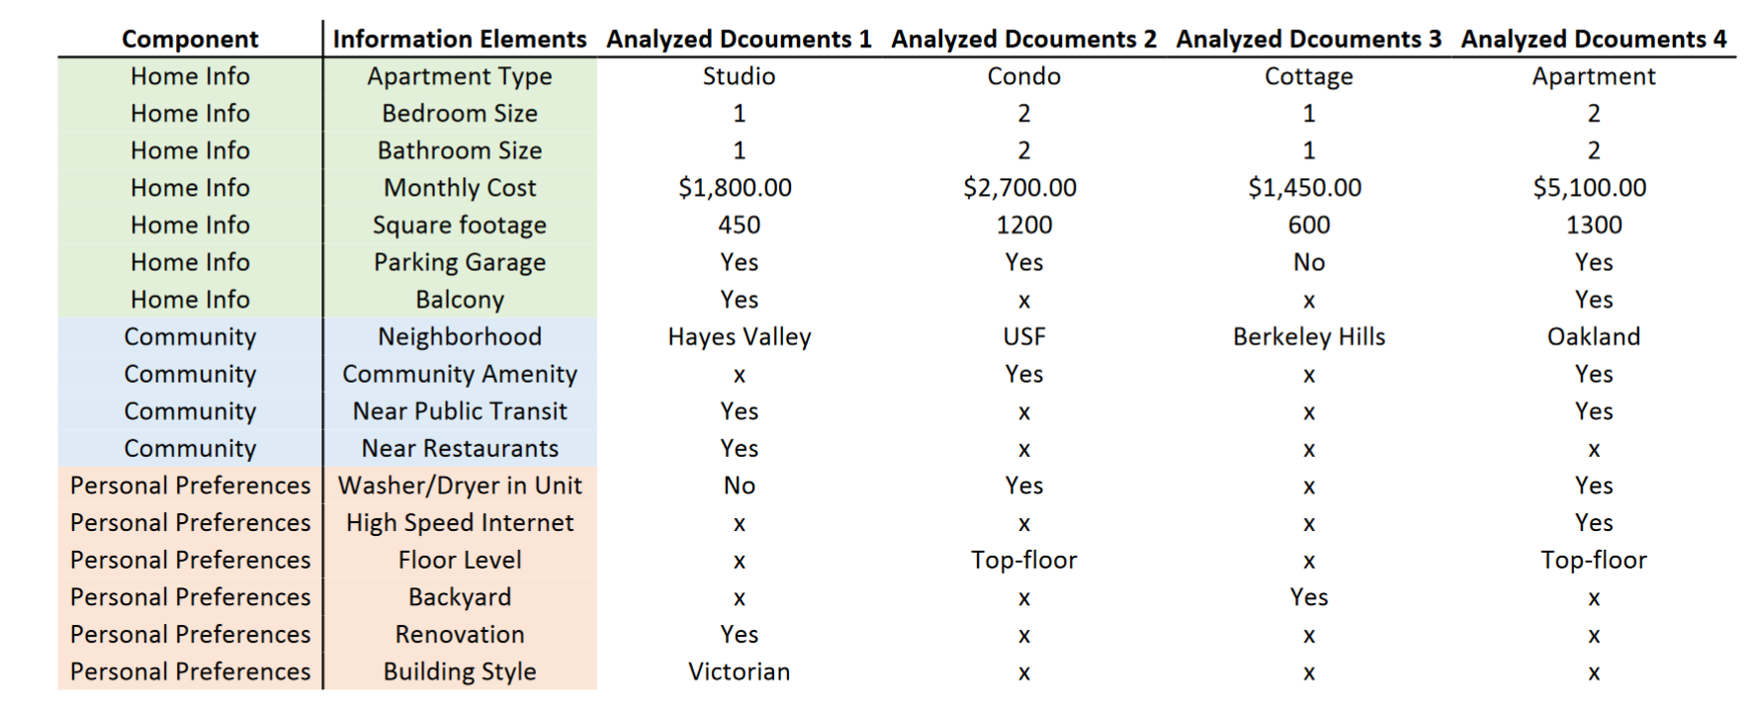
(Use of color to reinforce structure and content)

Slide 59
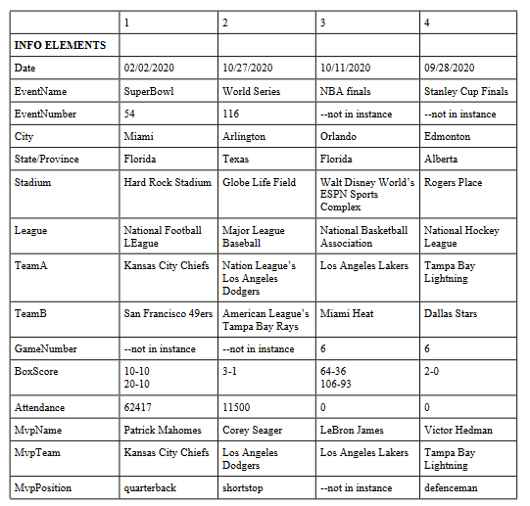
Harvest Table for Sports Event

Slide 60
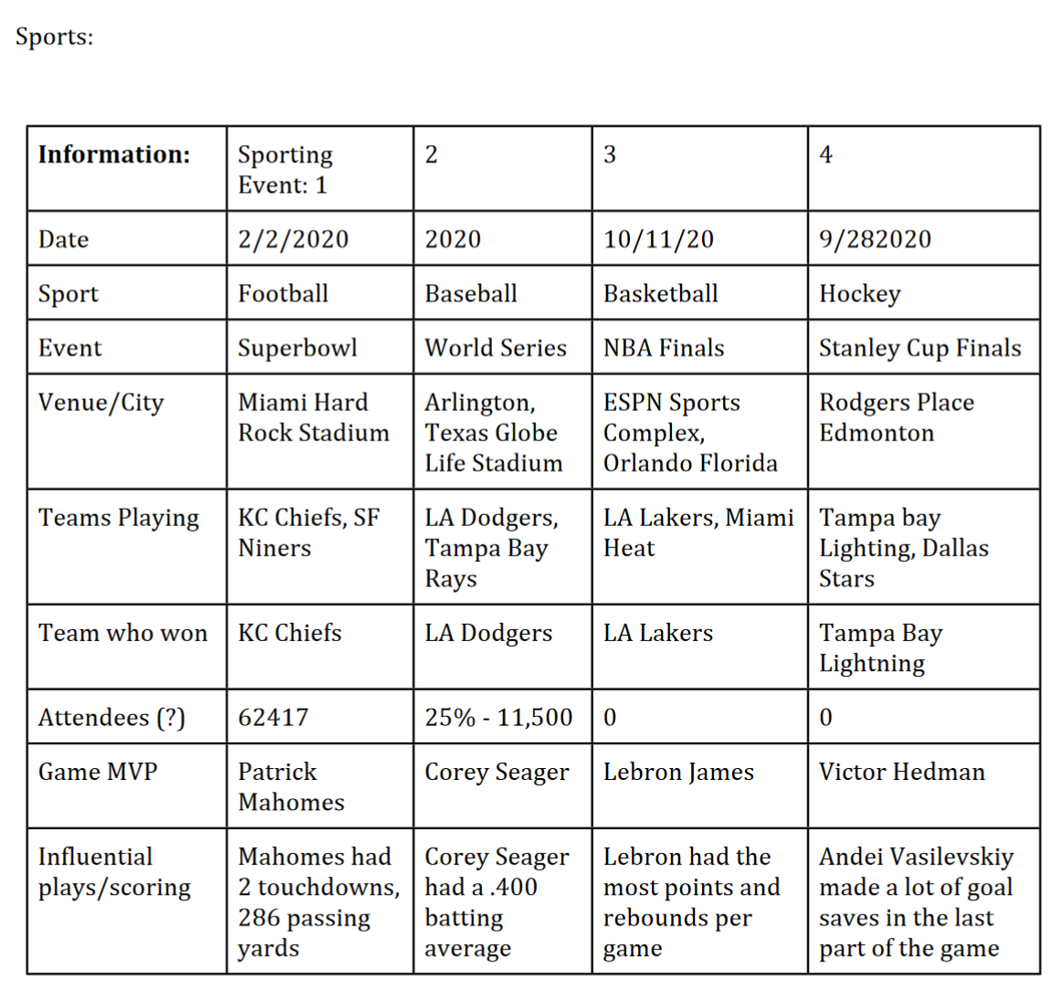
This and the previous “harvest” of the content elements from the sports stories are good, but this one is much less granular than the previous one
This is why “friends don’t let friends model alone” – these two models would have been reconciled if the two modelers compared their work

Slide 61
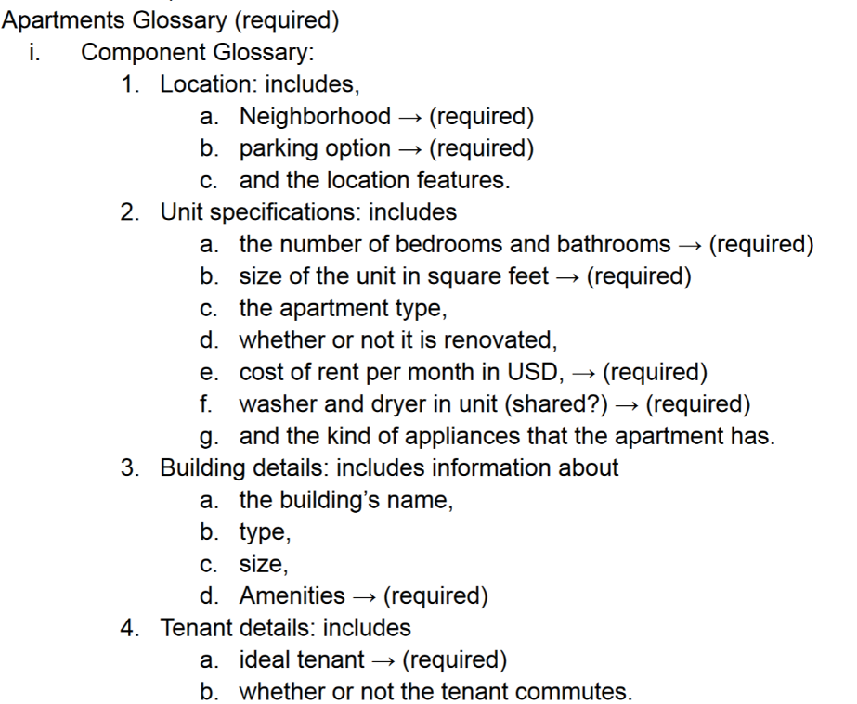
Apartments: Good Containers and Good Documentation

Slide 62
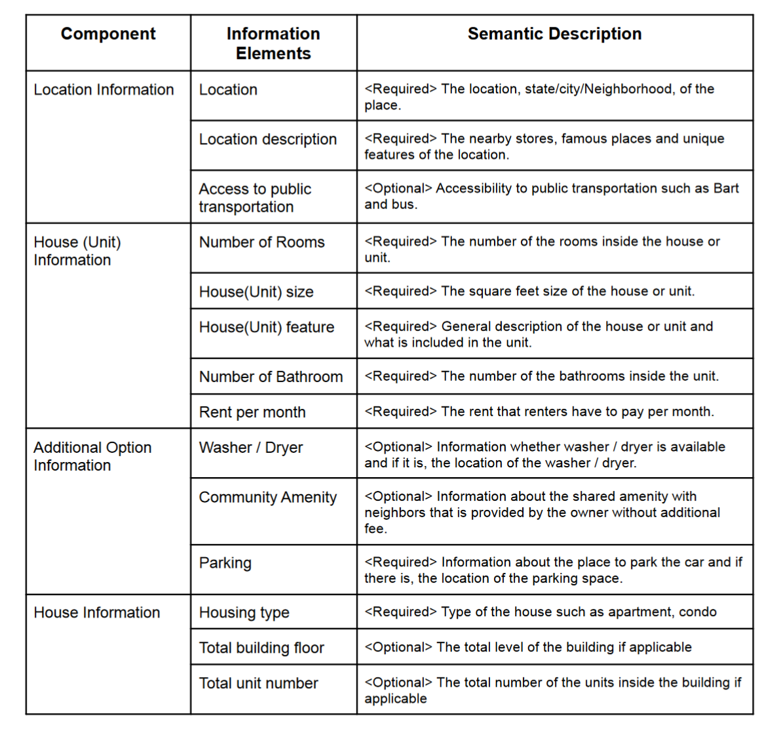
Another excellent model, clearly documented

Slide 63
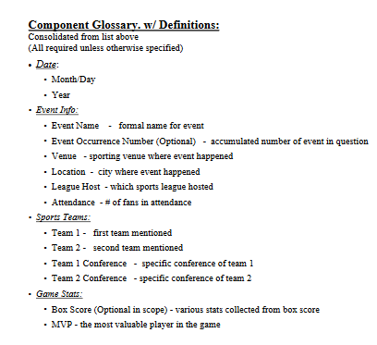
Sports: Good Containers and
Good Documentation

Slide 64
Misinterpreting “Required or Optional?”
“Does the instance need to include this component to be valid?” Given the “robo-journalism” back story, this means “does the program always need the component, or can it generate an acceptable story without it?” If every story contains the component, it is required.
Some of you instead focused on the content of the component, not whether it was present or absent. Every apartment story mentioned parking in one way or another, but some of the apartments didn’t have garages or reserved parking. A component about Parking is required so the story will be able to say whether or not there is any.

Slide 65
Granularity {and, or, vs.} Optionality (1)
All of my apartment stories mentioned a city and a neighborhood, and I hinted that because my descriptions about locations and neighborhoods were highly varied (and in every story) you might use phrases like “LocationDescription” as a broad component that could contain any of the descriptions
Some of you treated city+neighborhood as a single component like “Location,” which would be too semantically blunt with a realistic sized apartment collection (people would want to sort by city).

Slide 66
Granularity {and, or, vs.} Optionality (2)
The sports stories came from four different sports league, which I hoped would induce you to define a required element to identify the league
Some of you had elements for NFL, MLS, NBA… which makes it an optional binary element
Similarly, a “Distance to BART” element implies that this is an important descriptor for apartments, but if the apartment wasn’t in the Bay Area, it wouldn’t be, so it wouldn’t be required (vs. “distance to public transport”)
Lesson: Too many optional elements probably means your model is too granular and not abstract enough

Slide 67
Granularity {and, or, vs.} Optionality (3)
Same idea with location and amenity properties…Some of you got a little lost in the specific content of the stories and proposed a long list of optional components like “NearAForest” and “PackedWithBoutiquesAndRestaurants.” A robo-journalism program would need some kind of location description, but if you itemize with too much granularity, you’ll label all the components as Optional
A good compromise that some of you proposed was to divide “Amenities” into those for “Neighborhood,” “BuildingOrComplex,” and “Apartment”

Slide 68
Containers {and, or, vs.} Qualified Names
I should have used containers in step 6 of the assignment and used specific component names because I would have given you some implicit instruction about how to structure and name components. Containers convey meaning explicitly, which is considered a better modeling practice than conveying meaning implicitly with “qualified names”
Use qualified names to resolve homonyms (“EventTitle” vs “SpeakerTitle”), not to replace containers

Slide 69
Explicit Containers
SportingEvent
Title
Date
Day
Month
Year
Venue
Location
Name

Slide 70
Implicit Containers with Qualified Names
SportingEventTitle
SportingEventDateDay
SportingEventDateMonth
SportingEventVenueLocation

Slide 71
There Are No Modeling Shortcuts
FLASHBACK
Schemas developed without a stage of conceptual design (other than very simple ones) are rarely very useful because they are too closely tied to the particular instances used, which may not be representative
There is an inescapable tradeoff in description vocabularies between expressive power /computability (exemplified by XML) and ease of use (HTML)?
You get what you pay for… UNLESS SOMEONE ELSE HAS ALREADY DONE THE WORK
In general, if your work would benefit from a standard document schema, before you start trying to design one, look for one!
71

Slide 72
Yes, There is a SportsML
To provide a consistent format for sports scores, schedules, and statistics, an open, non-proprietary XML standard was created in 2003 by the International Press Telecommunications Council (IPTC), an association of the largest news agencies in the world including the Associated Press, Reuters, and the New York Times.
SportsML has a core schema used for all sports (competitors, locations, dates, etc.) and sport-specific “plug-ins” with the content components needed to describe events in that sport
https://www.iptc.org/std/SportsML/1.0/documentation/documentation-navigation.html

Slide 73
Yes, There is A “Real Estate” ML
https://www.retall.org/

