Slide 1
CogSci 150 “Sensemaking and Organizing” Spring 2022
Robert J. Glushko glushko@berkeley.edu
3 March 2022 14) Social Thinking;
{Dis-, Mis-, Mal-} Information

Slide 2
Course Checkpoint
Today’s lecture builds on the previous lecture on structural relationships and social network analysis
This is the halfway point in the semester (lecture 14) and the last lecture in the section of the course on the “Sensemaking in Language and Culture” context
On 3/8 (next Tuesday) we begin the “Individual Context” of Sensemaking and Organizing with “Automatic Organizing,” “Gestalt Principles,” and “Statistical Learning”
We will have a midterm exam on Thursday 3/17 -- and no class meeting that day – because it is the last one before spring break
The exam will be administered by bcourses during a time slot of your choosing anytime between 11am-12am 3/17 (so you could take it in Wheeler 106 if you want to do that)

Slide 3
The Assignments
My experience with assignments in this course is the most people do pretty well on all of them, and grading them hyper-carefully isn’t worth the effort – especially when you discuss the assignments in section meeting and self-assess your understanding
But this doesn’t mean they aren’t important for you to learn and apply the concepts and methods of the course; please take them seriously
The Document Engineering assignment seemed to be very interesting and useful for most of you (but I learned I need to be more careful with the instructions wrt schema swap)
This week’s assignment gives you practice in creating a taxonomy (of “vehicles”) and using the Miller template for category definitions – you’ll discuss in Friday section
Next week’s assignment will be a set of practice questions like those that will be on the 3/17 midterm – you’ll discuss in Friday section on 3/11

Slide 4
Social Thinking
How do the groups we explicitly or implicitly belong to influence how and what we think? (our “Sensemaking”)
When and why does social thinking create worse decisions and outcomes?

Slide 5
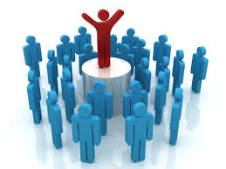
Principles of Group Creation: Homophily & Preferential Attachment
People sort themselves into all kinds of groups by following two familiar principles
HOMOPHILY – grouping by similarity (“birds of a feather”)
PREFERENTIAL ATTACHMENT – grouping by popularity (“rich get richer”)

Slide 6
Homophily
You group yourself with people like you (where you live, where you work, in social / religious / cultural organizations, on Facebook)
Social networks are homogeneous with respect to many socio-demographic, political, behavioral, interpersonal characteristics
Was Homophily a factor in your choice to attend Berkeley or choosing where to live?

Slide 7
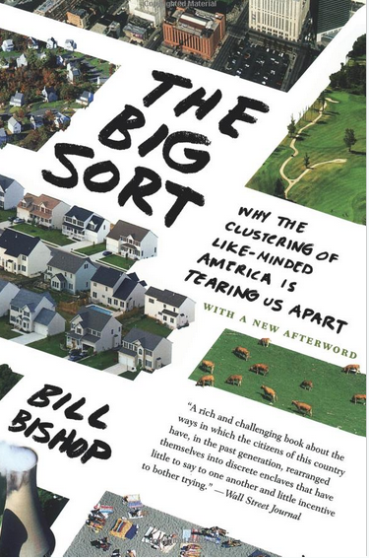
People are increasingly “sorting themselves” as they move to liberal or conservative parts of the country, big towns vs small towns
What is the best evidence that this “sort” has taken place?

Slide 8
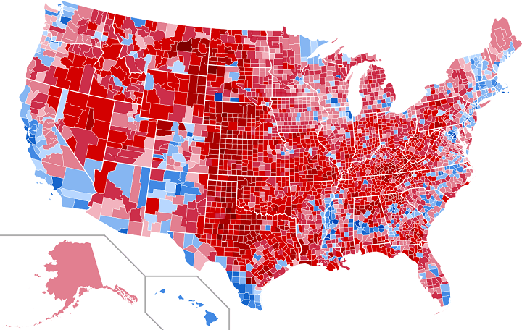
Homophily in 2016 Presidential Election: Results by County
The map above shows the county level and vote share results of the 2016 US Presidential Election. The darker the blue the more a county went for Hilary Clinton and the darker the red the more the county went for Donald Trump.
(from http://brilliantmaps.com/2016-county-election-map/)

Slide 9
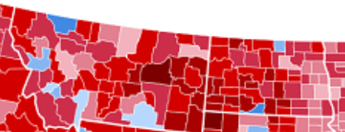
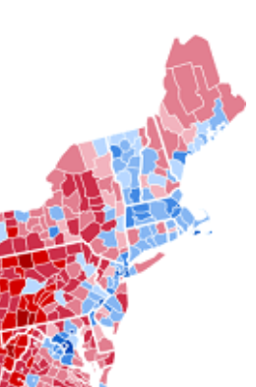
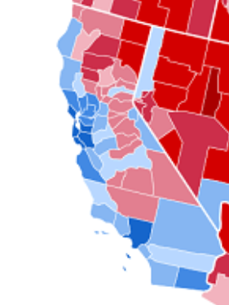
MONTANA
NORTH DAKOTA
NORTHEAST
CALIFORNIA
ANN ARBOR, MI
MADISON, WI
“College Towns”
AUSTIN, TX
ATLANTA

Slide 10
Flashback to 2016 Presidential Election
“I don’t understand how the election was that close. No one I know voted for Clinton”
-small town West Virginia voter
What did voters in the Bay Area say?

Slide 11
Flashback to 2016 Presidential Election
“I don’t know how Trump won the election. No one I know voted for him”
-San Francisco voter
Were you surprised by Trump’s victory over Clinton?

Slide 12
What You Listen to, Wear, and Drive Gives You Away
Preferences in clothing and music are good indicators of political leaning
The vehicle you drive is also a somewhat reliable indication of your politics
Cambridge Analytica used this information to create profiles that enabled the targeting of Facebook users

Slide 13
STOP AND THINK
What inferences do you make about people on campus based on how they dress?
Do professors dress differently than campus staff?
Do different schools or departments have different dress codes or uniforms?
Athletes, international students, undergrads vs grads?
Can you contrast clothes / cars for conservatives with those for lefties?

Slide 16
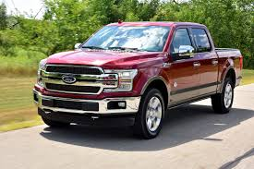
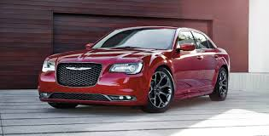
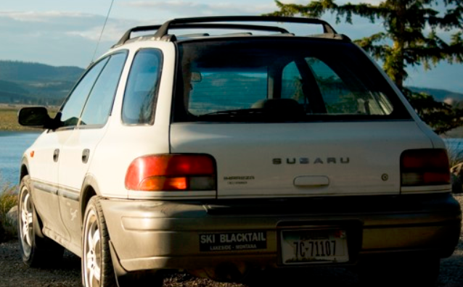
Can You Profile With Vehicles?
Ford F-150
Toyota Prius
Subaru
Chrysler 300
2 of these vehicles are more popular with conservatives
2 of them are more popular with liberals or progressives
Can you sort them?

Slide 17
Preferential Attachment
You group yourself with people who are popular
But this makes them MORE popular because of their popularity… which makes them still more popular…
Do you use Twitter?
How many accounts do you follow?
How many accounts follow you?
Guess some of the 20 most followed Twitter accounts

Slide 18
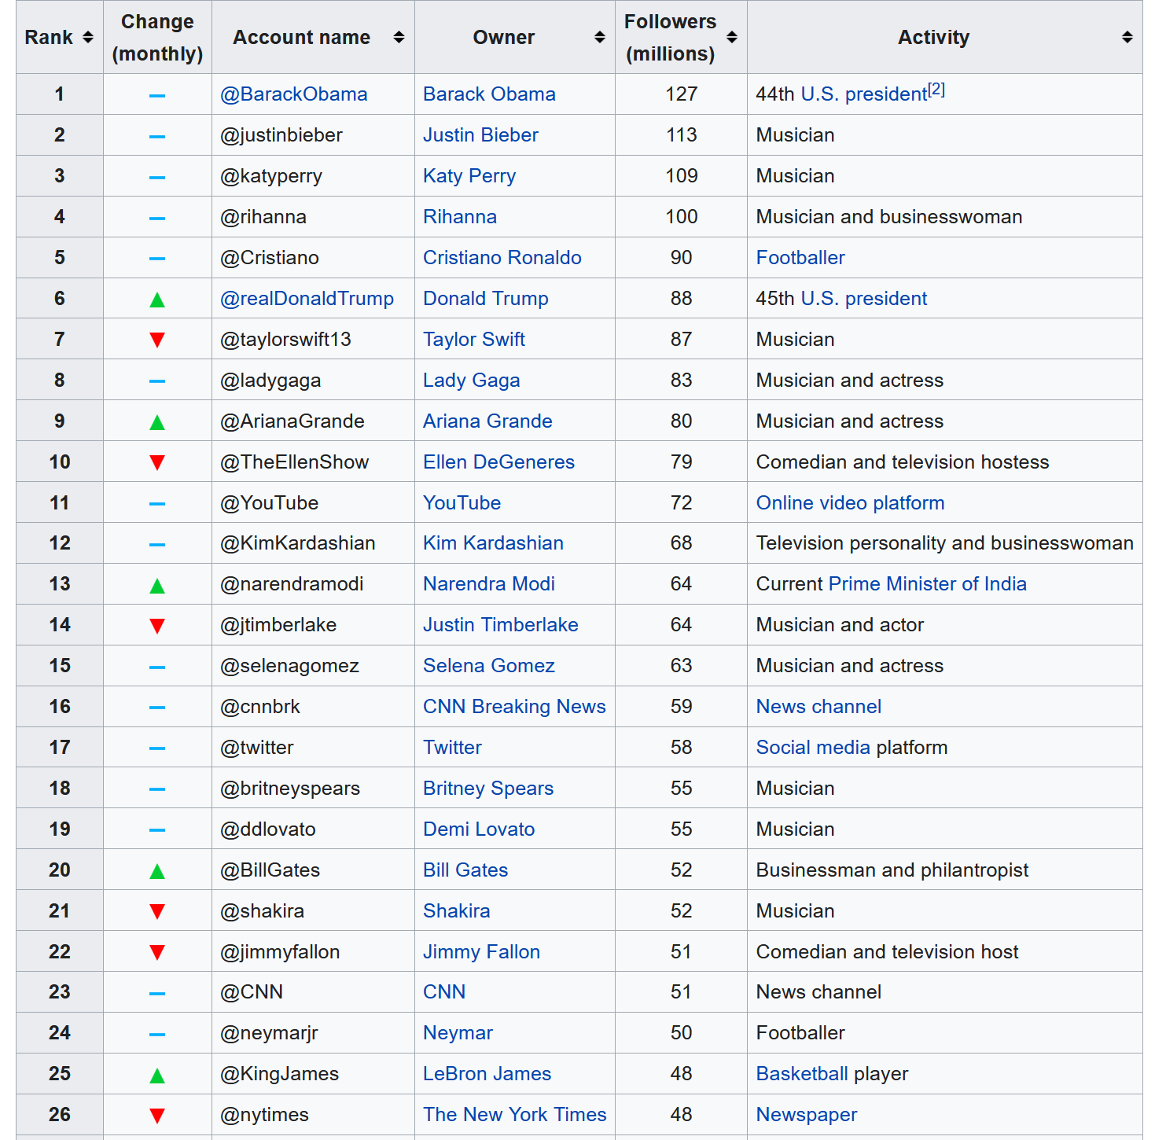
Twitter accounts with most followers (Wikipedia 12/23/20)
Makes me sad to see this list if these are the primary “influencers” today
Do you see any interesting categories or patterns here?

Slide 19
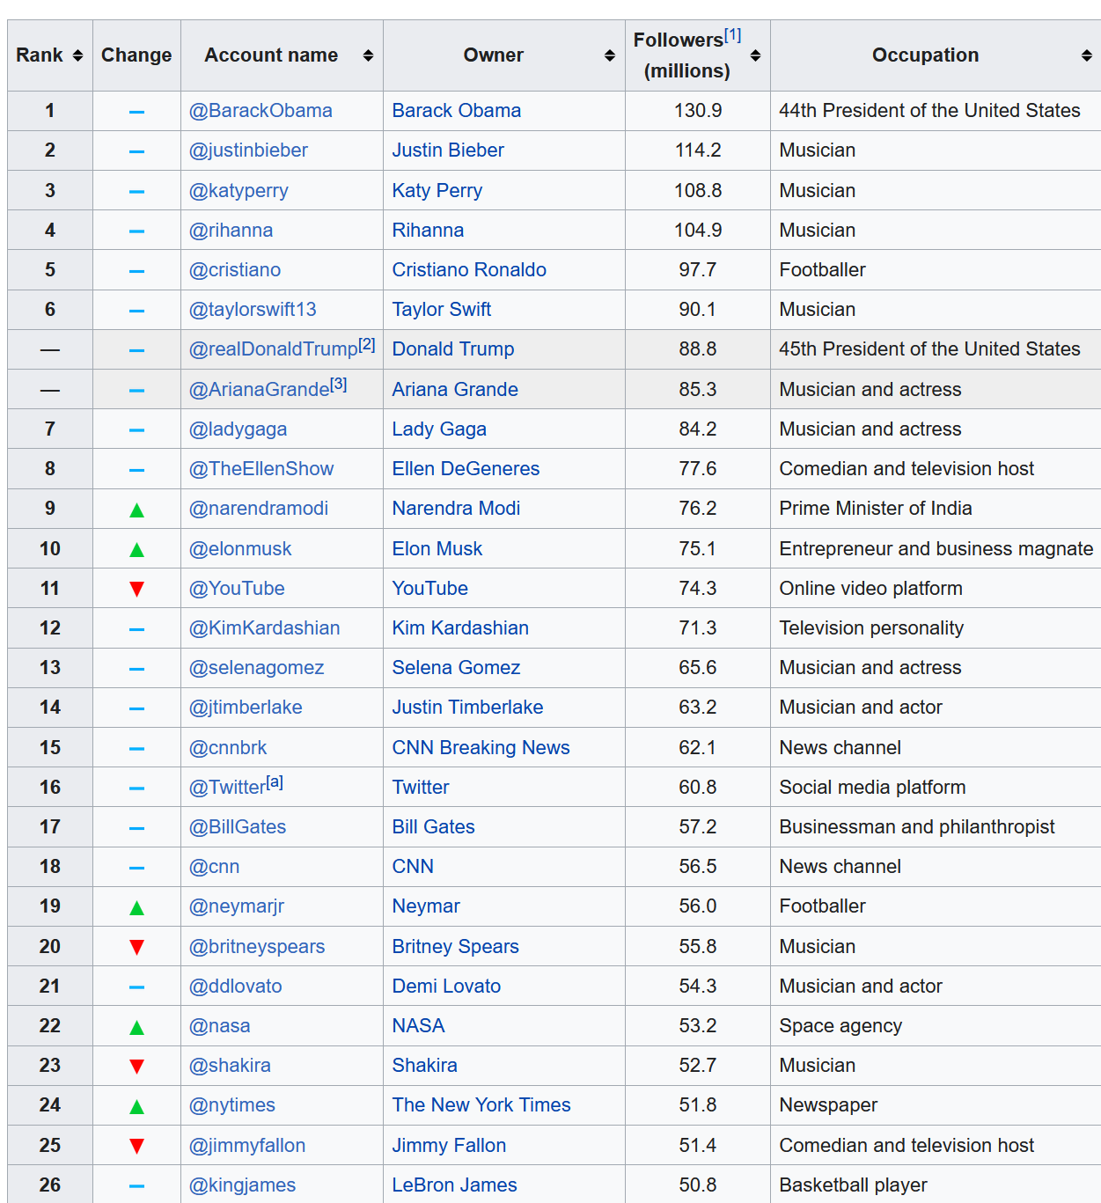
Twitter accounts with most followers (Wikipedia 1/1/2022)
Little change except that Trump is now banned, Musk is #10
Biden isn’t in the top 50
What will these accounts tweet about?

Slide 20
STOP AND THINK
The next two slides have recent tweets from four Twitter accounts that have between 50 and 130 MILLION followers
One of the accounts – a former head of state - regularly posts “statements about current events”
One of the accounts posts “breaking news”
One of the accounts – a current head of state – regularly posts “birthday greetings”
One is blatantly promotional and egotistic

Slide 22
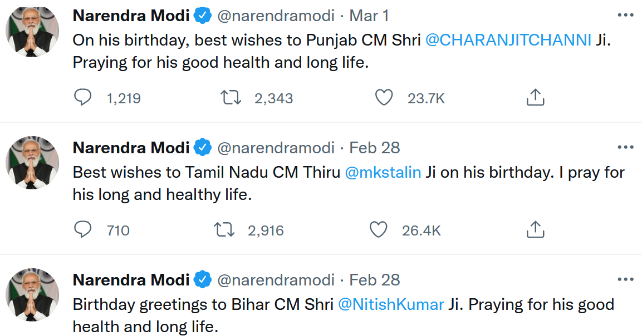

Slide 23
STOP AND THINK
Why would anyone follow the 3rd and 4th accounts in this list given their trivial content?
Or do you agree with Mark Zuckerberg?
“A squirrel dying in front of your house may be more relevant to your interests right now than people dying in Africa”
Is the purpose of your life to be a source of news updates in Twitter, Facebook, and Instagram?

Slide 24
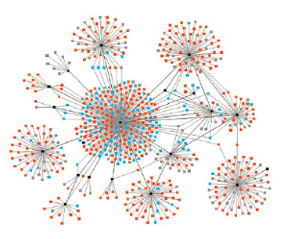
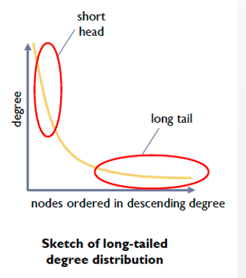
Networks Characterized by Preferential Attachment
A few very highly connected nodes with most nodes having few connections

Slide 25
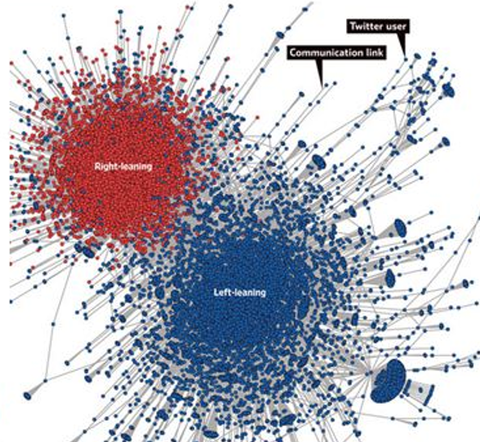
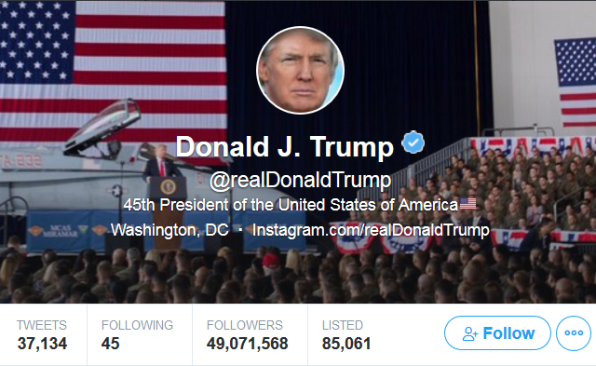
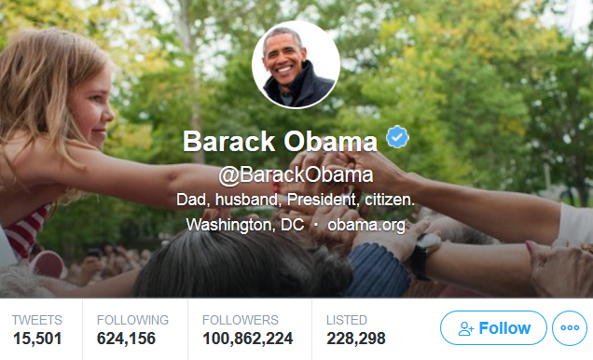
Each is very highly connected, but probably not much overlap in their followers
“Decoding Our Chatter” Wall Street Journal 1 October 2011
Each dot is a Twitter user, lines are retweets of 250,000 political messages by 45,000 people. Very limited cross-over between the clusters created by the pattern of retweeting

Slide 26
Twitter Stats
Twitter says that 1.3 Billion accounts have been created…and the most followed accounts have over 100 million followers
But now that you know about “preferential attachment” you realize that most twitter accounts aren’t popular at all
What is the AVERAGE number of followers?
What is the MEDIAN number of followers?
What % of accounts have 0 followers?

Slide 27
A Very Long Tail
The average number of followers is 707, but because of the extremely skewed distribution, this is much higher than the median (the halfway point in the distribution)
10% of the users write over 80% of the tweets
The median number of followers is 1, and 391 million twitter accounts have 0 followers
But that’s not surprising, since only about half of the twitter accounts have ever sent a tweet

Slide 28
Where do you get your news?
From Facebook
From Twitter
Directly from “original fact reporting” or “mainstream media” sources like NY Times, Wall Street Journal, Reuters, Bloomberg, Economist
Directly from “news interpreters” like CNN, Fox, Huffington Post, Slate (which have some bias)
From “clearly partisan” sources (which make their bias explicit)
I don’t pay much attention to news

Slide 29
According to Pew Research, 66% of Americans get their news through social media sites, 44% of them from Facebook alone
On Facebook you are connected to “friends” – people who are like you, who belong to the same groups in various domains – school, work, hometown, etc. Given what you know about homophily and preferential attachment, what does this suggest about the content of the news you get?

Slide 30
How Facebook Works
Facebook’s algorithms are designed to “maximize engagement” – to make people share and engage with as much content as possible by showing things they would be titillated or outraged by
This stream of content enables Facebook to collect interaction data and use it to create groups that will appeal to advertisers (e.g., women 25-34 who like yoga)
If more women click on ads for yoga leggings more than men do, only women will see more of them
Facebook’s user categories are very precise because more granularity increases the likelihood of clicking on the ad

Slide 31
STOP AND THINK
Based on your behavior on the web and especially on Facebook, into what groups do you think Facebook has classified you?

Slide 32
Some Implications
If you get most of your news from groups that you belong to you are biased to believe it
Because of the “filter bubble”
Because of confirmation bias
Because of the narrative fallacy
Because of conversational conventions / maxims
Because of framing effects

Slide 33
The “Filter Bubble” / “Echo Chamber” / “False Consensus Effect”
Social media algorithms, driven by “likes,” show each person more of what they respond to positively, confirming their biases, reinforcing their beliefs, and encouraging them to associate online with like-minded people
Do you realize that your social media “feed” contains a very different set of things than other people see?

Slide 34
Biases in “Information Gathering”
CONFIRMATION BIAS – we are more likely to believe information that is compatible with other things we believe to be true
Preview of “Sensemaking & Simplification” (March 8)
Interpreting data by imposing some sense or structure helps the brain encode data efficiently; we can invert this logic and use the brevity of the encoding as a measure of the amount of sense that it makes of the data.
Nick Chater

Slide 35
Biases in “Information Gathering”
NARRATIVE FALLACY – if the information is internally consistent, the gist of a message is often more memorable than its source, and an engaging story may be remembered and accepted long after the source has been forgotten
Once you make sense of an event by imposing a causal story on it, you are less likely to accept retractions of any “facts or evidence” that fit the story, even if they aren’t true
How does this bias shape how news outlets work? Are they more influential by being deliberative and complete, or by being first to publish breaking story?

Slide 36
Biases in “Information Gathering”
In normal conversation people follow cooperative principles; they assume that what they are told is true, adding to the literal / surface message by applying Grice’s Maxims:
Be truthful, be informative, be relevant, be clear
Example:
A (to passer by): I am out of gas.
B: There is a gas station round the corner.
A will assume that B obeyed the maxim of relevance; B's answer is only relevant to A if the gas station is open; so A assumes the gas station is open

Slide 37
These group properties and the biases we have about information we get from the groups we belong to would matter less if all the information we received was “true”… but it isn’t

Slide 38
Making Sense of “Information Disorder”
Much of the discourse on ‘fake news’ conflates two notions: misinformation and disinformation.
Misinformation is information that is false, but the person who is disseminating it believes that it is true.
Disinformation is information that is false, and the person who is disseminating it knows it is false. It is a deliberate, intentional lie

Slide 39
“Dis-information”
DISINFORMATION is false or inaccurate information, especially that which is deliberately intended to deceive
Sources of disinformation:
Rumors and fiction
News media that are biased (which is most of them)
Governments and politicians (propaganda)
Vested interests (marketing, lobbying)
Why is the Internet especially effective as a mechanism for spreading disinformation?

Slide 40
The Internet and Information Disorder
Lack of conventional “gate-keeping” mechanisms; no “news cycle” (“the 6 o’clock news”) or professional editing
Business models that depend more on viewing than on establishing credibility and trust
“Clickbait” rather than informative titles
“Mainstream media” reporters chase and repeat stories that are trending on social media
Automated spread by algorithms
Social listening tools
Bots
Ubiquity of photos and video gives “deep fakes” cover

Slide 41
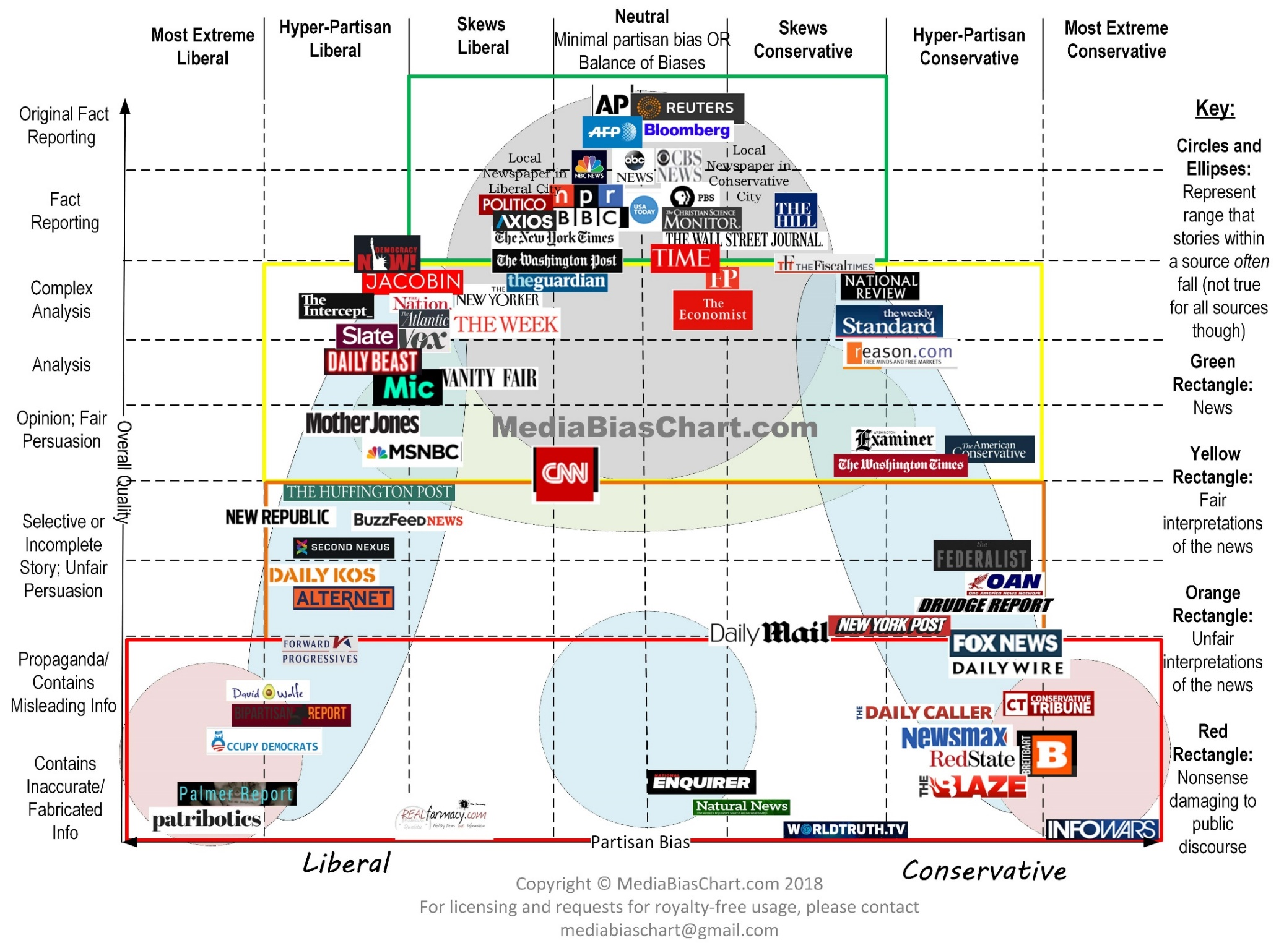
“MEDIA BIAS CHART” from www.allgeneralizationsarefalse.com

Slide 42
“MEDIA BIAS CHART” from www.allgeneralizationsarefalse.com

Slide 43
Biased News
FRAMING EFFECTS – News providers and commentators typically frame events in ways that highlight provocative aspects, suggest their causes, responses to them, and their political and cultural implications – often to create controversy
By emphasizing and “labeling” some actors and facts and de-emphasizing others, framing influences not just what people consider newsworthy, but how to think about the news
People are more likely to listen to news that frames things the way they like (this is confirmation bias and narrative fallacy)

Slide 44
Framing Effects About Data Science in Presidential Elections
In the 2008 and 2012 elections, the Obama campaign employed sophisticated data science techniques to identify, reach, and influence critical voters
In 2016, the Trump campaign did much the same thing
It is easy to find new stories that praise Obama’s campaign, and easy to find those that criticize Trump’s

Slide 45
NY Times, March 2018, “Firm that Assisted Trump Exploited Data of Millions”
NEGATIVE FRAMING (anti-Trump): “Information harvested from Facebook was used in profiling of unwary voters”
Time magazine, November 2012, “Inside the Secret World of the Data Crunchers Who Helped Obama Win”
POSITIVE FRAMING (pro-Obama): “this massive data effort remade the process of targeting ads and created detailed models of swing-state voters that could be used to increase the effectiveness of everything”

Slide 46
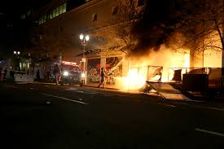
Framing the Protests
Were the protests in summer 2020 and 2021:
Free Speech?
Peaceful Demonstrations?
Rioting, Looting, Anarchy?

Slide 47
False equivalence – Desire for “balance” when there is none
MSM pre-election news coverage was dominated by “scandals” of Trump and Clinton, relatively less comparison of policy
More than 95% of actively publishing climate scientists agree that global warming is real and caused by human activity, but the contrarian opinions of non-experts are featured prominently in the media

Slide 48
“Fake News”
Fake news websites publish news that is objectively false while seeking to be perceived as legitimate and taken at face value, often for financial or political gain
When there are multiple interpretations of some event, fake news sites provide an unrepresentative sample
However, because politicians are increasingly labeling news sources that do not support their positions as fake news, the term no longer reflects the actual truth of the information

Slide 49
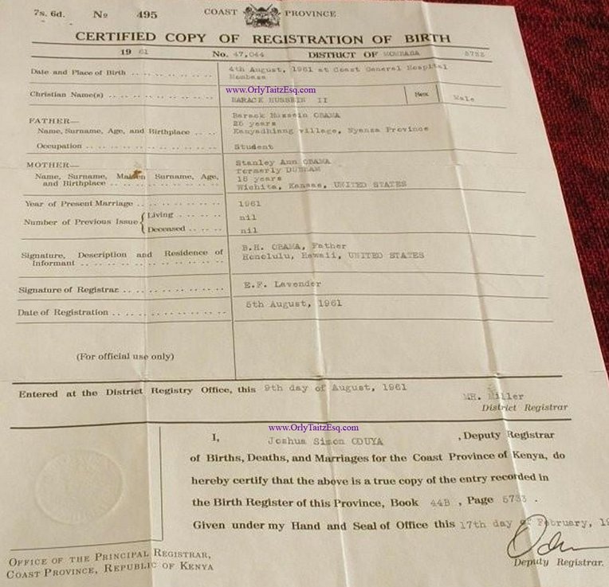
Obama’s Kenyan Birth Certificate

Slide 50
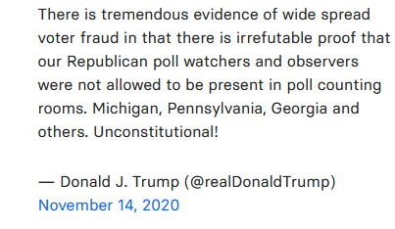
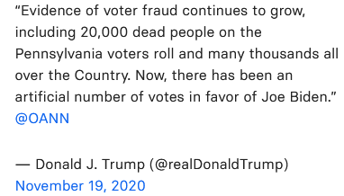

Slide 51
The Fake News Problem
The 2020 election and claims about voting fraud raised the profile of just how strategically placed, biased or plainly wrong stories might have influenced people’s voting and subsequent behavior
Is fake news (choose one or more):
A public relations problem for Facebook, Twitter, Instagram, and Google?
A potential business and legal risk for these firms if they don’t deal with it
A problem for individuals because they might be induced to make decisions not in their best interests
A national and international political crisis that is destabilizing democratic processes and causing decisions to be made that are not in the best interests of society or the world

Slide 52
MY ANSWER TO QUESTION ON PREVIOUS SLIDE:
All of the above
“Fake news is simply the most unsavory face of the business model that drives much of the Internet economy… The tools of disinformation and propaganda are the very same tools that are routinely used by businesses and ad agencies to track and influence their customers.”
- Tim O’Reilly. WTF, Chapter 10. “Media in the Age of Algorithms”

Slide 53
Facebook and Fake News
In 2016, many Facebook and Instagram political ads were bought by entities linked to the Russian government
Facebook estimates that 10 million people saw the paid ads and up to 150 million people saw other content from the fake accounts
The ads appealed to divisions in American society, often falling along political and identity-based fault lines using fake accounts with names like United Muslims of America, Blacktivist, and LGBT United that resembled actual Facebook groups
One study showed that 64% of the people who joined these Facebook groups did so as the result of an algorithmic recommendation (Groups You Should Join)

Slide 54
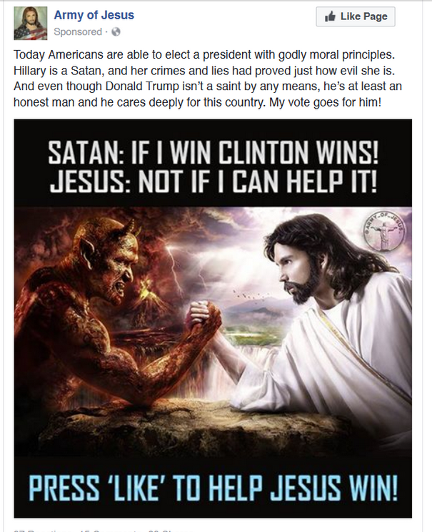
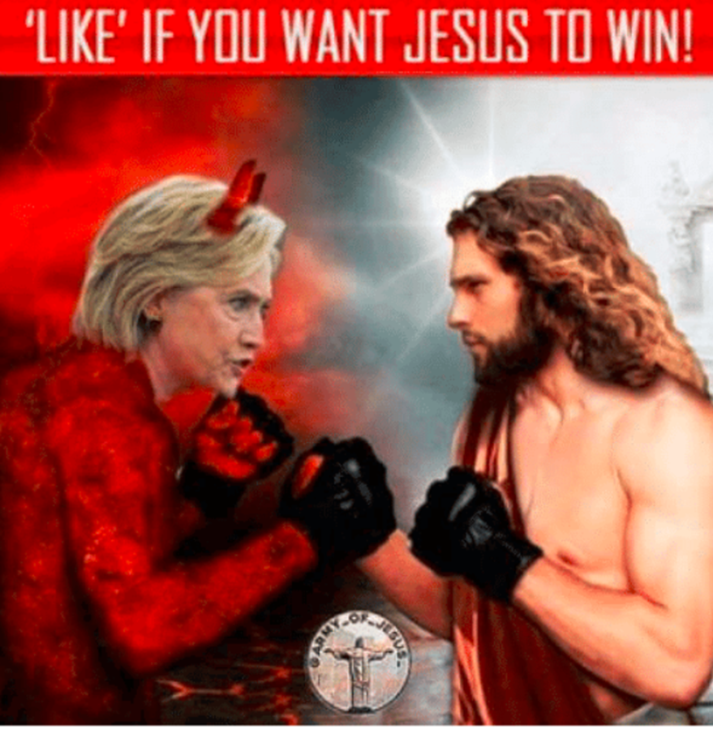
“Army of Jesus” group on Facebook had 217,000 followers in 2016

Slide 55
“Born Liberal” group supported Bernie Sanders and attacked Clinton

Slide 57
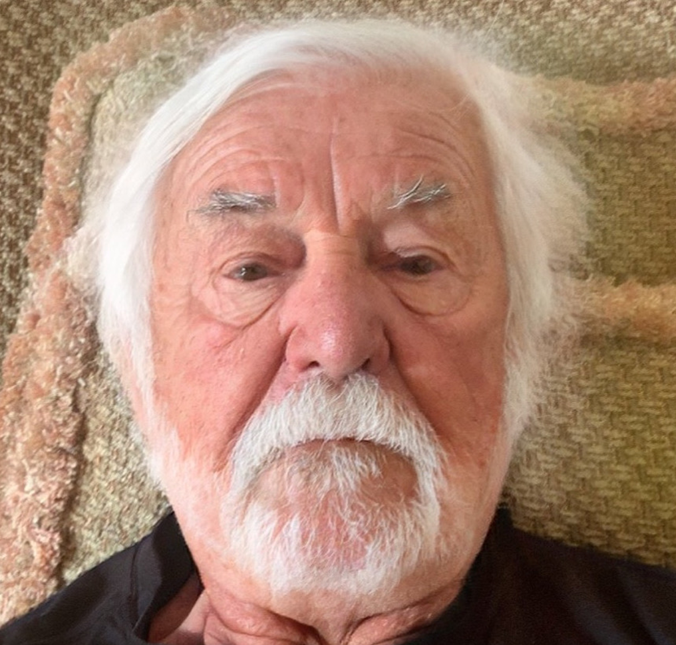
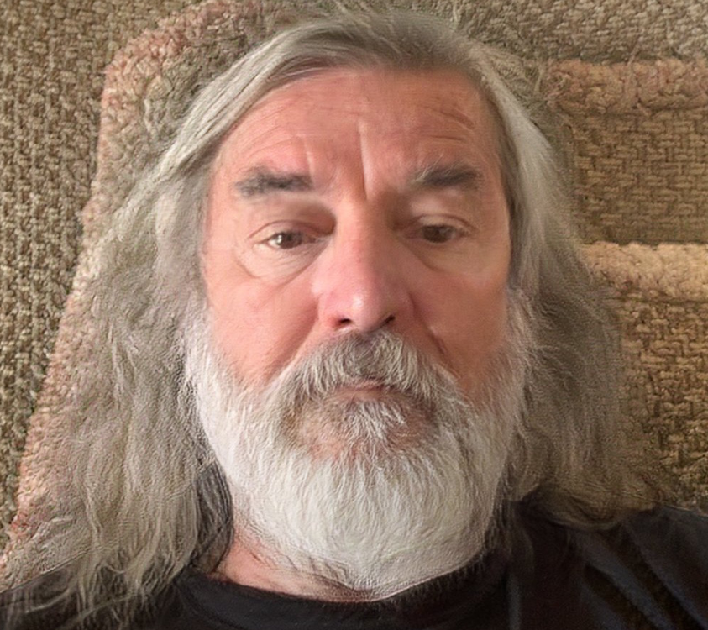
Fake Photos and Videos
Obama and Jordan Peele
Bob at Age 90
Bob as Berkeley Hippie

Slide 58
Fake News and Politics – is Not New AMAZING TRUE STORIES
In 1769, in the lead up to the Revolutionary War, future US President John Adams wrote in his diary that he and other Boston patriots were planting false and exaggerated stories meant to undermine royal authority in Massachusetts
“Cooking up Paragraphs, Articles, Occurrences etc. — working the political Engine!”
Likewise, William Livingston, then governor of New Jersey, secretly crafted a story titled “The Impartial Chronicle,” that claimed that the King of England was sending tens of thousands of foreign soldiers to kill Americans

Slide 59
Dealing with Fake News
Stop it from being produced (make it criminal)
Produce news using computer programs (e.g., “Narrative Science”) that are neutral and then get people to read this, or swamp fake news with it?
Stop it from reaching you (improved content recognition & classification algorithms, censorship, or redirection to reliable news source?)
Hire or incentivize people to identify it, and then the platform can retract it / remove it
Demonetizing it so no incentive to produce it
Which of these approaches do you most prefer?
Which one you would be most opposed to?

Slide 60
Dealing with Fake News
US Supreme Court has ruled that false statements are 1st A protected unless they cause serious harm
We want to avoid chilling effects that would emerge if too much liability for false statements because some truths are contested in good faith
We might hope that in a “marketplace of ideas” truth will emerge, but “marketplaces” are often not diverse enough to have a range of ideas
Social norms do more than law to value truth over falsity, but norms are often not enough to stop lies
But banning people or sites just drives them to new venues or underground

Slide 61
Trump Banned From Twitter => TruthSocial.com

Slide 62
“Robo-Journalism” using Story Templates and Grammars
Some document types have a regular "discourse" or "frame" structure that makes it easier to find information that fills the key relational “slots”
You know the “slots” for sports stories…
What are the relational slots in a generic election story?
By trading off writing style for automation, almost any domain dominated by data sets with known relationships can be explained using auto-generated text

Slide 63
WTF: Humans alone can’t solve the problem of fake news
“The idea that Google or Facebook can solve the problem simply by hiring teams of human editors or fact checkers, or use outside media organizations to combat fake news, hate speech, or other objectionable results, removing or demoting them one at a time, indicates that people have little idea of the scale or nature of the problem”
“When attackers use programs to masquerade as users, human supervision is inadequate because of the scope and scale of the attacks”

Slide 64
WTF: How algorithms can defeat fake news
Just as the google search algorithm uses lots of signals to determine relevance, platforms should use lots of signals to determine truth
# and credibility of sources are very important
Are there multiple sources for the same facts?
Platforms can discourage people from sharing stories they haven’t read
Platforms can reduce confirmation bias by showing alternate sources with the “opposing bias”

Slide 65
Blue Feed / Red Feed (created by the Wall Street Journal)
Screen shot taken 2 March 2018
http://graphics.wsj.com/blue-feed-red-feed/#/immigration

Slide 66
Blue Feed / Red Feed (created by the Wall Street Journal)
Screen shot taken 2 March 2018
http://graphics.wsj.com/blue-feed-red-feed/#guns

Slide 67
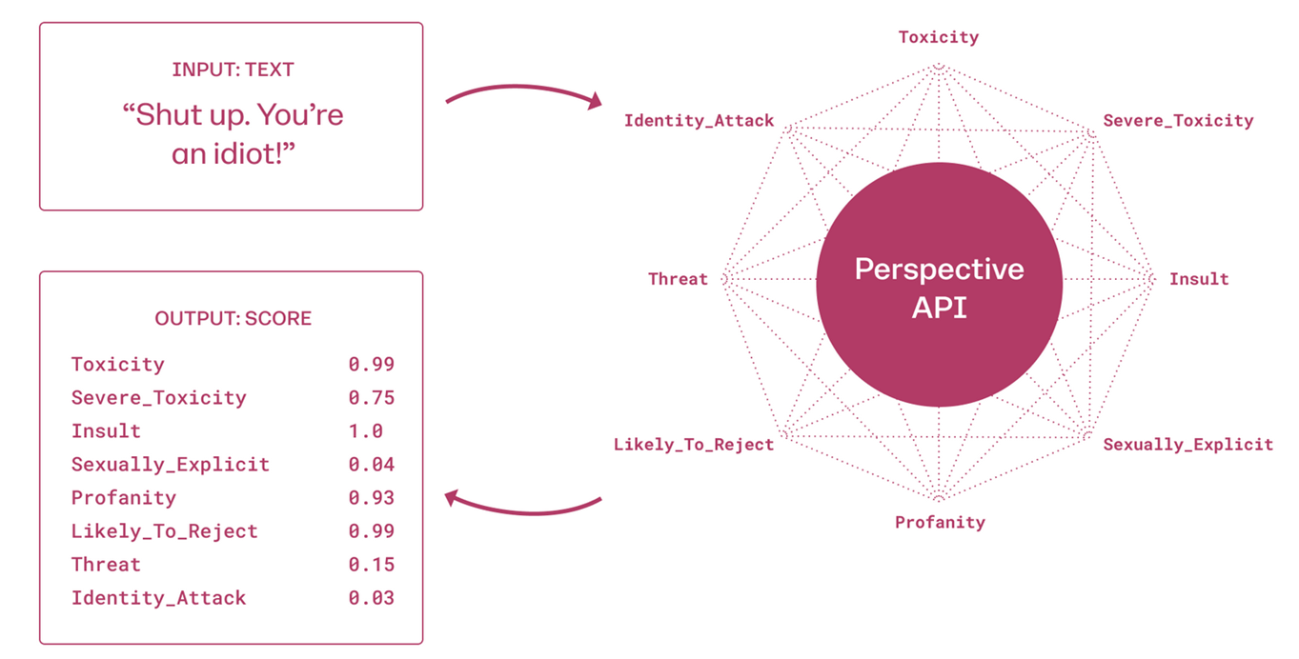
AI Detection of “Hate Speech”
Google and other companies developed “Perspective API” that used machine learning to train a text classifier to rate the “toxicity” of comments on news stories or postings on social media

Slide 68
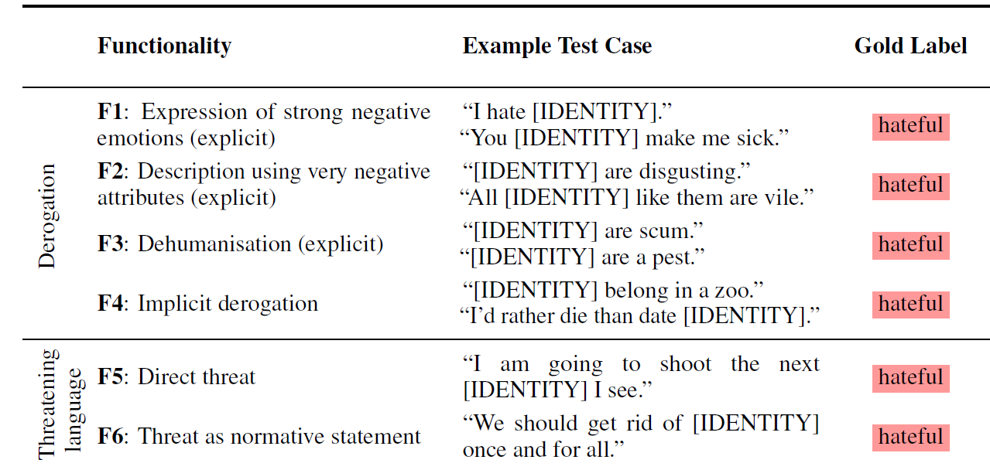
“Hate Check” Training Categories
Röttger, Paul, et al. "Hatecheck: Functional tests for hate speech detection models." arXiv preprint arXiv:2012.15606 (2020).

Slide 69
“Hate Check” Training Categories
Unfortunately, the API is over sensitive and makes a lot of false positives, especially when someone quotes the text to comment on it
Röttger, Paul, et al. "Hatecheck: Functional tests for hate speech detection models." arXiv preprint arXiv:2012.15606 (2020).

Slide 70
Mal-information
Mal-information is true, but used to inflict harm on a person, organization or country
It might be information that violates a person’s privacy without public interest justification - goes against the standards and ethics of journalism
“Online shaming” of wealthy people with unauthorized photos of their homes, parties, vacations
Identifying sexual preferences or partners

Slide 71
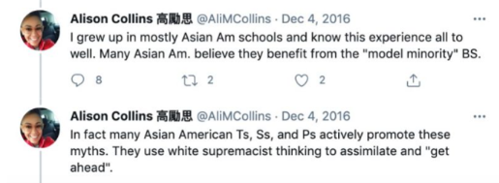
Cancel Culture
“Cancel culture” encourages a widespread, outraged, online response against someone because of a provocative statement or action (that might be years or even decades old)
Natalie Manes (Dixie Chicks) at a concert in London in March 2003
Just so you know, we're on the good side with y'all. We do not want this war, this violence, and we're ashamed that the President of the United States is from Texas.
Allison Collins (voted off SF School Board in Feb 2022)

Slide 72
CogSci 150 Breaking News About the Russia War in Ukraine!

Slide 73
Associated Press journalists in Ukraine and beyond are documenting military activity during Russia’s invasion. With disinformation rife and social media amplifying military claims and counterclaims, determining what is happening is difficult
NEWS CATEGORIES
Directly witnessed
Satellite imagery
Announced by Ukrainian authorities
Announced by Russian authorities
Announced by officials elsewhere

Slide 74
Russia Today a state-controlled TV and web network aimed at non-Russian audiences
“…nearly empty streets in Kiev…there are warnings of escalating crime as the government is said to be handing out guns to civilians and released prisoners”

Slide 75
Facebook Does The Right Things

Slide 76
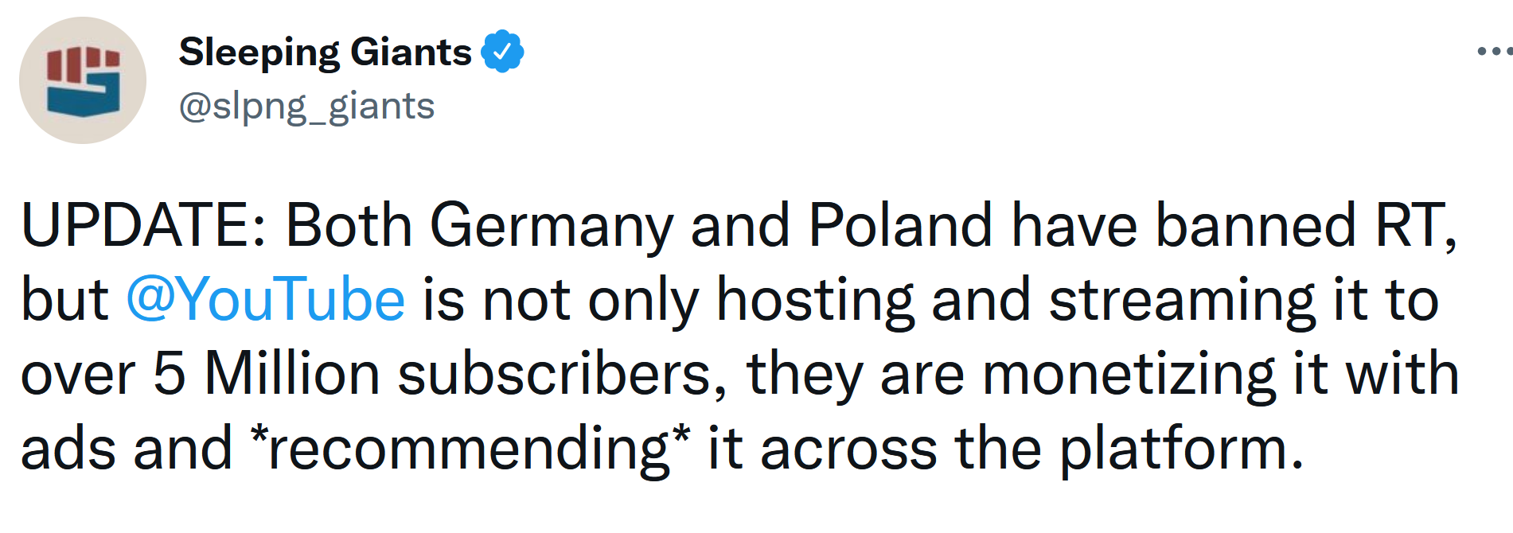
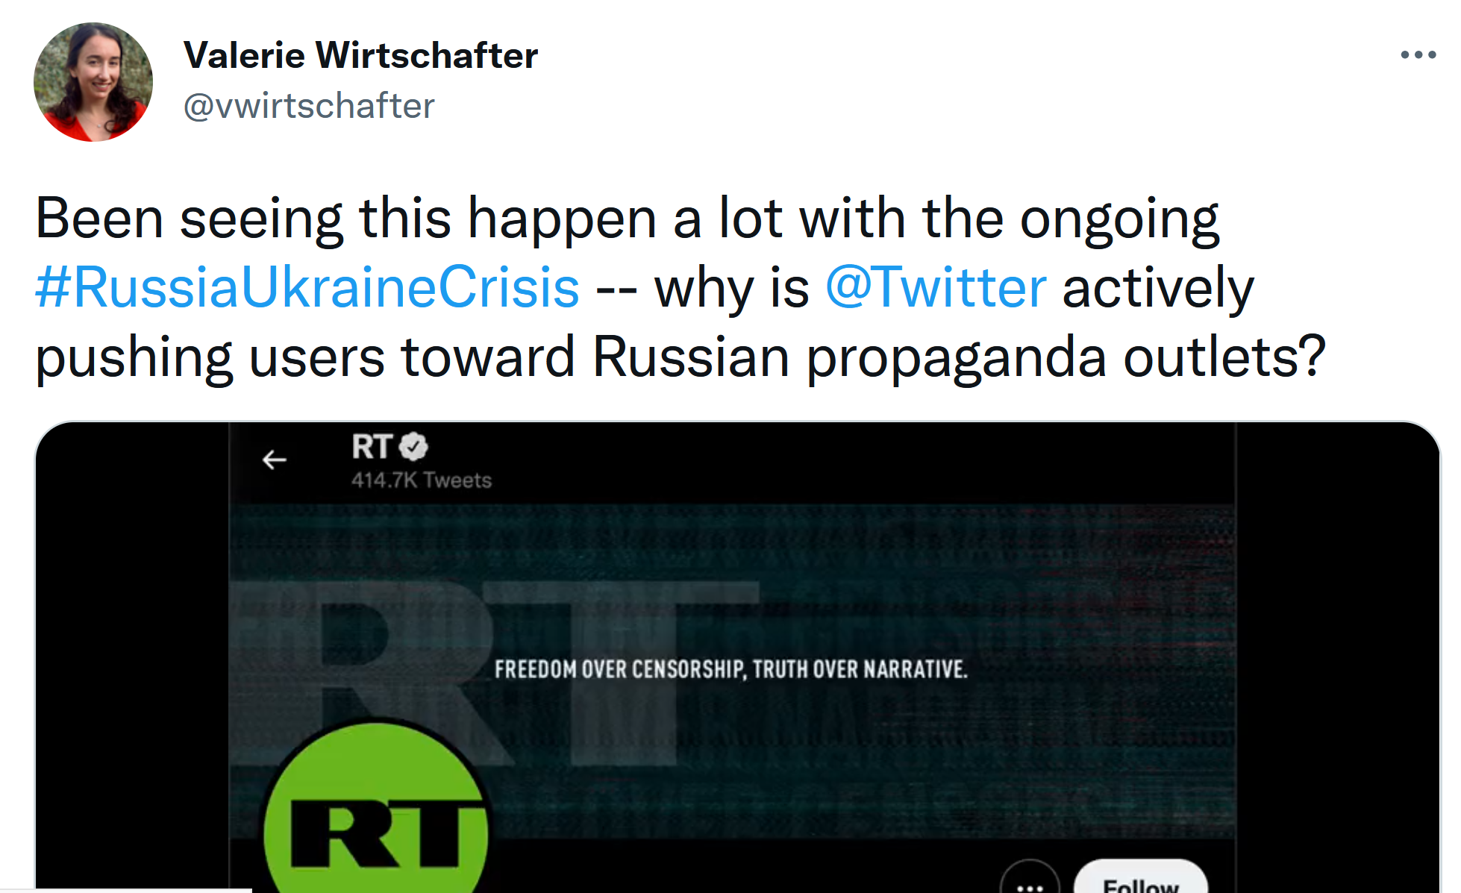
But YouTube and Twitter
Didn’t at First

Slide 77
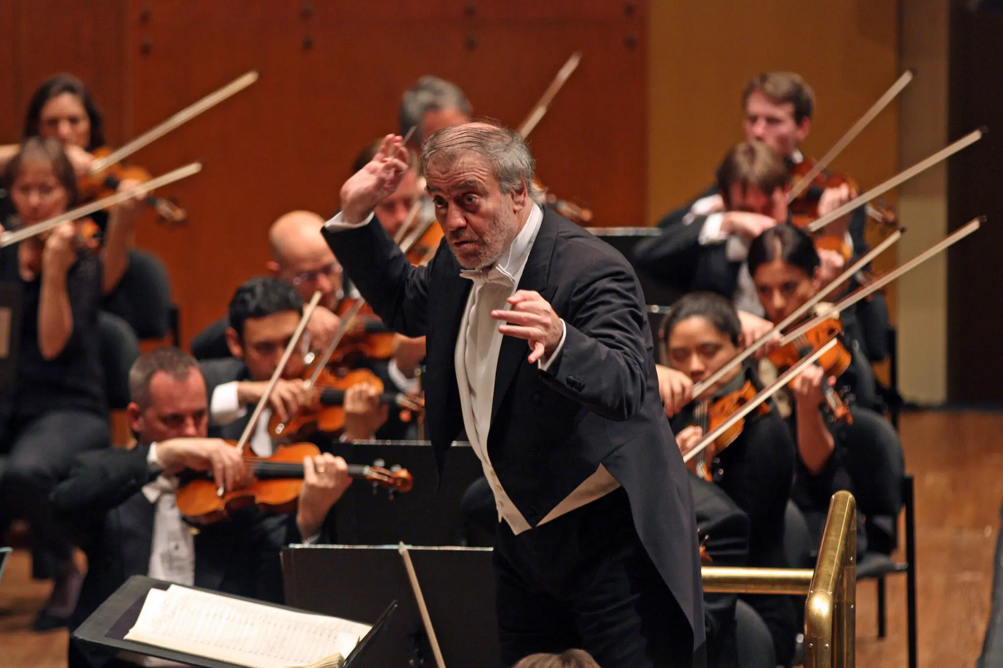
Canceled for Supporting Putin (NY Times, 3/1/22)
Valery Gergiev, a Putin Ally, Fired as Chief Conductor in Munich
Valery Gergiev, the star Russian maestro and prominent supporter of President Vladimir V. Putin of Russia, was removed Tuesday from his post as chief conductor of the Munich Philharmonic after he refused to denounce Mr. Putin’s invasion of Ukraine.
And Anna Netrebko, the Russian diva who is one of opera’s biggest international stars and also has ties to Mr. Putin, saw her upcoming engagements with the Bavarian State Opera canceled, and the Zurich Opera House announced that she had withdrawn from her next performances there.

