Slide 1
CogSci 150
“Sensemaking and Organizing”
Spring 2022
Robert J. Glushko
glushko@berkeley.edu
8 March 2022
15) "Automatic organizing" using perceptual processes, Gestalt principles, statistical learning

Slide 2
Our Questions Today
Most of the lectures so far have been about the concepts and methods for intentional organizing
Today we take a close look at automatic organizing in perception and language learning
Is there an automatic <-> intentional continuum defined by the extent to which organizing is intentional?
How does “automatic” processing work?
  Frequency and transitional probability statistics
  The simplicity principle

Slide 3



Sensemaking
Making sense of, or giving meaning to something, especially observations or experiences
Some sensemaking is automatic, done by hard-wired brain mechanisms that simplify and organize sensory and perceptual input

Slide 4

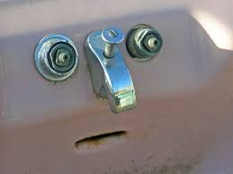
Sensemaking
Making sense of, or giving meaning to something, especially observations or experiences
We have a powerful impulse to interpret our sensations and perceptions. When we see something, is it possible NOT to categorize it, to see it as a kind of thing?
Pareidolia

Slide 5

Organizing
Creating capabilities by intentionally imposing order and structure
“TDO” from now on

Slide 6
Innateness
{and, or, vs.}
Learning

Slide 7
Perceiving and Learning
How much of how we perceive and think is innate and “built in” and how much is based on experience and learning?
  Some concepts and abilities appear to be innate or “core knowledge” even in infants
  Others are obviously learned
  But innate knowledge can constrain or guide what is/can be learned
How do “automatic” and “intentional” perception and cognition interact?

Slide 8

Structure is Everywhere
Much cognitive behavior requires the use of statistical structure of spoken and written language in words and sentences, object and scene perception, musical rhythm, and even in social interactions
An ability to learn and apply these statistical regularities has been proposed as an innate and general cognitive ability

Slide 9
“Core Knowledge” and Surprises
Research on cognitive development in hundreds of studies has revealed that even the youngest minds detect and respond to events that adults find surprising
The nature and patterns of these surprising events suggest that infants are born with rich interconnected expectations about how objects, people, and quantities behave
Surprises act as a force that “turns on” a drive to learn about the events and their causes

Slide 10
How Surprises Reveal
Core Knowledge
If infants are surprised to see
  A ball that appears to pass through a solid wall
  A ball that rolls off a table but hovers without falling
Then they must already know that
  Objects have permanence
  They don’t move on their own accord
  They don’t break into pieces or assemble from pieces

Slide 11
Outline
Gestalt Perception
Automatic / Pre-attentive Organizing
Camouflage and Trompe l'oeil
“trump luh-ee”… tricking the eye
Perception as Inference and Interpretation; the “Grand Illusion”
Sensemaking == Simplification?
Statistical Learning

Slide 12
Gestalt Perception

Slide 13
Figure and Ground
About 100 years ago Edgar Rubin studied the fundamental phenomenon of visual perception to organize some part(s) of the visual field as in the foreground and other parts as the background
When the visual information is ambiguous, this can result in two alternating interpretations
The contrast between the figure and ground determines how easily they are separated

Slide 14

Rubin’s Face-Vase Illusion
Flipping between the face and vase interpretations involves changing which part of the image is ‘figure’ and which is ‘ground’
The brain can only make sense of the world in one way at any point in time –
we see the face or the vase, but not both

Slide 15
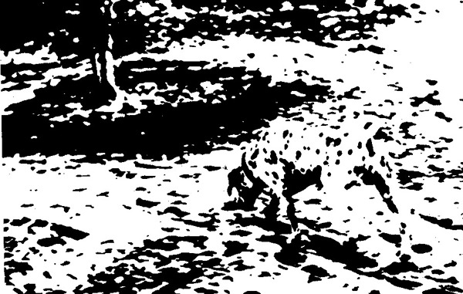
A Classic Figure-Ground Ambiguity

Slide 16
Gestalt Perception
In the 1930s, Psychologists Max Wertheimer, Wolfgang Kohler, and Kurt Koffka extended Rubin’s work and proposed six principles that explain how our visual system imposes order on what it sees to perceive as organized and structured wholes rather than the sum of their constituent parts
Figure/Ground
Proximity
Similarity
Continuity
Enclosure
Closure

Slide 17

Proximity
Objects close to each other, especially when they are aligned, are perceived as belonging together
What groupings do you perceive here?

Slide 18
Similarity
Elements that look similar are seen as being in the same group
The shape and visual design for the icons distinguishes files from folders, and file types from each other
You don’t need to be able to read the labels to perceive the groups, although the visual similarity of the names suggests some similarity of content
TDO 3.3..1.1 Organizing with Properties of Physical Resources

Slide 19

Proximity & Similarity Together
If we change the color here, how does it change the perceived groupings?

Slide 20

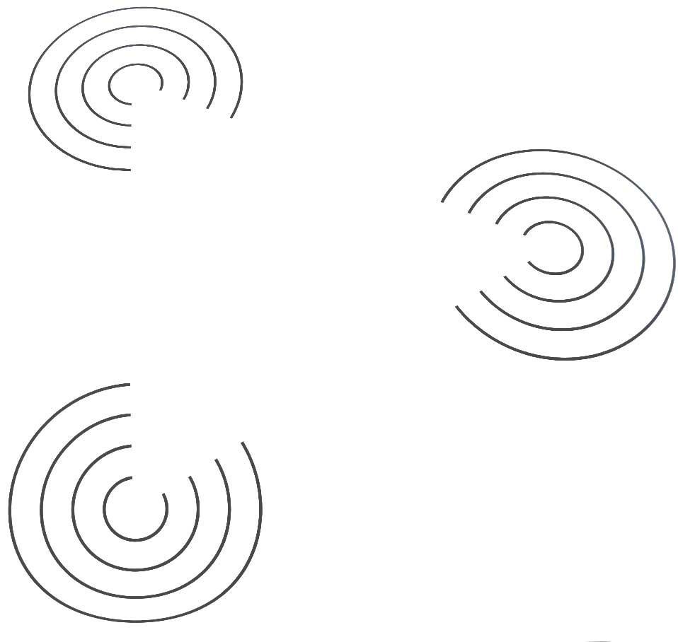
Continuity
Aligned objects are perceived as belonging together, and are perceived as a continuous whole when that perception is a simpler interpretation

Slide 21


Visual stimuli that could be perceived either as open, incomplete, or unusual forms are more naturally perceived as closed, complete, regular => simpler

Slide 22
Automatic / Pre-attentive Organizing

Slide 23
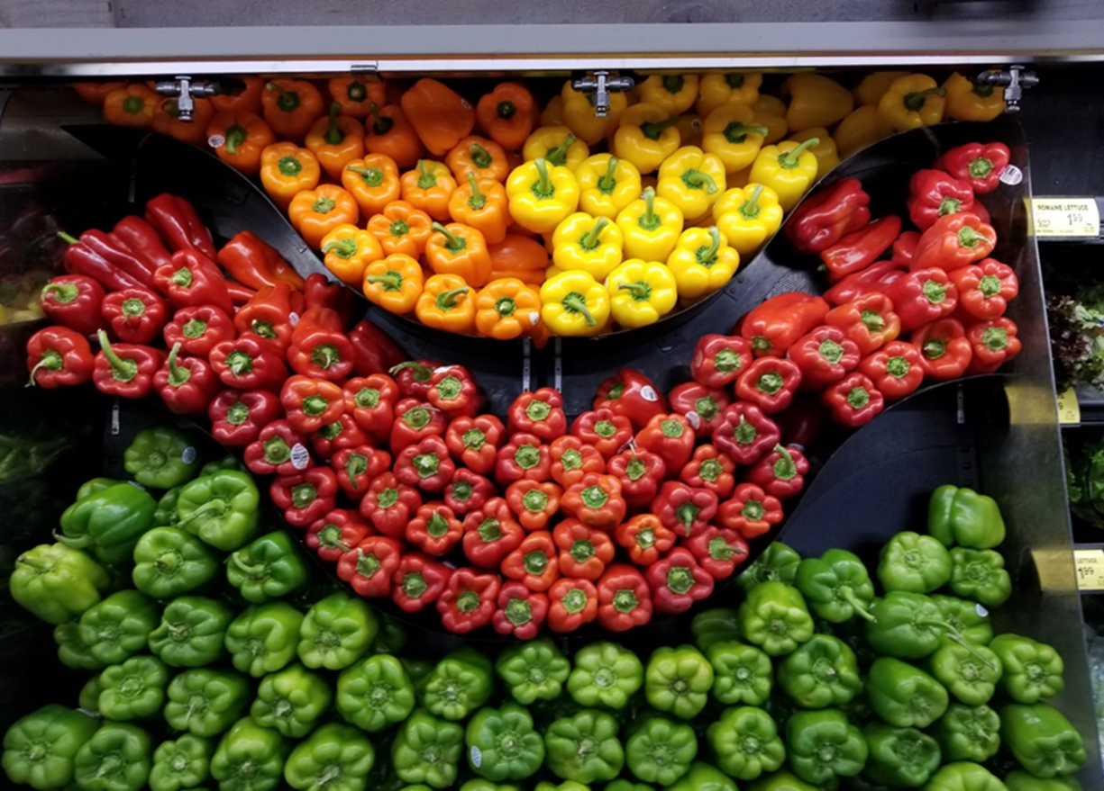
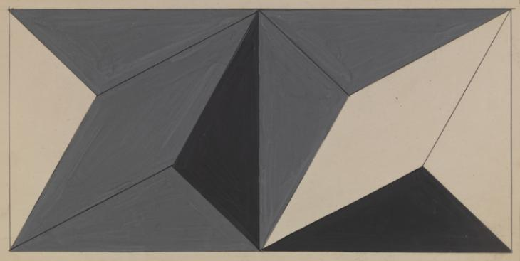

Automatic / Pre-attentive Organizing
Physical resources are often organized according their size, color, or shape, because the human visual system quickly and automatically pays a lot of attention to them
Automatic properties reinforce intentional organizing, facilitating interaction when these properties are selection criteria
Visual artists use automatic properties
    To encourage a specific interpretation
    To focus attention
  How does being able to detect some kinds of sensory events quickly provide an evolutionary advantage?
23

Slide 24

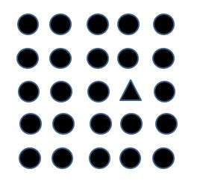
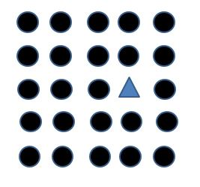
Pre-attentive Processing
of Shape and Color
Do any of these visual arrays contain a triangle?
Because shape and color are pre-attentive attributes, It takes about the same time to decide over a large range of array sizes
It is easier still if the shape is of a different color

Slide 25


Pre-attentive Processing
of Shape and Color

Slide 26
Pre-attentive Processing
of Shape and Color - NOT
Do these visual arrays contain any red triangles or blue circles?
When the shape and color properties are uncorrelated, pre-attentive parallel processing isn’t possible

Slide 27


Slide 28

Organizing Books by Color
FLASHBACK
Might be aesthetic for your personal book collection (or as a Zoom background decoration), but not an effective organizing principle for a library
(WHY NOT?

Slide 29
What Shape is Color?
Vassily Kandinsky believed primary shapes corresponded with specific primary colors.
Assign the colors RED, YELLOW, AND BLUE to the SQUARE CIRCLE, and TRIANGLE shapes
https://www.getty.edu/research/exhibitions_events/exhibitions/bauhaus/new_artist/form_color/interactive/

Slide 30
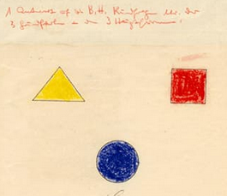
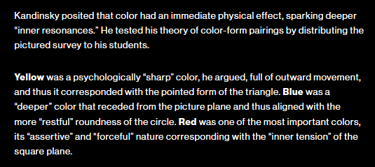
Kandinsky’s Survey and Results

Slide 31
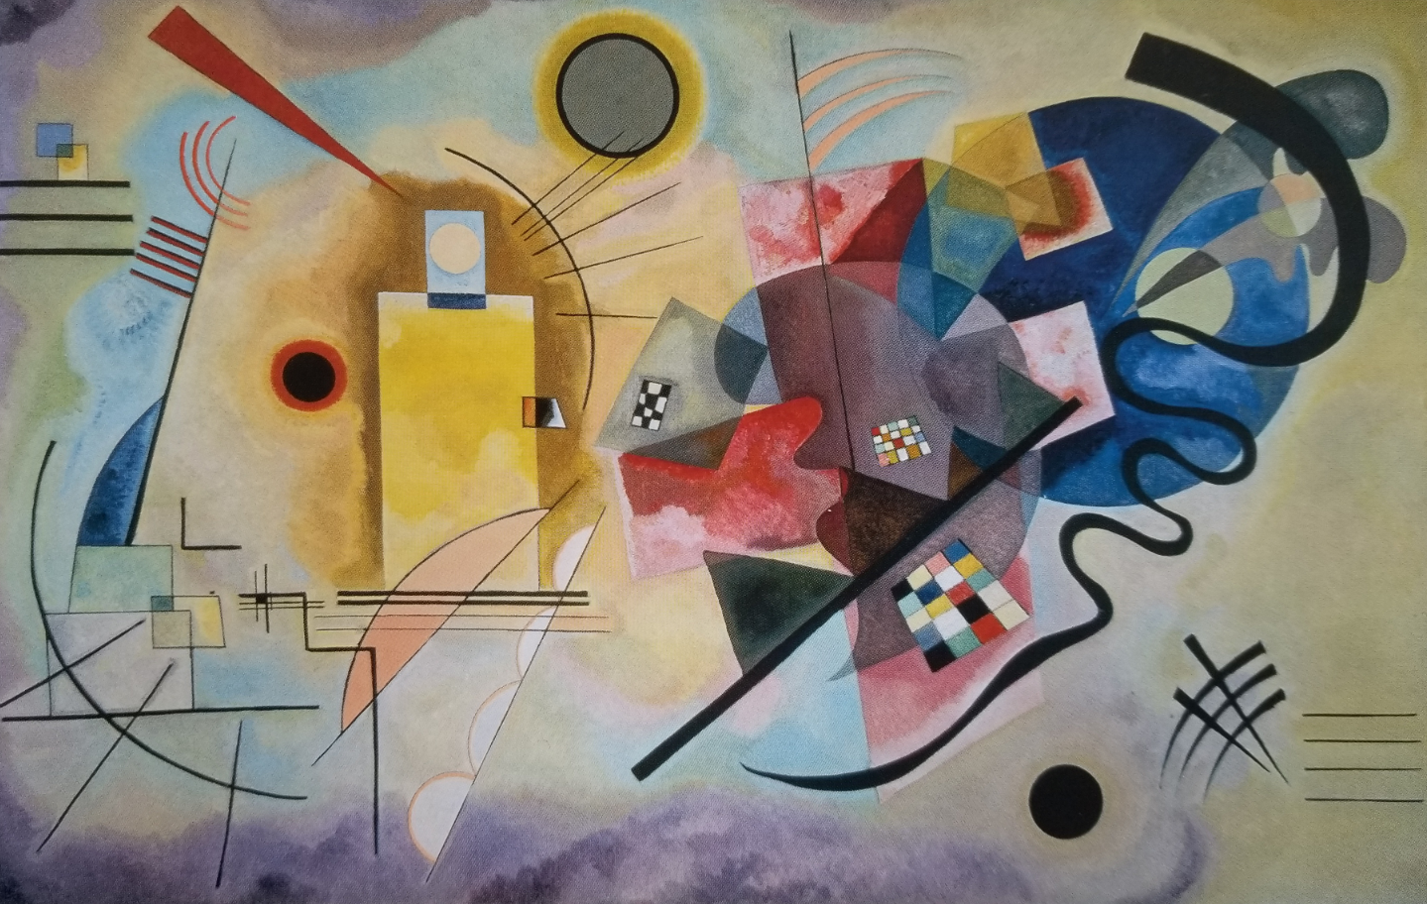
Yellow – Red – Blue (Kandinsky, 1925)

Slide 32
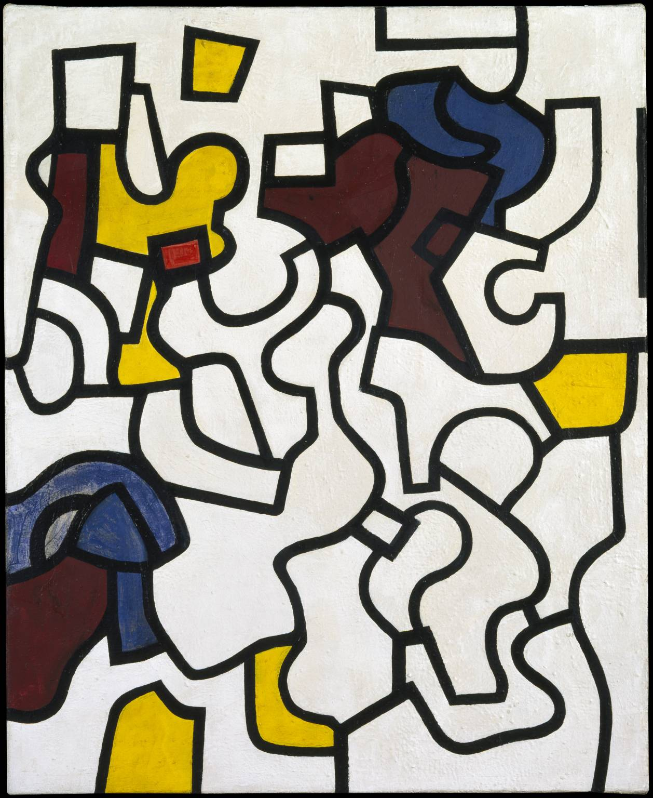
Judith Rothschild
1945
Untitled Painting
For more examples like this one see https://www.tate.org.uk/art/teaching-resource/colour-and-shape

Slide 33
Camouflage and
Trompe l'oeil

Slide 34


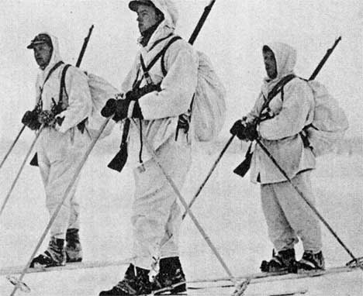
Camouflage
Disruptive coloration, colors and patterns that resemble backgrounds, countershading, shadow elimination, and techniques that disrupt edge detection prove the power of Gestalt processing

Slide 35
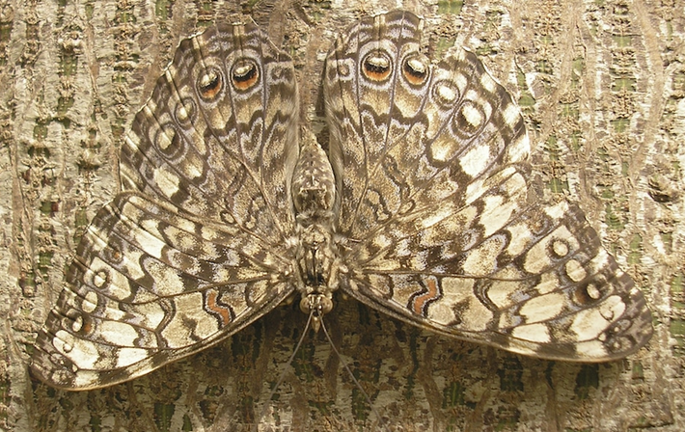


Animal Camouflage
Crypsis – makes animal hard to see
Mimesis – disguises them as something else
Adaptive – changes to match the environment

Slide 36

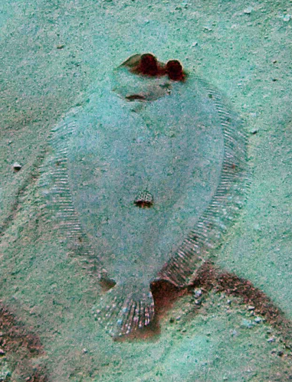


Underwater Camouflage

Slide 37



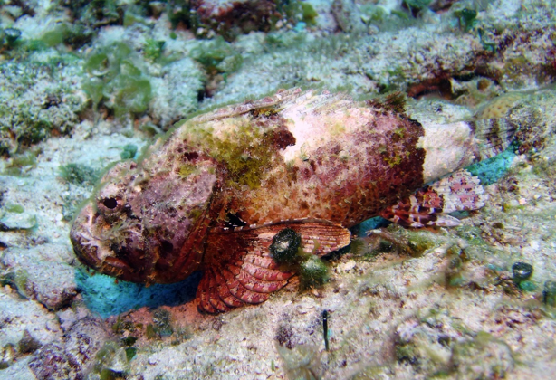
“Aggressive Resemblance”

Slide 38


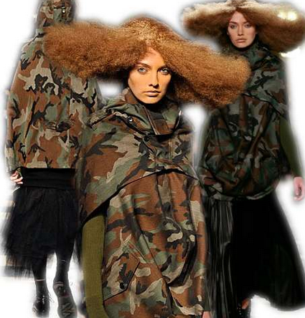
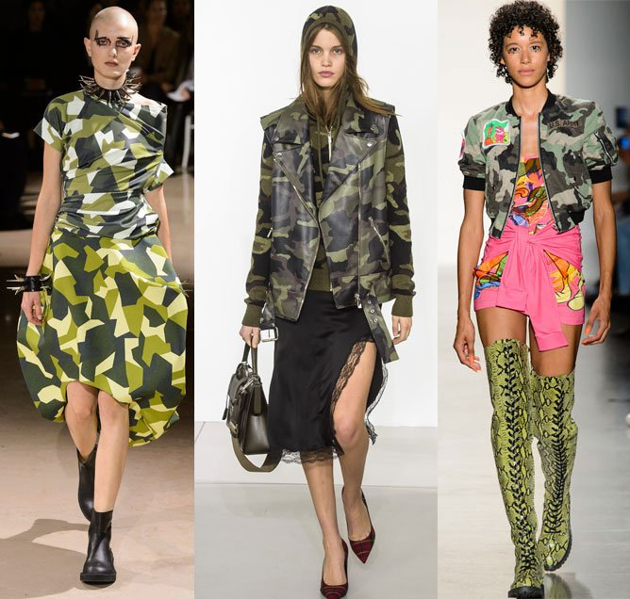
The Irony of Camouflage Fashion
If your goal is to be noticed as a fashionista, a person of style, then why hide?

Slide 39
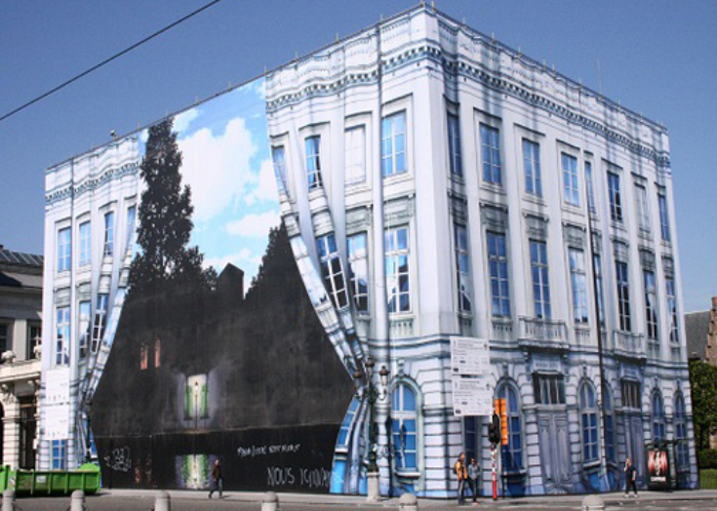
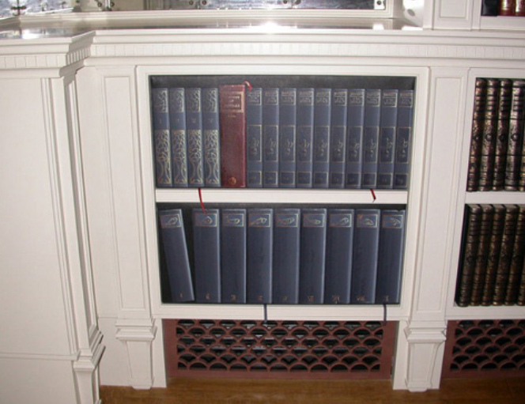

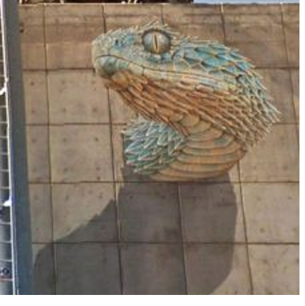
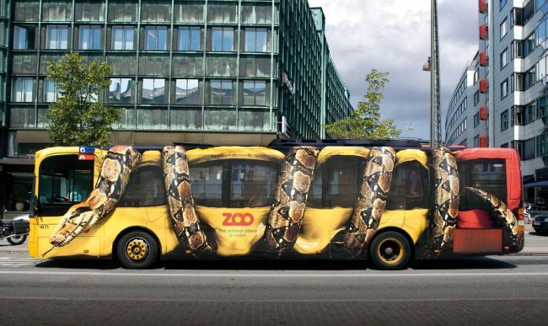
Trompe l'oeil (“trick of the eye”)
https://www.musee-magritte-museum.be/en/about-the-museum/origin
http://www.metanamorph.com/

Slide 40

L’empire des lumières
Daytime or
Nighttime?
Because the tree and other objects in the lower half of the painting are black or nearly black colors, with bright colors next to them, we perceive the bottom of the scene as nighttime and the top as daytime
Do you like this painting? What would you pay for it?
René Magritte, 1954

Slide 41


Slide 42
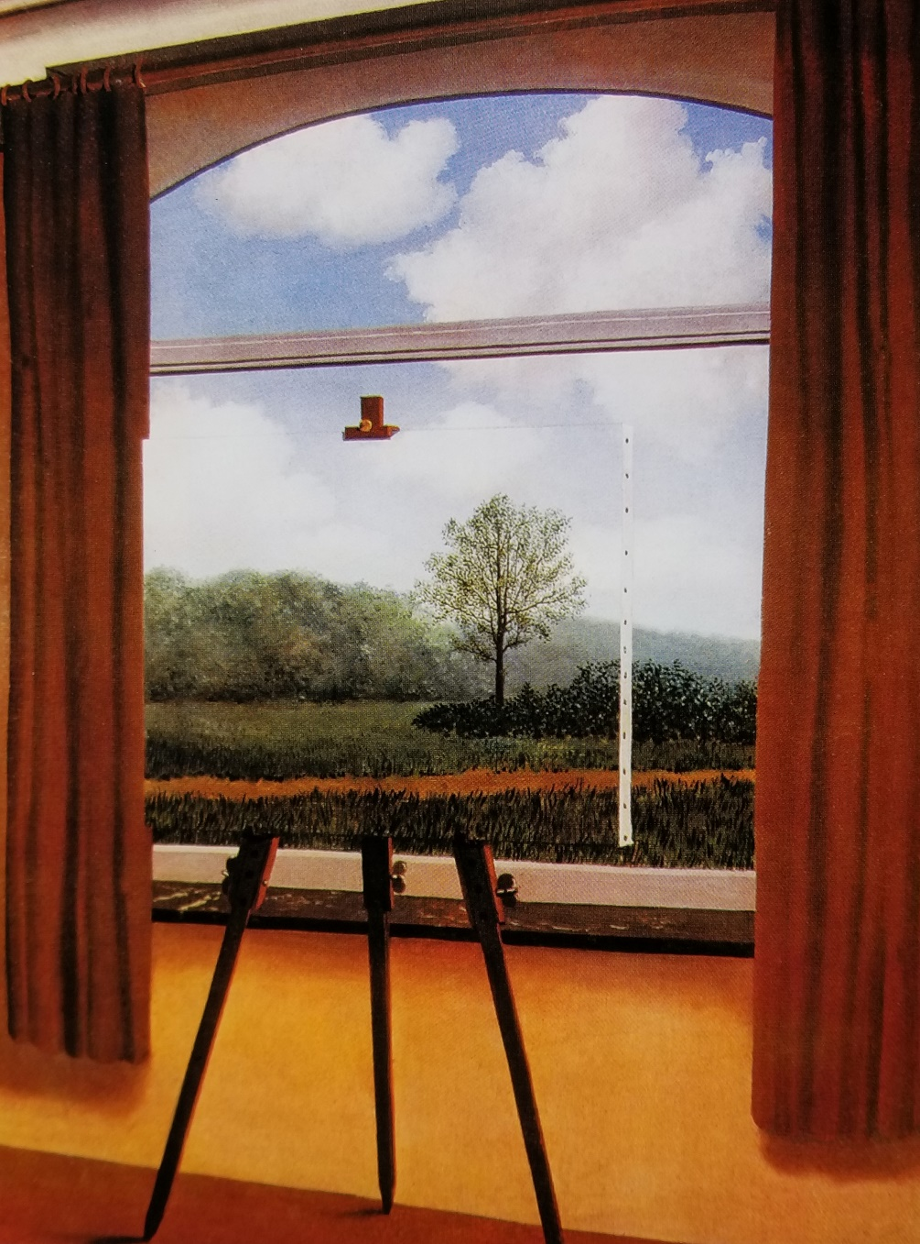
La condition humaine
“In front of a window seen from inside a room, I placed a painting representing exactly that portion of the landscape covered by the painting. Thus, the tree in the picture hid the tree behind it, outside the room. For the spectator, it was both inside the room within the painting and outside in the real landscape.”
René Magritte, 1933

Slide 43
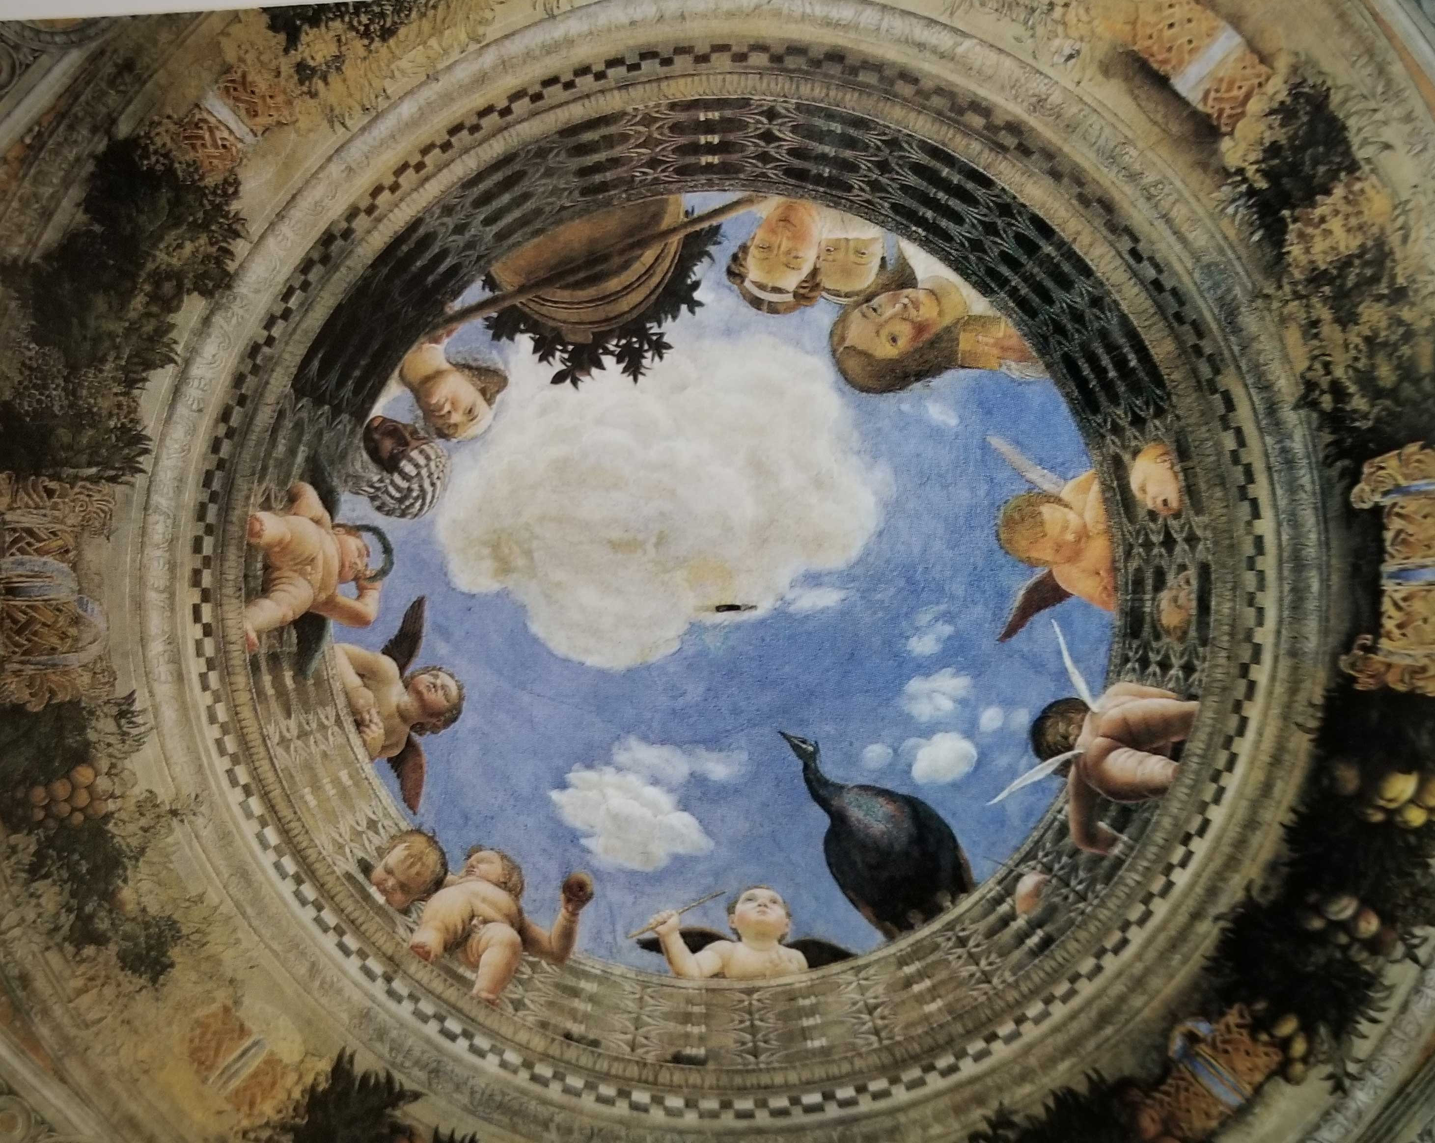
Mantegna, Painted Ceiling in Mantua Palace (1465-74)

Slide 44
Perception as Inference and Interpretation; the “Grand Illusion”

Slide 45
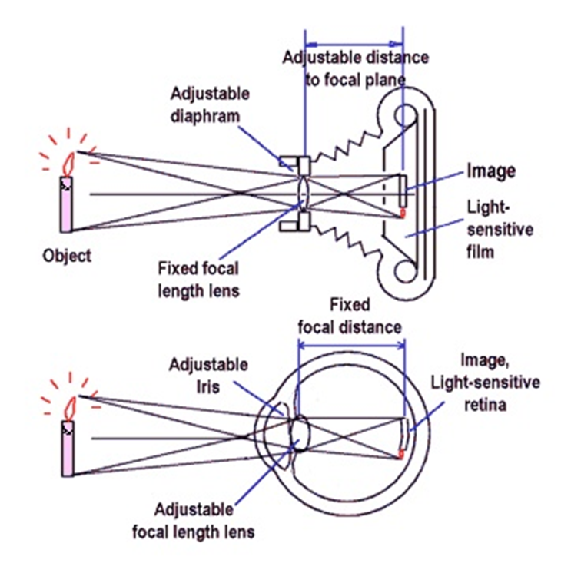
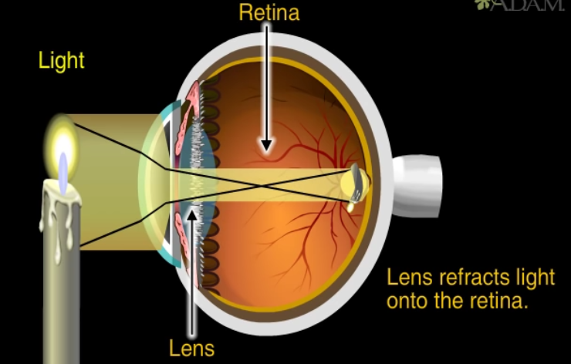
A Very Misleading Analogy –
This is NOT How Visual Perception Works
The “eye as camera” depiction trivializes the complex processes by which the visual system interprets visual input

Slide 46
The “Grand Illusion”
We experience the visual world in 3-D, with rich detail and in color
But the light projected on our retina is upside down, nearly flat (2-D), and we have no color receptors or much acuity except in the center (the fovea)
This disconnect between “what our eyes see” and “what we experience” is striking
  At each moment, we “lock on” to a set of information, which the brain then attempts to organize and interpret
  We impose what can be quite abstract meaning on sensory fragments
  We experience a stable and meaningful world: we experience the result, not the process of getting there
        Nick Chater, “The Mind is Flat”

Slide 47
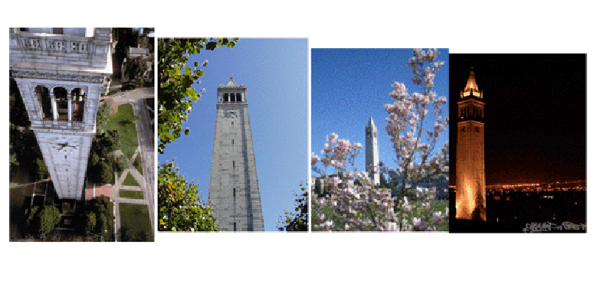
FLASHBACK
The “Sensory Gap”
An infinite number of different “sensory signals“ can be produced by the same object
…And different objects can produce similar signals
Human perceptual machinery excels at “Object Recognition” -- when are different "signal patterns" the same object, or are similar patterns different objects?
…And we do it automatically or sub-consciously

Slide 48
The Process of Visual Perception – Inference and Interpretation
Object recognition, Gestalt principles, camouflage, trompe l’oeil – together tell us that the process of visual perception uses some built-in constraints that relate to brightness, contrast, color, edges, motion, depth, light direction, object size, and many other characteristics of the visual input to make sense of it in an automatic and sub-conscious way

Slide 49
Visual Perception and Illusions
Some related constraints used by the visual system in constructing a 3D world are:
  Objects are smaller when they are further away
  An object's dimensions along the line of sight appear shorter than its dimensions across the line of sight
If some of the necessary visual input is missing or in conflict, the visual system can’t create a stable interpretation, resulting in ambiguity or illusion
(“illusion” here is a homonym wrt “Grand Illusion”)

Slide 50
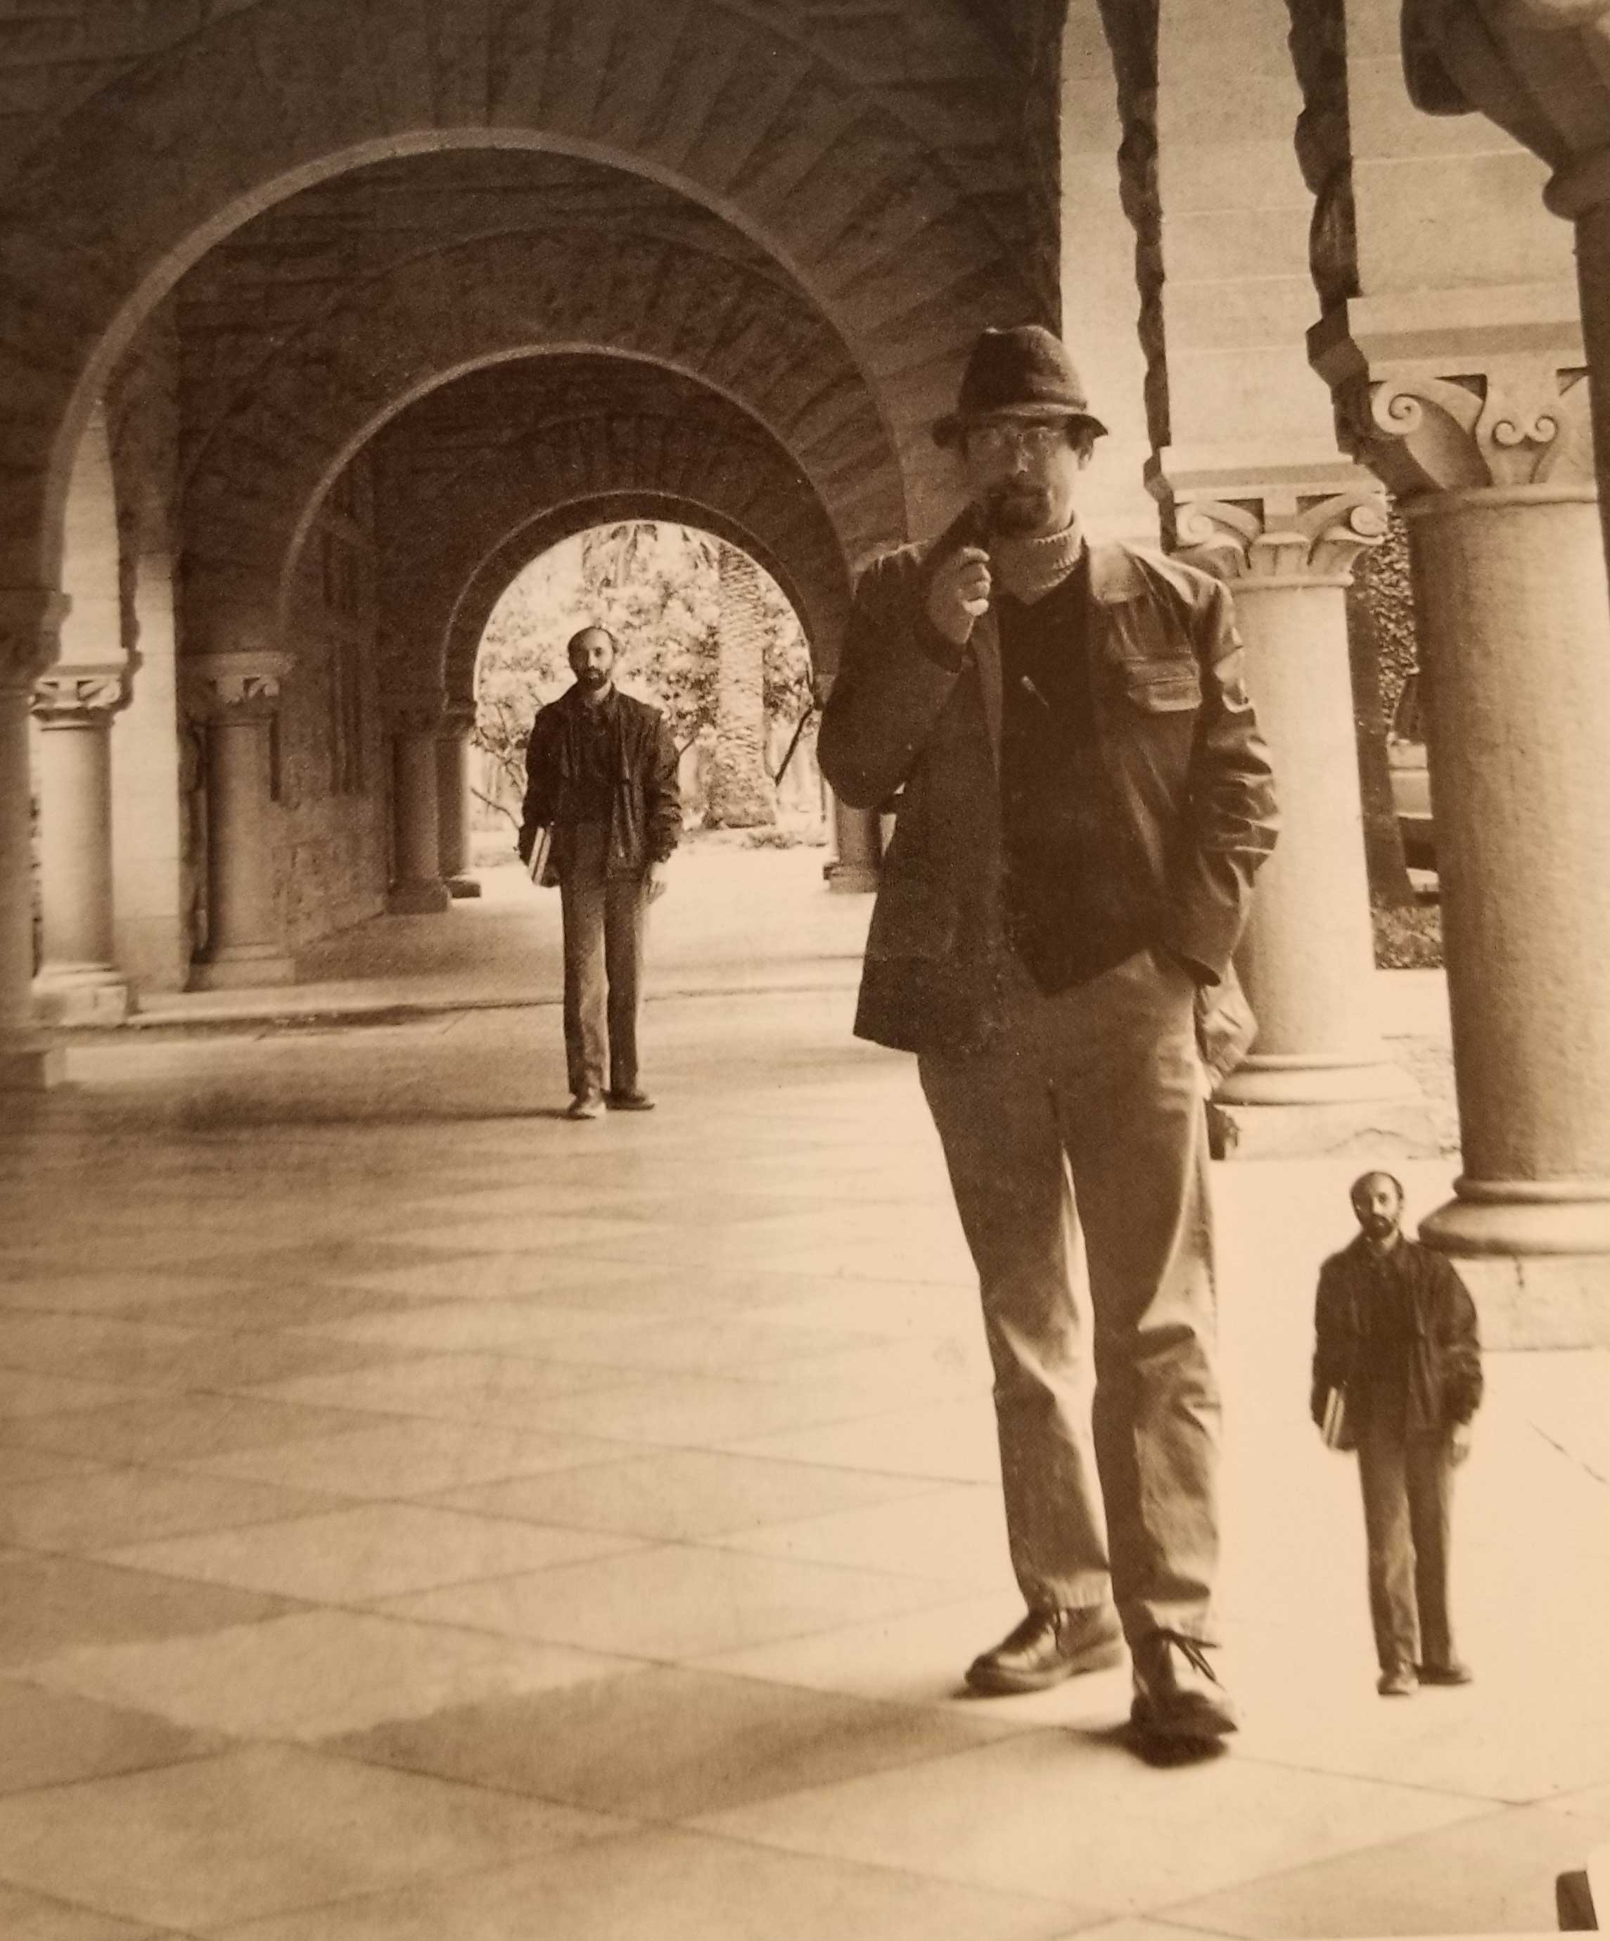

Slide 51
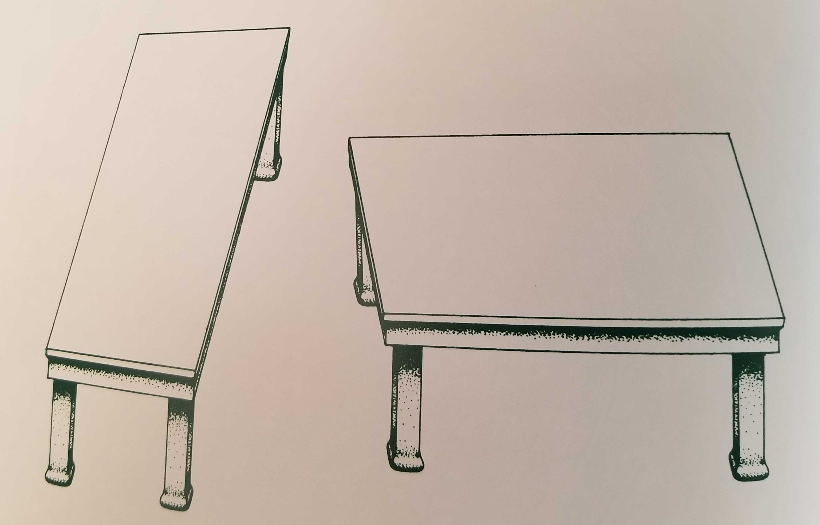

Slide 52
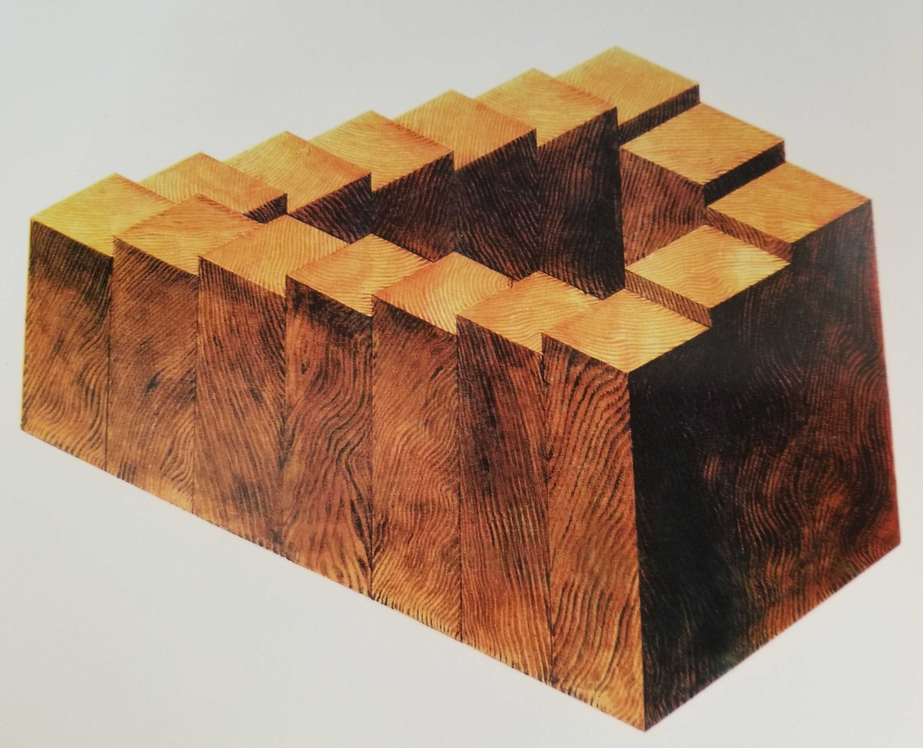
Interpretations of separate parts of the visual input are preserved even if they are inconsistent when combined

Slide 53
Sensemaking == Simplification?

Slide 54

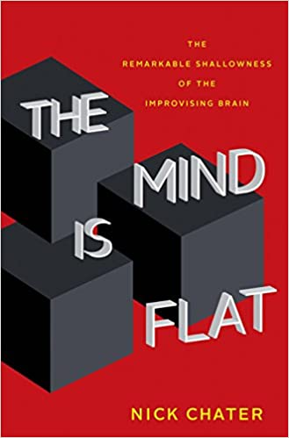
The Cycle of Thought
Attending to a set of information to be explained is setting the problem that the brain is to solve
Brain-style computation results from cooperation across highly interconnected, but slow, neural processing units, leading to coordinated patterns of neural activity across whole networks or perhaps entire regions of the brain
Each step in a sequence of thoughts is an attempt to find the most meaningful organization of this activity to find an answer that best fits the “brain’s question”

Slide 55
Sensemaking & Simplification
Evolution has produced elaborate neural mechanisms for the simpliﬁcation and distillation of information because of limitations on how much information the brain can process and store
if we are consciously thinking about one problem, we cannot even unconsciously, be thinking about another—because the brain networks involved would be likely to overlap; we can’t reach two different interpretations simultaneously
The cognitive system should prefer the inference or interpretation that gives the simplest description
Interpreting data by imposing some sense or structure helps the brain encode data efficiently; we can invert this logic and use the brevity of the encoding as a measure of the amount of sense that it makes of the data.
      Nick Chater

Slide 56
Which Description is Simpler?
A red square in front of a blue square
A red square bordered on all four sides by blue triangles

Slide 57

STOP AND THINK: Describe What You See

Slide 58

STOP AND THINK: Describe What You See
These are the identical black shapes from the previous slide, but arranged differently (Masanori Idesawa)

Slide 59
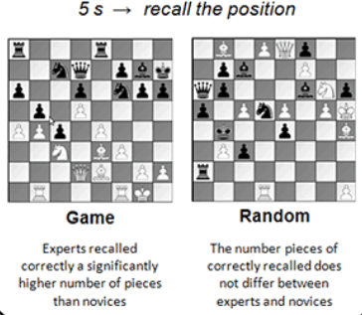
Perceptual Learning Enables Simpler Description
Perceptual learning: “an increase in the ability to extract information from the environment, as a result of experience and practice with stimulation coming from it”
Chase, W. G., & Simon, H. A. (1973). Perception in chess. Cognitive psychology, 4(1), 55-81.

Slide 60
Statistical Learning

Slide 61
Saffran’s Classic Study
Saffran, J. R., Aslin, R. N., & Newport, E. L. (1996). Statistical learning by 8-month-old infants. Science, 274(5294), 1926-8
8-month-old infants from an American-English language environment were familiarized with 2 min of a continuous speech stream consisting of four three-syllable nonsense words
To assess learning, each infant was presented with repetitions of one of four three- syllable strings on each test trial. Two of these three-syllable strings were "words" that had been presented during familiarization, and two were three-syllable "nonwords" that contained the same syllables heard during familiarization but not in the order in which they appeared as words
The infants showed a significant test- trial discrimination between word and non-word stimuli, with longer listening times for nonwords
This novelty preference, or dishabituation effect, indicates that 8-month-olds recognized the difference between the novel and the familiar orderings of the three-syllable strings

Slide 62
Statistical Learning: Why
Infants have the most to learn and the least prior knowledge to guide that learning
Infants need to learn their native language – but it can be any language
  What acoustic properties are language-significant?
  What sound patterns are syllables?
  What syllable patterns are words?

Slide 63
Statistical Learning: Why
Natural languages contain rich statistical structure and linguistic input unfolds in time
You need statistical learning to enable hierarchical chunking of phonemes into syllables and then into words. If you don’t do this very quickly, the ongoing speech overwhelms your memory capacity

Slide 64
Statistical Learning: What
Data can be collected about any property, but only those where the data have enough variation to make meaningful distinctions get used
Fortunately, the phoneme categories used by natural languages are constrained or “sculpted” by the auditory system, just as our visual system is constrained to extract a small set of properties
All spoken languages build on these primitive acoustic feature detectors; languages will survive if we can learn and use them, and those will be those that best exploit these features

Slide 65
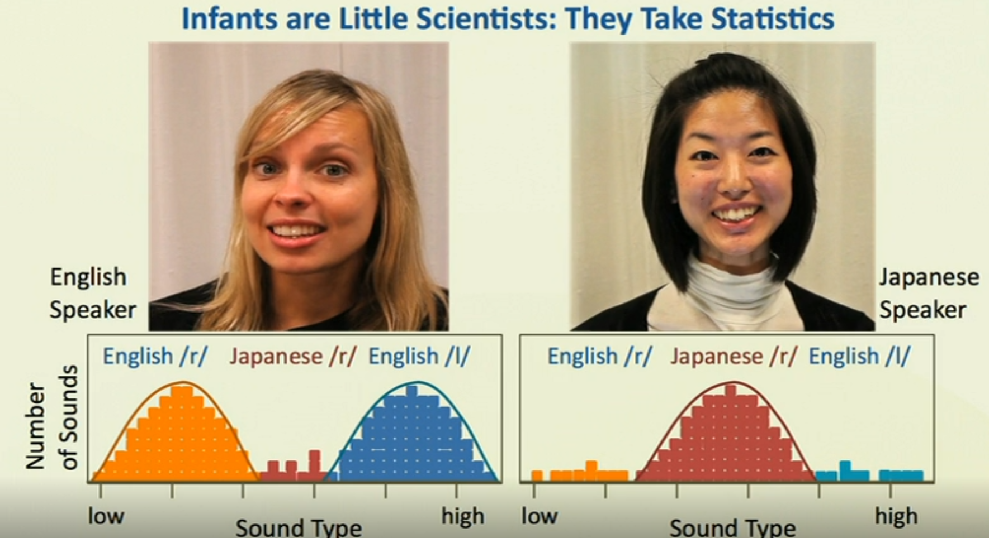
A lot of learning is learning to ignore
Any variable that has a statistically useless distribution gets ignored; Japanese learners ignore the acoustic differences between /r/ and /l/

Slide 66
Statistical Learning == Simplification
The simplicity principle says that if the data can be compressed by discovering patterns, you can focus your attention on those aspects of the input
Simplicity is a heuristic for deciding where to look for patterns
I.e., the statistical learning mechanism tries to compress data and when it succeeds, that must be the right interpretation

Slide 67

A Conversation with Chater & Saffran

