Slide 1
CogSci 150 “Sensemaking and Organizing” Spring 2022
Robert J. Glushko
glushko@berkeley.edu
10 March 2022
16) Categories made by individuals; Managing possessions;
Personal information management;
The Memex

Slide 2
Outline
Managing Personal Possessions
Managing Personal Information
Information Overload
The Memex

Slide 3
The Context: Individual Organizing Systems and Categories
Created to satisfy ad hoc requirements that emerge from an individual’s unique experiences, preferences, utility functions, and resource collections
Created intentionally in response to specific organizing requirements, often short-term ones
Can have an imaginative or metaphorical basis that distorts or misinterprets cultural categories
How people organize their personal possessions is a trendy cultural topic and a lucrative business domain
How people organize their personal information has been much studied by researchers
3

Slide 4
Managing Personal Possessions

Slide 5
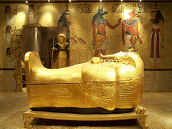
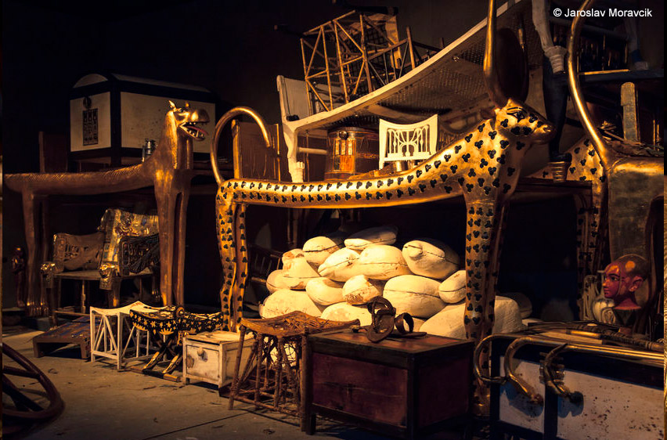
Managing Personal Possessions (1)
When King Tut was buried 3500 years ago, his tomb contained thousands of possessions -- golden shrines, jewelry, statues, a chariot, weapons, and clothing

Slide 6
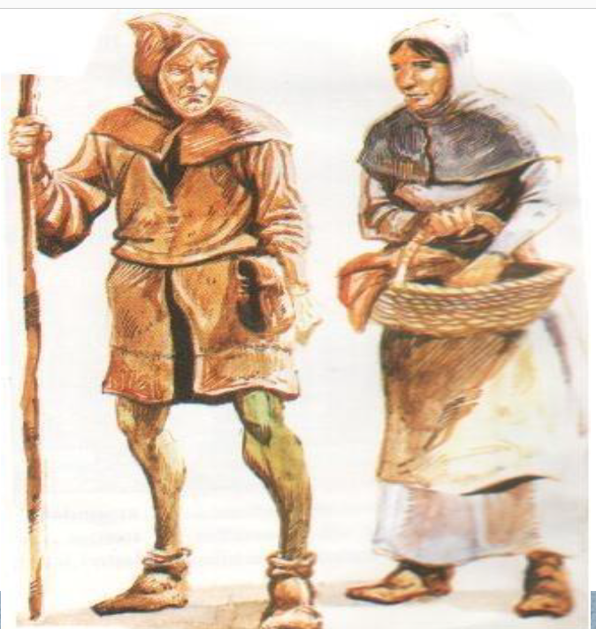
Managing Personal Possessions (2)
But until the last few hundred years, most people (other than extremely wealthy ones) accumulated few possessions because they couldn’t afford them (most people had only 2 or 3 changes of clothes, 1 coat, 1 hat, 1 pair of shoes)
When you have very little, managing your possessions is not a problem

Slide 7
Consumerism and Consumption
A middle class began to emerge in the 19th century when people began to have some “disposable income” to spend on goods and services that were non-essential
The 19th century industrial revolution greatly increased the number of consumer-facing businesses, and advertising agencies emerged to encourage buying
The now-familiar term “conspicuous consumption” was coined by American economist and sociologist Thorstein Veblen in his 1889 book, The Theory of the Leisure Class
Do you observe any “conspicuous consumption” on or around campus?

Slide 8
STOP AND THINK
How many things do you (or your household…) own?
Items of clothing (don’t forget shoes, coats)
Kitchen utensils, dishes, cooking ware
Other kitchen resources (cleaning supplies, sponges, towels, broom, dustpan, mop)
Appliances (refrigerator, stove, microwave, blender, coffee grinder and maker, washer, dryer)
Food, condiments, spices, etc. in pantry or refrigerator
Tools and associated resources (screws, nails, clamps)
Books, magazines, documents
Music and movies in various formats
Vehicles (bike, scooter, car) and associated resources
Furniture and associated resources (sheets, towels,..)

Slide 9
Too Much Stuff?
There are 300,000 items in the average American home
An overestimate because of granularity issues -- it probably counts every nail and screw and napkin as a separate resource
But no matter how you count, it is a lot of stuff
The average size of American families declined 15% between 1960 and 2010, but during the same 50-year period the average size of a new single-family home nearly tripled – people were accumulating stuff!
Is there room to park a car in your garage, or is it filled with stuff? Do you use offsite storage?

Slide 10
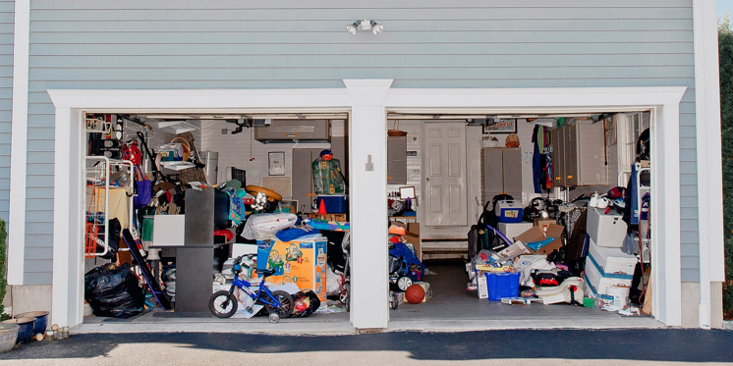
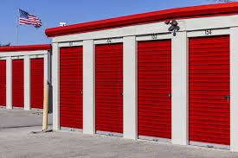
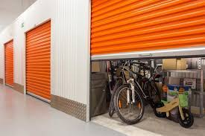
25% of people with two-car garages don’t have room to park cars inside them and 32% only have room for one vehicle
1 out of every 10 Americans rent offsite storage—the fastest growing part of the commercial real estate industry

Slide 11
In Contrast… Bob’s Garage (2014)
11

Slide 12
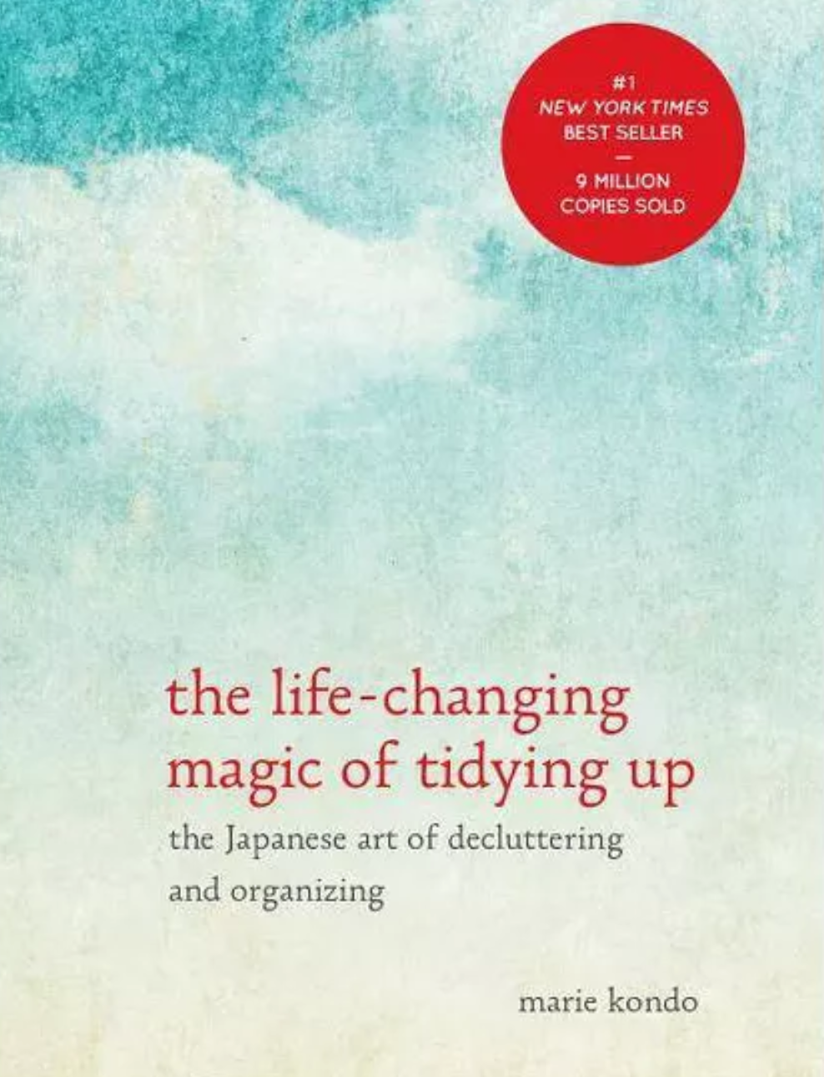
Marie Kondo
Very simple advice about how to de-clutter your life:
“Put your hands on every item you own, one at a time”
“If it doesn’t spark joy in your life, thank it - then get rid of it”
Ritualistic procedures for folding and arranging things
2014 book was a mega-million seller, followed by two Netflix series

Slide 13
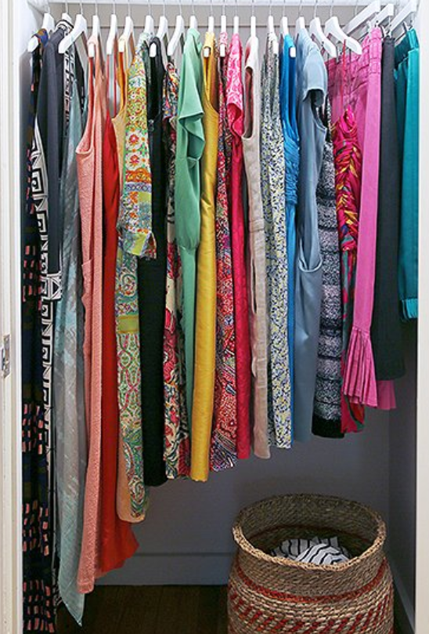
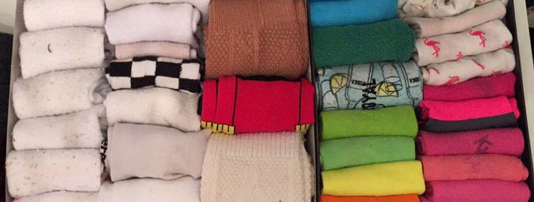
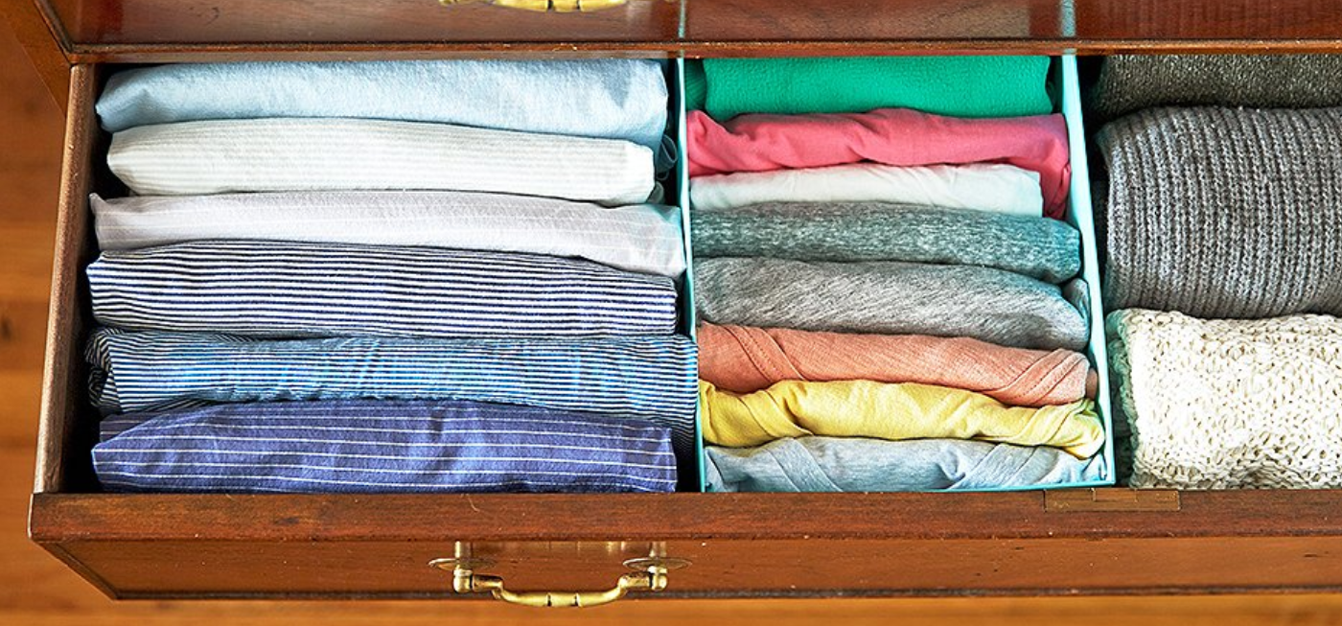
Socks, Shirts, and Dresses Organized According to the Kon-Mari Method

Slide 14
STOP AND THINK
Have any of you read the Kondo book or watched her Netflix shows?
Is Kondo’s advice brilliant in its simplicity, or trivially simplistic?
She targets her advice to individuals who make decisions based on their personal experience with specific things. Could this advice be followed by groups of people or by businesses?

Slide 15
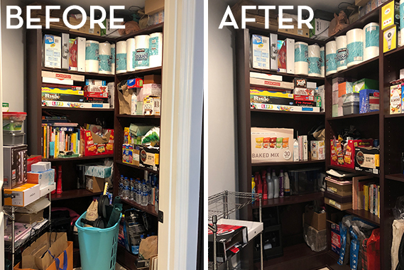
The Cult of Kondo Search for “Kondo before and after” to find an astonishing number of photos and videos How can we measure the cultural importance of Marie Kondo?

Slide 16
Lexicalization of “Marie Kondo”
Why are Google’s “ngram viewer” and “autocomplete” a good measure of the cultural significance of the Kondo cult?
Screen photos on 7 March 2022 by RJG

Slide 17
Kondo’s Methods in TDO-speak
Think architecturally -- you are not decluttering rooms or closets – you are analyzing categories of resources separately, and then instance by instance
Exploit pre-attentive perceptual processes to reduce search time by folding and arranging things that emphasize their colors and shapes
Use Gestalt principles of alignment and continuity to encourage a perception of simplicity and order

Slide 18
More TDO Perspective on Kondo
If resources have no current use or value, getting rid of them saves the costs and effort of maintaining them for some unpredictable future uses
However, prospect theory from behavioral economics suggests that people are biased to keep things even when they don’t have predictable future uses (because they value gains and losses differently, placing more weight on possible gains vs. possible losses)

Slide 19
“Professional Organizers”
Over 3500 NAPO members in the US
But they make money in consulting fees and by selling “storage solutions” (organizing furniture – boxes, shelves, cabinets) so this incentivizes a focus on implementation concerns rather than on the design of organizing systems

Slide 20
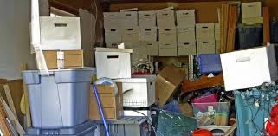
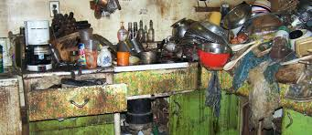
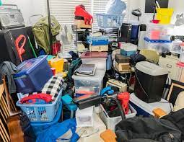
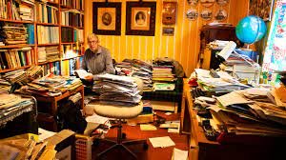
When Possession Management Goes Wrong

Slide 21
Hoarding Disorder (1)
Hoarding disorder, newly included in the Diagnostic and Statistical Manual of Mental Disorders, fifth edition, is characterized by persistent difficulty in parting with possessions, regardless of their actual value
The most commonly saved items include newspapers, old clothing, bags, books, and paperwork
The majority of persons with hoarding disorder excessively acquire items that they do not need or for which no space is available

Slide 22
Hoarding Disorder (2)
Persons with hoarding disorder attribute their difficulties in discarding items to the perceived usefulness or aesthetic value of the items, a strong sentimental attachment to them, or the wish to avoid creating waste
Persons with hoarding disorder may not have a place to sleep, sit, or cook in their homes
In severe cases, hoarding can pose a range of health risks, including fire, falling, and poor sanitation
Often the subject of books and movies (Hoarders TV series, Collyer Brothers, Gray Gardens)

Slide 23
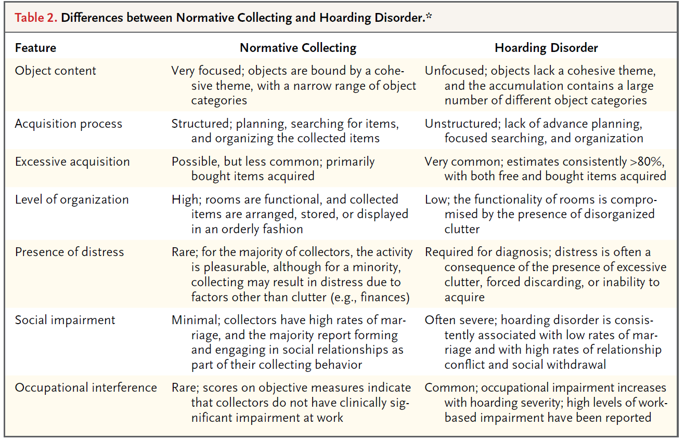

Slide 24
Professional Organizers Can Help! Call Now, Operators Are Waiting

Slide 25
Personal Information Management

Slide 26
You Don’t Need This Fake Graphic To Know That TMI Is A Thing
Eppler, M. J., & Mengis, J. (2004). The concept of information overload
“The quality of decisions or reasoning in general of an individual correlates positively with the amount of information he or she receives—up to a certain point. If further information is provided beyond this point, the performance of the individual will rapidly decline”
Why is this a “fake” graphic?

Slide 27
Definitions of Information Overload
Too much information supply
Too little processing capacity
Too little time to process the information
Too little time to interact with relevant people
When a backlog of “reading matter” builds up
Feelings of stress, confusion, anxiety, and low motivation for information-intensive tasks
Why does it matter how we define information overload? Can any of these definitions be the basis of quantitative measurement?

Slide 28
Factors Influencing Information Overload
Information quantity, frequency, intensity, and quality
The capabilities of the person receiving, processing, or communicating the information
The processes and tasks for the information
The information technology used
Formal and informal organizational / communication structures (“Social Thinking”)

Slide 29
Personal Information Management
"The practice and the study of the activities that people perform to acquire, organize, maintain, and retrieve information for everyday use"
PIM covers personal actions (or inactions) that are the result of individual choices
Having this discretion about information organization and "making sense of it" to make decisions is a defining characteristic of professional, as opposed to clerical, information work

Slide 30
PIM and Technology
Because PIM is embedded in user tasks and work context it reflects the prevailing technology support for information work
There have been numerous disruptive technologies for PIM
The personal computer had an enormous impact
Then came “luggables” and “portable” notebook computers
The smart phone and “cloud storage” enables much of a user’s PIM to be always accessible, making PCs and notebooks less important

Slide 31
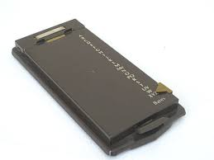
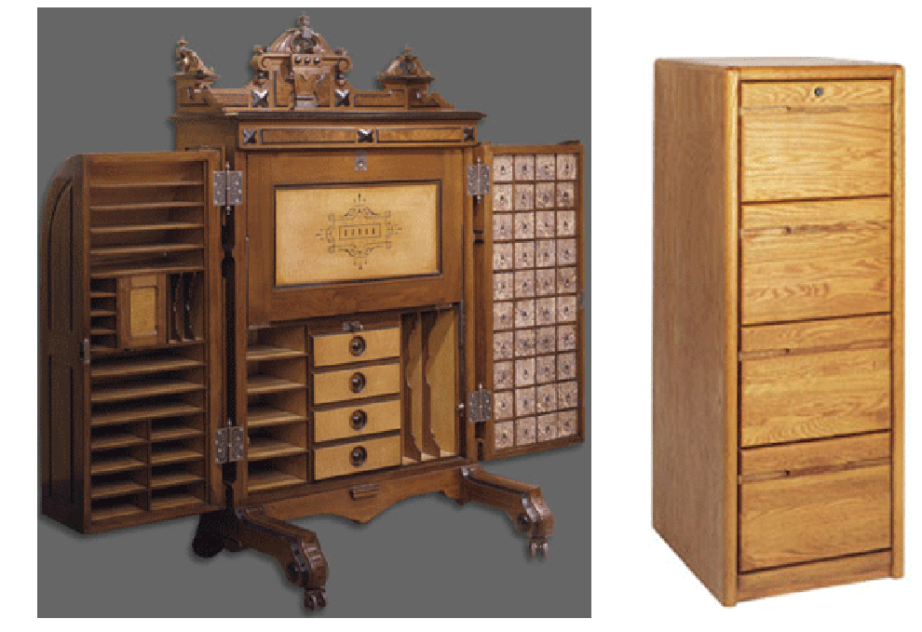
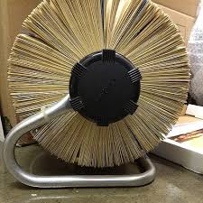
Historically Disruptive Technologies for PIM
3
1
2
4

Slide 32
The Contemporary PIM Challenge
Vastly more personal information of all kinds
Much of this information is in incompatible digital formats produced and consumed by a variety of devices and applications
These devices and applications separately provide support for PIM that is collectively incompatible
But our work often requires that information be created, managed, and retrieved in ways that cut across these format and device boundaries
What can be done to ensure that PIM can span devices and applications?

Slide 33
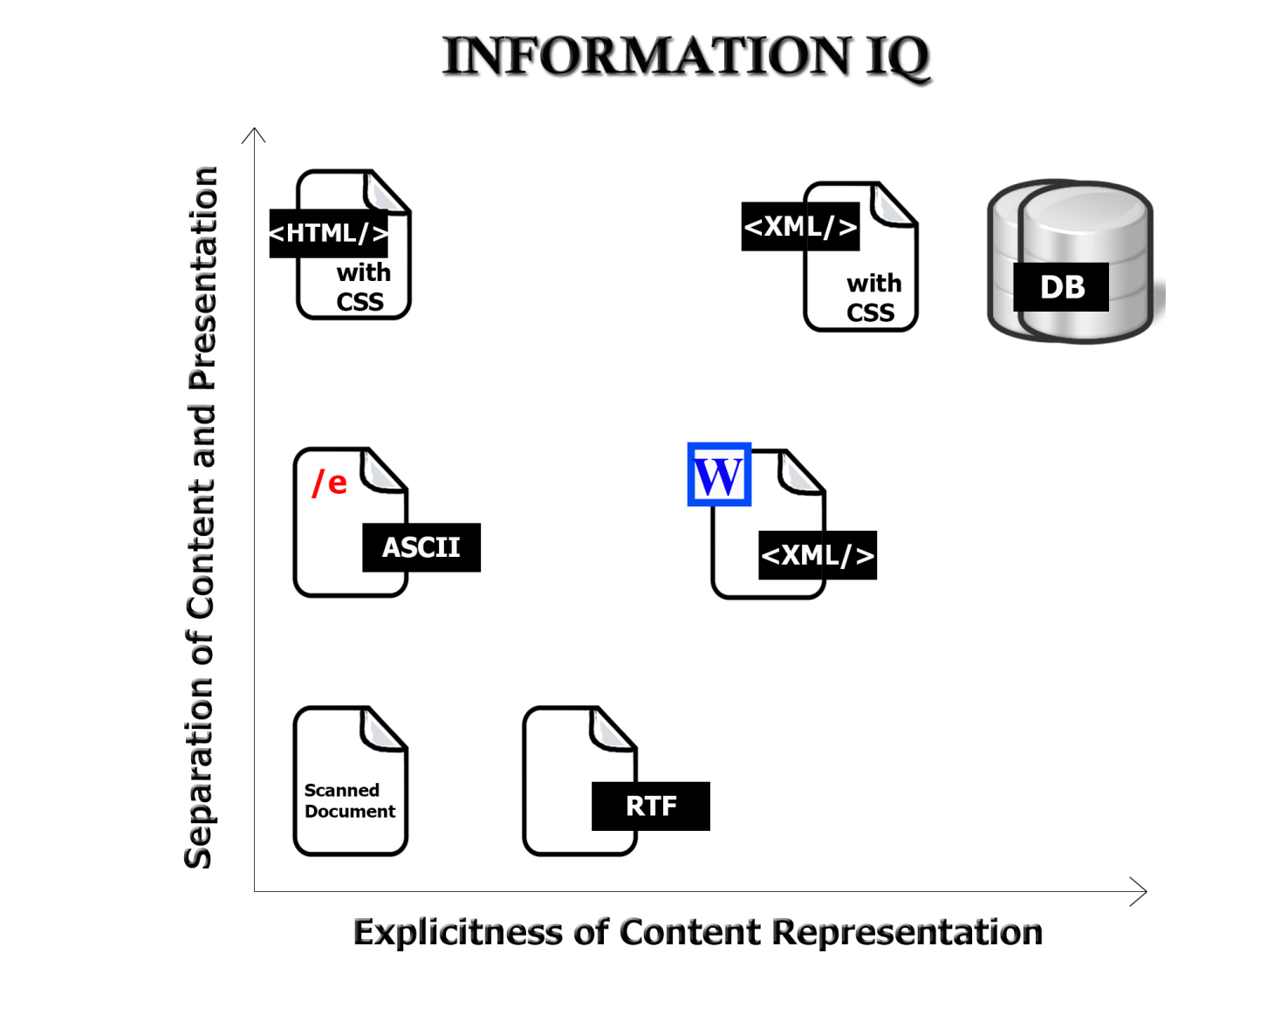
The Digital Format Matters!
FLASHBACK
33

Slide 34
Your “Personal Information Space”
Your PSI is an abstract organizing system that contains all the various physical and digital information resources that are nominally under your control
Some of these are located "in the cloud" and are thus only indirectly controllable, but people tend to think of all the distributed digital storage as being "in one place"
A fundamental challenge is maintaining an integrated view of the PSI
A corollary challenge is reconciling the tension between one's PSI and the need to contribute and use information from information spaces shared with others

Slide 35
What’s In YOUR PSI?
Dropbox Google Docs
Collaboration apps like Slack
Smartphone Apps

Slide 36
STOP AND THINK
What kinds of things can happen to make your local PSI storage inaccessible?
What kinds of things can happen to make your network PSI storage inaccessible?
Do you regularly back up your PSI?

Slide 37
A Taxonomy of PIM Apps/Systems
Graphical knowledge capture tools (“mind” or “concept” mapping)
Note-taking applications
Autonomous or wearable PIM applications
Functions built into operating systems or communication applications
Contrast between “document-centric” (files and folders) and “application-centric”) metaphors

Slide 38
Mind-Mapping Software

Slide 39
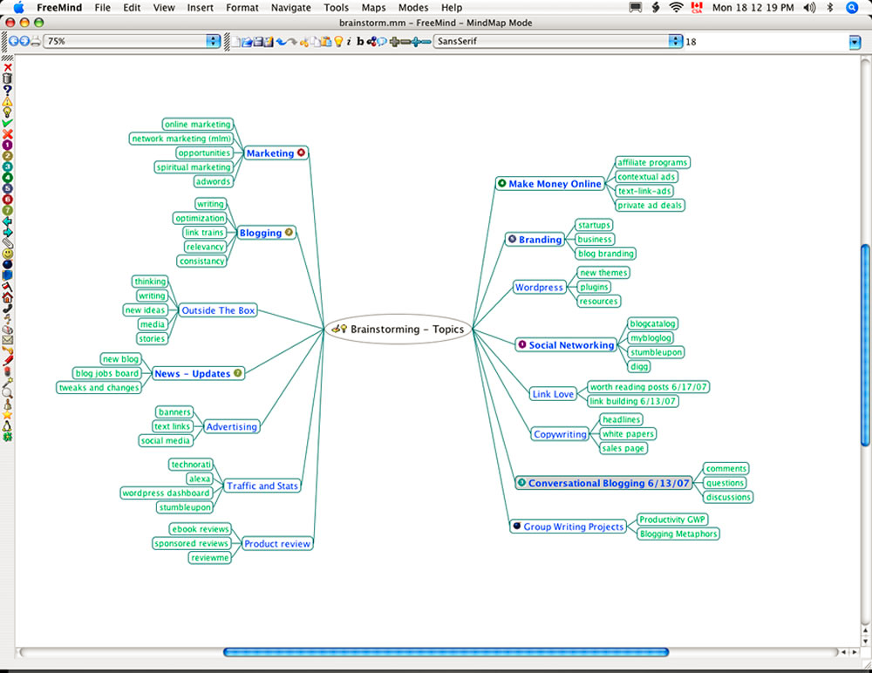

Slide 40
Note-Taking Software
BEST ONE
BEST FREE ONE

Slide 41
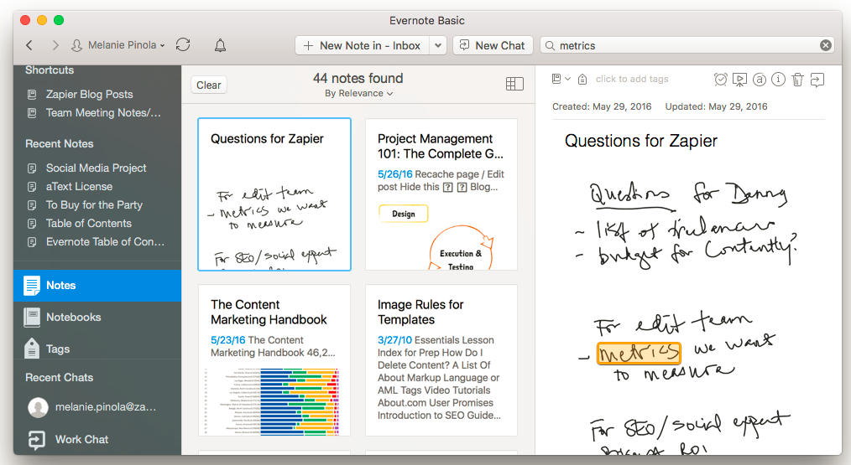

Slide 42
Autonomous / Wearable PIM

Slide 43
STOP AND THINK
PIM research has shown that people differ significantly in their strategies, so no single technological solution can satisfy everyone
Do you make a lot of effort to remember and organize information, or do you assume you can always find it on your phone or via web search?
Is part of your PIM strategy to rely on other people for information you might need?

Slide 44
Contrasting PIM Strategies
People differ a lot in their PIM strategies
“Pilers” vs. “Filers” (“Slobs” vs. “Neat Freaks”) is a classic contrast and a recurring theme in popular culture
Filers design an organizing system and continually maintain it
Pilers are ad hoc, often short-term activity based, and tradeoff organizing time for search time

Slide 45
PIM Activities
Selection (Keeping) activities are carried out when you encounter information - they determine the input of information into the PSI
Organizing by intentionally applying principles that arrange resources in ways that enable desired interactions
Interactions: Finding or re-finding activities within the PSI determine the output of info from the PSI or its use in work
Maintenance activities are those taken to organize, re-organize, or integrate the PSI

Slide 46
Selection Decisions
Pushed information comes to our PSI (not as the result of any immediate action on our part); could be previously-selected subscriptions, social media notifications
Pulled or Retrievable information is what we intentionally seek
What is YOUR mixture of pushed and pulled information? How (or do) you manage or maintain the proportions over time?

Slide 47
Decisions to Make on Information Exposure / Receipt
Consume immediately
Ignore (is this “keeping by default” ?)
Keep
What types of information fall into each category?
What are YOUR reasons for keeping information?

Slide 48
Decisions About Keeping and Organizing
Do you think in terms of information instances or in terms of information types? (How “Kondo” are you?)
Does the "to be kept" information item fit into your existing classification scheme within your PSI?
If you use an existing category or location or naming scheme, is the degree of "fit" acceptable or does it distort the existing organizational or naming scheme?
Is it necessary to create new categories, locations, or names?
Do you abstract / summarize / data mine / secure or otherwise process the "to be kept" information?
How much of this "keeping and organization" work could be done automatically?

Slide 49
New Design Concepts for PIM - Patina

Slide 50
New Design Concepts for PIM – Data Recommender

Slide 51
New Design Concepts for PIM – Temporary Folders

Slide 52
New Design Concepts for PIM – Temporary Apps

Slide 53
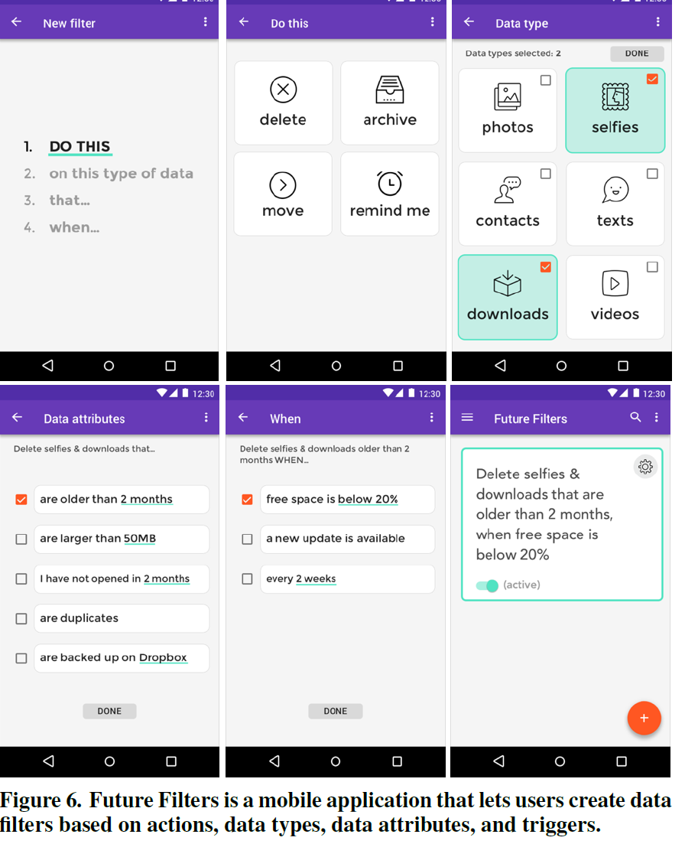
New Design Concepts for PIM – Future Filters

Slide 54
The Memex

Slide 55
Vannevar Bush ‘As We May Think”
MIT Scientist
Ran the Office of Scientific Research and Development during WW2, which coordinated all the work of scientists (including the Manhattan project)
His efforts after the war to continue federal funding for scientific research led to creation of NSF
“As We May Think” has been cited nearly 10,000 times and is one of the most influential writings of the “computing era”
55

Slide 56
“There is a growing mountain of research. But there is increased evidence that we are being bogged down today as specialization extends. The investigator is staggered by the findings and conclusions of thousands of other workers—conclusions which he cannot find time to grasp, much less to remember, as they appear.”
“The difficulty seems to be…that publication has been extended far beyond our present ability to make real use of the record.”

Slide 57
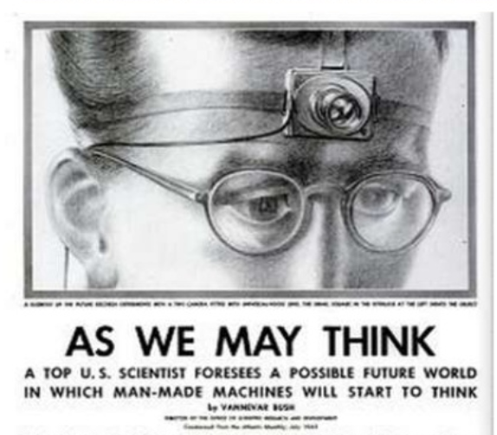
A memex is a device in which an individual stores all his books, records, and communications, and which is mechanized so that it may be consulted with exceeding speed and flexibility. It is an enlarged intimate supplement to his memory.
Consider a future device for individual use, which is a sort of mechanized private file and library

Slide 58
The Memex
58

Slide 59
Memex New Ideas
“The human mind works by association” -> hypertext linking in “trails”
Because trails are separate packages of links, they can be shared and combined
Text or voice annotation of documents
Speech synthesis

Slide 60
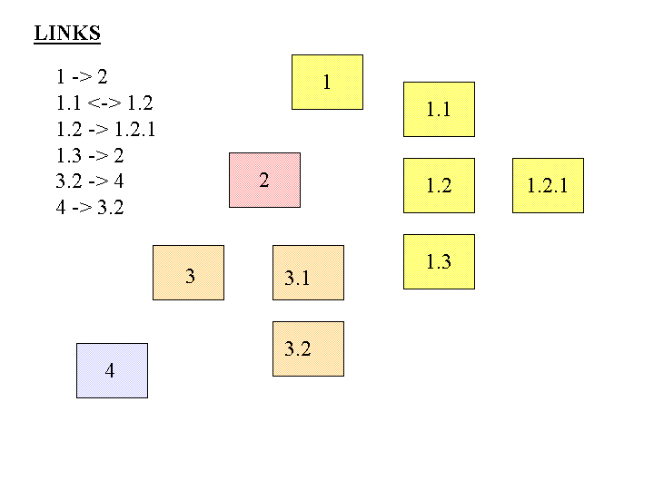
FLASHBACK
Separate Links
What would it mean to store links apart from the resources? What are the implications?

Slide 61
Memex Limitations
Linear extrapolation of prevailing technology, “technical difficulties of all sorts have been ignored”
No mechanism for searching documents or trails
Memexes are stand-alone, not networked

Slide 62
Memex as an Organizing System
What?
Why?
How much?
When?
Who (and by what means)?)
Test your understanding of Memex
62

