Slide 1
CogSci 150 “Sensemaking and Organizing” Spring 2022
Robert J. Glushko glushko@berkeley.edu
15 March 2022
17) Causality and Explanation

Slide 2
Outline
“The Search for Meaning”
Causality {and, or, vs.} Explanation & Correlation
Causality in Philosophy
Teleology
Scientific Explanation

Slide 3
Jane Gets Sick
Jane gets food poisoning after eating at a restaurant. Should she return to the restaurant?
To decide, you need to know what CAUSED Jane to get sick

Slide 4
Where Does The Sun Go At Night?
Irwin: Where does the Sun go at night?
Broom-Hilda: It’s kept in a big barn in California.
Irwin: Then how does it get back East in the morning?
Broom-Hilda: By bus.
Irwin: Things are so easy to understand when you have a smart person to explain them!
Does Broom-Hilda’s response explain Irwin’s observation?
Why is it inferior to other explanations?

Slide 5
Why Does It Rain?
CHILD: It rains so we can have water to drink
EDUCATED ADULT: It rains because water vapor condenses in clouds and forms droplets
Is it cognitively innate and natural to believe that things and events have a purpose?

Slide 6
Michotte’s Demonstrations
Albert Michotte in 1946 devised an elaborate mechanical apparatus that allowed him to manipulate the animation of two objects on a projection screen
Both could move left and right at various speeds and with various delays. Small variations in their movement produced large variations in the way his subjects described what they saw
These classic psychology experiments started a whole area of research to test all the variations and boundary conditions

Slide 7
“The question often boils down to whether we should see causes as a fundamental building block or force of the world (that can’t be further reduced to any other laws), or if this structure is something we impose.”
Kleinberg, S. (2015). WHY: A Guide to Finding and Using Causes. Chapter 1 (p. 7)
Can you see why “causality” is relevant to sensemaking and organizing?

Slide 8
The “Search for Meaning” (1)
Most of our decisions are influenced by our beliefs about the causal structure of the world
(flashback to Atran & Medin): People have a cognitive need to see purpose in the world by understanding and predicting properties and behaviors of:
Physical objects and substances (Physics)
Plants and animals (Biology)
Other people (Psychology)
Humankind needed to figure out what substances, animals, plants, and people might harm or help them

Slide 9
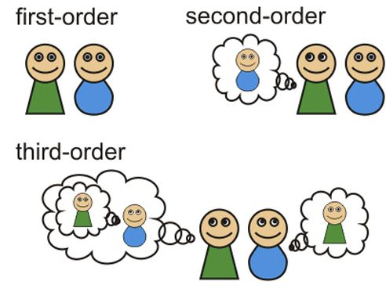
The “Search for Meaning” (2)
Our beliefs about “causality of people” are sometimes called “theory of mind”
What do I think about how you are thinking?
What do I think you are thinking about how I am thinking?
…

Slide 10
The “Search for Meaning” (3)
People also have a cognitive bias to see order and purpose in their lives
It is essential for psychological well-being to believe that your life has meaning
Plato first said this over 2000 years ago
People (and literature) create “stories” to give sets of events or experiences some coherent explanation
(and both kind of stories are often fictions)

Slide 11
“ a belief in some sort of guiding intentional agency or cosmic order in life is pervasive even among the non-religious due to a deeply-rooted social-cognitive bias to imbue the world with agency, intention, and purpose”
Banerjee, K., & Bloom, P. (2014). Why did this happen to me? (p. 278)
Can you believe in “cosmic order” without believing in a god (or gods)?

Slide 12
FLASHBACK “we assume that sense and sense-making is, in fact, pleasurable or painful to the extent that it does help us to make sense of aspects of our lives ”
“The inability to make sense of stimuli, or for that matter of one’s life, is generally aversive, and sense-making is especially pleasurable when the drive for sense-making has been activated”
- Chater, N., & Loewenstein, G. (2018). The under-appreciated drive for sensemaking. (p. 140)

Slide 13
The “Search for Meaning” (4)
This human need for order and purpose is especially important when dealing with emotional or traumatic life events where people often lack personal control
It often motivates a person to identify with and support the values and goals of a larger group – a family, profession, nation, religion
FLASHBACK to Homophily; join a “tribe” to get more control over your life

Slide 14
The “Search for Meaning” (5)
People don’t like randomness or not being able to predict the future
People like to use the probability of an event occurring to support a causal conclusion, even when it is inappropriate
“That’s too much of a coincidence for this to be happening by chance… something must have caused it”

Slide 15
Have You Ever Said?
“things happen for a reason”
“he got what was coming to him”
“the world was teaching him a lesson”
“my destiny was to be …”
“it was fate”
“it was God’s will”

Slide 16
Oops. We haven’t defined “Cause” or “Explanation”

Slide 17
What is a Cause?
(Kleinberg) “Cause” generally means something:
that makes an effect more likely
without which an effect would or could not occur
or that can produce a certain effect under the right circumstances

Slide 18
What is a Cause?
A cause can be a “story” that ties several events or observations together to make them coherent
STORIES are used in every culture to communicate concepts, relationships, and values – a lot of that is about causes and effects
It can be based on something you PERCEIVED
Or it can be based on INFERENCE, indirectly deducing causality using your understanding of some mechanism that could create the effect
How do the parts of this machine fit together to make it work?
What properties of these things cause them to behave in these ways?

Slide 19
How Does My Cup Know What To Do?
If I put hot coffee in my coffee cup, the cup gets warm
If I put water with ice cubes in my cup, the cup gets cooler and the ice melts
How does the cup know what to do? What causes it to heat up or cool down?

Slide 20
The Causes of “Causality”
Why are some sequences of events causal and others not?

Slide 21
What Causes Causality?
When one event is always or mostly followed by another one, we can think that the first event causes the second
When you see a brick go through a window, a billiard ball strike another and make it move, or a match light a candle, you have an impression of causality based on the sensory input.
When we count, 6 is always followed by 7. Does 6 cause 7?
Why do we think that 6 doesn’t cause 7?

Slide 22
Unobservable Causality
Some things are caused by the absence of a factor, which can’t be observed
A lack of vitamin C causes scurvy
Psychological states like beliefs or intentions can be causes, and they can’t be observed either (at least not easily)

Slide 23
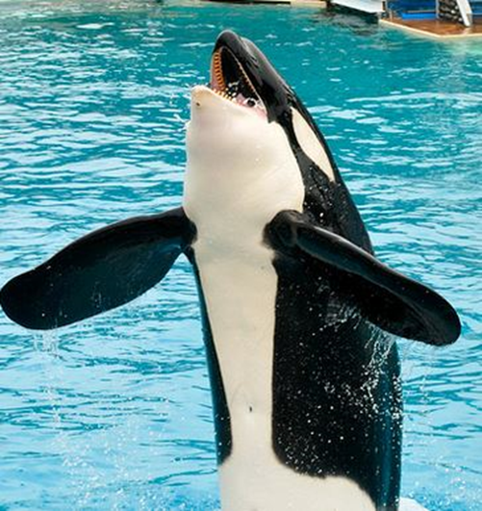
Causal Attribution
We often talk about causes “in general” – “Type-level” causality
Distracted or drunk drivers cause car accidents
We also take about causes of specific events – “causal attribution” or “token causality”
What caused the accident last week when Bob crashed his car into Carly’s scooter?
Do you understand why Shamu is here?

Slide 24
Why We Need Causes (1)
Explanation
Knowing the cause of an event is essential if you want to repeat it or prevent it
Jane gets food poisoning after eating at a restaurant. Should she return to the restaurant?

Slide 25
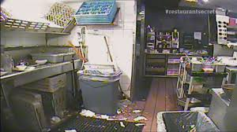
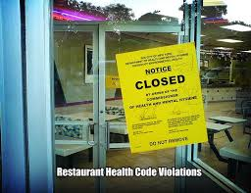
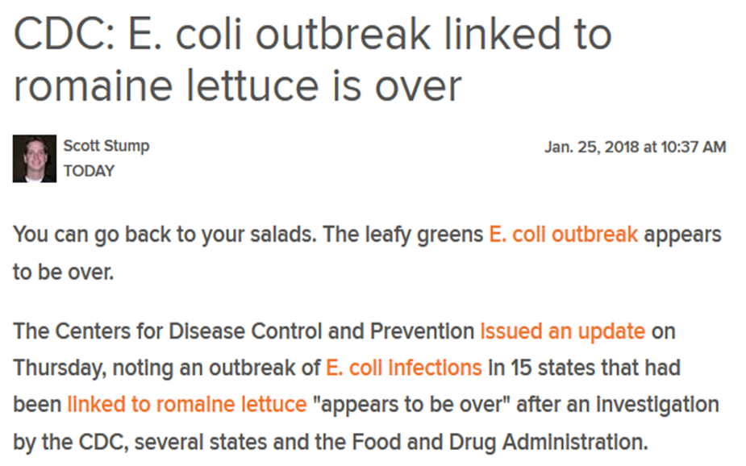
What Caused Jane’s Food Poisoning?
Poor restaurant hygiene? Don’t go back!
One-time contamination of a food ingredient? OK to return (try something else)

Slide 26
Why We Need Causes (2)
Prediction
If we don’t know why a prediction works, we can never anticipate its failure
Understanding why factors are predictive can improve both the accuracy and cost of decision-making (you won’t collect unnecessary data)
This is not to say that correlations can’t forecast events. Movies I watch, things I buy are used to predict future movies and purchases… but Netflix and Amazon don’t know why

Slide 27
Causal Mechanisms
Our judgments of causality are influenced by knowledge of possible causes, so we can reason even when we don’t see the cause and effect together
These two complementary ways of inferring causes, one using covariations (how often things happen together) and the other using mechanistic knowledge (explanations of how the cause produces the effect) can work together
People prefer explanations that include causal mechanisms more than those based only on covariations

Slide 28
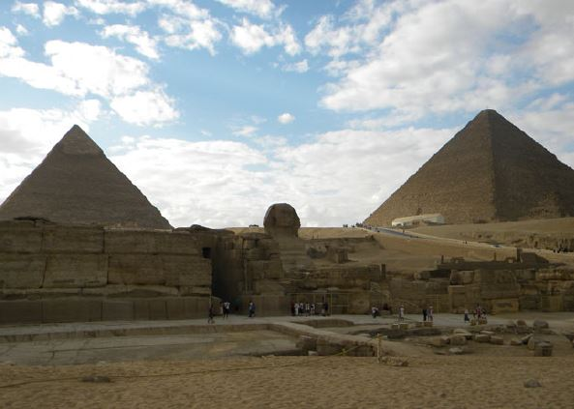
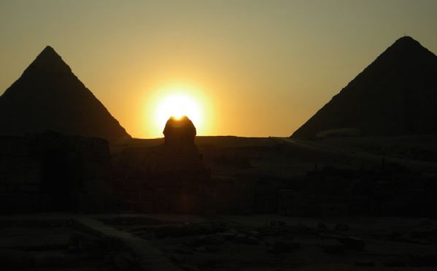
Archeo-astronomy in Ancient Egypt
(about 4500 years ago)
The pyramids of Giza in Egypt, the Great Sphinx that stands between them, and an observation terrace are aligned according to two events of critical religious and economic importance:
Sunset on the summer solstice
The onset of the Nile floods
The Egyptians didn’t think that Sirius rising caused the Nile to flood, but they knew that its position and flooding was correlated

Slide 29
Causality {and, or, vs.} Explanation
Explanations often mention causes as the reason or justification for an event, but not all explanations are causal, and not all causes are explanatory
Causal claims are often answers to why or how something occurred
We often infer that a causal hypothesis is true because it best explains the data

Slide 30
Causality {and, or, vs.} Explanation
People also have a bias to prefer simpler explanations to complex ones
The knowledge structures for simpler explanations are easier to remember and reason with
FLASHBACK
Interpreting data by imposing some sense or structure helps the brain encode data efficiently; we can invert this logic and use the brevity of the encoding as a measure of the amount of sense that it makes of the data.
Nick Chater

Slide 31
Why We Need Causes (3)
Intervention
We don’t just want to learn why things happen; we want to use this information to prevent or produce outcomes
Explanations that explain why time passes between cause and effect, or how long it takes for the effect to be produced, are essential for intervention
If you have smoked cigarettes for 40 years, will giving up smoking significantly reduce your chances of getting lung cancer?

Slide 32
Ineffective Interventions
We must be sure that interventions target causes that can affect outcomes. If we intervene only on something correlated with the effect, then the interventions will be ineffective
If smoking cigarettes causes lung cancer
banning matches and lighters to reduce to reduce smoking is likely to be ineffective

Slide 33
Causality {and, or, vs.} Correlation
Causes and correlations can both forecast events, but causes are more reliable (two correlated events could be independent but have a common cause)
If we have a correlation but don’t distinguish the cause from the effect our understanding will be “backwards”
Obesity and exercise are inversely correlated. Do overweight people exercise less, because it is hard, or do people who exercise less become obese?

Slide 34
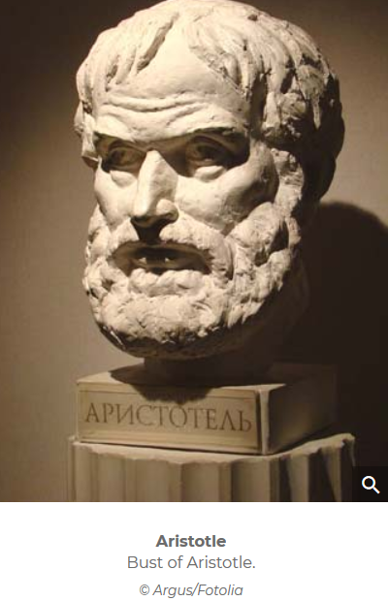
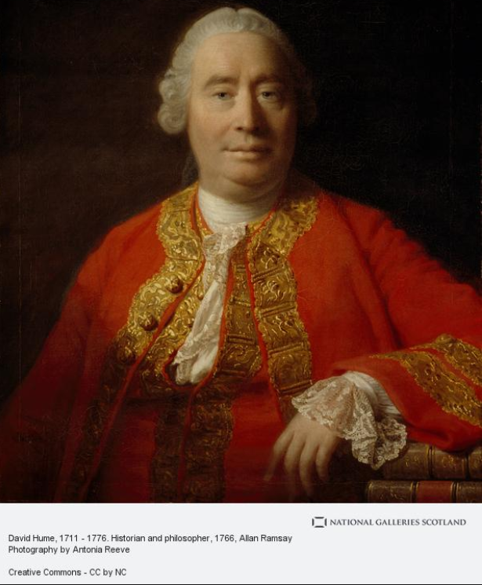
Causality in Philosophy
The concept of causality is central in philosophy and has a very long history
Aristotle (about 2400 years ago) defined four types of causes or “modes of explanation” that distinguish four types of answers to the question of why something happens
Hume (300 years ago) crisply analyzed the question of how we identify causal relationships by distinguishing two questions
What is a cause?
How do we find them?

Slide 35
The Problem of Induction
Hume and other philosophers posed and struggled with “the problem of induction”
how can we justify making any generalization or inference about the properties of some class of things after observing some instances of the class?
No matter how many observations we’ve made, we haven’t seen all of them
Our sample could be too narrow; there could be other variables that influence the observations
How would your concept of “bird” differ if you grew up in the desert, in the mountains, or in the tropics near the ocean?

Slide 36
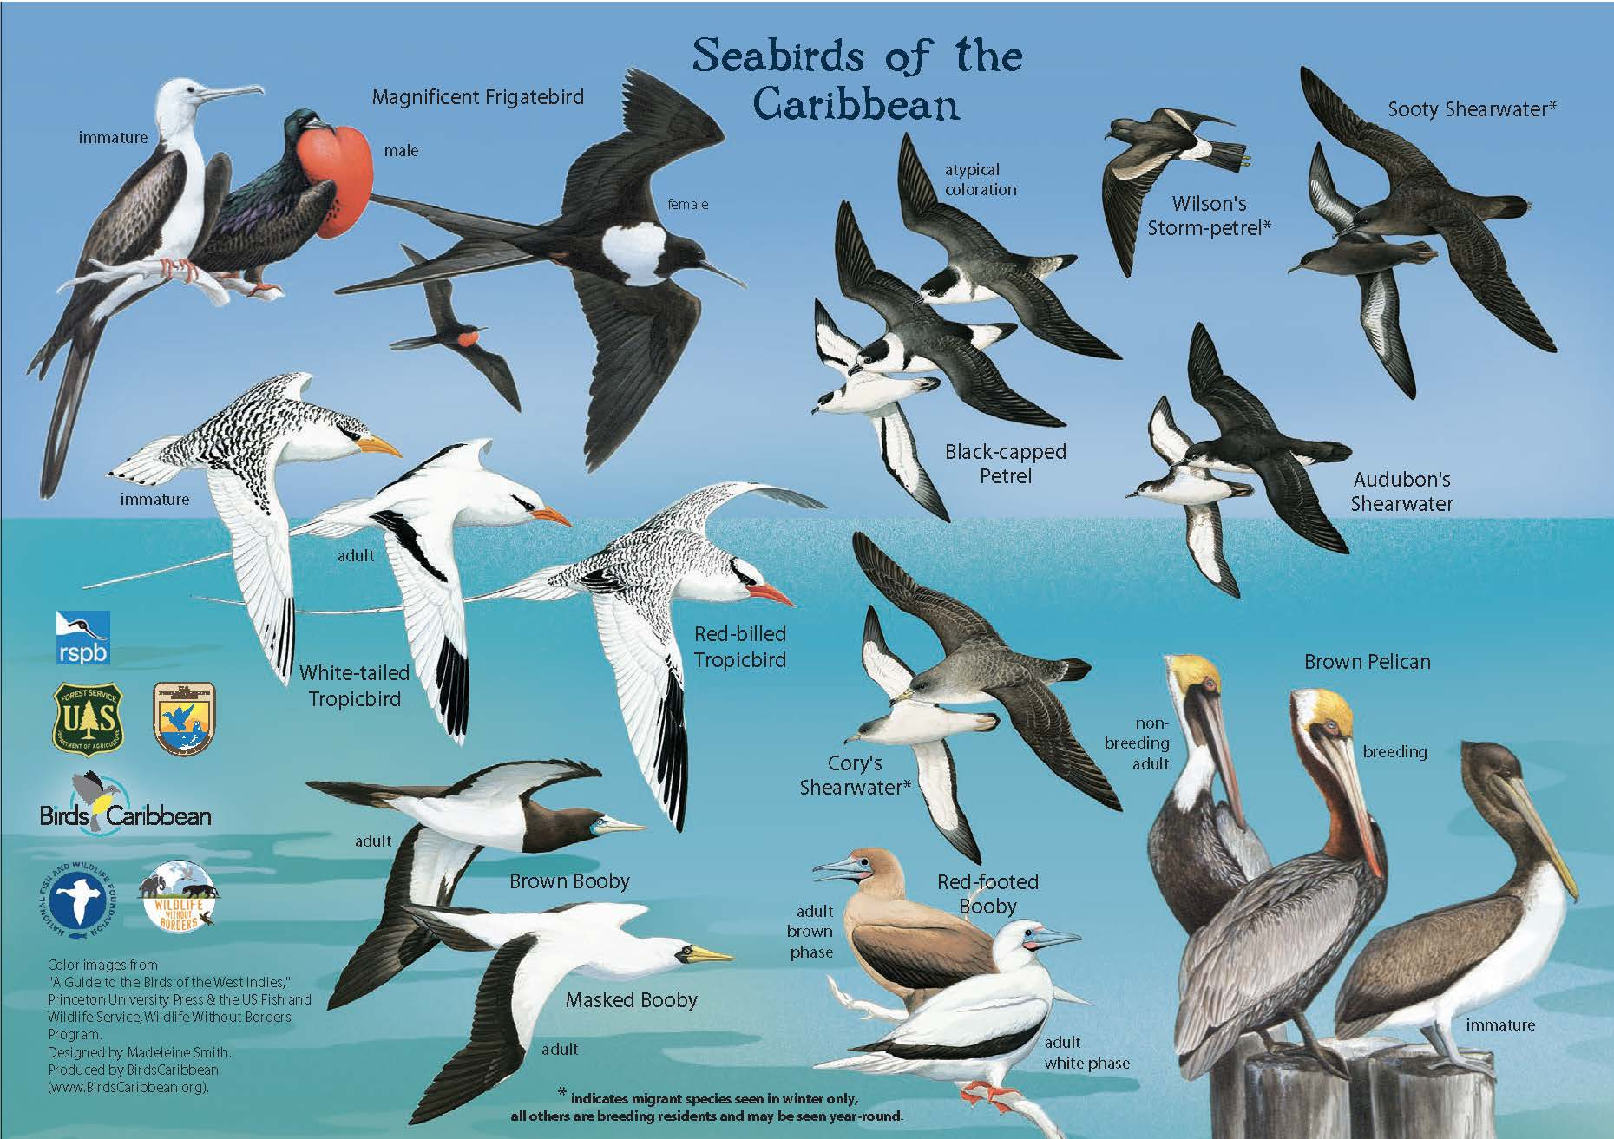
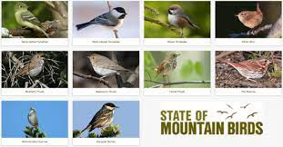

Slide 37
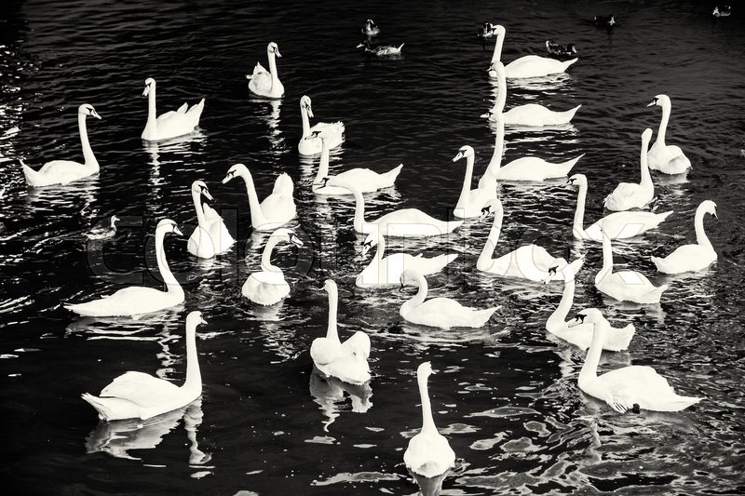
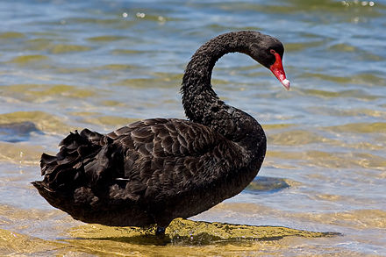
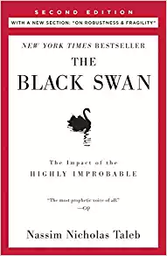
Black Swans
Example:
OBSERVATIONS: Every swan you’ve ever seen is white
INFERENCE: All swans are white
BUT in Australia there are black swans
Today a “black swan” is a metaphor for a rare unexpected event

Slide 38
Data Scientists: PAY ATTENTION!
If you are a data scientist trying to build a classifier, how much data do you need to train the program?
Sorry, you can never have all the potentially relevant data because of the “Curse of Dimensionality”
As the number of features grows, the number of possible combinations of feature values in this high dimensional space grows exponentially
You will never be able to learn which features REALLY are the most important because of sparse data
You might be able to use correlations among features to combine them to reduce dimensionality
You can give more important features more weight

Slide 39
Hume: How Do We Find Causes?
Causes are inferred from the spatial and temporal contiguity of the cause and effect
The cause comes first
Whenever the cause comes, the effect happens
By repeatedly seeing things happen together, we develop causal hypotheses
Causes are relationships that are distilled patterns of regular occurrence

Slide 40
Some Difficulties with “Temporal Contiguity”
Can we always tell what came first?
When a gun fires, a flash and then a loud noise follow
We might conclude that the gun causes the flash, and that the flash causes the noise
Two events might seem to be simultaneous only because of the granularity of measurements or limitations on our observation ability
Can we infer causes when there is a long delay between the cause and effect?
What causes climate change?

Slide 41
Counterfactuals
How can we discover a cause when the absence of a factor causes an effect?
Hume proposed the counterfactual approach, which defines causes in terms of how things would have been different had the cause not occurred
If you hadn’t run the red light, the car crash wouldn’t have happened …. you caused the car crash!
Counterfactuals are the building blocks of scientific thinking and legal/moral reasoning
the law wants to identify the “proximate” cause
How far back in time should you look for a cause?

Slide 42
Causality {and,or,vs.} Probability
For Hume, a causal relationship implies law-like necessity
But many causal relationships are probabilistic, where the antecedents make the consequences more likely but not certain:
Reckless driving causes accidents
Lazy students fail my courses
Probabilistic causal relationships can be represented with directed graphs (an arc between X and Y in the graph means that X is a direct cause of Y)
These “Bayesian networks” are causal models that show how factors are probabilistically connected
CogSci majors learn this in CogSci 131, Computational Models of Cognition. Too complex a topic to say anything more here…

Slide 43
Teleology (1)
Teleology, (from Greek telos, “end,” and logos, “reason”), explanation by reference to some purpose, end, goal, or function
People generally explain their actions and those of others in terms of ends or goals pursued or alleged to be pursued
Theories of our mind and our theories of other minds

Slide 44
Teleology (2)
People often use teleological reasoning (appropriately) when analyzing the design of “human-made” artifacts, which are most often designed and built for particular purposes
The saw is sharp so it can cut things

Slide 45
Promiscuous Teleology
“Promiscuous teleology” is the inappropriate application of teleological reasoning to living species and natural objects; “backwards causality” when a functional consequence is its own cause
Birds have wings so they can fly
Clouds are for raining; mountains are for climbing

Slide 46
Natural Theology
The strongest form of PT is in creationist views of the universe – starting with “Natural Theology” arguments of William Paley at beginning of 19th century
The great complexity and adaptation seen in nature must have been designed, and the perfection and diversity of these designs shows the designer to be omnipotent, the Christian God
When he was a student, Charles Darwin wrote to Paley and praised his arguments... 20 years later he refuted them when he proposed “natural selection” as the evolutionary mechanism that made a purposeful designer unnecessary

Slide 47
Some of the 79 Species of “Butterflyfish”
God created to entertain scuba divers

Slide 48
“Christians and Hindus generally conceive of fate in different ways; Christians primarily hold an agentic deity-centered worldview while Hindus believe in both a deity-centered worldview and also a non-agentic, destiny-centered conception of fate”
Banerjee, K., & Bloom, P. (2014). Why did this happen to me? (p. 278)

Slide 49
Karma
Karma in several Eastern religions is the spiritual principle of cause and effect where intent and actions of an individual (cause) influence the future of that individual (effect)
Good intent and good actions contribute to good karma and future happiness, while bad intent and bad actions contribute to bad karma and future suffering
Hindu theories of salvation posit that future births and life situations will be conditioned by actions performed during one’s present life—which itself has been conditioned by the accumulated effects of actions performed in previous lives

Slide 50
Dharma
A key moral and religious concept with multiple meanings in Hinduism, Buddhism, and Jainism
In Hinduism, dharma governs individual conduct; some dharma applies to everyone (sadharana dharma)—consisting of truthfulness, non-injury, and generosity, among other virtues
there is also a specific dharma (svadharma) to be followed according to one’s class, status, and station in life; this type of dharma is sometimes translated as “destiny”
Do any of you have any experience with these concepts in your culture or religion?

Slide 51
Scientific Explanation
Humankind has searched for scientific knowledge for several thousand years
Philosophers of science have long distinguished between “knowing that” (description) and “knowing how” (explanation)
But what counts as “reasonable explanation” has changed qualitatively over time

Slide 52
Thagard: Types of Scientific Explanation
Theological
Qualitative
Mechanistic
This can be considered as “intellectual development of the human species” (vs. cognitive development of a single person)

Slide 53
Theological Explanation
the primary explanatory entities are supernatural ones beyond the reach of science, such as gods, devils, angels, spirits, and souls;
No need to tie the explanation to observations about natural details
many cultures worldwide have different accounts of how one or more deities brought the Earth and the living things on it into existence.

Slide 54
Fire: Theological Explanation
The god Zeus gave the task of creating man from water and earth to Prometheus
Prometheus empathized with his human creations and stole fire from the gods to give to mankind
Zeus punished Prometheus by chaining him to a rock so eagles could chew on his liver

Slide 55
Qualitative Explanation
Explanations that reject supernatural entities, but which postulate natural entities not far removed from what they are supposed to explain
It might seem as though observations are relevant, but they are often interpreted tautologically
Living things have a “vital force” in them that creates life, and which leaves the body upon death (aka “soul”)

Slide 56
Fire: Qualitative Explanation
In Greek philosophy, fire is one of four fundamental elements or substances
Aristotle: the most important property of “fire atoms” was that they were hot and dry
Fire is also a fundamental substance in traditional Indian religions with the same qualitative arguments

Slide 57
Mechanistic Explanation
Explanations consist of identifying systems of discrete interacting parts that produce observable changes
Mechanistic explanation evolved with the understanding of the human biology (dissection, body parts and systems) and especially with the invention of more complex machines
Mechanical machines were especially important in enabling more complex explanations of natural phenomena

Slide 58
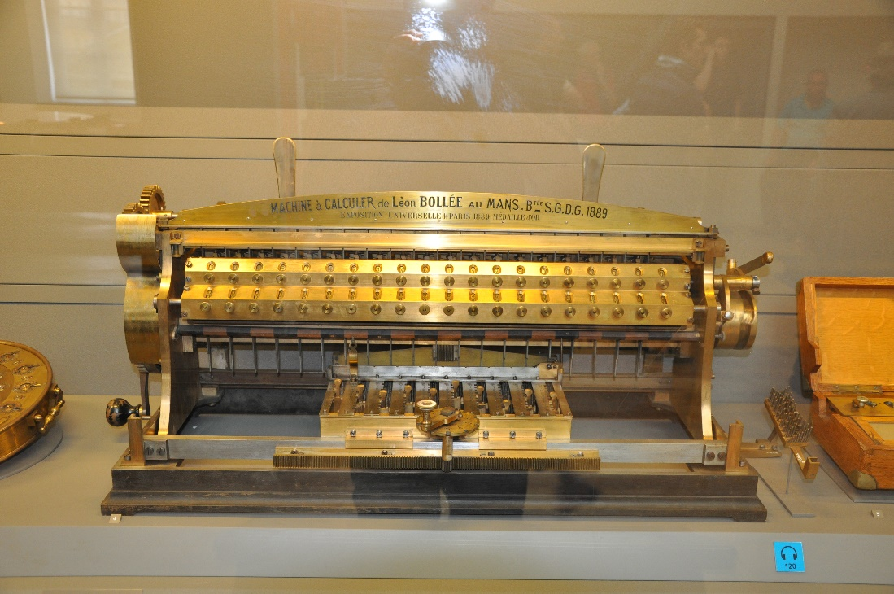
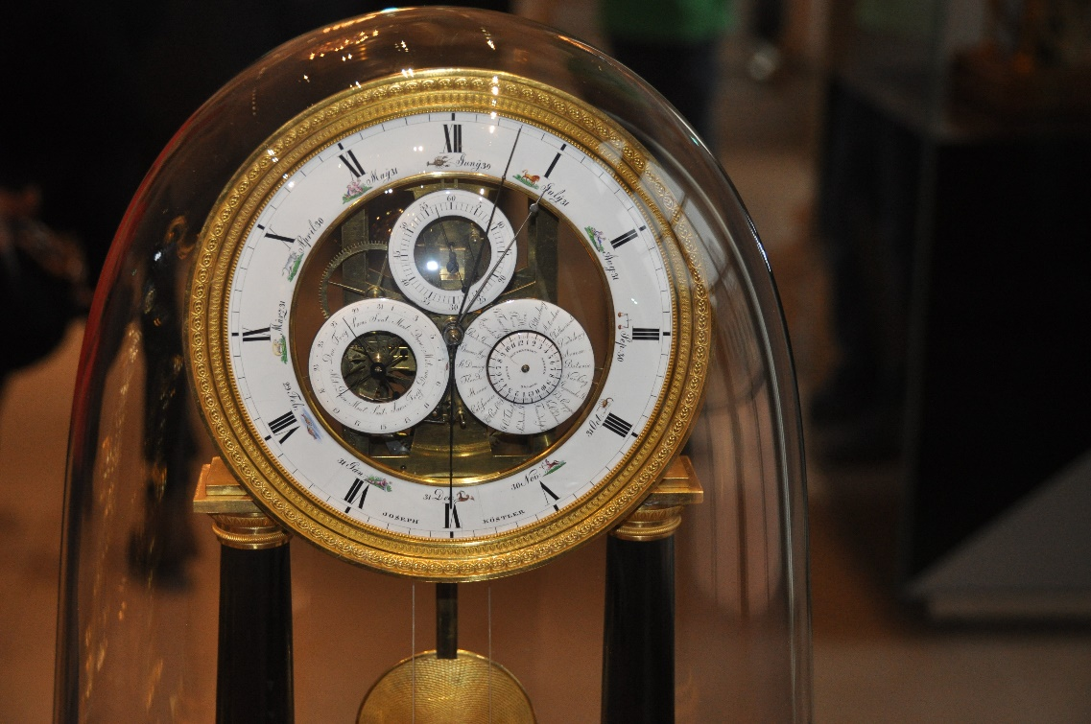
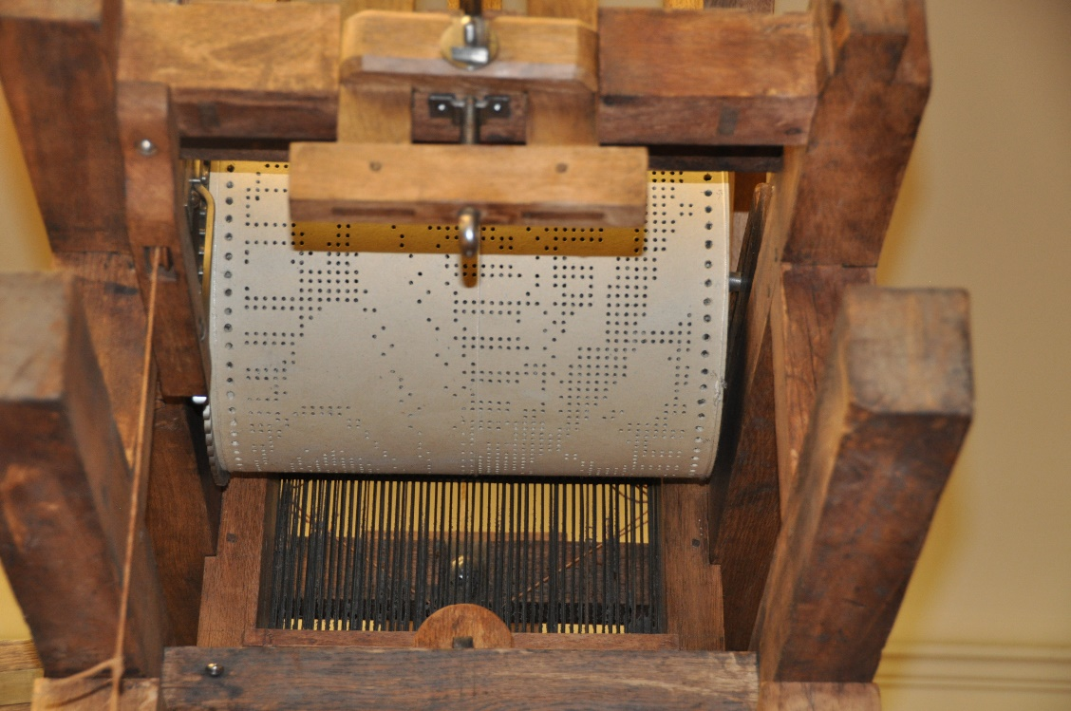
Calculating Machine (right)
Clock (below)
Programmable loom (lower right)

Slide 59
Fire: Mechanistic Explanation
Fire is rapid oxidation, a chemical reaction between oxygen and some kind of fuel
The reaction begins when the fuel reaches its ignition temperature
The heat released by oxidation sustains and grows the fire and can be controlled by careful fuel management

Slide 60
Mechanistic Explanation: Advantages and Disadvantages
+ Mechanistic explanations can be based on or complementary to scientific laws that are grounded in physics, chemistry, or other “hard” sciences
+ If you understand the mechanism, you can perform causal reasoning about the system without ever observing it in operation
- Mechanistic explanations often conflict with theological ones that are emotionally more satisfying

Slide 61
Conceptual Change in Science in terms of Knowledge Representation
Scientific explanation proceeds at different rates… some is relatively simple, incrementally addition of facts and concepts
Other changes are discontinuous and highly disruptive
These different degrees of change can be distinguished in terms of changes to the semantic structure or ontology of a scientific domain

Slide 62
Degrees of Conceptual Change
Learning about a new instance of a concept
Learning a new weak rule about some fact
Learning a new strong rule useful in problem solving and explanation
Learning new part-whole relation (adding a hyponym)
Learning a new kind-relation (splitting a hypernym)
Adding a new concept
Merging two hypernyms
Branch jumping – moving a concept to another part of the semantic taxonomy
Tree switching – changing the organizing principle embodied in a semantic taxonomy

Slide 63
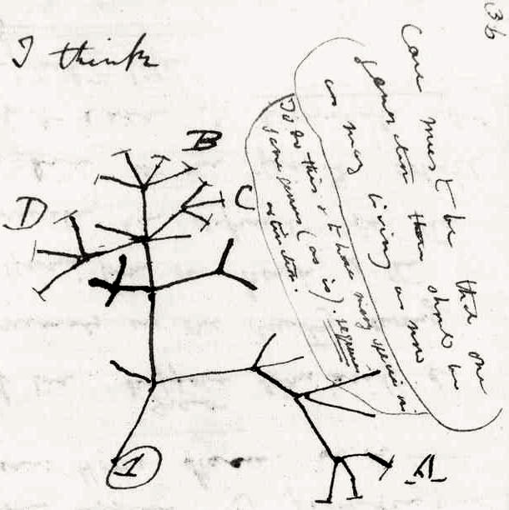
Darwin’s Radical Conceptual Changes
“Branch Jumping”- reclassifying people as animals
“Tree Switching” – changing the organizational principle of the tree of life to be evolutionary rather than morphological

