Slide 1
CogSci 150 “Sensemaking and Organizing” Spring 2022
Robert J. Glushko glushko@berkeley.edu
29 March 2022
19) Category Structure;
REVIEW OF MIDTERM
REVISIONS TO THE COURSE

Slide 2
Categories of Categories
FLASHBACK
Categories are sets or groups of resources, “classes of things” or abstract entities, that are treated the same
In TDO there are two ways to contrast categories
CATEGORY CONTEXT: How they are created (individual, cultural, institutional, computational)
CATEGORY STRUCTURE: How they are defined or structured (enumerated, property-based, similarity based…)

Slide 3
Plan for the Course
We can analyze sensemaking and organizing from four interrelated perspectives:
As a member of a social, cultural, or language community (linguistics, sociology, social network analysis)
As an individual (psychology and philosophy)
In institutional contexts (law, business, economics)
In data-intensive or scientific contexts (statistics, computer science, info visualization).
Why are we doing these 4 contexts in this order?

Slide 4
Sensemaking and Organizing in Defined/Institutional Contexts
[19 – March 29] Category Structure; Institutional Categories
[20 – March 31] Classification; Standardization
[21 – April 5] Measurement; Controlled Vocabularies; Interoperability
[22 – April 7] Organizing and Interaction Design

Slide 5
Category Structure
Categories are defined in lots of different ways depending on the type of resources you are organizing and the reasons for organizing them
The way in which a category is defined is called the “category structure” and it determines:
how you tell whether something belongs to the category
how similar the category members are to each other

Slide 6
Principles for Creating Categories (TDO 7.3) (“Category Structure”)
Enumeration
Single Properties
Multiple Properties
Similarity / Family Resemblance
Theory-Based (or Analogy-based)
Goal-Derived (or Activity-based)

Slide 7
Enumerated Categories

Slide 8
Defining Categories by Enumeration (1)
Simplest way to define a category is by enumerating (listing) its members
This principle is also called EXTENSIONAL definition; the members of the set are called the EXTENSION
This principle is easy to understand and implement; the meaning of a category or concept is NOT a property test; it is simply the specific set of resources in it

Slide 9
Defining Categories by Enumeration (2)
Learning an enumerative category just means “memorizing its members,” which is why it is impractical for categories with many members
Membership might seem arbitrary because it might or might not be based on shared properties

Slide 10
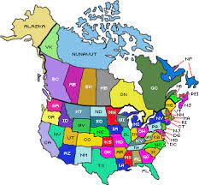
“The states in the US”
is an Enumerated Category
Is Alaska a US state? Is Ontario?

Slide 11
Stop and Think
The category of “state” can be defined using property tests like:
a geographical territory contained within a country
organized politically with its own government
A “US state” is a “state” but membership is NOT defined by property tests
you can list the US states, and something is a US state if it in the list
There are no tests about size, location, population, or other properties that determine whether some place is a US state

Slide 12
Competing Enumerations
Enumerative categories enable membership to be unambiguously determined, but that doesn’t mean that they are uncontroversial – there might be competing enumerations
EXAMPLE : Is Gender Binary?

Slide 13
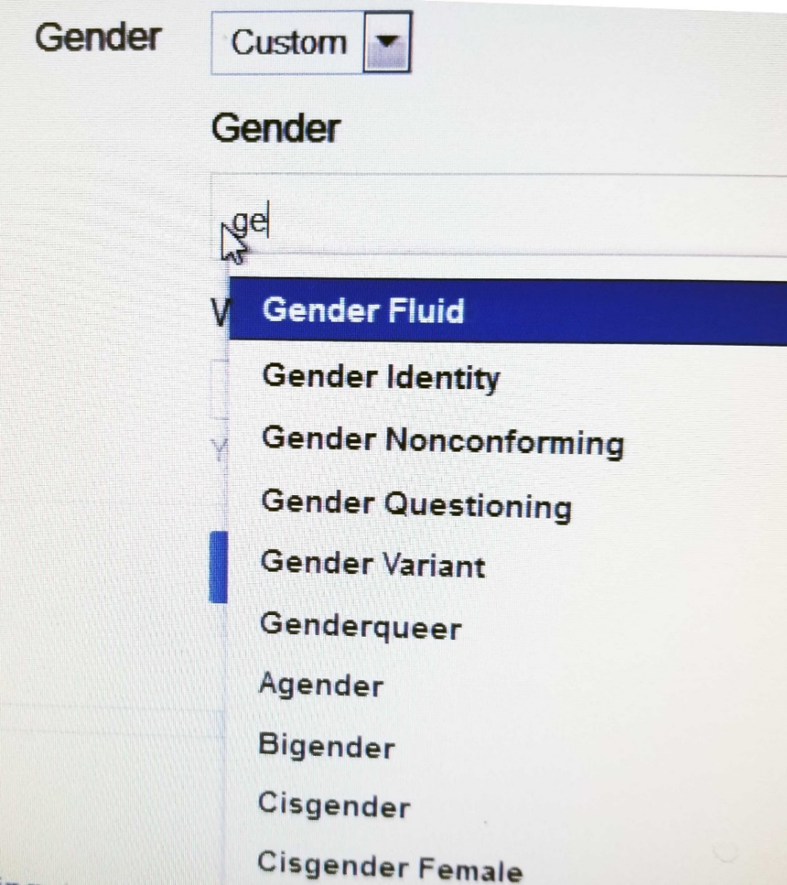
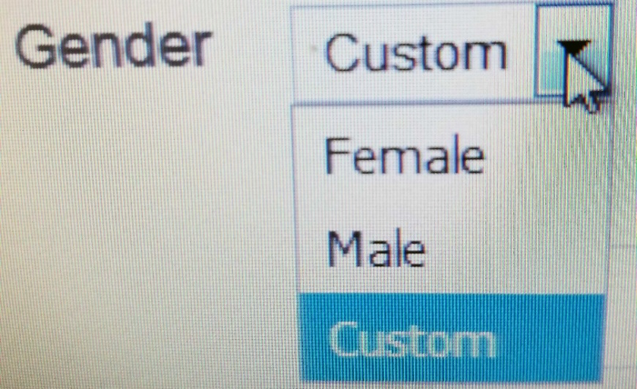
Facebook Offers 56 Gender Categories
Why are binary gender category systems much more common than non-binary gender category systems?
What other enumerated categories are highly controversial?

Slide 14
Specifying Enumerations
You should be excruciatingly careful when you define a category by enumeration
Legal disputes often reflect opposing interpretations of category membership and whether a list of category members is exhaustive or merely illustrative
Why is an “Other” category a bad idea!

Slide 15
Is A Fish a Document? (1)
John Yates, a commercial fisherman in Florida, was found with red groupers in his catch below the legal size limit. An inspector ordered him to return to port and hand the fish over to the authorities
When he allegedly dumped them overboard instead, he was charged with violating the Sarbanes-Oxley Act, which imposes harsh penalties for destroying “any record, document, or tangible object” to impede a federal investigation
15

Slide 16
Is A Fish a Document? (2)
District court and Court of Appeals said Yates violated Sarbanes-Oxley
The US Supreme Court reversed, ruling in favor of the fisherman (Yates v. United States 2015), finding that “tangible object” must be interpreted in the context of “record” and “document” and, as such, only applies to an object “used to record or preserve information”
16

Slide 17
In TDO Pro You Would Learn…
^{[3][Law]} For the complete history of the case, see: http://www.scotusblog.com/case-files/cases/yates-v-united-states/­
[408][Law] Legal disputes often reflect different interpretations of category membership and whether a list of category members is exhaustive or merely illustrative­
The legal principle of “implied exclusion”—expressio unius est exclusio al­ terius —says that if you “expressly name” or “designate” an enumeration of one or more things, any thing that is not named is excluded, by implication. However, prefacing the list with “such as,” “including,” or “like” implies that it is not a strict enumeration because there might be other members.

Slide 18
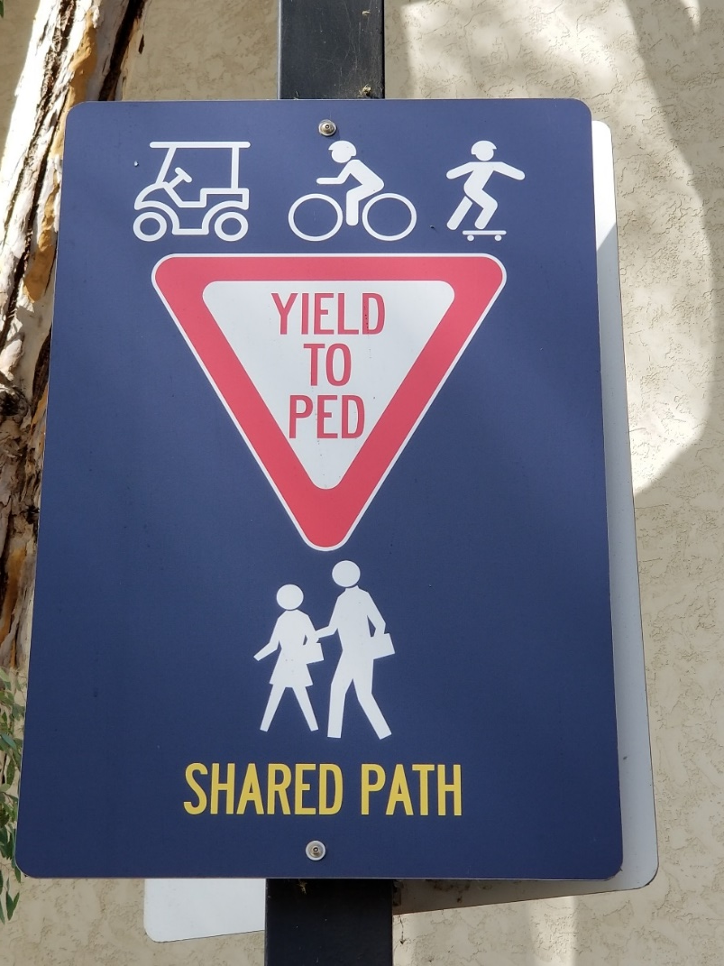
NOT Being “Excruciatingly Careful” –What Do These Categories Mean?
Defined by a Single Property?
Defined by Enumeration?

Slide 19
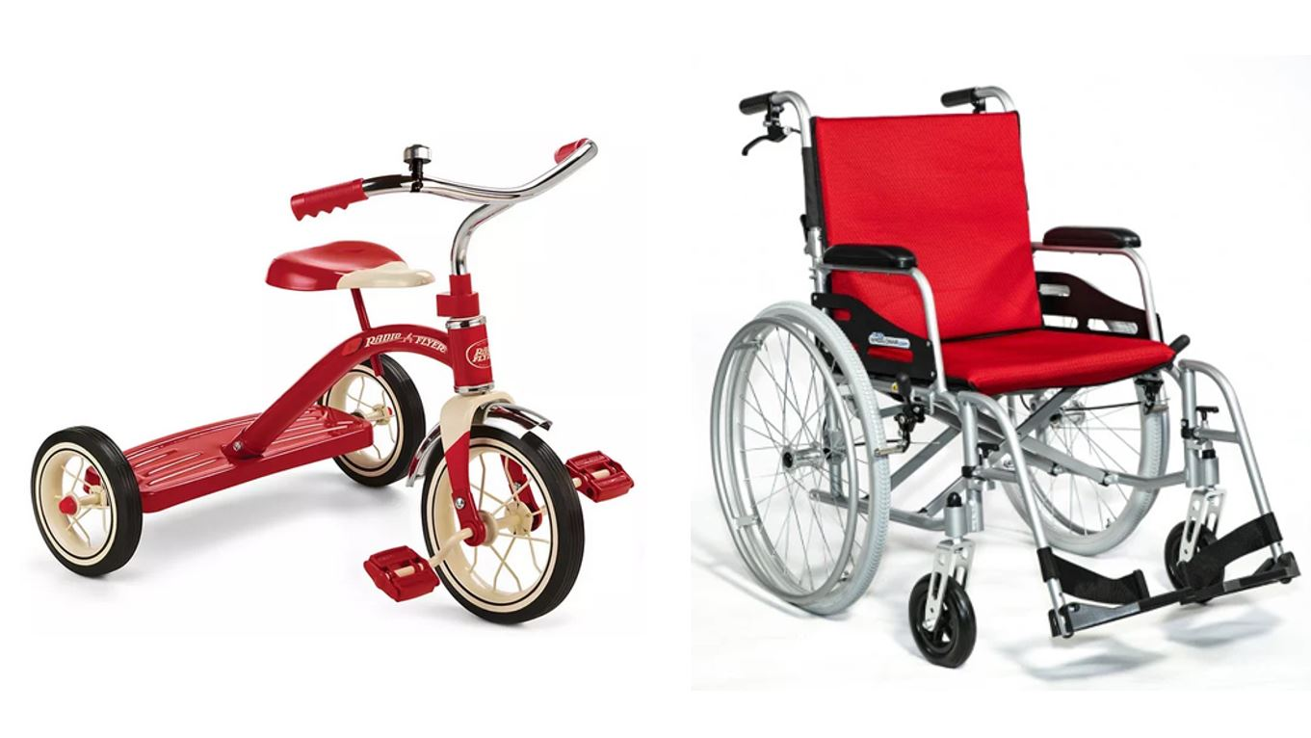
Yield or Not?
You must use the RIGHT enumerations or property tests to define the category!
These vehicles are not enumerated by the “Yield to Ped” sign, so scooters don’t yield?
They are “wheeled devices” so does the “Dismount and Walk” category defined that way require trikes and wheelchairs to yield?

Slide 20
The Enumerated “Planet” Category
For millennia, “planet” was an enumerated cultural category that contained the five visible planets in our solar system (Earth was not considered a planet, because it was assumed that the planets orbited the Earth)
Earth joined the planet category after the Copernican revolution, as did what we now know as the large asteroids
Asteroids were later removed from the category when it was discovered that they were much smaller that all other planets
When Pluto was discovered in 1930, it was added to the planet category as the ninth planet in our solar system

Slide 21
Enumerative Definition Doesn’t Scale
What happened to the “planet” category when “exoplanets” were discovered orbiting around stars other than the Sun? (over 4000 have been identified)
At some point an enumerative category might contains so many members that it is hard to use and must be sub-divided or be given a definition based on principles other than enumeration

Slide 22
International Astronomical Union Re-defines “Planet” using shared properties (2003)
“A celestial body that is
in orbit around a star
has sufficient mass for its self-gravity to overcome rigid body forces so that it assumes a hydrostatic equilibrium (nearly round) shape
has cleared the neighborhood around its orbit”
Did you experience this transition and conflict in the definition of “planet” in your science education?

Slide 23
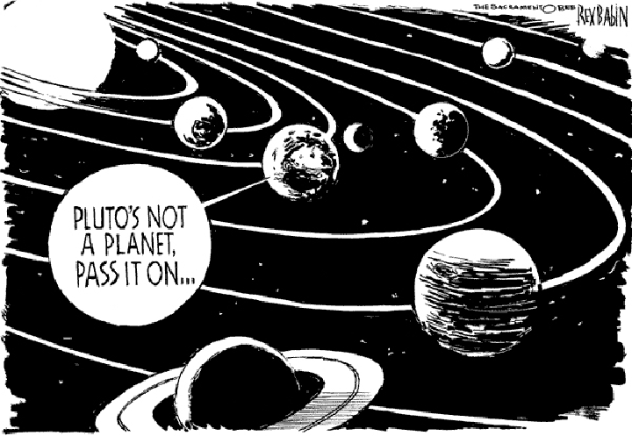
Sorry, Pluto, You’re Now a “Dwarf” Planet
Describe the competing definitions of “planet” in terms of “Category Contexts” and “Category Structure”

Slide 24
Categories Defined by Single Properties

Slide 25
Categories Defined by Single Properties
A simple way to define a category is to use only a single property, especially when the possible values are discrete and not very numerous
Intrinsic static properties are often the easiest ones to use (color, size, shape…)
It is also desirable to use properties that objectively measurable and orderable, or tied to well-established cultural categories
Learning the category is simple – what’s the property?

Slide 26
Categories Defined by Single Properties - Limitations
Whenever a single property is used to define a system of categories, the choice of property is critical (WHY?)
When a single property defines a category, how does this affect the coherence or homogeneity of the category members?

Slide 27
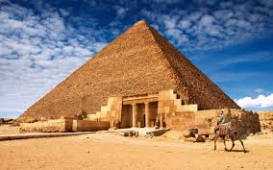
Single Property Category: “Pyramid- Shaped”
Is “pyramid-shaped” a useful category? When would you use it?

Slide 28
Categories based on other properties would have completely different members
Pyramid Man-Made? Location? Shape?
Yes Yes Egypt
Yes No Glacier Park
Yes Yes UC San Diego

Slide 29
A Category System for Shirts Using just the “Style” Property
SHIRTS
Dress
Work
Party
Athletic
Each value of the Style property becomes a sub-category
(This property and the values it can take are “cultural”)
Imagine the layout and appearance of the “SHIRT” section in a store using these “Style” categories

Slide 30
Multiple Property Categories

Slide 31
Multiple Property Categories
When items being categorized can be described using easily observed “separable” or “combining” properties, categories are often based on multiple properties
Each successive property differentiates the items in a category to create a hierarchy of sub-categories
Property order determines the hierarchy
How do we choose the properties?
How do we determine the order in which we apply them?

Slide 32
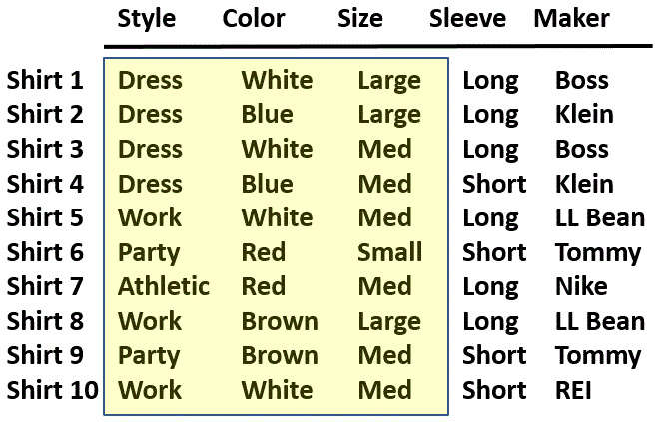
A Collection of Shirts (Using Separable “Cultural” Properties)
There are always more resource properties we DIDN’T use. In this example…?
32

Slide 33
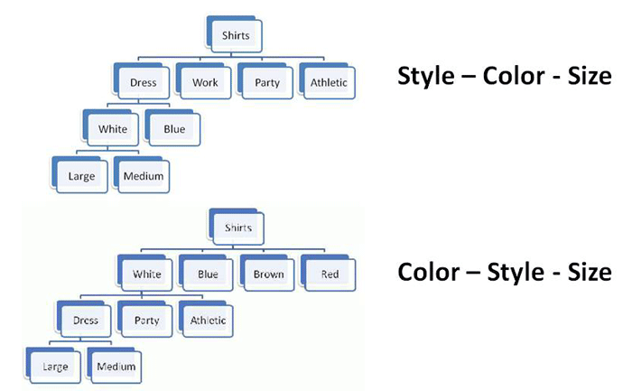
Property Order Determines the Category Hierarchy
Imagine the layout and appearance of the “SHIRT” section in a store using “Color” categories first and then “Style”

Slide 34
Classical Categories
“Classical” categories can have large numbers of category members, but they have clear boundaries defined by a small number of ESSENTIAL or necessary and sufficient properties
Necessary means that every instance must have the property to be in the category
Sufficient means that any instance that has the necessary properties is in the category
This principle is also called INTENSIONAL definition; the members of the set are called the INTENSION

Slide 35
Classical Category: Prime Number
A Prime Number is an integer divisible only by itself and 1
Every prime number has these properties (Necessity)
If a number has these properties, it is prime (Sufficiency)

Slide 36
Implications of “Necessary and Sufficient” Properties
Because category membership is defined by rules, all members of the category have equal status in the equivalence class
Classical categories are conceptually simple and have straightforward implementations in technologies like database schemas, decision trees, and classes in programming languages
Or put less positively… programmers and data scientists are biased to define categories with rule-based property tests because it makes them much easier to work with

Slide 37
Categories Defined by Probabilities and “Family Resemblance”

Slide 38
Wittgenstein
Ludwig Wittgenstein (1889-1951) – "philosophy of ordinary language" - first to discuss problems with classical category theory (often considered the most important 20th century philosopher)
Enumerative categories embody the idea that “meaning is reference” – a concept means what it refers to; you understand words by following the association to their “extensions”
Wittgenstein argued that most words don’t have fixed extensions because what they refer to can depend on context: “meaning is use”

Slide 39
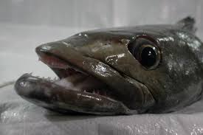
If Meaning was just Reference...
If "meaning" was just based on reference would names matter?
Prune == Dried Plum
Chinese Gooseberry == Kiwi Fruit
Patagonian Toothfish == Antarctic Cod == Chilean Sea Bass
Examples from languages other than English?

Slide 40
Implications of “Meaning is Use”
There may be defining features for typical instances
But there are no features that are necessary and sufficient for all examples of the category
Even when features can be identified, they change in different contexts and over time
Different instances vary substantially in how typical or representative they are of the category even though they share all the required features
Wittgenstein's classic counterexample is "Game“ (TDO 7.3.5) - can you define it?

Slide 41
Probabilistic Categories (comp/cog sci) or Family Resemblance (cog psych)
In some domains instances of a category can share many features, some instances might have properties that are not widely shared, and some important discriminating properties might be difficult to perceive
Birds:
All have feathers, wings, beaks, 2 legs
But some fly or swim and some don’t
The shape of their beaks, wings, and feet varies a great deal
41

Slide 42
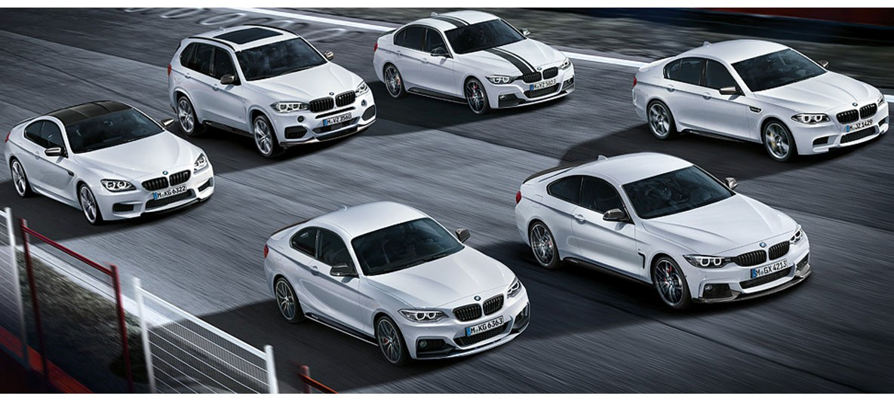
Family Resemblance
Categories defined by “family resemblance” have many features with high predictive value for category membership even if they are not perfectly correlated with each other
The BMW M Class
<put your family photo here>

Slide 43
Implications of Probabilistic Properties
Correlations among the properties make it necessary to determine an instance’s category membership in a statistical or probabilistic manner based on the overall similarity between it and other items in the category
Some features are better predictors of category members than others, which results in: Typicality / gradience / centrality effects
43

Slide 44
Implications of Probabilistic Properties
The perceived centrality or typicality of category membership depends on the extent to which the most characteristic properties are shared
Instances with more of the characteristic properties are “better” category members
➔ fuzzy and flexible category boundaries
44

Slide 45
Gradience in Category Membership
Which bird is most typical of the category?
Least typical?
45

Slide 46
“Typicality” – Another Shamu Question
We could consider a specific species of bird as the typical one – often called an EXEMPLAR
Or we could imagine a PROTOTYPE bird as typical – which might not exist but whose properties are a kind of statistical average of all birds
The debate between these two cognitive models of category representation is decades old and still important , especially now because of work in machine learning to build classifiers

Slide 47
Probabilistic Categories in Context
The correlations among properties that cause typicality effects also imply that the resemblances among the members of a category might be based on different subsets of their properties when different members are compared
Put another way, a definition of a category that enables accurate classification of instances in one context might not work in other contexts
47

Slide 48
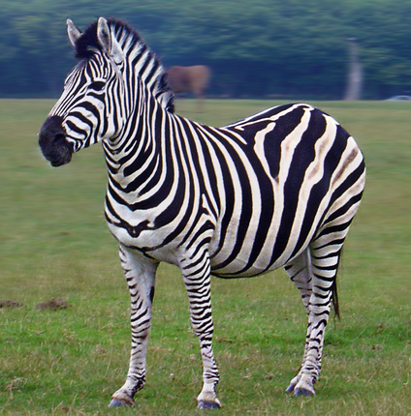
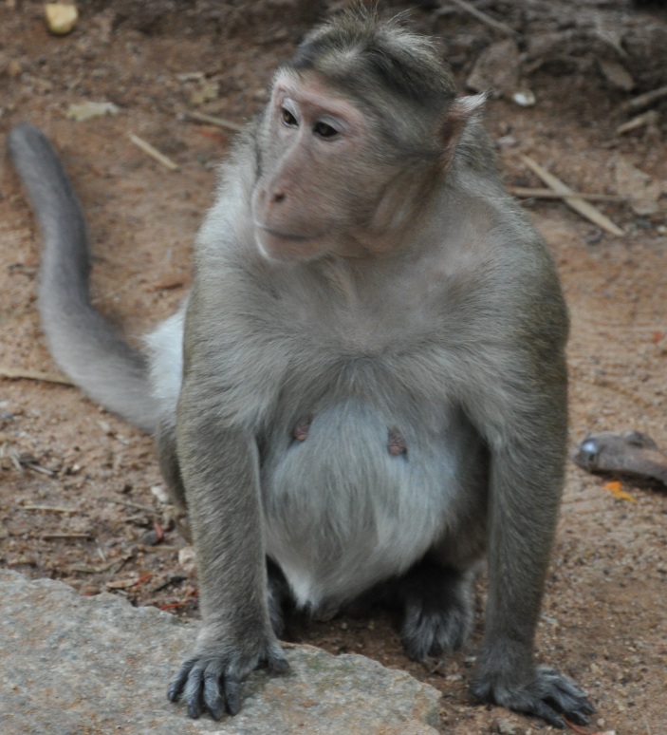
What Feature is Characteristic of Zebras and a Good Discriminating Feature with Other Animals?

Slide 49
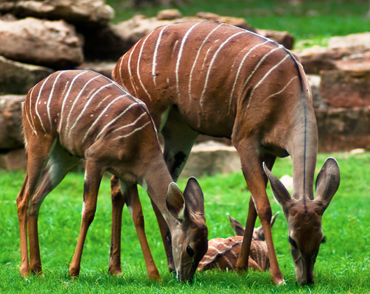
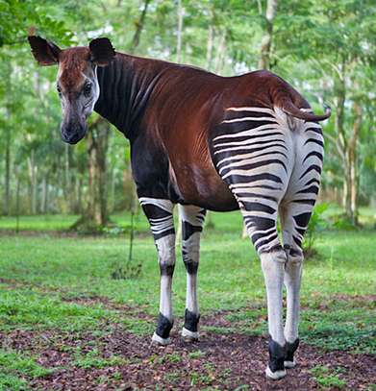
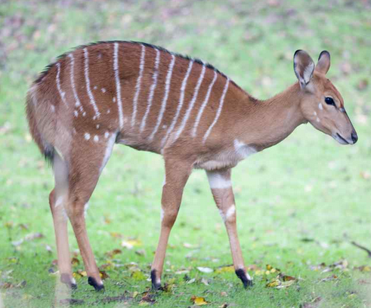
In this Context, Stripes Are NOT A Good Discriminating Feature for Zebras
Kudu
Bongo
Okapi

Slide 50
DATA SCIENTISTS: Stop and Think
NOTE TO DATA SCIENTISTS: Choose your training data carefully!
There is an inherent category structure of many domains (are they more rule-based or similarity based?), and your sampling strategy needs to be appropriate for it when you’re trying to do machine learning to train a classifier.
A sample with an unrepresentative set of instances, or in which the instances are described with too many features (especially features that aren’t very predictive of category membership), will cause your program to learn the wrong features and it won’t generalize

Slide 51
Similarity as a Categorization Principle
It is often said that we can define categories on the basis of resource similarity:
A resource is categorized as an A and not a B if it is more similar to A’s best or most typical member rather than it is to B’s
Similarity is a very intuitive notion, and it underlies the idea that some kinds of categories are more natural or basic than others
51

Slide 52
Oops.
We haven’t defined “Similarity”

Slide 53
Defining Similarity
Some people say that similarity is a meaningless and "mostly vacuous" concept that uses some unstated set of properties in some unstated way to calculate some measure of similarity
Once we identify the properties and how they are used, there is nothing for "similarity” to do
There are many ways to measure similarity in terms of shared features; some measures also count the non-shared features; some measure it as “distance” in n-dimensional property spaces
(lec #27 on 4/26, “Computational Classification”)
53

Slide 54
Theory-Based Categories
Sometimes a category is defined because of a theory of causation or capability that explains why some collection of things go together
A good theory yields an abstract or analogical similarity that can "trump" similarity or family resemblance based on surface properties
TDO’s example: “Computer” – a category of things that can compute
54

Slide 55
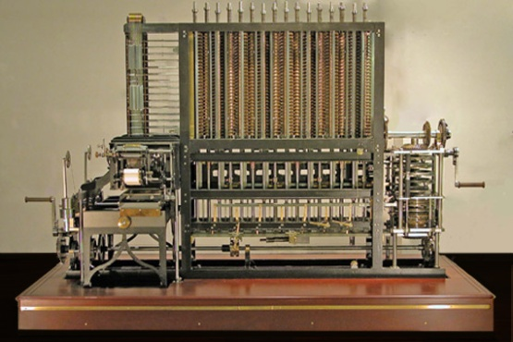
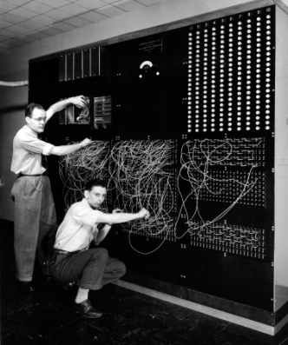
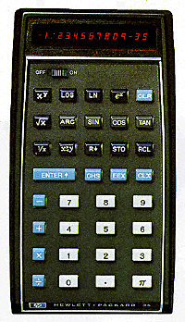
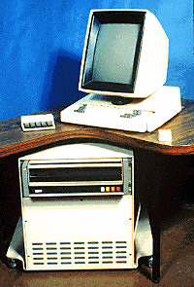
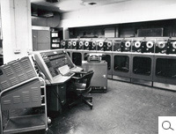
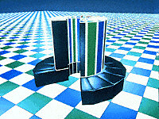
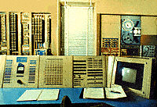
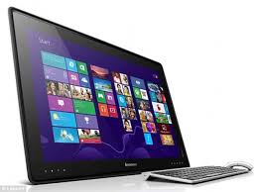
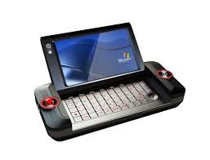
Theory-Based Category: Computer
Category of "computer" is based on being able to compute
There are few shared visible properties
55

Slide 56
Theory-Based Category: Water
All the same chemical compound, H2O
Category is unified by the theory of phase change
56

Slide 57
Goal-Derived Categories
You are moving to a far-off city and want to get rid of unwanted possessions. What will you sell at your “garage sale?”
You arrive at the new city. What are the ways you will try to make new friends?
Or maybe “personal theory-based categories”
The members of each of these categories have few or no discernable properties in common
These are unlikely to be lexicalized because of their ad hoc-ness and context-dependence
57

Slide 58
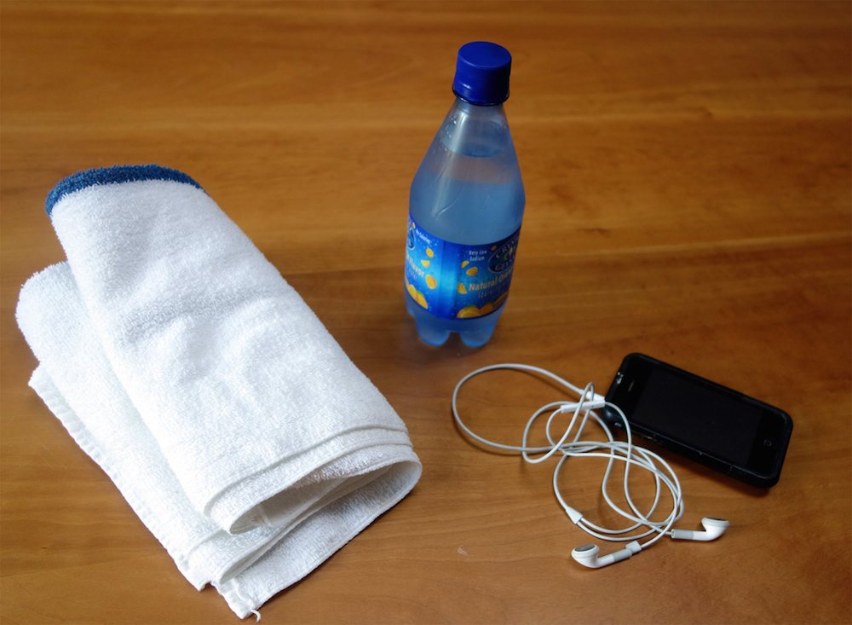
Goal-Derived Personal Category (TDO 7.3.7)
58

Slide 59
Category Structure
What kinds of category structures are most often used to create categories in each of the three category contexts?
Enumeration
Single Properties
Multiple Properties
Similarity / Family Resemblance
Theory-Based (or Analogy-based)
Goal-Derived (or Activity-based)
Category
Contexts
Individual
Cultural
Institutional
59

Slide 60
REVIEW OF MIDTERM

Slide 61
“Degree Centrality” for Each Node

Slide 63
Organizing Principles <=> Resource Descriptions
Frequency of Use <=> Usage information
Color, shape, size… <=> Physical properties
Alphabetical order <=> Sortable resource name or identifier
Chronological order <=> Sortable date/time of important event
Semantic <=> Content description

Slide 64
Organizing Resources
Almost any property of resources can be used to organize them, but the most appropriate or effective properties differ across resource types and tasks
The scope and scale of an organizing system influence/constrain organizing principles and interactions
Decisions about which resource properties will be used in organizing must often precede the creation or selection of the resources
64

Slide 65
Describing Resources <=> Organizing
Resource description and organizing are intrinsically connected
You can’t organize what you haven’t described implicitly or explicitly... because the principles embodied in any organizing system reflect decisions about:
resource granularity (WHAT to organize)
resource descriptions (HOW to organize)

Slide 66
The Level of Abstraction
We can identify a resource as a unique instance, a member of a narrow category of resources, or as a member of a broad category
The size of this category - the number of resources that are treated as equivalent - is determined by the properties or characteristics we consider when we examine any instance
The choice of these properties depends on context and intent, so the same resource can be identified abstractly in some situations and very concretely in others
66

Slide 67
The “Shamu” Question: How big is the category?
This is an orca (N > 100K)
This is an orca trained to perform at a marine park (N about 100)
This is an orca that used the stage name “Shamu” at Sea World ( N = 28)
https://www.flickr.com/photos/saechang/4496400672/in/photostream/
This is the orca that performed at San Diego Sea World on April 5, 2010 (N = 1)
67

Slide 68
Stop and Think
How do libraries and museums differ on this “thing” vs. “type of thing” issue?
How is this distinction realized with your personal resources? What do you treat as resource instances, and what do you treat as resource types?

Slide 69
Resource Description Checklist for Data Scientists
The size and diversity of datasets makes resource description the fundamental challenge in data science
Where did the data come from (provenance)? Is the source credible? Is the dataset relevant to the questions you’re asking?
Why were these descriptions selected? What are the possible values? Units and levels of measurement? Precision? Vocabulary control?
Are the values accurate? Stable? Current? Correlated? Human-interpretable?
Did the people who designed and collected this dataset think about it in the same way that you do?
69

Slide 70
Some Good Questions To Ask
Where did this dataset come from and what does it mean?
How were the resources (the rows) defined, designed, or selected?
How were the resource descriptions defined, designed, or selected?
Were the purposes for which these resources and resource descriptions were collected the same as or compatible with those of the intended data analysis?

Slide 71
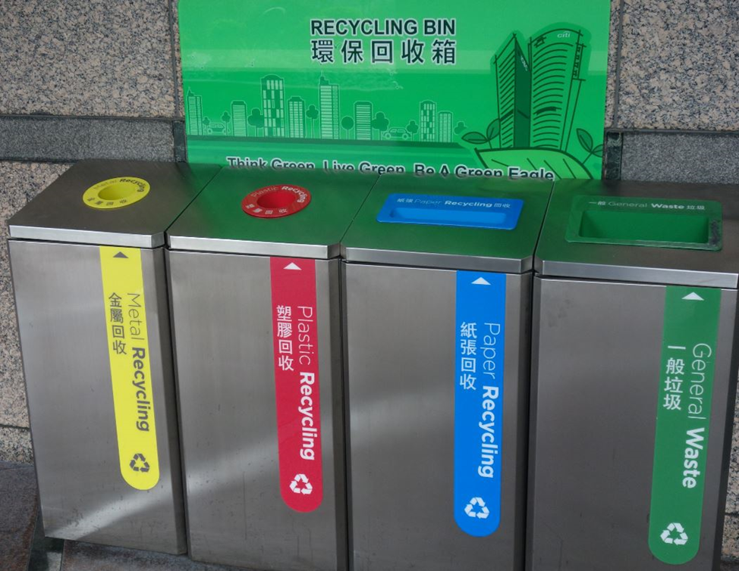
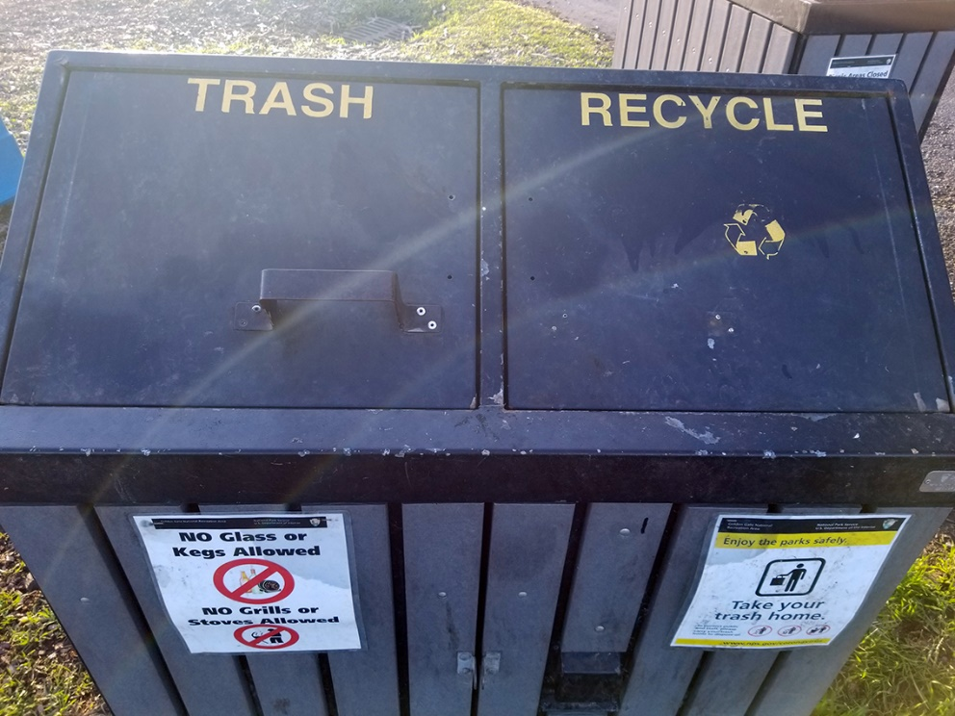
Organizing and Interaction Tradeoffs
How does recycling in Hong Kong (top photo) compare with recycling at SF Fort Mason park (bottom photo)?
What does this imply about the interactions with resources throughout the entire recycling system?
Who does the work? Who gets the benefits?

Slide 72
Descriptive Precision
Writers, poets, painters, composers, sculptors, technical writers, programmers, producers, architects, designers, and devices or machines can all “create” resources
The Dublin Core vocabulary for describing web pages has a single property for indicating a “creator” (TDO 5.3.1.3)
“Shakespeare” and “Hubble Telescope” are both “creators”
A small description vocabulary is easy to use, but this tradeoff loses a great deal of precision compared to larger and more controlled vocabularies

Slide 73
Tradeoffs in Abstraction and Granularity
The abstraction level we choose determines how precisely we identify resources. When we want to make a general claim, or communicate that the scope of our interest is broad, we use superordinate categories
As we go down in the category hierarchy, the categories have fewer members, so we can refer more precisely
I’m thinking of a building on campus…
I’m thinking of a tall building with a pyramid-shaped top…
73

Slide 74
A large SPAN OF CONTROL where a manager has many subordinates suggests that they are all doing the same job and don’t need a lot of individual attention (analogous to cattle ranch vs zoo)

Slide 75
Classifying and Reasoning About Birds and Fish
When people are asked to sort birds or fish into groups that “go together by nature” experts in diverse cultures rely on both visible features (“morphology”) and on less-visibly distinctive features that enable the same function
Experts put greater emphasis on ecological relationships (which animals share habitats) and commercial/utilitarian factors
In contrast, people without expert knowledge sort primarily on visible features
75

Slide 76
Identifiers - 1
An identifier is a special type of name assigned in a controlled way and governed by rules that define possible values and naming conventions; "some person or organization asserts the relationship between the string and the thing” (Coyle, 2006, p. 428)
The same resource can have more than one identifier
How many different identifiers can a person have?
What if the answer is “none”?
76

Slide 77
The “Vocabulary Problem”
People use a large variety of words for the same thing or concept
Most people - especially system designers - are surprised by this because they think their own word choices are “intuitive” or "natural“
The extreme variability of word selection is an inescapable fact that has its roots in the nature of language and categorization
77

Slide 78
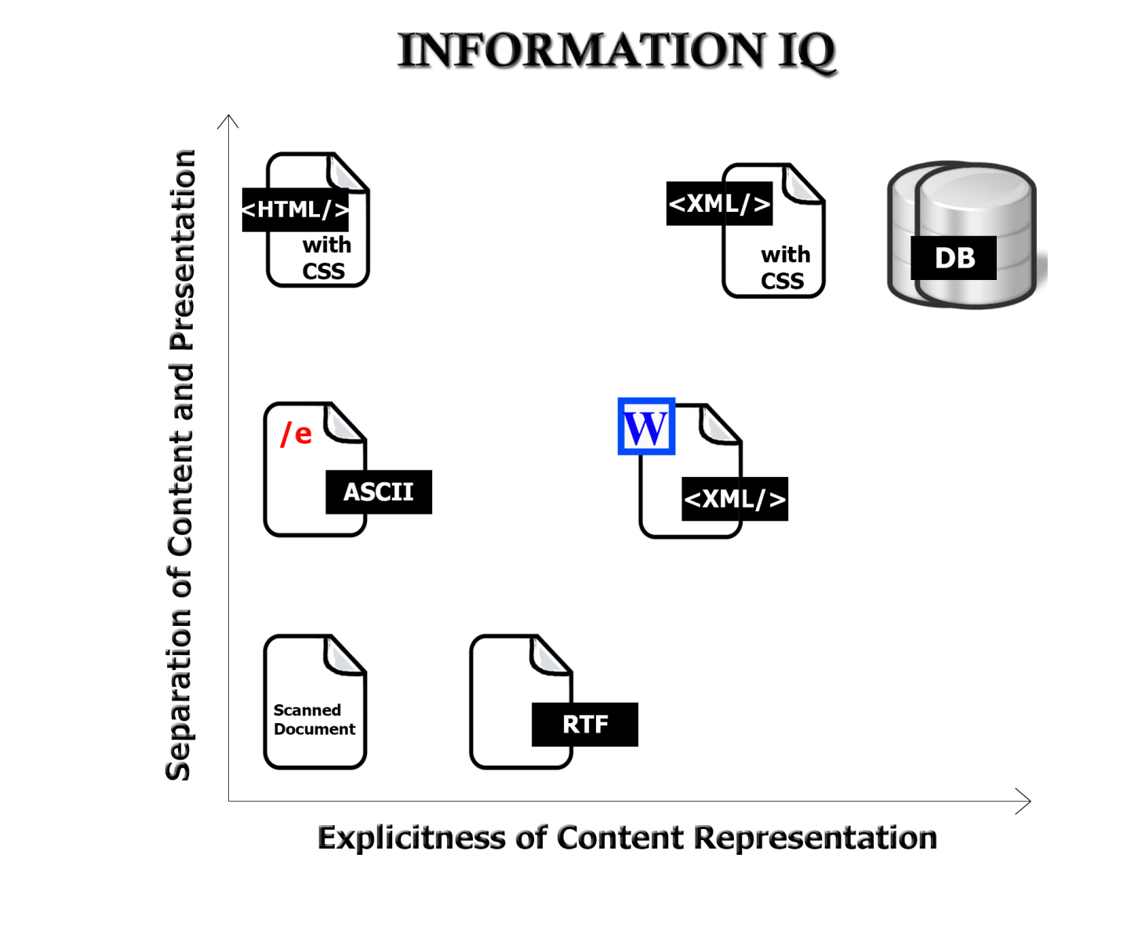
The Digital Format Matters!
FLASHBACK
78

Slide 79
The Document Type Spectrum
Different domains or types of documents can be distinguished according to the extent to which their content is semantically prescribed, by the amount of internal structure, and by the correlations of their presentation and for­matting to their content and structure
Documents and data fall on a continuum

Slide 80
Contrasting PIM Strategies
People differ a lot in their PIM strategies
“Pilers” vs. “Filers” (“Slobs” vs. “Neat Freaks”) is a classic contrast and a recurring theme in popular culture
Filers design an organizing system and continually maintain it
Pilers are ad hoc, often short-term activity based, and tradeoff organizing time for search time

Slide 81
PRIMARY: Marble statue of nude woman standing on a seashell
SECONDARY: Statue made in 2005 by Lucio Carusi of Carrara, Italy, titled “Venus”, made of local marble
INTERPRETIVE: 3D transformation of 1486 painting by Italian painter Sandro Botticelli, titled “Birth of Venus.” Carusi’s Venus is substantially slimmer in proportions because of changing notions of female beauty
(TDO Figure 5.6)
Panovsky’s 3-Level Scheme
81

Slide 82
REVISIONS TO THE COURSE

Slide 83
What I Learned From The Midterm
Some of you did well, most did OK, some not OK
Some of the concepts I’m teaching are intellectually deep and subtle (they were hard for Plato and Aristotle, and I adapted S&O from a graduate course) so I should not expect you to get everything quickly
The assignments and Friday sections that I designed to help you learn the concepts and methods are working for some of you, but not for others – you are not participating and discussing enough to learn what I want you to learn

Slide 84
What I Am Changing About The Course
I will slow down the “pace of content” – there are 10 lectures left in the syllabus, but I will drop 2 of them altogether and shorten the others
No more Friday sections – we will spend more time during Tu and Th class meetings doing the discussions and practical activities to better integrate them into the course
I will schedule meetings with everyone who is not doing very well, and we will together determine how to get you back on track

Slide 85
The Road Ahead
You need to start focusing on your case study
Instructions for a proposal will be published soon
Due by NOON on Monday April 11, so we can give feedback before you present to the class on April 12
Second exam will be on Th-F April 21-22
The 2nd exam will count 2x as much as first exam… but you can decide to discard first exam grade entirely and rely entirely on 2nd exam for the “exam component” of your course grade. You need to decide by April 15

