Slide 1
CogSci 150 “Sensemaking and Organizing” Spring 2022
Robert J. Glushko
glushko@berkeley.edu
31 March 2022
20) Institutional Categorization;
Classification Principles;
Bibliographic Classification
Faceted Classification

Slide 2
Today’s Lecture
Institutional Categorization
Understanding classification
Classification is purposeful
Classification is principled
Classification is biased
Bibliographic Classification
Classification Schemes/Structures
Faceted Classification

Slide 3
Institutional Categorization

Slide 4
Institutional Categories - What
Institutional categories are explicitly constructed models of a semantic domain
These categories are often defined by laws, regulations, and standards along with the rules for creating and maintaining them
Instead of describing the domain as it is, institutional categories are usually more formal, restrictive, and arbitrary than cultural categories
4

Slide 5
Institutional Categories - Why
Cultural categories are not precisely defined, are interpreted differently when contexts or users differ, and evolve in sometimes unpredictable ways
This makes cultural categories unsuited for many legal and commercial uses
When institutional categories are constructed to create a semantic model of a domain, more control, robustness, and interoperability is possible than with just cultural categories
Do you see that this implies that institutional and cultural categories for the same domain can be very different, even incompatible?
5

Slide 6
Creating & Managing Institutional Categories
Institutional categories are often developed via rigorous and formal processes (e.g., following “document engineering” and “parliamentary procedure” methods in standards organizations or legislative bodies) and require ongoing governance and maintenance
This is NOT how most individual categories are developed, and NO cultural categories are developed this way
Institutional categories require ongoing governance and maintenance because of changes taking place in related cultural and individual systems
6

Slide 7
Institutional != Unbiased
Creating institutional categories by more systematic processes than cultural or individual categories does not prevent them from being biased
Sometimes the goal of institutional categories is to impose or incentivize biases in interpretation or behavior
7

Slide 8
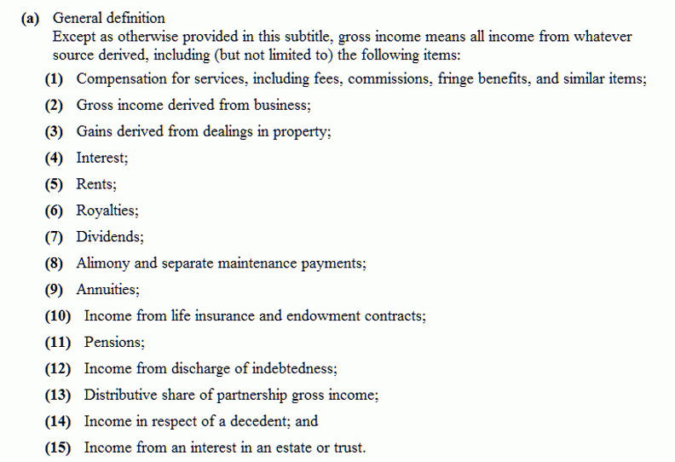
"Gross Income" Tax Code Categories
If dividends are taxable income, isn’t this double taxation?
Why isn’t inherited money taxable?
If school debt gets canceled, that’s income…sorry
8

Slide 9
Cultural / Nonstandard {and,or,vs.} Institutional / Standard Categories
Because institutional categories are usually defined in domains with established cultural categories, their co-existence and co-evolution can be problematic
Their definitions can be incompatible
Miscommunication results if one party is using a cultural definition and other is using an institutional one

Slide 10
Stop and Think
“CHICKEN” is a polysemous cultural category
As an animal raised for food
As an animal kept as a pet (especially in Asia)
As a metaphor to describe a person as weak or afraid
As a type of game in which two drivers (or opponents in some game or negotiation) will both suffer bad outcomes unless one or both concedes to the other
“CHICKEN” is also an institutional category. WHY?

Slide 11
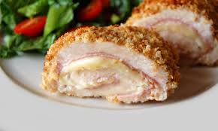
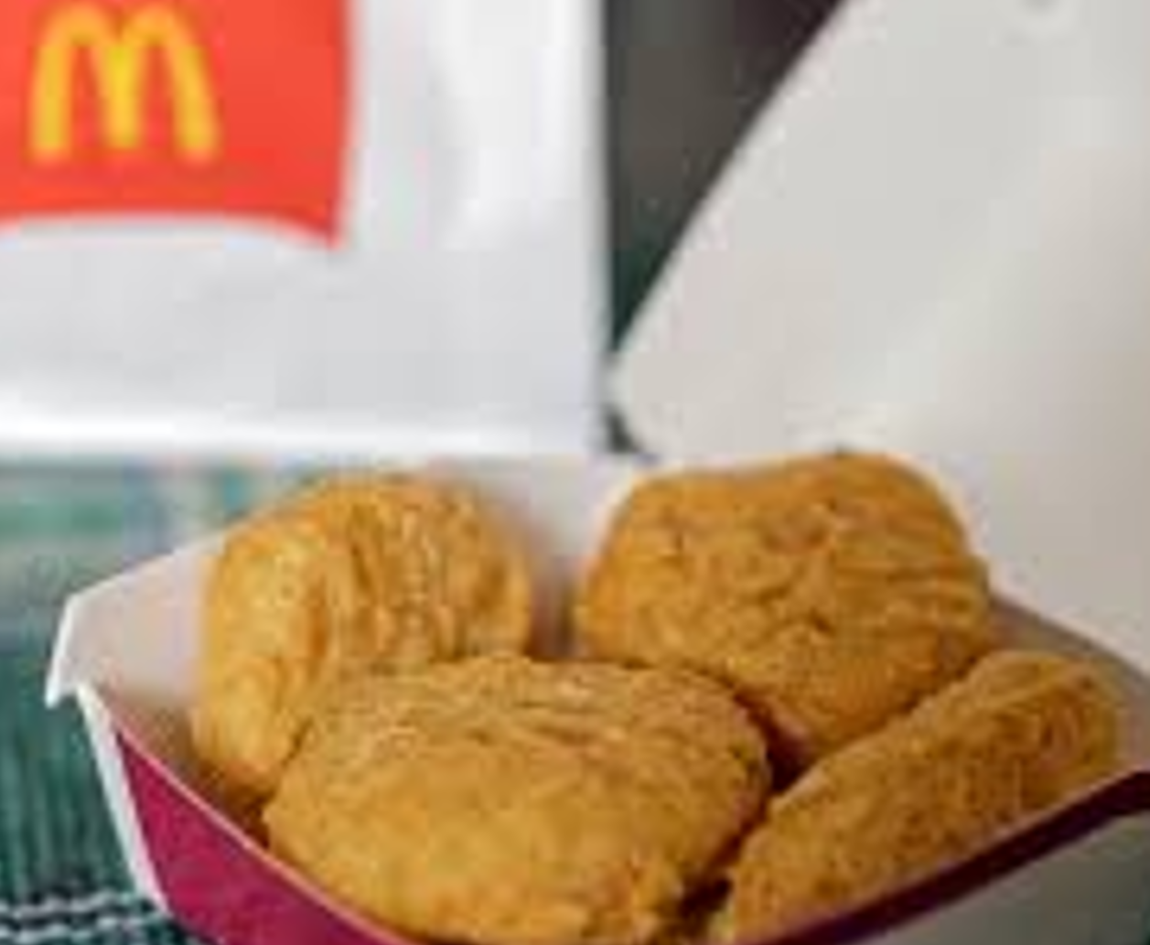
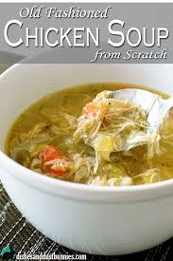
Do Chicken cordon bleu
Chicken nuggets
Chicken soup
require the same quality of chicken?
The “cost of quality” matters a lot to the food processing and restaurant industries
How do businesses make sure they get the chicken they want?

Slide 12
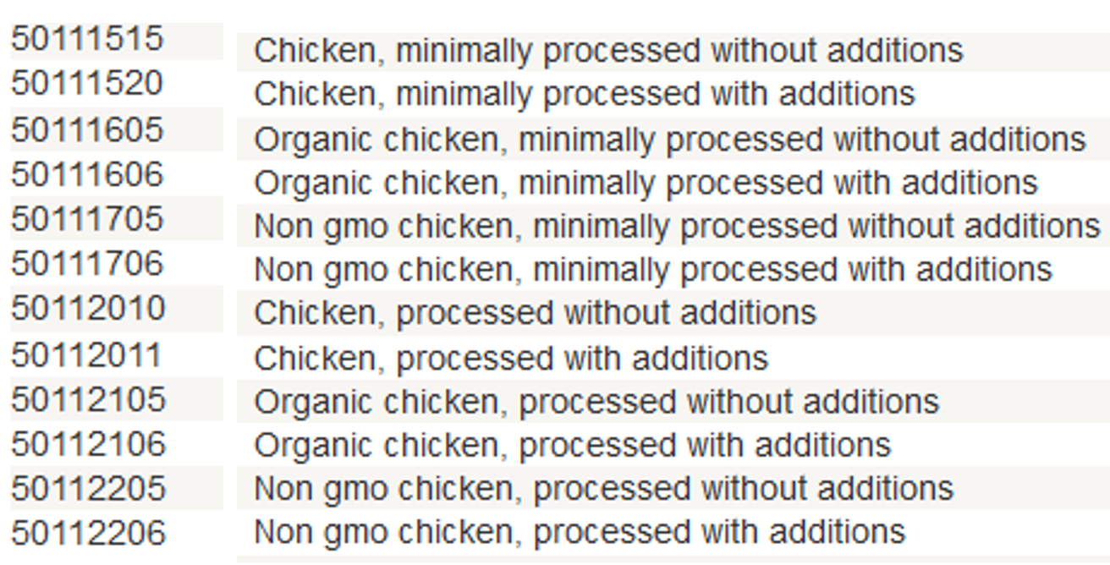
Institutional Categories for Chicken: UN Standard Products and Services Codes (unspsc.org)
12

Slide 13
Distinguishing Categorization and Classification
Categories are EQUIVALENCE CLASSES - sets of resources, processes, and events that we treat the same
A Classification (noun) (or Classification Scheme) is a SYSTEM OF CATEGORIES, ordered according to a PRE-DETERMINED SET OF PRINCIPLES and used to organize a collection of resources
Classification (verb) is the process of systematically assigning resources to intentional (often institutional) categories in a classification system
13

Slide 14
Classification Is Purposeful
Classifications arrange resources to provide structure for and increase the precision of INTERACTIONS in organizing systems by human or computational agents
Classifications are essential in useful work
They serve as a reference model to individual domains and the relationships among them to help people understand and communicate the concepts and relationships
14

Slide 15
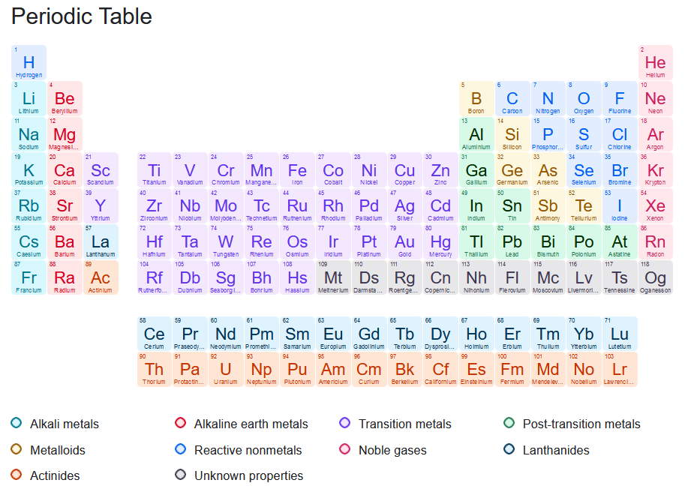

Slide 16
Classification is “Principled” (apology for the polysemy wrt “Organizing Principles”)
Any substantial classification system follows systematic design principles that reflect its purposes, scope, scale, intended lifetime, extensibility, and other considerations
Being "principled" means that once these design choices are made, they should be consistently followed
A very common principle is uniqueness; the categories are mutually exclusive
16

Slide 17
“Principled” Does Not Imply “Good” or “the Only Way”
Many of the category design choices can be arbitrary and others may involve tradeoffs that depend on:
the nature of the resources and the complexity of the resource domain
the purposes of the classification
the amount of effort available
the capabilities of the people doing the classification and of the people using it
17

Slide 18
Descriptive Precision
FLASHBACK
Writers, poets, painters, composers, sculptors, technical writers, programmers, producers, architects, designers, and devices or machines can all “create” resources
The Dublin Core vocabulary for describing web pages has a single property for indicating a “creator” (TDO 5.3.1.3)
“Shakespeare” and “Hubble Telescope” are both “creators”
A small description vocabulary is easy to use, but this tradeoff loses a great deal of precision compared to larger and more controlled vocabularies

Slide 19
“Justification” for the Classification Scheme
Warrant: What is the justification for the choice of categories and their names?
“Literary” Warrant: Classify only the resources we have?
“Scientific” Warrant: Use expert categories and names
“Use” Warrant: Use categories and names from “ordinary” people
19

Slide 20
Stop and Think
“WARRANT” is an obscure term for most of us but it is commonly used in library and information science
“Literary Warrant” would be more understandable if we said “Collection Warrant” - don’t try to build a general-purpose classification of everything, just classify the resources you have
Are “Scientific Warrant” and “Use Warrant” likely to yield the same classification?
Is it possible to use more than one classification for the same resources?

Slide 21
Maintaining a Classification
How long does the classification system need to last? Is there a commitment or methods to maintain the classification system? (forever?)
Do we classify resources or items just once, or can we change categories and assignments over time? (versioning?)
What if the meaning of the category (and its descriptors) changes?
What if the resources or items that have been categorized have changed?
21

Slide 22
Every Classification is "Biased"
Every classification is arbitrary because the criteria used to establish the categories reflect a point of view or perspective on the domain that intentionally excludes all other perspectives
Every classification system implicitly or explicitly contrasts {"good", "standard“} and {"bad", "nonstandard“} ways of understanding things
Natural vs. man-made disaster? (Katrina)
Dietary supplement vs. beverage? (Monster Energy)
Employee vs. contractor, full vs. part time? (Uber)
22

Slide 23
Understanding “Unemployed”
People with jobs are employed
People who are jobless, looking for a job, and available for work are unemployed.
The labor force is made up of the employed and the unemployed.
People who are neither employed nor unemployed are not in the labor force.
There is NO category that directly measures the percentage of people who “are not working”

Slide 24
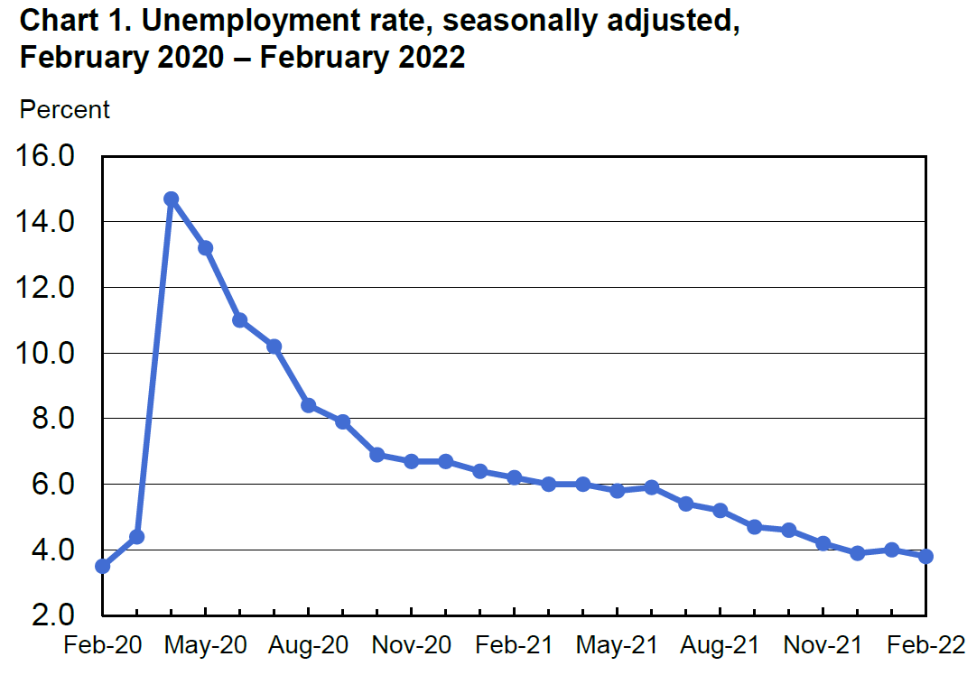
The Covid Effect on Unemployment: from 3.8% to 14.4% in 2 months

Slide 25
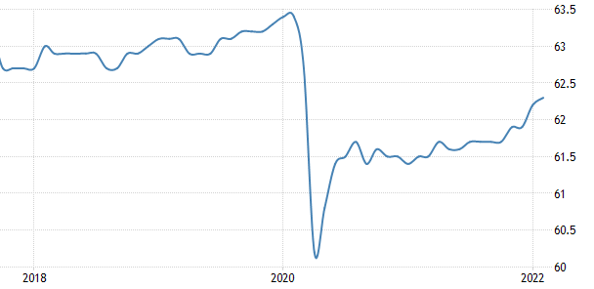
The Covid Effect on Labor Force Participation
In 2 months, 23 M people became unemployed, but another 3.4 M quit looking for one – which means that the official unemployment rate undercounted by 15% the Covid effect

Slide 26
Stop and Think
How are the definitions of “unemployed” and other categories tied to politics? HINT: It clearly isn’t good for the political party in power if unemployment goes up.
HINT: When the economy is going down, people stop looking for jobs, which slows the decline in the employment numbers. What does the party in power say?
HINT: During an economic recovery, people who had given up on finding jobs start looking again, which slows the statistical gain in the employment rate. What does the opposition party say?
SUMMARY: Things look better than they really are during a downturn, and look worse than they are during the recovery

Slide 27
Bibliographic
Classification

Slide 28
Bibliographic Classification
Much of our thinking about classification systems comes from the bibliographic domain, which is distinctive because of:
Scope, Scale, complexity, and degree of standardization
Standards and rules for classification
Legacy of physical arrangement, user access, circulation
28

Slide 29
Bibliographic Scope and Scale
How many distinct categories (SKUs) does a supermarket or “superstore” the size of Wal-Mart or Home Depot have?
How many distinct categories are in the Library of Congress subject headings?
How many unique items are in the libraries of a large research university?

Slide 30
Dewey Decimal Classification http://www.oclc.org/dewey.en.html
Started in 1876, the DDC is the most widely used classification system in the world, especially in public libraries
Easy to use to locate resources in libraries because of its numerical notation
The DDC is proprietary and must be licensed from OCLC in Dublin OH
30

Slide 31
Dewey Decimal Classification
The DDC is divided into ten main classes, which together cover the entire world of knowledge. Each main class is further divided into ten divisions, and each division into ten sections
Melvil Dewey wanted to develop a universal classification, but it was done in the context of the library of Amherst College, which introduced significant bias because of the contents of its collection and school’s religious orientation at the time
31

Slide 32
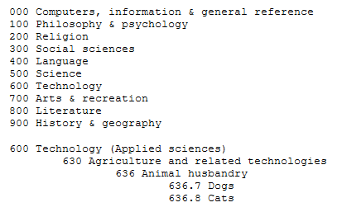
Dewey Decimal Classification
The concept of “pet” wasn’t commonly used in the 19th century
32

Slide 33
Dewey’s Biases
All knowledge can be organized by its primary discipline; fields that are multi-disciplinary won’t have a distinct “home” in a library
It was developed in the late 19th century, so our contemporary cultural categories won’t easily fit
It it very US and Christianity-centric

Slide 34
Dewey DC on Literature
800 – Literature
• 800 Literature, rhetoric & criticism • 810 American literature in English
• 820 English & Old English literatures
• 830 German & related literatures • 840 Literatures of Romance languages
• 850 Italian, Romanian, Rhaeto-Romanic
• 860 Spanish & Portuguese literatures
• 870 Italic literatures; Latin literature
• 880 Hellenic literatures; Classical Greek
890 Literatures of other languages
o 891 East Indo-European & Celtic
o 892 Afro-Asiatic literatures Semitic
o 893 Non-Semitic Afro-Asiatic literatures
o 894 Ural–Altaic, Paleosiberian, Dravidian
o 895 Literatures of East & Southeast Asia
o 897 North American native literatures
o 898 South American native literatures
o 899 Other literatures

Slide 35
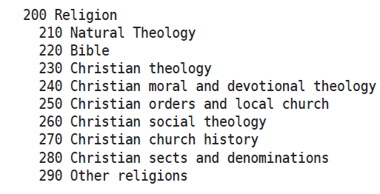
Dewey DC for “Religion”

Slide 36
Library of Congress Classification
The US Library of Congress was established in 1800 with a very practical focus, with no intent to devise an organizing scheme that could be used elsewhere
It got off to a bad start when the British burned it down (along with the White House) during the “War of 1812” in 1814
The library was restarted with Thomas Jefferson’s personal library, which broadened its scope, influenced the subsequent LCC scheme (Jefferson had a “hoarding disorder” wrt books)
36

Slide 37
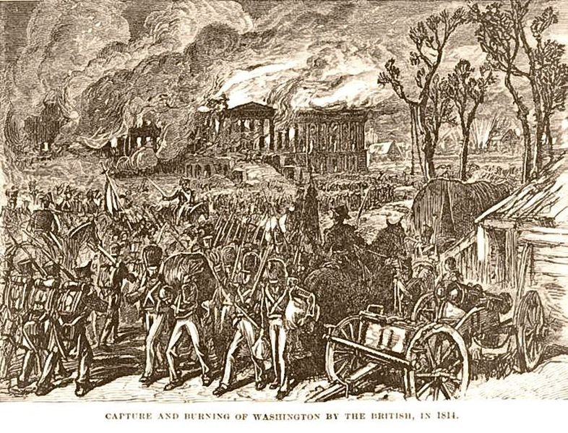
British Burn the White House (1814)
37

Slide 38
Library of Congress Classification
The LCC has 21 top level categories, identified by (arbitrary?) letters instead of numbers like the DCC
Each top-level category is further divided, and then once again… a very deep system that makes it practical but not theoretically grounded
The LCC is biased toward the US and toward the needs of a national government, and definitely shows its age
38

Slide 39
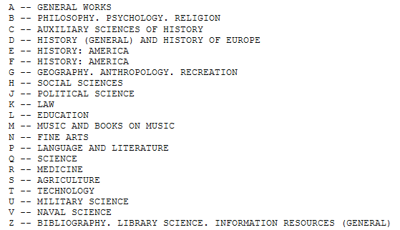
Library of Congress Classification
39

Slide 40
Meanings Change!
L of C established around 1800
Q Science
R Medicine
S Agriculture
T Technology
What did these terms mean in 1800? In 2020?
What did “Computing” mean 50 years ago? 10 years ago? 1 year ago? What will it mean in 2030?

Slide 41
When “Computers” Were People

Slide 42
Classification Schemes / Structures

Slide 43
Classification Schemes (TDO 8.1.4)
A CLASSIFICATION SCHEME follows one or more organizing principles
BUT I WISH I HADN’T USED THIS TERM IN TDO. IT WOULD HAVE BEEN BETTER TO USE
“CLASSIFICATION STRUCTURE”
Just as “category structure” (enumeration, properties, similarity, etc.) describes the ways in which the members of a category are defined, we can discuss “classification structure” as the principles by which sets of categories can be defined and related to each other
43

Slide 44
Classification Schemes/ Structures
A CLASSIFICATION SCHEME/STRUCTURE follows one or more principles
An ENUMERATIVE scheme itemizes all possible categories, and any resource can be assigned into one and only one of them
A HIERARCHICAL or TAXONOMIC scheme is created when multiple resource properties are used by organizing principles; each property creates another level whose categories are logically contained in the categories above them in the hierarchy
44

Slide 45
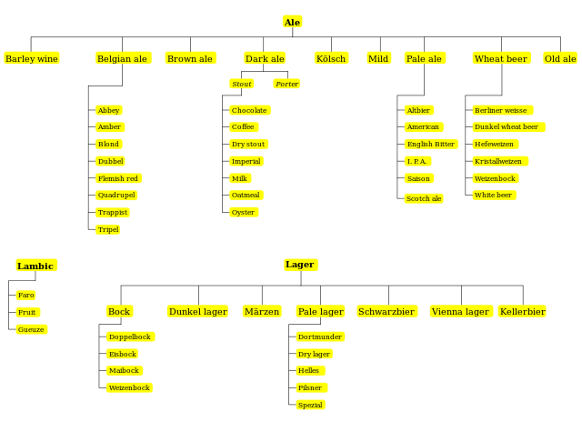
The Beer Kingdom

Slide 46
Faceted Classification

Slide 47
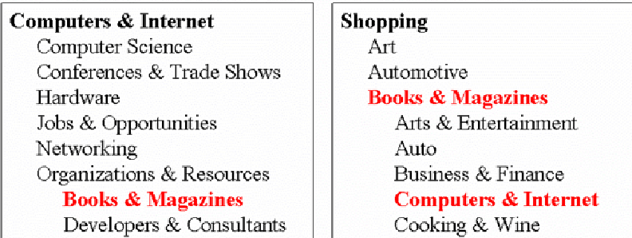
The Need For Multiple Classifications
47

Slide 48
Classification Structures: Faceted Classification
Some domains have a primary hierarchical structure (like biological taxonomies), while others have multiple dimensions or characteristics that determine their equivalence classes
A FACETED classification structure uses multiple resource properties like a hierarchical one, but does not require every resource to have a value for every property and allows the properties to be considered in any order
FACETED structures are especially useful when people differ in their property knowledge or preferences
48

Slide 49
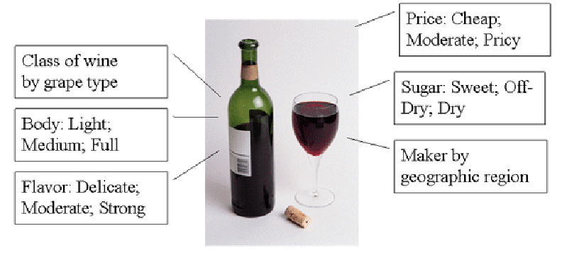
Facets in Wine Classifications
These facets yield thousands of different classifications
What determines the order in which you consider these facets?
49

Slide 50
Faceted Classification
FACETS are an alternative to hierarchical classification that overcome many of its limitations
Instead of creating a deep category hierarchy, facets create multi-dimensional categories that are defined (or generated) through grammatical composition (or combination) from the (characteristics or dimensions or relations) in the domain
Facets divide a domain or subject into "homogeneous" or "semantically cohesive" categories of manageable size
50

Slide 51
Facets as a Controlled Vocabulary
The relationships between the facets enable a small CONTROLLED VOCABULARY to generate:
Many structured descriptions
That are complex, but formally structured
That enable us to describe things we don't have words for
51

Slide 52
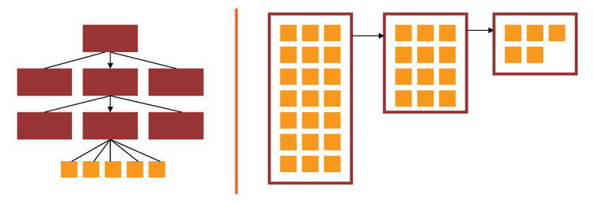
Facets and User Interfaces
Sequential category selection, results only at leaf nodes
Each selection yields a set of results, and subsequent selections refine the results set
52

Slide 53
Faceted classification is commonly used in web sites where the resources have many properties
Epicurious

Slide 54
Types of Facets
Enumerative -- a set of mutually exclusive possible values
Boolean -- yes or no on some dimension
Hierarchical or taxonomic -- organize the instances by logical containment
Spectrum -- numerical attributes on some range, with min and max (e.g, price, date)
54

Slide 55
Choosing Facets
ORTHOGONALITY - facets are independent dimensions
SEMANTIC BALANCE - top level facets are the most important semantic dimensions of the domain; values within facets are at equal semantic level
COVERAGE - all current instances can be classified
SCALABILITY - future instances can be classified
OBJECTIVITY - instances can be objectively classified; might also be called CONCRETENESS
NOT IDIOSYNCRATIC - facet semantics should be "mainstream" or "normative" and not rely on clever, fanciful or metaphoric interpretation
55

Slide 56
Contrasting Enumerative and Faceted Classification Structures
Enumerative and faceted structures are logically opposites of each other
Enumerative structures create every possible category in advance
A faceted classification structure creates its categories “on demand” only when they are needed when some resource takes on values on some set of facets
56

Slide 57
Faceted Classification – Table of Values
FACET1 FACET2 FACET3…
RESOURCE 1
RESOURCE 2
RESOURCE 3
RESOURCE 4
RESOURCE 5…

Slide 58
Would Faceted Classification Work Better Here? (properties in any order)

Slide 59
Faceted Classification for Vehicles
Cargo Environment …
Passenger Auto
Cargo Plane
Cruise Ship
Human Land …
Things Air …
Human Water …

