Slide 1
CogSci 150 “Sensemaking and Organizing” Spring 2022
Robert J. Glushko
glushko@berkeley.edu
5 April 2022
21) Standards;
Measurement;
Controlled Vocabularies; Interoperability

Slide 2
REVISIONS TO THE COURSE
Notes:
1210

Slide 3
The Road Ahead
More attention and help for your case study
Due by NOON on Monday April 11
April 12 will be dedicated to case studies
Everyone talks about their case study for 2-3 minutes
6 more case studies to read to get ideas, analysis and discussion tips – we’ll discuss them after your talks
Two more assignments on 4/11 and 4/18 to improve practical skills – they will be discussed in class on 4/14 and 4/21
Second exam is moved to Th-F April 28-29; practice Qs on 4/25
The 2nd exam will count 2x as much as first exam… but you can decide to discard first exam grade entirely and rely entirely on 2nd exam for the “exam component” of your course grade. You need to decide by April 15

Slide 4
Specifications
{and, or, vs.}
Standards

Slide 5
"Specifications"
A specification is an explicit and detailed description about how something (a product, system, service, or practice) works that might include:
the definitions of the key concepts or terms used in the description
the materials from which it is made
the components (tangible or intangible) that are arranged or assembled to make it work
the methods or processes by which it operates
the inputs and outputs for each method or process
You can think of these as the “objective” subset of resource descriptions in some domain. When are YOU most likely to be concerned with specifications?
5

Slide 6
Specifications Are Essential When Buying Technology Products

Slide 7
"Standards"
A standard is a published specification that is developed and maintained by consensus of all the relevant stakeholders in some domain
following a defined and transparent process
usually under the auspices of a dedicated organization with the authority to create standards
The rigor and transparency of the process by which a standard is created is essential to its legitimacy
Some governments or other large procurers or products of systems require that they be based on these "de jure" standards
Many of the products and systems you use regularly conform to standards for performance or safety
7

Slide 8
Standards-conformance can be important selection criteria of technology products

Slide 9
Classification and Standardization (1)
Classifications and standards both impose order on resources
They both distinguish, explicitly or implicitly, between standard / appropriate / effective and nonstandard / inappropriate / ineffective ways of creating organizing, and using resources
But this does not imply that a standard is a good one or that the best one will win a “standards war”
STOP AND THINK: Examples of standards wars?
9

Slide 10
Classification and Standardization (2)
Some classifications become standards
Every successful standard imposes a classification system
legal / correct / compatible / safe / etc. vs.
illegal / incorrect / incompatible / unsafe / etc.
Standards and classification systems can have significant inertia, becoming part of the "installed base" or "infrastructure" and difficult to change
10

Slide 11
Why Standards Exist (1)
Standards serve as a coordinating mechanism whenever there are alternative ways of doing or making something that might be incompatible or that otherwise wouldn't be possible
Cost savings from economies of scale and interoperability
Standards can also serve as a regulating mechanism to restrict behavior or operation that might be unsafe, unfair, or otherwise "harmful“
11

Slide 12
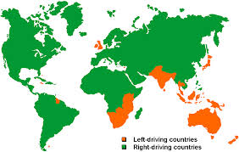
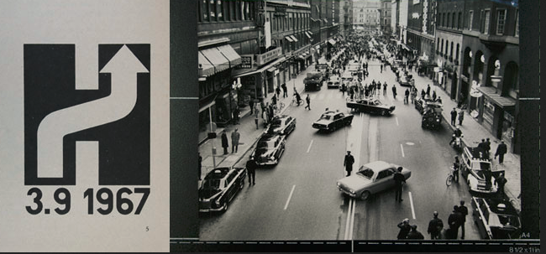
Which Side to Drive On? Why Would a Country Change Sides?
‘Högertrafikomläggningen’ in Sweden

Slide 13
Why Standards Exist (2)
Many standards define technical specifications and procedures to ensure a "common design" or "interoperability"-- TDO calls these "institutional semantics"
Standards define institutional categories about models, behaviors, or processes - TDO calls these "institutional taxonomies"
Interoperability is essential for infrastructure – “what other things run on” – plumbing, electricity, wires, roads, electromagnetic spectrum
13

Slide 14
Oops.
We haven’t defined “Interoperability”

Slide 15
Interoperability
"Common design" or "interoperability" aren't always clearly defined, but in practice they mean that two different companies or vendors could each implement the specifications and produce equivalent results (where equivalent might mean “exactly the same” or “close enough” depending on context)
Later in this lecture we’ll discuss Document Engineering’s more granular definition – 3 types of interoperability
15

Slide 16
Who Sets Standards? (1)
Some technical standards are set by governments to protect the public interest
Other standards are set by organizations created for the purpose of setting standards
Other standards are set by groups of companies who may or may not establish an ongoing organization and governance procedures to maintain and extend a standards "family" around the initial standard
These aren’t entirely separable processes. Would companies try to influence a government agency creating technical standards for their industry? Can standards affect purchasing decisions?
16

Slide 17
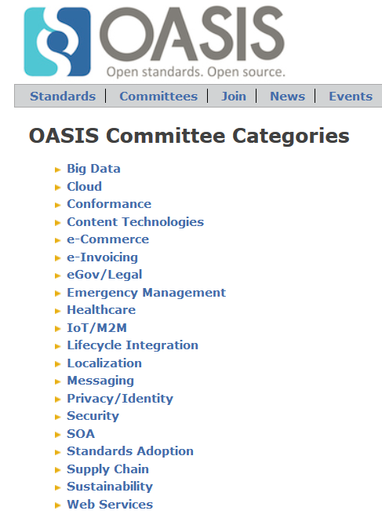
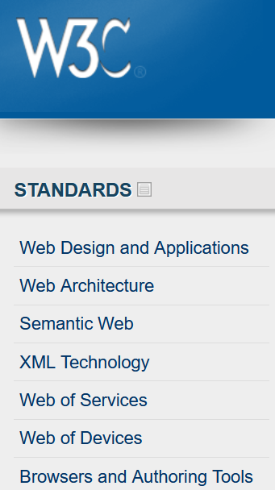

Slide 18
Who Sets Standards? (2)
All standards are specifications, but not all specifications are standards
Some "standards" begin as proprietary vendor specifications that will become "de facto" standards if they are widely adopted and achieve market dominance
Often "de facto" standards are submitted to a standards organization with the goal of "rubber stamping" them as "de jure" ones
18

Slide 19
Specifications {and,or,vs.} Standards
Any person, firm, or ad hoc group can create a specification and then use it themselves, try to get others to use it, or prevent others from using it
the adoption (or "traction") of a specification is more important than whether it was created by a "standards" organization
How do you Encourage and Enable Adoption of a Standard?
19

Slide 20
How do you Encourage and Enable Adoption of a Standard?
My Way or the Highway:
"Follow MY specifications or I won't do business with you (the “Wal-Mart Way”)
Safety in Numbers: Create or join an alliance
open- source community vs. Microsoft
Android vs Apple
Lots of others…
Begging: "Excuse me, here are my specifications, you can have them for free, would you like to do business with me?"
20

Slide 21
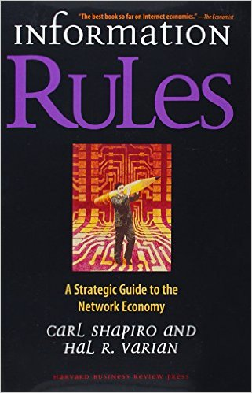
Standards and Network Effects
Standards are especially important in industries or domains that have "network effects" where the value of a product or service depends on the number of interoperable or compatible ones
These contexts are sometimes called "winner take all" markets, which is why standards wars take place - because of the economic implications
21

Slide 22
Lessons From Standards Making: The "Person-Concept" Tradeoff
Semantic agreement comes at a cost driven by the number of people who require a shared understanding, and by the number of concepts they must all understand
A small group of people can agree on a complex standard, or a large group of people can agree on a simple one
…especially when participants are just trying to agree on how to describe pre-existing shared concepts rather than having to define them first
22

Slide 23
Using Standards in Organizing Systems
You may be required by the government, by your customers, or by "business partners" to conform to some organizing standards
But to the extent that standards embody best practices, it is a good idea to follow them anyway
23

Slide 24
Standards for Document Description in Organizing Systems
For specific vocabularies or "domain-specific languages"
For the metalanguages used to encode the DSLs and schema languages (e.g., XML, SGML)
For "profiles" that suggest modeling practices like degree of abstraction and granularity, or constrain the possible values for some descriptor (e.g., AAT)
For identifying resources – file and document names, versions
24

Slide 25
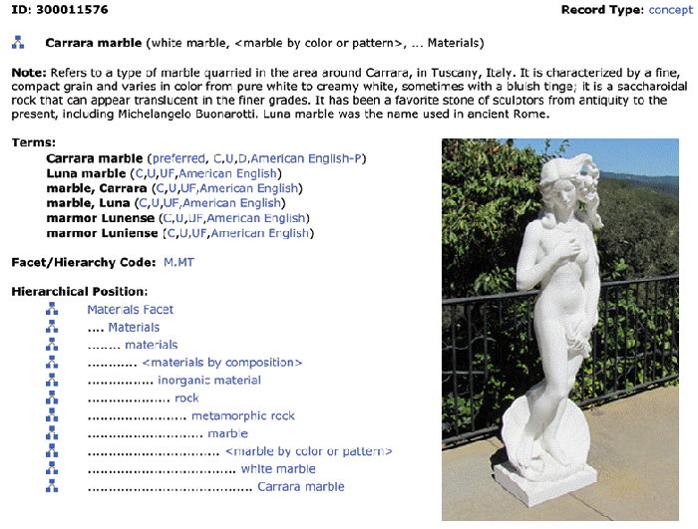
FLASHBACK
Art and Architecture Thesaurus
25

Slide 26
Measurement

Slide 27
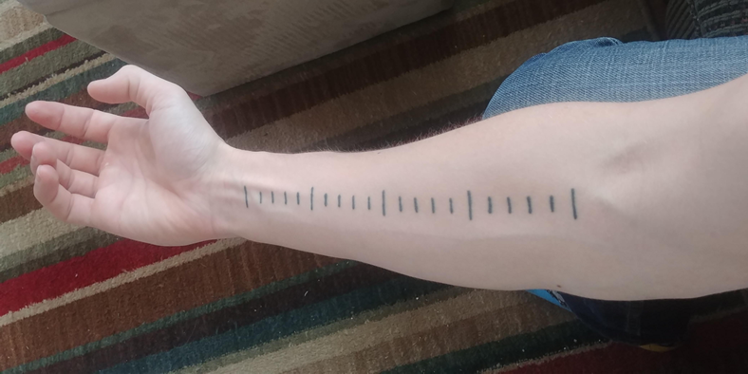
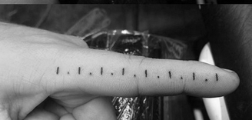
Measurement
Every business and much of modern life depends on the ability to accurately quantify properties and to communicate these measurements
Measurement units are highly abstract, enabling them to apply broadly across domains
But their origins are highly concrete, often based on body parts or work artifacts, and they were tied to narrow contexts of use

Slide 28
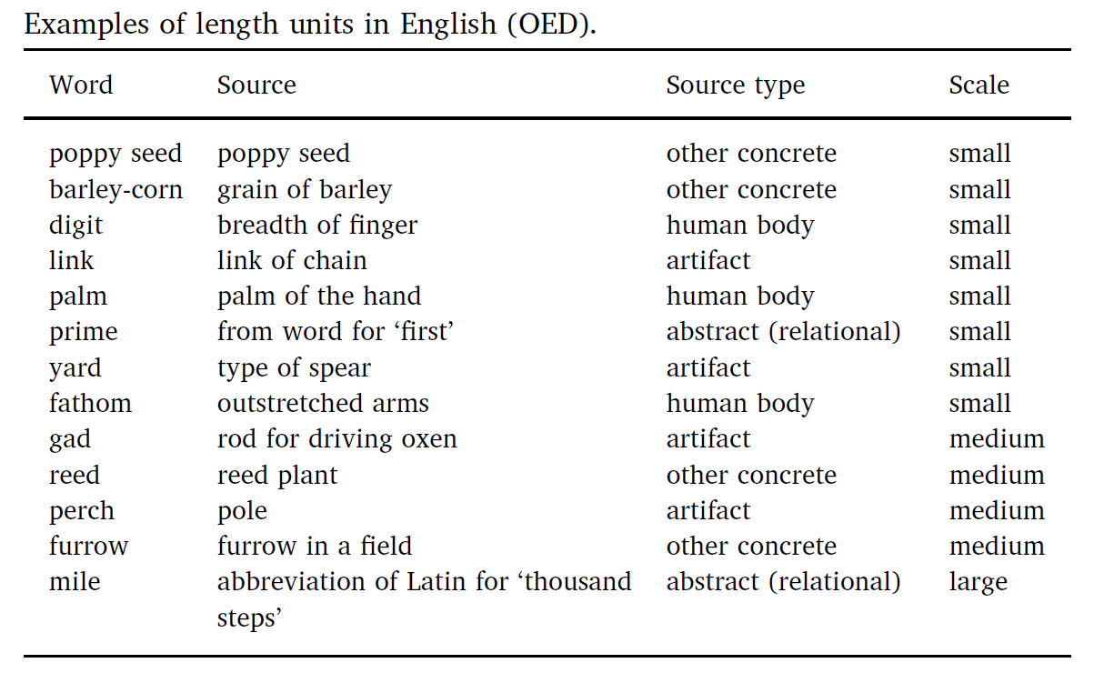

Slide 29
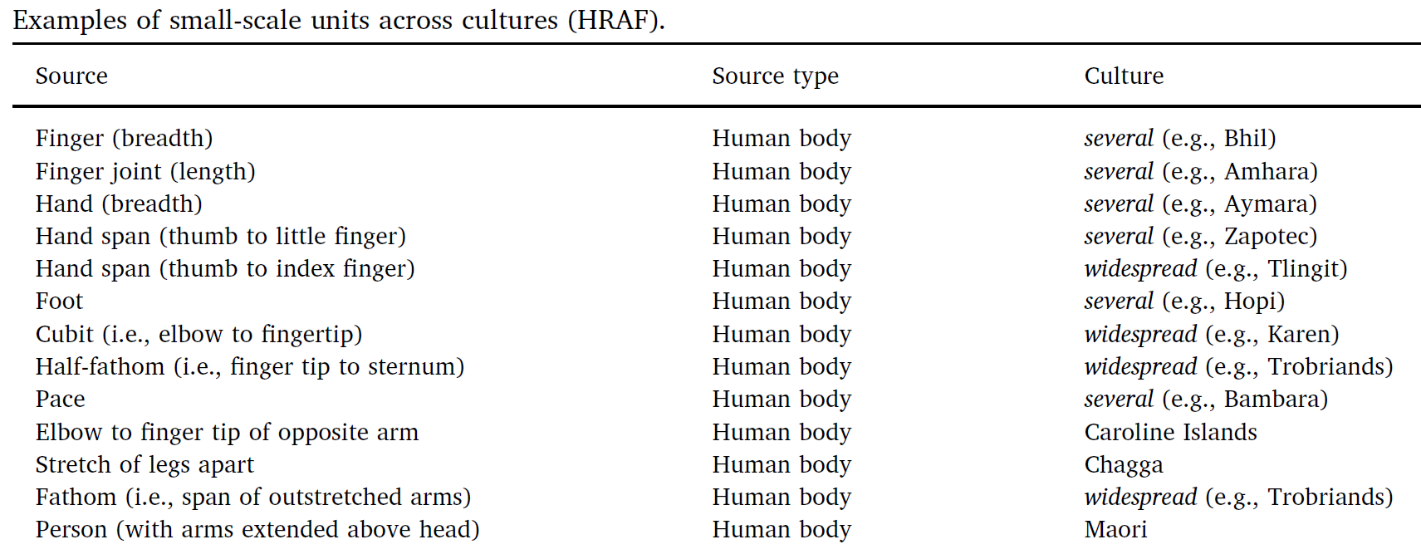
Body-Part Measures In Other Cultures
Why is the idea that people would use their bodies to impose structure on their environments pervasive in human culture?

Slide 30
Maori Measures (12 different units based on body parts)

Slide 31
An illustration from Geomtrei (1608 edition), by Jacob Köbel, of a procedure for determining a “lawful foot” and, at the same time, a “lawful rood” (a measure equivalent to 16 feet). He describes having sixteen men “of different sizes,” upon leaving church, arrange their left feet in a row. The resulting full length will be a standard rood, and one 16th of it will be a standard foot.
Standards-Making from Body Parts

Slide 32
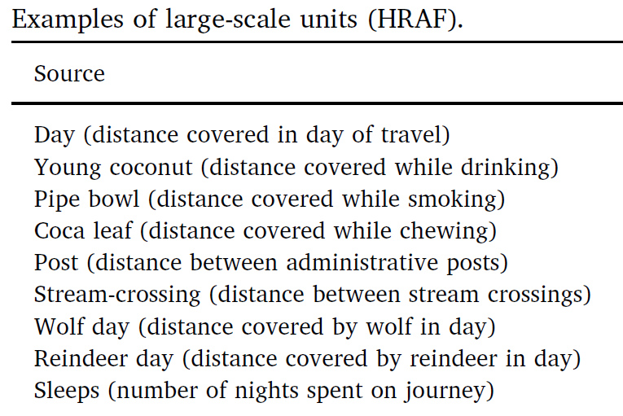
Large-Scale Measures
What commonly-used standard measurement unit is based on distance traveled in some fixed time period?
Why are these large-scale measures more heterogeneous across cultures than the small-scale measures?

Slide 33
The Evolution of Measurement
Ad hoc comparisons between two concrete things (measure a log with your foot)
Conventions emerge for comparators (always use your foot to measure length)
Standardization of the comparator (“foot” defined as an average or ideal)
Standardized comparators organized in hierarchical systems of units in which they are defined in terms of each other
Standard measures have obvious advantages…
but can there be advantages if they don’t exist?

Slide 34
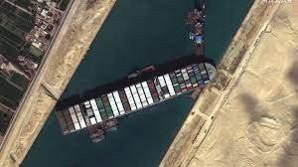
We’re Not Finished
Even though we now have abstract and standards systems of measurement, we continue to use concrete objects as comparators
“The Ever Given is one of the largest container ships in the world, about the length of four football fields”
https://thelanguagenerds.com/2021/27-examples-that-show-americans-will-measure-with-anything-but-the-metric-system/

Slide 36
Controlled Vocabularies

Slide 37
Why We Need Controlled Vocabularies
The words people use to describe things or concepts are "embodied" in their context and experiences... so they are often different or even "bad" with respect to the words used by others
These naturally-occurring words are an "uncontrolled vocabulary” that people use when they describe and search for resources
Searches made using an uncontrolled vocabulary will fail to match resources described using controlled terms

Slide 38
CV as an Artificial Language
A CV is an artificial language to be used in place of the "natural" ones that people would otherwise use
A CV standardizes the terms (such as subject headings, names, classifications, etc.) assigned by organizers / cataloguers / indexers
A CV can be thought of as a fixed or closed dictionary in which everything must be defined using the same set of terms

Slide 39
Types of Controlled Vocabularies
Dictionaries, thesauri, ontologies
Authority controls for names, places, time periods
Identifiers
Code lists
Subject heading lists
Classification schemes
Schemas/domain-specific languages/”tag sets”
Some of these we’ve covered before, because names and controlled vocabularies are essential in many contexts of sensemaking and organizing

Slide 40
A Formula for Definitions
hyponym = {adjective+} hypernym {distinguishing clause+}
Robin = Migratory BIRD with clear melodious song, a reddish breast, gray or black upper plumage
Doesn't mention every characteristic of hyponym, only those needed to distinguish from other hyponyms
40

Slide 41
Code Lists
Codes are constrained sets of values
Codes establish their meaning by reference to those values, often by abbreviations
Using codes in vocabularies and resource descriptions promotes consistency and makes meaning unambiguous

Slide 42
External and Internal Codes
External codes are those maintained by some entity or organization outside of your control (ISO, ANSI, etc.)
ISO 639 - language codes (DE, EN, FR, …)
ISO 3166 - country codes (CAN, FRA, MEX, USA, …)
ISO 4217 - currency codes (CAD, EUR, GDP, USD, …)
IATA airport codes (SFO, JFK, IAD, LHR, YYZ, YUL, ...)
Internet Top Level Domains (.com, .edu, .gov, …)
Postal codes (94109, 94574, N6G 1W8, …)
Internal codes are code sets that you can define and control (e.g., company mail codes)

Slide 43
Why Do Canadian Airport Codes All Begin With Y?

Slide 44
Schemas/Domain-Specific Languages
In addition to standardizing the content of resource descriptions a CV might also standardize the features/properties/categories to which the standardized vocabulary is applied
This work represents a significant investment in defining a domain, identifying its key semantic components, and specifying the constraints and rules governing the combination and reuse of those components

Slide 45
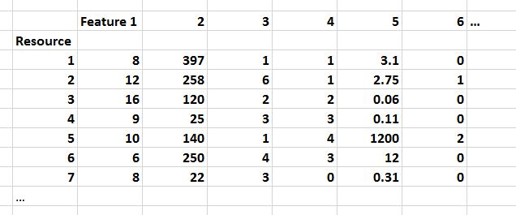
FLASHBACK
In data science, resource descriptions are typically called “properties” or “features” in a dataset like this…
A schema specifies the elements or features of a resource description
A CV specifies the possible values for a resource description

Slide 46
An Organizing System Perspective on Business

Slide 47
Businesses as Organizing Systems
The definition of Organizing System as an intentionally arranged collection of resources can be applied to business design and operation
It is also easy to see that at an abstract level almost all businesses are organized according to similar principles and patterns
Businesses share common external influences, especially those in the same industry
They also share common internal influences and goals
47

Slide 48
What Businesses Do
Design and Engineering – figuring out how to make stuff, increasingly by collaborating with people who make the materials and components; if the stuff is intangible, this activity means “how to deliver it successfully to customers”
Manufacturing – making stuff, often with much of the assembly done “upstream” in a supply chain or by collaborating with people who are "downstream" toward the customer to customize it; intangible stuff often is delivered in more tangible packages
Human Resources, Finance, MIS – organizing and taking care of the people who do everything
Information Systems – designing, deploying, supporting computing and communications infrastructure
48

Slide 49
STOP AND THINK
An ORG CHART is a structural model of a business that highlights the “control structure” or “management structure” that is reflected in reporting relationships (the “chain of command”)
The size of the business, its industry sector, and its history/culture influence the hierarchy depth, the number of sub-units or people at each level (the “span of control”), and the direction and amount of communication that is allowed or encouraged -- “the organizing principles and the interactions they support”
What are the most common structural models for businesses?

Slide 50
Describing What Businesses Do
Organization-level or business model patterns: marketplace, auction, supply chain, build to order, drop shipment, vendor managed inventory, etc.
Business process patterns: procurement, payment, shipment, reconciliation, etc.
Business information patterns: document models for catalog, purchase order, invoice, etc., and models for the components they contain for party, time, location, measurement, price, etc.
➔ Universal Business Language
50

Slide 52
A Hierarchy of Business Patterns
Stores generalize their sales and inventory processes whenever it is possible
Processes for some categories of goods might be specializations of the generalized patterns. But even they could be governed by more general patterns. E.g., processes for selling perishable goods are driven by expiration date both for are cut flowers and airline tickets

Slide 53
Generalizing Business Patterns
You can identify business model patterns inductively, by looking at specific examples of businesses and factoring out repeating elements
Bank in supermarket
Fast food franchise in supermarket
Post office in supermarket
Pharmacy in supermarket
What is the pattern here?
53

Slide 54
Supply Chains and Inter-Enterprise Information Exchange

Slide 55
The Supply Chain Pattern
A supply chain is an organizing system that defines the end-to-end view of the buy-side and sell-side relationships of an enterprise
A supply chain is the network of facilities and distribution capabilities an enterprise uses to:
"Source" (or "procure") raw materials (chemicals, ores, grains, ...) or components
Transform the materials or assemble the components into products
Deliver the products to customers (indirectly through distributors or stores or directly to the purchaser)
55

Slide 56
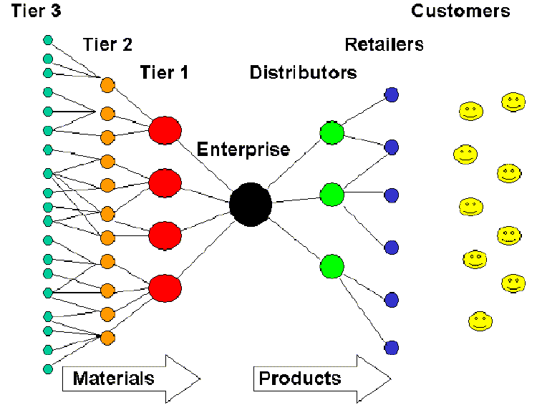
Conceptual Model of a Supply Chain
56

Slide 57
The Information Supply Chain
The flow of materials and goods in a supply chain is accompanied by information about it
But information about supply chain activities and processes is increasingly separated from the physical flow of materials and goods, and for information-based services there are no physical resources to move
57

Slide 58
FLASHBACK
Antonio, a Venetian merchant, has a friend Bassanio who is desperately in need of money to court Portia, a wealthy heiress
Bassanio asks Antonio for a loan in order to travel in style to visit Portia. Antonio agrees, but is unable to make the loan himself because his own money is all invested in several trade ships that are still at sea
Antonio suggests that Bassanio secure the loan from moneylender Shylock and name Antonio as the loan’s guarantor…

Slide 59
Design Issues for the Information Supply Chain
What information is exchanged?
Which entities in the supply chain exchange information?
What is the frequency of this information exchange?
Which entity or event initiates the exchange?
59

Slide 60
Businesses Want to be “Data-Driven”
Can a forecast ever be as accurate as actual sales and demand information?
What is more likely to lead to optimization in a business process – doing thing faster according to plans for customer demand, or doing things smarter according to actual demand?
How quickly can information collected by user applications and sensor networks be used to make "Information-driven” decisions?
“Organizing with Interaction Traces” – next week
60

Slide 61
Interoperability

Slide 62
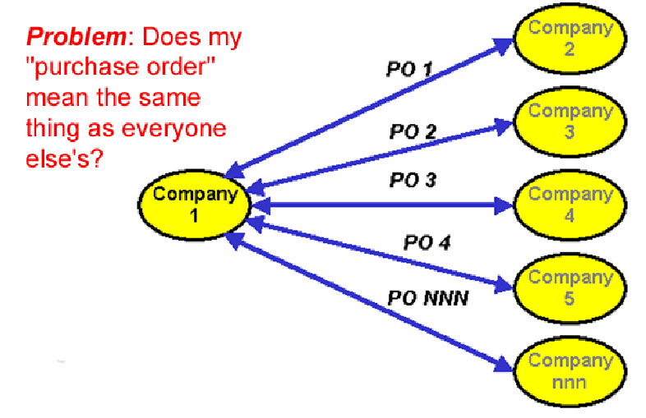
To Interoperate, or not to Interoperate?
62

Slide 63
Syntactic, Structural, & Semantic Interoperability
SYNTACTIC interoperability is just the ability to exchange information
STRUCTURAL interoperability means that all the expected information components are present with the same arrangement and granularity
SEMANTIC interoperability requires that the content of the message be understood by the recipient application or process
Semantic integration is the process by which this common semantic model is created
63

Slide 64
Some Ways NOT to Interoperate
Elements with the same meaning can have different names ("IssueDate" vs "OrderIssueDate")
Elements with the same meaning can have different names or different formats even when they have the same name (September 11, 2001, 9/11/2001 and 9-11-01; 11/09/01 in Europe)
Same meaning, but encoded differently: in XML using attributes instead of elements; in EDIFACT syntax instead of XML, in French rather than in English
64

Slide 65
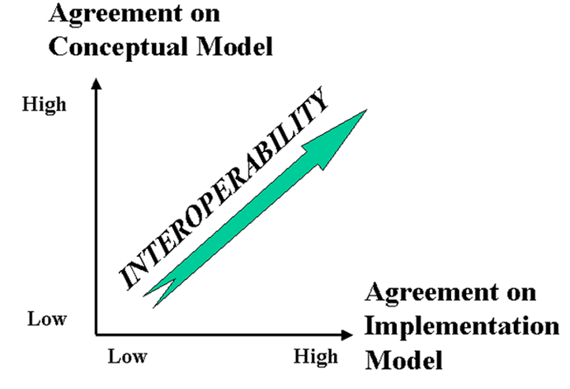
The Dimensions of Interoperability
65

Slide 66
Conceptual Disagreement
<Address>
<Latitude direction=“N”>37.871</Latitude>
<Longitude direction=“W”>-122.271</Longitude>
</Address>
If you give this address to the postal service… will your package be delivered?

Slide 67
Assignment– Interoperability
Do some “document engineering” and then some “software engineering” to determine if these 8 examples can be made to interoperate
Check your work with the analyses on the last slide

Slide 68
CONCEPTUAL MODEL FOR “BOOK ORDER”

Slide 69
Example: Conforming Order

Slide 70
1) What Interoperability Problem Is Posed Here? Can It Be Resolved Reliably?
(XML attributes rather than elements;
Aka “programmer ML”)

Slide 71
2) What Interoperability Problem Is Posed Here? Can It Be Resolved Reliably?
(comma-separated syntax, “Excel-style”)

Slide 72
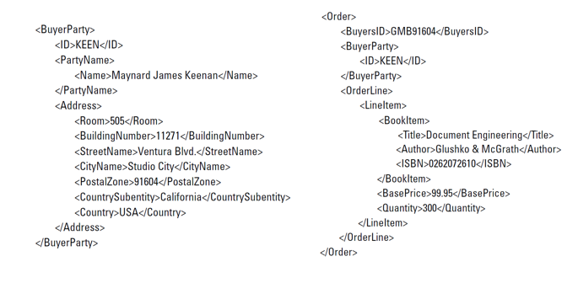
3) What Interoperability Problem Is Posed Here? Can It Be Resolved Reliably?
(two separate documents sent to the seller)

Slide 73
4) What Interoperability Problem Is Posed Here? Can It Be Resolved Reliably?

Slide 74
5) What Interoperability Problem Is Posed Here? Can It Be Resolved Reliably?

Slide 75
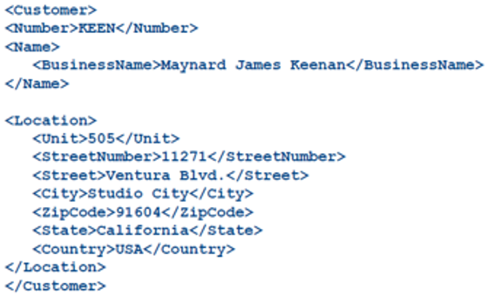
6) What Interoperability Problem Is Posed Here? Can It Be Resolved Reliably?

Slide 76
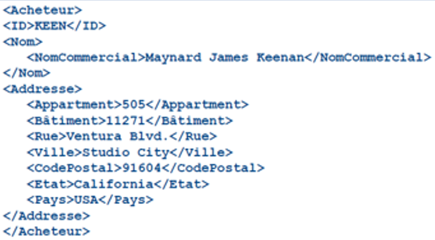
7) What Interoperability Problem Is Posed Here? Can It Be Resolved Reliably?

Slide 77
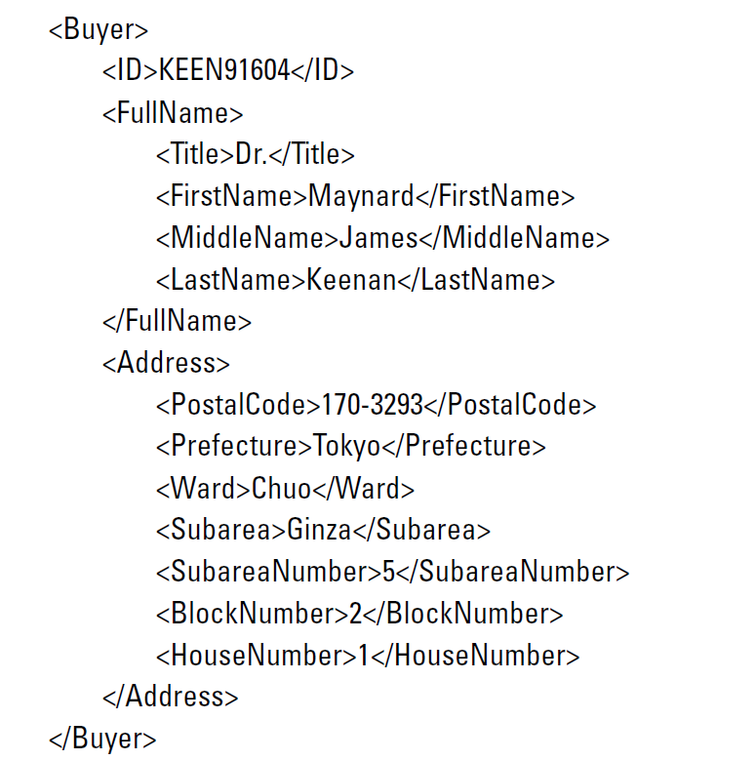
8) What Interoperability Problem Is Posed Here? Can It Be Resolved Reliably?

Slide 78
Analysis of the Examples
Fields are labeled as required by the model, so this is probably just a syntax problem, easy to fix
If the spreadsheet columns were defined with the correct semantics, this is also easy to transform to the desired order model
Because the document instances can be linked by the Buyer’s ID number, these two documents can easily be merged to create the desired order, and because each document conforms to the expected structure for its part, no additional transformation is required.
Easy fix; a more granular model can be transformed into the less granular target model
But a less granular model can’t reliably be parsed into the target model
Content semantics looks OK – synonyms can be transformed with a dictionary
Content semantics looks OK – but we need a French dictionary
The address is perfectly sensible for Japan but is conceptually incompatible with the North American address model in the target order. Looks like the sample from which the model was derived didn’t include Japanese orders

Slide 79
Discussion:
Data Quality

Slide 80
“Operation Clean Data”
This short article contains several crisp examples of situations where “dirty data” needed to be “cleaned up”
Important concepts and lessons:
Data synonyms
Data homonyms
Problems caused by technology {and, or, vs.} problems caused by process
Finding the “headwaters” of data
Most important lesson:
Data cleaning is like medical diagnosis
Symptoms can tell you what the diseases are
Cure the disease rather than continuously treat the symptoms

Slide 81
Causes of Dirty Data
Technology Causes – different or obsolete legacy systems with different data models/formats
Process Causes – different intended uses, quality standards, legal/regulatory requirements
Mergers, acquisitions, other organizational changes that bring data together that wasn’t designed to be combined

Slide 82
British Military Inventory
In 2003 one British military inventory system used stock number 99 000 1111 to identify a ration pack, while an­other inventory system used the same number to identify an electronic ra­dio valve (data “homynyms”)
Two inventory systems might use different identifiers for the same item (data “synonyms”)
Some items had hundreds of data attributes, but only six of them are “NATO standard” ones

Slide 83
Understanding the Causes (1)
Multiple small warehouses contain many of the same items but use different identifiers for them (Why many small warehouses instead of one large one?)
If the same item has more than one identifier, how do these “data synonyms” affect processes for purchasing and inventory management?

Slide 84
Understanding the Causes (2)
Because identifiers might be assigned by each warehouse, different items might end up with “data homonyms” (food rations and radio valves)
Warehouses might also manage the same resources but organize them in containers or packages of different sizes (aircraft oil in 1-liter cans or 250-liter drums)
The identical identifiers are used by purchasing and supply chain processes
The differences between the items might be found in other data attributes, but they are not used

Slide 85
Data (In-)Consistency
Data from questionnaires, surveys, etc. can be checked for logical consistency at the “headwaters” before it has a chance to flow downstream for other purposes
Can a 96-year-old describe herself as unemployed?
Is that 80-year-old man really the father of a new baby?
Could a company with three people on the payroll really have a salary bill of more than $1 million?
Is it reasonable that 150 companies applying for government money in the Covid Paycheck Protection Program would have the same phone number…. And that the phone number was associated with a gas station?

Slide 86
Note to Data Scientists: Py-Janitor
The name of this Python library says it all
https://pyjanitor-devs.github.io/pyjanitor/
Takes data file and removes null/empty rows, replacing them with other values, adding/renaming/removing columns of data, etc.

