Slide 1
CogSci 150 “Sensemaking and Organizing” Spring 2022
Robert J. Glushko
glushko@berkeley.edu
7 April 2022
22) Organizing and Interaction Design

Slide 2
Today’s Topics
Organizing and Interaction Design
Framing “Information Architecture” as an “Organizing Discipline”
How “Affordances” suggest/enable interactions
How the organizing principles, abstraction, and granularity of categories affect interactions

Slide 3
Interactions –The Why of Organizing Systems
INTERACTIONS include any activity, function, or service supported by or enabled with respect to the resources in a collection or with respect the collection as a whole
Whenever we select a resource for inclusion in an organizing system, describe it, or arrange it according to an organizing principle, we (should) have an interaction in mind
The interaction of ACCESS is fundamental in any collection of resources –why would you collect and organize resources you didn’t expect to access in the future?
3

Slide 4
Requirements for Interactions
All organizing systems have some common interactions, but we want to pay attention to the more resource-specific interactions that create the most value
The interactions must be discoverable and invokable by their intended users
“UID” = “user {interface, interaction} design
The priorities of the interactions are usually determined by the priority of intended users. How do we decide who gets priority?
4

Slide 5
Defining "Architecture"
An architecture describes a system's components (or "building blocks") and their relationships with each other
This gives an "architected" system an explicit model, in contrast with systems that are implemented incrementally without a master plan
Abstract patterns of information content or organization are sometimes called information architectures
5

Slide 6
IA as part of TDO: Motivation
“Information” and “Architecture” are elegant and abstract concepts
But for many people, “Information Architecture” is barely more than website design, emphasizing the presentation layer – an orphan who has lost these parents
How would you have defined IA before taking this course? Can we reconnect the meaning of IA to its roots by thinking of IA as an organizing discipline?
6

Slide 7
A Typical Definition of Information Architecture
Some practitioners of IA see content modeling and organization as complementary to or only equal to graphical or presentation layer design
7

Slide 8
Defining “Information Architecture” (TDO 3.3.3.2)
"IA is designing an abstract and effective organization of information and then exposing that organization to facilitate navigation and information use“
Intentional arrangement
Interaction support
8

Slide 9
Defining “Information Architecture” (TDO 3.3.3.2)
This definition implies a design methodology that puts conceptual modeling at the foundation, then adds organization and structure, and considers presentation or physical design issues at the end
NOTE: “Conceptual modeling,” “domain modeling,” “content modeling” and “document engineering” are approximate synonyms that mean “think abstractly, architecturally about the world in which you’re trying to design something”
9

Slide 10
Defining Information Architecture
Look closely at the parentheses -- they show the order of the process. First you create the content model, then add the structure to it, then add the structure needed to interact with it
10

Slide 11
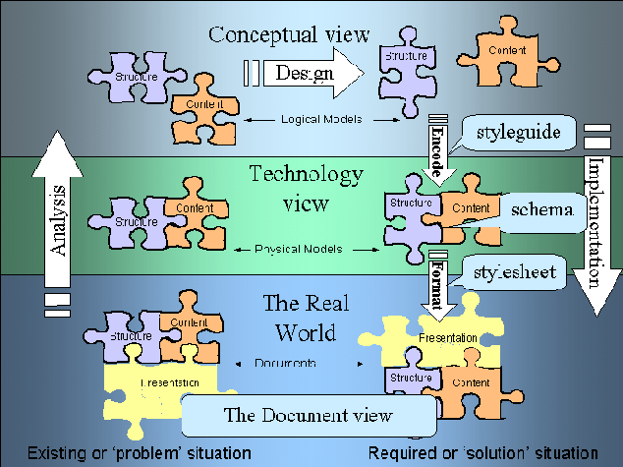
The Document Engineering Approach
FLASHBACK

Slide 12
A Definition of Information Architecture in User Interface Design
12

Slide 13
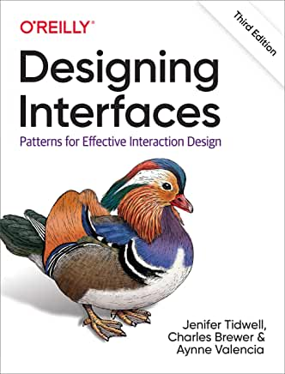
Read this for “TDO-compatible IA”
“Information architecture (IA) is the art of organizing and labeling an information space for optimal understanding and use…
You can find it online via the Berkeley library

Slide 14
Defining “Information Architecture” (Tidwell 2)
IA encompasses many things: presenting, searching, browsing, labeling, categorizing, sorting, manipulating, and strategically hiding information…
Arrangement
Interactions
14

Slide 15
The Activities of Information Architecture in TDO terms
Resource selection (content inventories and audits)
Resource organization (design patterns)
Interaction design (navigation patterns, responsive design, multi-channel design)
Maintenance (link management, integration of social media as content and as curation)
If you think of yourself as an IA or UX designer, is this course changing the way you think about the activities you perform?
15

Slide 16
Architectural Thinking

Slide 17
How Tidwell Uses TDO Vocabulary
“It can be helpful to think about an application in terms of its underlying data and tasks. What objects are being shown to the users? How are they categorized and ordered? What do users need to do with them? And now that you’re thinking abstractly about them, how many ways can you design a presentation of those things and tasks?”
“Several of the patterns in this chapter are large-scale, defining the interactions for large sections of applications or sites (or sometimes the entire thing).”
WHAT
WHY
HOW
17

Slide 18
Tidwell – What Web Pages Do Chapter 2 of Designing Interfaces, 2nd edition
Any page will primarily do one of these things:
Show one single thing, such as a map, book, video, or game
Show a list or set of things
Provide tools to create a thing
Facilitate a task
What is the relationship between a design pattern and the interactions it supports?
18

Slide 19
Affordances

Slide 20
Affordances
For physical resources, many potential interactions are inherent in their affordances – perceptible and actionable properties that determine what can be done with them
Many organizing systems use these inherent affordances as the basis for resource selection, arrangement, and interaction design
20

Slide 21
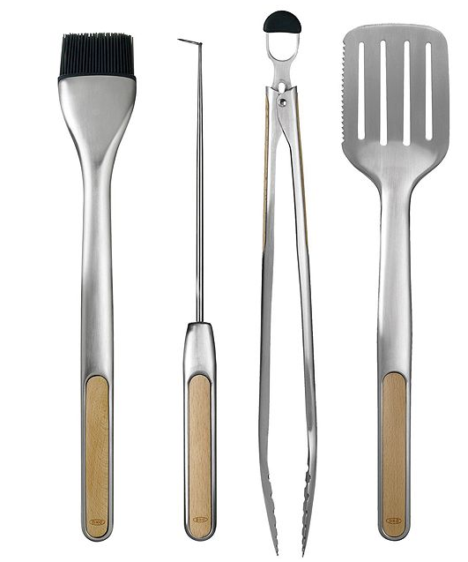
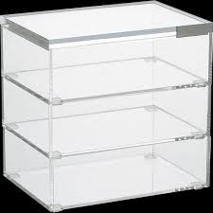
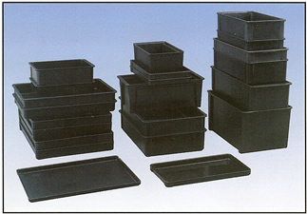
Easily Perceivable Affordances
21

Slide 22
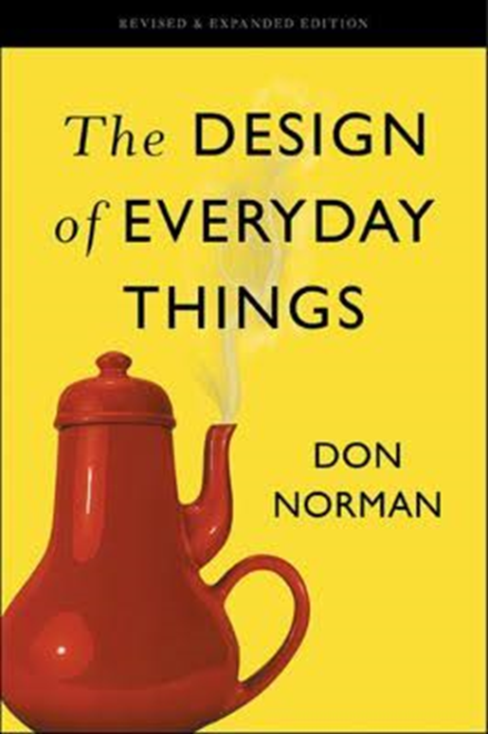
An Important History Lesson
One of the founders of the field of cognitive science and of the field of user interface design introduced the idea of “affordances” to these fields in a book called “The Design of Everyday Things”

Slide 23
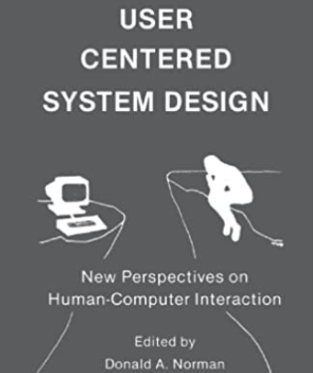
Don Norman
Author or co-author of several foundational texts in cognitive psychology and design
Organized the first (1979) conference of the Cognitive Science Society
Created the world’s first Cognitive Science Department (at UCSD)
Started the field of ‘User-Centered System Design”
Worked at Apple as VP of Advanced Technology where he proposed “User Experience Design”

Slide 24
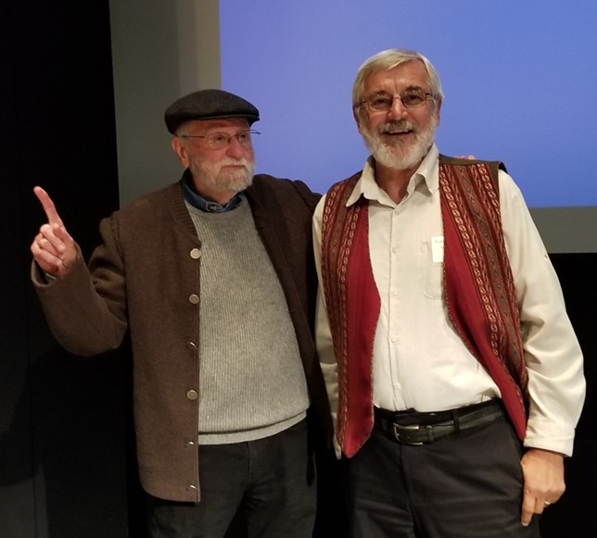
Organizing is Design
When I asked Don if he would review the first edition of TDO he said
“intentional arrangement of resources and the interactions they support? – that’s what design does”
24

Slide 25
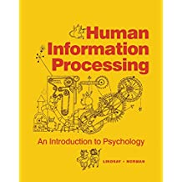
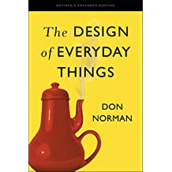
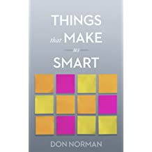
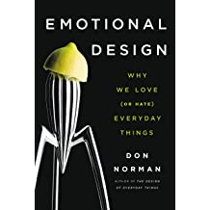
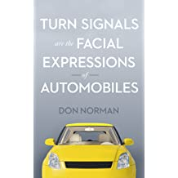
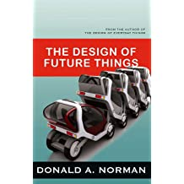
Some of Don Norman’s Books

Slide 26
Specialized Affordances
The design and shape of hammers lets you quickly perceive how you would hold and use one, but hammer designs are also very specialized
If you needed to perform a “hammering” task but didn’t have a hammer, what other things could you use instead?

Slide 27
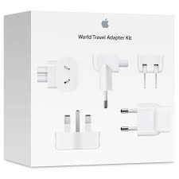
Easily Perceivable “Negative-Affordances”
“You can’t put a square peg in a round hole”
27

Slide 28
UI Design to Support Interaction
Many interactions with physical and digital resources are initiated using designed controls or other “user interface elements”
These controls and UI elements have affordances too, and good design makes it easy to see how to use them (and bad design doesn’t)
FUNDAMENTAL QUESTION: Does the arrangement of the controls map well to the arrangement of the resources they control?
28

Slide 29
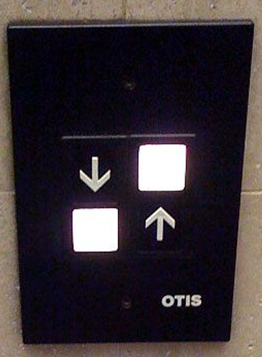
Which Button Do I Push?

Slide 30
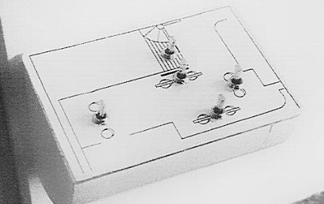
BEFORE: Array of 6 light switches
AFTER: Switches arranged to match room layout
Donald Norman, The Design of Everyday Things

Slide 31
Beer tap handles used to distinguish identical knobs in control room of a nuclear power plant
in Norman,
“Design of Everyday Things”

Slide 32
Creating New Capabilities
The interactions that are “afforded” by inherent properties are distinct from the “designed interactions” that are made possible by intentional acts of description, arrangement, or technological mediation
Creating new capabilities/affordances is often the purpose of design
32

Slide 33
Design and “Capability Discovery”
With physical resources, good design makes it easy to distinguish between parts and properties that are functional and those that are decorative or otherwise non-functional
But with digital and computational resources, it is often impossible to discern capability because it is internally implemented rather than inherent in perceptible surface properties
What can I do? How do you interact with me?
If you gave Plato or Isaac Newton a mobile phone, would they have any idea as to what it does?
33

Slide 34
Hanchen Ultrasonic Homogenizer Sonicator Processor
It is a SONICATOR
What can I do? How do you interact with me?

Slide 35
Interactions with Digital and Computerized Resources
Even when we see some indications of potential interactions we can't directly understand or compare their capability
35

Slide 36
Classifications and Interactions

Slide 37
Classifications and Interactions
Classifications arrange resources into categories
Every classification increases the capability and efficiency of interactions with resources that are “co-located” or “within-category” and makes “between-category” interactions less efficient
The granularity of the classification determines the specificity of the interactions
The structure and description of a classification influences how people use it
37

Slide 38
Classification on Sports Websites
What questions does this organization make easy / hard to answer?

Slide 39
ALTERNATIVE CLASSIFICATION:
HOW ARE MY HOME TEAMS DOING?
HOME NFL NBA MLB NHL
SF 49ers Warriors Giants Sharks
A’s
LA Rams Lakers Dodgers Kings
Clippers Angels
Boston Patriots Celtics Red Sox Bruins

Slide 40
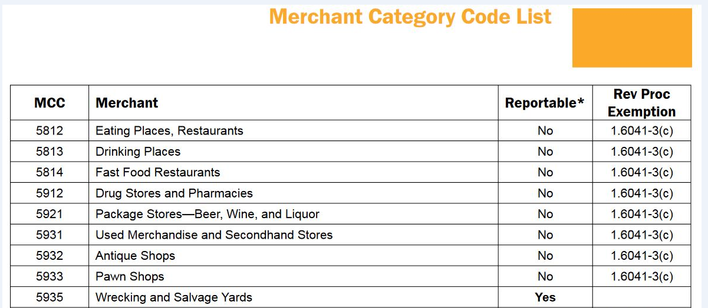
Classifications and Interactions
Standard classifications for products and business services make it easier to discover suitable resources, integrate them into your own processes, or to comply with rules and regulations
40

Slide 41
Classification and Interactions
Effective user interfaces to physical or digital organizing systems present and reinforce the logical classifications they embody
If the resources belong to logical groups or categories, does the arrangement of the controls reflect them?
41

Slide 42
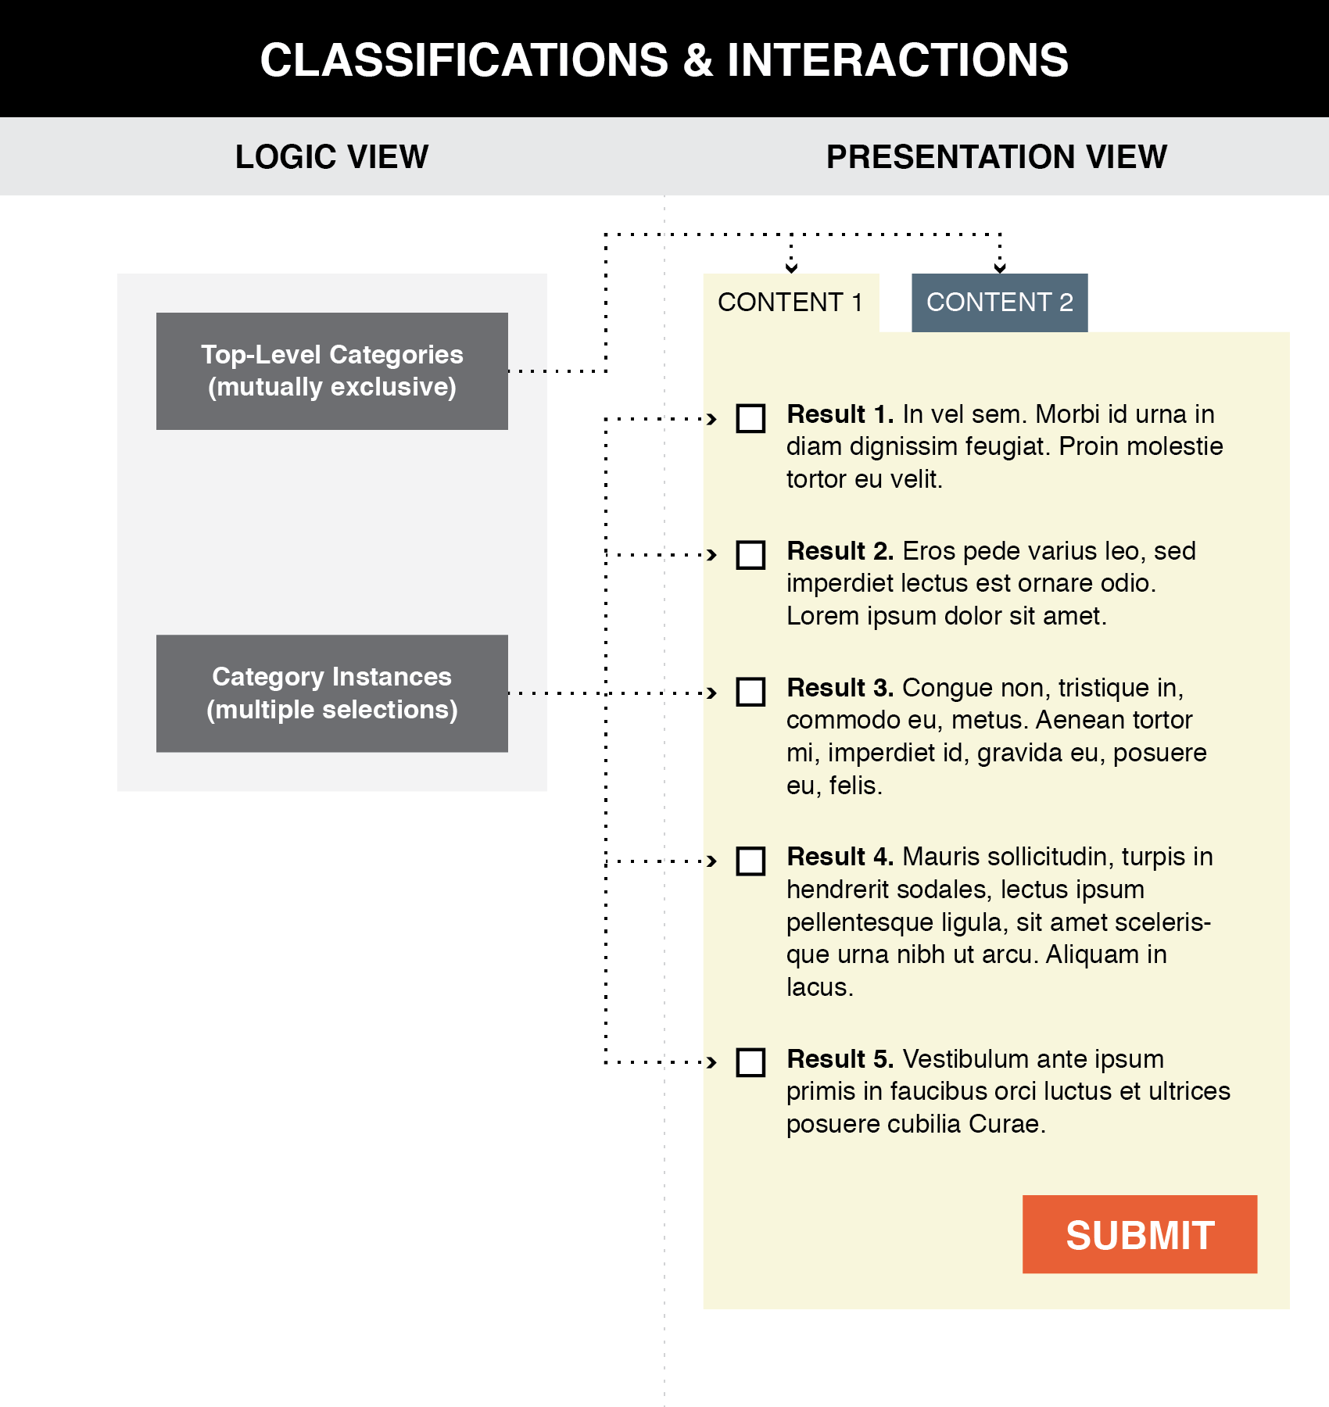
Good user interface design creates a clear mapping between a classification scheme and the arrangements and interactions that users see (TDO Figure 8.1)
42

Slide 43
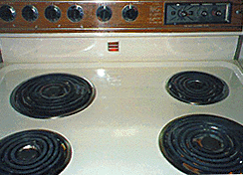
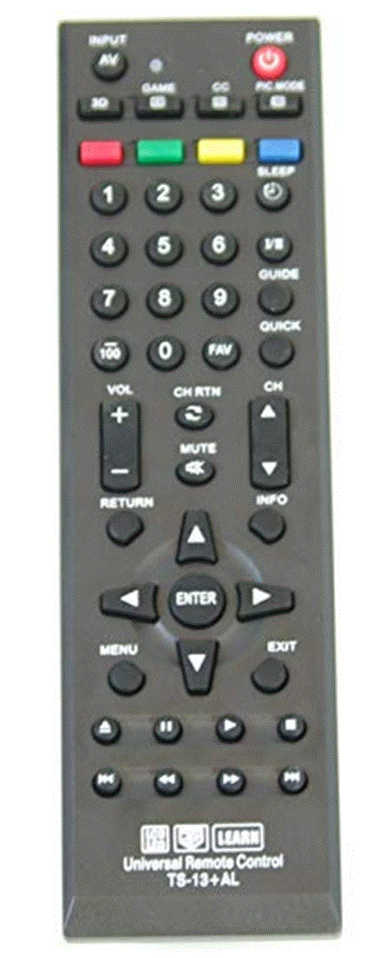
How Good is the Mapping from Logical Groups to Controls?
43

Slide 44
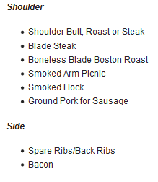
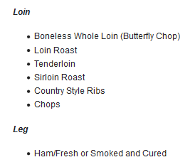
A Conventional Presentation of a Classification: Tabular categories and subcategories

Slide 45
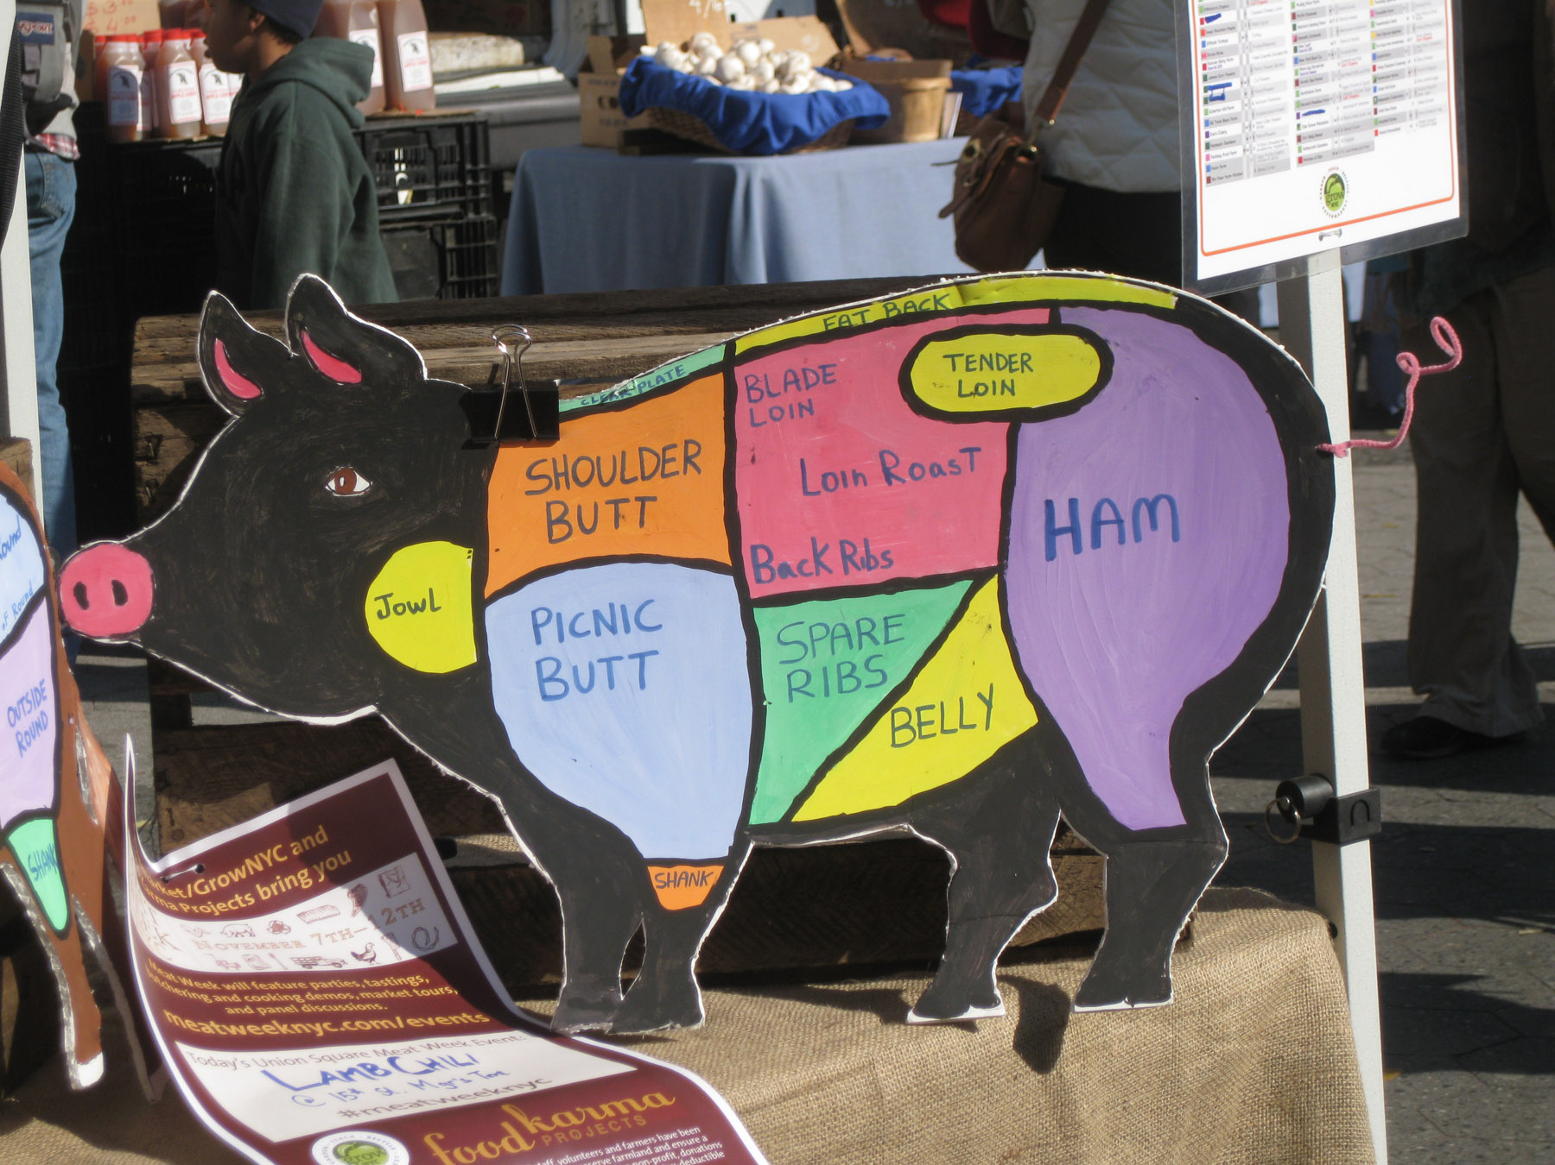
Why Is This a Better Presentation of the Classification?
Photo taken by Bob Glushko at Union Square Greenmarket, NYC

Slide 46
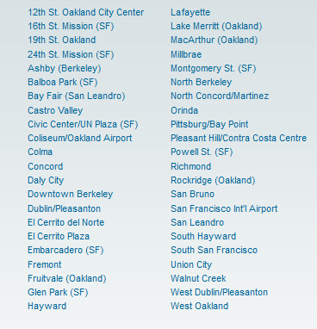
FLASHBACK: Poor Communication of a Classification
BART Station List
Better Might Be Something Like…
San Francisco
Embarcadero
Montgomery
Powell
Civic Center
…
Oakland
West Oakland
12 Street
19 Street
MacArthur
Rockridge
…
Berkeley
Ashby
Berkeley Downtown
Berkeley North

Slide 47
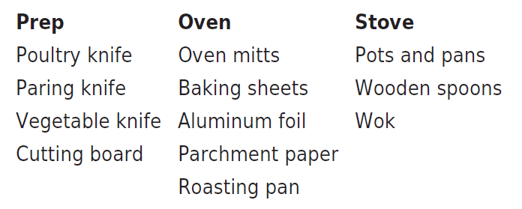
Taskonomy
In contrast to "taxonomy" - an approach to organization based on similarity of content or characteristics - a "taskonomy" organizes on the basis of purpose or "activity structure“
A COOK’S TASKONOMY (Figure 8.1 in TDO)
Grocery stores and supermarkets are mostly organized taxonomically, but have some taskonomic classification
47

Slide 48
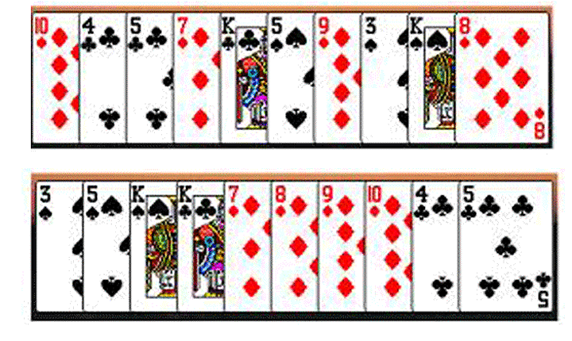
Task-Based Card Sorting
Which arrangement of cards better supports the gin rummy’s players sub-goals and plans?
48

Slide 49
Distributed Cognition & “External Representation”

Slide 50
“Distributed Cognition” (Hollan, Hutchins, & Kirsh, 2000)
"Distributed cognition" is a "dialect" of cognitive science that views cognitive activity as not just something that takes place within the mind of a single person at some moment in time; it is:
Distributed and organized across the members of a social or goal-oriented group
Distributed and organized between people and the technology and artifacts they create and use
Distributed through time; results of earlier events and interactions that transform future ones
50

Slide 51
Application Areas for DCog
DCog concepts are mostly used in systems design and implementation in specific work environments to make people efficient and effective
Its main method is field research, going into the workplace and making rigorous observations (often video), studying and coding the recorded activities using qualitative research methods (“ethnography”)
Goal is to understand and codify the various ways in which cognitive structures and processes are distributed between internal and external representations, across a group of individuals, and across space and time
HINT FOR FUTURE WORK: Search for “ethnography in X”

Slide 52
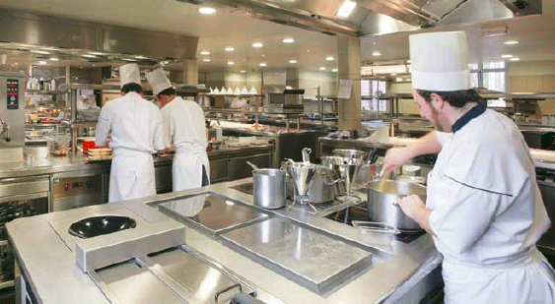
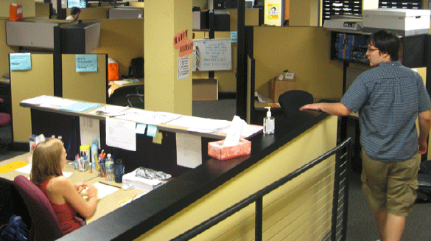
Intensive Care Units, Offices, Kitchens, & Cockpits

Slide 53
“The Intelligent Use of Space”
Kirsh, David. "The intelligent use of space." Artificial intelligence 73, no. 1 (1995): 31-68.
“Work materials” and “artifacts” are more than just the inputs and outputs of cognitive activity; they can become part of the cognitive system”
"Whether we are aware of it or not, we are constantly organizing and reorganizing our workplace to enhance performance"
53

Slide 54
“The Intelligent Use of Space”
Kirsh, David. "The intelligent use of space." Artificial intelligence 73, no. 1 (1995): 31-68.
“At times the histories of use are perceptually available to us in ways that support the tasks we are doing“
"When space is used well, it reduces the time and memory demands of our tasks... to simplify choice, to simplify perception, and simplify internal computation”
What are some examples of “histories of use” for physical resources? For digital ones?
54

Slide 55
Mise-en-place
What would it mean to mise-en-place your life?
55

Slide 56
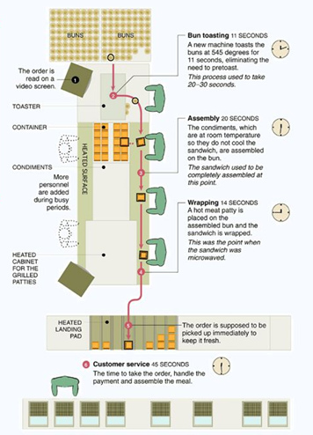
Using Space to Simplify Choice
A production line serially decomposes a complex task by dividing the space in which it is performed into functional stations where sub-tasks are performed
Each spatial region creates a task context in which only certain skills, tools, and rules are appropriate
Once a context has been selected, the local affordances make clear what can and must be done
The New McDonalds Layout

Slide 57
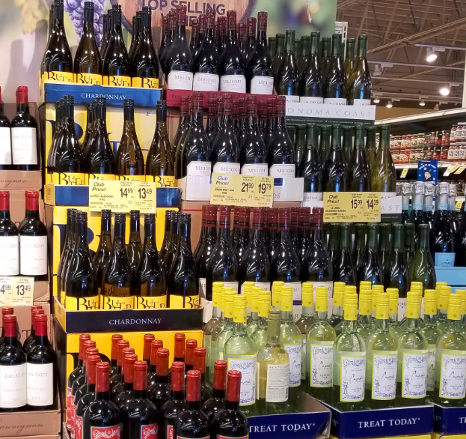
Using Space to Simplify Perception
Arrange objects in space so they form categories that reflect relevant preconditions, or properties that are useful to notice or exploit

Slide 58
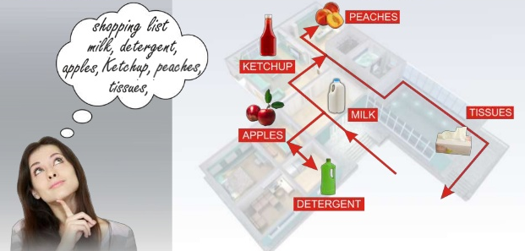
The Intelligent Use of “Mental Space” – The Method of Loci
The hippocampus, the brain component dedicated to memory, is highly developed for storing and recalling memories of physical locations
The ancient Greeks relied on this capability and devised a mnemonic system—the method of loci—which involved attaching things to remember, the key ideas in a speech perhaps, to well-known physical locations
While giving the speech one imagines walking through that physical location from idea to idea
Today, champion memorizers use this technique to associate items with places in vividly imagined “memory palaces.”

Slide 59
Offloading Memory
Offloading cognition into-the-world is a ubiquitous part of our everyday cognitive lives
We can also offload future memory demands into the world using external tools to supply perceptual cues that can trigger intended actions

Slide 60
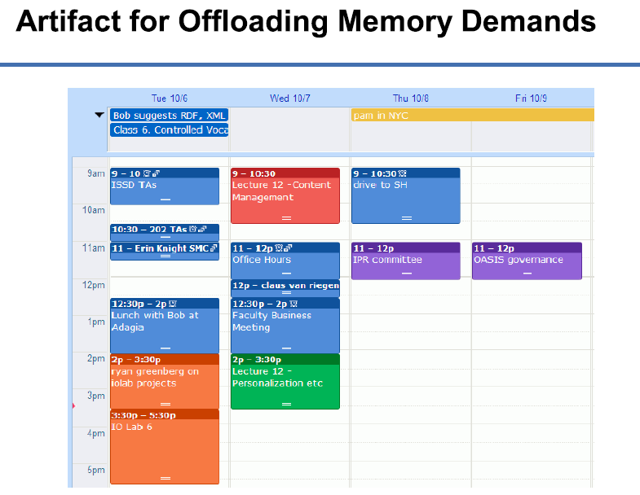

Slide 61
It’s Not Just a Cup; It’s a Document
What role does the “cup as document” perform at Starbucks?

Slide 62
It’s Not Just A Cup; It’s Offloaded Memory
The cup improves quality at “specification time” by recording drink orders in a consistent and robust way
The order of the cups is an external representation of the “production queue”
It improves quality at “production time” because the barista's memory load is minimized
Kirsh, D. (2005). Multi-Tasking and cost structure: Implications for design. In Proceedings of the Annual Meeting of the Cognitive Science Society

Slide 63
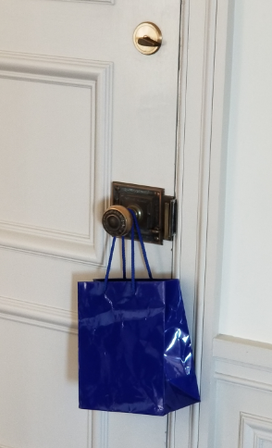
Offloading “Prospective Memory”
We rely on memory not only to recall information from the past but also to execute intended behaviors in the future. Our ability to remember delayed intentions is called “prospective memory”
Delayed intentions can be triggered by perceptual cues in our environment

Slide 64
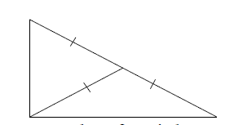
Benefits of “External Representation” (Kirsh – Interaction, External Representation, and Sensemaking (2009))
External representations enables us to solve problems and understand concepts that are too difficult “just by thinking”
A basic property of right-angled triangles is that the length of a median extending from the right angle to the hypotenuse is itself one half the length of the hypotenuse

Slide 65
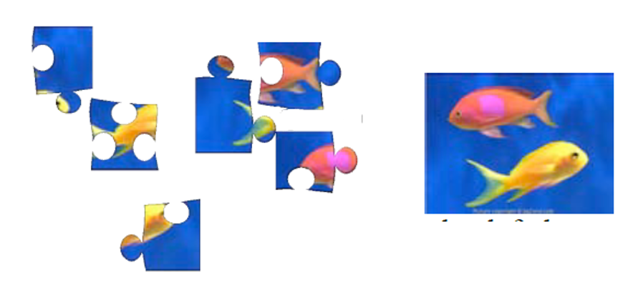
Benefits of Interaction with External Representations
Through interaction it is easier to process more efficiently (i.e., with better speed-accuracy), more deeply, more precisely, and often more broadly than by working inside the head alone
Can the jigsaw images on the left be perfectly assembled into the picture on the right?

Slide 66
Benefits of “Reformulation”
Representations differ in how explicitly they encode information
Externalized representations can often be reformulated to make them more explicit, easier to understand and think with
The cost structure of computation is very different outside the head than inside

Slide 67
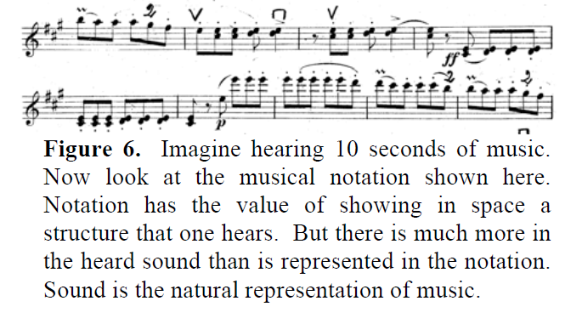
Benefits of “Natural Encoding”
Every representational system or modality has its strengths and weaknesses
An inference or attribute that is obvious in one system may be non-obvious in another

Slide 68
The BART System Map
In what ways is this map schematic rather than physical or literal?
What are the pros and cons of this design?

Slide 69
Benefits of “Multiple Representation”
Sometimes a non-natural or non-literal representation can be more revealing than the original representation because it can be parameterized or simulated
Multiple representations that emphasize different properties can suggest new benefits or insights
Visual designers who move between pen and paper, 3D mockups and rapid prototypes are familiar with this idea

Slide 70
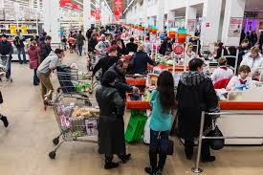
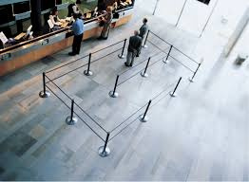
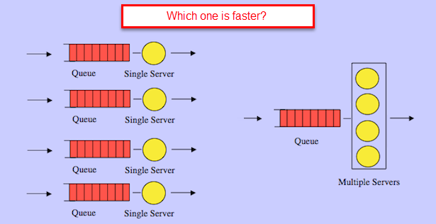
QUEUE LAYOUT Pictorial
Schematic

Slide 71
STOP AND THINK
You are a cognitive ethnographer whose job is to work in Amazon warehouses
What are your goals?
What specifically do you observe and measure?
What kinds of recommendations might you make?

Slide 72
Some Remaining Questions
Automated/autonomous systems and products are “smarter” the more we offload cognitive demands onto them. But what are the downsides?
Do you remember addresses and phone numbers, or do you just use them on your smartphone?
We can search the web for almost anything
How does this change how we read, study, learn?
Is Google making us lazy and stupid?

