Slide 1
CogSci 150 “Sensemaking and Organizing” Spring 2022
Robert J. Glushko
glushko@berkeley.edu
12 April 2022
23) Case Study Proposals

Slide 2
Today’s Topics
Case Study Proposals
2-3 minutes for presentations and discussion
Learning from today’s 6 cases
Sorting into similar “case study pods”

Slide 3
Organizing for Inebriation
Case study author is writing about the organizing system she works in and maintains as part of her job
Analyzes the organizing system in a typical college bar from two perspectives
The resources are the glassware, alcohol, mixers..
The resources are the people in the bar
Photos and diagrams do a superb job of explaining the organizing principles

Slide 4
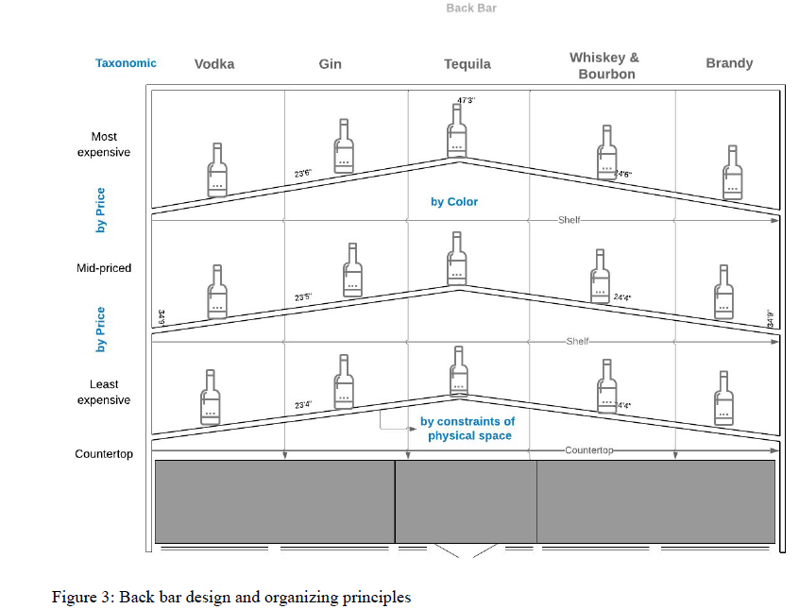

Slide 5
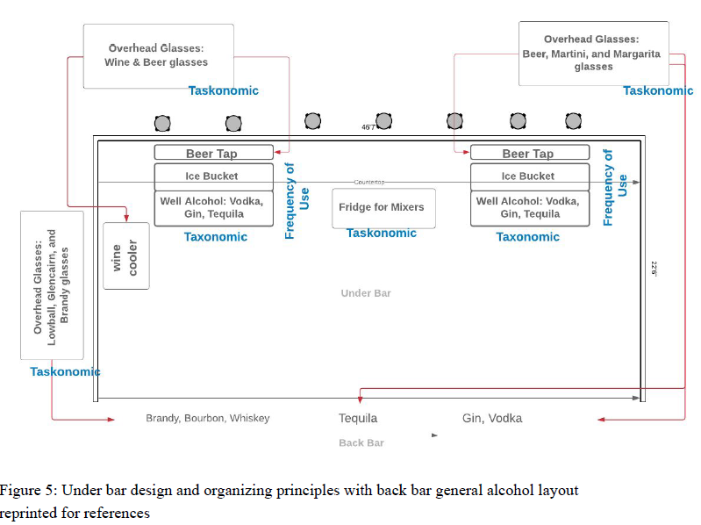

Slide 6
High-End Professional Kitchens (Chez Panisse)
Case study author talked her way into the restaurant kitchen, working for several nights doing real work to observe how it operated and interviewing several types of restaurant workers
Key artifact is a timeline showing the evolution of a menu item from ingredient availability to recipe selection and design
Clever contrast of Chez Panisse and Subway to reinforce how the former’s organizing system creates its distinctive value and interactions

Slide 7
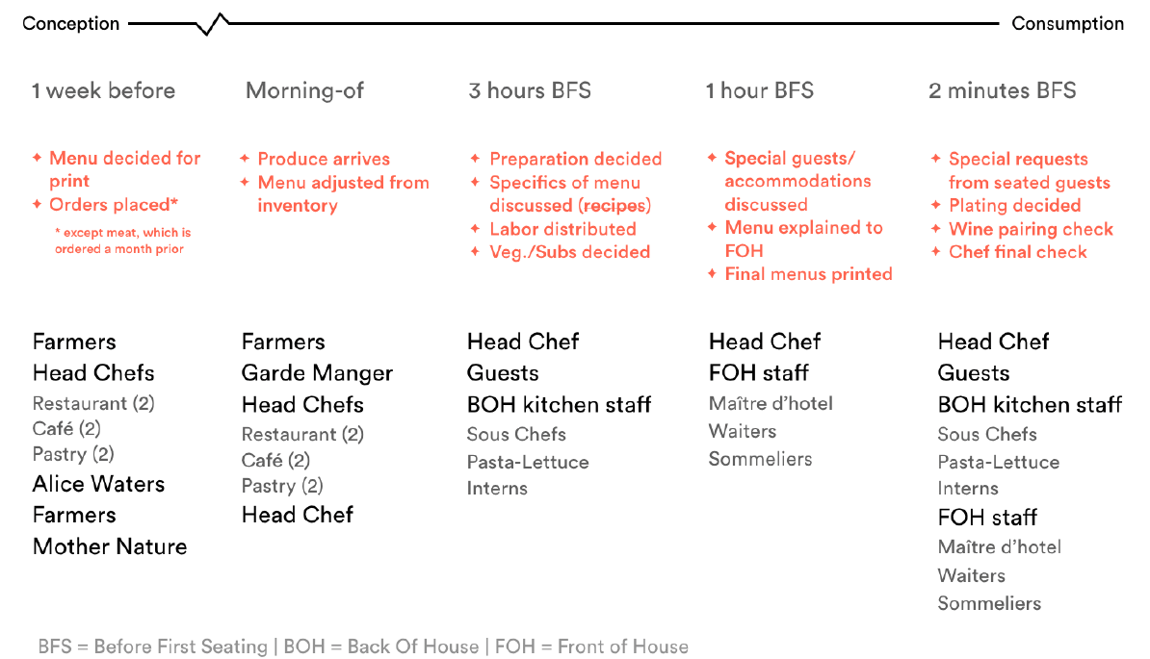

Slide 8
Chinese Medicine Cabinet
Case study author did “ethnographic study” of herbal medicine stores as part of Innovative case study that analyzes Chinese medicine cabinets
Organizing principles include some based on physical properties but also some based on concepts of herbal medicine in which different herbs take on roles as metaphorical agents to achieve a balanced treatment

Slide 9
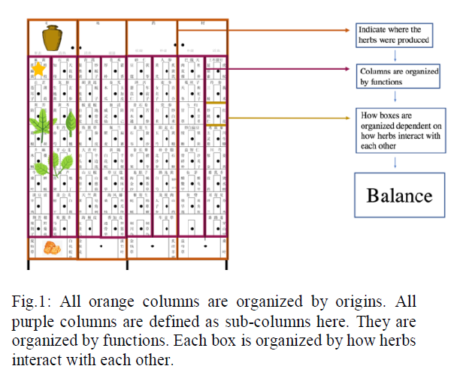

Slide 10
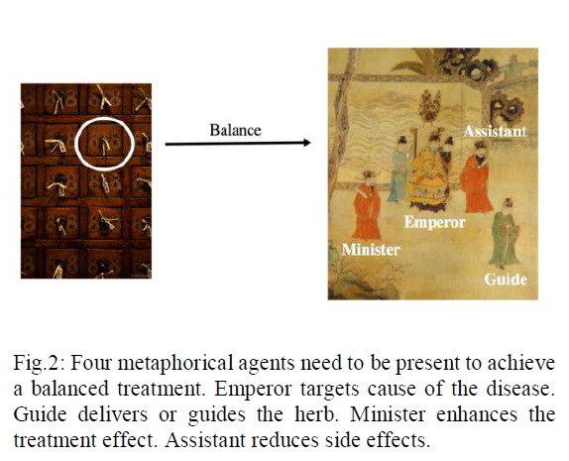

Slide 11
Managing a Round of Golf
The organizing system analyzed here is the golfer’s “model of the game” – how a golfer assesses the situation and environment on the course to select a golf club
Has some similarity to the case study about “guide dogs for the blind” in respect to how the golfer has to recognize and then strategically adapt as “situational resources” change

Slide 12
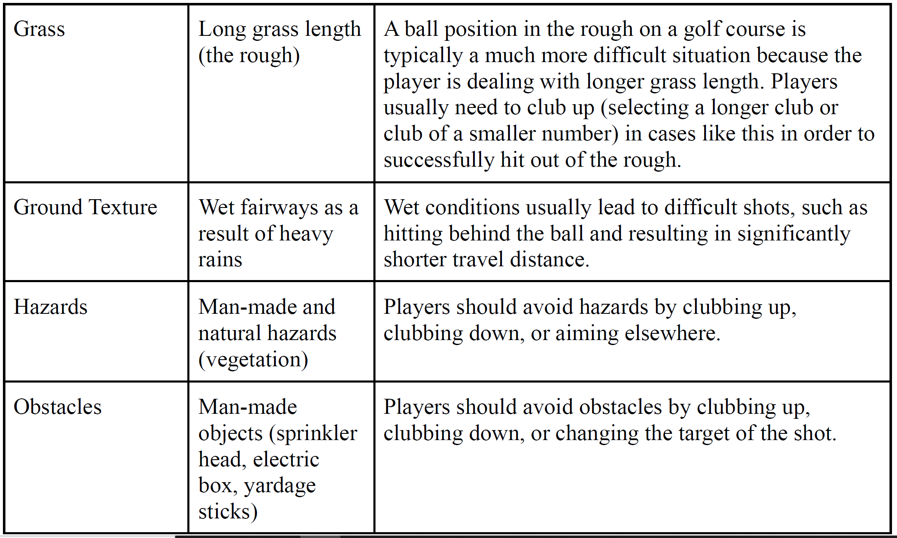

Slide 13
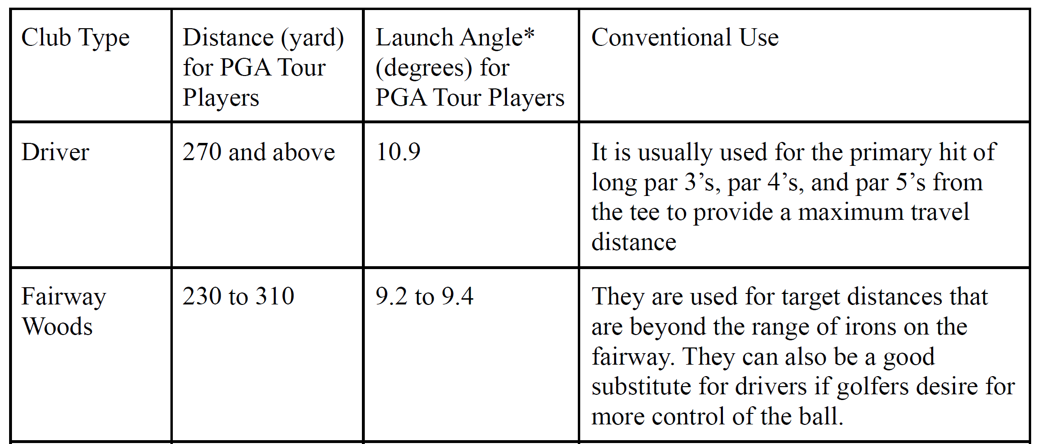
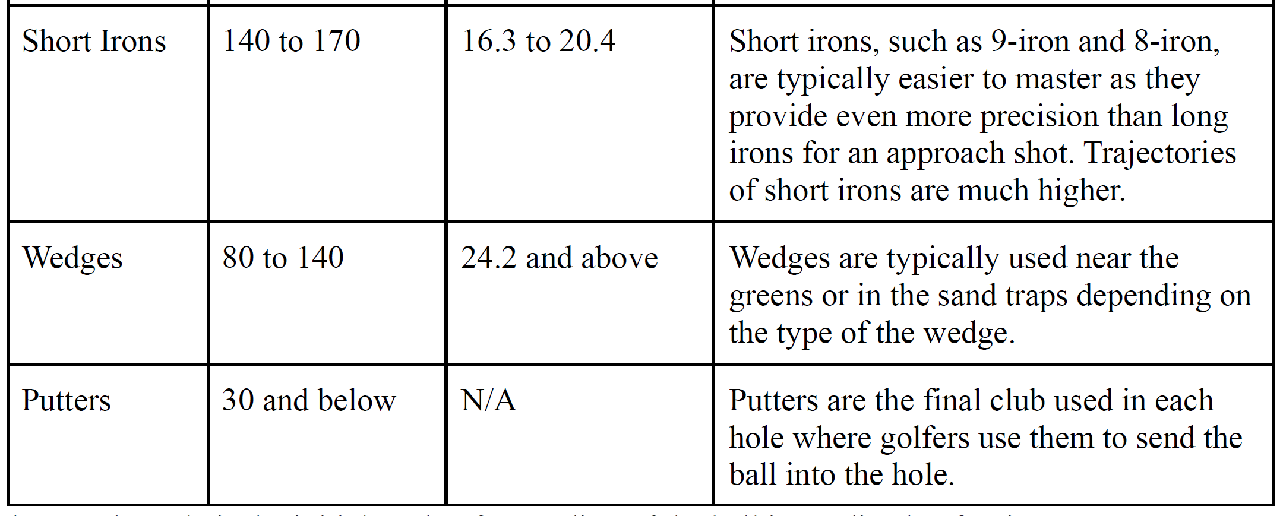

Slide 14
Residential Life Management
Like the “Organizing for Inebriation” case study, this one analyzes the organization of physical resources and human resources in student on-campus housing
Contrasts the organizing principles and enabled interactions before and during the covid pandemic

Slide 15
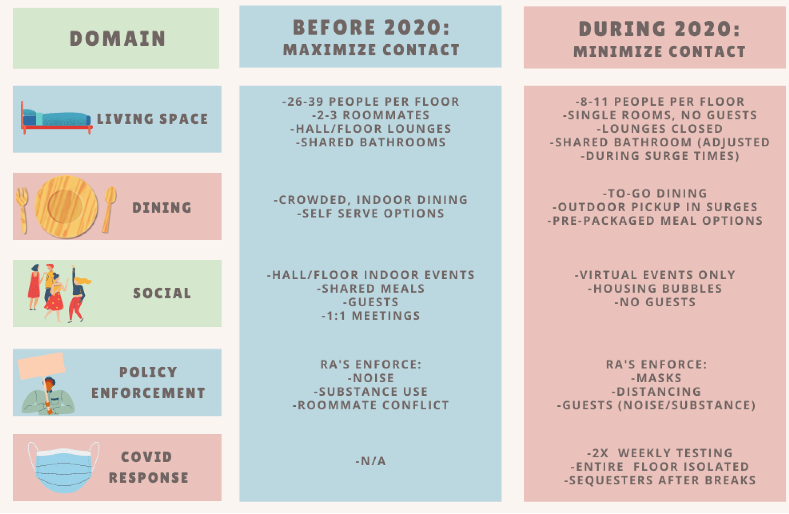

Slide 16
Credit Card Fraud
Author was a victim of credit card fraud
By analyzing reports and other analyses of fraud operations, she devised an abstract model of how a “scaleable fraud operation” would be organized – a “business design pattern” like those we discussed on 4/5
Some similarity to the “Organized Crime” case study you’ve read, but has more “MBA” texture and concepts than “Godfather” and crime concepts

Slide 17
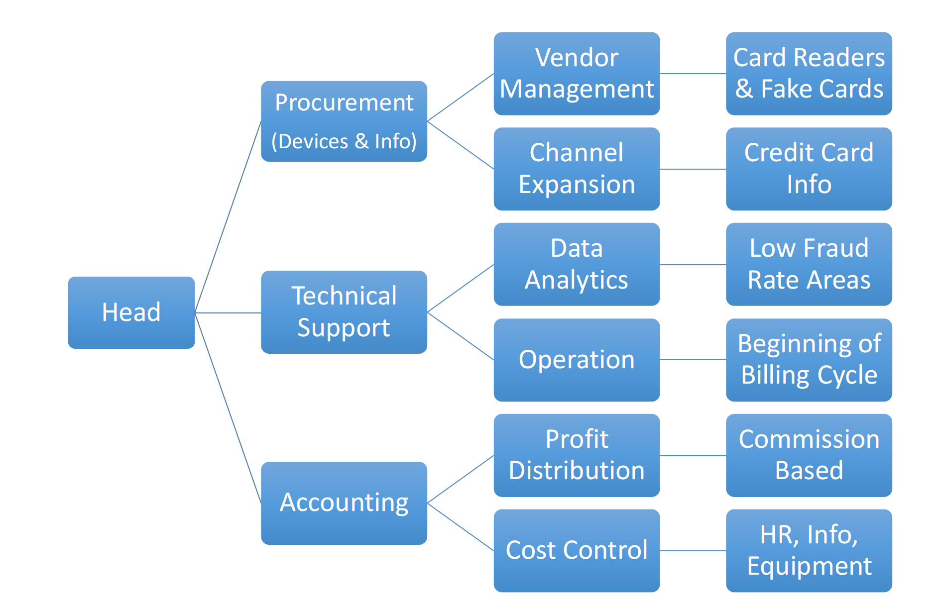

Slide 18
Good Ideas to Reuse in Your Case Study
Take multiple perspectives on the same organizing system
Devise hypothetical / invented systems to abstract or compare with existing ones
Analyze changes in a system over time or as contexts or requirements change
Do some ethnography or interviews to see your system in operation

Slide 19
Case Study “Discussion Pods”
People: Pham, Shankar, Youkana
Sports: Larsen, Wright, Tseng
Disciplines: Lu, Wilson
Design patterns: Cheung, Pierce
Branding: Ma, Oh
Technology-intensive: Patel, Shi, Turk
Everyone else will be in my pod

