Slide 1
CogSci 150 “Sensemaking and Organizing” Spring 2022
Robert J. Glushko
glushko@berkeley.edu
14 April 2022
24) Organizing with “Interaction Traces”

Slide 2
1984… written in 1949
The telescreen received and transmitted simultaneously. Any sound that Winston made, above the level of a very low whisper, would be picked up by it, moreover, so long as he remained within the field of vision which the metal plaque commanded, he could be seen as well as heard
There was of course no way of knowing whether you were being watched at any given moment. How often, or on what system, the Thought Police plugged in on any individual wire was guesswork. It was even conceivable that they watched everybody all the time. But at any rate they could plug in your wire whenever they wanted to.
You had to live -- did live, from habit that became instinct -- in the assumption that every sound you made was overheard, and, except in darkness, every movement scrutinized.
- George Orwell, 1984 (page 1)

Slide 3
Today’s Topics
Interaction traces
Transaction traces
Sensor traces and “Smart” Resources
How are these traces used?
They aren’t because it is too difficult or because there is no value proposition
They are used to help us
Personalization when we want it
Profiling: fraud detection with credit cards
They are used against us
Personalization when we don’t want it
Surveillance

Slide 4
Why Use Interaction Traces?
To classify
To predict
To recommend
These are not completely separable, but it is useful to discuss them as if they were

Slide 5
Examples of Classifiers
Classifiers for text identify its language, topic, author, sentiment, or other characteristics
Classifiers for activities or transactions can determine whether they are consistent with previous ones or likely to be fraudulent or illegal (credit card used in Romania?)
Classifiers can identify categories of people who are likely or not likely to do something (“behavior prediction” - to follow a link, make a purchase, get a disease)
5

Slide 6
Examples of Classifiers
Recommendation systems identify “matching” resources in different categories
Predictive maintenance systems analyze sensor data from engines or machines to anticipate service needs (and to recommend when professional athletes should sit out a game or play fewer minutes to maintain their performance)
6

Slide 7
Interaction Traces with Physical Resources
Interactions involving physical agents and resources often leave traces or other evidence
These traces can be unintentional or intentional
These traces tend to fade over time, and different traces with the same resource lack consistency

Slide 8
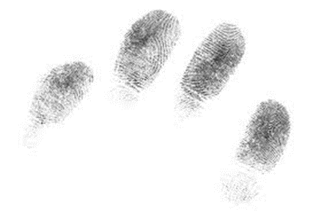
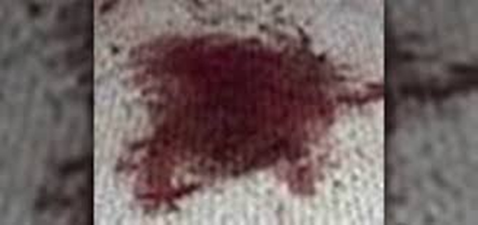
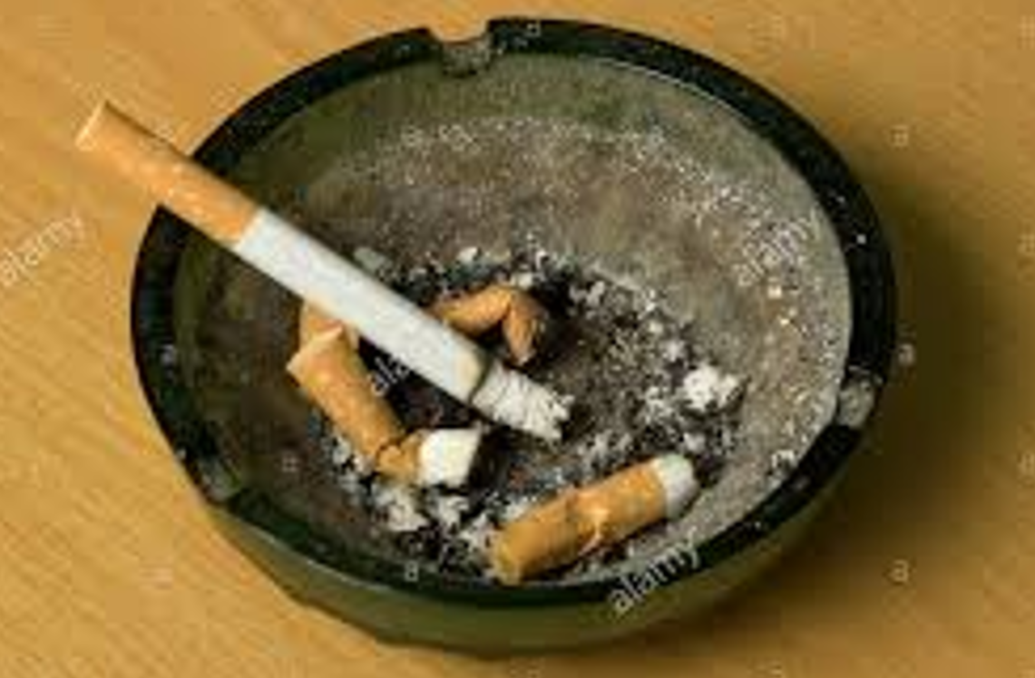
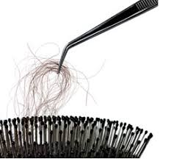
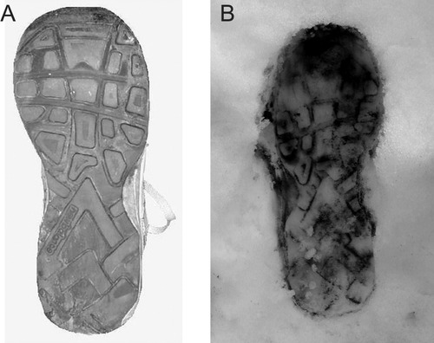
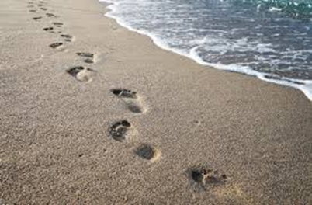
TRACES LEFT BY PEOPLE

Slide 9
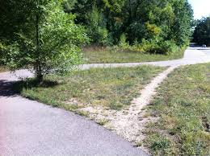
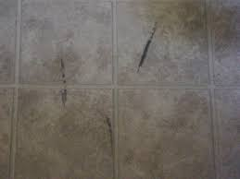
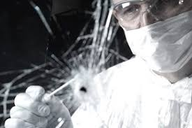
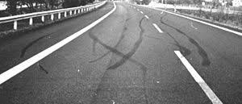
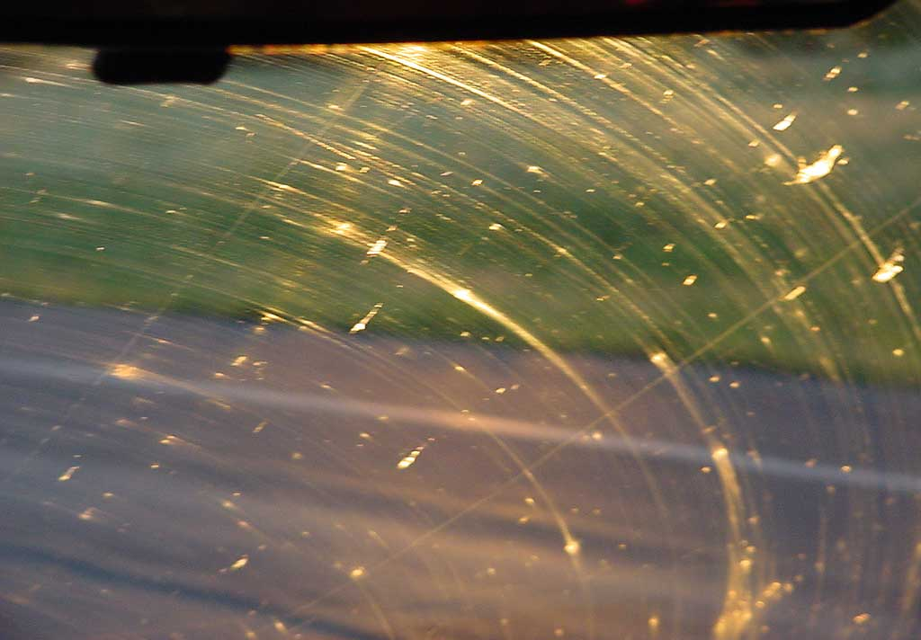
MORE TRACES
Can you identify specific resources, or only the category of resources that left these traces? (Shamu question…)

Slide 10
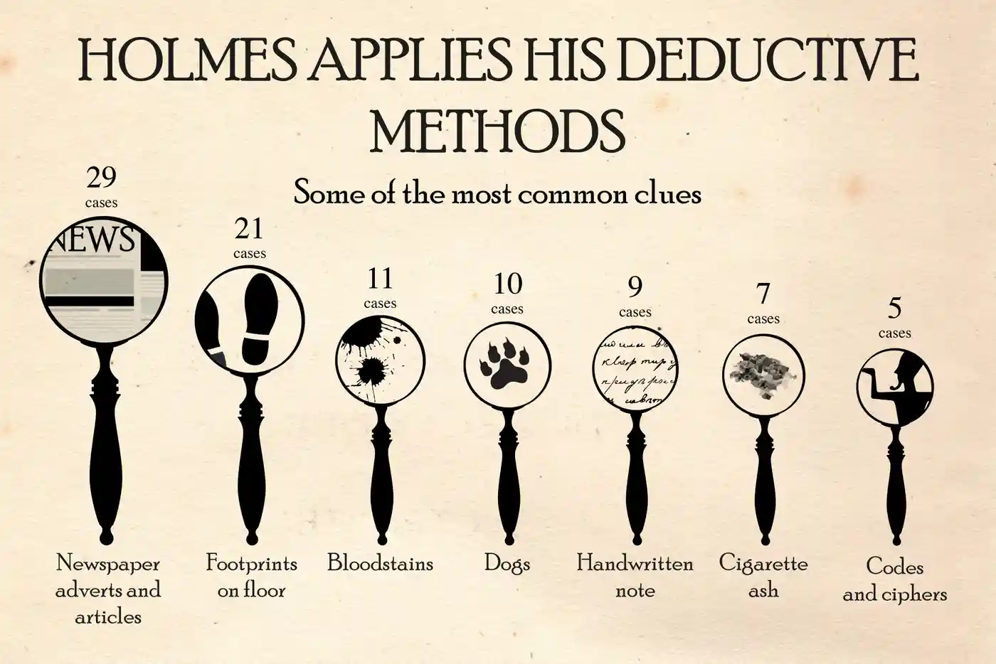
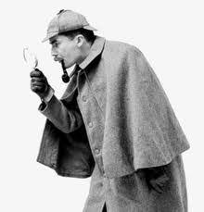
Traces can sometimes be used “forensically” to identify their sources

Slide 11
Resource Agency
Many organizing systems contain tangible and static resources that must be acted upon or interacted with to produce an effect
Active resource create effects or value on their own, sometimes when then initiate interactions with static or passive resources.
Sensors, web-based services, information feeds are active resources that often are combined to implement business processes or business models
People are almost always active resources that initiate interactions, especially with each other
11

Slide 12
Active / Operant / Smart Resources
“Smart” is a commonly used description of resources that can exploit sensing, computing, and communication capabilities
Virtually any product that uses electricity - toys, coffeemakers, cars, medical diagnostic machines - possesses inherent data processing capabilities. Each has a wealth of information about its current status, usage history, and performance
A “smart” resource with an IP address is said to be part of the “Internet of Things”
12

Slide 13
Stop And Think
There is a great deal of hype about the Internet of Things, and if you search for the phrase “Internet of Things” or “Smart” with almost any physical resource, chances are you will find something
What would you find with “crib,” “fork,” “lettuce,” “pajamas,” “chair,” streetlamp,” …
13

Slide 14
The “Smartness” Continuum
Sensing or Awareness – measuring some aspect of the environment
Actuation – initiate some action or message
Connectivity – connected to other resources
Computation or Programmability – so they can analyze and adapt
Composability and Cooperation – can function as modules or services in more complex systems
14

Slide 15
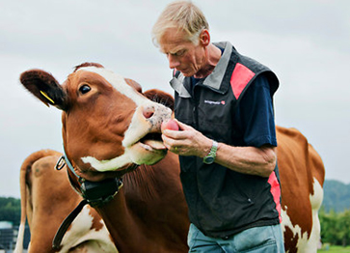
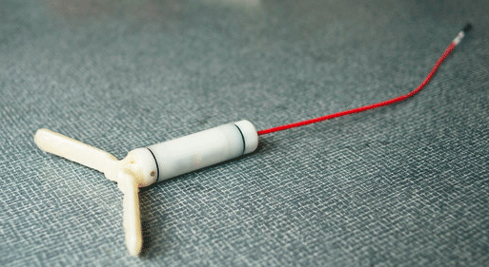
Just sensing something does not create any value. Something needs to be done with the information!
Actuation – the resource can initiate an action based on what it senses
Turning on lights, motors, speakers, cameras
Displaying, broadcasting, or sending information about its state
This device can “Sext” when the cow is “in heat”

Slide 16
What Makes a Resource Smart?
Connectivity – physical and permanent connection, or digital (e.g., with IP)
Can enable the resource to send information to a more capable resource
Computation – analyze, refine, learn from the information it senses or obtains from connected resources
Programmable resources can have their capabilities upgraded by software updates
What is the benefit of “edge computing” done by each resource that collects data, vs. “cloud computing” after the resource sends its data to a collecting point?

Slide 17
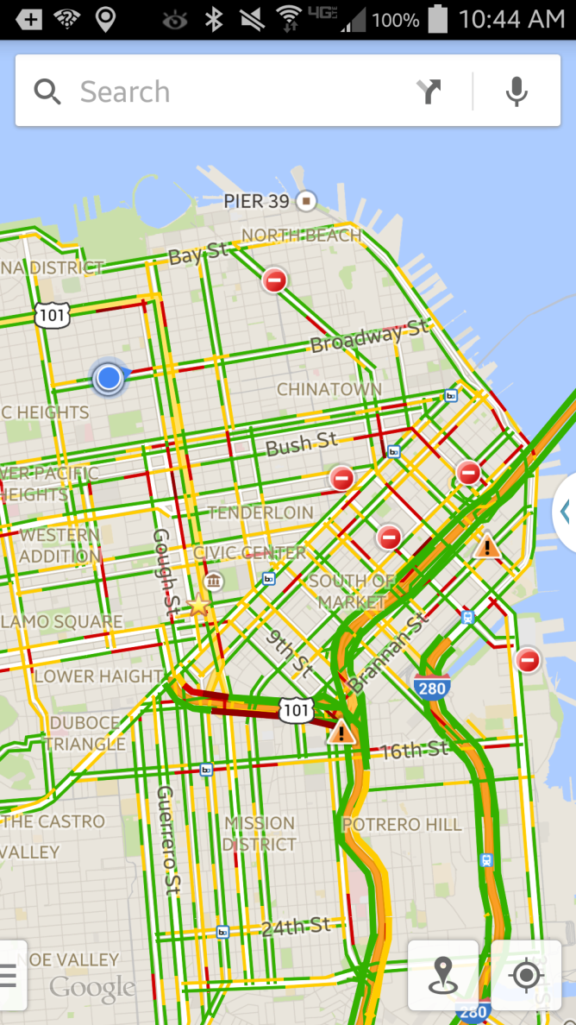
What Makes a Resource Smart?
Composability and Cooperating – independently designed and deployed resources can work together to enable services based on aggregated information

Slide 18
Interaction Traces with Digital or Sensor-Augmented Resources
Traces become predictable, persistent, and consistent
Traces can be analyzed, aggregated, and become the basis of new, enhanced, or personalized interactions
However, when these traces are made by people, their uses raise numerous issues of privacy and exploitation

Slide 19
Stop And Think
What types of interaction traces did you record in your diary?
Which ones were the result of an explicit action of yours?
Which ones were created without any explicit action (or permission)?
19

Slide 20
Human-Initiated Interaction Traces
Sensors in devices when people use them (smart workouts, Peloton, CAL-id keycards for doors)
Text communications (email, messaging apps)
Speech communications by phone
Cameras with automatic geotagging of photos
Location traces from vehicles (Fastrak, Uber, Lyft, parking apps)
Financial transactions (ATMs, credit cards, Venmo, etc.)
Web search and browsing (search terms, sequences)
Active video or audio use (viewing/listening history on streaming services or websites)

Slide 21
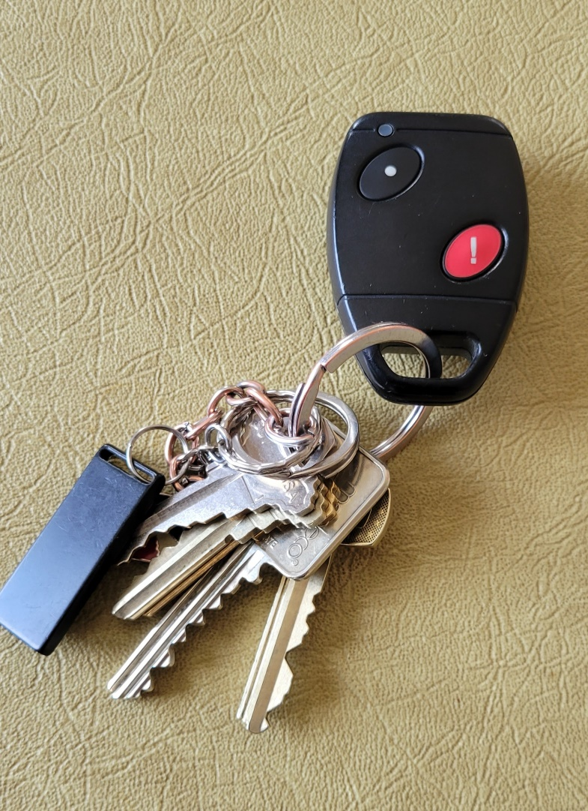
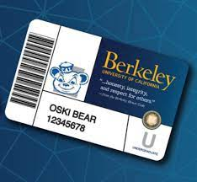

Slide 22
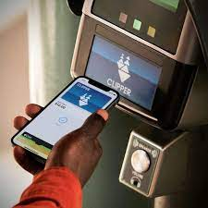
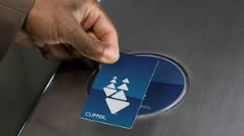
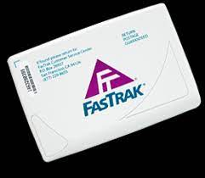
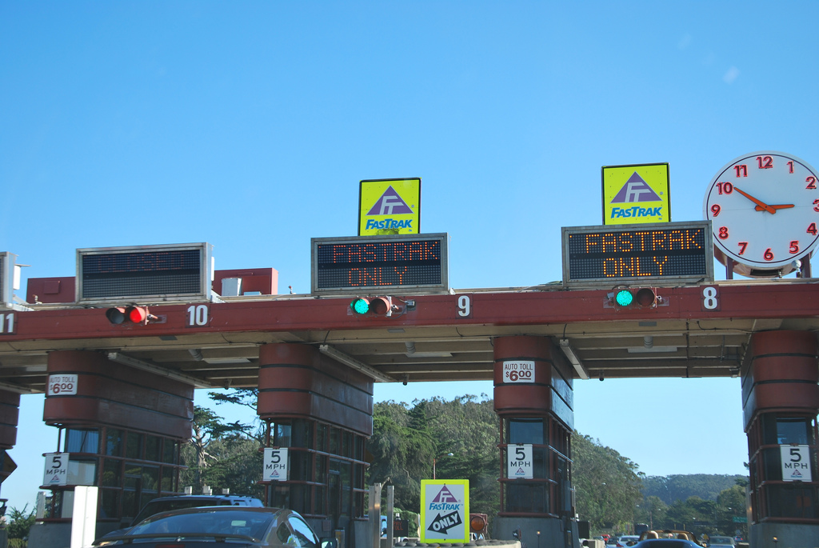

Slide 25
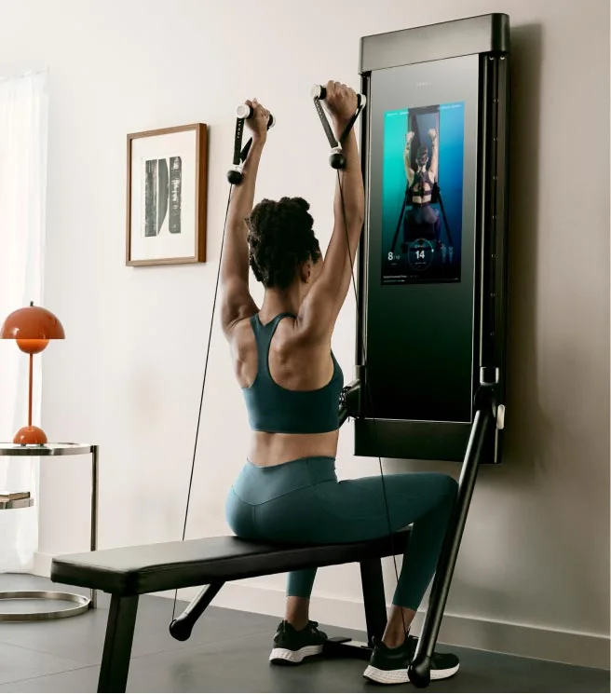
https://www.onepeloton.com
https://www.tonal.com

Slide 26
Interaction Traces not Explicitly Initiated by Humans
Wearable sensors (smart watch…)
Sensor traces from machines and devices in your environment (utility billing)
Location tracking using GPS built into your smartphone or computer
Video surveillance

Slide 27
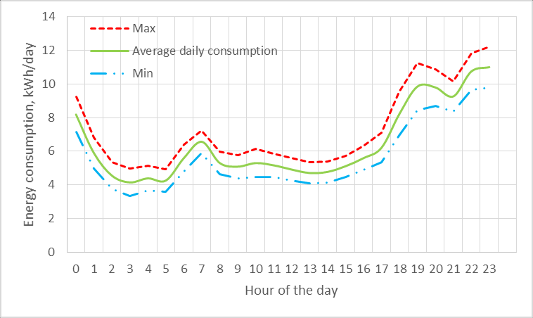
Utility Data Collection
What inferences about your behavior or device usage can be made from utility data?

Slide 28
Interaction Traces from Sensors
Sensors enable the continuous collection of streams of low-level data about people and their environments.
Locations, physiological states, contact with other people, situated uses of devices, and other digital traces can potentially be recorded and analyzed
Each of these kinds of data can be collected at virtually any frequency, with or without participant knowledge or intervention, and for extended periods of time

Slide 29
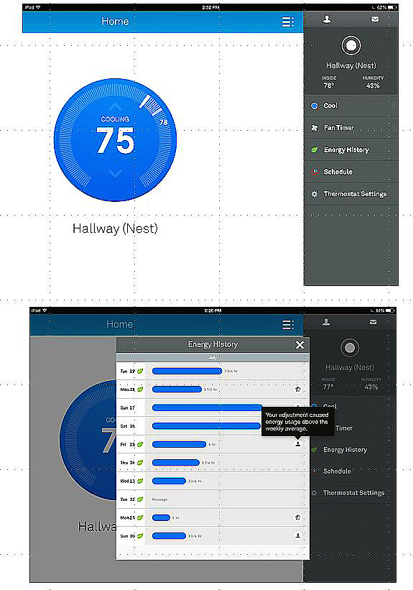
The Nest Learning Thermostat
The thermostat control panel and an energy history report
Can serve as a hub device, communicating with lights, appliances, alarms, your car, your fitness sensor, and other active resources

Slide 30
Healthcare Applications
Wearable fitness trackers
Smart health watches
ECG monitors
Blood pressure monitors
Biosensors for temperature, oxygen levels

Slide 31
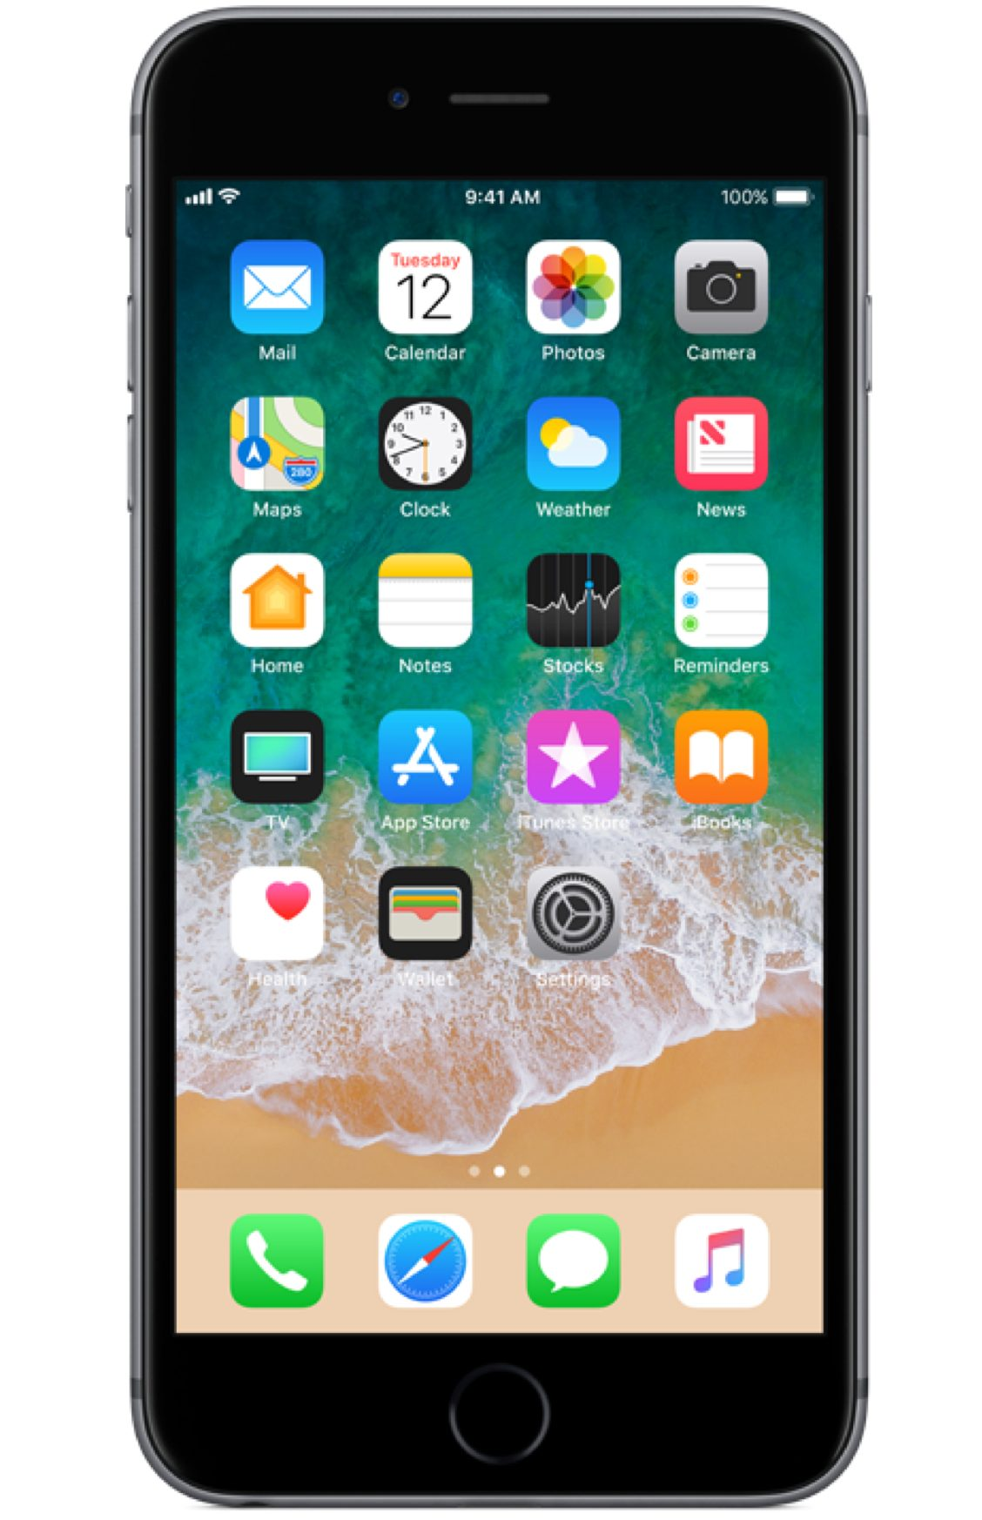
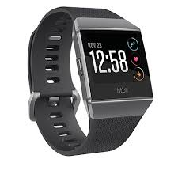
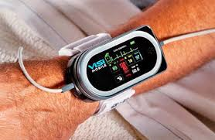
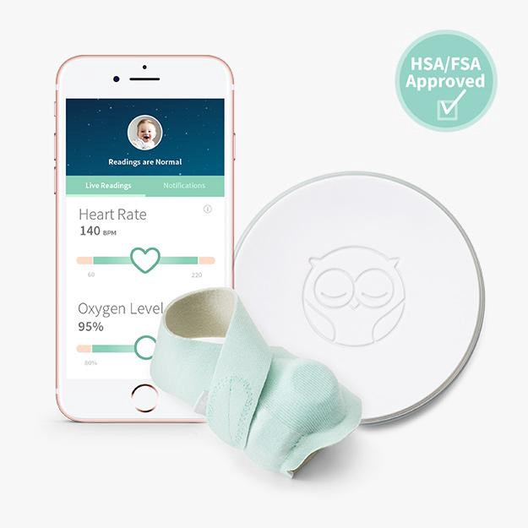
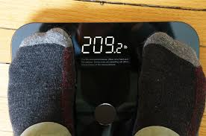
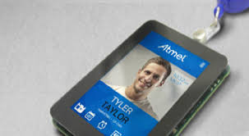
Does anyone have a smart watch or use other biometric tracking technology? Has this changed your behavior?

Slide 32
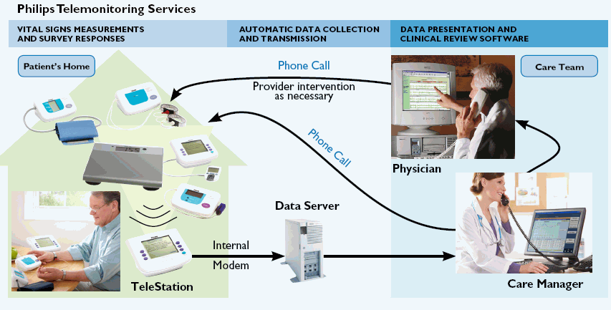
Remote Patient Monitoring
Wearable devices or home appliances can capture vital signs and activity data and inform medical personnel as needed
Enabling "aging in place" with "assistive technology" can vastly improve the quality of life for old folks
32

Slide 33
Stop And Think
Are you willing to strap on sensors that send info about everything you do to your doctor? What if you are ill? What if you are age 80?
What could your measure or monitor remotely in a house where an old person lived to determine if they were OK?
33

Slide 34
Other Uses of Health Sensors and Tracking
Ingestible “Smart pills” that detect when patient takes them
Ovia, a pregnancy-tracking app, sends data to a woman’s employer, which wanted to ensure that her pregnancy had no complications (to save medical insurance money)

Slide 35
Biometric Identity
Biometric data can create a very precise profile of an individual… and it is hard to change your biometric identity once it is created
"You can delete cookies. You can change browsers. And you can leave your smartphone at home. But you can't delete your face, and you can’t leave it at home.“
facial recognition expert Alvaro Bedoya, executive director of Georgetown Law's Center on Privacy & Technology.
Is face recognition a good thing, or a bad thing?

Slide 36
Face Recognition Now Required to Buy a Phone or use Internet in China
Since December 2019 Chinese telecom companies have required customers to take a face recognition test to buy a new phone or get Internet access
This new policy was justified in response to “an uptick in phone and internet fraud”
This makes it impossible for people to change their mobile numbers, use someone else’s phone, or access the Internet anonymously
https://gizmodo.com/chinese-citizens-will-have-to-scan-their-faces-to-get-i-1838936778

Slide 37
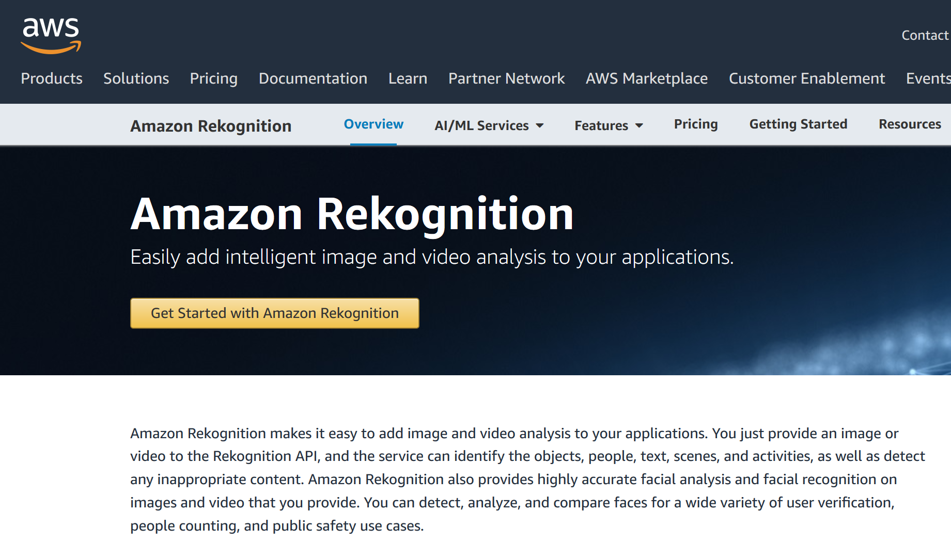
Image / Face Recognition as a Service
We could take class attendance with cameras at the door, using your campus ID photos. Good idea?

Slide 38
Facial Recognition Goes to War
Services that put a name to a face, including Clearview AI, are being used to identify Russian soldiers, living or dead, and to verify that travelers in Ukraine are who they claim.
“I remember seeing videos of captured Russian soldiers and Russia claiming they were actors,” Mr. Ton-That said. “I thought if Ukrainians could use Clearview, they could get more information to verify their identities.”
Identifying dead soldiers and notifying their families is part of a campaign, according to a Telegram post by the Ukrainian vice prime minister Mykhailo Fedorov, to break through to the Russian public the cost of the conflict and to “dispel the myth of a ‘special operation’ in which there are ‘no conscripts’ and ‘no one dies,’” he wrote.
https://www.nytimes.com/2022/04/07/technology/facial-recognition-ukraine-clearview.html

Slide 39
Interaction Traces from Digital Transactions
Credit card, debit card, mobile phone, APIs (e.g., Stripe) … one-time or recurrent payments
Arguably voluntary… because sometimes you could have paid with cash… although many merchants are now refusing cash
Both sides get accurate and complete transaction records
IF YOU DON’T LIKE THIS:
Pre-paid cards and “crypto” cards enable anonymous transactions
You can also hide behind a “limited liability company” and have payments made by it
How often do you pay with cash? Do you have any cash on you now?

Slide 40
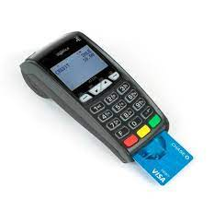
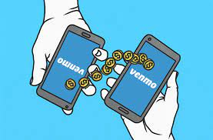
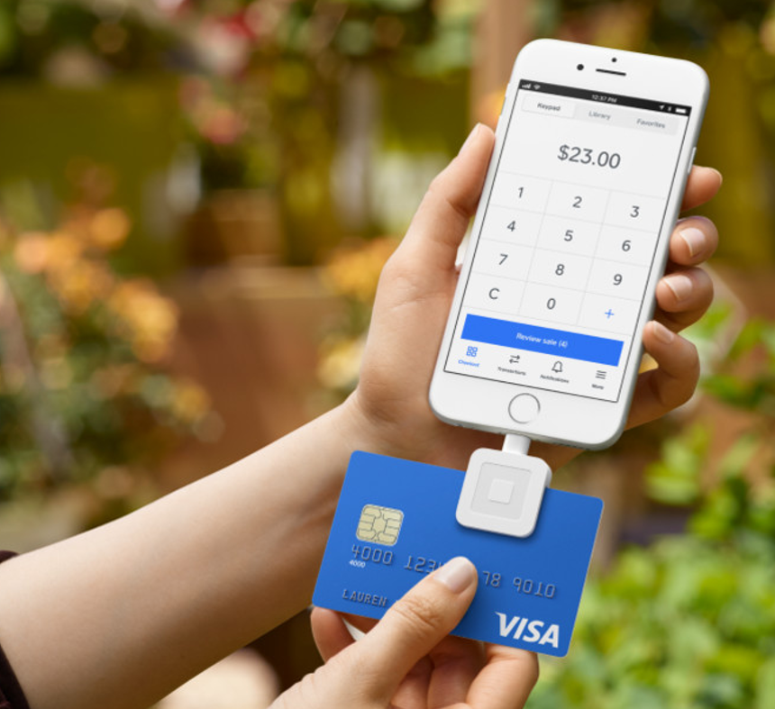

Slide 41
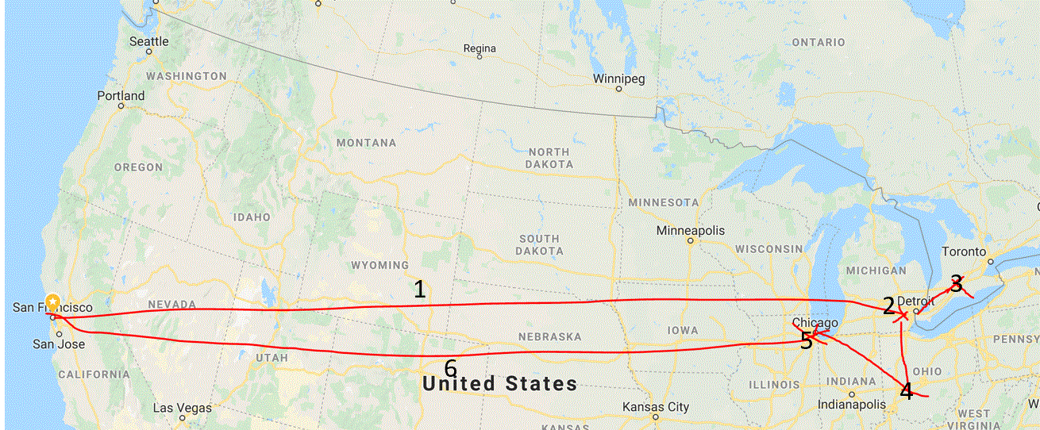
1- Flight to Detroit, 2- Rent Car, 3- Visit London ON, 4- Visit Dayton OH; turn in car; 5- Flight to Chicago, 6- Flight to SF
The Itinerary of My 2019 Spring Break Trip

Slide 42
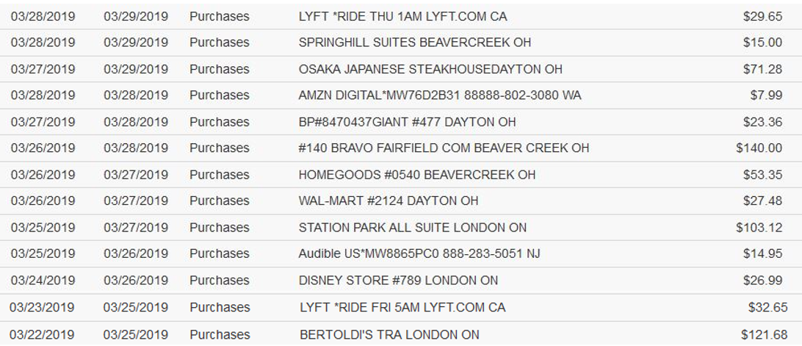
Credit Card Transactions – My 2019 Spring Break Trip to Canada and Ohio
From SFO to home
Hotel, Dayton OH
Hotel, London ON
Toys for grandchild
From home to SFO

Slide 43
My Google Maps Timeline (2013-19)
Did you know that Google collects location data by default any time you turn on your phone? I turned “location tracking” off the minute I discovered that

Slide 44
The Granularity of Location Tracking Enables Behavioral Inferences
What is my favorite activity when traveling?

Slide 45
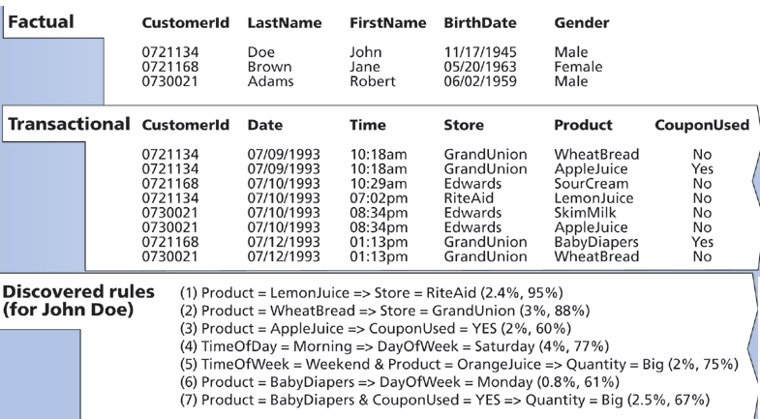
Building a Customer Profile with Data Mining
How would this profile be used to benefit the customer?
Could it be used in ways that don’t benefit the customer?

Slide 46
Inferring Customer Profile from Transaction Data

Slide 47
Unique Identifiers on Your Phone
Serial number
SIM card serial number
MAC address, used to identify your device on networks
Phone number
Advertising ID
On Android devices, AAID or GAID
On Apple devices, this IDFA (“Identifier for Advertiser” was made “opt-in” in latest iOS release
Did you know that there were so many ways to identify your phone?

Slide 48
Interaction Traces from Web Search and Navigation Behavior
Platforms and popular apps use “cookies” to record interaction traces to personalize your experiences and shape your behavior
IF YOU DON’T LIKE THIS it is possible to hide or anonymize some of your web transactions, but not all of them and not easily
How can you hide your interactions and prevent tracking?

Slide 49
How to Hide from Tracking
Use “private browsing” modes and do not allow sites to leave cookies
Use disposable phone numbers (e.g., https://quackr.io/)
Set up a VPN (virtual private network) to hide your real IP address
Use a mailbox address for any deliveries from online purchases
Don’t use your phone’s location service
Stop using Facebook

Slide 50
Interaction Traces with “Digital Assistants”
Any interaction with a digital assistant like Siri or Alexa or Google Home
Starts with speech recognition, but a transaction nonetheless
And you can buy stuff or search the web with them
But don’t they have to be “always on” to be useful?

Slide 51
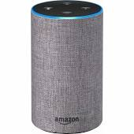
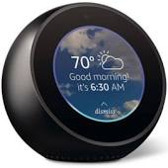
2022, or 1984?
Amazon's voice-controlled Alexa products are considered "always-on" devices — but that doesn't mean they record customers' conversations. The devices constantly listen for a user to say a "wake word," which triggers Alexa to begin recording voice data and respond to commands
On many occasions, however, Alexa has mistakenly detected its “wake word”, recorded a private conversation, and forwarded it to someone in the speaker’s list of phone contacts

Slide 52
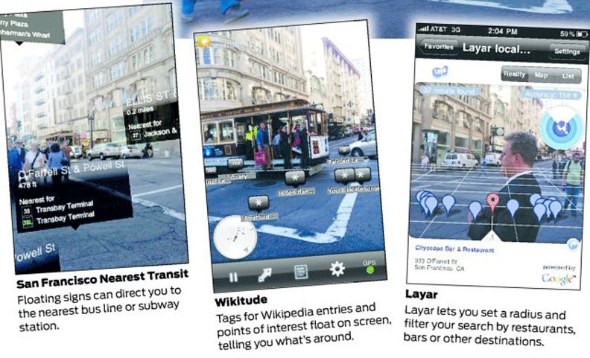
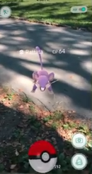
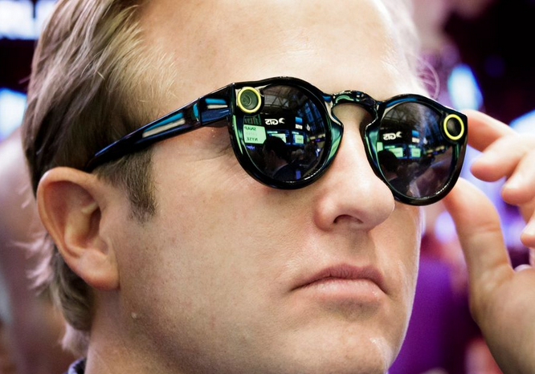
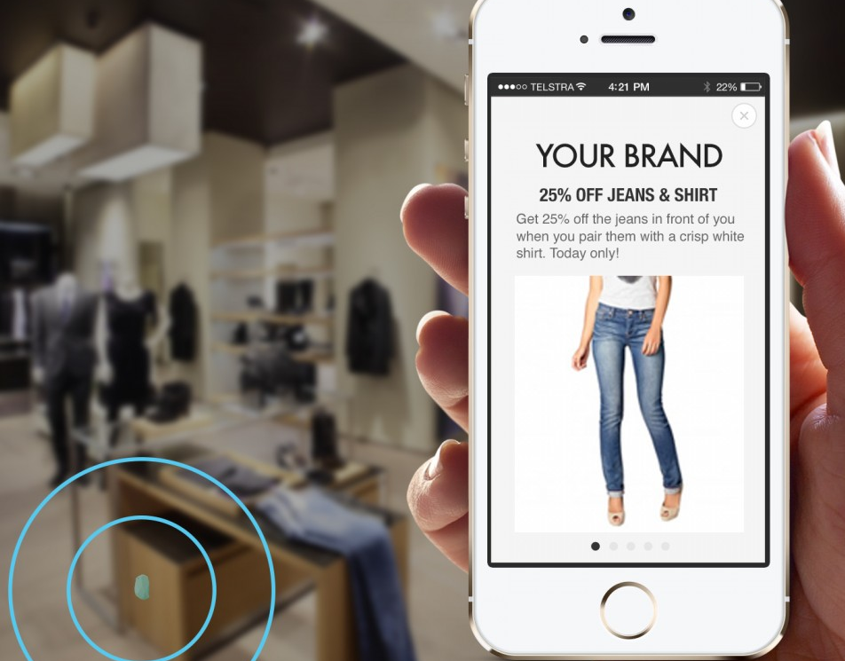
Location-Based Augmented Reality
Location and resource-based information is sent to or layered on your smart phone or eyeglasses

Slide 53
Data Modeling for Personalization
The information provided explicitly or implicitly by the consumer can be used to build a model or profile
This "model" can be trivial - like the set of "cookies" from previously visited sites, and simple "been there before" information can be used to personalize
Or it can be much more sophisticated and robust, based not just on a single customer but on other consumers who are similar to the target consumer
53

Slide 54
Data Mining for Prediction and Personalization
Data mining is a generic term for the collection of analysis techniques used to infer rules from or build models from large data sets
There are two distinct goals in data mining - knowledge discovery (or learning) and prediction
Knowledge discovery identifies association rules between one data item and another (like the tendency to purchase together or in a predictable temporal sequence)
A human analyst is usually involved to determine which associations are exploitable
54

Slide 55
Building a Customer Profile with Data Mining

Slide 56
Retail: “Customer Experience Management” Using Sensors
The retail environment is the medium through which customers and products come together
Real-time customer tracking (RFID, GPS, video, clickstream) allows retailers:
to manage the in-store communication and staffing processes
to connect consumers’ needs and goals with the available products and services (perhaps by organizing them on the basis of analyzed shopping behavior)

Slide 57
Important Customer “Touch Points”
Store Entrance and Window Displays
Lead Fixtures and Merchandising
End-of-Aisle Displays
High Volume / Margin Departments
Customer Service Desk
Checkout

Slide 58
Shopping Carts with Sensors (10 years ago)
Why is tracking carts a very limited and indirect way of collecting data about shopping?

Slide 59
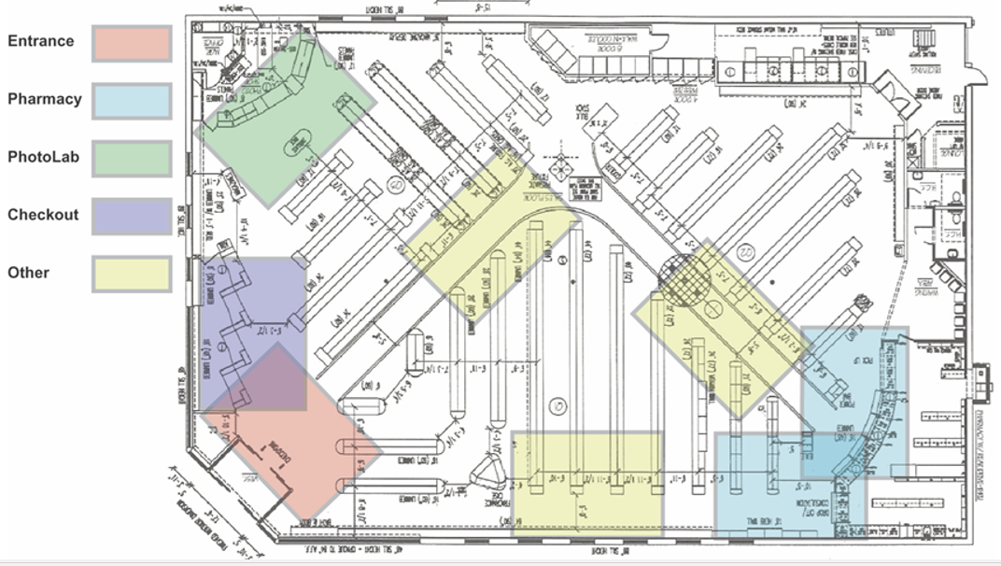
Video Tracking of Shoppers

Slide 60
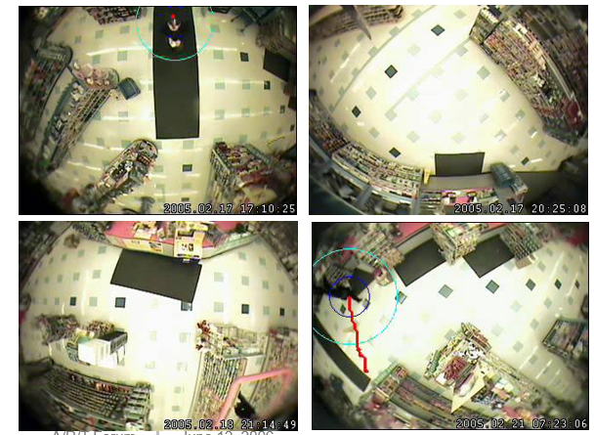
Real-time Behavior Analysis with Live Video
Detect Customer
Track Customer Movement
Recognize the Activity Pattern

Slide 61
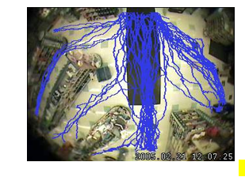
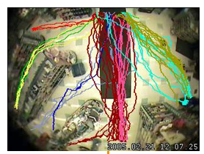
Aggregated Movement Tracking
Movement Patterns

Slide 62
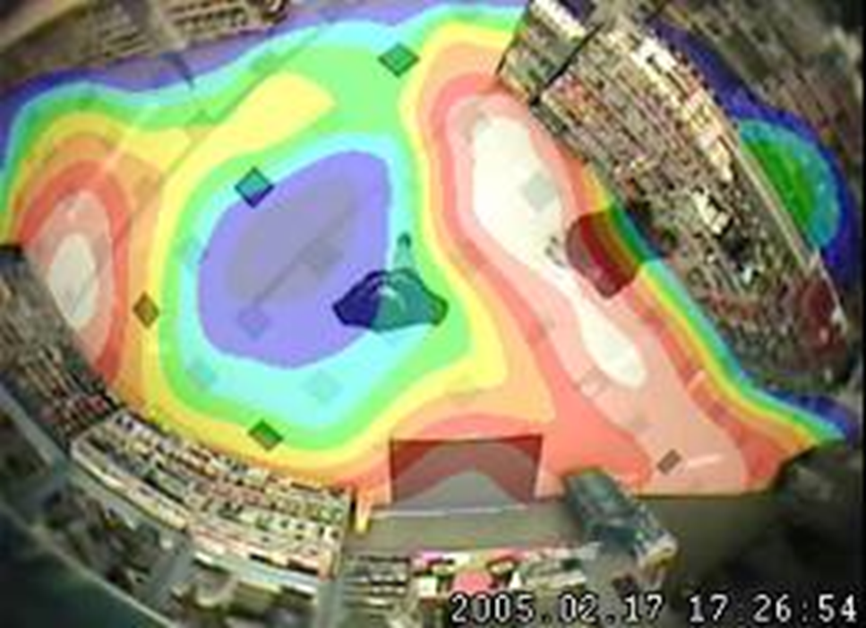
Patterns of “Dwell Time”

Slide 63
Where do customers go in the store?
How much time do they spend there?
Does this correlate with how much money they spend?

Slide 64
Stop and Think
Why do store employees wear uniforms?
To make it easy for customers to identify employees so they can ask for help?
To make it easy for …
Do the activity patterns for customers and employees differ?

Slide 65
Amazon Go Store (2019)
HOW MIGHT REAL TIME VIDEO ANALYSIS ENABLE AMAZON TO CONNECT PURCHASES TO A PERSON WITHOUT NEEDING A“PHYSICAL” CART?
How do less technically-advanced stores associate purchases with a person or account?

Slide 66
The “Hyperquantified Student”
Professor David Kellerman (University of New South Wales) keeps track of every “interaction trace” of every student in the course management system, in online discussions, homework assignments, and exams
This massive data set is used to predict performance on the final exam
The model is then used to create a personalized study guide for every student using course materials, lecture notes, homework answers, etc.

Slide 67
Personalized Study Pack for Final Exam

Slide 68
The “Hyperquantified Athlete”
Hundreds of different metrics can be analyzed using video analytics and wearables such as harnesses, sleeves, bands, straps, rings, and smart fabrics
Almost all major professional sports teams have analytics experts to find any advantage that can improve the chances of winning
Data collection and analysis are becoming increasingly real-time

Slide 69
The “Shift” – Positioning Baseball Players Using Data About Where Batters Hit the Ball

Slide 70
Two Categories of Data – Positional/Tracking and Biometric

Slide 71
Assignment Discussion -
Document and Data Diary
How many different document types?
What document type is the most common? Least common?
Is there any consensus on the concept hierarchy for document types?
How many different types of interaction traces?
What trace type is the most common? Least common?

