Slide 1
CogSci 150 “Sensemaking and Organizing” Spring 2022
Robert J. Glushko
glushko@berkeley.edu
19 April 2022
25) Applied Behavioral Economics
Choice Architecture

Slide 2
Today’s Topics
Applied behavioral economics
People don’t always make “rational” decisions because they aren’t cognitively capable of doing so
They use heuristics to reduce the cognitive load of decision making, which often work… but sometimes they don’t
Choice architecture
Behavioral economics from the perspective of the organizer rather than from the perspective of the user

Slide 3
Applied Behavioral Economics

Slide 4
Exercise 1
“Steve is very shy and withdrawn, invariably helpful, but with little interest in people, or in the world of reality. A meek and tidy soul, he has a need for order and structure, and a passion for detail.”
Is Steve more likely to be:
a farm worker
a college librarian
a pilot
a schoolteacher
a salesperson
a physician

Slide 5
Exercise 2
“Linda is thirty-one years old, single, outspoken, and very bright. She majored in philosophy. As a student, she was deeply concerned with issues of discrimination and social justice, and also participated in antinuclear demonstrations.”
Is Linda more likely to:
Be active in the feminist movement?
Be a bank teller?
Be a bank teller and active in the feminist movement?

Slide 6
Exercise 3
Which of these “Heads” and “Tails” sequences of 6 flips of a “fair” coin is most likely? Least likely?
1) H H H T T T
2) H H H H T H
3) H T H T T H

Slide 7
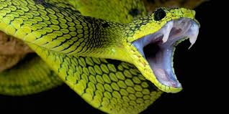
Exercise 4
Which of these is the most frequent cause of human deaths?
1. Shark attacks while swimming, surfing, or scuba diving
2. Bites from a poisonous snake
3. Bites from a mosquito
What information are you using to answer this question?

Slide 8
Decision Making and Assessing Probabilities
Many of the decisions we make in our personal and professional lives are in situations where outcomes are uncertain
Is there a “rational” way to assess probabilities of outcomes to make decisions?

Slide 9
Decision Making and Assessing Probabilities
Is there a “rational” way to assess probabilities and make decisions?
How does this “rational” way compare to what people actually do?
Do people want to act rationally?
If they don’t or can’t, why not?

Slide 10
Economic Theories of Human Decision Making (1)
Economic theories of human decision making assume that people can be reasonably approximated or described as “rational” agents
Individuals have precise information about the consequences of their actions
Individuals have sufficient time and capability to weigh alternatives
Did you follow a “rational” process like to decide what courses to take this semester? What would that require?

Slide 11
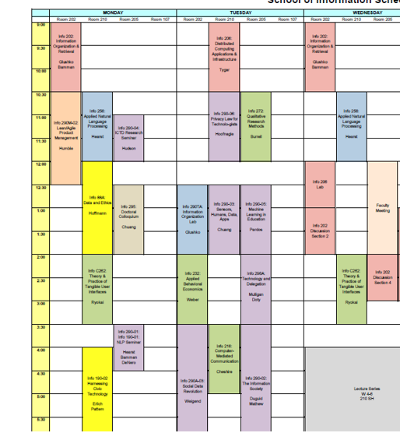
Deciding What Courses to Take
Did you have precise information about the content of a course, or how taking it would advance your career goals?
(…but first, do you know all of your career goals?)
Did you have sufficient time and capability to study the syllabus and course evaluations for every course you might take?

Slide 12
Economic Theories of Human Decision Making (2)
Different outcomes can be compared in terms of their “utility” (which is revealed by the choices people make)
The “value” or “utility” of a choice is the expected value of its probabilistic outcomes
Rational agents seek to maximize their utility

Slide 13
Deciding What Courses to Take
Can you rate each individual course in terms of how likely it is to advance your career goals?
Course A would be easy and interesting, and somewhat relevant to career goals
Course B would be pretty hard, but would probably help me get an internship
Course C would be very hard, but I’m sure that if I did well, the company that I worked for as an internship would offer me a full-time job
…
Can you compare different sets of courses in terms of how likely they are to advance your career goals?
Courses A, B, and G would be a pretty good schedule, not overwhelmingly hard, and would probably enhance my chances of getting a good job
Courses A, B, and C would be really hard, but I’d be sure of getting the job I want … but I’d have no free time
…

Slide 14
Deciding What Courses to Take
What future events comprise the “total number of outcomes” when it comes to choosing sets of courses to take?
Which combinations of courses will result in successful outcomes?
How far into the future do you look when you predict whether some set of courses will lead to a successful outcomes?

Slide 15
Economic Theories of Human Decision Making (3)
The “rational choice theory” enables calculations and predictions in situations with uncertainty (for example, in “game theory”)
Decisions that deviate from this theory can occur if people have incomplete information or insufficient time
But these deviations should be unsystematic because the factors that cause them are random and “average out”

Slide 16
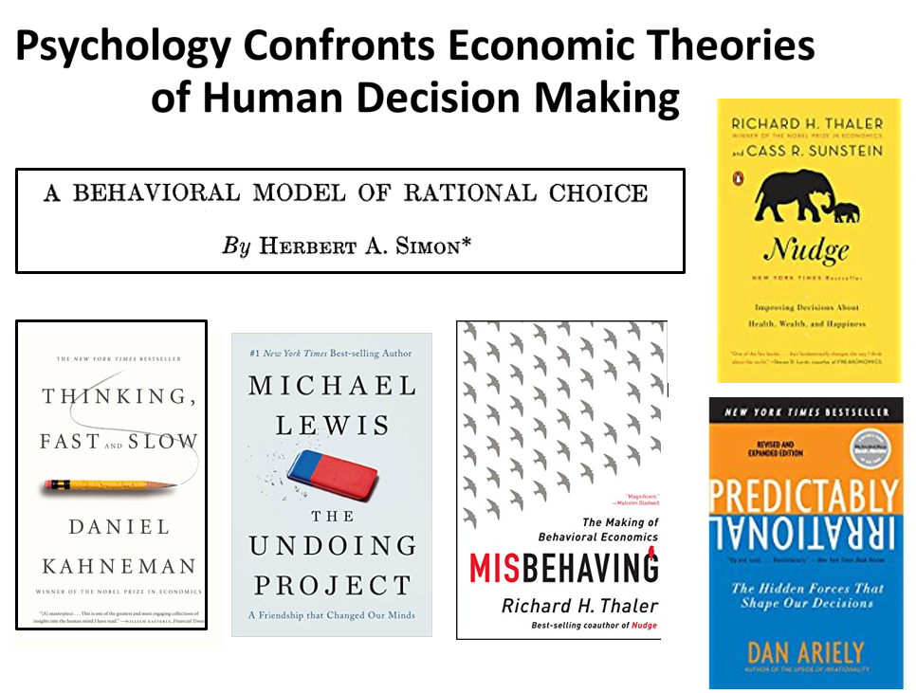

Slide 17
Bounded Rationality (Simon)
“Because of the psychological limits of the organism (particularly with respect to computational and predictive ability), actual human rationality-striving can at best be an extremely crude and simplified approximation to the kind of global rationality that is implied, for example, by game-theoretical models”
- Herbert Simon (1955). A behavioral model of rational choice. The quarterly journal of economics, 69(1), 99-118.

Slide 18
Bounded Rationality
People often lack perfect information of outcomes and probabilities, and don’t have the time and cognitive capabilities to make the calculations implied by rational choice theory
Decision-makers act as satisficers, seeking a satisfactory solution rather than an optimal one
We already demonstrated that choosing courses was satisficing…

Slide 19
Stop And Think
Can you think of situations where you settled for a satisficing solution rather than the optimal one?
Was choosing Berkeley a satisficing decision?
Finding a place to live… finding someone to live with?
When would you want to hold out for the optimal solution?
19

Slide 20
Beyond Bounded Rationality
Bounded rationality can explain why people sometimes make suboptimal decisions
But rational choice theory expects that suboptimal decisions should be unsystematic
WHY?
Tversky & Kahneman identified numerous systematic errors in judgment and proposed psychological mechanisms for them, mostly in terms of decision-making heuristics

Slide 21
“People rely on a limited number of heuristic principles which reduce the complex tasks of assessing probabilities and making predictions to simple judgmental operations. In general, these heuristics are quite useful, but sometimes they lead to severe and systematic errors”
Amos Tversky & Daniel Kahneman

Slide 22
Heuristics
A heuristic is any approach to problem solving, learning, or discovery that employs a practical method not guaranteed to be optimal or perfect, but sufficient for the immediate goals
When finding an optimal solution is impossible or impractical, heuristics can be used to speed up the process of finding a satisfactory solution
Heuristics can be mental shortcuts that ease the cognitive load of making a decision

Slide 23
Tversky & Kahneman’s Human Probability-Assessment Heuristics
Representativeness
The more object X is similar to class Y, the more likely we think X belongs to Y
Availability
The easier it is to consider instances of class Y, the more frequent we think it is

Slide 24
Representativeness Bias (1): Ignoring Prior Probabilities
It is easier to assess similarity than to compute probabilities
If people judge the probability that X belongs in class Y by how representative it is (its similarity to a stereotype) they will ignore the prior probabilities

Slide 25
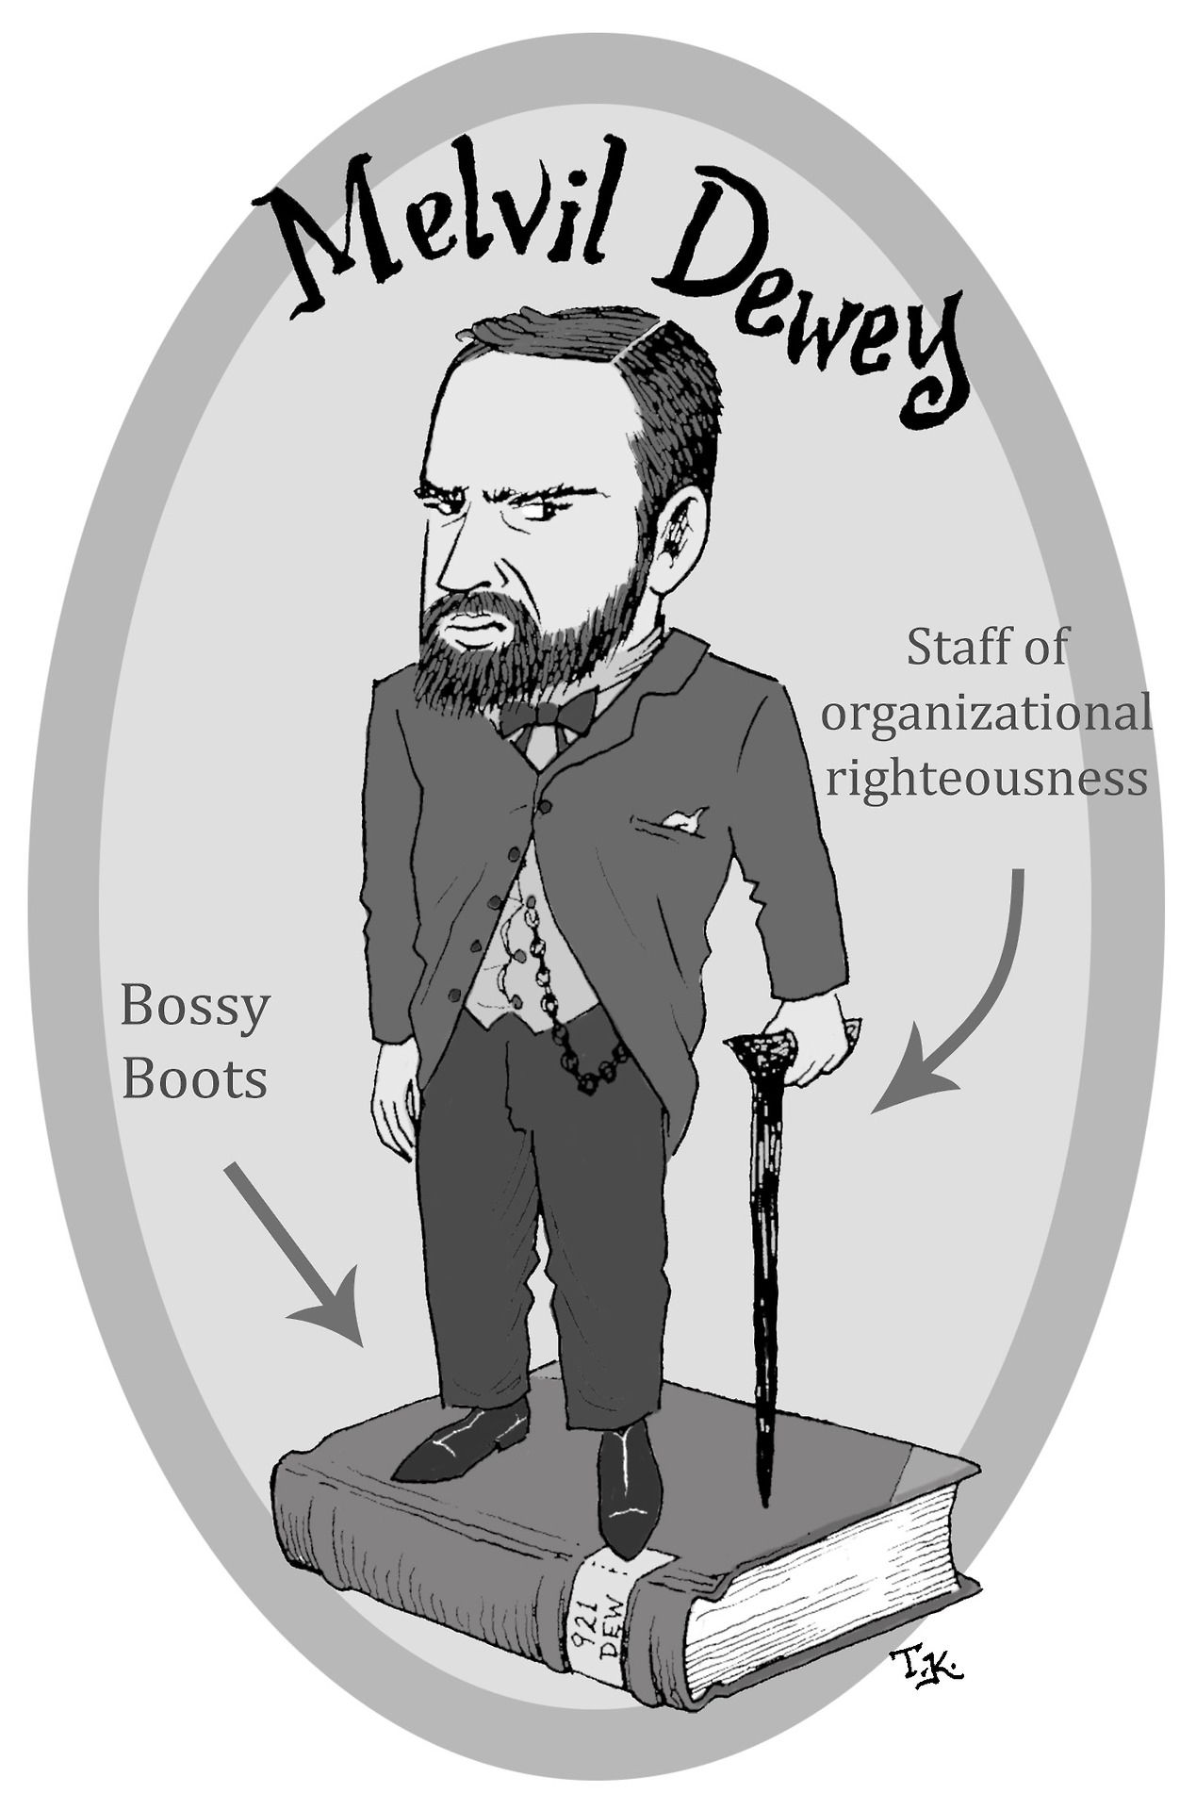
(Male) Librarian Stereotypes

Slide 26
Steve
Steve is very unlikely to be a college librarian because they are only ½ of 1 percent of the total people in these occupations (22.7 million)
a farm worker (over 3,000,000)
a college librarian (about 100,000)
a pilot (about 600,000)
a schoolteacher (over 3,000,000)
a salesperson (over 15,000,000)
a physician (over 1,000,000)

Slide 27
Representativeness Bias (2): Misconception of Chance
People expect random sequences to be “representatively random” even when the sequence is short
E.g., they consider a coin-toss run of HTHTTH to be more likely than HHHTTT or HHHHTH (they expect too many alternations and too few runs)
The Gambler’s Fallacy
After a run of reds in a roulette, black will make the overall run more representative

Slide 28
“Rational” Calculation of Probability
Example: 6 flips of a fair coin produces 64 different sequences, each of which is equally likely (½ * ½ * ½ * ½* ½ * ½ = 1/64)
H H H T T T, H H H H T H, H T H T T H, …
But in these 64 sequences there are
1 that have 0 or 6 heads (6 or 0 tails)
6 that have 1 or 5 heads (5 or 1 tails)
15 that have 2 or 4 heads (4 or 2 tails)
20 ways to get 3 heads and 3 tails

Slide 29
“Chance is commonly viewed as a self-correcting process in which a deviation in one direction induces a deviation in the opposite direction to restore the equilibrium. ”
Amos Tversky & Daniel Kahneman
Does this remind you of some concept from the lecture on causality and explanation?

Slide 30
Karma
FLASHBACK
Karma in several Eastern religions is the spiritual principle of cause and effect where intent and actions of an individual (cause) influence the future of that individual (effect)
Good intent and good actions contribute to good karma and future happiness, while bad intent and bad actions contribute to bad karma and future suffering
Hindu theories of salvation posit that future births and life situations will be conditioned by actions performed during one’s present life—which itself has been conditioned by the accumulated effects of actions performed in previous lives.

Slide 31
Representativeness Bias (3): Conjunctive Fallacy
The joint probability of two independent events cannot be more probable than either of them occurring separately
But if the conjunction seems like a representative outcome, it can be judged more likely

Slide 32
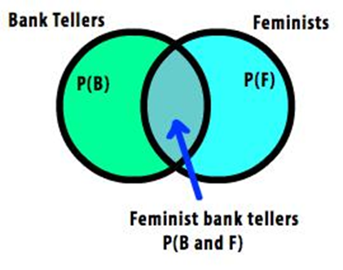
Conjunctive Fallacy with Linda
Be active in the feminist movement?
Be a bank teller?
Be a bank teller and active in the feminist movement?

Slide 33
The Availability Heuristic
“Availability is a useful clue for assessing frequency or probability, because instances of large classes are usually recalled better and faster than instances of less frequent classes. ”
Amos Tversky & Daniel Kahneman

Slide 34
Availability Biases : Ease of Retrievability
Classes whose instances are more easily retrievable will seem larger
For example, judging if a spoken list of names had more men or women depends on the relative frequency of famous names
Salience affects retrievability
E.g., watching a car accident increases subjective assessment of traffic accidents
Recency affects retrievability

Slide 36
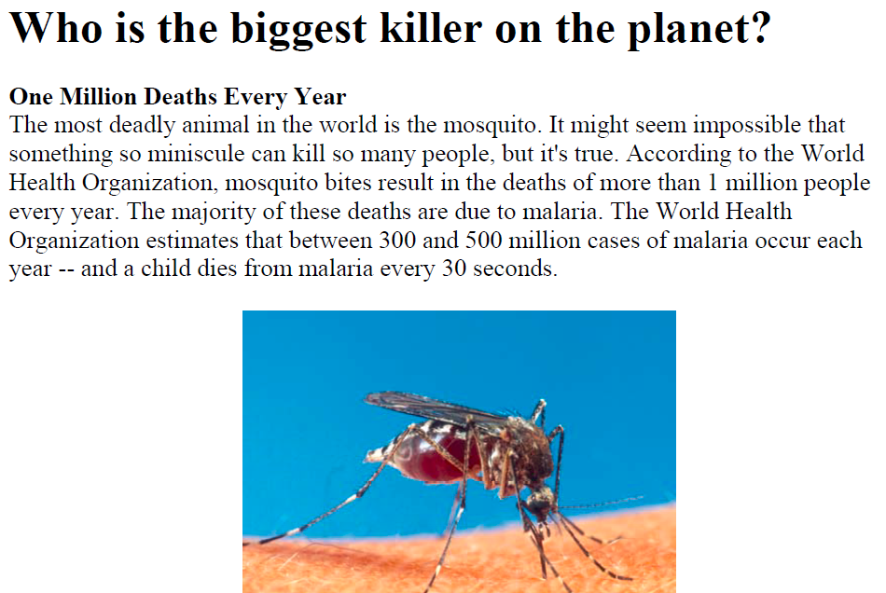

Slide 37
Biased News
FRAMING EFFECTS – News providers and commentators typically frame events in ways that highlight provocative aspects, suggest their causes, responses to them, and their political and cultural implications – often to create controversy
By emphasizing and “labeling” some actors and facts and de-emphasizing others, framing influences not just what people consider newsworthy, but how to think about the news
People are more likely to listen to news that frames things the way they like (this is confirmation bias and narrative fallacy)

Slide 38
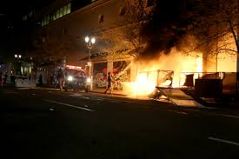
Framing the Protests
Were the protests in summer 2020 and 2021:
Free Speech?
Peaceful Demonstrations?
Rioting, Looting, Anarchy?

Slide 39
Choice Architecture

Slide 40
Stop And Think
Before I carefully define “choice architecture, let’s try to define it by considering the two words in the phrase
“Architecture” is typically used to describe the design of a building…. How do the architect’s design decisions influence the choices and behaviors of people who use the building?
40

Slide 41
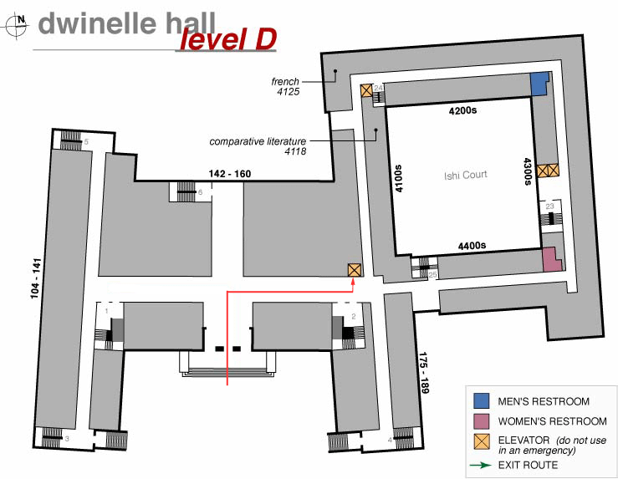
FLASHBACK
It is easy to make poor “navigation choices in Dwinelle Hall

Slide 42
FLASHBACK TO RESOURCE DESCRIPTION
Many interactions – especially with physical resources - seem unmediated when they take place
This means we don't always realize the role of additional descriptions or organization in supporting or improving interactions
Choices about descriptions and organizing principles involve tradeoffs that determine which interactions are efficient, possible, difficult, or impossible
42

Slide 43
Nudge
Known deviations from rational behavior can be used to design choice situations that nudge decision makers toward more beneficial
options
From a policy-making perspective, this approach aims to improve the public good without the use of regulatory processes or economic incentives

Slide 44
Categories of Nudge Interventions
Facilitate commitment - Enable participants to commit to an option
Provide social reference point – Provide information on other people’s behavior
Translate information – Change the format or presentation of information without changing the content
Provide reminders - Modifying the salience and the ease of access of options

Slide 45
Categories of nudge interventions
Change option consequences - Linking micro-incentives to the consequences of the options
Change range or composition of options - Making changes in the alternative options presented
Change option-related effort – Reduce the amount of effort the selection of an option requires

Slide 46
Nudge Domains
Nudges (or at least published studies of them) are most common in health-related domains
eating, drinking, or exercise behavior
Other domains (in decreasing order)
sustainability
consumer choice
prosocial behavior
finance
transportation
education

Slide 47
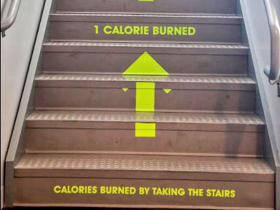
Don’t be lazy and take the elevator… walking stairs is good for you

Slide 48
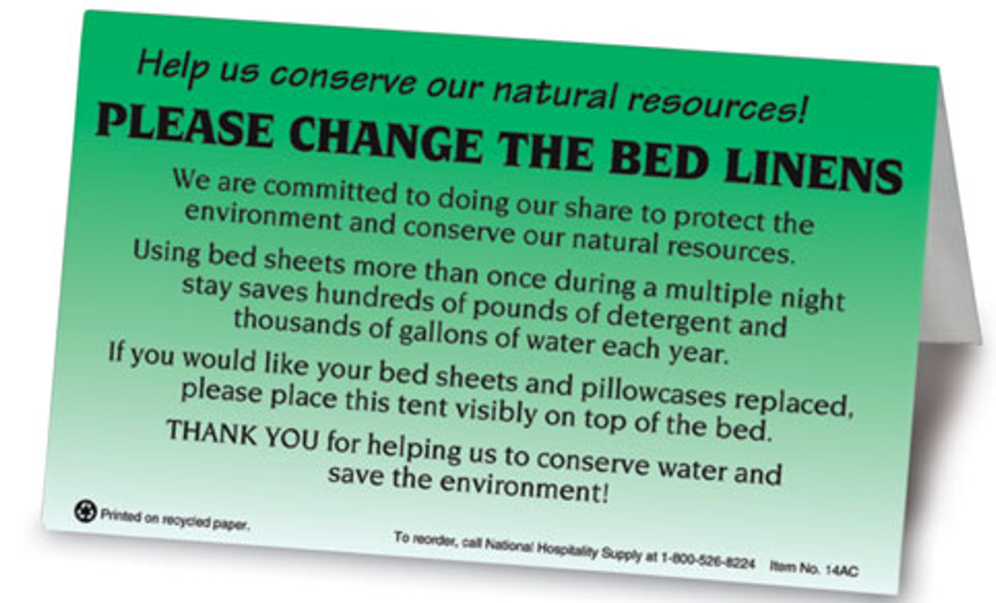
Save the planet (and some costs for the hotel, which they don’t offer to refund)

Slide 49
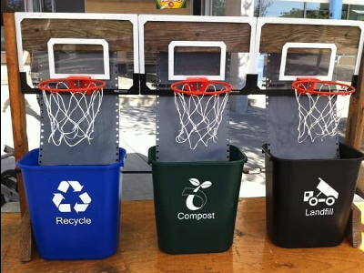
Gamify the task of recycling

Slide 50
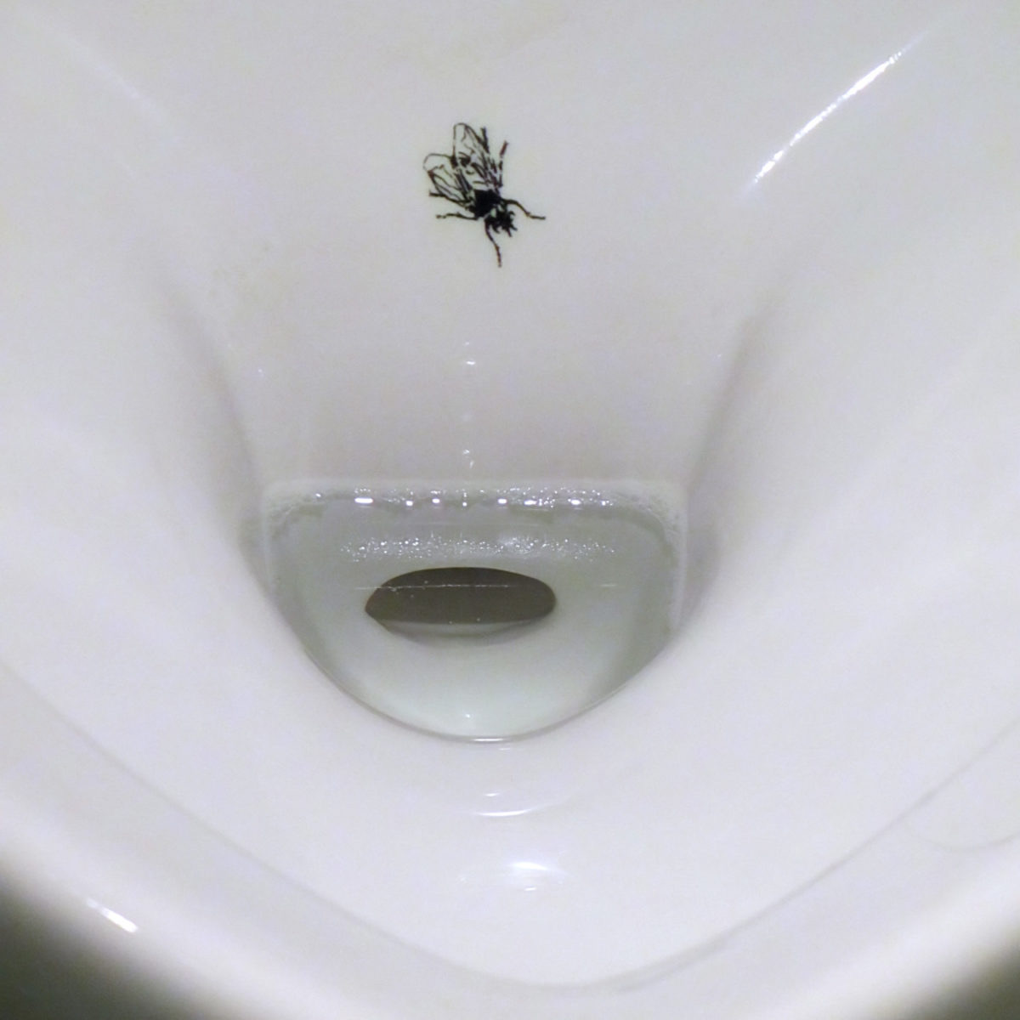
Gamify another task… for men only

Slide 51
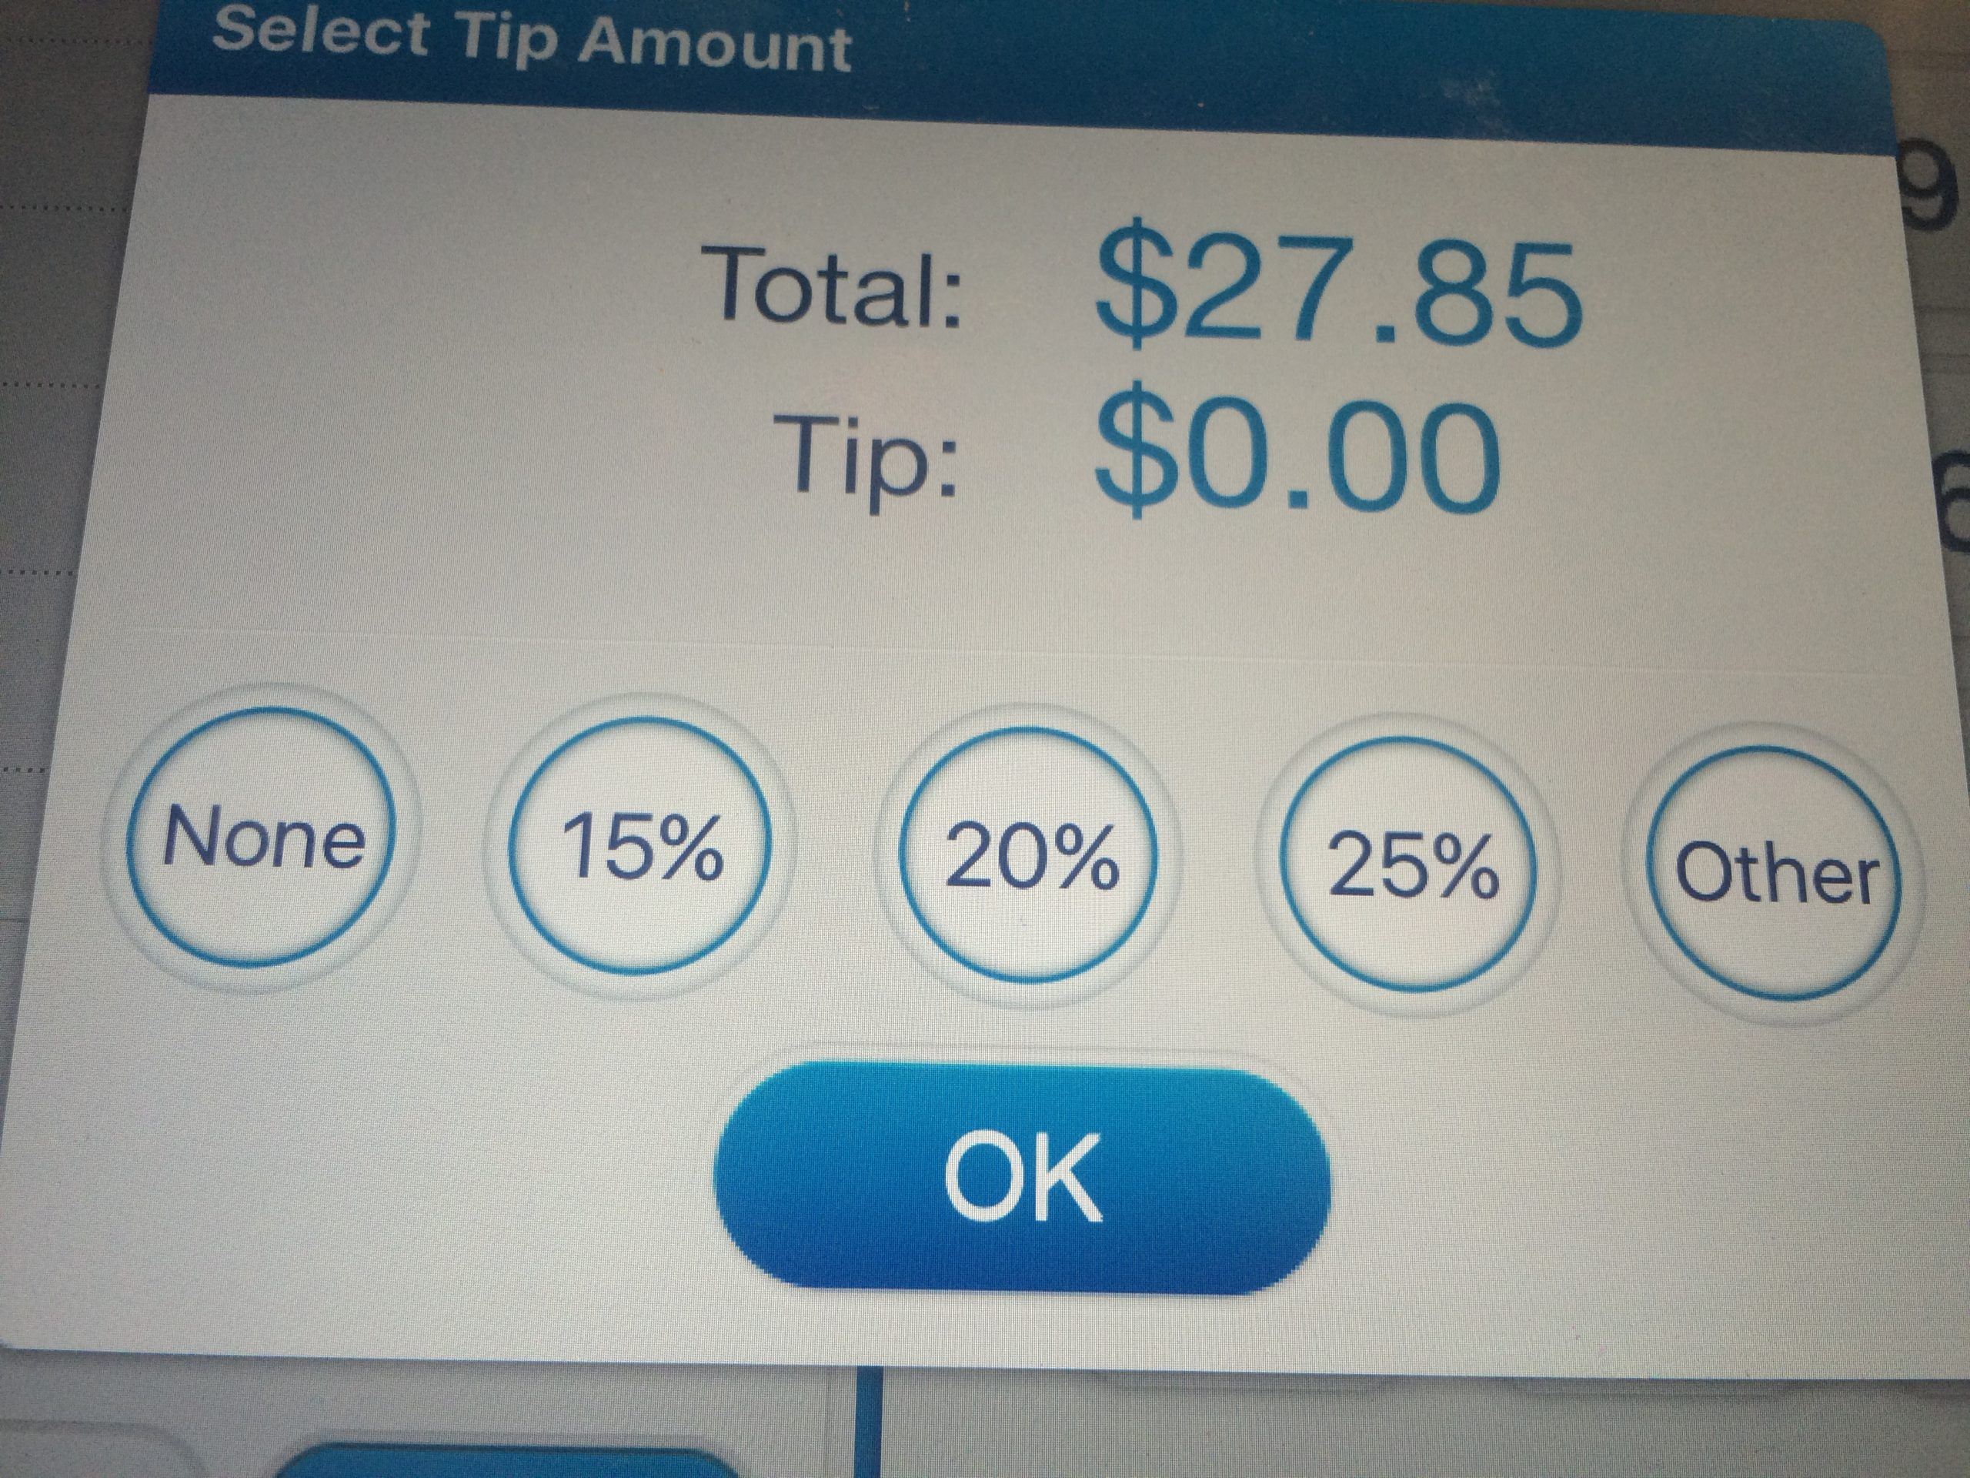
Biasing the set of options

Slide 52
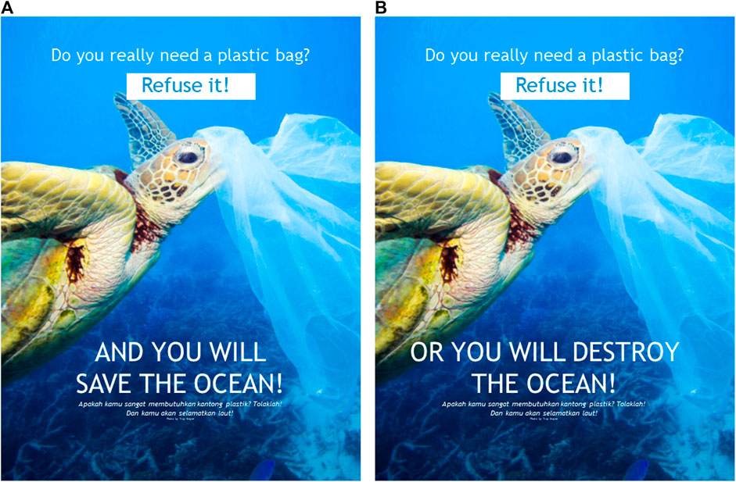
Which is more likely to change behavior?

Slide 53
“The Tools of Choice Architecture”
Johnson, Eric J., et al. "Beyond nudges: Tools of a choice architecture." Marketing Letters 23.2 (2012): 487-504.
The way a choice is presented influences what a decision-maker chooses. We divide these tools into two categories:
those used in structuring the choice task
those used in describing the choice options
53

Slide 54
Choice Architecture in TDOspeak
Choice Architecture says:
TDO says:
There is no neutral architecture
We can vary the order of choice alternatives
We can change the number of categories
We can change the labels of alternatives or categories
People prefer choices that are easier to describe
TRADEOFFS
All systems of categories are biased
We can use different organizing principles
We can vary the abstraction and granularity of categories
Naming and resource description is difficult, contentious, and makes a difference
TRADEOFFS

Slide 55
How Many Alternatives?
Need to enable “a reasoned consideration of tradeoffs among conflicting values” but “not seem overwhelming”
Too few options may generate context-specific preference where the presence or absence of one option influences what is chosen
Too many options create “choice overload” or the “paradox of choice” because the initial attractiveness of many alternatives decreases the motivation to choose any particular one
55
Notes:
more options increase the chances of offering a preference match to the consumer, and second that more options places a greater cognitive burden on consumers because of the additional need to evaluate options.

Slide 56
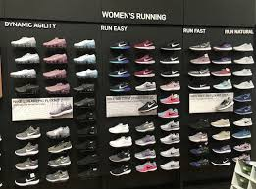
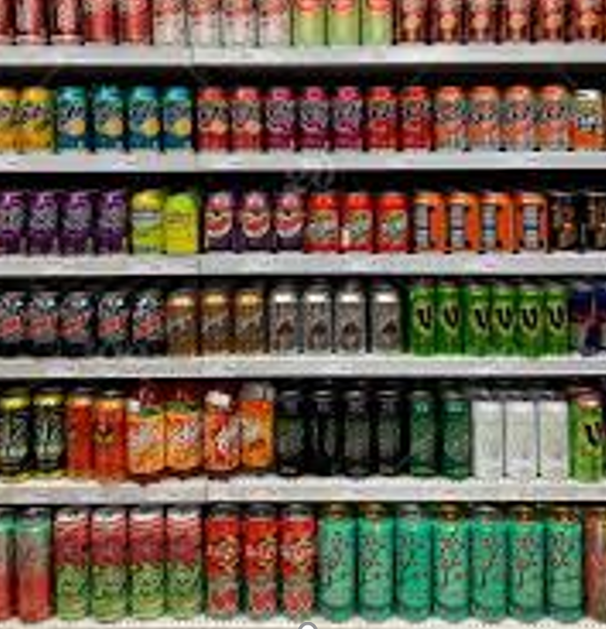
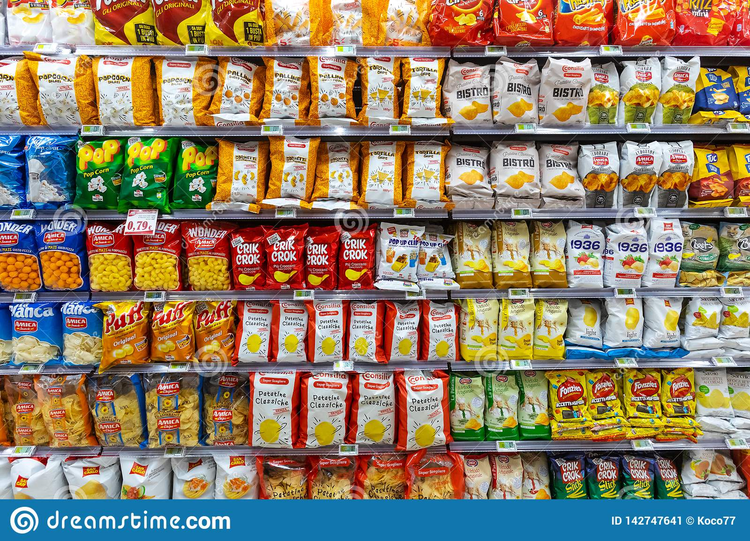
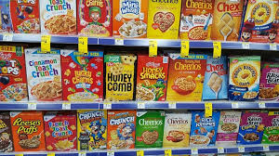
Choice Overload?

Slide 57
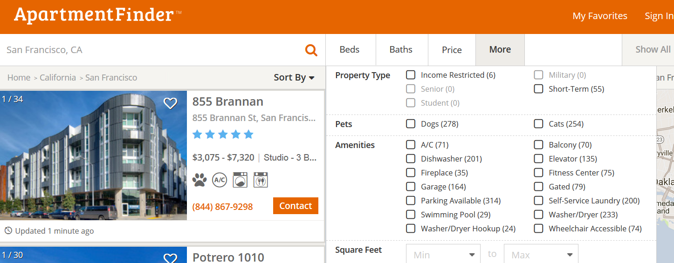
Choice Overload?
Looking for an apartment? Over 20 potentially relevant attributes here
Notes:
Choice Overload?

Slide 58
Stop And Think
Are there too many potentially relevant attributes here?
If you could only use one attribute to choose an apartment, what would it be? If you could use two, what? Three?
If you had lots of choices, you make different choices than if you only have time to look at a few places… you might take the first place that you could imagine living in (satisficing)
58

Slide 59
Defaults
For any choice that needs to be made, there should be an associated default rule that determines what happens to the decision maker who does nothing
Usually, the answer is that if you do nothing, nothing changes; whatever is happening continues to happen
For “opt-out” defaults most choosers will do nothing, and things can happen that the chooser might not want or not know about
How is this user bias to do nothing essential to Facebook’s business model?
What are some beneficial applications of opt-out defaults?
59

Slide 60
Stop And Think
Which default makes more sense?
If you are searching for an apartment and you don’t choose one, you remain living where you are
Entering students are told “unless you tell us otherwise, we are putting you in this student housing complex and assigning you a roommate based on our unsupervised learning clustering algorithm based on your resume and personal statement”
60

Slide 61
Types of Defaults
Configuration defaults apply at the first encounter with a choice
Could be the same for everyone, a normative or recommended alternative
Mandated choice (benefit or nuisance?)
Reuse defaults apply to subsequent encounters
Persistence of original choice
Reverting to original default
Predictive defaults based on user modeling
61

Slide 62
Decision Staging
When facing a small number of well understood alternatives, “rational” people will examine all the attributes of all the alternatives and then make tradeoffs when necessary
If consumers are rational, “utility-maximizing agents”, their preferences for any finished product should be independent of the order in which they considered its attributes: any order should yield an equivalent “final” bundle
But as the choices become more numerous or vary on more dimensions, people are more likely to adopt simplifying strategies that aren’t entirely rational
62

Slide 63
Product Configuration (miniusa.com)
Constructing the preferred product via a sequence of attribute decisions

Slide 64
How Attribute Order Affects Choice
Changes in the order by which the attributes are considered can substantially influence the choices made
If you start with attributes with lots of options, the chooser is more likely to accept default alternatives on later attributes, even if these decisions involve relatively few options that would ordinarily require less capacity to evaluate
What would cause this? How would a choice architect use this tendency to his advantage?
64

Slide 65
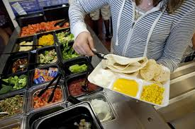
If school kids are more likely to eat foods at eye level at the beginning and end of the cafeteria buffet, how do you arrange the food?

Slide 66
Attribute Descriptions
People make comparisons on the basis of resource attributes, and ideal decisions would consider all attributes and weight them according to their importance to the decider
But choice architects can manipulate the salience of attributes
Choice sets that can be described simply are preferred over other sets that seem more complicated, even when the complicated ones offer more objective value
People like things that are orderly in arrangement

Slide 67
Choosing Beer Bundles
Two bundles differ only on the third beer
Some bundles have beers from 4 different breweries
People have a preference for all the same or all different bundles
Evers, Ellen R.K. and Inbar, Yoel and Loewenstein, George and Zeelenberg, Marcel, Order Preference (July 16, 2014). http://ssrn.com/abstract=2466991

Slide 68
Naïve Diversification / Partition Dependence
The is a general psychological tendency or preference towards equal amounts or proportions when given a set of allocation choices
If there are 3 categories you put 1/3 in each
Such “naive diversification" is thought to arise from a desire for variety-seeking, to hedge against risky or uncertain prospects, and minimize potential regret
Effects are stronger for people with weaker intrinsic preferences or knowledge

Slide 69
401K Allocation?
Imagine an employee is asked to determine her 401(k) asset allocation from one of one of two sets
Domestic stocks
International stocks
Bonds
Domestic stocks
Domestic bonds
International bonds
If she follows a naïve diversification strategy, first portfolio is stock heavy and more risky than bond-heavy than second

Slide 70
Vacation Planning?
What information is being conveyed by listing some items separately and others in a category?

Slide 71
Stop and Think: Supermarket Shopping
What categories do you use when you make a list (explicit or implicit) for supermarket shopping?
Do these categories align with those used by the store to organize the goods, or are they different (e.g., healthy, party foods, cheap?) than the store ones?
Are you influenced by the placement of items in the store to buy things not on your list?
If you wanted people to eat healthier, how would you redesign the store or shopping carts to do that?

Slide 72
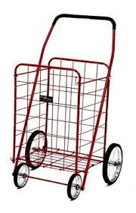
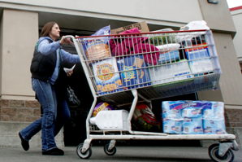
Shopping Cart Size and Partition Effects
When you go to the store, do you choose a shopping basket or shopping cart? Even if you didn’t intend to, do you often buy more if you pick the shopping cart?
Two grocery store studies found that most shoppers purchased fruits and vegetables in quantities relative to the size of their allocated partition within a shopping cart
Partitions are effective because they suggest purchase norms

Slide 73
Stop And Think
People are now more aware of the impact of air travel on climate change, but ticket price and schedules are still more important to air travelers
How might airlines change the ticket booking or flight processes to nudge air travelers to make more “climate-friendly” choices?
73

